Slide 1
Recent and Future improvements to the
Localized Aviation MOS Program (LAMP) For Aviation Forecasting
Judy Ghirardelli
National Weather Service
Meteorological Development Laboratory
Intermountain West Aviation Weather Safety Workshop
Boise, ID
09/14/2018
Portions of this research are in response to requirements and funding by the Federal Aviation Administration (FAA). The views expressed are those of the authors and do not necessarily represent the official policy or position of the FAA.
Portions of this material are based upon work supported by the Joint Technology Transition Initiative (JTTI) Program within NOAA/OAR Office of Weather and Air Quality.

Slide 2
Thanks to the LAMP team:
Michael Allard¹, Allison Bogusz², Jerome Charba¹, Bob Glahn¹, Felicia Guarriello³, Chenjie Huang³, Andrew Kochenash³, Michele Masuda⁴, Frederick G. Samplatsky¹, Adam Schnapp³, Gordana Sindic-Rancic¹
¹NOAA/NWS/OSTI/MDL
²Ace Info Solutions
³NOAA affiliate, KBRwyle Science, Technology & Engineering Group
⁴NOAA Rotational Assignment Program, National Marine Fisheries Service/Alaska Fisheries Science Center

Slide 3
Outline
  LAMP Background
  Tour of the LAMP Web Products
  Recent Improvements
  Current Work
    Development and Verification
    Case Studies
    Strengths and Weaknesses
  Schedule for implementation
  Future work

Slide 4
Outline
  LAMP Background
  Tour of the LAMP Web Products
  Recent Improvements
  Current Work
    Development and Verification
    Case Studies
    Strengths and Weaknesses
  Schedule for implementation
  Future work

Slide 5
LAMP Background
LAMP is a statistical system that uses observations, MOS output, and model output to provide guidance for aviation forecasting
LAMP acts as an update to MOS guidance
LAMP bridges the gap between the observations and the MOS forecast
LAMP outperforms
persistence in the early
period and trends towards
MOS at the end of the
period.
LAMP guidance covers the
short-range period
of 1-25 hours
Runs every hour in
NWS operations

Slide 6
LAMP Guidance Details
LAMP provides station-oriented guidance for:
      All LAMP forecast elements, ~2010 stations
      CONUS, Alaska, Hawaii, Puerto Rico
Gridded LAMP provides grid-oriented
guidance for:
      Lightning & Convection
      Temperature & Dewpoint
      Wind Speed & Direction
      Ceiling Height & Visibility
      Sky Cover
Available:
      At NWS WFOs in AWIPS
      Via FTP, in the National Digital Guidance Database
      Via website: http://weather.gov/mdl/lamp_home
Temperature and dewpoint
Wind speed, direction, and gusts
Probability of precipitation (on hr)
Probability of measurable precipitation (6- and 12-h)
Precipitation type
Precipitation characteristics
Lightning/Convection
Ceiling height
Conditional ceiling height
Opaque sky cover
Visibility
Conditional visibility
Obstruction to vision

Slide 7
LAMP Guidance Details
Historically:
      Station-based LAMP = Observations + Simple locally-run models + GFS MOS
      Gridded LAMP (GLMP) = LAMP station analyzed to a grid or LAMP equations evaluated on a grid
Now:
      Convection and Lightning:
        LAMP = Obs + local models + GFS MOS + NAM MOS + HRRR MOS
      Ceiling and Visibility:
        Base LAMP = Obs + local models + GFS MOS
        Meld LAMP = Obs + Base LAMP + HRRR MOS
Future:
      POP:
        Base LAMP = Obs + local models + NAM MOS + ECMWF MOS
        Meld LAMP = Base LAMP + HRRR MOS
  GFS = Global Forecast System, NAM = North American Model, HRRR = High Resolution Rapid Refresh,
  ECMWF = European Center for Medium-Range Weather Forecasts

Slide 8
LAMP 1-hr Convection Development:
The importance of the predictors
LAMP using initial observations only

Slide 9
LAMP 1-hr Convection Development:
The importance of the predictors
LAMP initial observations plus
advected obs only

Slide 10
LAMP 1-hr Convection Development:
The importance of the predictors
LAMP using
MOS only

Slide 11
LAMP 1-hr Convection Development:
The importance of the predictors
LAMP using HRRR only

Slide 12
LAMP 1-hr Convection Development:
The importance of the predictors
LAMP using MOS and HRRR only

Slide 13
LAMP 1-hr Convection Development:
The importance of the predictors
Best obs system (init obs + adv obs)
and
best model system (MOS + HRRR)

Slide 14
LAMP 1-hr Convection Development:
The importance of the predictors
LAMP using best obs system
and
best model system

Slide 15
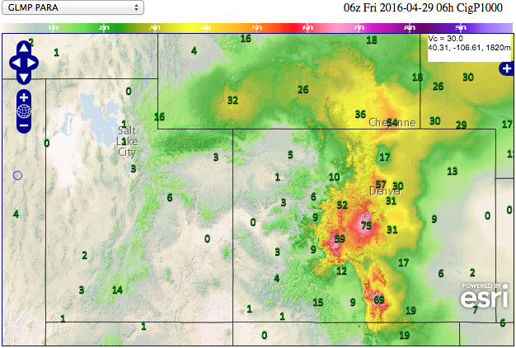
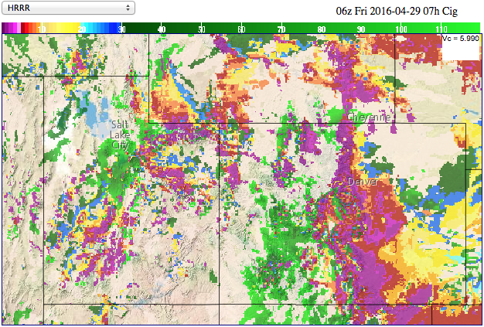
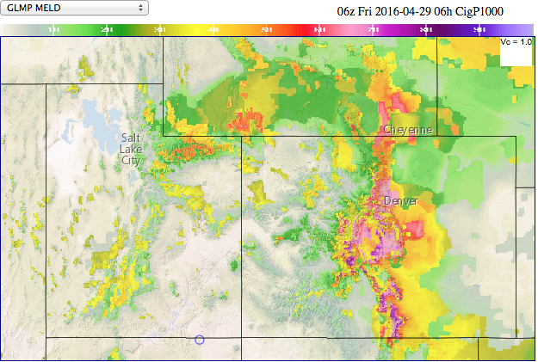
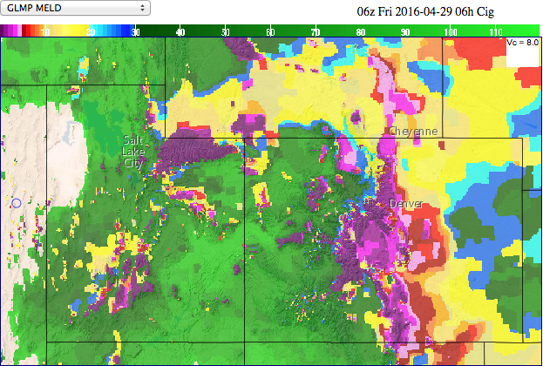
LAMP Probability Example: Ceiling < 1000 feet
GLMP Prob CIG < 1000 ft
3 runs of HRRR Ceiling Height
GLMP Meld Prob CIG < 1000 ft
GLMP Meld Ceiling Height

Slide 16
Outline
  LAMP Background
  Recent Improvements
  Tour of the LAMP Web Products
  Current Work
    Development and Verification
    Case Studies
    Strengths and Weaknesses
  Schedule for implementation
  Future work

Slide 17
Recent LAMP Implementations
GLMP/LAMP Upgrade (v2.1.2) effective January 2018:
  Added 1-h gridded convection and lightning guidance which statistically incorporates HRRR model output, Multi-Radar Multi-Sensor (MRMS) data, and total lightning data
  Added stations to LAMP guidance to match MOS stations (per WFO requests)
  Modified ​LAMP/GLMP to use the most-recent METAR and SPECI observations
  Produce ceiling and visibility guidance every 15 minutes; issuances at :00, :15, and :45 go out 3-h, issuance at :30 goes out 25-h (FAA AWRP funding)
These upgrades result in improved GLMP guidance for aviation elements

Slide 18
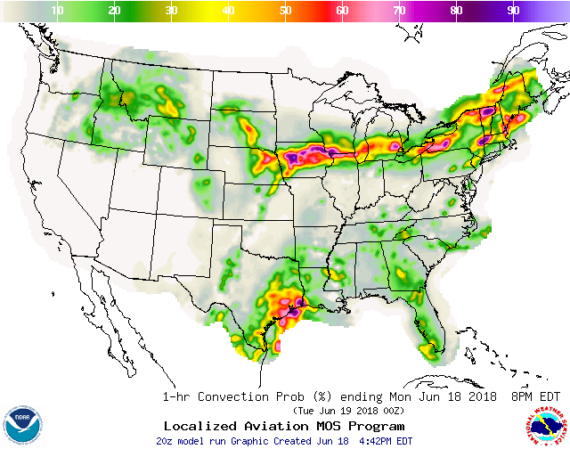
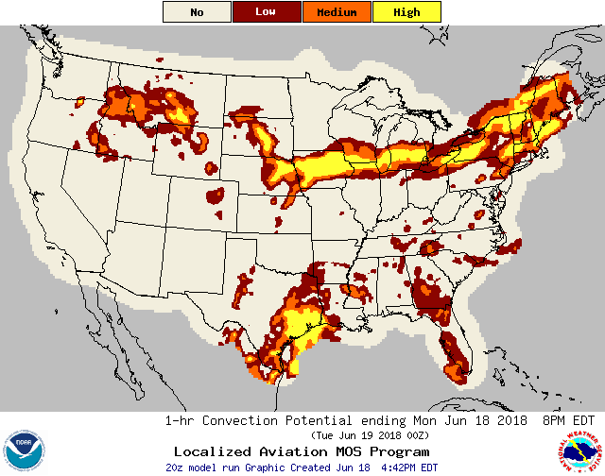
LAMP: Convection and Lightning
LAMP/GLMP Convection and Lightning changes (January 2018):
Replaced 2-hr LAMP Convection & Cloud-to-ground Lightning with 1-hr LAMP Convection & Total Lightning
  Uses MRMS, Total Lightning, and HRRR model output

Slide 19
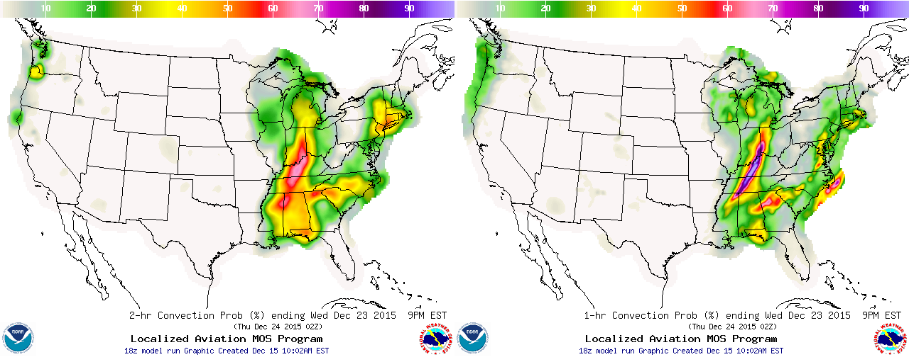
LAMP January 2018 Upgrade
  Adding 1-hr Convection and Lightning Guidance
8-h forecast from 18 UTC 12/23/2015
Operational 2-hr product
Valid 00-02 UTC
Upgraded 1-hr product
Valid 01-02 UTC
          By incorporating HRRR, MRMS, and Total Lightning data, this upgrade results in better temporal (1-hr projections) and spatial resolution of convection and lightning guidance

Slide 20
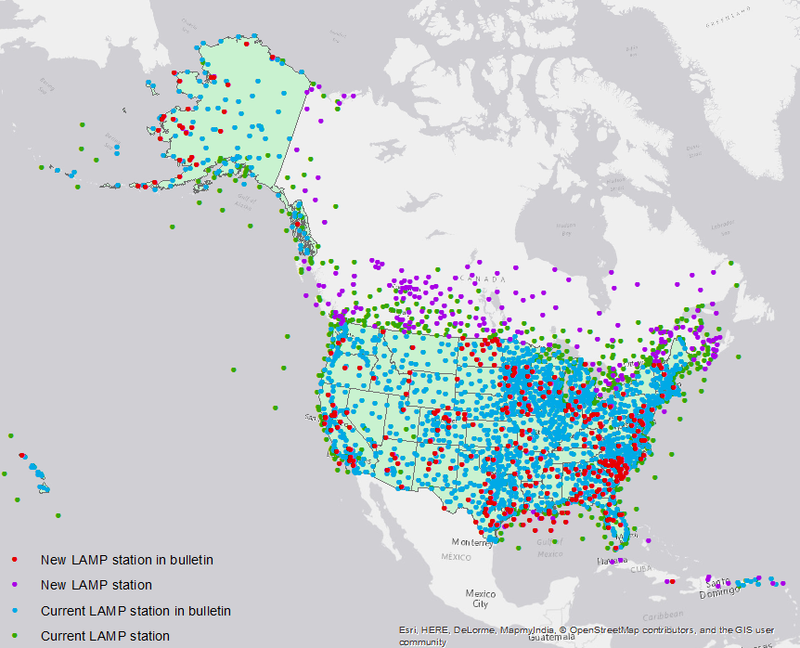
LAMP January 2018 Upgrade
  Adding stations to LAMP guidance
    Adding 555 new stations for
    use in LAMP to already
    existing equations and
    thresholds
    332 of those new stations
    will be added to the LAMP
    text Bulletins and BUFR
        Adding these stations for
        ceiling, visibility, obstruction
        to vision, convection, and
        lightning guidance
        Other elements will follow
        in time
    New stations will be added to GLMP as inputs in the next implementation (FY19)

Slide 21
Outline
  LAMP Background
  Recent Improvements
  Tour of the LAMP Web Products
  Current Work
    Development and Verification
    Case Studies
    Strengths and Weaknesses
  Schedule for implementation
  Future work

Slide 22
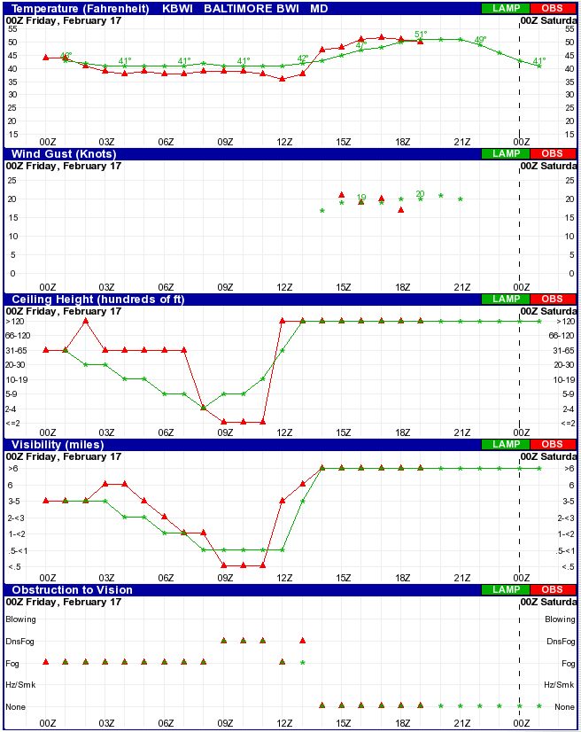
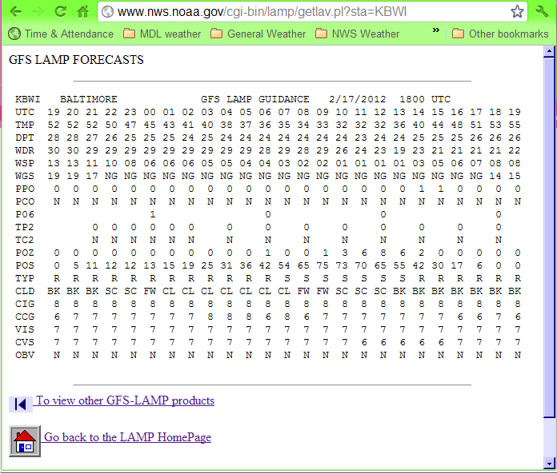
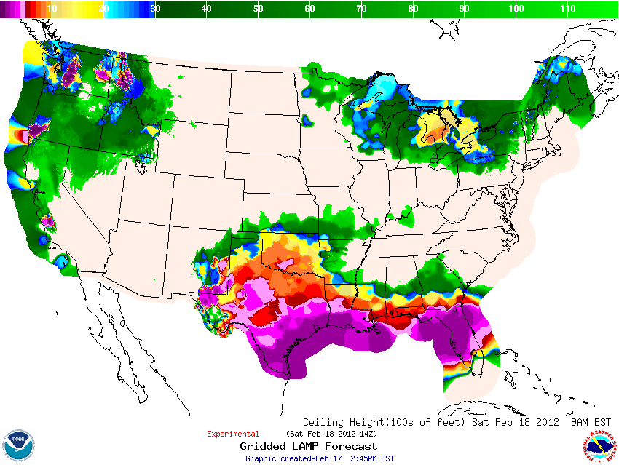
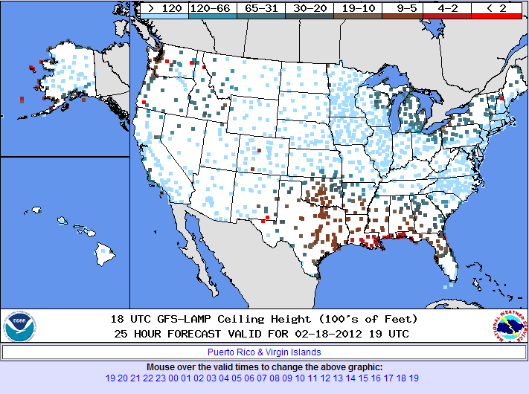
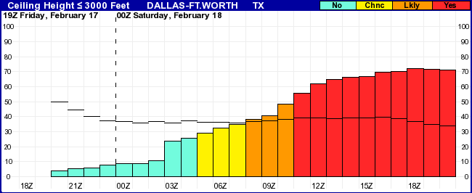
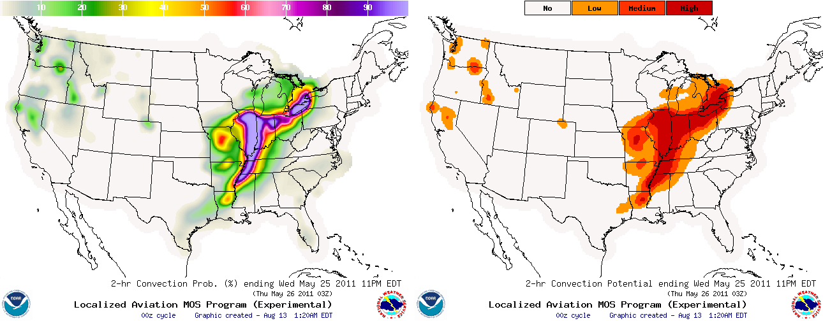
LAMP Current Status: Available Products
  Website products: https://www.weather.gov/mdl/lamp_home
Website products:
      Text bulletins
      Meteograms
      Station plots
      Probability/Threshold
      images
      Gridded lightning/
      convection images
      Gridded LAMP
      images

Slide 23
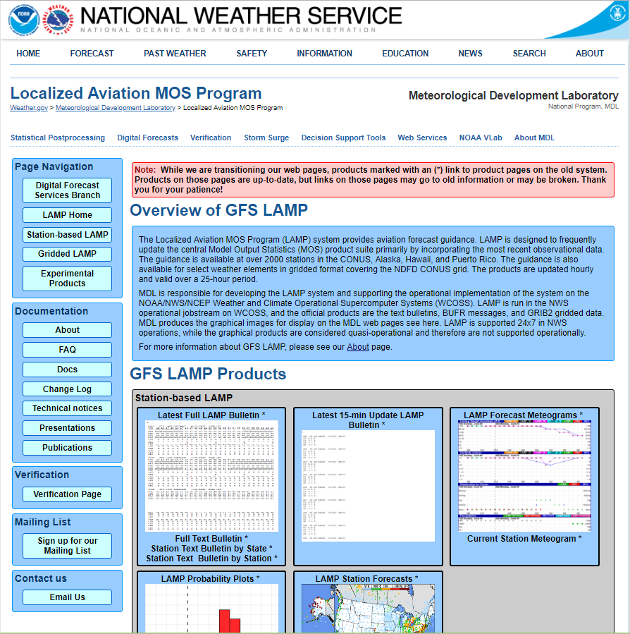
LAMP Web Page
https://www.weather.gov/mdl/lamp_home

Slide 24
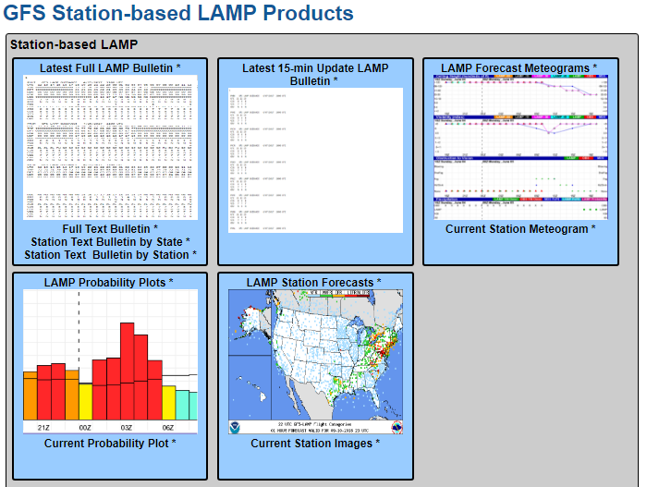
LAMP Web Page
Click here to find real-time station-based forecast guidance
https://www.weather.gov/mdl/lamp_home

Slide 25
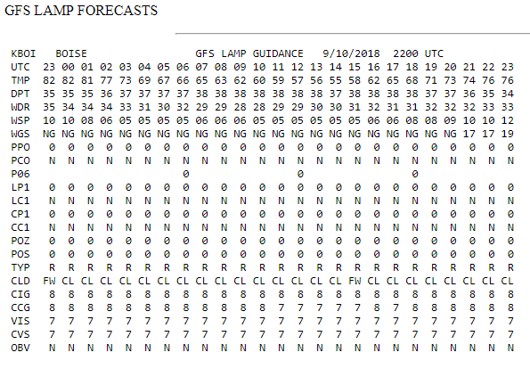

LAMP Web Page
Click here for LAMP Bulletins
https://www.weather.gov/mdl/lamp_home

Slide 26
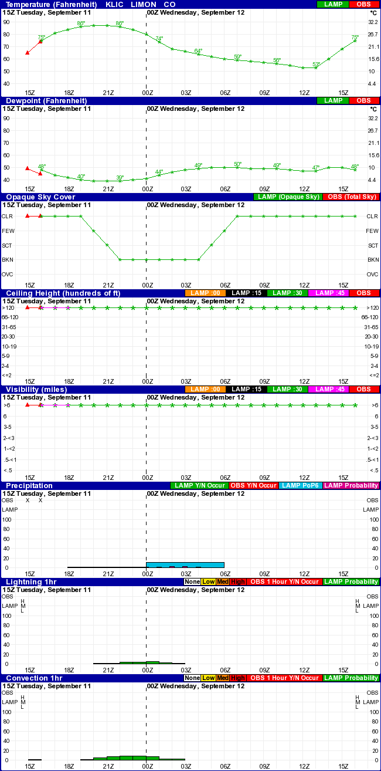
LAMP Web Page
Click here for LAMP Meteograms showing the future guidance
https://www.weather.gov/mdl/lamp_home

Slide 27
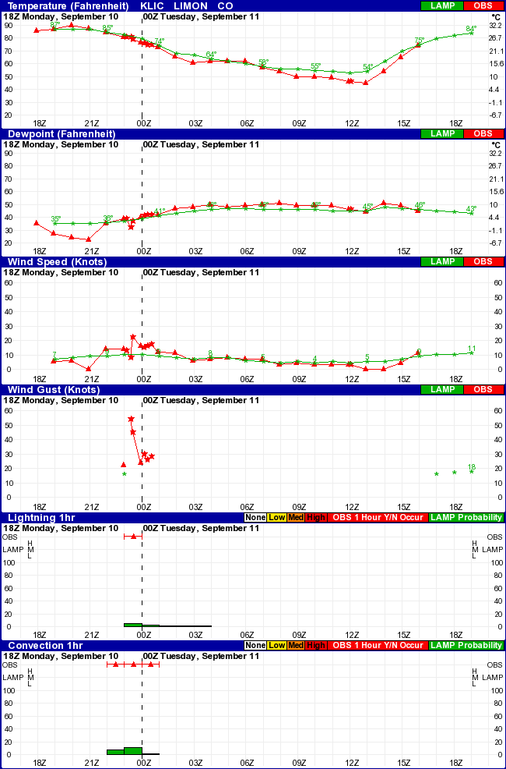
LAMP Web Page
Click here for LAMP Meteograms showing the past guidance
https://www.weather.gov/mdl/lamp_home

Slide 28
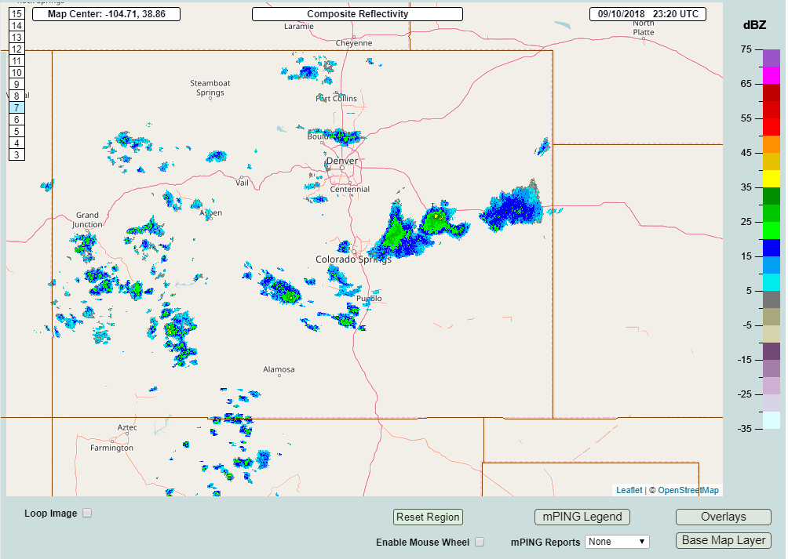
LAMP Web Page
KLIC 102255Z AUTO 14014G22KT 10SM CLR 27/04 A3001 RMK AO2 SLP086 T02720039
KLIC 102306Z AUTO 13013KT 10SM TS FEW120 27/04 A3001 RMK AO2 TSB06 T02720039
KLIC 102321Z AUTO 18008G54KT 120V230 10SM VCTS SQ BKN120 27/00 A3002 RMK AO2 PK WND 18054/2316 TSB06E21 T02720000
5-h forecast, low probs indicate possibility of lightning and convention

Slide 29
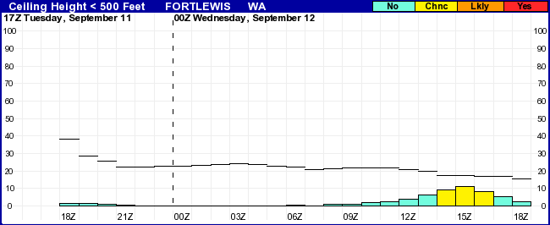
LAMP Web Page
Click here for LAMP Probability and Threshold Plots
Probabilities (bars) and thresholds (lines) KGRF
Ceiling < 500 feet
https://www.weather.gov/mdl/lamp_home

Slide 30
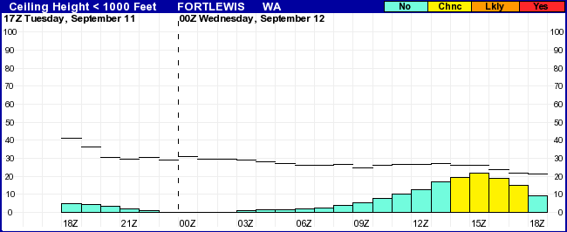
LAMP Web Page
Click here for LAMP Probability and Threshold Plots
Probabilities (bars) and thresholds (lines) KGRF
Ceiling < 1,000 feet
https://www.weather.gov/mdl/lamp_home

Slide 31
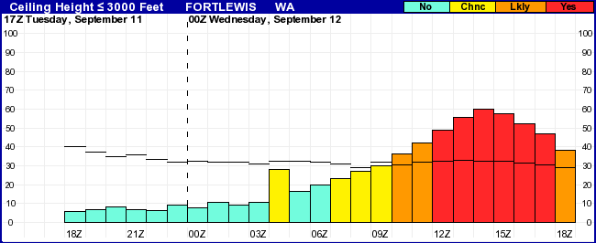
LAMP Web Page
Click here for LAMP Probability and Threshold Plots
Probabilities (bars) and thresholds (lines) KGRF
Ceiling ≤ 3,000 feet
https://www.weather.gov/mdl/lamp_home

Slide 32
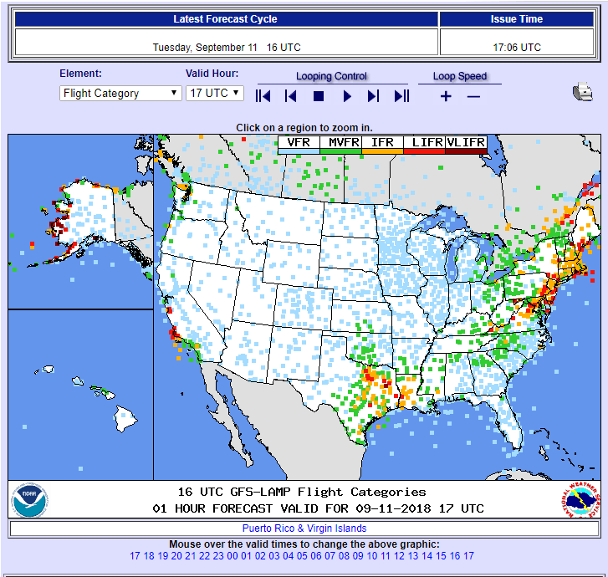
LAMP Web Page
Click here for LAMP Station Plots
https://www.weather.gov/mdl/lamp_home

Slide 33
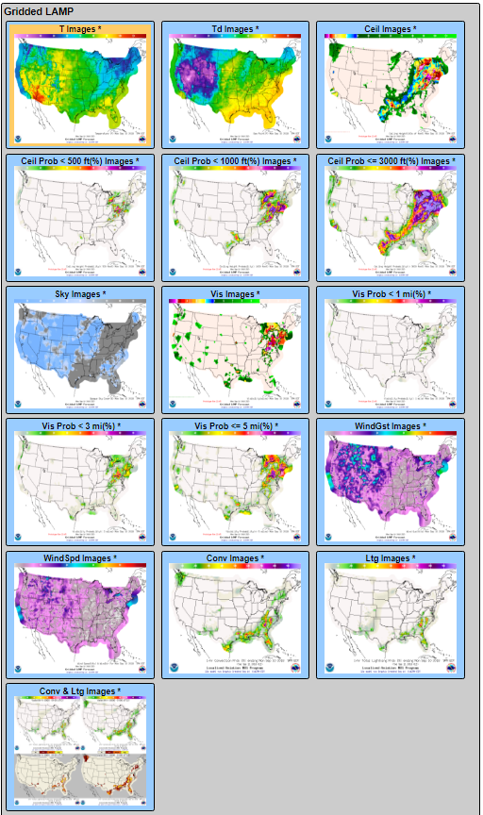
LAMP Web Page
Click here to find real-time gridded forecast guidance
https://www.weather.gov/mdl/lamp_home

Slide 34
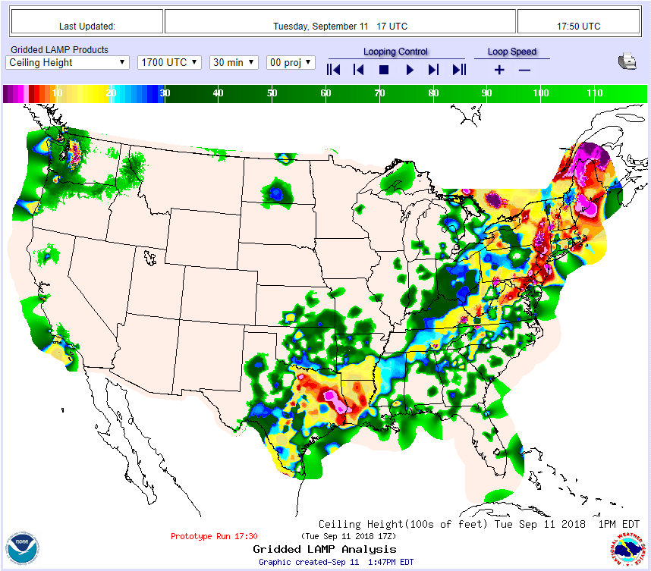
LAMP Web Page
https://www.weather.gov/mdl/lamp_home

Slide 35
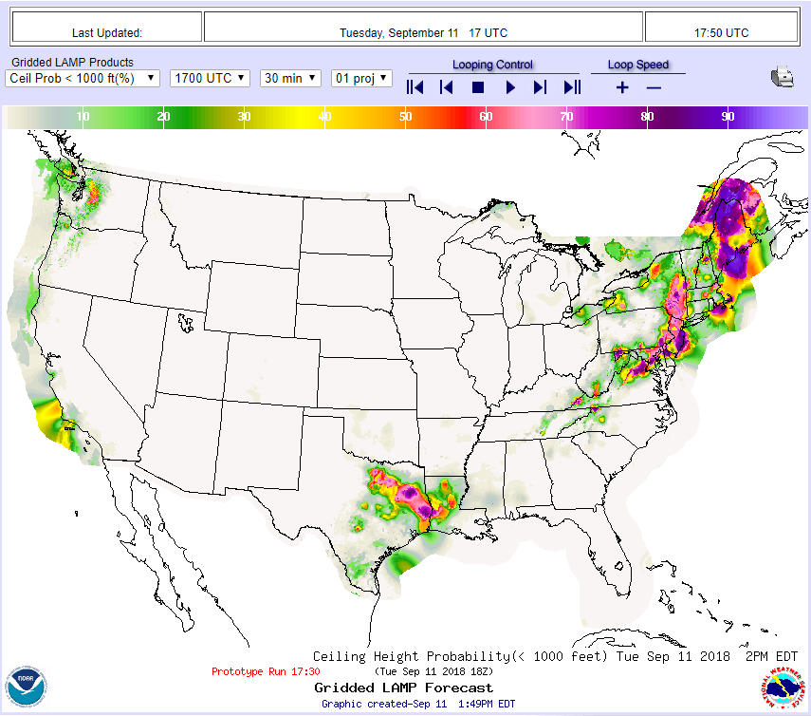
LAMP Web Page
https://www.weather.gov/mdl/lamp_home

Slide 36
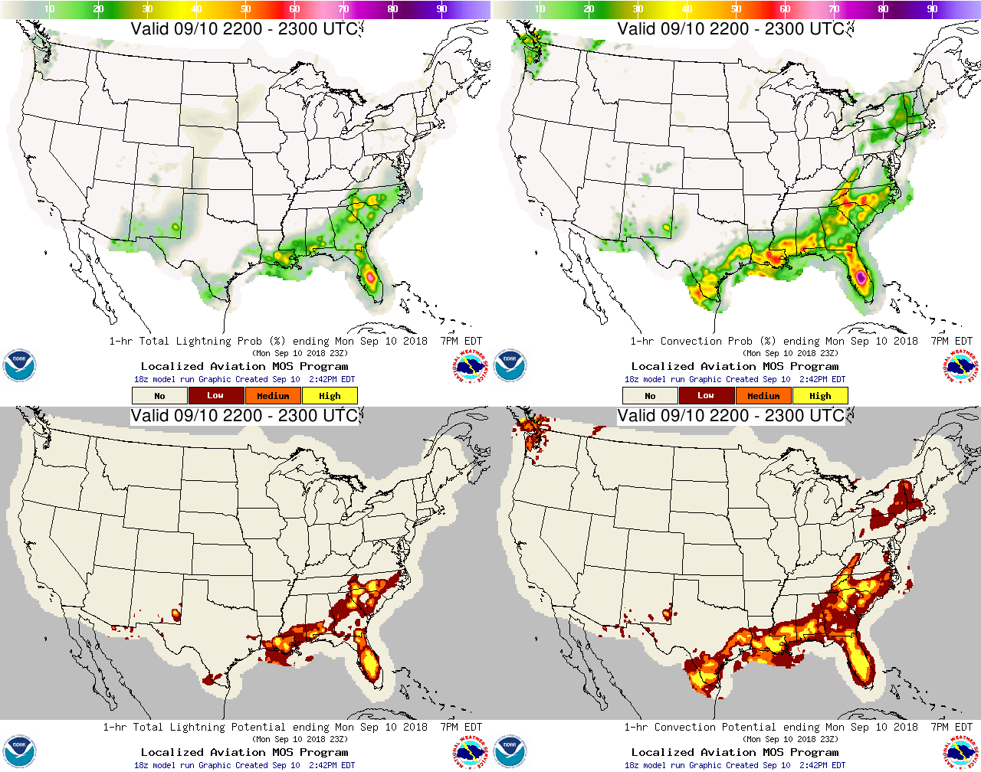
LAMP Web Page
1-h Lightning Probability
1-h Convection Probability
1-h Lightning Potential
1-h Convection Potential

Slide 37
LAMP Web Page
Click here to find experimental guidance that we are currently working on implementing
https://www.weather.gov/mdl/lamp_home

Slide 38
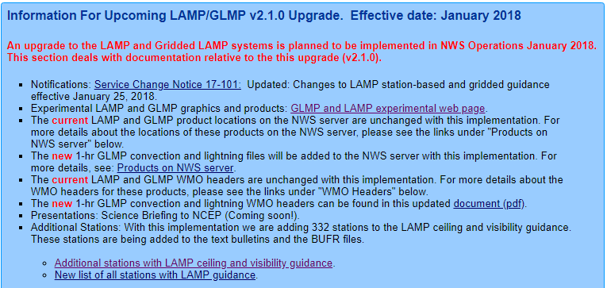
LAMP Web Page
Click here to find documentation:
Upcoming changes
  Stations lists
  WMO headers
  NWS (ftp) server locations of files
https://www.weather.gov/mdl/lamp_home

Slide 39
LAMP Web Page
Click here to find documentation:
Technical notices
Presentations (AMS, NWA, NCEP Briefings, Workshop Presentations) and Training
Publications
https://www.weather.gov/mdl/lamp_home

Slide 40
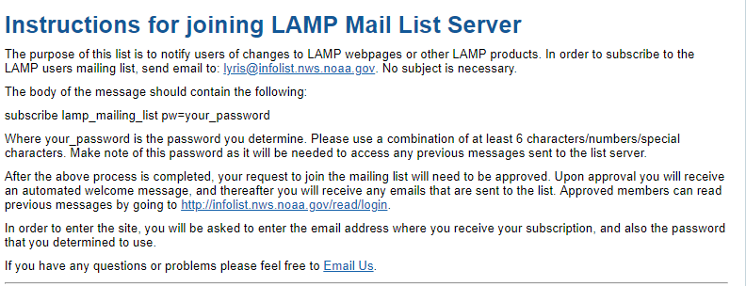
LAMP Web Page
Click here to sign up for our mailing list to receive information about:
Current known outages
Future anticipated outages
News about upcoming changes
https://www.weather.gov/mdl/lamp_home

Slide 41
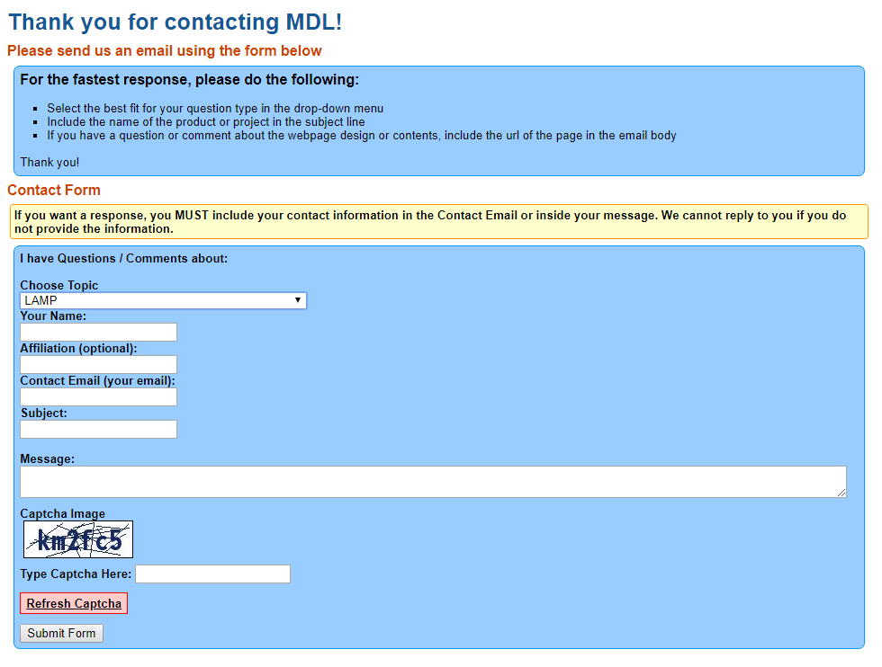
LAMP Web Page
Click here to contact the LAMP team
https://www.weather.gov/mdl/lamp_home

Slide 42
Outline
  LAMP Background
  Recent Improvements
  Tour of the LAMP Web Products
  Current Work
    Development and Verification
    Strengths and Weaknesses
  Schedule for implementation
  Future work

Slide 43
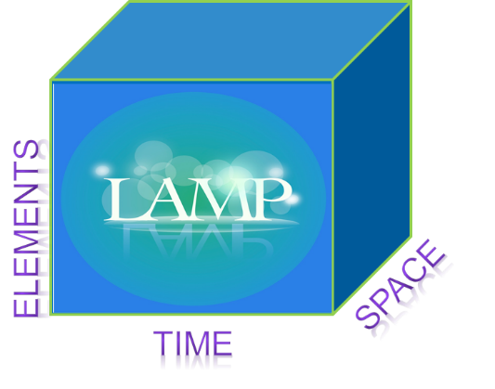

Next LAMP Implementation: Expanding LAMP to support the National Blend of Models (NBM)
National Blend of Models:
  The National Blend of Models (NBM) provides a skillful and spatially consistent gridded starting point for making National Digital Forecast Database (NDFD) forecasts.
  The NBM is a key component to the NWS’s efforts to evolve and build a Weather Ready Nation.
LAMP and GLMP guidance upgrade consists of the following 4 improvements:
  Redevelopment of ceiling and visibility guidance
  Adding new elements
  Time extension
  Space expansion

Slide 44
Next LAMP upgrade
Redevelopment of Ceiling and Visibility
  Using updated GFS MOS Ceiling and Visibility guidance and updated HRRRv3 data
  Adding new stations to GLMP inputs
  Adding new stations to other regional elements (ptype, sky cover, conditional ceiling, and conditional vis) to provide guidance at new stations (including in AK) for those elements
  Expanding grid domain to match the NBM CONUS domain
  Extending LAMP/GLMP guidance from 25-hrs to 38-hrs

Slide 45
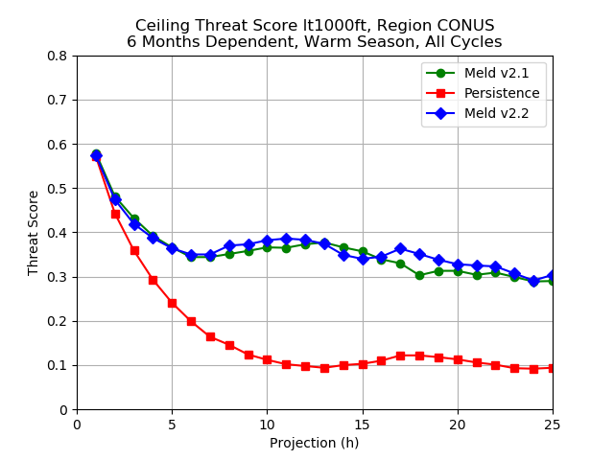
Redevelopment Verification: 1-25 h guidance
Ceiling < 1,000 ft Warm Season
Results mixed – most improvement after 16 hours

Slide 46
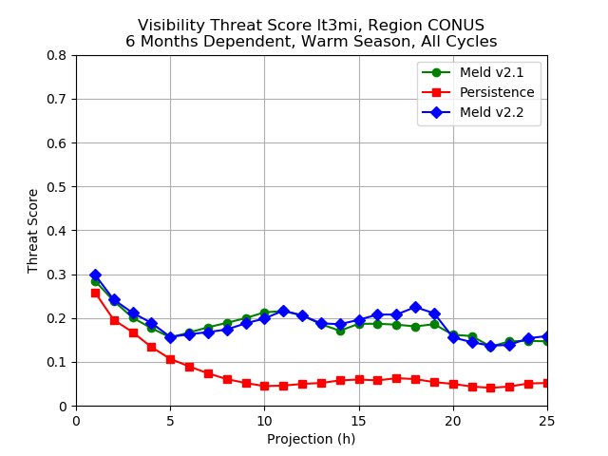
Redevelopment Verification: 1-25 h guidance
Visibility < 3 mi Warm Season
Results mixed – most improvement after 16 hours

Slide 47
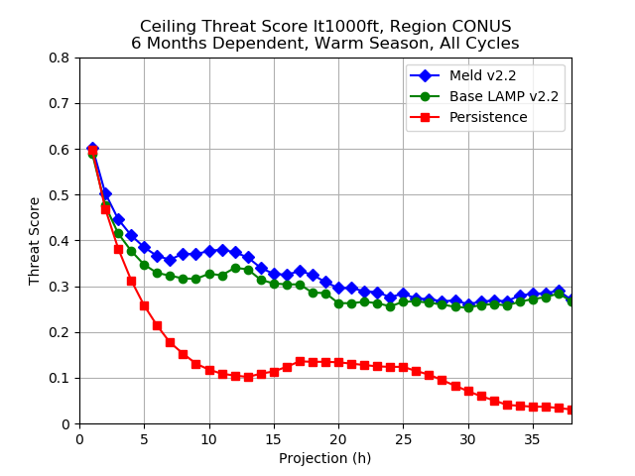
Redevelopment Verification: 1-38 h guidance
Ceiling < 1,000 ft Warm Season
Improvement over Base LAMP throughout period

Slide 48
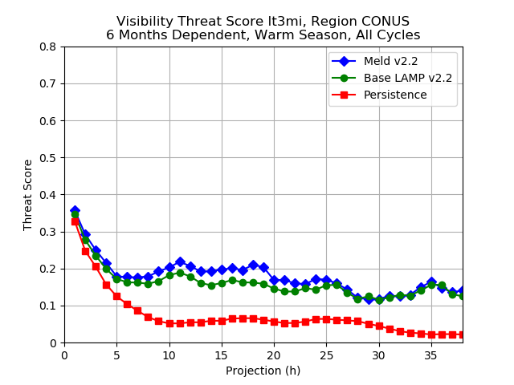
Redevelopment Verification: 1-38 h guidance
Visibility < 3 mi Warm Season
Improvement over Base LAMP throughout period

Slide 49
New Elements: Gridded LAMP POPs
LAMP/GLMP v2.2.0 (January 2019):
  Adding 1-, 6-, and 12-hr Probability of Precipitation (POP01/POP06/POP12) in CONUS
  All LAMP cycles out to 38 hours for use in NBM
  CONUS grid domain to match the NBM CONUS domain
  MRMS 1-h gauge-corrected QPE used to define predictand
  Uses ECMWF-based MOS, NAM-based MOS, RAP, HRRR, MRMS, observations as predictors (no GFS MOS component due to upcoming GFS upgrades)
  Will be available in gridded format and at stations
  MDL plans to replace current LAMP Probability of Precipitation Occurring on the hour with POP01 in time

Slide 50
New Elements: Gridded LAMP POPs
1-, 6-, and 12-h Probability of Precipitation (POP01, POP06, POP12) to 38 h; ​POP01 guidance can aid fine scale timing and positioning of predicted precipitation
POP01 00 UTC Cool

Slide 51
New Elements: Gridded LAMP POPs
1-, 6-, and 12-h Probability of Precipitation (POP01, POP06, POP12) to 38 h; ​POP01 guidance can aid fine scale timing and positioning of predicted precipitation
POP01 00 UTC Warm

Slide 52
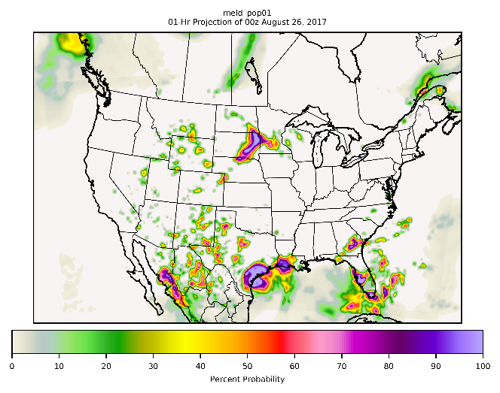
New Elements: Gridded LAMP POPs
POP01 Hurricane Harvey 00 UTC Aug. 26, 2017
01-h Projection

Slide 53
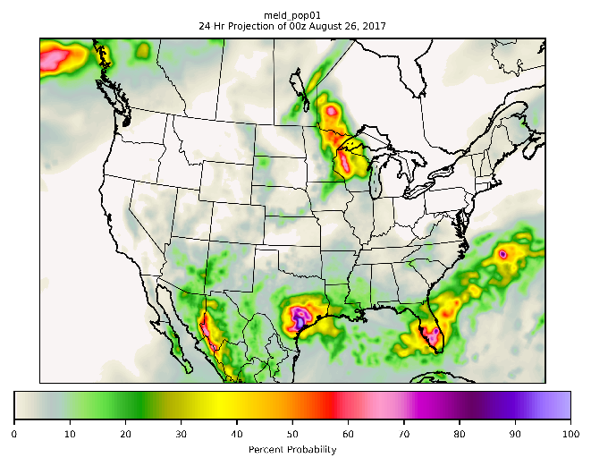
New Elements: Gridded LAMP POPs
POP01 Hurricane Harvey 00 UTC Aug. 26, 2017
24-h Projection

Slide 54
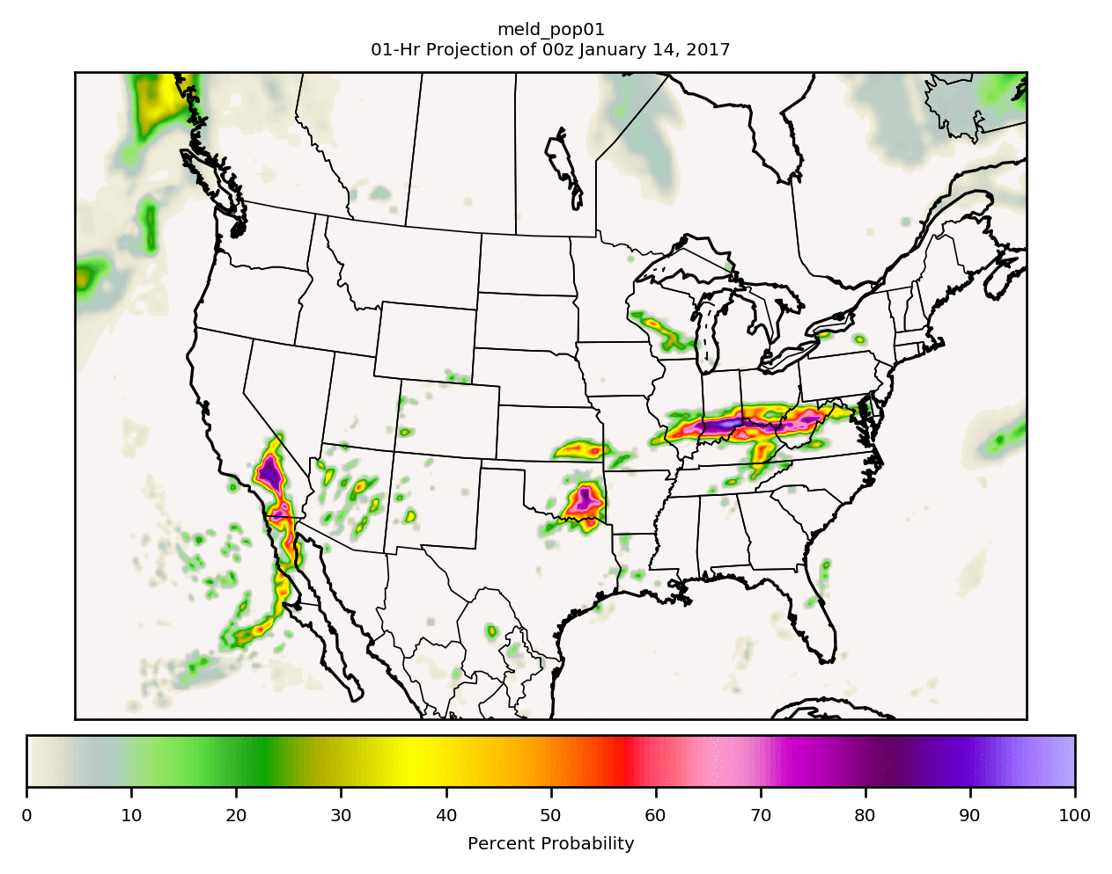
New Elements: Gridded LAMP POPs
POP01 00 UTC Jan. 14, 2017 1-38 h projections
POP01 loop

Slide 55
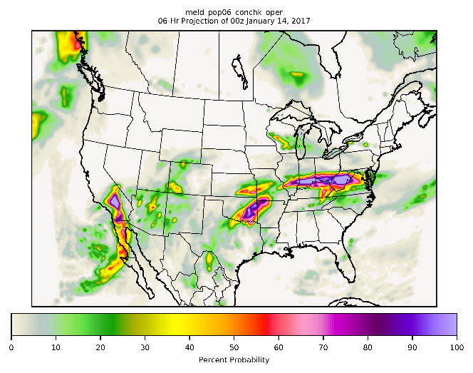
New Elements: Gridded LAMP POPs
POP06 00 UTC Jan. 14, 2017
POP06 06-h Projection

Slide 56
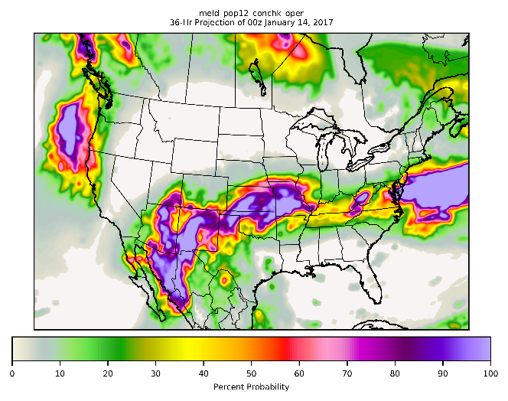
New Elements: Gridded LAMP POPs
POP12 00 UTC Jan. 14, 2017
POP12 36-h Projection

Slide 57
Time Extension: Forecasts to 38 hours
Bulletins:
  Ceiling, visibility, and POP01/06/12 guidance will go out to 38 hours
  Current 1-25 bulletin will continue
  Will add separate “extended” bulletin covering 26-38 hours for SBN
  KBOI GFS LAMP GUIDANCE 9/10/2018 0930 UTC
  DT /SEPT 11
  HR 26 27 28 29 30 31 32 33 34 35 36 37 38
  UTC 11 12 13 14 15 16 17 18 19 20 21 22 23
  PP1 0 0 0 0 0 0 0 0 0 0 0 0 0
  PC1 N N N N N N N N N N N N N
  CIG 8 8 8 8 8 8 8 8 8 8 8 8 8
  VIS 7 7 7 7 7 7 7 7 7 7 7 7 7
  OBV N N N N N N N N N N N N N

Slide 58
Time Extension : Forecasts to 38 hours
Bulletins:
  Will add “full” bulletin from 1-38 hours for web
  Probability of precipitation in a 1-h period (PP1) and categorical probability of precipitation in a 1-h period (PC1) will be added in the CONUS
  Probability of precipitation occurring on the hour (PPO) and categorical precipitation occurring on the hour (PCO) will be phased out

Slide 59
Time Extension : Forecasts to 38 hours
Example of a 38-h LAMP Bulletin:
KBOI GFS LAMP GUIDANCE 9/10/2018 0930 UTC
  DT /SEPT 10 /SEPT 11
  HR 01 02 03 04 05 06 07 08 09 10 11 12 13 14 15 16 17 18 19 20 21 22 23 24 25 26 27 28 29 30 31 32 33 34 35 36 37 38
  UTC 10 11 12 13 14 15 16 17 18 19 20 21 22 23 00 01 02 03 04 05 06 07 08 09 10 11 12 13 14 15 16 17 18 19 20 21 22 23
  TMP 61 60 59 58 58 63 68 72 75 78 81 83 84 85 84 83 79 74 71 68 66 64 62 60 59999999999999999999999999999999999999999
  DPT 29 30 30 31 32 33 33 33 33 34 34 33 33 32 32 32 34 36 36 36 37 37 37 38 38999999999999999999999999999999999999999
  WDR 14 13 14 13 13 10 35 33 32 31 32 33 33 33 33 33 33 33 32 31 30 28 28 29 29 99 99 99 99 99 99 99 99 99 99 99 99 99
  WSP 07 07 06 05 04 04 05 05 06 07 07 08 09 09 09 09 07 06 06 08 07 08 07 06 05 99 99 99 99 99 99 99 99 99 99 99 99 99
  WGS NG NG NG NG NG NG NG NG NG NG NG 15 15 16 NG NG NG NG NG NG NG NG NG NG NG999999999999999999999999999999999999999
  PPO 0 0 0 0 0 0 0 0 0 0 0 0 0 0 0 0 0 0 0 0 0 0 0 0 0999999999999999999999999999999999999999
  PCO N N N N N N N N N N N N N N N N N N N N N N N N N X X X X X X X X X X X X X
  PP1 0 0 0 0 0 0 0 0 0 0 0 0 0 0 0 0 0 0 0 0 0 0 0 0 0 0 0 0 0 0 0 0 0 0 0 0 0 0
  PC1 N N N N N N N N N N N N N N N N N N N N N N N N N N N N N N N N N N N N N N
  P06 0 0 0 0 0
  LP1 0 0 0 0 0 0 0 0 0 0 0 0 0 0 0 0 0 0 0 0 0 0 0 0 0999999999999999999999999999999999999999
  LC1 N N N N N N N N N N N N N N N N N N N N N N N N N X X X X X X X X X X X X X
  CP1 0 0 0 0 0 0 0 0 0 0 0 0 0 0 0 0 0 0 0 0 0 0 0 0 0999999999999999999999999999999999999999
  CC1 N N N N N N N N N N N N N N N N N N N N N N N N N X X X X X X X X X X X X X
  POZ 0 0 0 0 0 0 0 0 0 0 1 0 0 0 1 0 0 0 0 0 0 0 0 0 0999999999999999999999999999999999999999
  POS 0 0 0 0 0 0 0 0 0 0 0 2 0 0 0 0 0 0 0 0 0 0 0 0 0999999999999999999999999999999999999999
  TYP R R R R R R R R R R R R R R R R R R R R R R R R R X X X X X X X X X X X X X
  CLD CL CL CL CL CL CL CL CL CL CL CL CL CL CL CL CL CL CL CL CL CL CL CL CL CL XX XX XX XX XX XX XX XX XX XX XX XX XX
  CIG 8 8 8 8 8 8 8 8 8 8 8 8 8 8 8 8 8 8 8 8 8 8 8 8 8 8 8 8 8 8 8 8 8 8 8 8 8 8
  CCG 8 8 8 8 8 8 8 8 8 8 8 8 8 8 8 8 8 8 8 8 8 8 8 8 8 99 99 99 99 99 99 99 99 99 99 99 99 99
  VIS 7 7 7 7 7 7 7 7 7 7 7 7 7 7 7 7 7 7 7 7 7 7 7 7 7 7 7 7 7 7 7 7 7 7 7 7 7 7
  CVS 8 8 8 8 8 8 8 8 8 8 8 8 8 8 8 8 8 8 8 8 8 8 8 8 8 99 99 99 99 99 99 99 99 99 99 99 99 99
  OBV N N N N N N N N N N N N N N N N N N N N N N N N N N N N N N N N N N N N N N

Slide 60
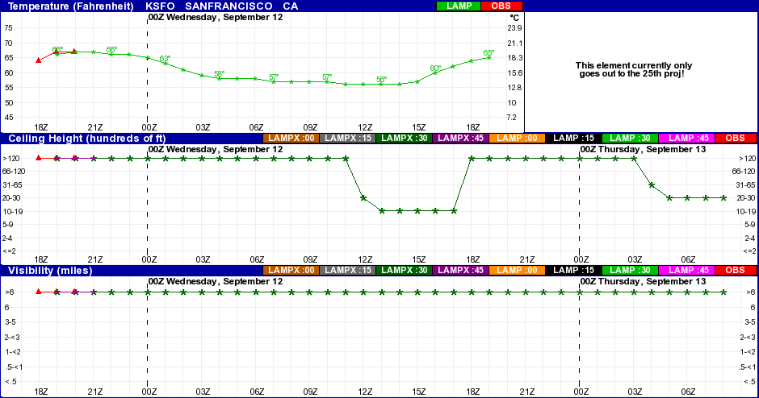
Time Extension : Forecasts to 38 hours
Meteograms to 38 hours (ceiling, visibility, POP01/POP06/POP12):

Slide 61
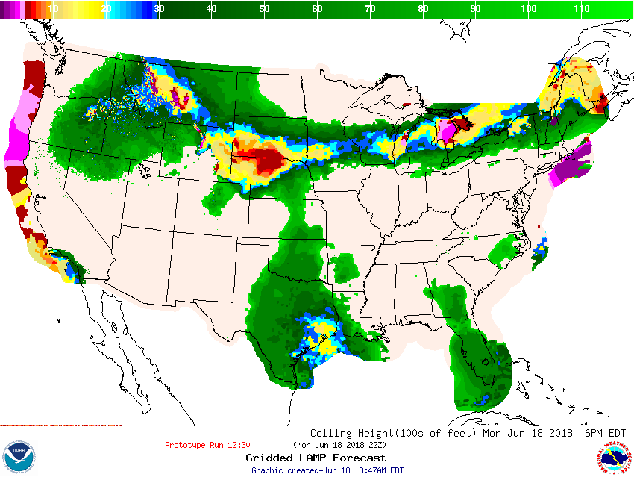
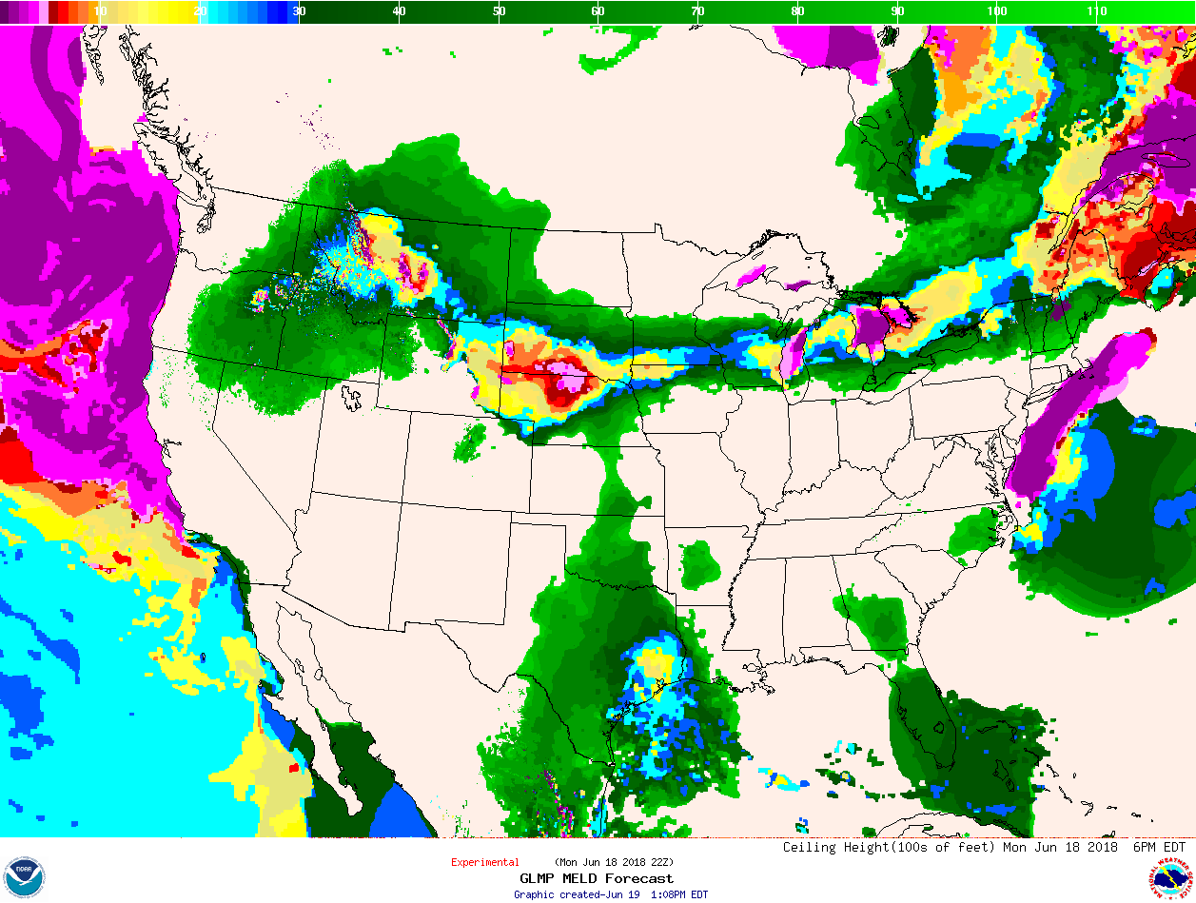
Spatial Expansion
GLMP valid over NBM domain (ceiling, visibility, POP01/POP06/POP12):
Current LAMP Grid
Expanded LAMP Grid

Slide 62
Outline
  LAMP Background
  Recent Improvements
  Tour of the LAMP Web Products
  Current Work
    Development and Verification
    Strengths and Weaknesses
  Schedule for implementation
  Future work

Slide 63
Strengths and Weaknesses
Strengths:
  LAMP provides skillful guidance for aviation forecasting
  The power of the observation: Persistence is often very hard to beat, so observations are critical predictors.
  Calibrating the HRRR model output to the station data provides skillful forecasts and mesoscale detail in the period from 6- to 17-h.
  Calibrating the global model output to the station data provides skillful forecasts out to 25 (and soon 38) hours.

Slide 64
Weaknesses
Weaknesses:
  As we phase in new models, the potential for the LAMP guidance to be inconsistent with other LAMP elements increases.
  Therefore, timing of events can differ based on the different elements.
  Remember that this is GUIDANCE, and intended to be interpreted by a human.
LAMP Element | GFS MOS predictors | NAM MOS predictors | HRRR predictors | ECMWF predictors
Most elements | Yes
Ceiling and Visibility | Yes |  | Yes
Convection and Lightning | Yes | Yes | Yes
POP01/06/12 |  | Yes | Yes | Yes

Slide 65
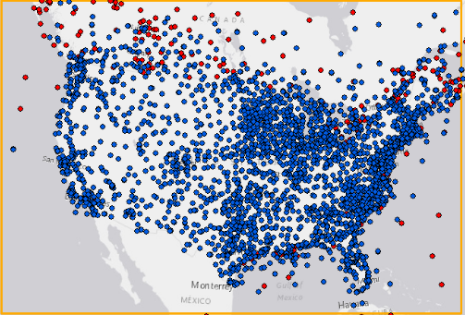
Weaknesses
Weaknesses:
  GLMP Ceiling and Visibility:
    Reminder: Meld LAMP = Obs + Base LAMP + HRRR MOS
    However, Base LAMP has
    NO INPUT POINTS in the
    SW portion of the grid.
    To overcome this, we include
    HRRR/RAP data into
    BASE LAMP over water
    areas, but we only use the
    HRRR/RAP data through
    17 h, so beyond 17 the
    guidance over water may be
    suboptimal.
  Gridded LAMP Ceiling and Visibility guidance in the oceans and Gulf of Mexico should be used with caution beyond 17 hours.
    MDL may “clip” the grid to the CONUS after 17 hours.

Slide 66
Weaknesses
Weaknesses:
  Elements that use HRRR inputs have HRRR data through 17 hours; future developments will leverage 36-h HRRR forecasts
  Some GLMP elements (e.g., sky cover) have issues over the Western CONUS (to be addressed in FY19-20)
  Current GLMP is not yet using the Unified Terrain (to be addressed in FY19-20). Impacts include terrain around the Great Salt Lake.

Slide 67
Outline
  LAMP Background
  Recent Improvements
  Tour of the LAMP Web Products
  Current Work
    Development and Verification
    Strengths and Weaknesses
  Schedule for implementation
    Upgrade ceiling and visibility to 38 hours, expand domain, add of POP(01, 06, 12) to 38 hours
      Evaluation: September or October 2018
      Implementation: February 2019
  Future work

Slide 68
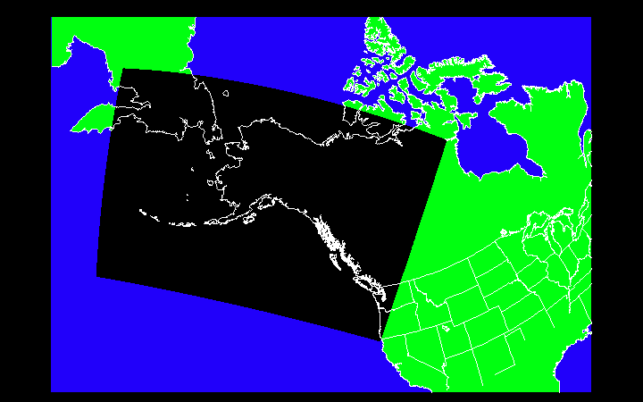
Future Work: Gridded LAMP for Alaska*
The Gridded LAMP system is being extended to create gridded guidance over the Alaska domain for:
  Ceiling height
  Visibility
  Convection
  lightning
Alaska Gridded LAMP will:
  follow existing methodology for CONUS Gridded LAMP
  use Rapid Refresh (RAP) and/or HRRR model output
Alaska Domain
* This task is funded through the Office of Atmospheric Research’s Joint Technology Transition Initiative

Slide 69
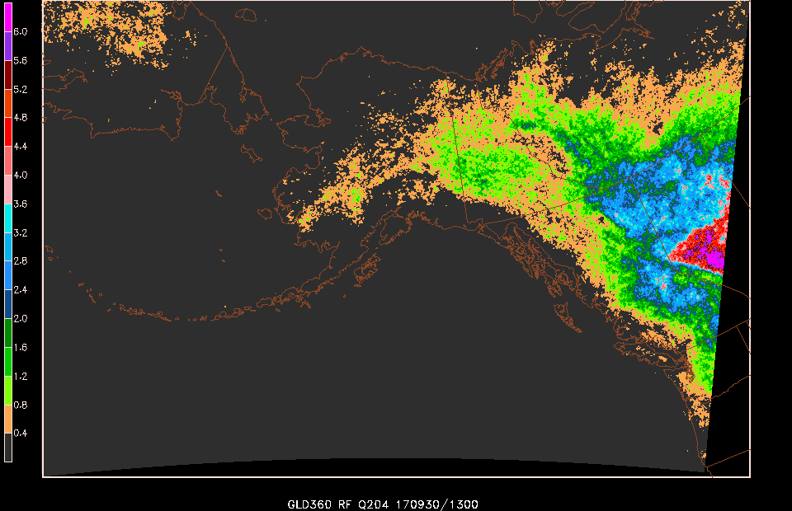
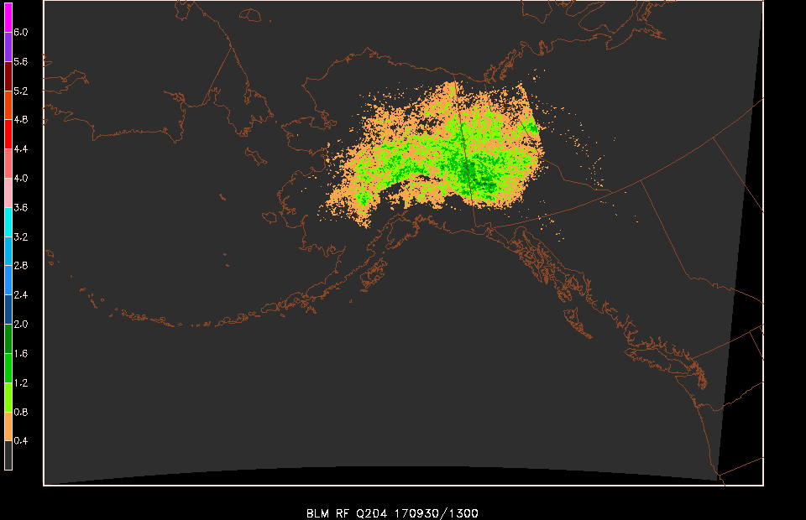
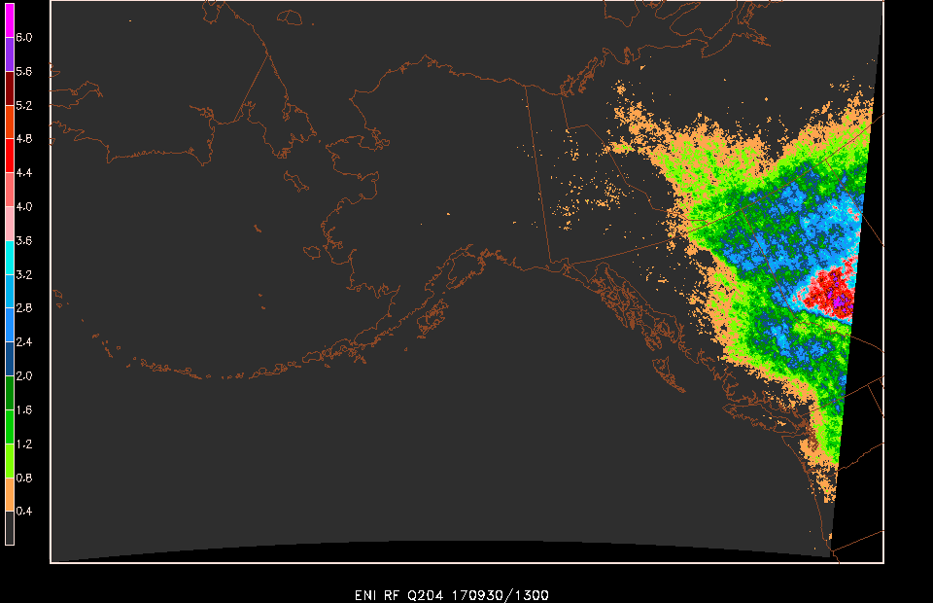
Future Work: Gridded LAMP for Alaska*
Example predictor: Relative Frequency of lightning observations for 2013-2017, May - September
Vaisala Inc. Data
Bureau of Land
Management Data
ENI Data
* This task is funded through the Office of Atmospheric Research’s Joint Technology Transition Initiative

Slide 70
Alaska GLMP
  MDL will work with AWC and AAWU on demonstrations and evaluation
  Planned AK Gridded LAMP prototype evaluations:
    Ceiling and visibility 2019
    Convection and lightning 2020

Slide 71
  Additional Resources
  Additional Resources:
  LAMP website: http://weather.gov/mdl/lamp_home
  LAMP Experimental website:
  http://www.weather.gov/mdl/lamp_experimental
  Contacts: Judy.Ghirardelli@noaa.gov
  Thank you!

