Slide 1

IWAWS: Convective SIGMET
Scott Minnick
Convective SIGMET Forecaster
Aviation Weather Center

Slide 2
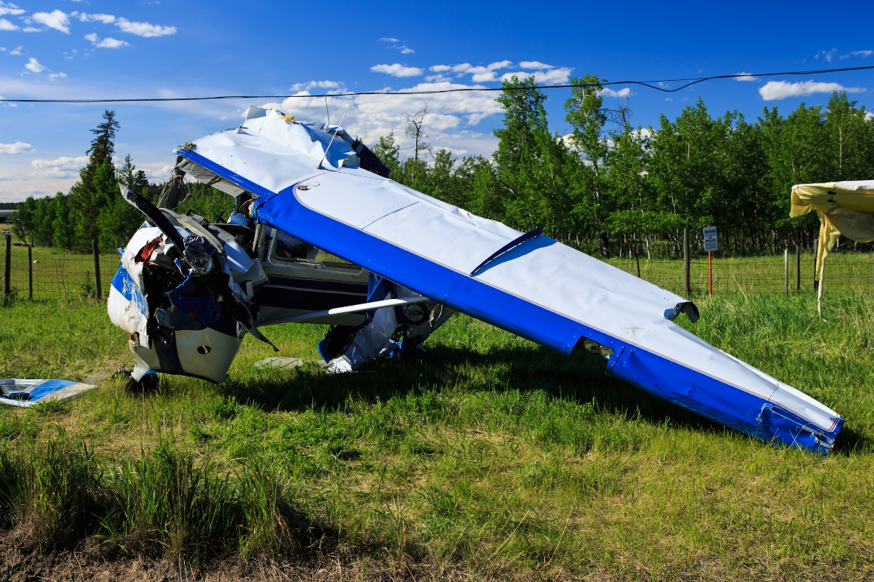
Thunderstorm Impacts
Loss of Control (LOC) events remain one of the leading causes of aircraft accidents. -NTSB
Weather accounts for ~38% of LOC events. –NTSB
  Adverse Winds
  In-flight Icing
  Thunderstorms
In an effort to warn pilots of
dangerous thunderstorms, the
AWC’s convective SIGMET
forecaster monitors thunderstorm
activity to protect life and property.

Slide 3
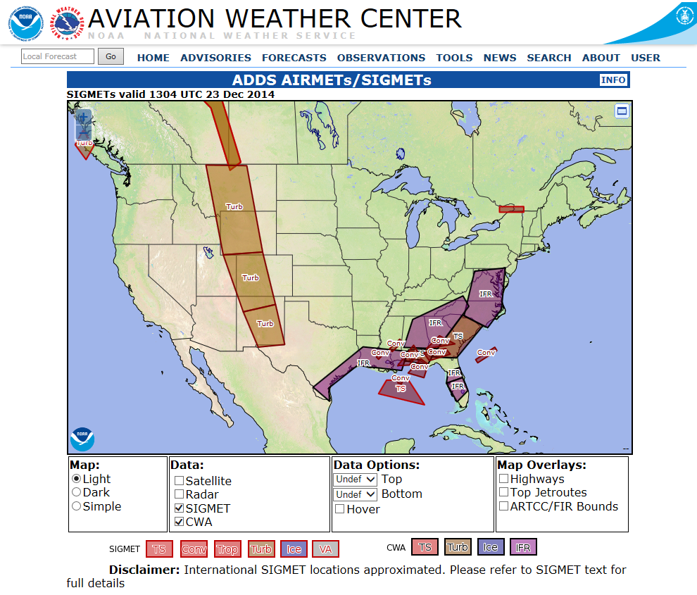
What is a Convective SIGMET?
Convection:
Rising air due to surface heating that results in the development of clouds and thunderstorms.
SIGMET:
Significant Meteorological Information which is an advisory on significant meteorological phenomena that concern the safety of airspace and aircrafts.
Convective SIGMET= Inflight weather advisory to advise aircraft of hazardous weather.

Slide 4
Convective SIGMET Background
The convective SIGMET desk began after Southern Airways flight 242 crashed while flying into an area of severe thunderstorms during the late afternoon of April 4th 1977.
While enroute from Huntsville to Atlanta, GA, it entered a severe thunderstorm over Rome, GA while cruising between FL140 to FL170. After both engines failed and couldn't be restarted an emergency landing was attempted on State Spur Highway 92. Of the 85 persons aboard Flight 242, 62 were killed, 22 were seriously injured, and 1 was slightly injured. One passenger died on June 5, 1977.
Additionally, eight persons on the ground were killed and one person was seriously injured; the injured person died about 1 month after the accident all totaling 72 fatalities. The aircraft was destroyed. (NTSB)

Slide 5
AWC Thunderstorm Definitions
Severe Thunderstorm:
  Produces tornadoes, hail of 3/4-inch diameter or larger, and/or wind gusts of 50 knots (58 mph) or greater.
Embedded Thunderstorm:
  Occurring within and obscured by haze, stratiform clouds, or precipitation from stratiform clouds.
Line of Thunderstorms:
  A line is at least 60 miles long with thunderstorms affecting at least 40 percent of its length.
Area of Thunderstorms:
  Affecting at least 3,000 square miles (1deg Lat Lon square)
Isolated Thunderstorm:
  Refer to single cell thunderstorms with a diameter less than 40 miles. (Can use forecaster judgment for cells greater than 40 miles.)

Slide 6
Convective SIGMET Criteria
Convective SIGMETs are advisories consisting of an observation, including a 2-hour trend forecast and remarks. It is a description of phenomena compiled from radar reports, satellite and lightning data, Pilot Reports (PIREPs), or other reports. Convective SIGMET forecasters are given discretion to satisfy the criteria below:
  A Convective SIGMET is issued when one or more of the following is expected to be met for more than 30 minutes:
    A line of thunderstorms at least 60 miles long with thunderstorms affecting at least 40 percent of its length.
    An area of active thunderstorms affecting at least 3,000 sq. miles covering at least 40 percent of the area concerned and exhibiting a very strong radar reflectivity intensity or a significant satellite or lightning signature.
    Embedded or severe thunderstorm(s) expected to occur for more than 30 minutes during the valid period regardless of the size of the area.
NWSI 10-811

Slide 7
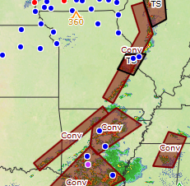
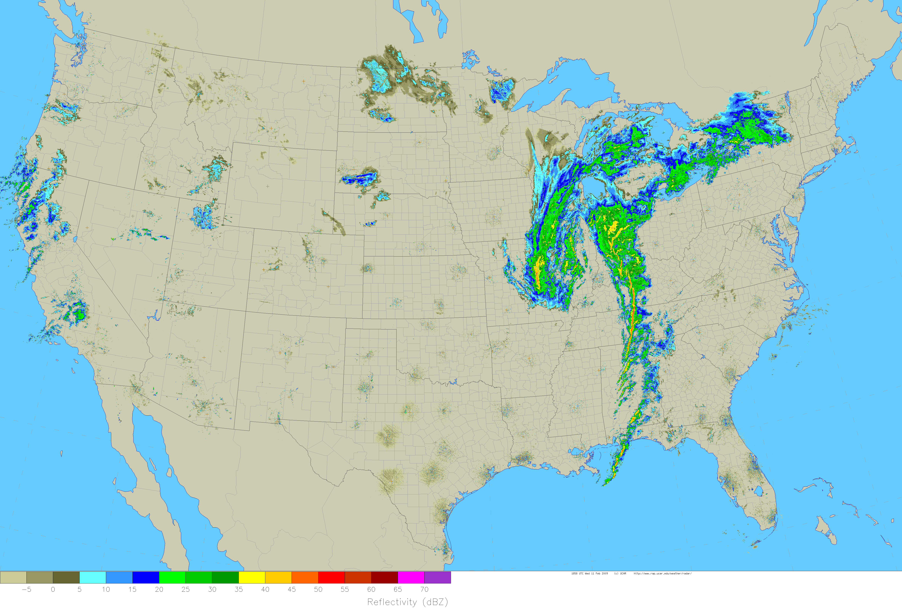
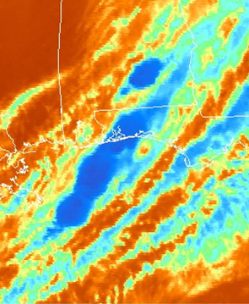
Line of Thunderstorms
A line of thunderstorms at least 60 miles long with thunderstorms affecting at least 40 percent of its length.
Line

Slide 8
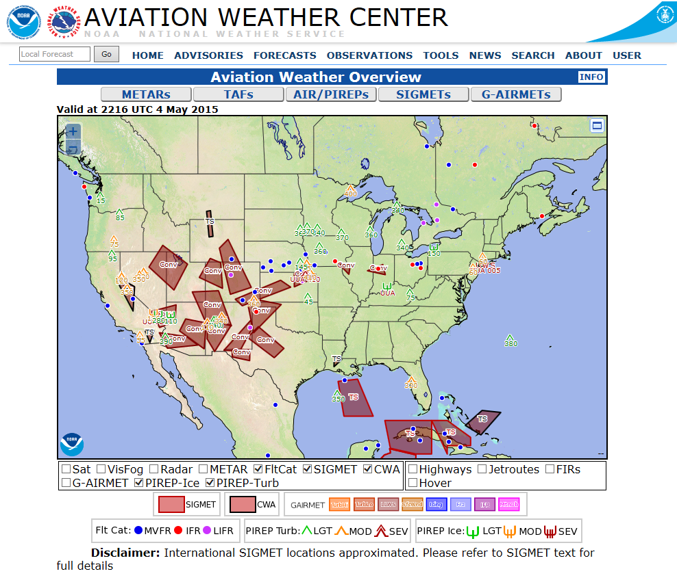
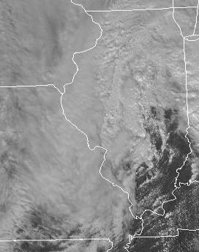
Area of Thunderstorms
An area of active thunderstorms affecting at least 3,000 sq. miles covering at least 40 percent of the area concerned and exhibiting a very strong radar reflectivity intensity or a significant satellite or lightning signature.
-
-
+
-
+
-
-
-
-
+
-
-
+
+
+
-
-
-
+
-
+
-
-
-
-
-
+
-
-
-
-
-
-
-
-
-
-
-
-
+
-
-
-
-
-
-
-
-
+
-
+
-
-
-
-
-
-
+
+
+
+
+
-
-
-
-
-
-
-
-
-
+
-
+
-
-
-
-
-
-
+
-
-
-
-
-
-
+
-
Area
-
-
+
-
-
-
-
-
+
+
+
+
-
-

Slide 9
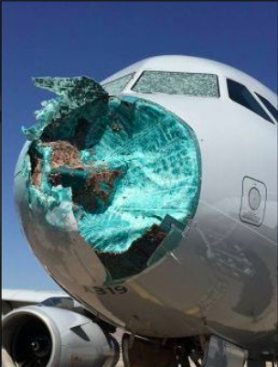
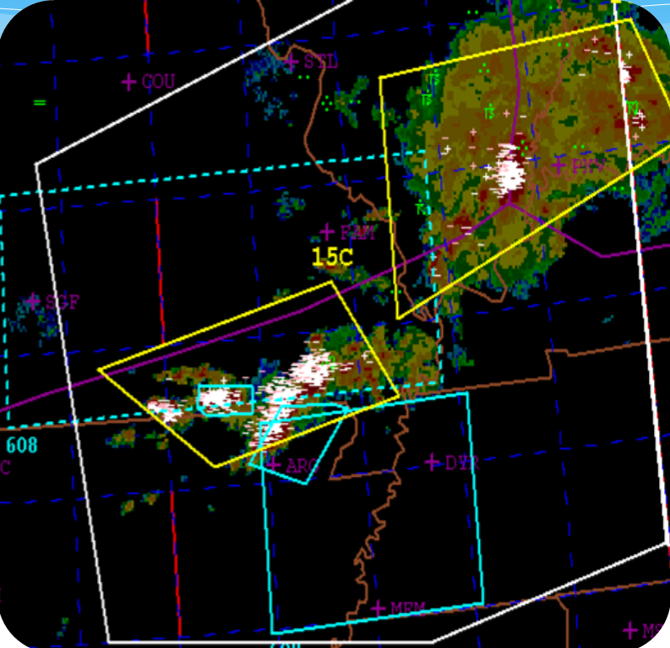
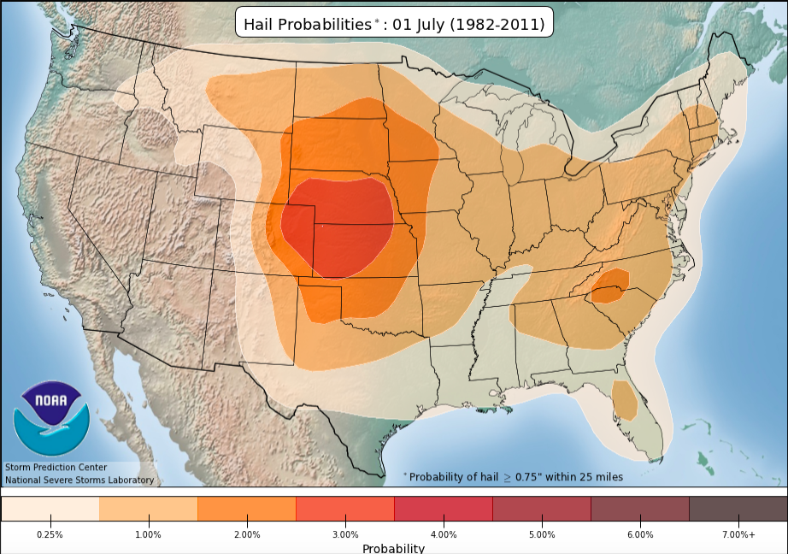
Embedded or Severe Thunderstorm(s)
Embedded or severe thunderstorm(s) expected to occur for more than 30 minutes during the valid period regardless of the size of the area.
Aren’t all thunderstorms severe to pilots?
  Strong updrafts loft hail high into the thunderstorm
  Severe Turbulence and icing are implied.
Watches are referenced in the outlook text.
Valid SIGMETs are not updated to add severe wording.
American Airlines Flight 1897
Severe

Slide 10
Special Issuance Criteria
A special Convective SIGMET may be issued when any of the following criteria are occurring or, in the judgment of the forecaster, are expected to occur for more than 30 minutes of the valid period:
  A Tornado, hail greater than or equal to 3/4 inch, or wind gusts greater than or equal to 50 knots are reported.
  Indications of rapidly changing conditions, if in the forecaster’s judgment, they are not sufficiently described in existing Convective SIGMETs.
  Special issuance is not required for a valid Convective SIGMET.

Slide 11
Issuance Time and Valid Period
Three (3) Convective SIGMET bulletins for the eastern, central and western regions of the CONUS will be issued hourly on a scheduled basis.
Convective SIGMETS are valid for 2 hours or until superseded by the next hourly issuance.
A SIGMET bulletin must be transmitted each hour for each region. When conditions do not meet or are not expected to meet Convective SIGMET criteria within a region at the scheduled time of issuance a “CONVECTIVE SIGMET...NONE” message is transmitted.

Slide 12
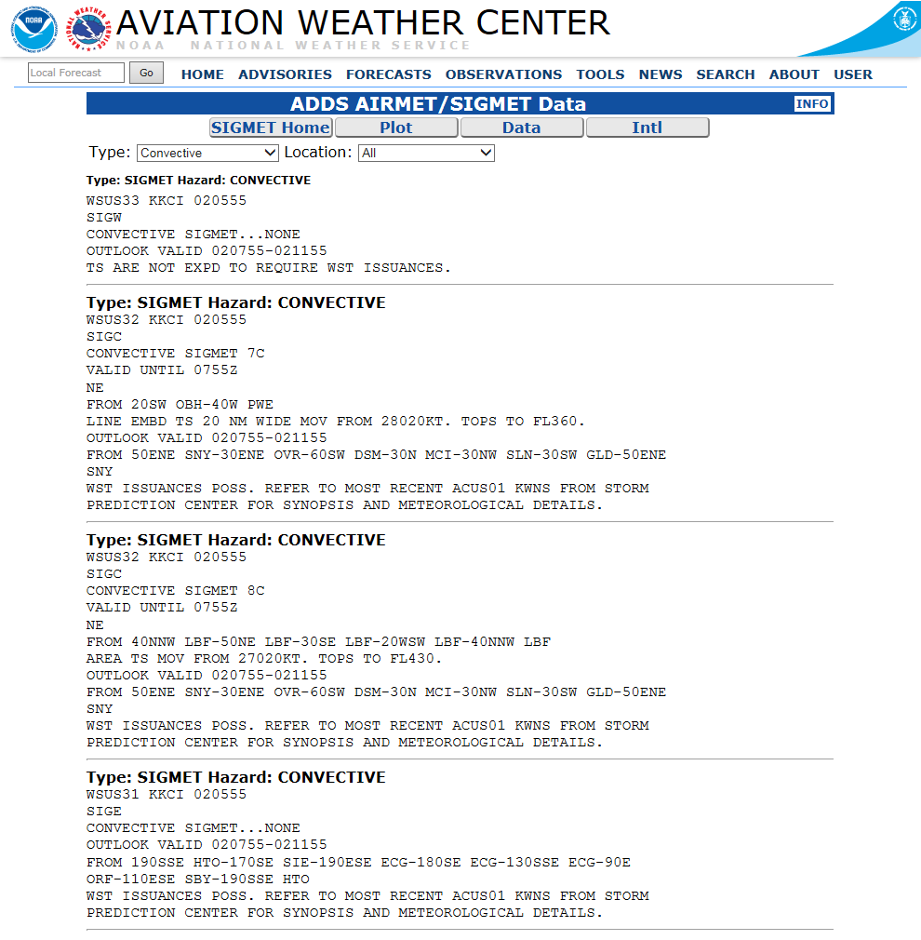
Convective SIGMET Format
Number
Region
Areal Descriptor
Valid Time
Description/ Remarks
States
Outlooks and Valid Time
Areal Descriptor

Slide 13
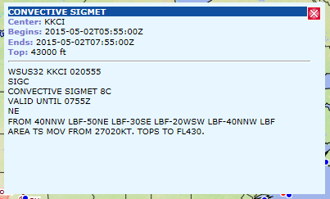
Convective SIGMET Format
Text Representation:
West
Central
East

Slide 14
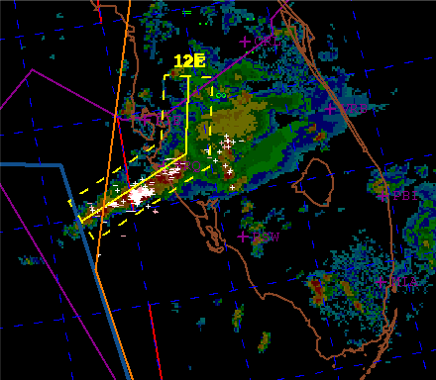
Convective SIGMET
CONVECTIVE SIGMET 12E
VALID UNTIL 1855Z
FL AND CSTL WTRS
FROM 40NE PIE-20ENE SRQ-60WSW SRQ
LINE TS 30 NM WIDE MOV FROM 28015KT. TOPS TO FL410.

Slide 15
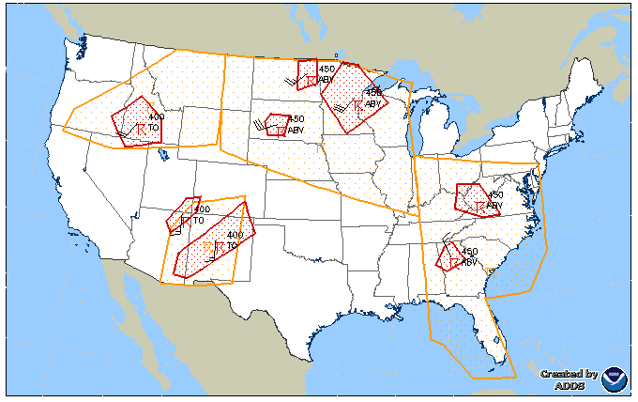
Convective SIGMET Outlook
Outlooks are a planning tool
2 to 6 hour outlook where
convective SIGMETs are
possible.
Outlook
Outlook
Outlook

Slide 16
Area of Responsibility
One forecaster per shift covers the entire CONUS.
Roughly 28,000 Convective SIGMETs issued in 2017.
15 to 20 SIGMETs/hour is not uncommon.
  Up to 25 to 30 an hour possible.

Slide 17
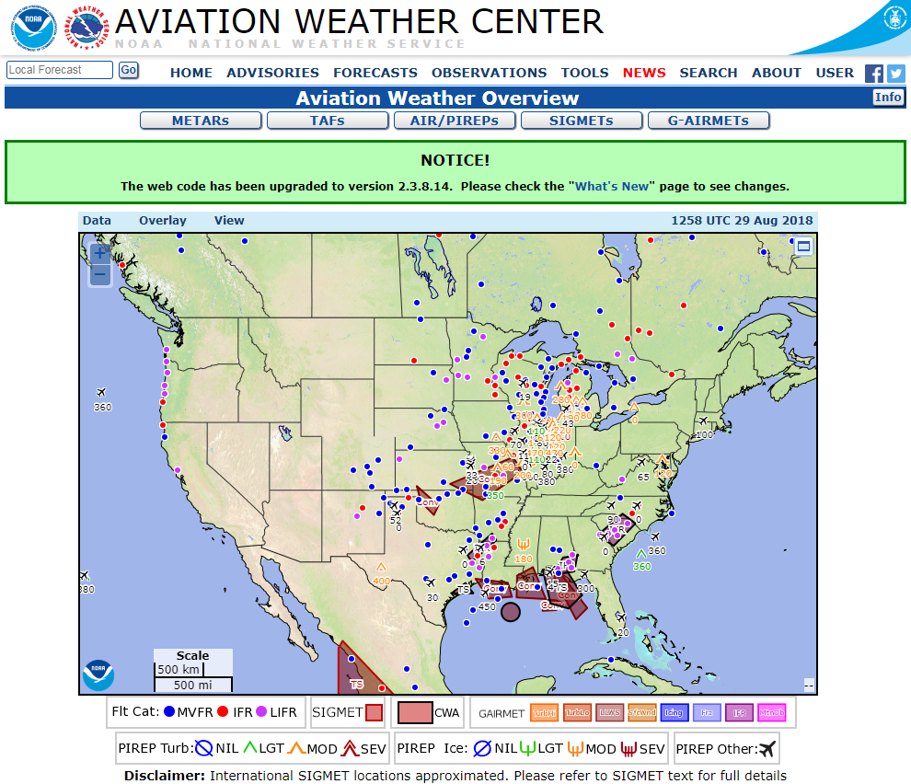
Where Can I Find Convective SIGMETs?
Aviationweather.gov
Aviationweather.gov/sigmet
  Click SIGMETs Tab
  Under Advisory
Aviationweather.gov/gfa
  Under Tools

Slide 18
Things to Remember
CSIG coverage
  40% area and line
Its an hourly product (issued at :55) and valid for 2 hours
  CWSU’s can issue CWAs between the hour
  Forecaster discretion to issue a SPECIAL for rapidly evolving situations
CSIG boxes are a snap shot and do not “move” with the storm
  Unlike severe thunderstorm warnings
  Motion is given in the text portion of the SIGMET
Points are based on VHF Omnidirectional Range (VOR)
  Limited VOR points over coastal areas
CSIGs are not updated if a severe weather warning is issued in an active SIGMET.

Slide 19
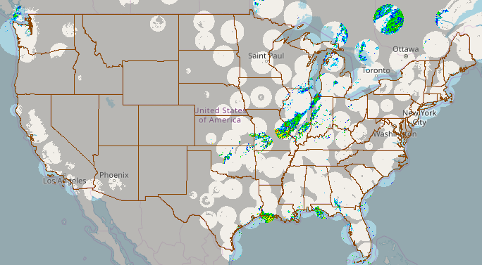
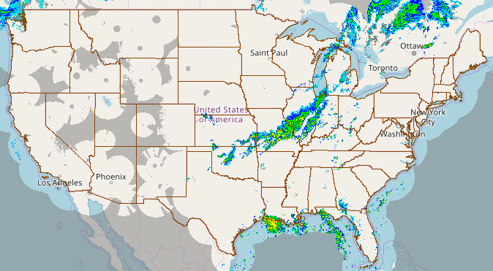
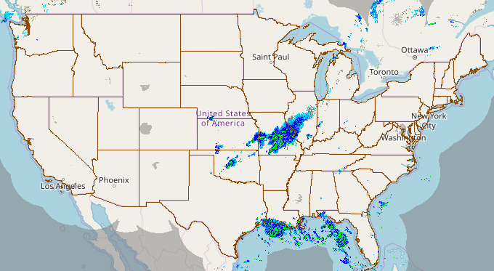
Radar Coverage and Latency
Multi-Radar Multi-Sensor System (MRMS) Coverage
  Uses multiple radars to create a seamless radar product
  Better coverage, but. . .
MRMS 1km
3D Mosaic
MRMS 4km
3D Mosaic
MRMS 9km
3D Mosaic
https://mrms.nssl.noaa.gov/

Slide 20
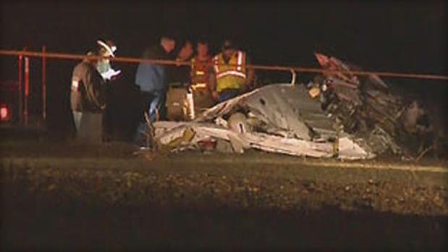
Radar Latency
Radar Latency (delay): Difference in time between the radar image being created and the image getting to the user.
Typically 4 to 6 minutes, but up to 15 minutes.
Conditions can change rapidly during thunderstorm initiation.
“Age indicator on NEXLAB indicates the age of the mosaic image created by the provider, not the age of the weather conditions.” –NTSB
On Dec. 19, 2011 a Piper broke up in flight near Bryan, TX.
Pilot diverted to avoid weather but ended up in an area of developing showers.
Nexrad updates were 4-8 minutes old.
Fast moving storms/Fast moving aircraft need quick information.
Avoid thunderstorms by at least 20nm.
Dec. 19 Bryan, TX Plane Crash -CBS

Slide 21
Thunderstorm Climatology
Thunderstorm Days
  Limited thunderstorm coverage west of the Continental Divide
  Winter: Fronts
  Summer: Monsoon High and associated moisture plume
  “Ring-of-Fire”
Convective SIGMET Frequency
Good topic due to infrequency of Convective SIGMETs in the West

Slide 22
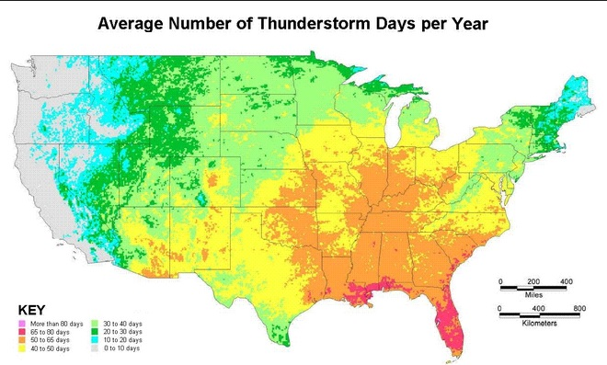
Thunderstorm Days
10-20 Days
20-30 Days

Slide 23
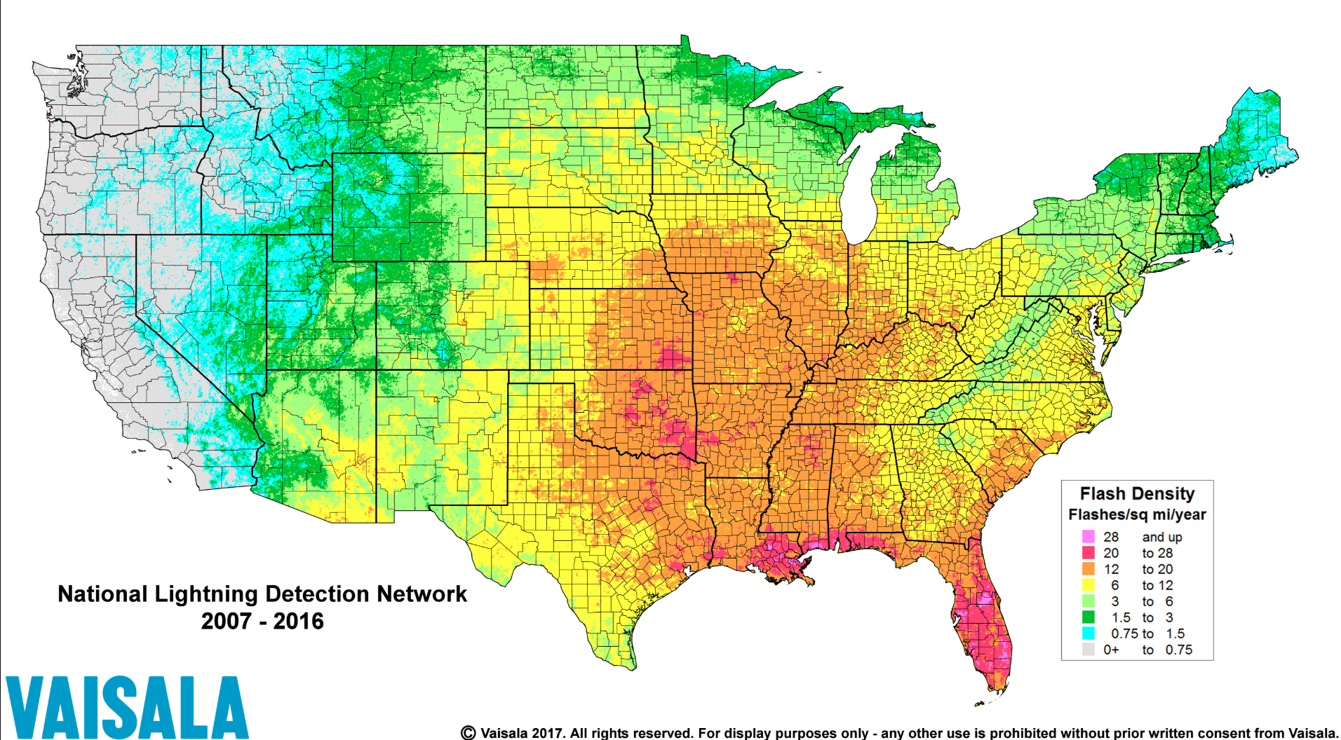
Lightning Flash Density

Slide 24
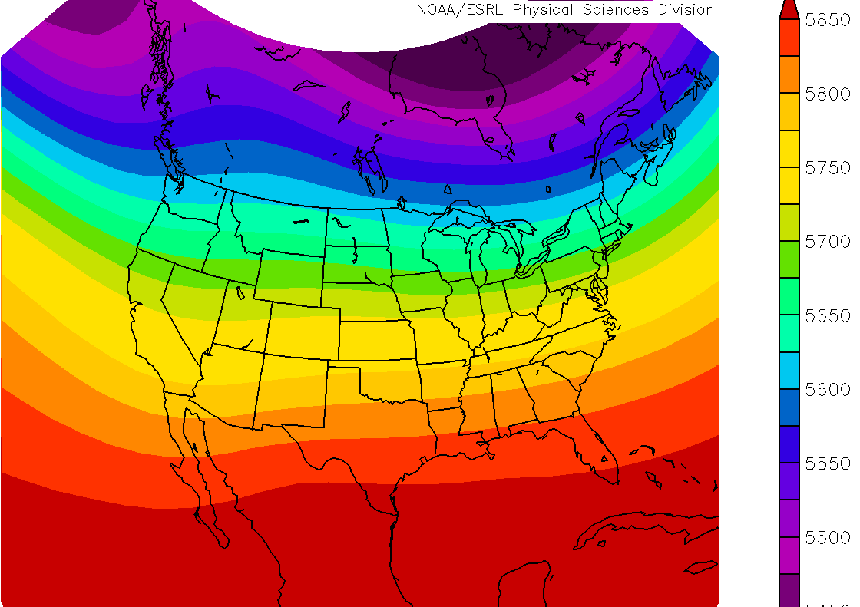
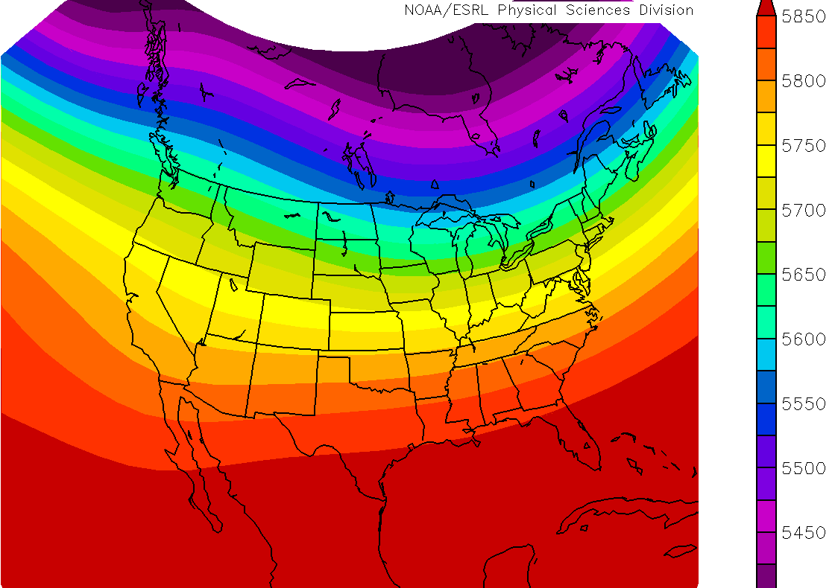
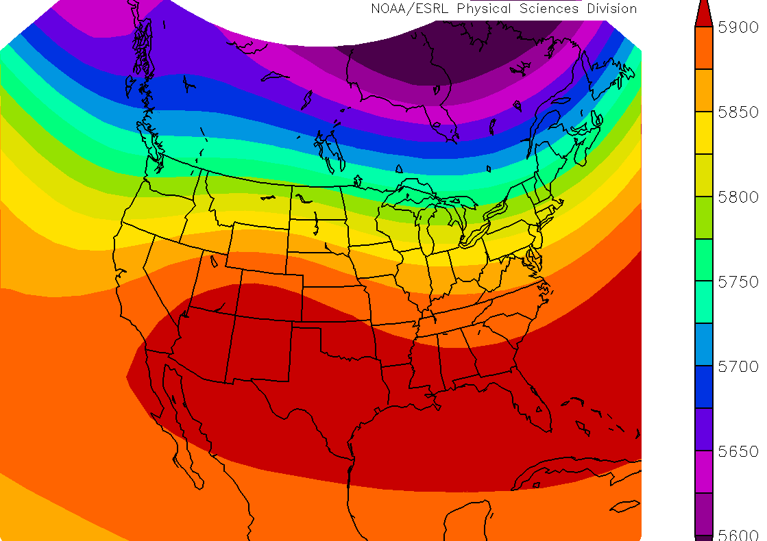
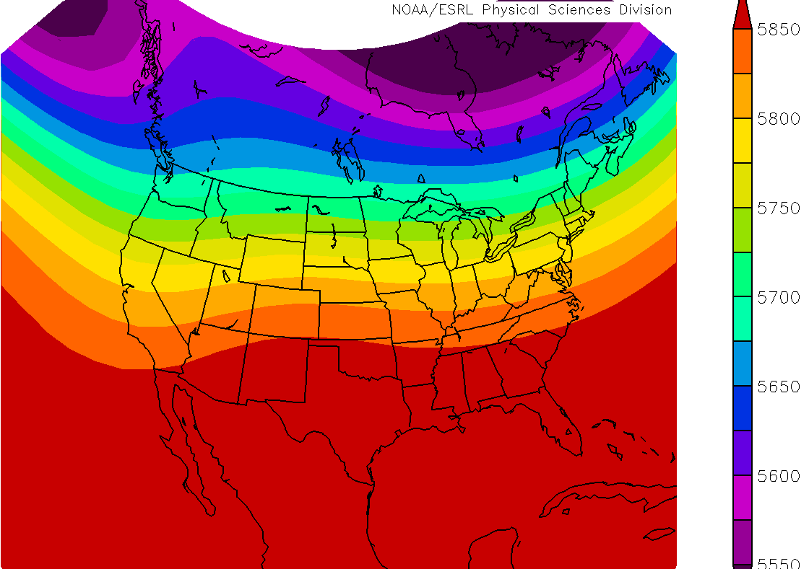
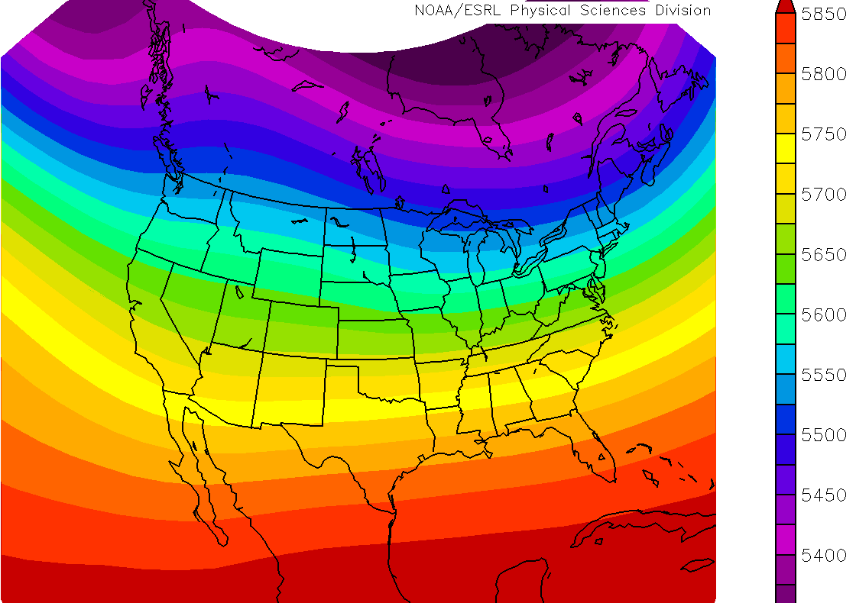
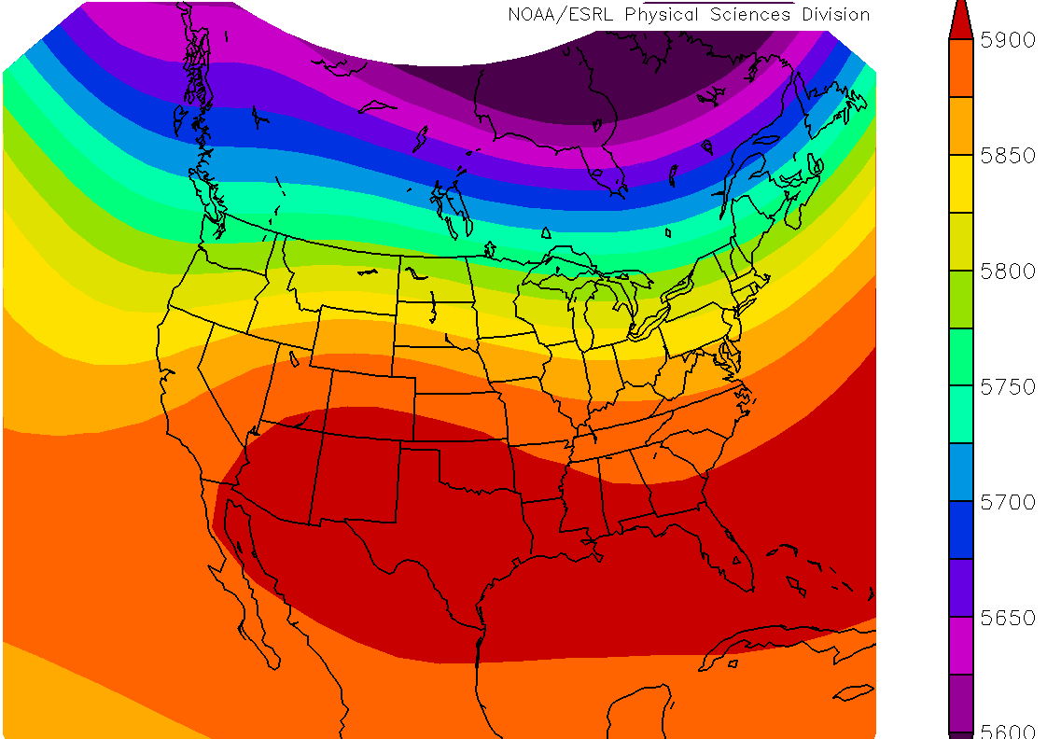
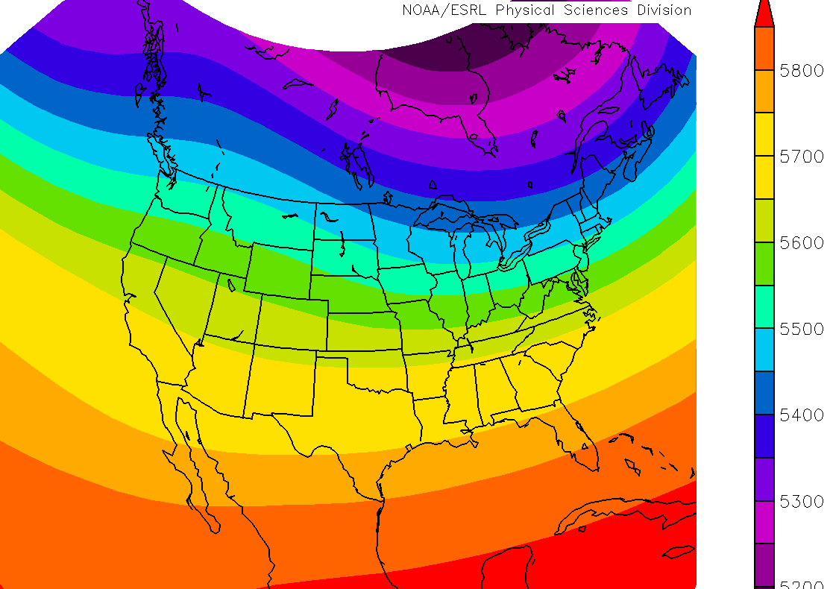
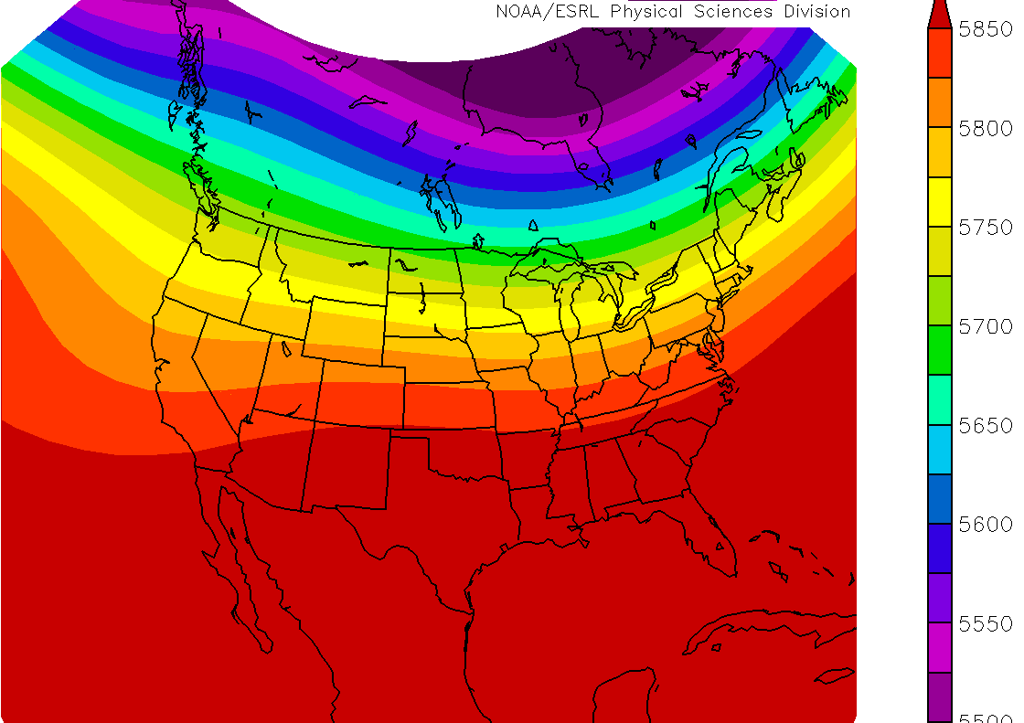
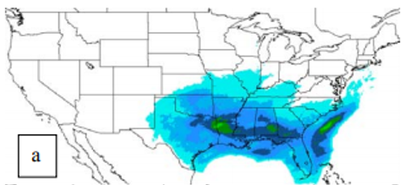
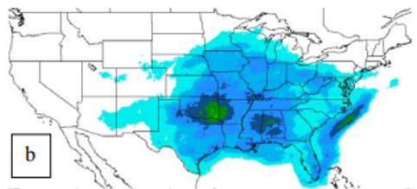
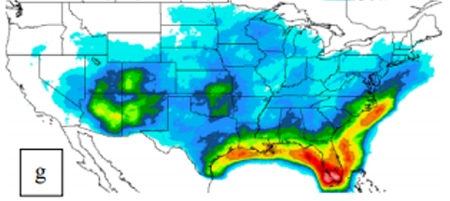
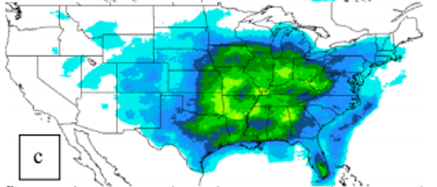
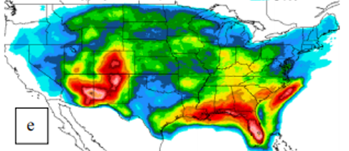
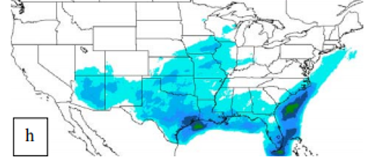
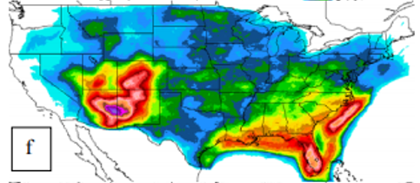
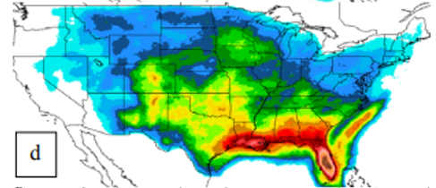
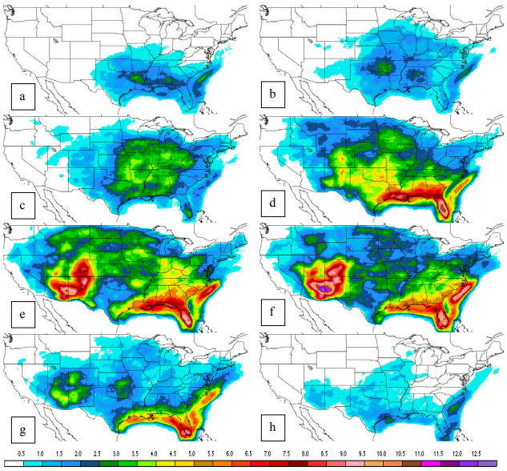
Convective SIGMET Frequency
Percent of time that a 8 km grid cell had a CSIG during the month.
October
March
April
May
June
July
September
August
Monthly CSIG Percent
Frequency: 1999-2004
NCEP/NCAR Reanalysis
500mb Composite Mean
Slemmer et al. 2004

Slide 25
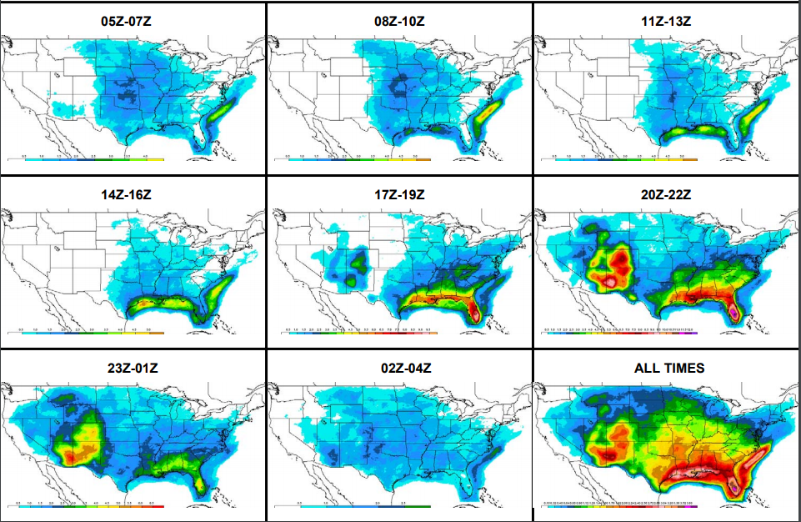
Thunderstorm Frequency
Hourly CSIG
Percent
Frequency
During Conv.
Season
1999-2004
Slemmer et al. 2004

Slide 26
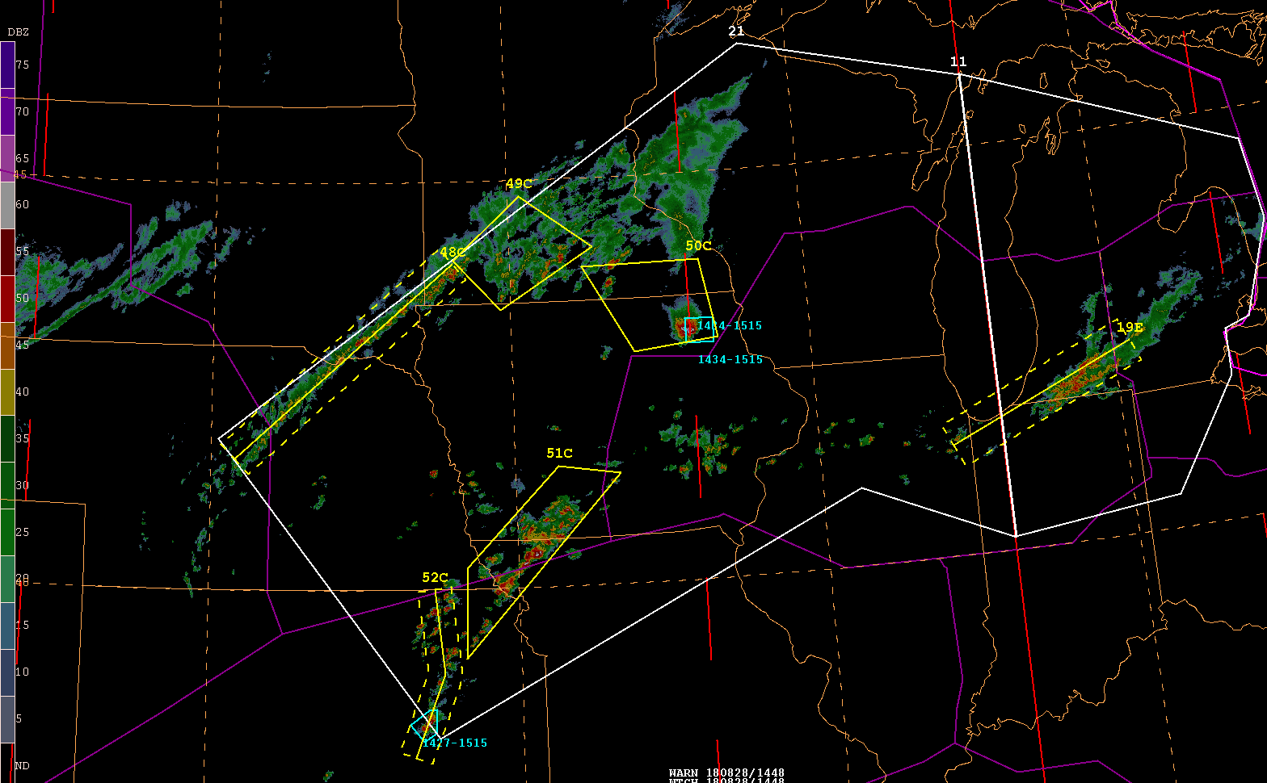
Tools Used
Multi-Radar Multi-Sensor System(MRMS)
  Combines data streams from multiple radars, satellites, surface and upper-air observations, lightning reports, rain gauges, and forecast models
  Produces a suite of decision-support products every 2 minutes.
  https://mrms.nssl.noaa.gov/
Products:
  Reflectivity at Lowest Altitude (RALA)
  Composite Reflectivity
  Echo Tops (-18 dBz and -30 dBz)
  Vertically Integrated Ice (VII)
    Characteristics of the updraft
  -10°C Reflectivity
    Onset of Lightning Activity

Slide 27
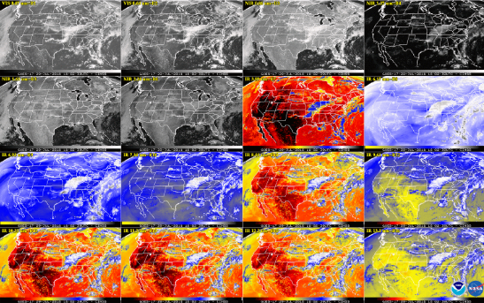
Tools Used
https://www.star.nesdis.noaa.gov/GOES/index.php
GOES-16
  16 different channels (2 visible, 4 near-infrared, 10 infrared)
  Red Band resolution: 0.5 km (hi-res radar data 0.25km)
  CONUS scans every 5 minutes
  2 meso scans every 1 minute
GOES-17 coming late this year.
  Already seeing experimental products

Slide 28
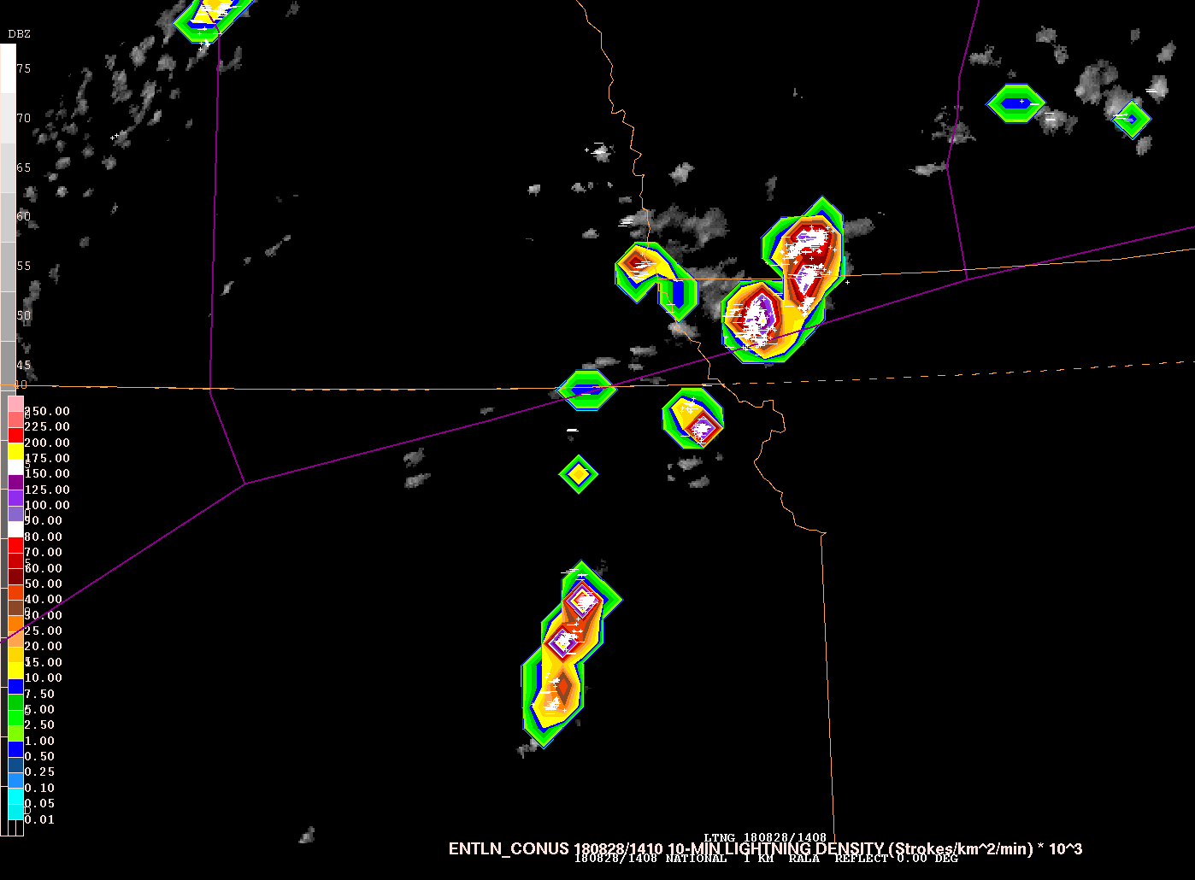
Tools Used
Geostationary Lightning Mapper
  First operational lightning mapper flown in geostationary orbit
  Detects the momentary changes in an optical scene, indicating the presence of lightning
  Measures total lightning (in-cloud, cloud-to-cloud, and cloud-to-ground)
  Resolution: 10 km
AWC is the first National Center to use GLM operationally.
  Convective SIGMET and Tropical Desks
  Promising results vs. NLDN and Earth Networks

Slide 29

Pilot Reports (PIREPs)
NTSB Forum June 21-22, 2016
  Several accidents noted where a PIREP may have provided critical information of the environmental conditions prior to the accident.
We Want Your PIREPs

Slide 30



Thank You!!
Contact:
  Scott Minnick
  scott.minnick@noaa.gov
Acknowledgements:
  Amanda Martin
  Gregory Harris
  Jonathan Slemmer
  Brian Pettigrew
  Jesse Sparks
  Deb Blondin
/NWSAWC
@NWSAWC
aviationweather.gov

