Slide 1
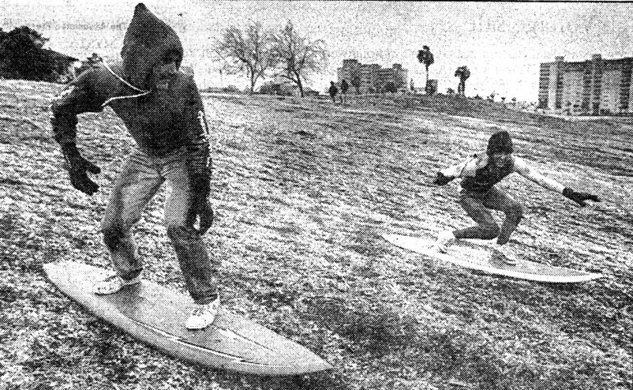
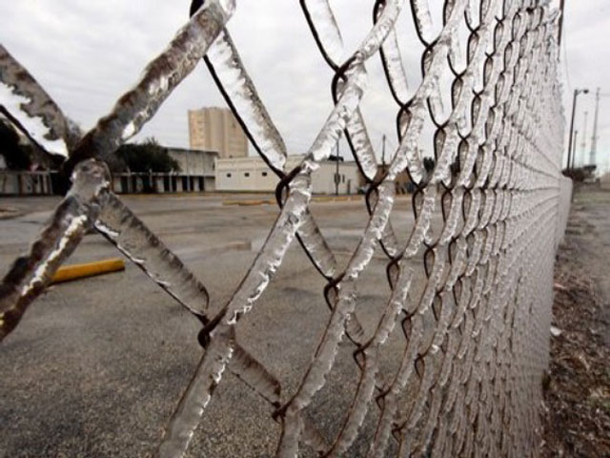
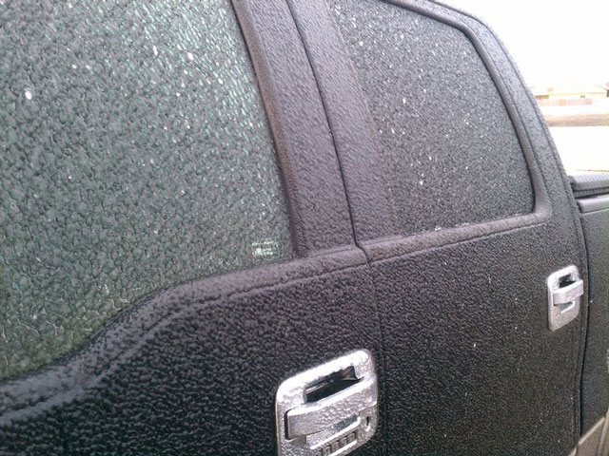
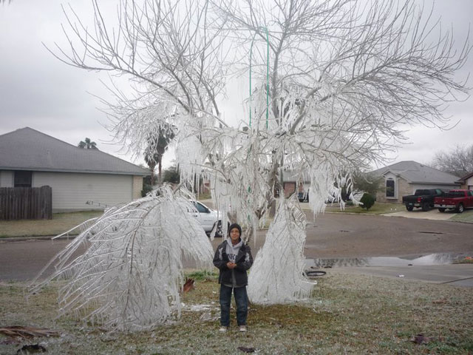
Significant Ice Storms Affecting Corpus Christi, Texas
Michael Buchanan
Science & Operations Officer
WFO Corpus Christi

Slide 2
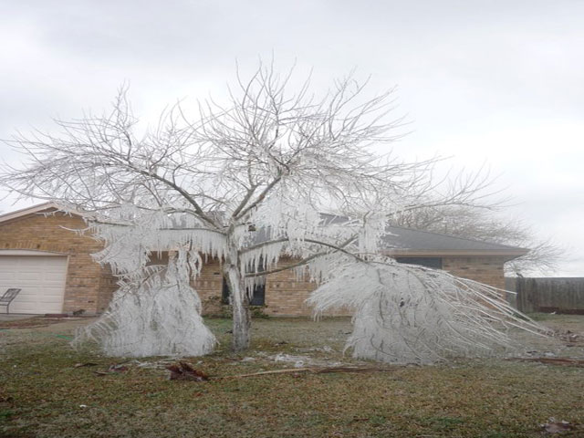
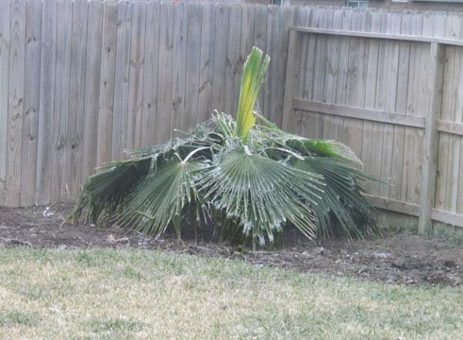
Why do an ice storm study for Corpus Christi?
The impetus was the Feb 3-4, 2011 ice storm.
Was this the “worst” ice storm to affect Corpus Christi?
Would it be possible to quantify the “severity” of past ice storms?
Feb 3-4, 2011

Slide 3
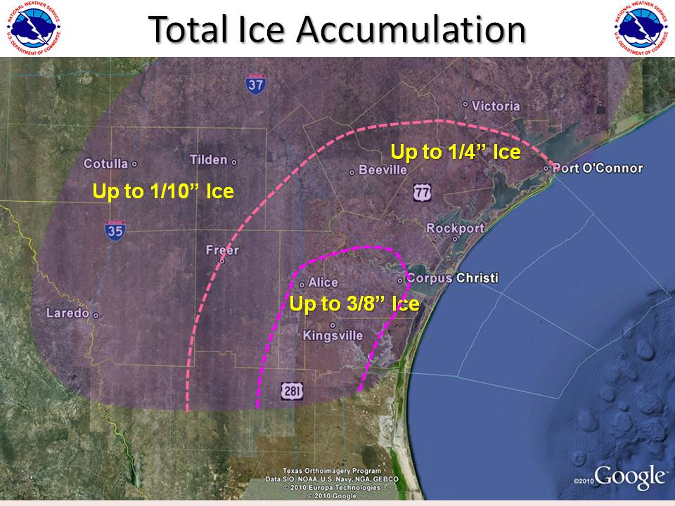
Feb 3-4, 2011

Slide 4
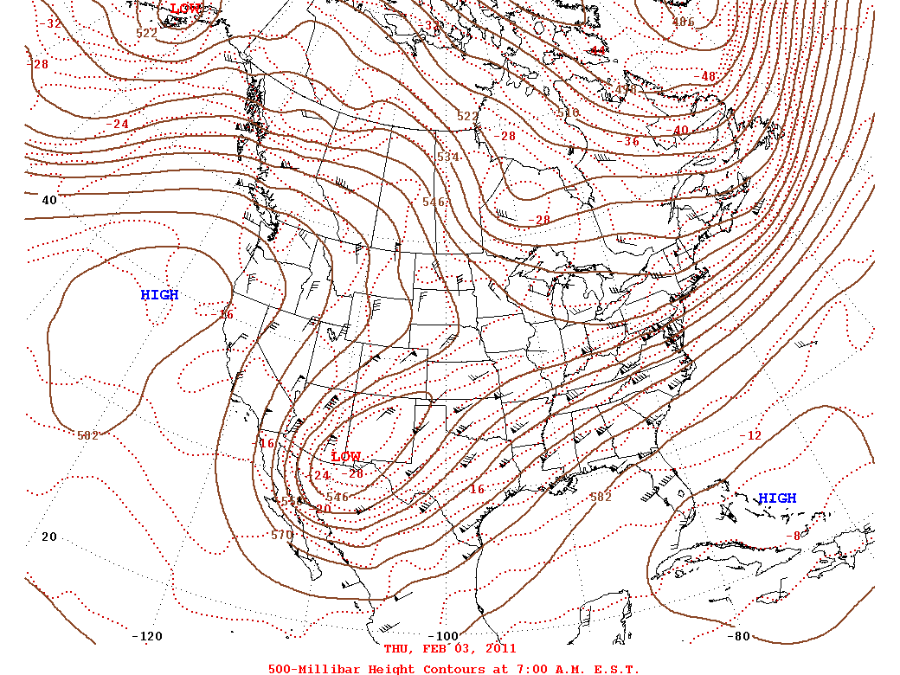
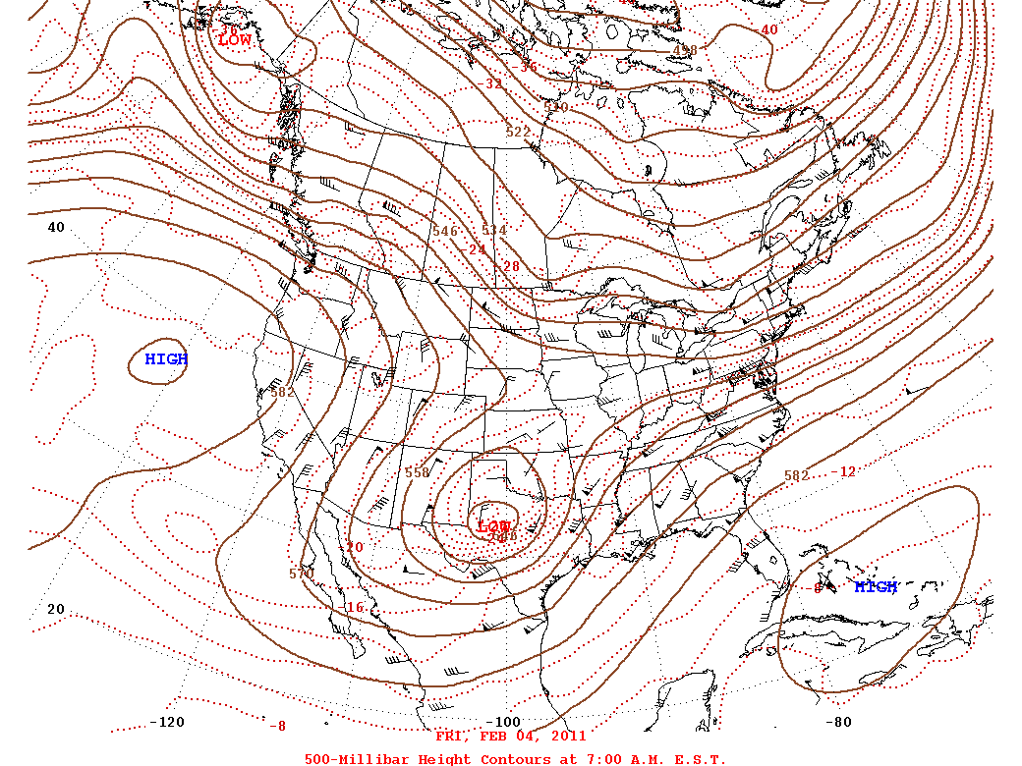
Feb 3-4, 2011 – 500 mb

Slide 5
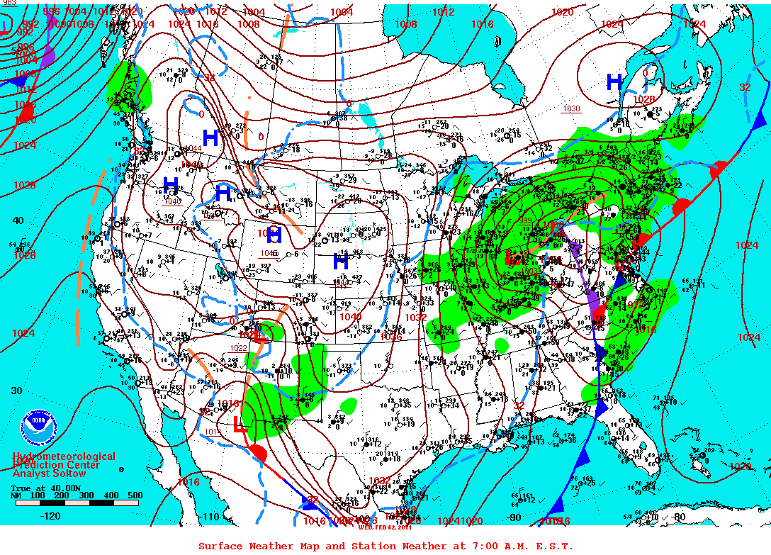
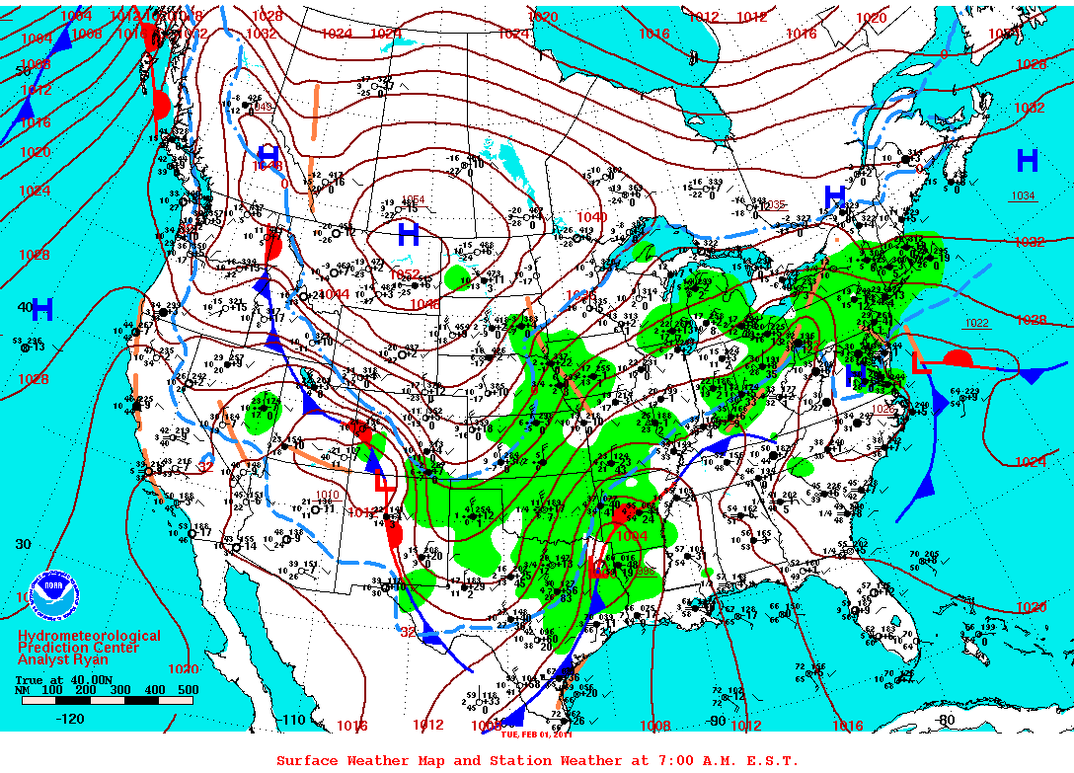
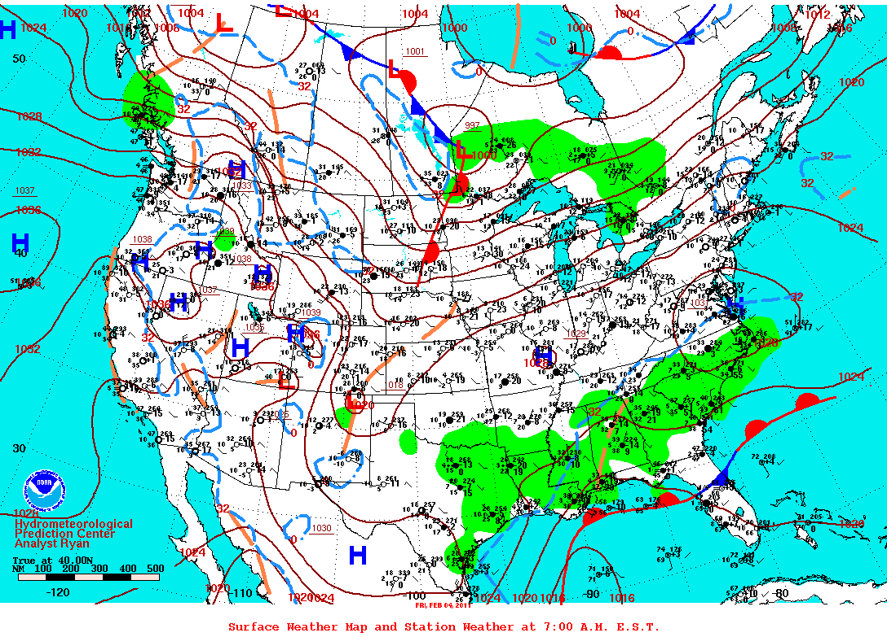
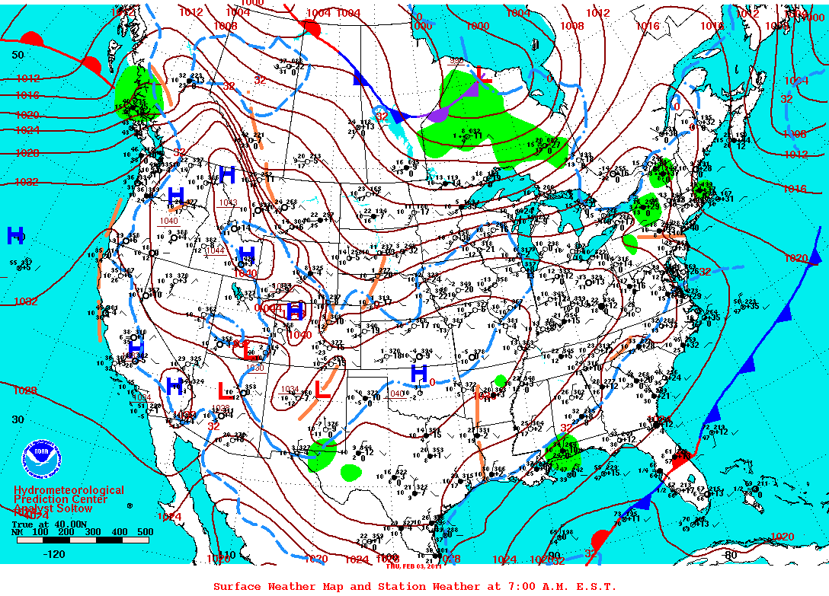
Feb 1-4, 2011 – Surface Map

Slide 6
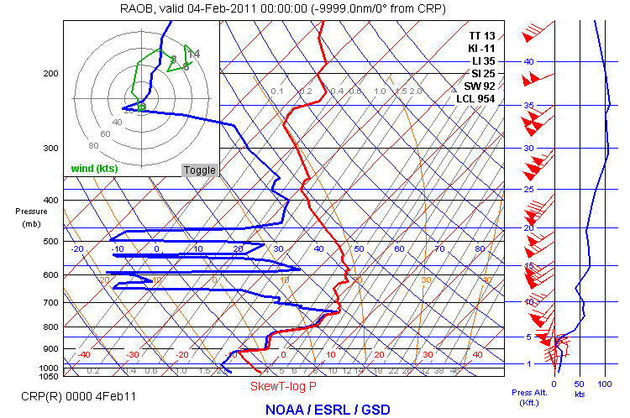
Feb 3-4, 2011
0 degree
isotherm

Slide 7
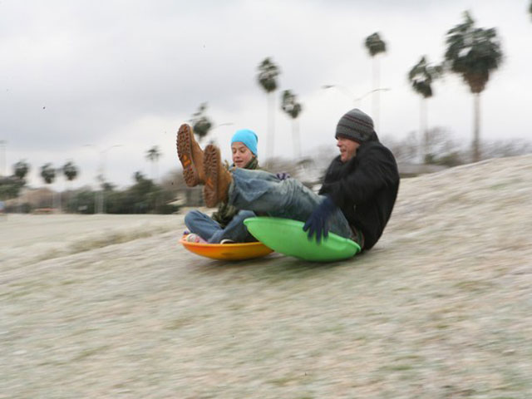
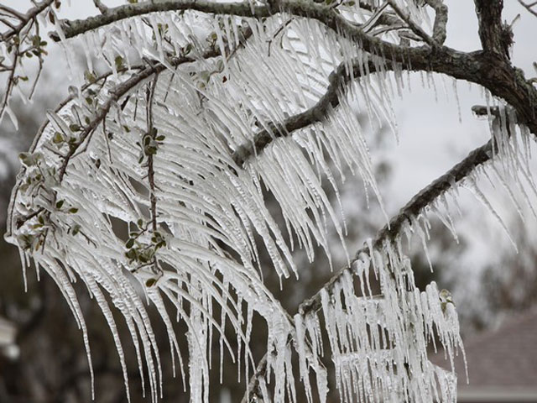
Feb 3-4, 2011
14 hours of freezing drizzle (2/3 eve thru 2/4 morn).
0.05” total pcpn.
1/4-3/8” ice accumulation.
Arctic front on morning of 2/1.
  1054 mb High over Montana.
  5th coldest 3-day stretch Max Temp in Feb.
  1 record low.
  37 hours of freezing temps!
  60 hours after fropa…freezing pcpn began.

Slide 8
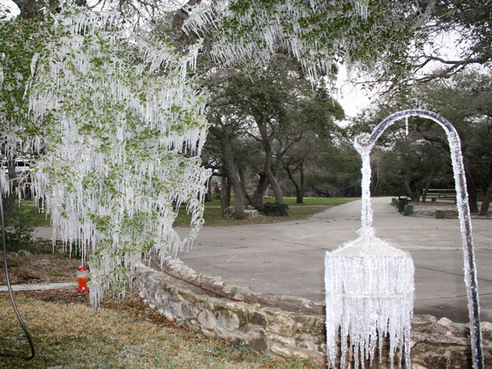
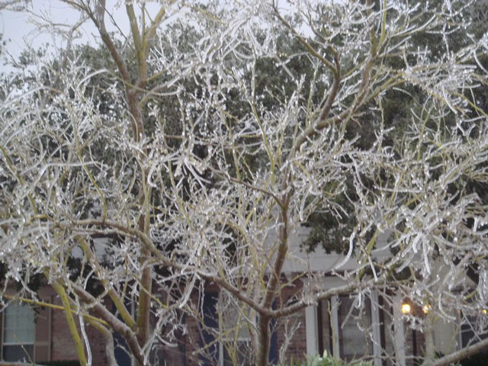
Feb 3-4, 2011
Roads, bridges, schools & city offices closed.
At least 200 car accidents.
Multiple injuries.
Ice melted by the aftn on 4th.
Caller Times reported that a long-time resident said it was “not as disruptive as other winter storms in the 1950s and ‘60s”.

Slide 9
“Other” factors
Does ice thickness tell the whole story?
Are there are other “factors” which complete the picture?
Can these be quantified?
Or do we simply qualitatively rank past storms using this “non-meteorological data”?

Slide 10
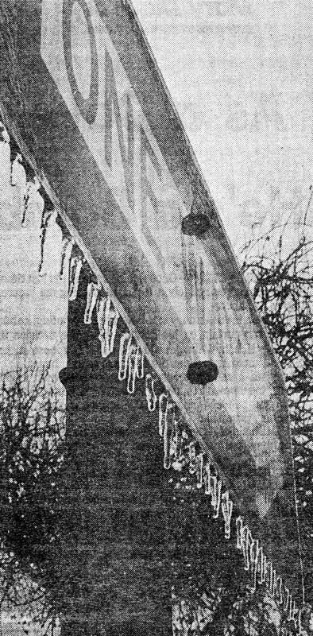
What about ice thickness?
Little to no official record except for recent events!!!
So, how can one compare historical ice storms without ice thickness data?
Must use socio-economic data in addition to the surface observations.
Jan 9-10, 1973

Slide 11

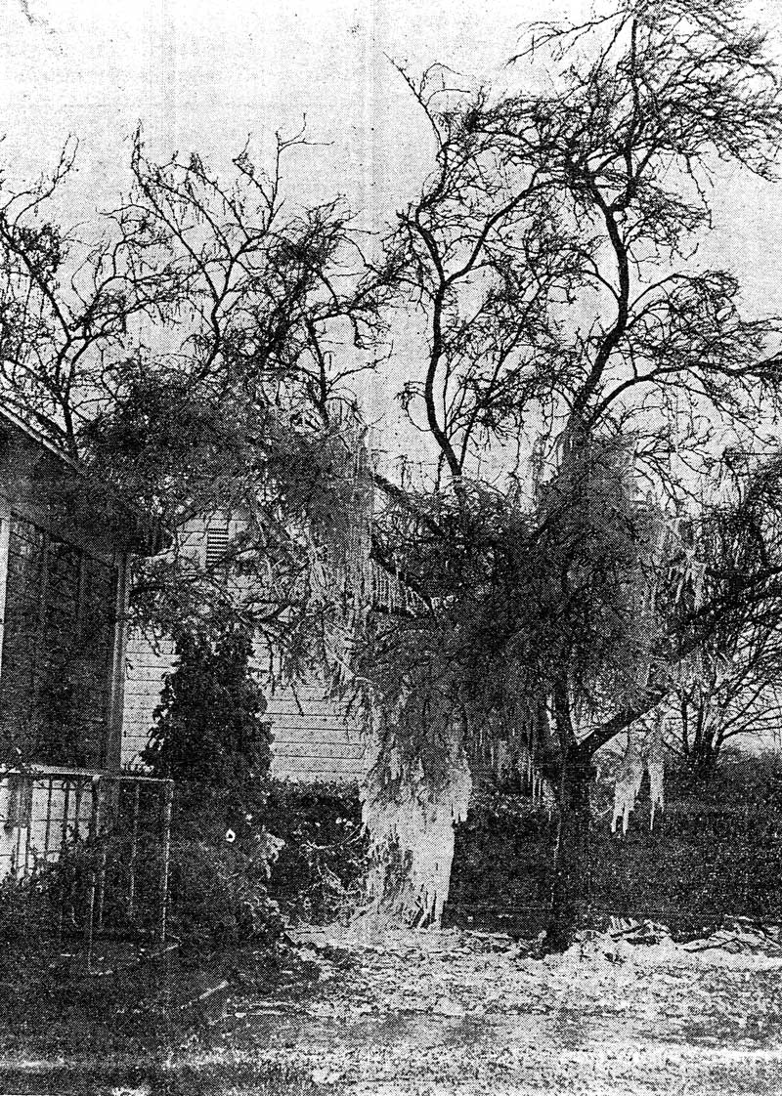
Socio-economic Data from
Fatalities
Injuries
Damage
Traffic Accidents
Airport Closures
Road Closures
Businesses Closed
Schools Closed
Communication Disruption
Jan 29-31, 1951

Slide 12
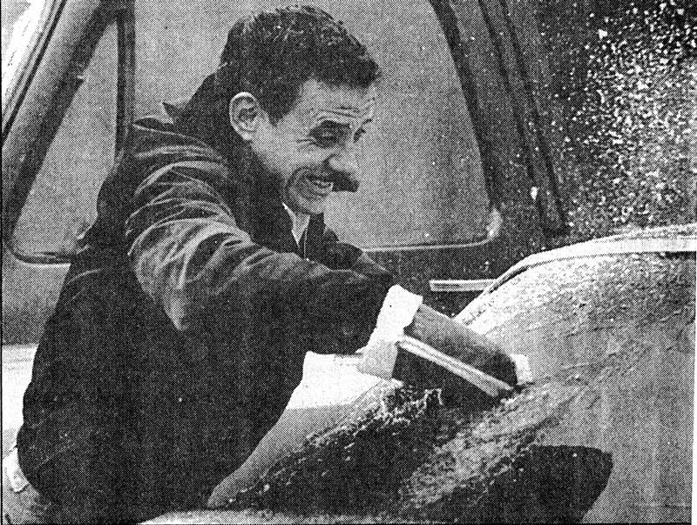
NCDC Hourly Global Surface Data
Since 1924, Freezing rain/drizzle has been observed on average once every 3-4 years in Corpus Christi.
At least one report of freezing rain/drizzle in 24 separate years since 1924.
Jan 12-14, 1985

Slide 13
All Freezing Rain/Drizzle Events
1924, 1940, 1946, 1947, 1948, 1949, 1951, 1956, 1961, 1962, 1963, 1964, 1973, 1978, 1982, 1983, 1985, 1989, 1990, 1994, 1996, 1997, 2007, 2011.
Questionable years in which freezing rain/drizzle MAY have occurred:
  1896, 1897, 1918, 1925, 1929, 1932.
  Sleet and/or snow recorded in these years.

Slide 14
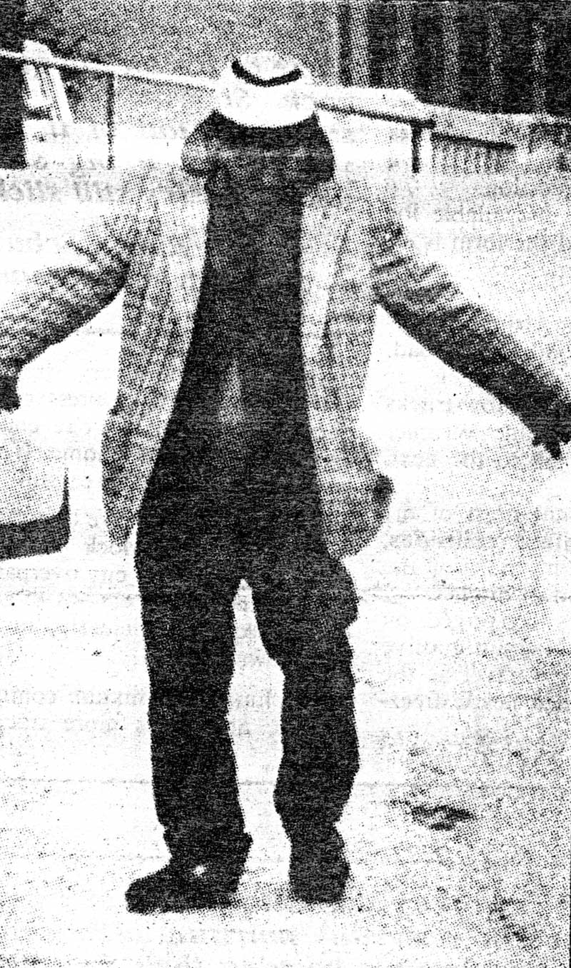
Other supplemental Met Data
Total Precipitation
  More Pcpn = More Ice?
How long did Freezing Rain/Freezing Drizzle occur?
How long was it below freezing?
“How cold did it get?”
  Was it record cold?
  Less chance of melting.
Feb 4-7, 1989

Slide 15
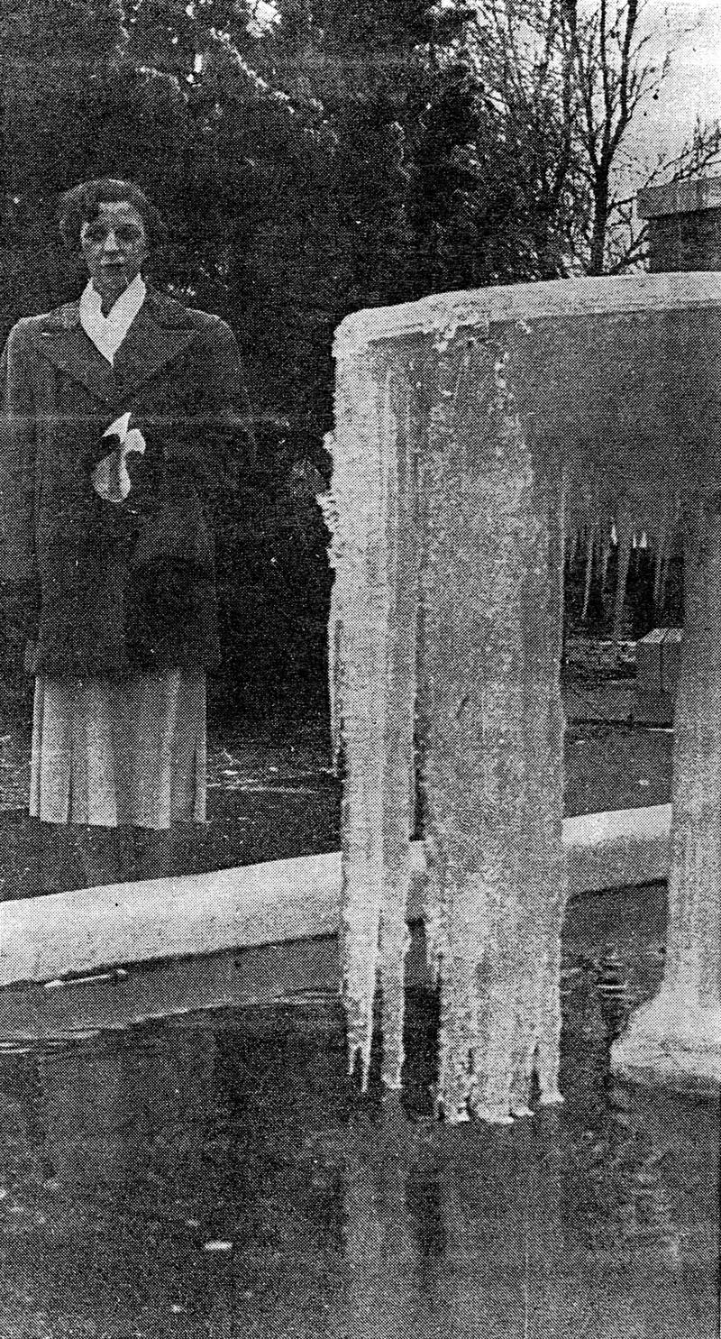
Worst Ice Storms
1924
1940
1951
1973
1982
1985
1989
2011
Feb 3-4, 2011
Jan 29-31, 1951

Slide 16
Worst Ice Storms
Highly amplified synoptic regime:
  Strong Ridge aloft across Alaska & West Coast.
  Deep Low Pressure in NE Canada & Greenland.
The net result is Arctic air is driven very far southward across most of the United States.
Shortwave trough axis evident in subtropical branch moving through Desert Southwest and Northern Mexico.

Slide 17
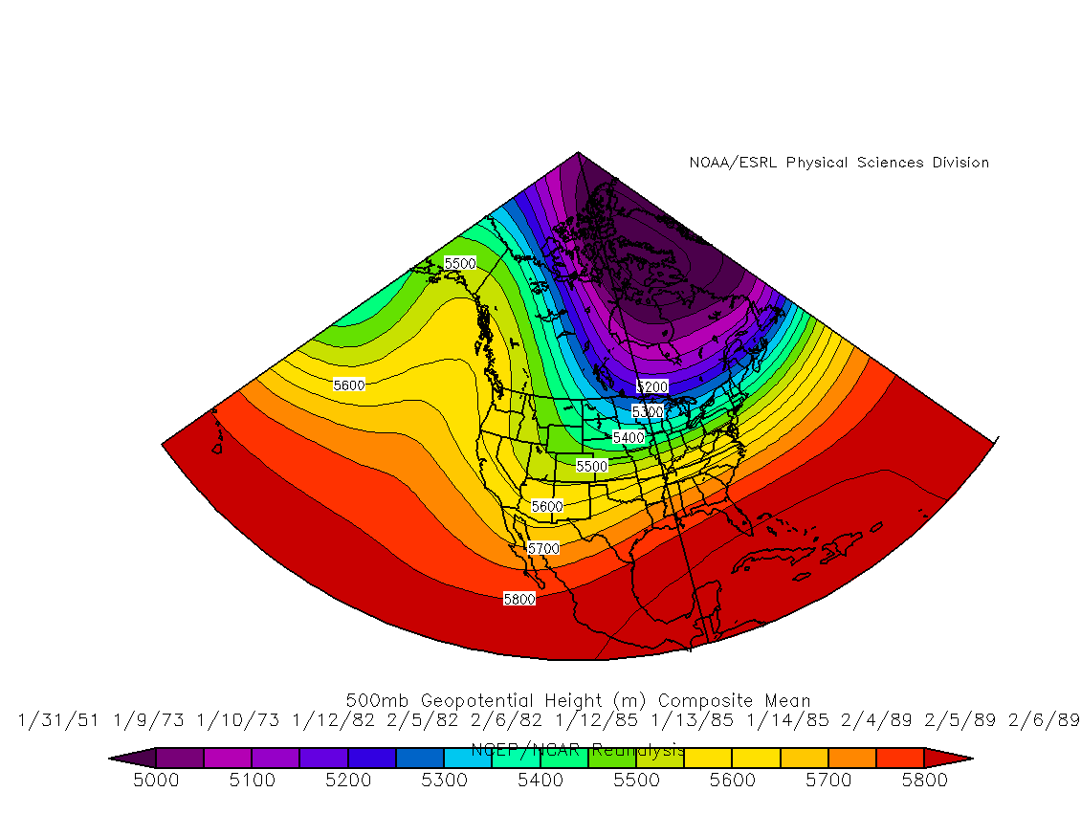
500 mb Composite

Slide 18
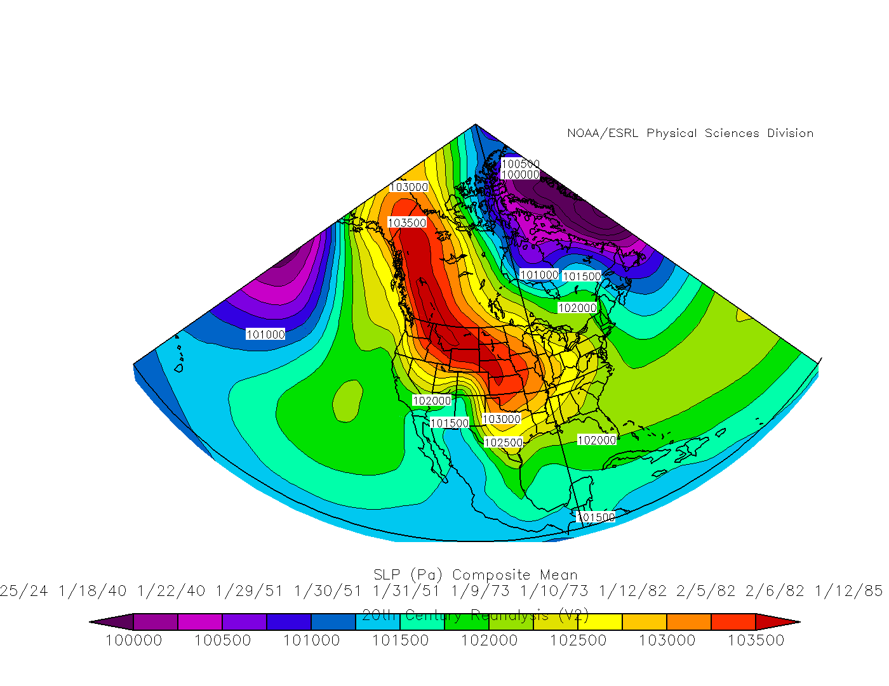
Surface Composite

Slide 19
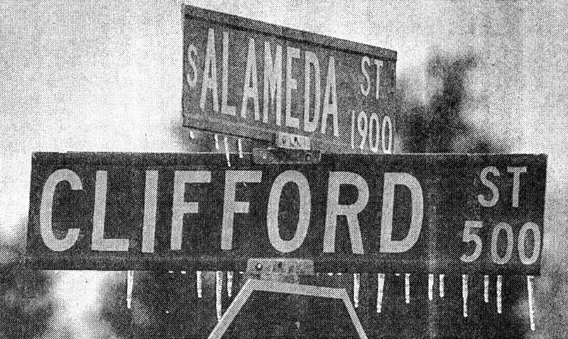
Worst Ice Storms
Associated behind Arctic cold front.
Observed in all cases.
This is consistent with Changnon 2002 & Rauber et al. 2001.
Jan 12-14, 1985

Slide 20
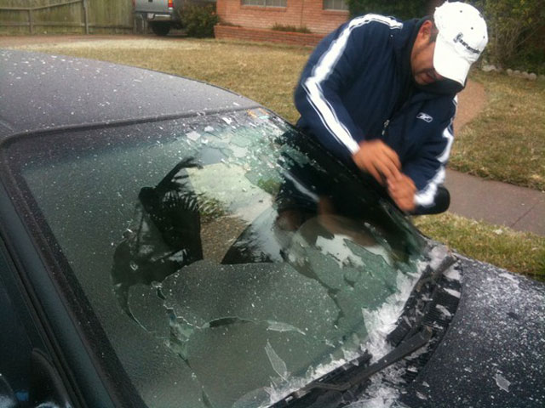
Is the Feb 3-4, 2011 ice storm the worst?
In one word…NO!
Why not?
Then which storms are the worst of the worst and why?

Slide 21
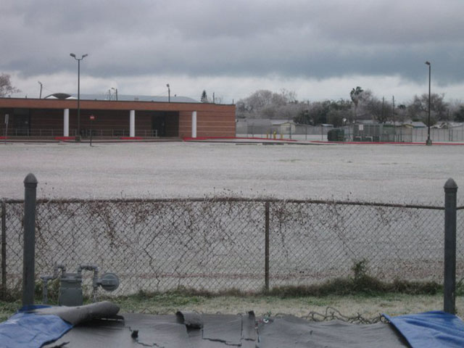
Why are the 1924, 1951 & 1985 ice storms worse than the Feb 3-4, 2011 ice storm?
More fatalities.
Thicker ice.
Longer period of freezing rain/freezing drizzle.
Greater amount of pcpn.
Longer period of below freezing temps.
Greater amount of damage and disruption.

Slide 22
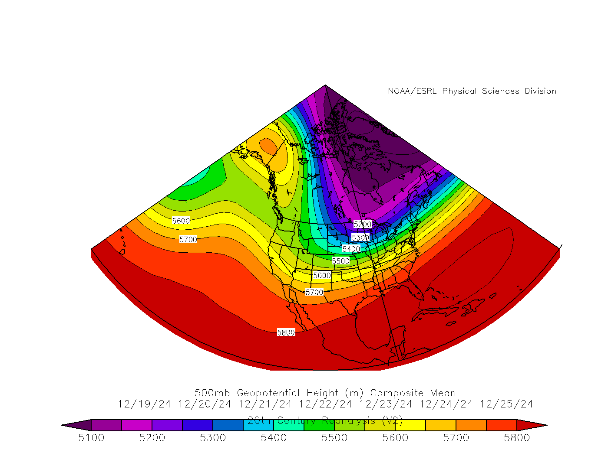
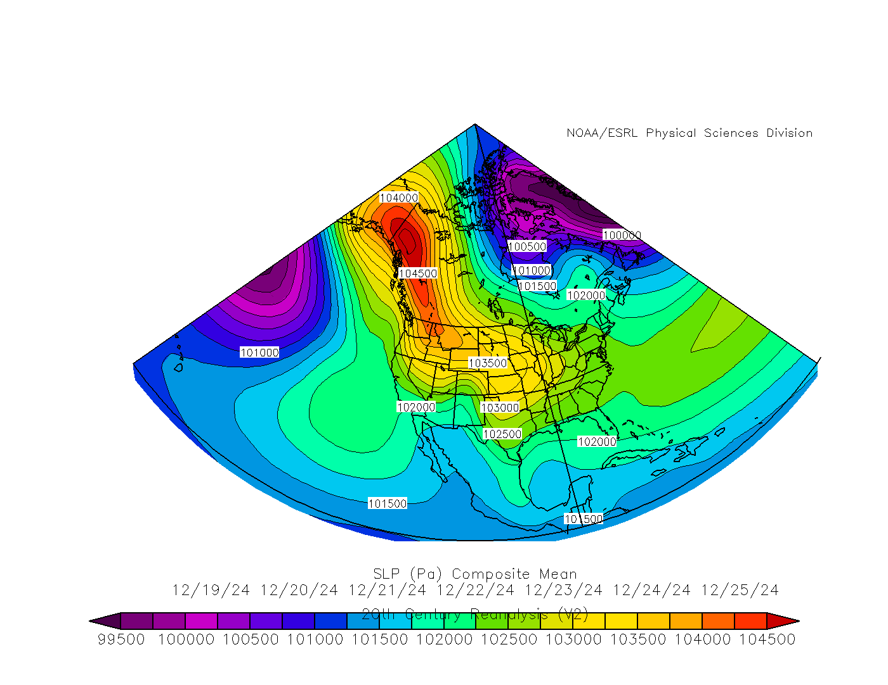
Dec 19-25 1924*
500 mb Composite
Surface Composite

Slide 23
Dec 19-25 1924*
~4 days (19,20,21,25) of freezing pcpn.
Approx. 1.45 inches total pcpn (Mix of freezing rain, sleet & snow).
2 Arctic cold fronts (19th morning and 24th morning):
  1060 mb anticyclone center in the Yukon.
  Tied 2nd all-time for 2 consecutive days with max temp <= 32 degs.
  ~72 hours below freezing.
  1 record low and 2 record low maxes still exist.
9 hours after first fropa…freezing pcpn began.

Slide 24
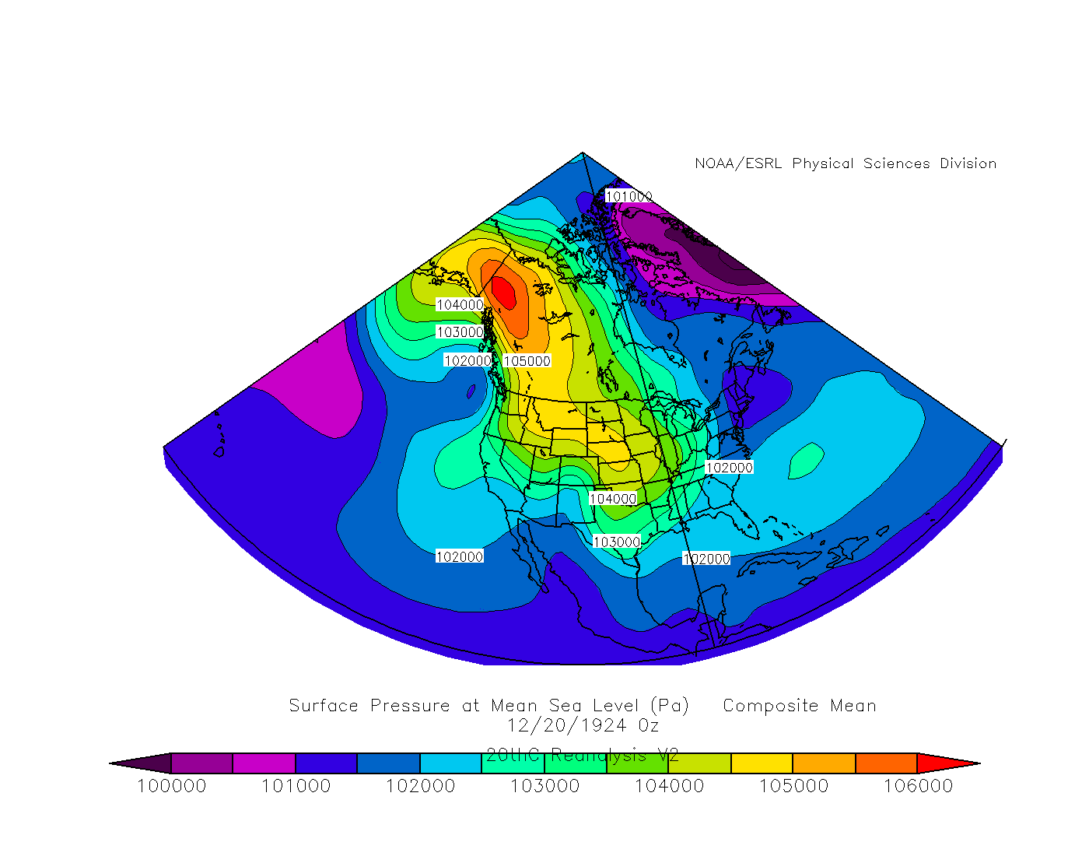
1060 mb high centered over Yukon

Slide 25
Dec 19-25 1924*
J.P. McAuliffe, former MIC WSO CRP (1922-1946) wrote:
  “heavy coating of glaze making travel of all sorts difficult and dangerous”
  “The coating on the wires and trees soon became so heavy as to cause the wires to break and branches of trees to collapse.”
  “ice caused telephonic communication to cease”

Slide 26
Dec 19-25 1924*
Telephone lines down for as long as 4 months!
Most communication down for days.
Extensive damage to crops and vegetation.

Slide 27
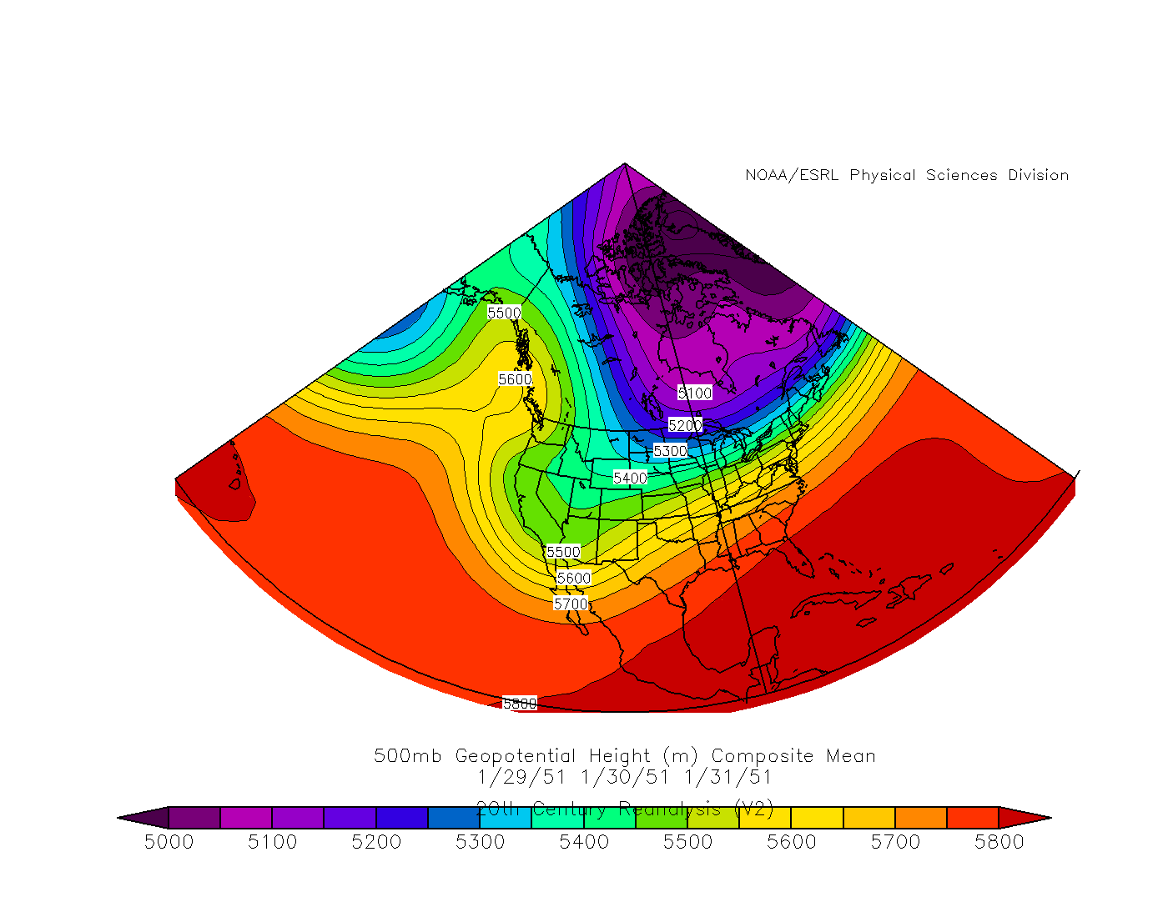
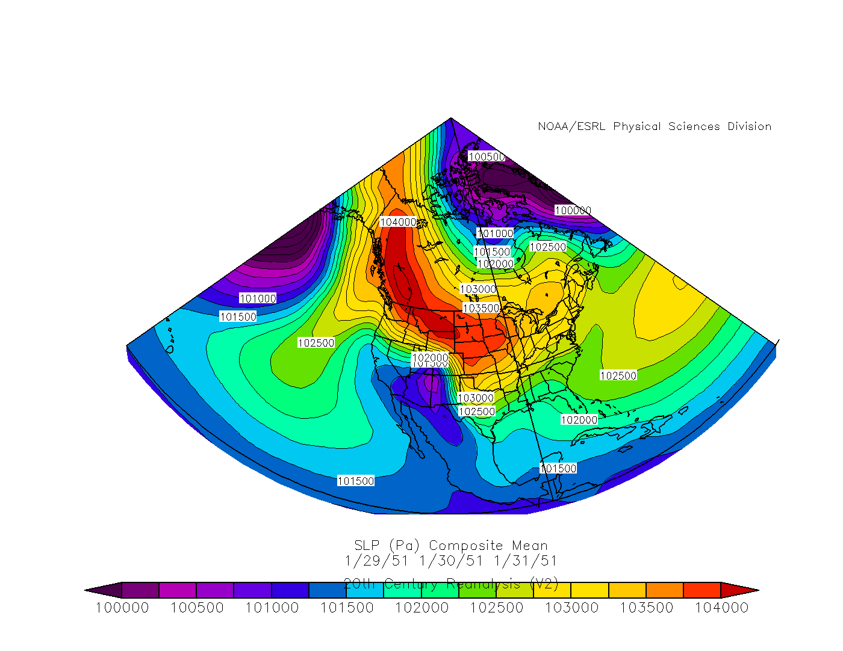
Jan 29-31, 1951*
500 mb Composite
Surface Composite

Slide 28
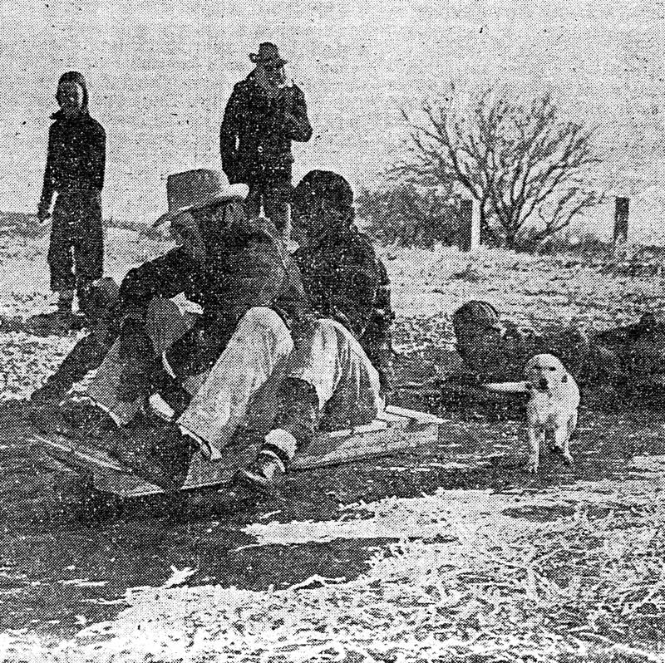
Jan 29-31, 1951*
~42 hours of freezing pcpn.
0.10 inches total pcpn.
Arctic cold front on the 28th (evening).
  1062 mb anticyclone center in the Yukon.
  Coldest 6 day stretch (ending Feb 3rd)
  in history!!!
  96 consecutive hours at or below freezing is
  the all-time record!!!
  5 record lows for the 29th, 30th, 1st, 2^{nd &} 3rd.
  More than 10000 broken pipes!
  Killed countless fish.
Strong shortwave in southern stream.
  Induces surface low in NW Gulf.
19 hours after fropa…freezing pcpn began.
Jan 29-31, 1951

Slide 29
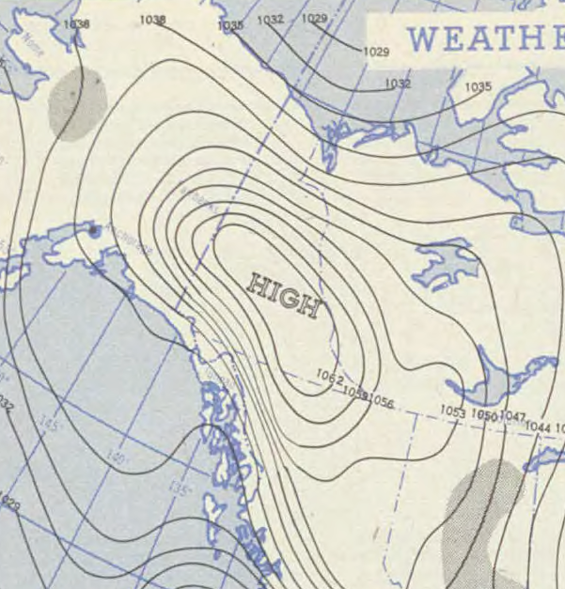

Jan 28, 1951 1930Z Surface Map
1062 mb High over Yukon
H

Slide 30
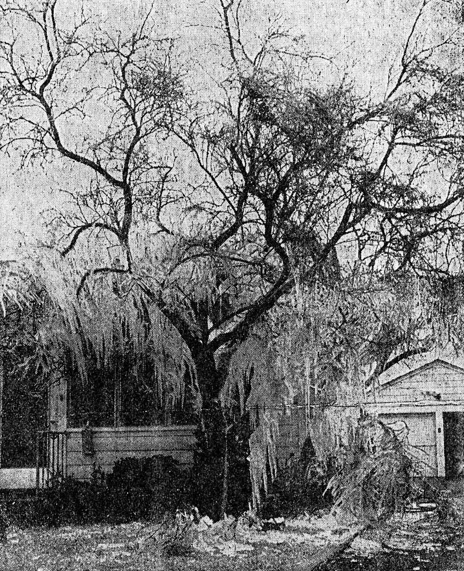
Jan 29-31, 1951*
2 Fatalities.
“Hospitals filled to overflow” due to many injuries.
3800 wire breaks.
1200 circuit breaks.
2100 poles down.
More than 100 poles leaning.
240 miles of wire had to be restrung at a cost of $450K.

Slide 31
Jan 29-31, 1951*
All flights cancelled.
Buses stopped for the first time.
Most schools and businesses closed.
Roads closed.
No mail deliveries.
Caller Times stated:
  “Not within the memory of any city official has an ice storm caused such widespread damage.”
  “Another coating of ice on top of 1/10 of an inch that had already accumulated”.

Slide 32
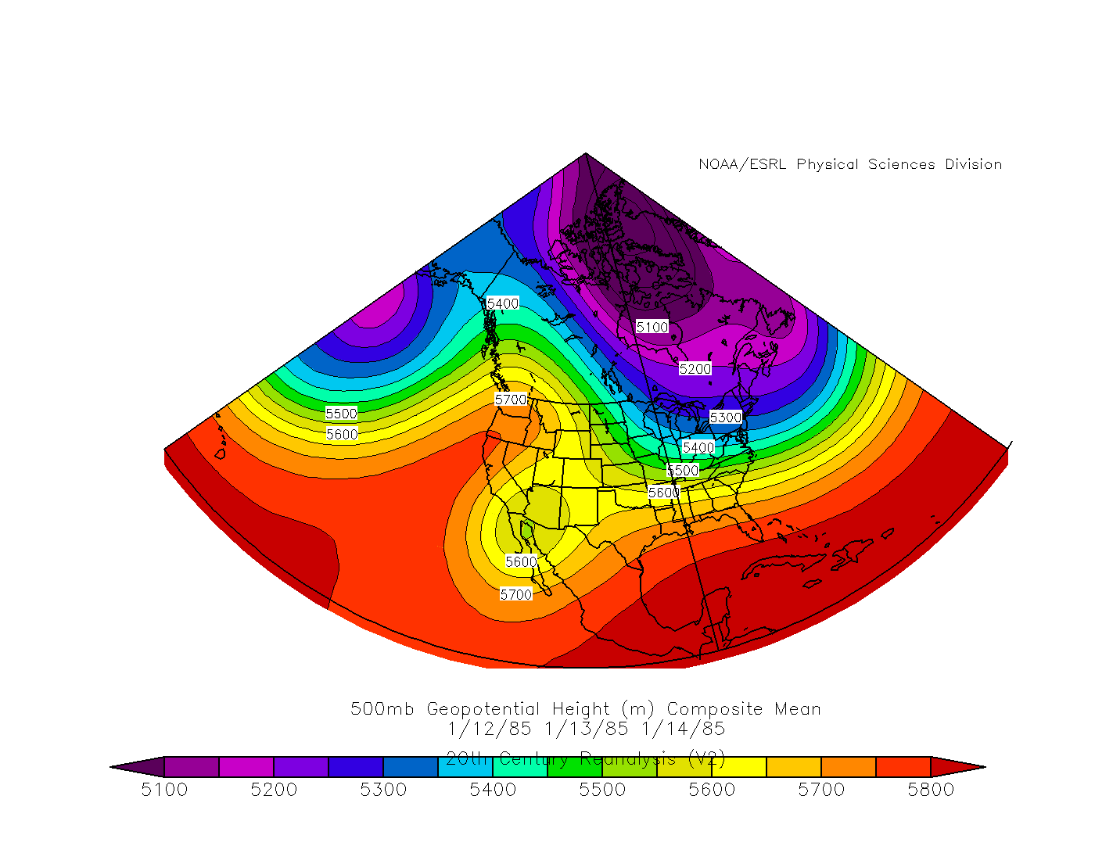
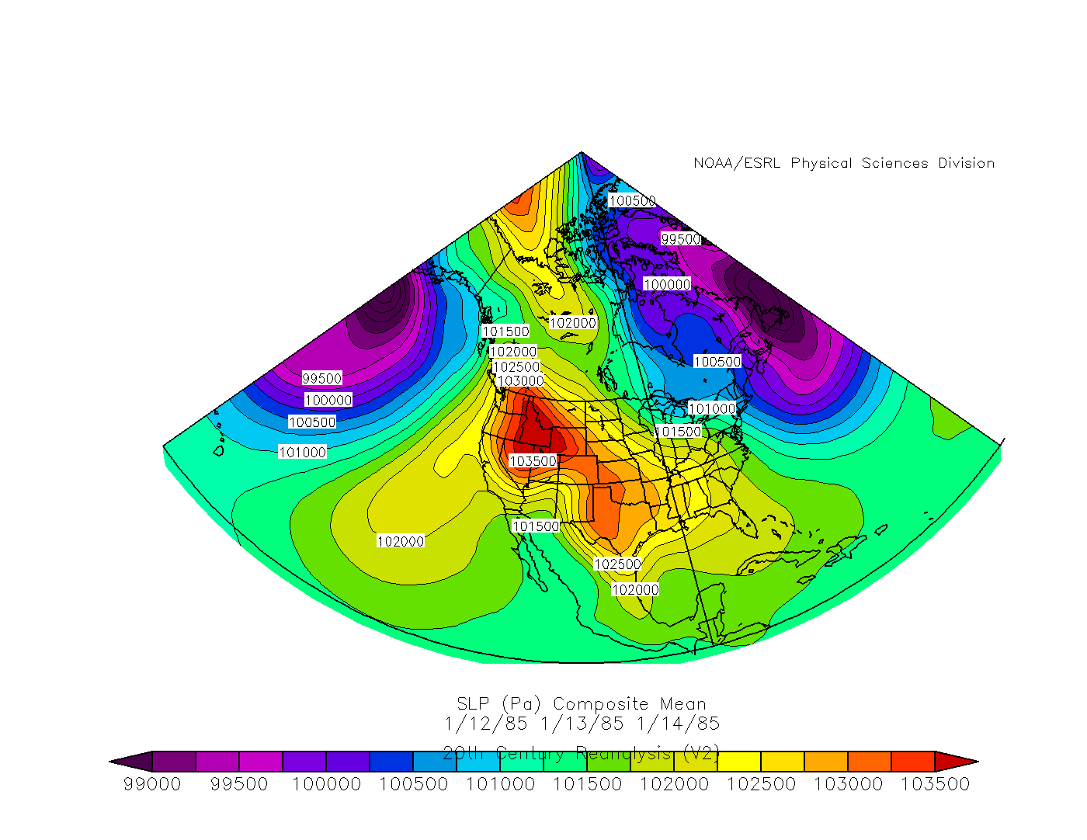
Jan 12-14, 1985*
500 mb Composite
Surface Composite

Slide 33
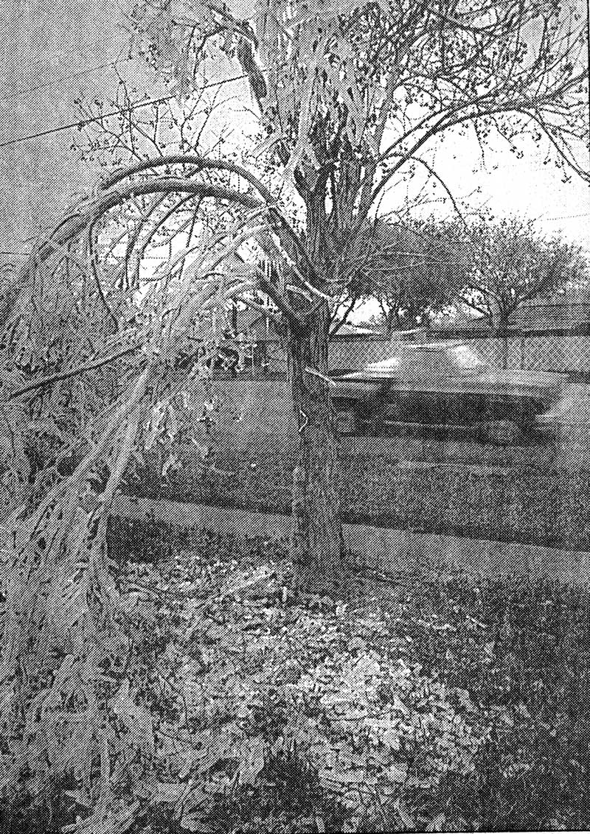
Jan 12-14, 1985*
30 hours of freezing pcpn.
0.57” total pcpn.
“A solid inch of ice” reported on the Nueces Bay Causeway.
Arctic front 1/10 morning.
  1048 mb High in Montana.
  32 hours below freezing.
49 hours after fropa… freezing pcpn began.

Slide 34
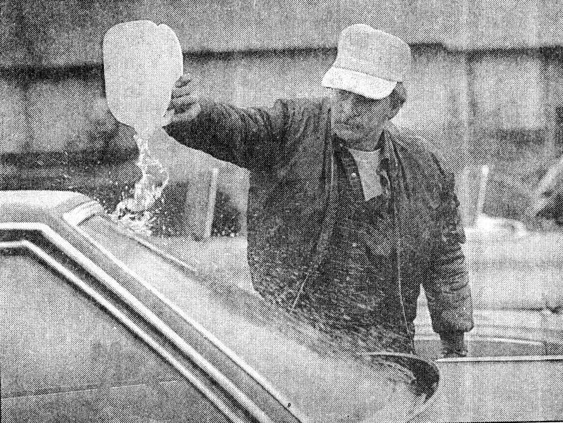
Jan 12-14, 1985*
1 fatality and 1 injury in San Patricio county
  A second fatality due to CO poisoning.
At least 27 traffic accidents with injuries.
Closed bridges and roads (up to several days) to allow sanding.
Cancelled airline flights.
Schools closed.

Slide 35

 | 1/19-25, 1924 | 1/29-31, 1951 | 1/12-14, 1985 | 2/3-4, 2011
Ice Thickness | Unknown | >1/10" | 1" | 1/4-3/8"
Total Liquid Equivalent | 1.45" | 0.10" | 0.57" | 0.05"
Duration of Event | ~4 days | ~42 hours | 30 hours | 14 hours
Duration of Freezing Temps | ~72 hours | 96 hours | 32 hours | 37 hours
Fatalities | Unknown | 2 | 2 | None
Injuries | Unknown | Multiple | >=27 | Multiple
Socio-economic | Telephone lines down 4 months, Extensive damage to crops and vegetation, Most communication down for days | 3800 wire breaks, 1200 circuit breaks, 2100 poles down, more than 100 poles leaning, 240 miles of wire needed at a cost of $450k, All flights cancelled, Buses stopped for the first time, No mail delivery, Schools, business & roads closed | At least 27 auto accidents, Bridges and roads closed for several days to allow sanding, Schools closed, Airline flights cancelled | More than 200 auto accidents, Roads, bridges, schools and city offices closed
Notable Quotes | “Heavy coating of glaze", “Telephonic communication to cease”, “The coating on the wires and trees soon became so heavy as to cause the wires to break and branches of trees to collapse." | "Hospitals filled to overflow", "Not within the memory of any city official has an ice storm caused such widespread damage" | "Very hazardous driving conditions", "Solid inch of ice"

Slide 36
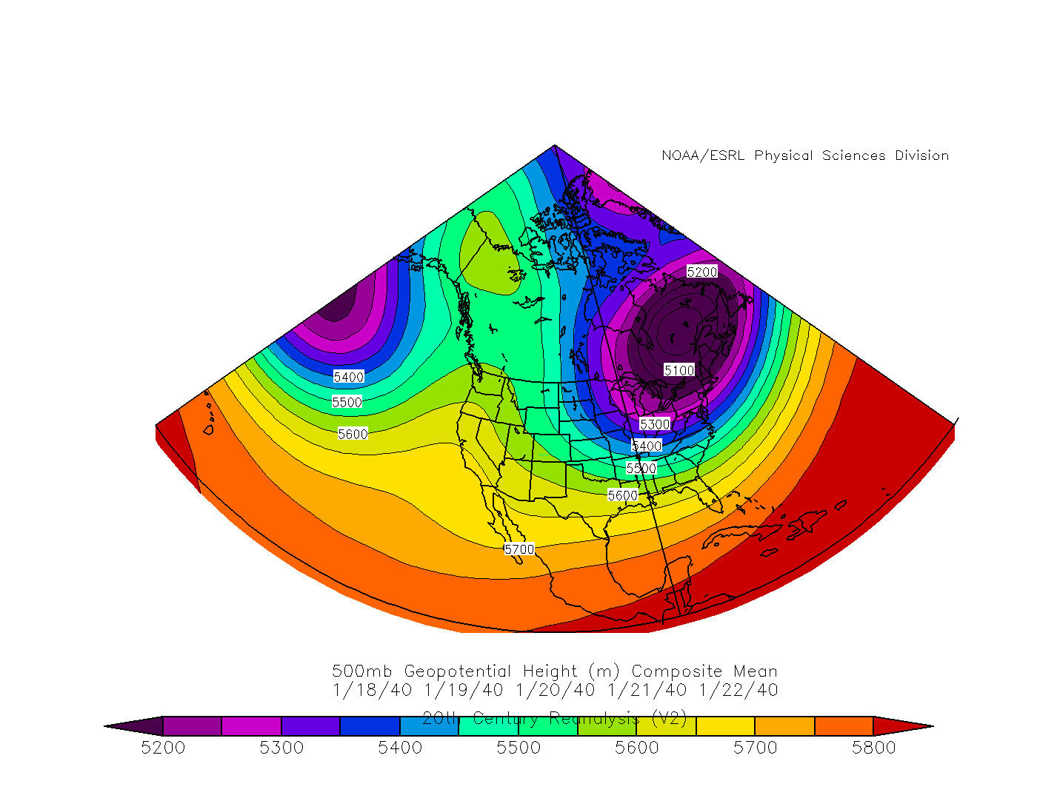
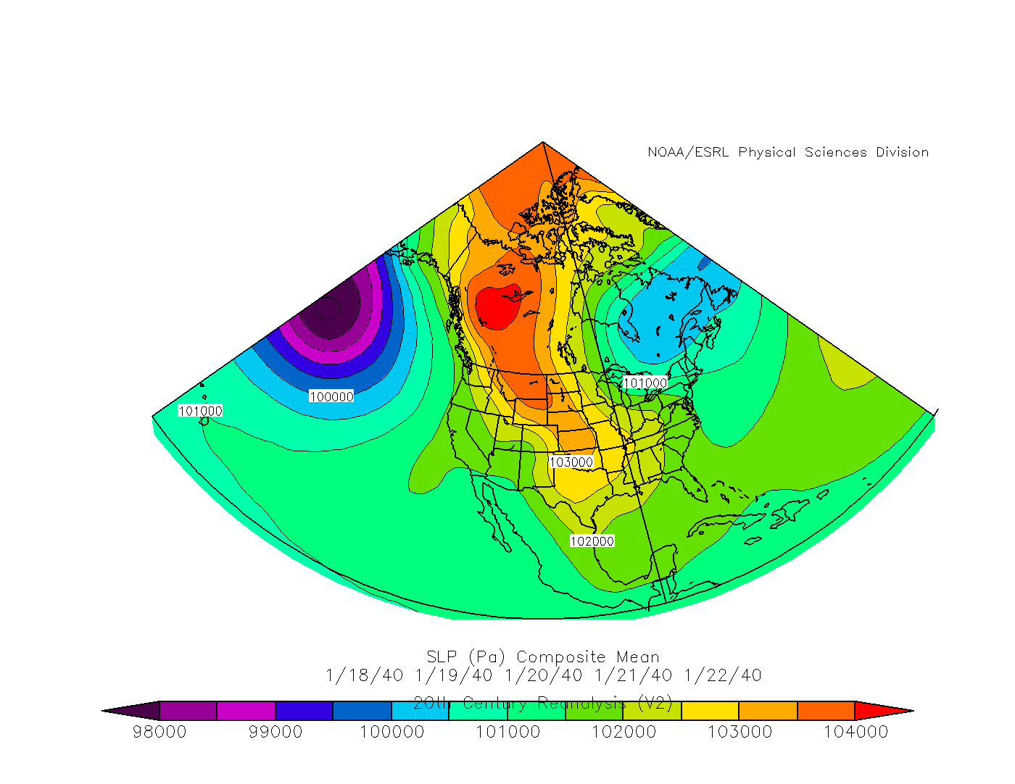
Jan 18-22 1940
500 mb Composite
Surface Composite

Slide 37
Jan 18-22 1940
6 hours of freezing pcpn.
Amount unknown.
Began 5 hours after fropa.
Arctic front 1/18 noon.
  1047 mb High across the NW Territories into Montana.
  3rd coldest January period (19-23rd) ever!
  2 record lows.
  23 hours below freezing.
Secondary surge along with surface low in NW Gulf (SE of Brownsville) on 1/22.

Slide 38
Jan 18-22 1940
“Utility lines damaged”.
Heavy crop damage.
Hazardous driving conditions.

Slide 39
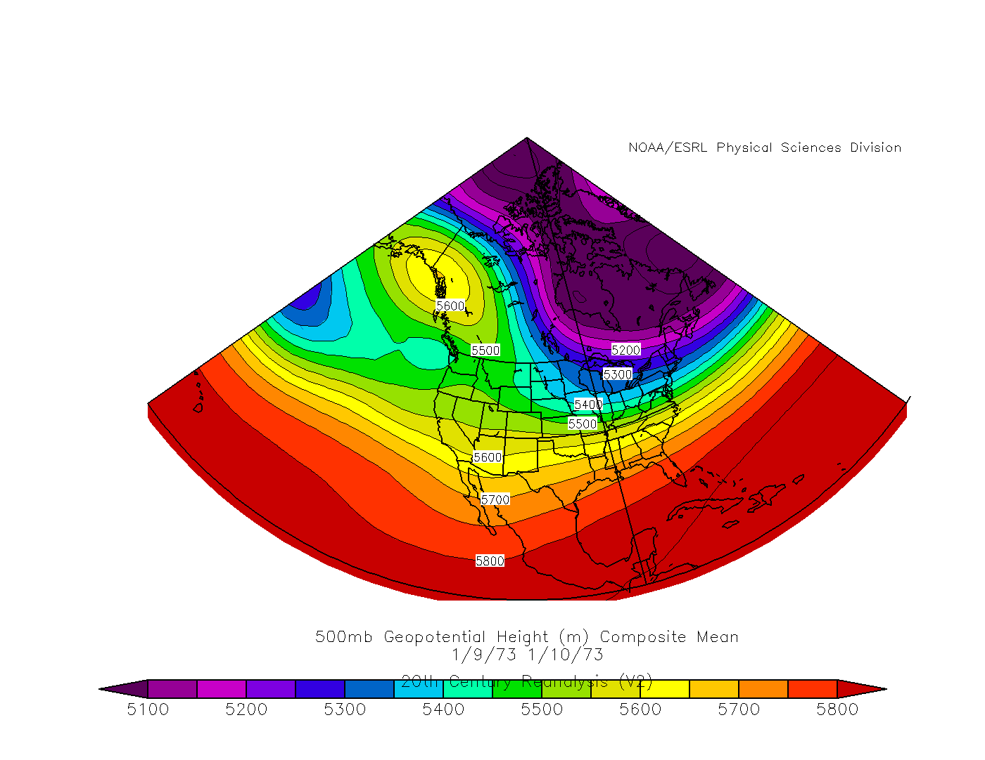
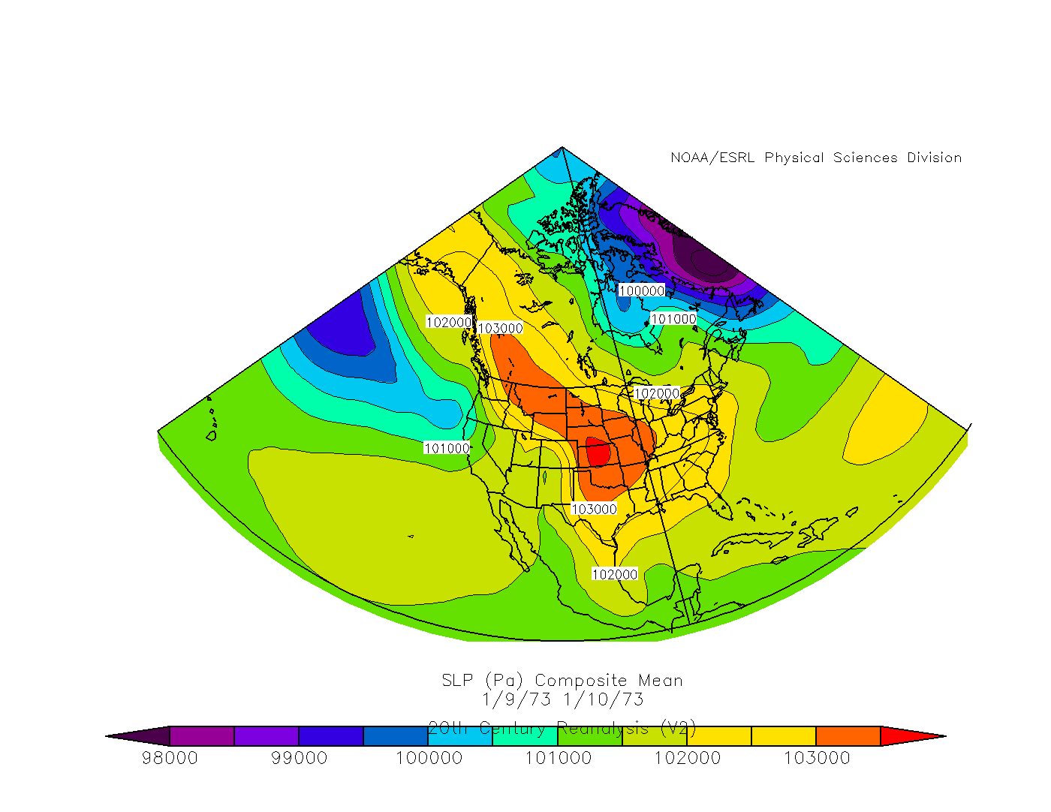
Jan 9-10 1973
500 mb Composite
Surface Composite

Slide 40
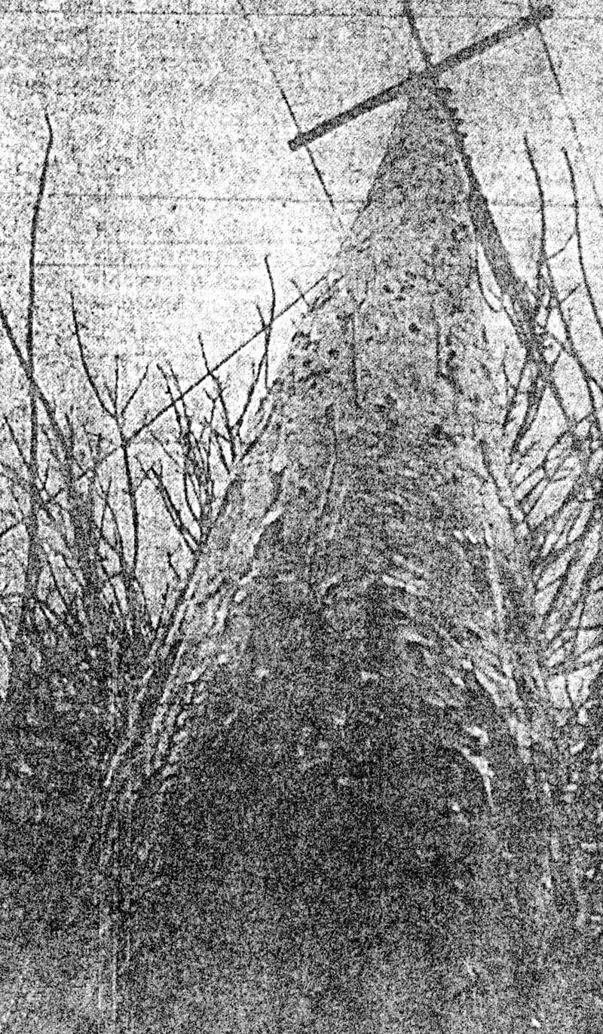
Jan 9-10 1973
16 hours of freezing pcpn.
0.39” total pcpn.
“Ice a quarter to half an inch”.
Modified arctic front on 1/5 evening.
  1045 mb High in Southern Canada.
  14 hours below freezing.
  4th coldest 3-day Max Jan Temp through the 11th.
Freezing pcpn began 82 hours after fropa.

Slide 41
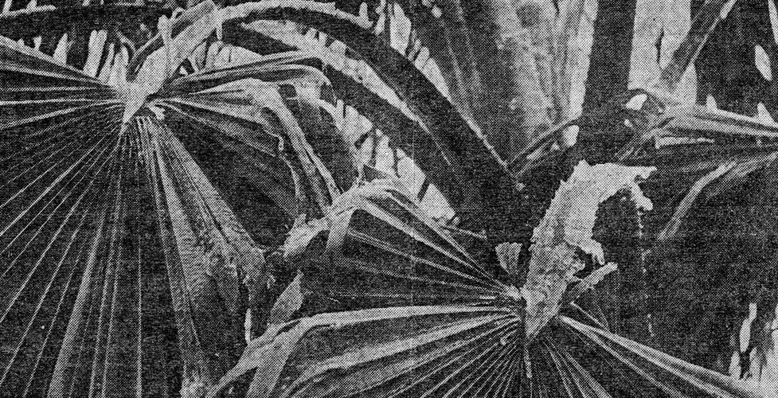
Jan 9-10 1973
10 people injured.
Several dozen auto accidents.
More than 100 lines down and 30 poles lost.
Some highways, roads, bridges and businesses closed.
No airline interruption.
“Limbs breaking off trees”.
“Worst winter disaster ever to hit the Nueces Electric Cooperative”.
Similar to 2011 ice storm.

Slide 42
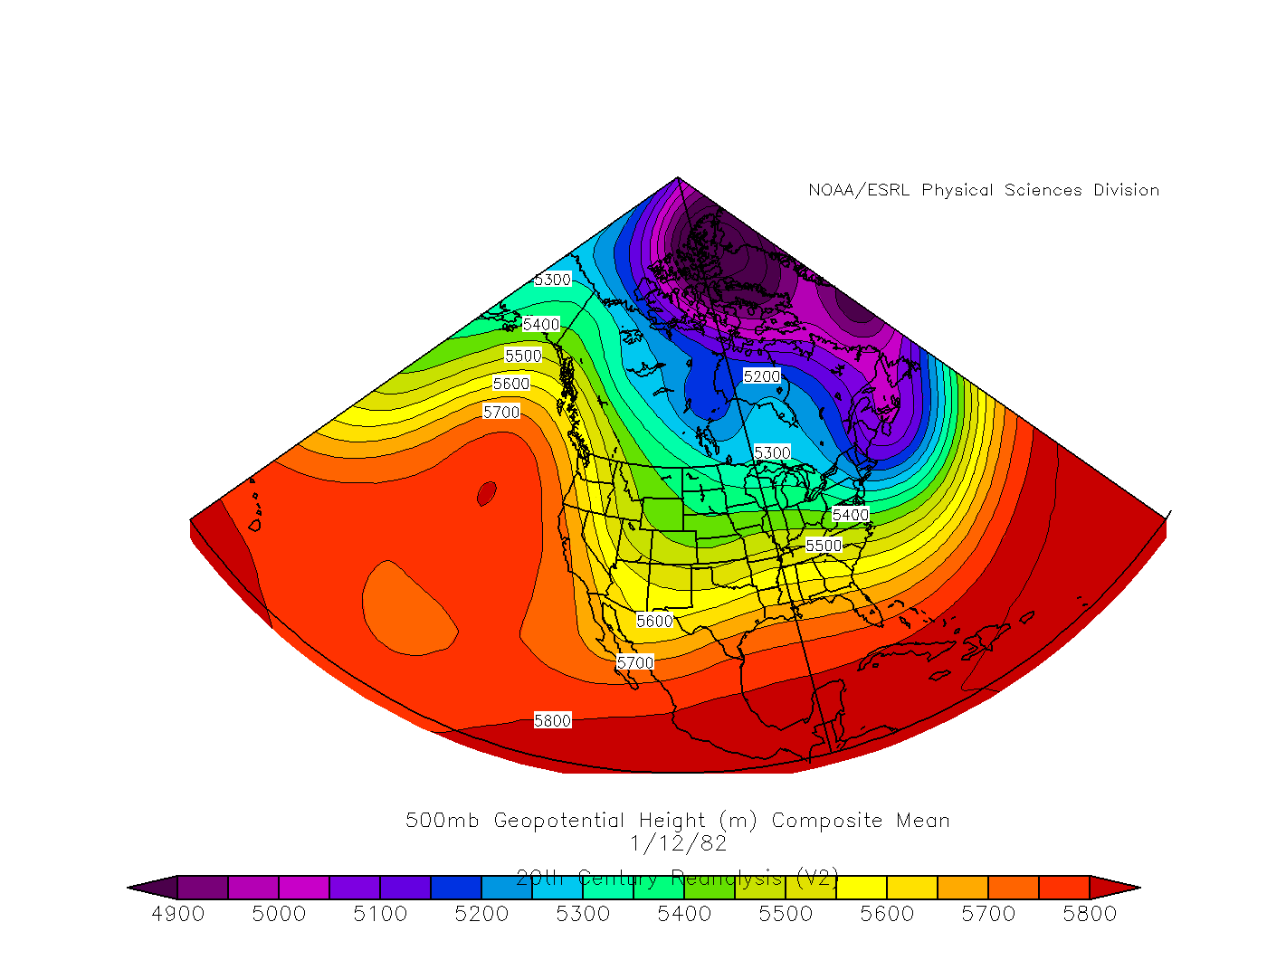
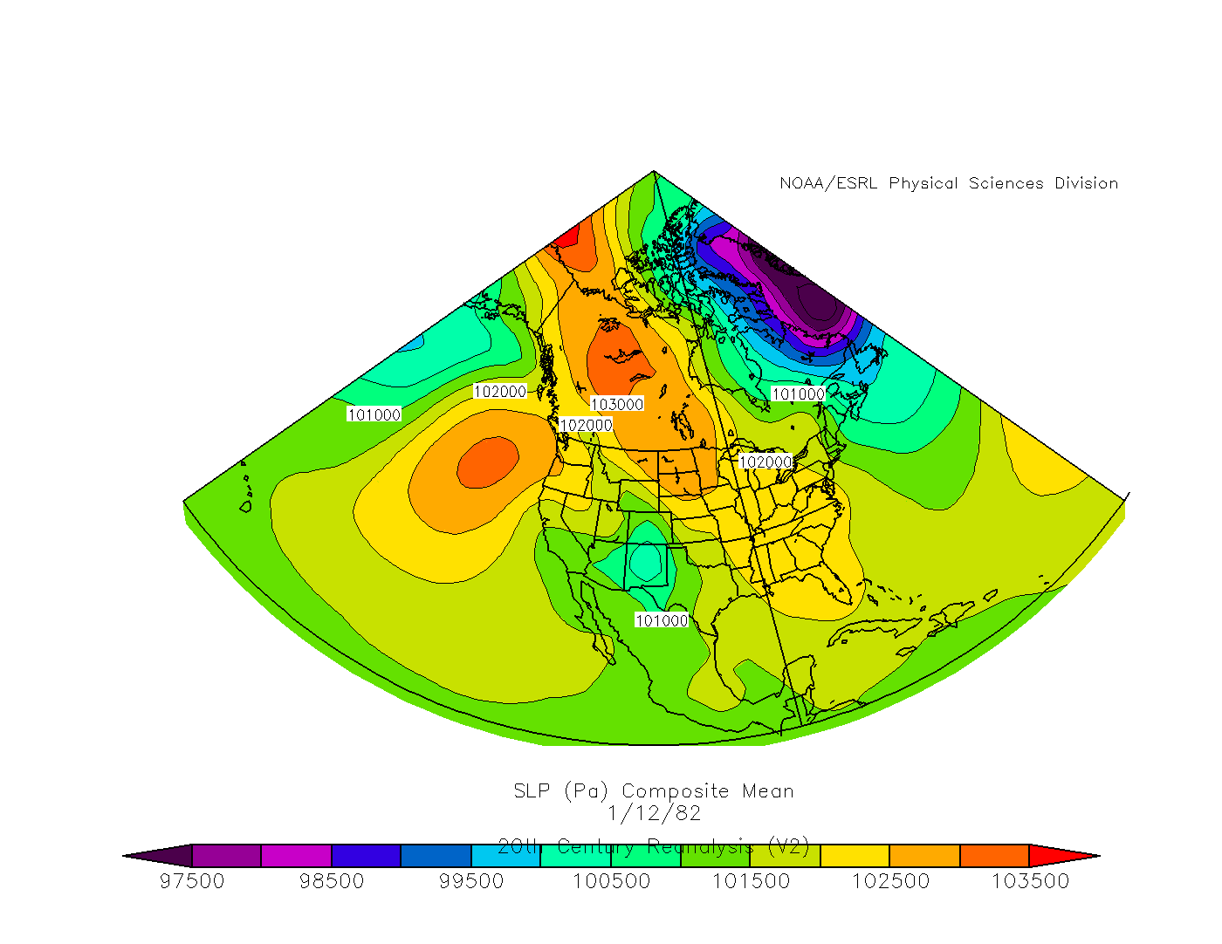
Jan 12, 1982
500 mb Composite
Surface Composite

Slide 43
Jan 12, 1982
2 hours of freezing pcpn (Most likely more).
0.05” total pcpn (Not all freezing).
Arctic front 1/10 morning.
  1056 mb High in Southern Canada on 1/10.
  31 hours below Freezing.
Freezing pcpn began 38 hours after fropa.

Slide 44
Jan 12, 1982
“Travel disruption due to ice coated expressways, overpasses, and bridges”.
“Numerous accidents”.
“Significant glazing” north of Corpus Christi.

Slide 45
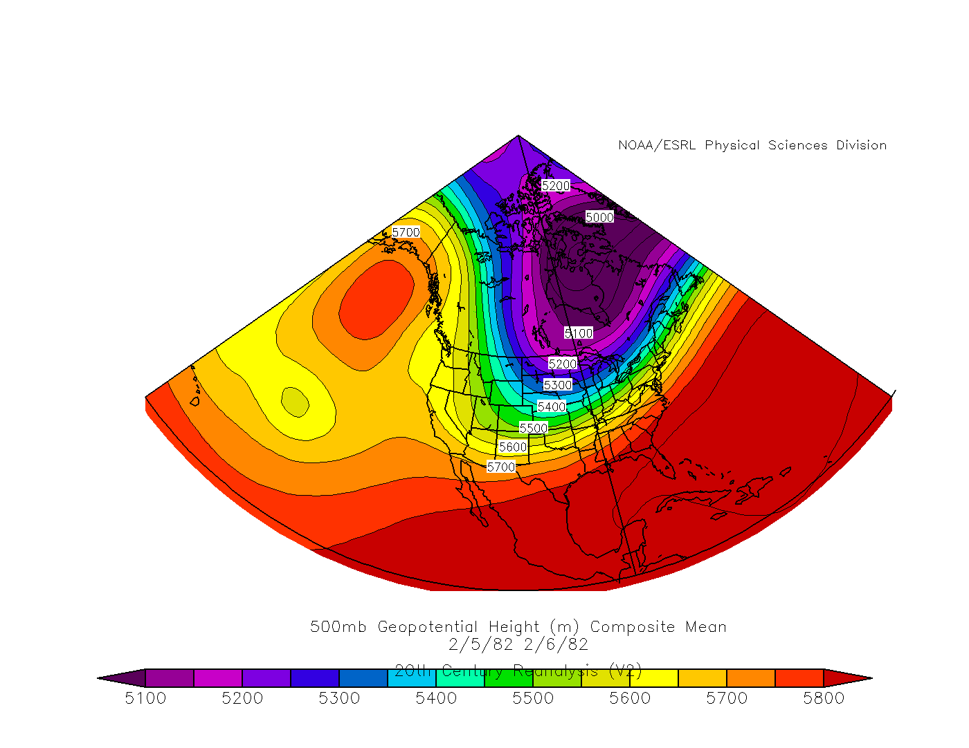
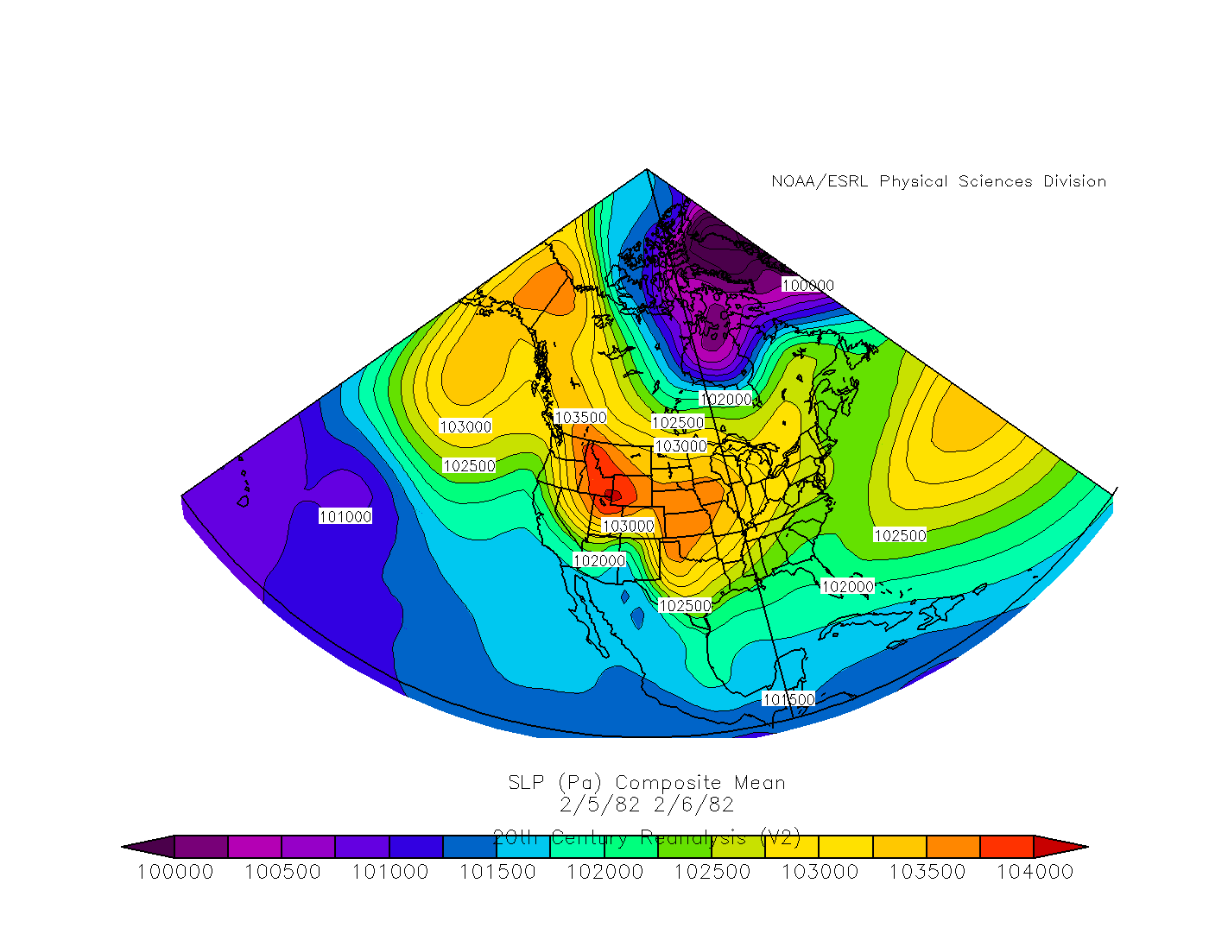
Feb 5-6, 1982
500 mb Composite
Surface Composite

Slide 46
Feb 5-6, 1982
5 hours of freezing pcpn.
0.04” total pcpn.
Arctic front 2/2 aftn.
  1044 mb High across Southern Canada into the Northern Plains.
  17 hours below freezing.
84 hours after fropa…freezing pcpn began.

Slide 47
Feb 5-6, 1982
1 fatality in George West (north of Corpus Christi).
Dozens of injuries.
Lots of traffic accidents.
Harbor Bridge closed to allow sanding.

Slide 48


Feb 4-7, 1989
500 mb Composite
Surface Composite

Slide 49


Feb 4-7, 1989
39 hours of freezing pcpn.
0.09” total pcpn.
1/3-1/4” ice accumulation.
Arctic front 2/3 morning.
  1060 mb High in the Yukon.
  7th coldest 3-day stretch Max Temp (ending 2/6).
  1 record low.
  38 hours below freezing.
23 hours after fropa... freezing pcpn began.

Slide 50

Feb 4-7, 1989
Many injuries.
Several traffic accidents.
Roads, bridges, schools and businesses closed.
Some flights cancelled.
Disruption in mail service.

Slide 51
So…in summary

Slide 52
 | 1/19-25 1924 | 1/18-22 1940 | 1/29-31 1951 | 1/9-10 1973 | 1/12 1982 | 2/5-6 1982 | 1/12-14 1985 | 2/4-7 1989 | 2/3-4 2011
Ice Thickness | Unknown | Unknown | >1/10" | 1/4-1/2" | Unknown | Unknown | 1" | 1/3-1/4" | 1/4-3/8"
Total Liquid | 1.45" | Unknown | 0.10" | 0.39" | 0.05" | 0.04" | 0.57" | 0.09" | 0.05"
Event Duration | ~4 days | 6 hours | ~42 hours | 16 hours | 2 hours | 5 hours | 30 hours | 39 hours | 14 hours
Freezing Duration | ~72 hours | 23 hours | 96 hours | 14 hours | 31 hours | 17 hours | 32 hours | 38 hours | 37 hours
Fatalities | Unknown | Unknown | 2 | None | None | 1* | 2 | None | None
Injuries | Unknown | Unknown | Multiple | >=10 | Unknown | Dozens | >=27 | Multiple | Multiple
Worst storms | 1924 Storm | 1951 Storm | 1985 Storm
Socio-economic | Telephone lines down 4 months, Extensive damage to crops and vegetation | 3800 wire breaks, 2100 poles down, $450k wire damage, Flights & buses cancelled, Schools, businesses & roads closed, No mail | At least 27 auto accidents, Bridges and roads closed for days to allow sanding, Schools closed, Airline flights cancelled
Notable Quotes | “Heavy coating of glaze", “The coating on the wires and trees soon became so heavy…” | "Hospitals filled to overflow", "Not…has an ice storm caused such widespread damage" | "Very hazardous driving conditions", "Solid inch of ice"

Slide 53
References
Changnon, Stanley A., 2003: Characteristics of Ice Storms in the United States. J. Appl. Meteor., 42, 630–639.
Rauber, Robert M., Larry S. Olthoff, Mohan K. Ramamurthy, Dianne Miller, Kenneth E. Kunkel, 2001: A Synoptic Weather Pattern and Sounding-Based Climatology of Freezing Precipitation in the United States East of the Rocky Mountains. J. Appl. Meteor., 40, 1724–1747.

Slide 54

Questions
Jan 12-14, 1985

