Slide 1
NESDIS Report on NOAA and Non-NOAA Satellites
Joint APSDEU/NAEDEX Meeting
May 2-6, 2011
UCAR
Boulder, Colorado
John Paquette
NOAA/NESDIS/OSPO
Notes:
1

Slide 2
Outline
OSPO Reorganization
GOES Status
GOES-11 to GOES-14 Transition
GOES-R Update
POES Status
NPP and JPSS Status
Future Plans for Distribution of Satellite Data
Non-NOAA Satellite Update – Slides provided by Hanjun Ding, OSPO

Slide 3
Office of Satellite and Product Operations (OSPO)
Director
E/SPO
Kathy Kelly
Admin Officer
Linda Brown
Corporate
Services
E/SPOx1
Keith Amburgey
Special Projects Selina Nauman
Deputy Director
E/SPO
Mark Moran (a)
MOD
E/SPO1
Ron Mahmot
Wallops CDA
E/SPO2
Doug Crawford
Fairbanks CDA
E/SPO3
Larry Ledlow
NOAA Ice Center
E/SPO4
Sharolyn Young
SPSD
E/SPO5
Dave Benner
Deputy: Linda Stathoplos
Operations (E/SPO21)
Al McMath
Deputy: Tom Renkevens
Operations (E/SPO11)
Joe Perez (acting)
Satellite Products (E/SPO51)
Ricky Irving
Support
(E/SPO22)
Stephen Howard
Support (E/SPO12)
Mike Settles
Satellite Analysis (E/SPO52)
Davida Streett
Systems Engineering (E/SPO23)
Bob Clark
Systems (E/SPO13)
Alva Barnette
Direct Services (E/SPO53)
Chris O’Connors
Engineering (E/SPO14)
Cindy Hampton
Acronyms
CDA – Command and Data Acquisition
MOD – Mission Operations Division
SPSD – Satellite Products and Services Division
IT Services (E/SPO15)
Andre Hammond

Slide 4
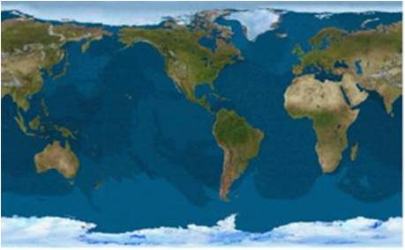
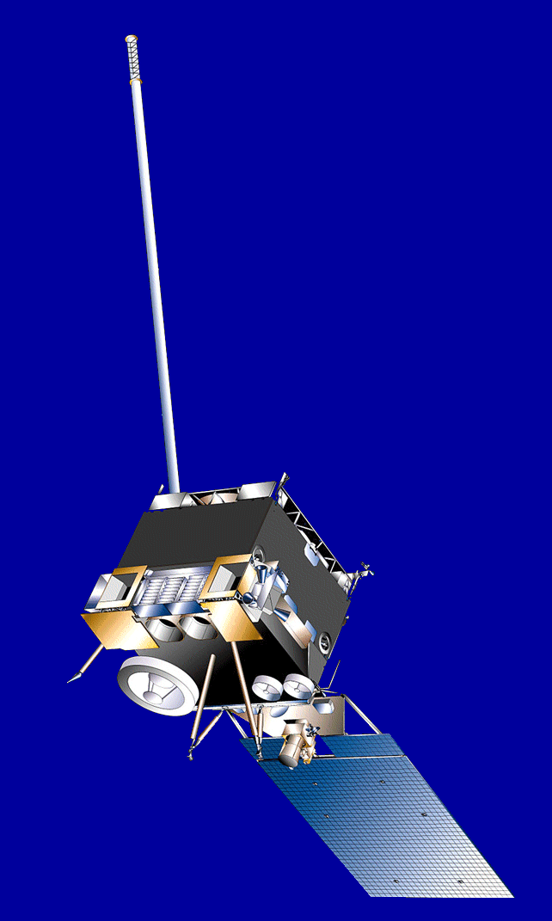
GOES On-Orbit Configuration Current as of April 2011
GOES-11 | GOES-14 | GOES-15 | GOES-13 | GOES-12
Launched: 5/2000 Located: 135°W GOES-WEST | Launched: 6/2009 Located: 105°W On-Orbit Storage | Launched: 3/2010 Located: 89.5°W Standby SEM Operational | Launched: 5/2006 Located: 75°W GOES-EAST | Launched: 7/2001 Located: 60°W South America Support
GOES-11
135° West
GOES-13
75° West
GOES-12
60° West
GOES-14
@105W
GOES-15
@ 90°W

Slide 5
Geostationary Operational Environmental Satellite (GOES)
Operations Status
Payload Instrument | GOES-11 (West) Launch: May 00 Activation: Jun 06 | GOES-12 (S. American) Launch: Jul 01 Activation: Apr 03 | GOES-13 (East) Launch: May 06 Activation: Apr 10 | GOES-14 (Storage) Launch: Jun 09 | GOES-15 (Standby) Launch: Mar 10
Imager | G | G | G | G | G
Sounder | G | Y | G | G | Y
Energetic Particle Sensor (EPS) | G | Y | G | G | Y
Magnetometers | G | G | G | G | G
High Energy Proton and Alpha Detector (HEPAD) | G | G | G | G | G
X-Ray Sensor (XRS) | R | R | R | G | G
Solar X-Ray Imager (SXI) | N/A | R | Y | G | S/C
Spacecraft Subsystems
Telemetry, Command & Control | S/C | G | G | G | G
Attitude and Orbit Control | G | G | G | G | G
Inclination Control | G | R | G | G | G
Propulsion | G | Y | S/C | G | G
Mechanisms | G | G | G | G | G
Electrical Power | Y | G | G | G | G
Thermal Control | G | G | G | G | G
Communications Payloads | S/C | G | G | G | S/C
Key
Operational
Spacecraft issues but no user impacts
Operational with limitations
Non-operational
Not Applicable
G
S/C
Y
R
N/A
Notes:
1

Slide 6
GOES-West Transition
GOES-West Transition to occur December 2011
PLAN:
GOES-14 will replace GOES-11
GOES-14 taken out of storage before fall eclipse season for yearly inclination maneuver and imager testing
Start drift to 135 Deg W - October 2011

Slide 7
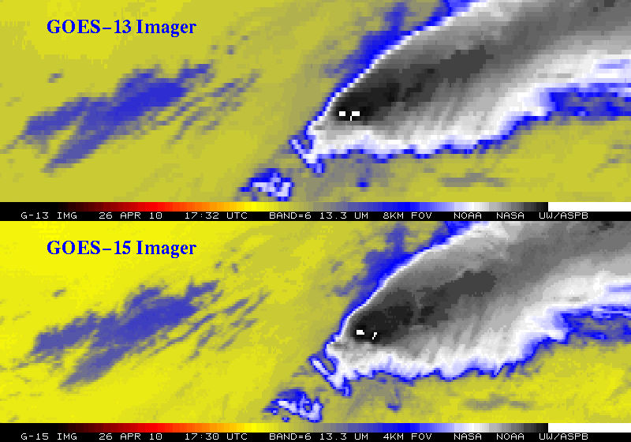
Improved spatial resolution of Band 6 on
GOES-14/15 Imagers
- Note the finer resolution of the cloud edges and the ‘cleaner’ G-15 image
- Changes in spectral bands inc. 8km to 4km WV channel require a subsequent change in GVAR format
Notes:
GOES-14 (previously GOES-0) was launched on June 27, 2009.
The issue with the band 6 of the imager, was the detector order was initially flipped in the data stream. This was fixed on August 24, 2009 (not shown).
More information can be found at:
http://rammb.cira.colostate.edu/projects/goes-o/
http://cimss.ssec.wisc.edu/goes/blog/archives/3054
Don Hillger and Tim Schmit are co-leading the GOES-14 NOAA science test.
The above images were ingested by the SSEC data center in Madison, WI. Image generated by T. Schmit of NOAA NESDIS STAR ASPB.
###

Slide 8
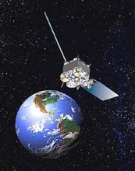
Changes to GVAR Summary
GOES- 8 through 11:
Instrument Factory Coefficients in Block 0 (GVAR Version 1)
GOES- 12 and 13:
Instrument Factory Coefficients both in Block 0 and Block 11 (GVAR Version 2)
GOES-14 and 15 (GVAR Version 3):
The data for the 8th detector have been added to block 0
Instrument Factory Coefficients are located in Block 11
Instrument Nadir and Detector Offsets located in Block 11 but will also be located in Block 0
Detector Offsets to be located in block 0, words 7933 to 8028
Instrument Nadir to be located in block 0, words 8033 to 8038
Requirement: have guaranteed delivery of Detector Offsets + Instrument Nadir in the start of a frame to ensure proper INR operations in the RPM system.
Published at: http://www.osd.noaa.gov/gvar/gvardownload.htm

Slide 9
GVAR Web Links
NOAA/NESDIS/OSDPD:
http://www.osdpd.noaa.gov/ml/info/index.html#GOES
NOAA/NESDIS/OSO:
http://www.oso.noaa.gov/goes/index.htm
NOAA/NESDIS/OSO/GVAR Download Site
http://www.osd.noaa.gov/gvar/gvardownload.htm
GOES I/M (8-12) Databook:
http://rsd.gsfc.nasa.gov/goes/text/goes.databook.html
GOES N/O/P (13-15) Databook:
http://goes.gsfc.nasa.gov/text/GOES-N_Databook_RevC/Databook_RevC.pdf

Slide 10
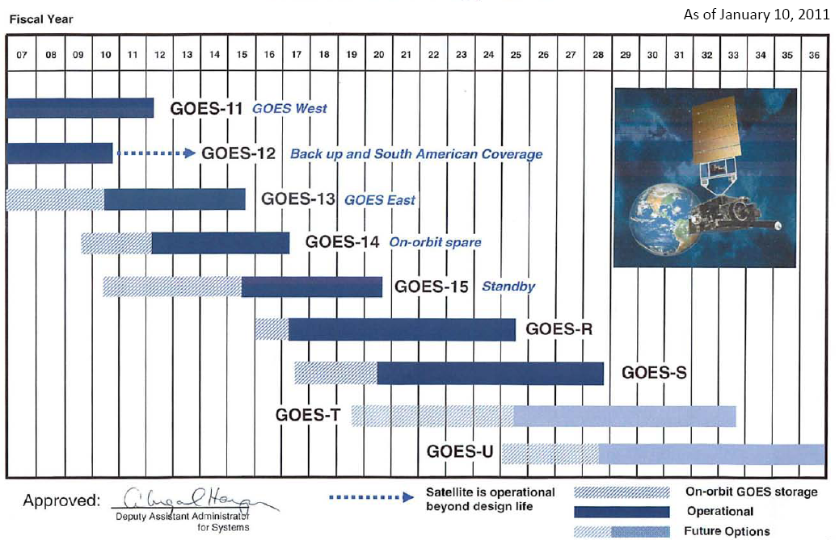
Continuity of GOES Operational Satellite Program

Slide 11
GOES-R Overview URL: http://www.goes-r.gov/
- Advanced Baseline Imager (ABI)
- No dedicated Sounder
- Geostationary Lightning Mapper (GLM)
- Space Weather
Space Environmental In-Situ Suite (SEISS)
Solar Ultra Violet Imager (SUVI)
Extreme Ultra Violet/X-Ray Irradiance Sensor (EXIS)
Magnetometer
- Communications
GOES Rebroadcast (GRB)
High Rate Information Transmissions (HRIT)
Emergency Managers Weather Information Network (EMWIN)
Search and Rescue (SAR)
Data Collection System (DCS)
Notes:
Advanced Baseline Imager (ABI) Earth-viewing
Geostationary Lightning Mapper (GLM) Earth-viewing
Solar Ultra-Violet Imager (SUVI) Sun-viewing
EUVS and XRS Irradiance Sensors (EXIS) Sun-viewing
Space Environment In-Situ Suite (SEISS) Space-viewing
Magnetometer (MAG) Space-viewing

Slide 12
Direct Readout Comparisons
 | GOES I-P | GOES-R
Full Disk Image | 30 minutes | 5 minutes
Imager bands | 5 | 16
Visible | 1 kilometer | 0.5 kilometer
Near Infrared | N/A | 1 kilometer
Infrared | 4 kilometer | 2 kilometer
Bit Depth | 10 bits | 12 bits – Visible, 14 bits Infrared
Raw Instrument Data | 2.62 Mbps | ~ 100 Mbps (ABI: ~60Mbps)
Space Weather | ~100 kbps | 3.5 - 4Mbps
Geostationary Lightning Mapper | N/A | 7.5 Mbps
Telemetry | 4 kbps | 1, 4 & 32 kbps
Planned Data Outage | >300 hrs/yr | <2 hrs/year
GRB/GVAR | 2 Mbps | 31 Mbps
HRIT/EMWIN | LRIT: 128 kbps EMWIN: 19.2 kbps | 400 kbps
DCS | 233 simultaneous downlinks | 466 simultaneous downlinks
SARSAT | 36 dBm uplink power | 32 dBm uplink power (will be able to detect emergency beacons with weaker signals)

Slide 13
The Advanced Baseline Imager
ABI Current
Spectral Coverage 16 bands 5 bands
Spatial resolution
0.64 μm Visible 0.5 km Approx. 1 km
Other Visible/near-IR 1.0 km n/a
Bands (>2 μm) 2 km Approx. 4 km
Spatial coverage
Full disk 4 per hour Scheduled (3 hrly)
CONUS 12 per hour ~4 per hour
Mesoscale Every 30 sec n/a
Visible (reflective bands)
On-orbit calibration Yes No

Slide 14
GOES Rebroadcast (GRB) Data Transition
Full set of level 1b products, including data from all ABI channels and the other GOES-R instruments
GOES users must acquire new hardware, or upgrade their existing GVAR systems in order to receive GOES-R data.
Existing GVAR systems will need new receiver antenna hardware, as well as new signal demodulation hardware and computer hardware so that they are able to handle the large amount of GOES-R data.
CLASS will provide permanent archive for GOES-R data as part of its mission to be the single data repository for NOAA.

Slide 15
AWG Algorithm Development Scope
Develop algorithms for the following L2 products…
Baseline Products
Option 2
Cloud Layer/Heights
Cloud Ice Water Path
Cloud Liquid Water
Cloud Type
Convective Initiation
Turbulence
Low Cloud and Fog
Enhanced “V”/Overshooting Top
Aircraft Icing Threat
SO₂ Detections (Volcanoes)
Visibility
Upward Longwave Radiation (TOA)
Downward Longwave Radiation (SFC)
Upward Longwave Radiation (SFC)
Total Ozone
Aerosol Particle Size
Surface Emissivity
Surface Albedo
Vegetation Index
Vegetation Fraction
Flood Standing Water
Rainfall probability and potential
Snow Depth
Ice Cover
Sea & Lake Ice Concentration, Age, Extent, Motion
Ocean Currents, Currents: Offshore
Clouds and Moisture Imagery (KPP)
Clear Sky Mask
Cloud Top Pressure and Height
Cloud Top Phase
Cloud Top Temperature
Cloud Particle Size Distribution
Cloud Optical Path
Temperature and Moisture Profiles
Total Precipitable Water
Stability Parameters (Lifted Index, etc.)
Aerosol Detection
Aerosols Optical Depth
Derived Motion Winds
Hurricane Intensity
Fire/Hot Spot Characterization
Land and Sea Surface Temperature
Volcanic Ash
Rainfall Rate
Snow Cover
Downward Solar Insolation: Surface
Reflected Solar Insolation: TOA
Lightning Detection
Advanced Baseline Imager (ABI)r (ABI)
GLM

Slide 16
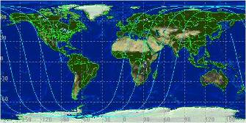
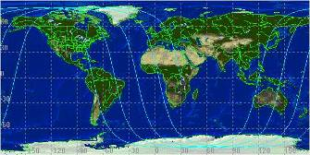
POES Overview URL: http://www.oso.noaa.gov/poes/index.htm
Two polar operational satellites; one in morning and one in afternoon orbit
Continuity of operations since early 1960s
Since May 2007, through NOAA and EUMETSAT Partnership - EUMETSAT operates Metop-A for mid-morning orbit
2 p.m. Orbit
10 a.m. Orbit

Slide 17
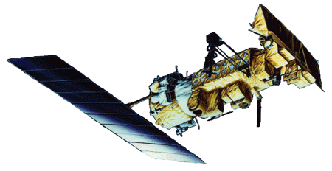
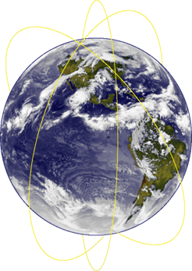
POES Orbits
Metop-A – LTAN 09:30
NOAA-19 – LTAN 13:33
NOAA-18 – LTAN 14:13
NOAA-17 – LTAN 20:58
NOAA-16 – LTAN 19:26
NOAA-15 – LTAN 16:36

Slide 18
Polar Operational Environmental Satellite (POES)
Performance Status
March 30, 2011
Spacecraft Subsystems | NOAA-19 | NOAA-18 | NOAA-17 | NOAA-16 | NOAA-15
Launch Date | Feb 2009 | May 2005 | Jun 2002 | Sep 2000 | May 1998
Operational Date | Jun 2009 | Aug 2005 | Oct 2002 | Mar 2001 | Dec 1998
Mission Data Category | Primary (PM) | Secondary (PM) | Secondary (AM) | Secondary (PM) | Secondary (AM)
Payload Instruments
AVHRR | G | G | R | Y | Y
HIRS | G | R | G | Y | R
AMSU-A1 | G | G | R | Y | Y
AMSU-A2 | G | G | G | G
AMSU-B | N/A | N/A | O | G | R
MHS | Y | G | N/A | N/A | N/A
SEM | G | G | G | G | G
SBUV | S/C | G | G | Y | N/A
Spacecraft Subsystems
Telemetry, Command & Control | G | G | G | G | G
ADACS | G | G | G | Y | Y
EPS | G | G | G | G | G
Thermal Control | G | G | G | G | Y
Communications | G | G | G | G | Y
APT/LRPT | G | G | G | R | G
SAR | G | G | G | Y | Y
Operational GG | G | Spacecraft Issue but No User Impact | S/C
Operational with Limitation | Y | Operational with Degradation | O
Non-Operational | RR | Not Applicable | N/A
Notes:
1

Slide 19
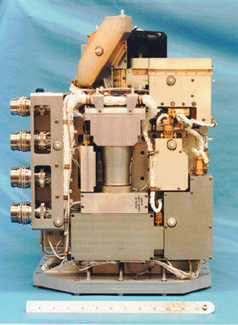
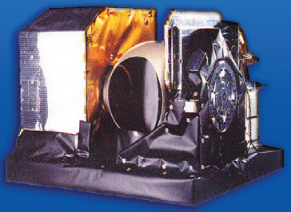
NOAA-19 (N’)
Launch Date: February 6, 2009 HRPT: STX1 1698.0 MHz
APT: VTX1 137.1 MHz
MHS: Channel H3 is out of spec. It has stabilized but dynamic range decreases – 27 Aug 2009
SBUV
MHS
SBUV: Lamp Door Stuck; effects calibration of instrument – 7 Apr 2010
A-DCS: Transmitter turned off due to frequency interference with Alarm industry

Slide 20
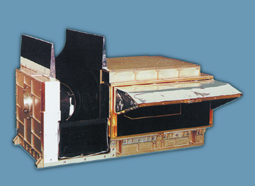
NOAA-18 (N)
Launch Date: May 20, 2005 HRPT: STX3 1707.0 MHz
APT: VTX2 137.9125 MHz
HIRS
HIRS: Noise in most channels due to instability of the Lens – Sensitive to Attitude Disturbances 5 Feb 2009
MIMU: Miniature Inertial Measurement Unit #2 Failure – Loss of redundancy – 8 Jun 2009

Slide 21
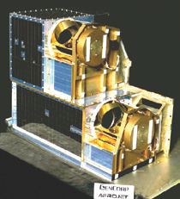
NOAA-17 (M)
Launch Date: June 24, 2002 HRPT: STX1 1698.0 MHz
APT: VTX1 137.5 MHz
AMSU-A1
AMSU-A1: Scan Motor Failure - 29 Oct 2003
Communication:
STX3 (1707 MHz) Failed 14 Feb 2008
STX1 (1698) Power dropped to 2 Watts 02 Mar 2008

Slide 22
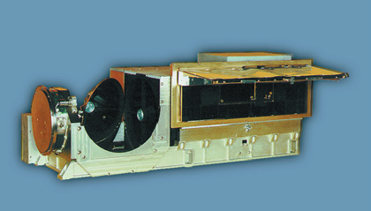
NOAA-17 (M) - Continued
Launch Date: June 24, 2002 HRPT: STX1 1698.0 MHz
APT: VTX1 137.5 MHz
AVHRR
AVHRR: Stalled Motor Failure - 15 Oct 2010
AMSU-B: Local Oscillator Failed effecting Channels 18,19 and 20 - 6 Dec 2009

Slide 23
NOAA-16 (L)
Launch Date: September 21, 2000 HRPT: STX2 1702.5 MHz
APT: Not Operational
SBUV: Diffuser position error – 03 Feb 2004
Attitude Control: 2 of 3 Gyro Degraded. Using Reduce Gyro Mode.
May effect pointing errors of the Instruments – 24 Oct 2005
AVHRR: Scan Motor Current Surges started January 14, 2004
Improved performance since late July 2004. Currently, minimum impact to data

Slide 24
NOAA-16 (L) – Continued
Launch Date: September 21, 2000 HRPT: STX1 1698.0 MHz
APT: Not Operational
APT: RF Hybrid failure in Sept. 2001
AMSU-B: Very Noisy in Some Channels
AMSU-A1: Phase Lock Loop Oscillator #2 Failed Nov 2002
HIRS: Long wave channel degradation in Jan 2005
DHS: Digital Tape Recorders 4B, 5A and 5B no longer functioning

Slide 25
NOAA-15 (K)
Launch Date: May 13, 1998 HRPT: STX2 1702.5 MHZ
APT: VTX1 137.5 MHz
AMSU-B: Antenna Scan Motor Failed – 28 March 2011
HIRS: Filter Wheel Motor Stalled - 22 Jun 2009
Attitude Control: 2 of 3 Gyro Degraded. Using Reduce Gyro Mode.
May effect pointing errors of the Instruments - 10 Mar 2010
AVHRR: Scan Motor Current Surges started April 2000

Slide 26
NOAA-15 (K) – Continued
Launch Date: May 13, 1998 HRPT: STX2 1702.5 MHZ
APT: VTX1 137.5 MHz
AMSU-A1: Channel 11 failed - April 2002 and Channel 14 failed in October 2000
Comm: STX#1 (1698.0 MHz) Parts Failure Nov 1998
STX#2 (1702.5 MHz) Operating in OMNI mode
since May 1998
STX#3 (1707 MHz) Parts Failure May 1998

Slide 27
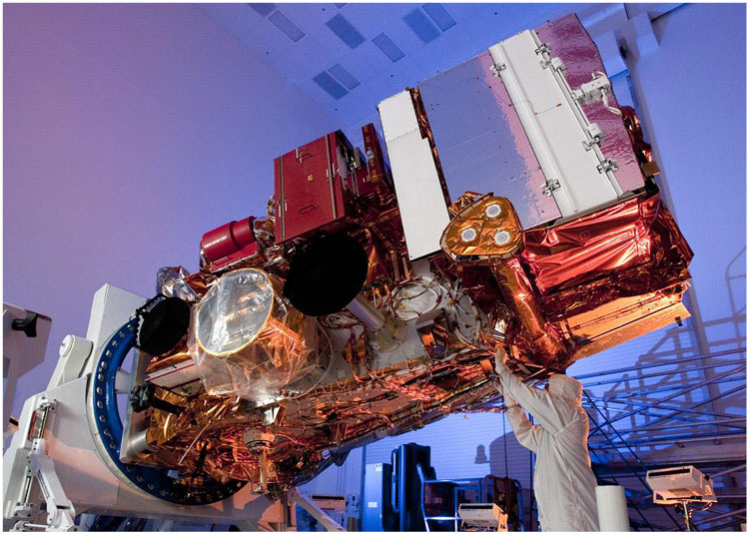
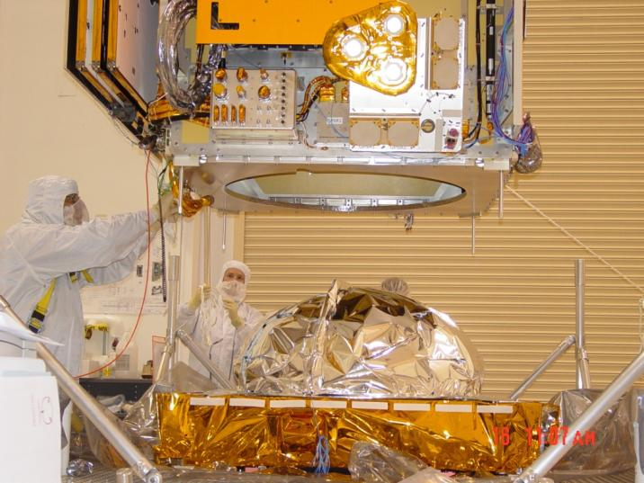
NESDIS – Restructuring of Future Polar Satellite Program
NOAA and Air Force will no longer continue to jointly procure the polar orbiting satellite system called NPOESS
Restructuring program will be modeled after the procurement structure of the successful POES and GOES, where NASA and NOAA have a long and effective partnership. NOAA using NASA as satellite acquisition agent.
New NOAA program will be called Joint Polar Satellite System (JPSS)

Slide 28
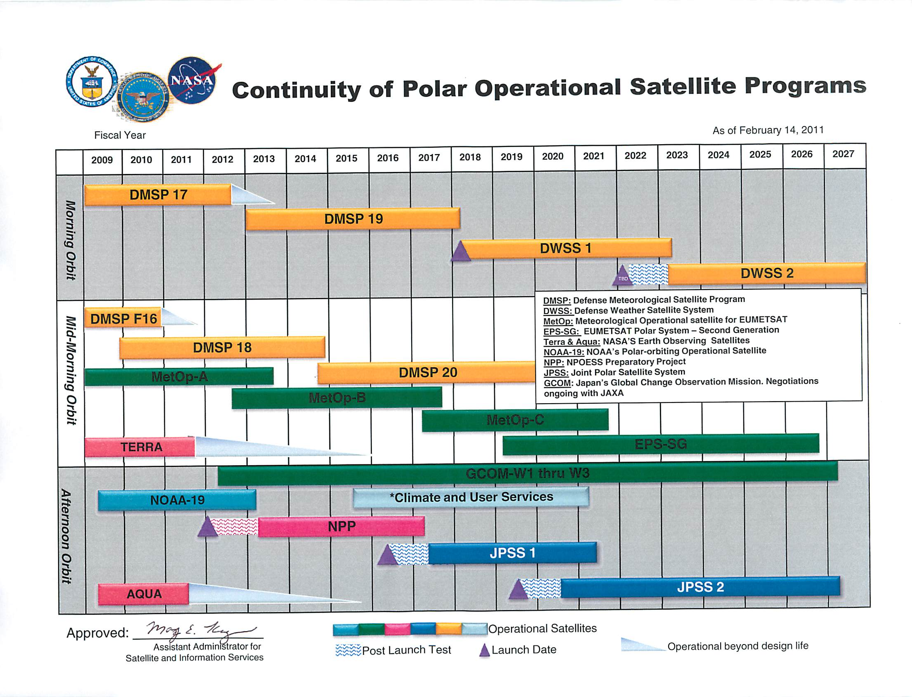
Notes:
28

Slide 29
Status of JPSS Transition
NPP to launch October 2011
JPSS-1 spacecraft
Selection of NPP-like spacecraft announced in June 2010
Contractual arrangements on track
Ground system contract in place
Ground transferred from AF to NASA management control on November 1, 2010
Ozone Mapping and Profiler Suite (OMPS) contract in place
OMPS transferred from AF to NASA management control on November 1, 2010
Cross-track Infrared Sounder (CrIS) contract in place
CrIS transferred from AF to NASA management control on November 1, 2010
Visible/Infrared Imager/Radiometer Suite (VIIRS) letter contract in place in September 2010
Transfer of VIIRS property from AF to NASA management control pending negotiations
Advanced Technology Microwave Sounder (ATMS)
Transfer of ATMS property from AF to NASA management control pending negotiations

Slide 30
NPP/Follow-On Status
Visible Infrared Imaging Radiometer Suite (VIIRS) (heritage-AVHRR)
~ 22 spectral channels with 400 m and 750 m resolution
Ozone Mapping and Profiler Suite (OMPS) (heritage-SBUV)
~ 50 km resolution
Advanced Technology Microwave Sounder (ATMS) (heritage-AMSU-A/B and MHS)
22 channels for temperature retrievals
Cross track Infrared Sounder (CrIS) (heritage–HIRS)
Over one thousand spectral channels at ~ 17 km resolution
Cloud and Earth Radiant Energy System (CERES)
Measurement of ERB using three spectral channels from .3 to 50 microns
For current software documentation on data formats and other specifications refer to URL: http://jointmission.gsfc.nasa.gov/project/science-documents.html

Slide 31
NOAA’s NPP Data Exploitation (NDE) http://projects.osd.noaa.gov/nde/
The mission of the NDE System is to provide satellite products derived from NPP, JPSS and GCOM-W1 observations to NOAA’s operational and other civilian users and to facilitate their integration into NOAA’s operational and distribution systems
NDE System will receive data products from the NPP/JPSS ground system, create additional NOAA Unique Products (NUPs), process and package satellite products to meet user requirements, ensure that NUPs are archived, distribute data to authorized subscribers, and provide customer service to users of its products

Slide 32
NPP Data Formats
Sensor Data Records (SDRs, Level 1 Products) and Environmental Data Records (EDRs, Level 2 Products) will be made operationally available to the user community from the NDE in HDF5 and NetCDF4 formats. Selected products for NOAA NWS will be available in BUFR and GRIB2 formats.
For current documentation on NPP HDF5 data formats and other NPP specifications refer to URL: http://jointmission.gsfc.nasa.gov/project/science-documents.html

Slide 33
NDE Product Priorities List
# | Product Priority | NDE Ops Readiness Planning Date | NPP | GCOM-W1
1 | ATMS Radiances | Jul-12 | X | --
2 | ATMS Radiances (BUFR) | Jul-12 | X | --
3 | Sea Surface Temperature (SST) | Jan-13 | X | --
4 | CrIS Radiances | Jul-12 | X | --
5 | CrIS Thinned Radiances (BUFR) | Jul-12 | X | --
6 | OMPS Radiances | Sep-12 | X | --
7 | Nadir Profile Ozone | Apr-13 | X | --
8 | Ozone Total Column | Apr-13 | X | --
9 | Ozone (BUFR) | Apr-13 | X | --
10 | VIIRS Radiances | Jul-12 | X | --
11 | VIIRS Radiances (BUFR) | Jul-12 | X | --
12 | AMSR-2 Radiances | Sep-13 | -- | X
13 | Snow Cover | Apr-13 | X | --
14 | Blended Snow Cover | Dec-13 | X | --
15 | Aerosol Optical Thickness | Apr-13 | X | --
16 | Aerosol Optical Thickness (BUFR) | Apr-13 | X
17 | Sea Surface Temperature (SST) (BUFR) | Jan-13 | X | --
18 | Polar Winds (VIIRS) | Oct-12 | X | --
19 | Sea Surface Wind Speed (GCOM) | Sep-13 | -- | X
20 | Green Vegetation Fraction | Aug-12 | X | --
NDE Ops Readiness Planning Date is our estimate when we will go operational on products
Blue flooded cells represent JPSS contractor delivered products (referred to as xDRs)
Yellow flooded cells represent NOAA Unique Product (NUPs) developed within NESDIS
Red text indicates satellite product development has not started
[New] indicates product not available from POES satellites.

Slide 34
NDE Product Priorities List (Continued)
# | Product Priority | NDE Ops Readiness Planning Date | NPP | GCOM-W1
21 | AMSR-2 SDR | Sep-13 | -- | X
22 | AMSR-2 Radiances (BUFR) | Dec-13 | -- | X
23 | Rainfall Rate (ATMS) | Jul-12 | X | --
24 | Total Precipitable Water (ATMS) | Jul-12 | X | --
25 | Precipitable Water (GCOM) | Sep-13 | -- | X
26 | Precipitation (Type/Rate) GCOM | Sep-13 | -- | X
27 | Blended Total Precipitable Water | Jul-12 | X
28 | Blended Total Precipitable Water (GCOM) | Sep-14 | -- | X
29 | Blended Total Precipitable Water Anomaly | Jul-12 | X
30 | Blended Total Precipitable Water Anomaly (GCOM) | Sep-14 |  | X
31 | Blended Rain Rate | Jul-12 | X
32 | Blended Rain Rate (GCOM) | Sep-14 |  | X
33 | Tropical Rainfall Potential | Sep-14 | X
34 | Tropical Rainfall Potential (GCOM) | Sep-14 |  | X
35 | Tropical Cyclone Intensity | Jan-14 | X
36 | Tropical Cyclone Intensity (GCOM) | Sep-14 |  | X
37 | Blended SST (Imagery) | Feb-13 | X | --
38 | Sea Surface Temperature (GCOM) | Sep-13 | -- | X
39 | Blended SST (GCOM) | Sep-14 | -- | X
40 | SST Anomalies | Feb-13 | X | --
41 | SST Degree Heating Weeks | Feb-13 | X | --
42 | SST Hot Spots | Feb-13 | X | --
43 | Coral Reef Bleaching Indices/Alerts | Feb-13 | X | --
NDE Ops Readiness Planning Date is our estimate when we will go operational on products
Blue flooded cells represent JPSS contractor delivered products (referred to as xDRs)
Yellow flooded cells represent NOAA Unique Product (NUPs) developed within NESDIS
Red text indicates satellite product development has not started
[New] indicates product not available from POES satellites.

Slide 35
NDE Product Priorities List (Continued)
# | Product Priority | NDE Ops Readiness Planning Date | NPP | GCOM-W1
44 | Active Fires | Apr-13 | X | --
45 | Ocean Color/Chlorophyll | Apr-13 | X | --
46 | Normalized Water Leaving Radiances | Mar-14 | X | --
47 | Chlorophyll a (5 tailored regions) | Mar-14 | X | --
48 | Harmful Algal Bloom Anomaly | Mar-14 | X | --
49 | Emiliania huxleyi Bloom | Mar-14 | X | --
50 | Chesapeake Bay Ocean Color | Mar-14 | X | --
51 | Near Coast Ocean Color (SWIR) | Mar-14 | X | --
52 | CrIS Cloud Cleared Radiances | Jan-13 | X | --
53 | VIIRS Imagery | Oct-12 | X | --
54 | Soil Moisture GCOM | Sep-13 | -- | X
55 | Blended Soil Moisture (GCOM) | Sep-14 | -- | X
56 | Cloud Cover/Layers | Apr-13 | X | --
57 | Cloud Mask | Apr-13 | X | --
58 | Atmospheric Temperature Profile | Apr-13 | X | --
59 | Atmospheric Temperature Profile (CrIS/ATMS) | Jan-13 | X | --
60 | Atmospheric Moisture Profile | Apr-13 | X | --
61 | Atmospheric Moisture Profile (CrIS/ATMS) | Jan-13 | X | --
62 | Snow Cover (ATMS) | Jul-12 | X | --
63 | Land Surface Emissivity (ATMS) | Jul-12 | X | --
64 | Temperature Profiles (ATMS) | Jul-12 | X | --
65 | Moisture Profiles (ATMS) | Jul-12 | X | --
66 | Cloud Liquid Water (ATMS) | Jul-12 | X | --
67 | Sea Ice Concentration (ATMS) | Jul-12 | X | --
NDE Ops Readiness Planning Date is our estimate when we will go operational on products
Blue flooded cells represent JPSS contractor delivered products (referred to as xDRs)
Yellow flooded cells represent NOAA Unique Product (NUPs) developed within NESDIS
Red text indicates satellite product development has not started
[New] indicates product not available from POES satellites.

Slide 36
NDE Product Priorities List (Continued)
# | Product Priority | NDE Ops Readiness Planning Date | NPP | GCOM-W1
68 | Sea Ice Characterization (GCOM) | Sep-13 | -- | X
69 | Snow Cover/Depth (GCOM) | Sep-13 | -- | X
70 | Snow Water Equivalent (GCOM) | Sep-13 | -- | X
71 | Snow Water Equivalent (ATMS) | Jul-12 | X | --
72 | Ice Water Path (ATMS) | Jul-12 | X | --
73 | Land Surface Temperature (ATMS) | Jul-12 | X | --
74 | Rain Water Path (ATMS) | Jul-12 | X | --
75 | Ozone Limb Profile Radiances | Jun-13 | X | --
76 | Ozone Profile (OMPS LP) | Jun-13 | X | --
77 | Ozone (CrIS) | Jan-13 | X | --
78 | Blended Ozone | Apr-14 | X | --
79 | Suspended Matter [New] | Apr-13 | X | --
80 | Fire & Smoke Analysis | Sep-13 | X | --
81 | Volcanic Ash [New] | Sep-13 | X | --
82 | Outgoing Longwave Radiation (CrIS) | Jan-13 | X | --
83 | Vegetation Index | Apr-13 | X | --
84 | Land Surface Type | Apr-13 | X | --
85 | Quarterly Surface Type Gridded [New] | Apr-13 | X | --
86 | Surface Type (GCOM) | Sep-13 | -- | X
87 | Surface Albedo | Apr-13 | X | --
88 | Aerosol Particle Size | Apr-13 | X | --
89 | Cloud Top Temperature | Apr-13 | X | --
90 | Cloud Top Pressure | Apr-13 | X | --
NDE Ops Readiness Planning Date is our estimate when we will go operational on products
Blue flooded cells represent JPSS contractor delivered products (referred to as xDRs)
Yellow flooded cells represent NOAA Unique Product (NUPs) developed within NESDIS
Red text indicates satellite product development has not started
[New] indicates product not available from POES satellites.

Slide 37
NDE Product Priorities List (Continued)
# | Product Priority | NDE Ops Readiness Planning Date | NPP | GCOM-W1
91 | Cloud Effective Particle Size | Apr-13 | X | --
92 | Cloud Optical Thickness | Apr-13 | X | --
93 | Cloud Top Height (VIIRS) | Apr-13 | X | --
94 | Cloud Base Height [New] | Apr-13 | X | --
95 | Land Surface Temperature (VIIRS) [New] | Apr-13 | X | --
96 | Sea Ice Characterization (VIIRS) | Apr-13 | X | --
97 | Ice Surface Temperature [New] | Apr-13 | X | --
98 | Atmospheric Pressure Profile [New] | Apr-13 | X | --
99 | Stability Products (CrIS) | Jan-13 | X | --
100 | Trace Gases (Carbon Dioxide, Methane, Sulfur Dioxide) | Jan-13 | X | --
101 | SST (AVHRR-like) | Jan-13 | X | --
102 | Clear Sky Brightness Temperatures | Jan-13 | X | --
103 | Aerosol Optical Depth (AVHRR-like) | Jan-13 | X | --
104 | Ocean Optimized Cloud Mask | Jan-13 | X | --
105 | Cloud Top Fraction (CrIS) | Jan-13 | X | --
106 | Cloud Top Pressure (CrIS) | Jan-13 | X | --
107 | Aerosol Optical Depth (OMPS LP) | Jun-13 | X | --
NDE Ops Readiness Planning Date is our estimate when we will go operational on products
Blue flooded cells represent JPSS contractor delivered products (referred to as xDRs)
Yellow flooded cells represent NOAA Unique Product (NUPs) developed within NESDIS
Red text indicates satellite product development has not started
[New] indicates product not available from POES satellites.

Slide 38
General Guidance for NPP Data Access
Users without a near real time operational requirement are asked to access NPP, JPSS and GCOM-W1 data from NOAA archive system (i.e., CLASS)
Process for identifying operational international users requirements
To identify the specific data or product being requested , an OSPO Data Access Request Form is filled-in by the requester and thoroughly reviewed by OSPO’s Data Access Review Team and the Data Access Review Board
If resources are available for data access, per the U.S. Federal Information Security Management Act and the Office of Management and Budget Circular A-130, interconnections between two or more IT systems that are owned or operated by different organizations , require joint development of an MOU/MOA and Interconnection Security Agreement
The MOU/MOA documents the terms and conditions for sharing data and information resources in a secure manner
The Interconnection Security Agreement is a security document that specifies the technical and security requirements for establishing, operating, and maintaining the interconnection
Non-NOAA operational users with significant data requirements should establish a point to point connection and associated equipment to interface with the NPP data at NSOF

Slide 39
Current/Planned Distribution and Access of NOAA Satellite Data
Previous plans called for the new GOES R-Series (GOES-R) and Joint Polar Satellite System (JPSS) missions to provide their own separate distribution and access systems: GOES-R Access Subsystem (GAS) and NPOESS Data Exploitation (NDE), respectively
Plans are now to consolidate legacy and future mission distribution subsystems into an enterprise solution for ESPC operations
Notes:
DDS is primarily built with Perl scripts and tables, requiring operator action to support new subscription and ad hoc requests.
McIDAS is not simply a satellite data format, it is rather a suite of applications for analyzing and displaying meteorological data for research and education. McIDAS has been in use and under continual development by the University of Wisconsin-Madison Space Science and Engineering Center (SSEC) since 1972. The Unidata McIDAS software (a superset of SSEC McIDAS) has been under development since 1985 and in distribution since 1988. The software can be used with conventional observational, satellite, and grid-point data. Unidata distributes a version of McIDAS (McIDAS-X) for a variety of platforms running Unix, Linux, and MacOS-X.

Slide 40
Moving to an Enterprise Solution
System acquisition planned through the NESDIS Office of System Development (OSD) Environmental Satellite Processing and Distribution System (ESPDS) Development contract
Service oriented architecture planned to accommodate new missions or new mission needs

Slide 41
Enterprise Data Delivery Solution
Decision made to incorporate landline distribution and access functionality within an enterprise solution:
Product Distribution and Access (PDA)
Identify PDA enterprise and project-unique requirements from the comprehensive set of the legacy, GOES-R, and NDE requirements
Capture project schedule needs and constraints (e.g., reviews, integration and test, operational capability)
Derived enterprise PDA services
Receive Data (push and pull)
Route Data (to users and storage)
Distribute Data (includes user interface)
Store Data (internal short term and interface to CLASS)
Support Data Exploitation (additional external processing of data)
Notes:
Identify any functional, performance, constraint, and interface requirements substantially different between the legacy requirements, NDE Specifications, and the functional and performance specification requirements levied on GAS.
Requirements traceability facilitated through use of the IBM Rational Dynamic Object-Oriented Requirements System (DOORS) software.
41

Slide 42
Non-NOAA Satellites Types and Instruments
Defense Meteorological Satellite Program (DMSP)
F15: SSM/I, SSM/T and SSM/T2
F16, F17, F18: SSM/IS
NASA/JMA/CSA Earth Observation System (EOS)
Terra: MODIS
Aqua: AIRS, MODIS, AMSR-E
EUMETSAT Metop-A: ASCAT, GOME and IASI
IPO/Navy Coriolis: WindSAT
EUMETSAT/CNES/NOAA/NASA Jason-2: POSEIDON-3 Altimeter
NASA/JAXA TRMM: TMI, PR, and VIRS
Selection Criteria:

Slide 43
Non-NOAA Satellites Current Activities: DMSP
Receiving F15 SSM/I and SSM/T(2) data; and F16, F17, F18 SSM/IS data in real time from FNMOC
Converting native FNMOC SSM/I into EOS-HDF format
Converting native FNMOC SSM/IS into WMO BUFR and EOS-HDF formats
Receiving 8th and 16th Mesh Snow Depth Data from Air Force Weather Agency (AFWA) and converting them into GRIB format for NCEP and other users
Generating calibrated F16 SSM/IS TDRs with NOAA/STAR calibration schema
Product Access Information Website :
http://www.osdpd.noaa.gov/ml/spp/ssmis.html#RR/
Selection Criteria:

Slide 44
Non-NOAA Satellites Current Activities: NASA/EOS
Receiving raw Terra (MODIS) and Aqua (AIRS, MODIS, AMSR-E) data in real time from NASA
Processing MODIS data (Aqua and Terra)
L1A, L1B (radiance) and L2 (Ocean color, SST) products generated within 3-4 hours of observation in HDF
Processing AMSR-E data (Aqua)
Level 1A (Counts) and Level 1B (BT) in BUFR
Level 2 (Geophysical Products, e.g., rain rate, total precipitable water, land surface emissivity ) in HDF-4
Processing AIRS data (Aqua)
AIRS thinned data sets (300 channels) produced within 3 hours of observation, in BUFR
Full resolution data sets in HDF and Temperature and moisture soundings
Selection Criteria:

Slide 45
Non-NOAA Satellites Current Activities: JPSS/WindSAT
Receiving raw and processed WindSAT data from Navy
Processing WindSAT data:
Polarimetric microwave radiometric measurements for near surface (10m height) wind speed and directions over Earth’s Oceans.
Level 1b and Level 2 products (25km resolution) provided by FNMOC
NOAA providing WindSAT BUFR files
Product Access Information Website :
http://manati.orbit.nesdis.noaa.gov/windsat/
Selection Criteria:

Slide 46
Non-NOAA Satellites Current Activities: EUMETSAT/Metop
Receiving and Processing ASCAT Level 1B data
25 km resolution products in BUFR generated within 3 hours of observation
Receiving and Processing GOME data
Total Ozone Field (orbit) within 3 hours of observation
Daily gridded Total Ozone Product
Aerosol Index
Receiving and Processing IASI data :
Vertical Temperature and Moisture Profiles produced within 3 hours of observation
Radiances in BUFR
Selection Criteria:

Slide 47
Non-NOAA Satellites Current Activities: Jason-2 (Joint NOAA/NASA/CNES/EUMETSAT mission)
Receiving Jason-2 payload telemetry data in near real time down linked to NOAA’s ground stations at Wallops, VA and Fairbanks, AK
Processing POSEIDON-3 Altimeter data
Radar altimeter measurements reflected by the ocean surface
NRT Sea Surface Height Anomaly, Significant Wave Height, and Altimeter Wind Speed products produced within 3-5 hours of acquisition
CNES provides NRT science processing software to generate OGDRs.
Jason-2 Product Distribution
Operational Geophysical Data Records (OGDRs) in NetCDF format
OGDR-BUFR files in BUFR format available via the WMO GTS (gateway)
Product Access Information Website:
http://www.osdpd.noaa.gov/ml/ocean/Access%20to%20Jason-2%202008-12-12-08.pdf

Slide 48
Status of Non-NOAA Satellite Planning
Future Plans for EOS (NASA)
Expand MODIS and AMSR-E product suite
Future Plans for ASCAT (EUMETSAT)
Provide higher resolution (12.5km) wind vector products
Future Plans for DMSP F19 (DoD/FNMOC)
Launch October 2012
Process and Distribute SSM/IS data products

Slide 49
Status of Non-NOAA Satellite Planning
Future Plans for GCOM (JAXA)
Launch 2014
Advanced Scatterometer (SeaWINDS follow-on)
Passive Microwave Radiometer (Advanced AMSR-E)
VIIRS-like Radiometer
Partner with JAXA, NASA, and JPSS for software and data/product access/exchange
Future Plans for OceanSAT2 (ISRO)
Launched late September 23, 2008
OCM; Scatterometer – Sea Surface Wind Vectors
Investigating availability of resources to Process and Distribute Data products

Slide 50
Thank You!
If you have any questions, please contact John.Paquette@NOAA.GOV

Slide 51
Back-Up Slides

Slide 52
GOES-R Update
Launch scheduled in 2015
Enhanced Imager Specifications (Advanced Baseline Imager)
16 spectral channels
Will scan during fall and spring eclipse periods
ABI scans about 5 times faster than the current GOES imager
There are two anticipated scan modes for the ABI
Full disk images every 15 minutes + 5 min CONUS images (with 30 second mesoscale, if needed)
Full disk every 5 minutes

Slide 53
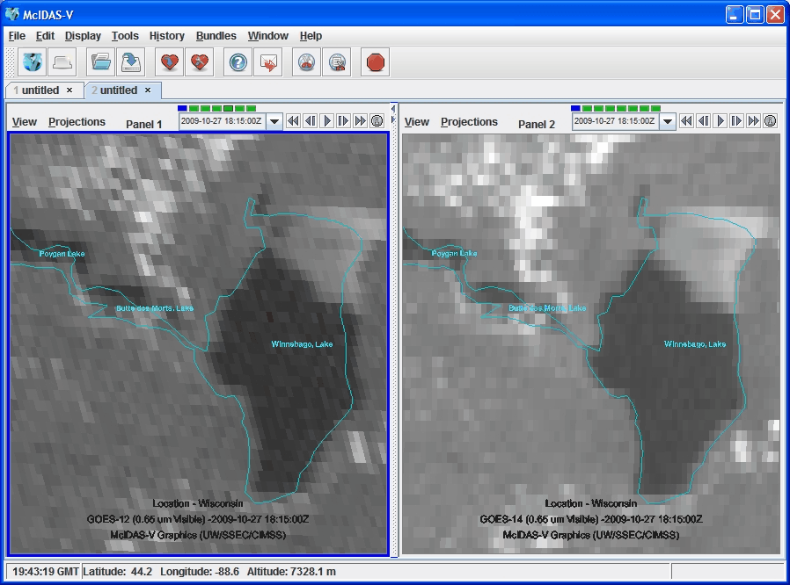
Improved INR with GOES-R

Slide 54
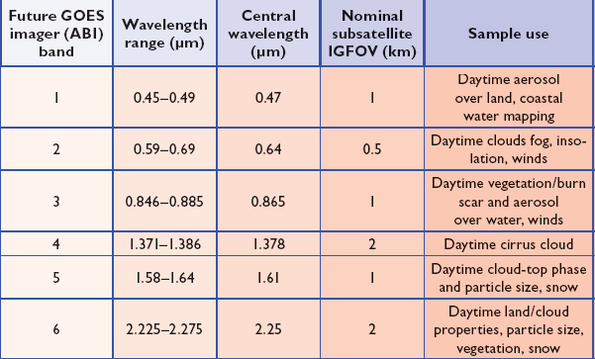
ABI Visible/Near-IR Bands
Schmit et al, 2005
Notes:
Schmit, T. J., M. M. Gunshor, W. P. Menzel, J. J. Gurka, J. Li, and A. S. Bachmeier, 2005: Introducing the next-generation Advanced Baseline Imager on GOES-R. Bull. Amer. Meteor. Soc., 86, 1079-1096.

Slide 55
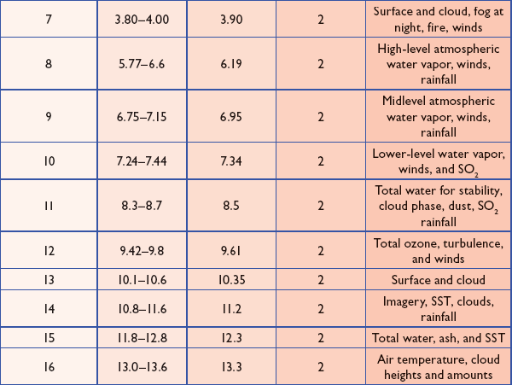
ABI IR Bands
Notes:
Schmit, T. J., M. M. Gunshor, W. P. Menzel, J. J. Gurka, J. Li, and A. S. Bachmeier, 2005: Introducing the next-generation Advanced Baseline Imager on GOES-R. Bull. Amer. Meteor. Soc., 86, 1079-1096.

Slide 56
GOES-11(L) Status
Launch Date: May 3, 2000
Orbital Location: 135°W longitude
Designation: Operational West
XRS: X-ray Positioner electronics failed. XRS
cannot track Sun – 10 Feb 2008
Power: Reduced battery 1 capacity. Services may be turned off during eclipse periods
COMM: Primary Sensor Data transmitter failed. Switched to redundant transmitter - 16 May 2006

Slide 57
GOES-13 (N) Status
Launch Date: May 24, 2006
Orbital Location: 75°W longitude
Designation: Operation East
SXI: Solar X-Ray Imager CCD detector partial
damage during X9 solar flare – 5 Dec 2006
New on-board software loaded for protection against large flares.
Propulsion: N2 thruster anomalous thrust level. Thruster use restricted.
XRS: A capacitor short. Does not detect flares

Slide 58
GOES-14 (O) Status
Launch Date: June 27, 2009
Orbital Location: 105°W longitude
Designation: Storage Mode
No Spacecraft or Instrument Issues

Slide 59
GOES-15 (P) Status
Launch Date: March 4, 2010
Orbital Location: 89.5°W longitude
Designation: Standby – Space Environment Monitor Operational
Sounder: Patch Temperature Control problems due to blanket issue – Yaw Flip at Equinox to control temperature. User impact - data outage during recovery from maneuver
SEM: MAGED Telescope 7 channel is noisy
EMWIN: S-Band Receiver 1 failed
SXI: Power on failure at initial turn on. Now that it is working, there are no plans to turn off.

Slide 60
GOES-12(M) Status
Launch Date: July 23, 2001
Orbital Location: 60°W longitude
Designation: South America
Sounder: Filter Wheel Motor Problems Dec 2009
EPS: Energetic Particle Sensor channels noisy
XRS: X-ray positioner electronics failed and cannot track Sun.
SXI: Solar X-Ray Imager high voltage power
supply failed
Propulsion: Thruster 2B oxidizer valve leak. “B” side thrusters isolated.
Imager: Periodic Cycle Slips
Fuel: Inclination will increase due to lack of fuel

Slide 61
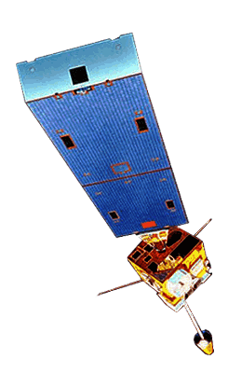
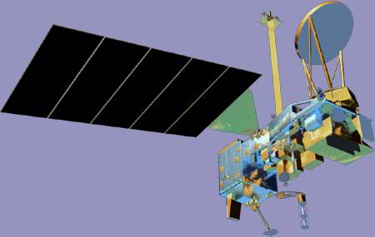
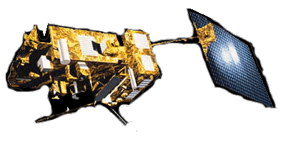
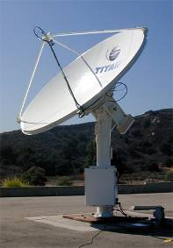
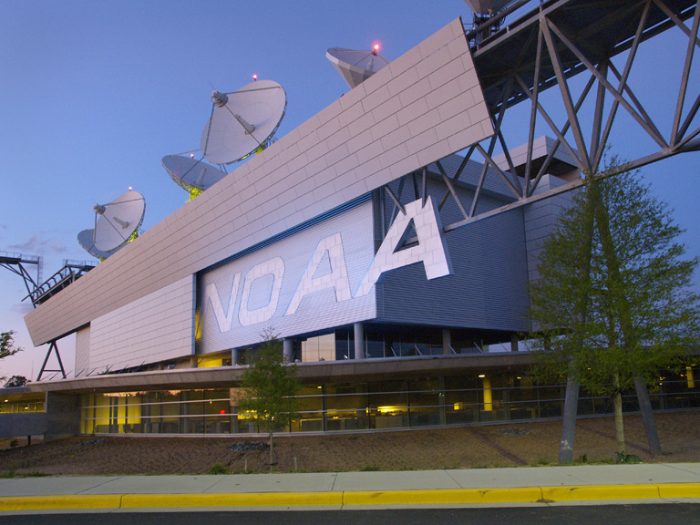
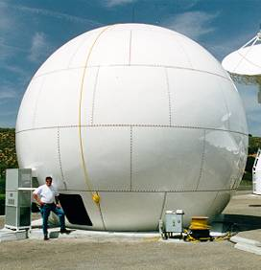
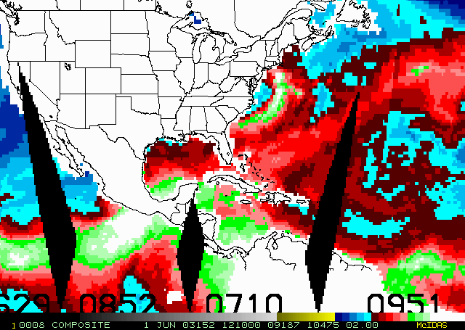
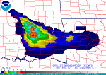
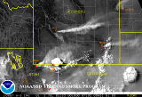
Geostationary Satellites
Polar Orbiting Satellites
NOAA-15, 16, 17, 18, 19
Metop-A
NASA Terra, Aqua
DoD DMSP
MTSAT-1R (DOMSAT)
MSG (landline and DOMSAT via Wallops)
Meteosat-7 (landline)
GOES-11, 12, 13, 14
“Raw” Data
Various Ways
Polar Acquisition Stations for POES, MetOp, EOS
Wallops, VA
Fairbanks, AK
Gilmore Creek, AK
Svalbard
Honolulu, HI
Miami, FL
Australia
Monterey, CA
NASA DAACs
Processed data, products, and services
Partners and Customers
Public

