Slide 1
EUMETSAT Operational Status - 2011
Simon Elliott
Meteorological Operations Division
simon.elliott@eumetsat.int

Slide 2
Geostationary Spacecraft Operations
MET-9 (launched 21 Dec 2005) and located at 0°. It supports the Meteosat Prime mission. No significant anomalies to report. Mass release events expected (following Met-8 experience!) from Sept 2010, but not observed yet. ☹ → 😐.
MET-8 (launched 28 Aug 2002) and located at 9.5°E. It is a backup for Met-9 and supports RSS. No significant in-orbit anomalies to report. Last NS inclination manœver successfully performed in October 2010.
MET-7 (launched 2 Sept 1997) and located at 57.5°E. It supports the full IODC service. No new in-orbit anomalies to report. It will be used in the next eclipse season as if Met-6 was no longer available.
MET-6 (launched 20 Nov 1993) and located at 67.5°E. It was re-orbited in April 2011.

Slide 3
SEVIRI Water Vapour channels’ improvement
During MSG-1 commissioning it was discovered that the raw images from two SEVIRI channels, although of far better quality than specified, could be further improved by changing the S/C operations and IMPF processing.
A testing campaign of about three weeks was performed in Nov/Dec 2010 involving external users.
The campaign was fully successful from a S/C, CF and IMPF operational perspective. The impact of the change on Image and Met Products quality is under evaluation both internally and externally by the involved NMS.
STG Operations Working Group (March 2011) decided to try it first with the rapid scanning mission and then later for the full earth scanning mission.

Slide 4
Meteosat satellites’ usage in the next years

Slide 5
MSG-3/4 Project Status
MSG-3/4 (Meteosat-10/11) Ground Segment upgrade close to completion. The final activities (inclusion in the system of the 3rd Primary Ground Station Antenna, the new release of the Central Facility and 2nd generation Meteorological Product Extraction Facility) was completed by end of Feb 2011.
Final testing campaign from 11-4-11 until 13-5-11. This includes a joint “Multi-Mission Elements” load test which is to be executed in coordination with the Metop-B/C (Metop-1/3) project.
Final review and handover to MSG-3 Operations Preparation on 6-7-11.
MSG-3 S/C Operations Preparation started (procedures and database).
1st MSG-3 Commissioning meeting held on 1-2-11

Slide 6
MSG-3 Operations Preparation
  Kick-off meeting of the MSG-3 LEOP on 9-11-2010:
    ESOC M&C under procurement and MSG-3 mission analysis started.
  Kick-off meeting of the MSG-3 launch service on 9-12-10:
    The MSG-3 launch configuration includes some shock damping devices; Arianne Espace seem able to optimize the shock damping configuration to reduce its mass and increase the range of potential co-passengers.
  MSG-3 S/C de-storage notification given on 1-12-10:
    MSG-3 S/C preparation in two parts: Part 1 from 1-12-10 until 15-7-2011 and Part 2 from Sept 2011 until launch.
    MSG-3 Launch period agreed with Arianne Espace from 1-6-12 until 31-8-12.

Slide 7
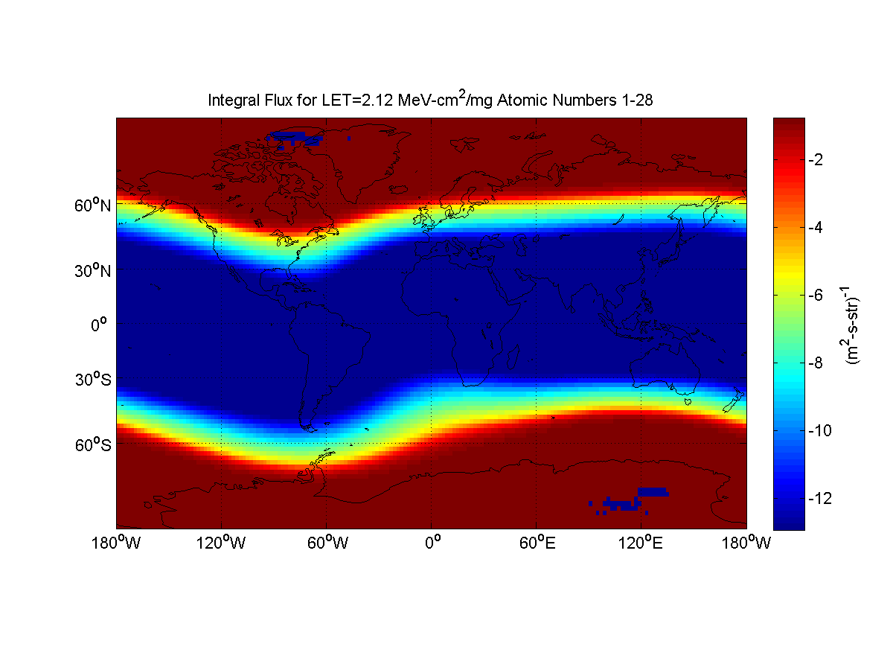
Heavy Ion Risk Assessment – Steady State Flux (NOAA)
Map of radiation Steady State Flux (NOAA):
Blue zone : low risk, Red zone : high risk
Yellow shape : South Atlantic Anomaly

Slide 8
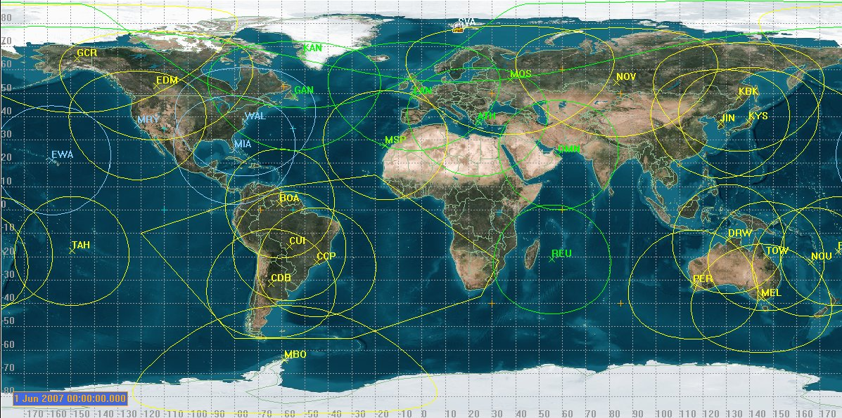

Extended AHRPTswitch-ON zone: descending part of the orbit

Slide 9
Extended AHRPTswitch-ON zone: ascending part of the orbit

Slide 10
4. Metop-A status and planning a. In orbit status incl. extension of HRPT zone
Self-recovery worked Jan 23rd

Slide 11
EPS Routine Ground Segment Operations
Operations generally running well.
  EUMETCast outages occurred in December 2010 (approx 3 hours) and January (25 mins)
  Svalbard CDA_1 over-running in Azimuth: Investigations led to cancellation of some NOAA blind-orbit support. Potential root cause and fix now identified / implemented and under observation.
Hardware and operating system upgrades about to complete
  Quality Control Facility: upgrade nearing completion
  PSR and BUCC completed.
Metop-B validation and ADA verification on-going

Slide 12
EPS Product Operations Status and Planning
Product (Metop-A) | Current Status | Future Status
All Level 1 Products | Operational
GOME-2 v5.0 | Operational since 01/2011
ATOVS Level 2 | Operational
IASI Level 2 (twt, clp, ozo) | Operational
IASI Level 2 (trg) | Operational for CO, N₂O
IASI Level 2 (ems) | Pre-operational
AVHRR L2 NDVI | Operational
AVHRR L2 Polar Winds | Operational since 01/2011
ASCAT Soil Moisture | Operational
IASI L1 Compressed (PC scores) | Operational since 01/2011
IASI L2P SST | Demonstration 03/2011
All Level 1 NOAA-19 products operational.
ATOVS L2 products from NOAA-19 operational

Slide 13
EPS Operations Planning
2011:
  Validation of combined Metop-A/B operations (now until September)
  Antarctic Data Acquisition Demonstration Service from 1st May (9 out of 14 orbits)
  Metop-B System Rehearsals after SIVVR
2012:
  Metop-B Rehearsals involving external partners
  Metop-B launch, commissioning and routine ops start.
2014:
  ADA Operational Service Start (all orbits, one satellite).

Slide 14
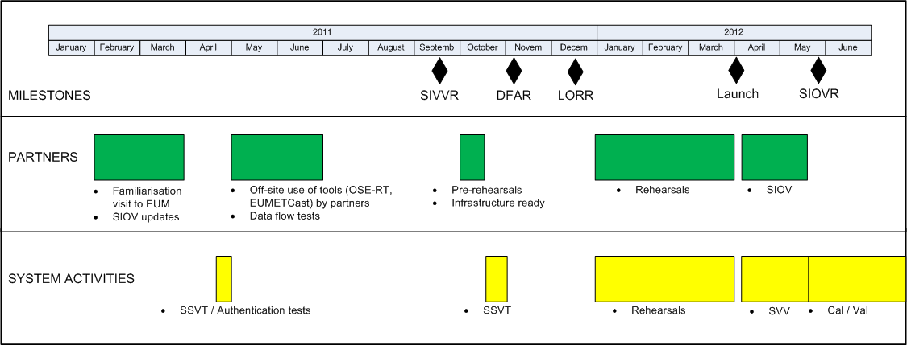
Metop-B Planning
SIVVRR in Q4 2010 confirmed good state of preparations for GS-2 validation start – leading to SIVVR in September 2011.
Preparations starting with external partners for the SIOV.
Also for the EUMETSAT Ground Segment to satellite testing (SSVTs)

Slide 15
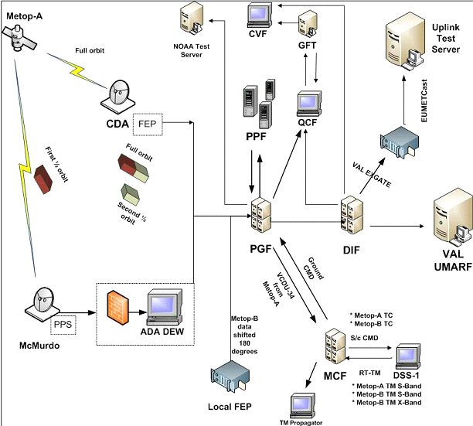
Antarctic Data Acquisition (ADA)
Status and Planning
Metop-A systematic dumping over McMurdo since December 2010
Communications at 20Mbps from McMurdo into EUMETSAT verified in January.
System Verification in EUMETSAT on-going
Results to date extremely promising

Slide 16

ADA Status and Planning
Losses (about 1%) being experienced in data acquisition in McMurdo
  Rf interference from microwave link detected, but mostly filtered out.
  Main problem in antenna movement and autotrack
EUMETSAT system can cope with the losses, but would cause some product degradation.
Impact on introduction of the ADA service is being assessed (Demonstration Service planned to go operational in May, with limited user trials from GS1 started in March).

Slide 17
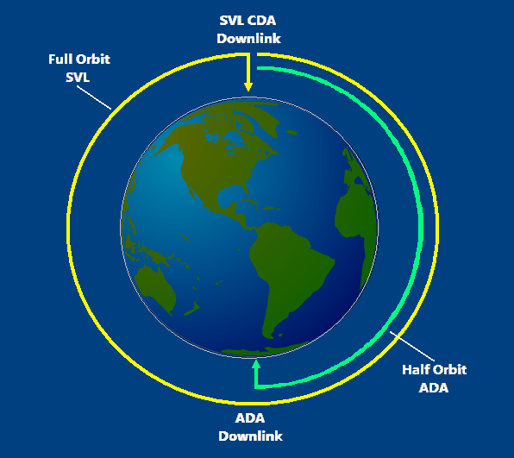
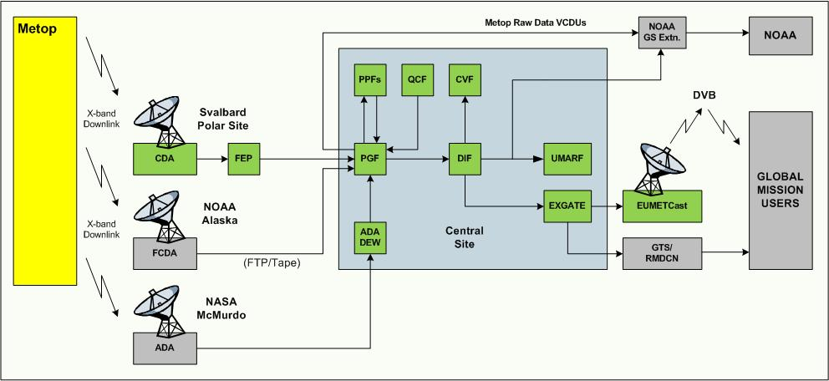
ADA System Concept
McMurdo MG1 station at 77.8°S
9-10 orbits/day average in ADA Demonstration Phase (Q2 2011)
All orbits expected in ADA Operational Phase (Q1 2014)

Slide 18
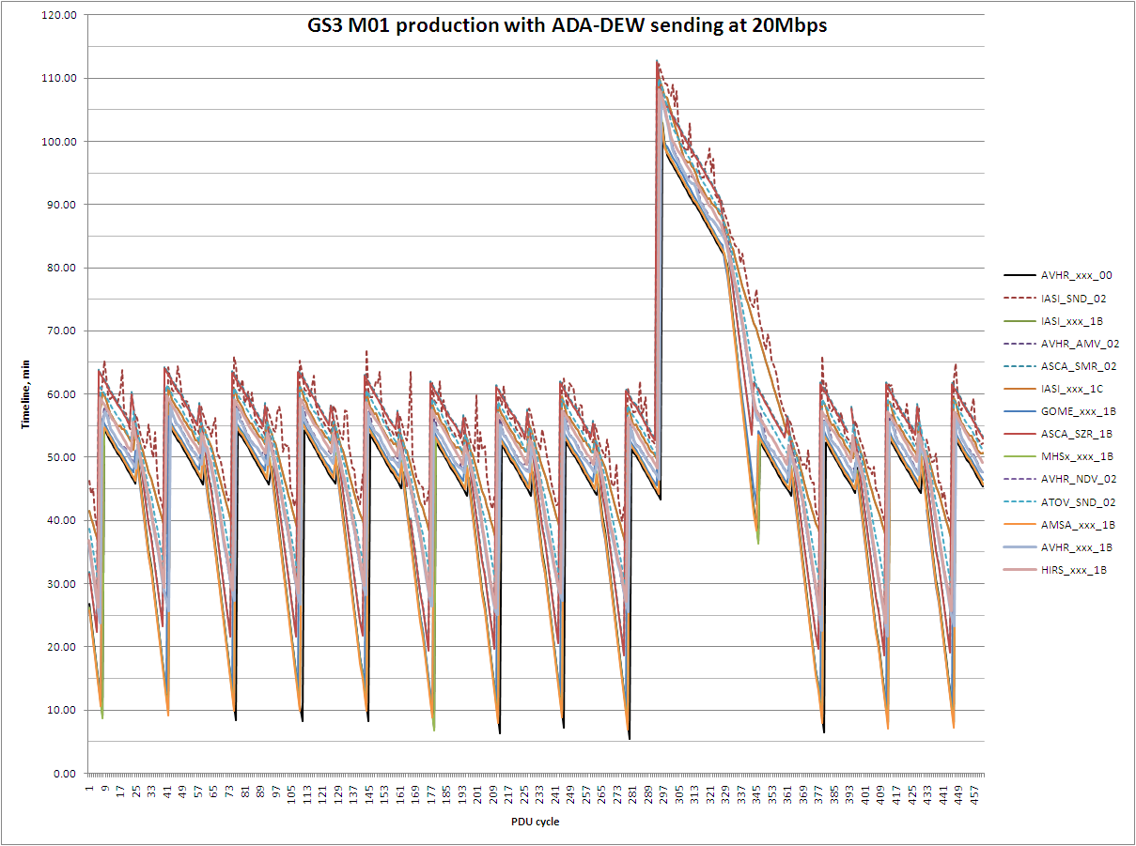
ADA Performance from System Verification
65 Minutes worst case timeliness achieved for L1 data
Recovery time only about one orbit after missing McMurdo dump
Processing of Svalbard full orbit dump
Processing of Svalbard ascending orbit dump
Processing of McMurdo descending orbit dump
Processing of McMurdo descending orbit dump
Best case timeliness per orbit from McMurdo better than Svalbard due to fast data transfer from McMurdo

Slide 19
NPP data availability for European users
NPP and JPSS1 global and regional data to be provided
Regional data will be an evolution of existing EARS/RARS service
Global data will be acquired at EUMETSAT, tailored and redistributed to European users via EUMETCast and globally via the GTS (until NOAA does this)
Global data required from NDE will include:
  ATMS SDRs, all channels, all fields of view
  CrIS SDRs, all channels, all fields of view
  VIIRS cloud EDRs
VIIRS cloud EDRs will be merged with CrIS SDRs in the common BUFR template until NDE can deliver these directly
Details of telecoms currently being addressed

Slide 20
Oceansat-2 user requirements (target/threshold)
Data on EUMETCast:
      L2a ( σ0@50km grid)
      L2b ( wind @50km grid)
Data to NOAA:
      L1b (σ0@original resolution)
      L2a (σ0@50km grid)
      L2b ( wind @50km grid)
Timeliness :
      Overall: 180min / 240 min
      EUMETSAT part: 60min / 120min
Availability : 98% / 85%

Slide 21
Oceansat-2 contribution - DRAPSO
Based on the user requirements and the constraints, a dataflow scheme was developed in co-operation with ISRO and NOAA.
The Data Routing and Alternative Processing System for Oceansat-2 (DRAPSO) represents the EUMETSAT contribution to this Oceansat-2 NRT system

Slide 22
DRAPSO processing modes
Nominal mode
  Raw data are transferred from Svalbard to Shadnagar, India
  Processing to L1 and L2 in Shadnagar
  Transfer of products via Svalbard to EUMETSAT, Darmstadt
  Dissemination via EUMETCast and to NOAA
Alternative mode
  Raw data are transferred from Svalbard to EUMETSAT
  Processing to L1 and L2 in Darmstadt
  Dissemination via EUMETCast and to NOAA
Switch between modes is done on the basis of data availability at Svalbard and controlled by ISRO. The processing mode is transparent for the users.

Slide 23
Raw data
KSAT/SVB
reception
ISRO
DEG
ISRO /SAN
Processing
Products
auxiliary
Compressed Product tar–file 220MB
L1b
418
L2a
84
L2b
1.6
raw
240~90
ISRO
archiving
SVB
Firewall
L2a & L2b & L1b or raw
Darmstadt
EUM
Proc.
EUM
Rout.
L2a &1b & L2b
NOAA
EXGATE
EUMETCAST
OSI-SAF
L2a & L2b

Slide 24
Status: Data Routing ISRO
ISRO/K-SAT:
NRSC (Shadnagar) processing system ready (Oct 2010).
Data Exchange Gateway (DEG) Svalbard active (Dec 2010).
Link Svalbard-Shadnagar in place (01/01/2011).
Reception of orbits SVB/TRO scheduled regularly (15/1/2011).
Stabilisation of data transfer to EUMETSAT solving problems on data format, file naming, and timeliness (15/2/2011)

Slide 25
Status: Data Routing EUMETSAT
EUMETSAT:
Hardware for routing/processing server available (Nov 2010).
Tunnel on GEANT link (SVB-EUM) and connection to ISRO-DEG ready (Dec 2010).
Installation of EFTS, GEMS, seg. software on server (Dec 2010).
Enabling workaround for ftp incompatibility (Feb 2011)
Start of EUMETCast test dissemination to ISRO, KNMI, ECMWF (3/3/2011)
Preliminary ftp-dissemination to NOAA (14/3/2011)

Slide 26
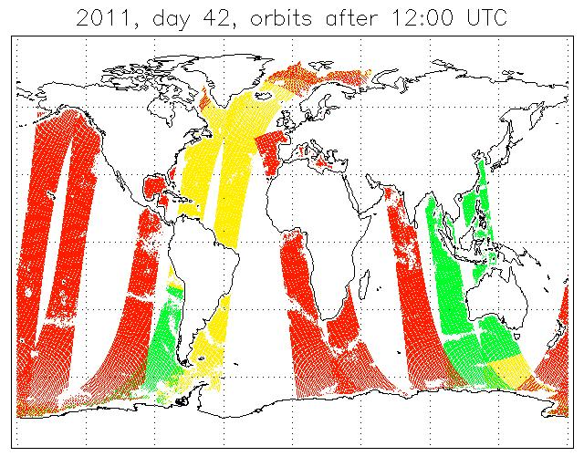
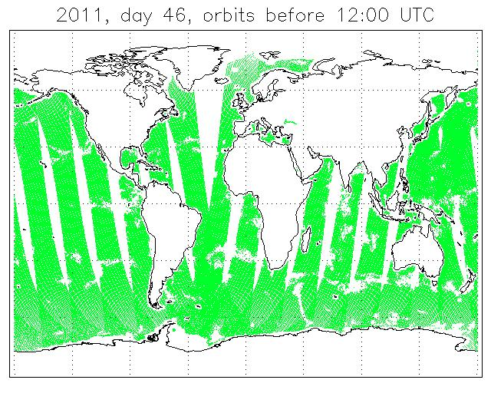
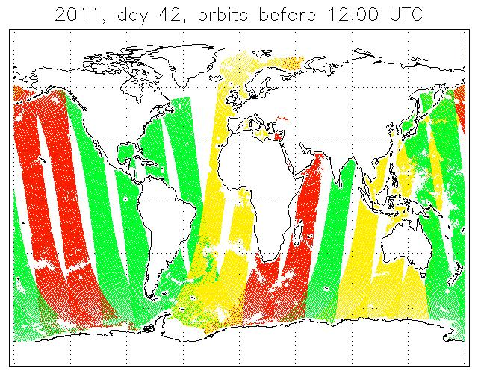
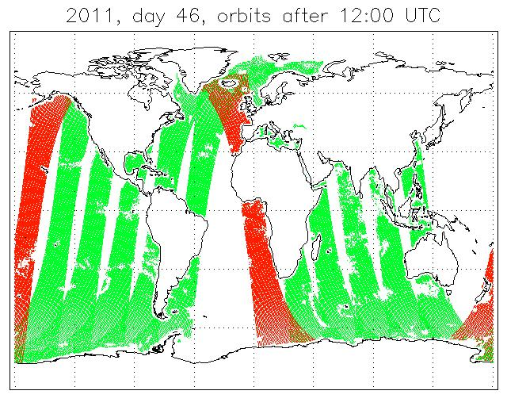
Coverage and Timeliness, early and late February
11/2/2011
15/2/2011
Timeliness < 180 min
Timeliness > 180 min and < 240 min
Timeliness > 240 min

Slide 27
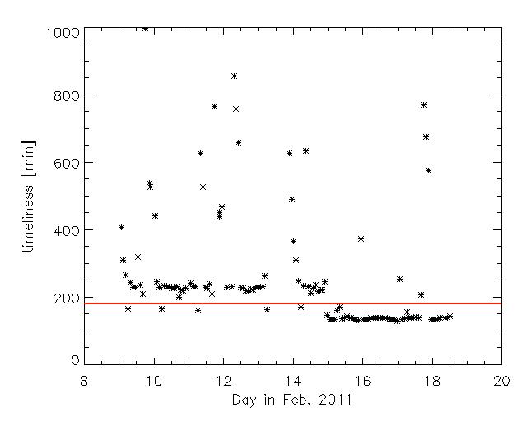
Development of timeliness during Feb. 2011

Slide 28
Data verification
Data Availability:
12-14 orbits received per day since 15/2/2011 (outage 10-14/3/2011)
Data timeliness:
For 9-14 orbits per day (~85% of data) ~135 minutes , for the playback orbits (received at Shadnagar) considerably worse.
Data contents:
All data sets readable since 10/2/2011, except during recovery from outage (14/3/2011), geo-location consistent, data values plausible
Quality monitoring of L2a and L2b to be done by OSI-SAF
Validation/monitoring of L1b to be done by NOAA

Slide 29
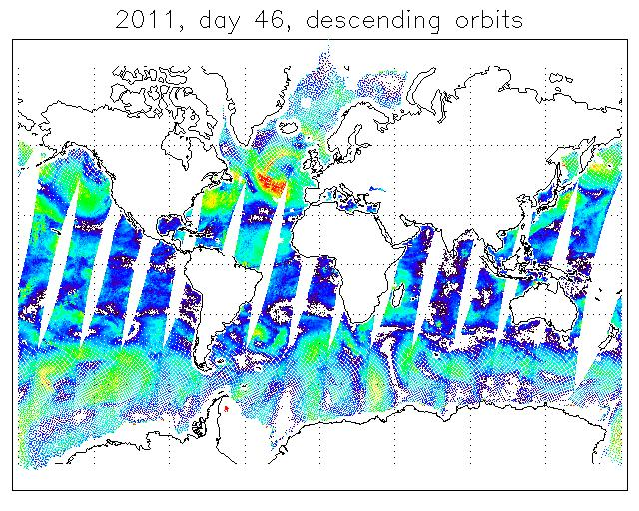
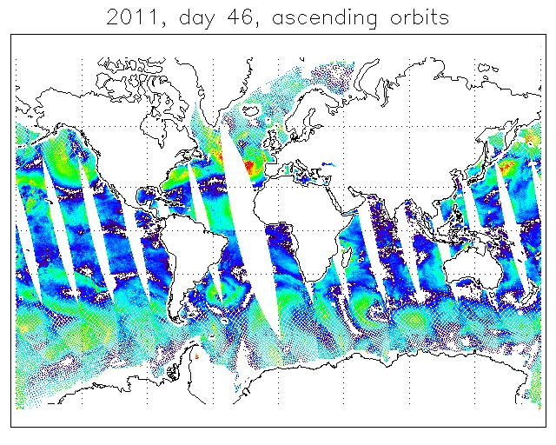
OSCAT winds from ISRO L2b product, 15/02/2011
0 5 10 15 20 25
Wind speed [m/s]

Slide 30
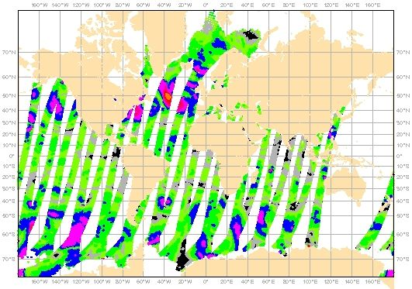
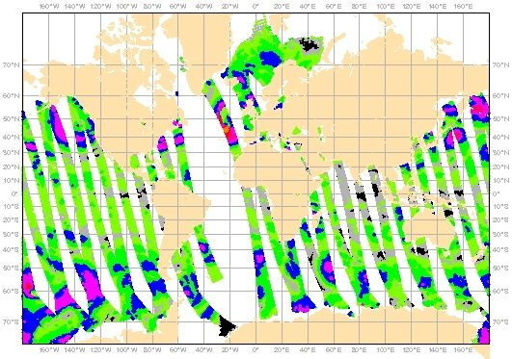

ASCAT winds from OSI-SAF product, 15/02/2011
Wind speed [m/s]

Slide 31
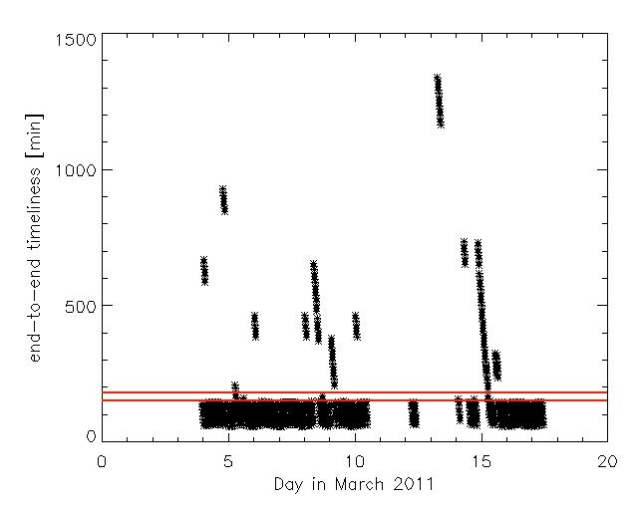
End-to-end timeliness of L2a segments, March 2011

Slide 32
Status: Alternative Processing
Raw data from Svalbard were received for several days (Jan 2011)
Auxiliary data are received regularly from Svalbard (Jan 2011)
Hardware, including the implementation of a mandatory workstation was prepared for the processing system (Jan 2010).
Pilot installation of ISRO processing software packages took place on development environment and DRAPSO server (11/2/2011).
Data processing, raw → L0 (ADP software) and L0 → L1 → L2 (DP software) works, patch for automated triggering received (10/3/2011), clarification on forecast frequency pending.

Slide 33
Measured timeliness routing/processing mode
 | Routing mode | Processing mode
Orbit: | 100 minutes | 100 minutes
Raw data transfer SVB → SAN: | 1 minute
Raw data transfer SVB → EUM: |  | 3 minutes
Processing SAN raw → L2: | 25 minutes
Processing EUM raw → L2: |  | 10 minutes
Product transfer SAN→ SVB: | 2 minutes
Product transfer SVB → EUM: | 6 minutes
Product segmentation/routing: | 2 minutes | 2 minutes
Dissemination (EUMETCast): | 7 minutes | 7 minutes
Total: | 143 minutes | 122 minutes

Slide 34
Open issues
ftp application level incompatibility (currently workaround in place)
Clarification on required forecast data for processing
user information process
product versioning:
  Technical update process
  Version numbering in data
  User information
  Test/parallel data delivery
Finalising monitoring and reporting
Enable alternative processing system (requires additional testing, especially for ADP software and forecast handling)
Documentation of ADP software (requirements for monitoring under preparation)
Validation report by OSI/NWP-SAF
Start trial dissemination
Agree Joint Operations Rules and Procedures (JORP/OICD)

Slide 35
EUMETSAT Conditions to declare product operational
Product fulfils user requirements on availability, timeliness and quality:
  Monitoring and verification report by EUMETSAT
  Product verification and validation reports by users (ISRO, SAFs, NOAA ...)
Joint Procedures co-signed and available to all parties
All interface documents available (data and operations)
Processing chain has operational standard:
  Redundancy of all processing and monitoring components
  All procedures in place (including failover and change procedures)
  All components and procedures tested
  Training of controllers and on-call support took place

Slide 36



Simplified North America / Europe data flow
internet
NOAA link
mid-term
direct reception
MeteoFrance
internet
GTS link
EARS network
North American source (eg RARS)
NESDIS link
chaos

Slide 37
Potential North America to Europe data flow
European users (NMHS)
EXGATE
European users (research)
Data grooming
EUMETCast
GTS/RMDCN
European user (xxx)
North American source (eg RARS)
order

