Slide 1
JAXA Earth Observation Satellite Programs associated with APSDEU
Kazuo Umezawa
JAXA/EORC
May 2-6, 2011, APSDEU-11, Boulder, Colorado, USA
Notes:
1

Slide 2







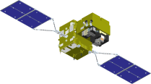


Long-Term Plan of
Earth Observation by JAXA
Targets | ~2005 | 2006 | 2007 | 2008 | 2009 | 2010 | 2011 | 2012 | 2013 | 2014 | 2015 | 2016 | 2017 | 2018
Disasters & Resources | [Optical radiometer] MOS-1, ADEOS (87~95) (96~97) [Optical sensor, Synthetic Aperture Rader] JERS-1 (92~98)
Climate Change Water Cycle | [Precipitation Rader] PR (97~) [Microwave radiometer] MOS-1(87~95) ADEOS2/AMSR(2003
Climate Change | [Optical radiometer] MOS-1, ADEOS (87~95) (96~97) ADEOS2/GLI [Cloud profiling radar]
Greenhouse gases | [Spectrometer] ADEOS/ILAS (96~97) ADEOS2/ILAS2
ALOS/PALSAR
ALOS-2 SAR
ALOS "DAICHI"
[Land and Disaster monitoring]
ALOS/PRISM AVNIR2
ALOS-3 Optical
TRMM/PR
TRMM
GPM/DPR
[Precipitation]
Aqua/AMSR-E
[Wind, SST , Water vapor]
GCOM-W2
Aqua
GCOM-W1/ AMSR2
[Vegetation, aerosol, cloud, SST, ocean color]
GCOM-C2
250m, multi-angle, polarization
GCOM-C1/ SGLI
[Cloud and Aerosol 3D structure]
EarthCARE/CPR
GOSAT "IBUKI"
[CO_{2,} Methane]
[CO_{2,} Methane]
GOSAT-2
Mission status
On orbit
Phase B~
Phase A
Extension

Slide 3
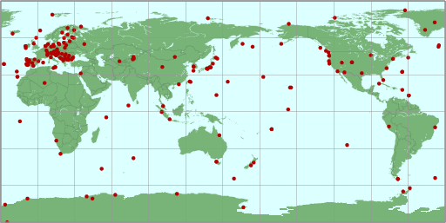
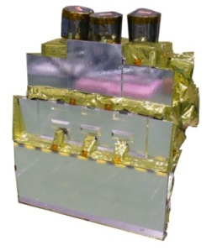
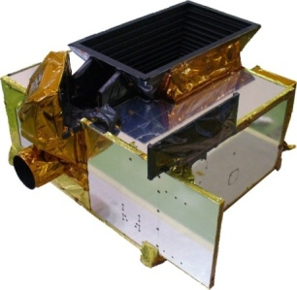
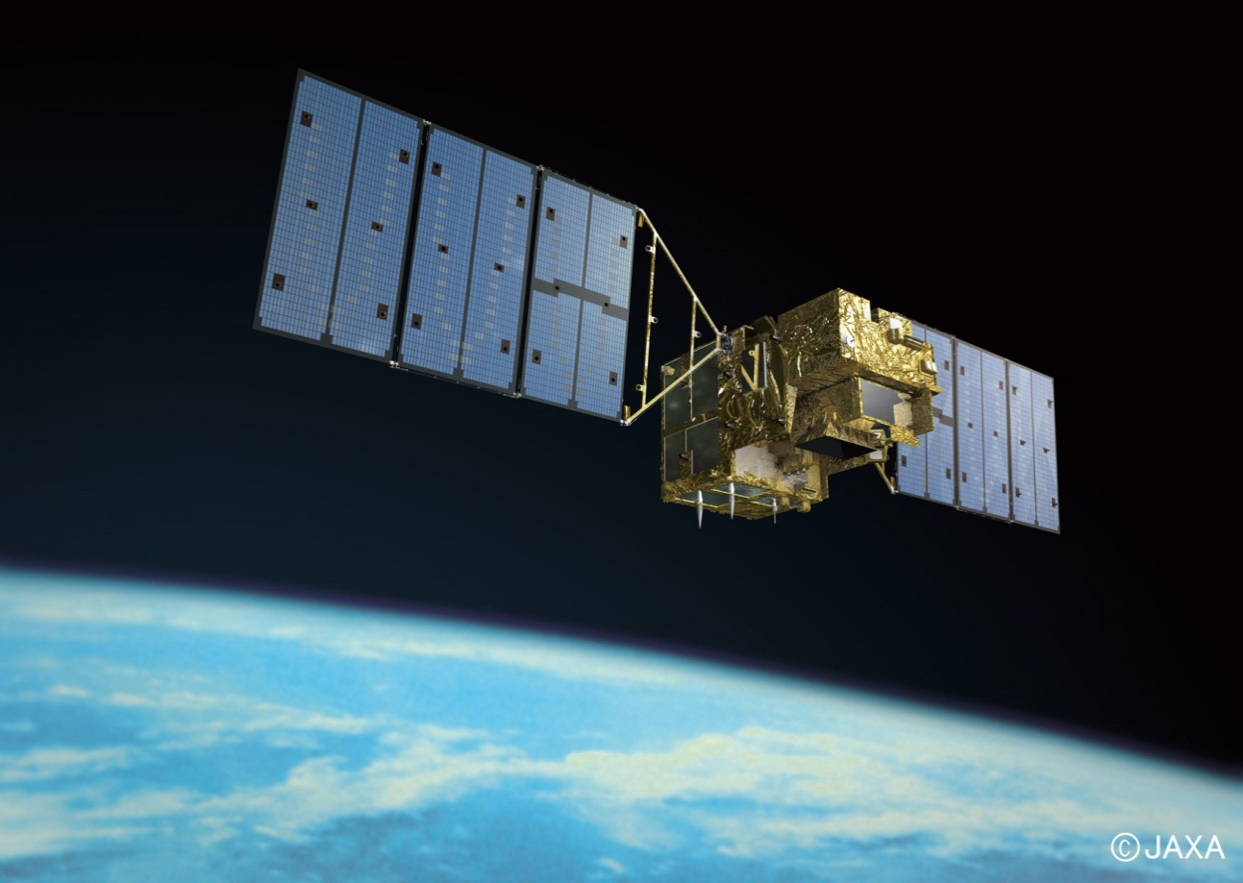
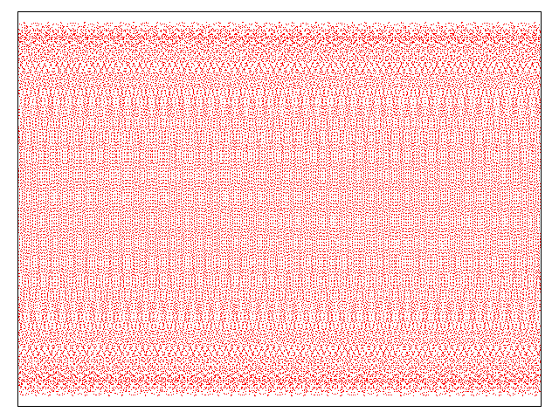
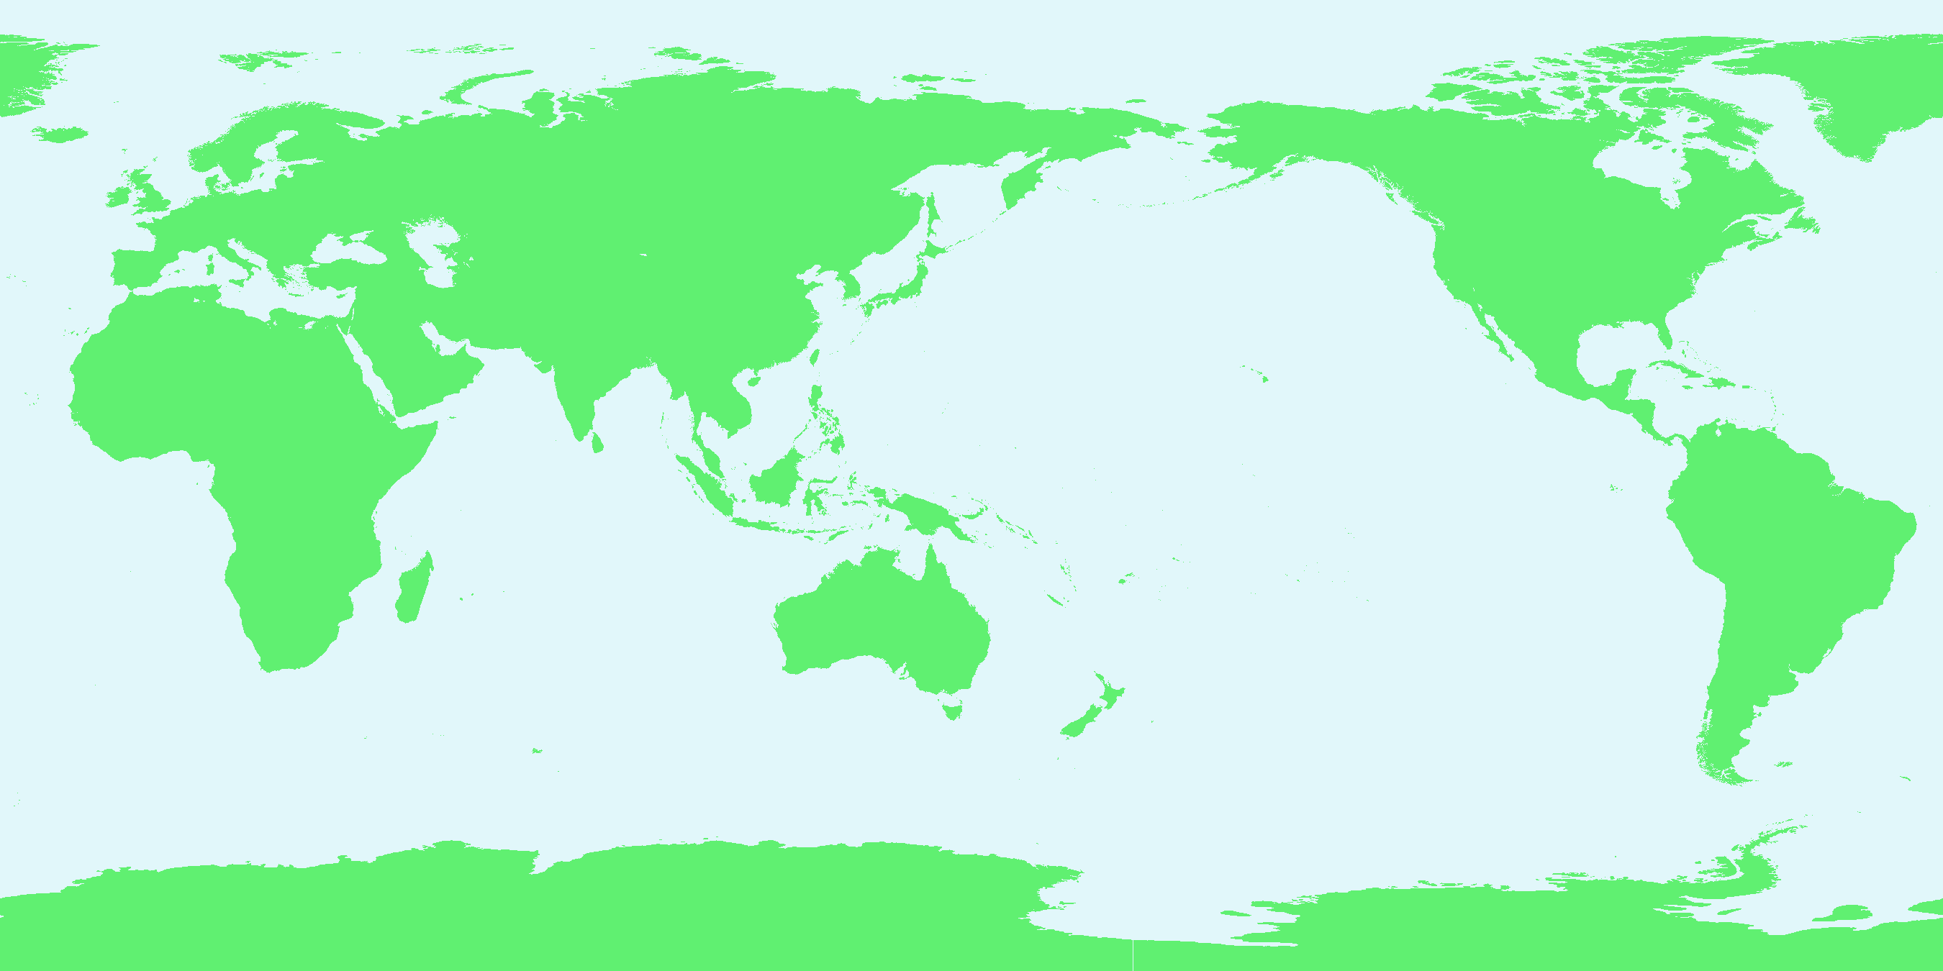
Greenhouse Gases Observing Satellite (GOSAT)
GOSAT enables global (with 56,000 points) and frequent (at every 3 days) monitoring CO2 and CH4 column density. (Launched in Jan 2009)
Current Ground-based Observation Points
(320pts) Provided by WMO WDCGG
TANSO-CAI
(Cloud and Aerosol Imager)
TANSO-FTS
(Fourier Transform Spectrometer)
Increase of Observation Points using GOSAT (56,000pts)
Notes:
Environmental problems, such as global climate change, irregular water cycles, and environmental pollution, are now recognized destabilizing factors in the quest for peace and prosperity worldwide.
These factors are exacerbated by the explosive increase of populations and economic activities.
Clearly, future human society cannot achieve sustainable development without overcoming these environmental problems.
This is especially critical in the Asian region because of its large population and rapid economic growth.
Therefore, it is important for policy makers in all countries to know and understand the exact status of such environmental situations in order to provide the proper guidance to protect our peaceful planet Earth.
JAXA has a powerful tool for observation of climate change and global warming such as AMSR-E, TRMM, GPM, GCOM and GOSAT.
To promote the implementation of an integral Earth observation system, JAXA is contributing to developing the GEOSS.

Slide 4
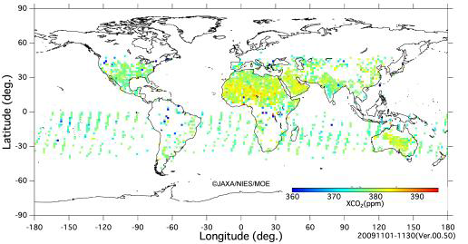
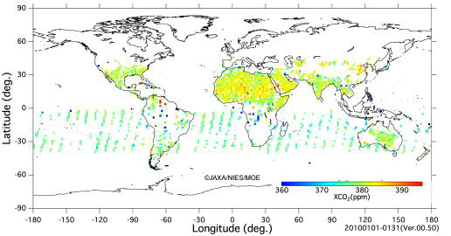
Column-averaged volume mixing ratios of CO₂
April, July and November, 2009 and January, 2010
April
July
November
January
Available from Website of NIES, February 18, 2010:
http://www.gosat.nies.go.jp/eng/related/download/GOSAT_20100216_en.pdf

Slide 5
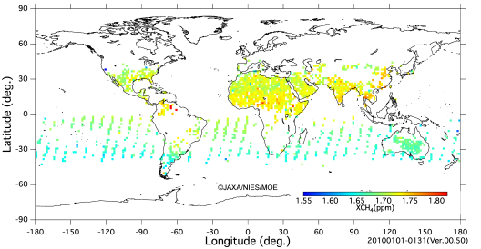
Column-averaged volume mixing ratios of CH₄
April, July and November, 2009 and January, 2010
April
July
November
January
Available from Website of NIES, February 18, 2010:
http://www.gosat.nies.go.jp/eng/related/download/GOSAT_20100216_en.pdf

Slide 6

Tropical Rainfall Measuring Mission
TRMM is ;
  Japan-U.S. joint mission, flying since Nov. 1997
  World‘s first and only space-borne precipitation radar (PR) on-board with microwave radiometer and visible-infrared sensor
  Still operational, and continues to provide the data
Results of the TRMM
  Accurate and highly stable rain measurement in the tropical and sub-tropical region, over the land as well as the ocean
  More than 10 years rain observation data archive
  Proved that the radar (PR) and microwave radiometer (TMI) is a very good combination for rainfall measurement
  PR greatly contribute to the improvement of the rainfall retrieval error by microwave radiometer
  Precipitation system three dimensional structure, diurnal cycle, seasonal change, long term variation such as El-Nino and La-Nina observation
  New products development such as latent heating, soil moisture, and sea surface temperature
  Demonstrated that TRMM data is valuable for the operational use, such as flood prediction, numerical weather forecast, typhoon prediction
US-Japan joint mission
Japan: PR, launch
US: satellite, TMI, VIRS, CERES, LIS, operation
Launch | 28 Nov. 1997 (JST)
Altitude | About 350km (since 2001, boosted to 402km to extend mission operation）
Inc. angle | About 35 degree, non-sun-synchronous orbit
Design life | 3-year and 2month (still operating)
Instruments | Precipitation Radar (PR) TRMM Microwave Imager (TMI) Visible Infrared Scanner (VIRS) Lightning Imaging Sensor (LIS) CERES (not in operation)
6
Notes:
6

Slide 7

Latent Heating by TRMM/PR
JAXA/EORC began to provide the Latent Heat Products estimated by SLH algorithm as research product via web page from May 2008.
Level2 (NonGrid & Gridded) and Level 3 LH data are available to download from launch to latest.
Co-operative study with Prof. Y. N. Takayabu (Univ. Tokyo) and Dr. Shige (Osaka Pref. Univ).
(a) Latent heat at altitude of 7.5km
(b) Latent heat at altitude of 2km
Latent heat distribution during December, January, and February using TRMM PR 3D data between 1998 and 2007. The data can be utilized for evaluation of global water & energy cycle and for improvement of climate models.
Latent Heat Research Product -- http://www.eorc.jaxa.jp/TRMM/lh/index.html

Slide 8
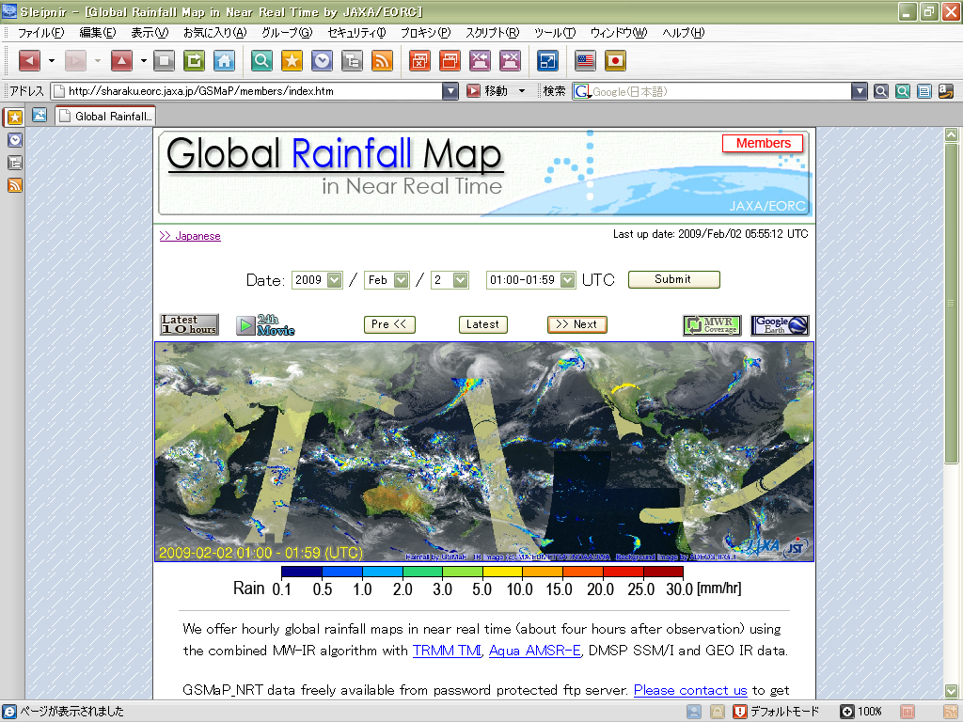
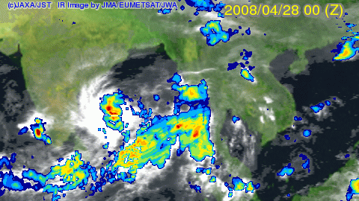
Global Rainfall Map using TRMM and other satellite information
GSMaP (Global Satellite Mapping for Precipitation) is originally funded by JST/CREST during 2002-2007, led by Prof. K. Okamoto.
  Development of reliable MWR algorithm consistent with TRMM/PR and precipitation physical model developed by using PR (Aonashi et al., 2009).
  Combination of microwave radiometer retrievals with GEO IR by the moving vector (like CMORPH) and new Kalman filtering method (Ushio et al., 2009).
JAXA/EORC began to provide near-real-time version data of GSMaP (GSMaP_NRT) about 4-hour after observation via password protected ftp site since October 2008.
Hourly browse images, kmz files for GoogleEarth, and 24-hour movies are also available from Web server.
Cyclone "NARGIS" attacked Myanmar
Global Rainfall Map in near-real-time -- http://sharaku.eorc.jaxa.jp/GSMaP/

Slide 9

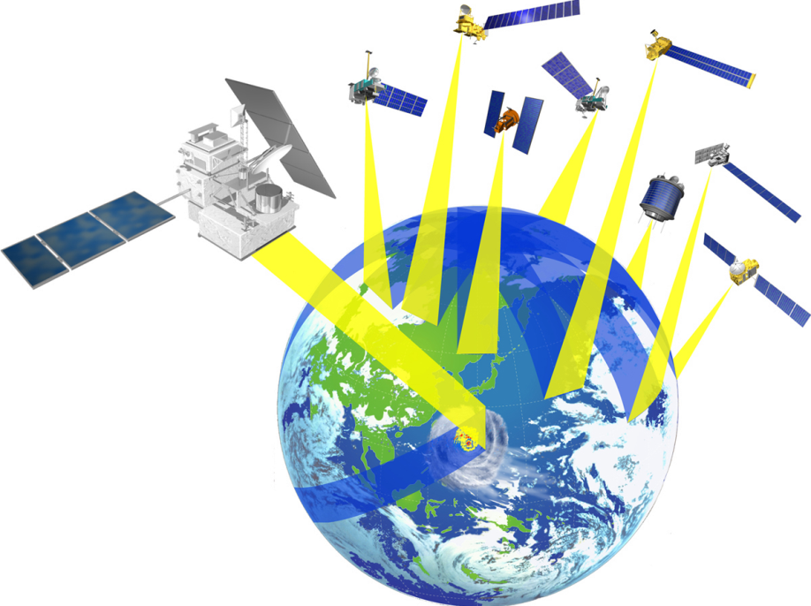
Global Precipitation Measurement (GPM)
OBJECTIVE: Understand the Horizontal and Vertical Structure of Rainfall and Its Microphysical Element. Provide Training for Constellation Radiometers.
OBJECTIVE: Provide Enough Sampling to Reduce Uncertainty in Short-term Rainfall Accumulations. Extend Scientific and Societal Applications.
Core Satellite
Joint mission between Japan & U.S.
Dual-frequency Precipitation Radar (JAXA and NICT)
Multi-frequency Radiometer (NASA)
July 2013, H2-A Launch
Non-Sun Synchronous Orbit
~65° Inclination
~407 km Altitude
Constellation Satellites
Small Satellites with Microwave Radiometers
Aggregate Revisit Time,
3 Hour goal
Sun-Synchronous/Non-sun-synchronous orbit
500~900 km Altitude
International Partners; NOAA, NASA, JAXA, CNES/ISRO, etc.
Precipitation Validation Sites
Global Ground Based Rain Measurement
Global Precipitation Processing Centers
Capable of Producing Global Precipitation Data Products as Defined by GPM Partners

Slide 10
Updated Plan of JAXA GPM Products
Level | Algorithm | Product | Major physical parameter | Unit | Coverage
1 | KuPR algorithm | KuPR product | Received power profile | Orbit | 245km (swath)
 | KaPR algorithm | KaPR product | Received power profile | Orbit | 125km (swath)
2 | DPR algorithm (Japan-US joint) | KuPR product | Radar reflectivity profile, normalized radar surface cross section (σ⁰), rain type, bright-band height, attenuation corrected radar reflectivity profile, rain rate profile | Orbit | 245km (swath)
 |  | KaPR product | Radar reflectivity profile, normalized radar surface cross section (σ⁰), rain type, bright-band height, attenuation corrected radar reflectivity profile, rain rate profile | Orbit | 125km (swath)
 |  | Dual-frequency precipitation product | Rain rate profile, drop size distribution, precipitation status (rain/snow), attenuation profile | Orbit | 245km (swath)
 | DPR/GMI combined algorithm (Japan-US joint) | DPR/GMI combined product | rain rate profile, surface rain rate | Orbit | 245km/800km (swath)
3 | DPR algorithm (Japan-US joint) | Dual-frequency precipitation product | Mean rainfall, observation number, rain pixel number, mean bright-band height, storm height | Monthly | Global
 | DPR/GMI combined algorithm (Japan-US joint) | DPR/GMI combined product | Mean rainfall, observation number, rain pixel number, | Monthly | Global
 | Global precipitation map algorithm | Global precipitation map product | Mean rainfall, observation number, rain pixel number | 1-hr/ monthly | Global (Horizontal: 0.1º grid box)

Slide 11
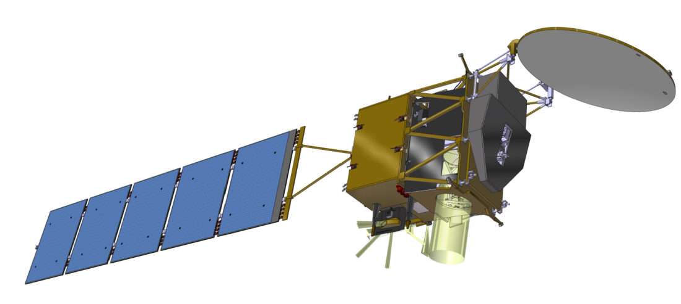
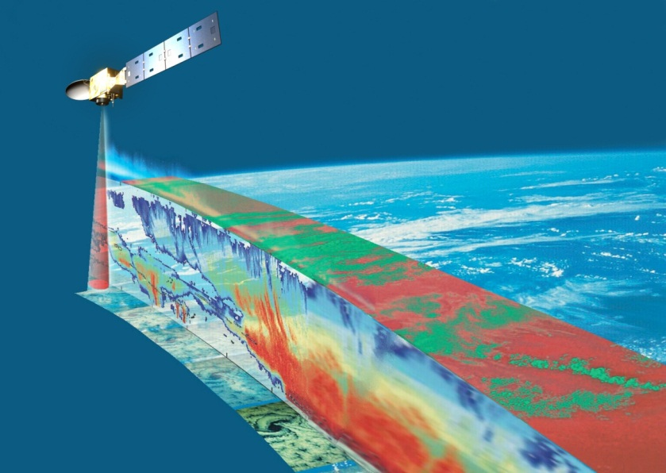
EarthCARE/CPR
Climate monitoring of earth radiation, cloud and aerosol
Cooperation between ESA and Japan (JAXA/NICT)
Mission
  Vertical profile of clouds, aerosol
  Interaction between clouds and aerosol
  Cloud stability and precipitation
Orbit
  Sun synchronous
  Equator crossing time 13:45
  Altitude 400km
Instrument
  CPR (Cloud Profile Radar)
  ATLID (Atmospheric LIDAR)
  MSI (Multi-Spectral Imager)
  BBR (Broad Band Radiometer)
Task sharing
  JAXA/NICT （CPR）
  ESA （LIDAR, MSI, BBR, Spacecraft)
Launch target
  JFY2013
CPR
BBR
MSI
ATLID
11
Notes:
11

Slide 12
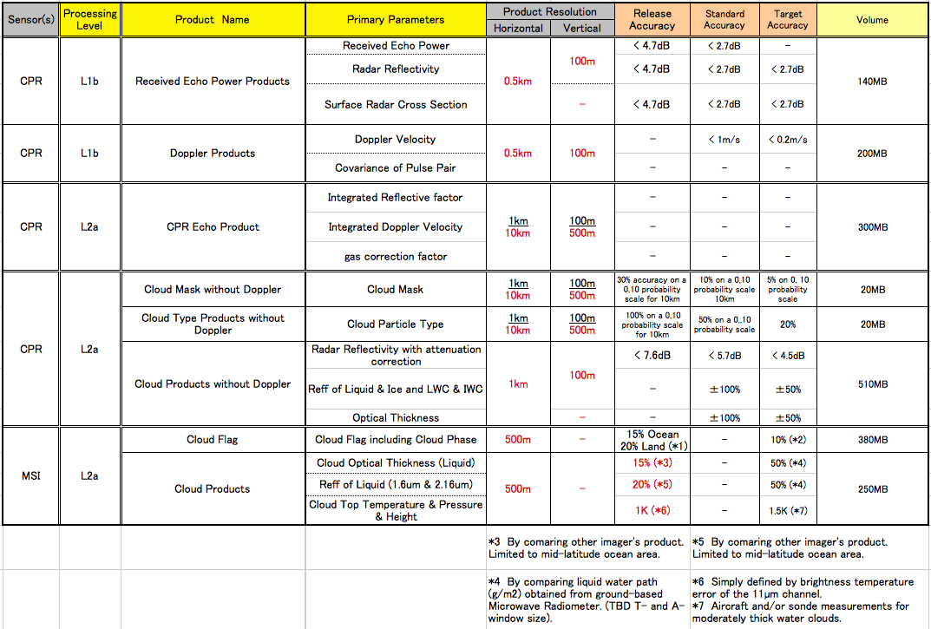
EarthCARE Japanese Standard Products *Draft (1/2)

Slide 13
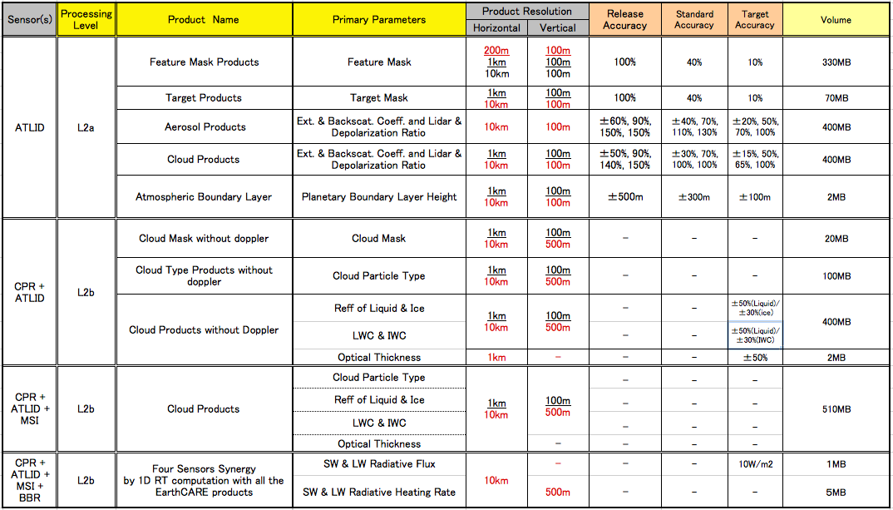
EarthCARE Japanese Standard Products *Draft (2/2)

Slide 14

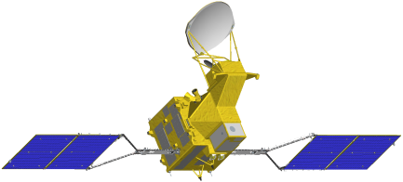
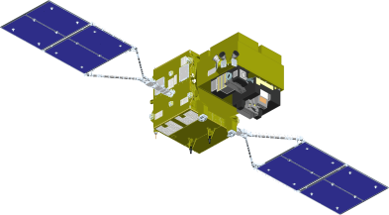
Concept of the Global Change
Observation Mission (GCOM)
GCOM aims to construct, use, and verify systems that enable continuous global-scale observations of effective geophysical parameters for elucidating global climate change and water circulation mechanisms.
GCOM will consist of 2 satellite series (GCOM-W and C) spanning 3 generations in order to perform uniform and stable global observations for 13 years.
 | GCOM-W | GCOM-C
Orbit | Type : Sun-synchronous, sub-recurrent Altitude : Approx. 700 km Inclination : 98.19 degrees Local time of ascending node : 13:30 (Join in the “A-Train”) | Type : Sun-synchronous, sub-recurrent Altitude : Approx. 800 km Inclination : 98.6 degrees Local time of descending node : 10:30
Satellite overview
Mission life | 5 years
Launch vehicle | H2A launch vehicle
Instrument | Advanced Microwave Scanning Radiometer 2 (AMSR2) | Second Generation Global Imager (SGLI)
Launch (target) | Japanese Fiscal Year (JFY) 2011 | JFY 2014 (TBD)

Slide 15

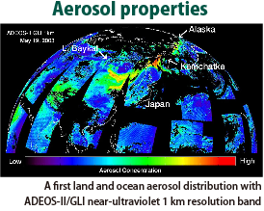
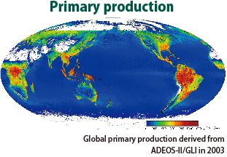

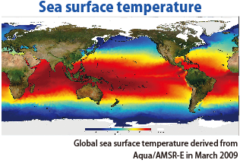
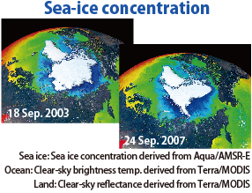
GCOM Observation Parameters
Climate change observation will be performed by the SGLI on the GCOM-C satellite.
GCOM-C sensors will observe clouds, aerosol, ocean color (marine organisms), vegetation, snow and ice.
Water cycle variation will be observed by the AMSR2 on the GCOM-W satellite.
GCOM-W will observe precipitation, water vapor, sea surface wind speed, sea water temperature, soil moisture, snow depth and etc…
Notes:
15

Slide 16
GCOM-W/AMSR2 Standard Products
Product | Range | Comments
Brightness temperatures
Brightness temperatures | 2.7-340K | Global, 6 frequency with dual polarizations
Geophysical parameters
Integrated water vapour | 0 - 70kg/m² | Over global ocean*, columnar integrated value
Integrated cloud liquid water | 0 - 1.0kg/m² | Over global ocean*, columnar integrated value
Precipitation | 0 - 20mm/h | Global (except over ice and snow), surface rain rate
Sea surface temperature | -2 - 35℃ | Global ocean*
Sea surface wind speed | 0 - 30m/s | Global ocean*
Sea ice concentration | 0 - 100% | High latitude ocean areas
Snow depth | 0 - 100cm | Land surface (except dense forest regions)
Soil moisture | 0 - 40% | Land surface (except ice sheet and dense forest regions)

Slide 17
GCOM-C/SGLI Products
GCOM-C products accuracy targets (Standard-1)
Area | group | Product | Day/night | Grid size | Release threshold^{*1} | Standard accuracy^{*1} | Target accuracy^{*1}
Common | radiance | TOA radiance (including system geometric correction) | TIR and land 2.2μm: both Other VNR,SWI: daytime (+special operation) | VNR,SWI Land/coast: 250m, offshore: 1km, polarimetory:1km TIR Land/coast: 500m, offshore: 1km | Radiometric 5% (absolute^{*3})^{*5} Geometric<1pixel | VNR,SWI: 5% (absolute^{*3}), 1% (relative^{*4}) TIR: 0.5K (@300K) Geometric<0.5pixel | VNR,SWI: 3% (absolute^{*3}), 0.5% (relative^{*4}) TIR: 0.5K (@300K) Geometric<0.3pixel
Land | Surface reflectance | Precise geometric correction | both | 250m | <1pixel^{*6} | <0.5pixel^{*6} | <0.25pixel^{*6}
 |  | Atmospheric corrected reflectance (incl. cloud detection) | Daytime | 250m | 0.3 (<=443nm), 0.2 (>443nm) (scene) ^{*7} | 0.1 (<=443nm), 0.05 (>443nm) (scene) ^{*7} | 0.05 (<=443nm), 0.025 (>443nm) (scene)^{*7}
 | Vegetation and carbon cycle | Vegetation index |  | 250m | Grass:25%(scene), forest:20%(scene) | Grass:20%(scene), forest:15%(scene) | Grass:10%(scene), forest:10%(scene)
 |  | Above-ground biomass |  | 1km | Grass:50%, forest: 100% | Grass:30%, forest:50% | Grass:10%, forest:20%
 |  | Vegetation roughness index |  | 1km | Grass&forest: 40% (scene) | Grass& forest:20% (scene) | Grass&forest:10% (scene)
 |  | Shadow index |  | 250m, 1km | Grass&forest: 30% (scene) | Grass& forest:20% (scene) | Grass&forest:10% (scene)
 |  | fAPAR |  | 250m | Grass:50%, forest: 50% | Grass:30%, forest:20% | Grass:20%, forest:10%
 |  | Leaf area index |  | 250m | Grass:50%, forest: 50% | Grass:30%, forest:30% | Grass:20%, forest:20%
 | temperature | Surface temperature | Both | 500m | <3.0K (scene) | <2.5K (scene) | <1.5K (scene)
Common note:
*1: The “release threshold” is minimum levels for the first data release at one year from launch. The "standard" and "research" accuracies correspond to full- and extra success criteria of the mission respectively. Accuracies are shown by RMSE basically.
Radiance data note:
*2: TOA radiance is derived from sensor output with the sensor characteristics, and other products are physical parameters estimated using algorithms including knowledge of physical, biological and optical processes
*3: absolute error is defined as offset + noise
*4: relative error is defined as relative errors among channels, FOV, and so on.
*5: Release threshold of radiance is defined as estimated errors from vicarious, onboard solar diffuser, and onboard blackbody calibration because of lack of long-term moon samples
Land data note:
*6: Defined as RMSD from GCP
*7: Defined with land reflectance~0.2, solar zenith<30deg, and flat surface. Release threshold is defined with AOT@500nm<0.25

Slide 18
GCOM-C/SGLI Products
GCOM-C products accuracy targets (Standard-2)
Area | Group | Product | Day/night | Grid size | Release threshold^{*1} | Standard accuracy^{*1} | Target accuracy^{*1}
Atmosphere | Cloud | Cloud flag/Classification | Both | 1km | 10% (with whole-sky camera) | Incl. below cloud amount | Incl. below cloud amount
 |  | Classified cloud fraction | Daytime | 1km (scene), 0.1deg (global) | 20% (on solar irradiance)^{*8} | 15%(on solar irradiance)^{*8} | 10%(on solar irradiance)^{*8}
 |  | Cloud top temp/height | Both |  | 1K^{*9} | 3K/2km (top temp/height)^{*10} | 1.5K/1km (temp/height)^{*10}
 |  | Water cloud OT/effective radius | Daytime |  | 10%/30% (CloudOT/radius) ^{*11} | 100% (as cloud liquid water^{*13}) | 50%^{*12} / 20%^{*13}
 |  | Ice cloud optical thickness |  |  | 30%^{*11} | 70%^{*13} | 20%^{*13}
 | aerosol | Aerosol over the ocean |  |  | 0.1(Monthly τa_670,865)^{*14} | 0.1(scene τa_670,865)*¹⁴ | 0.05(scene τa_670,865)
 |  | Land aerosol by near ultra violet |  |  | 0.15(Monthly τa_380)^{*14} | 0.15(scene τa_380)^{*14} | 0.1(scene τa_380 )
 |  | Aerosol by Polarization |  |  | 0.15(Monthlyτa_670,865)^{*14} | 0.15(scene τa_670,865)^{*14} | 0.1(scene τa_670,865)
Ocean | Ocean color | Normalized water leaving radiance (incl. cloud detection) | Daytime | 250m (coast) 1km (offshore) 4~9km (global) | 60% (443~565nm) |  | 50% (<600nm) 0.5W/m²/str/um (>600nm) | 30% (<600nm) 0.25W/m²/str/um (>600nm)
 |  | Atmospheric correction param |  |  | 80% (AOT@865nm) |  | 50% (AOT@865nm) | 30% (AOT@865nm)
 |  | Photosynthetically available radiatioin |  |  | 20% (10km/month) |  | 15% (10km/month) | 10% (10km/month)
 | In-water | Chlorophyll-a concentration |  |  | −60~+150% (offshore) |  | −60~+150% | −35~+50% (offshore), −50~+100% (coast)
 |  | Suspended solid concentration |  |  | −60~+150% (offshore) |  | −60~+150% | −50~+100%
 |  | Colored dissolved organic matter |  |  | −60~+150% (offshore) |  | −60~+150% | −50~+100%
 | temperature | Sea surface temperature | Both | 500m (coast) 1km (offshore) 4~9km (global) | 0.8K (daytime) |  | 0.8K (day&night time) | 0.6K (day&night time)
Cryosphere | Area/ distribution | Snow and Ice covered area (incl. cloud detection) | Daytime | 250m (scene) 1km (global) | 10% | (vicarious val with other sat. data) | 7% | 5%
 |  | OKhotsk sea-ice distribution |  | 250m | 10% |  | 5% | 3%
 | Surface properties | Snow and ice surface Temperature |  | 500m (scene) 1km (global) | 5K (vicarious val with other sat. data and climatology) |  | 2K | 1K
 |  | Snow grain size of shallow layer |  | 250m (scene) 1km (global) | 100%(vicarious val with climatology between temp-size) |  | 50% | 30%
Atmosphere note:
*8: Comparison with in-situ observation on monthly 0.1-degree
*9: Vicarious val. on sea surface and comparison with objective analysis data
*10: Inter comparison with airplane remote sensing on water clouds of middle optical thickness
*11: Release threshold is defined by vicarious val with other satellite data (e.g., global monthly statistics in the mid-low latitudes)
*12: Comparison with cloud liquid water by in-situ microwave radiometer
*13: Comparison with optical thickness by sky-radiometer (the difference can be large due to time-space inconsistence and large error of the ground measurements)
*14: Estimated by experience of aerosol products by GLI and POLDER

Slide 19
GCOM-C/SGLI Products
GCOM-C products accuracy targets (Research)
Area | Group | Product | Day/night | Grid size | Release threshold^{*1}
Land | Application | Land net primary production | Daytime | 1km | 30% (yearly)
 |  | Water stress trend | N/A | 500m | 10% ^{*15} (error judgment rate)
 |  | Fire detection index | Both | 500m | 20% ^{*16} (error judgment rate)
 |  | Land cover type | Daytime | 250m | 30% (error judgment rate)
 |  | Land surface albedo |  | 1km | 10%
Atmos-phere | Cloud | Water cloud geometrical thickness | Daytime | 1km (scene), 0.1deg (global) | 300m
 | Radiation budget | Long-wave radiation flux |  |  | Downward 10W/m2, upward 15W/m2 (monthly)
 |  | Short-wave radiation flux |  |  | Downward 13W/m2, upward 10W/m2
Ocean | Ocean color | Euphotic zone depth | Daytime | 250m (coast), 1km (offshore), 4~9km (global) | 30%
 | In-water | Inherent optical properties |  |  | a(440): RMSE<0.25, bbp(550): RMSE<0.25
 | Application | Ocean net primary productivity |  | 500m (coast), 1km (offshore), 4~9km (global) | 70% (monthly)
 |  | Phytoplankton functional type |  | 250m (coast), 1km (offshore), 4~9km (global) | error judgment rate of large/ small phytoplankton dominance<20%; or error judgment rate of the dominant phytoplankton functional group <40%
 |  | Redtide |  |  | error judgment rate <20%
 |  | multi sensor merged ocean color |  | 250m (coast), 1km (offshore) | −35~+50% (offshore), −50~+100% (coast)
 |  | multi sensor merged SST | Both | 500m (coast), 1km (offshore) | 0.8K (day&night time)
Cryosphere | Area/ distribution | Snow and ice classification | N/A | 1km | 10%
 |  | Snow covered area in forest and mountain | Daytime | 250m | 30%
 | Surface propaties | Snow grain size of subsurface layer |  | 1km | 50%
 |  | Snow grain size of top layer |  | 250m( scene), 1km (global) | 50%
 |  | Snow and ice albedo |  | 1km | 7%
 |  | Snow impurity |  | 250m( scene), 1km (global) | 50%
 |  | Ice sheet surface roughness | N/A | 1km | 0.05 (height/width)
 | Boundary | Ice sheet boundary monitoring | N/A | 250m | <500m
Research product note:
*15: Evaluate in semiarid regions (steppe climate etc.)
*16: Fires >1000K occupying >1/1000 on 1km pixel at night (using 2.2um of 1 km and thermal infrared channels)

Slide 20
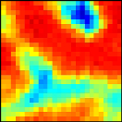
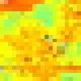
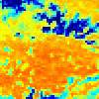

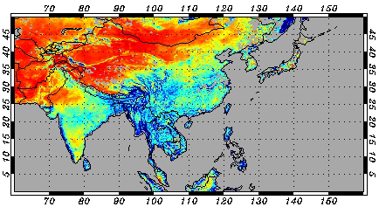
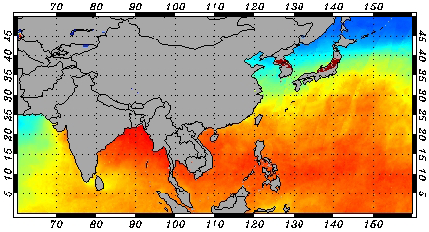
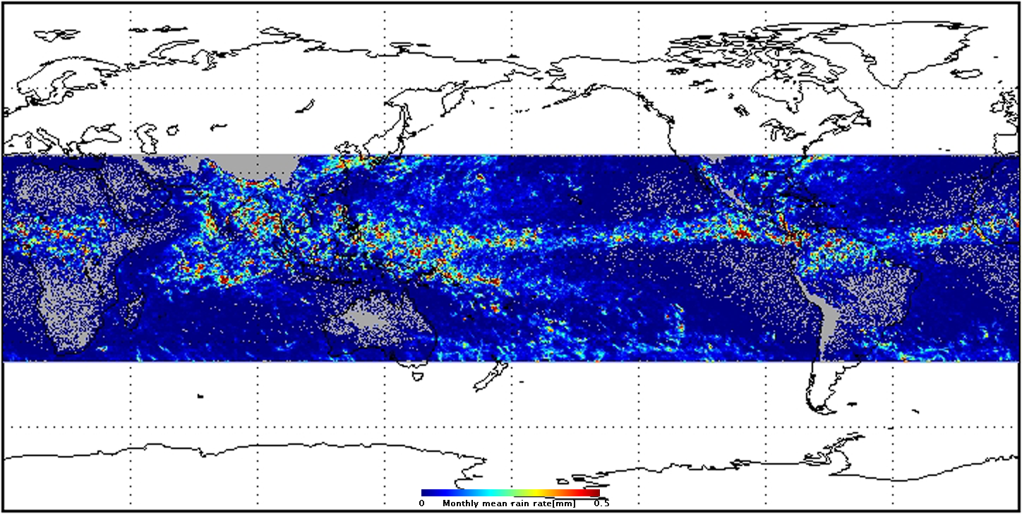
JAXA Satellite Datasets on DIAS http://www.editoria.u-tokyo.ac.jp/dias/link/portal/english_index.html
Three Scales
  250km rectangular covering each Reference Sites,
  Monsoon Regional
  Global Area
Product Levels
  Level-1b: Radiance product with full resolution at reference sites.
  Level-2: Geophysical product at the same resolution at reference sites and monsoon regions.
  Level-3: Statistical geophysical product in space and/or time at reference sites, monsoon regions and global. (example: Monthly mean rain rate at reference sites, etc.)
Metadata
  Consist of an image element and a metadata part element that is compliant with the ISO-19115 metadata standard.
Reference Sites
Monsoon Regional
Global Area

Slide 21
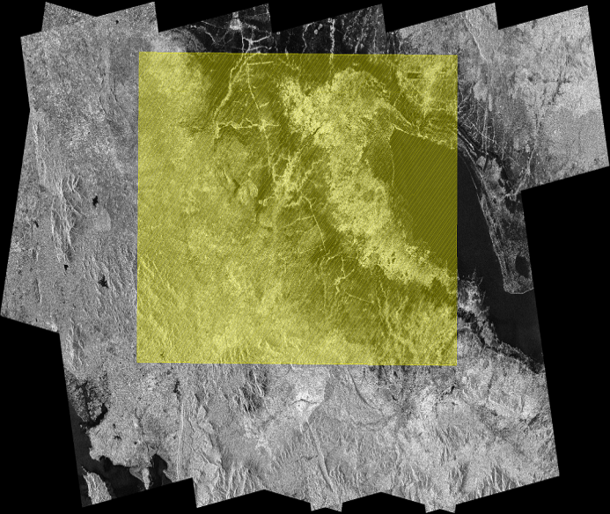
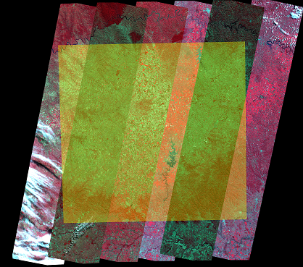
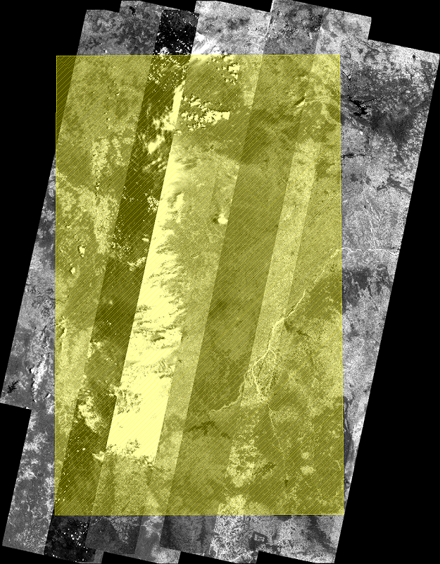
Daichi (ALOS) Path-Mosaics for CEOP
Produced with Level 1 products of three sensors: PRISM, AVNIR-2 and PALSAR
Associate with CEOP Reference Sites and AWCI River Basins
Path-mosaiced instead of subsets because of the original small scene size and the large data volumes
Seonath-river, India
PRISM
10 paths of Mosaic images
Sangker, Cambodia
PALSAR FBD(HH)
8 paths of mosaic images
Cruz Alta, Brazil
AVNIR-2 R:G:B=4:3:2band
6 paths of mosaic images

Slide 22
Number of Processed Scenes for CEOP
S/C | Sensor | EOP-3^{※1} | EOP-4^{※2} | 2007 | 2008 | 2009 | 2010 | Total
DMSP | SSMI | 53,780 | 66,885 | 76,303 | 65,492 | 45,000 | 26,371 | 333,831
Midori-II (ADEOS-II) | AMSR | 103,590 | - | - | - | - | - | 103,590
 | GLI | 114,550 | - | - | - | - | - | 114,550
TRMM | PR | 22,291 | 27,851 | 18,685 | 23,478 | 22,066 | 23,316 | 137,687
 | TMI | 49,793 | 62,385 | 49,503 | 58,575 | 58,414 | 58,452 | 337,122
Aqua | AMSR-E | 230,607 | 282,784 | 172,348 | 232,592 | 231,956 | 232,618 | 1,382,905
 | MODIS | - | 792,880 | - | - | - | - | 792,880
 | AIRS | 72,972 | 88,240 | - | - | - | - | 161,212
Daichi (ALOS) | PRISM | - | - | 504 | 1410 | 1,636 | 1,454 | 5,004
 | AVNIR-2 | - | - | 276 | 644 | 442 | 522 | 1,884
 | PALSAR | - | - | 698 | 1,437 | 1,120 | 1,082 | 4,337
Terra | MODIS | 614,407 | 791,403 | - | - | - | - | 1,405,810
^{※1} EOP-3: 2002/10/1 – 2003/9/30 ^{※2} EOP-4: 2003/10/1 – 2004/12/31 |  |  |  |  |  |  | Total | 4,780,812
Notes:
22

Slide 23






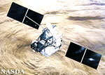
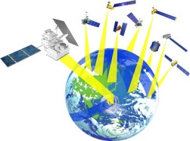


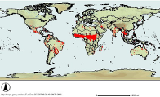
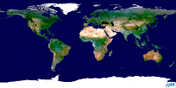







Cross-Cutting/Interdisciplinary
Science at JAXA/EORC
EarthCARE/CPR
ALOS
GOSAT
GCOM-W
GCOM-C
Aqua/
AMSR-E
GPM
TRMM
Data Sets
Other Satellites
Coordinated studies directly contribute to societal needs
MODIS
Disaster
Eco-system
Water Cycle
Climate
Modeling
NILIM
MLIT
PWRI
Universities
Research Organizations
GEO/GEOSS
For keep track of disaster status, improvement of prediction accuracy,
and from real-time analysis to long-term prediction of variabilities

Slide 24
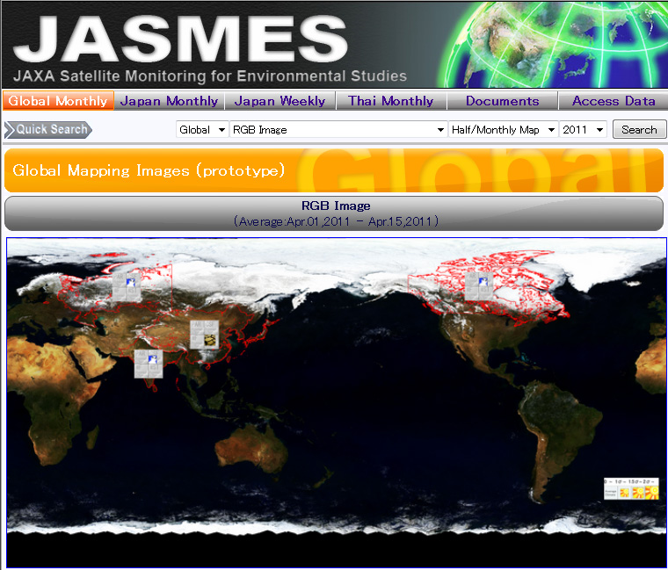
http://kuroshio.eorc.jaxa.jp/JASMES/index.html
Photosynthetically Available Radiation (PAR)
Snow Cover Extent (CSF)
Water Stress Trend (WST)
Wild Fire (WF)

Slide 25
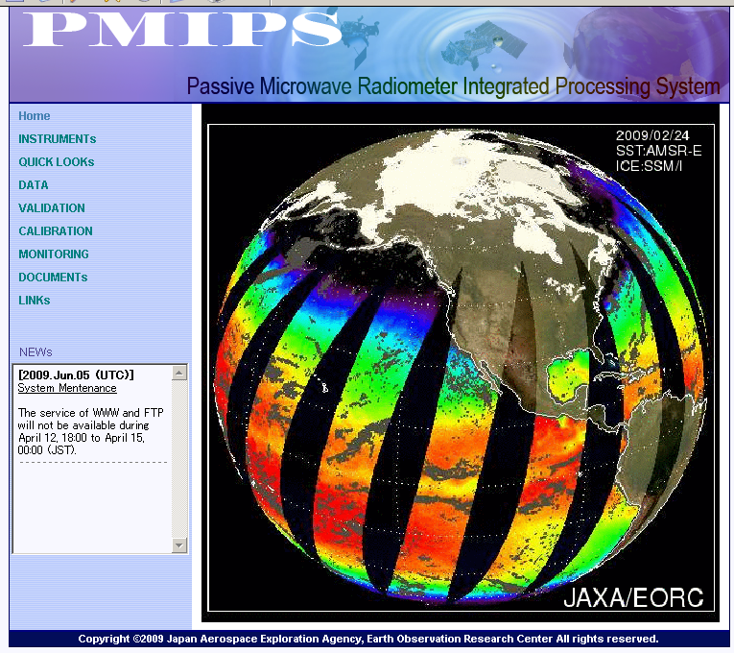
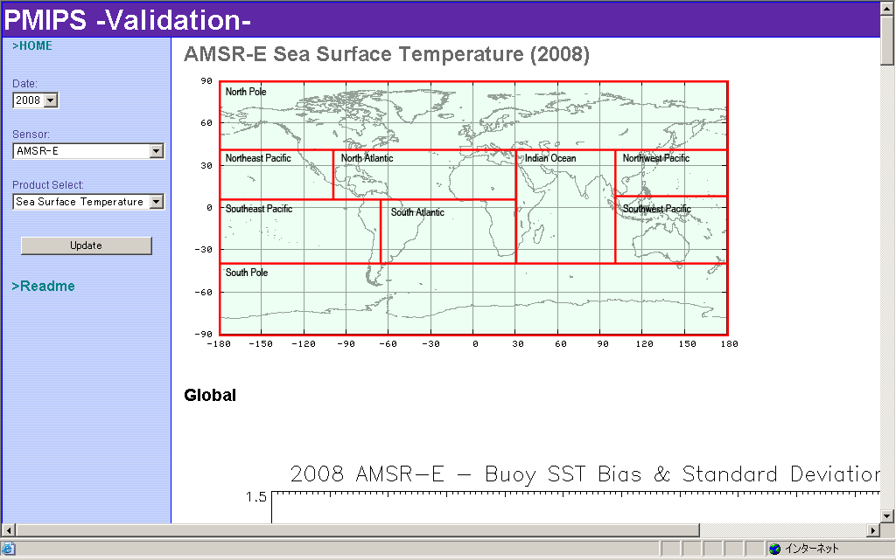
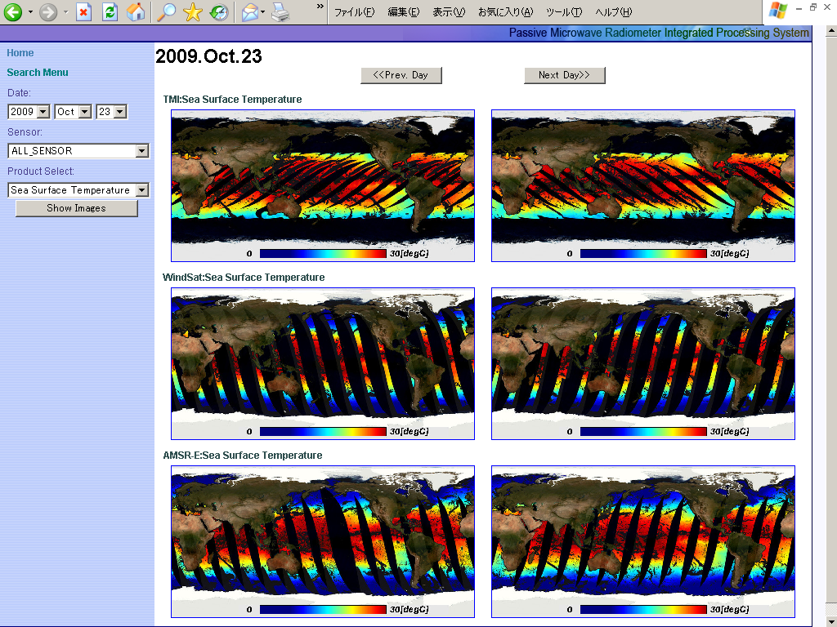
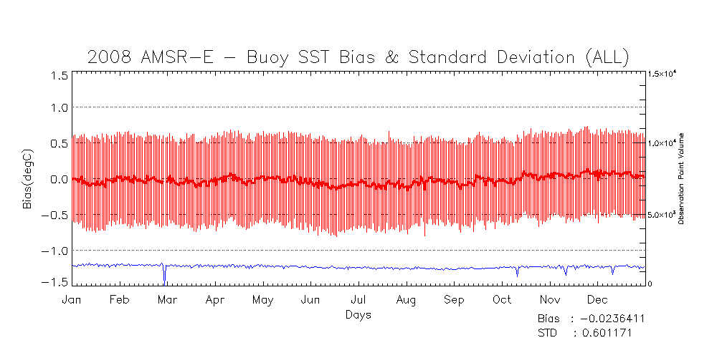
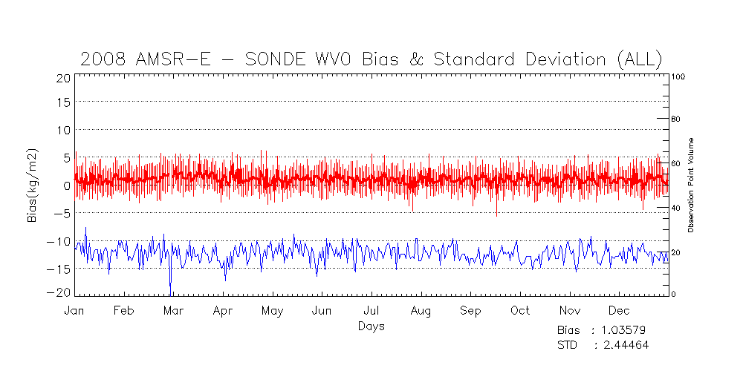
Multi-Radiometer Processing

Slide 26
Summary
JAXA have been developing, operating, and providing data for the atmospheric research, climate change science communities and user organizations.
'DAICHI' (ALOS) operation was stopped by power generation anomaly on April 22, 2011.
Forthcoming satellite missions dedicated and/or contribute to monitor the global hydrological cycles are ahead.
  GCOM-W1 will be launched in JFY 2011.
  GPM/DPR, EarthCARE/CPR will be launched in JFY 2013.
  GCOM-C1 will be launched in JFY2014
JAXA has been contributing to WCRP/GHP (former CEOP) by providing dedicated satellite datasets.
  Archived datasets are available via DIAS.
JAXA/EORC’s cross-cutting activities is going on.
  JASMES provides not only satellite datasets but also information on the current status of the climate.

