Slide 1
Recent activities on NWP and satellite data assimilation at JMA
Yoshiaki Sato (JMA/NPD)
and colleagues in JMA/NPD
The Eleventh Asia-Pacific Satellite Data Exchange and Utilization (APSDEU-11)
and The Twenty Third North-America Europe Data Exchange meeting(NAEDEX-23)
2-6 May 2011, Boulder, Colorado, USA

Slide 2
Contents
JMA NWP Systems
Updates
Developments
Super computer upgrades

Slide 3
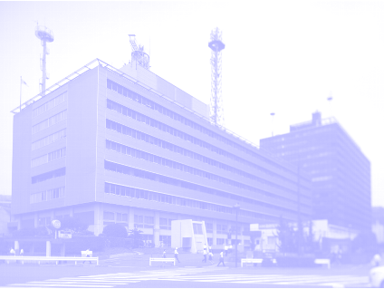
JMA NWP Systems
JMA HQ Building

Slide 4
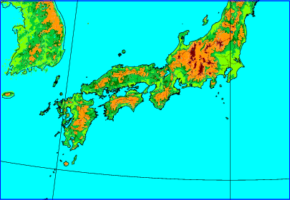
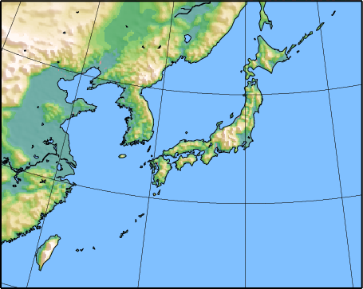

Current NWP models at JMA/NPD deterministic models only
GSM: Global Spectral Model
short- and medium-range forecast
TL959(0.1875deg.) / 60 Layers up to 0.1hPa
84-hours forecast at 00, 06, 18UTC,
216-hours forecast at 12UTC
MSM: MesoScale Model
Disaster reduction, short-range forecast
5km (3600x2880km) / 50 Layers up to 22km
15-hours forecast at 00,06,12,18UTC,
33-hours forecast at 03,09,15,21UTC
LFM: Local Forecast Model
Disaster prevention, Aviation forecast
2km (1600x1100km) / 50 Layers up to 21km
9-hours forecast at 00,03,06,09,12,15,18,21UTC
New!
But…
The LFM trial operation was started on Nov. 2010, However the operation was stopped on Mar. 2011. And the operation schedule is under consideration.

Slide 5
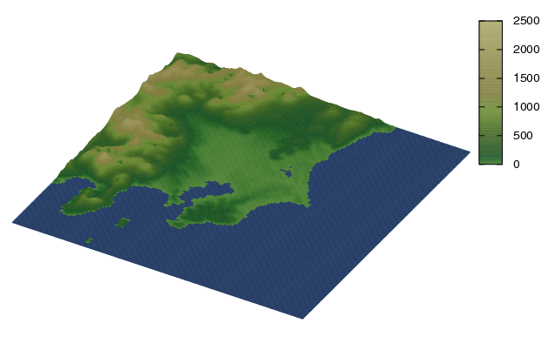
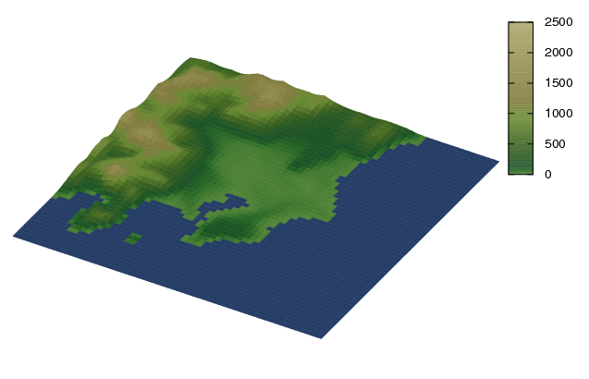
Development of Local NWP System
Official operation will be started in 2012
Planned specification
  Horizontal resolution is 2km
  60 vertical layers
  Three-hourly 9 hours forecast
System enhancement is planned in 2013
  Hourly 9 hours forecast
  Model domain extension to cover Japan
Purpose of the operation
  Very short range dynamical forecast
    To predict heavy rain
  Airport weather forecast
    To predict local phenomena, such as sudden change of the wind direction.
TBD
LFM(2km)
MSM(5km)
5

Slide 6
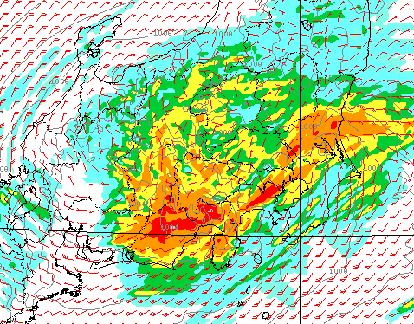
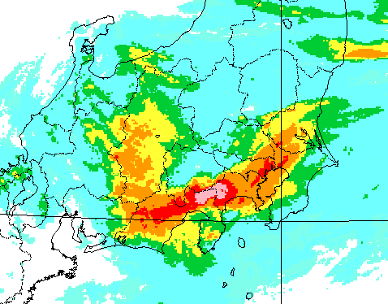
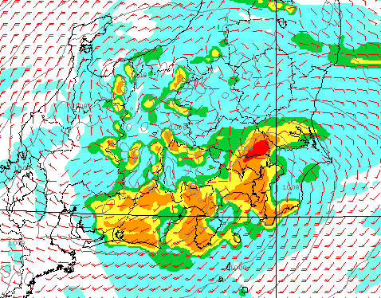
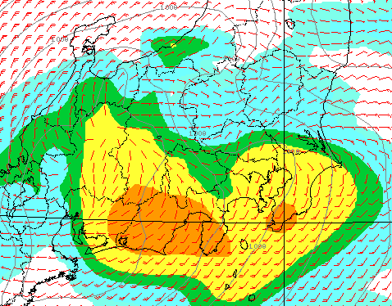
Sample case of LFM forecast
LFM(2km): 107mm/3hr
OBS(2km): 240mm/3hr
MSM(5km): 69mm/3hr
GSM(20km): 35mm/3hr

Slide 7
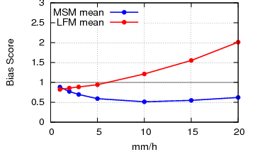
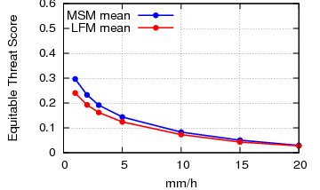
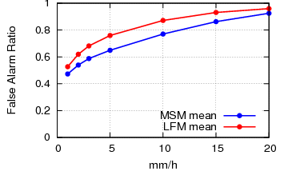
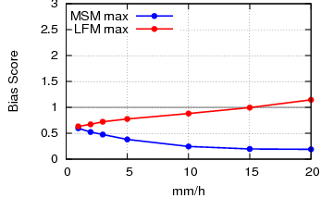
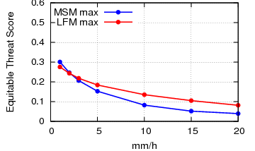
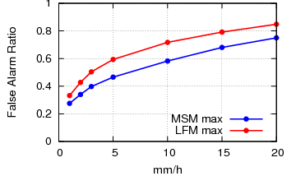
Rainfall Verification of LFM
Rain forecast characteristics of LFM in summer
  20km grid average: The larger bias in the larger threshold
  20km grid max.: The smaller bias than MSM
  The larger False Alert Ratio (FAR)
MSM/LFM
Bias
ETS
FAR
Grid average
Grid max.

Slide 8
Current DA systems at JMA/NPD
GA: Global Analysis (4DVAR)
Model resolution: Outer: TL959 / Inner: T159
Data cut off time
for Early Analysis: +2h20m
for Cycle Analysis: +11h35m(00,12), 5h35m(06,18)
Assimilation Window: -3h to +3h
MA: Mesoscale Analysis (4DVAR)
Model resolution: Outer: 5km / Inner: 15km
Data cut off time: +50min.
Assimilation Window: -3h to Analysis time
LA: Local Analysis (3DVAR Rapid Update Cycle)
Resolution: 5km
Data cut off time: +30min.
Assimilation Window: -30min. to +30min.
New!
But…
The LA trial operation was started on Nov. 2010, However the operation was stopped on Mar. 2011. And the operation schedule is under consideration.

Slide 9
Operation of GSM/MSM
Ma00
Meso Analysis
For Global Analysis,
We have two systems:
Early Analysis (EA)
for weather forecast
Cycle Analysis (DA)
for the better analysis
Meso Analysis (MA)
is mostly independent of the Global systems,
except for the boundary condition
and bias the correction coefficients.
Ma21
Ef18(~FT84)
Ef00(~FT84)
00
Ea00
Ma03
Ea18
Da18
Early Analysis
Boundary Condition
Da12
Ma18
Cycle Analysis
18
06
Data Cutoff Time
Da00/12: 11^{h}35^{m}
Da06/18: 05^{h}35^{m}
Ea: 2^{h}20^{m}
Ma: 0^{h}50^{m}
Ma06
Da00
Da06
Ea06
Ma15
12
Ea12
Ef06(~FT84)
Ef12(~FT216)
Ma09
Ma12

Slide 10
Local Analysis
Specifications
  Horizontal resolution is 5km, 50 vertical layers
  Model domain: 2000km x 1500km (400x300grid)
  Analysis time: 00,03,06,09,12,15,18,21（UTC）
    hourly observation is assimilated
  Observation cut off time is 30 minutes (Very Short!)
  Data assimilation method: 3D-Var by Rapid Update Cycle (RUC)
  Assimilated observations:
    AWS (AMeDAS)
    Aircraft observations
    WPR (Wind profiler)
    Doppler velocity
    Ground based GPS IPW
      Under development: radar reflectivity
18
21
22
23
00
03
06
09ＵＴＣ
Operational MSM forecast
First Guess
3DVAR
3DVAR
3DVAR
3DVAR
Analysis
MSM
MSM
MSM
LFM
Boundary
Operational MSM forecast

Slide 11
Observations assimilated at JMA
Will be assimilated near future.
Radiance assimilation in MA was started in the last year.
M
G: GA
M: MA
L: LA

Slide 12
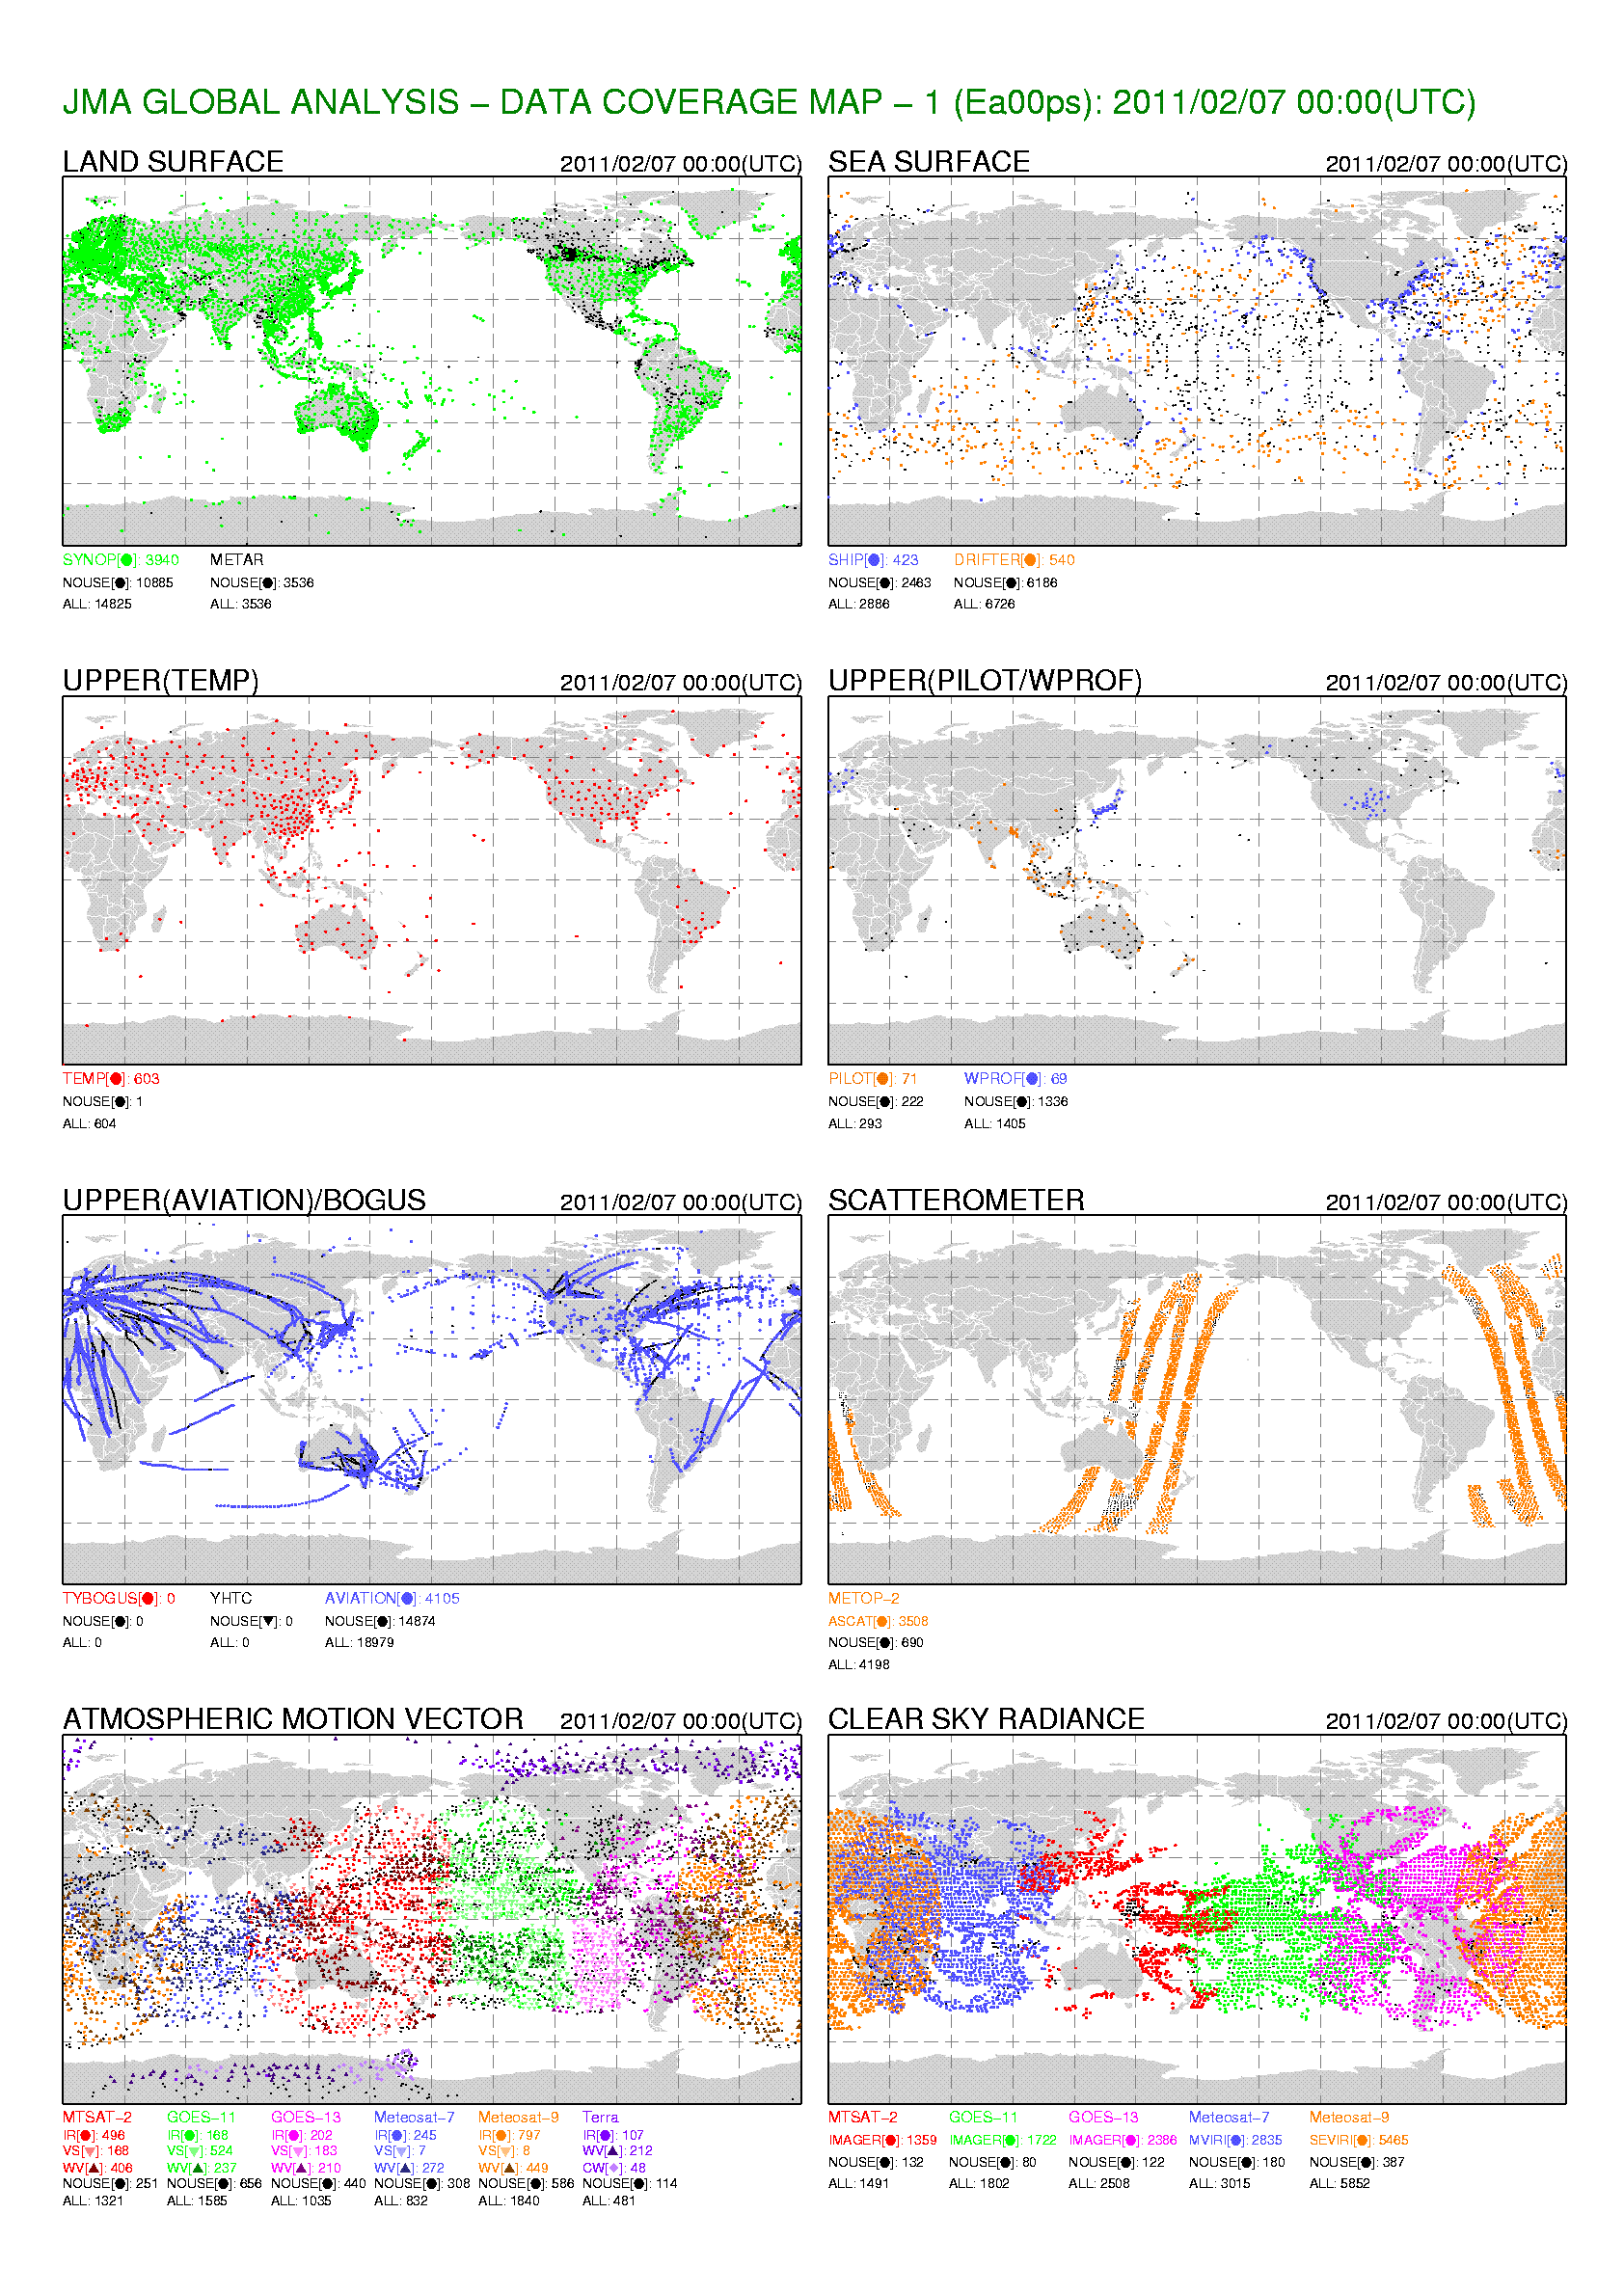
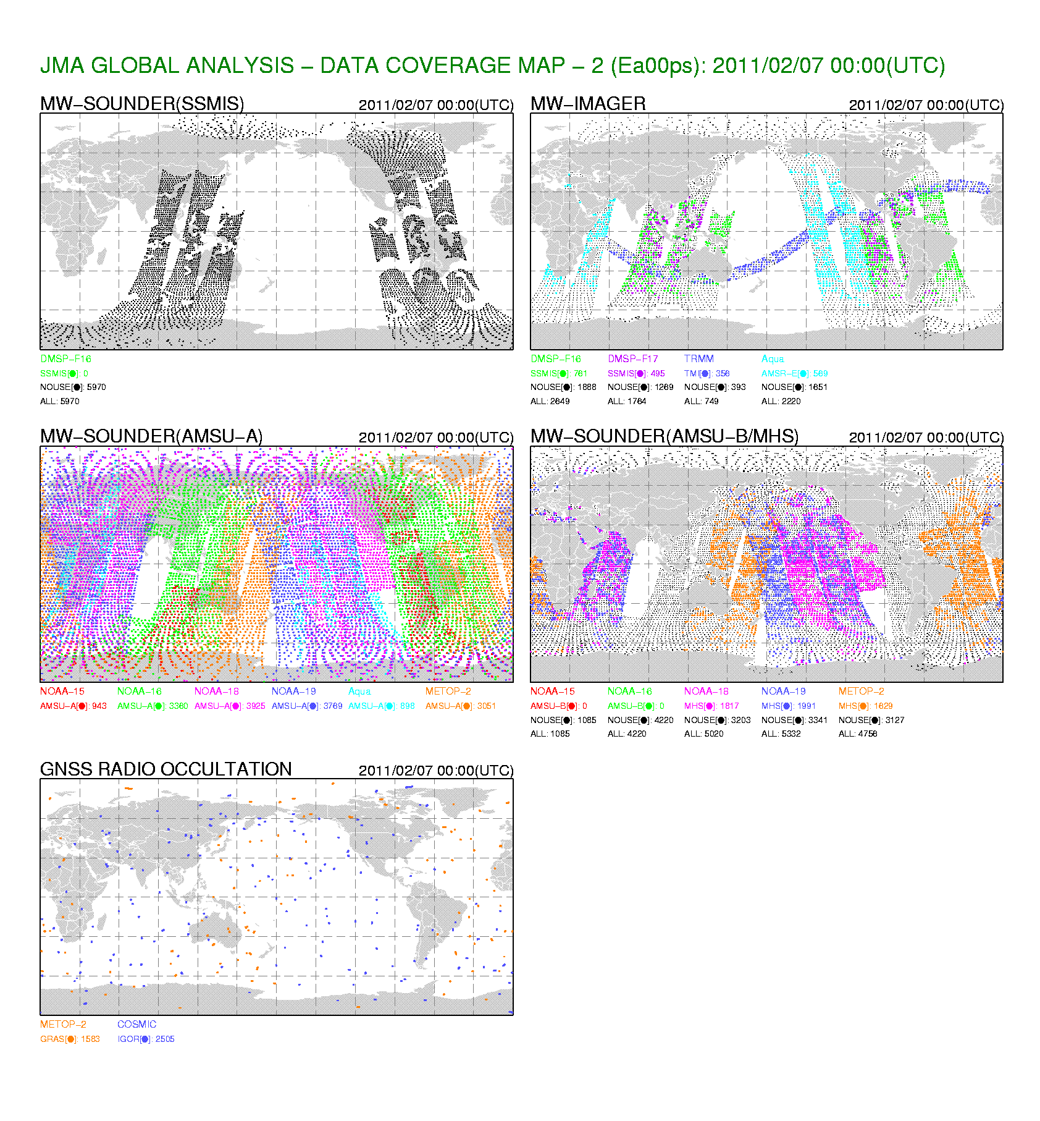
Coverage Map (Early Analysis)
SYNOP:N=14825
SHIP:N=2888
BUOY:N=6726
ALL:N=5970
ALL:N=11805
TEMP:N=604
PILOT:N=293
WPROF:N=1405
ALL:N=15944
ALL:N=20415
AVIA:N=18979
ASCAT:N=4198
ALL:N=4088
ALL:N=7094
ALL:N=14668

Slide 13
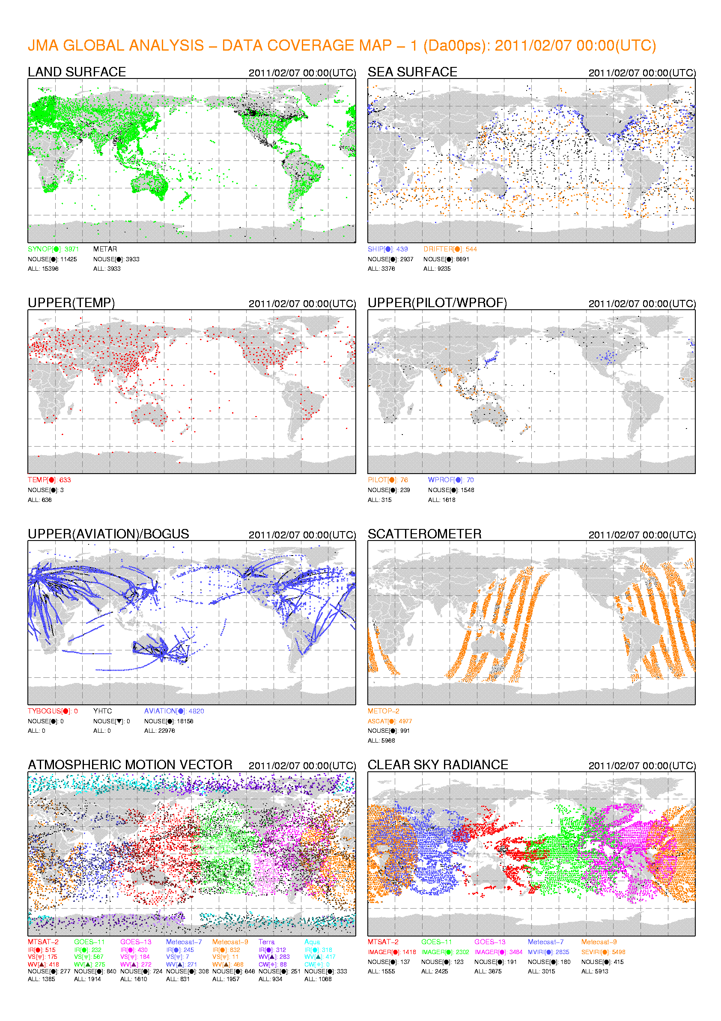
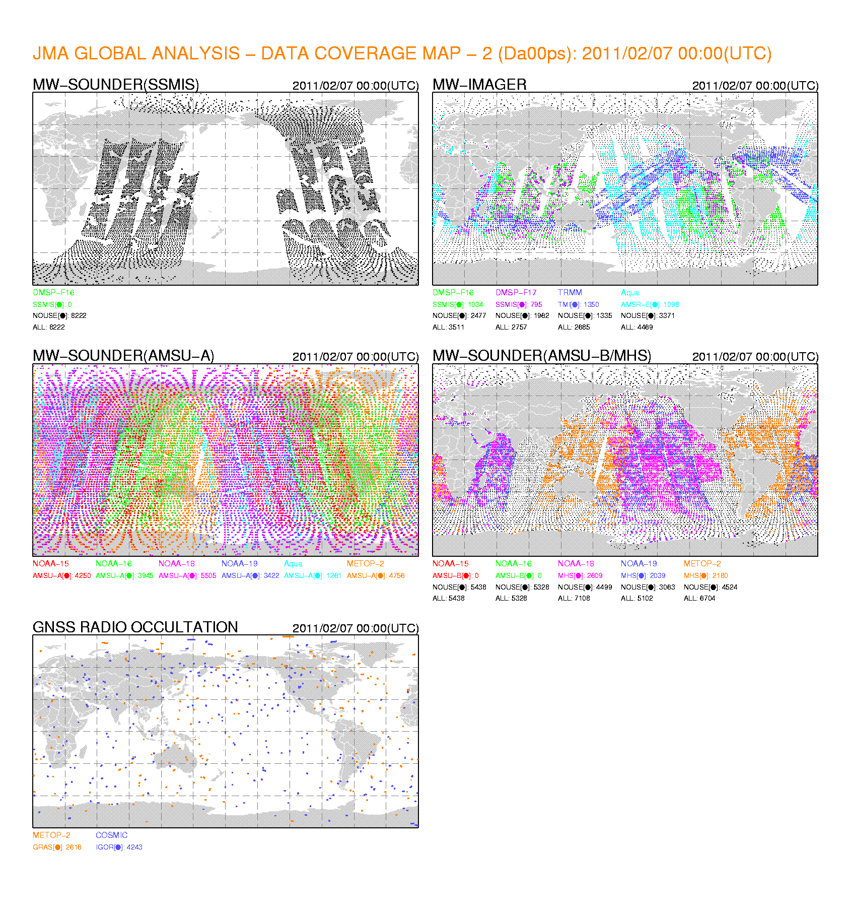
Coverage Map (Cycle Analysis)
SYNOP:N=15396’(+4%)
SHIP:N=3378(+17%)
BUOY:N=9235(+37%)
ALL:N=8222(+38%)
ALL:N=13642(+30%)
TEMP:N=636(+5%)
PILOT:N=315(+8%)
WPROF:N=1618(+15%)
ALL:N=23141(+45%)
ALL:N=29680(+45%)
AVIA:N=22976(+25%)
ASCAT:N=5968(+42%)
ALL:N=6859(+68%)
With the longer waiting time in DA, the available data number is much larger than
the one in EA ! (Total+30%)
ALL:N=9719(+37%)
ALL:N=16783(+15%)

Slide 14
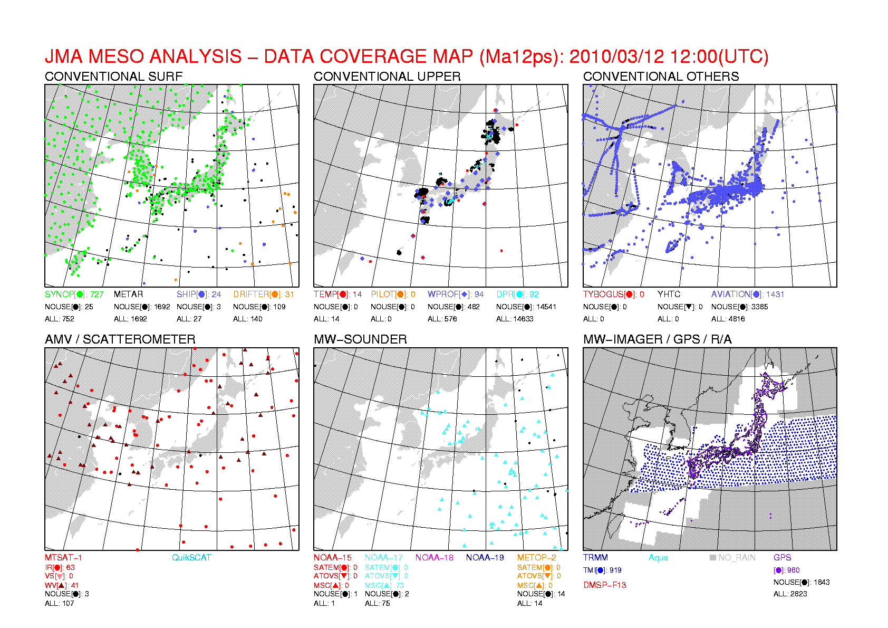
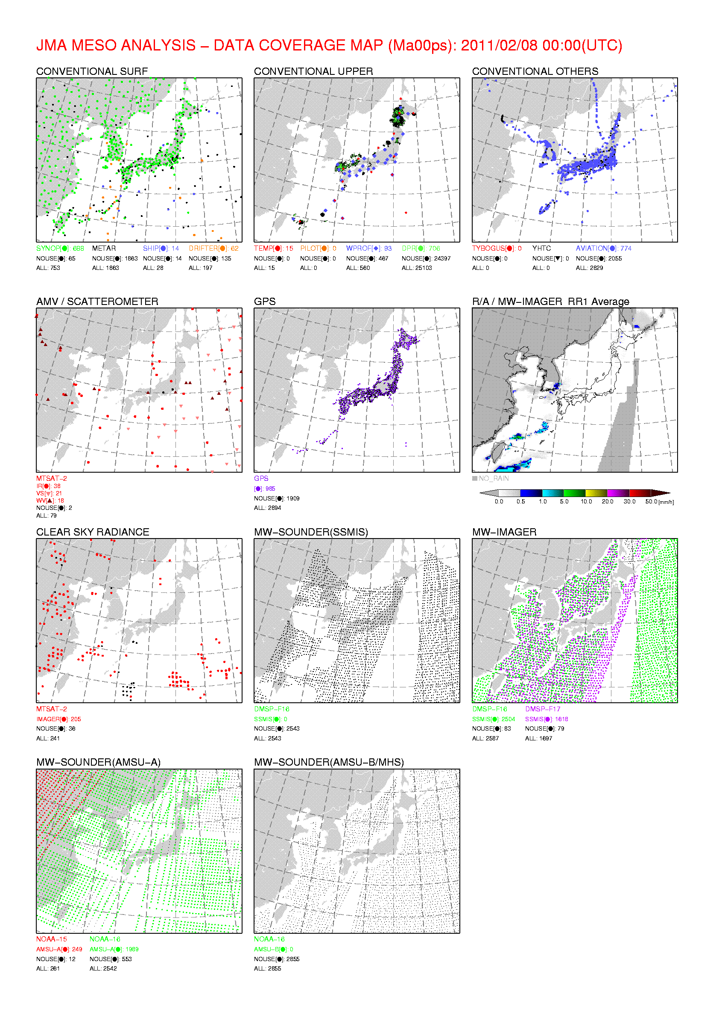
Coverage Map (Meso-scale Analysis)
Before Dec. 2010
(retrieval assimilation)
After Dec. 2010
(radiance assimilation)

Slide 15
Updates in JMA data assimilation after Feb 2010
(G) Typhoon bogus scheme upgrade (Apr. 2010)
  Bogus number adjustment function was introduced
(G) Introduction of GOES-13/CSR, AMV (May 2010)
  as replacement of GOES-12/CSR,AMV
(G) introduction of Brazilian RARS data (May 2010)
(G,M) Introduction of MTSAT-2/CSR, AMV (Aug. 2010)
  as replacement of MTSAT-1R/CSR,AMV
(M) Introduction of Variational Quality Control (Sep. 2010)
(M) Typhoon bogus scheme upgrade (Sep. 2010)
  Bogus number adjustment function was introduced
(M) Addition of Doppler Velocity data (Oct. 2010)
  Four radar sites: Hiroshima, Ishigakijima, Fukui, Osaka

Slide 16
Updates in JMA data assimilation after Feb 2010
(G) Introduction of COSMIC refractivity data (Nov. 2010)
(G) Improvement on AMSU-A data usage (Nov. 2010)
  Channels 6, 7, 8 data are now assimilated over coastal area.
(M) Introduction of radiance data assimilation (Dec. 2010)
  As replacement of Temperature and IPW retrievals
  AMSU-[AB], SSMIS, AMSR-E, TMI, CSR
(G) improvement on MODIS AMV usage (Feb. 2011)
  DB MODIS AMV and NESDIS MODIS AMV are now assimilated.
(G,M) Introduction of Metop direct receiving AMSU-[AB] data (Feb. 2011)

Slide 17
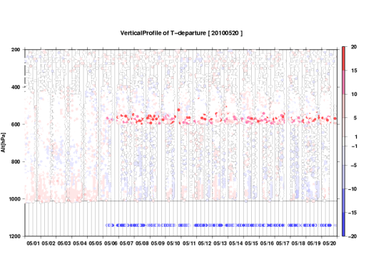
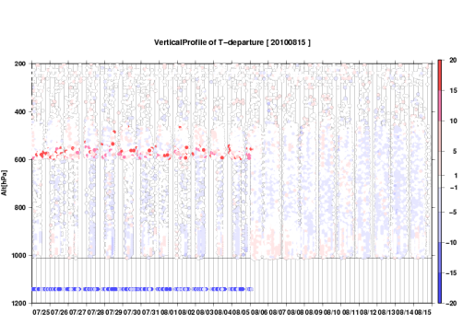
Quality Control Issues
Low quality data contamination
  (G,M) Korean AMDAR data assimilation was stopped between May and September, 2010
Stop using the data (quality degrade)
  (G) NOAA-15/AMSU-B (Sep. 2010)
  (M) NOAA-17/HIRS (Oct. 2010), Note that ATOVS retrievals are assimilated “BEFORE” Dec. 2010
  (G) DMSP-F16/SSMIS sounding channels (Oct. 2010)
  (G,M) Aqua/AMSU-A/ch5, Feb. 2011
5th May
5th Aug.
Large O-B data were found
RMSE sequence
Aqua/AMSU-A/ch5
NOAA-18/AMSU-A/ch5
17

Slide 18
Satellite data assimilation status
[]: under investigation
Satellite/Instrument |  | GA | MA | LA
1. MW Sounder | NOAA15,16,18,19/AMSU-A | Radiance | Radiance | [Radiance]
 | NOAA16,18,19/AMSU-B,MHS | Radiance | Radiance | [Radiance]
 | Aqua/AMSU-A | Radiance | Radiance | [Radiance]
 | Metop-A/AMSU-A,MHS | Radiance | Radiance | [Radiance]
 | DMSP-F18/SSMIS | [Radiance] | [Radiance] | [Radiance]
2. IR Sounder | Aqua/AIRS | [Radiance] | [Radiance] | [Radiance]
 | Metop/IASI | [Radiance] | [Radiance] | [Radiance]
3. MW Imager | TRMM/TMI | Radiance | Radiance, Rain Rate | [Radiance]
 | Aqua/AMSR-E | Radiance | Radiance, Rain Rate | [Radiance]
 | DMSP-F16,17/SSMIS | Radiance | Radiance, Rain Rate | [Radiance]
 | DMSP-F18/SSMIS | [Radiance] | [Radiance, Rain Rate] | [Radiance]
4. VIS/IR Imager | MTSAT-2 | CSR, AMV | CSR, AMV | [CSR], [AMV]
 | GOES-11,13 | CSR, AMV | - | -
 | Meteosat-7,9 | CSR, AMV | - | -
 | NOAA/AVHRR | [AMV] | - | -
 | Aqua,Terra/MODIS | AMV | - | -
5. Scatterometer | Metop-A/ASCAT | OSWV | [OSWV] | [OSWV]
 | Oceansat-2/SCAT | [OSWV] | [OSWV] | [OSWV]
6. GPS-RO | GRACE/Blackjack | [Refractivity] | (Under development) | (Under development)
 | Metop-A/GRAS | Refractivity
 | TerraSAR-X/IGOR | [Refractivity]
 | COSMIC/IGOR | Refractivity
CSR: Clear Sky Radiance on water vapor channels, AMV: Atmospheric Motion Vector,
OSWV: Ocean Surface Wind Vectors, IPW: Integrated Precipitable Water Vapor
GPS-RO: Global Positioning System – Radio Occultation

Slide 19

Updates
Hodo-san mountain shrine in Saitama

Slide 20
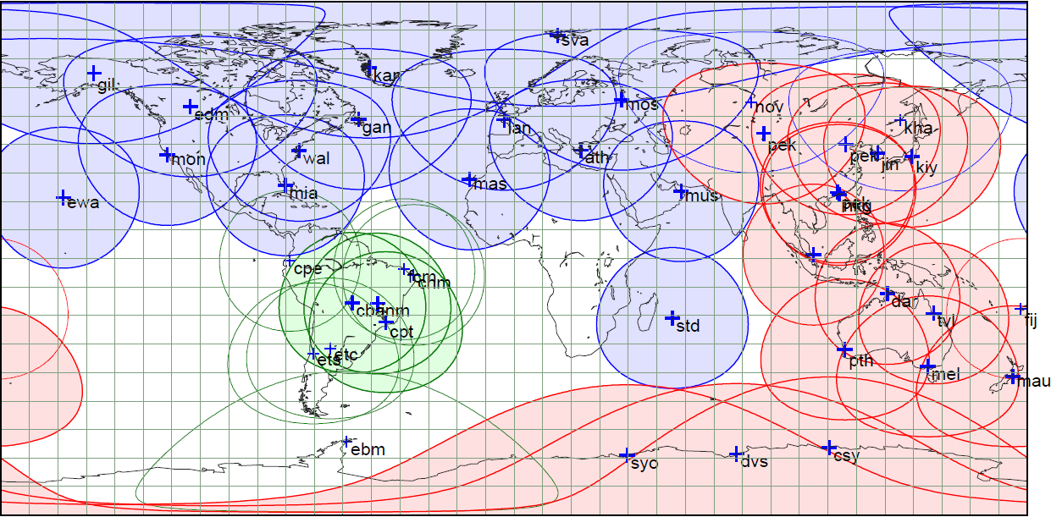
Assimilated RARS sites
AP-RARS data assimilation: started on 22 Feb. 2007
EARS data assimilation: started on 2 Aug. 2007
SA-RARS data assimilation: started on 18 May 2010
  The data are received via GTS through Washington.

Slide 21
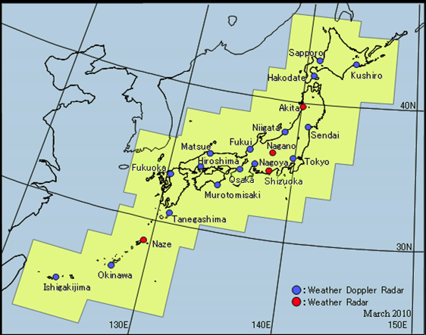
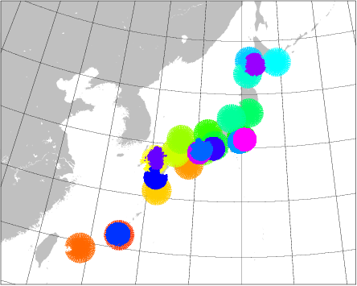
Doppler Radar Sites (Y. Ishikawa)
Radial velocity observation function was added to some radar sites. The data are additionally ingested in MA.
◆
shin-
chitose
fukuoka
◆
◆
◆
◆
osaka
kansai
narita
haneda
Assimilated Radial Velocities,
accumulated between
18UTC 22nd and 21UTC 23rd April, 2011
Observation Range of DRAWs
is smaller than WDRs.
(R=120km/150km)
◆
◆
◆
chubu
kagoshima
naha
◆
: Doppler Radar for Airport Weather

Slide 22
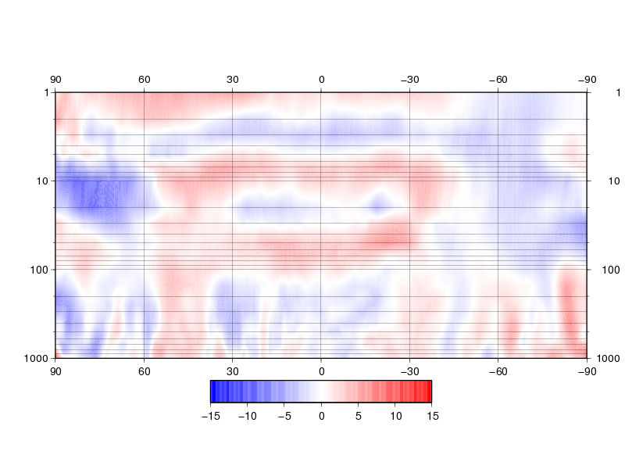
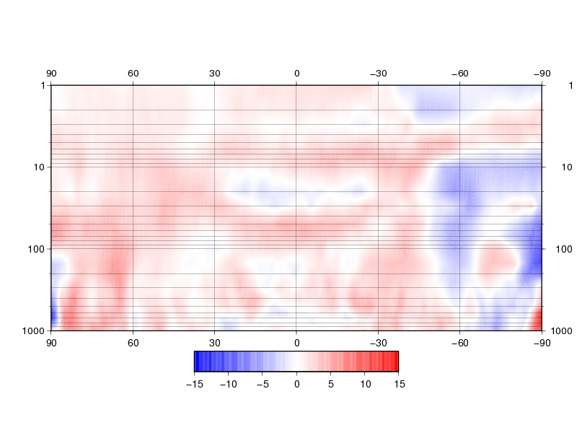
COSMIC data assimilation (E. Ozawa)
The bias corrected refractivity data are assimilated.
Pre-operational impact test results
  Zonal mean improvement rate for 72hrs GPH forecast
    Improvement rate: (RMSE_{cntl}-RMSE_{test})/RMSE_{cntl}
Aug., 2009
Jan., 2009
Height [hPa]
NH
SH
NH
SH
Red: Test is Better / Blue: Test is Worse

Slide 23
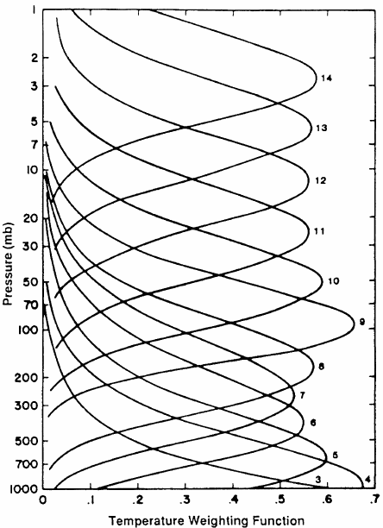
AMSU-A data usage (H. Murata)
Each line shows the sensitivity functions for each channels in AMSU-A.
With some reasons,
We did not use the lower channels’ data over the coast. But we found it brought positive impact !
used over the Clear Sky Ocean
used over the land
used over the coast
ch8
These channels’ data are included in this modification.
ch7
ch6

Slide 24
“Coast” data distribution
The data numbers over “land” and “coast” are almost same !
because there are many inland lakes in the world.
coast
19%
clear ocean
41%
land
19%
Sea Ice
Rainy
ocean
cloudy
ocean

Slide 25
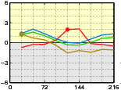
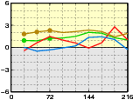
Z500 RMSE improvement rate
OSE for this issue.
  Cntl: same as the past routine,
  Test: use the lower channels over the coast
improvement rate : (RMSE_{cntl}-RMSE_{test})/RMSE_{cntl}
  against the own initial conditions
  The result show the positive impact mostly.
Summer Test
Winter Test
Better

Slide 26
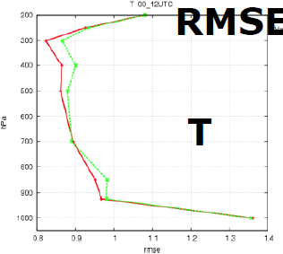
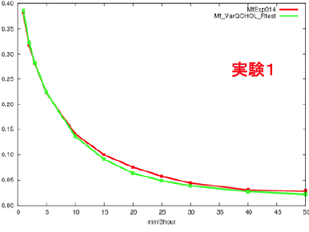
Radiance assimilation in MA
(M. Kazumori)
Satellite radiance assimilation system was developed
  Preprocessor is the same module as the one used in GA.
  Data thinning interval is 45km.
  Above the model top, T and Q profiles are extrapolated.
  Employed RTM is RTTOV9.3.
  Bias correction coefficients are taken from GA.
Data usage
  ATOVS-T and MWR-PW are unused.
  ATOVS-Radiance, MWR-Radiance, SSMIS-Radiance, MTSAT/CSR are used.
The impacts
  RMSE on temperature analysis against sonde is reduced.
  ETS against radar estimated rainfall data is improved mostly
This system was introduced into operation in Dec. 2010
ETS
EXP1

Slide 27
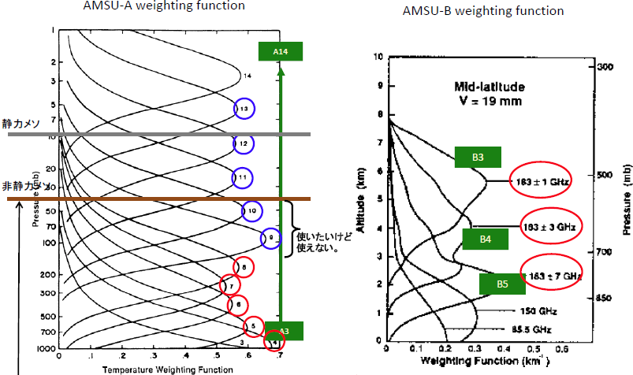
The model top issue
MSM4D-Var
MSM4DVAR
These data cannot be used because of the model top issue !
The model top is around 40hPa.
Channel 9 and 10 is not available because the weighting function shows the sensitivity extends to the higher levels.
O: The channel is used in Global Analysis and Meso-scale Analysis
O: The channel is used in Global Analysis only.

Slide 28
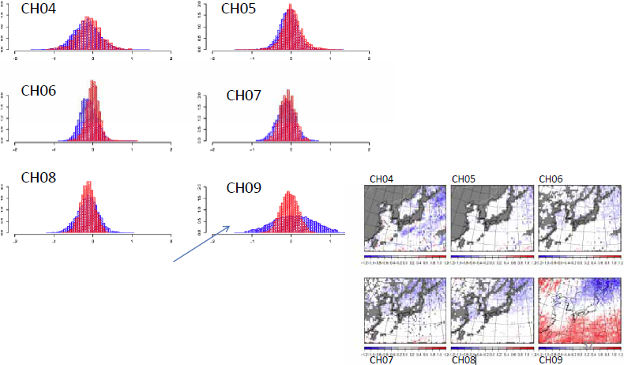
Sample of the O-B histogram
Red: GA, Blue : MA
O-B: Observation – Background
Background: The first guess
Averaged O-B, Oct. 2010
The histogram pattern is almost same in the channels 4-8. But the error in MA is much larger than GA in the channel 9. The cause is the model top height.
We are requesting to the MSM developers to raise up the model top.

Slide 29
Start using MODIS DB Winds and NESDIS Winds
It makes the data coverage wider especially in the Early Analysis.
And the data thinning intervals are modified.
CIMSS（Rtn）
CIMSS DB
Old
New
NESDIS

Slide 30
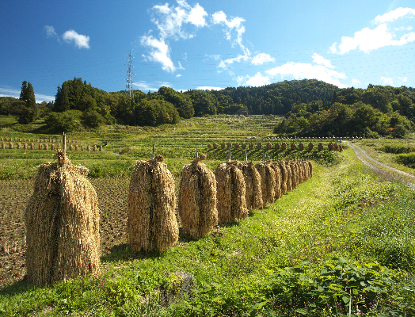
Developments
A country side of Tohoku Area

Slide 31
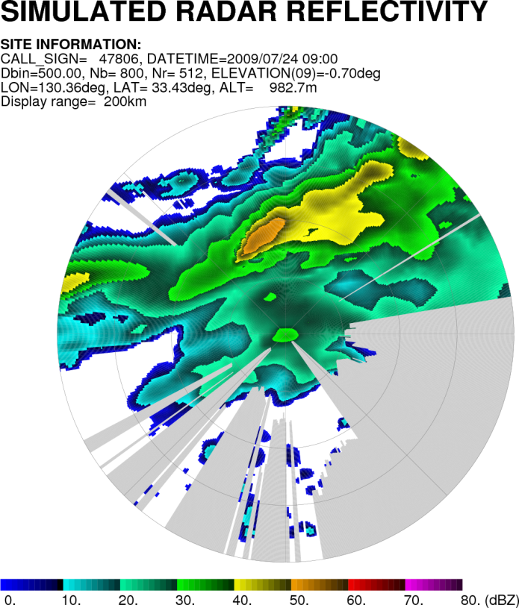
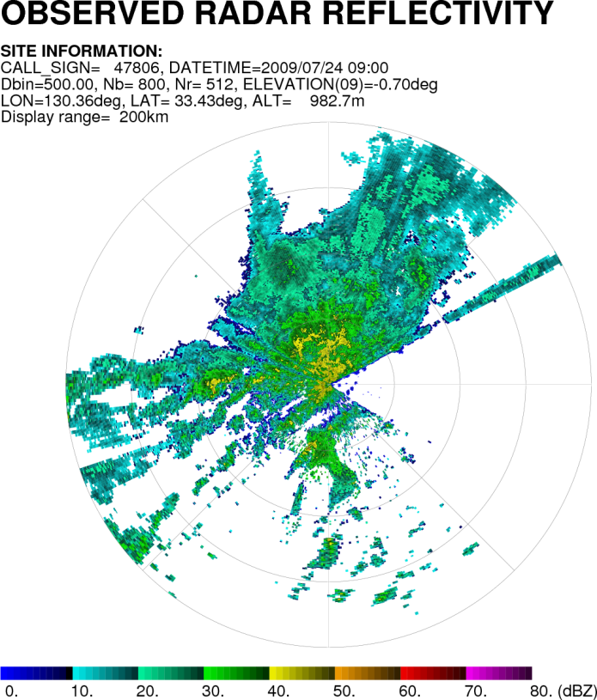
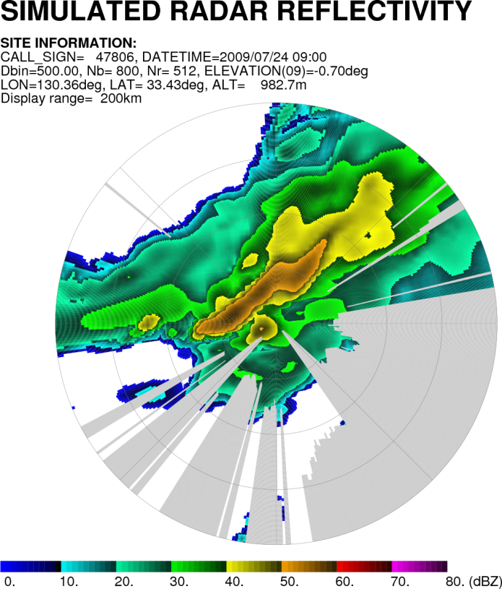
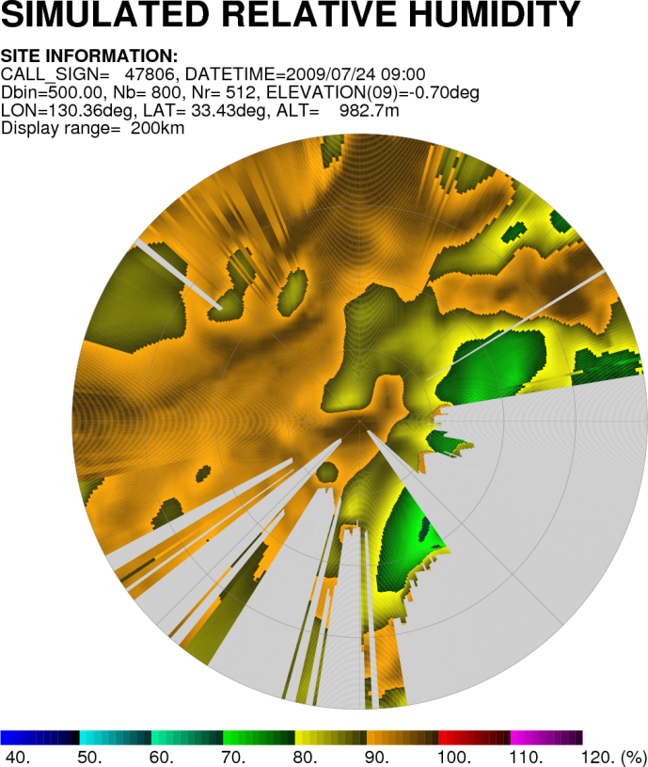
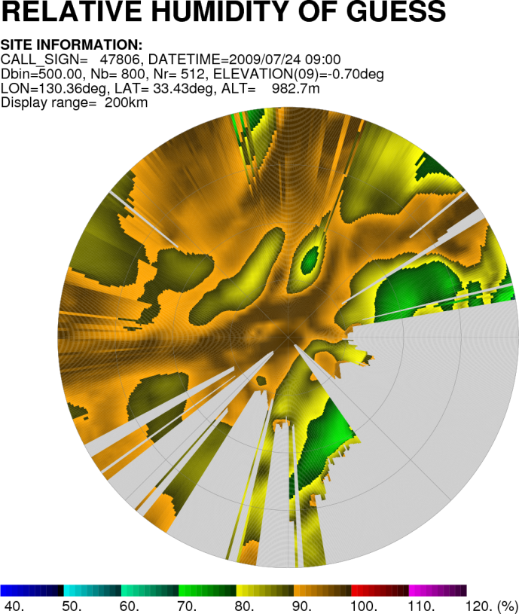
Radar Reflectivity (Y.Ikuta)
We have a plan to start assimilation of the pseudo-RH data retrieved from 3D radar reflectivity by Bayesian method near future.
The First Guess
Observation
The Analysis
Pseudo-RH assimilation
The echo position was relocated appropriately!

Slide 32
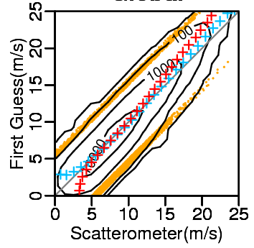
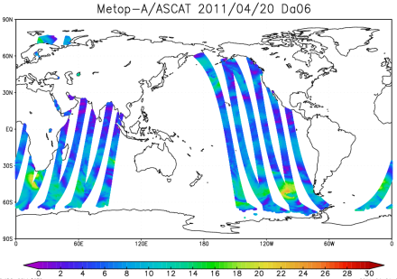
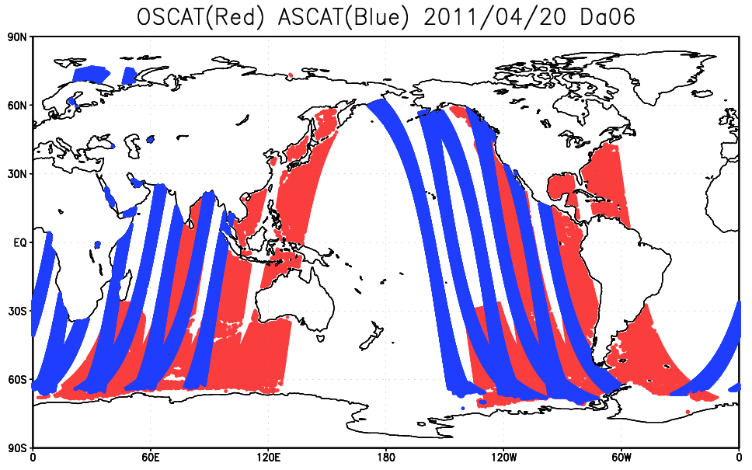
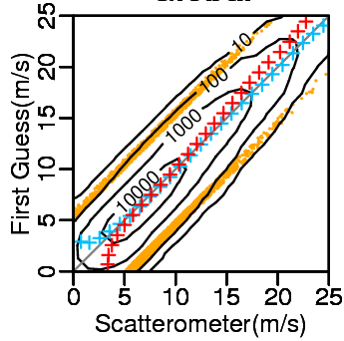
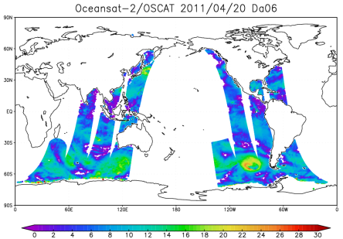
Scatterometer (M. Takahashi)
ASCAT data are assimilated operationally in GA,
  only under 15m/s because of the wind speed bias
  Use of NESDIS winds is under investigation.
  The assimilation in MA is also investigated.
Oceansat-2/SCAT
  Just start checking the data.
KNMI Winds
NESDIS Winds

Slide 33
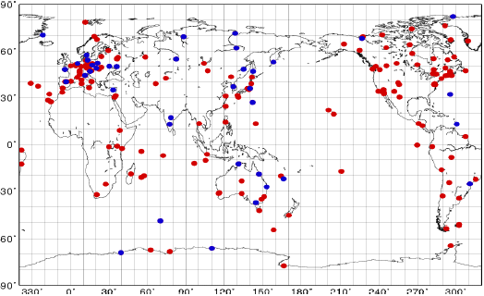
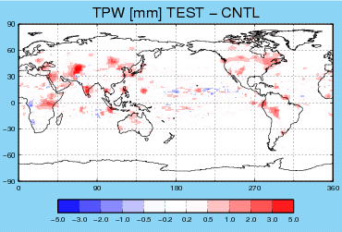
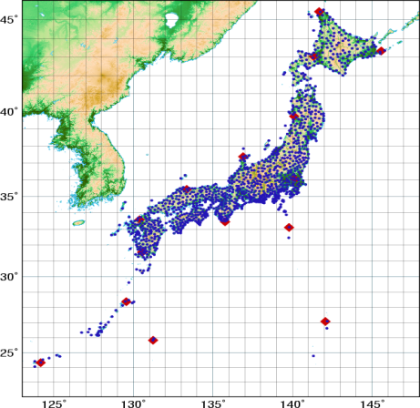
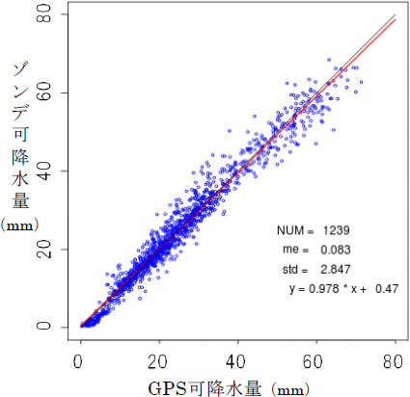

Ground-based GPS (K. Yoshimoto)
In Japan, GEONET (operated by The Geospatial Information Authority of Japan) data are used for IPW retrievals.
  And the IPW data are assimilated in MA.
IGS (International GNSS Service) data are investigated for GA.
IGS sites
Better
Global, NH, SH, TR
Sonde-IPW
GEONET sites
Preliminary Test
Improvement Rate
for GPH forecast
IGS-IPW

Slide 34


LEOGEO-AMVs (M. Kazumori and K. Yamashita)
Just start getting LEOGEO-AMVs from Wisconsin Univ. It can complement the data blank between the GEO AMVs and the polar AMVs
Operationally assimilated AMVs
Addition of LEOGEO AMVs

Slide 35

Super Computer Upgrade
Tokyo station in Autumn

Slide 36

JMA HPC upgrade
Upgrade “was” planned on March 2012
  The schedule must be changed later…
Machine: HITACHI next SR series
  Peak performance: 829.4TFLOPS
    2 sub-systems: 414.7TFLOPS x 2
      Operation + Backup (Model Development)
    Memory: 108TB
    High-speed Storage: 348TB
    Data Storage: 3.7PB + Tape Library
?

Slide 37
Current NWP model upgrade plan #1/2
Model |  | Current | Planned
GSM Global Spectral Model | Resolution | TL959L60 | TL959L100
 | Initial time | 00,06,12,18UTC | ->
 | Forecast period | 216hour for 12utc 84hour for else | ->
 | Assimilation | 4DVAR | 4DVAR
WEPS One-Week Ensemble Prediction System | Resolution | TL319L60 | TL479L100
 | Initial time | 12UTC | 00,12UTC
 | Member | 51 | 27 x 2
 | Forecast period | 216hour | 432hour(13member) 216hour(14member)
TEPS Typhoon Ensemble Prediction System | Resolution | TL319L60 | TL479L100
 | Initial time | 00,06,12,18UTC | ->
 | Member | 11 | 25
 | Forecast period | 132hour | ->

Slide 38
Current NWP model upgrade plan #2/2
Model |  | Current | Planned
MSM Meso Scale Model | Resolution | 5km(721x577x50) | 5km(817x661x75)
 | Initial time | 00,03,06,09, 12,15,18,21UTC | ->
 | Forecast period | 15hour for 00,06,12,18UTC 33hour for 03,09,15,21UTC | 36hour
 | Analysis | 4DVAR | 4DVAR
LFM Local Forecast Model | Resolution | 2km(800x550x60) | 2km(1581x1301x60)
 | Initial time | 00,03,06,09, 12,15,18,21UTC | Hourly
 | Forecast period | 9hour | ->
 | Assimilation | 3DVAR | 3DVAR
MEPS Meso Ensemble Prediction System | Resolution | - | 10km(409x331x60) (TBD)
 | Initial time | - | 00,06,12,18UTC
 | Member | - | 5 (TBD)
 | Forecast period | - | 39hour

Slide 39

Thanks for your Attention
A rainbow observed near meteorological satellite center of JMA in 23rd April 2011

