Slide 1
JAXA Earth Observation Satellite Programs associated with APSDEU
Kazuo Umezawa
JAXA/EORC
22-26 October 2012, APSDEU-12/ NAEDEX-24 Meeting
Met Office, Exeter, U.K.
Notes:
My talk is titled “JAXA Earth Observation Satellite Programs associated with GEWEX”.
In this presentation, I will talk about not only the status of the satellite programs but also related activities especially associated GEWEX.
Namely, it includes JAXA’s contribution to CEOP by producing satellite datasets, and EORC crosscutting, interdisciplinary science.
1

Slide 2







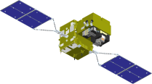


Long-Term Plan of
Earth Observation by JAXA
Targets | ~2005 | 2006 | 2007 | 2008 | 2009 | 2010 | 2011 | 2012 | 2013 | 2014 | 2015 | 2016 | 2017 | 2018
Disasters & Resources | [Optical radiometer] MOS-1, ADEOS (87~95) (96~97) [Optical sensor, Synthetic Aperture Rader] JERS-1 (92~98)
Climate Change Water Cycle | [Precipitation Rader] PR (97~) [Microwave radiometer] MOS-1(87~95) ADEOS2/AMSR(2003
Climate Change | [Optical radiometer] MOS-1, ADEOS (87~95) (96~97) ADEOS2/GLI [Cloud profiling radar]
Greenhouse gases | [Spectrometer] ADEOS/ILAS (96~97) ADEOS2/ILAS2
ALOS/PALSAR
ALOS-2 SAR
ALOS "DAICHI"
[Land and Disaster monitoring]
ALOS/PRISM AVNIR2
ALOS-3 Optical
TRMM/PR
TRMM
GPM/DPR
[Precipitation]
Aqua/AMSR-E
[Wind, SST , Water vapor]
GCOM-W2
Aqua
GCOM-W1/ AMSR2
[Vegetation, aerosol, cloud, SST, ocean color]
GCOM-C2
250m, multi-angle, polarization
GCOM-C1/ SGLI
[Cloud and Aerosol 3D structure]
EarthCARE/CPR
GOSAT "IBUKI"
[CO_{2,} Methane]
[CO_{2,} Methane]
GOSAT-2
Mission status
On orbit
Phase B~
Phase A
Extension

Slide 3
CURRENT EARTH OBSERVATION PROGRAMS

Slide 4
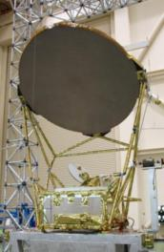
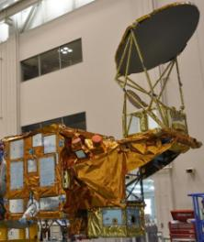
AMSR2 onboard GCOM-W1 “SHIZUKU”
Successor of AMSR-E on Aqua and AMSR on ADEOS-II.
Deployable main reflector system with 2.0m diameter (1.6m for AMSR-E).
Frequency channel set is identical to that of AMSR-E except 7.3GHz channel for RFI mitigation.
Two-point external calibration with improved HTS (hot-load).
Add a redundant momentum wheel to increase reliability.
GCOM-W1/AMSR2 characteristics
Scan and rate | Conical scan at 40 rpm
Antenna | Offset parabola with 2.0m dia.
Swath width | 1450km
Incidence angle | Nominal 55 degrees
Digitization | 12bits
Dynamic range | 2.7-340K
Polarization | Vertical and horizontal
AMSR2 Channel Set
Center Freq. [GHz] | Band width [MHz] | Pol. | Beam width [deg] (Ground res. [km]) | Sampling interval [km]
6.925/ 7.3 | 350 | V and H | 1.8 (35 x 62) | 10
10.65 | 100 |  | 1.2 (24 x 42)
18.7 | 200 |  | 0.65 (14 x 22)
23.8 | 400 |  | 0.75 (15 x 26)
36.5 | 1000 |  | 0.35 (7 x 12)
89.0 | 3000 |  | 0.15 (3 x 5) | 5

Slide 5
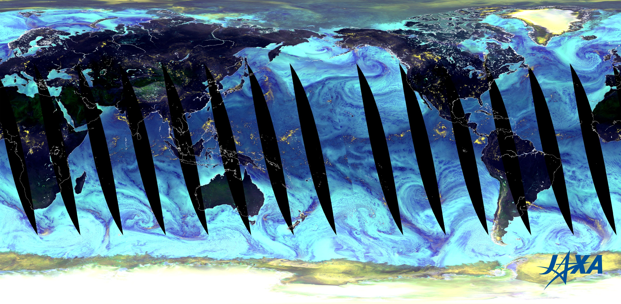
Color Composite Image of Global Earth Observed by SHIZUKU

Slide 6
On-Orbit Radiometer Sensitivity
All channels meet the requirements of radiometer sensitivity.
■AMSR-E on-orbit (2002/6-2003/1)
■AMSR2 on-orbit (2012/7)
―Nominal ＊Target
Radiometer sensitivities were computed as follows.
Use center 2-points among 16-points (4-points among 32-points for 89GHz) and consecutive 10-scans (in total, 2*10=20 samples for lower frequencies, 4*10=40 samples for 89GHz) to compute standard deviation of radiometer counts, and then convert to temperature scale.
Compute radiometer sensitivities for HTS (approx. 290K) and CSM (approx. 3K) temperatures, and then interpolate those values to derive radiometer sensitivities at150K temperature.
Average those instantaneous values during the period indicated in the chart.

Slide 7
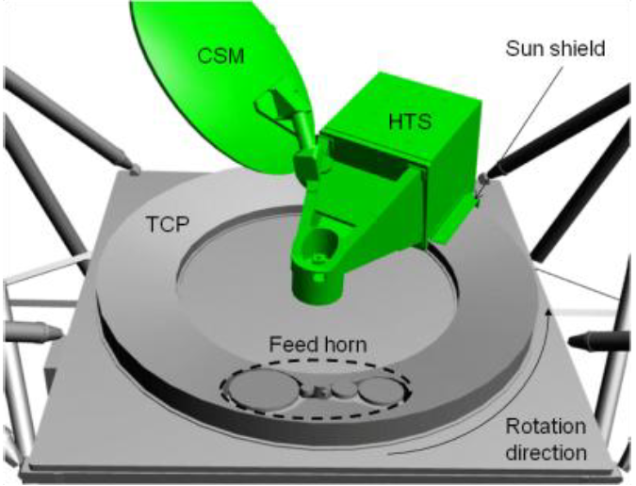
On-Orbit Temperature of HTS
Instantaneous peak-to-peak difference among 10-points of HTS temperature readings is less than 0.5 degrees during a revolution.
Continue evaluation of seasonal changes (e.g., solar beta angle) which affects the HTS control temperature.

Slide 8
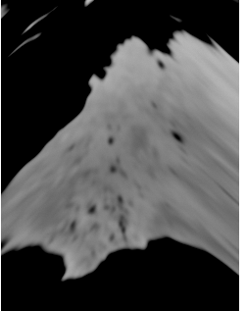
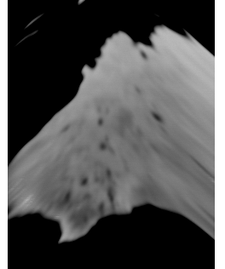
Spatial Resolution: vs AMSR-E
AMSR2 6.9GHz H-pol
AMSR-E 6.9GHz H-Pol
Increase of antenna size (1.6 to 2.0 m) resulted in around 18% improvement in spatial resolution at 6.9 GHz channels (hope you see it).

Slide 9
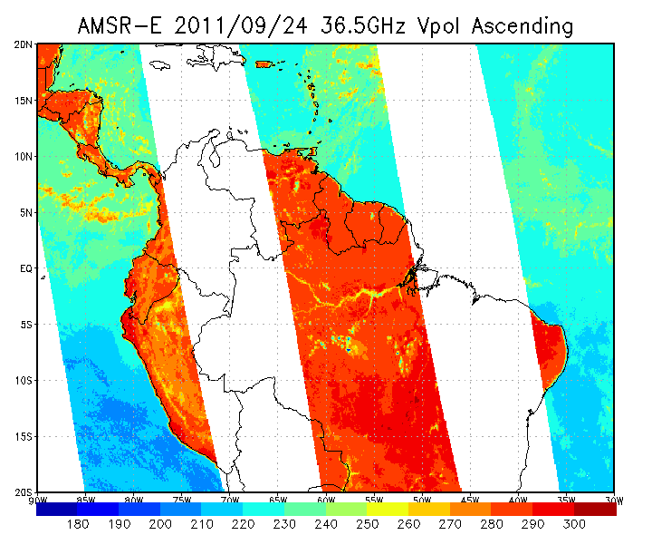
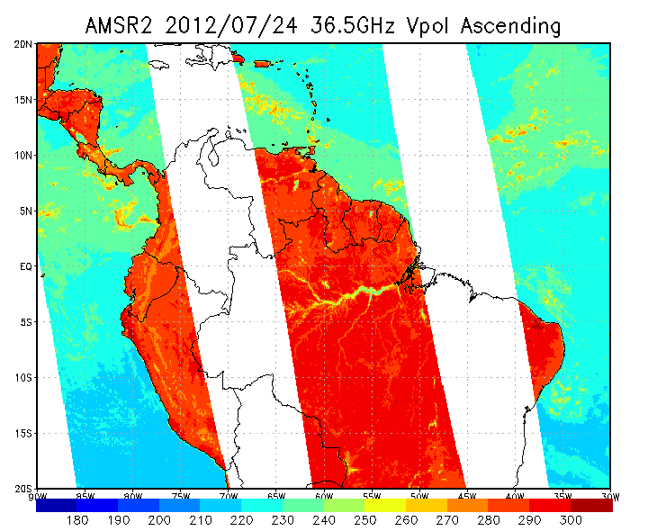
Increase of Swath Width
AMSR-E:1457.8km
AMSR2:1617.6km
AMSR2 Level-1B and -1R products retain all scan positions from Level-1A product, resulting in the increase of swath width.
Nominal swath width (instrument assured) is 1450km, but effective swath width is wider than 1600km after scan-edge bias correction.

Slide 10
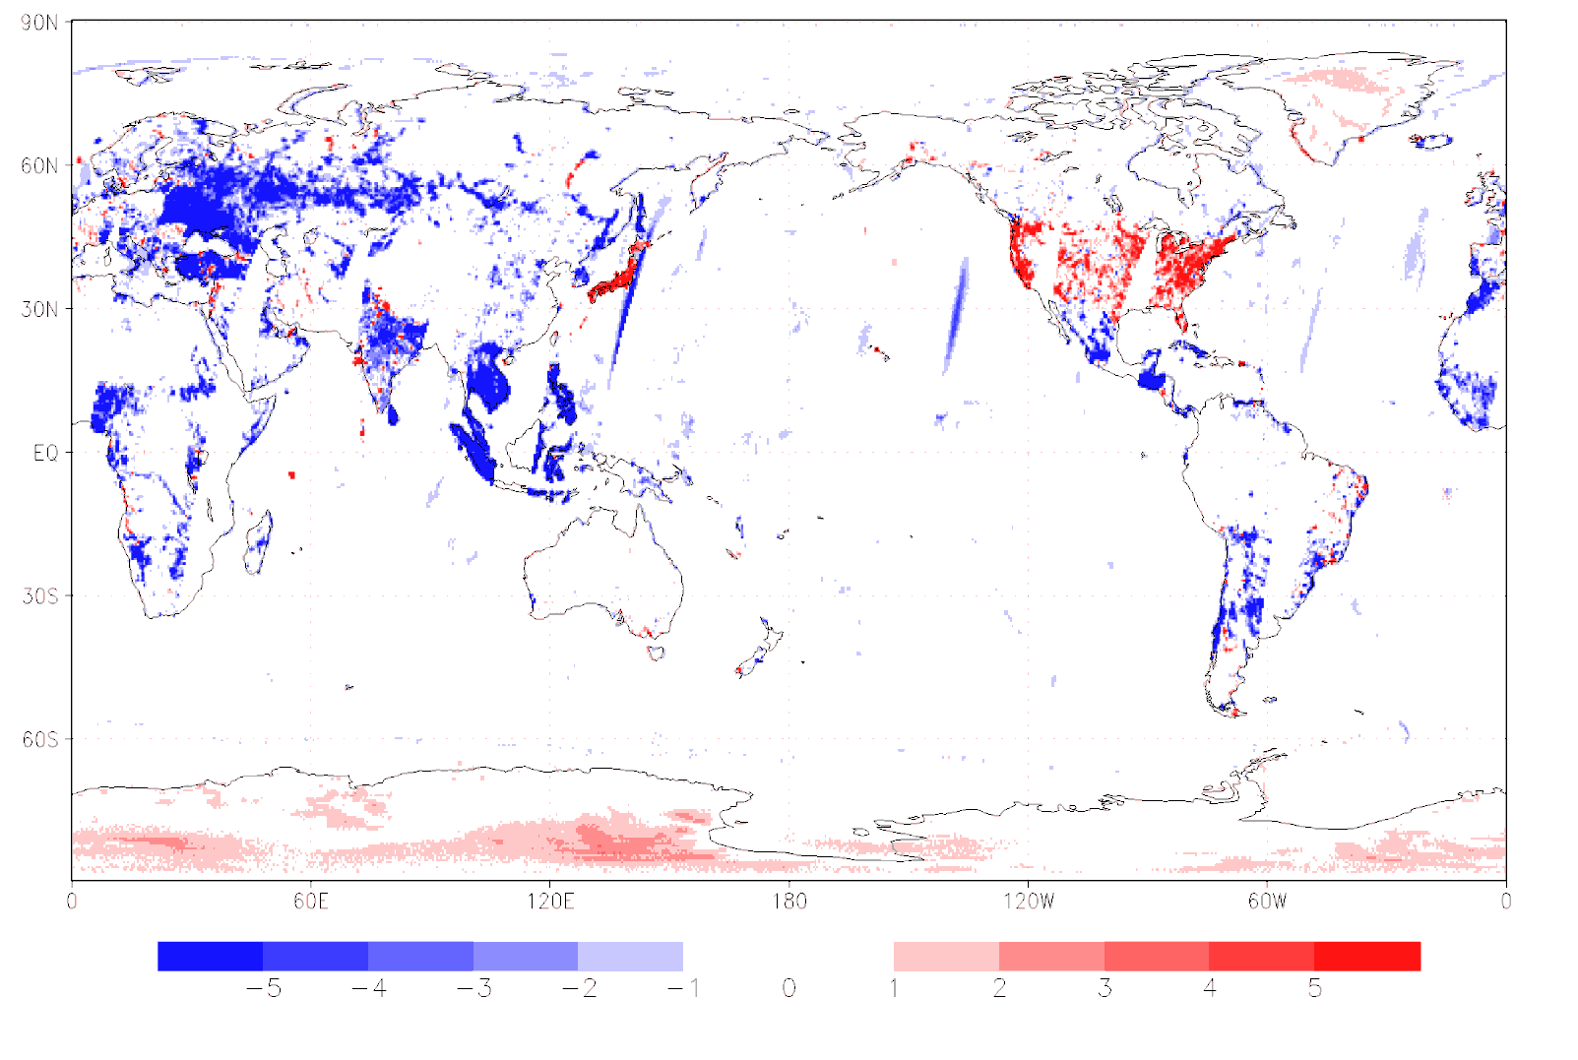
C-Band RFI Status
TB_{6.9V}-TB_{7.3V} , Descending daily passes on July 25, 2012
Red areas probably indicate 6.9GHz RFI signatures.
Blue areas probably indicate 7.3GHz RFI signatures.
Likely natural signals are also seen such as ice sheet, precipitation, and so forth in Tb differences.
Brightness temperatures at C-band channels should be handled with care for radio-frequency interference (RFI). RFI at 6.9GHz channels are similar to those of AMSR-E, while those at 7.3GHz channels seem to be more widespread.
Over land, 7.3GHz RFI signatures are evident over Southeast Asia, Eastern Europe, Russia, and so forth. Also, frequency of occurrences of 7.3GHz RFI are higher over ocean too.
There are still many regions with small TB difference between 6.9 and 7.3 GHz channels. Simple RFI identification based on the TB difference will be tested and implemented as RFI-flag if effective.

Slide 11
Cross-Calibration in Progress
Global assessment with computed TB
  Compute brightness temperature (SimTB) by using radiative transfer calculation with inputs from JMA’s global analysis and MGDSST (merged global SST).
  Assess ObsTB – SimTB for potential intra-orbit variation.
Cross-calibration with AMSR-E
  Direct comparison with AMSR2 and AMSR-E (under discussion).
  Compute ObsTB-SimTB for both AMSR2 and AMSR-E, and further create double difference (this roughly cancels out differences in year, but not perfect).
Cross-calibration using TMI as a transfer radiometer
  Create space/time matchup dataset between AMSR2 and TMI.
  Compute ObsTB-SimTB for both AMSR2 and TMI, and further create double difference (this cancels out differences such as in center-frequency and incidence angle).
  Consistent with GPM X-CAL team method.
  Also applied for other radiometers (e.g., WindSat, SSMIS).
Comparison over dense forest and polar regions.

Slide 12
GCOM-W1 Data Products
Standard Products
Products |  | Areas | Res. | Accuracy |  |  | Range
 |  |  |  | Release | Standard | Goal
Brightness Temperature |  | Global | 5-50km | ±1.5K | ±1.5K | ±1.0K (systematic) ±0.3K (random) | 2.7-340K
GEO | Integrated water vapor | Global, over ocean | 15km | ±3.5kg/m² | ±3.5kg/m² | ±2.0 kg/m² | 0-70kg/m²
 | Integrated cloud liquid water | Global, over ocean | 15km | ±0.10kg/ m² | ±0.05kg/ m² | ±0.02kg/ m² | 0-1.0kg/m²
 | Precipitation | Global, except cold latitude | 15km | Ocean ±50% Land ±120% | Ocean ±50% Land ±120% | Ocean ±20% Land ±80% | 0-20mm h⁻¹
 | Sea surface temperature | Global, over ocean | 50km | ±0.8℃ | ±0.5℃ | ±0.2℃ | -2-35℃
 | Sea surface wind speed | Global, over ocean | 15km | ±1.5m s⁻¹ | ±1.0m s⁻¹ | ±1.0m s⁻¹ | 0-30m s⁻¹
 | Sea ice concentration | Polar region, over ocean | 15km | ±10% | ±10% | ±5% | 0-100%
 | Snow depth | Land | 30km | ±20cm | ±20cm | ±10cm | 0-100 cm
 | Soil moisture | Land | 50km | ±10% | ±10% | ±5% | 0-40%
Research Products: Potential candidates include all-weather sea surface wind speed, sea ice moving vector, sea ice thickness, land hydrological assimilated products, and so forth.
12

Slide 13
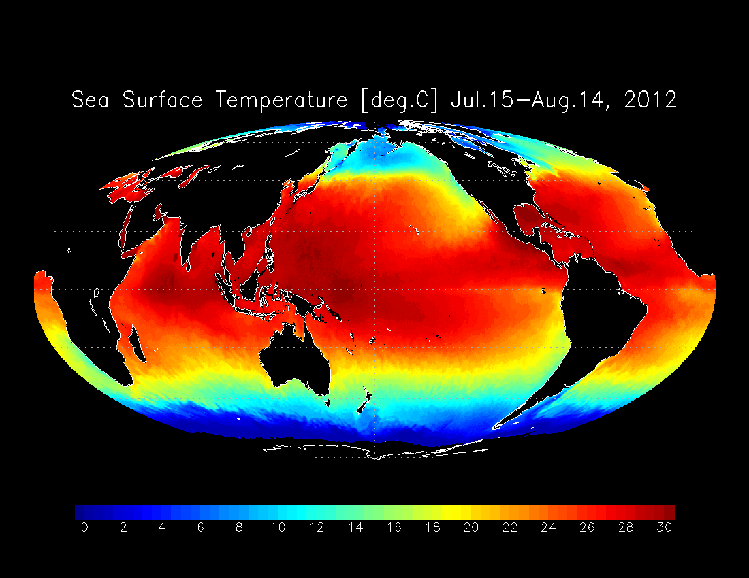
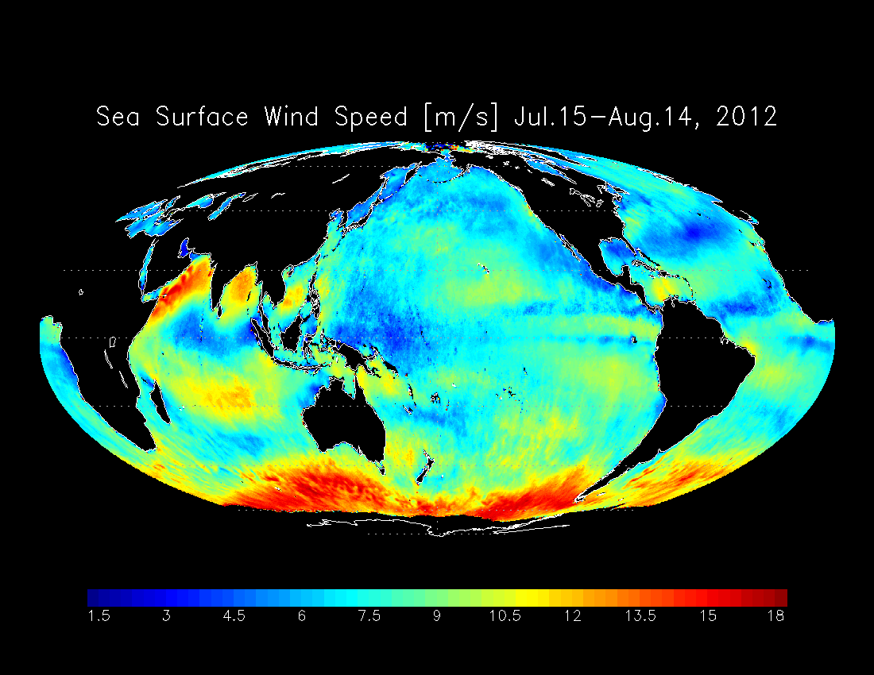
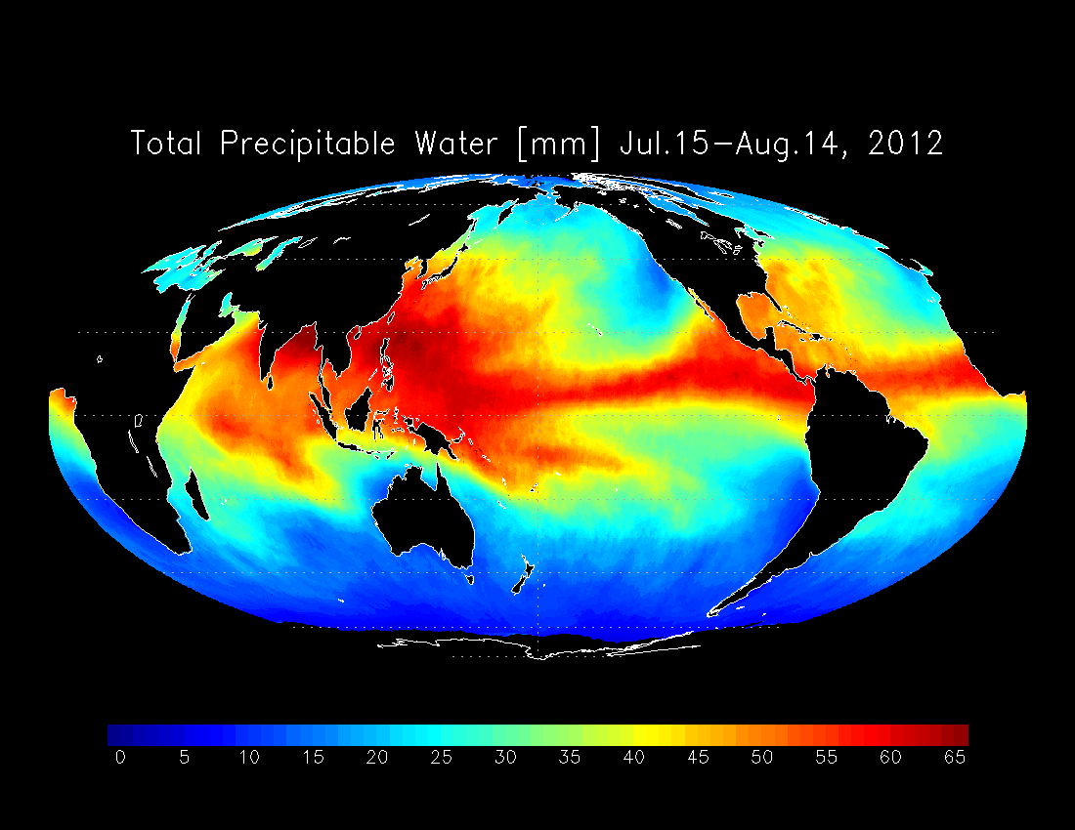
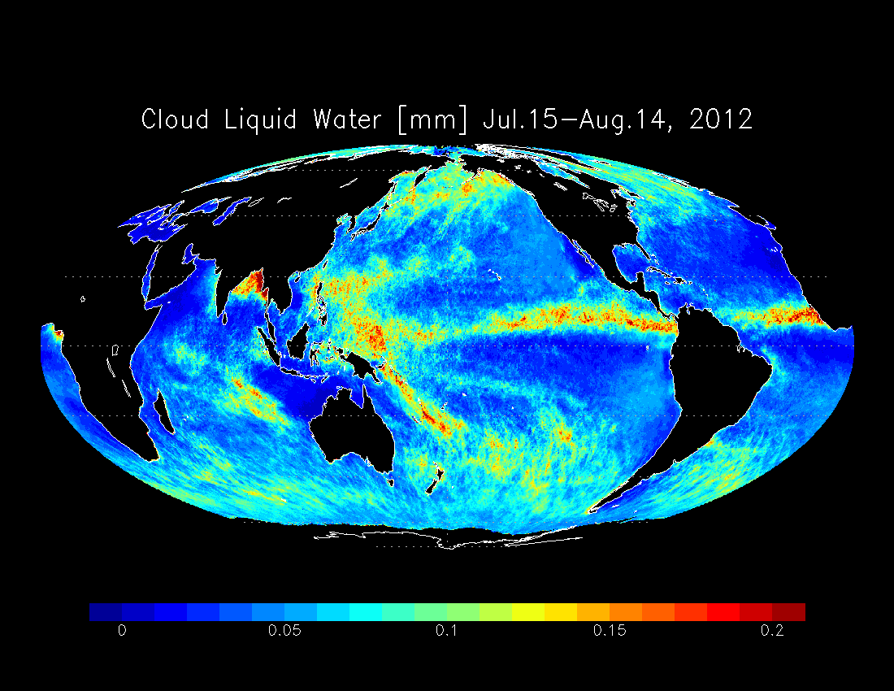
Monthly AMSR2 Images (unvalidated)
Sea Surface Temperature
Sea Surface Wind Speed
Total Precipitable Water
Cloud Liquid Water
Monthly average (July 15 – August 14, 2012)
13

Slide 14

GCOM-W1 “Shizuku” Status
Successfully launched on 18 May 2012.
Joined A-Train constellation on 29 June 2012.
Started continuous observation on 3 July 2012.
Completed the initial checkout phase on 10 August 2012.
Calibration and validation activities are ongoing.
Public product release will be January 2013 (L+8 months) and May 2013 (L+12 months) for brightness temperatures and geophysical parameters respectively.
GCOM Data Providing Service at: http://gcom-w1.jaxa.jp/
14
Notes:
Feasibility study to accommodate US scatterometer is ongoing, as well as summarizing research and operational users requirements with NOAA and NASA.

Slide 15
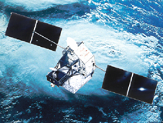
Tropical Rainfall Measuring Mission (TRMM)
Major characteristics
  Focused on rainfall observation. First instantaneous rainfall observation by three different sensors (PR, TMI, VIRS). PR, active sensor, can observe 3D structure of rainfall.
  Targeting tropical and subtropical region, and chose non-sun-synchronous orbit (inc. angle 35 degree) to observe diurnal variation.
Major achievement in Japan
  Demonstration of high quality and high reliability of a satellite onboard precipitation radar
  Improvement of MWR precipitation retrieval by PR 3D observation
  Pioneering precipitation system climatology by PR observation
  Operational use in NWP etc.
  New products including all-weather SST, global soil moisture
Version 7 standard products were released in Jul. 2011.
US-Japan joint mission
Japan: PR, launch
US: satellite, TMI, VIRS, CERES, LIS, operation
Launch | 28 Nov. 1997 (JST)
Altitude | About 350km (since 2001, boosted to 402km to extend mission operation）
Inc. angle | About 35 degree, non-sun-synchronous orbit
Design life | 3-year and 2month (still operating)
Instruments | Precipitation Radar (PR) TRMM Microwave Imager (TMI) Visible Infrared Scanner (VIRS) Lightning Imaging Sensor (LIS) CERES (not in operation)

Slide 16
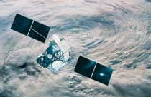
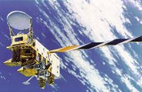
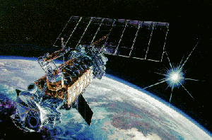
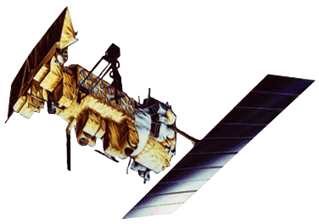
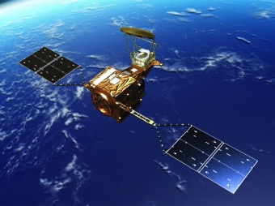
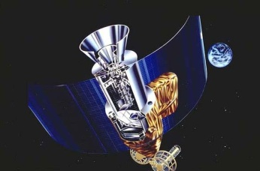
Production of “GSMaP” from Multi-satellite Data
GSMaP: Global Satellite Mapping of Precipitation
TRMM
TMI
SHIZUKU
AMSR2
Aqua
AMSR-E
DMSP
SSM/I, SSMIS
NOAA&MetOp
AMSU-A/MHS
Geostationary
Satellite
Rain models developed from PR observations
Rainfall data retrieved
from each microwave
imager and/or sounder
Calculate cloud
moving vectors
GSMaP rainfall
in 0.1-deg grid
and hourly
Hourly merged microwave
rainfall map

Slide 17
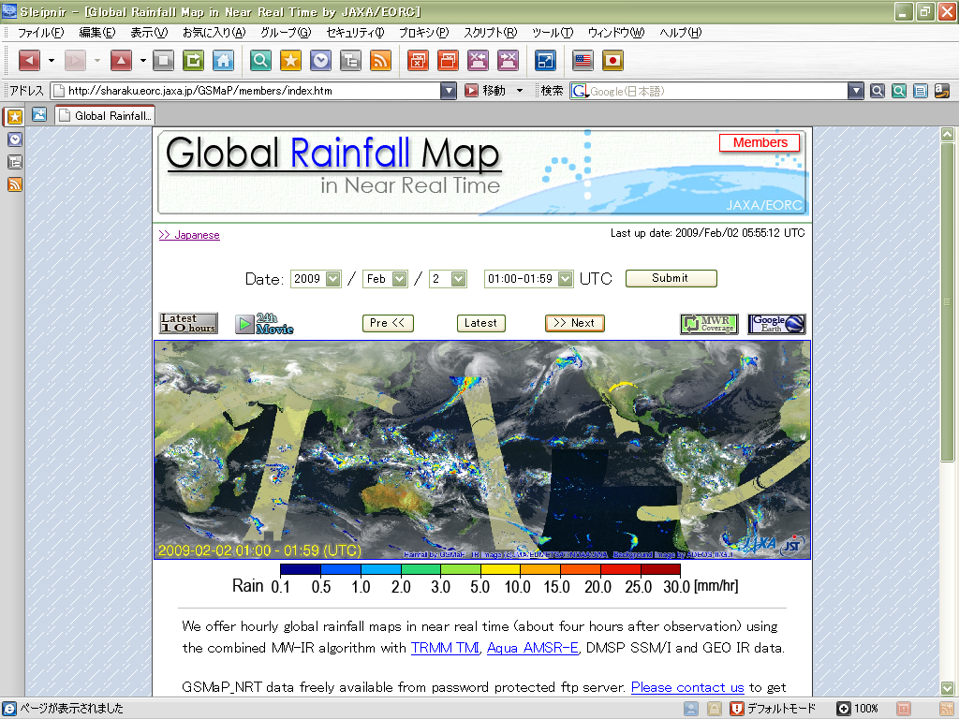
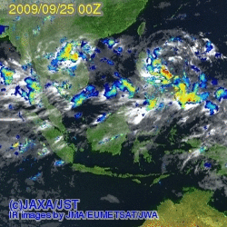
Global Rainfall Map in Near-Real-Time
GSMaP (Global Satellite Mapping for Precipitation)
  0.1-deg and hourly global rainfall product
  Rainfall retrievals from available MWRs are merged, and moving vector information from five GEO IR data with Kalman filtering techniques is combined to fill temporal gaps.
GSMaP_NRT is distributed via internet
  Hourly browse images are available from Web server, 4-hour after observation.
  Binary data (and text files) has been available via password protected ftp site.
Reprocessing data from Mar. 2000 to Nov. 2010 has been distributed to NRT users.
3-hourly animation of three typhoons (No.17-19) in 2009 by GSMaP_NRT.
http://sharaku.eorc.jaxa.jp/GSMaP/
Notes:
17

Slide 18
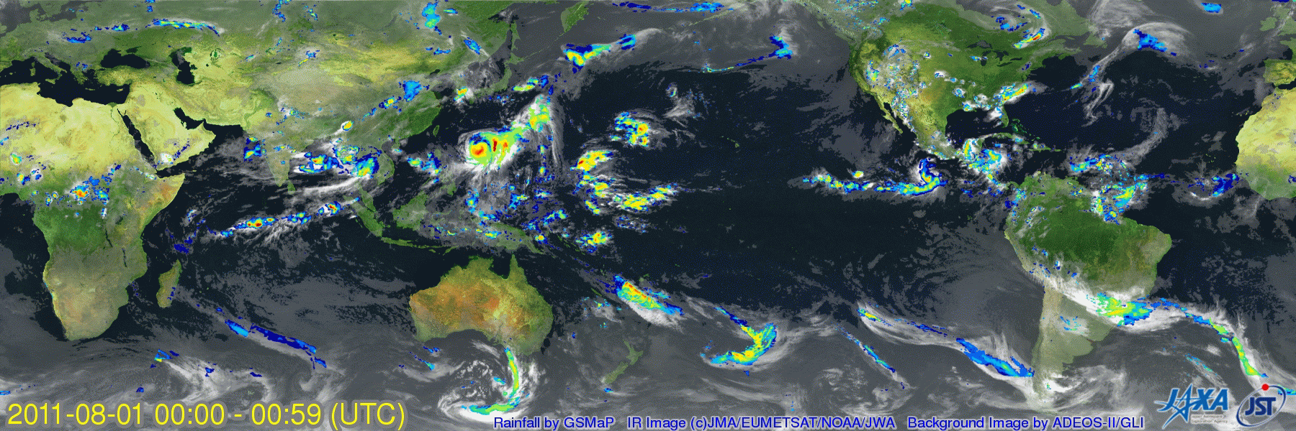
JAXA/EORC Global Rainfall Watch
1-8 August 2011 (6-hourly) - Typhoon No.9 in 2011 “MUIFA” can be seen near Okinawa, Japan.
  0.1-deg and hourly global rainfall product
  available 4-hour after observation via internet.
http://sharaku.eorc.jaxa.jp/GSMaP/
Notes:
18
18

Slide 19
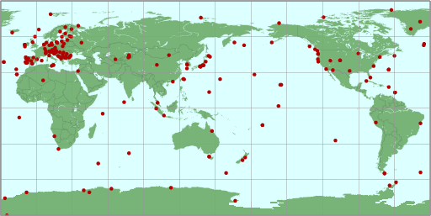
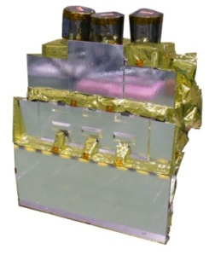
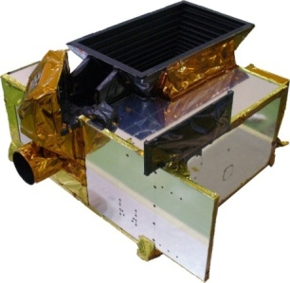
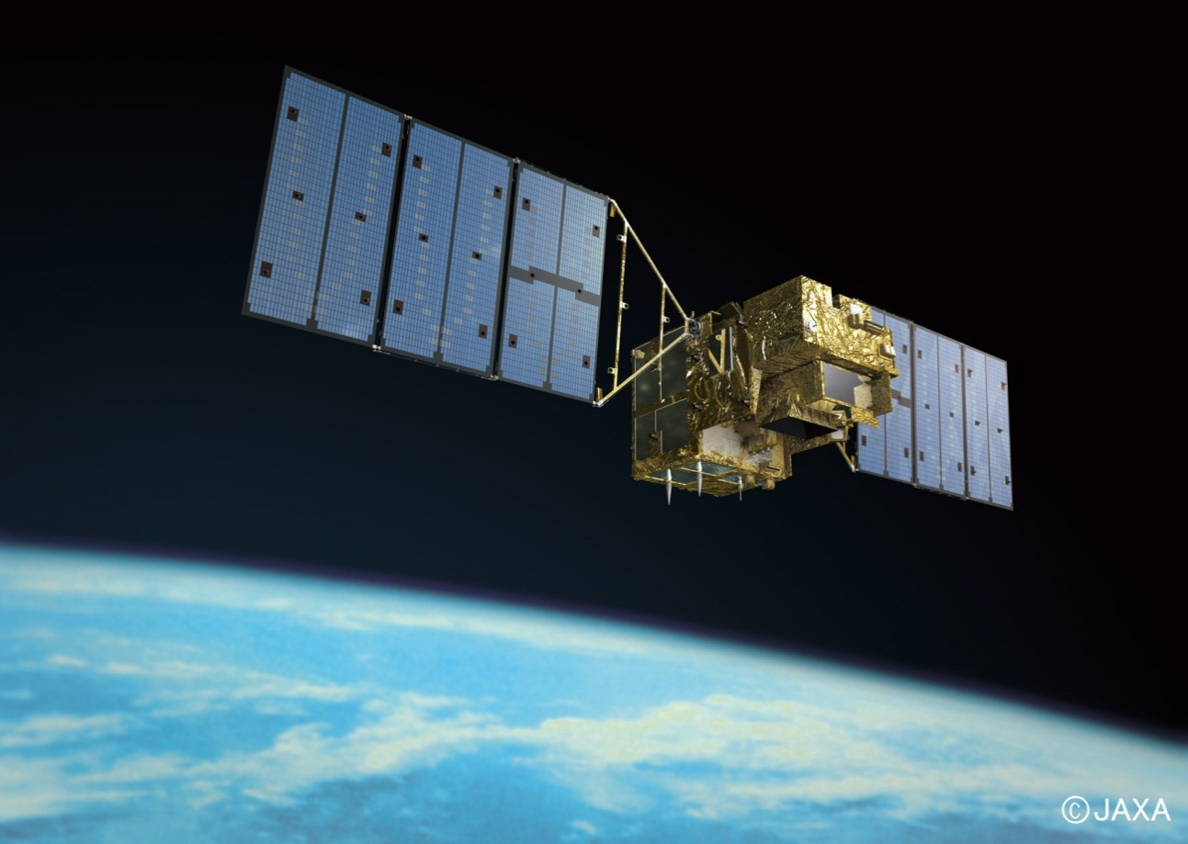
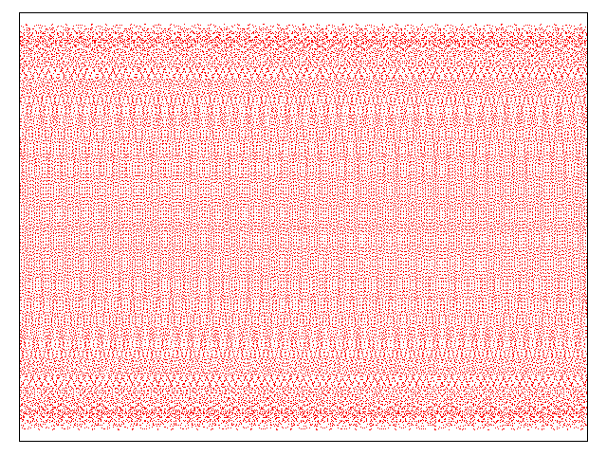
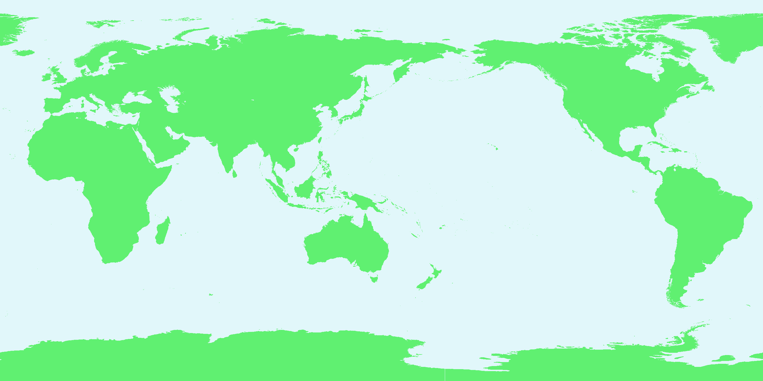
Greenhouse Gases Observing Satellite (GOSAT), Ibuki
GOSAT enables global (with 56,000 points) and frequent (at every 3 days) monitoring CO2 and CH4 column density. (Launched in Jan 2009)
Current Ground-based Observation Points
(320pts) Provided by WMO WDCGG
TANSO-CAI
(Cloud and Aerosol Imager)
TANSO-FTS
(Fourier Transform Spectrometer)
Increase of Observation Points using GOSAT (56,000pts)
Notes:
Environmental problems, such as global climate change, irregular water cycles, and environmental pollution, are now recognized destabilizing factors in the quest for peace and prosperity worldwide.
These factors are exacerbated by the explosive increase of populations and economic activities.
Clearly, future human society cannot achieve sustainable development without overcoming these environmental problems.
This is especially critical in the Asian region because of its large population and rapid economic growth.
Therefore, it is important for policy makers in all countries to know and understand the exact status of such environmental situations in order to provide the proper guidance to protect our peaceful planet Earth.
JAXA has a powerful tool for observation of climate change and global warming such as AMSR-E, TRMM, GPM, GCOM and GOSAT.
To promote the implementation of an integral Earth observation system, JAXA is contributing to developing the GEOSS.

Slide 20
GOSAT “IBUKI” Status
Radiometric calibration on orbit in 3 years
  Inter-comparison attempt with other TIR sensors of IASI and AIRS
  Vicarious calibration field campaign with in-situ measurements and aircraft over-flight collaborated with NASA ACOS research
  Annual degradation monitoring at uniform desert sites
Data distribution
  Data products are distributed through the GOSAT User Interface Gateway (GUIG), a website for GOSAT data distribution
  Prior user registration is required for accessing the data products and can be done on "user authentication" page reached from "product & service" page on GUIG.
    https://data.gosat.nies.go.jp/GosatUserInterfaceGateway/guig/GuigPage/open.do;jsessionid=0F6497855D3B130F97D71E3D2BEC9323?lang=en

Slide 21
FUTURE EARTH OBSERVATION PROGRAMS

Slide 22

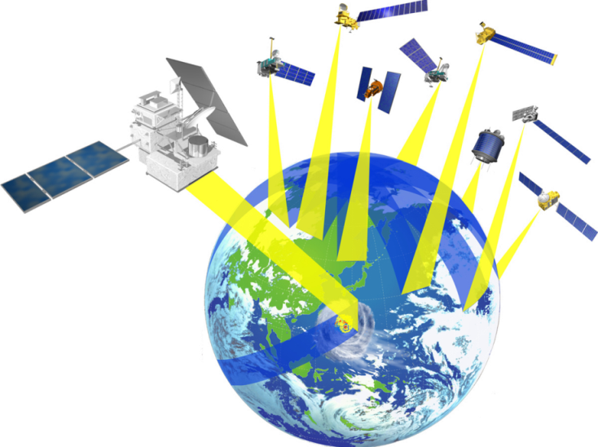
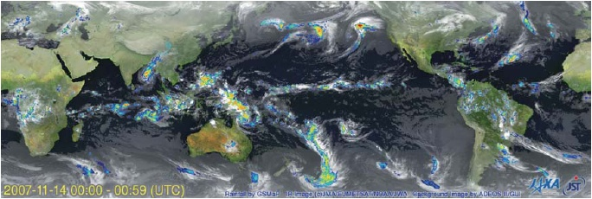
Global Precipitation Measurement (GPM)
GPM Core Observatory
Objective:
Understanding the horizontal and vertical structure of precipitation
system
Drop size distribution measurement
Improvement of precipitation rate accuracy with constellation satellites
DPR (JAXA, NICT) (13.6, 35.5 GHz)
GMI （NASA）
Launch in early 2014 by H-IIA
Non-Sun-synchronous orbit, inclination: 65deg., altitude: 407 km
Constellation Satellites
Objectives:
Observation frequency
Science, social applications
Cooperation with constellation providers; JAXA (GCOM-W), CNES/ISRO (Megha-Tropiques), NOAA, etc.
3 hourly observation of 80% of the globe.
Launch around 2013 by each organization
Mainly sun-synchronous orbit with altitude 600~800 km
Generation and dissemination of global map of precipitation rate with high frequency and accuracy

Slide 23
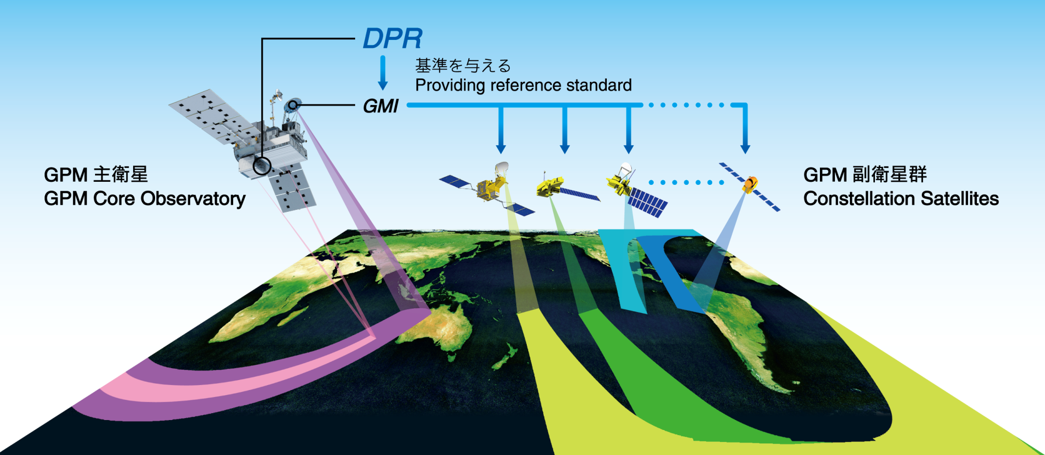
Role of DPR on the GPM Core Observatory
Core satellite and several satellites will make formation flight to realize global precipitation frequent observation with high accuracy.
Dual-frequency Precipitation Radar (DPR) onboard core satellite and microwave radiometers onboard constellation satellites will measure precipitation rate.

Slide 24
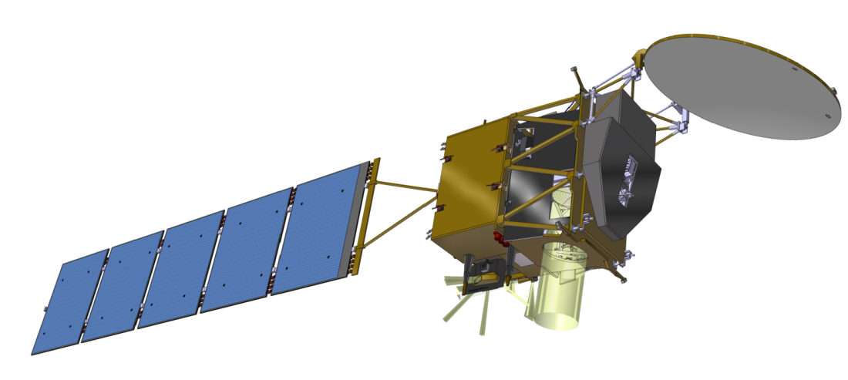
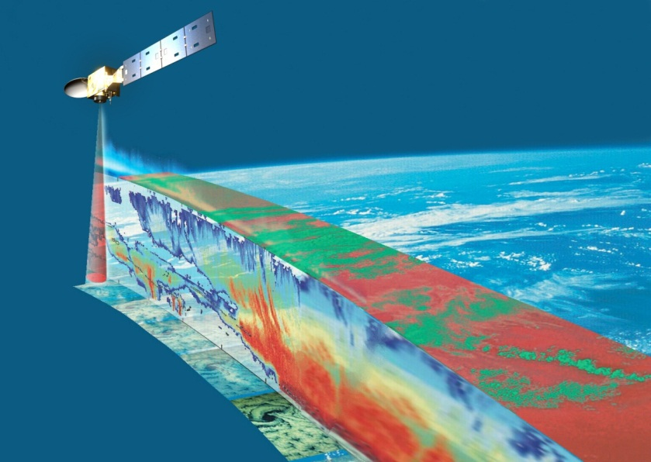
EarthCARE/CPR
Climate monitoring of earth radiation, cloud and aerosol
Cooperation between ESA and Japan (JAXA/NICT)
Mission
  Vertical profile of clouds, aerosol
  Interaction between clouds and aerosol
  Cloud stability and precipitation
Orbit
  Sun synchronous
  Equator crossing time 13:45
  Altitude 400km
Instrument
  CPR (Cloud Profile Radar)
  ATLID (Atmospheric LIDAR)
  MSI (Multi-Spectral Imager)
  BBR (Broad Band Radiometer)
Task sharing
  JAXA/NICT （CPR）
  ESA （LIDAR, MSI, BBR, Spacecraft)
Launch target
  JFY2013
CPR
BBR
MSI
ATLID
24
Notes:
24

Slide 25
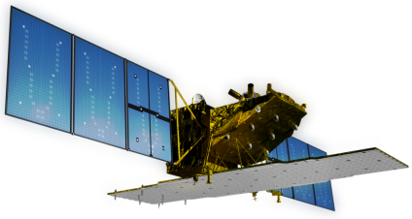
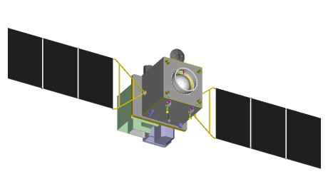
Concept of ALOS F/O Missions
ALOS F/O Missions: ALOS-2 (PALSAR-2) and ALOS-3 (PRISM-2)
National land monitoring and managements
Resources managements
Disaster monitoring
ALOS-2 is planed to be launch in 2013, and ALOS-3 is hoped in 2015 (TBD)
Current System Concept (under investigation)
Monitoring disaster area affected by earthquake, volcano, flood, etc.
Observing the disaster affected area within 3 hr (6 hr in night)
A satellite constellation of two optical sensor satellites and two SAR satellites
ALOS-2: 3m resolution (3x1m in spotlight mode) with 50km swath (PALSAR-2)
ALOS-3: Panchromatic stereo - 0.8m GSD in 50km swath; multi - 5m GSD in 50km swath; and hyper-spectral 30m in 30km swath (TBD)
ALOS-2: SAR Satellite
ALOS-3: Optical Sensor Satellite

Slide 26
ALOS-2 Specification
Orbit |  |  | Sun-Synchronous Sub-Recurrent
 |  |  | Altitude: Approx. 630km
 |  |  | LST: 12：00 in descending orbit
Design Life |  |  | 5 years
Launch | Target |  | JFY2013
 | Rocket |  | H-2A
Satellite | Mass |  | Approx. 2 ton
 | Solar Paddle |  | Two-wings type panel
Mission Data Transmission |  |  | Direct / via. Data Relay Satellite
Mission Sensor |  |  | Synthetic Aperture Radar (SAR)
Frequency |  |  | L-band (1.2GHz)
Major Observation Mode |  | Fine | Resolution: 1-3 m, Width: 25 km
 |  | Basic | Resolution: 3 / 6 / 10 m Width: 50 / 50 / 70 km
 |  | Wide | Resolution: 100 m, Width: 350 km
Mission Objectives |  |  | Crustal change, volcano monitoring, surface deformation
 |  |  | Sea ice, river, forest and agriculture monitoring etc.
ALOS-2: SAR Satellite
August, 2009: Project Team was established
December 2009: Preliminary Design Phase
October 2010: Critical Design Phase
Now: manufacturing EM

Slide 27
ALOS-3 Specification (TBD)
Orbit |  |  | Sun-Synchronous Sub-Recurrent
 |  |  | Altitude: Approx. 620km
 |  |  | LST: 10：30 in descending orbit
Design Life |  |  | 5 years
Launch | Target |  | JFY2014-2015
 | Rocket |  | H-2A
Satellite | Mass |  | Approx. 2 ton
 | Solar Paddle |  | Two-wings type panel
Mission Data Transmission |  |  | Direct / via. Data Relay Satellite
Mission Sensor |  |  | Optical instruments
Major Observation Mode |  | Panchromatic | Resolution: 0.8 m, Width: 50 km
 |  | Multi spectral | Resolution: 3.2 m, Width: 50 km (TBD)
 |  | Hyper spectral | Resolution: 30 m, Width: 30 km (TBD)
Mission Objectives |  |  | Cartography, volcano monitoring, surface change detection
 |  |  | Sea ice, river, forest and agriculture monitoring etc.
ALOS-3: Optical Sensor Satellite
11 bits quantization for panchro
JPEG 2000 onboard compression
Stereo function (two telescopes)
Body pointing function (+/-60 deg.)

Slide 28
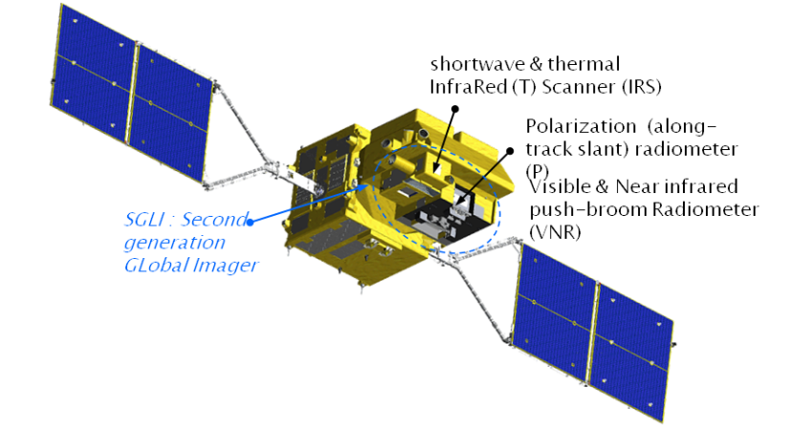
GCOM-C1 and SGLI
Improvement of land, coastal, and aerosol observations.
  fine (250m) spatial resolution
  polarization/along-track slant view
250m over land or coastal area, and 1km over offshore
GCOM-C SGLI characteristics (Current baseline)
Orbit | Sun-synchronous (descending local time: 10:30) Altitude: 798km, Inclination: 98.6deg
Launch Date | Jan. 2014 (HII-A)
Mission Life | 5 years (3 satellites; total 13 years)
Scan | Push-broom electric scan (VNR: VN & P) Wisk-broom mechanical scan (IRS: SW & T)
Scan width | 1150km cross track (VNR: VN & P) 1400km cross track (IRS: SW & T)
Digitalization | 12bit
Polarization | 3 polarization angles for P
Along track direction | Nadir for VN, SW and T, +45 deg and -45 deg for P
On-board calibration | VN: Solar diffuser, Internal lamp (LED, halogen), Lunar by pitch maneuvers (~once/month), and dark current by masked pixels and nighttime obs. SW: Solar diffuser, Internal lamp, Lunar, and dark current by deep space window T: Black body and dark current by deep space window All: Electric calibration
SGLI channels
CH | λ | Δλ | L_{std} | L_{max} | SNR at Lstd | IFOV
 | VN, P, SW: nm T: μm |  | VN, P: W/m²/sr/μm T: Kelvin |  | VN, P, SW: - T: NEΔT | m
VN1 | 380 | 10 | 60 | 210 | 250 | 250
VN2 | 412 | 10 | 75 | 250 | 400 | 250
VN3 | 443 | 10 | 64 | 400 | 300 | 250
VN4 | 490 | 10 | 53 | 120 | 400 | 250
VN5 | 530 | 20 | 41 | 350 | 250 | 250
VN6 | 565 | 20 | 33 | 90 | 400 | 250
VN7 | 673.5 | 20 | 23 | 62 | 400 | 250
VN8 | 673.5 | 20 | 25 | 210 | 250 | 250
VN9 | 763 | 12 | 40 | 350 | 1200(@1km) | 250
VN10 | 868.5 | 20 | 8 | 30 | 400 | 250
VN11 | 868.5 | 20 | 30 | 300 | 200 | 250
P1 | 673.5 | 20 | 25 | 250 | 250 | 1000
P2 | 868.5 | 20 | 30 | 300 | 250 | 1000
SW1 | 1050 | 20 | 57 | 248 | 500 | 1000
SW2 | 1380 | 20 | 8 | 103 | 150 | 1000
SW3 | 1630 | 200 | 3 | 50 | 57 | 250
SW4 | 2210 | 50 | 1.9 | 20 | 211 | 1000
T1 | 10.8 | 0.7 | 300 | 340 | 0.2 | 500/250
T2 | 12.0 | 0.7 | 300 | 340 | 0.2 | 500/250
Multi-angle obs. for 674nm and 869nm
250m-mode possibility

Slide 29
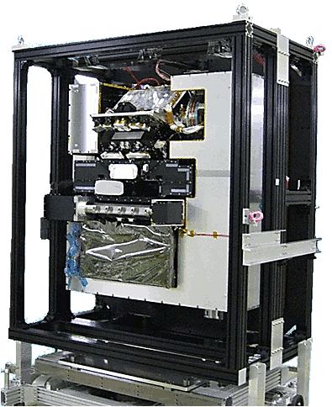
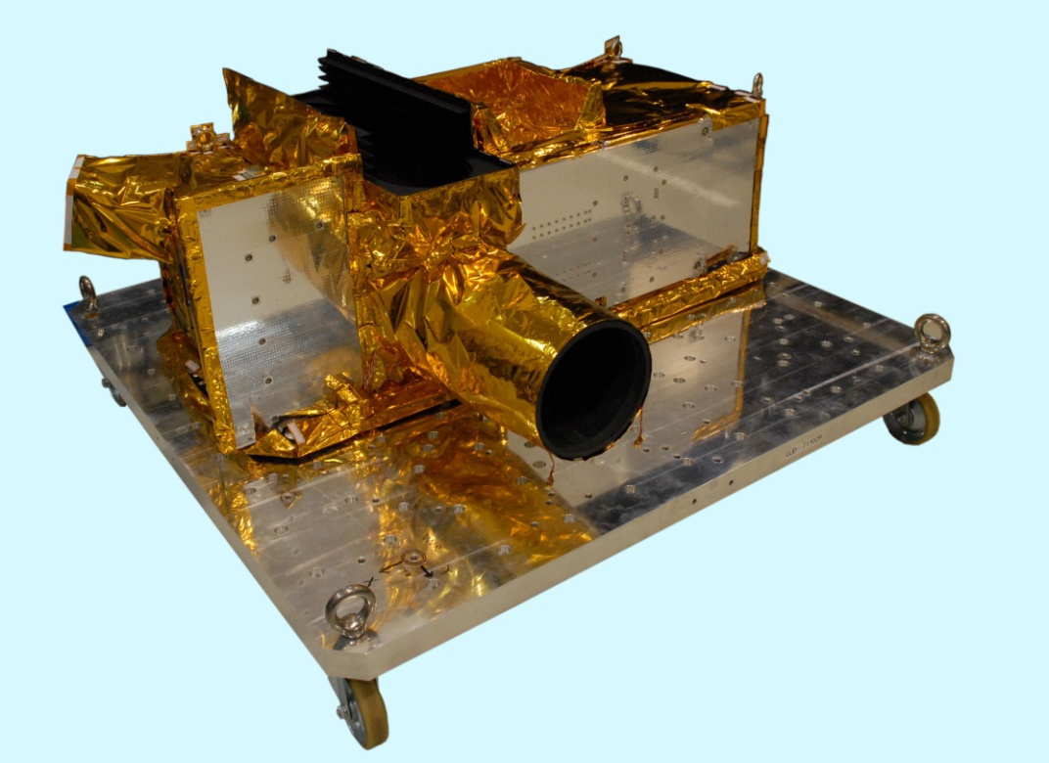
SGLI Engineering Model
SGLI Infrared Scanning Radiometer
(SGLI-IRS)
SGLI Visible and Near infrared radiometer
(SGLI-VNR)

Slide 30
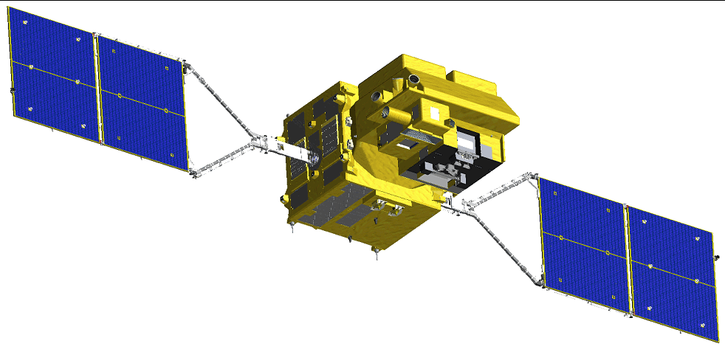
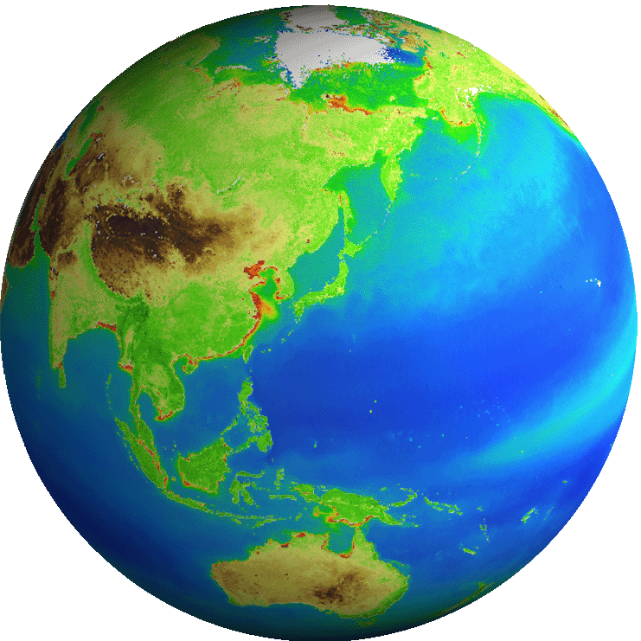
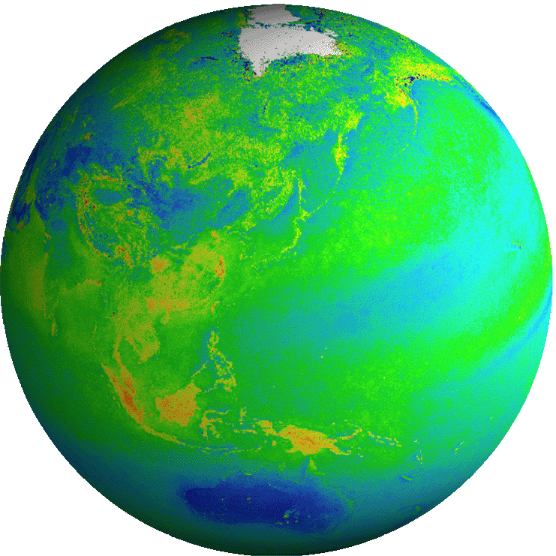
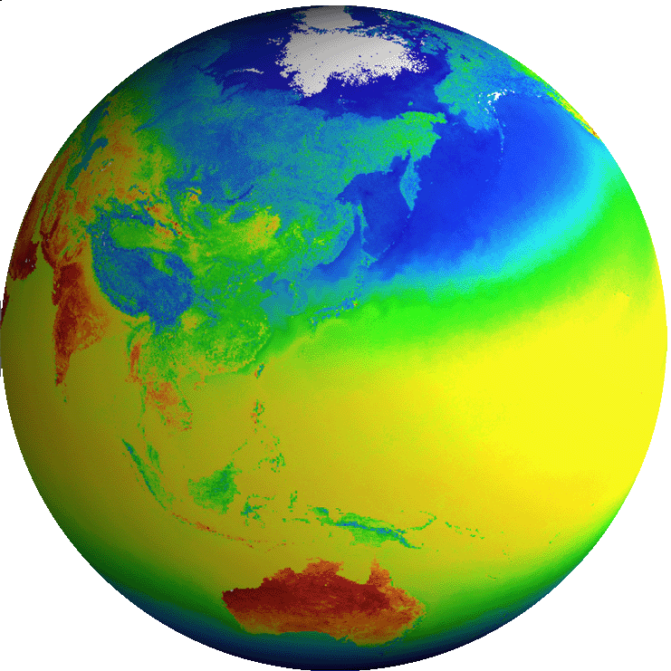

GCOM-C Products
Common
Radiance | TOA radiance (including system geometric correction)
Blue: standard products
Red: research products
Radiation budget by the atmosphere-surface system
Carbon cycle in the Land and Ocean
Land
Surface reflectance | Precise geometric correction
 | Atmospheric corrected reflectance
Vegetation and carbon cycle | Vegetation index
 | Above-ground biomass
 | Vegetation roughness index
 | Shadow index
 | Fraction of Absorbed Photosynthetically available radiation
 | Leaf area index
Temp. | Surface temperature
Application | Land net primary production
 | Water stress trend
 | Fire detection index
 | Land cover type
 | Land surface albedo
Atmosphere
Cloud | Cloud flag/Classification
 | Classified cloud fraction
 | Cloud top temp/height
 | Water cloud optical thickness /effective radius
 | Ice cloud optical thickness
 | Water cloud geometrical thickness
Aerosol | Aerosol over the ocean
 | Land aerosol by near ultra violet
 | Aerosol by Polarization
Radiation budget | Long-wave radiation flux
 | Short-wave radiation flux
Ocean
Ocean color | Normalized water leaving radiance
 | Atmospheric correction parameter
 | Photosynthetically available radiation
 | Euphotic zone depth
In-water | Chlorophyll-a conc.
 | Suspended solid conc.
 | Colored dissolved organic matter
In-water | Inherent optical properties
Temp. | Sea surface temp.
Application | Ocean net primary productivity
 | Phytoplankton functional type
 | Redtide
 | multi sensor merged ocean color
 | multi sensor merged SST
Cryosphere
Area/ distribution | Snow and Ice covered area
 | Okhotsk sea-ice distribution
 | Snow and ice classification
 | Snow covered area in forest and mountain
Surface properties | Snow and ice surface Temperature
 | Snow grain size of shallow layer
 | Snow grain size of subsurface layer
 | Snow grain size of top layer
 | Snow and ice albedo
 | Snow impurity
 | Ice sheet surface roughness
Boundary | Ice sheet boundary monitoring
ECV
ECV
ECV
ECV
ECV
ECV
ECV
ECV
ECV
ECV
ECV
ECV
ECV
ECV
30

Slide 31
Thank you for your attention

