Slide 1
JMA reports
Presented by Yoshiaki SATO
(Prepared by JMA colleagues)

Slide 2
Contents
Recent activities on NWP at JMA
  JMA NWP Systems
  Super Computer System Upgrades
  Updates
  Plan
  Topics
Status of Himawari-8/9 Project
Status of the GTS connection to RTH Tokyo
Answer to the Action Items

Slide 3
Recent activities on NWP at JMA
Yoshiaki Sato (JMA/NPD)
and colleagues in JMA/NPD
The Twelfth Asia-Pacific Satellite Data Exchange and Utilization (APSDEU-12)
and The Twenty Fourth North-America Europe Data Exchange meeting(NAEDEX-24)
22-25 October 2012, Exeter, UK

Slide 4
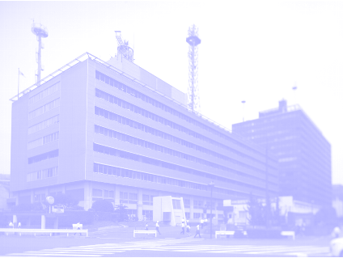
JMA NWP Systems
JMA HQ Building

Slide 5
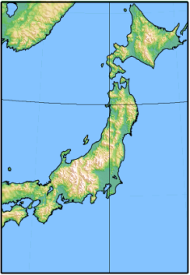
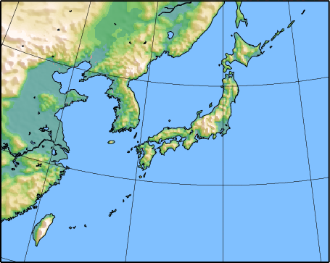

Current NWP models at JMA/NPD deterministic models only
GSM: Global Spectral Model
short- and medium-range forecast
TL959(0.1875deg.) / 60 Layers up to 0.1hPa
84-hours forecast at 00, 06, 18UTC,
216-hours forecast at 12UTC
MSM: Meso Scale Model
Disaster reduction, short-range forecast
5km (3600x2880km) / 50 Layers up to 22km
15-hours forecast at 00,06,12,18UTC,
33-hours forecast at 03,09,15,21UTC
LFM: Local Forecast Model
Disaster prevention, Aviation forecast
2km (1600x1100km) / 60 Layers up to 20km
9-hours forecast at 00,03,06,09,12,15,18,21UTC
Official operation was started on August 2012.

Slide 6
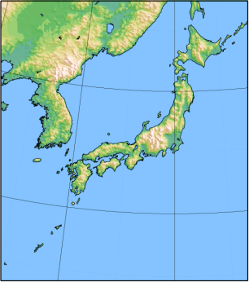
Current DA systems at JMA/NPD
GA: Global Analysis (4DVAR)
Model resolution: Outer: TL959 / Inner: TL319
Data cut off time
for Early Analysis: +2h20m
for Cycle Analysis: +11h50m(00,12), 7h50m(06,18)
Assimilation Window: -3h to +3h
MA: Mesoscale Analysis (4DVAR)
Model resolution: Outer: 5km / Inner: 15km
Data cut off time: +50min.
Assimilation Window: -3h to Analysis time
LA: Local Analysis (3DVAR Rapid Update Cycle)
Resolution: 5km
Data cut off time: +30min.
Assimilation Window: -30min. to +30min.
Official Operation was stated on August 2012.

Slide 7
Observations assimilated at JMA
G: GA
M: MA
L: LA

Slide 8
Satellite data assimilation status
Satellite/Instrument |  | GA | MA | LA
1. MW Sounder | NOAA15,16,18,19,Metop-A,Aqua/AMSU-A | Radiance | Radiance | [Radiance]
 | NOAA18,19,Metop-A/MHS | Radiance | Radiance | [Radiance]
 | DMSP-F18/SSMIS | [Radiance] | [Radiance] | [Radiance]
 | S-NPP/ATMS | [Radiance] | [Radiance] | [Radiance]
2. IR Sounder | Aqua/AIRS | [Radiance] | [Radiance] | [Radiance]
 | Metop/IASI | [Radiance] | [Radiance] | [Radiance]
 | S-NPP/CrIS | [Radiance] | [Radiance] | [Radiance]
3. MW Imager | TRMM/TMI | Radiance | Radiance, Rain Rate | [Radiance]
 | DMSP-F16,17/SSMIS | Radiance | Radiance, Rain Rate | [Radiance]
 | DMSP-F18/SSMIS | Radiance | Radiance, Rain Rate | [Radiance]
 | GCOM-W1/AMSR2 | [Radiance] | [Radiance, Rain Rate] | [Radiance]
4. VIS/IR Imager | MTSAT-1R,2 | CSR, AMV | CSR, AMV | [CSR], [AMV]
 | GOES-13,15 | CSR, AMV | - | -
 | Meteosat-7,9 | CSR, AMV | - | -
 | NOAA/AVHRR | [AMV] | - | -
 | Aqua,Terra/MODIS | AMV | - | -
5. Scatterometer | Metop-A/ASCAT | OSWV | [OSWV] | [OSWV]
 | Oceansat-2/SCAT | [OSWV] | [OSWV] | [OSWV]
6. GNSS-RO | GRACE/Blackjack | [Refractivity] | (Under development) | (Under development)
 | Metop-A/GRAS | Refractivity
 | TerraSAR-X/IGOR | [Refractivity]
 | COSMIC/IGOR | Refractivity
 | SAC-C/Blackjack | [Refractivity]
 | C/NOFS/CORISS | [Refractivity]
[]: Under Development
CSR: Clear Sky Radiance on water vapor channels, AMV: Atmospheric Motion Vector,
OSWV: Ocean Surface Wind Vectors, GNSS-RO: Global Navigation Satellite Systems – Radio Occultation

Slide 9
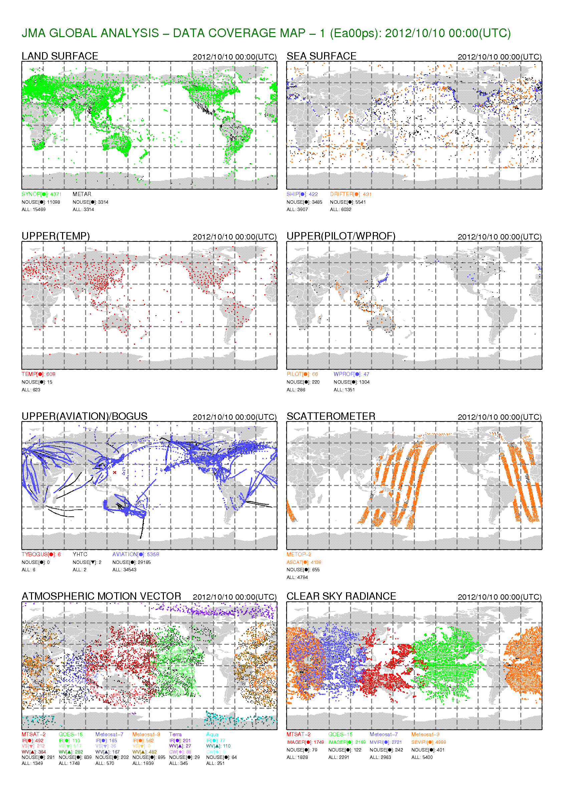
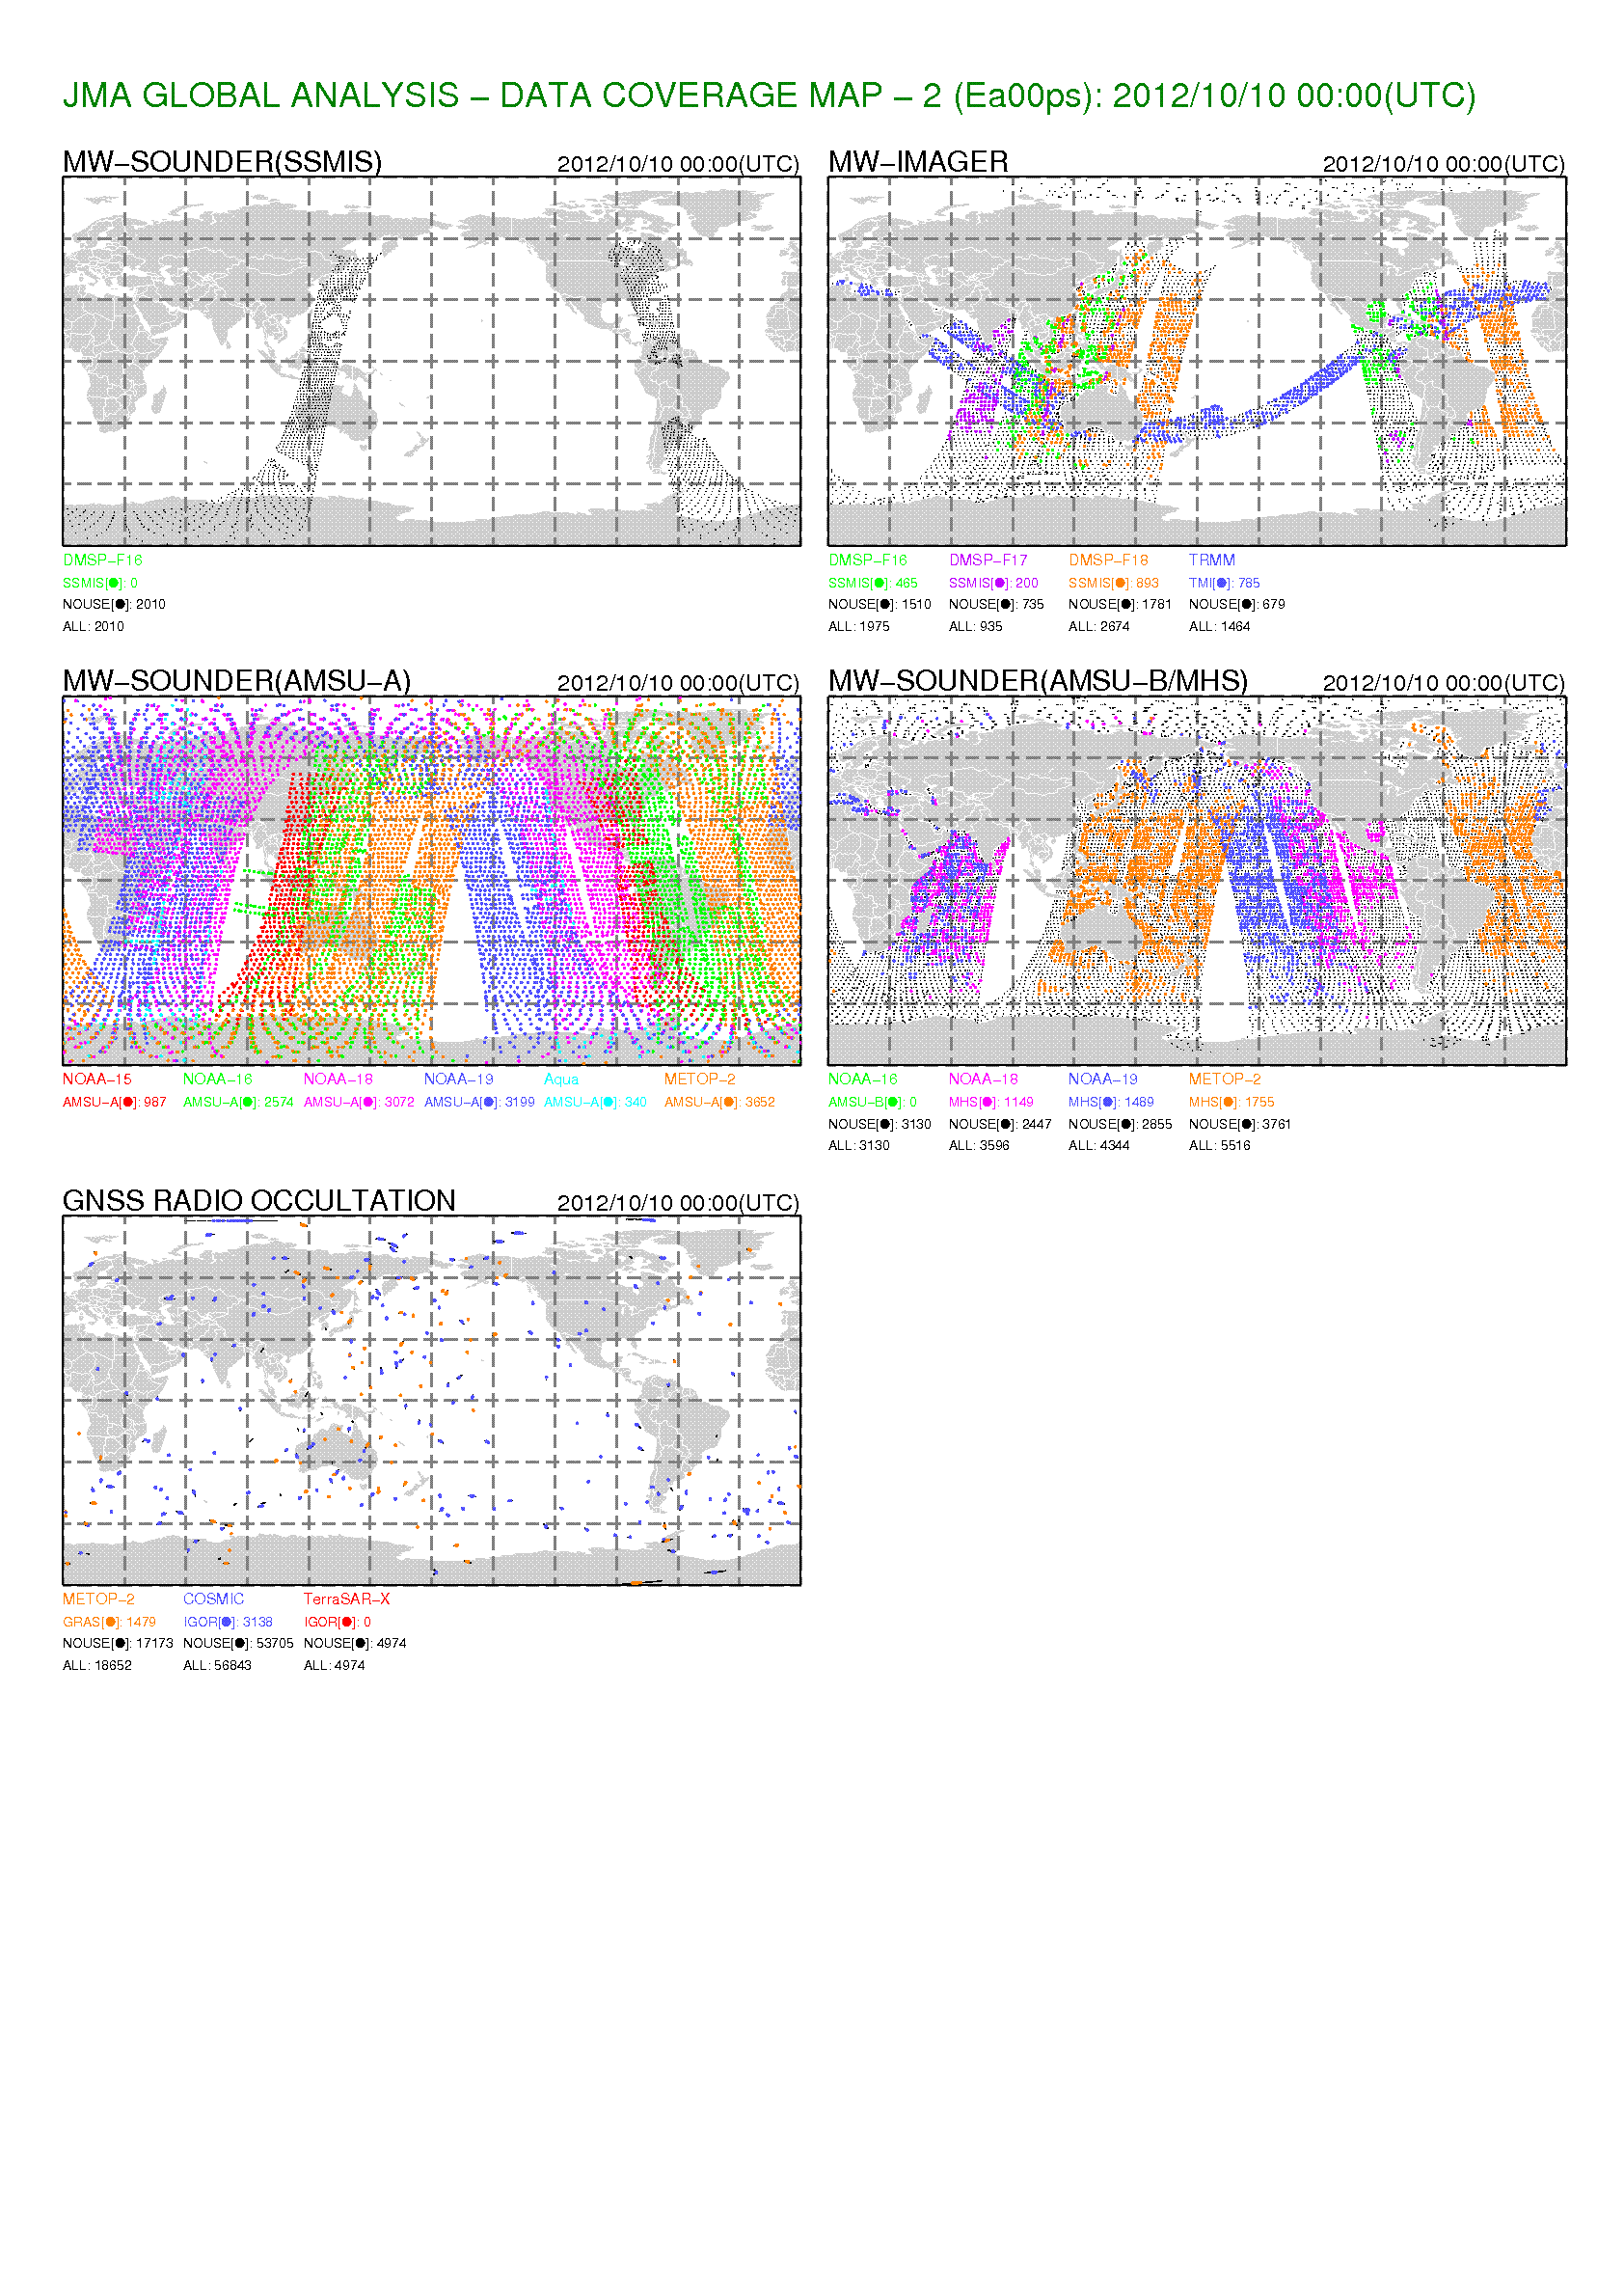
Coverage Map (Early Analysis)
Cut off : +02:20

Slide 10
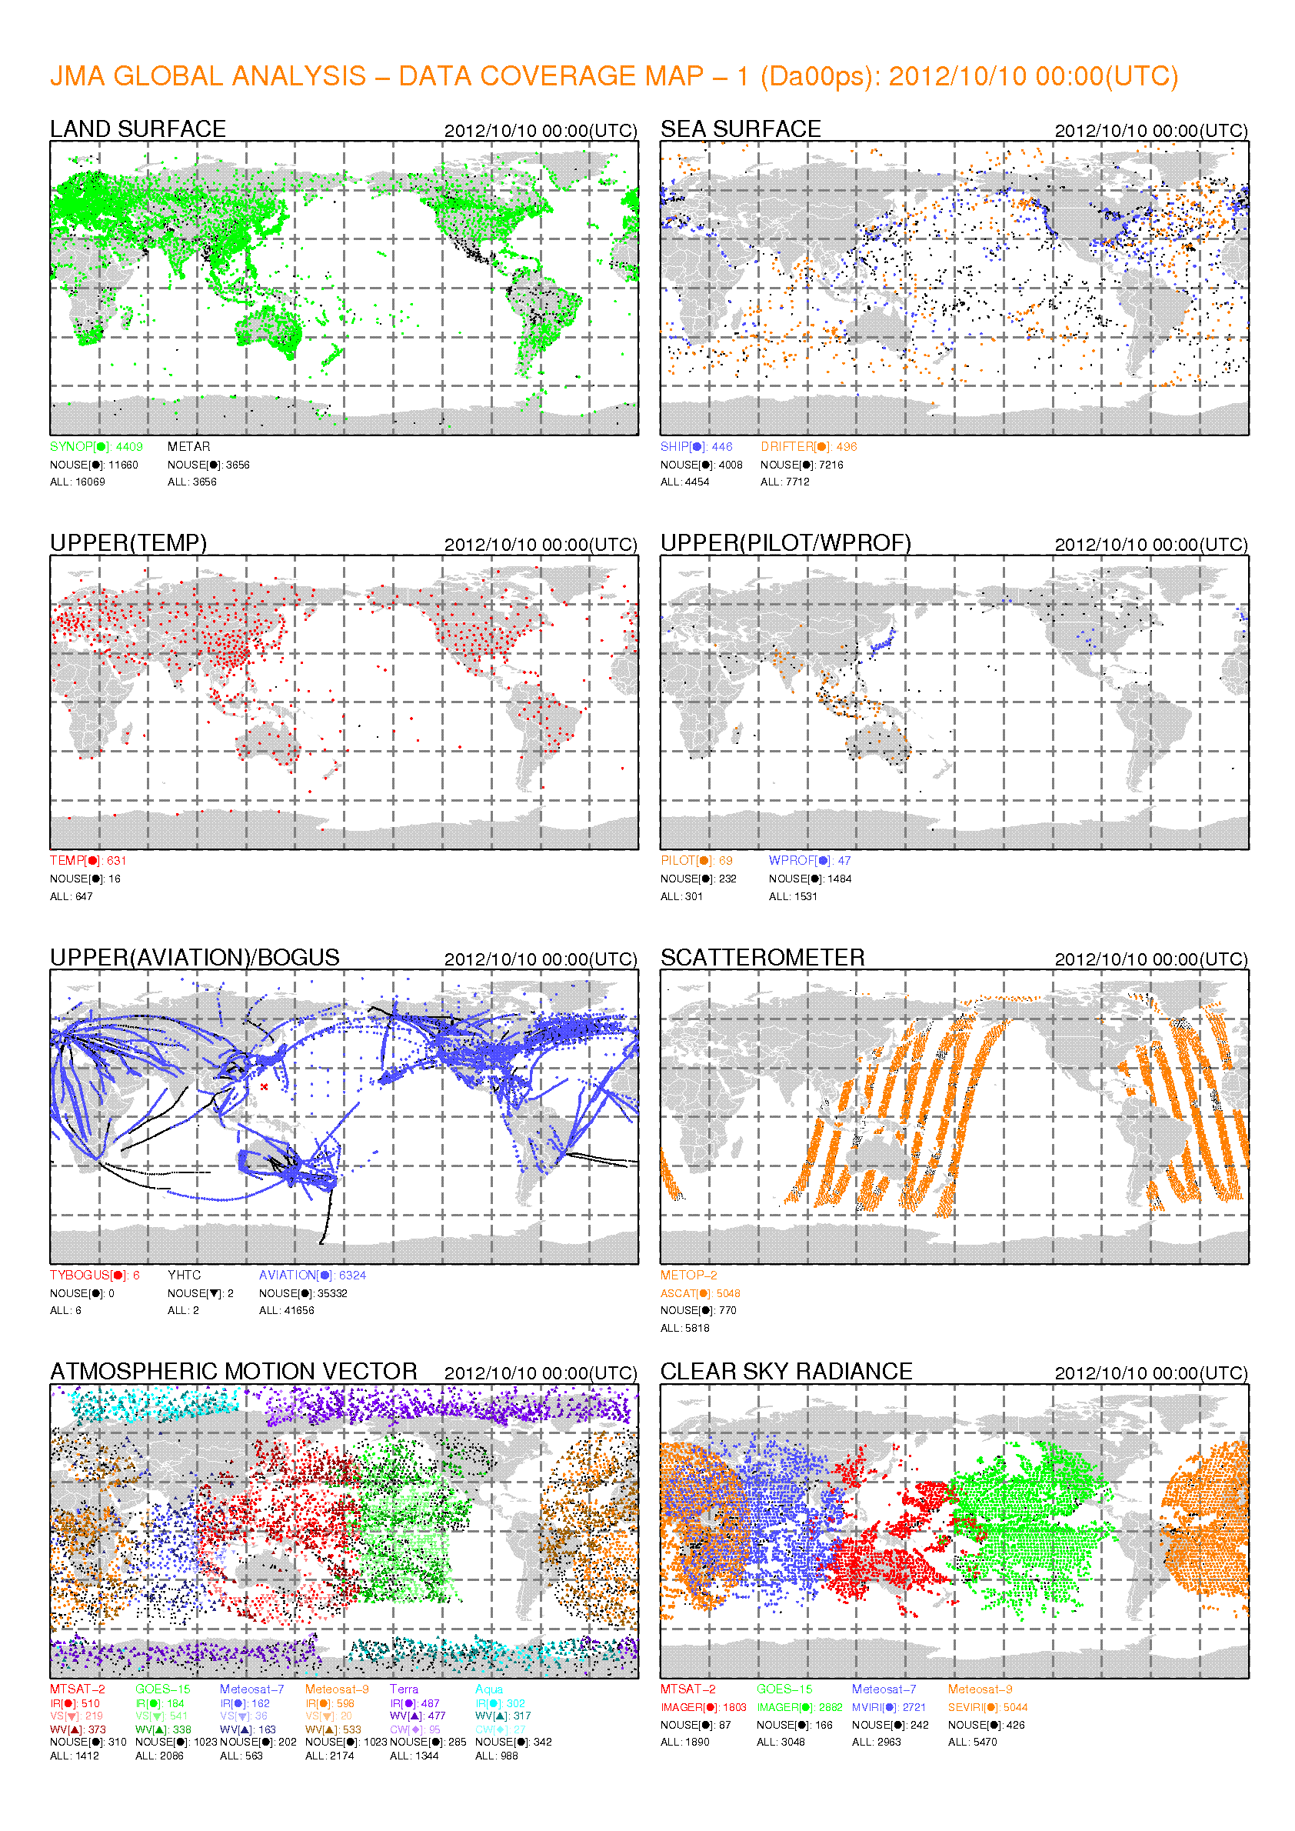
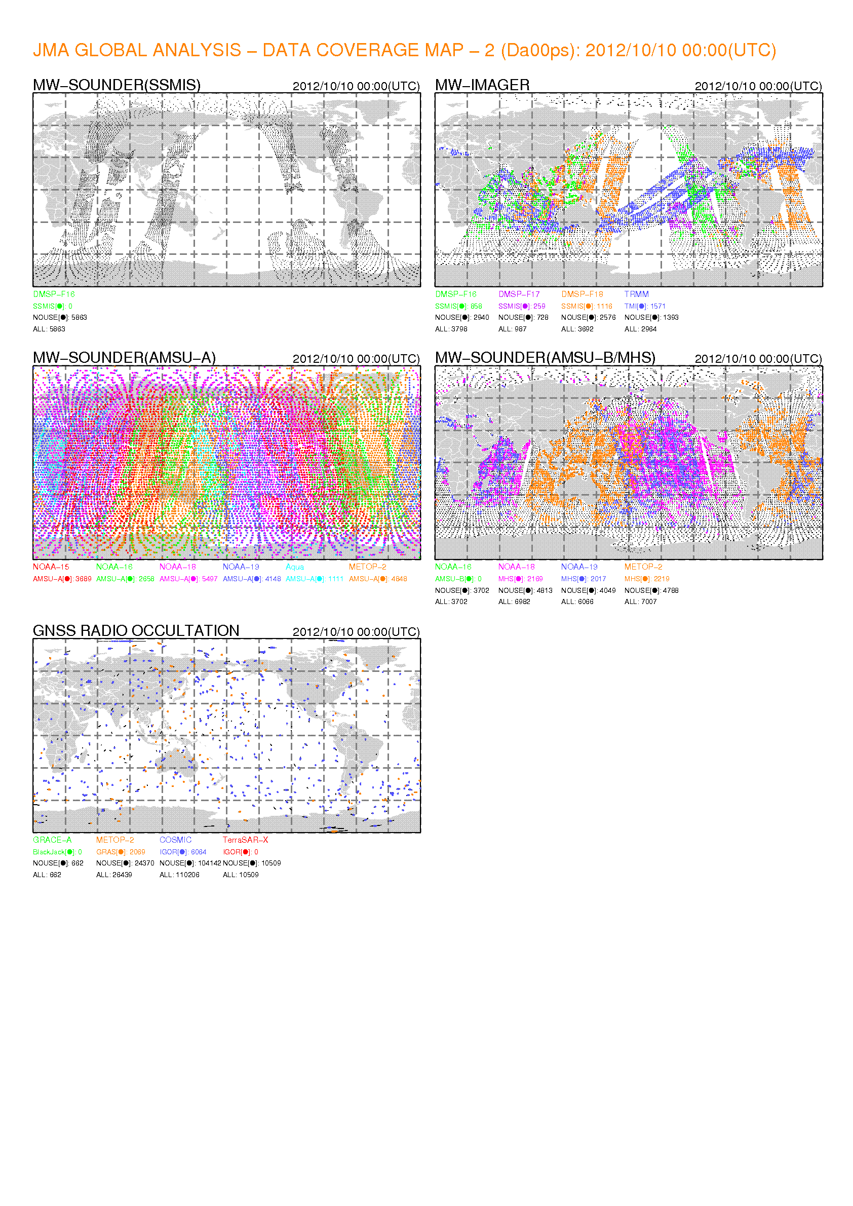
Coverage Map (Cycle Analysis)
Much more data are available in the cyclic (late) analysis.
Cut off : +11:50
for 00UTC

Slide 11
Assimilated Data Amount History
RMSE on 48-hours GPH forecast
This graph shows the assimilated data amount on the first day of each month.
So that it contains sampling error.

Slide 12
Updates for JMA DA systems after May 2011
Past
  (M) Introduction of Radar Reflectivity (Jun. 2011)
    RH retrievals are assimilated with 4D-Var
  (G) Global 4D-Var Enhancement (Oct. 2011)
    Inner model upgrades, Revised observation error settings
  Super Computing System Upgrade (Jun. 2012)
  (L) LFM/LA operation was started (Aug. 2012)
  (M,L) Introduction of a new Doppler Radar (Oct. 2012)
Plan (near future)
  (G,M) RTM upgrades (RTTOVv9.3→v10)
  (G) GNSS-RO observation operator upgrades
  (G) Introduction of AIRS, IASI
The operational NWP suits were fixed about a year for the upgrade preparation.

Slide 13
Super Computer System Upgrade

Slide 14

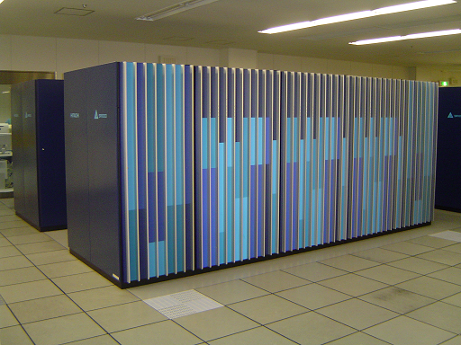
New Super Computing Systems
 | New | Old
Machine | Hitachi SR16000/M1 | Hitachi SR11000/K1 Hitachi SR11000/J1
CPU | Power 7 (3.83GHz, 8core) | Power 5 (1.9GHz), Power 5+ (2.1GHz)
CPU/NODE | 4 processors (total 32cores) | 16 processors
NODE | 864 (432x2) | 210 (80x2+50)
Peak Performance | 847 (423.5x2) T Flops | 27.5 (10.75x2+6) T Flops
Main Memory | 108 T Byte | 13.1 T Byte
operation was started on | 5 June 2012 - | 1 March 2006 -

Slide 15
Planned NWP system enhancement
Model | Plan
GSM | Increase the model levels (from 60 to 100) Raise the model top (from 0.1hPa to 0.01hPa) Extend the forecast range (TBD)
MSM | Increase the model levels (from 50 to 75) Raise the model top (TBD). Extend the forecast range (TBD).
LFM | Increase the operation frequency from three-hourly to hourly Expand the model domain
WEPS one Week EPS | Increase model resolution (from TL319L60 to TL479L100) Increase the operation frequency and the members (from M51/day to M27/12hours) Extend forecast range (TBD).
TEPS Typhoon EPS | Increase the model resolution (from TL319L60 to TL479L100) Increase the members (from M11 to M25)
MEPS Meso EPS | Start test operation of the EPS system

Slide 16
Updates

Slide 17
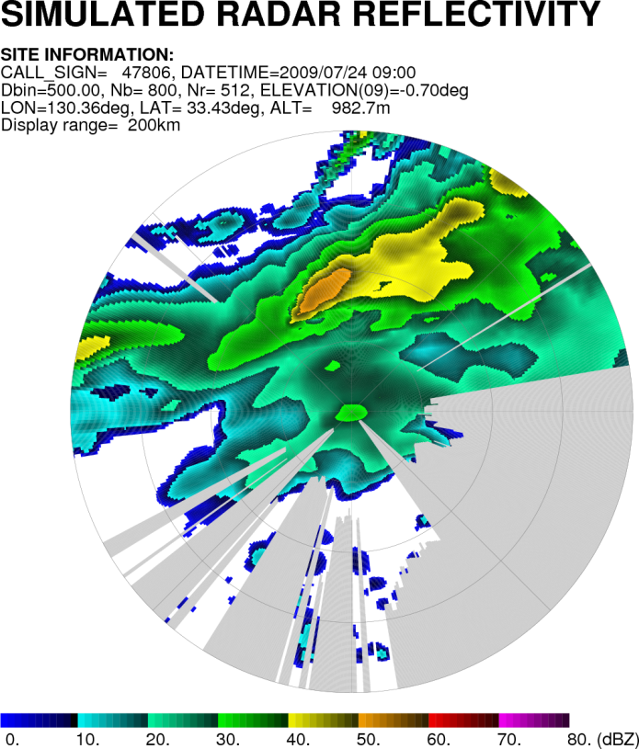
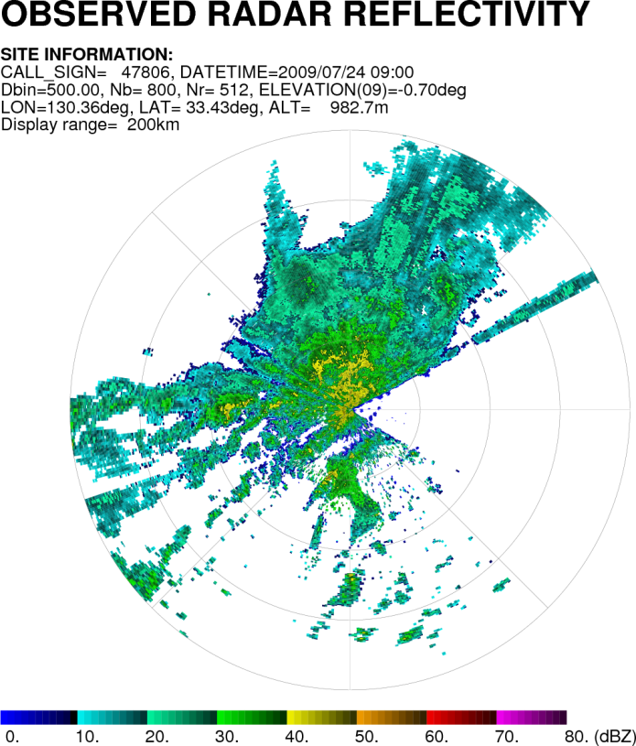
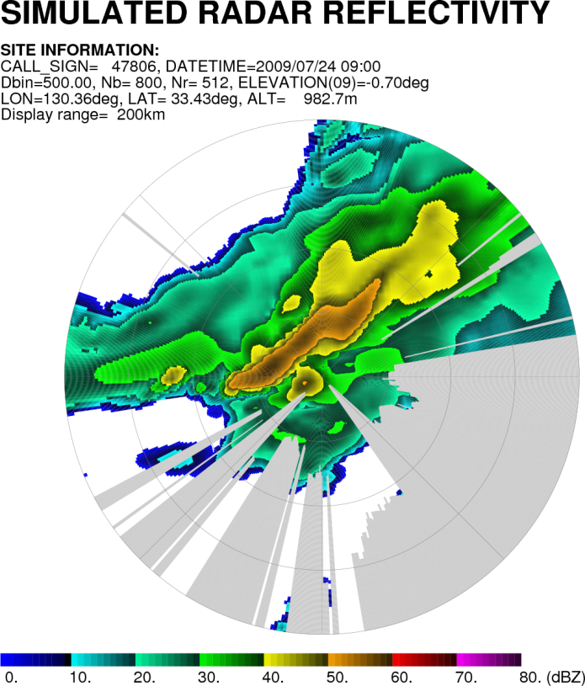
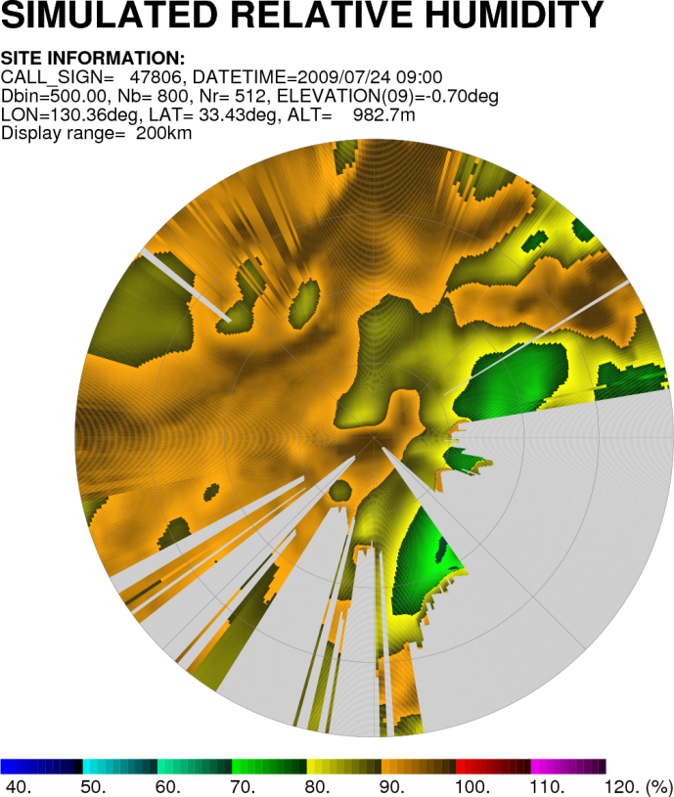
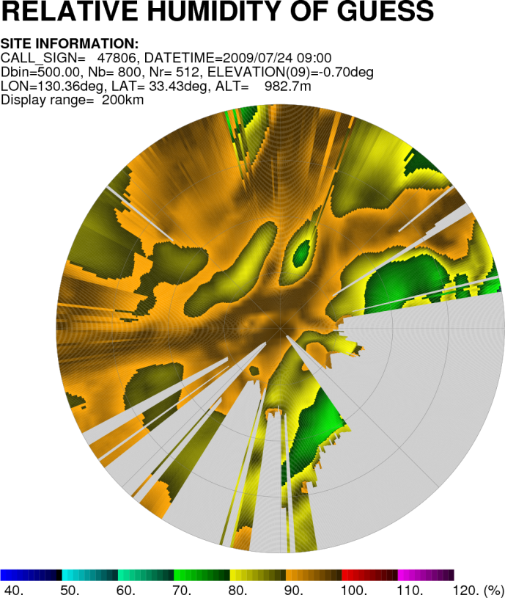
Introduction of Radar Reflectivity
We had started assimilation of the pseudo-RH data retrieved from 3D radar reflectivity by Bayesian method for MA on June 2011. The development for LA is underway.
The First Guess
Observation
The Analysis
Pseudo-RH assimilation
The echo position was relocated appropriately!

Slide 18
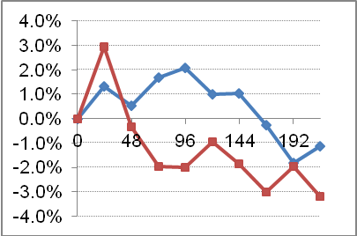
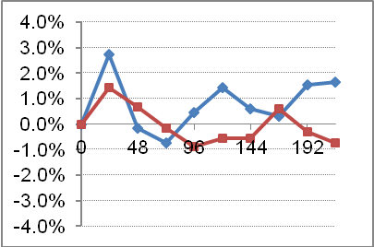
Global 4D-Var Enhancement
The inner model was upgraded about
  adoption of semi-Lagrangian scheme
  adoption of adaptive grid
  increase of the resolution (T159 → TL319)
Observation error variances were revised at the time.
The impact test
  showed improvement on Z500 forecast RMSE over NH.
Both of them were already introduced in the forecast model some years ago.
Jan. 2010
Aug. 2010
Improvement Rate on Z500 RMSE
NH
NH
SH
SH

Slide 19
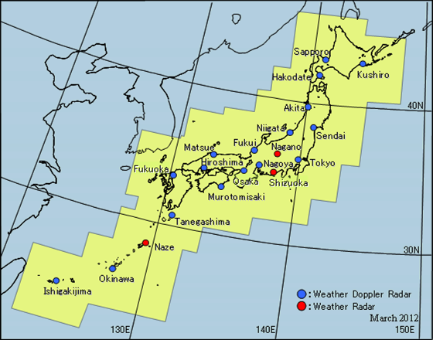
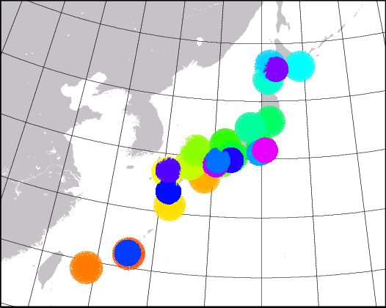
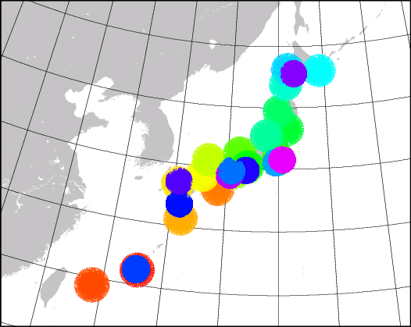
Doppler Radar
Doppler velocity observation function was added to Akita radar in March 2012. The data are added in MA/LA in this month.
Nagano, Shizuoka and Naze radar will be upgraded within a year
Before
◆
shin-
chitose
fukuoka
◆
◆
◆
◆
osaka
kansai
narita
haneda
◆
◆
◆
chubu
After
kagoshima
naha
◆
: Doppler Radar for Airport Weather

Slide 20
Plan

Slide 21

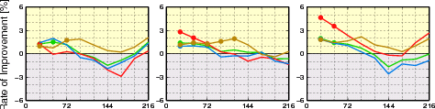
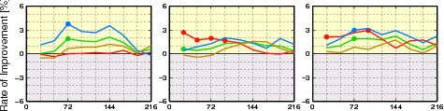
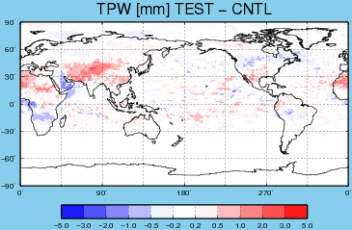
RTM upgrades
JMA plans to update RTTOV v9.3→v10
  Test periods: Jan. 2012 and Aug. 2011
    The test used MHS over the land area with RTTOV v10
      JMA does not use it over the land area at present.
  Results:
    the data humidifies the
    analysis field over land and
    showed the positive impact.
Rate of Improvement [%]
Better
+
0
-
Worse
Forecast time [hr]
PSEA
T850
Z500
Aug.
Jan.
Parallel operation of this system is underway.

Slide 22
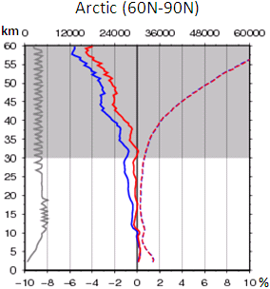
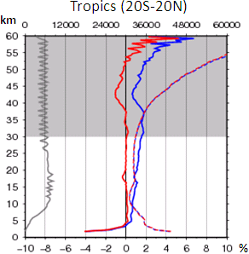
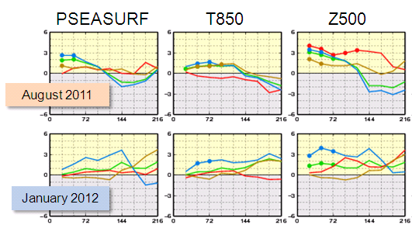
Improvement on GNSS-RO usage
Addition of new satellites/sensors
  SAC-C, GRACE-A, TerraSAR-X and C/NOFS
Revision of the observation operator
  Several inappropriate configurations were fixed,
  So that the bias correction procedures can be eliminated.
  # “Use of bending angle instead of refractivity” is the next step
Rate of Improvement [%]
Better
+
0
-
Worse
Forecast time [hr]
Solid lines: Bias structure against height
Blue; Cntl / Red: Test

Slide 23
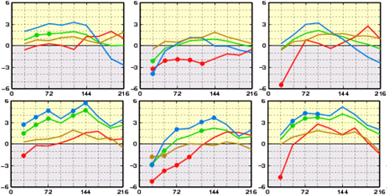
Introduction of AIRS/IASI
We could hardly obtain a good result from
AIRS/IASI assimilation for several years.
Finally we got a good result by applying several revisions
  channel selection, cloud height detection, …
The latest test showed improvements on P_{MSL} and Z500 forecast but on T850 especially over Tropics.
  A careful investigation is
  underway
Rate of Improvement [%]
Better
+
0
-
Worse
Forecast time [hr]
PSEA
T850
Z500
Aug.
Jan.

Slide 24
Topics

Slide 25
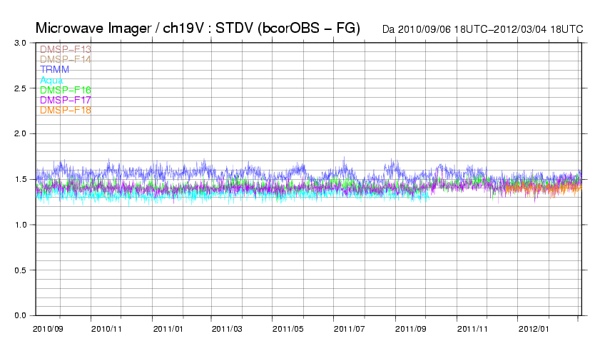
Quality Monitoring for MW imager
TMI quality improvement by the product version up
(K)
Reduction of TMI STDV
Cause: TMI version up (v6→v7)
Slight increase of STDV on DMSP-F17/SSMIS
Cause: It might be the first guess quality degradation from AMSR-E data stop
AMSR-E data stop
50 days sequence

Slide 26
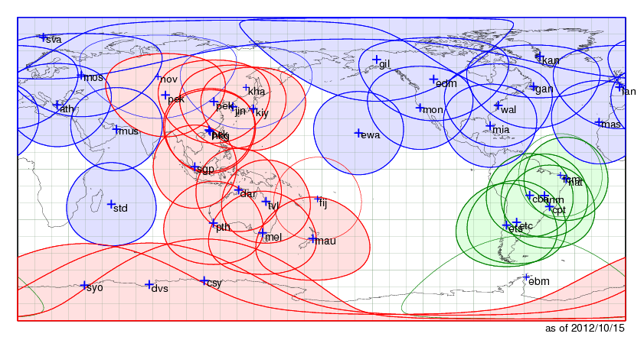
Available RARS sites in JMA
AP-RARS(from 22 Feb. 2007)/EARS(from 2 Aug. 2007)/SA-RARS(from 18 May 2010)
Used AMSU data (Sampled on 1-9 September 2012)
Cycle Analysis
Data Cut-off: 11:50 or 7:50
Early Analysis
Data Cut-off: 2:20
Meso Analysis
Data Cut-off: 0:50
(Limited Area)

Slide 27

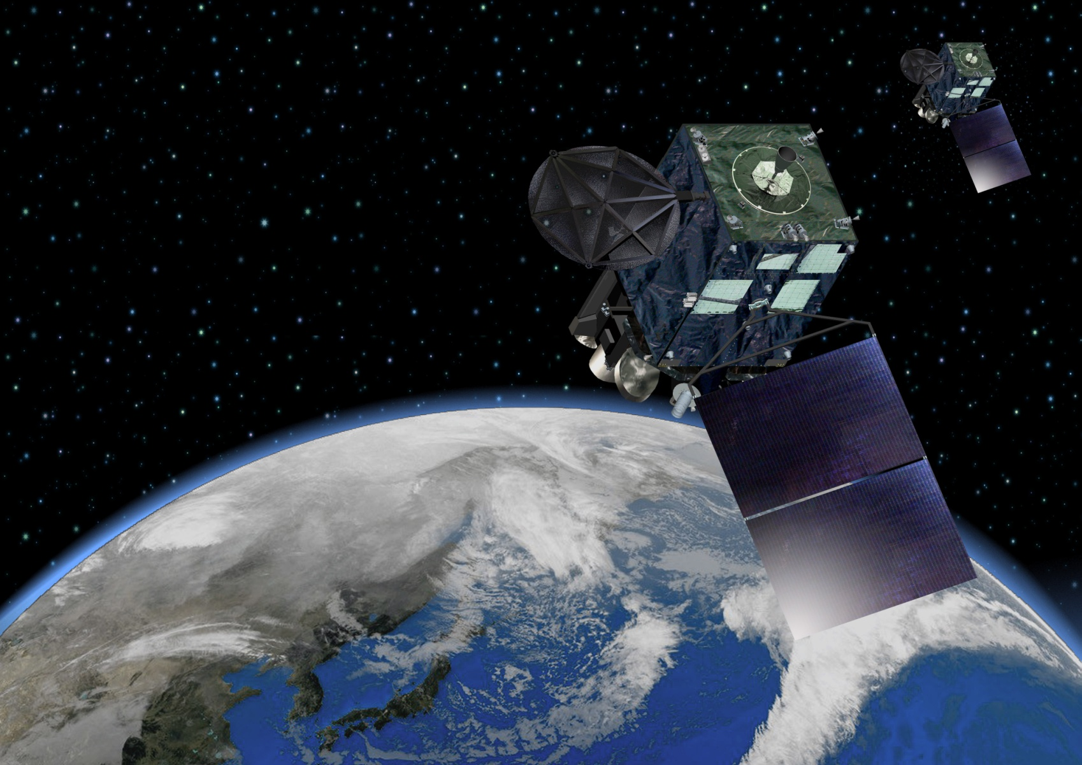
Status of Himawari-8/9 Project
prepared by
Satellite Program Division, Japan Meteorological Agency

Slide 28
Schedule of Himawari-8/9 Project

Slide 29
Schedule (updated)
JMA has made a contract with Mitsubishi Electric Corp. (MELCO) for the manufacture of Himawari-8/9 in July 2009
JMA has made a contract with Himawari OPeration Enterprise Corp. (HOPE) for the operation of Himawari-8/9 in September 2010
JMA plans to launch Himawari-8 in 2014 and begin its operation in 2015
The launch of Himawari-9 for in-orbit standby is also scheduled in 2016
Himawari-8/9 will be in operation around 140 degrees East covering the East Asia and the Western Pacific
Notes:
General objectives;
- Dedicated satellite to meteorological function
- Observation mission by the Advanced Himawari Imager (AHI)
- Data Collection System mission

Slide 30
Schedule
Himawari-8
Himawari-9
AHI
The work seems on schedule at present.
▲
EQSR
▲
CDR
Satellite BUS
▲
PDR
▲
CDR
▲
PDR
Ground
Sub-System
▲
CDR
EQSR: Equipment Qualification Status Review
PDR: Preliminary Design Review
CDR: Critical Design Review

Slide 31
Specification of Himawari-8/9

Slide 32
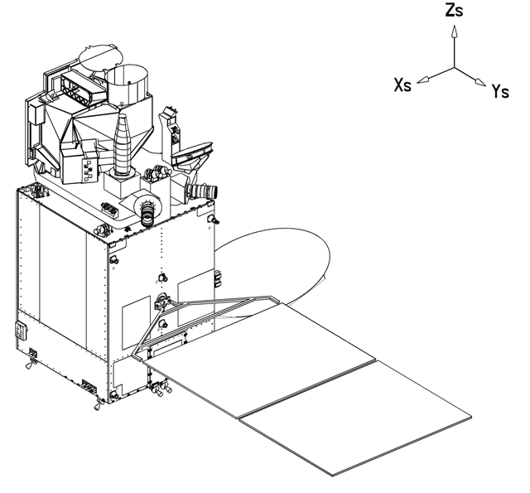
Appearance of Himawari-8/9
DS-2000
AHI (Advanced Himawari Imager)
UHF-band Antenna
Ku-band Antenna
Star Tracker
Imager Bench
Ka-band Antenna
Space Environment Data Acquisition Montor (SEDA)
Solar Array Panel

Slide 33





Operational Plan of Himawari-8/9
Operational Plan (with Improved Instruments)
 |  | MTSAT-1R and -2 |  |  |  | Himawari-8 and -9
Spatial resolution | VIS: IR: | 1.0 km 4.0 km |  |  |  | 0.5/1.0 km 2.0 km
Interval |  | 60 min./Full Disk, 30 min./Nor. |  |  |  | 10 min./Full Disk, 2.5 min./region
(Central) Wavelength (μm) | VIS: | VIS (0.55 - 0.90) |  |  |  | 3 ch (0.46, 0.51, 0.64)
 | Near IR: | -- |  |  |  | 3 ch (0.86, 1.6, 2.3)
 | IR: | IR4 (03.5 - 04.0) IR3 (06.5 - 07.0) IR1 (10.3 - 11.3) IR2 (11.5 - 12.5) |  |  |  | 10 ch (3.9, 6.2, 7.0, 7.3, 8.6, 9.6, 10.4, 11.2, 12.3, 13.3)
⇒
（almost doubled）
?
What would it be like to see
satellite images with
10-minute time interval?
JMA had performed test RS operations with a back up satellite
⇒
（almost tripled）
⇒
（almost tripled）

Slide 34
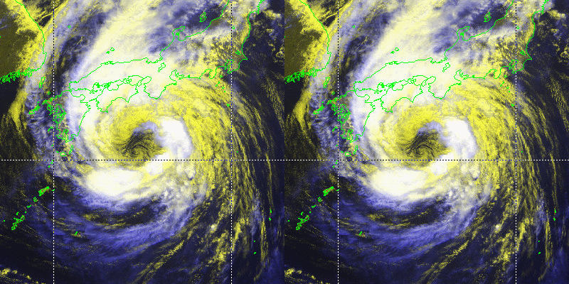
Typhoon with obs. time interval of
Left: 10 min, Right: 60 min

Slide 35
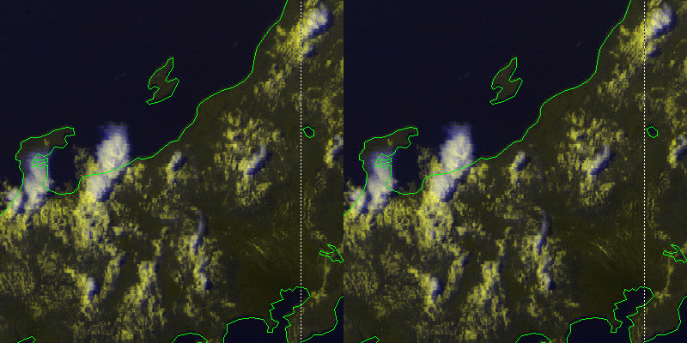
Thunderstorms with obs. time interval of
Left: 10 min, Right: 60 min

Slide 36
Wind Vectors derived from Rapid Scan
(performed by MTSAT-1R)

Slide 37
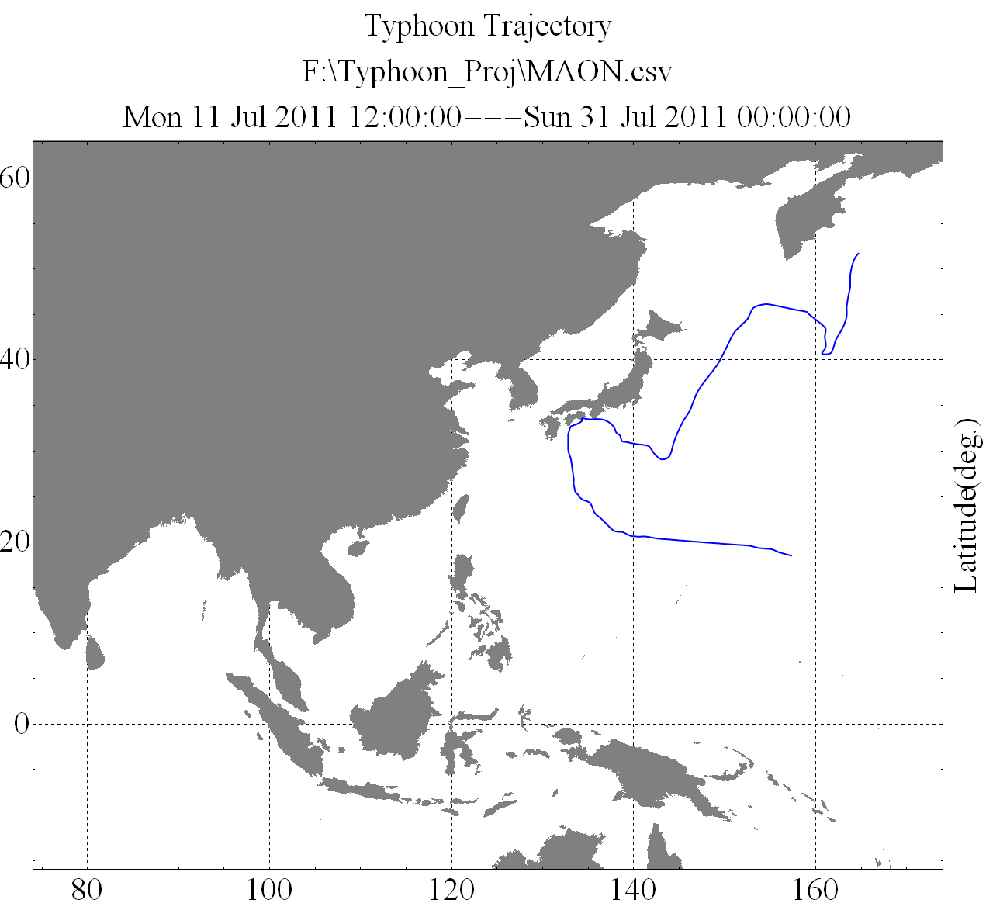
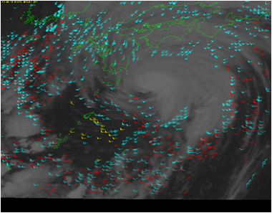
Derivation of MTSAT-1R Rapid-Scan Winds
Rapid-Scan Area
MTSAT-1R Rapid-Scan Winds:
Objective: Spatially and temporally high-resolution AMV for typhoon monitoring and meso-scale NWP
Area: Around Japan
Image: 5-minute intervals of IR (10.8 um), WV (6.8 um), VIS
Time: Daytime (00-09 UTC) in summer (Jun. to Sep.)

Slide 38
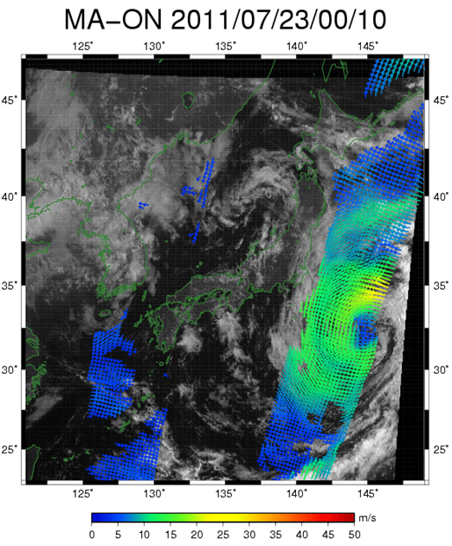
Comparison of Rapid Scan AMVs (VIS) with ASCAT Sea Surface Winds
A case study of Typhoon Ma-on
ASCAT winds and
Rapid-scan VIS winds (up to 1000km from TC center)
ASCAT vs Rapid Scan AMVs (visible)
Collocation condition
± 1 hour
± 0.2 deg. (Nearest Neighbor)
≤ 1000 km from JMA’s TC best track
Statistics period
17th to 23rd of July 2011
Quality control
QI > 0.8 (AMV)
Rejecting land, ice and rain flag etc.
(ASCAT)

Slide 39
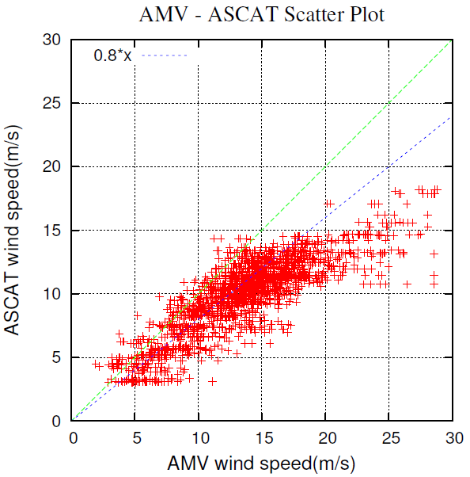
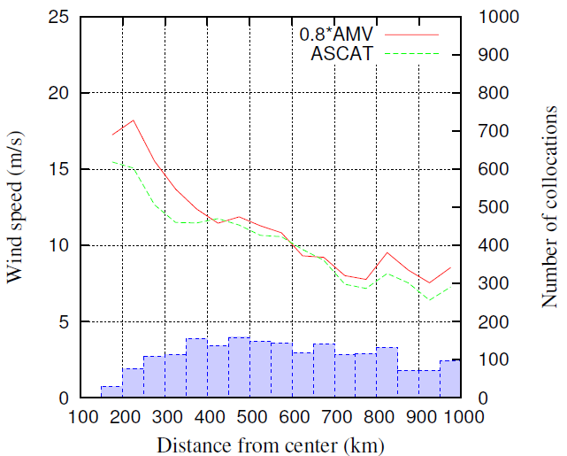
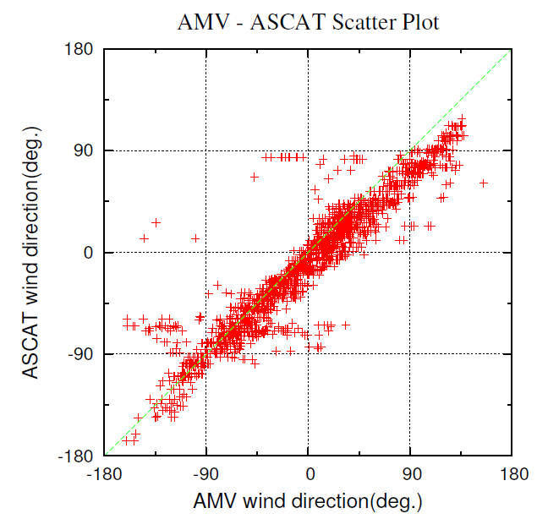
Comparison between ASCAT and
MTSAT-1R Rapid-scan VIS wind
The two data seemed correlated
ASCAT wind speeds are about 20% lower than MTSAT VIS ones
Histograms of ASCAT wind speeds and 0.8 * MTSAT VIS ones are well correlated

Slide 40
Disseminating Plan

Slide 41



Disseminating Plan of Himawari-8/9 data to
MDUS/SDUS Users
Disaster areas where landline is down
Countries where landline is not well-developed
Himawari-8/9
Commercial Telecommunication Satellite (CTS)
C-band (3 GHz)
HRIT/LRIT compatible data
Data
CTS Operator
Internet
USERS
Full data
Users with developed
internet environment
JMA
jpeg imagery
Users with limited
internet connection

Slide 42
Himawari-8/9 Imagery Data Dissemination via Commercial Telecommunication Satellites
Feasibility Study has just started in JMA
# No budget commitment at present
Feasibility study on data dissemination via
commercial telecommunication satellites
in early 2013
Parallel dissemination for users’ smooth transition from MTSAT to Himawari

Slide 43
Status of the GTS connection to RTH Tokyo
Kenji Tsunoda
RTH focal point for Tokyo, JMA
Presented by Yoshiaki SATO
(Numerical Prediction Division of JMA)
Twelfth Meeting on Asia-Pacific Satellite Data Exchange and Utilization (APSDEU-12)
(Exeter, UK, 22 to 25 October 2012)

Slide 44
GTS connections (Oct. 2012)
Melbourne
Exeter
RMDCN
MPLS network
(OBS)
Beijing
Washington
New Delhi
3Mbps
10Mbps
MPLS network
(NTT)
Tokyo
64kbps
2Mbps
Khabarovsk
Bangkok
Manila
128kbps
Seoul
Hong Kong

Slide 45
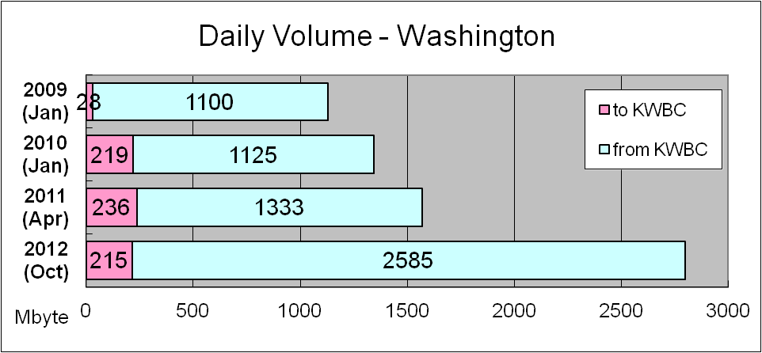
Daily Volume
Washington - Tokyo
      Bandwidth ---- 1Mbps
      Network type - MPLS

Slide 46
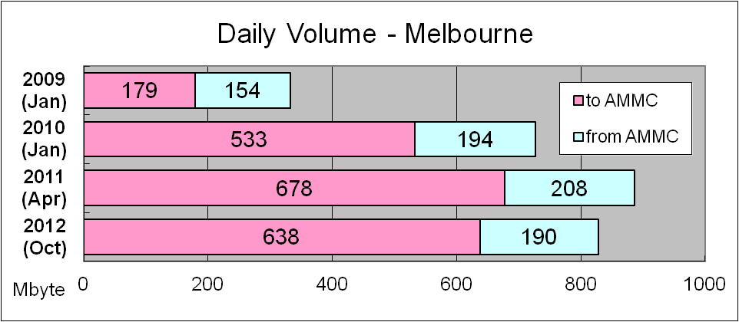
Daily Volume
Melbourne - Tokyo
      Bandwidth ---- 2Mbps
      Network type - MPLS

Slide 47
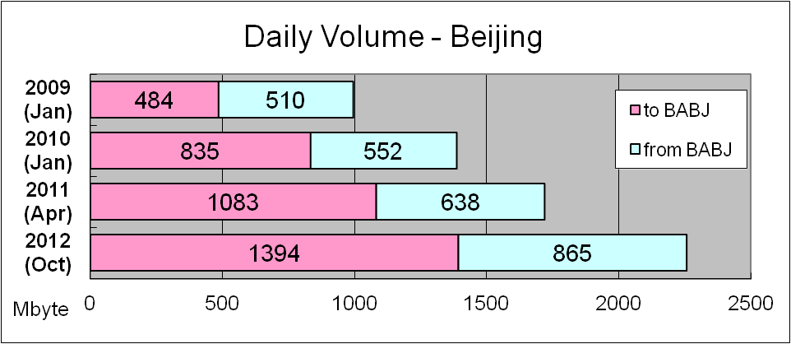
Daily Volume
Beijing - Tokyo
      Bandwidth ---- 4Mbps
      Network type - MPLS

Slide 48
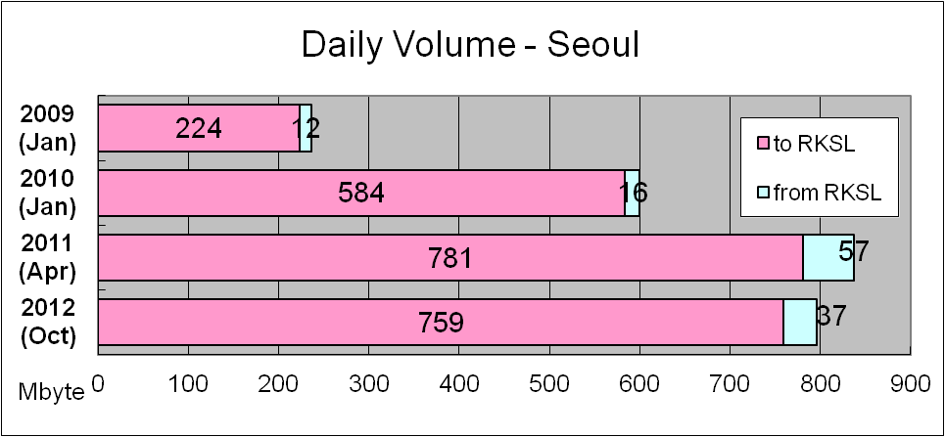
Daily Volume
Seoul - Tokyo
      Bandwidth ---- 128Kbps
      Network type - Dedicated line

Slide 49
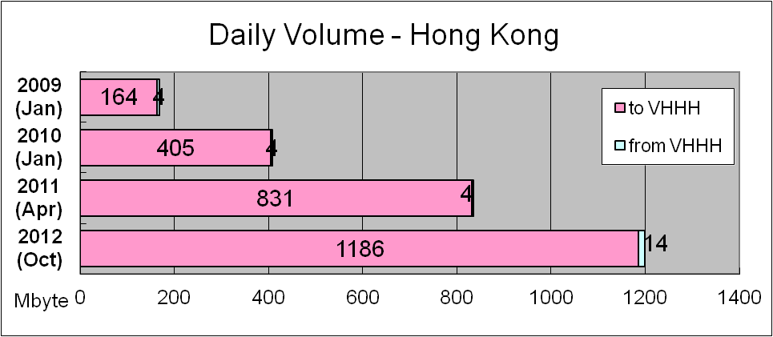
Daily Volume
Hong Kong - Tokyo
      Bandwidth ---- 1Mbps
      Network type - MPLS

Slide 50
Satellite Data Exchange APSDEU11 to 12
IASI
  10 Feb. 2012: To Hong Kong
MTSAT CSR
  23 Mar. 2012: To ECMWF
COSMIC
  12 Sep. 2012: To Beijing

Slide 51

AP-RARS connectivity
Singapore
Hong Kong
Jincheon
Fiji
Asia-pacific regional RARS center
Melbourne
Tokyo
Crib Point1
Darwin
Perth
Townsville
Casey
Davis
Beijing
Guangzhou
Urumuqi
Kiyose
Syowa
Kelburn
Maupuia
Exeter
Washington

Slide 52
Answer to the Action Items

Slide 53
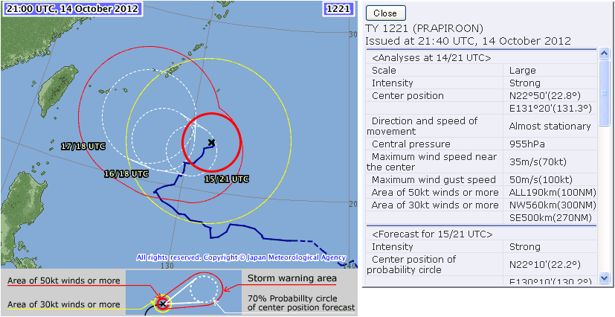
Answer to the Action Items
Action 2011-11-11 Tropical Cyclone Data
  Tropical Cyclone information in JMA (RSMC Tokyo) is already disseminated in SAREP report or Tropical Cyclone Advisory via GTS.

Slide 54
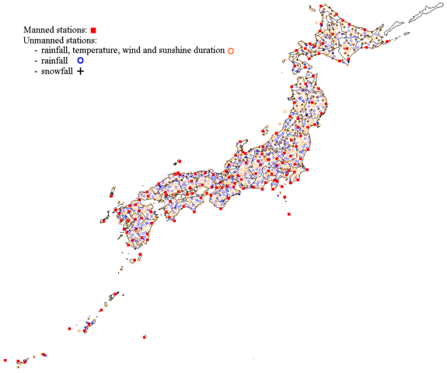
Answer to the Action Items
Action 2011-11-12 Hourly Surface Observations/Soil Temperatures
  Soil temperature is NOT observed by JMA
  Hourly observation data provision will be considered on the request basis.

Slide 55
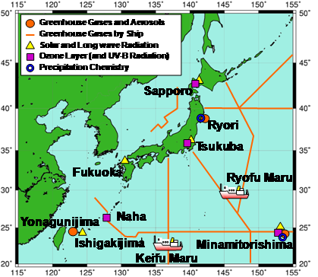
Answer to the Action Items(cont)
Action 2011-11-13 Ozone Soundings
  Ozone observations are being conducted by JMA. But the system is not designed for real-time data distribution. Upon request, the upgrade and the data distribution will be considered.

Slide 56
Answer to the Action Items(cont)
Action 2011-11-13 Ocean Data/Tidal Gauges/Sea Level Observations
  Observation ships, Argo float, drifters and Tidal Gauges/Sea Level Observations in JMA are already exchanged via GTS.

Slide 57
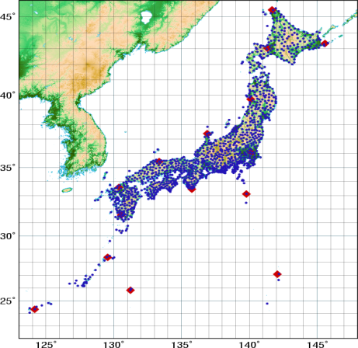
Answer to the Action Items(cont)
Action 2011-11-14 GPS Total Column Water Vapor
  Recently, JMA decided to disseminate the Japanese ground based GNSS PWV data via GTS. The work is undergoing.
  We strongly hope the other countries also provide their data.
GEONET sites

Slide 58
Answer to the Action Items(cont)
Action General 2.x operational exchange of radar data.
  JMA has 20 C-band radar and 17 of them have Doppler function.
    The rest 3 will be upgraded within a year.
  The data size is very large for real-time exchange.
    67MB/10min for Ref. and 26MB/10min for DPV in GRIB2
  A careful consideration is needed for such a large data exchange.
    ex) thinned / superobbed data, some product such as VAD winds, etc.

Slide 59
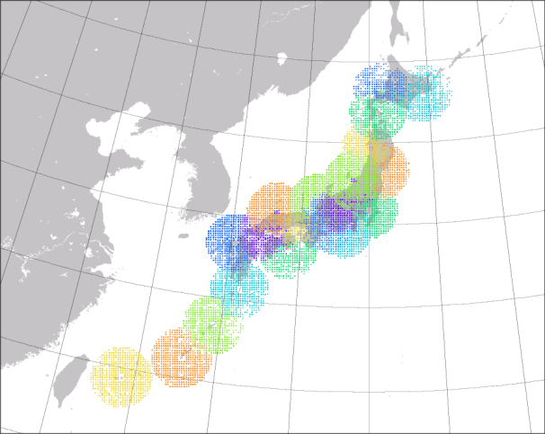
Weather (Doppler) Radar
Doppler velocity observation function was added to Akita radar in March 2012. The data are added in MA/LA.
Nagano, Shizuoka and Naze radar will be upgraded within a year
◆
Answer to the Action Items
shin-
chitose
Reflectivity
fukuoka
◆
◆
◆
◆
osaka
kansai
narita
haneda
◆
◆
◆
chubu
kagoshima
naha
◆
: Doppler Radar for Airport Weather
Doppler Velocity

Slide 60

Thanks for your Attention
Questions?

