Slide 1
Satellite Activities in KMA, Status of COMS and Future Plans
JAE-DONG JANG
Satellite Operation Division
NMSC/KMA

Slide 2
Status of COMS operation

Slide 3


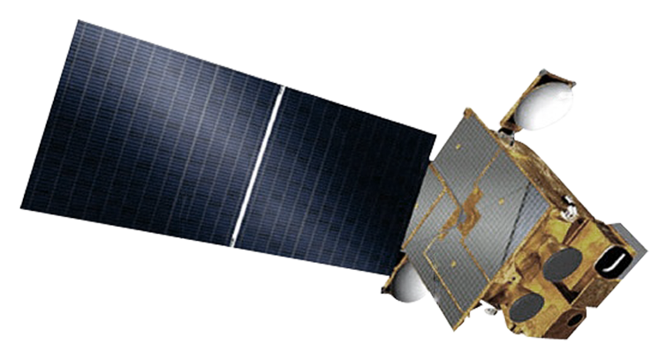


COMS Program
COMS is the first multi-purpose geostationary satellite for Korea in the application of Meteorology, Ocean and Communication
    Meteorological Mission : Continuous Meteorological Observation to support weather forecasting and early detection of severe weather phenomena
    Period : 2003 - 2010 (8 yrs)
    Orbit : 128.2°E over equator (36,000 km)
    Mass : 2,500 kg
    Design life : 7 years (04/2011~03/2018)
    Data Dissemination: HRIT/LRIT services
Solar Panel
Ka-band Antenna
Meteorological
Imager
Communication, Ocean and
Meteorological Satellite
GOCI

Slide 4
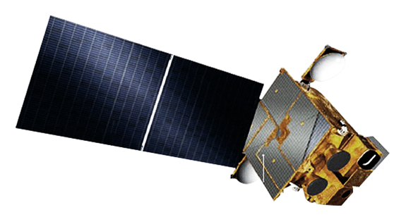

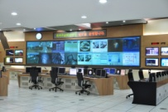









COMS Operation and Services
COMS
HRIT/LRIT
MDUS/SDUS
ㄱ
User Agencies
ㄱ
HRIT/LRIT
Raw data
TM/TC(backup)
Raw data
KMA
TM/TC
HRIT/LRIT(backup)
NWP
NMSC
KARI
(Korea Aerospace Research Institute)
Internet
HRIT (High Rate Information Transmission)
LRIT (Low Rate Information Transmission)
End User

Slide 5


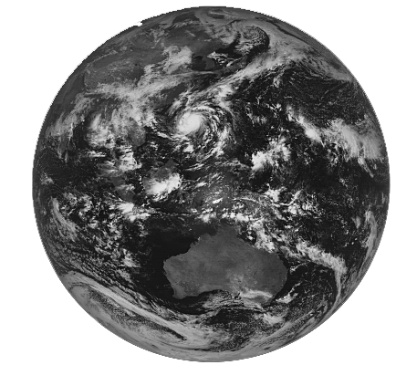

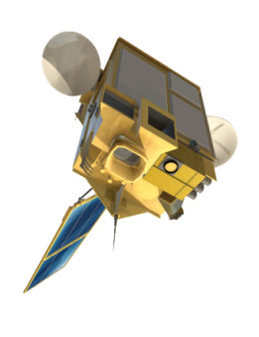
Observation Schedule for COMS
Full Disk: Every 3hrs
Northern Hemisphere: 15 min
➤ Support for early detection of severe weather phenomena
 |  |  |  |  |  |  |  |  |  | 10 |  |  |  |  |  |  |  |  |  | 20 |  |  |  |  |  |  |  |  |  | 30 |  |  |  |  |  |  |  |  |  | 40 |  |  |  |  |  |  |  |  |  | 50 |  |  |  |  |  |  |  |  |  | 60
0 |  |  |  |  | 5 |  |  |  |  |  |  |  |  |  | 15 |  |  |  |  |  |  |  |  |  | 25 |  |  |  |  |  |  |  |  |  | 35 |  |  |  |  |  |  |  |  |  | 45 |  |  |  |  |  |  |  |  |  | 55
00 UTC
 | ENH 02 |  |  |  |  |  |  |  |  |  |  |  |  |  |  | ENH 03 |  |  |  |  |  |  |  |  |  |  |  |  |  |  | ENH 04 |  |  |  |  |  |  |  |  |  |  |  |  |  |  | ENH 05
01 UTC
 | ENH 06 |  |  |  |  |  |  |  |  |  |  |  |  |  |  | ENH 07 |  |  |  |  |  |  |  |  |  |  |  |  |  |  | ENH 08 |  |  |  |  |  |  |  |  |  |  |  |  |  |  | ENH 09
02 UTC
 | ENH 10 |  |  |  |  |  |  |  |  |  |  |  |  |  |  | FD 01 |  |  |  |  |  |  |  |  |  |  |  |  |  |  |  |  |  |  |  |  |  |  |  |  |  |  |  |  |  | ENH 11
03 UTC
 | ENH 12 |  |  |  |  |  |  |  |  |  |  |  |  |  |  | ENH 13 |  |  |  |  |  |  |  |  |  |  |  |  |  |  | ENH 14 |  |  |  |  |  |  |  |  |  |  |  |  |  |  | ENH 15
04 UTC
 | ENH 16 |  |  |  |  |  |  |  |  |  |  |  |  |  |  | ENH 17 |  |  |  |  |  |  |  |  |  |  |  |  |  |  | ENH 18 |  |  |  |  |  |  |  |  |  |  |  |  |  |  | ENH 19

Slide 6
COMS L/HRIT Dissemination Schedule
 |  |  |  |  |  |  |  |  |  | 10 |  |  |  |  |  |  |  |  |  | 20 |  |  |  |  |  |  |  |  |  | 30 |  |  |  |  |  |  |  |  |  | 40 |  |  |  |  |  |  |  |  |  | 50 |  |  |  |  |  |  |  |  |  | 60
0 |  |  |  |  | 5 |  |  |  |  |  |  |  |  |  | 15 |  |  |  |  |  |  |  |  |  | 25 |  |  |  |  |  |  |  |  |  | 35 |  |  |  |  |  |  |  |  |  | 45 |  |  |  |  |  |  |  |  |  | 55
23 UTC 08 KST
MI Schedule |  |  |  |  |  |  |  |  |  |  |  |  |  |  |  |  |  |  |  |  |  |  |  |  |  |  |  |  |  |  |  |  |  |  |  |  |  |  |  |  |  |  |  |  |  | ENH 01
HRIT
LRIT
00 UTC 09 KST
MI Schedule | ENH 02 |  |  |  |  |  |  |  |  |  |  |  |  |  |  | ENH 03 |  |  |  |  |  |  |  |  |  |  |  |  |  |  | ENH 04 |  |  |  |  |  |  |  |  |  |  |  |  |  |  | ENH 05
HRIT |  |  |  |  |  |  |  |  |  | ENH 01 |  |  |  |  |  |  |  |  |  |  |  |  |  |  | ENH 02 |  |  |  |  |  |  |  |  |  |  |  |  |  |  | ENH 03 |  |  |  |  |  |  |  |  |  |  |  |  |  |  | ENH 04
LRIT |  |  |  |  |  |  |  |  |  | ENH 01 |  |  |  |  |  |  |  |  |  |  |  |  |  |  | ENH 02 |  |  |  | CT 01 |  |  |  | CTH 01 |  |  | CTT 01 |  |  |  | ENH 03 |  |  |  |  |  | GOCI 01 |  |  |  |  |  |  |  |  | ENH 04
01 UTC 10 KST
MI Schedule | ENH 06 |  |  |  |  |  |  |  |  |  |  |  |  |  |  | ENH 07 |  |  |  |  |  |  |  |  |  |  |  |  |  |  | ENH 08 |  |  |  |  |  |  |  |  |  |  |  |  |  |  | ENH 09
HRIT |  |  |  |  |  |  |  |  |  | ENH 05 |  |  |  |  |  |  |  |  |  |  |  |  |  |  | ENH 06 |  |  |  |  |  |  |  |  |  |  |  |  |  |  | ENH 07 |  |  |  |  |  |  |  |  |  |  |  |  |  |  | ENH 08
LRIT |  |  |  |  |  |  |  |  |  | ENH 05 |  |  |  |  |  |  |  |  |  |  |  |  |  |  | ENH 06 |  |  |  |  |  |  |  |  |  |  |  |  |  |  | ENH 07 |  |  |  |  |  | GOCI 02 |  |  |  |  |  |  |  |  | ENH 08
02 UTC 11 KST
MI Schedule | ENH 10 |  |  |  |  |  |  |  |  |  |  |  |  |  |  | FD 01 |  |  |  |  |  |  |  |  |  |  |  |  |  |  |  |  |  |  |  |  |  |  |  |  |  |  |  |  |  | ENH 11
HRIT |  |  |  |  |  |  |  |  |  | ENH 09 |  |  |  |  |  |  |  |  |  |  |  |  |  |  | ENH 10 |  |  |  |  |  |  |  |  |  |  |  |  |  |  |  | FD 01
LRIT |  |  |  |  |  |  |  |  |  | ENH 09 |  |  |  |  |  |  |  |  |  |  |  |  |  |  | ENH 10 |  |  |  |  |  |  |  |  |  |  |  |  |  | GOCI |  | 03 | FD 01
03 UTC 12 KST
MI Schedule | ENH 12 |  |  |  |  |  |  |  |  |  |  |  |  |  |  | ENH 13 |  |  |  |  |  |  |  |  |  |  |  |  |  |  | ENH 14 |  |  |  |  |  |  |  |  |  |  |  |  |  |  | ENH 15
HRIT |  |  |  |  |  |  |  |  |  | ENH 11 |  |  |  |  |  |  |  |  |  |  |  |  |  |  | ENH 12 |  |  |  |  |  |  |  |  |  |  |  |  |  |  | ENH 13 |  |  |  |  |  |  |  |  |  |  |  |  |  |  | ENH 14
LRIT |  |  |  |  |  |  |  |  |  | ENH 11 |  |  |  |  |  |  |  |  |  |  |  |  |  |  | ENH 12 |  |  |  | CT 02 |  |  |  | CTH 02 |  |  | CTT 02 |  |  |  | ENH 13 |  |  |  |  |  | GOCI 04 |  |  |  |  |  |  |  |  | ENH 14
04 UTC 13 KST
MI Schedule | ENH 16 |  |  |  |  |  |  |  |  |  |  |  |  |  |  | ENH 17 |  |  |  |  |  |  |  |  |  |  |  |  |  |  | ENH 18 |  |  |  |  |  |  |  |  |  |  |  |  |  |  | ENH 19
HRIT |  |  |  |  |  |  |  |  |  | ENH 15 |  |  |  |  |  |  |  |  |  |  |  |  |  |  | ENH 16 |  |  |  |  |  |  |  |  |  |  |  |  |  |  | ENH 17 |  |  |  |  |  |  |  |  |  |  |  |  |  |  | ENH 18
LRIT |  |  |  |  |  |  |  |  |  | ENH 15 |  |  |  |  |  |  |  |  |  |  |  |  |  |  | ENH 16 |  |  |  |  |  |  |  |  |  |  |  |  |  |  | ENH 17 |  |  |  |  |  | GOCI 05 |  |  |  |  |  |  |  |  | ENH 18
05 UTC 14 KST
MI Schedule | ENH 20 |  |  |  |  |  |  |  |  |  |  |  |  |  |  | FD 02 |  |  |  |  |  |  |  |  |  |  |  |  |  |  |  |  |  |  |  |  |  |  |  |  |  |  |  |  |  | ENH 21
HRIT |  |  |  |  |  |  |  |  |  | ENH 19 |  |  |  |  |  |  |  |  |  |  |  |  |  |  | ENH 20 |  |  |  |  |  |  |  |  |  |  |  |  |  |  |  | FD 02
LRIT |  |  |  |  |  |  |  |  |  | ENH 19 |  |  |  |  |  |  |  |  |  |  |  |  |  |  | ENH 20 |  |  |  |  |  |  |  |  |  |  |  |  |  | GOCI |  | 06 | FD 02
COMS MI Schedule Modification for Satellite Operation
- Station keeping : 2 times/week (N-S(TUE), E-W(THR))
- House keeping : 2 times/day (00:45, 06:45 15:21 UTC)
- Albedo monitoring : 1 time/day (Around 21:35 UTC)
- Dark image observation : 1 time/3 months
- Moon observation : 1 time/month

Slide 7
Result of COMS Data Services
Average of COMS data services for HRIT: 99.76% (April 2011 ~ August 2012)
- COMS Data Services : 43647/43750 (April 2011 ~ August 2012)

Slide 8
Data, production and service

Slide 9
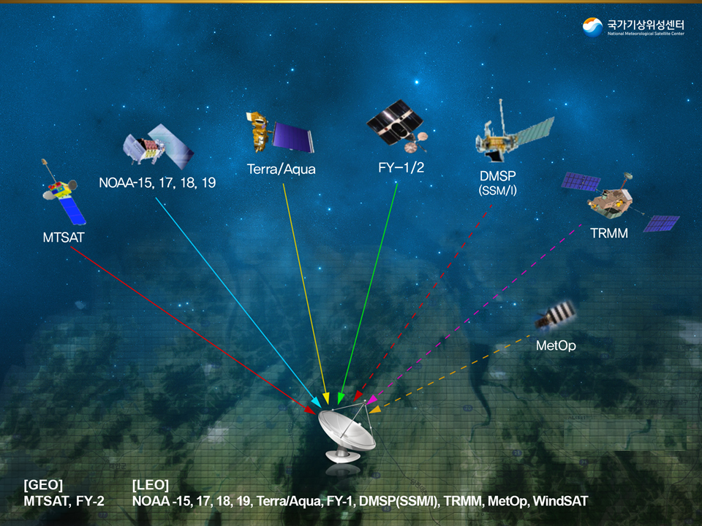
Utilization of Foreign Satellite Data
Total 3 GEO
Total 13 LEO
Solid line : MDUS
Dashed line : FTP

Slide 10
Satellite Data in KMA
Orbit | Satellite | Receiving Method | Period | Products
GEO | COMS | Direct | 178/day | 16
 | MTSAT | Direct FTP | 52/day | Fog, yellow dust, SST
 | FY-2D | Direct | 28/day | Image
LEO | NOAA (15,17,18,19) | Direct | 14~16/day | image Fog, SST, Dust ATOVS
 | FY-1D | Direct | 3~4/day | Image
 | Terra Aqua | Direct | 7~8/day | Image Fire, Dust Ozone, NDVI
 | DMSP (SSM/I) | FTP | 14/day | Soil moisture, LST, Land cover
 | Coriolis (Windsat) | FTP | 14/day | SSW, SST, CLW
 | TRMM | FTP | - | Rain
 | METOP (ASCAT) | FTP | Every 3miny | SSW, Soil moisture
NPP data have been received and will be serviced in the second half of 2012

Slide 11

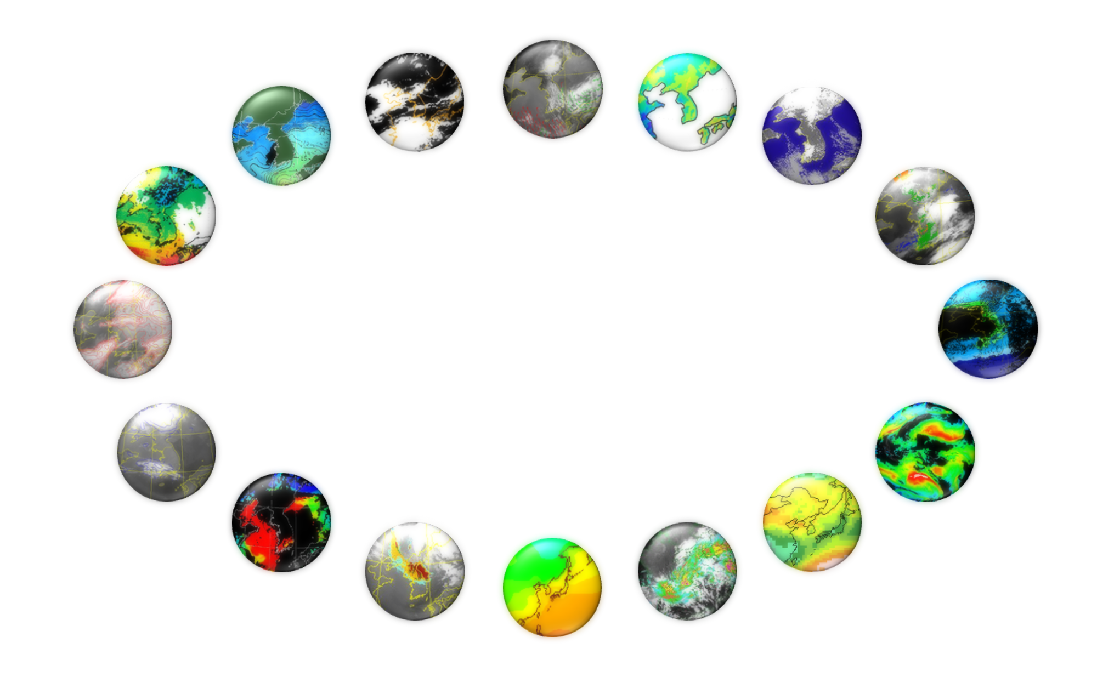
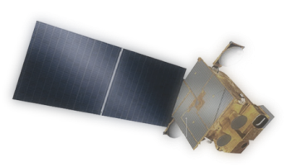
COMS Product
16 Baseline Products : Development (2003-2010) and operation (2011~)
CLD
(Cloud Detection)
AMV
(Atmospheric Motion Vector)
LST
(Land Surface Temperature)
SST
(Sea Surface Temperature)
SSI
(Sea Ice/Snow)
TPW
(Total Precipitable Water)
Fog
CTT/CTH
(Cloud Top Temperature/Height)
UTH
(Upper Tropospheric Humidity)
COMS
CA
(Cloud Analysis)
CSR
(Clear Sky Radiance)
AOD
(Aerosol Optical Depth)
INS
(Insolation)
AI
(Aerosol Index)
OLR
(Outgoing Longwave Radiation)
RI
(Rain Intensity)

Slide 12
Satellite Data Production
Presently 24,664,204 data of 28 satellites from GMS (488 TB)
Data level: Level 0, Level 1b, Images, Products
Image
Data
L1B

Slide 13
Annual Data Production
Annual Data: 10,363,283ea (From 5/11 to 4/12)
- Level 1: 171,707ea / Binary: 3,519,205ea / Images : 6,672,371ea
Image
Data
L1B

Slide 14
Monthly Data Production
Monthly Data: 900,810 ea
- COMS : 463,632ea , MTSAT : 276,902ea , Others : 160,278ea
Image
Data
L1B

Slide 15

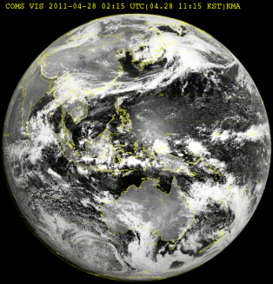
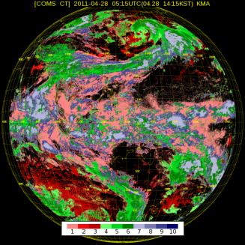
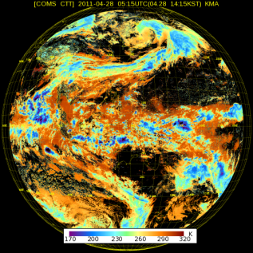
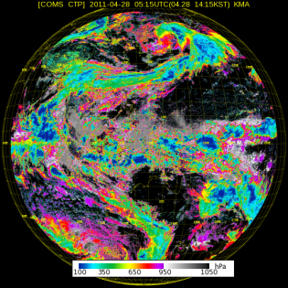
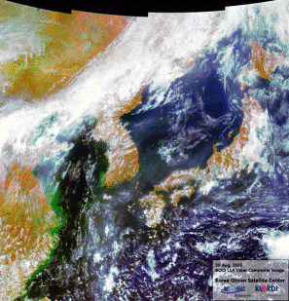
L/HRIT Service of COMS MI Data
Category | HRIT | LRIT
Data rate | 3 Mbps | 521 kbps
Data contents | MI images (high res.) Alpha-numeric text Encryption key information | MI images (high res.) Alpha-numeric text Encryption key information Level 2 products GOCI images ( 3 images / day)
Station | MDUS | SDUS
Encryption | Yes | Yes
Example of LRIT data
VIS image
Cloud Detection
Cloud Top Temperature
Cloud Top Pressure
GOCI image

Slide 16



COMS Data Service (via ground network)
Internal/Cooperation Organization : Intranet, Comprehensive WIS*, Disaster Prevention WIS*
General Public : KMA Homepage (www.kma.go.kr)
Expert Group : NMSC Homepage (nmsc.kma.go.kr)
Strengthen COMS Data Service
Strengthening the Expert Group Support
Hierarchical Satellite Data Service (Homepage, ftp)
  Level 1B, HRIT/LRIT format data
  Cloud and analysis image, COMS products, etc
Improvement of Satellite Data Service Capability
  Enable to select for various period, region, type and format
Enhancement of easy utilization of data
  Provision of data conversion program
  Provision of data quality information, algorithm technical document, data user’s guide, etc
  Satellite data processing/analysis software development and support
*WIS : WMO(World Meteorological Organization) Information System

Slide 17




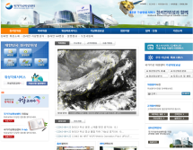




Data Service
COMS data are provided via HTTP, FTP and broadcasting in real time by COMS.
COMS data will be serviced via WIS GISC-DCPC in 2013.
HRIT
HRIT
Dissemination
사용자
Data
Request
Request
Air-Line
HTTP service
MDUS and SDUS
Land-Line
FTP
FTP service
Intranet
HTTP, FTP service
E-MAIL service
Support McIDAS-V users
OpenWIS in 2013
Send E-MAIL
WIS
DCPC
McIDAS
OpenADDE

Slide 18

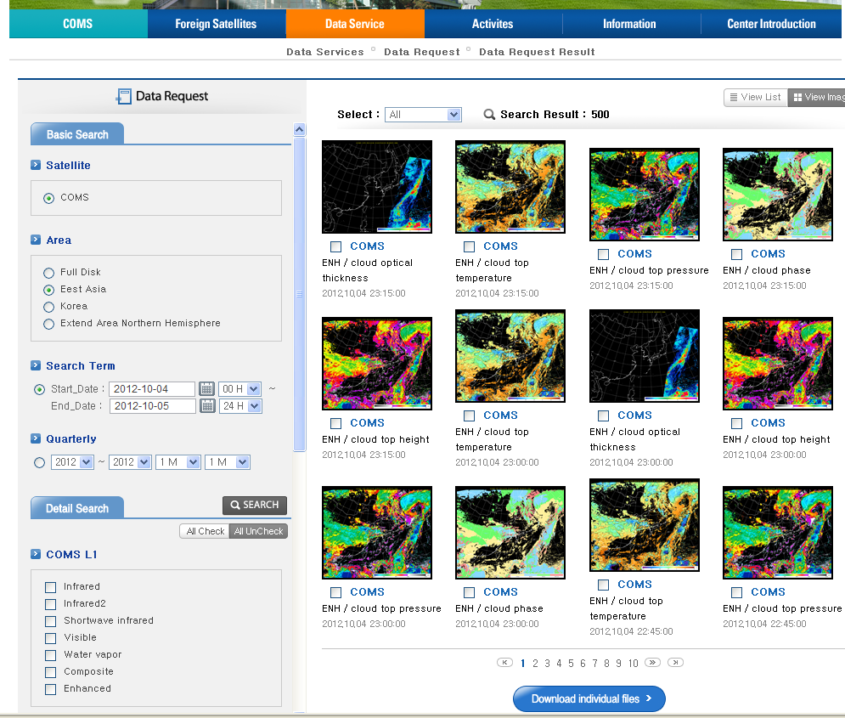
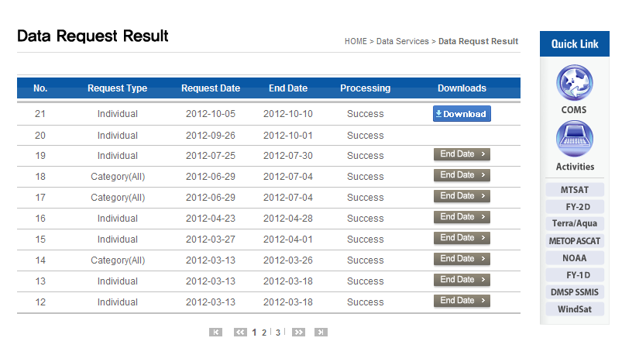
Data Ordering
Download

Slide 19
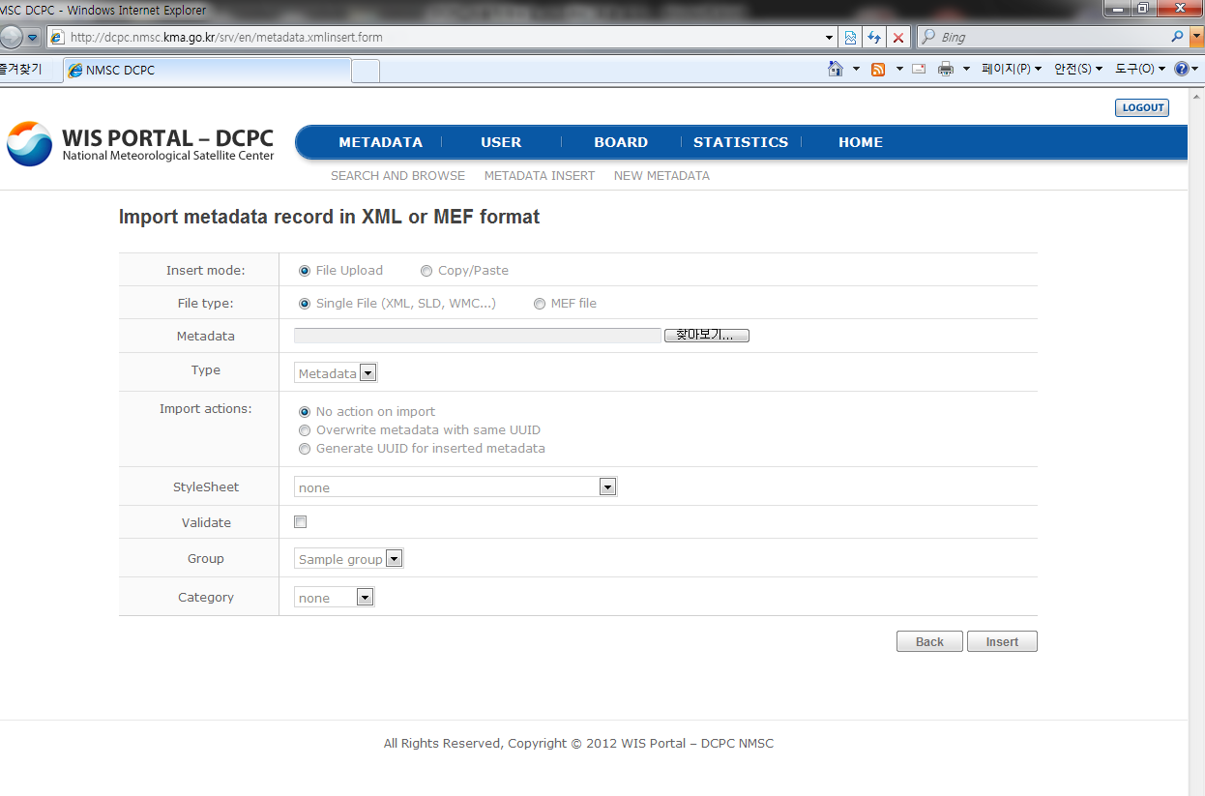
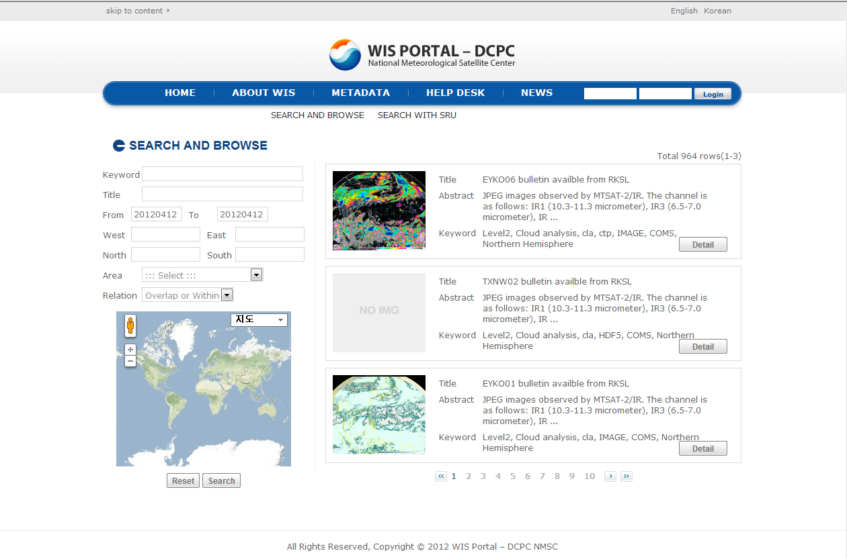
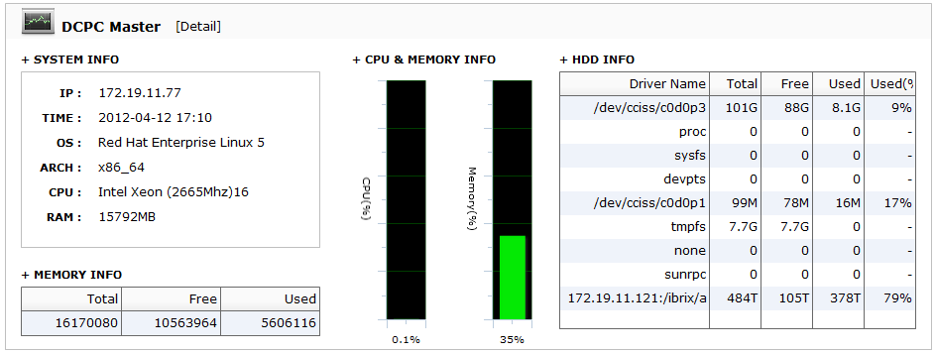
OpenWIS-DCPC in 2013

Slide 20
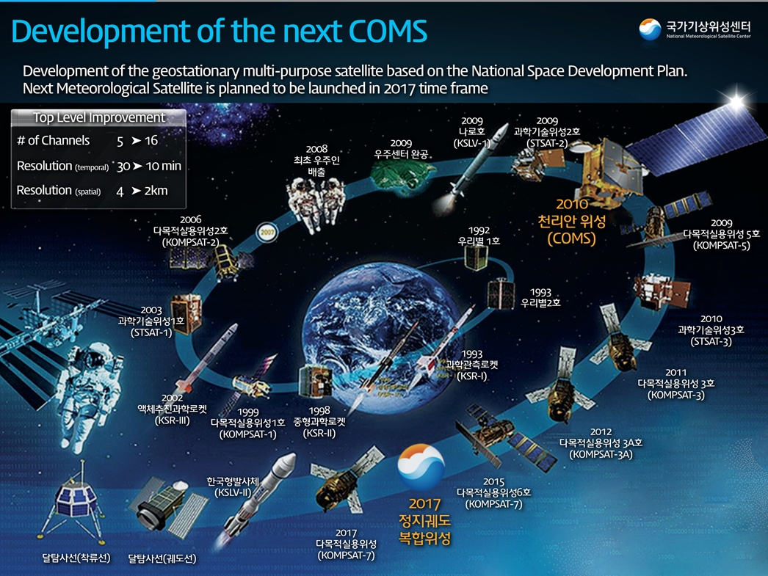
Notes:
KMA’s development of geostationary multi-purposed satellite is based on the “national space development plan”
As you know COMS was successfully launched in last June. As for “National Space Development Plan”, COMS follow-on, named, GEO-KOPMSAT-2A is scheduled to be launched in 2017 to succeed the meteorological mission.

Slide 21
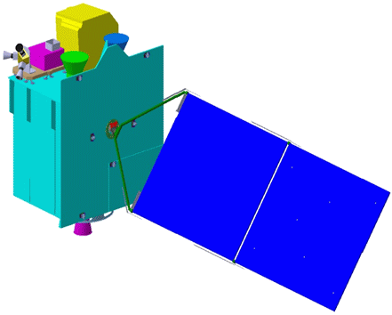
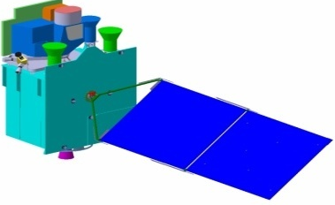


Geo-KOMPSAT-2 Program
One for the next generation Meteorological Imager
The other for the Ocean and Atmospheric Trace Gas monitoring
KMA
Space weather Sensor
Meteorological Sensor
Geo-KOMPSAT-2B
Geo-KOMPSAT-2A
Ocean /
Environmental Sensor
  2011 ~ 2017 (7 years)
Ground Segment
Data Processing System
Notes:
The schematic diagram is brief introduction of development of GEO-KOMPSAT-2 satellite
Differently from COMS, two satellites will be developing, one is GEO-KOMPSAT-2A which is for meteorological mission only, and the other is GEOKOMPSAT-2B which is for ocean and environmental mission. Ministry of Land, Transport and Maritime Affairs, and Ministry of Environment will be in charge of GEO-KOMPSAT-2B.
As for sub-payload, KMA considers the space weather sensor, and detailed specification will be decided in 1st quarter of 2012.
For the ground segment and data processing system, preliminary studies will be accomplished in the end of this year.

Slide 22
Data assimilation in KMA

Slide 23
Data Assimilation in KMA
Atmospheric Motion Vector
  In operation from Dec. 2011
  Release through FTP is available NOW!!
Clear Sky Radiance
  Preliminary test finished (SEP 2012)
  Semi operation in KMA (Nov. 2011)
Snow cover and Sea Ice
  was evaluated and upgraded (SEP 2012)
  Will be used in NWP office on KMA
Verified of impact of IASI surface channels using FSO
  KMA started to use surface channels of IASI over land (JUL 2012)
  Impact of IASI surface channel large in night time

Slide 24
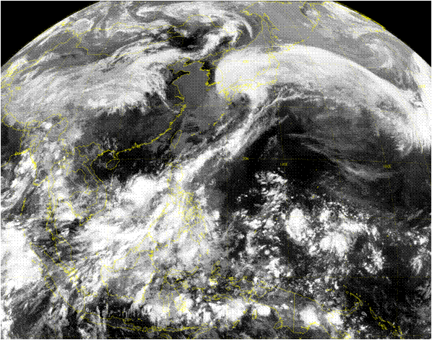
The specifications of COMS AMV
COMS AMV
Target size (pixels) | 24 X 24 (96 km x 96 km)
Time interval between satellite images | 15-minute
Target selection method | Regular (12 grids)
Height assignment | EBBT, STC, IR/WV for IR EBBT, NTC, NTCC for WV
Search area | Dynamic range (based on FG)
Area of AMV generation

Slide 25
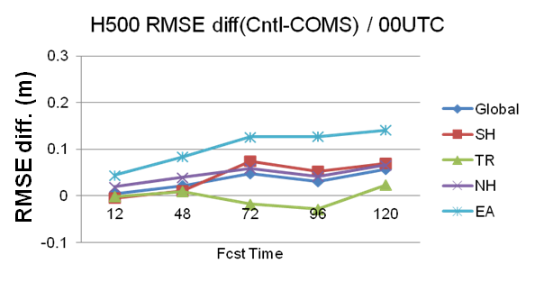
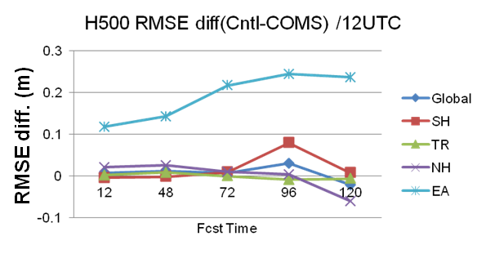
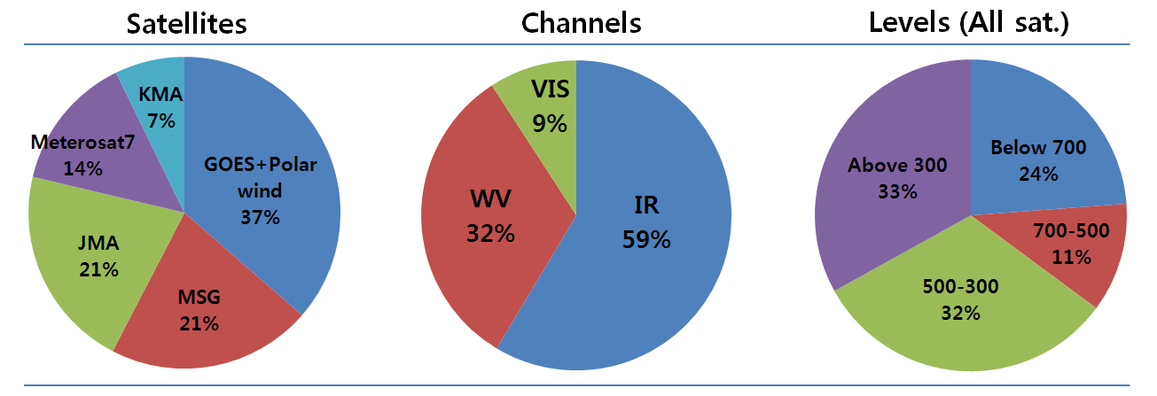
FSO result of COMS AMV
I. Largest impact over East Asia (OSE from ’12.9~’12.10)
II. 7% of All of AMV impact (FSO from ’12.7~’12.9)

Slide 26
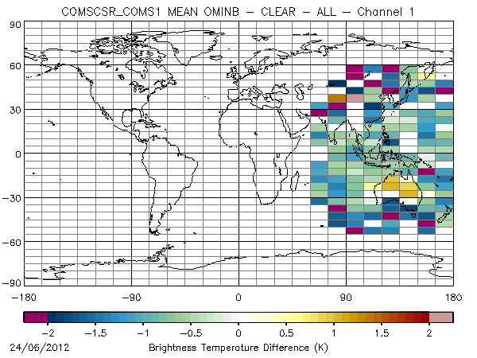
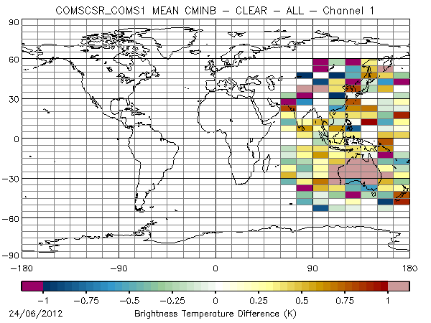
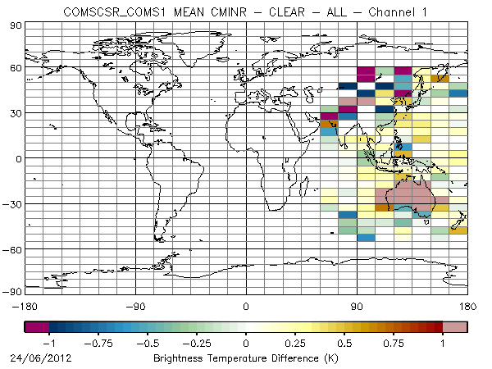
COMS CSR
Monitoring Process of water vapor channel
  O-B : Monitoring bias of COMS CSR
  C-B : observational increment from bias corrected
  C-R : difference between bias corrected and retrieved radiances
Preliminary result from the OSE impact test
  Experiment : from 2012.6.11~2012.7.10
  Positive impact is largest over East Asia
Bias (O-B)
Bias (C-B)
Bias (C-R)

Slide 27
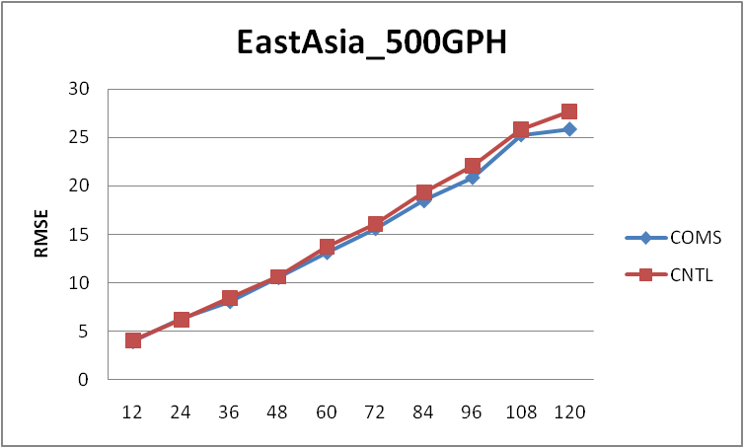
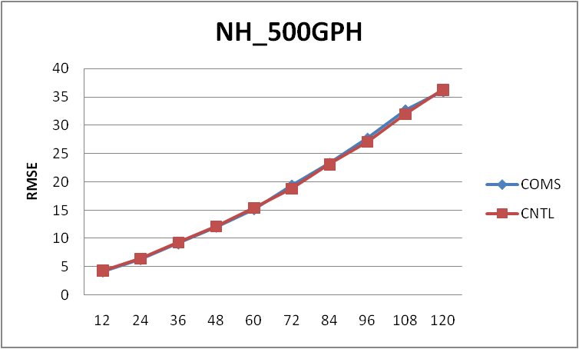
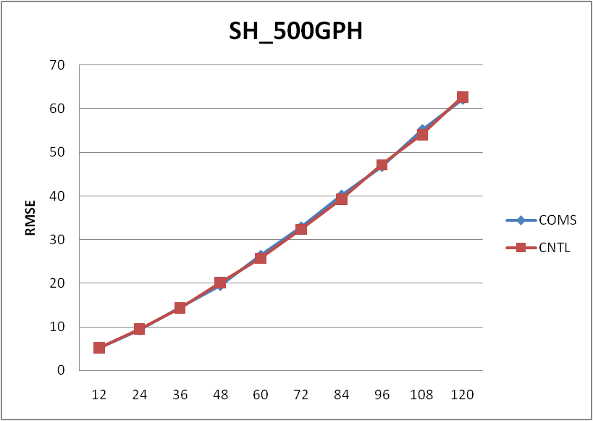
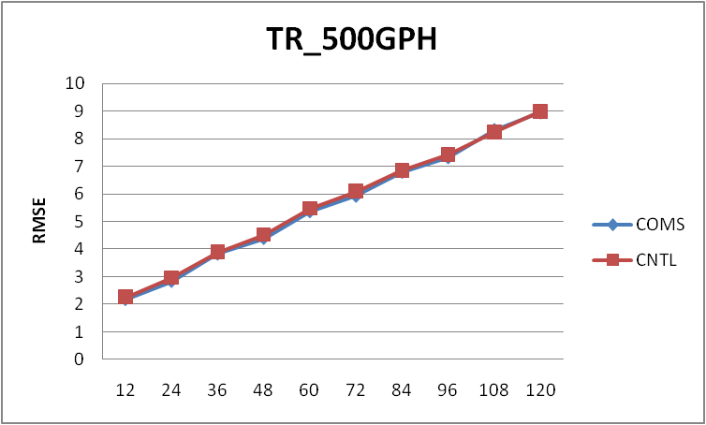
Preliminary result (Exp. of COMS CSR)

Slide 28
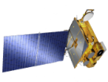
Thank you
FY-1
(CHINA)
Metop-A
(EUMETSAT)
MTSAT-1R
(JAPAN)
140°E
GOES-W
(USA)
135°W
COMS
(KOREA)
128.2°E
FY-2
(CHINA)
105°E
GOES-E
(USA)
75°W
NOAA
(USA)
METEOR
(RUSSIA)
GOMS
(RUSSIA)
76°E
INSAT
(INDIA)
74°E
METEOSAT-9
(EUMETSAT)
0°
METEOSAT-8
(EUMETSAT)
63°E

