Slide 1
EUMETSAT Operational Status - 2012
Simon Elliott
Meteorological Operations Division
simon.elliott@eumetsat.int

Slide 2
Spacecraft Routine Operations
MET-9 : launched 21 Dec 2005 and located at 0°. It supports the Meteosat Prime mission. Suspected thermal frames release on 12-8-12 and 21-9-12 (see next slide). An outage the imaging service of about 6 hours on 31-8-12 due to a loss of synchronisation on board after a sensor swap at eclipse exit (Incident #49)
MET-8 : launched 28 Aug 2002 and located at 9.5°E. It is a backup for Met-9 and supports RSS. No new anomalies to report.
MET-7 (launched 2 Sept 1997) and located at 57.5°E. It supports the full IODC service. No new anomalies to report.

Slide 3
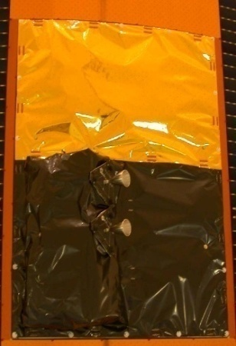
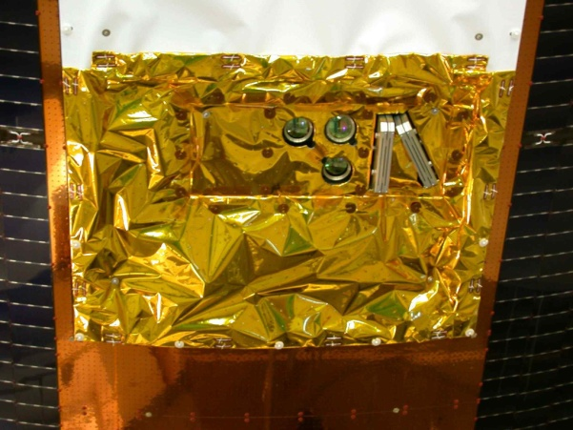
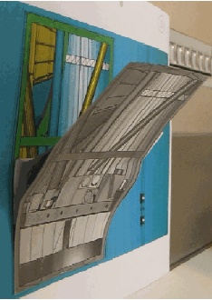
Detachment of thermal frames on Meteosat-8/9 (shown: MSG-1)
A total of 5 Thermal Frames have been affected by the anomaly:
Meteosat-8 1st and 2nd Events (2007 & 2008): R1/R2 thrusters then R3/R4 thrusters thermal frames fully detached. Radial thruster R1 impaired, East-West manoeuvres with redundant thrusters R2/R4. Meteosat-9 2nd Event (21-9-12): R1/R2 thrusters thermal frame (Fig. 1) detached and left the satellite. Thrusters R1/R3 tested and none affected. R2/R4 to be tested
Meteosat-8 3rd Event (20-3-12): AOCS thermal frame (Fig. 2 ) partially detached, obstructs sun sensor view when sun is above equator (Fig. 3)
Meteosat-9 1st Event (12-8-12): Thermal Control radiator Thermal Frame detached and left the satellite
Solar Cells
Gold MLI
Mounting Frame
Earth Sensor Optics
R2
Sun Sensor Slits
R1
High Temp. MLI
Fig. 1: MSG-1 Thrusters R1/R2 Thermal Frame
Fig. 2: MSG-1 AOCS Thermal Frame
Fig. 3: Possible configuration of MSG-1 AOCS Thermal Frame after event on 20-3-12

Slide 4
Meteosat Long-Term Planning Perspective
2011
2012
2013
2014
2015
2016
2017
2018
N
D
J
F
M
A
M
J
J
A
S
O
N
D
J
F
M
A
M
J
J
A
S
O
N
D
J
F
M
A
M
J
J
A
S
O
N
D
J
F
M
A
M
J
J
A
S
O
N
D
J
F
M
A
M
J
J
A
S
O
N
D
J
F
M
A
M
J
J
A
S
O
N
D
J
F
M
A
M
MSG-3 Commissioning
MSG-4 Commissioning
Met-11 IOS (Duration TBD)
MTG-I1 Commissioning
3.4ºW
Met-10 drift start
Met-11 drift start
MSG-3 Launch
MSG-4 Launch
MTG-I1 Launch
Met-9
0º
Met-10 drift start
Met-9 drift start
Met-11 drift stop
Met-11
Met-10 drift stop
3.5ºE
Met-8
Met-8 at 3° inclination
Met-9
9.5ºE
Met-10
Met-9 RSS stop/Drift start
Met-10 drift stop/RSS start
57.5ºE
Met-7
Met-7
Met-8
Met-8 takes over IODC (if agreed by Council)
63ºE
Met-8 RSS stop/Drift start
Met-8 at 5° NS inclination
67.5ºE
Met-9 drift stop/RSS start
Met-7 disposal
N
D
J
F
M
A
M
J
J
A
S
O
N
D
J
F
M
A
M
J
J
A
S
O
N
D
J
F
M
A
M
J
J
A
S
O
N
D
J
F
M
A
M
J
J
A
S
O
N
D
J
F
M
A
M
J
J
A
S
O
N
D
J
F
M
A
M
J
J
A
S
O
N
D
J
F
M
A
M
2011
2012
2013
2014
2015
2016
2017
2018
Slide: 4

Slide 5
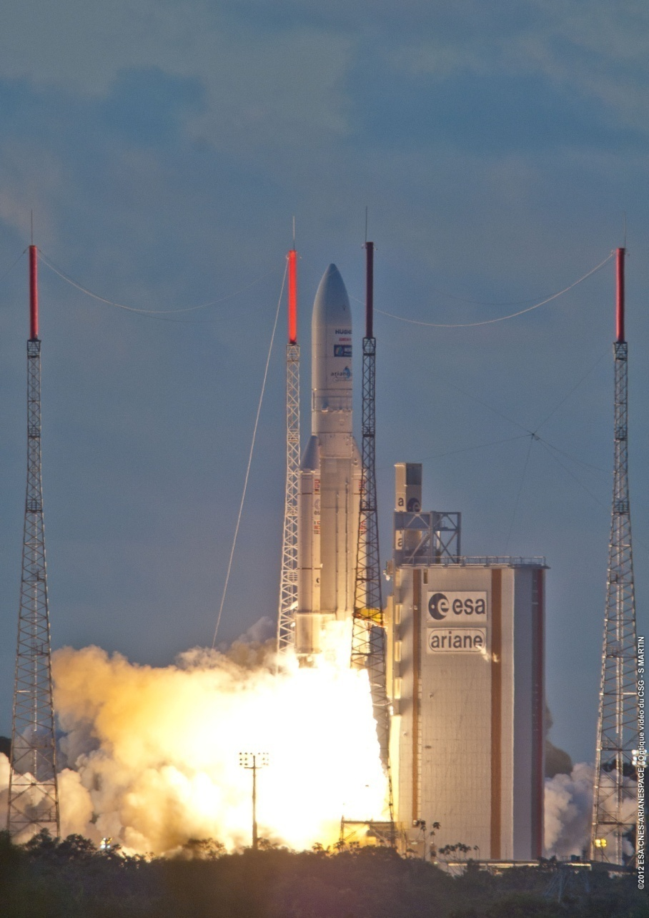
MSG-3 Launch
The launch of MSG-3 took place on 5 July 2012, right at the opening of the launch window (21:36 UTC).
The assessment of the flight recorded data showed that:
the flight was calm,
the launch environment was within specification,
the injection accuracy of MSG-3 was very high.

Slide 6
MSG-3 LEOP Main Facts and Results
Pre-Handover tests → 12 July
Hand-over ESOC to EUM → 16 July
Excellent LEOP service by ESOC, with effective interface with EUMETSAT
LEOP completed nominally with fuel saved based on optimised strategy
Despite the A5 lower perigee (which alone is reducing the “fuel lifetime” of almost 1 year), the expected MSG-3 “fuel lifetime” is similar to the one of MSG-1 and MSG-2

Slide 7
MSG-3 Commissioning
Scope of commissioning
MSG-3 satellite commissioning. Verification of compliance with the Satellite Specification (SY2), System Requirements Document (SRD), and Operations Service Specification (OSS) in terms of functionality and performance
MSG system commissioning while Meteosat-8 and Meteosat-9 routine operations are on-going (tri-satellite operations capability, images, products, direct dissemination)

Slide 8
Commissioning Status (end Sept 2012)
From 16 July to 22 July → Radio Frequency, Flight Dynamics activities, test of Ultrasonic Gauging Sensors, etc.)
Drift Stop manoeuvres to stop MSG-3 at 3.4°W → 23 and 24 July
Mission Communication Payload activation/test → from 30 July to 2 August
SEVIRI activation and First Image → from 6 to 10 August
GERB activation and First Image → from 10 to 18 August
Additional decontamination from 5 to 10 September
Stable Imaging started 13 September, Test dissemination (images and products to Met Services) started resp. 25 September and 27 September.
No significant issue detected so far !

Slide 9
MSG-3 commissioning anomalies/observations
MSG3 SEVIRI chain error word affects one detector in channel IR9.7 and IR13.4. This behaviour was also seen on MSG-1 and MSG-2, on these specific channels but it seems more severe on MSG-3 (i.e. started much earlier and does not seem to “reset” after switch off). Image performance remains in spec. Test of the redundant unit planned in late Oct 2012.
SEVIRI Visible Near Infrared Optical Bench temperature behaviour. The thermal control of the visible focal plan showed some “jumps” in temperature, of limited amplitude (approximately 0.3°C). Monitoring continues, no “jumps” observed since several weeks. Impact on the noise performance of the SEVIRI visible channels is negligible. Image performance remains in spec.

Slide 10
Some Commissioning images

Slide 11
Satellites Exploitation
Current usage:
MSG-3 : launched 5 July 2012 and located at 3.4°West. It is being commissioned
Met-9 : launched 21 Dec 2005 and located at 0°. It supports SEVIRI HRIT (via EUMETCast), Met Products, SEVIRI LRIT (via EUMETCast and Direct Dissemination), GERB, DCP and SAR
Met-8 : launched 28 Aug 2002 and located at 9.5°East. It is a backup for Met-9 and supports RSS (Imaging and reduced set of Met Products)
Usage after MSG-3 Commissioning:
Met-10 : replaces all Meteosat-9 services
Met-9 : replaces Meteosat-8 services
Met-8 : relocated at 3.5°East, remains in full disc imaging but not disseminating, to provide an “hot stand-by” backup for Met-10 and Met-9

Slide 12
Spacecraft Relocations
MSG-3
Met-9
Met-8
3.4°W
0°
3.5°E
9.5°E
Met-10
Met-9
Met-8
3.4°W
0°
3.5°E
9.5°E

Slide 13
Driving Principles for Satellite Relocations
Relocations can start only after successful Routine Operations Readiness Review (RORR) at the end of MSG-3 Commissioning
2 months of Met-9/Met-10 parallel dissemination of SEVIRI HRIT and Met Products are provided to ensure smooth transition at the user side. 1st month of parallel dissemination is with Met-9 prime, 2nd month Met-10 is prime
2 months of Met-8/Met-9 parallel dissemination of RSS are provided to ensure smooth transition at the user side. 1st month of parallel dissemination is with Met-8 prime, 2nd month Met-9 is prime
The impact of satellite relocation on the LRIT direct dissemination and SAR service shall be minimised (no need to re-point LRIT and SAR antennas)
The difference in DCP footprint shall be minimised when swapping from Met-9 to Met-10
The satellite drift rate should be around 0.5 °/day so that fuel saving and safety rules are fulfilled and proper image quality maintained while drifting

Slide 14
Impact on Services (Tentative dates!)
Prime Service
12 Dec 12 → Start of Met-9/Met-10 “official” parallel dissemination (both rectified at 0°)
14 Jan 13 → Met-10 becomes prime (LRIT and DCP to Met-10)
12 Feb 13 → Met-9 parallel dissemination stops
RSS
24 Jan 13 → Met-8 RSS interrupted for the 1-month yearly pause
26 Feb 13 → Start of Met-8/Met-9 “official” RSS parallel dissemination (both rectified at 9.5°E)
2 Apr 13 → Met-9 becomes RSS prime
2 May 13 → Met-8 RSS parallel dissemination stops

Slide 15
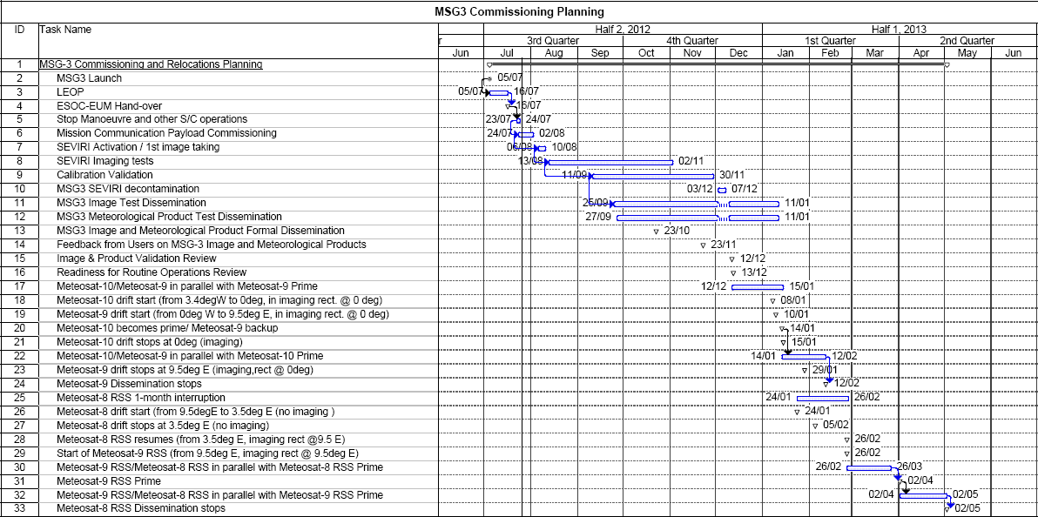
Commissioning and Early MSG-3 Operations

Slide 16
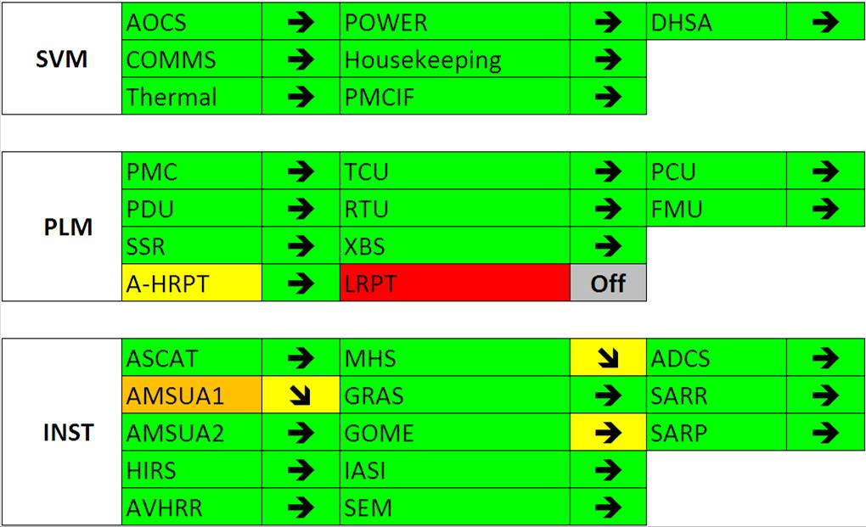
Metop-A Status
DHSA: Redundant CCU I/O Board Recovered after last PLSOL
HRPT:B unit in restricted operation. Complete longitudinal coverage zone active since 18th January 2011 (No transmission at higher latitudes in both hemispheres)
AMSU A1: H7 is declared failed. NEDT on H3 is rising exponentially – at spec. threshold (0.4 K) in September 2013. H8 NEDT also starting to rise.
MHS Local oscillator swap has improved H3/4 NEDT, but trend still continues – out of spec ca. Mid/late 2013
A-DCS: frequency complaints - no requests to stop operations.
GOME throughput loss in UV stabilised with limited performance degradations.

Slide 17
EUMETSAT Polar System: Metop-A Events
Metop-A Major Events 1 June – 10 October 2012
Sub-Sys. | Event
SVM | 18 July 2012: In-plane manoeuvre
PLM | No special operations
ADCS | No special operations.
AVHRR | No special operations.
AMSU-A1-A2 | No special operations.
HIRS | No special operations.
SEM | 18 July 2012: Outage for In-plane manoeuvre
ASCAT | No special operations.
GRAS | No special operations.
GOME | 18 July 2012: Outage for In-plane manoeuvre
MHS | No special operations.
IASI | No special operations.

Slide 18
EPS Product Operations Status and Planning
Product (M02) | Current Status | Future Status
All Level 1 Products | Operational
ATOVS Level 2 | Operational
IASI Level 2 (temperature water profile, clouds properties, ozone, trace gas) | Operational
IASI Level 2 Sea surface temperature | Demonstration | Operational in 2013
IASI Level 2 (emissivity) | Pre-Operational
AVHRR L2 NDVI | Operational
AVHRR L2 Polar Winds | Operational
ASCAT Soil Moisture | Operational
IASI L1 Compressed | Operational
No changes since last QM
Focus is currently on Metop-B Cal / Val
All Level 1 NOAA-19 products operational.
ATOVS L2 products from NOAA-19 operational

Slide 19
Metop-B Commissioning Status
Follow the Metop-B Commissioning Link from the EUMETSAT website:
http://www.eumetsat.int/Home/index.htm

Slide 20
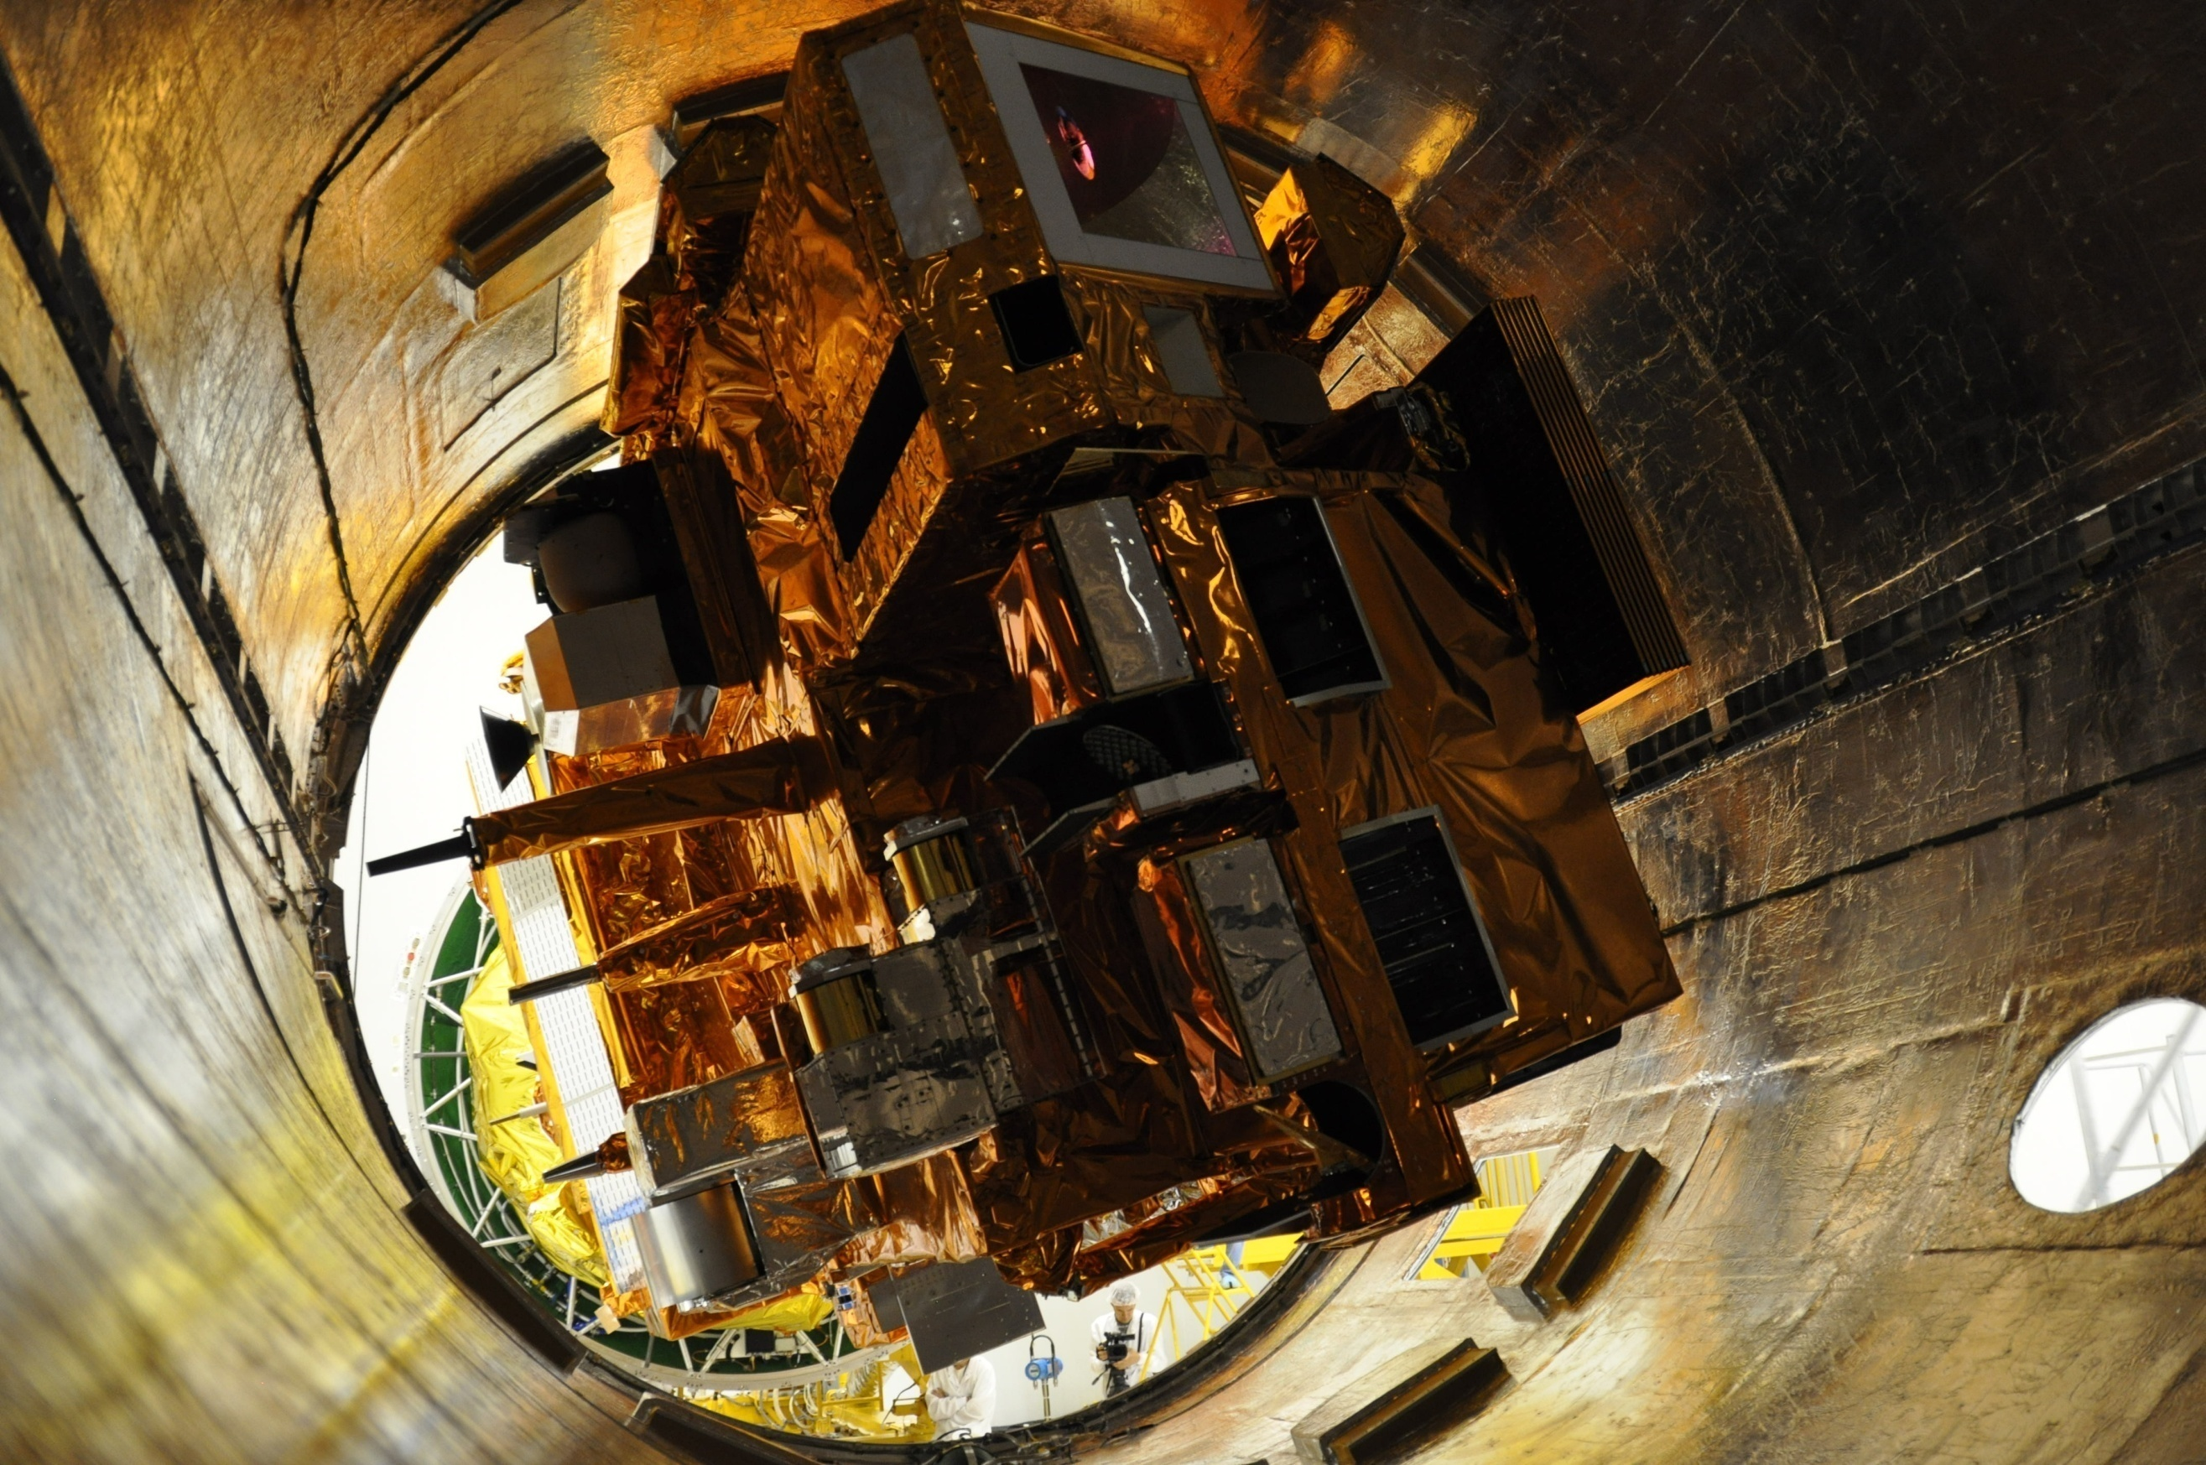

Slide 21
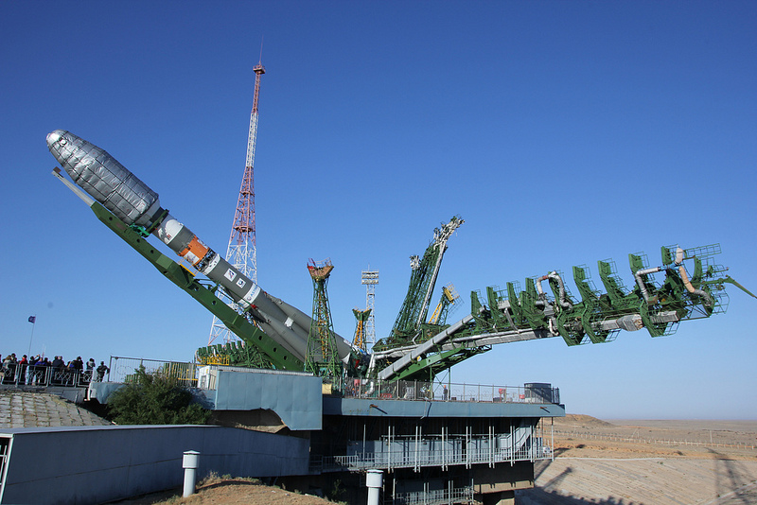

Slide 22
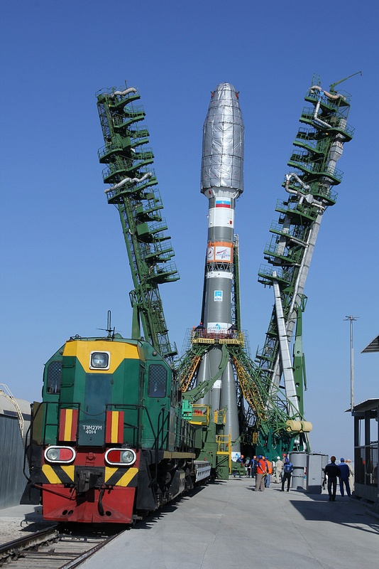

Slide 23
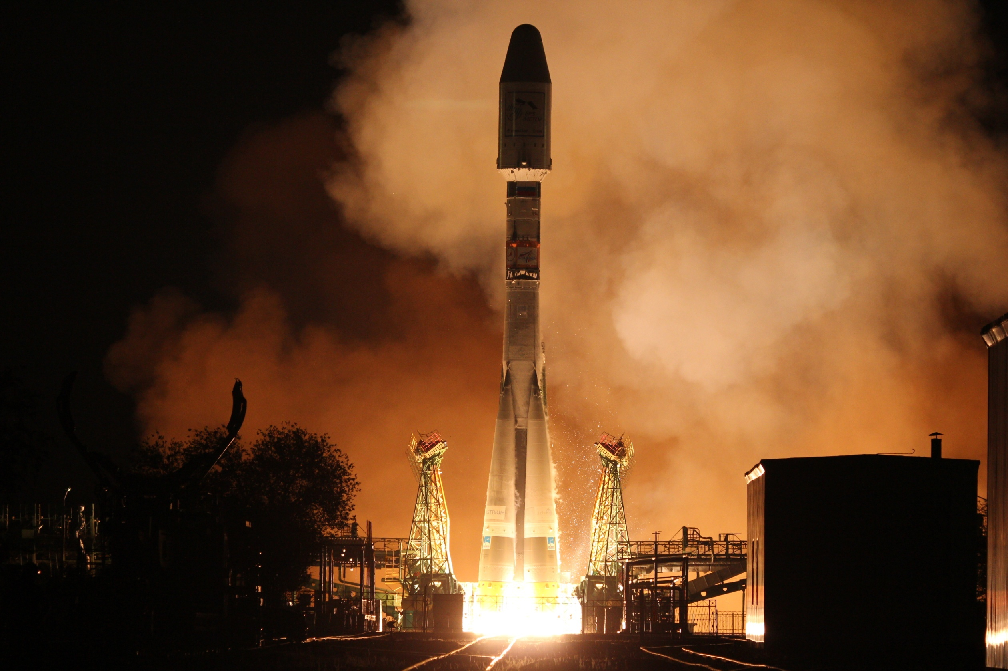

Slide 24
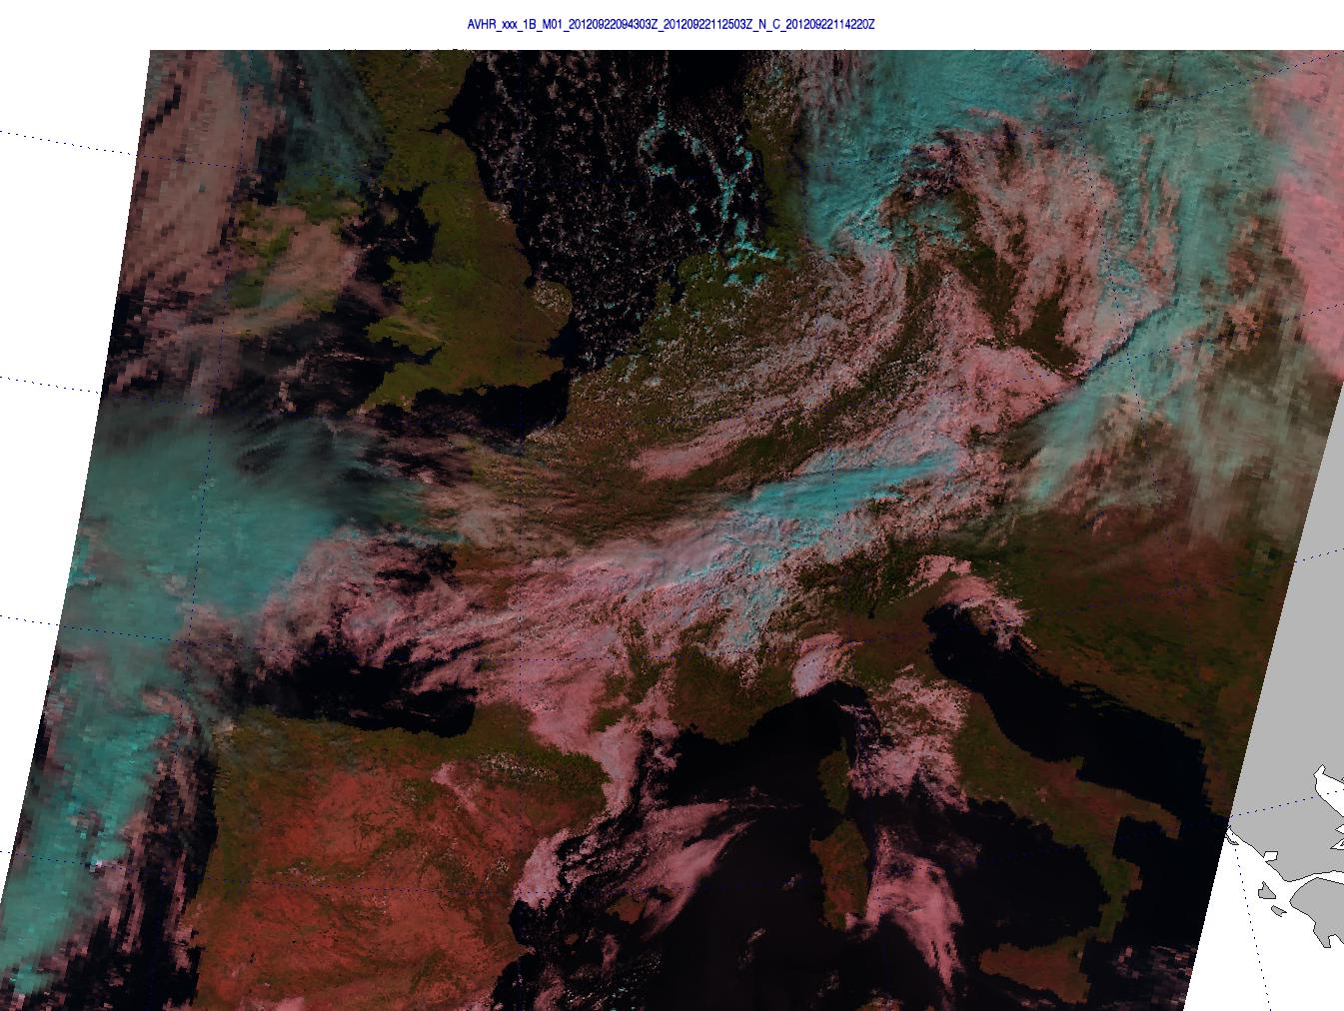

Slide 25
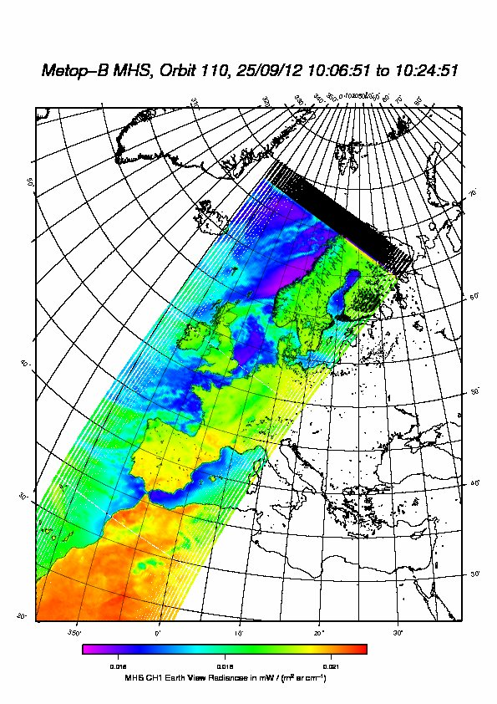

Slide 26
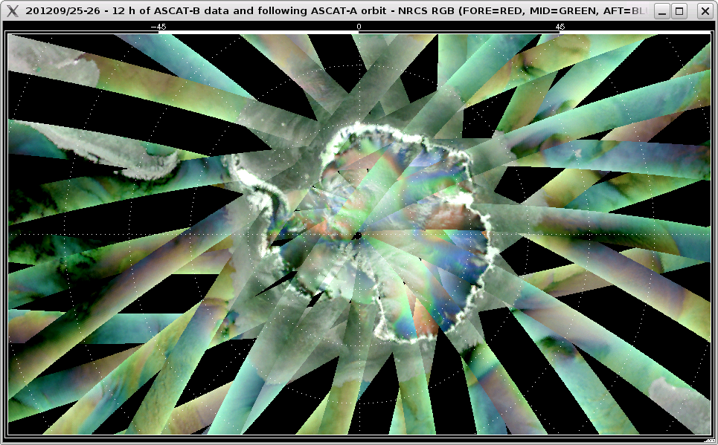

Slide 27
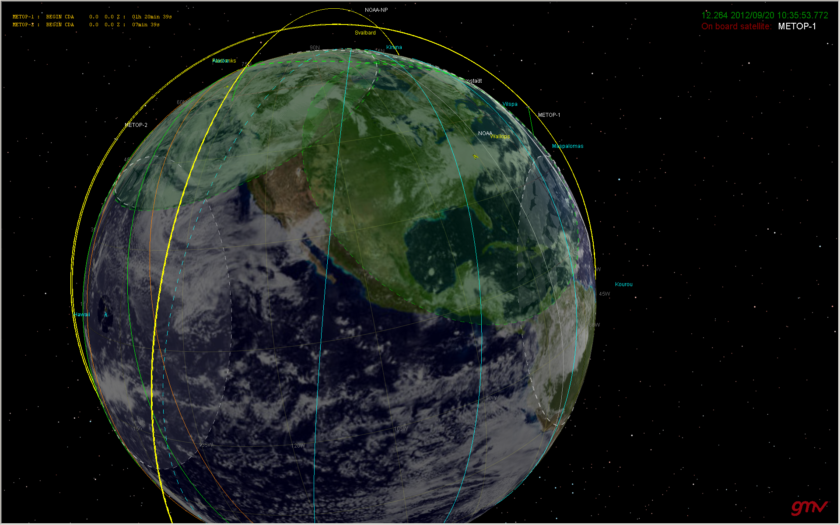
Metop-A
Metop-B
Orbit at Handover – Metop-A following Metop-B by approx 25 mins
12 km lower and adding about 4 mins/day of separation

Slide 29
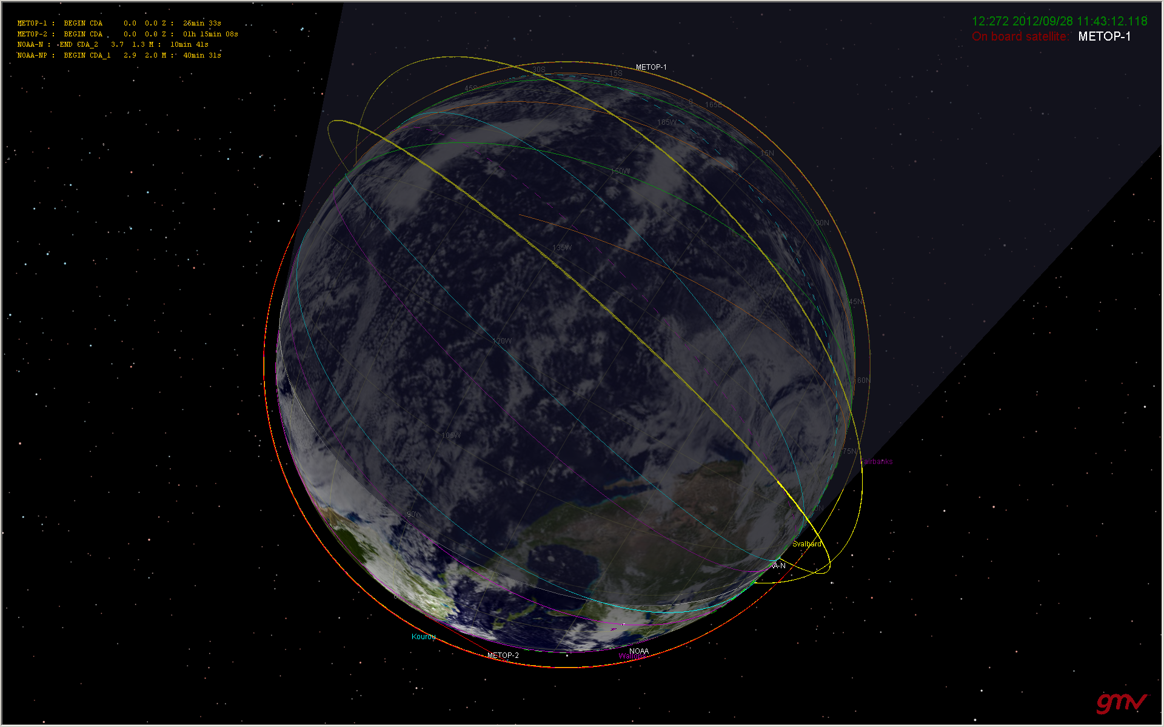
Metop-B
Following transfer manoeuvre, Metop-A following Metop-B by approx. 49 mins.
Metop-A

Slide 30
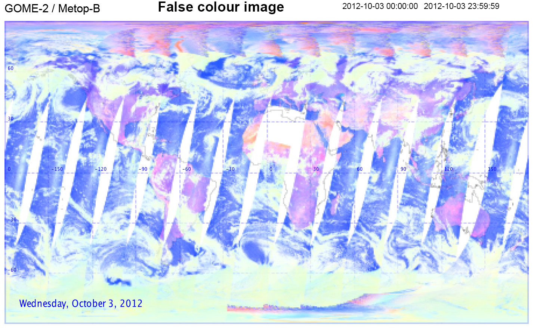

Slide 31
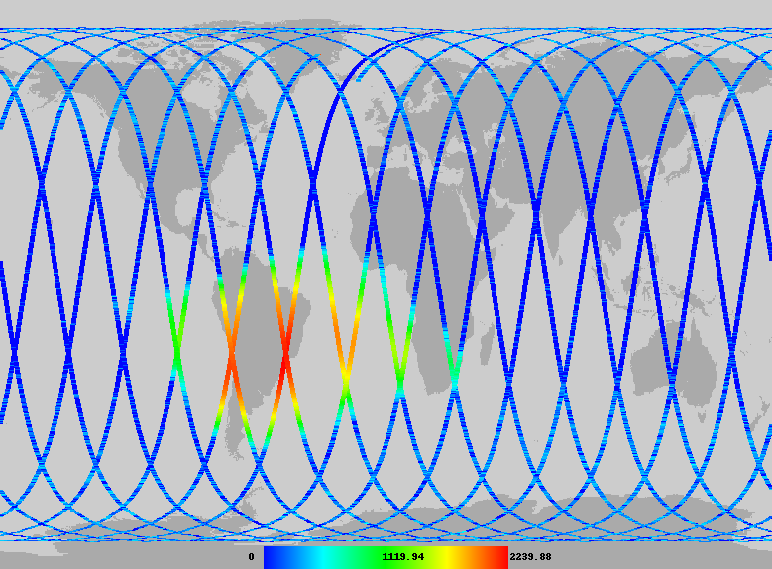

Slide 32
Metop-B SIOV Status
Sub system | Health / Current Status (wrt latest Timeline) | Comment
Service module | J | Nominal, STD-B
Payload module | J | Nominal
ASCAT instrument | J | MEASUREMENT MODE (with external calibrations)
GRAS instrument | J | OCCULTATION (Measurement)
GOME instrument | J | Timelines Running, Coolers Off & Shutter Closed
IASI instrument | J | HEATER 1 Decontamination Mode
MHS instrument | J | SCAN MODE (Measurement), SCAN PROFILE 0
AVHRR instrument | J | Outgassing, Visible Channels Enabled
HIRS/4 instrument | J | Outgassing
AMSU-A instruments | J | MEASUREMENT MODE, COLD CAL POS 1
SEM-2 instrument | J | MEPED & TED ON
A-DCS instrument | K | ON, CNES Report Rx Power from CRA down 10dB
S&R instrument | K | SARP ON, SARR ON (Side B) , CNES Report Rx Power from CRA down 10dB

Slide 33
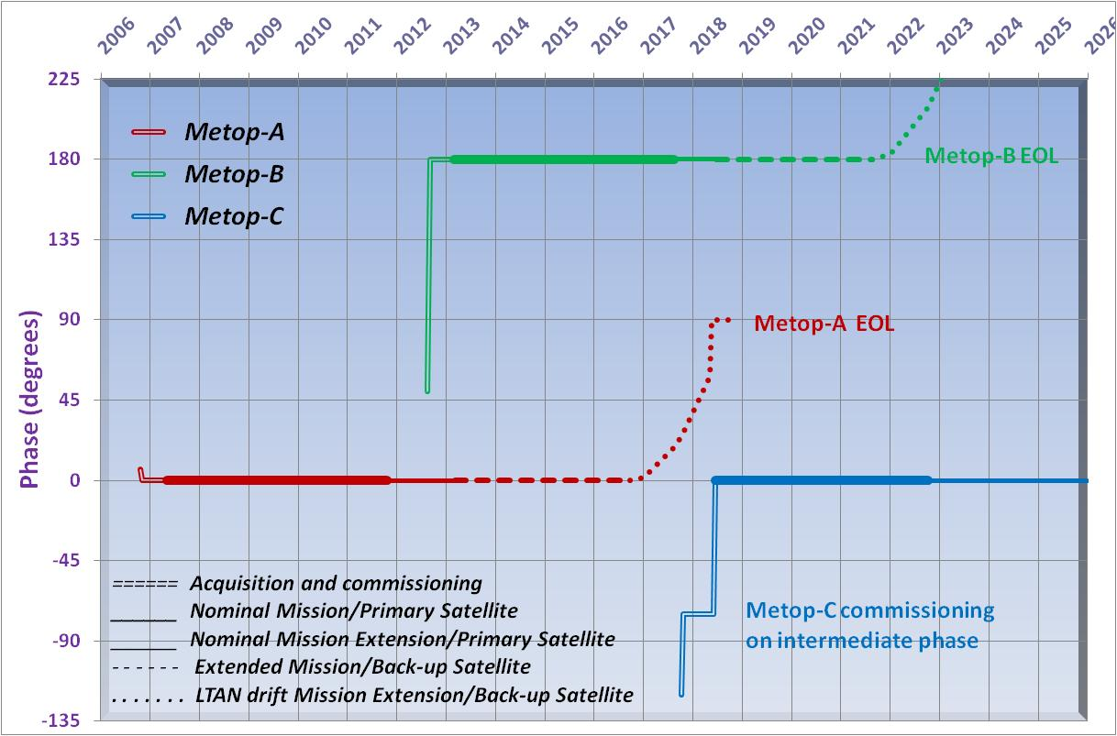
EPS-Metop Orbit Position Planning
Last OOP Manoeuvre for Metop-A in 2015 to allow operations to mid-2018
Inclination drift leads to phase drift.
At least 20 mins AOS separation should be available between Metop-A and Metop-C Commissioning Position

Slide 34
EUMETSAT Polar System: Ground Segment + Services
The EPS Ground Segment has performed very well in support of the dual-satellite operations;
The smooth operations so far is testament to the dedication and professionalism of the combined PRD/LEO and OPS teams involved in the preparation and operations of the entire system;
The system is still under launch freeze management, but this will be lifted by start of November;
Investigations into the occasional losses of PDUs are restarting;
Efforts will also shortly recommence to increase the incoming data rates from Svalbard to EUMETSAT to further improve data delivery timeliness;
Performance of the system for Jan-June 2012 can be seen from the latest Central Operations Report Issue;
http://www.eumetsat.int/Home/Main/ServiceStatus/index.htm?l=en.

Slide 35
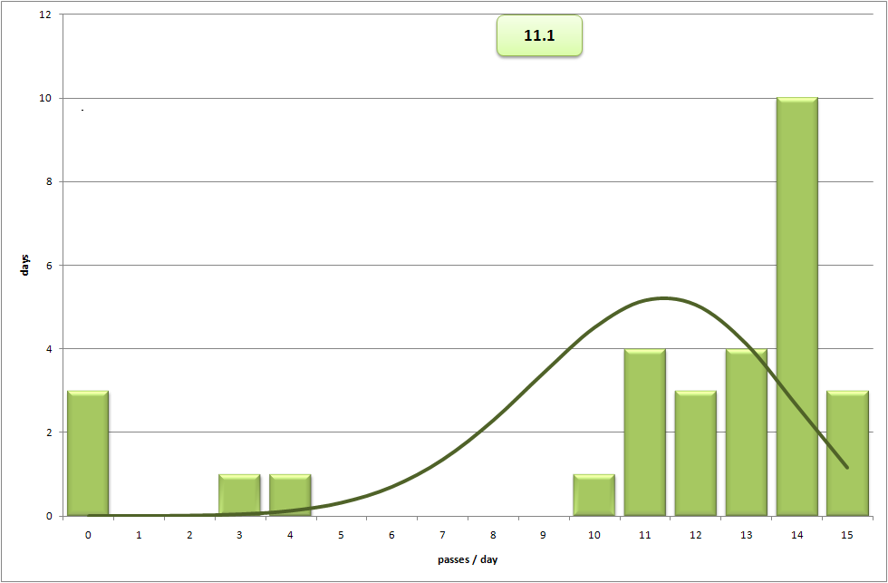
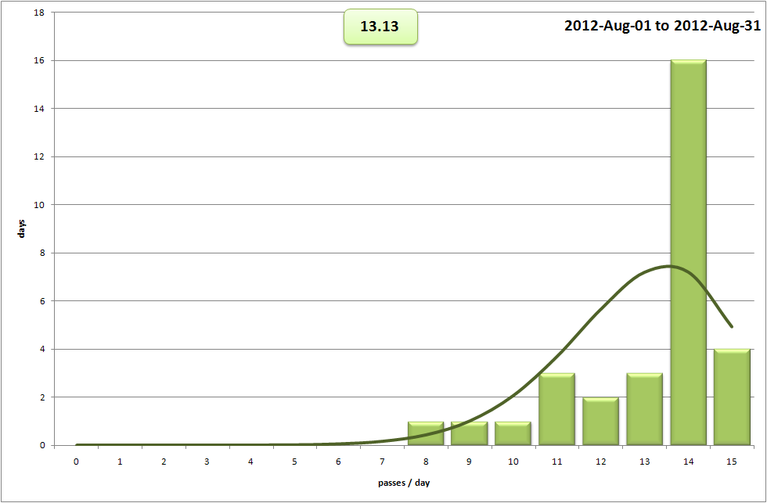
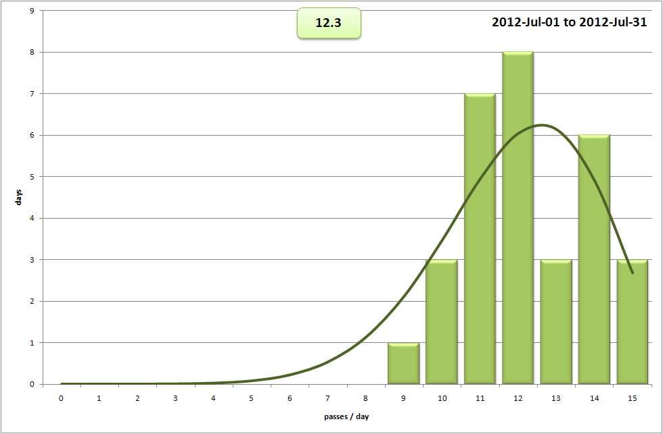
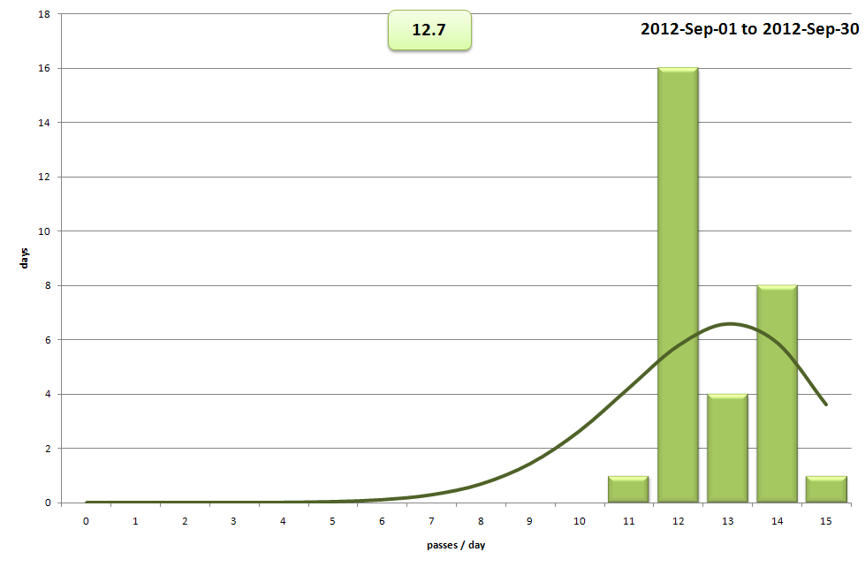
ADA - McMurdo Performance – June- Sept. 2012
Outage due to electrical damage on MG1 following storm
June 2012 Daily Passes Acquired
August 2012 Daily Passes Acquired
July 2012 Daily Passes Acquired
Sept. 2012 Daily Passes Acquired

Slide 36
Initial Joint Polar System (IJPS)
 | Metop-A Prime-AM | N 19 Prime-PM | N18 Back-up-PM
AMSUA1 | H7, 3,8 | H7,8 | H8
AMSUA2
AVHRR
HIRS |  |  | H1-12
SEM
SARR
SARP-3
MHS | H3,4 | H3
HRPT | B-Side Zone Ops
Outages on NOAA tracking stations and communications link problems between Darmstadt and Suitland led to some data losses. An upgrade to the link is on-going, including addition of redundancy.
NPP launched on 28 October 2011 ....

Slide 37
EUMETSAT Central Operations Report for January - June 2012
Metop/NOAA Global Data Service → AMSU Level 1B BUFR Products
The Advanced Microwave Sounding Unit (AMSU) is a 15-channel microwave radiometer supplied by NOAA which measures atmospheric temperature profiles.
Level 1B products are derived from the data generated by the instruments onboard both Metop-A and NOAA-19 satellites.
Events Which Impacted Availability:
None significant for Metop.
Jan & March: Telecom link problems impacted transfer of data from NOAA to EUMETSAT
Notes: (1) Metop-A’s AMSU channel 7 is degraded beyond spec and is no longer used for product processing.
(2) NOAA-19’s AMSU channel 8’s degradation has not worsened in this reporting period and therefore the data is still considered usable for the time-being

Slide 38
Suomi-NPP Status and Plans
First of new generation NOAA LEO meteorological satellites, in afternoon orbit (to be followed by JPSS-1, basically a copy of Suomi-NPP);
EUMETSAT’s Suomi-NPP activities encompass both global and regional operational services for the CrIS, ATMS and VIIRS instruments:
reception from NOAA GS & tailoring of global data and user dissemination via EUMETCast and the GTS/RMDCN;
Global ATMS and CrIS SDR products have been available since 31/07/12.
acquisition of direct broadcast data at core European EARS stations to establish operational regional services;
Operational readiness at Athens, Lannion, Svalbard and Maspalomas is expected before end-2012. Kangerlussuaq readiness delayed due to July flooding.
Early access to the EARS services is expected by end-2012 for ATMS and CrIS and Q1 2013 for VIIRS.

Slide 39
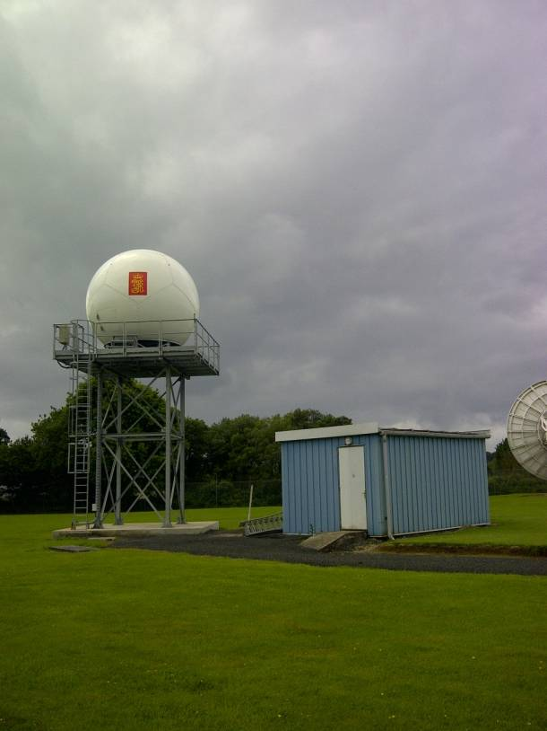
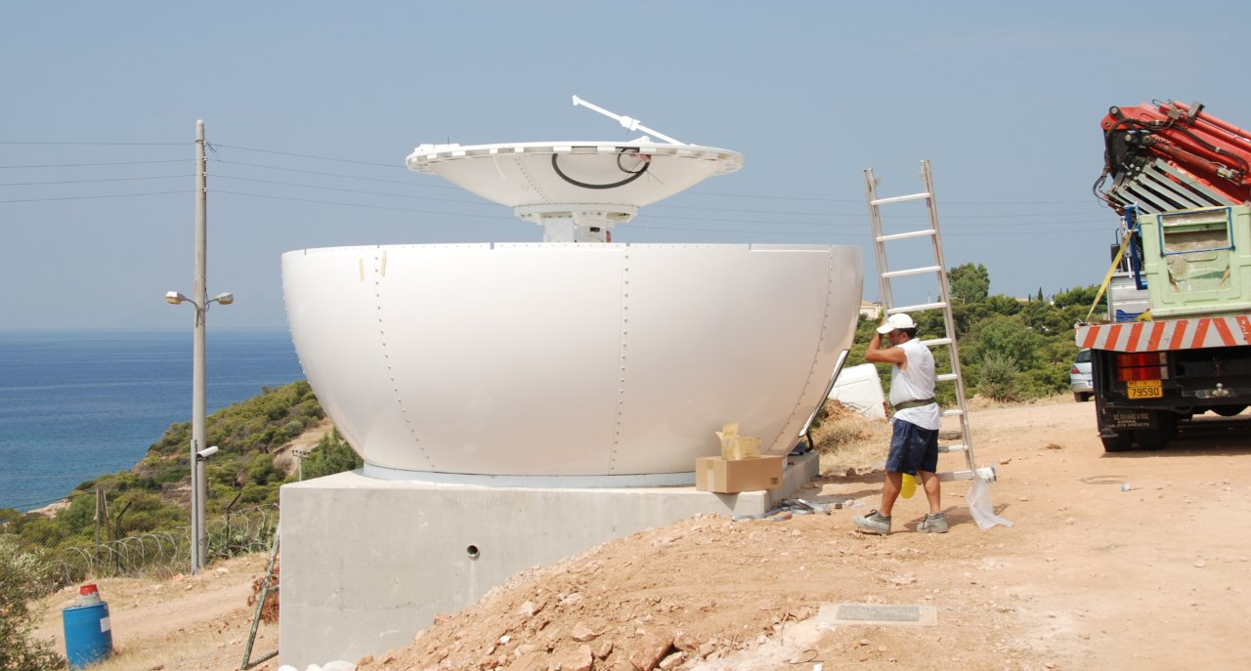
New X/L-band antennas supporting EARS-NPP
Athens: New 3.0 m L/X-band antenna
Lannion: New 2.4 m L/X-band antenna
Kangerlussuaq: Installations delayed to 2013 due to access bridge flooding and damage

Slide 40
EARS Service Status, Performance and Planning
EARS-ATOVS, -AVHRR, -ASCAT and the new EARS-IASI operational services had high availability;
Distribution of EARS-IASI via the RMDCN/GTS expected to be during Q4 of 2012;
EARS-NWC (nowcasting) initial testing with one reception station and some beta users is planned to take place during Q4 2012;
Dissemination via EUMETCast to all users is expected to start soon afterwards.

Slide 41
EUMETSAT Central Operations Report for January - June 2012
Metop/NOAA Regional Data Service → EARS-AVHRR
This service provides data from the AVHRR instrument onboard the NOAA satellite N19 and from the instrument on Metop-A (AHRPT partial coverage data and FDES).
Availability shown on the chart is for Level 0 data received by users (relative to scheduled regional passes). Note that no higher-level products are generated.
Events Which Impacted Availability:
None significant.

Slide 42
Jason-2 Service Status and Performance (1 April – 31 August 2012)
The Jason-2 System provided a good operational service with high availability and good timeliness:
Some outages affected the data latency, mainly due to ground stations anomalies (Usingen, Fairbanks and Wallops), connectivity problems between NOAA and EUMETSAT;
- Data sent < 3 hours = 91%;
Data sent < 5 hours = 99%.
The Jason-2 products have been enhanced to the GDR-D standard on 31 July 2012; the BUFR encoding software was also upgraded accordingly.

Slide 43
EUMETSAT Central Operations Report for January - June 2012
Jason-2 OGDR Service
The chart shows the availability of the Jason-2 near real-time Operational Geophysical Data Record products disseminated via EUMETCast.
The target figure of 95% applies to the availability of data received on EUMETCast reception stations with a timeliness of 5 hours. The further target of 75% is for the more demanding objective of 3-hour timeliness.
Events Which Impacted Availability:
None significant.
(In general, redumps are taken at next visibility (or by other ground station) in cases of problematic passes and connection problems – this ensures minimisation of data loss, although some impact on timeliness occurs)
Notes:
1-Aug-2012: confirmed with SD that none of her so-called ‘major’ events were really major in the course of the 6 months.
POST-DG-REVIEW: indentation correction on last para

Slide 44
LEO Operations Near-Term Planning
2012:
Mid-November 2012: Completion of Metop-B SIOV (responsibility from SSST to EUM PRD)
New EARS Services: EARS Nowcasting, EARS NPP for ATMS, CrIS
DRAPSO operational dissemination in 2012, pending agreement finalisation with ISRO.
SARAL Launch December 2012
2013
January 2013: Metop-B Handover from PRD to OPS and Cal/Val Phase 2 start
EARS NPP for VIIRS (Q1)
May 2013 (TBC): McMurdo acquisitions to switch from Metop-A to Metop-B.
2014
Sentinel-3A Launch (December 2014)
ADA Operational Service Start Q1/2 2014 (all orbits, one satellite).
Jason-3 Launch (end 2014)

Slide 45
Third Party Services
Oceansat 2
Nominal – data reception at SVL, sent to India, processed in India, sent to SVL, sent to EUMETSAT, sent on to user community
Alternative – data reception at SVL, sent to EUMETSAT, processed in EUMETSAT, sent on to user community
Switch controlled by ISRO
Service becomes fully operational on 25 October 2012
Megha-Tropiques
Joint ISRO/CNES mission
MADRAS (microwave imager) and SAPHIR (microwave sounder) from ISRO via EUMETSAT on to user community
GPS-ROS (radio occultation sounder) data may follow
SMOS
Data produced by ESAC in Madrid, sent via UK Met Office using RMDCN to EUMETCast uplink
No data through EUMETSAT HQ, co-odinated helpdesk/registration functions
Ocean products fro MyOcean
Sea Surface Temperature from NPP
Ocean Colour from NPP
Other source of ocean colour
Other services are also being developed (SARAL, FY3 A/B, HY2, Electro-L N1)

