Slide 1

NESDIS Report on NOAA and Non-NOAA Satellites
Joint APSDEU/NAEDEX Meeting
October 22-25, 2012
U.K. MetOffice
Exeter, U.K.
John Paquette
NOAA/NESDIS/OSPO
Notes:
1

Slide 2
Outline
GOES Status
POES/Metop-B Status
NPP Status
Future JPSS Plans
Future GOES-R Plans
Non-NOAA Satellite Update

Slide 3
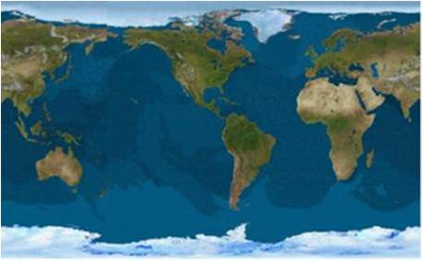
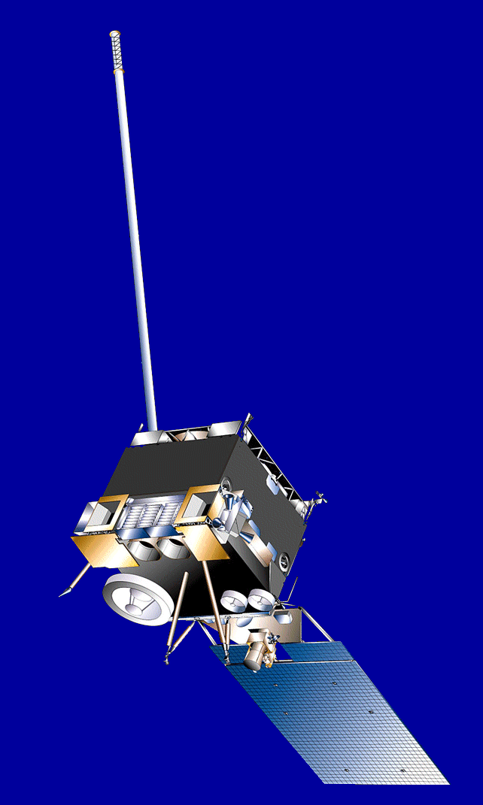
GOES On-Orbit Configuration
Current as of September 2012
GOES-15 | GOES-14 | GOES-13 | GOES-12
Launched: 3/2010 Located: 135°W GOES-WEST | Launched: 6/2009 Located: 89.5W On-orbit storage | Launched: 5/2006 Located: 75°W Restored to GOES-EAST on Oct. 18 | Launched: 7/2001 Located: 60°W South America Support
GOES-15
135° West
GOES-13
75° West
GOES-12
60° West
GOES-14
89.5 West

Slide 4
Geostationary Operational Environmental Satellite (GOES)
Performance Status
Payload Instrument | GOES-12 (S. America) Launch: Jul 01 Activation: Apr 03 | GOES-13 (East) Launch: May 06 Activation: Apr 10 | GOES-14 (Standby) Launch: Jun 09 Activation: Sep 12 | GOES-15 (West) Launch: Mar 10 Activation: Dec 11
Imager | G | G | G | G
Sounder | Y (1) | G | G | Y (9)
Energetic Particle Sensor (EPS) | Y (2) | G | G | G
Magnetometers | G | G | G | G
High Energy Proton and Alpha Detector (HEPAD) | G | G | G | G
X-Ray Sensor (XRS) | Y (3) | R (7) | G | G
Solar X-Ray Imager (SXI) | R (4) | Y (8) | G | G
Spacecraft Subsystems
Telemetry, Command & Control | G | G | G | G
Attitude and Orbit Control | G | G | G | G
Inclination Control | R (5) | G | G | G
Propulsion | G | G | G | G
Mechanisms | G | G | G | G
Electrical Power | G | G | G | G
Thermal Control | G | G | G | G
Communications Payloads | G | G | G | G
Key
Operational
Spacecraft issues but no user impacts
Operational with limitations
Non-operational
Not Applicable
G
S/C
Y
R
N/A
Notes:
1

Slide 5
GOES Status October 2012 http://www.oso.noaa.gov/goesstatus
Payload Instrument | GOES-12 (S. America) Launch: Jul 01 Activation: Apr 03 | GOES-13 (East) Launch: May 06 Activation: Apr 10 | GOES-14 (Standby) Launch: Jun 09 Activation: Sep 12 | GOES-15 (West ) Launch: Mar 10 Activation: Dec 11
Imager | S/C (1) | G | G | G
Sounder | Y (2) | G | G | Y (11)
Energetic Particle Sensor (EPS) | Y (3) | G | G | G
Magnetometers | G | G | G | G
High Energy Proton and Alpha Detector (HEPAD) | G | G | G | G
X-Ray Sensor (XRS) | Y (4) | R (8) | G | G
Solar X-Ray Imager (SXI) | R (5) | Y (9) | G | S/C (12)
Spacecraft Subsystems
Telemetry, Command & Control | G | G | G | G
Attitude and Orbit Control | S/C (14) | G | G | G
Inclination Control | R (6) | G | G | G
Propulsion | Y (7) | S/C (10) | G | G
Mechanisms | G | G | G | G
Electrical Power | G | G | G | G
Thermal Control | G | G | G | G
Communications Payloads | G | G | G | S/C (13)
Key
Operational
Spacecraft issues but no user impacts
Operational with limitations
Non-operational
GOES-15 Sounder temperature control blanket is raised. Yaw flip at Equinox to keep Sun angle below cooler plane. Data outage and degraded products during each yaw flip maneuver and 28 hours of INR recovery period.
G
GOES-12 X-ray Imager has failed. No recovery possible.
S/C
GOES-13 X-Ray Sensor Failed. No x-ray space measurements being collected.
GOES-12 Inclination Control is non-operational. No fuel remains for inclination control maneuvers. Code was loaded to mitigate image motion at slightly inclined orbit. XGOHI (eXtended GOES High Inclination.) Users should expect a 4 minute delay from the time actually imaged. As with the past GOES-10, users should also expect if there is a frame break during an image that the rest of the image will be lost. Without XGOHI, the growing satellite inclination would continue to cause loops with an ever increasing "wobble".
Y
R
Notes:
1

Slide 6
GOES Operations Status -
October 2012
GOES-13 Sounder Event
  GOES-13 Sounder scan motor overload fault tripped at 1126z on September 23.
    Root cause of Sounder Anomaly: filter wheel vibration
GOES-13 Imager Event
  GOES-13 Imager scan motor overload fault tripped at 2117z on September 23.
    Root cause of Imager Anomaly: Sounder filter wheel vibration disturbance was transmitted to the Imager/Sounder optical bench & Imager scan mirror had an anomalous response
GOES-14 Operations Status
  GOES-14 supporting GOES-East operations as it drifted to east from September 24 to October 18 . GOES-14 Imager and Sounder products were retransmitted through GOES-13.
GOES-13 Operations Status
  Effective October 18, GOES-13 transmitting GVAR data from 75W, nominal GOES-East sub-point, and generation of GOES-13 Imager and Sounder products restored.

Slide 8
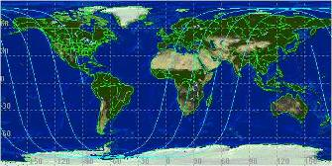
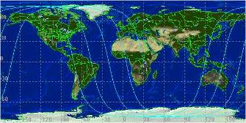
Polar-Orbiting Overview URL: http://www.oso.noaa.gov/poes/index.htm
Two polar operational satellites; one in morning and one in afternoon orbit
Continuity of operations since early 1960s
Since May 2007, through NOAA and EUMETSAT Partnership - EUMETSAT operates Metop-A for mid-morning orbit
2 p.m. Orbit
10 a.m. Orbit

Slide 9

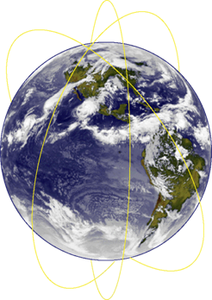
Polar-Orbiting Local Times
Metop-A – 0930 AM Primary
NOAA-19 – 1334 PM Primary
Metop-B – Launched 9/17
  Currently in PLT & Commissioning Phase
NOAA-18 – 1502 PM Secondary
NOAA-17 – 0656 AM Back-up
NOAA-16 – 2040 PM Secondary
NOAA-15 – 0444 AM Secondary

Slide 10
Metop-B Status
Launched – September 17, 2012
0950 Orbit Planned
OSPO is now testing and validating products. Most products will be available in March 2013.
Products Slated
  ATOVS
  Blended TPW and Blended RR
  Radiation Budget
  AMVs
  ASCAT Winds
  IASI
  GVI

Slide 11
POES Status (Oct 1, 2012)
http://www.oso.noaa.gov/poesstatus/index.asp
Spacecraft Subsystems | METOP-A | NOAA-19 | NOAA-18 | NOAA-17 | NOAA-16 | NOAA-15
Launch Date | Oct 2006 | Feb 2009 | May 2005 | Jun 2002 | Sep 2000 | May 1998
Operational Date | May 2007 | Jun 2009 | Aug 2005 | Oct 2002 | Mar 2001 | Dec 1998
Mission Data Category | Primary (AM) | Primary (PM) | Secondary (PM) | Secondary (AM) | Secondary (PM) | Secondary (AM)
Payload Instruments
AVHRR | G | G | G | R (11) | Y(13) | Y(20)
HIRS | G | G | Y (3) | G | Y(14) | R (6)
AMSU-A1 | Y(26) | G | G | R (4) | Y(15) | Y(21)
AMSU-A2 | G | G | G | G | G
AMSU-B | N/A | N/A | N/A | Y (9) | G | R (12)
MHS | G | Y (8) | G | N/A | N/A | N/A
SEM | G | G | G | G | G | G
SBUV | N/A | S/C (9) | G | G | Y(16) | N/A
Spacecraft Subsystems
Telemetry, Command & Control | G | G | G | G | G | G
ADACS | G | G | Y (7) | Y(26) | Y(17) | Y(10)
EPS | G | G | G | Y(25) | G | G
Thermal Control | G | G | G | G | G | Y(22)
Communications | Y (1) | G | G | S/C (5) | G | Y(23)
APT/LRPT | R (2) | G | G | G | R(18) | G
SAR | G | G | G | G | Y(19) | Y(24)
AVHRR Scan Motor Failed
AMSU –A1 Scan Motor Failed
N15 still available to users
HIRS Filter Wheel Stalled, N17 & METOP-A still available to users
HIRS Longwave channel noise
AMSU-B Antenna Scan Motor Failed, METOP-A MHS still available to users
Transmitter off, no LRPT
APT 1 & 2 Failed, N19 still available to users

Slide 12
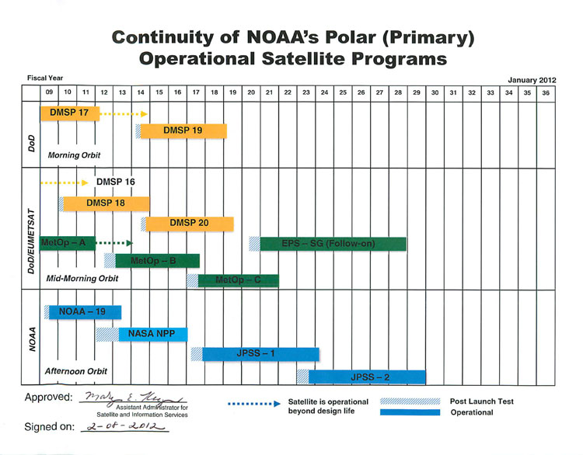

S-NPP Status

Slide 13
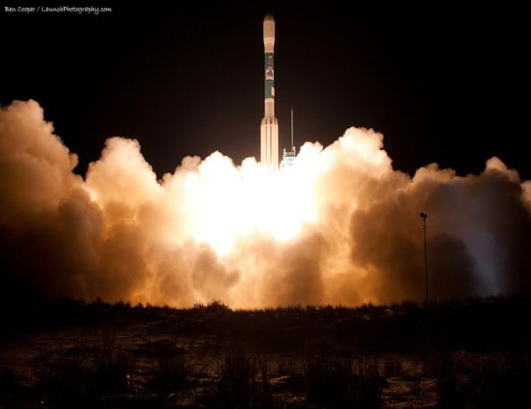
Suomi-National Polar-orbiting Partnership (S-NPP) Status
Launched October 28, 2011
Observatory and Ground systems functioning nominally
All Instruments in science mode
Instruments are producing quality sensor data records
  Calibration and validation continues
  Public release of S-NPP data available from NOAA’s archive system (i.e., CLASS)
Transition of satellite and ground system operations to NOAA planned to occur about 15 months post-launch
May 2012 S-NPP microwave radiance (ATMS) data assimilated into Numerical Weather Prediction Models by NOAA’s National Weather Service
Notes:
TS: overall I didn’t like this slide.
TS: recommended changes in red. Not sure what is meant by successful commissioning. I would delete this bullet. Don’t talk about beta. You don’t need to go into this w/the audience. FYI. All SDRs are at beta or beyond.
TS: I pretty sure May 2012 is when NWS began using ATMS data in their models.
KB: Suggest using a consistent font (& font size) throughout slide package.

Slide 14
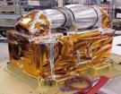

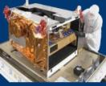
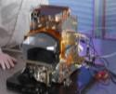
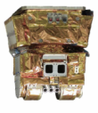
System Description
(Space Segment)
NOAA Heritage | NASA Heritage | JPSS Instrument |  | Measurement
AMSU | AMSU |  | ATMS | ATMS and CrIS together provide profiles of atmospheric temperature, moisture, and pressure
HIRS | AIRS |  | CrIS
AVHRR | MODIS |  | VIIRS | Provides daily high-resolution imagery and radiometry across the visible to long-wave infrared spectrum
SBUV-2 | OMI |  | OMPS | Spectrometers with UV and IR bands for ozone total column measurements and NADIR and Limb profiler measurements
ERBE | CERES |  | CERES | Scanning radiometer that supports studies of Earth Radiation Budget
Notes:
TS: added boxes.
KB: Added border around Tom’s new box’s. Content is good.

Slide 15
NOAA’s NPP Data Exploitation (NDE)
NDE Mission
  The NDE Project’s primary mission is to provide near real time products derived from NPP observations to NOAA’s operational and climate communities and other civilian and U.S. government users.
NDE System Objectives
  Disseminate S-NPP Data Records to users
  Develop a sustainable system that meets its user needs
  Provide software for S-NPP Data Record format translation and other data manipulations
For additional information: http://projects.osd.noaa.gov/nde/ &
http://npp.gsfc.nasa.gov/science/documents.html
Notes:
TS: changes in red. Pasted in NDE mission and objectives from our recent NDE Overview slides.

Slide 16
Near Real Time S-NPP Data
NOAA’s NPP Data Exploitation (NDE) Project
  NDE serves the near real time user community on an 8x5, best-effort basis
    NOAA’s Office of Satellite and Product Operations (OSPO) provides a 24x7 Help Desk facility to report anomalies
    ftp-s protocol, push and pull
  Datasets are presently for evaluation purposes only (still being calibrated/validated)
  NOAA will not monitor production on a 24x7 basis until mid to late 2013
  NOAA is preparing a NPP Ground System remote backup capability in 2015
  Users must:
    Submit NPP Data Access Request (DAR) Form to NESDIS.Data.Access@noaa.gov (NOAA has JMA’s DAR and is currently establishing a process to evaluate all NPP DAR’s)
    User must establish a network point of presence at Suitland, MD facility and provide communication capabilities to user facility. Limited tests may be conducted via Internet.
Direct Readout Capability (X-Band) can be used to receive NPP in regional areas
  For more info: http://cimss.ssec.wisc.edu/cspp/

Slide 17
Near Real Time S-NPP Data (cont.)
Global Telecommunications Service (GTS) & EUMETCast
  EUMETSAT redistributes/makes available NDE test CrIS and ATMS radiance sensor data records in BUFR format on GTS and EUMETCast (Activated on 31 July 2012)
  EUMETSAT to access cloud cover and cloud height products at end of October 2012
  GTS is used for operational international exchange of meteorological data between National Centers
  EUMETCast is a satellite multicast system using DVB-S technology. Users register for access via EUMETSAT
  For more info: http://www.eumetsat.int/Home/Main/News/ProductServiceNews/820742?l=en

Slide 18
Archived S-NPP Data
NOAA’s archive system: Comprehensive Large Array-data Stewardship System (CLASS, http://www.class.noaa.gov/)
  Data delayed by 6 hours or more and normally made available to users within 24 hours
    Delay to improve completeness of data set (repaired granules, data recovery)
  NOAA archives
    raw, sensor and environmental data records (RDRs, SDRs, EDRs)
    ancillary and auxiliary data
    software release packages
  Registered public users have access after JPSS Program Office declares products have reached beta status
Notes:
TS: I recommend you use the S-NPP data availability slides that NDE, OSPO and IIA have developed. We keep these slides updated and they are used by a number of people when doing briefings to users. I replaced you last few slides with the next four slides.

Slide 19
Joint Polar Satellite System (JPSS)
  JPSS will provide operational continuity of satellite-based observations and products for NOAA Polar-orbiting Operational Environmental Satellites (POES), NASA’s Earth Observing Satellites (EOS), and Suomi NPP
  JPSS-1 will fly the following instruments in the afternoon orbit utilizing an NPP-like spacecraft:
  Visible/Infrared Imager/Radiometer Suite (VIIRS)
  Cross-track Infrared Sounder (CrIS)
  Advanced Technology Microwave Sounder (ATMS)
  Ozone Mapping and Profiler Suite –Nadir (OMPS-Nadir)
  Clouds and Earth Radiant Energy System (CERES)
Launch Readiness Date | JPSS-1: FY 2017 JPSS-2: FY 2022 Free Flyer-1: FY2016 Free Flyer-2: FY2021
Program Architecture | 3 Satellites (S-NPP, JPSS-1, JPSS-2), 2 free-flyer satellites
Program Operational Life | FY 2016 – FY 2028
Program Life-cycle FY 2013 President’s Budget | $12.9 billion
*Launch Readiness Date based on FY 2013 President’s Budget Request

Slide 20
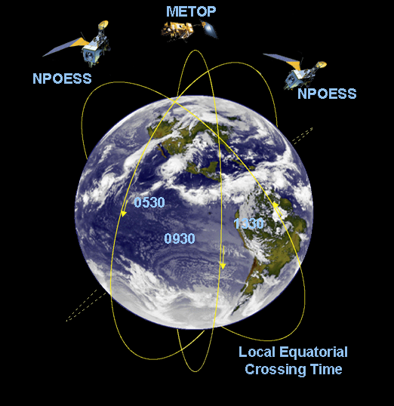
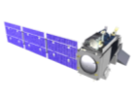

JPSS: Integral to 3-Orbit Global Polar Coverage
JPSS implements US civil commitment, interagency and international agreements to afford 3-orbit global coverage.
METOP/
EPS-SG
DMSP
DoD Follow-on
Suomi NPP /
JPSS-1/JPSS-2
JAXA GCOM-W
Local Equatorial Crossing Time

Slide 21
JPSS Environmental Products
VIIRS (22 EDRs)
GCOM AMSR-2
(11 EDRs)
RDRs & SDRs (for each band)
EDRs
RDR & SDR
ALBEDO (SURFACE)
CLOUD BASE HEIGHT
CLOUD COVER/LAYERS
CLOUD EFFECTIVE PART SIZE
CLOUD OPTICAL THICKNESS
CLOUD TOP HEIGHT
CLOUD TOP PRESSURE
CLOUD TOP TEMPERATURE
ICE SURFACE TEMPERATURE
NET HEAT FLUX
OCEAN COLOR/CHLOROPHYLL
SUSPENDED MATTER
VEGETATION INDEX
AEROSOL OPTICAL THICKNESS
AEROSOL PARTICLE SIZE
ACTIVE FIRES
IMAGERY
SEA ICE CHARACTERIZATION
SNOW COVER
SEA SURFACE TEMPERATURE
LAND SURFACE TEMP
SURFACE TYPE
EDRs
CLOUD LIQUID WATER
PRECIPITATION TYPE/RATE
PRECIPITABLE WATER
SEA SURFACE WINDS SPEED
SOIL MOISTURE
SNOW WATER EQUIVALENT
IMAGERY
SEA ICE CHARACTERIZATION
SNOW COVER/DEPTH
SEA SURFACE TEMPERATURE
SURFACE TYPE
CrIS/ATMS (3 EDRs)
OMPS (2 EDRs)
RDR & SDR
RDR & SDR
EDRs
TSIS (1)
EDRs
CERES (2 EDRs) (1)
ATM VERT MOIST PROFILE
ATM VERT TEMP PROFILE
PRESSURE (SURFACE/PROFILE)
RDR & SDR
O₃ TOTAL COLUMN
O₃ NADIR PROFILE
RDR & SDR
SOLAR IRRADIANCE
EDRs
NET SOLAR RADIATION (TOA)
OUTGOING LW RADIATION (TOA)
A-DCS
SARR & SARP
SDRs
PLATFORM REPORTS
DISTRESS BEACON REPORTS
LONG WAVE RADIANCE (TOA)
REFLECTED SOLAR RADIANCE (TOA)
TOTAL RADIANCE (TOA)
KEY
JPSS Ground System (NPP, JPSS – ½)
RDR = Raw Data Record
SDR = Sensor Data Record
EDR = Environmental Data Record
ESPC (GCOM-W1)
Free-flyer Ground System (FF-1)
EDRs with Key Performance Parameters
(1) CERES and TSIS Climate Data Record (CDR) production is outside the scope of JPSS
Notes:
TS: added item in red under GCOM-W

Slide 22
Partnerships
  EUMETSAT
    EUMETSAT provides mid-morning orbit
    Both support planning and operations (e.g., Antarctic Data Acquisition)
  Japan (Japan Aerospace Exploration Agency)
    Global Change Observation Mission – Water (GCOM-W1) provides AMSR-2 data – continuity for NASA’s Aqua satellite and satisfies NOAA’s conical microwave data requirements
    NOAA provides ground system services in exchange for data from AMSR2
  Norway (Norwegian Space Centre)
    Satellite tracking and environmental data acquisition
  Canada (DND) and France (CNES) for SARSAT Program
  France (CNES) – Argos Program
Notes:
TS: added item in Green under Japan. This is an extremely important point.
WB: added item in Green under EUMETSAT and CNES.

Slide 23
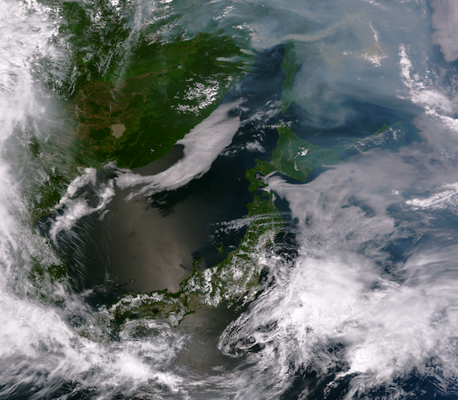
Benefits
Cloud Imagery and smoke plumes
VIIRS Visible Imagery
June 29, 2012
Notes:
June 29: VIIRS. good central pass over Japan. Also shows the massive wildfires off of China with tremendous smoke plumes.
NOAA has been producing imagery like this for wildfires that have been plaguing the southwest United States over the past several weeks. Using a combination of the high resolution visible and infrared bands (I3, I2, I1) provides more details than previously available from NOAA POES: vegetation condition, hot spots showing where the active fires are located, burn scars from where the fire was extinguished, and smoke plumes.

Slide 24
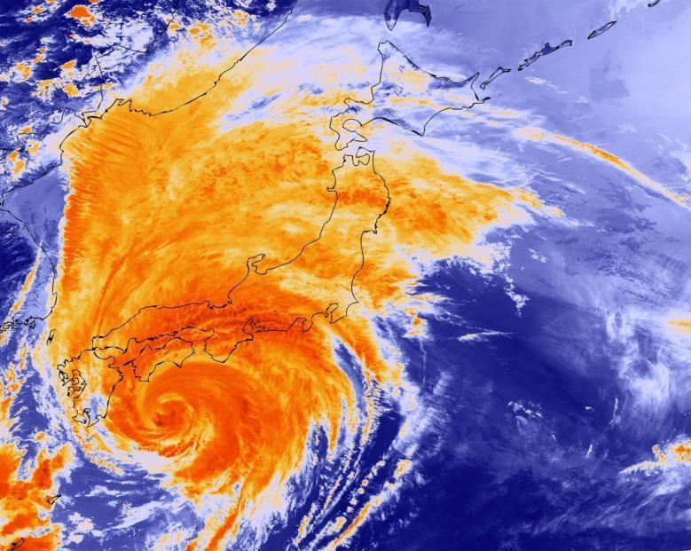
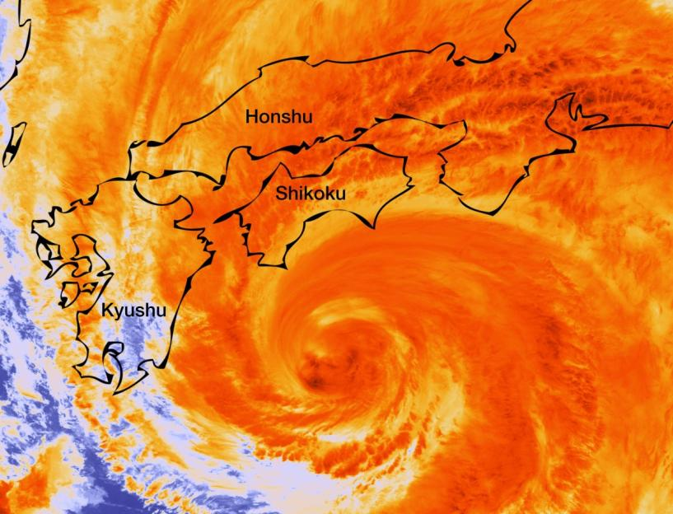
Benefits
Typhoon Guchol
VIIRS Infrared Imagery
June 19, 2012
Notes:
June 19th as Typhoon Guchol made landfall. VIIRS SVI05 colorized. (High resolution infrared cloud imagery band). Both images are at full 375m resolution.

Slide 25
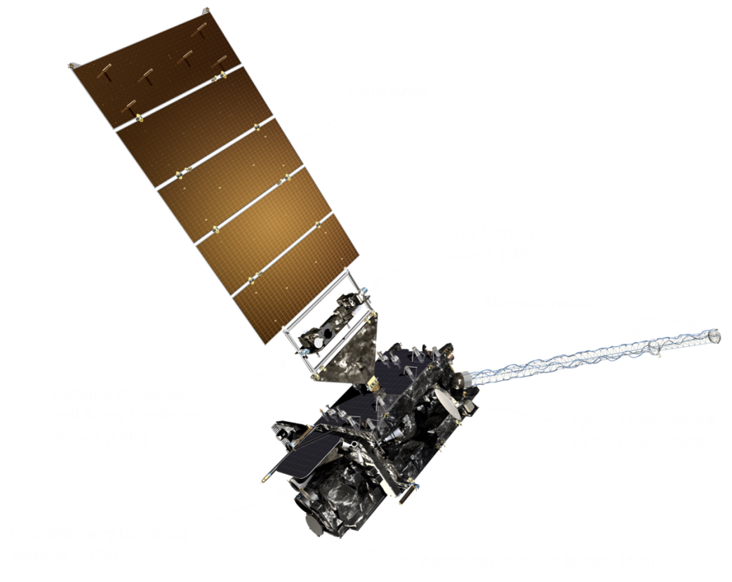
GOES-R Spacecraft
Specifications
Size: ~5.5 meters (from launch vehicle interface to top of ABI)
Mass: Satellite (spacecraft and payloads) dry mass <2800kg
Power Capacity: >4000W at end-of-life (includes accounting for limited array degradation)
Spacecraft on-orbit life of 15 years with orbit East-West and North-South position maintained to within +/-0.1 degree
3-axis stabilized

Slide 26
ABI Comparison to Current Imager
ABI Current
Spectral Coverage 16 bands 5 bands
Spatial resolution
0.64 mm Visible 0.5 km 1 km
Other Visible/near-IR 1.0 km n/a
Bands (>2 mm) 2 km 4 km
Spatial coverage
Full disk 4 per hour 3 hourly
CONUS 12 per hour ~4 per hour
Mesoscale 30 sec (typical) n/a
Visible (reflective bands)
On-orbit calibration Yes No
Notes:
ABI Full disk- 5 min or 12 per hour dedicated mode
Current Imager- 60 sec dedicated mode for research (Super Rapid Scan)
Image Navigation and Registration- ABI- 0.5 km, Current Imager- 2km

Slide 27
GOES-R Products
Baseline Products
Future Capabilities
Advanced Baseline Imager (ABI)
Absorbed Shortwave Radiation: Surface Aerosol Particle Size Aircraft Icing Threat Cloud Ice Water Path Cloud Layers/Heights Cloud Liquid Water Cloud Type Convective Initiation Currents Currents: Offshore Downward Longwave Radiation: Surface Enhanced “V”/Overshooting Top Detection Flood/Standing Water Ice Cover Low Cloud and Fog Ozone Total Probability of Rainfall Rainfall Potential Sea and Lake Ice: Age Sea and Lake Ice: Concentration Sea and Lake Ice: Motion Snow Depth (Over Plains) SO₂ Detection Surface Albedo Surface Emissivity Tropopause Folding Turbulence Prediction Upward Longwave Radiation: Surface Upward Longwave Radiation: TOA Vegetation Fraction: Green Vegetation Index Visibility
Advanced Baseline Imager (ABI)
Aerosol Detection (Including Smoke and Dust) Aerosol Optical Depth (AOD) Clear Sky Masks Cloud and Moisture Imagery Cloud Optical Depth Cloud Particle Size Distribution Cloud Top Height Cloud Top Phase Cloud Top Pressure Cloud Top Temperature Derived Motion Winds Derived Stability Indices Downward Shortwave Radiation: Surface Fire/Hot Spot Characterization Hurricane Intensity Estimation Land Surface Temperature (Skin) Legacy Vertical Moisture Profile Legacy Vertical Temperature Profile Radiances Rainfall Rate/QPE Reflected Shortwave Radiation: TOA Sea Surface Temperature (Skin) Snow Cover Total Precipitable Water Volcanic Ash: Detection and Height
Geostationary Lightning Mapper (GLM)
Lightning Detection: Events, Groups & Flashes
Space Environment In-Situ Suite (SEISS)
Energetic Heavy Ions Magnetospheric Electrons & Protons: Low Energy Magnetospheric Electrons: Med & High Energy Magnetospheric Protons: Med & High Energy Solar and Galactic Protons
Magnetometer (MAG)
Geomagnetic Field
Extreme Ultraviolet and X-ray Irradiance Suite (EXIS)
Solar Flux: EUV Solar Flux: X-ray Irradiance
Solar Ultraviolet Imager (SUVI)
Solar EUV Imagery

Slide 28
Direct Readout
GOES Rebroadcast (GRB)

Slide 29
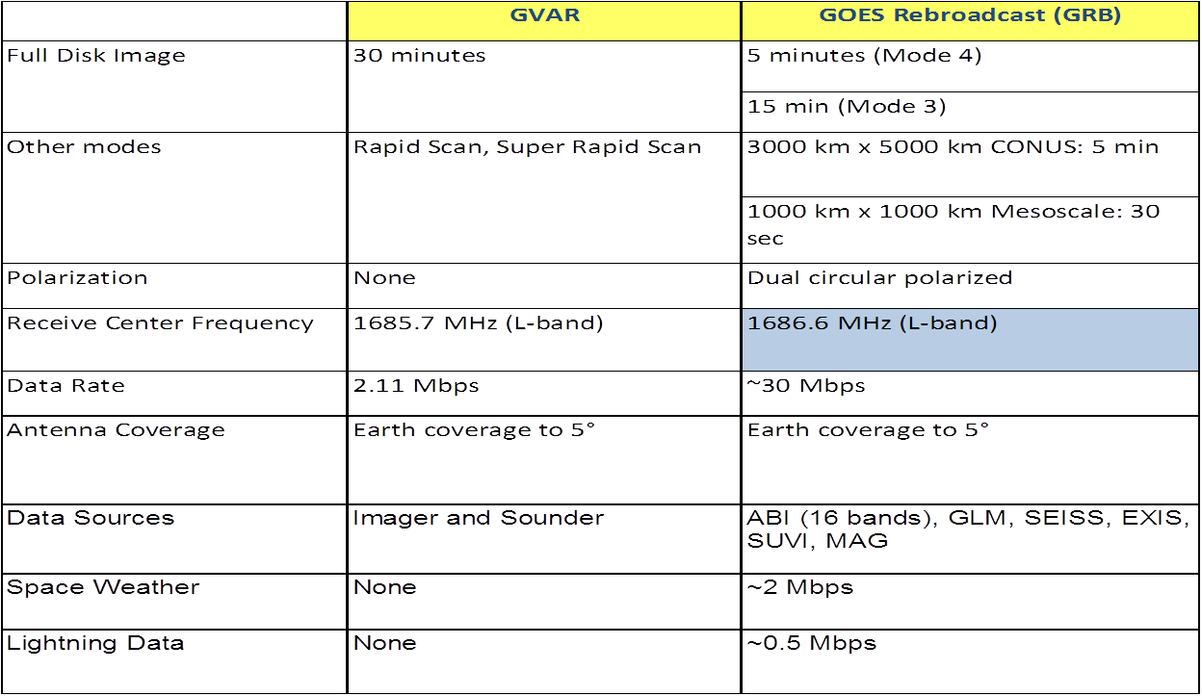
Transition from GVAR to GRB

Slide 30
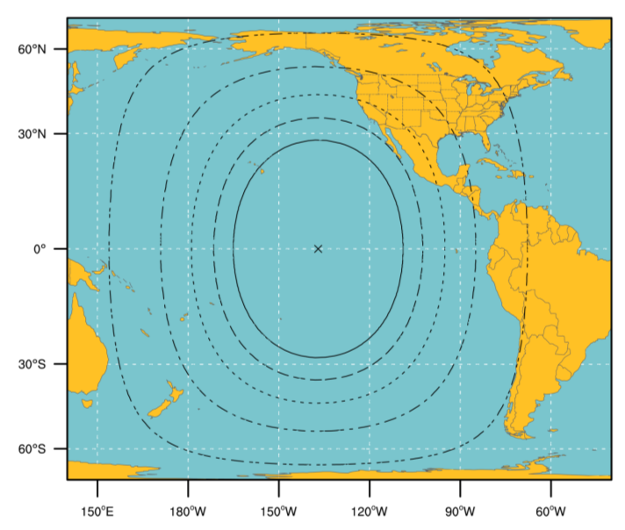
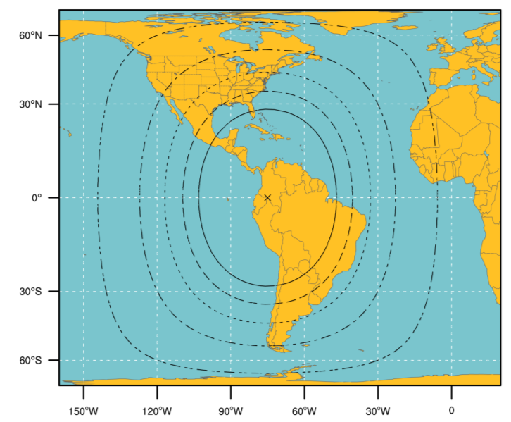
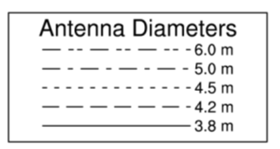
GRB Ground Antenna Sizes
NOTES:
Calculations based on available data as of May 2011
Each antenna size is usable within the indicated contour
Rain attenuations included are:
1.3/1.6/2.0/2.2/2.5 dB (3.8 to 6 m)
4. An operating margin of 2.5 dB is included as the dual polarization isolation is likely to vary within each antenna size area

Slide 31
Real-Time Data Access

Slide 32
Near Real-Time Data Access – GOES-R
Environmental Satellite Processing and Distribution System (ESPDS) / Product Distribution and Access (PDA)

Slide 33
Access: Near Real-Time Use – GOES-R
ESPDS/PDA – Product Distribution and Access
  Operational Data Access Portal being acquired by NOAA/NESDIS/OSD
  Time-sensitive distribution of L1B and L2+ data sets and associated metadata
    Seven Day revolving store
    NetCDF-4 format
      McIDAS format available on–demand
  Access via PDA Discovery and Subscription Services
  Project Information and Status:
    http://www.osd.noaa.gov/Spacecraft Systems/Ground_Systems/GAS/gas.html
  Access requires authorization per NESDIS Policy for Access and Distribution of Environmental Satellite Data and Products, dated Feb 17, 2011
    http://www.ospo.noaa.gov/Organization/Documents/PDFs/NESDIS_Data_Access_Distribution_Policy.pdf
Notes:
Volumes to PDA
NSOF:
8.89 TB/day (two satellites)
219,924 Files/day
GOES-NOP Volumes (for today’s equivalent of PDA):
46 Gbytes/day/satellite (~92 Gbytes/day for two satellites)
PDA includes all legacy products
**The system can only handle 20 concurrent users.

Slide 34
Research and Retrospective Use
Comprehensive Large Array-data Stewardship System (CLASS)

Slide 35
Data Access: Research and Retrospective Use – GOES-R
NCDC/NGDC via CLASS
  Archived data will include :
    L0, L1B, and L2+ Mission Data Products including raw, sensor and environmental data records (RDRs, SDRs, EDRs)
    Calibration and Processing Parameters
    Algorithm Software and Test Data
    Instrument Calibration Data
    Ancillary Data used to generate Mission Data Products
  Access via CLASS Discovery and Subscription Services
  Data formatting
    NetCDF-4
Notes:
Volumes to CLASS:
NSOF:
0.9 TB/day (two satellites)
20,249 files/day
WCDAS/RBU:
8.75 TB/day (two satellites)
224,640 files/day average
GOES-NOP Volumes:
25 Gbytes/day/satellite (~50 Gbytes/day for two satellites)

Slide 36
General Data Formats – GOES-R
Data Formats will be described in the Product User Guide (PUG)
  Five Volume Set
    Volume 1: General Information
    Volume 2: Level 0 Data Formats
    Volume 3: Level 1 Data Formats
    Volume 4: GRB Data Formats
    Volume 5: Level 2 Data Formats
  Includes Sample Data Sets
  Preliminary Version available to the Public in September 2012
    Access via GOES-R website: http://www.goes-r.gov/
Specific queries should be addressed to the GOES-R Data Operations Manager, Stephen D. Ambrose (Stephen.Ambrose@noaa.gov)

Slide 37
GOES-R Summary
GOES-R data products will be available using new product distribution and access technologies tailored to the User Community
Continuing to work with User Community to fine tune optimized data distribution paths
Capabilities will be fully verified during Post Launch Test
Product improvements and adjustments can be made continually after launch and into operations

Slide 38
Non-NOAA Satellites
Types and Instruments
Defense Meteorological Satellite Program (DMSP)
  F15: SSM/I, SSM/T and SSM/T2
  F16, F17, F18: SSM/IS
NASA/JMA/CSA Earth Observation System (EOS)
  Terra: MODIS
  Aqua: AIRS, MODIS, AMSR-E
EUMETSAT Metop-A: ASCAT, GOME and IASI
IPO/Navy Coriolis: WindSAT
EUMETSAT/CNES/NOAA/NASA Jason-2: POSEIDON-3 Altimeter
NASA/JAXA TRMM: TMI, PR, and VIRS
Selection Criteria:

Slide 39
NESDIS Products Operational in FY12
Blended GOES Biomass Burning Emissions Program (GBBEP)
Global Blended Rate Rate (bRR)
Global Tropical Cyclone Formation Probability (TCFP)
GOES Land Surface Temperature (GLST)
Ocean Heat Content (OHC)
Microwave Integrated Retrieval System (MiRS)
Microwave Surface and Precipitation Products System (MSPPS) Snowfall Rate
MODIS Ocean Color products using near-infrared (NIR) and shortwave infrared (SWIR)
Soil Moisture Operational Product System (SMOPS)

Slide 40
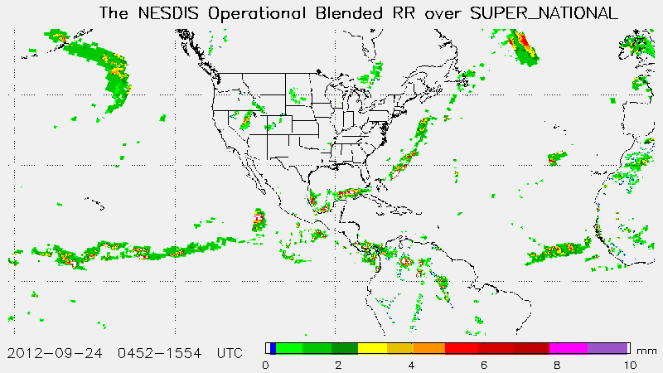
The blended Rain Rate (bRR)
  On September 18, 2012, the blended rain rate (bRR) product was implemented into the ESPC operation and declared its operational status with 24/7 support.
  The operational bRR provides a unified global rain rate product hourly by blending together recent rain rate retrievals from the passive microwave instruments onboard six polar-orbiting satellites, including NOAA-18, NOAA-19, Metop-A, DMSP F16, F17 and F18.
  The product is made available in HDF-EOS, McIDAS and AWIPS formats, and provided to users through the ESPC Data Distribution Server (DDS), McIDAS ADDE servers, and also through NWS AWIPS and N-AWIPS. The imagery products are also available on the Internet through: http://www.ospo.noaa.gov/Products/atmosphere/brr

Slide 41
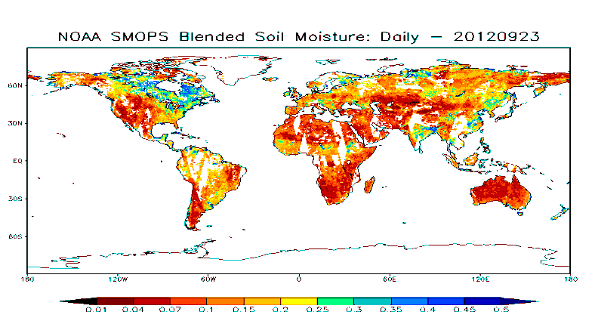
Soil Moisture
  On September 26, 2012, the SMOPS was implemented into the ESPC operation and declared its operational status with 8x5 support.
  The SMOPS retrieves and merges soil moisture retrievals from multi-satellites/sensors, including Windsat, ASCAT, SMOS, to provide a unified soil moisture product over global land in supporting the NCEP/EMC’s needs for a satellite-based global soil moisture observational data product for its land surface model assimilation.
  The product is made available in both GRIB2 and netCDF formats, and provided to users through the ESPC Data Distribution Server (DDS). The imagery products are also available on the Internet through: http://www.ospo.noaa.gov/Products/land/smops

Slide 42
Non-NOAA Satellites
Types and Instruments
MTSAT-2 (145E)
  Products –
  Remapped sectors from all imager channels every hour
  AMVs every three hours
  ADT every 30 minutes
  TCFP every 6 hours
  Meteosat-9 (0 degrees)
  Products –
  Remapped sectors from SEVIRI channels every thirty minutes
  ADT every 30 minutes
Selection Criteria:

Slide 43
Non-NOAA Satellites
Current Activities: NASA/EOS
Receiving raw Terra (MODIS) and Aqua (AIRS, MODIS, AMSR-E) data in real time from NASA
Processing MODIS data (Aqua and Terra)
  L1A, L1B (radiance) and L2 (Ocean color, SST) products generated within 3-4 hours of observation in HDF
Processing AMSR-E data (Aqua)
  Level 1A (Counts) and Level 1B (BT) in BUFR
  Level 2 (Geophysical Products, e.g., rain rate, total precipitable water, land surface emissivity ) in HDF-4
Processing AIRS data (Aqua)
  AIRS thinned data sets (300 channels) produced within 3 hours of observation, in BUFR
  Full resolution data sets in HDF and Temperature and moisture soundings
Selection Criteria:

Slide 44
Non-NOAA Satellites
Current Activities: WindSAT
Receiving raw and processed WindSAT data from Navy
Processing WindSAT data:
  Polarimetric microwave radiometric measurements for near surface (10m height) wind speed and directions over Earth’s Oceans.
  Level 1b and Level 2 products (25km resolution) provided by FNMOC
  NOAA providing WindSAT BUFR files
Product Access Information Website :
  http://manati.orbit.nesdis.noaa.gov/windsat/
Selection Criteria:

Slide 45
Non-NOAA Satellites
Current Activities: EUMETSAT/Metop
Receiving and Processing ASCAT Level 1B data
  25 km resolution products in BUFR generated within 3 hours of observation
Receiving and Processing GOME data
  Total Ozone Field (orbit) within 3 hours of observation
  Daily gridded Total Ozone Product
  Aerosol Index
Receiving and Processing IASI data :
  Vertical Temperature and Moisture Profiles produced within 3 hours of observation
  Radiances in BUFR
Selection Criteria:

Slide 46
Non-NOAA Satellites
Current Activities: Jason-2
(Joint NOAA/NASA/CNES/EUMETSAT mission)
Receiving Jason-2 payload telemetry data in near real time down linked to NOAA’s ground stations at Wallops, VA, Fairbanks, AK, and EUMETSAT’s ground station at Usingen, Germany
Processing POSEIDON-3 Altimeter data
  Radar altimeter measurements reflected by the ocean surface
  NRT Sea Surface Height Anomaly, Significant Wave Height, and Altimeter Wind Speed products produced within 3-5 hours of acquisition
  CNES provides NRT science processing software to generate OGDRs.
Jason-2 Product Distribution
  Operational Geophysical Data Records (OGDRs) in NetCDF format
  OGDR-BUFR files in BUFR format available via the WMO GTS (gateway)
  Product Access Information Website: http://www.ospo.noaa.gov/Products/ocean/ssheight.html

Slide 47
Status of Non-NOAA
Satellite Planning
Future Plans for ASCAT (EUMETSAT)
  Provide higher resolution (12.5km) wind vector products
Future Plans for DMSP F19 (DoD/FNMOC)
  Launch October 2012
  Process and Distribute SSM/IS data products

Slide 48

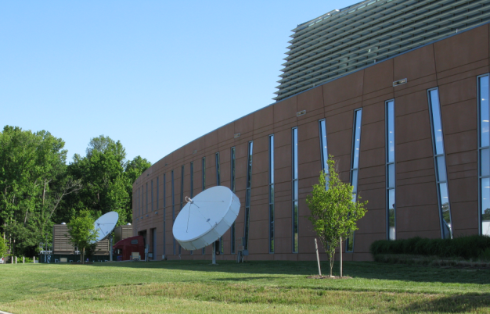
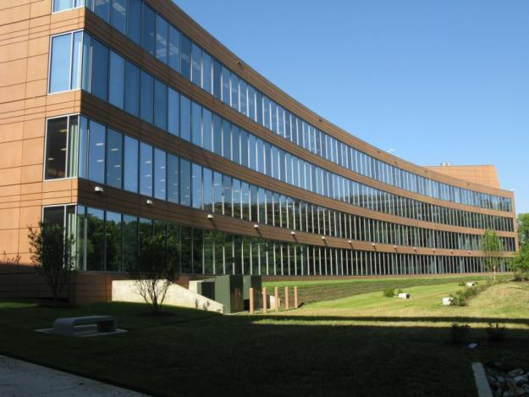

Slide 49
Thank You
If you have any questions, please contact John.Paquette@NOAA.GOV

