Slide 1
NCEP Status Update Joint APSDEU-12/NAEDEX-24 Annual Meeting
Michelle Mainelli
NOAA/NWS/NCEP Central Operations
October 23, 2012

Slide 2
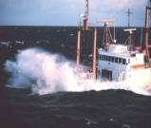
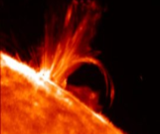
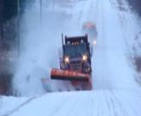
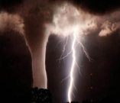
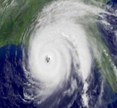
Topics
We Moved!
Current and Future NOAA High Performance Computing
New Data Usage and Acquisition
Recent Model Upgrades
Planned Model Upgrades
Development Priorities

Slide 3
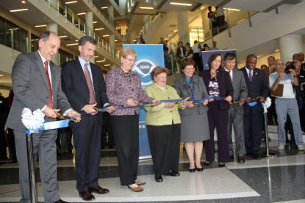
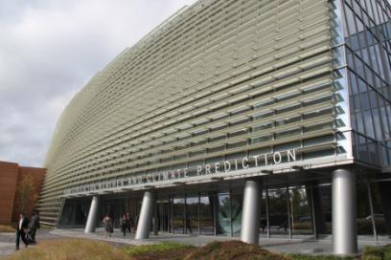
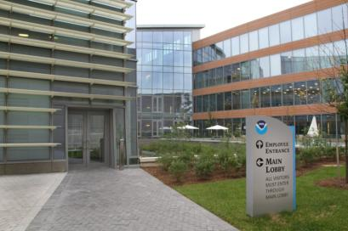
NOAA Center for Weather & Climate Prediction
3
APSDEU-12 / NAEDEX-24 – NCEP Update – October 2012

Slide 4
NCEP Computing Update
High Performance Computing
4
APSDEU-12 / NAEDEX-24 – NCEP Update – October 2012

Slide 5
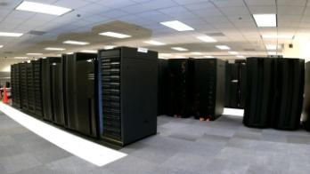
Bridge Contract Current NOAA Weather and Climate Operational Supercomputer System
Location
Primary
Gaithersburg, MD (IBM provided facility)
Backup
Fairmont, WV (GFE NASA IV&V facility)
Configuration
Identical Systems (per site)
IBM Power 6/P575/AIX
73.9 trillion calculations/sec
5,314 processing cores
0.8 petabytes of storage
Performance Requirements
Minimum 99.0% Operational Use Time
Minimum 99.0% On-time Product Generation
Minimum 99.0% Development Use Time
Minimum 99.0% System Availability
Failover tested regularly
Inputs and Outputs
Processes 3.5 billion observations/day
Produces over 15 million products/day
Significance
Where our Nation’s weather forecast process starts for the protection of lives and livelihood
Produces model guidance at global, national, and regional scales
Examples:
Hurricane Forecasts
Aviation / Transportation
Air Quality
Fire Weather
Contract ensures no gap in operations
5
APSDEU-12 / NAEDEX-24 – NCEP Update – October 2012

Slide 6
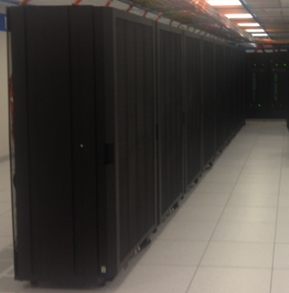
WCOSS Contract Future NOAA Weather and Climate Operational Supercomputer System
Location
Primary
Reston, VA (IBM provided facility)
Backup
Orlando, FL (IBM provided facility)
Configuration
Identical Systems (per site)
IBM iDataPlex/Intel Sandy Bridge/Linux
208 trillion calculations/sec
10,048 processing cores
2.59 petabytes of storage
Performance Requirements
Minimum 99.9% Operational Use Time
Minimum 99.0% On-time Product Generation
Minimum 99.0% Development Use Time
Minimum 99.0% System Availability
Failover tested regularly
Inputs and Outputs
Processes 3.5 billion observations/day
Produces over 15 million products/day
Significance
Where our Nation’s weather forecast process starts for the protection of lives and livelihood
Produces model guidance at global, national, and regional scales
Examples:
Hurricane Forecasts
Aviation / Transportation
Air Quality
Fire Weather
6
APSDEU-12 / NAEDEX-24 – NCEP Update – October 2012

Slide 7
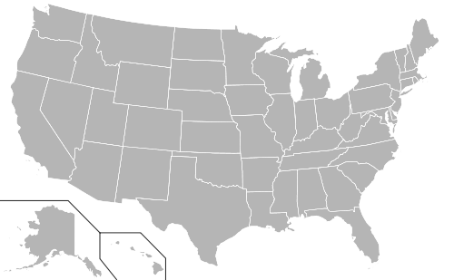
Locations
NOAA High Performance Computing
System: Gaea
Oak Ridge. National Laboratory (ORNL)
Research HPC System
(Recovery Act)
Fairmont, WV
Boulder, CO
Gaithersburg, MD
PRIMARY WCOSS: Stratus
National Centers for Environmental Prediction (NCEP)
Primary Operational HPC System (Tide)
(future ocation Reston, VA)
Oak Ridge, TN
System: tJet
Earth Systems Research Laboratory (ESRL)
Development HPC System
BACKUP WCOSS: Cirrus
National Centers for Environmental Prediction (NCEP)
Backup Operational HPC System (Gyre)
(future location Orlando, FL)
System: Zeus
NOAA Environmental Security Computing Center
Test System: Hercules (NESCC - Development HPC Systems)
(Recovery Act)
7
APSDEU-12 / NAEDEX-24 – NCEP Update – October 2012

Slide 8
Transition Status Bridge Contract, WCOSS Contract and Transition from Bridge to new WCOSS Services
FY11
FY12
FY13
FY14
Previous Contract
Bridge Contract
New WCOSS Contract
Major Milestones
Operations
Transition activities
Date | Milestone
Aug 2011 | Awarded 2-year Bridge Contract
Sept 2011 | Previous WCOSS contract expired
Nov 2011 | Awarded new WCOSS ID/IQ Contract
Apr 2012 | Installed early access system & started early testing with new architecture
Sep 2012 | Complete installation of Primary system (Reston, VA)
Nov 2012 | Complete installation of Backup system (Orlando, FL)
Dec 2012 | Acceptance of all systems completed
May2013 | Achieve Authority to Operate (ATO) for new WCOSS (NOAA8866)
July 2013 | Complete transition porting, testing, validation and tuning
Aug2013 | Go operational on new WCOSS (Ops on new WCOSS Contract)
Sep 2013 | Close out Bridge contract
8
APSDEU-12 / NAEDEX-24 – NCEP Update – October 2012

Slide 9
Production
High Water Mark Chart
9
APSDEU-12 / NAEDEX-24 – NCEP Update – October 2012

Slide 10
FY12 On-Time
Product Generation
impact significantly worsened due to system usage
Aaa
Cirrus Infrastructure caused emergency switch
Aaa
Model failure
Aaa
CCS system problems
Aaa
Implementation error
Yearly Average
2006: 99.42%
2007: 99.70%
2008: 99.82%
2009: 99.85%
2010: 99.83%
2011: 99.73%
10
APSDEU-12 / NAEDEX-24 – NCEP Update – October 2012

Slide 11
FY11 – FY12 NCEP Computing Activities
New data Usage and Data acquisition
11
APSDEU-12 / NAEDEX-24 – NCEP Update – October 2012

Slide 12
Conventional Data Received
APSDEU-12 / NAEDEX-24 – NCEP Update – October 2012

Slide 13
Non-Conventional Data Received
APSDEU-12 / NAEDEX-24 – NCEP Update – October 2012

Slide 14
Non-Conventional Assimilated Data
APSDEU-12 / NAEDEX-24 – NCEP Update – October 2012

Slide 15
New Observations and BUFR/GRIB Packages
Canadian Radar data – still under evaluation
Update to NASA Langley cloud decoder to handle files from GOES-15 instead of GOES-11 – December 2011
ENVISAT with new 30-day orbit – March 2012
Migrated BUFR radiosonde data – April 2012
Japanese AMDAR data – July 2012
Jason-1 and Cryosat-2 SSHA data – July 2012
GRIB library updates – November 2011 and July 2012
BUFRLIB update – July 2012
P3 Tail Doppler Radar data – September 2012
APSDEU-12 / NAEDEX-24 – NCEP Update – October 2012

Slide 16
Satellite Data (Radiances) Used by Assimilation
Satellite | GFS | NAM | RAP
NOAA-15 (AMSU-A) | Yes | Yes | Yes
NOAA-15 RARS (AMSU-A) | Yes | No | NO
NOAA-17 (HIRS-3) | No | No | Yes
NOAA-18 (AMSU-A, MHS) | Yes | Yes | Yes
NOAA-19 (HIRS-4, AMSU-A, MHS) | Yes | Yes | No
METOP-1(A) (HIRS-4, AMSU-1, MHS) | Yes | Yes | Yes
AQUA (AIRS, AMSU-A, IASI) | Yes | Yes | No
GOES-13 (SOUNDER) | Yes | No | No
GOES-15 (SOUNDER – over water only) | Yes | No | No
METEOSAT-9 (SEVIRI) | Yes | No | No
NPP (ATMS) | Yes | No | No
APSDEU-12 / NAEDEX-24 – NCEP Update – October 2012

Slide 17
Satellite Data Retrieved Products/Ozone/Radar/GPSRO
Satellite | GFS | NAM | RAP
TRMM (TMI – rain rate, clw, cloud ice) | Yes | No | No
GOES-13 and GOES-15 (IMAGER – ctp, ctt, cloud fraction clw, cloud levels) | No | No | Yes
NOAA-17, -18, -19 (SBUV-2 – ozone) | Yes | No | No
AURA (OMI – ozone) | Yes | No | No
WSR-88D (Level 2 radial wind, level 2.5 radial wind superobs, level 3 (NIDS) radial wind superobs | No | Yes | No
WSR-88D – Reflectivity | No | No | Yes
COSMIC-1 to COSMIC-6, GRACE-A and METOP-2(A) - refraction/bending angle | Yes (b) | Yes (r) | No
SAC-C ,TerraSAR-X, and C/NOFS–bending angle | Yes | No | No
APSDEU-12 / NAEDEX-24 – NCEP Update – October 2012

Slide 18
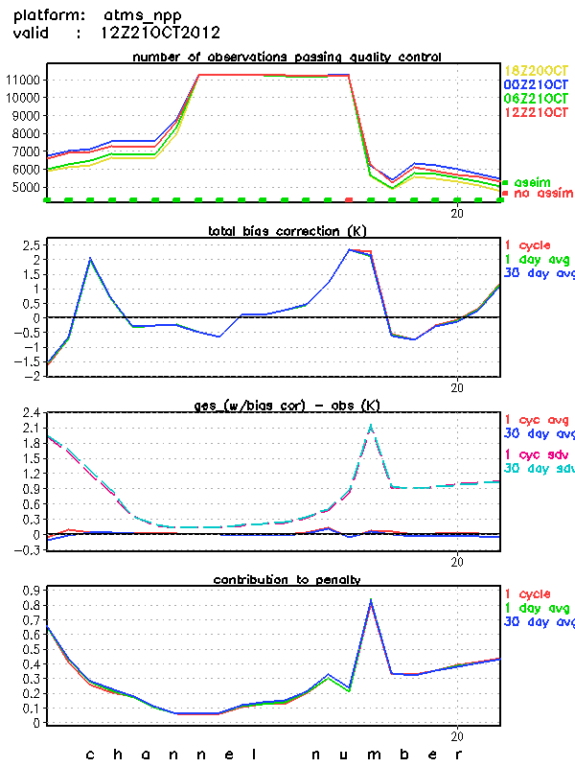
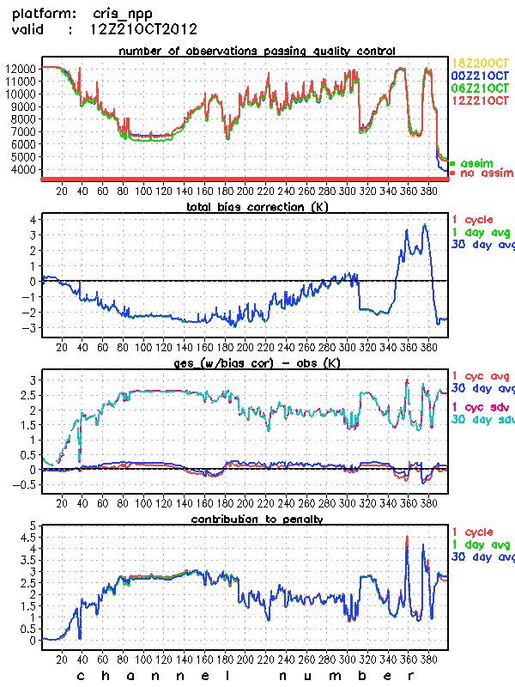
NPP Data
http://www.emc.ncep.noaa.gov/gmb/gdas/index.html
18
APSDEU-12 / NAEDEX-24 – NCEP Update – October 2012

Slide 19
FY11Q4 – FY12 NCEP Computing Activities
Recent Model Upgrades
19
APSDEU-12 / NAEDEX-24 – NCEP Update – October 2012

Slide 20
Model Upgrades June – September 2011
June 2011- GSI upgrade
Improved OMI QC
Inclusion of SBUV and MHS from NOAA-19
Improved GSI code w/optimization and additional options
Ambiguous vector quality control for ASCAT (type 290) data
New Thermal Roughness Length – reduce low level warm bias over land
Changes to LAMP station guidance
NAQFC: Upgrade of CONUS/HI/AK V5.0.0
GDAS V9.0.0 (w/GFS bug fix V9.1.0)
(NAEFS) CMC Ensemble data input format (GRIB/GRIB2) V10.1.0
Real Time Global SST
Gridded LAMP V1.0.0 Production
GFS-based Hi-Res MOS w/QPF V1.0.0
APSDEU-12 / NAEDEX-24 – NCEP Update – October 2012

Slide 21
Significant FY12
Model Implementations
Implementations | Oct-Dec 2011 | Jan-Mar 2012 | Apr-Jul 2012 | Aug-Sep 2012
Global HYCOM ocean model v1.0.0 | X
North American Model system v3.0.1 | X
NRL Aircraft Quality Control |  | X
Rapid Refresh v6.0.0 |  | X
Global Wave Model v3.0.0 |  | X
WSA Enlil model v1.0.0 |  | X
HWRF v6.0.0 |  |  | X
21
APSDEU-12 / NAEDEX-24 – NCEP Update – October 2012

Slide 22
Significant FY12
Model Implementations
Implementations | Oct-Dec 2011 | Jan-Mar 2012 | Apr-Jul 2012 | Aug-Sep 2012
RTGSST V3.0.0 | X
Combined NCEP/FNMOC Wave Ensemble Product V1.0.0 | X
Global Wave Model V2.2.1 | X
GFS-based Hi-Res MOS w/QPF V1.0.2 |  | X
2.5 km Gridded MOS Guidance for the CONUS V1.0.1 |  | X
GEFS Resolution Increase V10.0.0 |  | X
Interim Dust predictions: HYSPLIT Upgrades V2.0.0 |  | X
Northern Gulf OFS V1.0.0 |  |  | X
Hybrid EnKF-3DVar Assimilation V1.0.1 |  |  | X
Ensemble Kernel Density MOS (EKDMOS) V1.0.1 |  |  | X
Environmental Equivalence Project |  |  | X
SREF NEMS Upgrade V6.0.0 |  |  |  | X
Global Aerosol System V1.0.0 |  |  |  | X
Extra-tropical Surge and Tide OFS V1.1.0 (ESTOFS) |  |  |  | X
22
APSDEU-12 / NAEDEX-24 – NCEP Update – October 2012

Slide 23
FY13 – NCEP Computing Activities
Planned Model Upgrades
23
APSDEU-12 / NAEDEX-24 – NCEP Update – October 2012

Slide 24
FY13 Model Upgrades
None - Focus is on the WCOSS Transition
24
APSDEU-12 / NAEDEX-24 – NCEP Update – October 2012

Slide 25
Data Assimilation: Future
Development Priorities
25
APSDEU-12 / NAEDEX-24 – NCEP Update – October 2012

Slide 26
Development Priorities / Data Requests
Migration from IBM P6 AIX system to IBM Linux Cluster (WCOSS)
Efforts to discontinue GRIB1 dissemination by November 2013 – followed by removal of GRIB1 creation on the CCS
Data
Improved Quality Control
Developing station specific quality control
NPP – GOES-R
Developing Radiative Transfer and Data Handling
Must be ready before launch
Would like METEOSAT high resolution precipitation index (with note: “Per EUMETSAT Web Site these are transmitted on GTS”.)
Improved implementation process of models
26
APSDEU-12 / NAEDEX-24 – NCEP Update – October 2012

Slide 27
Questions ???
Where America’s Climate, Weather, Ocean, and Space Prediction Services Begin”
“From the Sun to the Sea…
Where America’s Climate, Weather, Ocean and Space Weather Services Begin”
27
APSDEU-12 / NAEDEX-24 – NCEP Update – October 2012

