Slide 1
NCEP Status Update Joint APSDEU-13/NAEDEX-25 Annual Meeting
Michelle Mainelli
NOAA/NWS/NCEP Central Operations
May 26, 2014

Slide 2
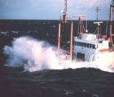
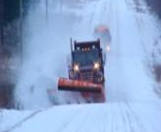
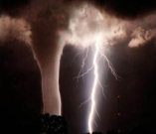
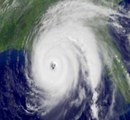
Topics
Migration to NOAA’s Weather & Climate Operational Supercomputing System (WCOSS)
New Data Usage and Acquisition
Recent Model Upgrades
Planned Model Upgrades
NOAA’s Integrated Dissemination Program System

Slide 3
NCEP Computing Update
High Performance Computing
3
APSDEU-13 / NAEDEX-25 – NCEP Update – May 2014

Slide 4
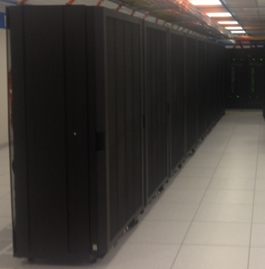
Weather & Climate Supercomputing System (WCOSS) Transition in July 2013
Location
Primary
Reston, VA (IBM provided facility) - Tide
Backup
Orlando, FL (IBM provided facility) - Gyre
Configuration
Identical Systems (per site)
IBM iDataPlex/Intel Sandy Bridge/Linux
213 trillion calculations/sec
10,048 processing cores
2.59 petabytes of storage
Performance Requirements
Minimum 99.9% Operational Use Time
Minimum 99.0% On-time Product Generation
Minimum 99.0% Development Use Time
Minimum 99.0% System Availability
Failover tested regularly
Inputs and Outputs
Processes 3.5 billion observations/day
Produces over 15 million products/day
Significance
Where United States weather forecast process starts for the protection of lives and livelihood
Produces model guidance at global, national, and regional scales
Examples:
Hurricane Forecasts
Aviation / Transportation
Air Quality
Fire Weather
4
APSDEU-13 / NAEDEX-25 – NCEP Update – May 2014
Notes:
4

Slide 5
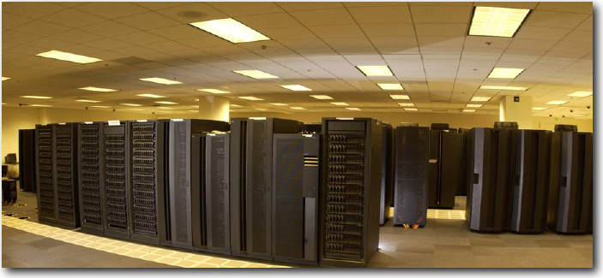
NOAA Research & Development Supercomputing
System | Location | Owner | Vendor | Capability (number and clock speed of cores) | %Avail NCEP
GAEA | Oak Ridge, TN | NOAA OCIO | CRAY | 77,800 Cores/ 1.1 PF AMD/Linux | 6.2%
ZEUS | Fairmont, WV | NOAA OCIO | SGI | 27,648/ 383 TF Intel/Linux | 44.8%
S4 | Madison, WI | U of Wi |  | 3,072 Cores AMD Opteron 2.2 GHz Linux | No Set Limit
JIBB | Greenbelt, MD (GSFC) | JCSDA | IBM | 3,456 Cores/37.8 TF iDataPlex/Intel/Linux | No Set Limit
Jet | Boulder, CO | NOAA OCIO |  | T-Jet 10,000, U-jet 16,648, S-Jet 23,050 Cores/182 TF
5
APSDEU-13 / NAEDEX-25 – NCEP Update – May 2014

Slide 6
HPC Growth
TeraFLOP per operational system
Built into the contract are capability and storage increases approximately every 3 years with no increase in funding
NOAA modeling plans rely heavily on “built-in” contractual increases
1.5
PetaFLOPS
Bridge
WCOSS Phase 1
6
APSDEU-13 / NAEDEX-25 – NCEP Update – May 2014

Slide 7
FY13 – FY14 NCEP Computing Activities
New data Usage and Data acquisition
7
APSDEU-13 / NAEDEX-25 – NCEP Update – May 2014

Slide 8
Conventional Data Received
APSDEU-13 / NAEDEX-25 – NCEP Update – May 2014

Slide 9
Non-Conventional Data Received
GPS Ref/Ben
APSDEU-13 / NAEDEX-25 – NCEP Update – May 2014

Slide 10
Non-Conventional Assimilated Data
10
APSDEU-13 / NAEDEX-25 – NCEP Update – May 2014

Slide 11
New Observations and BUFR/GRIB Packages
October 2012 – September 2013
Transitioned libraries and decoders to WCOSS (July 2013)
Dual Pol Radar decoder / NeXRad Level 3 decoder
SYNOP-R BUFR decoder
Updates to GRIB & GRIB2 Template Libraries
Update to NCEP WMO GRIB2 documentation version 11.0
October 2013 – May 2014 (* in process)
GRIB2 downstream product transition for GFS model upgrade*
Update WAFS for maximum wind interpolation
Update Japanese Wind Profiler decoder
Decode GTS format for NZKL aircraft bulletins
Glider data BUFR decoder
Add height assignment methods/pressures to EUMETSAT winds*
APSDEU-13 / NAEDEX-25 – NCEP Update – May 2014

Slide 12
FY13 – FY14 NCEP Computing Activities
Recent Model Upgrades
12
APSDEU-13 / NAEDEX-25 – NCEP Update – May 2014

Slide 13
Model Upgrades Oct 2012 – Sep 2013
NARRE (North American Rapid Refresh Ensemble) product updates
Increased resolution to 2.5km for GMOS and Gridded LAMP
GDAS V9.0.0 (w/GFS bug fix V9.1.0)
Discontinuation of the following products:
GDAS2
Legacy GFS products
Legacy radar products
Legacy Climate Diagnostic Center Products
HWRF model upgrade
WCOSS went live on July 25, 2013
Addition of satellite data to GFS Model – August 20, 2013
METOP-B
SEVIRI data from Meteosat-10
S-NPP CrIS data
http://www.nco.ncep.noaa.gov/pmb/changes/
APSDEU-13 / NAEDEX-25 – NCEP Update – May 2014

Slide 14
Model Upgrades Oct 2013 – July 2014
Additional fields added to the GFS World Area Forecast System (WAFS) products
Temperature, Geopotential Height, and u & v components of the wind added for FL80, FL210, FL410, FL490
RH added for FL80 & FL210
Upgrade to the SREF Model
Upgrade to Gridded MOS and LAMP model
Upgrade to the GEFS and NAEFS (April 8, 2014)
Added variables to bias-corrected products globally and downscaled probabilistic products for CONUS and Alaska from GEFS and NAEFS
Removal of legacy GFS products (June 3, 2014)
Old Text Products, FAX and Redbook graphics
Upgrade HIRES Window (June 11, 2014)
Upgrade HWRF v8.0 and GFDL v12.0 model (week of June 10, 2014)
Observation Processing Suite Upgrade (June 2014)
Upgrade to Global Wave Ensemble System (July 1, 2014)
Upgrade to NAM v3.2.0 (July 2014)
http://www.nco.ncep.noaa.gov/pmb/changes/
APSDEU-13 / NAEDEX-25 – NCEP Update – May 2014

Slide 15
Observation Processing Suite Upgrade
Observation Processing Suite Upgrade (June 2014) – several satellite-related observations will be assimilated into the following models:
NESDIS GOES cloud (in NAM)
LaRC GOES cloud (in NAM)
NPP: CrIS and ATMS radiances in RAP model
NPP: Ozone (profile, total column)
METOP-A/B IASI Radiances in RAP model
METOP-B ASCAT
Canadian Wind Profilers
Oceansat scatterometer winds
GOES Hourly satellite winds
Include shortwave (3.9 micron) GOES winds for testing
Include more robust aircraft QC processing
Update the entire observation processing suite into vertical structure/environment equivalence
http://www.nco.ncep.noaa.gov/pmb/changes/
APSDEU-13 / NAEDEX-25 – NCEP Update – May 2014

Slide 16
FY14Q4/FY15Q1 – NCEP Computing Activities
Planned Model Upgrades
16
APSDEU-13 / NAEDEX-25 – NCEP Update – May 2014

Slide 17
Planned Model Upgrades August – December 2014
High-Resolution Rapid Refresh (HRRR) v1.0.0 – September 2014
Initial version of 3 km HRRR – F000-F015 every 15 minutes
Similar to RAP but allows explicit convection
Radar assimilated every 15 min / allow a one-hour “spinup” forecast / and final 3km GSI
GDAS/GFS v12.0.0 – September / October 2014
0.25 degree resolution (T1534)
Improved model physics
Enhanced data assimilation – T574 EnKF
Extension of high resolution to 10 days
3 hourly output through F240
RTOFS Global Upgrade
RTG SST High Resolution to include METOP-B
Sea Ice Drift Model v2.1.0
SREF Major Upgrade
http://www.nco.ncep.noaa.gov/pmb/changes/
17
APSDEU-13 / NAEDEX-25 – NCEP Update – May 2014

Slide 18
Data Dissemination: Future
Dissemination Priorities
18
APSDEU-13 / NAEDEX-25 – NCEP Update – May 2014

Slide 19
NOAA Integrated Dissemination Program
NOAA’s Integrated Dissemination Program (IDP) established to transform organization’s dissemination capabilities from a collection of independent stovepipes to an integrated enterprise-wide dissemination service
IDP funding is derived from three separate funding lines (NWSTG Re-architecture, NextGen, and NWS Ground Readiness Project (GRP))
IDP includes multiple projects and subprojects
Primary IDP dissemination facility to be part of NCEP Central Operations in College Park, MD…backup in Boulder, CO
Projects and applications are to be moved into (e.g. NOAA National Operational Model Archive and Distribution System (NOMADS)) or established in overall dissemination service facilities
19
APSDEU-13 / NAEDEX-25 – NCEP Update – May 2014

Slide 20
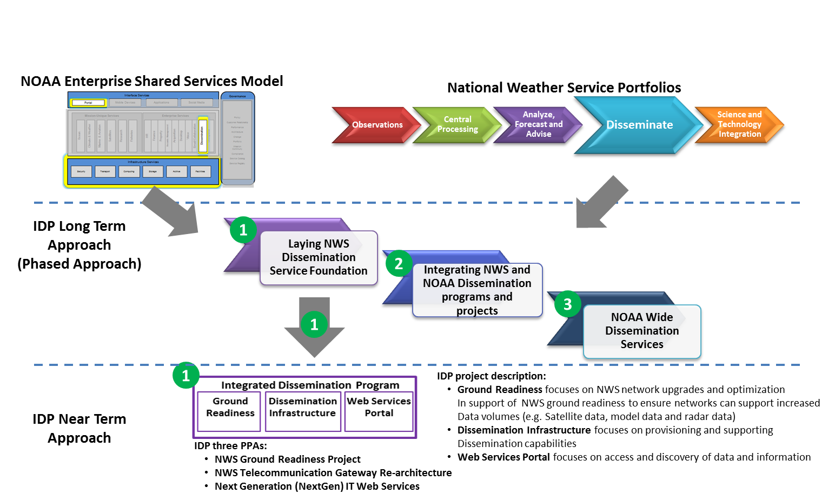
IDP Overview
IDP plans to deliver NOAA Wide Dissemination Services in a phased approach.
In Phase 1, IDP’s focus is on executing against NWS requirements.
20
APSDEU-13 / NAEDEX-25 – NCEP Update – May 2014

Slide 21
IDP’s Projects and Subprojects
IDP’s Projects and Subprojects
Program
Project
Sub-project
GRB Assessment and
Site Survey
Network Upgrade and Optimization (Long-term)
OCONUS Network Upgrade & Optimization (DUSO Mem.)
Ground Readiness
Satellite Broadcast Network (SBN) Upgrade
GRP Engineering and Coordination
Integrated Dissemination Program
Web Services Portal
Multiple Radar/ Multiple Sensor Implementation
MDL NextGen Web Service
WRIP/NOAA Weather
Wire Service (NWWS)
NextGen Web Services
Portal Project Roadmap
Dissemination Infrastructure primary facility
Dissemination Infrastructure
Dissemination Infrastructure backup facility
NWSTG Re-architecture Technical Evaluation
21
APSDEU-13 / NAEDEX-25 – NCEP Update – May 2014
Notes:
Note – Illustrated above is a representation of IDPs project and subproject as of January 2014
As the Program evolves, additional projects/subprojects will be stood-up

Slide 22
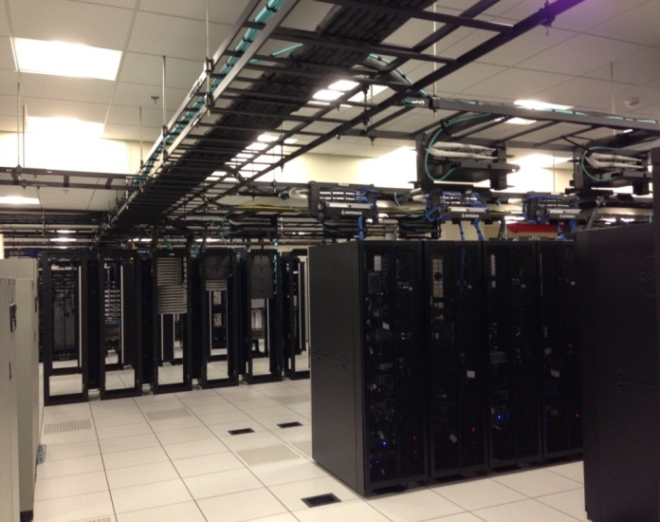
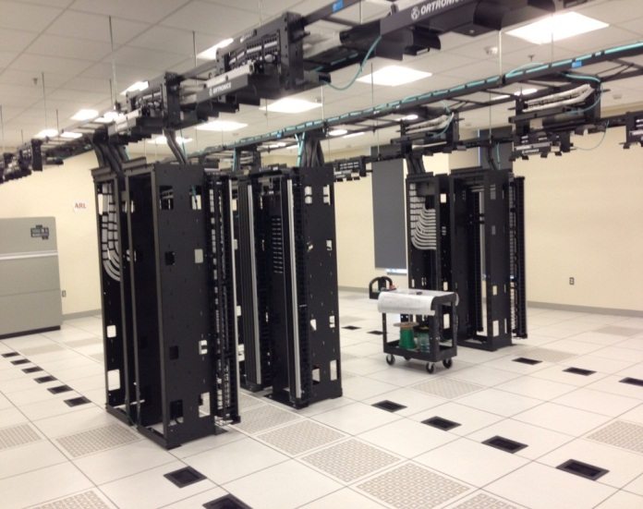
IDP Project:
Dissemination Infrastructure
Project Scope:
Build a service-oriented dissemination infrastructure at a primary facility (College Park, MD) and a backup facility (Boulder, CO).
Goals:
Implement a scalable, robust, secure, and commonly shared dissemination infrastructure
Ensure NWS GOES-R and JPSS ground readiness (particularly increase in satellite, model, and radar data).
Standardize scalable architecture.
Provide Infrastructure services.
Provide cloud computing where appropriate.
Support NOAA OCIO Principles:
Build Enterprise Shared Services
Modernize IT Infrastructure
Consolidate Data Centers
Phase 1: IDP Primary Site Current Compute Farm augmented at NCWCP - COMPLETED
Phase 2: Build out IDP Primary Site at NCWCP, College Park - Summer 2014
22
APSDEU-13 / NAEDEX-25 – NCEP Update – May 2014

Slide 23
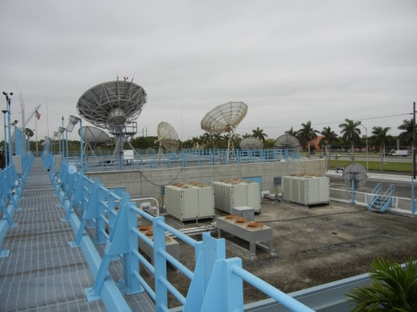
IDP Project: Ground Readiness
Network Upgrade & Optimization - FY16
Provide telecommunication upgrades to ensure the NWS network is able to accommodate the increased volume of data due to increases in model, radar and satellite (e.g., GOES-R, GOES-S, and JPSS) data.
Satellite Broadcast Network (SBN) Expansion - Q1 FY15
The NWS's Advanced Weather Interactive Processing System (AWIPS) SBN is the primary data-supplier network for over 95% of the NWS field offices.
The SBN Upgrade will increase the SBN bandwidth to meet Ground Readiness and will ensure that NWS field offices can receive critical weather data using the SBN.
GRB Assessment and Site Survey – Q4 FY15
The purpose of the GOES-R Rebroadcast (GRB) Site Survey Project is to ensure that NWS Centers & Regions can receive GOES-R data and products, thus extending their current operational capabilities to exploit this next generation of satellite data.
NWS Sites to be upgraded with GRB Capabilities
NCWCP in College Park, MD
NHC in Miami, FL
SPC in Norman, Oklahoma
SWPC in Boulder, CO
Pacific Region in Honolulu, HI
Guam
Alaska Region in Anchorage, AK
AWC in Kansas City, MO
23
APSDEU-13 / NAEDEX-25 – NCEP Update – May 2014

Slide 24
Questions ???
Where America’s Climate, Weather, Ocean, and Space Prediction Services Begin”
“From the Sun to the Sea…
Where America’s Climate, Weather, Ocean and Space Weather Services Begin”
24
APSDEU-13 / NAEDEX-25 – NCEP Update – May 2014

