Slide 1
NAEDEX-26 / ASPDEU-14 - October 2015
EUMETSAT Status Report
Susanne Dieterle - EUMETSAT

Slide 2
Summary
EUMETSAT Geostationary Missions
EUMETSAT Low Earth Orbit Missions
EUMETSAT Advanced Retransmission Services (EARS)
Data Availability
Future missions

Slide 3
Geostationary Missions
Meteosat-7, launched on 2 September 1997, has been providing the 57.5°E Indian Ocean Data Coverage (IODC) service since 5 December 2006
Meteosat-8, launched 28 August 2002, has been on station at 3.5°E since 11 February 2013.
The satellite is available as hot backup for Meteosat-10 prime service and to fill the Meteosat-9 RSS interruptions
Nominally configured in Full Earth Scan imaging mode, images archived but not disseminated

Slide 4
Geostationary Missions
Meteosat-9, launched 21 December 2005, has been on station at 9.5°E since 5 February 2013 and supports the Rapid Scanning Service (RSS) since 9 April 2013
Meteosat-10, launched on 5 July 2012, following January 2013 relocations, has been the prime Meteosat satellite for the 0° service since 21 January 2013
The spacecraft is currently in imaging mode, fully configured including GERB-3, DCP and Search and Rescue transponders

Slide 5
Geostationary Missions
MSG-4 was launched on 15 July 2015
After the LEOP phase by ESOC, EUMETSAT took over the responsibility for the operations of MSG-4 in orbit on 26 July
Several commissioning tests were executed with the satellite drifting and finally on 2 August 2015 the spacecraft was successfully stopped at the planned commissioning position of 3.4°W
A few dates:
8-September – start of MSG-4 stable imaging
22-September – start of image dissemination to selected users
24-September – start of test product dissemination to selected users
12-October – start of dissemination to all users in parallel with MSG-3
The MSG-4 commissioning is planned to finish in December followed by the In-Orbit Storage as of 7-December

Slide 6
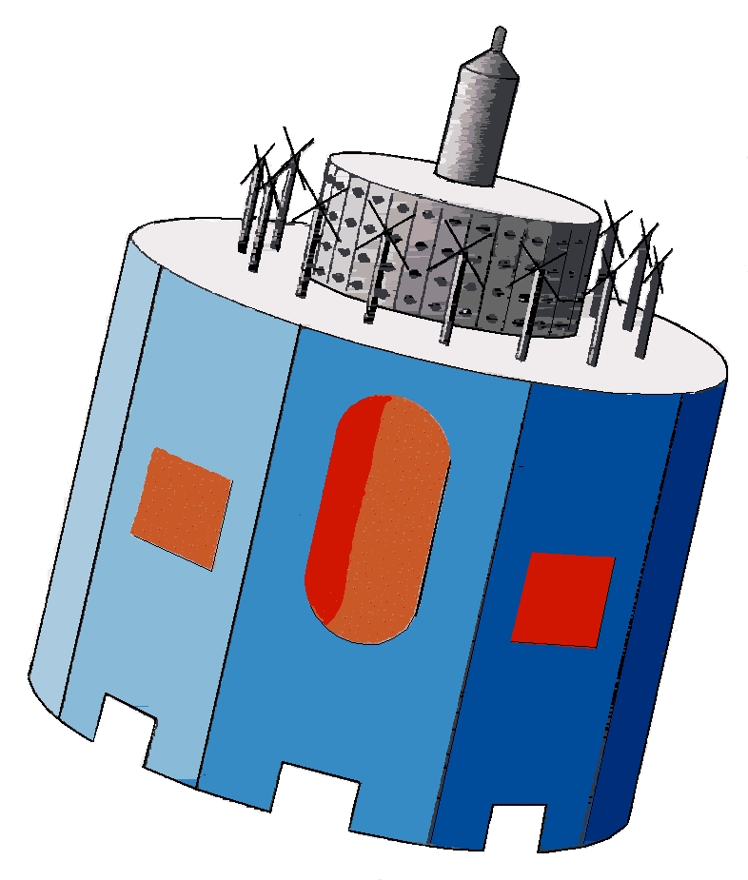
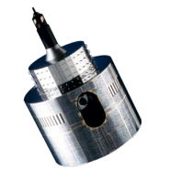
In-orbit Geostationary Spacecrafts after MSG-4 Commissioning
MSG-4
Met-10
Met-8
Met-9
Met-7
3.4°W
0°
3.5°E
9.5°E
57.5°E
In-Orbit Storage
Prime Mission
Back up
(IODC – TBD)
Rapid Scan Service
IODC

Slide 7
Low Earth Orbit Missions – EUMETSAT Polar System
The EUMETSAT Polar System has continued to perform well and to meet its operational service specification. Metop-B and Metop-A are providing a dual-Metop operational service, with Metop-B designated as the prime Metop satellite. Metop-B half-dumps are routinely acquired over McMurdo, giving the improved data timeliness of the Antarctic Data Acquisition Service for those orbits.

Slide 8
Status of Metop Spacecrafts
Metop-A S/C Launched 19 October 2006 | LRPT: Red | AMSU-A1: Channel 7 failed, Channel 3 NEDT is out of spec. Channel 8 NEDT is out of spec. | MHS: H3 and H4 degrading but NEDT still within spec. | AHRPT: Operated only over “secure” zones
Metop-B S/C Launched 17 September 2012 | HIRS: Channels 5, 6 and 10 currently out of spec. Others in specification. | ADCS: Degradation of received messages between 30 and 50% because of CRA antenna cable swap. as per request, run mission as ARGOS-2. ADCS transmitter is off, ADCS receiver is on. |  | SARR and SARP: Degradation of received messages in nominal beacon conditions between 0 and 10%, in worst beacon and environmental conditions up to 100%, because of CRA antenna cable swap

Slide 9
NOAA Initial Joint Polar System Satellites
NOAA-19, launched 6 February 2009, continues to be operated with the support of EUMETSAT as prime for ADCS and SARSAT mission services and with all other instrument data also being processed, within the IJPS framework. NOAA-19 HIRS IR Channels remain noisy
Suomi-NPP, launched on 28 October 2011, is the first of the new generation polar orbiting satellites from NOAA in the afternoon orbit. Suomi-NPP has been the nominal IJPS satellite on the afternoon orbit since 1 May 2014.
It is recalled that EUMETSAT has no direct support to operations of Suomi-NPP. Initially a NASA satellite, EUMETSAT is however supporting global and regional Suomi-NPP data services within the scope of IJPS and in the framework of Copernicus

Slide 10
Jason-2 - Ocean Surface Topography Mission
Jason-2, launched 20 June 2008, provides Operational Geophysical Data Record (OGDR) - which main geophysical parameters are significant wave height and ocean surface wind speed derived from the Poseidon altimeter on board the Jason2 satellite
Jason-3, follow-on of Jason-2, is due to be launched soon…

Slide 11
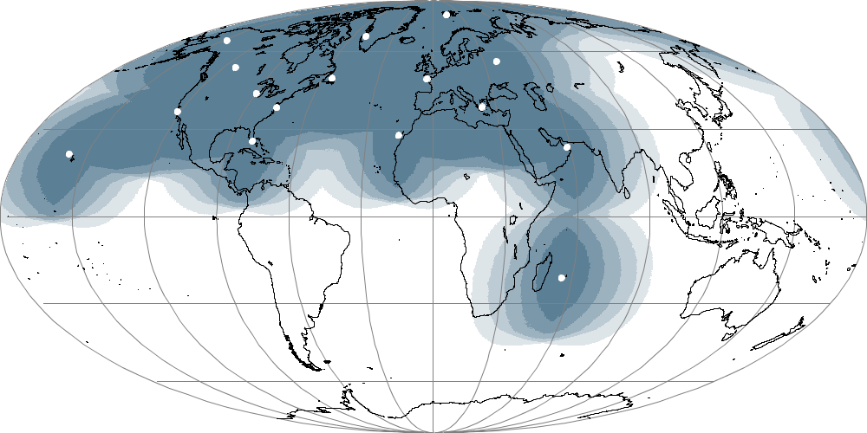
Network of EARS stations and coverage
Svalbard
Gilmore Creek
Kangerlussuaq
Edmonton
Moscow
Gander
Lannion
Monterey
Wallops
Athens
Miami
Maspalomas
Muscat
Ewa Beach
Saint-Dennis
100 %
POES, Metop
75-100 %
Suomi NPP, POES, Metop
50-75 %
25-50 %
0-25 %

Slide 12
EARS Service Status and Performance
The following services are provided by EARS:
EARS-ATOVS, EARS-AVHRR, EARS-ASCAT, EARS-IASI, EARS-NWC
based on Metop and NOAA data
EARS-ATMS,EARS-CrIS and EARS-VIIRS (including DNB)
based on Suomi-NPP data
Overall, the availability and timeliness of these services are meeting their requirements, i.e. delivering products via EUMETCast within 10 to 30 minutes from sensing
Future: FY-3C VASS Service
VASS – Sounder data from FY3C++ (MWTS, MWHS, IRAS)

Slide 13
Data Availability to Users
For all EUMETSAT missions, data is available the following ways:
In Near Real Time via:
EUMETCast Dissemination
GTS/RMDCN
EUMETSAT Data Centre for archived data

Slide 14
Future Missions – EUMETSAT Mandatory Programmes
Meteosat Third Generation (MTG)
Imagery mission implemented by a two-satellite MTG-I system:
Full disk imagery every 10 minutes in 16 spectral bands
Fast imaging of European weather every 2.5 minutes
new Lightning Imager (LI)
Hyperspectral infrared (IRS) sounding mission:
3D mapping of water vapour, temperature, O3 every 1 hour
Air quality monitoring and atmospheric chemistry in synergy with GMES Sentinel-4 Ultraviolet Visible
Full MTG mission implemented by two MTG-I satellites and MTG-S satellite in orbit
EPS-Second Generation
Primary mission: further improvement observational inputs to Numerical Weather Prediction models
Significant improvements of other applications, like e.g. Nowcasting at high latitudes, Marine meteorology and operational oceanography, Operational hydrology, Air quality monitoring, Climate monitoring
Two satellites in orbit configuration:
Metop-SG A: optical imagery and sounding mission
Metop-SG B: microwave imaging mission
Continuation of polar orbiting service 2021 – 2040

Slide 15
EUMETSAT mission planning
YEAR...
03
04
05
06
07
08
09
10
11
12
13
14
15
16
17
18
19
20
21
22
23
24
25
26
27
28
29
30
31
32
33
34
35
36
37
38
39
40
METEOSAT FIRST GENERATION
METEOSAT-7
METEOSAT SECOND GENERATION
METEOSAT-8
METEOSAT-9
METEOSAT-10
MSG-4/METEOSAT-11*
METEOSAT THIRD GENERATION (MTG)
MTG-I-1
MTG-S-1
MTG-I-2
MTG-I-3
MTG-S-2
MTG-I-4
EUMETSAT POLAR SYSTEM (EPS)
METOP-A
METOP-B
METOP-C
EPS-SECOND GENERATION (EPS-SG)
METOP-SG SOUNDING & IMAGERY SATELLITES
METOP-SG MICROWAVE SATELLITES
JASON
JASON-2
JASON-3
JASON CONTINUITY OF SERVICES (JASON-CS)

Slide 16
Future Missions – Sentinels for Copernicus
Most of the Sentinel missions are based on a constellation of two satellites to fulfill revisit and coverage requirements, providing robust datasets for Copernicus Services.
These missions carry a range of technologies, such as radar and multi-spectral imaging instruments for land, ocean and atmospheric monitoring. The Sentinels in which EUMETSAT is involved are:
Sentinel-3 is a multi-instrument mission to measure sea-surface topography, sea- and land-surface temperature, ocean colour and land colour with high-end accuracy and reliability. The mission will support ocean forecasting systems, as well as environmental and climate monitoring. Foreseen launch is 10 December 2015.
Sentinel-4 is a payload devoted to atmospheric monitoring that will be embarked upon a Meteosat Third Generation-Sounder (MTG-S) satellite in geostationary orbit.
Sentinel-5 is a payload that will monitor the atmosphere from polar orbit aboard a Metop Second Generation satellite.
Sentinel-6 carries a radar altimeter to measure global sea-surface height, primarily for operational oceanography and for climate studies. It is a follow-on of the Jason missions, and is implemented through the Jason-CS (Continuity of Service) space segment.

Slide 17
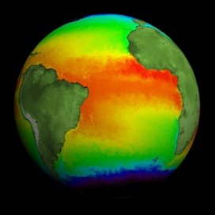
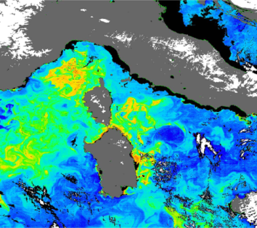
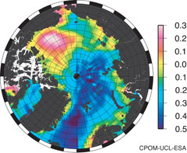
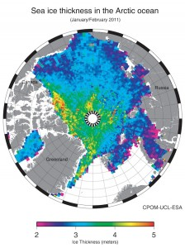
Sentinel-3 Marine product contents
Level 1B (ESA and EUMETSAT)
- SLSTR – Sea and Land Surface Temperature Radiometer
OLCI – Ocean and Land Colour Instrument
SRAL - SAR Radar Altimeter
Level 2 SLSTR:
Sea surface temperature
(L2P GHRSST standard)
Level 2 SRAL:
Sea/coastal zone surface height
Significant wave height
Wind speed
Backscatter coefficient s₀
Sea ice height, freeboard
Total water, liquid water (from MWR)
Level 2 OLCI:
Normalised water surface reflectance
Algal pigment concentration for open and for coastal waters
Total suspended matter concentration
Diffuse attenuation coefficient
Coloured dissolved matter absorption
Photosynthetically active radiation
Integrated water vapour
Aerosol optical depth
Aerosol Angström exponent

Slide 18
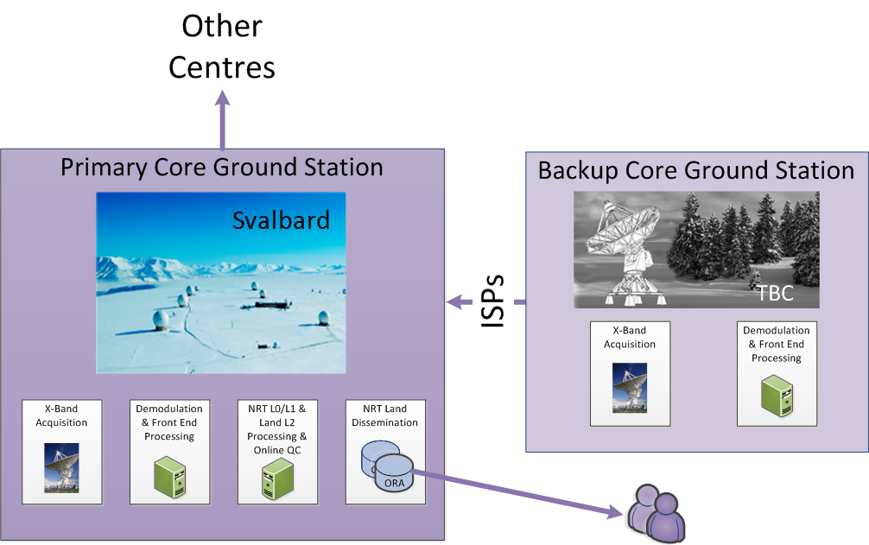
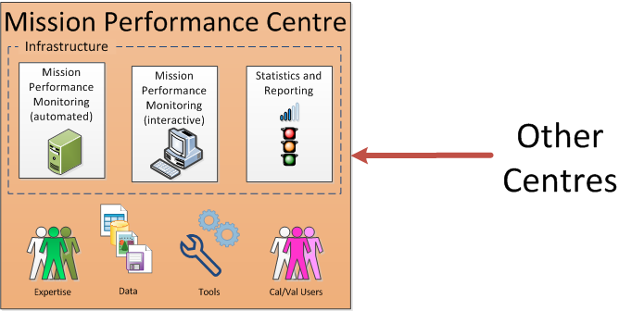
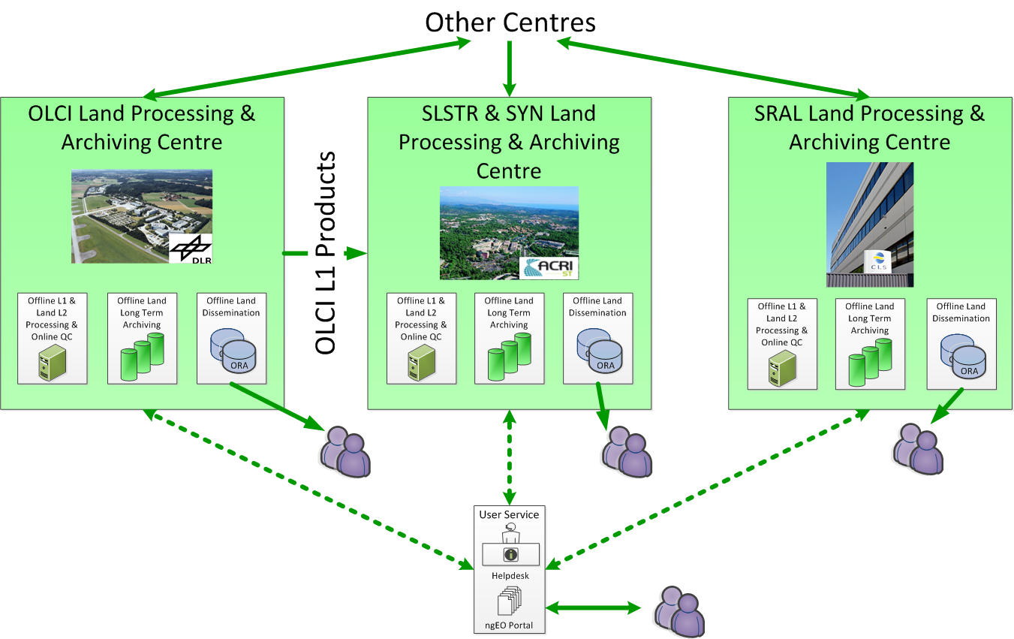
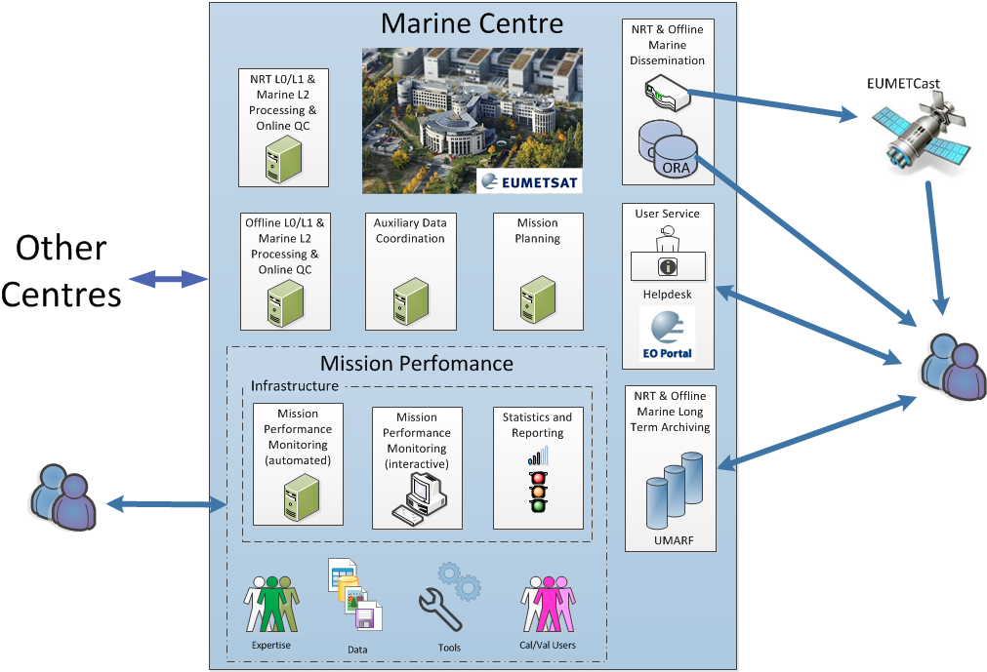
Copernicus Sentinel-3 Payload Data Ground Segment - Overview
Product Dissemination Units (PDUs) apply to both EUMETCast and ODA/ORA dissemination
Online Rolling Data Archive (ODA/ORA): Supports ftp/http access to level 1&2 PDUs over the Internet

Slide 19
Copernicus Sentinel-3 Payload Data Ground Segment - Elements
The Payload Data Ground Segment (PDGS) provides functions for Instrument Science Data acquisition, processing (and reprocessing), calibration, mission planning, archiving, user services and dissemination to the users
The overall mission management being under ESA responsibility
PDGS functions (facilities) are hosted in the following Centres:
The Marine PDGS Centre and Land PDGS Centre respectively under EUMETSAT and ESA responsibility
The X-Band Core Ground Station(s) Centre(s) under ESA responsibility
The Precise Orbit Determination (POD) facilities comprising:
The Near-Real-Time (NRT) POD processing, (part of the PDGS)
The Offline Processing centre which encompasses Short-Time-Critical (STC) and Non-Time-Critical (NTC) POD
The EUMETSAT Marine PDGS Centre includes the following facilities:
Near Real Time (NRT) and Offline (STC, NTC) processing: L0, L1 and L2 Marine product generation, Archiving, and Dissemination, to Users
Marine Mission Performance
Mission Planning providing FOS/MPS with instruments operation requests
Handling of all communications with PDGS Centres and External interfaces

Slide 20
Thank you for your attention

