Slide 1
ECMWF Status Report
NAEDEX-APSDEU 2015
Stephen English, Marijana Crepulja, Erik Andersson
ECMWF
Stephen.English@ecmwf.int
Erik.Andersson@ecmwf.int
Marijana.Crepulja@ecmwf.int

Slide 2
Outline
Satellite observations for weather – Stephen English
Events September 2014 – September 2015
IFS cycle updates in 2015, and planned for early 2016
Status of ECMWF Data Assimilation
ECMWF observation monitoring
Conventional observations for weather – Erik Andersson
Required data sets
Progress with BUFR migration
Atmospheric composition observations – Marijana Crepulja
Satellite data usage and recent progress

Slide 3
Satellite observations 1996-2015: projected to 2018
EPS-SG
MTG
FY4
2019-2025
Number of satellite products operationally monitored
Notes:
Is this showing assimilated OR monitored? Both words are used on this slide
Is this counting ‘product’ or instruments, or both. I thought the bars represented the number of instruments. But that is not states.

Slide 4
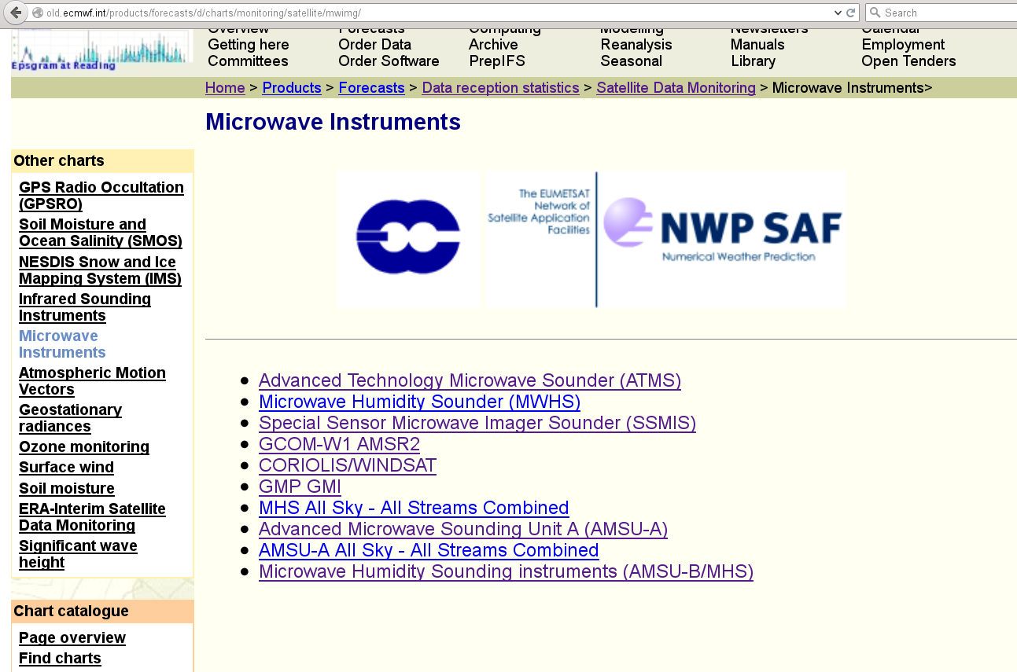
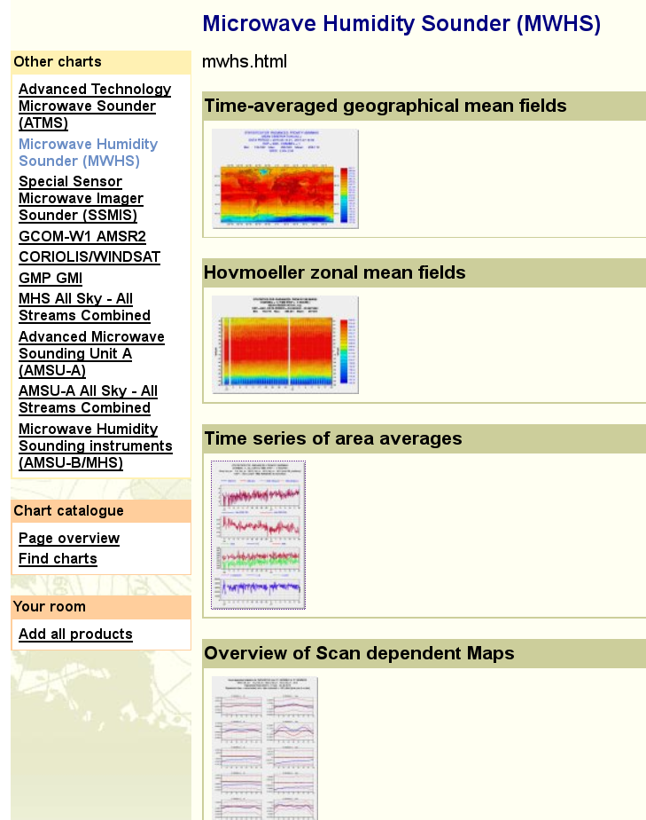
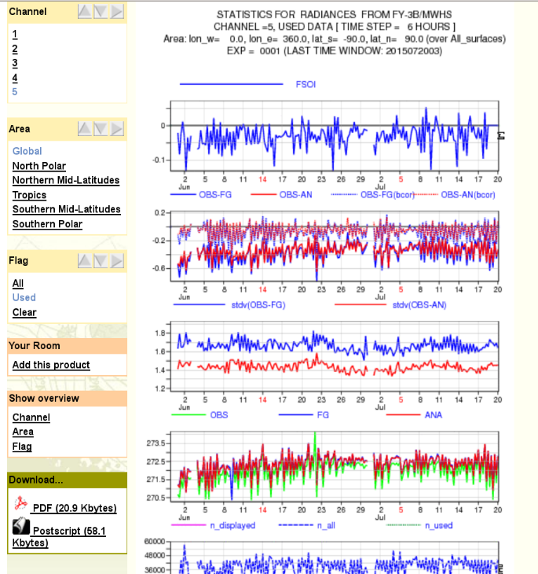
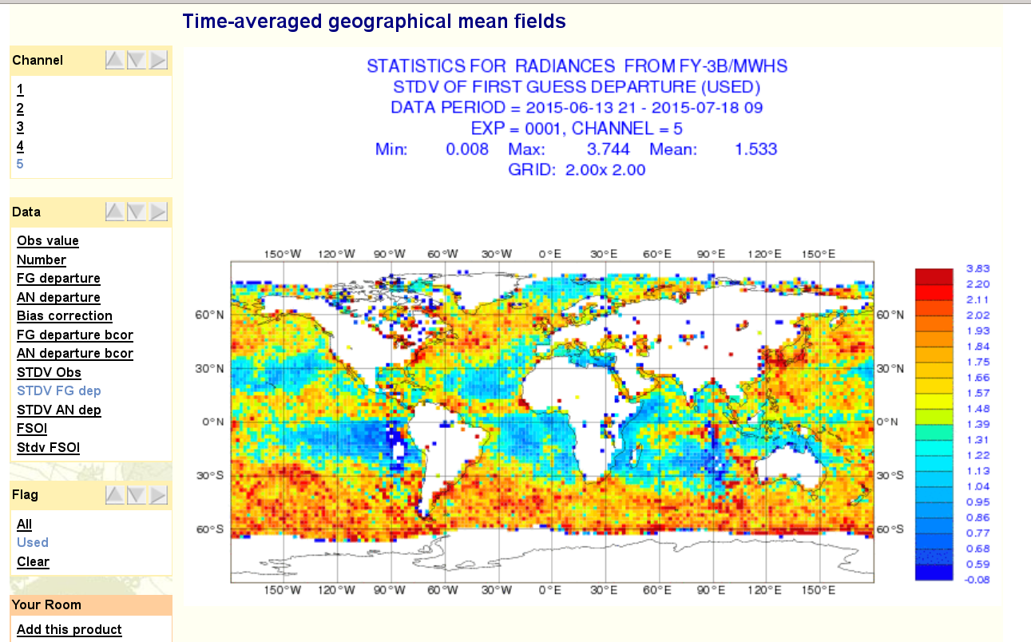
ECMWF Observation Monitoring

Slide 5
Key data events Sept 2014 – Sept 2015
September | Data in | Data out | System
September | FY-3B MWHS GOME-2 Ozone |  | AIREP decoder change
October | Increase in in situ | Major outage of US data
November |  |  | Cycle update TAC2BUFR
December
January | S-NPP/CrIS
February | Metop-B HIRS
March | BUFR Synop Block 10
April |  | End of TRMM
May | BUFR Synop/TEMP from Spain, Portugal and New Zealand Cryosat+SARAL SWH | Remove Metop-B HIRS | Cycle 41r1
June
July
August | GPM/GMI GCOM-W/AMSR2
September

Slide 6
AMSR2 and GMI impact
Winds – global fit
ATMS – global fit
Lonitz et al. 2015, RD Memo, RD15-201
Geer A., Lonitz K., Lean P.
Notes:
SETUP: 41R1 experiments from 2015022600 to 2015072012
RESULTS:
MWI: SSMIS fits improvement up to 3% in ch.14
Winds: surface winds show improved fit
ATMS: humidity sensitive channels 18 -22 show improved fit, temperature sensitive channels 6 -8 slight improved fit
Other (not shown): radiosonde obs of humidity show improved fits in tropics and SH up to 500hPa, CRIS and IASI show improved fits as well
SUMMARY: For almost all obs a positive impact from the assimilation of additional microwave imagers is seen, except AMSU-A

Slide 7
AMVs: Dual-LEO bridging gap GEO to Polar
Salonen, K.

Slide 8
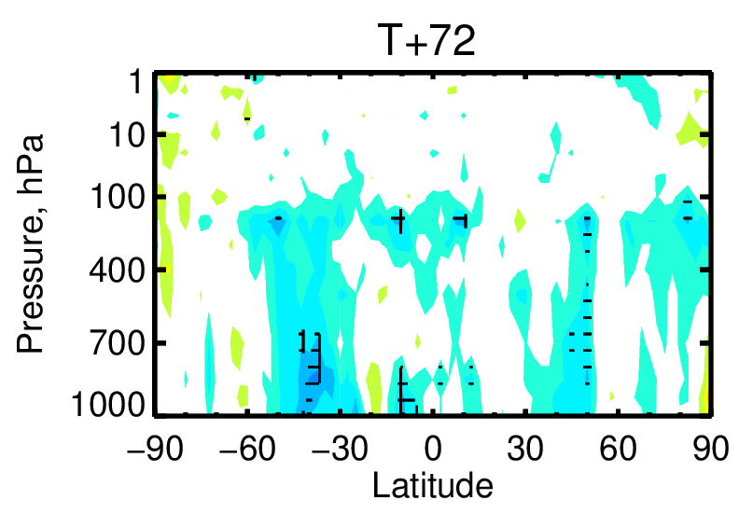
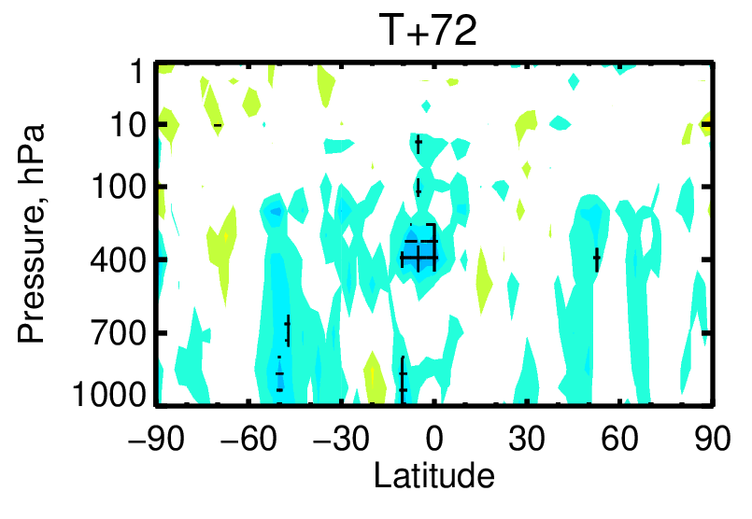
Forecast impact over 6 months, wind
Assimilating COMS AMVs
MTSAT-2 vs Denial
COMS vs Denial
Improvement
Degradation
-0.04
-0.02
0.02
0.04
COMS and MTSAT impact is comparable – both are positive
Lee, S.

Slide 9
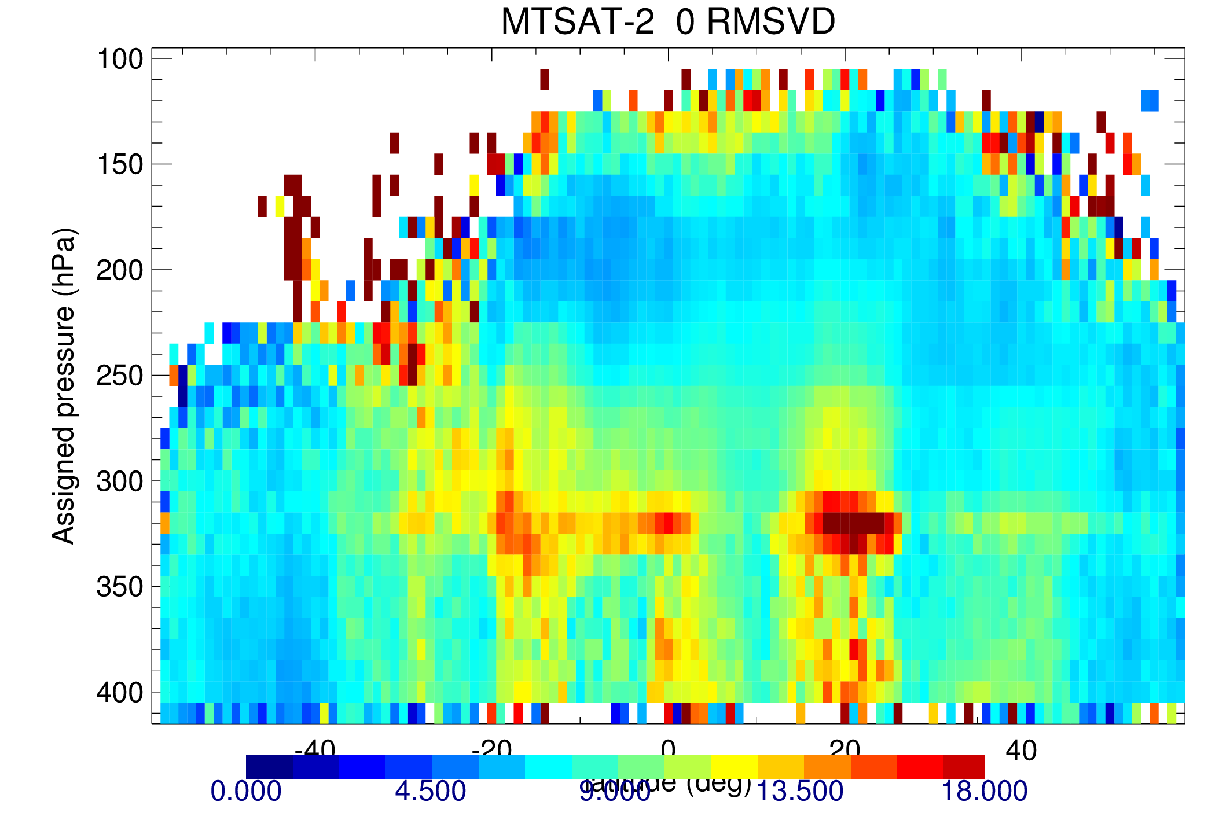
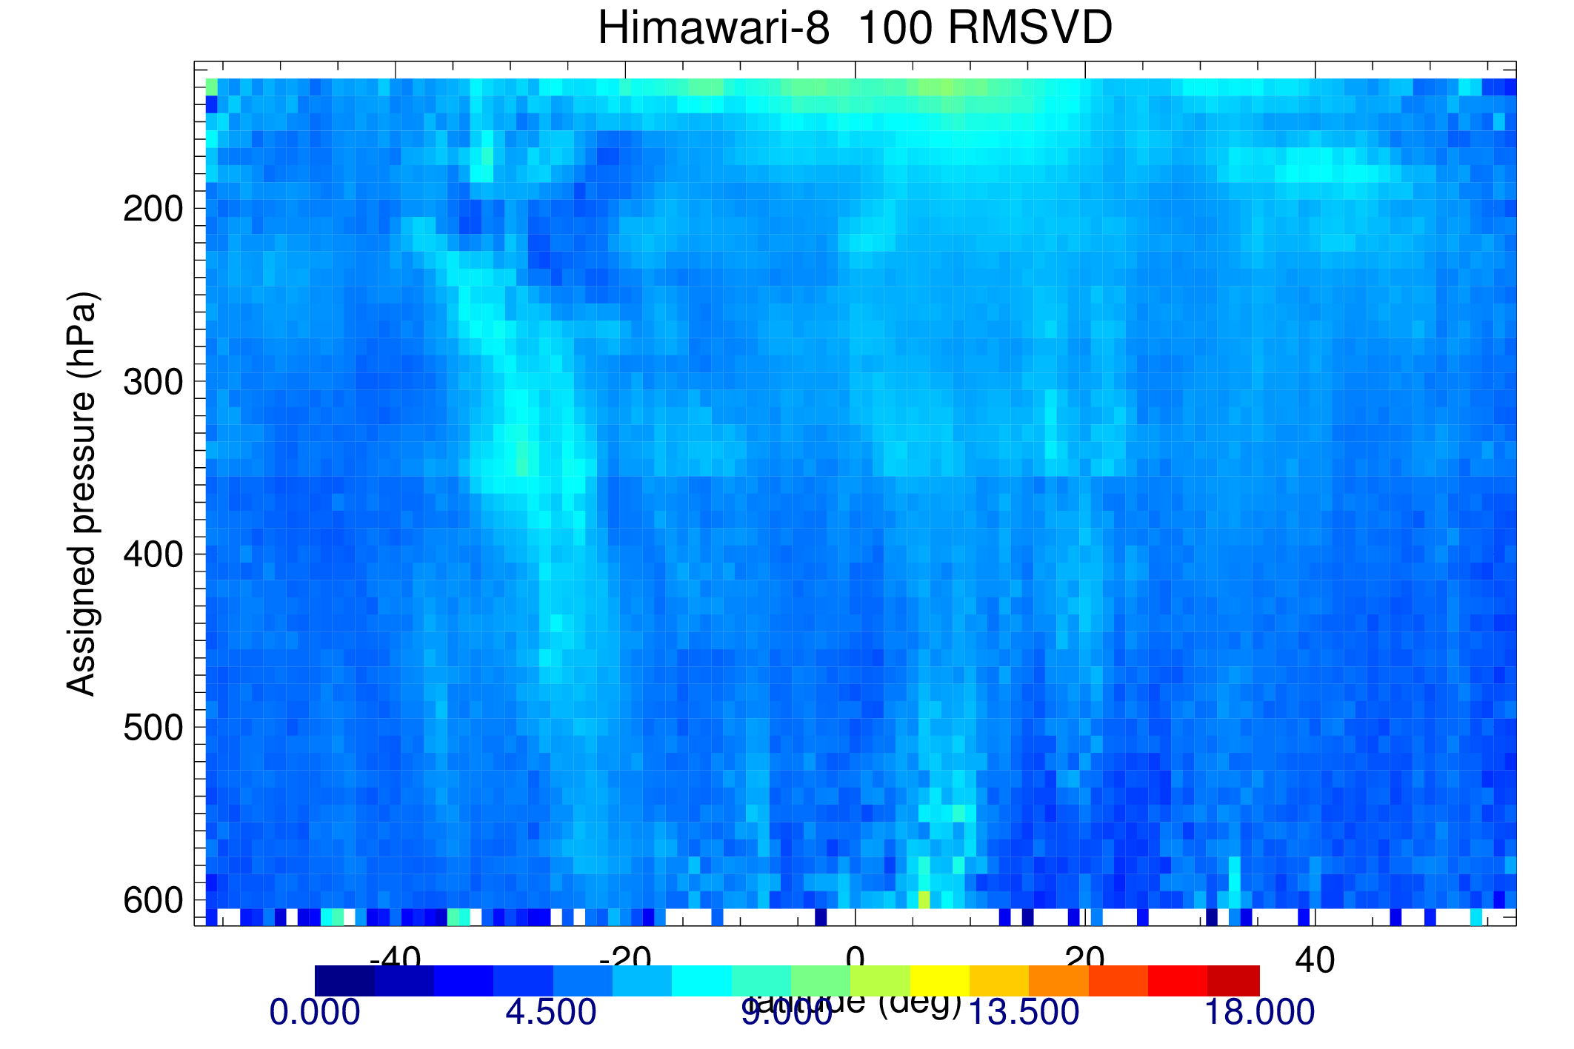
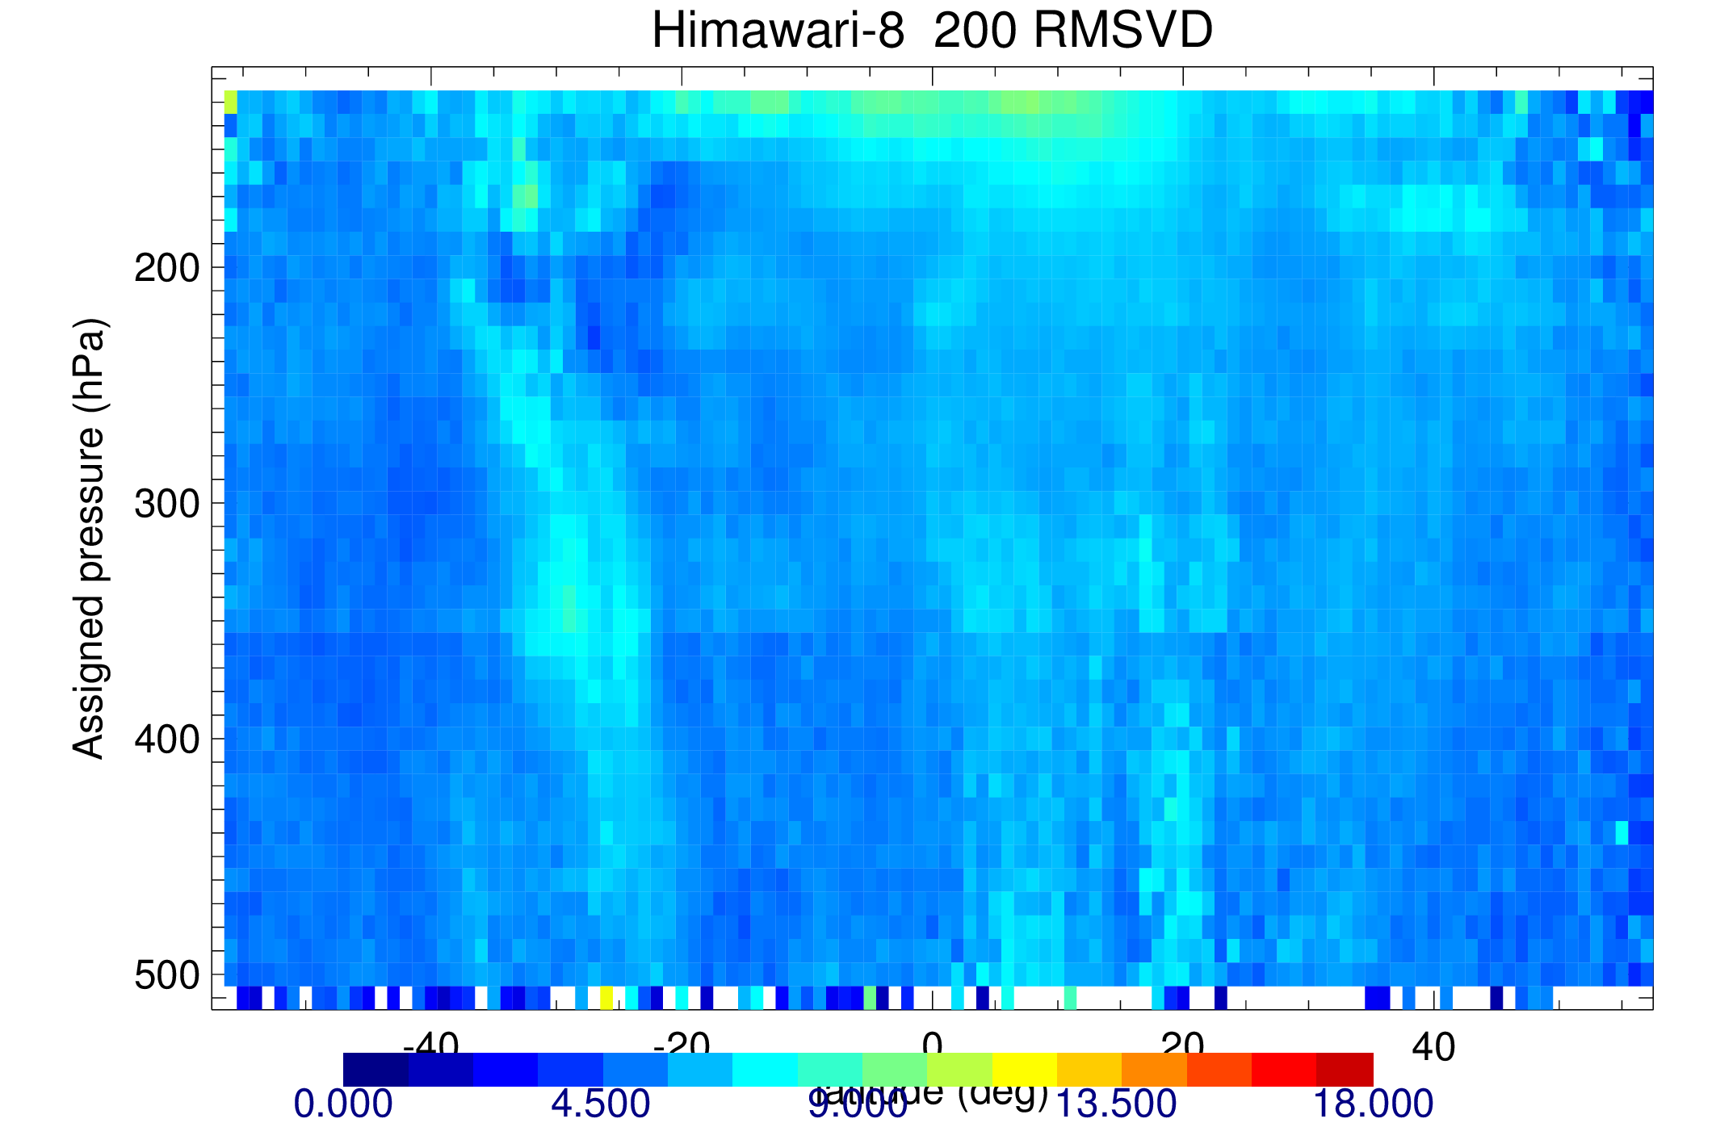
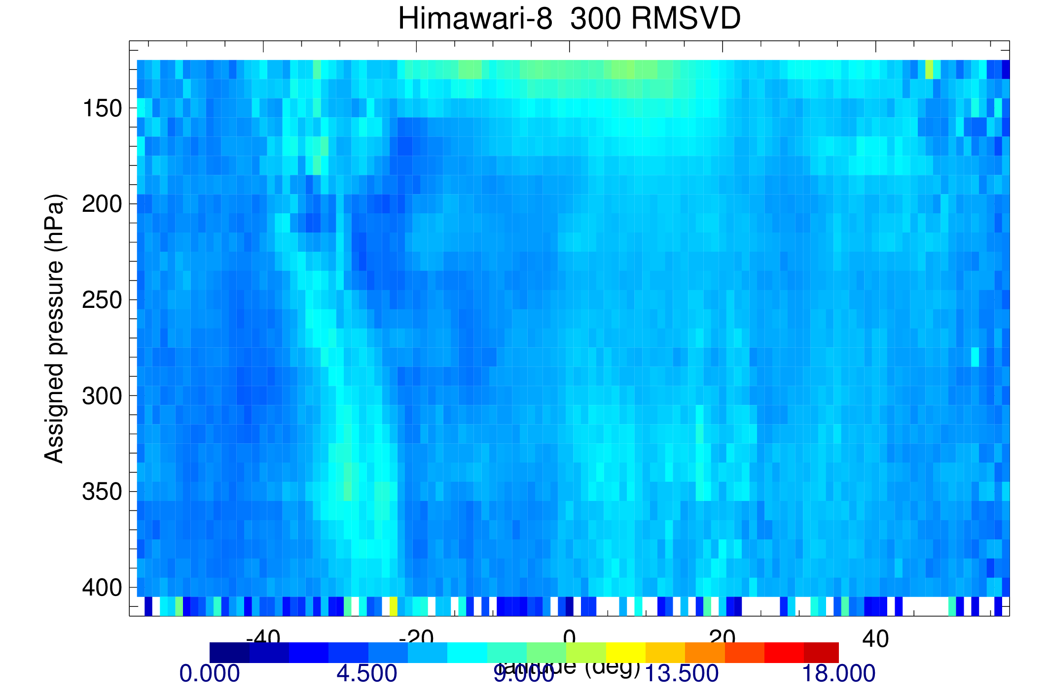
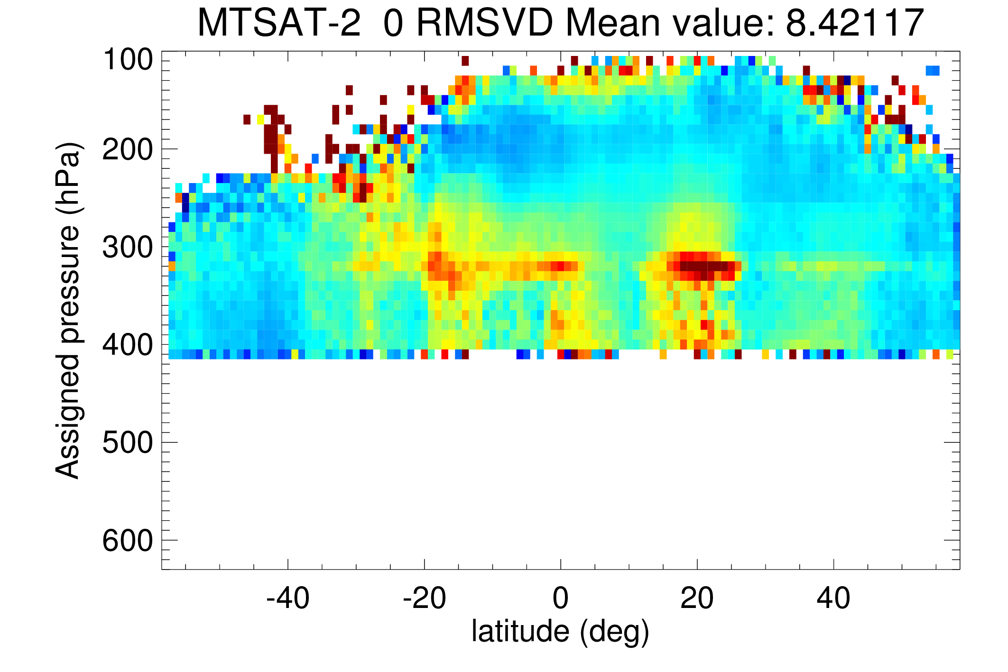
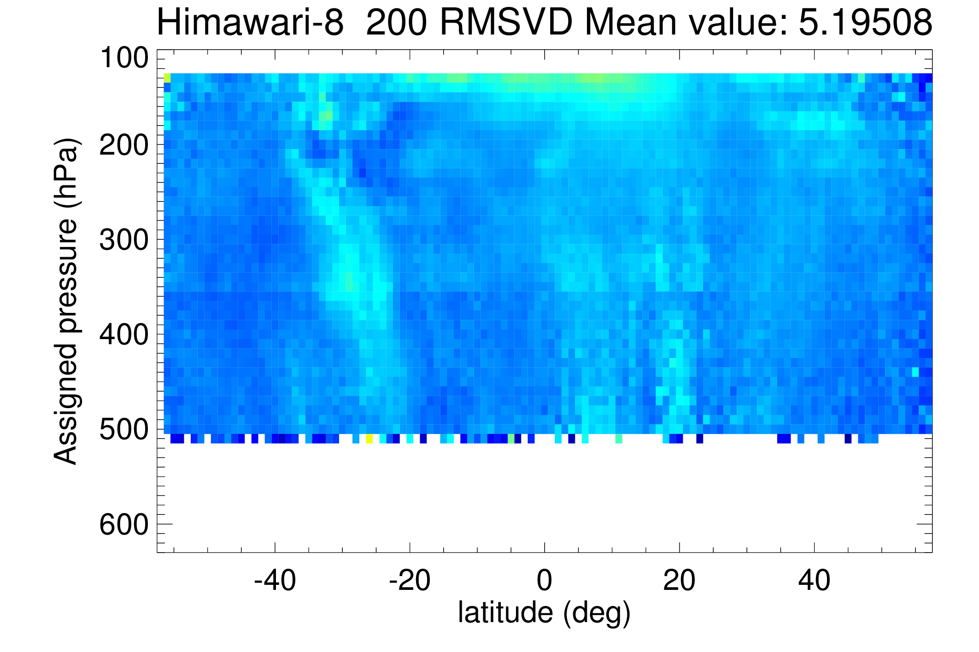
Evaluating Himawari-8
6.75µm
6.95µm
>
Himawari-8 fits ECMWF much better than MTSAT
Lean K.
Notes:
Considered several different statistics to look at data e.g. speed bias, normalised vector difference. Example here for rms vector difference. Immediately clear that the RMS values are improved. Some structure – elevated values at lowest pressures around tropics (not where majority of data are though) and some slightly higher values in S. hem esp. around 30S.
In most cases there is general improvement in the statistics for Himawari-8 compared to MTSAT-2. Tried comparing to the MTSAT-2 data that was assimilated and see comparable or improved statistics for Himawari-8 prior to any screening.

Slide 10
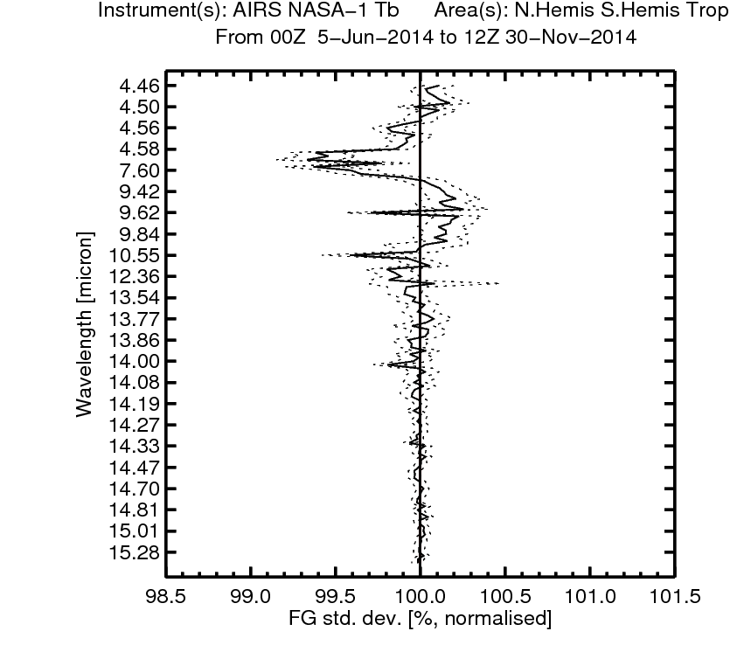
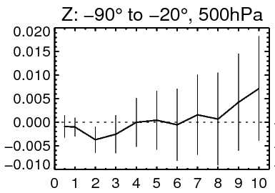
Assimilating FY-3C MWHS-2
6 month assimilation trial led to a positive impact:
Improved fits to humidity observations:
Forecast scores:
AIRS
degradation
Normalised Difference
stdev(fc – an)
improvement
improvement
Forecast Day
Aim to operationally assimilate the 183 GHz channels soon
Lawrence H.

Slide 11
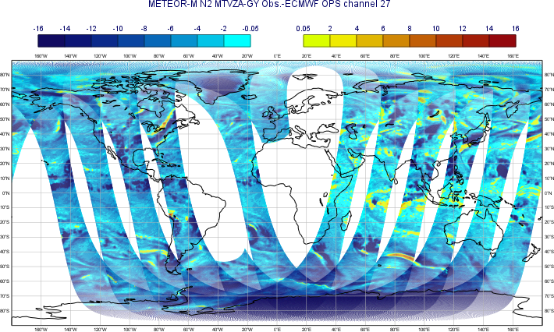
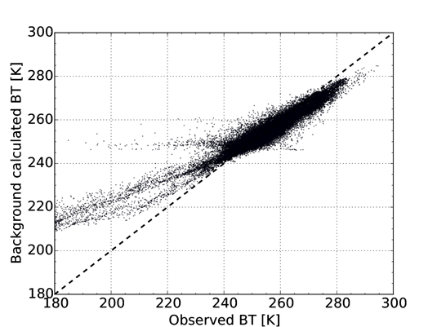
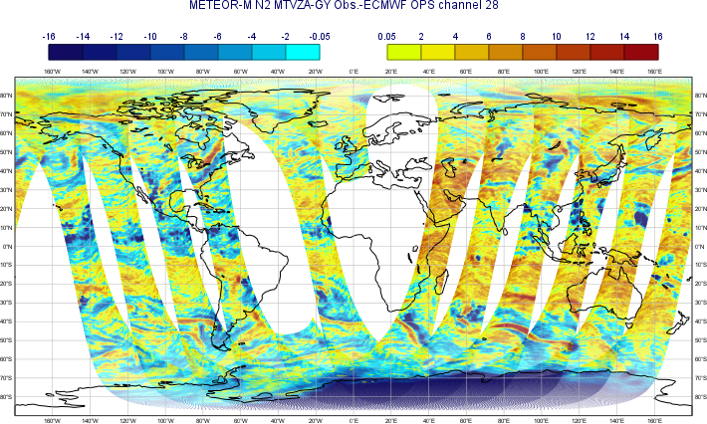
Evaluating Meteor M N2 MTVZA
Like MHS: Bias in wings, OK near line centre.
Some evidence of calibration error.
Temperature channels have more issues.
Fig. 6. As Fig. 1 but for channel 28 (similar to MHS-3).

Slide 12
Preparing new satellite obs from US and Europe
NOAA
Preparing for GOES-R
NASA
SMAP L-band radiometer under evaluation
US DoD
SSMIS on F19 under evaluation (to add to F17 & F18).
ESA
SMOS BT assimilation to go operational in 2016
Preparing for Aeolus ADM, EarthCARE (with JAXA) and later Sentinels
(Note: EUMETSAT Metop, MSG and NOAA POES, S-NPP, GOES is critically important)

Slide 13
Preparing new satellite obs from Asia and Russia
CMA
FY-3C instruments evaluated; MWHS-2 ready for operations
Roshydromet
MTVZA being evaluated at ECMWF.
ISRO
INSAT-3D giving encouraging results
Meghatropiques – evaluation to begin in November
JAXA/JMA
Evaluation of Himawari-8 underway
KMA
COMS AMVs evaluated – comparable quality to MTSAT

Slide 14
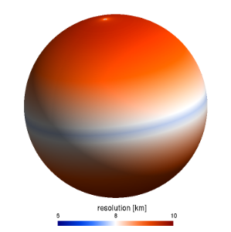
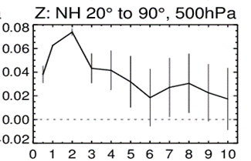
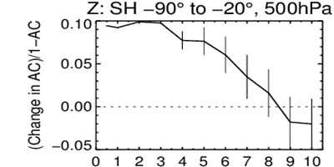
Cycle 41r2: Science and resolution upgrade
1279 spectral modes
41r2 is not a pure resolution change
Many important science changes (5 iterations for SL departure point, physics upgrade, more “all-sky” radiances, new hybrid formulation for B)
E-suite Summer 2015 41r2
preliminary results

Slide 15
2 months sample
(gdi0=) TCo1279/TL399/41r2 – TL1279/TL255/41r1 (=0001)
Z dAC
MSLP dRMSE
T850 dRMSE
Scores good! Initial kick in Tropics from larger σ_{b} => RMSE(a-f) increases

Slide 16
Data Acquisition
NOAA server to deliver to Met Office (and so to ECMWF etc.) was a single point of failure leading to single largest data outage in recent years.
Aqua, Terra, Aura, DMSP, SMAP, GOES, SBUV, Snow & Sea ice products lost during NOAA outage
GTS data
KMA
Met Office
JMA
DWD
ECMWF
NOAA
Met Office
Other US agencies
EumetCast
Geonetcast
(RARS ATOVS “saved day” during NOAA data outage)
EUMETSAT
CMA
?

Slide 17
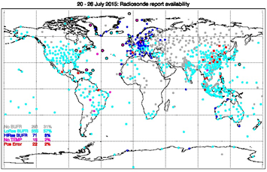
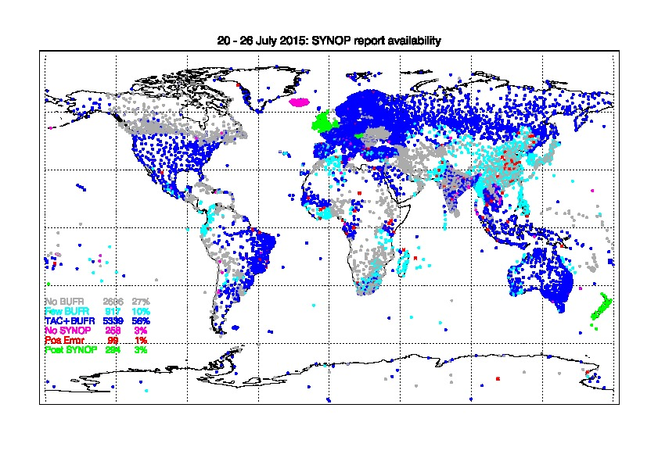
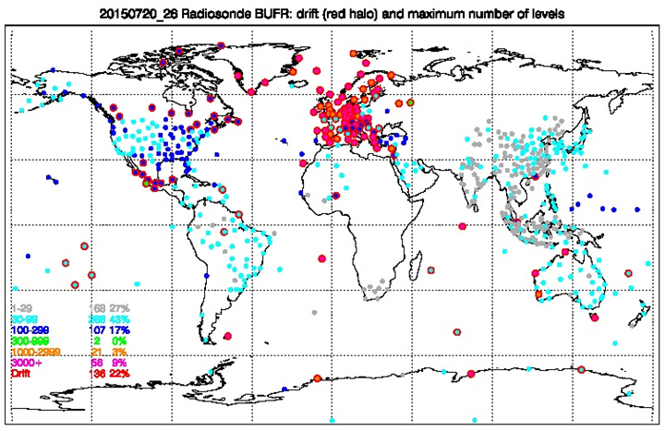
Conventional data, current priorities
BUFR observations of snow depth
New specific WMO template available
Improved reporting by adopting BUFR
High-resolution radiosonde profiles
Time and position of all data in the ascent
Better handling of meta-data, included in the message
Hourly surface observations
Improved coverage
Complement sparse WMO/GTS reporting with regional or national data
Improved maintenance of the WMO station list, and accuracy of station metadata

Slide 18
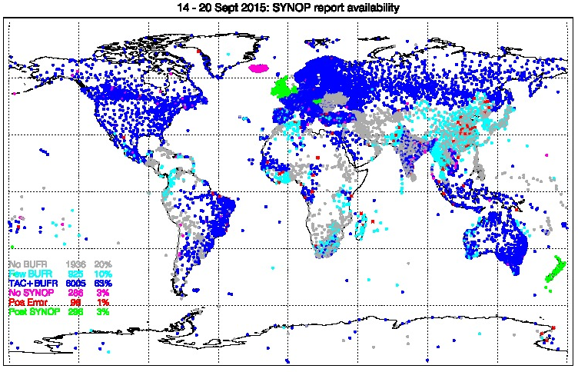
BUFR migration, surface
From some countries we get less frequent data in BUFR than in SYNOP (China, Japan, Korea).
Some countries convert other countries’ TAC to BUFR and put on GTS – can be confusing, leading to duplicates
Some position errors (red dots).

Slide 19
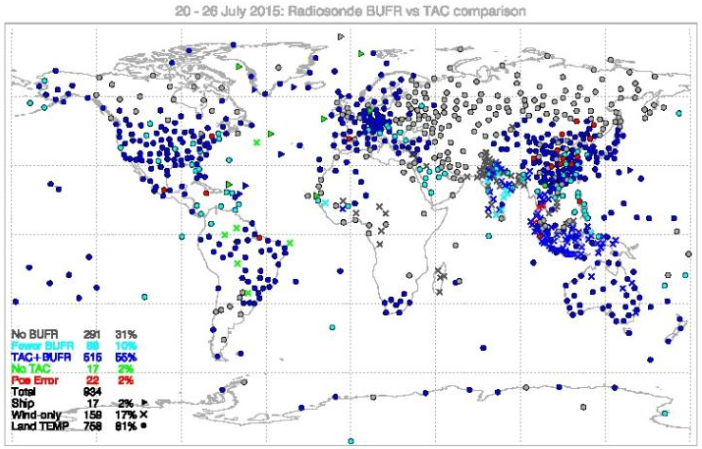
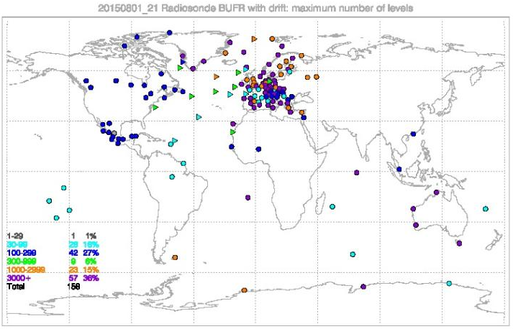
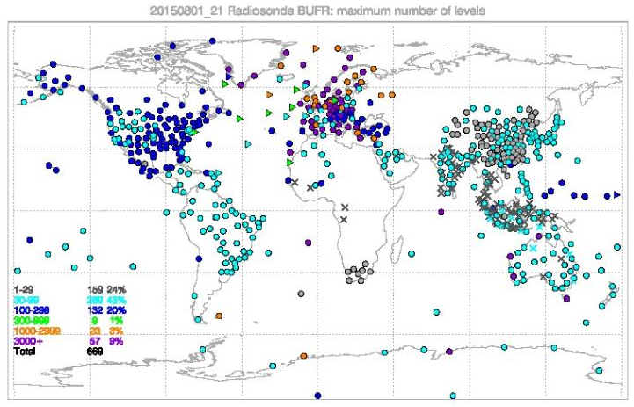
BUFR radiosondes
BUFR converted from TEMP generally poor
Progress with high vertical resolution
Native BUFR can provide drift info

Slide 20
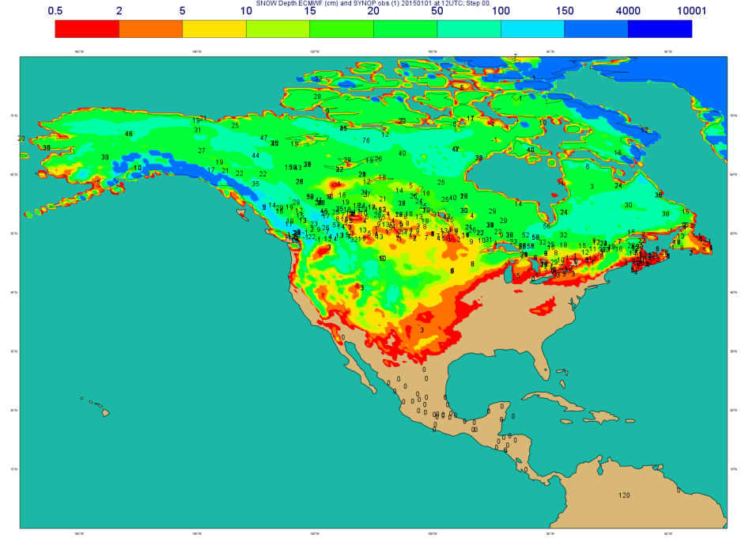
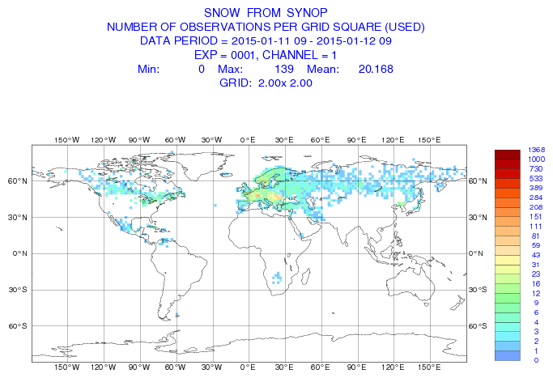
Snow Observations
GTS SYNOP Snow depth availability
Status in January 2015
Operational snow observations monitoring
(SYNOP TAC + national data):
http://old.ecmwf.int/products/forecasts/d/charts/monitoring/conventional/snow/
2015 01 01 at 12UTC
Gap in USA, China and southern hemisphere
NRT data exist and is available (more than 20000 station in the US)
But it is not on the GTS for NWP applications.
WMO Members States encouraged to put their snow depth data on the GTS
BUFR template for national data approved by WMO in April 2014
WMO GCW Snow Watch initiative on snow reporting, Brun et al 2013

Slide 21
Copernicus Atmosphere Monitoring Service
ECMWF is operating CAMS on behalf of the European Union
Operational monitoring and forecasting of atmospheric composition data and aerosols
Build on ECMWF NWP system
Heritage from GEMS, MACC, -II, -III, PROMOTE
Global and European regional scale

Slide 22
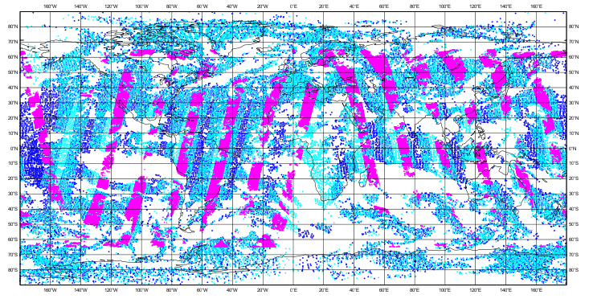
CO NRT data used in data assimilation
Data coverage during one 12-h assimilation cycle
P
Metop A/B IASI from LATMOS by ftp
TERRA MOPITT from NCAR by ftp
IASI Metop-A
IASI Metop-B
MOPITT TERRA
Notes:
Assimilation of IASI and MOPITT CO retrievals leads to improved fit to observations

Slide 23
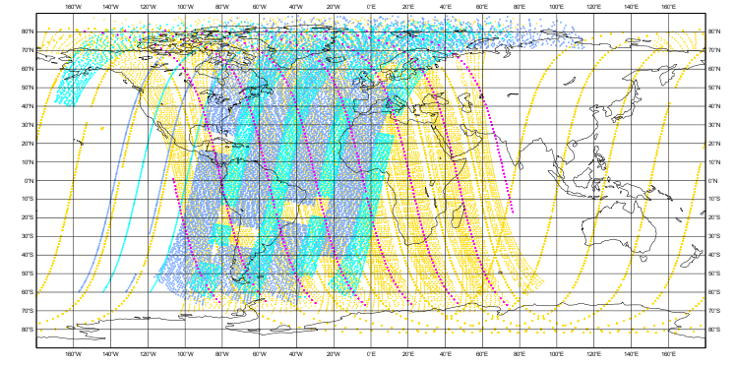
Ozone NRT data used in data assimilation
Data coverage during one 12-h assimilation cycle
Metop A/B GOME2 from EUMETCAST
AURA OMI and MLS from NASA by ftp
NOAA-19 SBUV/2 through GTS
GOME-2 Metop-A
GOME-2 Metop-B
OMI, MLS
AURA
SBUV/2
NOAA-19
Notes:
MLS and SBUV give us vertical profile

Slide 24
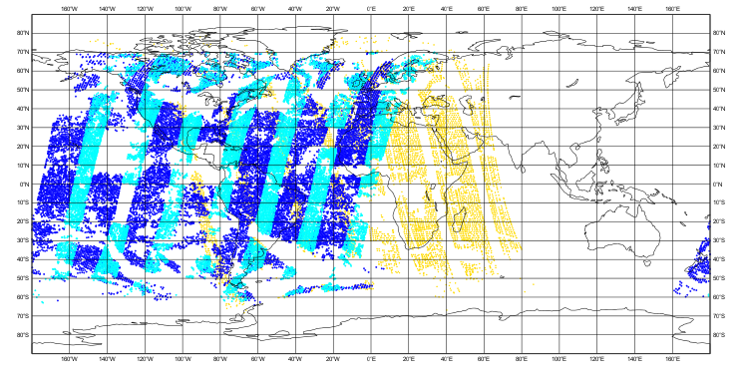
NO2 NRT data used in data assimilation
Data coverage during one 12-h assimilation cycle
AURA OMI from KNMI by ftp
Metop A/B Gome-2 from EUMETCAST
OMI
AURA
Notes:
NO2 data used in the NRT analysis

Slide 25
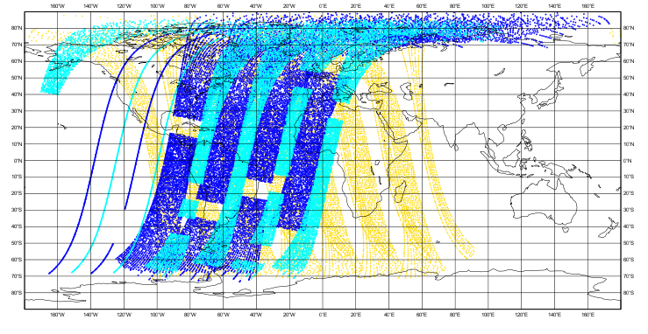
SO2 NRT data used in data assimilation
Data coverage during one 12-h assimilation cycle
Metop A/B GOME-2 from EUMETCAST
AURA OMI from NASA by ftp
Notes:
We assimilate SO2 only for volcanic eruptions. All data from GOME-2A and GOME-2B that have been flagged as volcanic are assimilated in NRT. Volcanic SO2 is modelled better using gome-2 a/b

Slide 26
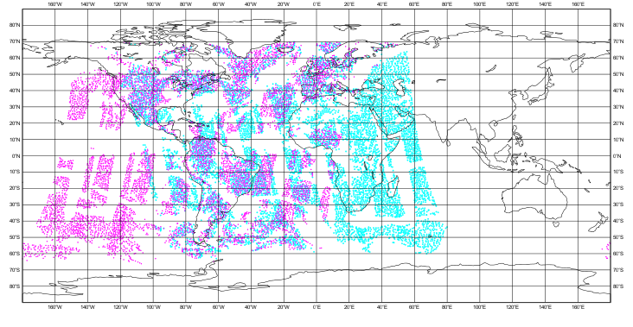
Aerosol NRT data used in data assimilation
Data coverage during one 12-h assimilation cycle
AQUA/ TERRA MODIS AOD from NASA by ftp
MODIS
AQUA
MODIS TERRA

Slide 27
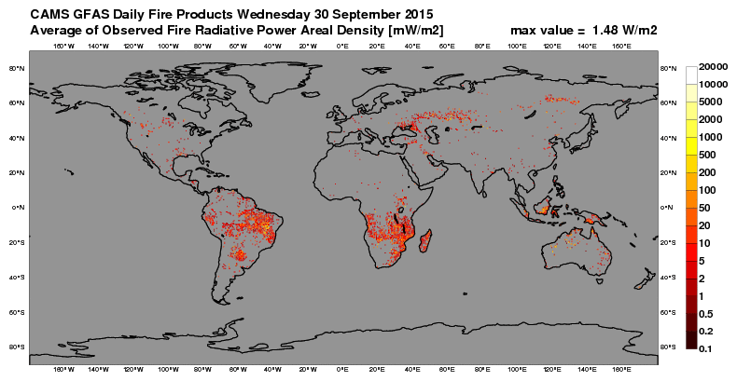
Fire radiative power data used in fire assimilation
AQUA/TERRA MODIS FRP from NASA by ftp
MSG SEVIRI FRP from EUMETCast
GOES-E/W FRP from LSA SAF/IPMA by ftp

Slide 28
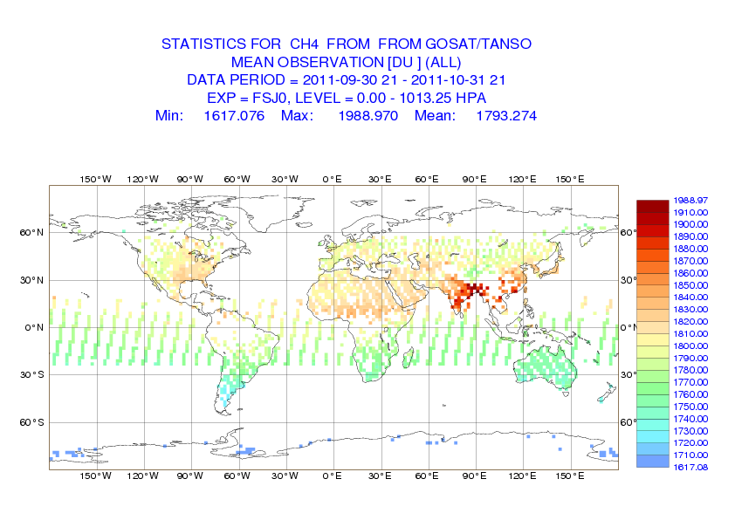
CH4 and CO2 data used in data assimilation
Column-averaged dry-air mole fractions of GOSAT/TANSO CO2 and CH4 are provided by SRON and U.of Bremen
Notes:
We are assimilating products from retrieval algorithm (dry-air mole fractions of CO2 and CH4). Not radiances. Note that SCIAMACHY and TANSO are sensitive to the lower troposphere (SWIR) while IASI is sensitive to the middle troposphere (TIR).

Slide 29
Recent progress
Ozone data
METOP A/B IASI from EUMETCAST -testing in progress
S-NPP OMPS –being tested
METOP A/B GOME2 from RAL – testing in progress
Aerosol
PMAP AOD – monitoring
VIIRS AOD – testing in progress
SEVIRI - being tested
CO2 and CH4
IASI – available from LMD; testing in progress

Slide 30
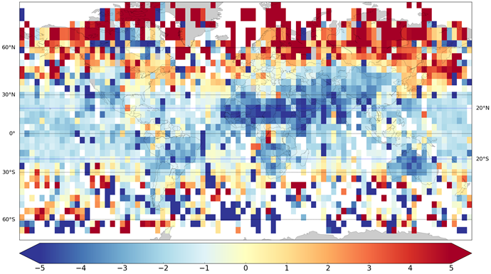
Enhancing the assimilation system with new data
First results with v7 of OCO-2 data
Good progress with SNPP data
VIIRS AOT
OMPS O3 profile
VIIRS FRP – not yet
Ready to use Sentinel 3, 5p, 4, 5 when become available

Slide 31
CAMS service provision
https://atmosphere.copernicus.eu/

Slide 32
Thank you
Acknowledgments: V.H.Peuch, R.Engelen, M.Suttie, A.Benedetti, A.Inness, S.Massart, M.Parrington, J.Flemming,A.Agusti-Panareda and CAMS team

