Slide 1
APSDEU-14 / NAEDEX-26 Objectives of the meeting
1st objective/part of the meeting (1.5 day)
Update from NWP centres on their usage of observational data
Update from Satellite Agencies on their products and activities
To review actions from previous meetings
2nd objective/part of the meeting (1.5 day)
Review of requirements of observational data from NWP centres
Consolidation of new and remaining actions from the requirements
Discussion on the format of requirements following the update exercise
3rd objective – 4th day of the meeting
Session on DBnet
Session on Sentinel

Slide 2
Logistics
Lunches areas
The imperatives: Tea / Coffee / vending machines / toilets
Access to public WIFI
Put talks on PC with a USB stick during break before your session or email it at naedex.apsdeu@gmail.com
Cloak room upstairs (floor of the meeting room)
Opening hours of the Biosphere
7:00 to 18:00
Meeting room will be locked overnight
Open to public Wednesday to Friday : no visitor activities on the floor of the meeting room
Wednesday
Meeting dinner at 18:30 at the Institut d’Hotellerie : Number of participants required for reservation at lunch time (Tuesday) today
Group photo Tuesday (today) afternoon at break time
Thursday – Guided tour of the Biosphere at 13:30
Taxis for return to the airport Friday
Reservation should be done in the morning
It’ll be a long weekend →lots of traffic expected
Difficult (if not impossible) to get a taxi after 15h30!

Slide 3
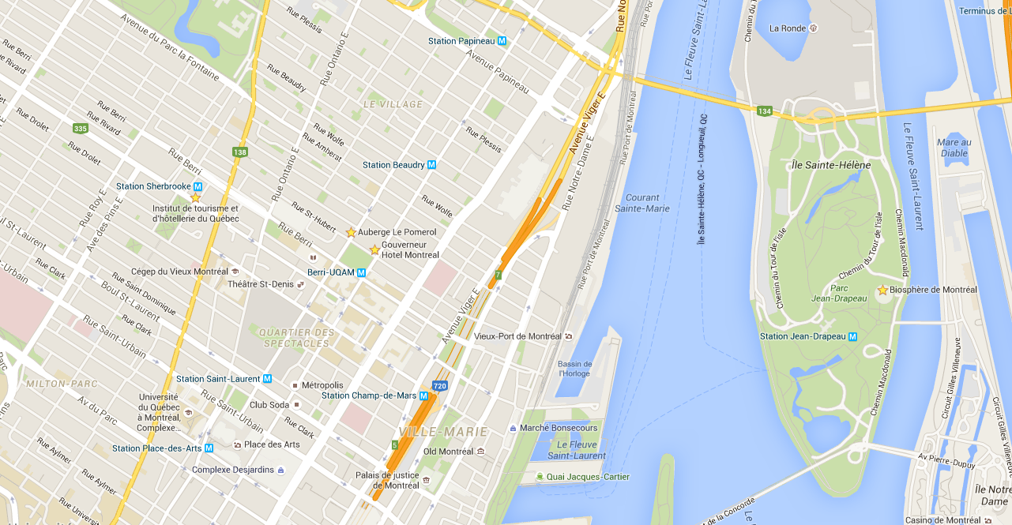
Where are we?

Slide 4
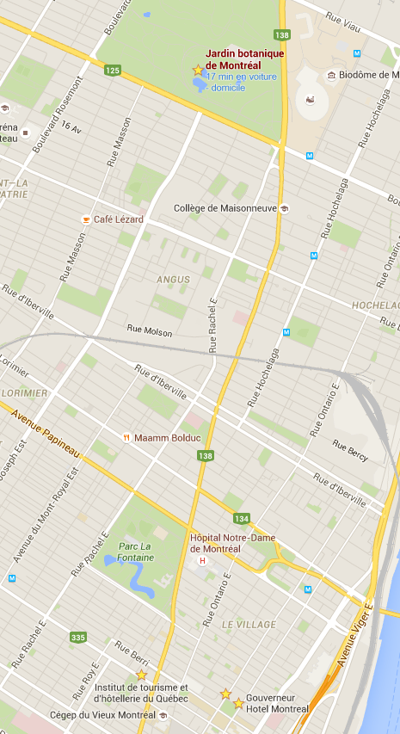
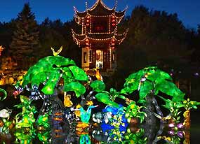
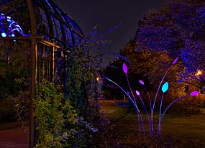
An idea of evening activity
Pie-IX station
On the green line
Gardens of light
Botanical garden
Metro Pie-IX
Closing at 9 pm

