Slide 1
Joint APSDEU-14/NAEDEX-26
Data Exchange Meeting (Montreal 2015)
Deutscher Wetterdienst (DWD) status report
Alexander Cress
Deutscher Wetterdienst, Frankfurter Strasse 135, 6003 Offenbach am Main, Germany
alexander.cress@dwd.de
and Christof Schraff, Klaus Stephan, Annika Schomburg, Robin Faulwetter, Olaf Stiller,
Andreas Rhodin, Harald Anlauf, Christina Köpken-Watts etc…

Slide 2
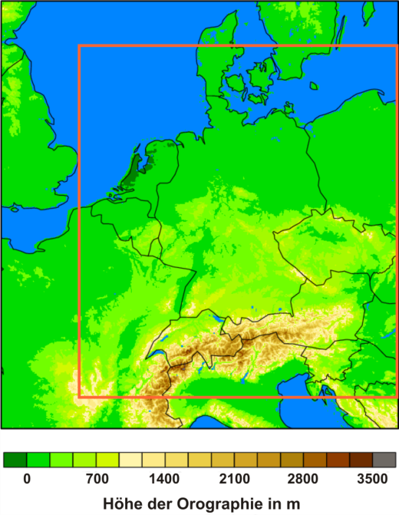
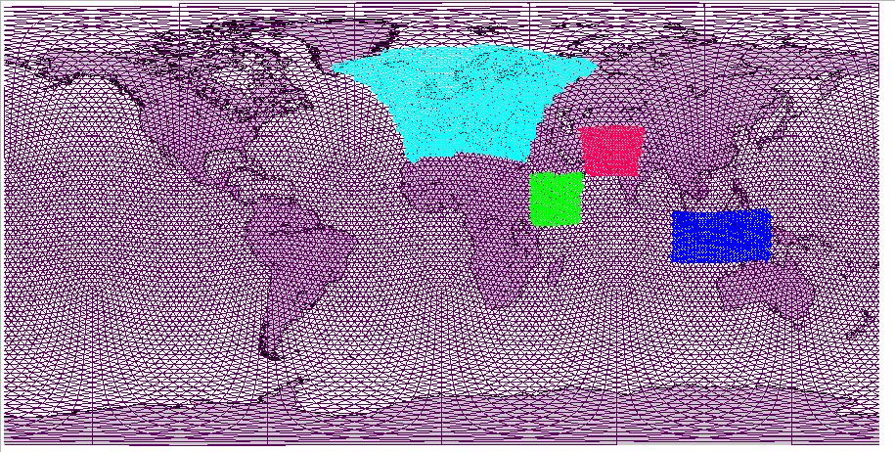
Numerical Weather Prediction
at DWD in 2015
Global model ICON
Grid spacing: 13 km
Layers: 90
Forecast range:
174 h at 00 and 12 UTC
78 h at 06 and 18 UTC
1 grid element: 173 km²
ICON zooming area Europe
Grid spacing: 6.5 km
Layers: ~ 60
Forecast range:
78 h at 00, 06, 12 and 18 UTC
1 grid element: 43 km²
plus three other zooming areas
COSMO-DE (-EPS)
Grid spacing: 2.2 km
Layers: ~ 80
Forecast range:
24 h at 00, 03, 06, 09,
12, 15, 18, 21 UTC
1 grid element: 5 km²

Slide 3
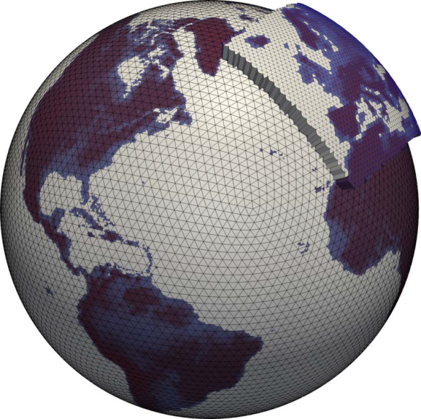
New Global Model ICON
Operational since Jan 20, 2015 and Nest over Europe since July 2015
Non-hydrostatic model developed jointly by MPI and DWD.
Icosahedral grid, 13 km horizontal resolution.
90 z-coordinate levels up to 75 km (approx.
0.026hPa).
Two-way nesting, replaced limited area model (COSMO-EU) in July 2015.
Improved physics schemes.
APSDEU-14/NAEDEX-26 Data Exchange Meeting Alexander Cress Montreal 2015l

Slide 4
Assimilation schemes
Global: 3DVAR PSAS
    Minimzation in observation space
    Wavelet representation of B-Matrix
      seperable 1D+2D Approach
      vertical: NMC derived covariances
      horizontal: wavelet representation
    Observation usage: Synop, Temp/Pilot, Dropsonde, AMV, Buoy, Scatterometer, IASI,
    AMUSU-A/B, Aircraft, Radio Occultation
    Time window: 3 hours
Local:
    Continous nudging scheme and latent heat nudging
    Time windows: 0.5 – 1 hour
    Observation usage: Synop, Temp/Pilot, Dropsonde, Buoy,
Aircraft, Scatterometer, Windprofiler,
Radar precipitation

Slide 5
Satellite data usage
Microwave and infrared instruments
Obs.System | Satellite | Channels | Remarks
AMSU/A | NOAA 15 NOAA 18 NOAA 19 METOP-A/B | 5-14 | RTTOV10 over sea and high peaking channels over clouds and land
AMSU/B MHS | NOAA 19 METOP-A/B | 3-5 | Only over sea
ATMS | NPP | 6-15 | Over sea and high peaking channels over clouds and land
SSIM/S | F-16, F-17, F18 |  | monitoring
AMSR-2 | GCOM-W1 |  | monitoring
GMI | GPM |  | monitoring
SAPHIR | Megha-Tropiques |  | monitoring
IASI | METOP-A/B | 49 | over sea and high peaking channels over clouds and land
Cris | NPP |  | monitoring
MWTS-2/MWHS-2 | FY-3C |  | monitoring

Slide 6
Satellite data usage
Microwave and infrared instruments
Obs.System | Satellite | Channels | Remarks
Radioccultation | Cosmic, Grace, Gras, TerraSar, Tandem-X | Upper troposhere and stratosphere | Observation operator; own development
AMV | NOAA13/15, Meteosat 7/10, MTSAT-2, MODIS, NOAA series and Metop, NPP/VIIRS, Himawari-8, Insat-3 FY-2G, COMs | Infrared, visible and wv | Over sea and partly over land. Qi threshold
Scatterometer | ASCAT on Metop-A/B RapidScat, HY-2A |  | Sea only
Altimetry | Jason-2 | Wind speed | monitoring
Geostationary radiances | Meteosat Seviri |  | Monitoring and experiments in global and regional model

Slide 7
Global
Ensemble Data Assimilation (EDA)
Implementation following the LETKF method based on Hunt et al. (2007).
VarEnKF. Flow dependent B: B_{VarEnKF} = αB_{LETKF} + (α-1)B_{3DVAR}
Boundary conditions for KENDA-COSMO.
Natural initialization for global EPS.
Prior for particle filters.
Deterministic DA
40km/13km 3D-VAR.
SST, SMA and snow ana.
Incremental analysis update.
Hybrid DA
40km/13km VarEnKF(hyprid )
13 km pre-operational
Ensemble DA
40 member 40km LETKF.
Horizontal localization radius 300km.
Relaxation to prior perturbations ( 0.75).
Adaptive inflation (0.9 - 1.5).
SST perturbations.
Soil moisture perturbations

Slide 8
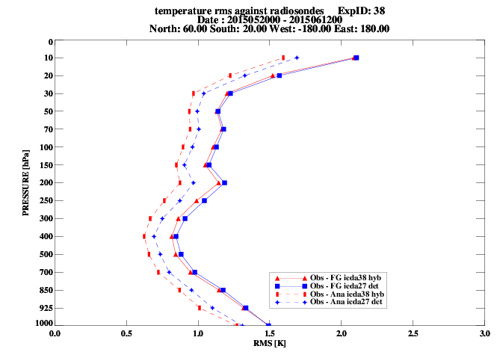
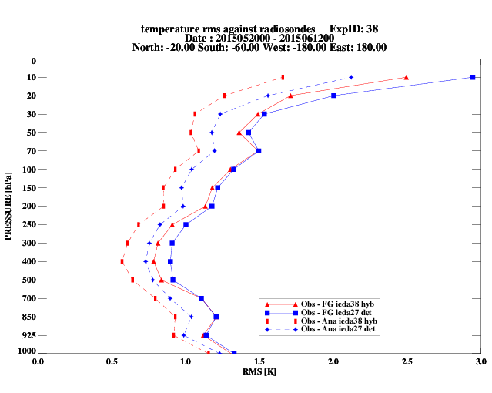
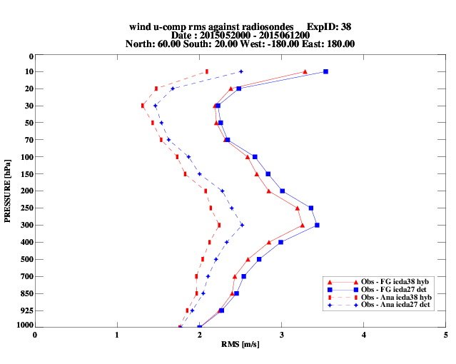
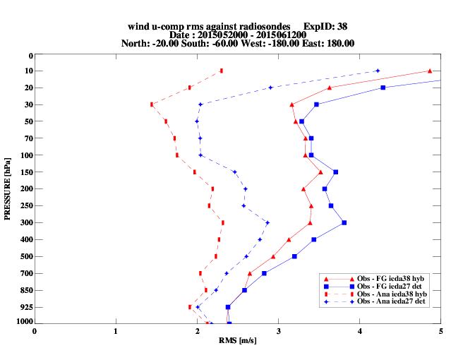
Radiosonde comparison
3dvar – hyprid 3dvar
NH
SH
NH
SH

Slide 9
Kilometer ScaleEnsemble Data Assimilation (KENDA)
Implementation following the LETKF method based on Hunt et al. (2007).
Should replace the nudging scheme for COSMO-DE in 2017
Full System with conventional data running
including Latent Heat Nudging
Further Observation Systems under development (e.g. SEVIRI, GPS/GNSS, Lidar, …)
Longer Periods/Winter Periods to be tested.
Technical work on operational setup (member loss) ongoing
Archive/Storage challenges remain severe
Pattern Generator and further Refinements (Localization, Covariance Inflation, …)
Estimation of observation influence on forecast quality possible (Project Uni Munich / Herz Centre)

Slide 10
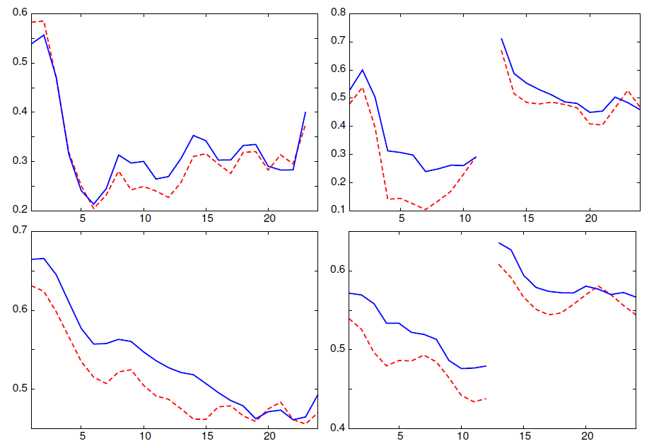
LETKF + LHN-allvs. Nudging + LHN:
verification against radar precipitation
FSS
11 GP. 30 km
0.1 mm/h
00 UTC
12 UTC
Period:
06 days
nudging + LHN
LETKF + LHN
2. Period
12 days

Slide 11
New developments since last meeting
Global scale
    ICON with 13 km resolution operational since Jan. 2015
    ICON Nest over Europe (6.5 km) operational since July 2015
    Revised background error correlations for new model
    Global ICON Ensemble system pre-operational Aug. 2015
    Global hybrid 3dvar pre-operational since 24. Sept. 2015
    Use of Radio Occultation (bending angles) from Tamdem-X
    and improvements in the usage
    Use of AMSU-A radiances (high channels) above land/clouds
    Global Metop A/B, NPP/VIIRS and HIMAWARi-8 AMVs pre-
    operational
    Use of RapidScat scatterometer pre-operational
    European humidity observations from aicraft operational
    Radiosondes in Bufr format (including drifting) operational
    selected Synop, Ship and Buoies in bufr format

Slide 12
New developments since last meeting
Local scale
    LETKF for local model COSMO-DE experimental
    Use of doppler radar wind data and reflectivities
    Cloud analyses based on NWCSAF products
    Use of Meteosat 10 Seviri CSR
    selected radiosonde bufr data operational
    selected Synop, Ship and Buoies bufr data operational
    Monitoring of GNSS data
    Monitoring of MODE-S data

Slide 13

Radiances from highest channels
1. step: highest channels
everywhere
Currently:
cloud-free
over sea
2. step: high
cloud-free
channels
4. step: cloud affected
+ VarBC
3. step: surface
affected
channels
Land
Sea
Use information from those observations
So far we have very different observation systems over land and sea.
  Radiance impact for Europe is small.
  Large improvements are expected for Europe
Robin Faulwetter, Routine meeting 21.07.2015
13/63

Slide 14
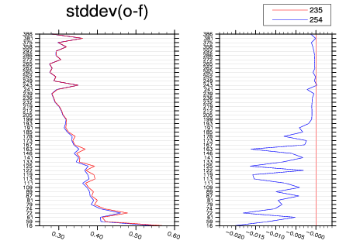
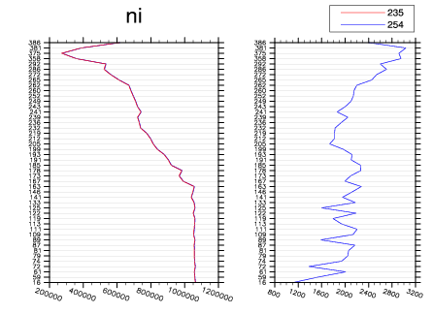
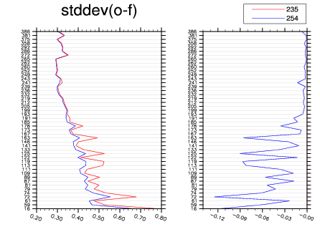
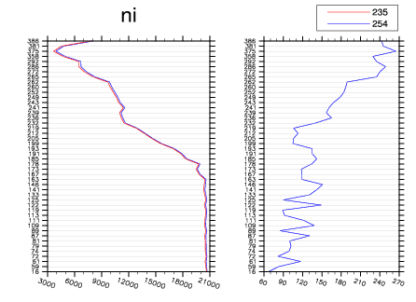
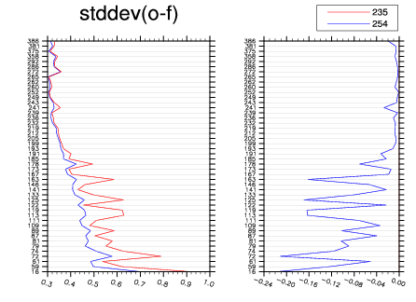
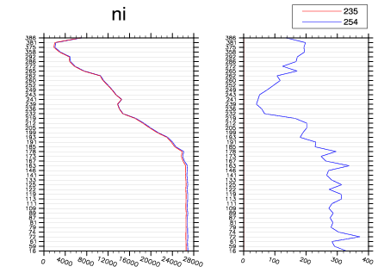
Analysis cycle verification:
IASI winter
stddev(obs-fg)
number obs
Low peaking channels
global
!
High peaking channels
Europe
polar north
Robin Faulwetter, Routine meeting 21.07.2015
14/63

Slide 15
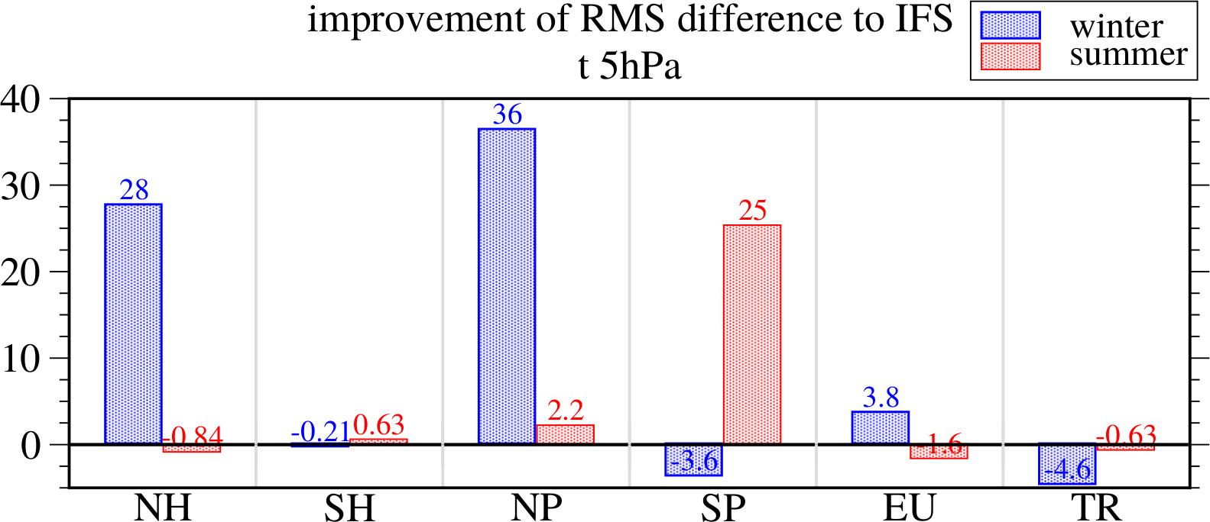
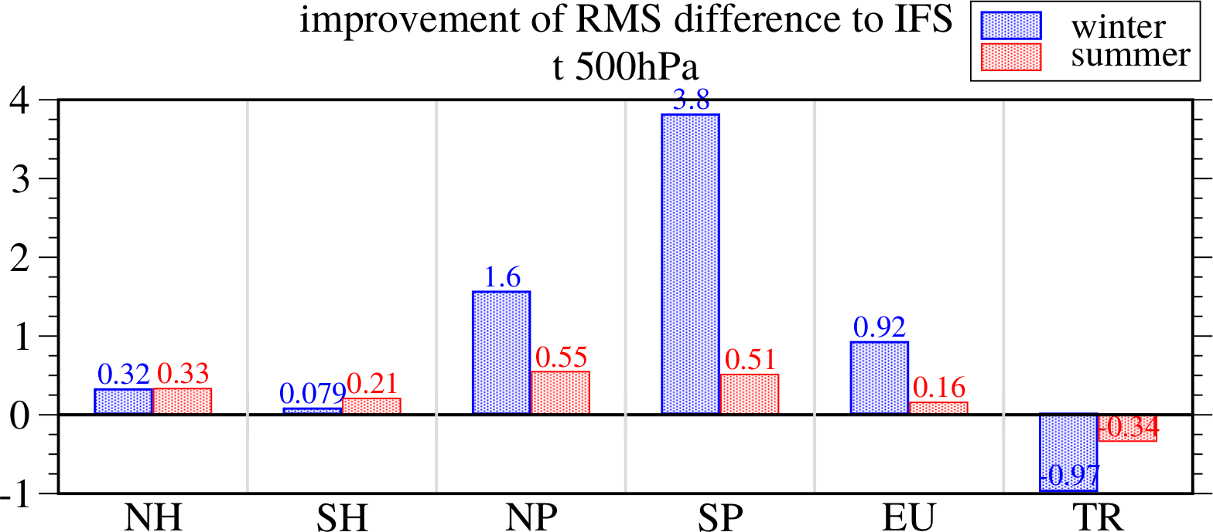
Analysis cycle verification:
RMS difference to IFS analyses
!
%
%
Robin Faulwetter, Routine meeting 21.07.2015
15/63

Slide 16
Improvements in Radiooccultation
Use of Tamdem-X data
Improved Bending-Angle-Operator
  Considering density of humid air as not-ideal gas
  Extended formulation of the index of refraction
    better consistency between Radiookkultations and radiosondes
Tuning steps
  Reduction of the background error for relative humidity necessary
  More realistic description of the GPSRO-observation error
    better usage of the GPSRO data information content
This steps leads to an improvement of the forecast scores on the southern hemisphere and small improvements on the northern hemisphere and the Tropics
16/63

Slide 17
Use of Atmospheric motion vector winds
Use of dual Metop winds
Experiments using NPP/VIIRS winds from NOAA and CIMSS
Start experiments replacing MTSAT-2 with HIMAWARI-8 winds
Monitoring of several additional AMVs from
  China (FY-2G)
  Korea (COMS)
  India (INSAT3)
  Metosat 11 (Test data set)
  new polar Metop winds (three images instead of two)
  leo/geo winds from CIMSS
AMV height correction using Calipso lidar heights (Univ. Munich)
  Derivation of a AMV-lidar height correction profile for Geo. Sat.
  new layer average operator developed
  Experiment using this height correction profile is running
17/63

Slide 18
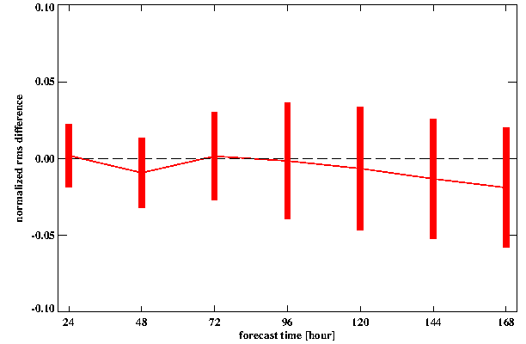
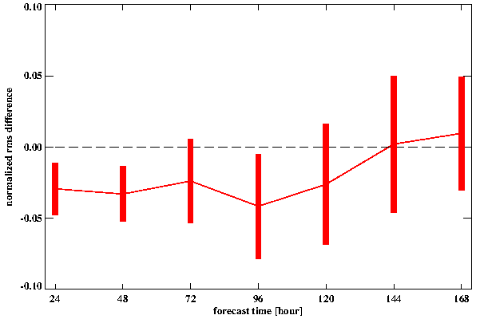
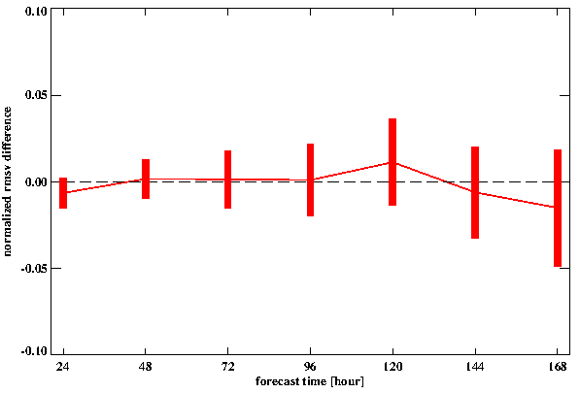
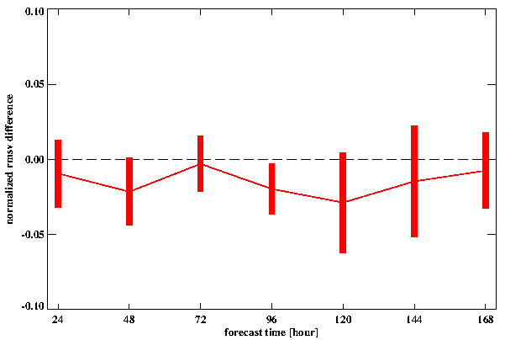
Normalized rms difference
(Crtl + Dual Metop) – Crtl
2015070100 - 2015073100
500 hPa Geopotential
NH
500 hPa Geopotential
SH
200 hPa Wind Vector
NH
200 hPa Wind Vector
SH

Slide 19
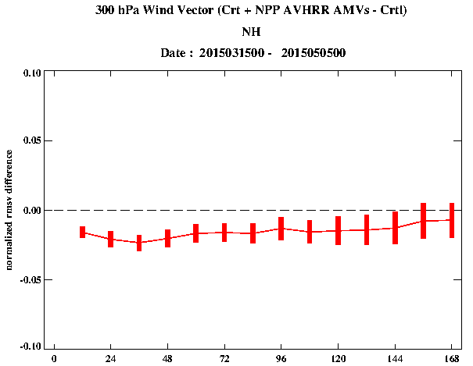
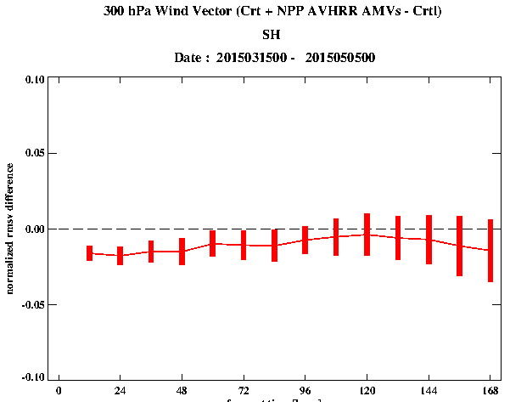
Normalized wind vector error scores
Experiment using NPP-VIIRS AMVs

Slide 20
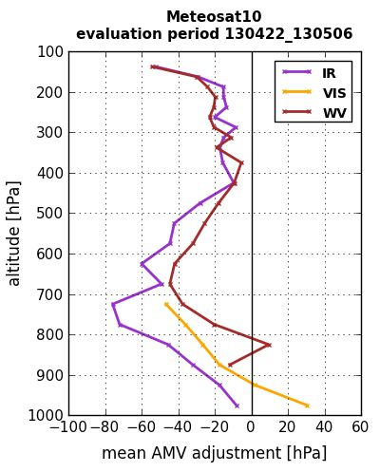
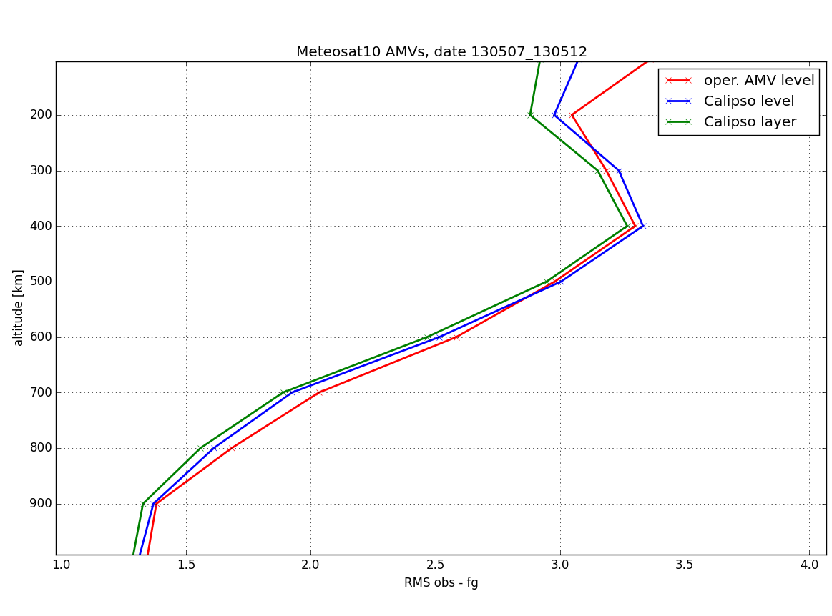
AMV-Lidar height correction

Slide 21
Use of bufr format in addition
to the former TAC format
Synop, ship, buoy or radiosonde measurements in bufr format
are stored in seperate data base
All bufr meta data are compared to the corresponding TAC data
In case there are no differences bufr data are stored in second
data base
Data in second data base are used within a test data assimilation
system
In case no conspicuoussies are found data are put into the
operational observation data base and used

Slide 22
Radiosonde observation in
Bufr format
Radiosonde observation in ascii and bufr format in data base
Radiosonde bufr format gives position (spatial and timely) of
every measurement
3dvar/letkf can read both formats
So far the spatial position of the measurement is consider both,
in assimilation and verification
Correct time is more difficult (no FGAT system so far)
Nudging can handle also the new TEMP, Synop, Ship and
buoy bufr formats

Slide 23
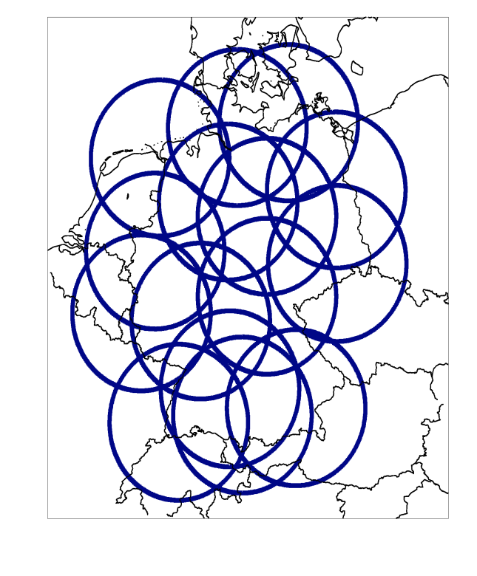
Assimilating 3D radar reflectivity and radial winds with an Ensemble Kalman Filter on a convection-permitting scale
(Uni Bonn (Theresa Bick), Uni Munich (Yuefei Zeng) + DWD (Klaus Stephan))
Goal:
Improve short term model forecasts of
Convective events
Use of the COSMO-DE and the KENDA
system
Use of 3D radar reflectivities and
radial winds from German radars

Slide 24
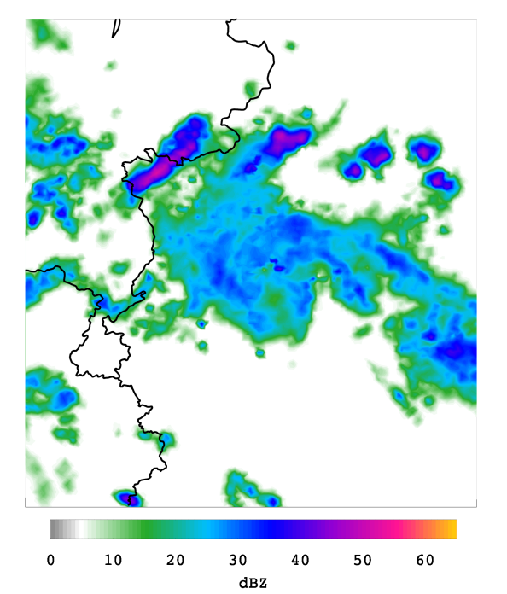
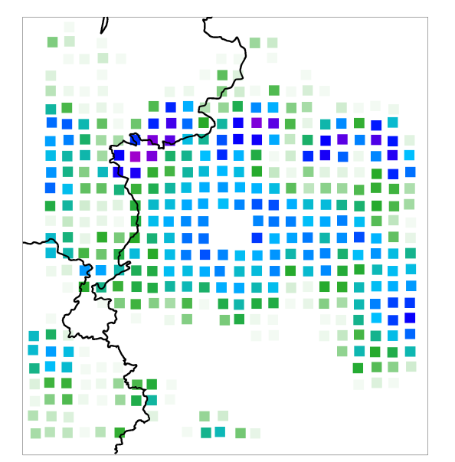
Radar forward operator
Simulate synthetic 3D radar scan based on COSMO-DE model fields (EMRADSCOPE,
developed at DWD/KIT)
No-reflectivity: set all values below 5 dBZ to 5 dBZ
Superobbing: achieve relatively homogeneous horizontal data distribution
  Reduce computational costs
  Relax necessity of direct match between model and obs (double penalty problem)

Slide 25
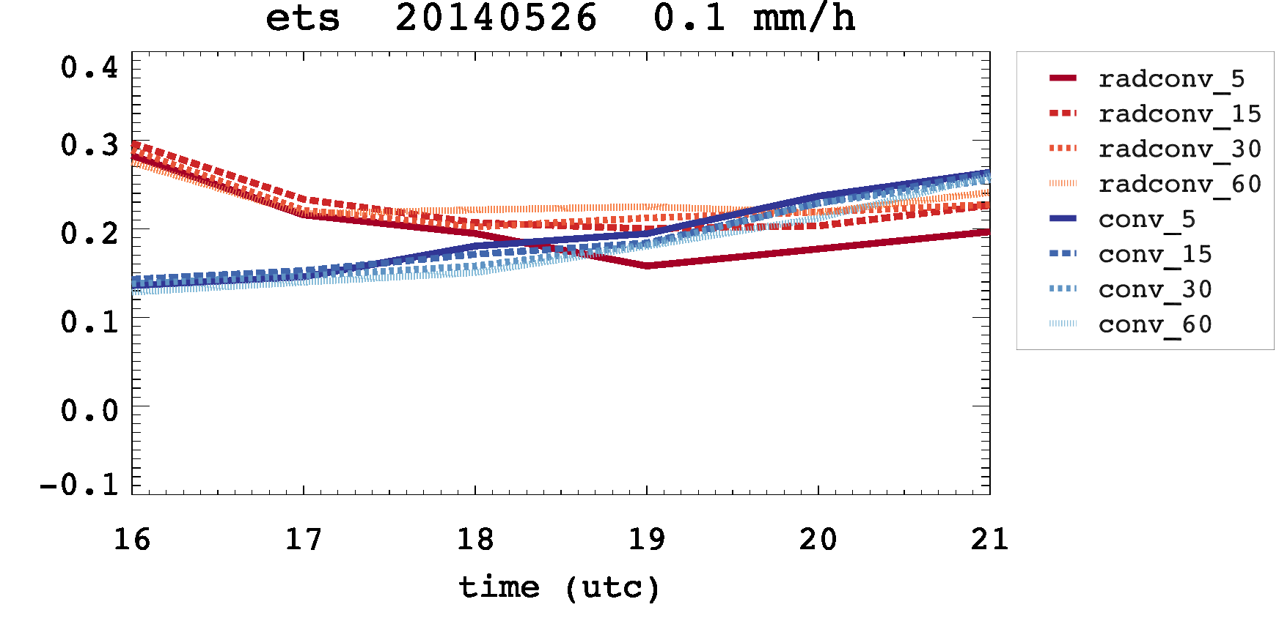
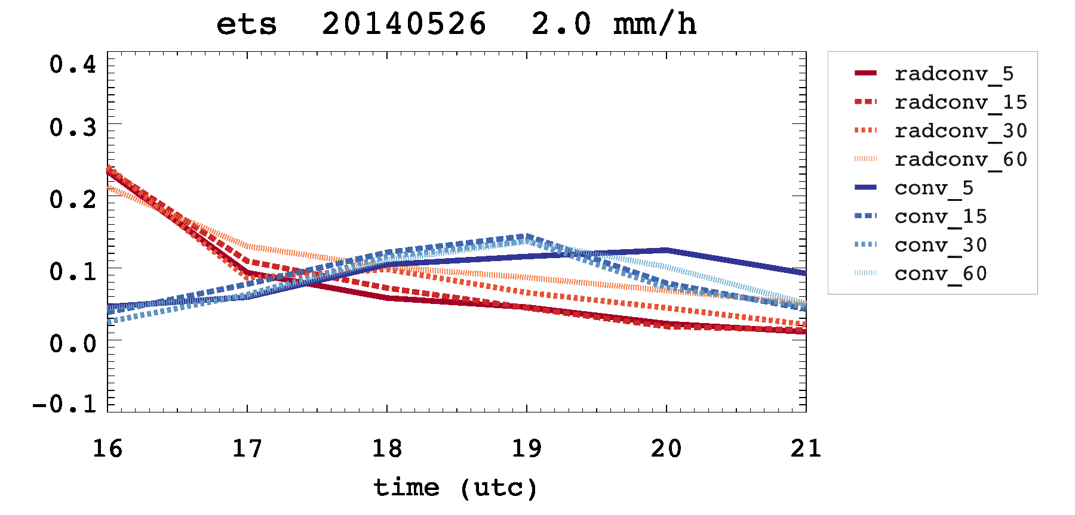
Equitable
threat score
0.1 mm/h:
2.0 mm/h:
(Forecast initialized
at 15 UTC)

Slide 26
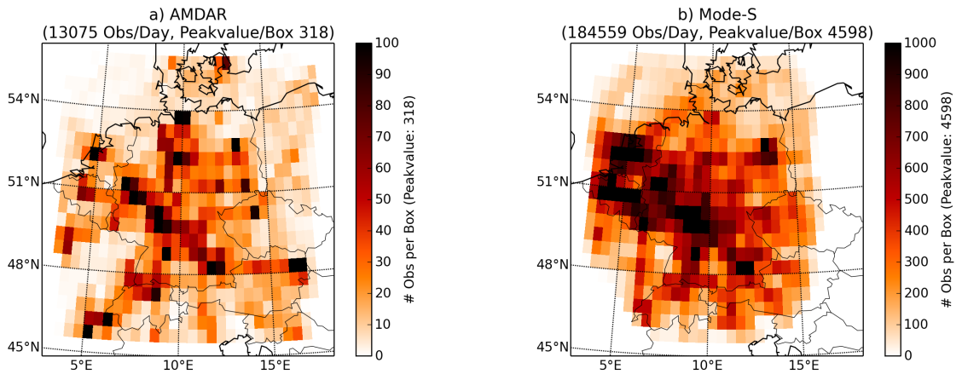
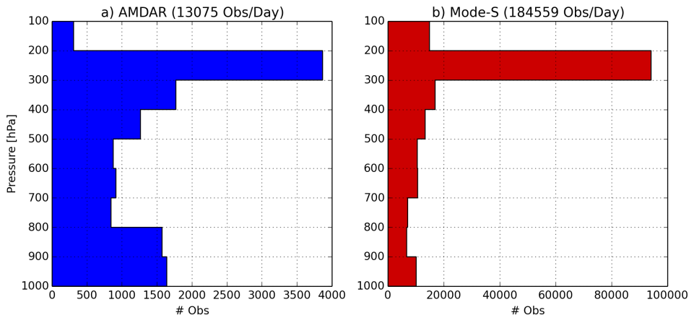
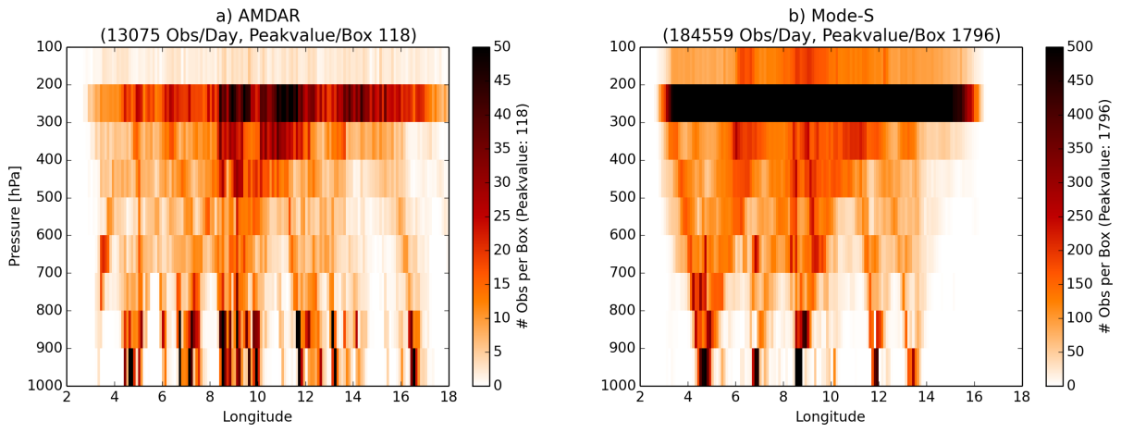
MODE-S data
Project at Uni Munich
Aircraft related meteorological information originates from tracking and ranging radar for air traffic control provided by KNMI
From aircraft information temperature and wind vector can be inferred
Mode-S original resolution: every aircraft every 4 sec
Mode-S averaged along flight tracks in AMDAR-fashion
Averaging distance between consecutive observations: 15 km
15 x times more flights in Mode-S than in AMDAR

Slide 27
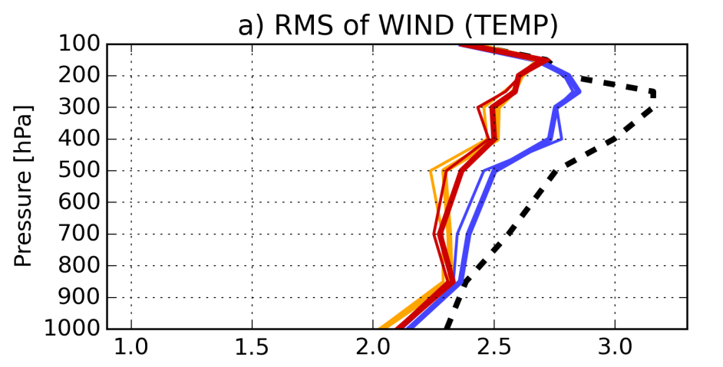
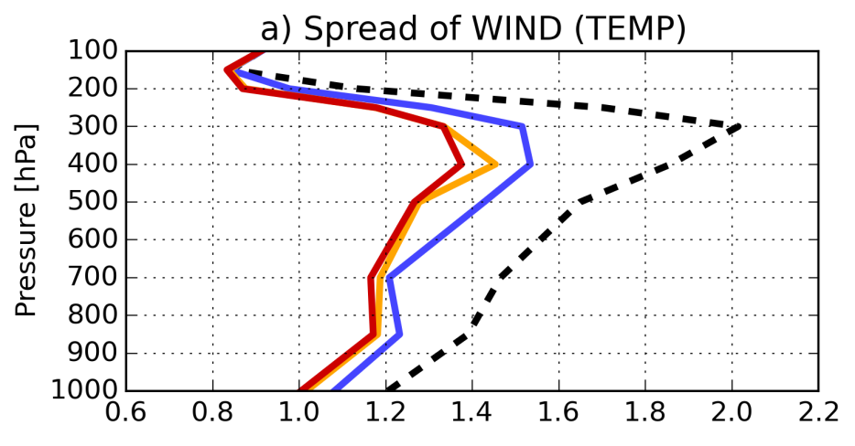
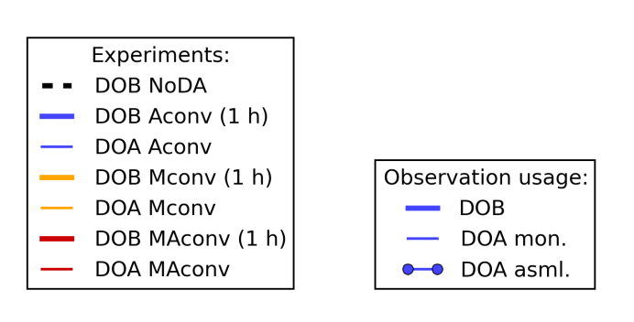
AMDAR MODE-S assimilation results
3-h forecast

Slide 28
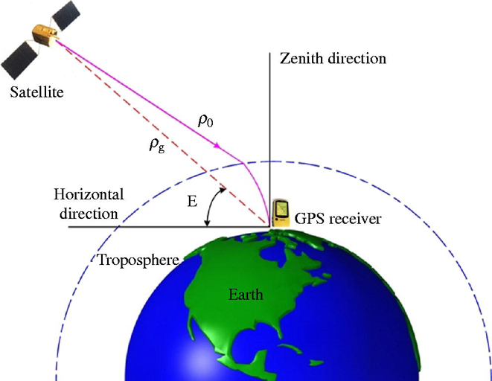
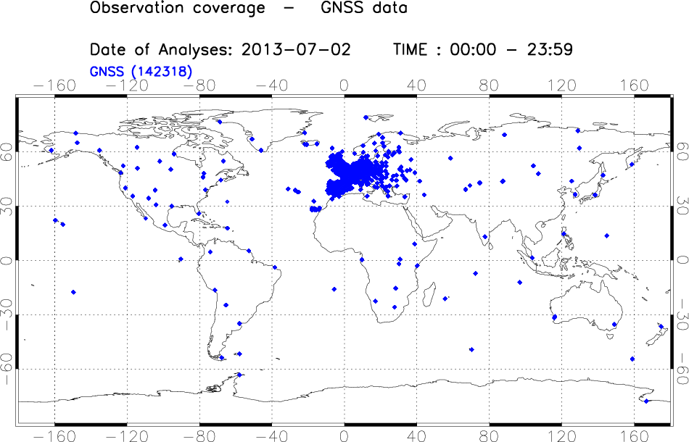
Use of GNSS
Zenit Total Delay data
Lack of highly resolved water vapor observations
Several regional networks of GPS stations provide observations of zenit total delay (ZTD)
ZTD descibes the delay in receipt of a signal from a GPS satellite to a recieving station caused by the presence of the atmosphere
ZTD = delay due to hydrostatic pressure + delay due to the amount of water vapor
The slant path delays are mapped to the zenit using a mapping function
ZTD/STD observation operator developed by DWD/GFZ Potsdam

Slide 29
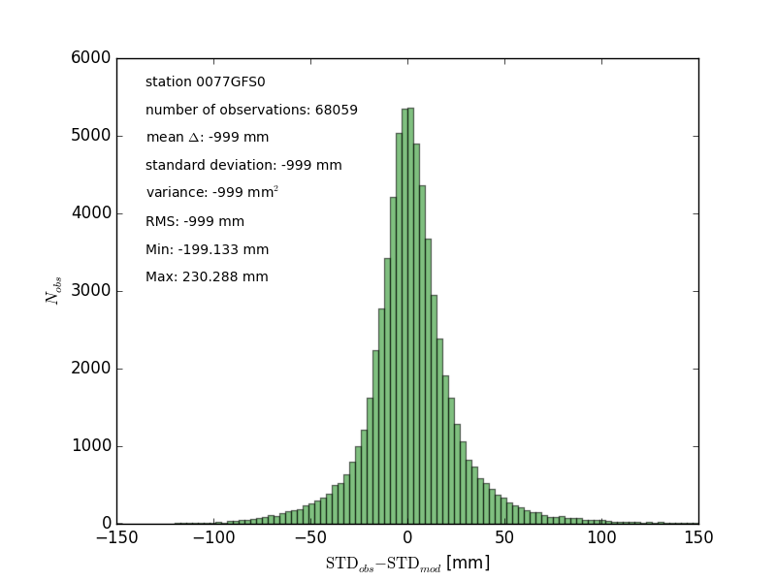
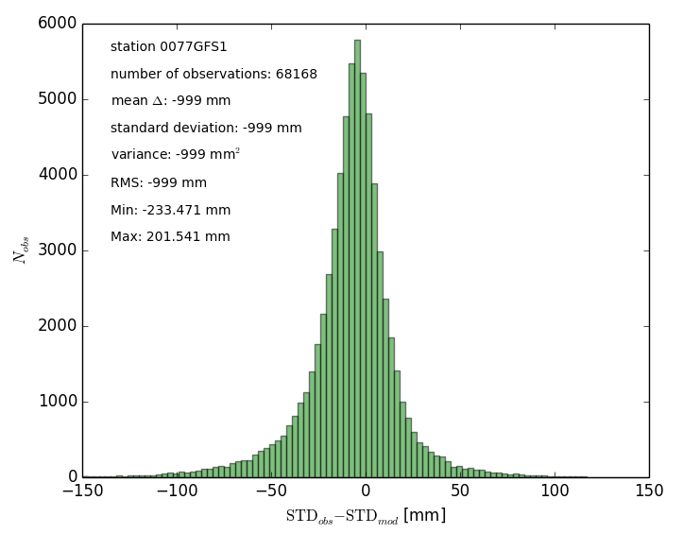
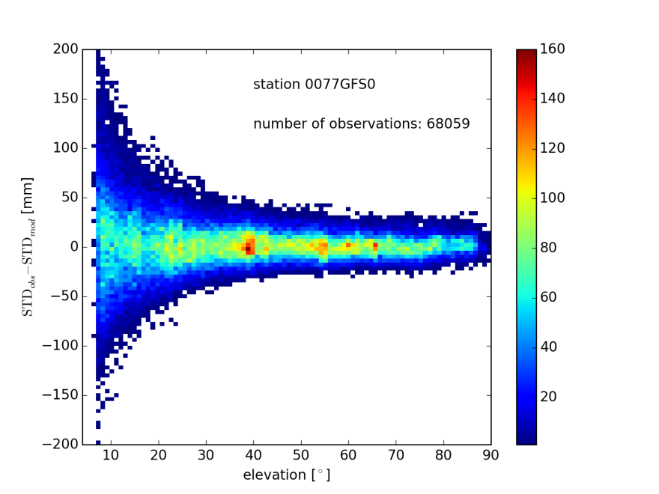
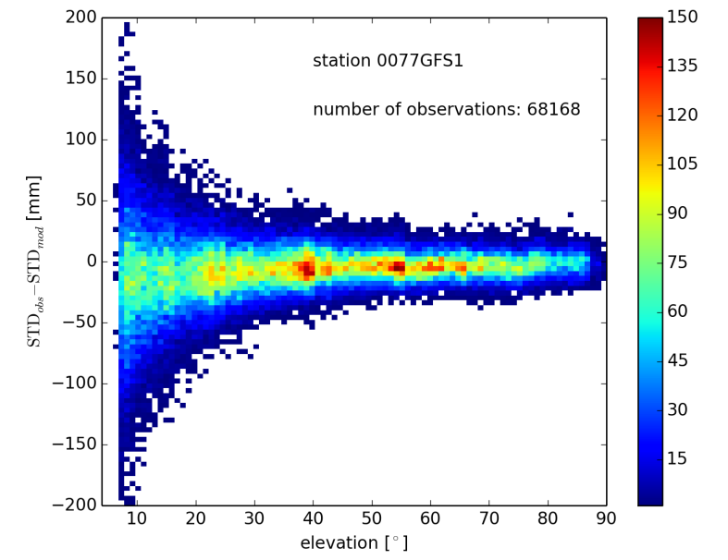
From STD derived ZTD
ICON
COSMO
ICON
COSMO

Slide 30
Future Plans
Increase the use of radiances (more satellites/more channels)
SEVIRI VIS/NIR window channels (Uni Munich)
Direct use of SEVIRI IR window channels
Use of more AMV data sets and height correction
Preparation for AEOLUS wind lidar observations
Using 3D radar oberator for radar reflectivities / radial velocities
Use of ground-based GNSS total and slant delay observations
Use of MODE-S data and aircarft humidity data over Europe

Slide 31
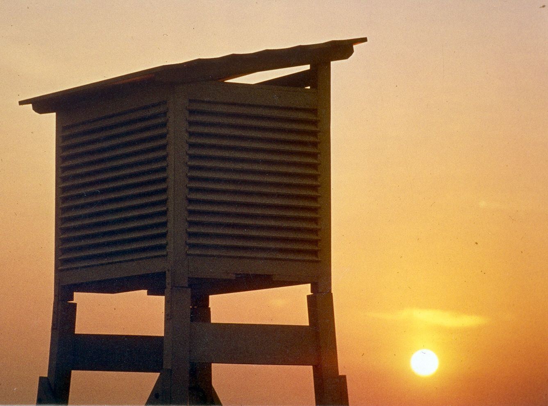
Thank you for your attention!
Questions?

