Slide 1
The Centre de Météorologie Spatiale - satellite meteorology center
Pascal Brunel and Sylvain Le Moal
Direction des opérations pour la prévision
Centre de Météorologie Spatiale

Slide 2
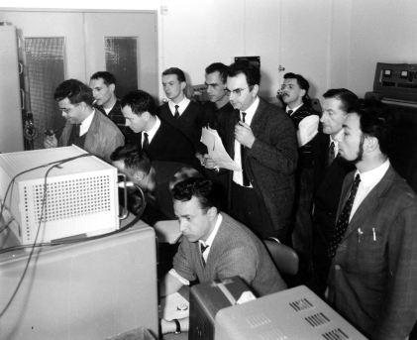
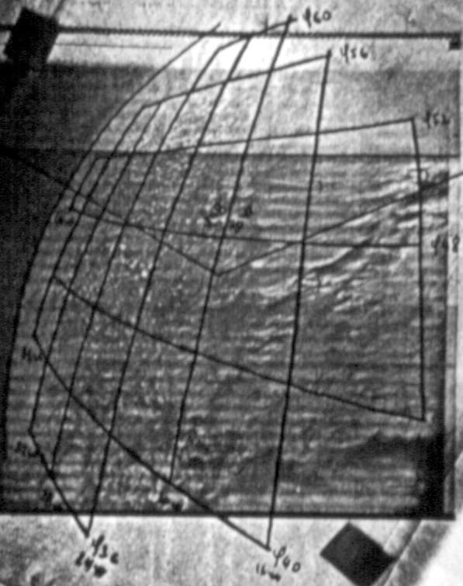
History: some key dates
1960: First meteorological satellite TIROS-1 (USA).
1963: Creation of CEMS (Centre d’Etudes Météorologiques Spatiales). In December, the CEMS was the first center in Europe able to receive meteorological satellite images.
1974: First meteorological geostationary satellite SMS-1 (USA).
1977: First European geostationary satellite Meteosat.
1986: Creation of EUMETSAT (Darmstadt – Germany).
2002: First MSG launch (operational in 2004).
2006: First European polar-orbiting satellite MetOp.
2011: Launch of Suomi-NPP.
2014: Launch of Himawari-8 (JMA).
24th December 1963: First image received in Europe (satellite: TIROS-8)

Slide 3
M-F top-level organisation (satellite relevant part)
Direction des Missions Institutionnelles et des Affaires Internationales (D2I) :
In charge of institutional relationship with Space Agencies (incl. EUMETSAT)
Centre National de Recherches Météorologiques (CNRM)
Direction des Systèmes d’Observation (DSO) :
In charge of M-F surface, altitude and ground based radar observation networks
No direct implication in satellite data acquisition and processing activities
Development of data fusion products, using various observation sources (including satellites)
Direction des Opérations pour la Prévision (DirOP) :
In charge of M-F central operational production for weather forecast
M-F Satellite Centre (CMS), located in Lannion, is also part of DirOP

Slide 4
M-F Satellite Centre (CMS)
Operational production missions :
Acquisition, processing (level 1 and ≥ 2), NRT distribution and archiving of meteorological satellite data and products (GEO and LEO), for the operational needs of M-F (incl. over-sea territories) and its customers
Contribution to EUMETSAT ground segment (FSDS, EARS, SAF OSI) and to DBNet
Contribution to Copernicus (CMEMS)
Customer-tailored production (ex : medias)
Contribution to AERIS (French data centre for atmospheric research)
=> Operational infrastructure (satellite receiving systems, processing and storage servers…)

Slide 5
Organization chart
MANAGEMENT
C. Grégoire
RESEARCH AND DEVELOPMENT
H. Roquet
(P. Brunel)
SOFTWARE DEVELOPMENT AND MAINTENANCE LOGICIELS
O. Péron
PRODUCTION
P. Labrot
SATELLITE DATA VALORISATION
S. Le Moal
TELECOMMUNICATIONS, SYSTEMS AND NETWORKS
T. Labrot
ACCOUNTING AND GENERAL SERVICES
M. Voisneau

Slide 6
CMS : R&D activities
Main competence areas :
L1 processing of polar orbiting satellite direct readout data (imagers and sounders) : AAPP, OPS-LRS
Retrieval of clouds physical and micro-physical properties from VIS/IR imagers
Retrieval of ocean surface physical properties from VIS/IR imagers
Atmospheric sounding and radiative transfer modelling (mainly VIS/IR) : LBLRTM, RTTOV
Multispectral composite imagery
Contribution to :
Nowcasting SAF
Numerical Weather Prediction SAF
Ocean and Sea Ice SAF
Copernicus Marine Environment Monitoring Service (CMEMS)

Slide 7
CMS : other roles and activities
French representation in EUMETSAT scientific and technical groups :
STG-SWG, STG-OPS, STG, J-STG-AFG
Training :
Yearly training session at CMS on meteorological satellites and remote sensing
Technical training on EUMETCast (depending on demands)

Slide 8
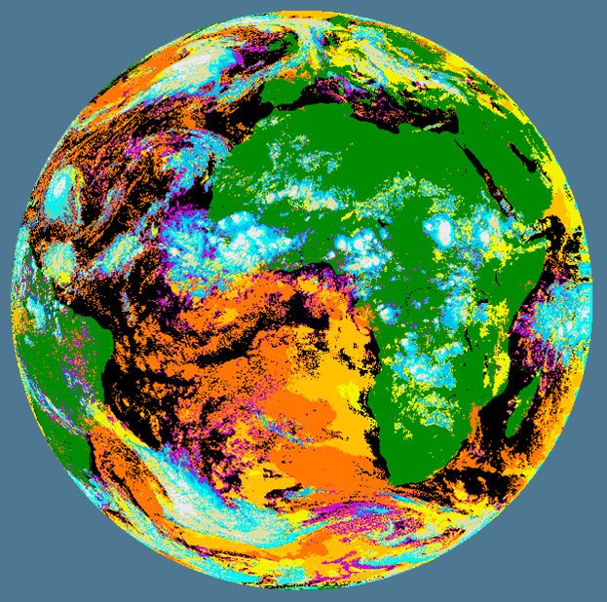
SAF on support to nowcasting and very short range forecasting
Cloud type
The NWC SAF provides the tools and software that deliver tailored satellite information to support forecasting up to 12 hours ahead
Cloud type
Cloud top temperature and height
Convection rainfall rate, precipitating clouds, cloud physical properties
Stability analysis imagery
High resolution winds
Automatic satellite image interpretation
Rapid development thunderstorms

Slide 9
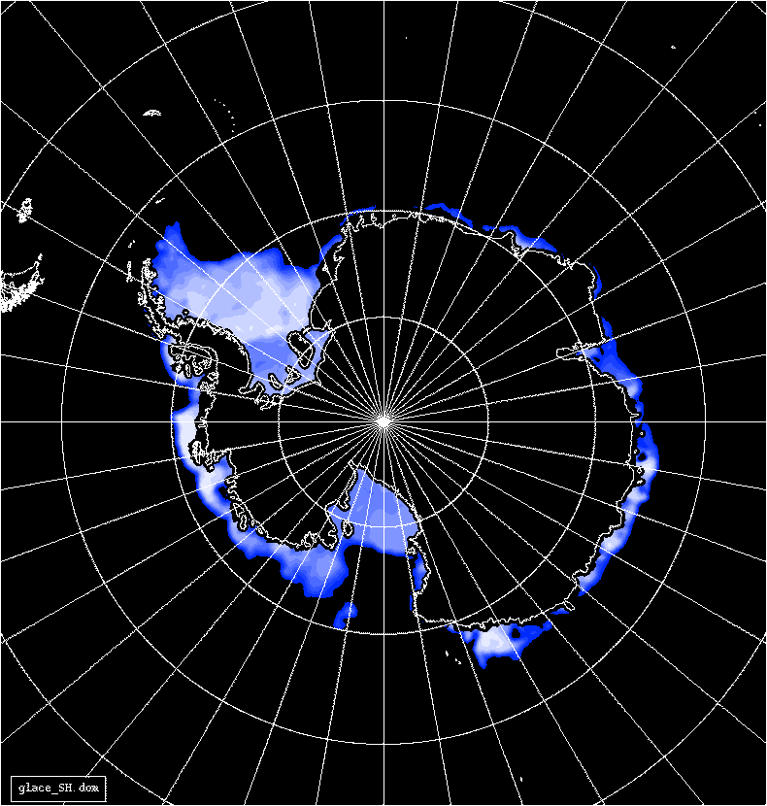
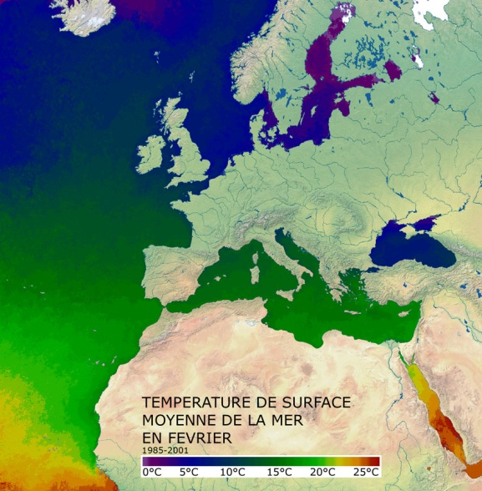
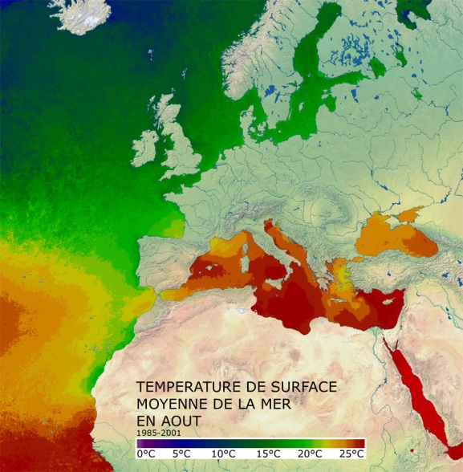
Ocean and sea ice SAF
MF/CMS is the OSI SAF leader
Ocean surface wind vector
Sea surface temperature
Radiative fluxes : surface short wave irradiance and downward long wave irradiance
Sea ice edge, concentration, emissivity and drift

Slide 10
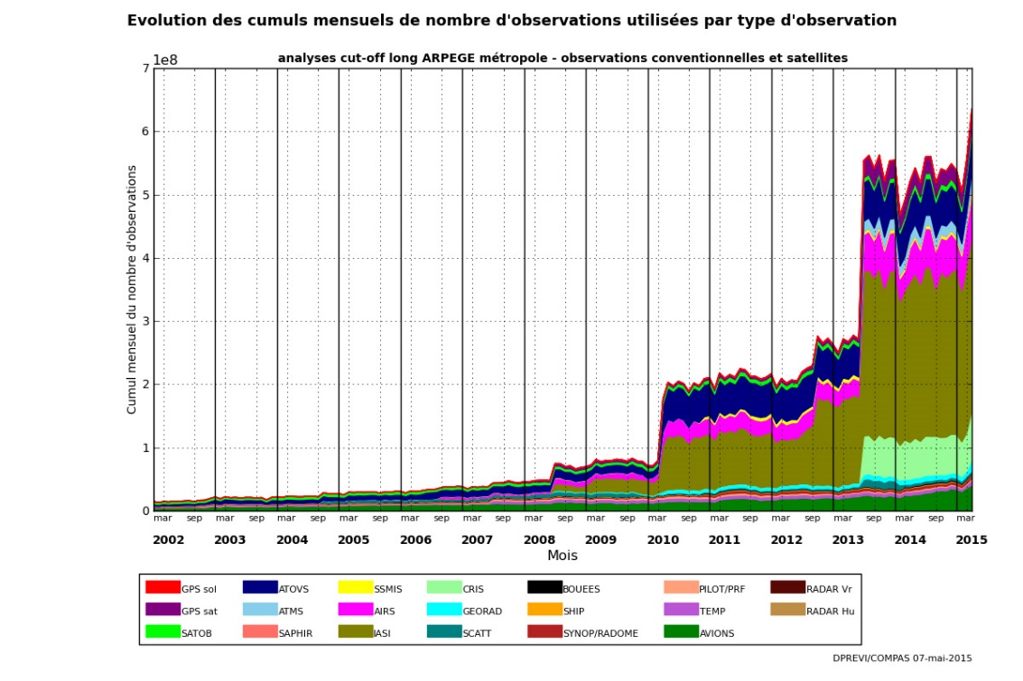
SAF on Numerical Weather Prediction
To improve and support the interface between satellite data/products and European activities in global and regional NWP
Satellite Data Pre-processing Packages (ie AAPP)
Cloud and Aerosol Detection Software
Radiative transfer modeling products (ie RTTOV)
R&D Tools
1DVar and Radiance simulator
Data monitoring
Level 1 radiances
Level 2: AMV, Lidar Doppler winds
Timeliness
Auto alerts
Forecast Sensitivity to Observations
Outreach and training

Slide 11
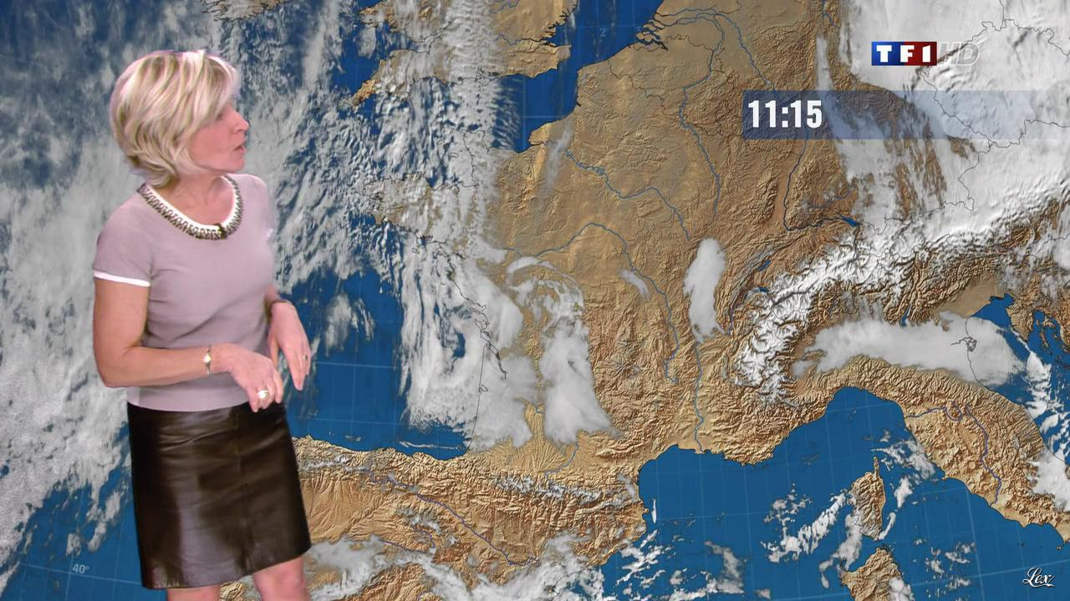
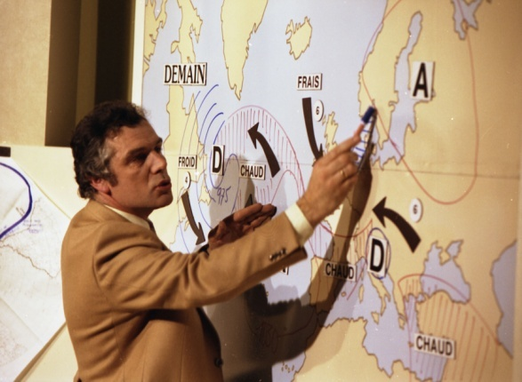
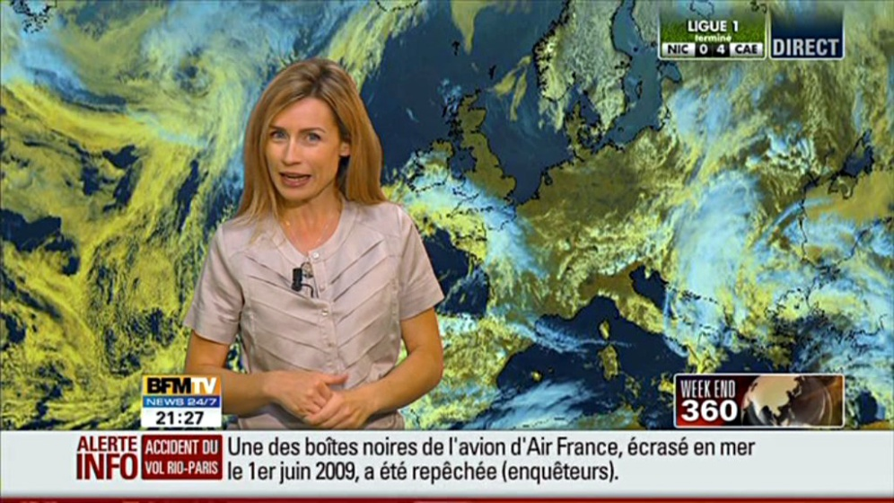
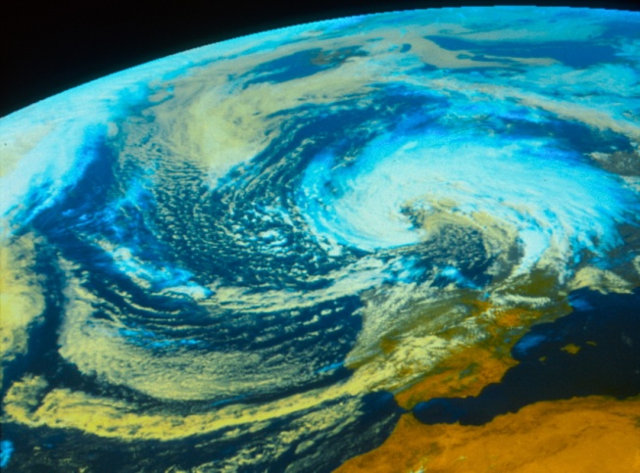
Images for media
16th June 1990 :
For the first time, a satellite picture was broadcasted by TF1.
12th September 1993: First “event” picture
Ex tropical storm Floyd

Slide 12
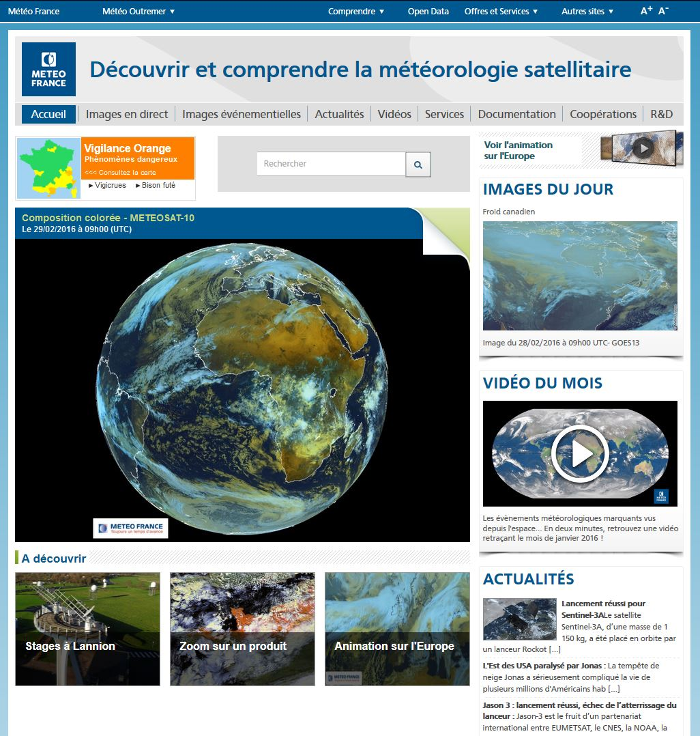
Websites
http://www.meteo-spatiale.fr
Meteo-France/CMS website dedicated to satellite meteorology
E-mail : meteo-spatiale@meteo.fr

Slide 13
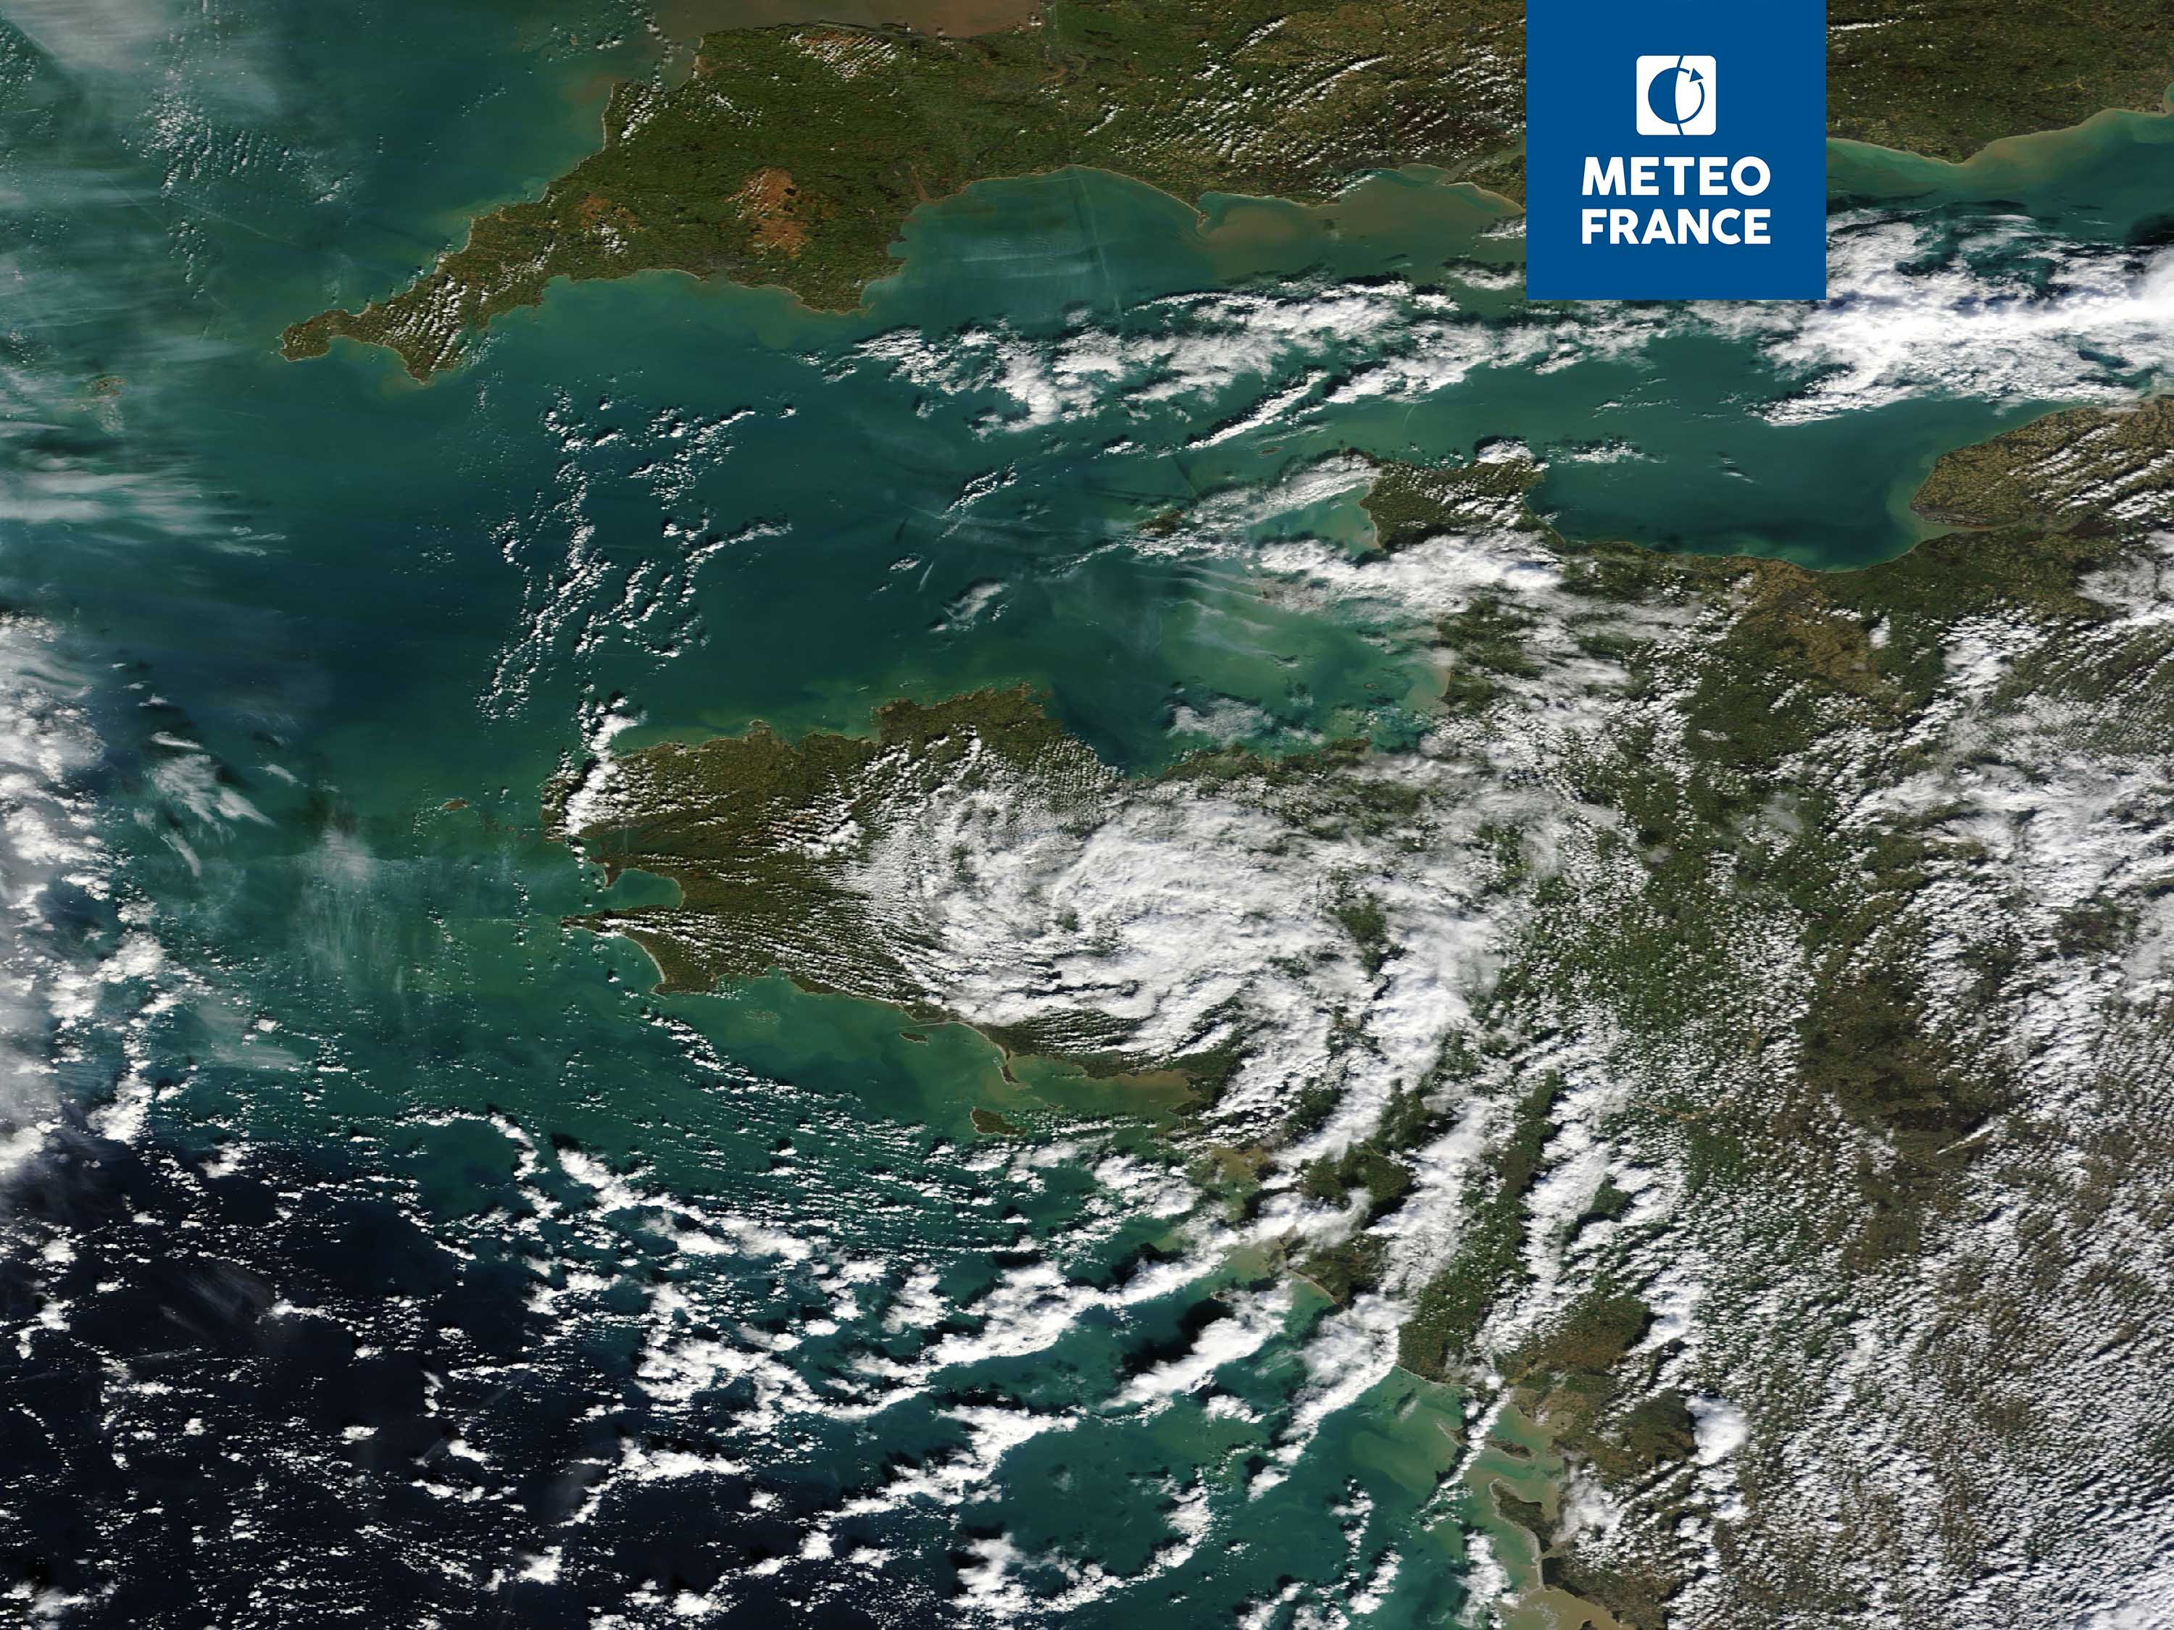
TERRA – 16th February 2014 at 11h20 UTC
Welcome to Lannion

