Slide 1
NWS Strategic Outcome: A Weather & Water-Ready Nation
Becoming a Weather-Ready Nation is about building community resiliency in the face of increasing vulnerability to extreme weather, water and climate events “Ready, Responsive, Resilient”
Requires NWS to produce:
Better forecasts and warnings
Consistent products and services
Actionable environmental intelligence
NWS needs to address the “last mile” that connects forecast to critical national, state and location decisions
Provide Impact-based Decision Support Services (IDSS)
Deliver through multiple and reliable dissemination pathways
Work with partners, including embedding NWS in Emergency Operations Centers and incorporating Social Sciences, to gain public’s needed response
We have 2800
WRN Ambassadors
Involves entire US Weather, Water and Climate Enterprise WORKING TOGETHER
to achieve national preparedness for weather, climate and water events
1

Slide 2
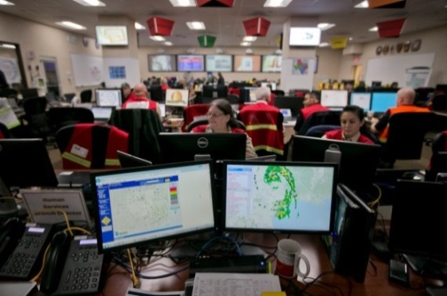
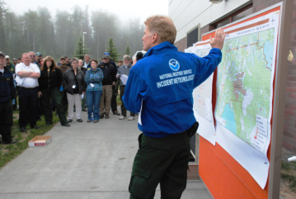
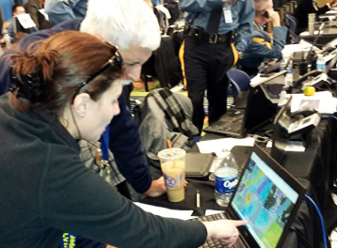
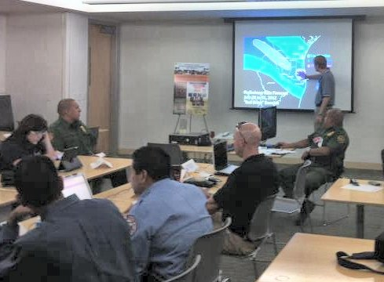
Realizing Intrinsic Value
Intrinsic Value is realized through providing
Impact-Based Decision Support Services (IDSS)
Generating forecasts
and warnings
Connecting those forecasts/warnings with impacts
=
IDSS
Practice, practice,
practice!
Trust
Embed
The best hydrometeorological forecasting in the world
Develop
relationships/ know partner needs
“Ready, Responsive, Resilient”
2
Notes:
Evolve – is the outcome of the national conversation
What does IDSS mean?

Slide 3
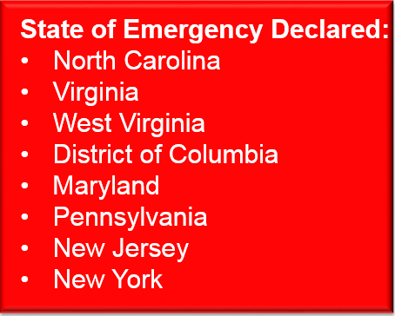
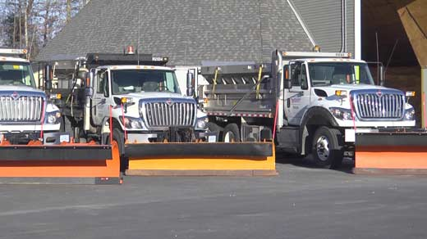
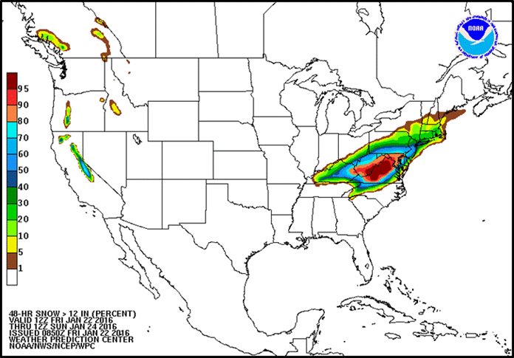
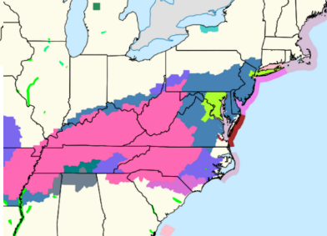
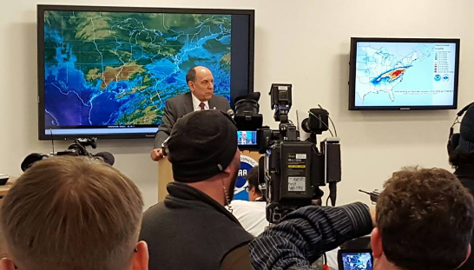
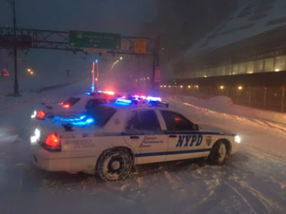
January 2016 Blizzard & Coastal Storm:
Connecting All of the Pieces
Jan 15 - 18
Jan 19
Jan 20
Jan 21
Jan 22
Medium Range products begin
identifying snowstorm threat for the end of next week
NWS offices begin briefing partners on potential storm
Confidence increasing
Partner Coordination/Briefings
Media interviews
Partner Coordination/ Briefings
Media interviews
Blizzard Watches
Issued
Fed./state/local govts make critical decisions before the snow begins
Blizzard Warnings Issued
1 pm: Press Briefing
Snow begins in the Mid-Atlantic
Snow forecast adjusted to include NYC in Blizzard Warning
Schools/Govt Close
Flights Canceled
Roads Closed

Slide 4
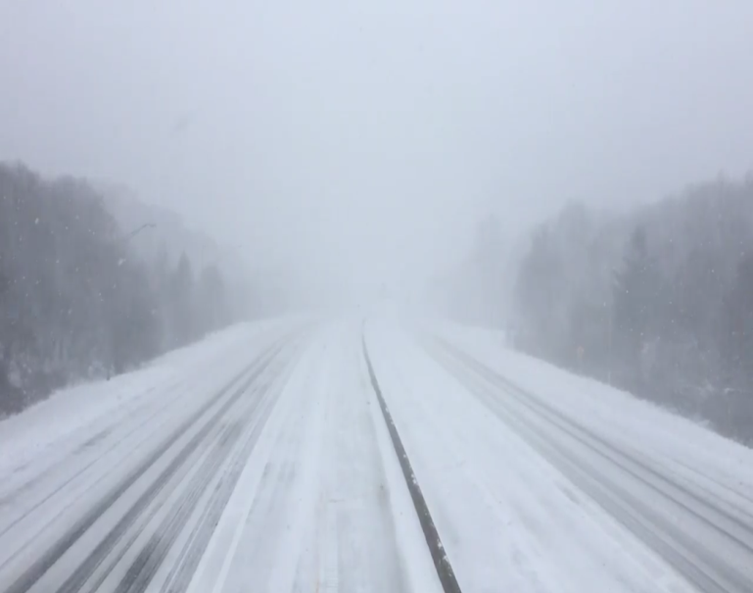
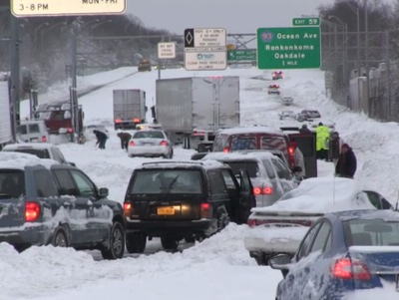
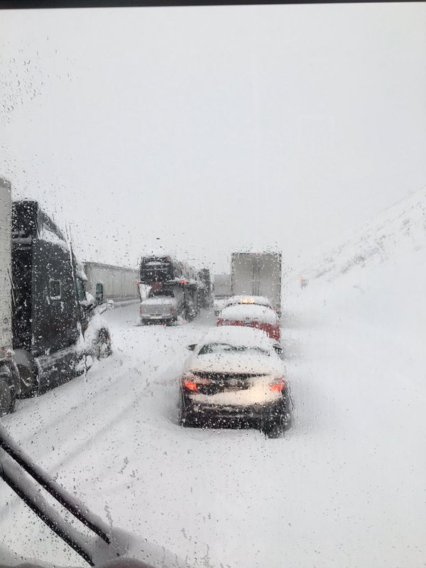
Connecting All the Pieces
2016 Snowstorm
2013 Snowstorm
Long Island Expressway
With NWS Decision Support
The Past
Pennsylvania Turnpike
Without NWS Decision Support

