Slide 1
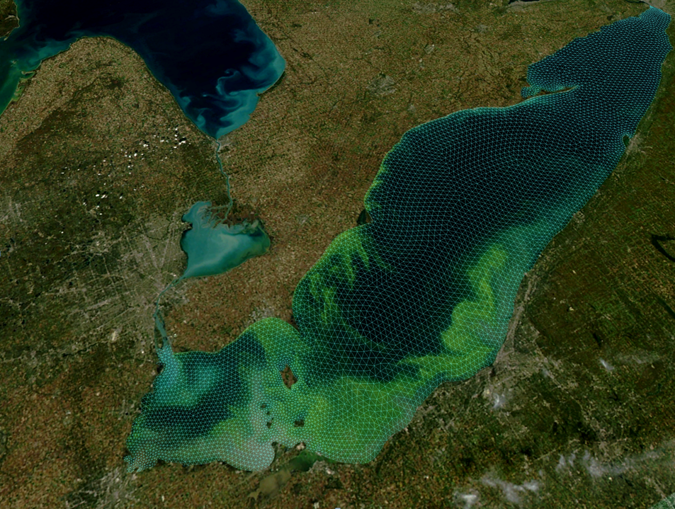

Next-Generation Forecasts of Hydrodynamics and Harmful Algal Blooms
in Lake Erie
Eric J. Anderson, Mark Rowe, Tim Davis, Hank Vanderploeg, Dave Fanslow
NOAA | Oceanic and Atmospheric Research
Great Lakes Environmental Research Laboratory
Notes:
Thank you, I’m glad to have the opportunity to present some recent work on next-generation forecast models for Lake Erie.
Although I’m speaking today, this presentation really represents the work of a large team from GLERL, the HABs team at NCCOS, and the team at CO-OPS.

Slide 2
Next-Generation GLOFS
Finite Volume Community Ocean Model (FVCOM)
unstructured mesh
sigma- and sigma-z coordinates
3D integral flux equations
similar to POM
Los Alamos Ice Model (CICE)
5 lakes FVCOM
30 m - 2 km grid
connecting channels
ice
Lake Erie FVCOM (LEOFS)
Michigan-Huron FVCOM (LMHOFS)
Lake Superior FVCOM
(LSOFS)
Lake Ontario FVCOM
(LOOFS)
Huron-Erie Corridor (HECOFS)

Slide 3
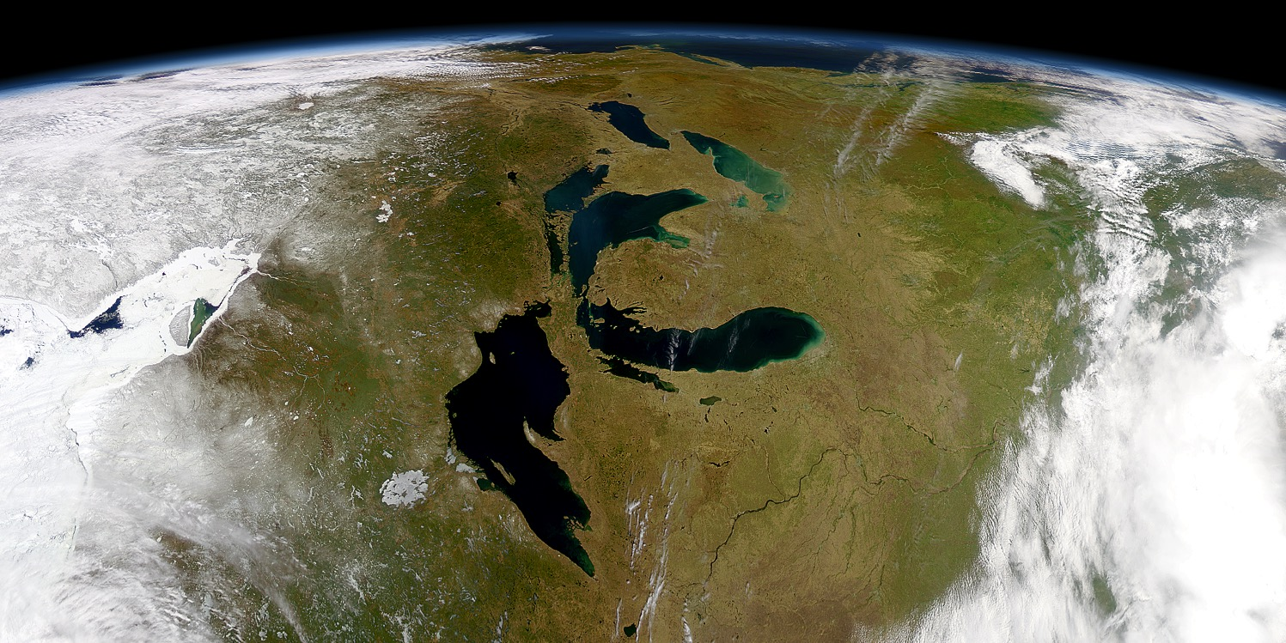
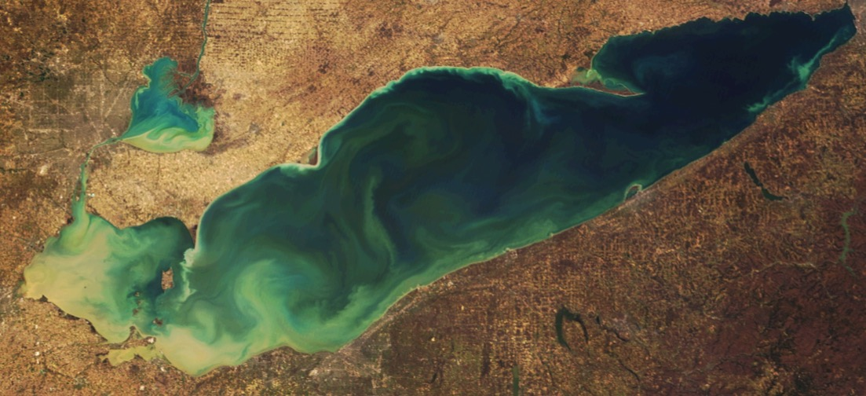
Great Lakes: 20% Earth’s surface freshwater
Lake Erie
Buffalo
Detroit
Erie
Public Drinking Water Intakes
Toledo
Cleveland
Notes:
Like any good Great Lakes scientist, I usually start by telling you how large the lakes are, seen here in a rotated view from space with Lake Superior at the bottom and Lake Erie toward the top.
Although the shallowest of the Great Lakes, it’s the most biological productive and serves a number of large cities in Detroit, Toledo, Cleveland, and Buffalo
As well as contains several public drinking water intakes found along the coastline.

Slide 4
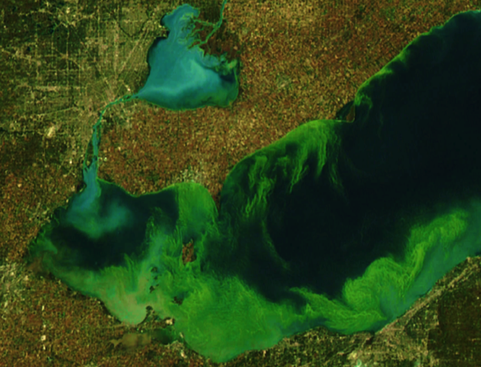
Harmful Algal Blooms (HABs) in Lake Erie
HAB
severity
Algal Blooms
1960
1970
1980
1990
2000
2010
Great Lakes Water Quality Agreement signed
Zebra mussels
Lake Erie
Notes:
Instead of focusing on spatial scale however, I’m going to give a very brief history of Lake Erie’s water quality and the need for accurate forecast products.
Going back to the mid 60’s and early 70’s, Erie was plagued by algae and water quality issues, which led to the GLWQA, an effort to reduce point sources of nutrients to the lake.
This approach worked, reducing blooms and improving water quality through the 80’s
However, around the late 1990’s, algal blooms began to worsen.
It’s worth noting that this roughly coincides with the introduction of the invasive zebra mussel, though changes in tributary discharge and other factors are potential contributors, and is still an active area of research.
Since the early 2000’s, we’ve seen a rise in HAB severity, including toxicity that sets this apart from the 60’s/70’s era, with 3 notable years that I’ll point out.

Slide 5
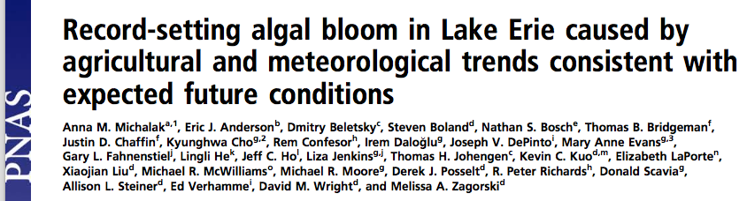
HABs in Lake Erie
2011
Largest Bloom in Lake Erie history!
Notes:
The first, in 2011, when the largest bloom ever recorded in Lake Erie occurred.
The image here showing peak bloom extent that summer.

Slide 6
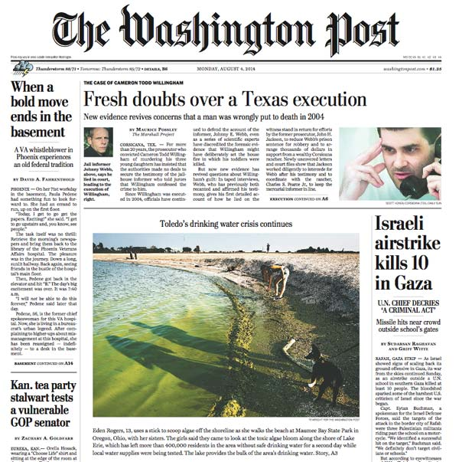
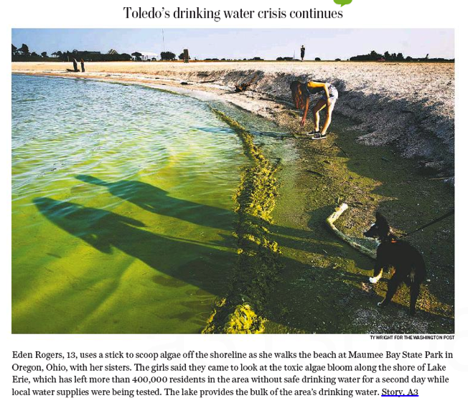
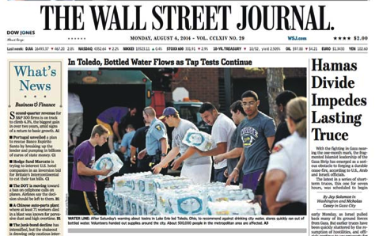
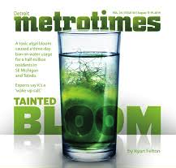
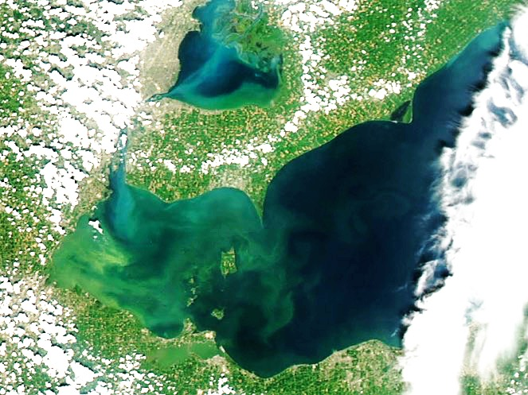
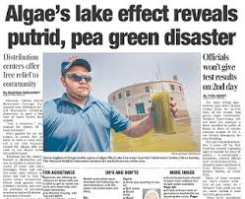
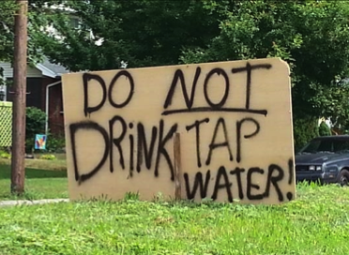
HABs in Lake Erie
Drinking water ban for 400,000 residents
Millions in economic impacts
2014
Notes:
Then in 2014, during the algal bloom outbreak, toxic water infiltrated the City of Toledo drinking water supply
During which 400,000 residents didn’t have access to city drinking water
And severe economic impacts were felt as well ($60million to Mill, $40 in ecosystem services), putting Erie in the national spotlight

Slide 7
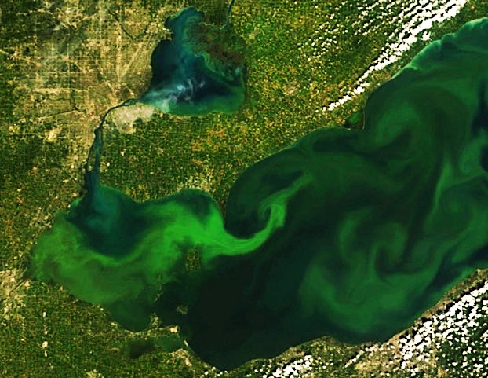
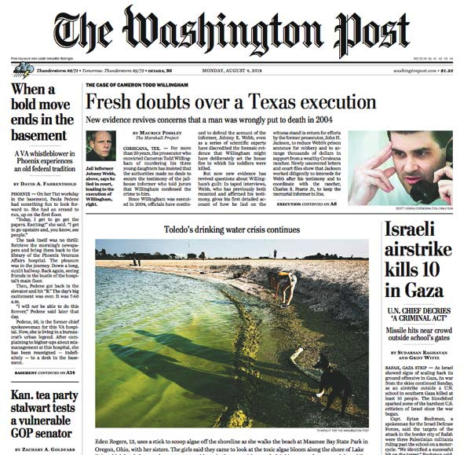
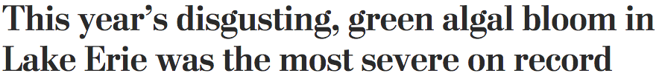
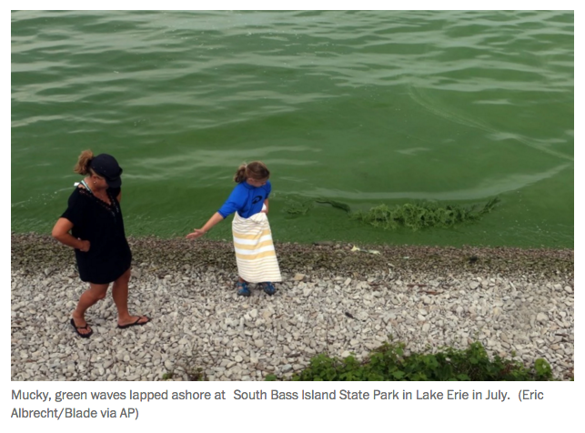
HABs in Lake Erie
Record broken for Lake Erie!
2015
Notes:
Then in just this past summer, 2015, the record for most severe bloom was broken again

Slide 8
How can we support the public?
Stakeholders
What’s needed?
Water Quality Agreement
Long-term trends in bloom severity
Years
Lake Managers
Nutrient Regulation
Coastal Managers
Seasonal forecast of bloom severity
Months
Water Treatment Plants
Drinking Water Intakes
Next-Generation
Short-term forecasts of extent/intensity
Days
Boaters
Fishing
Beach goers
Notes:
With such a devastating impact on drinking water safety and the economy that relies on Lake Erie as a result of these blooms, the public has a range of forecast needs from multi-year lake management, to seasonal severity, to short-term forecasts.
And it’s on this short-term scale, specifically 5-days, that I’ll present our next-generation forecast tools

Slide 9
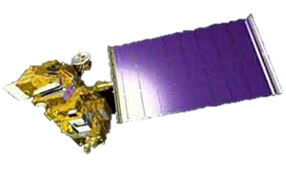

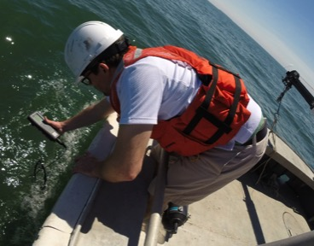
What’s our current capability?
Satellite detection
HAB Environmental Intelligence:
Where is it now?
Sampling & real-time monitoring stations
Flyover detection
2D surface concentration
Notes:
Short-term forecasts consist of 2 components, the first is the current status of the bloom, or “Where is it now?”
To answer this question, we use a combination observing and remote sensing techniques.
Such as in-situ water sampling and real-time monitoring to extract HAB concentration and toxicity at several sites in the western basin.
Daily satellite imagery to get surface concentrations and HAB extent
And we’re starting to use hyperspectral imagery from flyovers to supplement spatial extent and concentrations, particularly useful on cloudy days
In combination, these provide our best understanding of the HAB extent, concentration, and toxicity at the present time

Slide 10
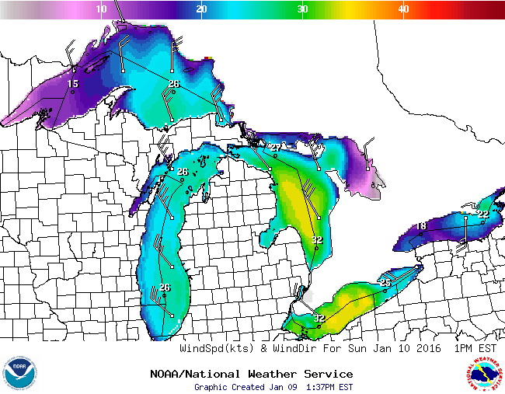
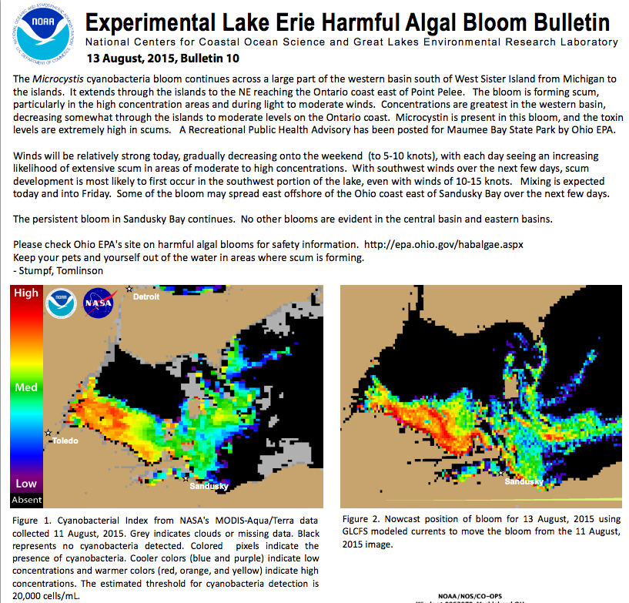

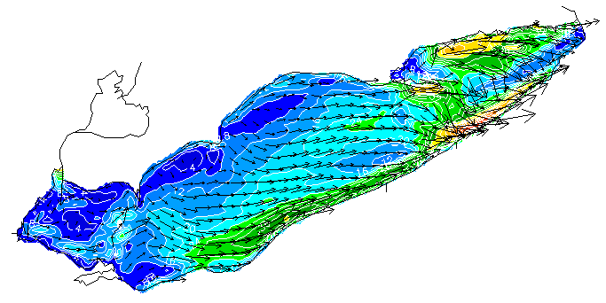
What’s our current capability?
Weather Forecast
NWS/NDFD
HAB Environmental Intelligence:
Where is it going?
Experimental Lake Erie HAB Bulletin
2D Currents
OAR/GLERL
NOS/NCCOS
Notes:
But what’s going to happen over the next few days? This is the 2nd component of the short-term forecast
Using forecasted meteorology, primarily the over-lake wind conditions, and the forecasted currents in the lake, we can take our can take our current state of the HAB and forecast it’s trajectory and concentration over the next 120 hours.
This is what’s currently being done by NCCOS and transitioning to CO-OPS, known as the Lake Erie HAB Bulletin, which is produced 2x per week during the bloom season.

Slide 11
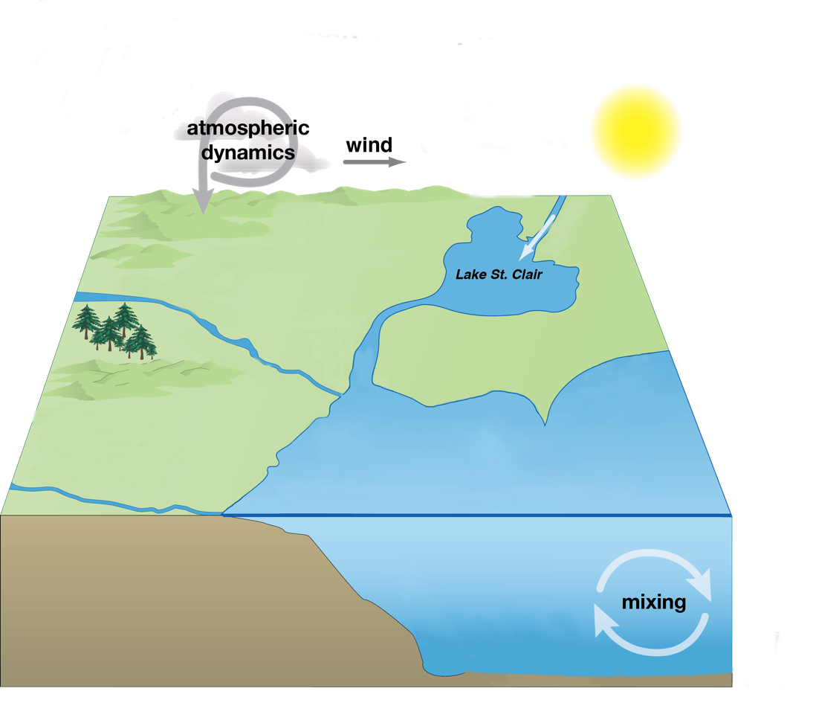

Next-Generation Modeling
Where is the HAB now?
Where will it be tomorrow?
  5 days from now?
  What is the concentration?
Below the surface
  Will it form a scum?
  Will it mix to the bottom?
Notes:
Now, this helps us answer the questions, where is the HAB now and where will it go, providing vital information to decision makers like water intake managers and health officials.
But we’re still limited to providing primarily surface information of the algal bloom
Although helpful, there is still a need to dig below the surface of the lake and understand the 3D structure (or total biomass) of the bloom and whether we expect the HAB to float to the surface and form a scum or whether it will be mixed throughout the water column.
This way we can tell water intake operators not only the likelihood of the HAB floating over their intake in the next few days, but also if we expect it to mix down to the depth of the intake itself.
And this is where our next-generation models come in…how do we improve our current capability to provide sub-surface HAB forecasts?

Slide 12
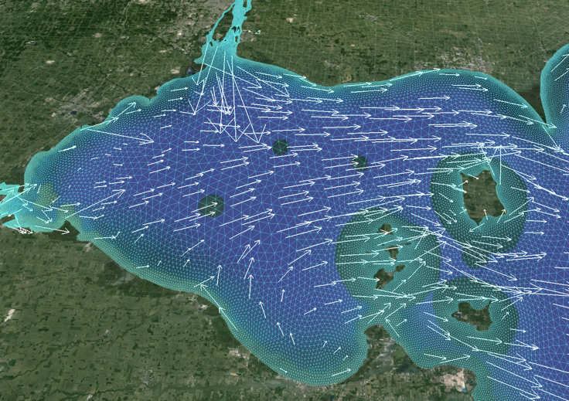
Next-Generation Modeling
How do we improve our short-term HAB forecast?
Improve real-time environmental forecasts
  Lake Erie Operational Forecast System (LEOFS)
Develop 3D HAB particle model
  FVCOM HAB tracker
Next-Generation
Lake Erie Operational Forecasting System
NOS/CO-OPS
3D currents, temperature
Mixing
Fine-scale coastal resolution
Notes:
We’re approaching this in two ways:
The first is to improve our understanding and prediction of the currents and mixing in the lake
Through partnership between GLERL, CO-OPS, and CSDL, we’re upgrading the NOAA Lake Erie Operational Forecast System (LEOFS)
The next-generation of this model provides improved 3D currents and mixing, as well as finer-scale coastal resolution that can provide better tracking of the HAB
This model is actually transitioning to operations at CO-OPS next month!
Second, along with CILER and NCCOS, we’re developing a 3D HAB forecast model that uses an FVCOM-based Lagrangian particle model, that we’ve dubbed the “HAB Tracker”
This model can track the buoyant migration of the algae, as the form as scum on the surface
As well as when wind conditions mix them down into the water column
Or even incorporate simple parameterizations of growth to capture early season dynamics.

