Slide 1
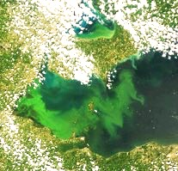
HAB Particle Model
HAB
Intensity
Location
=
Initial
Location
+
+
+
Currents
Mixing
Buoyancy
Field / Laboratory
Hydrodynamic Model
Field / Laboratory
Remote Sensing
Hydrodynamic Model
Remote Sensing
MODIS
HAB Detection
NOS/NCCOS
Notes:
This HAB model relies on 4 components: the initial location/concentration, the 3D currents, turbulent mixing, and buoyancy of the algal colonies
Which are provided by 3 methods
The first, the remote sensing piece, provided by NCCOS, gives the surface extent and concentration from satellite imagery, as mentioned earlier.

Slide 2
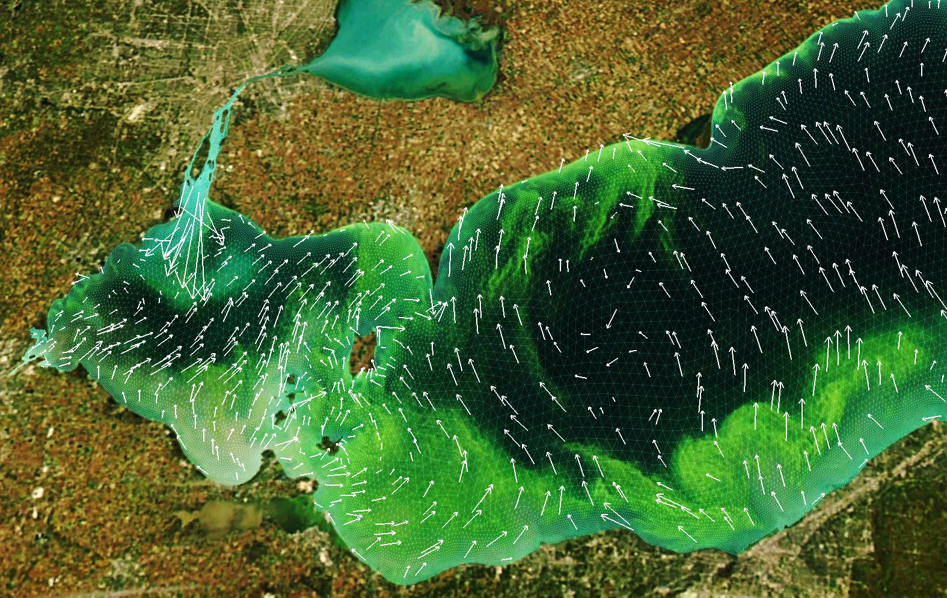
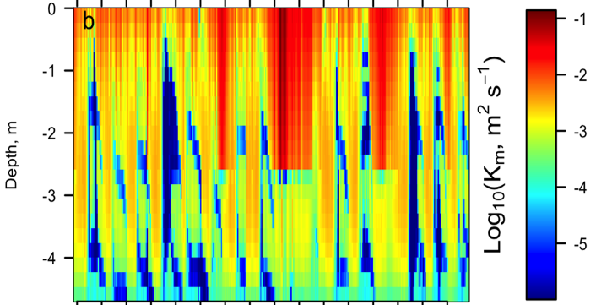
HAB Particle Model
HAB
Intensity
Location
=
Initial
Location
+
+
+
Currents
Mixing
Buoyancy
Remote Sensing
Hydrodynamic Model
Field / Laboratory
LEOFS - currents
Turbulent Diffusivity (Mixing)
0
-1
-1
-2
-2
-3
Depth (m)
-3
-4
-4
-5
Time (Hours)
Notes:
The 2nd and 3rd components are provided by our hydrodynamic model (LEOFS), which is driven by over-lake meteorology such as the NWS HRRR And NDFD products.
These simulations gives us not only the 3D current field, but also the 3D turbulent diffusivity, or mixing in the lake, which will come into play in a couple of slides.

Slide 3
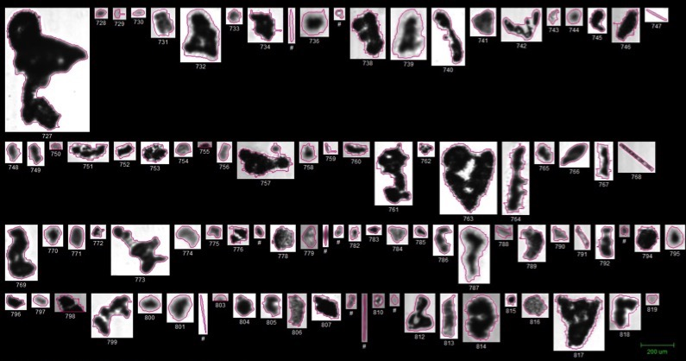
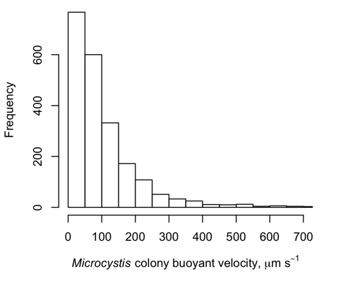
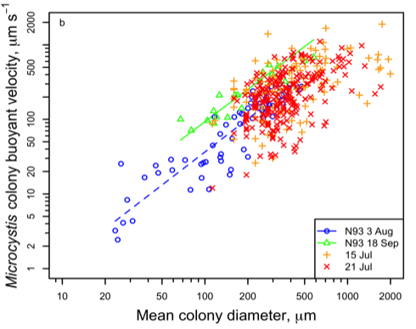
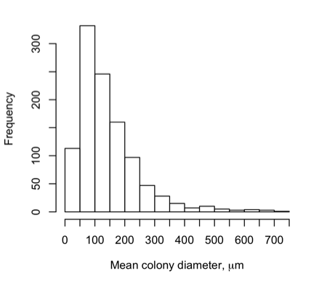
HAB Particle Model
HAB
Intensity
Location
=
Initial
Location
+
+
+
Currents
Mixing
Buoyancy
Hydrodynamic Model
Field / Laboratory
Remote Sensing
Freq.
Freq.
Buoyant velocity
(μm s⁻¹)
Buoyant velocity
(μm s⁻¹)
Mean colony diameter (μm)
Mean colony diameter (μm)
Microcystis
Notes:
The last component actually comes from field collection and lab analysis
Where we take collected algea (microcystis) samples from Lake Erie, and measure their size in the laboratory
This gives us an idea of the colony size distribution in the lake.
Then if we take these samples and put them into something called a FlowCam, we can measure their buoyant velocities, or how quick they float to the surface relative to their size
As a result, we get a buoyant velocity distribution that can be applied in the model to represent how the bloom will float in the water.

Slide 4
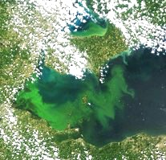
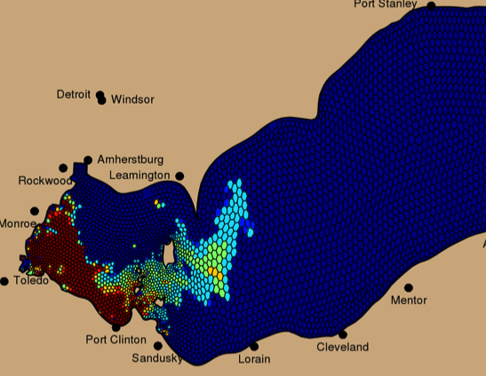
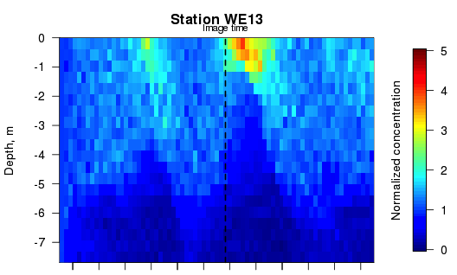
Model Starting Conditions
MODIS
HAB Detection
How to translate surface (2D) scum into 3D bloom?
NOS/NCCOS
Vertical Distribution
Surface HAB particles
Depth (m)
Mixed Layer Depth
t₀
(Present Time)
Notes:
But how do we initialize the model below the surface?
We the know the initial location/concentration of the bloom on the surface from remote sensing, but since a big effort of the next-generation model is to resolve the 3D structure of the bloom, we have to be careful with how we handle the subsurface conditions.
To do this, first we take the surface concentration at each pixel in the image and convert that to virtual HAB particles, which is exactly what’s done in the current model with the HAB Bulletin, but again that only covers the surface.
For the depth-based or water column distribution, we use the output from the hydrodynamic model to define what’s called the “surface mixed layer”.
We take the depth of this “mixed layer” at the time of the satellite image from each pixel, and make the assumption that the HAB concentration seen at the surface during this time is uniformly distributed in this layer, meaning it’s the same concentration from the surface down to this depth.
This can end up giving us a surface scum, a completely mixed water column, or something in between.
But we’re not done yet, because what happens if it’s a cloudy day and there is missing data in the satellite data?
In this case, we use the previous model simulation to “fill in” this missing information, placing the previous HAB concentration in for the missing info.
And now we have a 3D representation of the bloom and we’re ready to make a forecast.

Slide 5
Model Initialization
How to translate surface (2D) scum into 3D bloom?
Vertical Distribution
Depth (m)
Mixed Layer Depth
t₀
(Present Time)

Slide 6
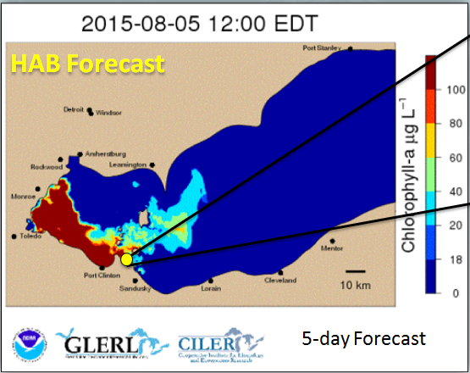
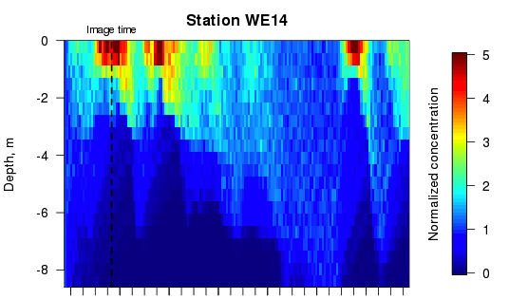
Short-term HAB Forecast
Vertical Distribution
Image time
0
-2
-4
Depth (m)
-6
-8
1
2
3
4
5
Forecast Day
(Animation Available Upon Request)
Notes:
You’re looking at an example of the HAB Tracker forecast from this past summer (2015) where the bloom in the western basin of Lake Erie is actually being transported toward the City of Toledo, and up the shoreline in a Clock-wise manner, bringing it very close to water intakes that surround the western basin.
With model back-filling technique, we can run this forecast as often as the hydrodynamics are forecasted, providing updated information as a result of the meteorology and currents, even if we don’t have updated satellite imagery.
But also, since it’s a 3D model, we can also dive below the surface at any point and see how the HAB is being mixed into the water column or forming a scum over the next 5 days
Now, it’s always fun to watch these animations, but how well does the model actually do? Is it forecasting reality?

Slide 7
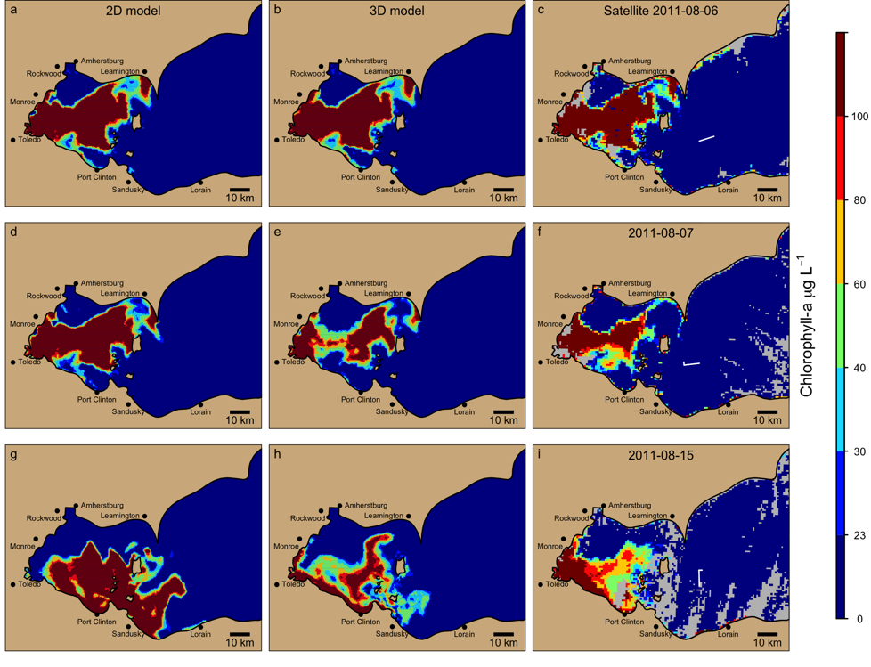




Forecast Validation
Current 2D Capability
Next-Generation
3D Forecast
Remote Sensing
Observations
Aug 6, 2011
100
80
60
Aug 7, 2011
Chlorophyll-a μg L⁻¹
40
30
Aug 15, 2011
20
0
Notes:
For the sake of time, I will show a representative case from August 2011. We’ve gone back and run forecasts for 2011 based on MERIS satellite data.
In this plot, you’ll see the left column is the current 2D particle model, the middle column is the next-generation 3D model, and the right column is the satellite-derived HAB
The top row is our initialization, so each model uses the satellite to get it’s starting conditions, with model-filling where need be.
Then we can look at the forecast progression 1 Day later (the next satellite image) and then 8 days later on August 15
You can see even by the next day, as the surface concentration of the bloom dissipates in the observation, the 3D model is tracking this well.
And by August 15, 8 days later, we have very different results for the 2D and 3D cases.

Slide 8
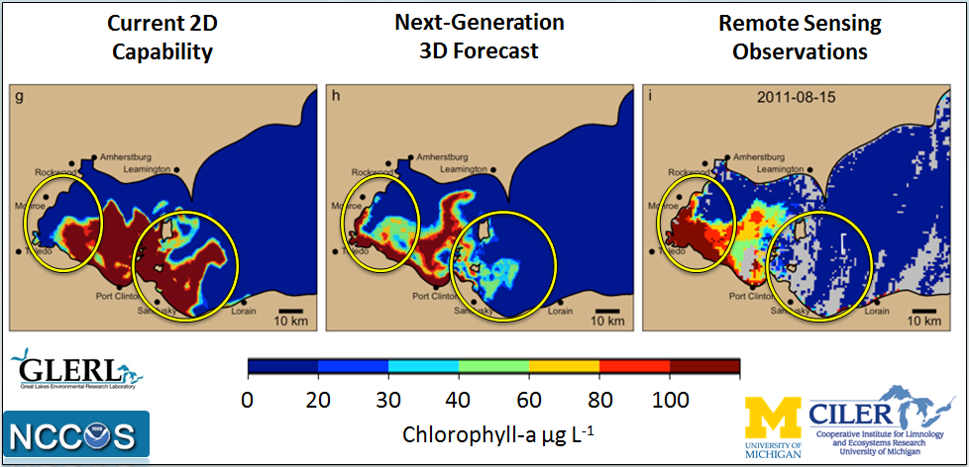
Forecast Validation
Notes:
If I zoom in on this bottom row, 9 days after the model start, we see both models have discrepancies as compared to the satellite image.
However, we see the 2D model pulls away from the western shoreline and out of Maumee Bay, but that’s not the case in the 3D model or the observations.
In fact, this is something we see that’s pretty consistent across time with the 2D vs 3D models
This is critical considering that drinking water intakes are very close the shoreline.
Furthermore, we also the 2D is the only one to transport the HAB into eastward past these islands and into the central basin, something that would raise a red flag for decision makers interested in this section of the coastline.
However, the observations and for the most part the 3D model keep the bloom contained in this western basin.

Slide 9
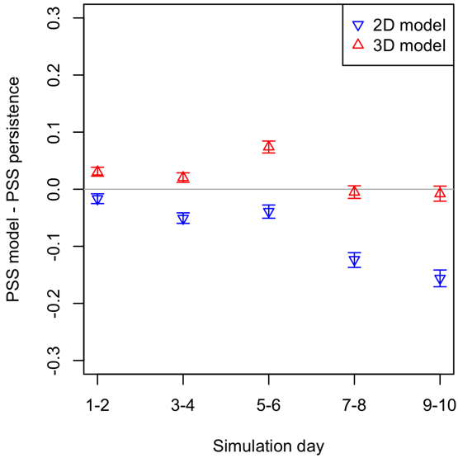
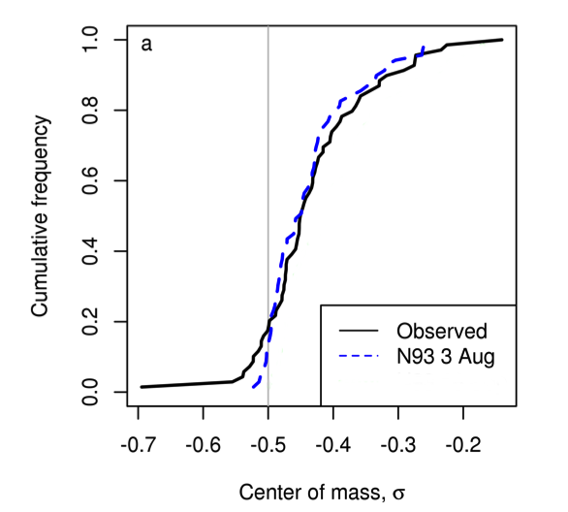
Forecast Validation
Surface Concentration
Existing 2D model
0.3
Next-generation 3D model
0.2
0.1
Vertical Distribution
0.0
Bias = -0.01
RMSD = 0.08
Pierce Skill Score (PSS)
model vs. persistence
-0.1
-0.2
Cumulative Frequency
-0.3
1-2
3-4
5-6
7-8
9-10
Observed
Forecast Day
Model
Center of Mass (σ)
3D model with buoyancy improves skill out to 10 days!
Sub-surface concentrations follow observed conditions
Notes:
If we look at how the models do over all hindcasts, we can clearly see a difference.
Here I’m showing model skill vs the persistence model (the last good image) as a function of forecast day.
The 3D model, shown in red, out performs the 2D model over the entire 10-day period
And it also does an excellent job at matching sub-surface conditions.
Here we plot the vertical distribution of the HAB, taken from measurements in the field, as compared with the model.
Based on the data we have, it seems vertical mixing in the model, which includes this rough approximation of biology through buoyant migration, reasonably captures what we see in the lake
Remember, this is a critical piece for informing drinking water treatment plants about HAB conditions that they might experience

Slide 10
Conclusions
Next-generation Great Lakes Operation Forecast System (GLOFS)
  Improvements in 3D water temperature, currents
    Transition to FVCOM
    Higher coastal resolution
    Improved over-water meteorology (3-km data-assimilated HRRR model)
  Lake Erie FVCOM is operational this month
  Lake Michigan-Huron is next (2018)
  Complete upgrade to GLOFS by 2021

Slide 11
Conclusions
Improvements to short-term HAB forecasting
  HAB particle model development
    3D model & vertical mixing scheme
      Better surface and coastal concentrations
    Microcystis buoyant velocity improves scum/mixing
Next-gen models improve over-water meteorology and circulation
    Critical for bloom transport, toxicity, hypoxia
    Moving toward Cleveland or Ontario?
    Need to adjust treatment or restrict drinking water
Future of forecasting
  Can growth dynamics improve short-term forecasts?
  How do we forecast toxicity information?
  Next-steps toward a 3D biophysical model
Notes:
So, we’re does this leave us.
We’re seeing improvements to short-term HAB forecasting thanks to a number of NOAA scientists
Both through upgrade of the Lake Erie hydrodynamic model, as well as through the development of a next-generation 3D HAB model
Where both better physics, in the form of currents and mixing, and some biology, via buoyant velocity, yields forecast improvement
But where do we go from here?
I brought it up earlier, but we’re still working on understanding and incorporating HAB growth into our models.
We’re also trying to understand an extremely important component, which is toxicity, when the bloom will turn toxic?
And finally, progression toward a 3D biophysical model, that can better represent the biology and water quality, and aid in bloom initiation forecasting

Slide 12
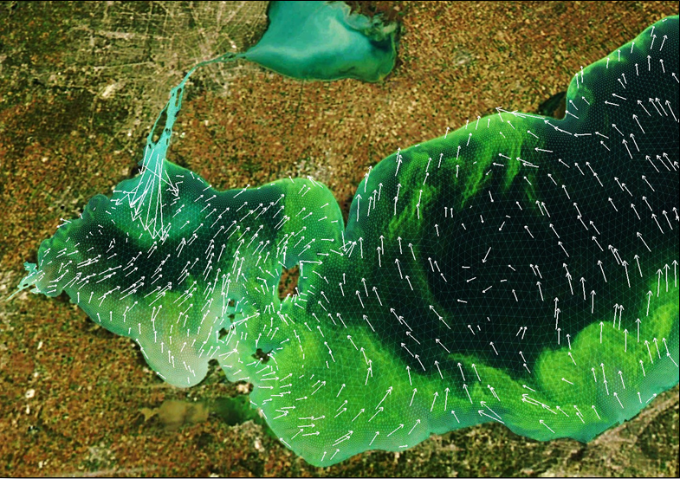
Questions?
Notes:
Thank you and I’ll take any questions!

