Slide 1
The Canadian Ice Service and Support to Mariners
Scott Weese
Senior Ice Forecaster
Meteorological Service of Canada
4 May 2016

Slide 2
Contents
Who We Are
Products
Main Sources of Data
Iceberg Program
Community Support
MetAreas
Climate Data
Long Range Program
Special Products
ISTOP

Slide 3
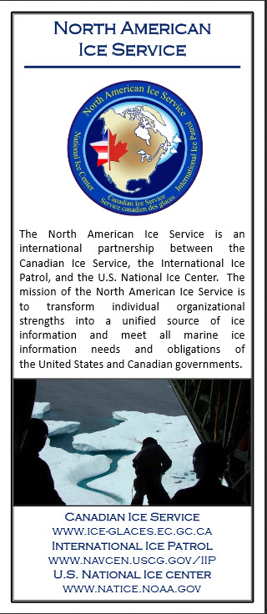
Who We Are
Our Mission
At the Canadian Ice Service, our mission is to provide the most timely and accurate information about ice in Canada's navigable waters. In support of this, our two main objectives are:
To ensure the safety of Canadians, their property and their environment by warning them of hazardous ice conditions in navigable Canadian waters.
To provide present and future generations of Canadians with sufficient knowledge about their ice environment, in order to support sound environmental policies.
We are a division of the Meteorological Service of Canada and are located in Ottawa, Ontario.
We are a member of the
North American Ice Services
a partnership between the Canadian Ice Service, the United States' National/Naval Ice Center, and the United States Coast Guard's International Ice Patrol
International Ice charting Working Group / Expert Team on Sea Ice
International network of sea ice experts

Slide 4
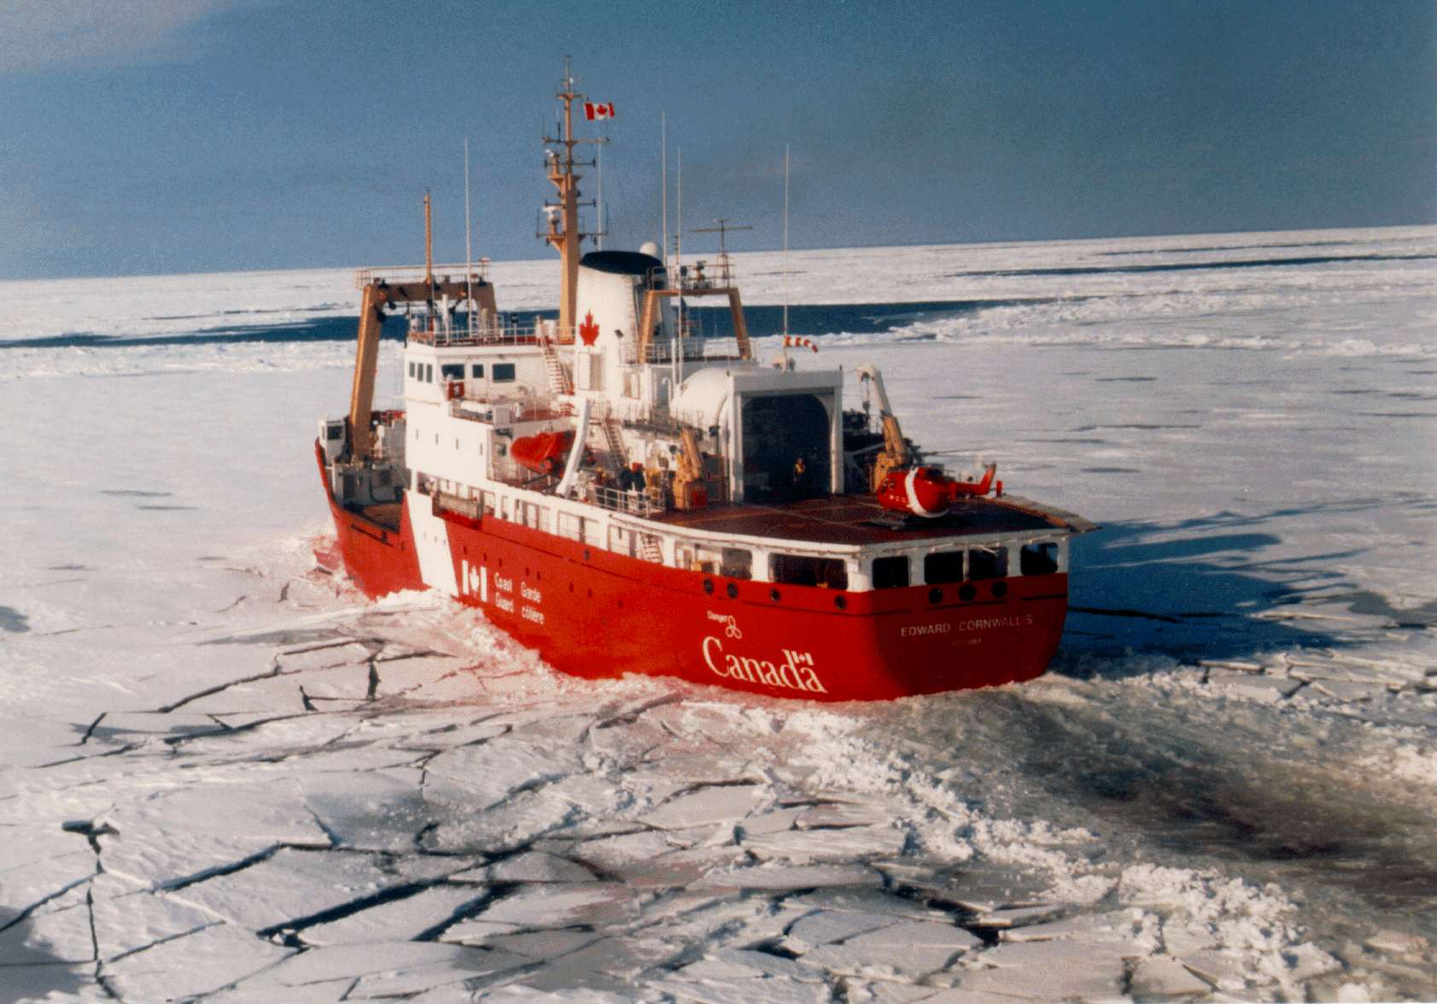
What We Do
Operational Services:
Analyse satellite imagery
Forecast sea ice and lake ice
Forecast icebergs
Respond to media requests
Monitor oceans for oil spills
Ice reconnaissance from ships and aircraft
Office contains:
Image analysts
Meteorologists
Ice Service Specialists (co-located with Canadian Coast Guard and as observers on ships/aircraft)

Slide 5
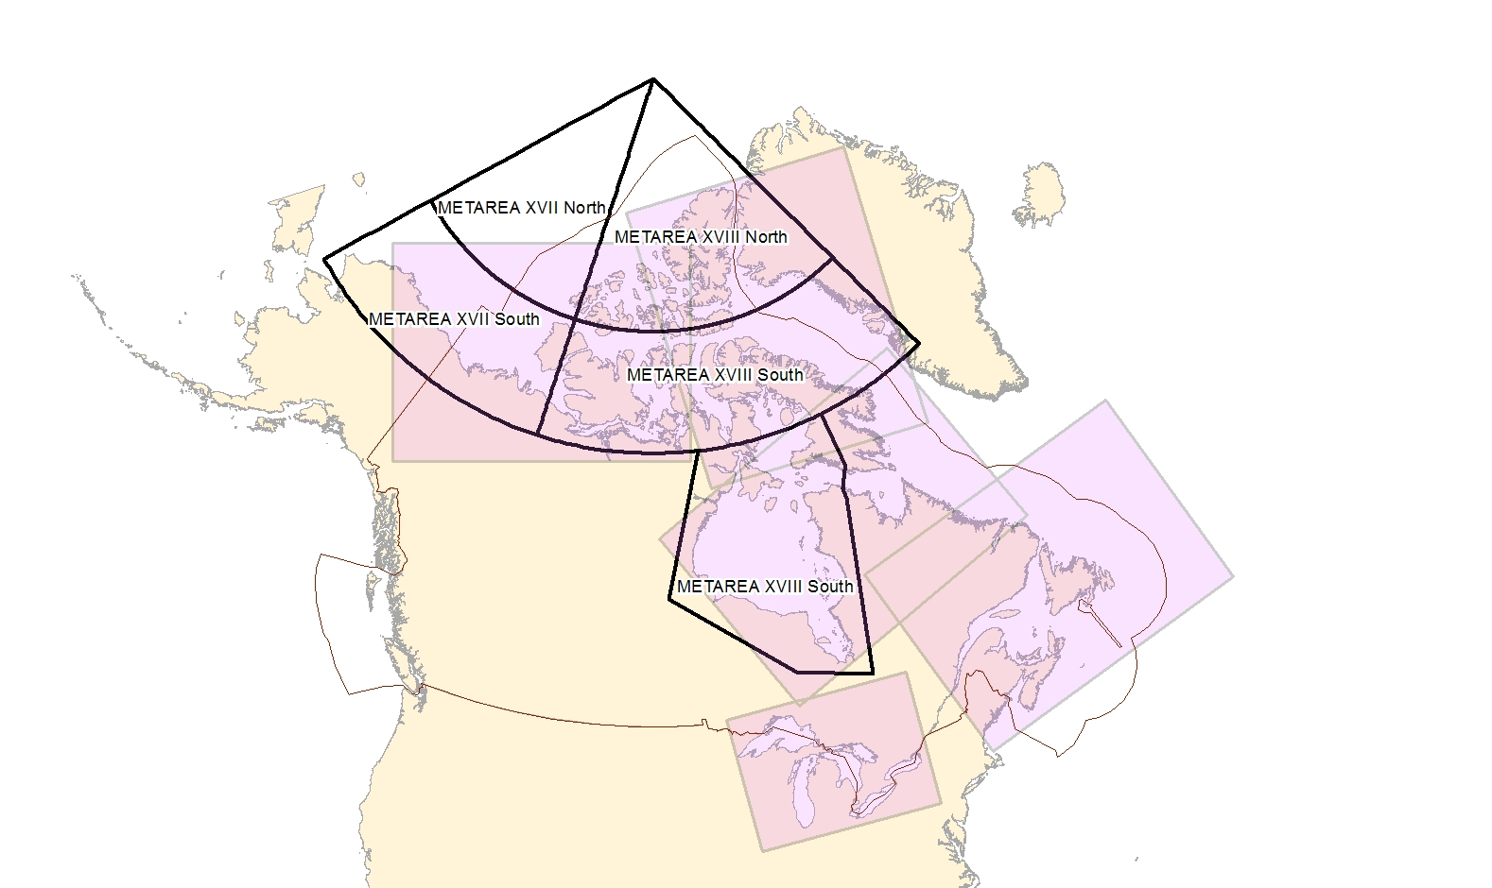
Area of Responsibility
140 Inland lakes
St Lawrence Seaway
Notes:
Wide geographic area from Alaskan waters to the East Coast of Canada
Our approach is seasonally driven as we focus on regions with marine activity

Slide 6
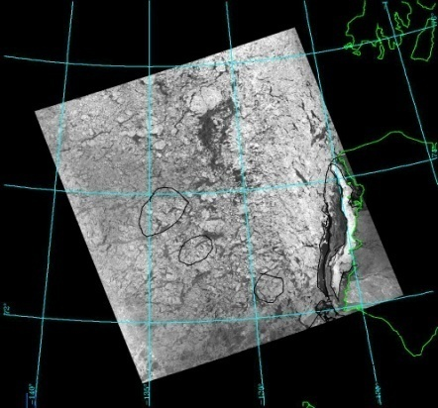
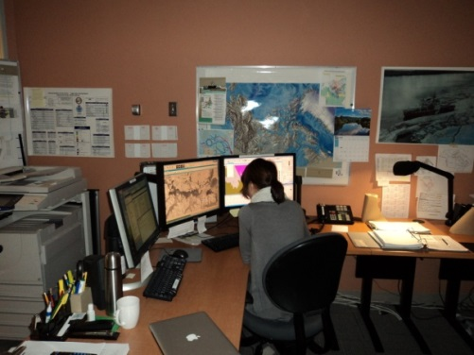
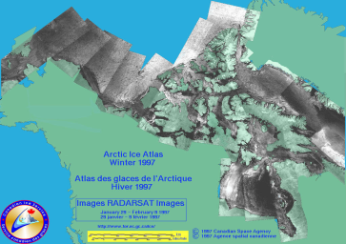
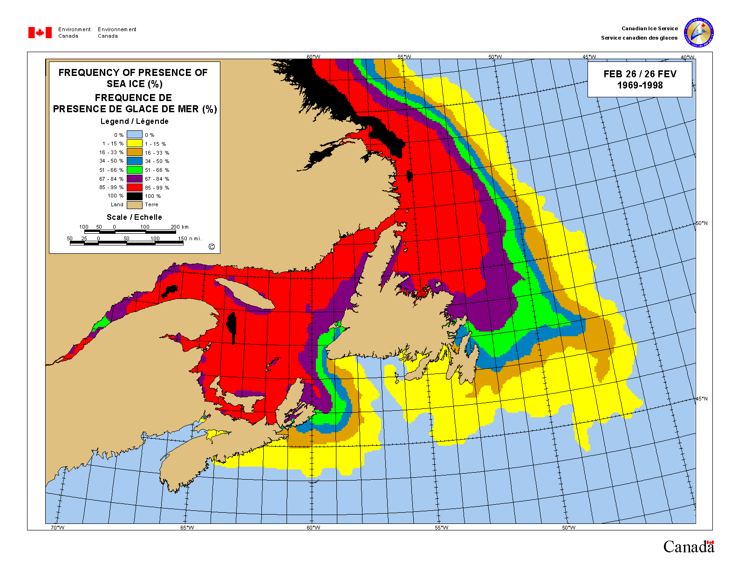
Variety of Products
Charts
Satellite analyses
Daily
Weekly
Climatology
Ice Atlases
Normals / Extremes
Text Products
Ice hazard warnings
30-day forecasts
Seasonal Outlooks
Dissemination
Product Delivery System
FICN17 CWIS 161345 Ice forecasts for the Gulf of St. Lawrence issued by Environment Canada at 10:00 a.m. EDT Monday 16 January 2016 for today tonight and Tuesday.
.
Notes:
- Mention PDS here, how it works

Slide 7
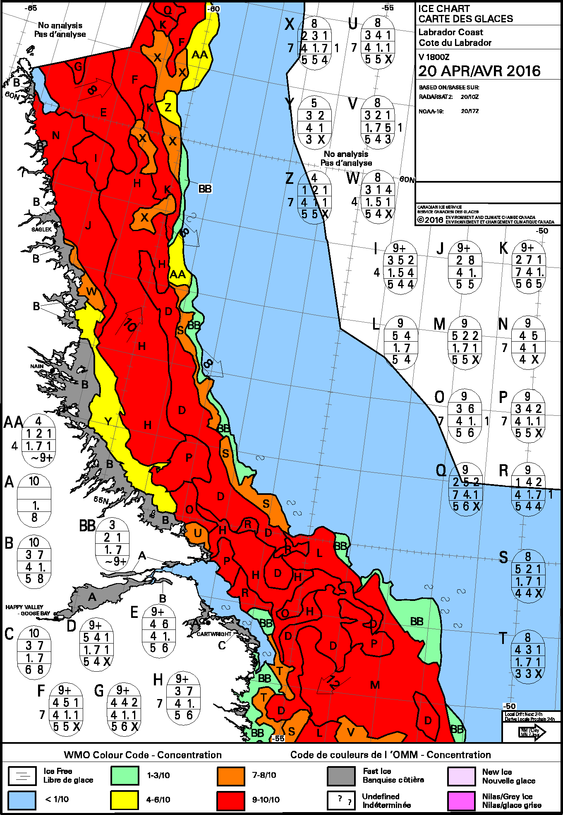
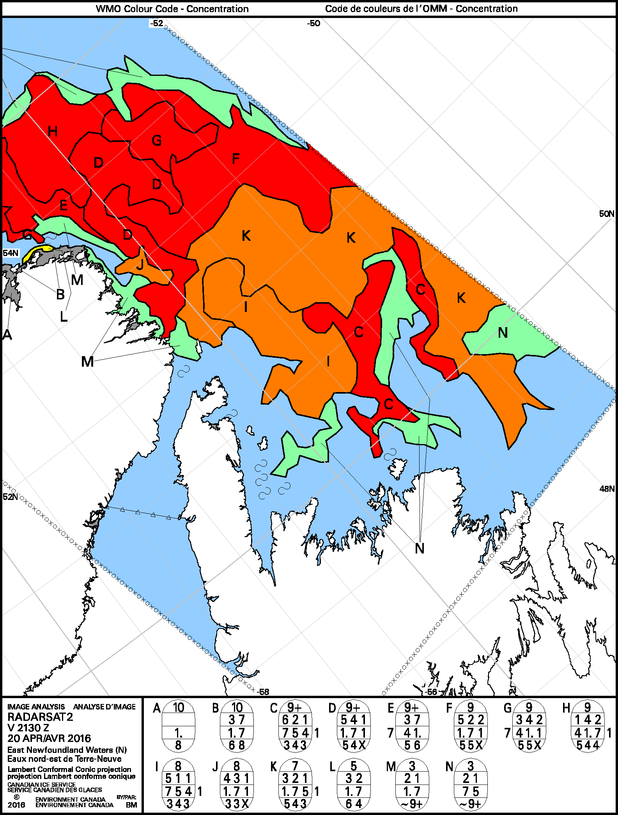
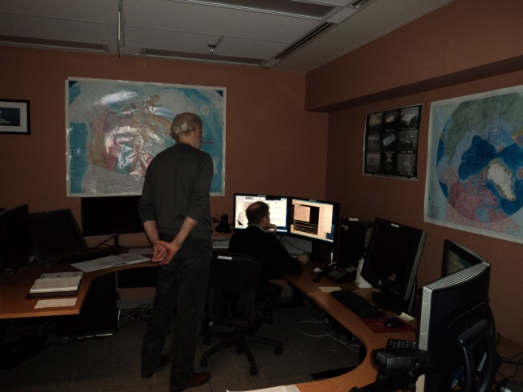
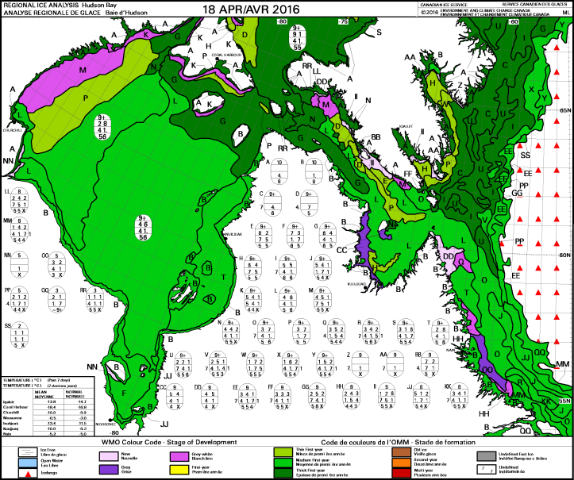
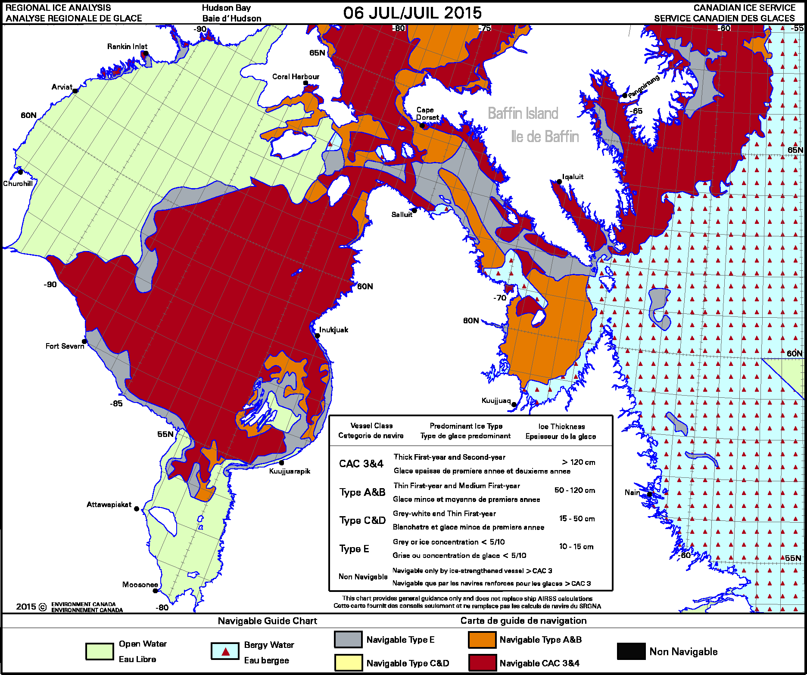
Ice Charting
Notes:
Talk about ISIS/ArcEdit and Polaris

Slide 8
Sources of Data
Satellite:
SAR
Radarsat-2, Sentinel-1A
Visual
NPP-VIIRS, MODIS, NOAA-geostationary, NOAA-polar orbiting.
Microwave
AMSR2
Flights
Ship observations
Notes:
Dash 8 CFJ part of NASP (National Aerial Surveillance Program) and Dash 7 CFR for recos
Ship obs come from Coast Guard, industry and pleasure craft

Slide 9
Types of imagery
Notes:
3 images –
VIIRS (NIR) 375m resolution
Radarsat-2 – 100m
Sentinel-1a – 40m

Slide 10
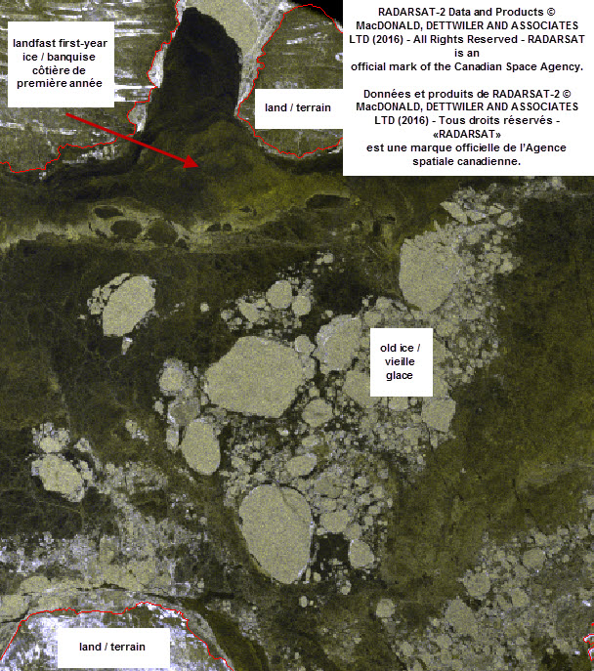
Notes:
3 different radarsat-2 images.
New (some grey) in the Estuary of the St. Lawrence (top left).
Fast ice – first-year and old ice – Lancaster/Barrow.
Grey ice – Amundsen gulf.
Synthetic aperture radar
ScanSAR Wide beam mode – 500km imaging width, 100m resolution. Smaller scale images can be ordered for specific purposes
Advantages
Images through clouds
Floe detection
Ice type detection (including new/thin ice)
Surface roughness.
High resolution

Slide 11
Visual and Infrared - VIIRS
Imaging width - 3000 km
Resolution ~ 375 m.
Advantage:
Day/night bands designed to image under nocturnal lunar illumination
Disadvantage:
clouds
lower resolution
Notes:
VIIRS nighttime mode along Labrador coast.
Discuss enhancement, canned from science

Slide 12
NOAA – polar orbiting - AVHRR
Raw 5-band imagery
Enhanced
Notes:
Resolution ~1 km. Enhancement is done on per image basis in operations. Data scaling and enhancement are possible to determine ice vs cloud.

Slide 13
Microwave – AMSR2 (89 GHz)
Imaging width - 1450m
Resolution ~ 6km.
Advantage: full daily coverage
Allows definition of thicker/thinner ice types

Slide 14
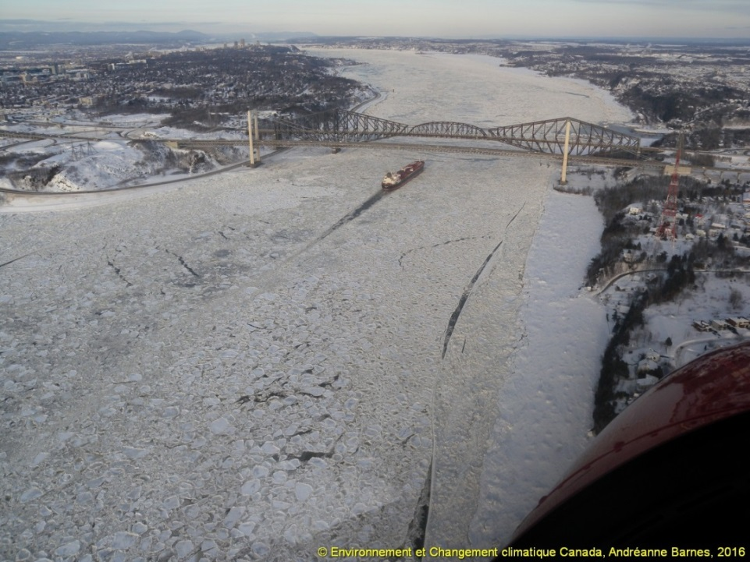
Observations
- Ship observations
- Ice flight charts
- Aerial photos
Vessel's position : 48 57.2 N 068 02.0 W
Course : 252 (T)
Speed : 11.9 kts
Ice conditions : 6/10 New ice
Freezing spray : No
Wind direction and speed : WSW 30 knots
Air temperature : minus 10°C
Notes:
Helicopter observation chart from ISS (top right).
Aerial photo taken from Helicopter patrol – near Quebec City (bottom left).
Ship observation – received by email (bottom right)

Slide 15
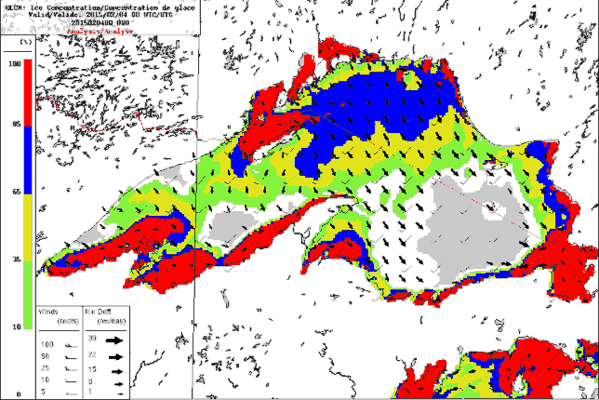
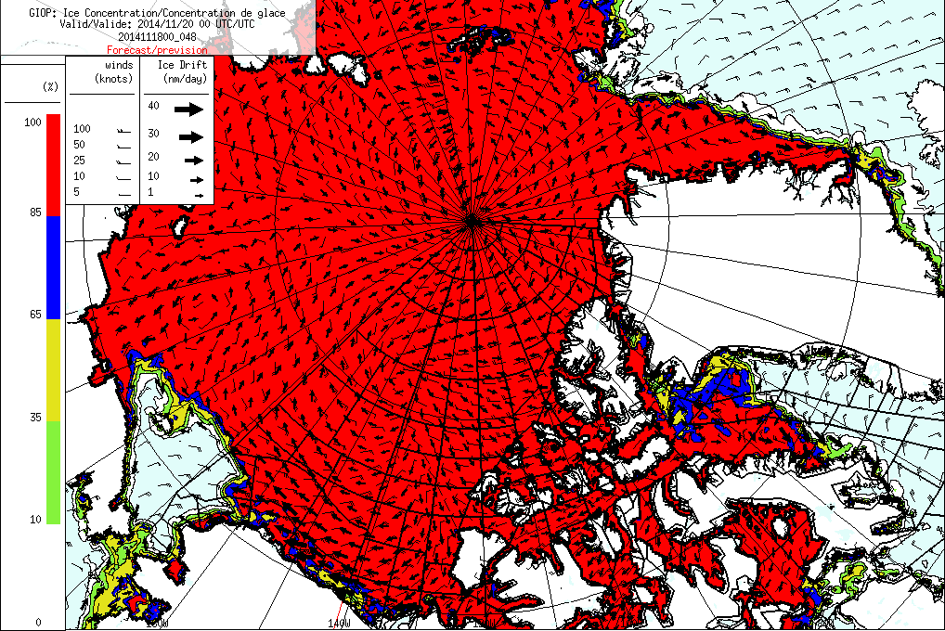
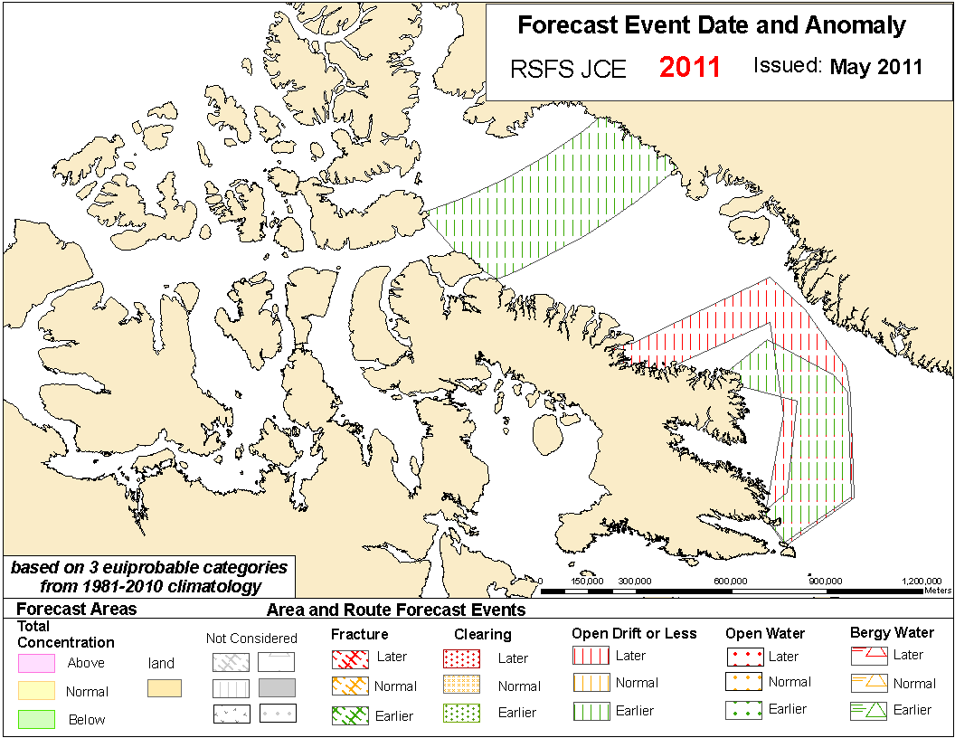
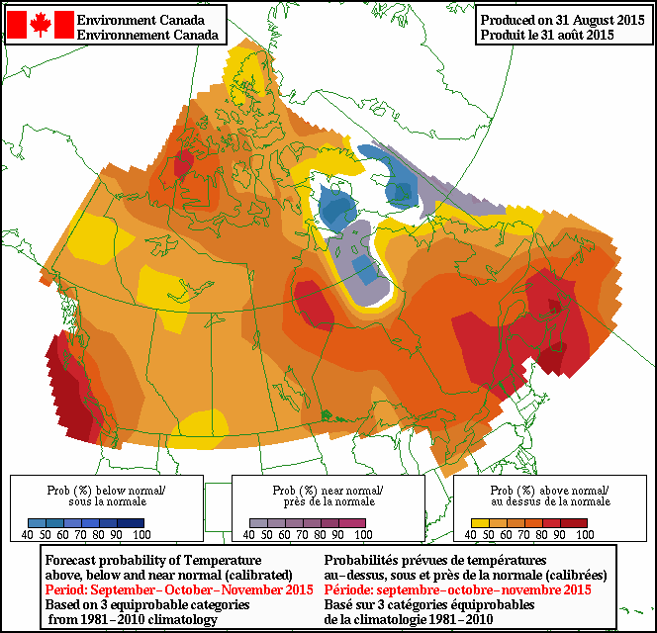
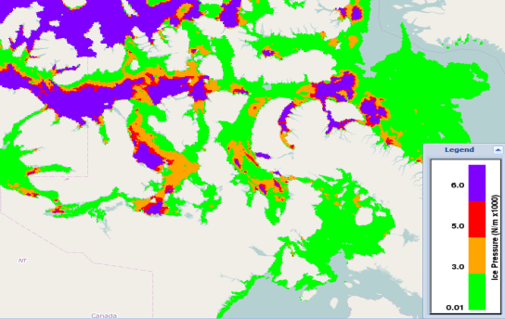
Model Guidance
RIPS and GIOPS used operationally
CanSIPS used for long range forecasting program
RIOPS and Coupled Great Lakes Model showing great promise
Post-processed fields also available to CIS, including GEM FDDs
WMS maintained by CIS science group providing guidance to operations
Forecast Ice Pressure (N/m x1000)
Notes:
Using inputs including ice pressure, concentration, thickness, SST, ice drift, ocean currents, etc.
WMS allows forecasters to view data on web (via a viewer), in Ninjo or in Google Earth/ArcGIS Explorer/ArcMap
Statistical models run by CIS Operations
2 main systems: 1) multiple linear regression system, 2) linear prediction
MLR draws from ~1000 predictors and automatically generates forecast based on “best” regression equation
MLR predictors include: SAT, SLP, SST, z500, AO, PDO, ENSO, ice, etc.
Linear prediction decomposes signal/noise and extrapolates signal

Slide 16
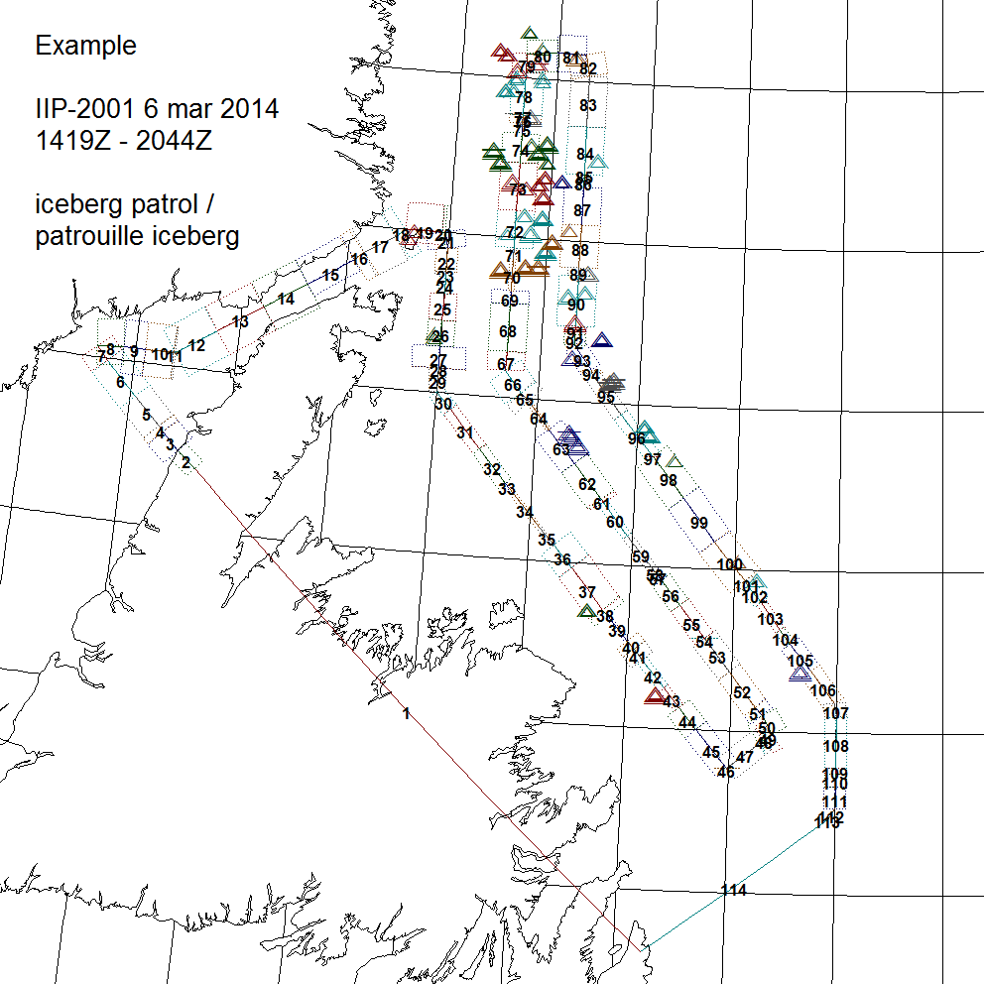
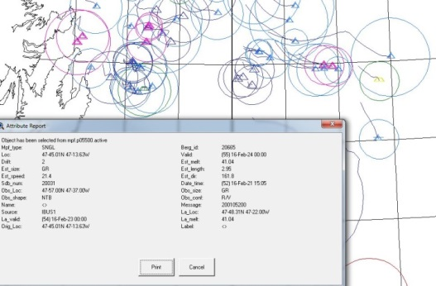
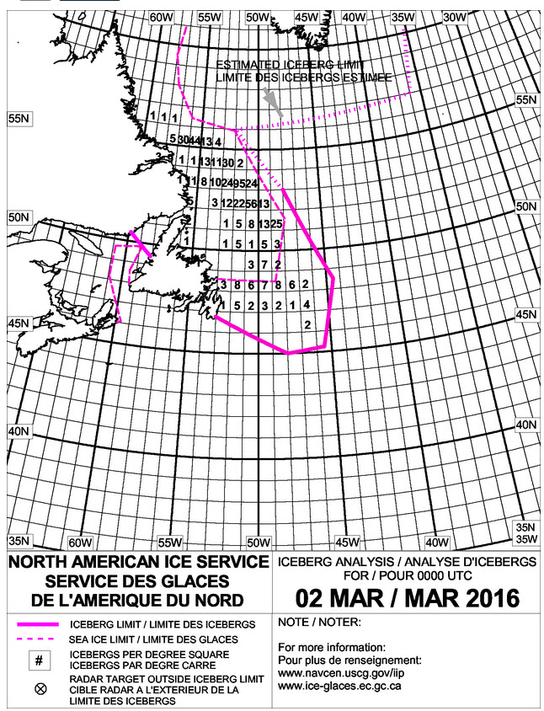
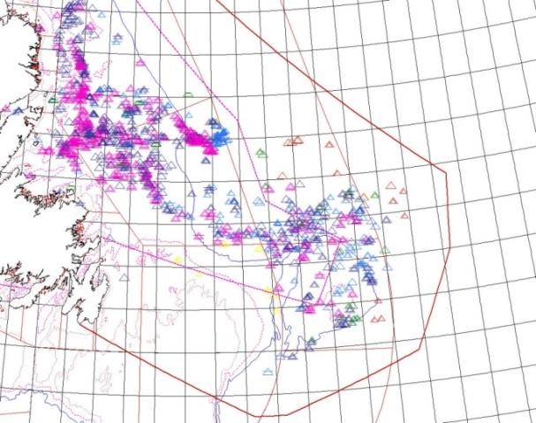
Icebergs
In conjunction with the International Ice Patrol (United States Coast Guard) CIS keeps track of iceberg locations in eastern Canada.
Aerial observation, satellite observation, and modeling are used to keep track of icebergs to maintain marine security.
Notes:
Discuss difference between sea ice and icebergs
Iceberg program. (right)
Flights observing the region. Satellite analysis also used when available. (top centre)
Database of current iceberg locations. (top right)
Modeling to drift icebergs. Based on currents, atmospheric data, size and type of iceberg. (bottom centre)

Slide 17
Community Support
Provide community focused analyses during freeze-up and break-up periods
Limited to Arctic
60 nautical mile radius from community
Analyses commence when navigation becomes possible and end when ice limits the likelihood of marine activity

Slide 18
Metareas
Notes:
Ice concentration and general iceberg presence (unlikely, isolated, many).
Ice edge. Canada in charge of METAREA 17 and 18 (Western and Eastern Arctic)

Slide 19
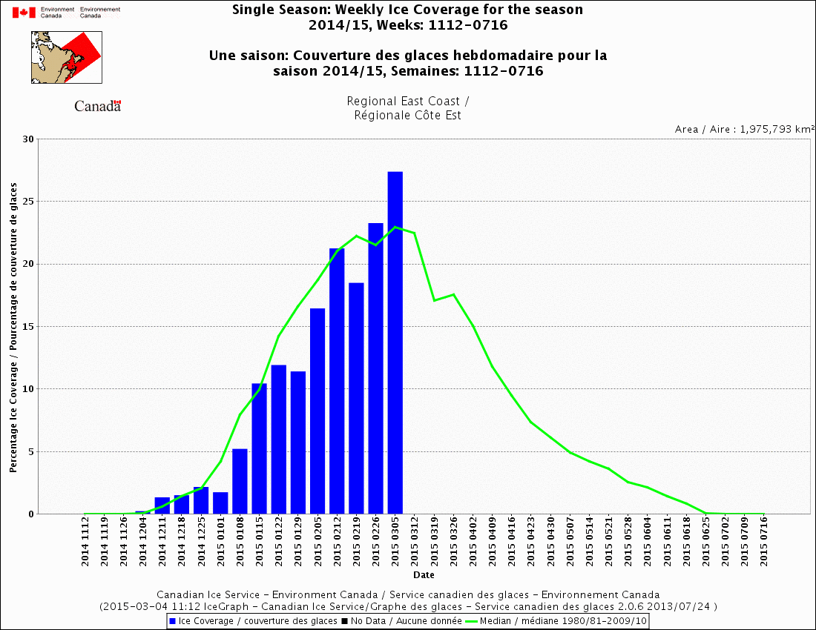
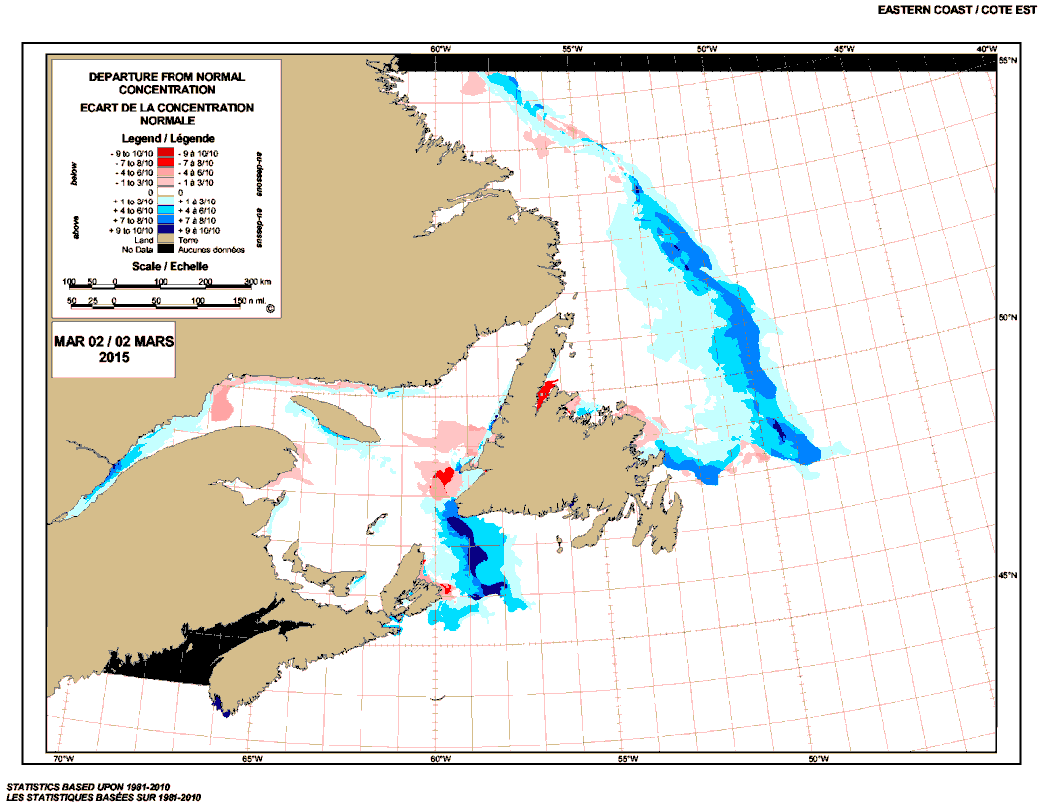
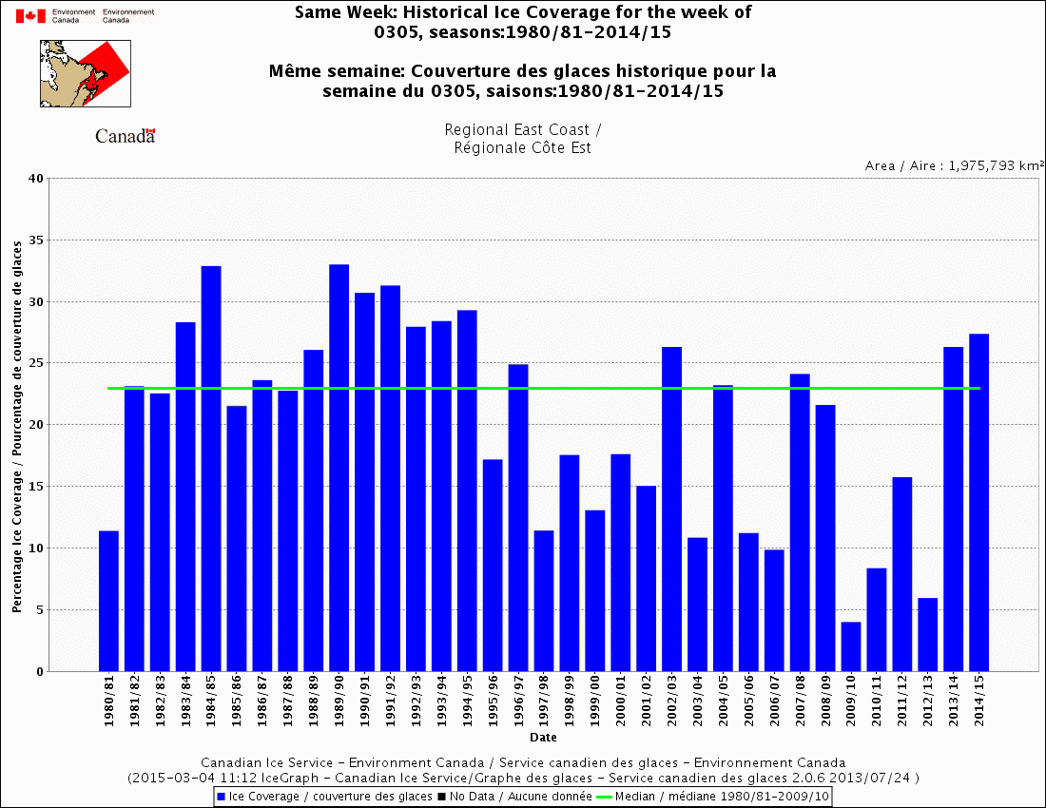
Climatological Analysis
Notes:
CIS maintains a database of historical ice conditions. Charts and data are available on the website to create custom data analysis.

Slide 20
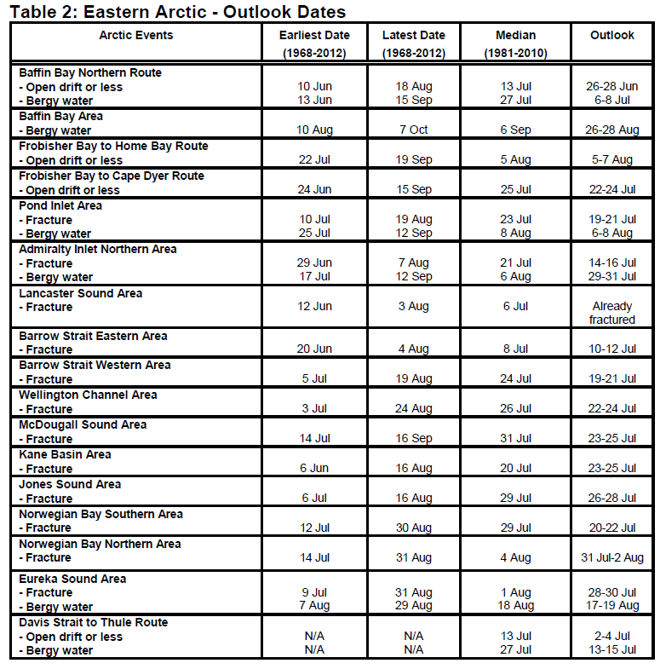
Long range forecasts
Arctic Region
Runs May to December
focused on predicting the sea ice break-up in in the Canadian Arctic.
Southern Canada
Runs October to June
focused on predicting lake and sea ice growth on the Great Lakes and East Coast.
Great Lakes forecast done in conjunction with the National Ice Center (United States Ice Service) in NAIS partnership.
Products
Seasonal outlooks
Seasonal Summary
30 day forecasts – produced twice monthly
Notes:
For each forecast region in the Arctic, we forecast specific events: fast ice breakup, open drift ice, and complete sea ice melt, freeze-up.
South focuses on freeze-up, break-up and conditions on a bi-weekly basis

Slide 21
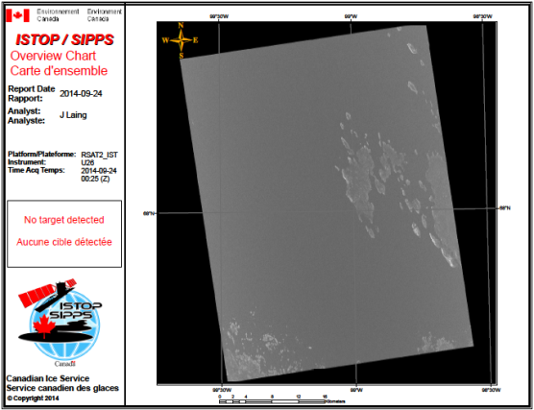
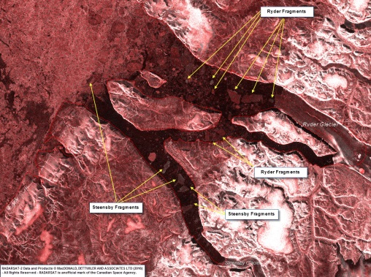
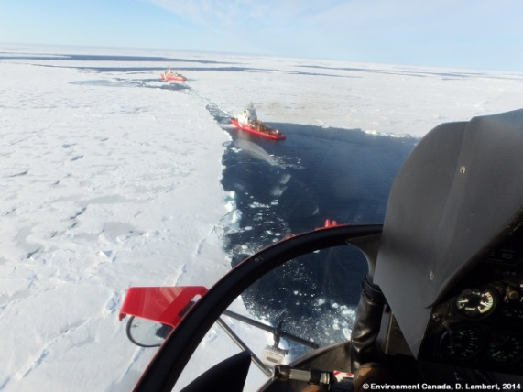
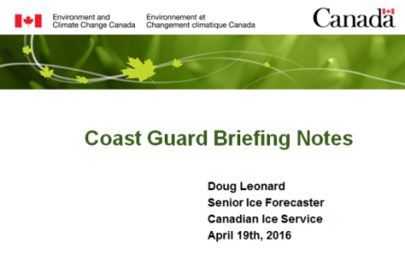
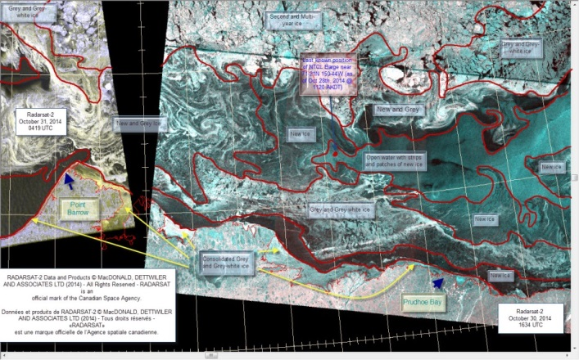
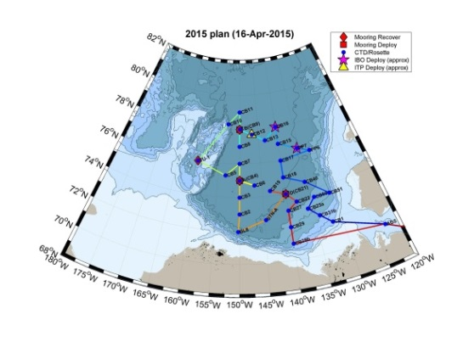
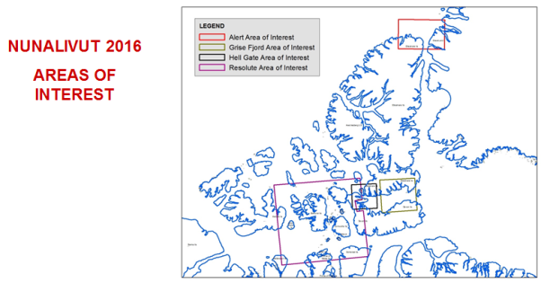
Special Products
Notes:
SAR
Science – Amundsen
Cruise vessels
UNCLOS, JOIS
Briefing Packages
DND
Parks – Erebus
Other Departments (CHS) and EIAs
Ice Island tracking

Slide 22
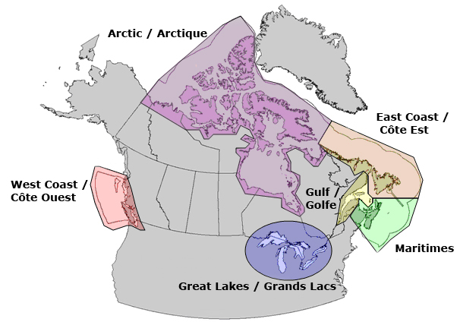
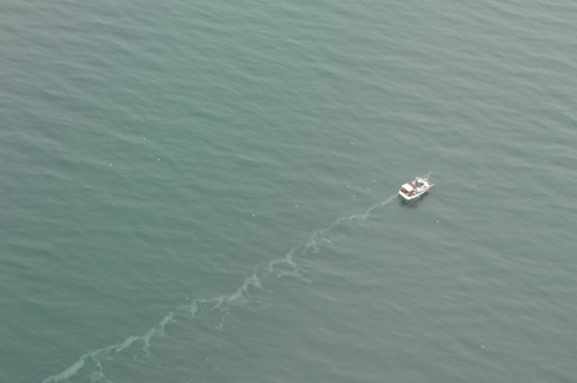
ISTOP – Oil Pollution Monitoring
Notes:
Integrated satellite tracking of pollution, since 2006

Slide 23
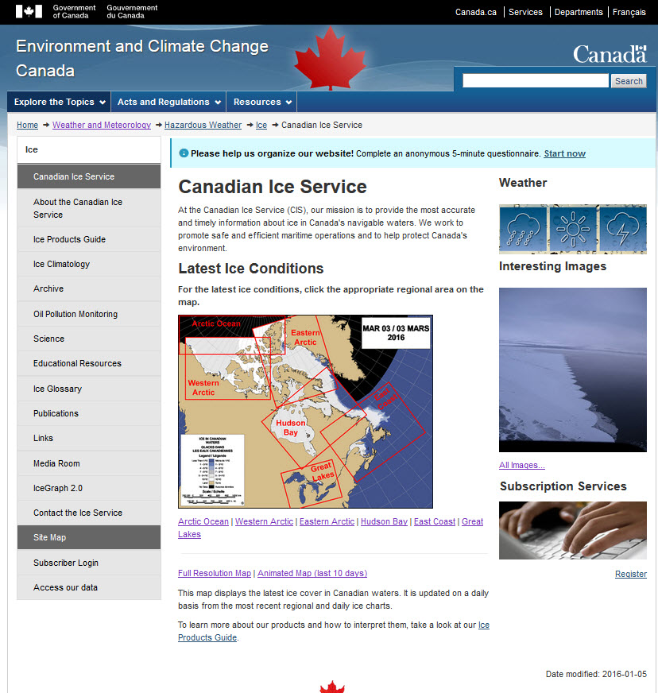
Our Website
http://ice-glaces.ec.gc.ca/
Or
http://www.ec.gc.ca/glaces-ice/?lang=En

