Slide 1
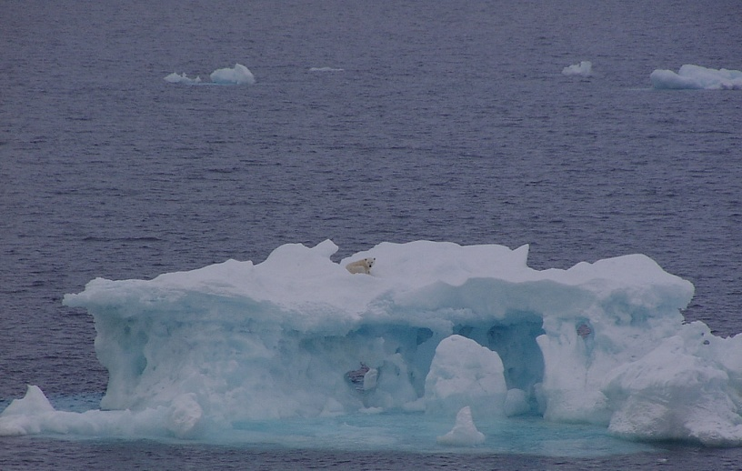

Impacts of Arctic climate patterns on
changes in sea ice along the Arctic
Northeast Passage (NEP) and High-latitude
Sea route (HSR) since 1979:
Results from remote sensing data
Jia Wang
NOAA Great Lakes Environmental Research Laboratory (GLERL)
Haogu Hu, Ayumi fujisaki-Manome
University of Michigan, CILER
Ruibo Lei
Polar Research Institute of China (PRIC),
Shanghai, China
NOAA-EC Workshop, Ann Arbor, MI, May 3-5, 2016
Acknowledgements: NOAA Climate Program Office
Arctic Research Program
Notes:
効率を考えると中間発表にそのまま使える方が良いが、K1のお金で行くので、K1結果を中心に話を進める。
練習でうまくいかないのに本番でうまくいく確率は低い。９割方うまくいくくらい練習しないと。

Slide 2
Arctic Climate Patterns:
Arctic Oscillation (AO, 1st mode, 66%) and Dipole Anomaly (DA, 2nd mode, 13%)
Wang et al. (2009, GRL)
Wang et al. (2014, Spinger)

Slide 3
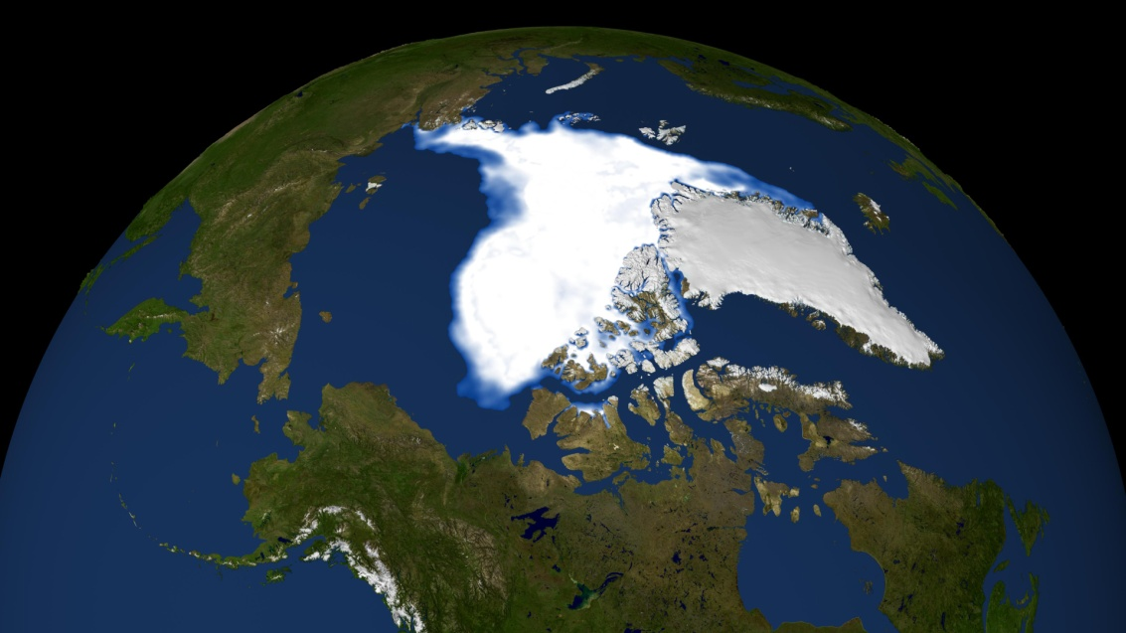

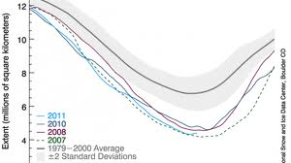
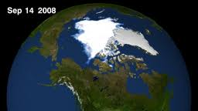
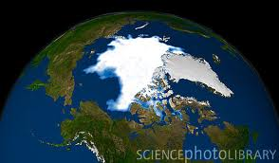
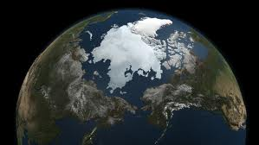
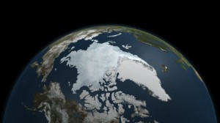
1. Introduction: September Ice minima: 2007-2011
96, 01, 03-04, 06
95, 99, 02,05 07---11
2007
08 09
10 11

Slide 4
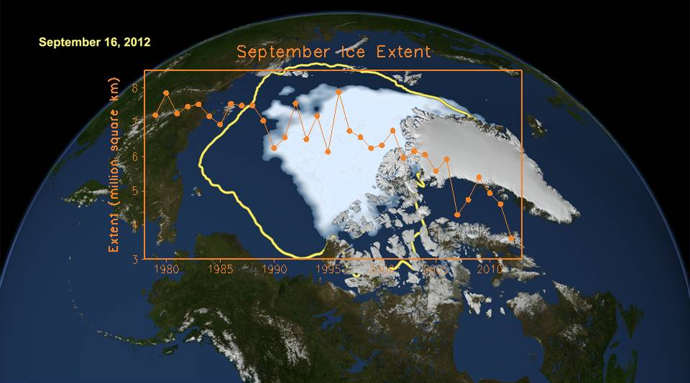
Ice-free
in 2035?
Time series of average September sea ice extent from satellite measurements
from 1979 to 2012 and the spatial minimum sea ice extent on September 16, 2012.
A linear trend is fit to the period of 1979-1996, and a second trend is fit to 1996-2012.
The second trend is illustrated with a dashed line and is extended to an ice- free summer
at ~2035, conservatively assuming that the ice/ocean albedo feedback and ice/cloud
feedback processes maintain the same rate between now and then.

Slide 5
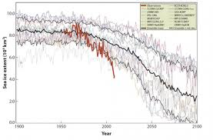
IPCC models’ projection misses the rapid decline of summer sea ice!
Possible reasons:
Resolution: h&v, eg. CAA,
Bering and Fram Straits, &
Atlantic warm layer
2) Ice/ocean-albedo &cloud&
Ocean-HF feedback
3) Ocean heat transport:
Bering and Fram Strait
4) Basin-scale processes,
such as Dipole Anomaly
associated with ocean
heat transport and feedback
processes
…

Slide 6
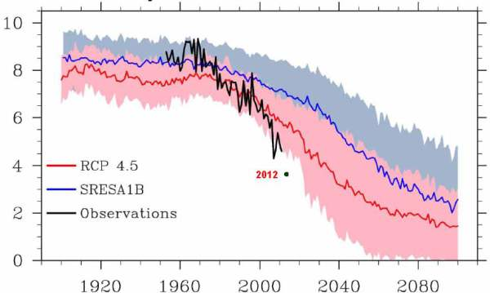
Observation (black) and IPCC models’ projections

Slide 7
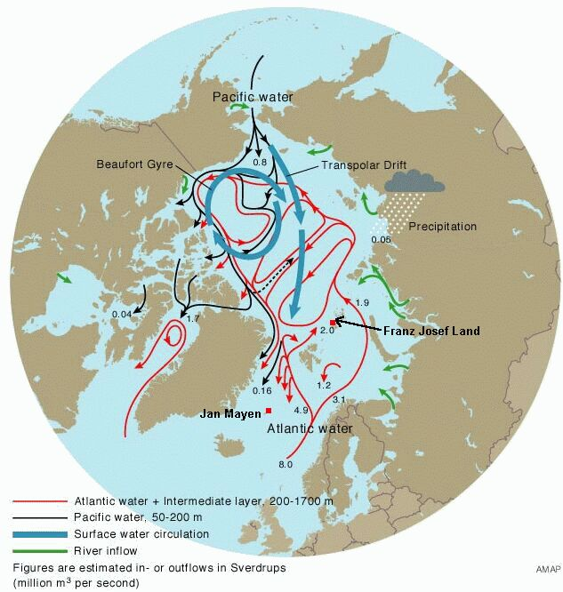
TDS

Slide 8
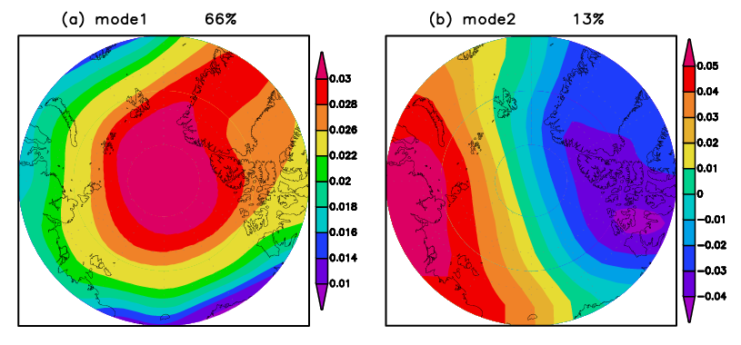
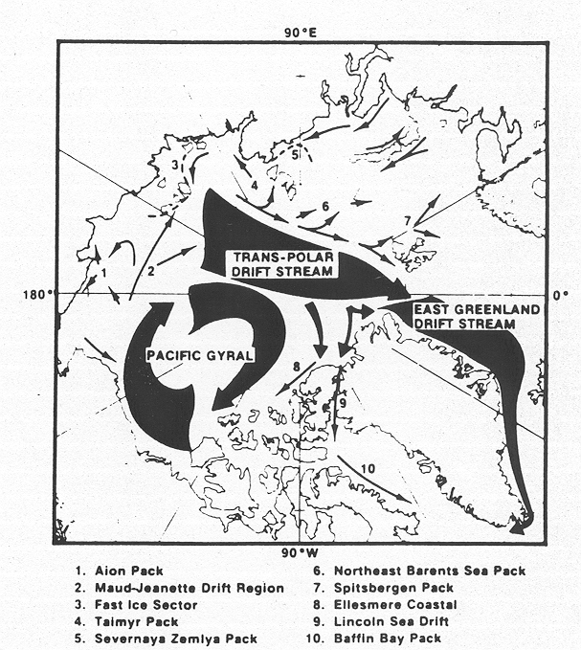
What is DA? Second mode of SLP of the Arctic Ocean (from 70-90N)
Wang, van der Baaren, Mysak (1995, internal report, McGill Univ)
Wu, Wang, Walsh (2006, J. Climate); ,
Watanabe, Wang, Sumi, Hasumi (2006, GRL);
Maslanik et al. (2007, GRL)
Overland et al (2008, Tellus)
Zhang et al. (2008, GRL)
+DA
+AO
-DA
TDS

Slide 9
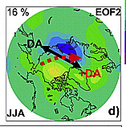
R&D: Arctic Dipole Anomaly (DA) is the major forcing
that accelerates Arctic summer sea ice decline
DA is the 2nd EOF mode of Sea Level Pressure Anom. north of 70N (Wang et al. 2009, 2014),
(Collaborated with PMEL)
Ice-free
in 2040?
(Beyond R&D: Application to walrus, fisheries, whales, Inuit life style and
support of new leadership of Arctic Council by U.S. in 2015-2017)

Slide 10
A proposed atmosphere-ice-ocean feedback loop with polar amplification due to positive ice/ocean albedo feedback, triggered by Dipole Anomaly, even intermittently!
Wang al. 05, Clim Dyn
Ice/ocean albedo: ice/water~.7/.1
+
-
Pacific Arctic
sea ice
Ocean heat storage by absorbing solar radiation
-
Present and next-yr SST/SAT anomaly
+
-
DA mode:
SLP anomaly
Transpolar Drift Stream
-
-
Wu et al. 06, J. Clim
Wang et al. 09, GRL
Zhang et al. 08, GRL
-,3
+,1
+
Cloud cover/vapor
in fall-to-spring
+,2
+,4
Bering Inflow/heat transport
+
Northward wind anomaly
Ikeda al. 03, JMSJ
Mizobata al. 10, JO; Woodgate et al. 10, GRL,
Shimada et al. 06, GRL
An ice/ocean albedo feedback loop and ice/cloud feedback loop are accelerated by a series of intermittent +DA forcings. The red arrows are associated with +DA forcing, which applies the positive feedback to the SST/SAT, or negative feedback to the sea ice, causing the unprecedented loss of Arctic summer sea ice and a series of record-breaking ice minima. + and – signs denote the positive and negative feedback, respectively. The positive feedback means that a change in one item (say A) affects the other item (say B), which feeds back so that A makes the change in the same direction as the original change. Note that associated with +DA, red arrow 1 indicates the northward advection of warmer SAT in the northern North Pacific to the Arctic by the anomalous meridional wind; Red arrow 2 denotes that anomalous meridional wind directly accelerates the TDS, which promotes export of more ice out of the Arctic; Red arrow 3indicates the direct advection of sea ice by the anomalous meridional wind; and red arrow 4 denotes the warming impact of the ocean heat transport from the Bering Sea promoted by the anomalous northward (or meridional) wind.
.

Slide 11
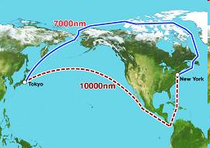
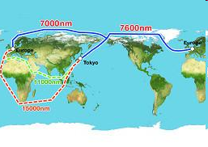
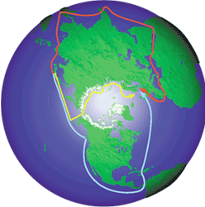
R2X: Impacts of diminishing summer sea ice on commercial shipping (Lei, Wang, et al. 2015 CRST)
7000nm
7600nm
7000nm
11000nm
10000nm
15000nm
nm = Nautical Mile = 1.852 km
Arctic sea routes
Northeast passage (NEP) Northern Sea Route (NSR) | Northwest passage (NWP)
Exact definition of the Northern Sea Route is the route between the Kara Gate and the Bering Strait under the NSR Administration Agency.
(Support of new leadership of Arctic Council by U.S. in 2015-2017)

Slide 12
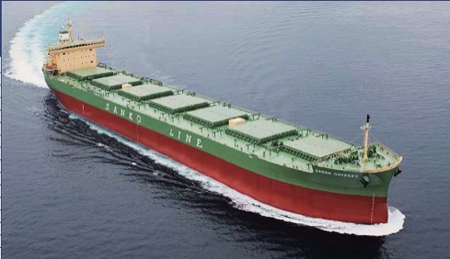
Northern Sea Route transit voyages
No. of transit voyages
Rapid increase due to international business use
SANKO ODYSSEY
Majority of the cargo has been gas condensate and iron ore to China and Korea.
year
Kitagawa, 2013

Slide 13
NEP and HSR
SMMR/SSMI-derived Arctic sea ice edges in September averaged from 1981 to 2010 and those
for years 2007–2012, R/V Xuelong's tracks along the standard NEP (A to B) and in the high
latitudes (from C through F and E to D), and the HSR (from C through F to G).
CS, EES, LS, KS, and BS denote the Chukchi, East Siberian, Laptev, Kara, and Barents Seas.
HSR-High latitude Sea Route

Slide 14
Satellite data
Product | Data source | Overlap period | Spatial resolution | Archive | Reference
Ice concentration | SMMR SSM/I SSMIS AMSR-E | 1979–1986 1987–2007 2008–2012 2003-2010 | 25km | ftp://sidads.colorado.edu/pub/DATASETS/ | Cavalieri et al., 1996
 |  |  | 6.25km | http://www.iup.uni-bremen.de:8084/amsr/amsre.html | Speen et al., 2008
Ice extent | SMMR SSM/I SSMIS | 1979–1986 1987–2007 2008–2012 | 25km | ftp://sidads.colorado.edu/pub/DATASETS/ | Fetterer et al., 2002
Melt/freeze-up onset | SMMR SSM/I SSMIS | 1979–1986 1987–2007 2008–2011 | 25km | http://neptune.gsfc.nasa.gov/csb/index.php?section=54 | Markus et al., 2009
Ice thickness | ICESat | 2003–2008 | 30-50km | http://icdc.zmaw.de/seaicethickness_satobs_arc.html?&L=1 | Kwok et al., 2009
Ice thickness | CryoSat-2 | 2011–2012 | 20-30km | http://www.meereisportal.de/de/datenportal/karten_und_datenarchiv/ | Hendricks et al., 2013
Ice type | OSI SAF | 2005–2012 | 25km | http://osisaf.met.no/p/ice/#edgeAndType_details | Eastwood, 2012
Ice type | QuikSCAT | 2003–2009 | 8–10 km | http://www.scp.byu.edu/data/Quikscat/iceage/Quikscat_MYFY.html#2003 | Swan and Long, 2012
Table 1 Descriptions of the satellite remote sensing data

Slide 15
SIC SIC Anomaly along NEP
SMMR/SSMI-derived multi-year average sea ice concentration along the NEP
from 1 June to 30 November (a–d) and their corresponding anomalies relative
to the 1979–2012 average (e–h).

Slide 16
SIC SIC Anomaly along HSR

Slide 17
Monthly mean ice concentration from 60°E to 180°E, 1979-2012
NEP
HSR
SMMR/SSMI-derived monthly mean ice concentration from 60°E to 180°E along the
NEP (a) and the HSR (b). Also shown are the slope with unit of percent per year (S),
correlation coefficient (R), and confidence level (P) of linear trend of monthly ice concentration
from 1979 to 2012.

Slide 18
Opening Duration (days)
NEP HSR
Threshold
75%
50%
15%
SMMR/SSMI-derived open period defined by ice-concentration thresholds of 75%, 50% and
15% along the NEP (a-c) and the HSR (d-f) from 1979 to 2012.

Slide 19
1979-2011 (Julian day) for NEP
Onset of
Ice melt
Onset of
freeze-up
Length of
melt
season
SMMR/SSMI-derived onset of surface ice melt (a) and freeze-up (b), the length of melt season (c), their long-term averages (d–f), and the slopes of linear trend (g–i) from 1979 to 2011 in the NEP. Black marks (n.s.) denote the trend was insignificant at the 0.05 level.

Slide 20
Statistical correlation for NEP
Table 4. Statistical relationships between melt season and open period of the NEP. Significance levels are P<0.001 (***), P<0.01 (**), and P<0.05 (*). n.s. denotes insignificant at the 0.05 level.
Chukchi East Siberian Laptev Kara
Melt onset vs. Melt season : -0.64*** -0.53** -0.83*** -0.84***
Freeze-up vs. Melt season : 0.89*** 0.96*** 0.94*** 0.94***
Melt onset vs. Freeze-up: n.s. n.s. -0.58*** -0.61***
Melt season vs. Open period (75%): 0.72*** 0.89*** 0.86*** 0.81***

Slide 21
1979-2011 (Julian day) for HSR
Onset of
Ice melt
Onset of
freeze-up
Length of
melt
season
SMMR/SSMI-derived onset of surface ice melt (a) and freeze-up (b), the length of melt season (c), their long-term averages (d–f), and the slopes of linear trend (g–i) from 1979 to 2011 in the HSR. Black marks (n.s.) denote the trend was insignificant at the 0.05 level.

Slide 22
Statistical correlation for HDR
Table 5. The same as Table 4, but for the HSR.
Chukchi East Siberian Laptev Kara Barents
Melt onset vs. Melt season: -0.63*** n.s. -0.74*** -0.60*** -0.74***
Freeze-up vs. Melt season : 0.94*** 0.92*** 0.94*** 0.94*** 0.92***
Melt onset vs. Freeze-up: n.s. n.s. -0.48** n.s. -0.36*
Melt season vs. Open period (75%): 0.73*** 0.85*** 0.84*** 0.65*** 0.70***

Slide 23
NEP Ice thickness distribution (cm), 2003-2012
Oct-Nov
Feb-March
H-histo-
gram
2003
2012
Spatial average
Sea ice thicknesses derived from ICESat from 2003 to 2008 and derived from CryoSat-2 from 2011 to 2012 along the NEP during October-November (a), and February-March (b); the spatial averages and the deviations between them (c); frequency distributions of ice thickness in October-November of 2003 (d) and 2012 (e).

Slide 24
HSR Ice thickness distribution (cm), 2003-2012
H-histo-
gram
Oct-Nov
2003
Feb-Mar
2003
Oct-Nov
2012
Feb-Mar
2012
Oct-Nov
Feb-Mar
Mean
Sea ice thicknesses derived from ICESat from 2003 to 2008 and derived from CryoSat-2 from 2011 to 2012 along the HSR during October-November (a), and February-March (b); the spatial averages and the deviations between them (c); frequency distributions of ice thicknesses in October-November/February-March of 2003 (d/f) and 2012 (e/g).

Slide 25
Ice type distribution
Distributions of ice type on 15 March 2003 (a), 2005 (b), 2007 (c), 2009 (d), and the fraction of multiyear sea ice along the NEP and HSR. The data shown in panels a-d are derived from the QuikSCAT product, and those in panel e are derived from both the QuikSCAT and OSI-SAF products.

Slide 26
Open period for NEP
SMMR/SSMI AMSE-E Deviation Mean+Std Relative Std
Open period defined by ice-concentration threshold of 50% determined by SMMR/SSMI data (a), AMSR-E data, (b) and their deviation (c) along the NEP from 2003 to 2010. The multiyear average (red line) and standard deviation (gray line) of absolute biases, with the dashed blue lines dividing the subsection along the NEP; also shown are the spatial average and standard deviation of the subsections (d). The frequency distributions of deviation and relative deviation of open period (e).

Slide 27
AO/DA vs open period in NEP
 | Chukchi | East Siberian | Laptev | Kara | Barents
AO_w vs. Open period | n.s. | 0.41* | n.s. | n.s. | n.s.
AO_sp vs. Open period | n.s. | 0.49** | n.s. | n.s. | n.s.
AO_su vs.Open period | n.s. | n.s. | n.s. | -0.46** | n.s.
AO_a vs. Open period | n.s. | n.s. | n.s. | n.s. | n.s.
DA_w vs. Open period | n.s. | n.s. | n.s. | n.s. | n.s.
DA_sp vs. Open period | n.s. | 0.49** | 0.34* | n.s. | n.s.
DA_su vs.Open period | 0.42* | 0.49** | 0.63*** | 0.63**** | n.s.
DA_a vs. Open period | n.s. | 0.49** | 0.34* | n.s. | n.s.
Table 6. Statistical relationship of seasonal average AO/DA indices and the open period defined by 50% ice
concentration threshold for the NEP. Significance levels are P<0.001 (***), P<0.01 (**), and P<0.05 (*).
n.s. denotes insignificant at the 0.05 level, N/A denotes inapplicable. The subscripts of w, sp, su, and a
denote the winter (December-February), spring (March-May), summer (June-August), and autumn
(September-November).

Slide 28
AO/DA vs open period in HSR
 | Chukchi | East Siberian | Laptev | Kara | Barents
AO_w vs. Open period | n.s. | 0.35* | n.s. | n.s. | n.s.
AO_sp vs. Open period | n.s. | 0.40* | n.s. | n.s. | n.s.
AO_su vs.Open period | n.s. | n.s. | n.s. | -0.39* | n.s.
AO_a vs. Open period | n.s. | n.s. | n.s. | n.s. | n.s.
DA_w vs. Open period | n.s. | n.s. | n.s. | n.s. | n.s.
DA_sp vs. Open period | n.s. | 0.49** | n.s. | n.s. | n.s.
DA_su vs.Open period | 0.41* | 0.45** | 0.61*** | 0.60* | n.s.
DA_a vs. Open period | n.s. | 0.49** | n.s. | n.s. | n.s.
Table 7. The same as Table 6, but for the HSR.

Slide 29
Summary
NEP: The spatial average open period, defined by 50% ice concentration threshold, became about twice as long, from about 70 days in the early 1980s to about 140 days in the early 2010s
HSR: The summer opening of the HSR north of the islands of the eastern Arctic Ocean was also lengthened during recent years. The summer ice-free period reached 42 days in 2012
DA closely relates to NEP and HSR openings, than AO!
Although both NEP and HSR have become more accessible during recent years, the spatial distributions of sea ice have a large interannual and seasonal variability. Using the same threshold of ice centration, the continuous period with the entire sea route open completely was much shorter than the open period averaged from test points due to local blockade by sea ice

Slide 30
Future effort: Seasonal sea ice forecast using CIOM and FVCOM-ice

Slide 31
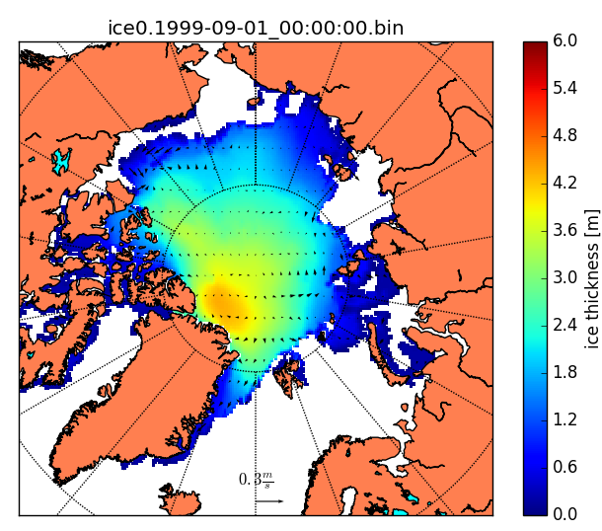
Arctic-ICEPOM
Primitive equations (POM-based)
Ice dynamics with EVP rheology
0-layer ice thermodynamics with snow cover
25km grids
Climate Forecast Reanalysis (CFSR)
  Initial conditions
  Hourly atmospheric forcing
  Climatology precipitation (NCEP)
Initial ice thickness on Sep. 1, 1999 from CFSR
Fujisaki and Oey (2011, JGR), De Silva et al. (2015, Polar Res)

Slide 32
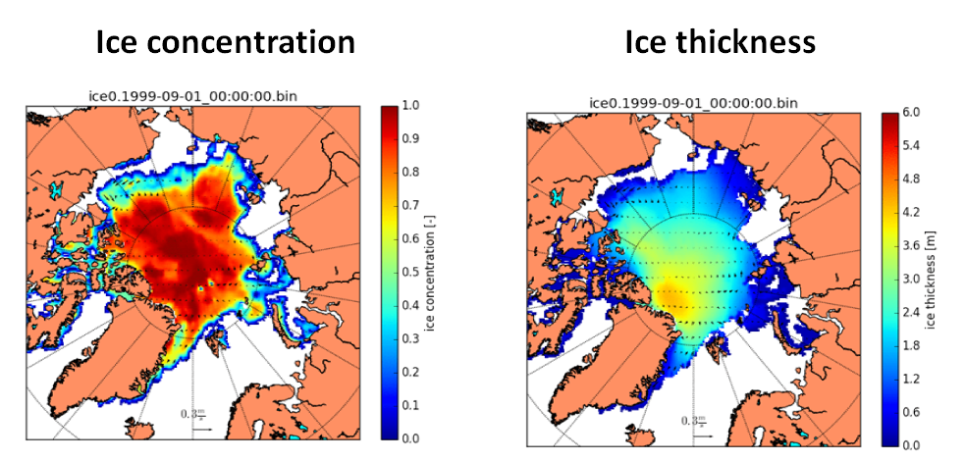
New configuration with nested fine grids in the East Siberian Sea for NOAA CPO RUSALCA Arctic project
(Animation Available Upon Request)
Wang et al. (2002, 05, 09, 14)

Slide 33
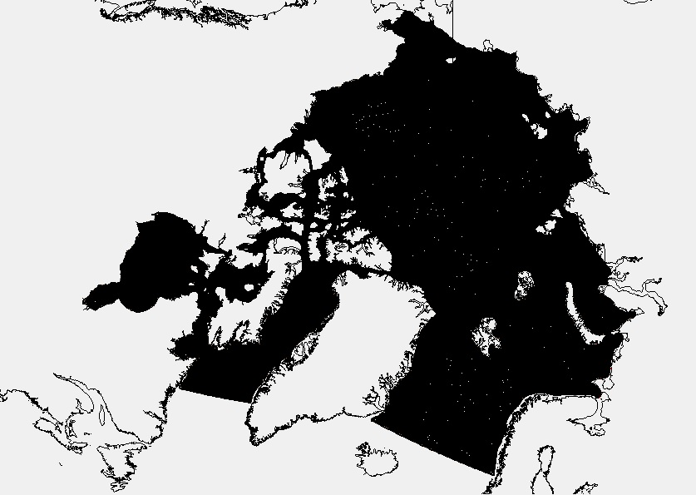
Arctic-FVCOM-ice unstructured variable grid

Slide 34
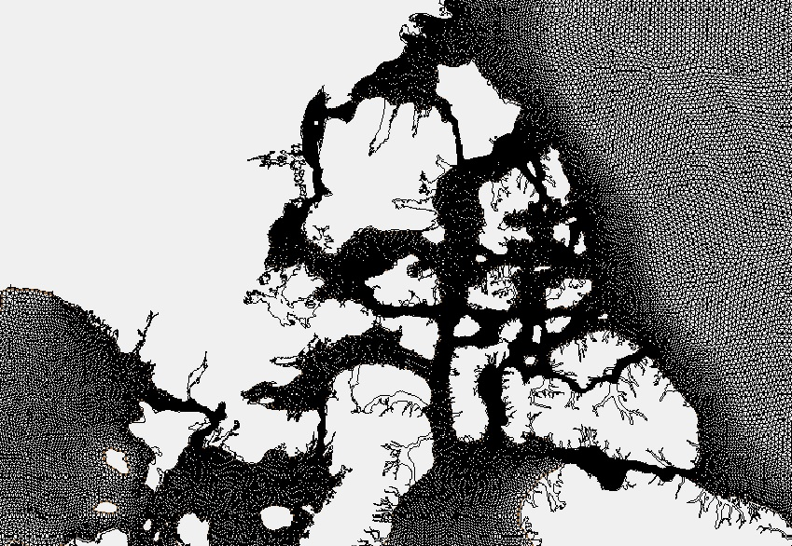
Enlarged grid covering CAA

Slide 35
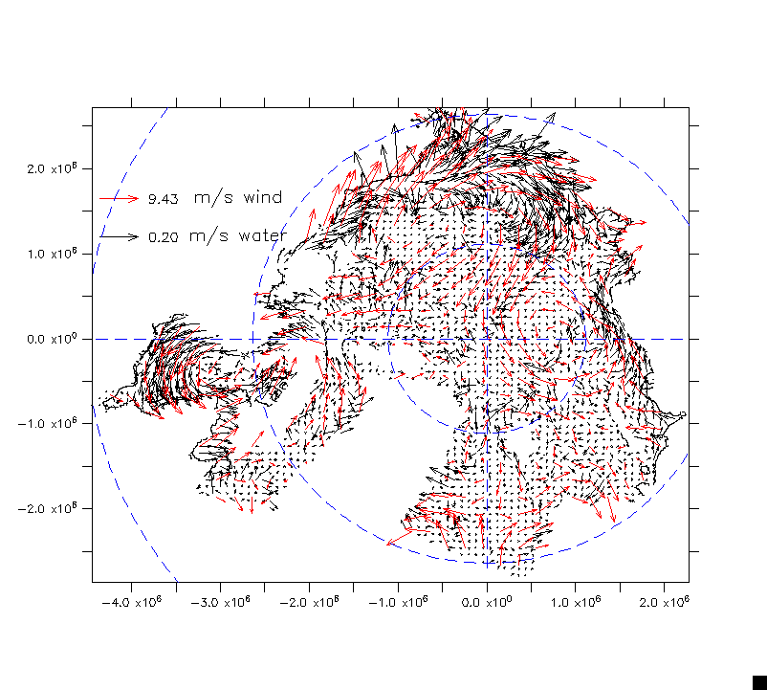
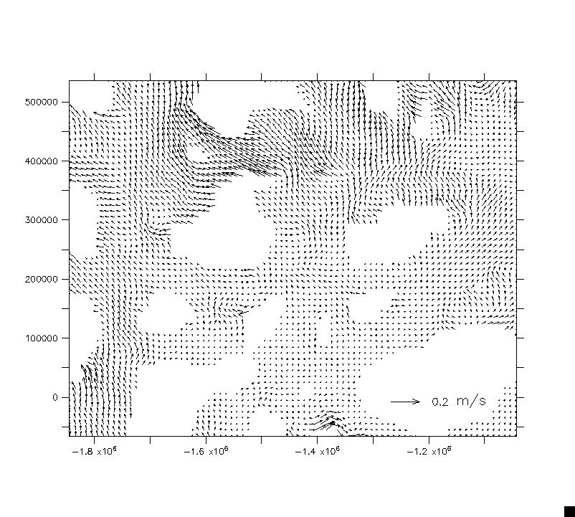
GLERL Arctic-FVCOM-ice simulated surface ocean circulation (test run)

