Slide 1
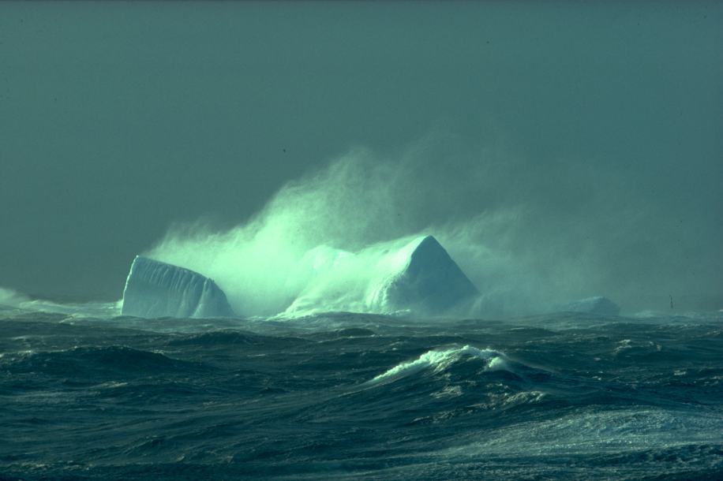
ECCC’s Contribution to the Year of Polar Prediction
Photo: G. Dieckmann, AWI
Greg Smith
Meteorological Research Division, Environment and Climate Change Canada
NOAA-ECCC Bi-lateral Marine Focus Area Workshop,
Ann Arbor, MI, 3-5 May, 2016

Slide 2
Year of Polar Prediction (YOPP)
Goal:
"Enable significant improvement in environmental prediction capabilities for the polar regions and beyond, by coordinating a period of intensive observing, modelling, prediction, verification, user engagement and education activities."
Notes:
YOPP is at the heart of PPP, goals quasi identical with PPP goals, but more concrete shape

Slide 3
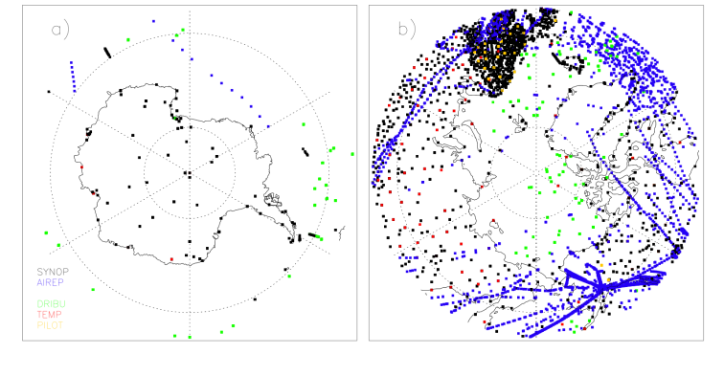
Why?
1. Significant gaps in the polar observing systems
Synop, AIREP, DRIBU, TEMP and PILOT
Polar data coverage of conventional observations in the ECMWF operational analysis on 1 January 2012
P. Bauer (ECMWF)
Notes:
- Here only conventional data, but also true for satellite data and ocean data (Argo!)
- Obs. Difficulties: Harsh environment, sea ice prevents Argos, weak thermal and optical contrast between ice and clouds

Slide 4
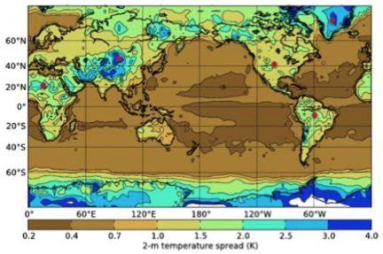
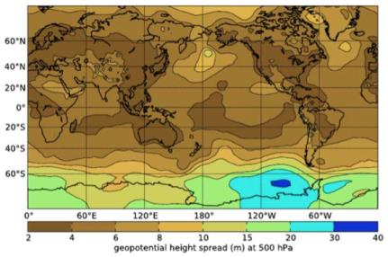
Why?
2. Emphasis of previous international efforts
on lower latitudes
TIGGE* analysis spread (Oct-Nov 2010)
Spread is roughly equivalent to forecast error
2-meter temperature (K)
500hPa geop. height (m)
Small error
Large error
Largest forecast error in polar regions
* UKMO, ECMWF, NCEP, CMC, CMA
Hamill 2012, (pers. comm.)
Notes:
The figure shows how uncertain current medium-range forecasting systems are regarding the initial state in the polar regions which clearly stand out
This translates into higher forecast errors in polar regions

Slide 5
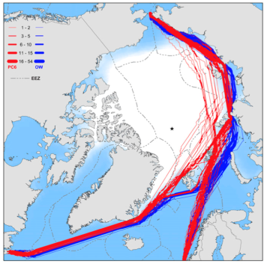
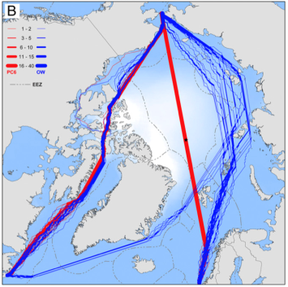
Why?
3. Arctic opening
Optimal Arctic shipping routes
1979-2005
2040-2059 (RCP 4.5)
open water ships
(40% success)
(94% success)
polar class 6 ships
Smith and Stephenson (2013)
Notes:
Climate change has moved the polar regions into the focus, in particular the rapidly opening Arctic, giving rise to new opportunities, example shipping shown here
Suppl. info:
Northern Sea Route (NSR):
Used by 34 (50) vessels in 2011 (2012)
Estimates suggest that cargo carried through the NSR will increase by a factor of 80 by 2020
NSR: reduction of distance by 22% from Rotterdam to Shanghai
NWP: reduction of distance by 15% from Rotterdam to Shanghai
RCP 4.5 is a relatively moderate emissions and land-use change scenario used in CMIP5; the S&S 2013 paper is based on CMIP5 data

Slide 6
Year of Polar Prediction (YOPP)
Endorsement process for YOPP now open
www.polarprediction.net
Preparation Phase 2013 to mid-2017
YOPP mid- 2017 to mid-2019
Consolidation Phase mid-2019 to 2022
Preparation Phase 2013 to mid-2017
Consolidation Phase mid-2019 to 2022
Community engagement
Intensive observing periods
Data denial experiments
Align with other planned activities
Dedicated model experiments
Model developments
Develop imple- mentation plan
Research into use & value of forecasts
Dedicated reanalyses
Preparatory research
Intensive verification effort
Operational implementation
Summer school Workshops
Summer school
YOPP publications
Liaise with funders
YOPP conference
Notes:
- Long year ☺; core period from mid-2017 to mid-2019
- Example 1: Intensive observing periods: (i) more observations needed in general, additional value having them in the same time
(ii) snapshot for higher-quality REANALYSIS (ERA-YOPP) -> useful for verification, process understanding, ...
(iii) enables judgement upon value of certain obs for forecasting (OSEs, ie data denial experiments)
(iv) aligned with planned MOSAiC campaign (where Polarstern drifts through Arctic)
Example 2: Dedicated model experiments: OSSEs / OSEs; in NWP context OSSEs are common practice for satellite planning; autonomous gliders under sea ice could be a target in the context of YOPP
Example 3: Verification effort: baseline skill comparison between current operational 7-day sea-ice forecasts (US Navy; Env. Can.; MyOcean (Europe)) currently being discussed

Slide 7
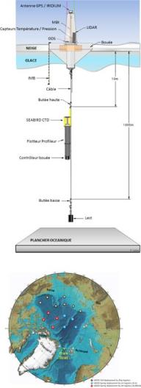
The YOPP-Observational Component
Purpose: Comprehensive observational “snapshot” for
Improved initial conditions
Model development
Forecast verification
Selected Elements
Mobile systems (buoys, ships etc.)
Extra observations from existing sites
Supersites ➔ e.g., SIOS and IAOOS
Satellite snapshots
Special campaigns (aircraft etc.)
User relevant data ➔ verification
Data availability (GTS, data sharing)

Slide 8
The YOPP-Modelling Component
Purpose
Improved coupled models
Selected Elements
Operational forecasts with special archiving
Multi-model sea ice ensemble
Sub-seasonal and seasonal experiments (case studies, extra starting dates, special archiving)
Frontier experiments (e.g. high-resolution prediction)
Align Transpose-CMIP with YOPP

Slide 9
The YOPP-Satellite Component
Purpose
Improvement of satellite retrievals
Provide comprehensive satellite snapshot
Selected elements
Satellite validation
Improved model and data assimilation systems
Improved atmospheric products in lower atmosphere
Sea ice information (e.g. deformation)
Ice bergs

Slide 10
Canadian YOPP Contributions
Increased observations
Operational support
Improved models and data assimilation
Government of Canada
User engagement
Forecast Verification
Observing system evaluations
Ensemble forecasting
Improved Products
(NAVTEX, WMS)

Slide 11
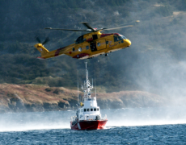
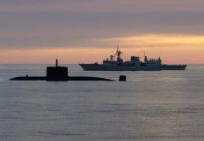
National Collaborations
Coast Guard

Slide 12
ECCC Drivers and Needs
High-resolution coupled atmosphere-ocean-ice-wave modeling and forecasting is very important for MSC, CCG, DND, Metareas, S&R and ECCC emergency response
Need for :
Improved and validated atmospheric physical processes: microphysics (including precipitation), radiation, air-ocean-ice fluxes, boundary layer….
Improved soil-snow-vegetation-hydrological modeling and prediction (including blowing snow), are also very important for services and for all numerical systems.
Improved lower boundary conditions of our weather forecasting systems is particularly important in regions poor in observations.
Improved simulation of small-scale sea ice features (e.g., ridges, leads, melt ponds, ice edge), including impacts of waves, critical for CIS.
Improved and validated precipitation, snow, ice and ocean analyses.

Slide 13
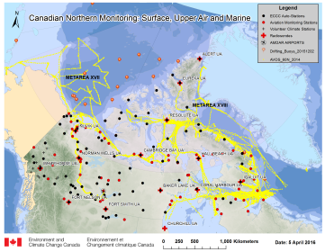
ECCC Contributions to YOPP
EC Observations during YOPP
Augmentation of existing observing system
buoys, AVOS, Argo
Deployment of additional instrumentation
HF Radar, LIDAR, Radiosondes
Participation in national/international projects
SnowPEx, ESM-SnowMIP, CanSISE, GOV
Exploitation of new satellite products
RCM, IceSAT2, SMAP, ADM-Aeolis, Sentinel 1,3
EC YOPP Forecast Products
Demonstration forecasts
high-resolution coupled atmosphere-ice-ocean-wave prediction system
Ensemble ice forecasts
Observing system experiments
Operational Support
Increased interaction with users of marine products
Demonstration of Arctic emergency response capabilities

Slide 14
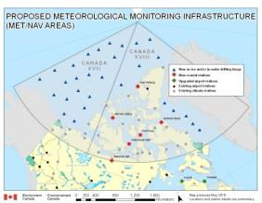
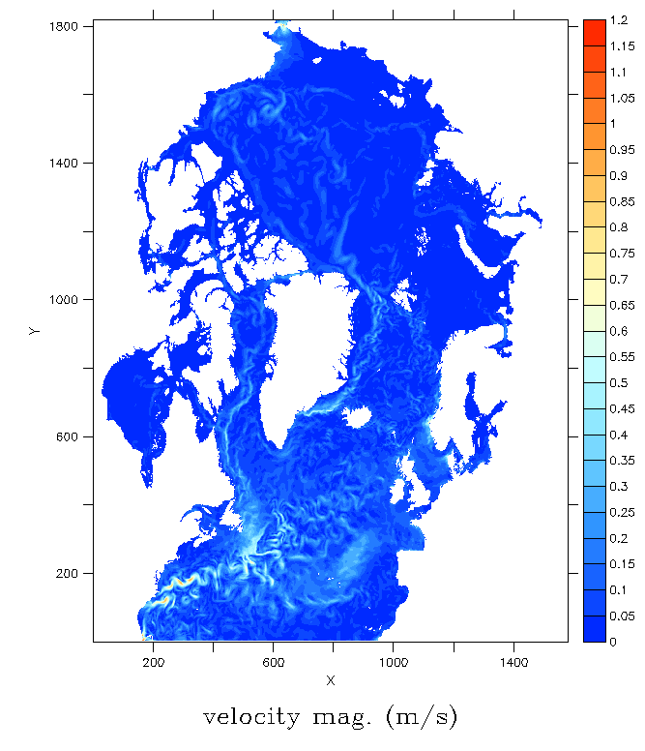
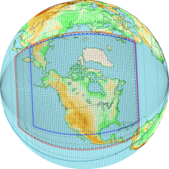
ECCC YOPP Prediction System
High-resolution coupled atmosphere-ice-ocean prediction system
In support of :
Weather prediction for northern Canada
EC METAREAs Services
Marine emergency response
Coupled atmosphere-ice-ocean model
GEM (2.5km)
Improved microphysics
NEMO-CICE (3-8km) and WW3
Tides, landfast ice,
wave-ice coupling
48-72hr forecasts
RIOPS
GEM
2.5km

Slide 15
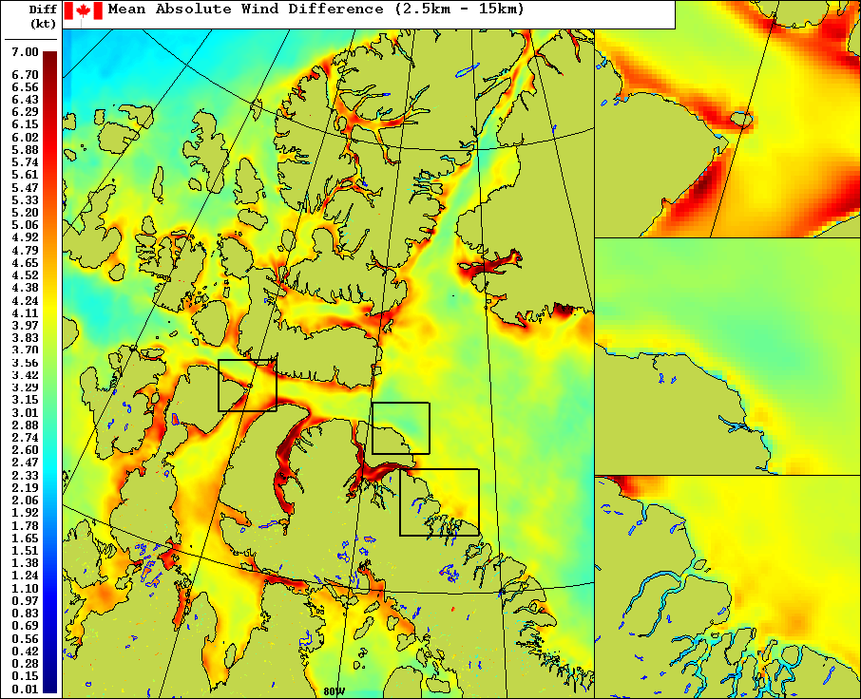
Impact of atmospheric resolution on winds
Difference between daily 2.5km and 15km 48hr forecasts for August 2012
Chris Subich

Slide 16
RPN/ARMA YOPP Contributions Data Assimilation
Atmospheric Data Assimilation:
Observing System Experiments (OSEs) for IOPs
buoys, radiosondes
Forecast Sensitivity to Observations (FSO) studies
Assimilation of ADM-Aeolis data
Sea Ice Data Assimilation:
Concentration:
SAR (Radarsat2, Sentinel1)
AVHRR, VIIRS
Thickness:
SMOS thin ice retrievals (0-50cm)
Radarsat2 stage of development
Coupled SST, ice, ocean assimilation
Ocean Assimilation:
Under-ice profiles
ITPs (Temp, salinity)
Gliders
High-res Altimetry
High-res SST

Slide 17
RPN/ARMA YOPP Contributions Verification
Atmospheric Verification:
Environment Canada was proposed as a potential key centre for verification of pre-YOPP versus post-YOPP model performance.
The group of David Richardson at ECMWF proposed to perform the real time verification (against GTS obs).
Sea Ice and Ocean Verification:
Extension of GODAE Oceanview Class4 Intercomparison to include sea ice concentration, drift and ocean surface drift.
Intercompare ice-ocean forecasting systems

Slide 18
Monthly-seasonal forecasting
Dedication effort together with CIS
Evaluate CanSIPS seasonal sea ice forecasts
including new GEM-NEMO-CICE coupled model
Evaluate impact of ice thickness initialization and ocean resolution (1deg vs ¼ deg)
Develop new metrics and products
E.g. onset of melt, freeze-up
Coupled GEPS-GIOPS monthly forecasts

Slide 19
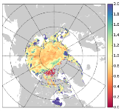
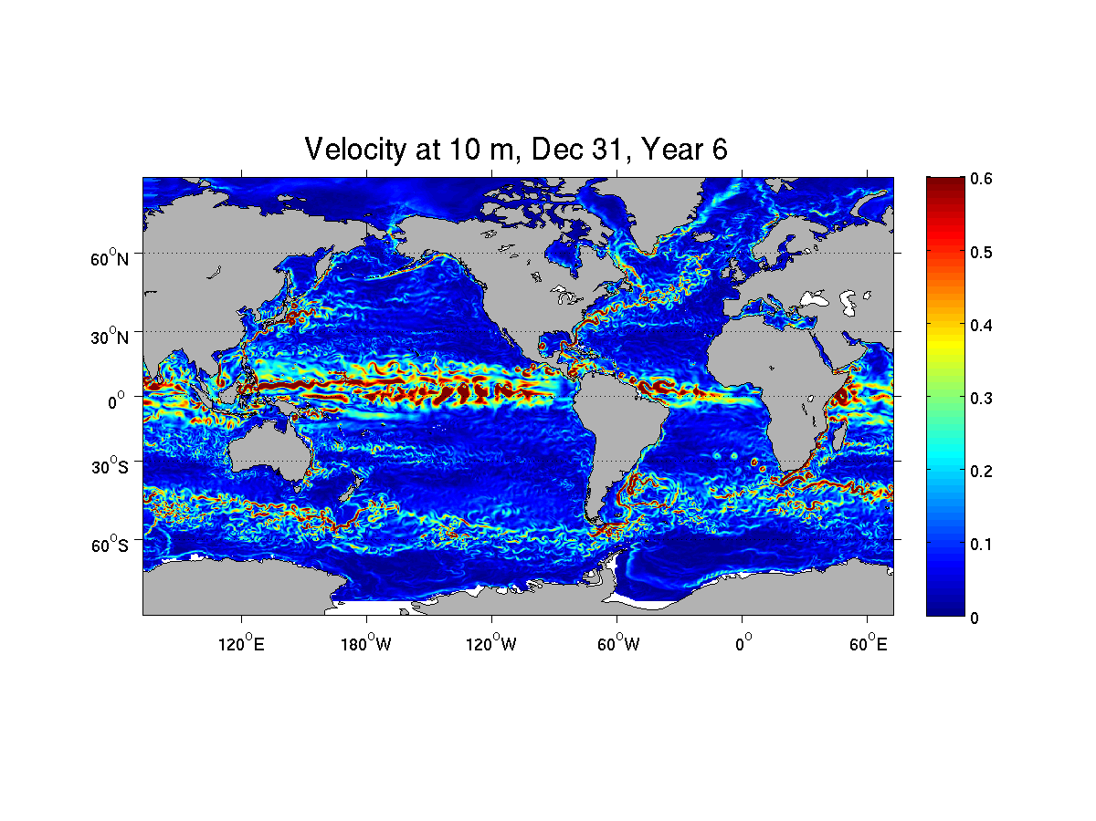
ECCC Ice forecasts for YOPP
Coupled RIOPS
Arctic/N.Atl., fully-coupled A-I-O, 2.5km(A)-3-8km(IO), 5day
GDPS-GIOPS
Global, fully-coupled A-I-O, 15km(A)-1/4deg(IO), 10day
GIOPS Ensembles
Global, 1/4deg, 32 day, 20 member
Seasonal Predictions
CanESM & GEM-NEMO-CICE
Global, 1deg, 2x20 member

Slide 20
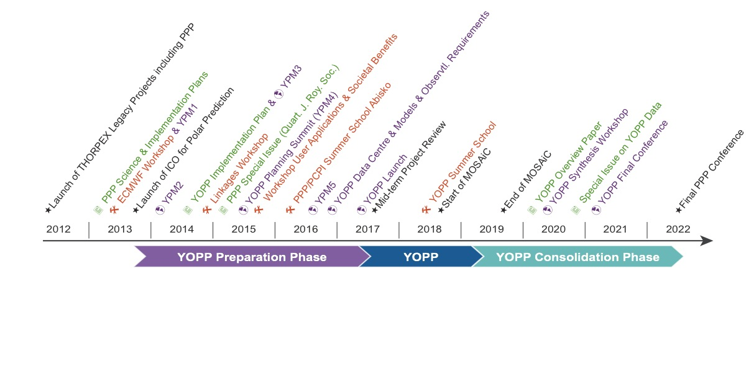
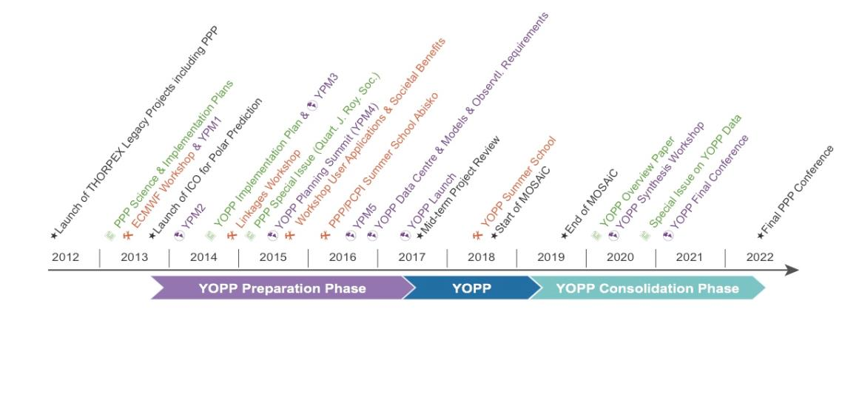
Summary
Polar prediction is fundamental to what we do
YOPP provides an opportunity to benefit from international focus on polar prediction issues and develop/enhance collaborations.
PPP/YOPP has gained high visibility
YOPP Summit (13-15 July 2015, Geneva)
EU H2020 Proposals currently under consideration…
Detailed ECCC Implementation plan being developed
YOPP Planning Meeting
Sept. 5-9, 2016, Reading, UK
YOPP Kickoff meeting:
July 2017, WMO Headquarters, Geneva
Further information: http://polarprediction.net

Slide 21
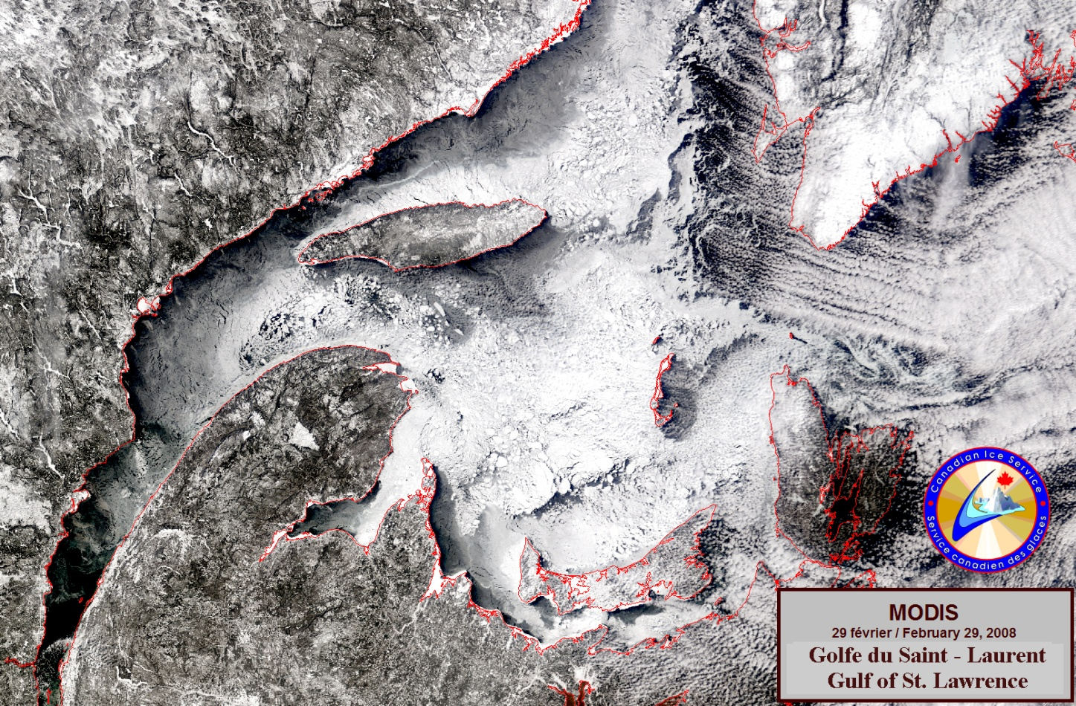
Thank you!

