Slide 1
Remote Sensing Support for the National Weather Service’s Alaska Sea Ice Program
Eric Stevens¹, Mary-Beth Schreck²
Carl Dierking¹, Tom Heinrichs¹, and Jessie Cherry¹
¹Geographic Information Network of Alaska (GINA)
²National Weather Service, Anchorage, Alaska

Slide 2
Roadmap
The Alaska Challenge
Not bear wrestling…but the challenge of meteorological analysis and forecasting
The High Latitude Proving Ground
Specific Proving Ground products that help the NWS Ice Program do its job

Slide 3
The Alaska Challenge
Alaska is a synoptic-scale Region within a mesoscale-oriented NWS
Areas of responsibility are (comparatively) huge
The land portion of these areas of responsibility are topographically complex, yielding myriad microclimates
Many observational networks (such as 88Ds) are very sparse…
Big problem because the first step in forecasting is analyzing and understanding the weather now at time=0
The specter of climate change being concentrated in the high latitudes means that old “rules of thumb” may suffer from diminishing relevance

Slide 4
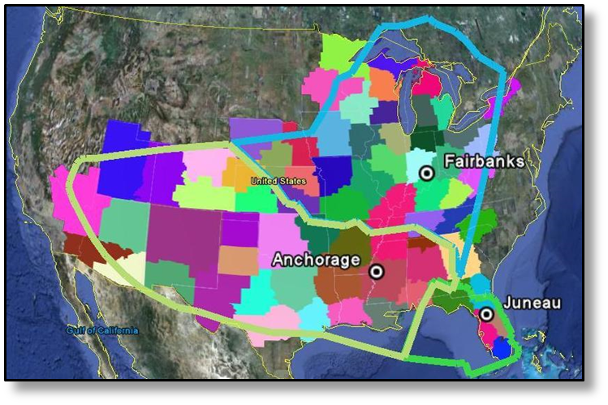

Slide 5
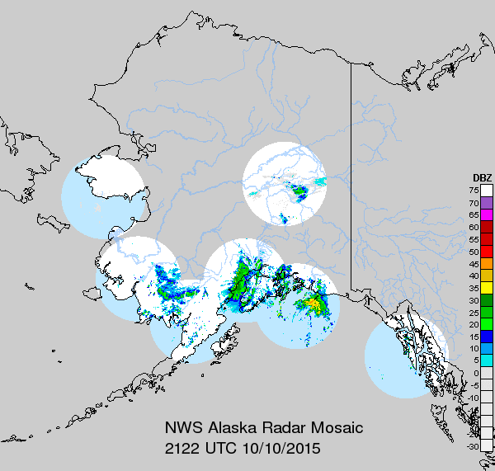

Slide 6
The High Latitude Proving Ground
Thanks to its high latitude, Alaska enjoys frequent coverage from polar orbiting satellites
The University of Alaska Fairbanks (UAF) receives data from a number of polar orbiting satellites, including S-NPP
The data are then processed into AWIPS-ready imagery, as well as into non-AWIPS image formats
The resulting imagery is delivered to the NWS via Local Data Management (LDM)
This approach minimizes latency

Slide 7
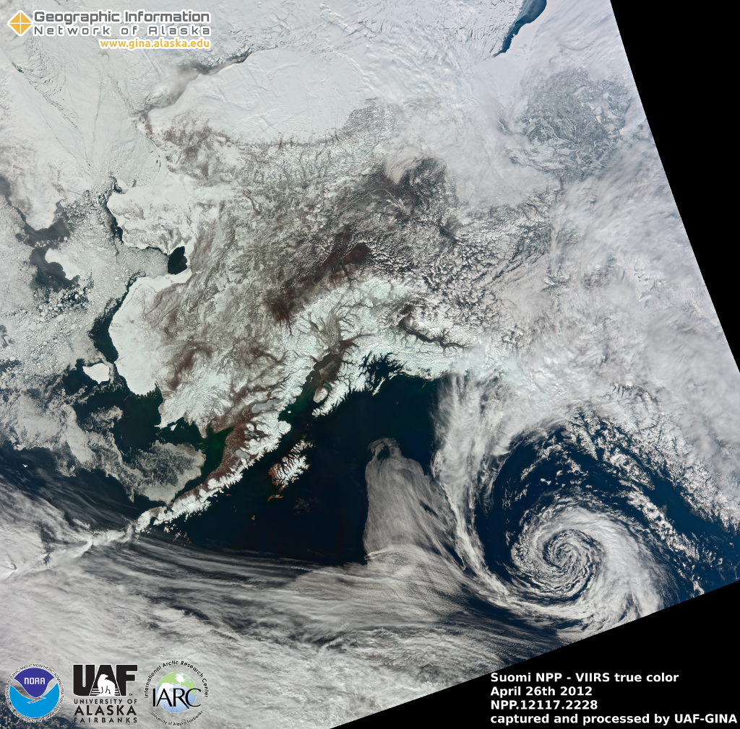

Slide 8
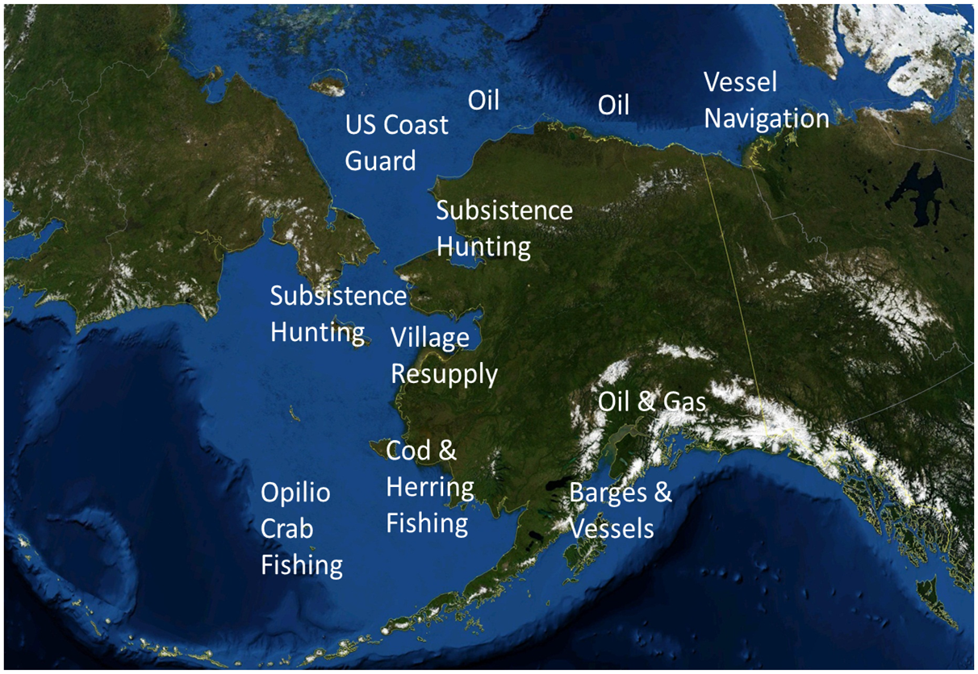
Sea Ice Program Customers

Slide 9
Products Used by the Ice Program
Multispectral RGB (Red Green Blue)
Built from SNPP-VIIRS bands I01, I02, and I03
Spectral range from 0.64µm to 1.61µm
1.61µm channel highlights difference between liquid water and ice/snow
375m resolution
These short wavelengths rely on reflection of incoming sunlight: great during summer, less useful during winter
This product allows forecasters to easily identify which areas are cloud, which are sea ice
Just to keep us confused, this product is known by different names within different groups: False Color, Natural Color, and Land Cover

Slide 10
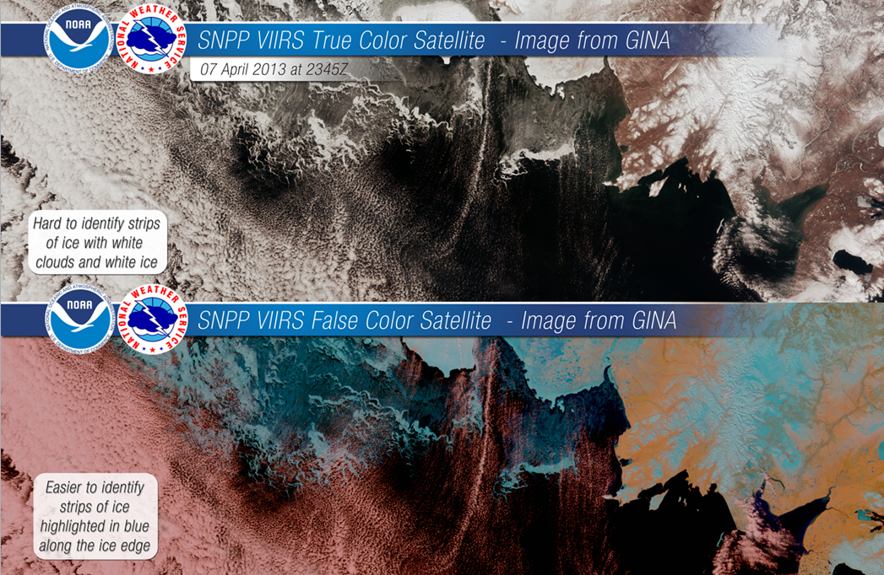

Slide 11
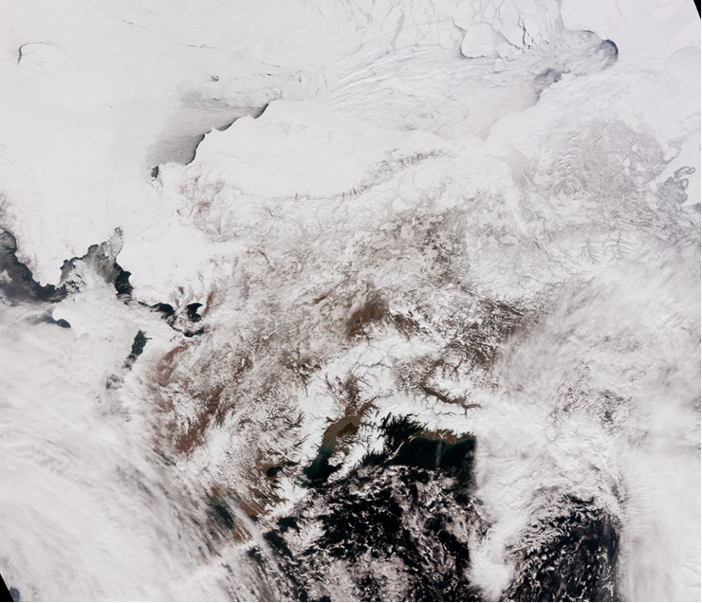
Notes:
This image, as well as the following few, is from April 17, 2016 at 2205Z, or 205pm local time.

Slide 12
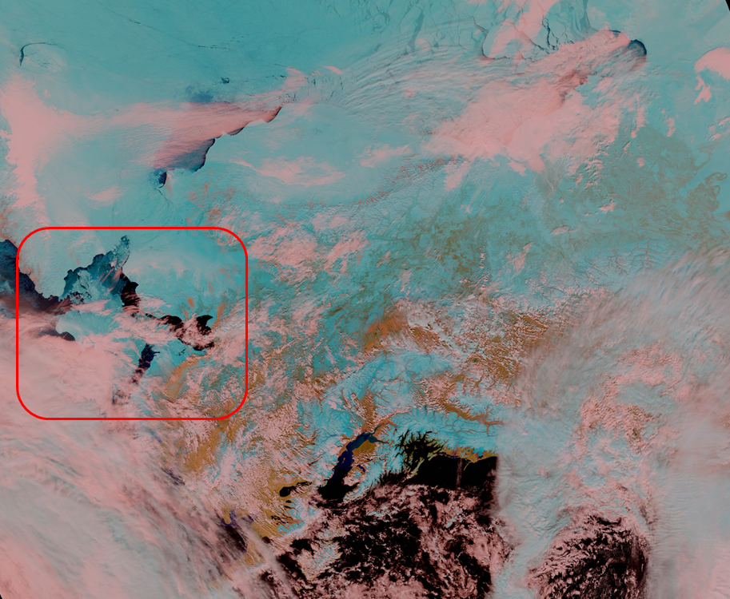

Slide 13
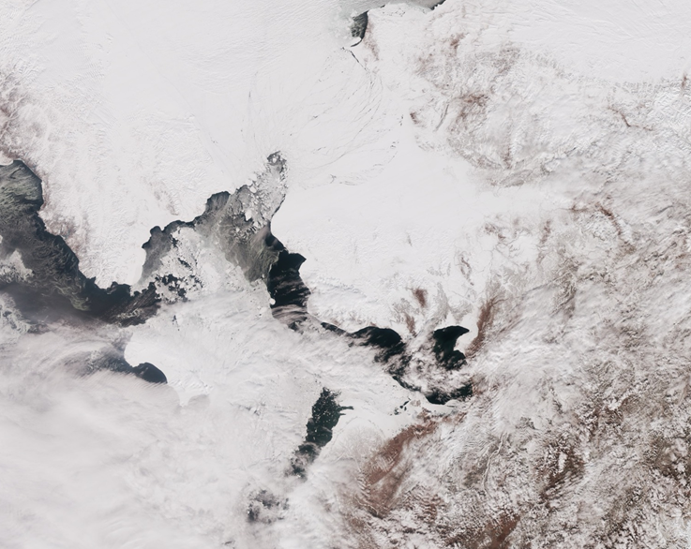

Slide 14
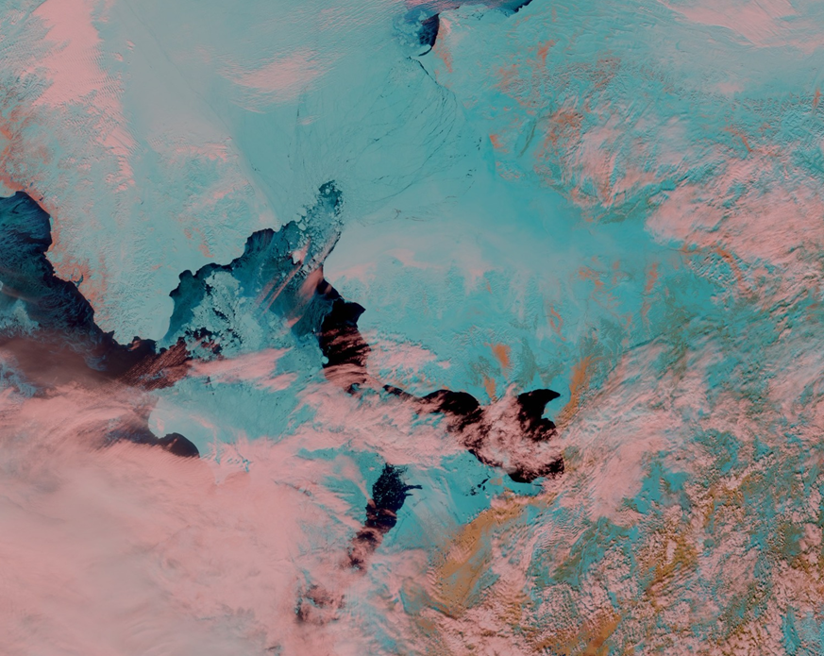

Slide 15
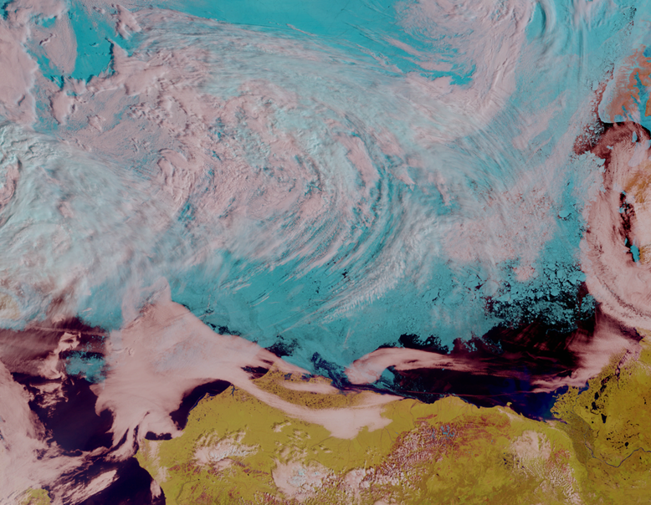
Notes:
July, 2014

Slide 16
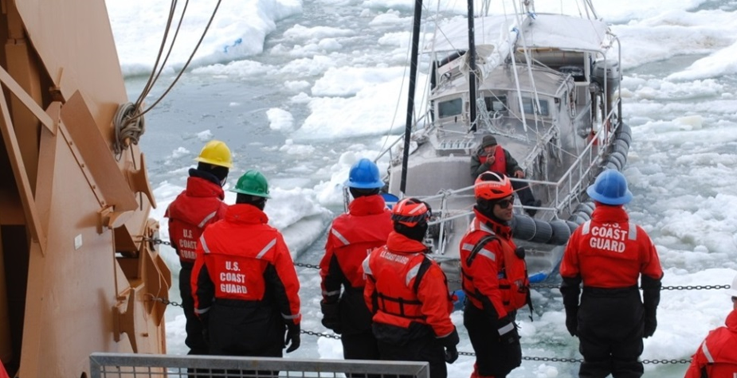
USCG Rescues Mariner in Sailboat Trapped in Ice North of Barrow
WFO Anchorage sea ice forecasters provided “phenomenal weather products” that proved key to USCG decision makers, said Rear Adm. Dan Abel, commander, 17th Coast Guard District.

Slide 17
Products Used by the Ice Program
The VIIRS Day Night Band (DNB)
A single-channel image covering visible to near-IR wavelengths: 0.5µm to 0.9µm
Sensitive to visible light emissivity and reflection across seven orders of magnitude of signal strength
The upshot: the DNB can “see in the dark”
Very useful during the Alaska winter, especially because there is minimal anthropogenic light pollution in Alaska (although aurora occasionally obscures meteorological and terrain features)

Slide 18
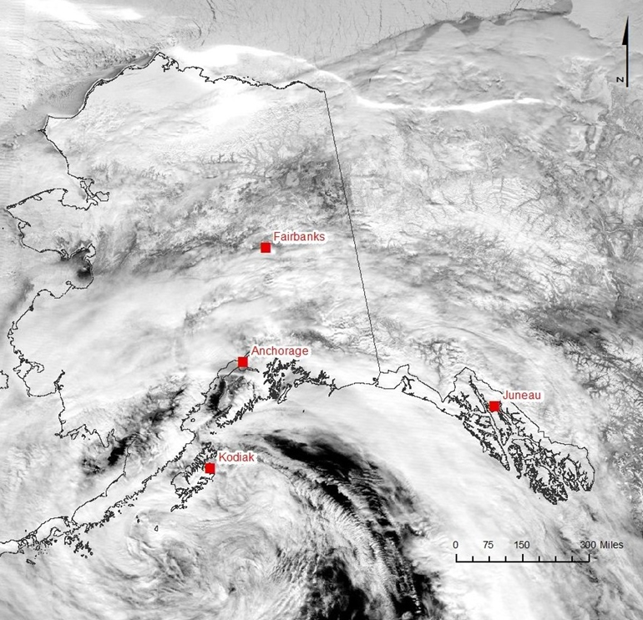
Notes:
VIIRS DNB from December 30, 2012 at 1141Z, or 241am local time

Slide 19
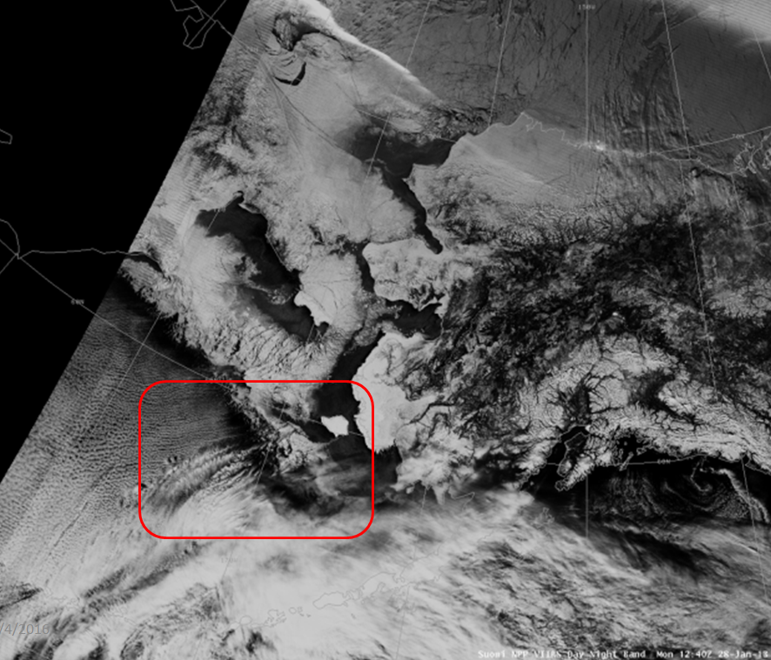

Slide 20
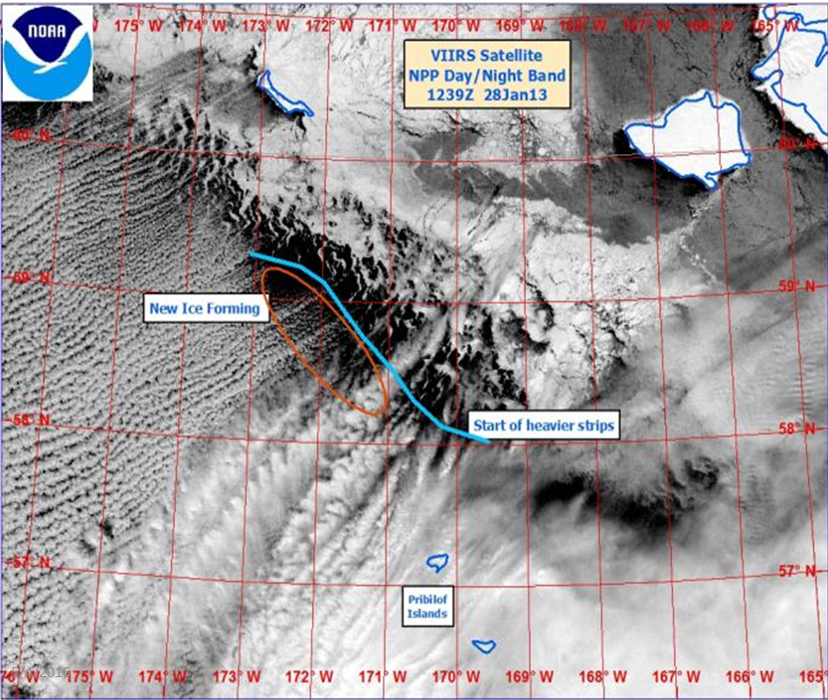

Slide 21
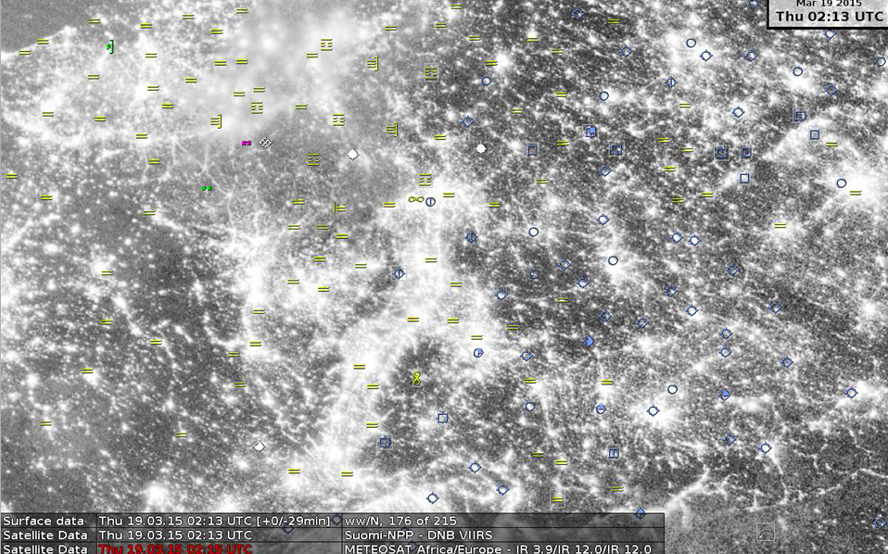

Slide 22
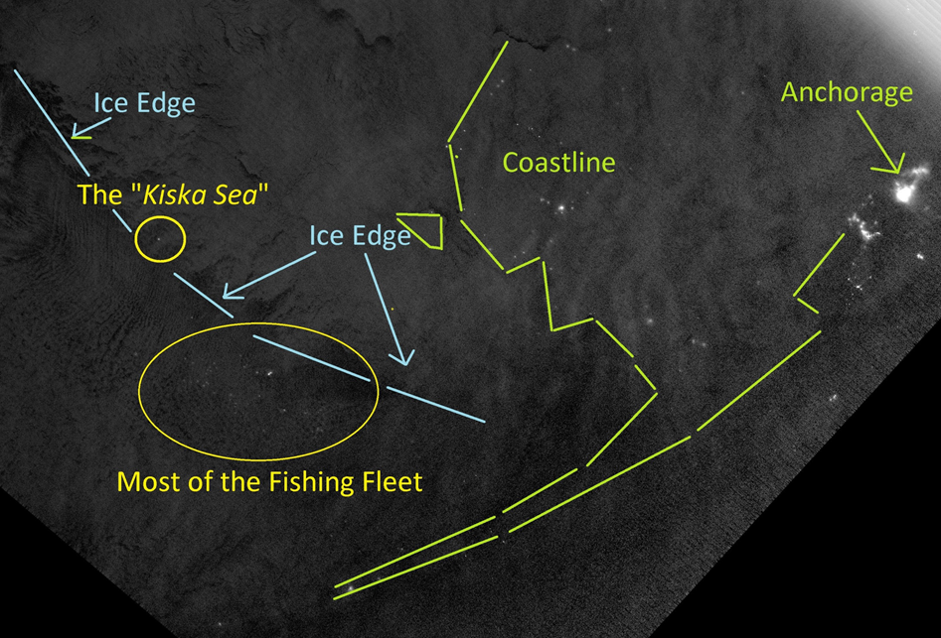
Notes:
The classic “Kiska Sea” shot. Feb 13, 2013, near period of new moon

Slide 23
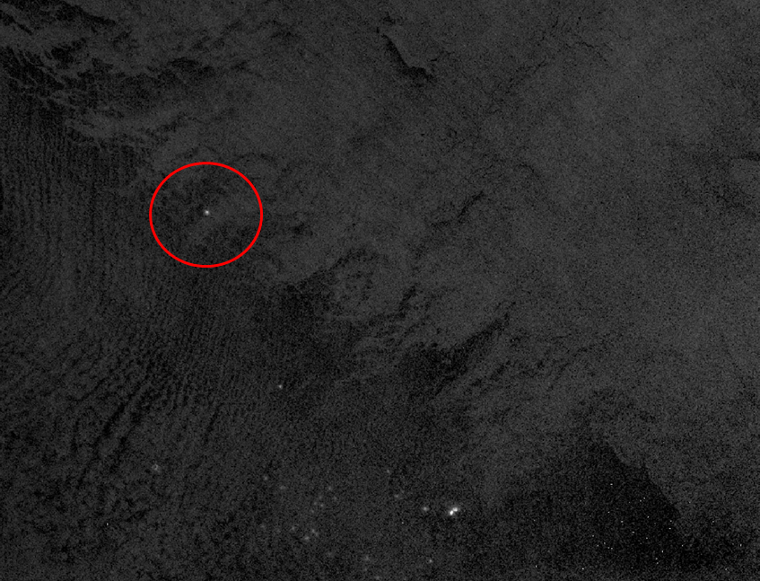

Slide 24
Products Used by the Ice Program
In winter, classic longwave IR (around 11µm) is useful, especially for multi-year ice
“Without longwave IR and the Day Night Band, could not do analysis north of Norton Sound in the winter” –Mary-Beth Schreck
In summer, classic visible imagery
SAR very useful, get 2-5 images per day
The more SAR the better, particularly useful when combined with other imagery

Slide 25
Light gray: Leads with New Ice Growth
Mid-tone Gray: First Year Ice
Dark gray: Multi-year Ice Floes

Slide 26
Roadmap
The Alaska Challenge
Not bear wrestling…but the challenge of meteorological analysis and forecasting
The High Latitude Proving Ground
Specific Proving Ground products that help the NWS Ice Program do its job

Slide 27
Question and Answers
Mary-Beth Schreck of the NWS Alaska Ice Program is in the house! Any questions for Mary-Beth or Eric?
marybeth.schreck@noaa.gov
eric@gina.alaska.edu

