Slide 1
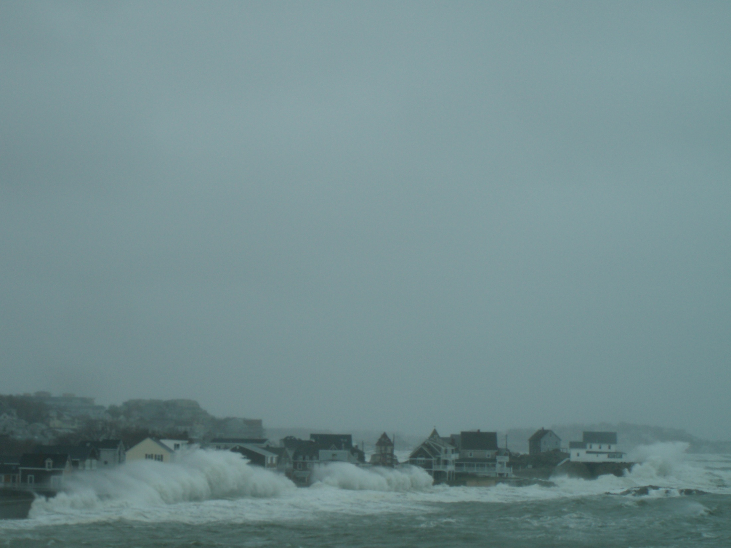
Overtopping of Seawalls
Tony Mignone National Weather Service Caribou Maine anthony.mignone@noaa.gov

Slide 2
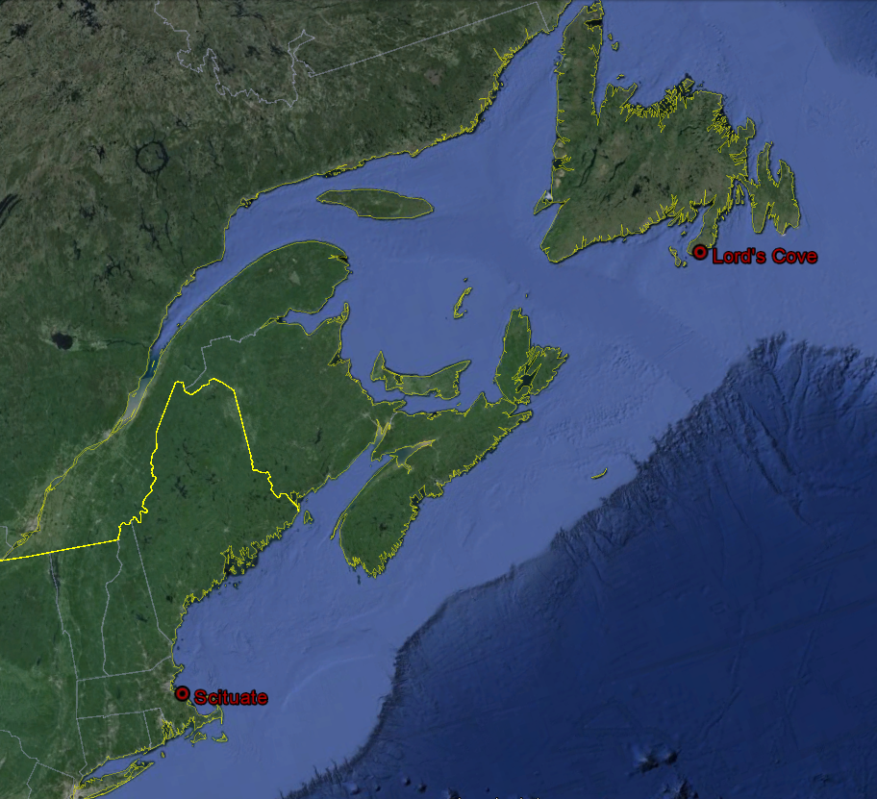
Location of Test Sites

Slide 3
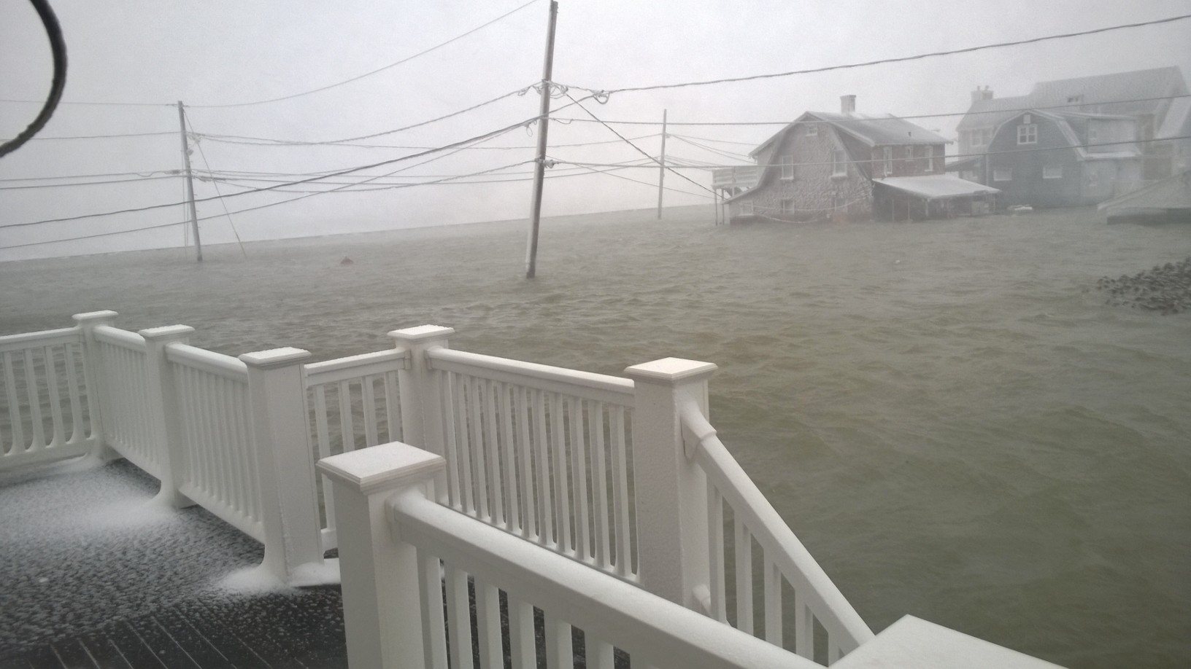
Avenues Basin Flooded from Overtopping
Time Stamp = 27th/0754 EST
Water Level = 15.476 feet
Seawall
Seawall
Seawall
Stop Sign 7th &
Ocean Side Dr.
January 27, 2015

Slide 4
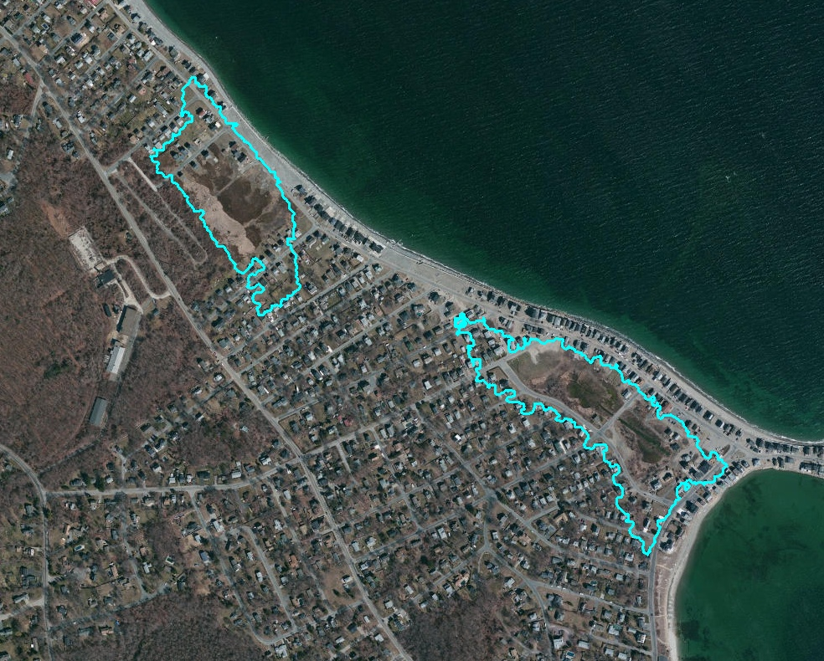
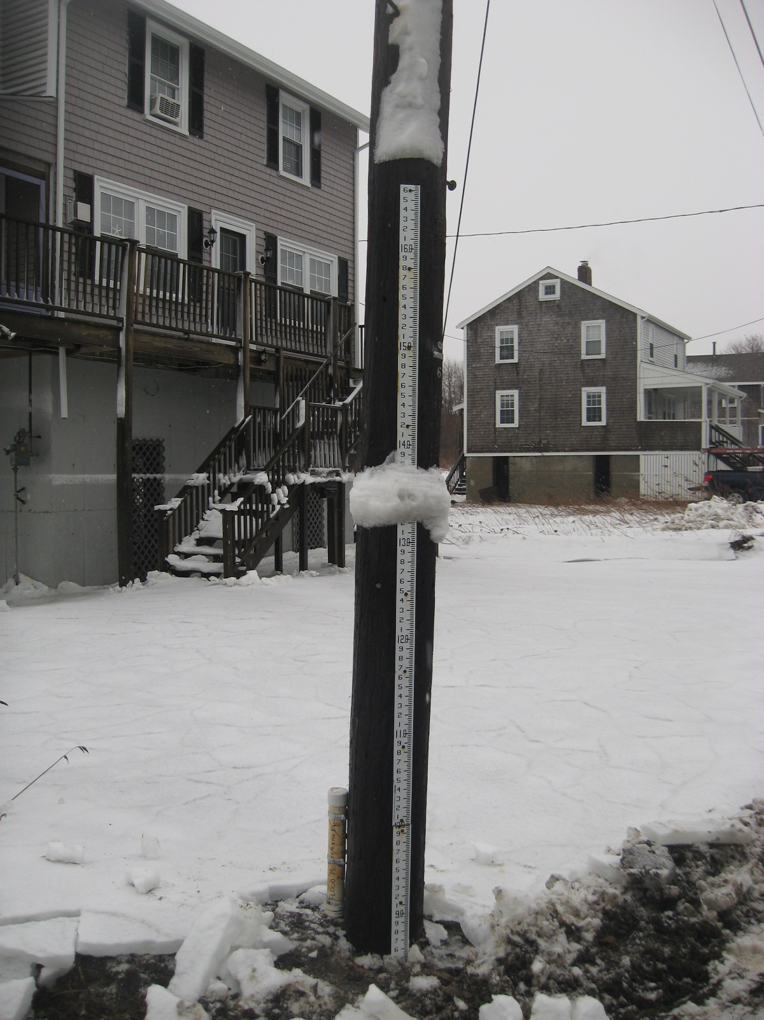
Seawall at Scituate Massachusetts
Length of seawall used for calculations
Seawall
Staff Gauge
7th Avenue Basin
Seawall
Data Logger
Seawall
Staff Gauge
Scituate Ave Basin

Slide 5
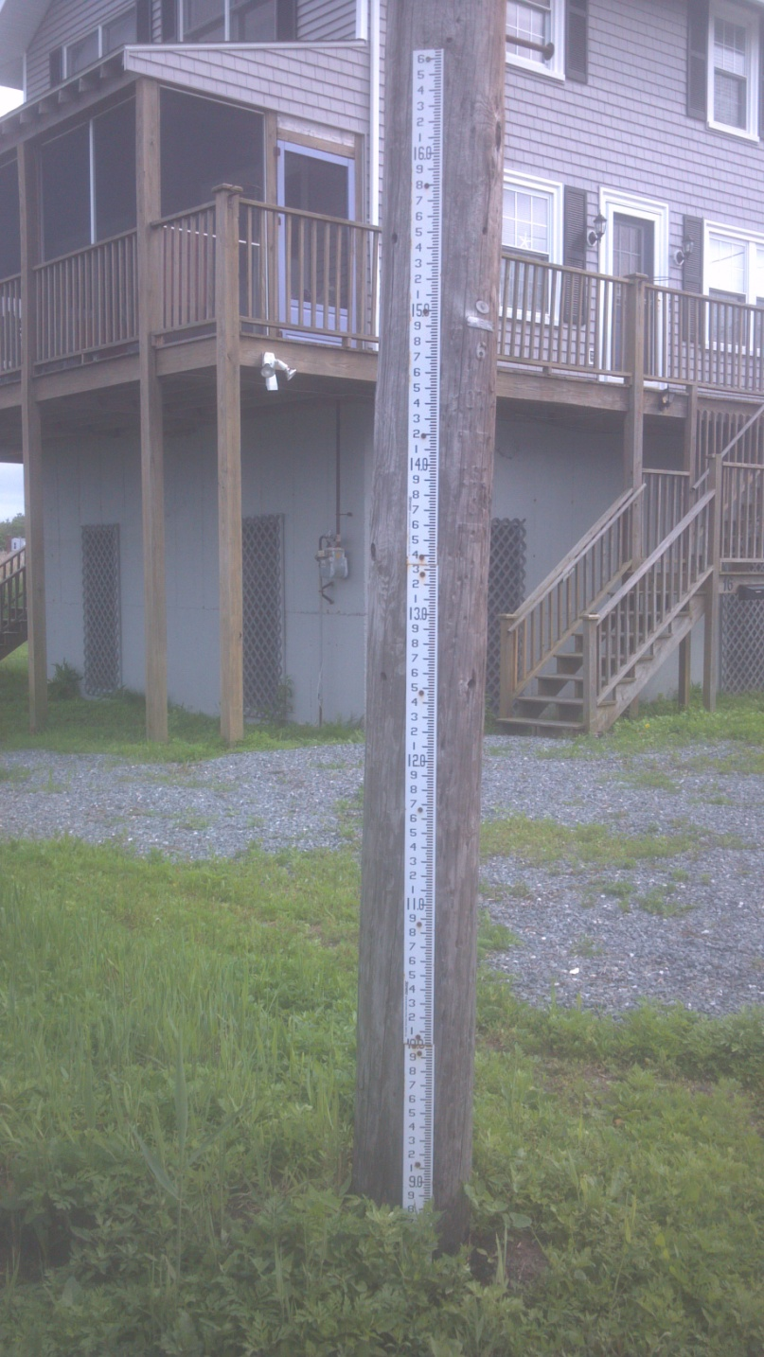
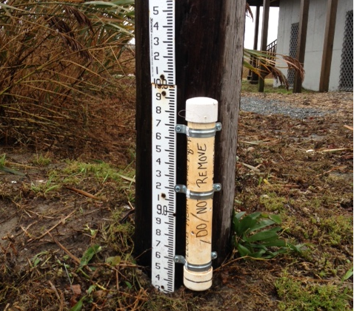
Test Events
Deploy Water Level Pressure Gauge/Data Logger to Bottom of Staff gauge prior to expected storm event to measure water depth per unit time.

Slide 7
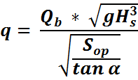
Overtopping Parameterization
Bruce, van der Meer, and Jansen
Mean overtopping discharge
m³/s per meter of structure length
Off shore wave steepness
Dimensionless Freeboard for slopes
Adjusted Dimensionless Freeboard for slopes (Bruce)
Plunging wave dimensionless discharge

Slide 8
Algorithm Parameters
Freeboard & Slope
Seawall Crest
Freeboard
Seawall
toe
Slope measured from the +2.0 MLLW level to the seawall toe
Still Water Level (SWL)

Slide 9
Reduction Factors
= Reduction factor for shallow water
= Reduction factor for Berm/Sandbar
= Reduction factor for foreshore roughness
= Reduction factor for angle of wave attack

Slide 10
Shallow water reduction factor
J.P. de Waal & J.W. van der Meer
Smaller waves break closer to the seawall
Larger waves break in deeper water
Notes:
We are currently using wave heights derived by the Near Shore Wave Model at the 20 meter isobath on a line normal to the site. This is problematic in shallow water sites in that large higher period waves break further off-shore than small shorter period waves that break closer to the structure. The larger waves pack more energy but lose much of this since they break further off-shore. The smaller waves have less energy but break closer to the structure so deliver more of their energy for overtopping. The idea of this reduction factor is to equalize this discrepancy.

Slide 11
Angle of wave attack reduction factor
J.P. de Waal & J.W. van der Meer
Seawall
Short crested waves
Long crested waves
Wave Direction

Slide 12
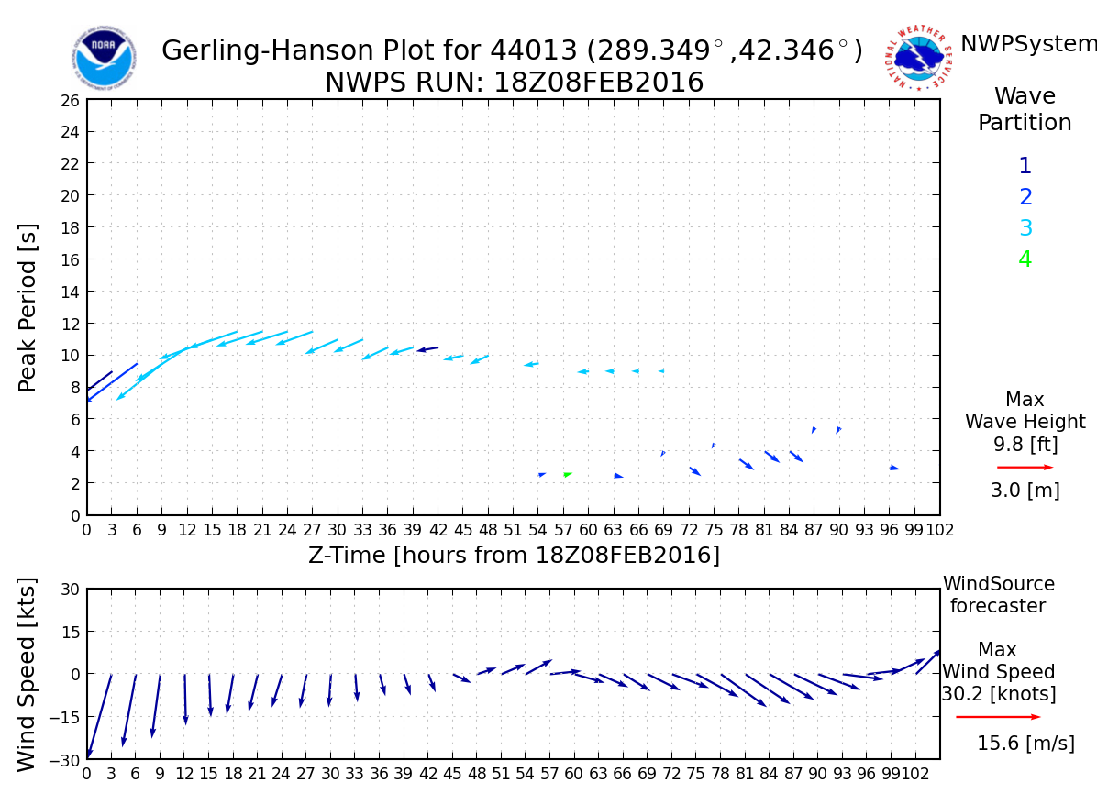

Slide 13
Suggested Adjustment
Kalman Filter
Application of a Kalman Filter to determine bias?
Suggested By:
Andrew Teakles (Environment Canada)

Slide 14
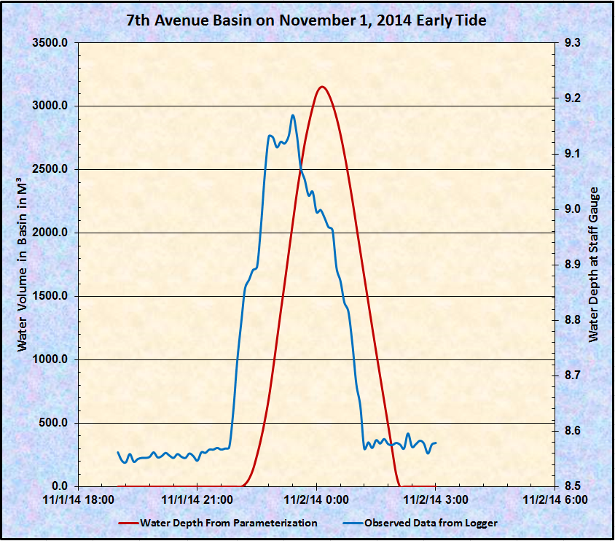

Slide 15
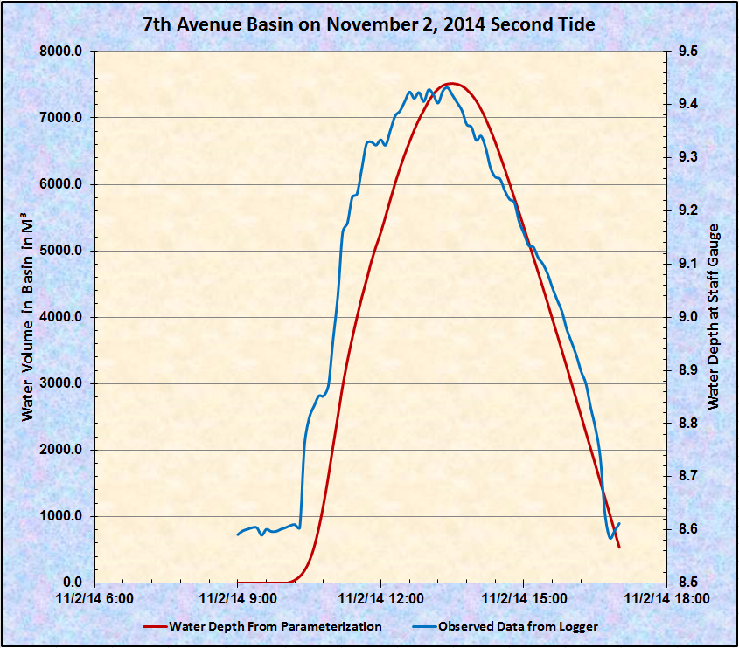

Slide 16
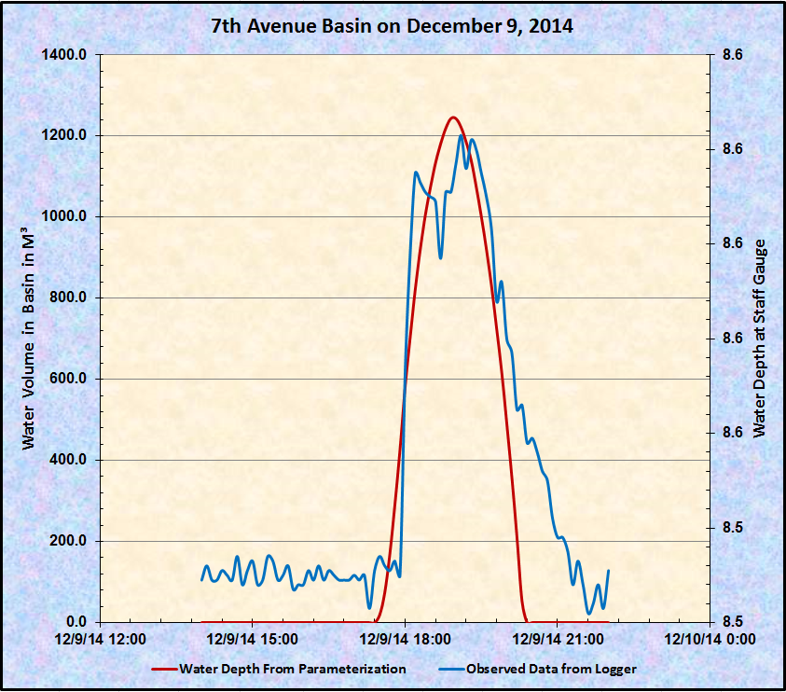

Slide 17
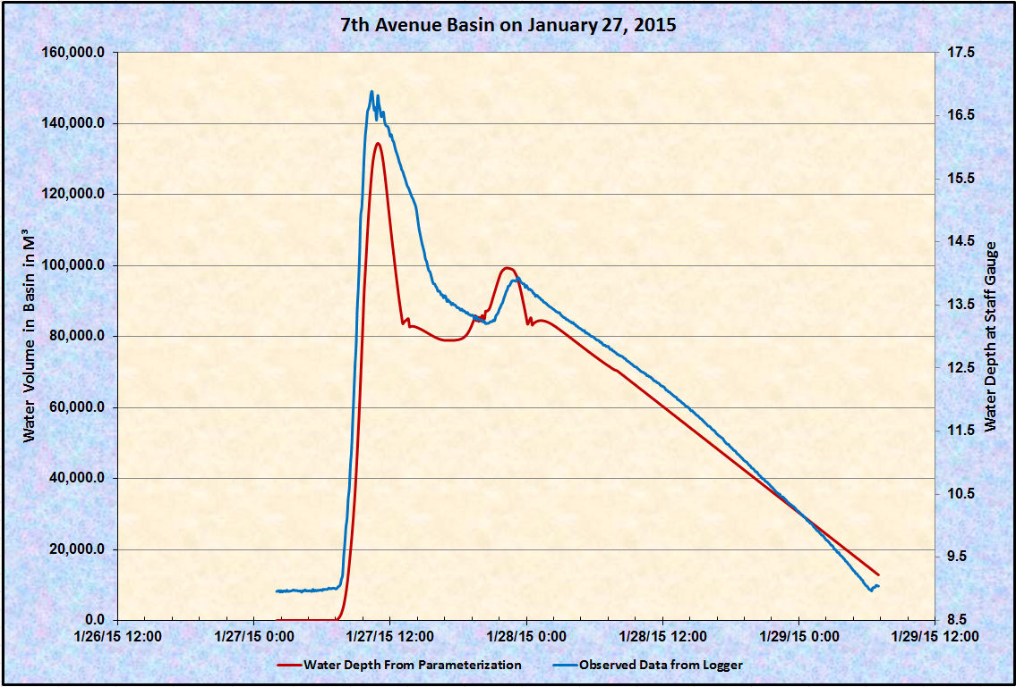

Slide 18
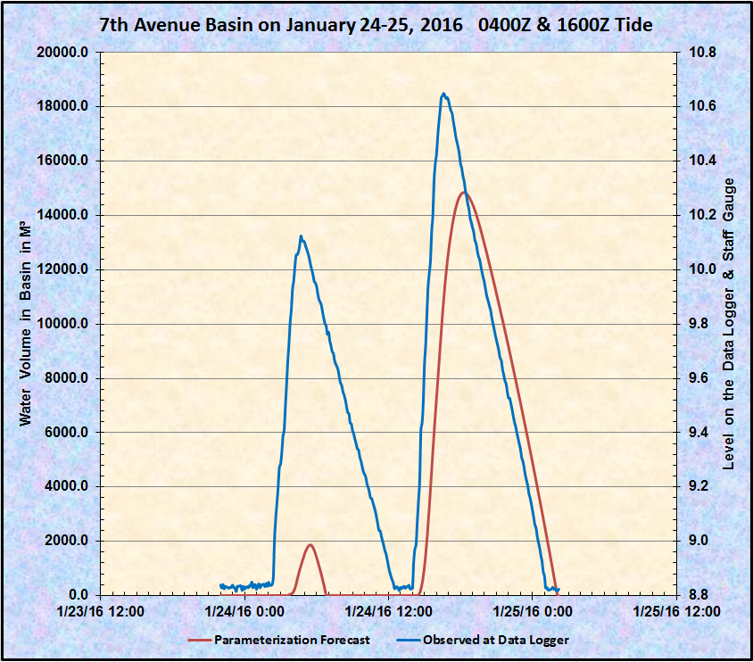

Slide 19
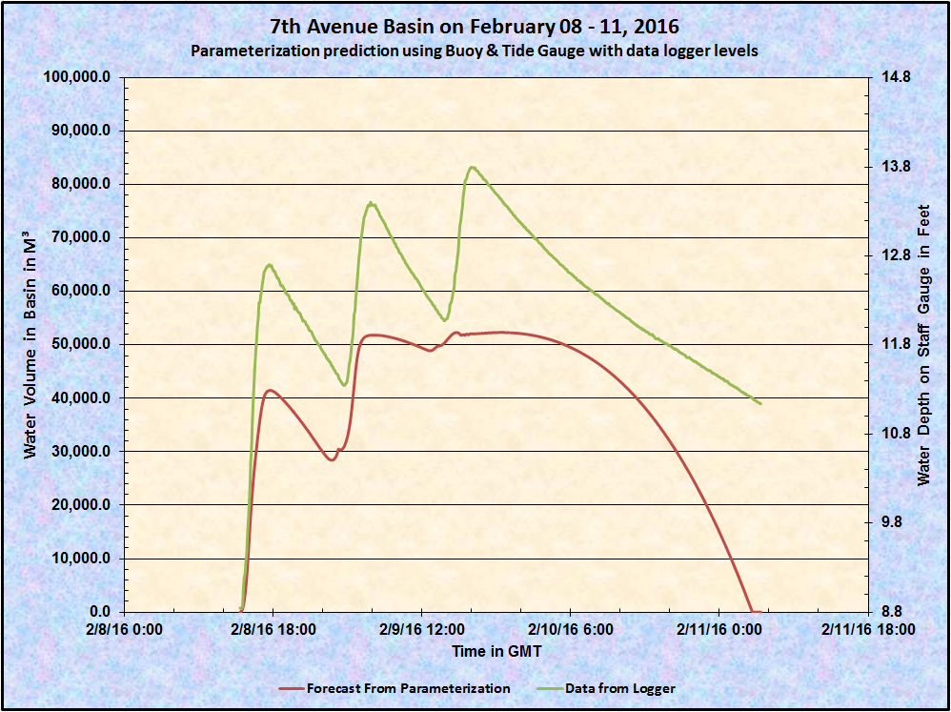

Slide 20
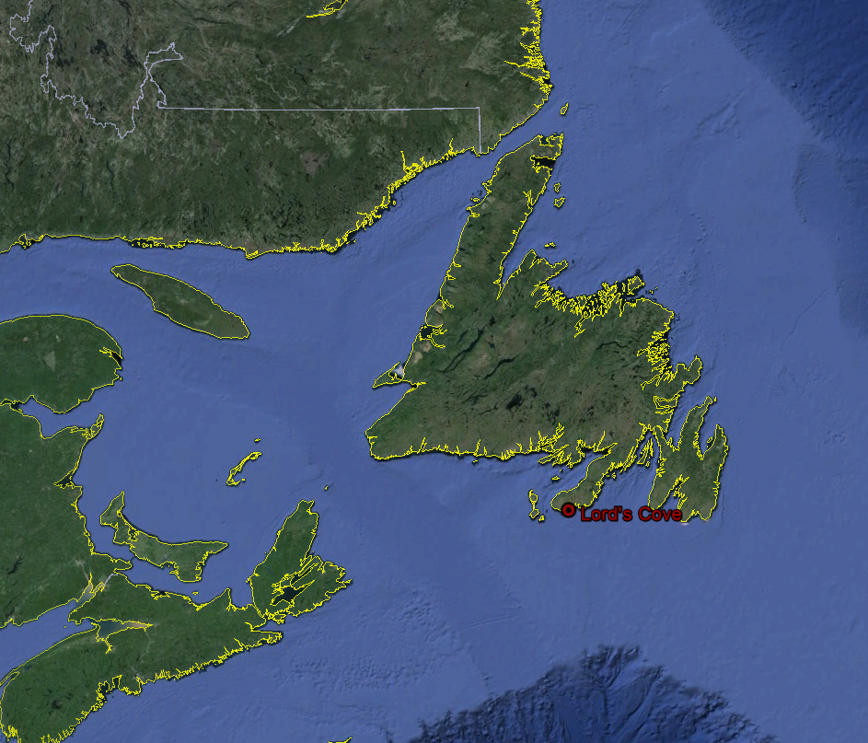
Lord’s Cove

Slide 21
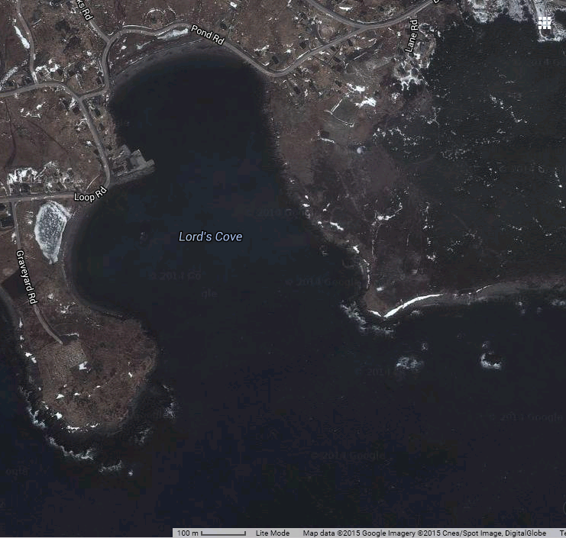
Lord’s Cove
Wave Energy Research Centre
(WERC)

Slide 22
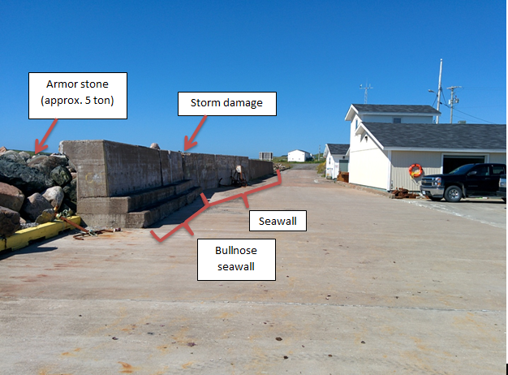
Seawall at WERC

Slide 23
Lord’s Cove, NL Devon Telford

Slide 24
J.P. de Wall & J.W. van der Meer Parameterizations Devon Telford

Slide 25
Lord’s Cove, NL - March 22, 2015 Event Devon Telford
Using Goda (2008) empirical formulas for breaking wave height and the estimated near shore slopes from the bathymetry charts.
Hb=5.5m
Hb=5.6m
Hb=5.5m
m=.014
m=.007
Hb=5.5m
m=.02
m=.015

Slide 26
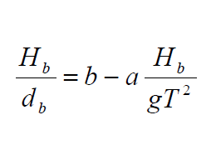
Lord’s Cove, NL - March 22, 2015 Event Devon Telford
Using Goda (2010) empirical formulas for breaking wave depth and the estimated near shore slopes from the bathymetry charts.
hb=-4.2 m
hb=-4.5m
hb=-4.0m
hb=-4.1m
m=.014
m=.007
m=.02
m=.015

Slide 27
Lord’s Cove, NL - March 22, 2015 Event Devon Telford
So we can “know” everything but the depth of the water when the waves break again right before the revetment.
But we can estimate it from the video and picture.
h [m] | q (cu m) | q (cu ft)
1 | 0.04135 | 1.460
1.5 | 0.04718 | 1.666
2 | 0.05525 | 1.951
2.5 | 0.06388 | 2.256
3 | 0.07303 | 2.579
3.5 | 0.08264 | 2.918
4.000 | 0.09266 | 3.272

Slide 28
Lord’s Cove Seawall
(46.878208⁰ N 55.669737⁰ W)
Crown Wall
Berm Width
Revetment
Slope
$$A_{c}$$
$$cotα$$

Slide 29
Overtopping Parameterization
Jan Pedersen
$$Q=3.2 X {10}^{−5}\left(\frac{L_{om}^{2}}{T_{om}}\right){\left(\frac{H_{s}}{R_{c}}\right)}^{3}\frac{H_{s}^{2}}{A_{c}βcotα}$$
$T_{om}$ = Mean Wave Period
$L_{om}$ = Wave Length
$H_{s}$ = Wave Height at Toe of Revetment
$R_{c}$ = Free board
$A_{c}$ = Berm Elevation
$β$ = Berm Width
$cotα$ = Revetment Slope

Slide 30
Common Runup & Overtopping Parameterization
Data Points
Deep water outside Surface Zone
At the toe of the foreshore
At the toe of the Structure

Slide 31
Goda Equations
$H_{\frac{1}{3}}= \left\{\begin{aligned}K_{s}H_{o} : h/{L_{o}}≥0.20 \\ min\left\{\left(β_{o}H_{O}+β_{1}H_{1}\right), β_{max }H_{o}, K_{s}K_{o} :h/{L_{o}}<.0.20 \right.\end{aligned}\right.$
$β_{o}=0.028{\frac{H_{o}}{L_{o}}}^{−0.38} e^{\left[20\tan^{1.5}\right]}$
$β_{1}=0.52e^{\left[4.2tanθ\right]}$
$β_{max}= \left\{0.92, 0.32{\left(\frac{H_{o}}{L_{o}}\right)}^{−0.29}\right.e^{\left[2.4tanθ\right]}$
$β_{0}^{∗}$ = 0.052${\left(\frac{H_{0}}{L_{0}}\right)}^{−0.38}e^{\left[20\tan^{1.5}\right]}θ$
$L_{0}=1.56T^{2}$

Slide 32
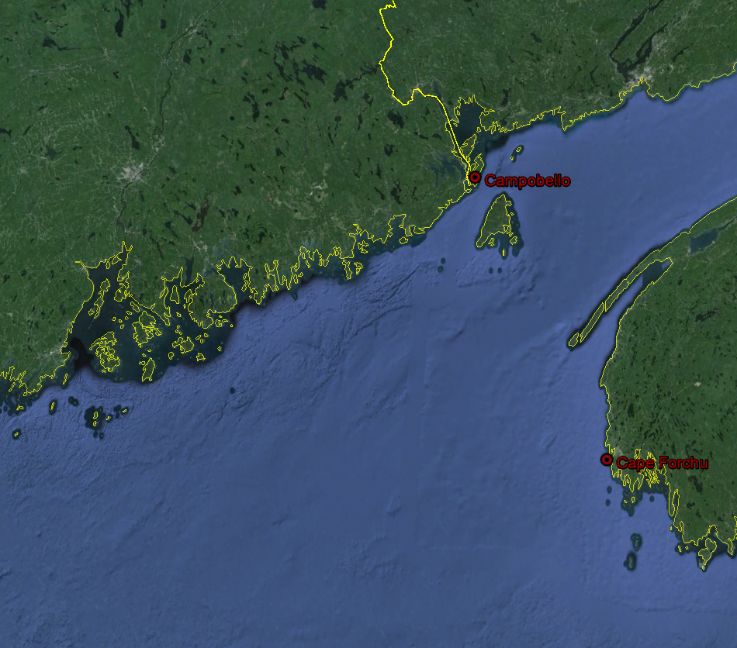
Campobello in our NWPS Domain
Model Boundary Spectral Point
CAR59

Slide 33
Questions ??

