Slide 1
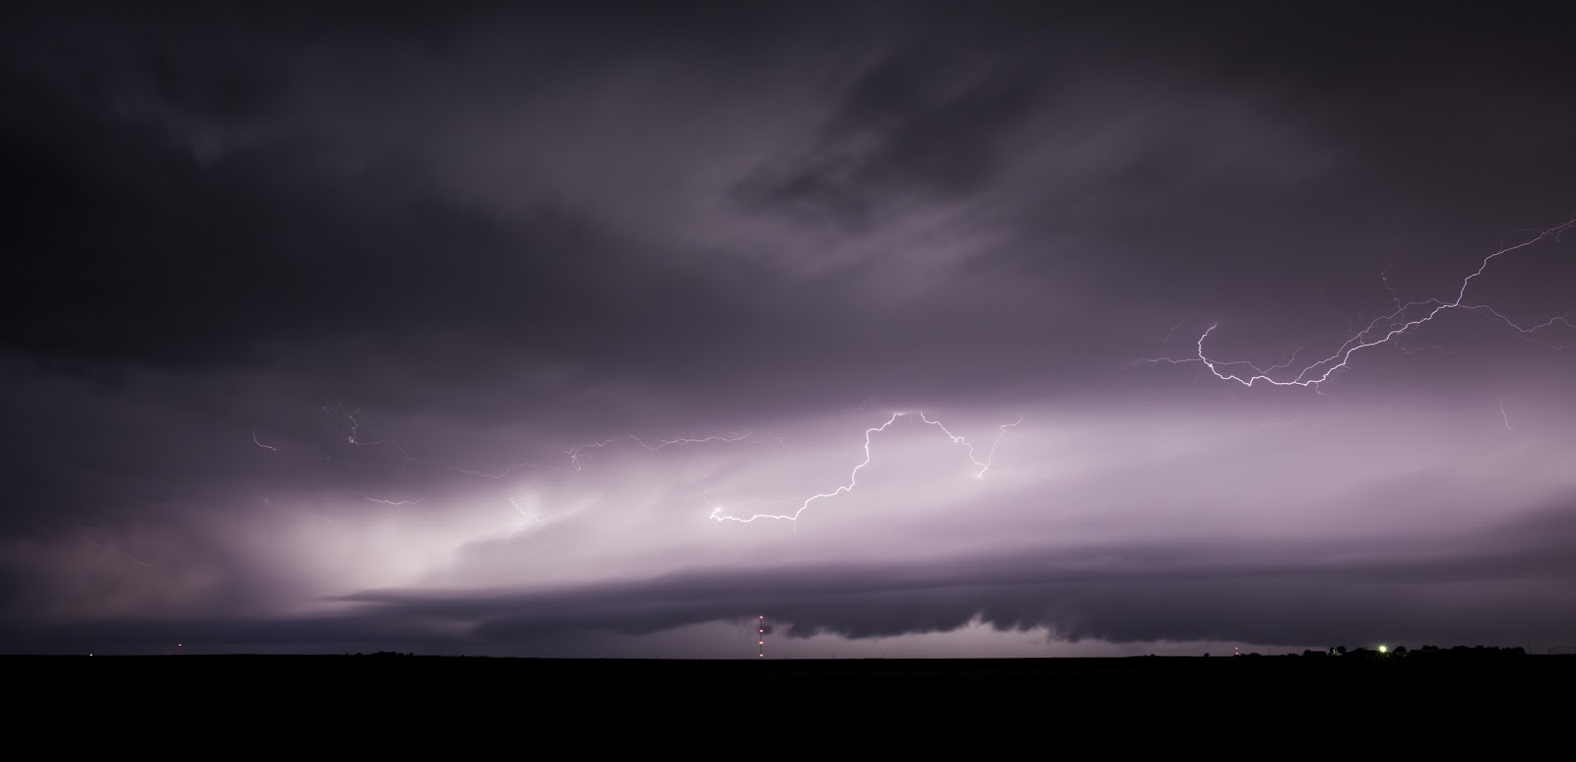
Preliminary Results from a Study on the Environments of Thunderstorms Over the Northeastern Pacific Ocean and Gulf of Alaska
Jonathan Garner
National Weather Service
Juneau, AK

Slide 2
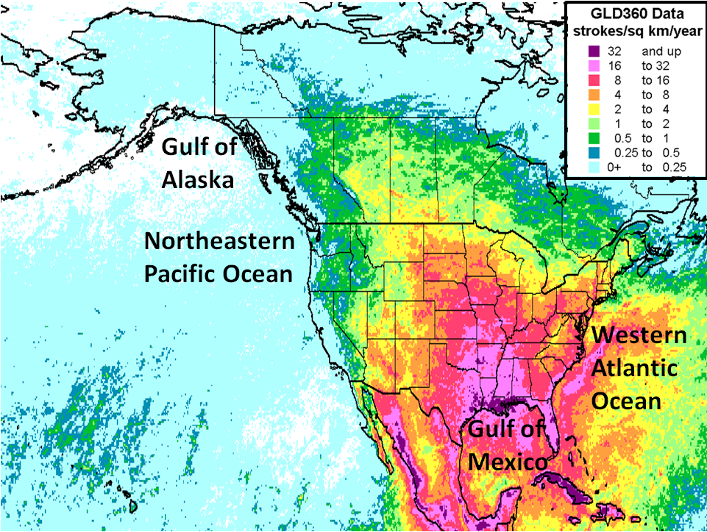
Introduction
Image courtesy of
Ron Holle
Marine lightning hazard is pronounced over the Atlantic Ocean and Gulf of Mexico
Thunderstorms still occur frequently enough over the GOA and NERN PAC, such that forecasters must remain alert
The purpose of this study is to evaluate the thunderstorm environment specific to cool marine environments
End goal is better decision support for mariners

Slide 3
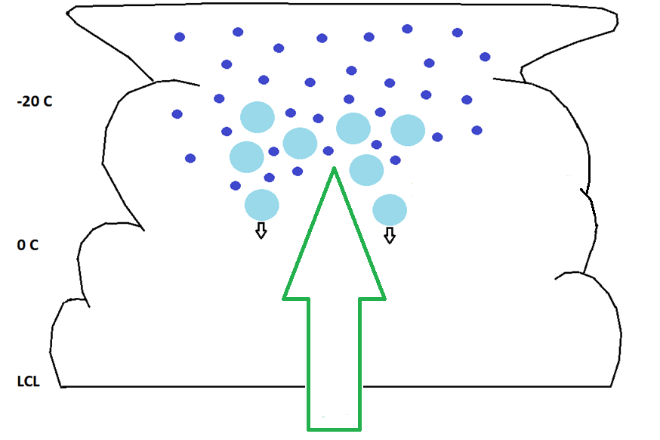
Thunderstorm Electrification Bright et al. (2005)
Equilibrium Level Temperature ≤ −20° C: Ensures updraft extends through the charge reversal temperature zone
CHARGE
REVERSAL
TEMPERATURE
ZONE
CAPE in the 0° to −20° C layer ≥ 100 to 200 J kg⁻¹: Ensures sufficient upward vertical motion exists through the charge reversal temperature zone
WARM
CLOUD
LAYER
Temperature at the Lifting Condensation Level ≥ −10° C: Ensures the presence of supercooled water

Slide 4
Methodology
Lightning strikes (null-events) observed during operational shifts
GLD360 lightning data
40-km GFS proximity soundings used to analyze thermodynamic parameters
GFS utilized due to large model domain
Model surface temperature/dewpoint compared with closest fixed buoy…modified if difference exceeded 1° C
Model error analysis performed from the surface to 300 mb for PAYA, PANT, and KUIL

Slide 5
Methodology
Results presented today span from August 2014 to March 2016
Lightning and null events were classified by warm season (WS; May-Oct) and cool season (CS; Nov-April) occurrence
Null event defined as environment with positive CAPE and convective cloud structures (observed in satellite imagery), not associated with lightning strikes occurring with the prevailing synoptic regime
Events also classified based on synoptic location

Slide 6
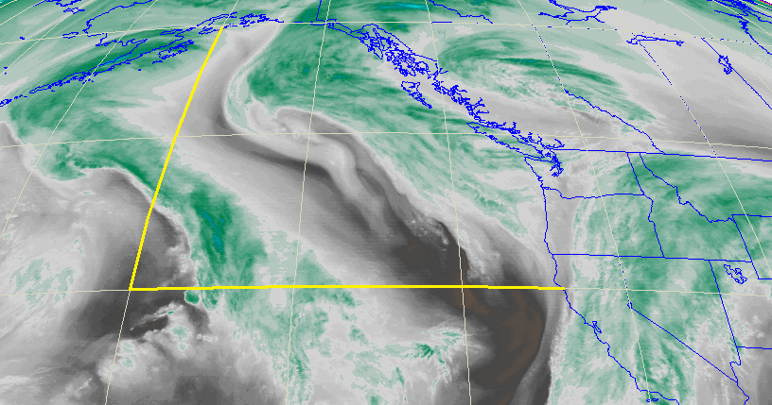
Domain
150° W
40° N

Slide 7
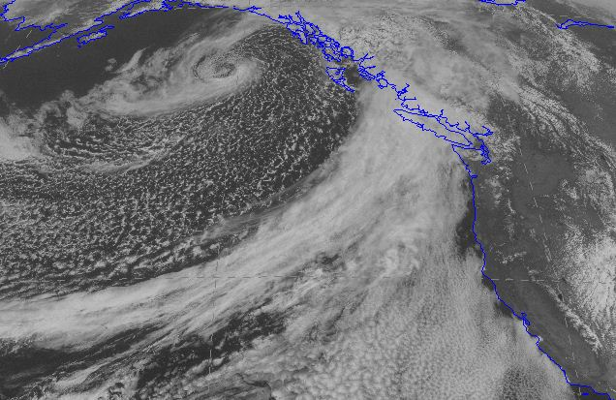
Synoptic Classification
Post Frontal
(106 Lightning Events /
75 Null Events)
Warm Conveyor
Belt (8 Lightning
Events / 8 Null
Events)
Frontal
(56 Lightning Events /
30 Null Events)

Slide 8
40-km GFS Error Analysis
Temperature
Dewpoint
mb
mb
° C
° C

Slide 9
Thermodynamic Parameters
PARAMETER | LIGHTNING WARM SEASON (mean) | NULL WARM SEASON (mean) | LIGHTNING COOL SEASON (mean) | NULL COOL SEASON (mean)
PW (GFS) | 0.96 in. | 0.96 in. | 0.53 in. | 0.47 in.
SST (Satellite) | 15.7° C | 13.1° C | 11.3° C | 8.6° C
925-mb T (GFS) | 10.3° C | 8.3° C | 4.6° C | 2.5° C
500-mb T (GFS) | -21° C | -20.5° C | -29.6° C | -31.2° C
925―600-mb Lapse Rate (GFS) | 6.3° C km⁻¹ | 5.8° C km⁻¹ | 7.3° C km⁻¹ | 7.2° C km⁻¹

Slide 10
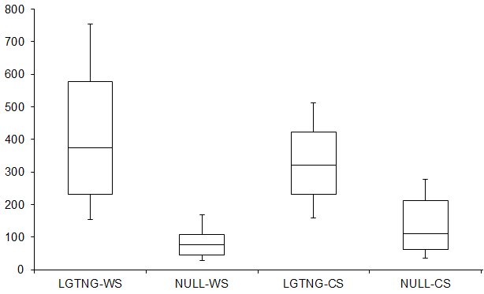
MUCAPE
J kg⁻¹
LGTNG-WS MEAN | 419 J kg⁻¹ (n=65)
NULL-WS MEAN | 88 J kg⁻¹ (n=41)
STATISTICALLY SIGNIFICANT | >99% Confidence Level
LGTNG-CS MEAN | 334 J kg⁻¹ (n=105)
NULL-CS MEAN | 148 J kg⁻¹ (n=72)
STATISTICALLY SIGNIFICANT | >99% Confidence Level

Slide 11
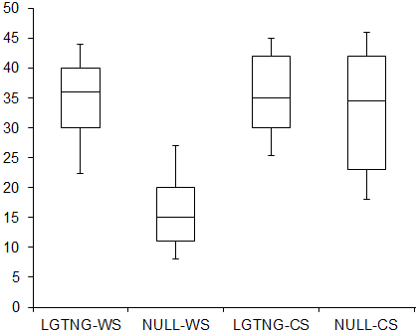
EL Temperature
° C
-
-
-
-
-
-
-
-
-
-
LGTNG-WS MEAN | -35° C (n=65)
NULL-WS MEAN | -16° C (n=41)
STATISTICALLY SIGNIFICANT | >99% Confidence Level
LGTNG-CS MEAN | -35° C (n=105)
NULL-CS MEAN | -32° C (n=72)
NOT STATISTICALLY SIGNIFICANT | <95% Confidence Level

Slide 12
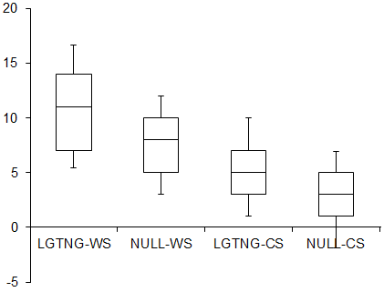
LCL Temperature
° C
LGTNG-WS MEAN | 11° C (n=65)
NULL-WS MEAN | 8° C (n=41)
STATISTICALLY SIGNIFICANT | >99% Confidence Level
LGTNG-CS MEAN | 5° C (n=105)
NULL-CS MEAN | 3° C (n=72)
STATISTICALLY SIGNIFICANT | >99% Confidence Level

Slide 13
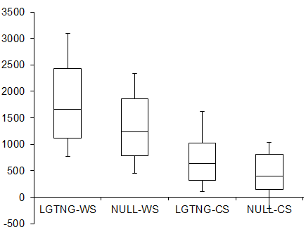
Warm Cloud Depth HFZLVL-HLCL (meters)
m
LGTNG-WS MEAN | 1777 m (n=65)
NULL-WS MEAN | 1289 m (n=41)
STATISTICALLY SIGNIFICANT | 99% Confidence Level
LGTNG-CS MEAN | 723 m (n=105)
NULL-CS MEAN | 412 m (n=72)
STATISTICALLY SIGNIFICANT | 99% Confidence Level

Slide 14
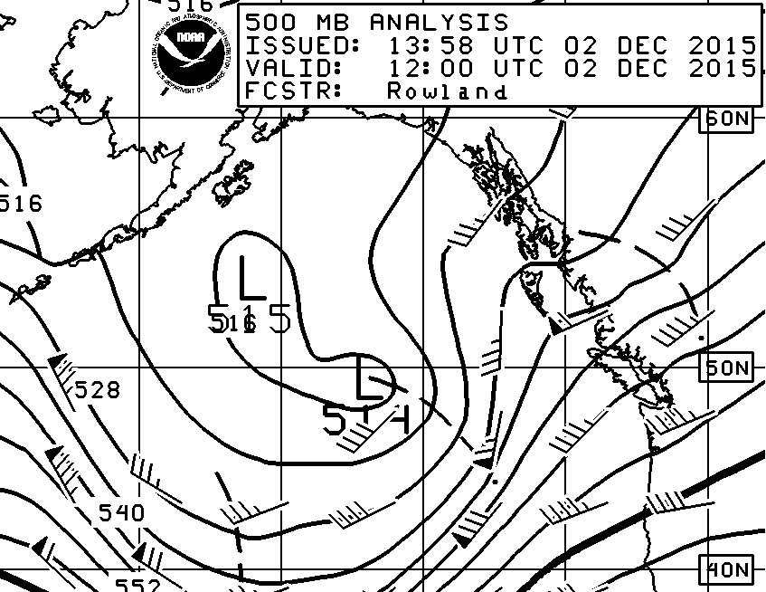
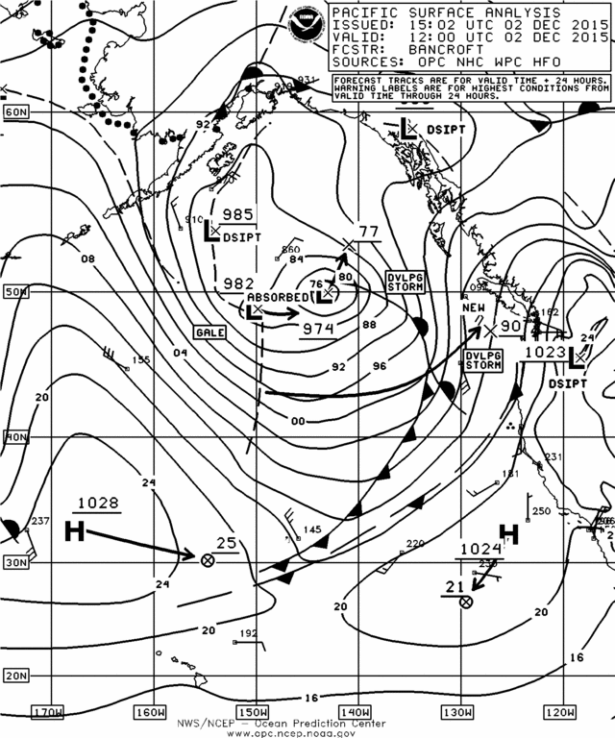
Shortwave Trough
*
*
LIGHTNING EVENTS | 64%
NULL EVENTS | 61%

Slide 15
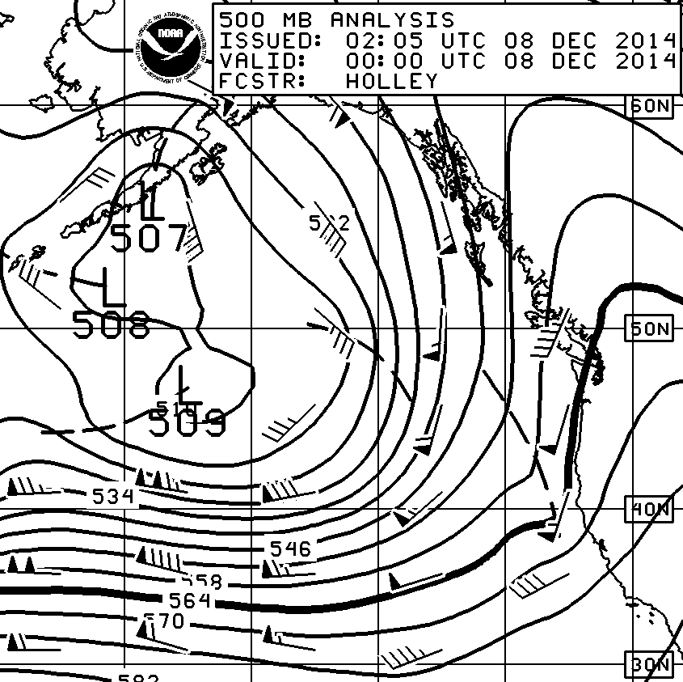
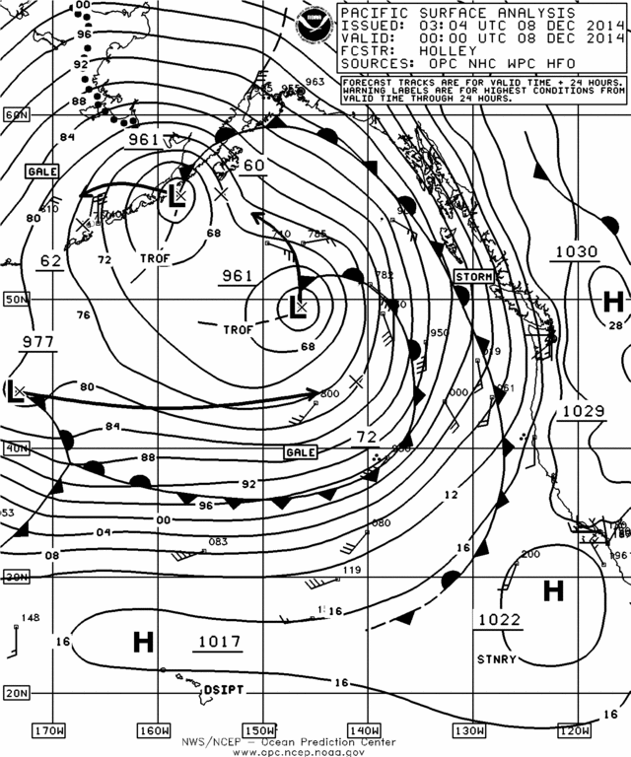
Jet Stream
*
*
LIGHTNING EVENTS | 25%
NULL EVENTS | 7%

Slide 16
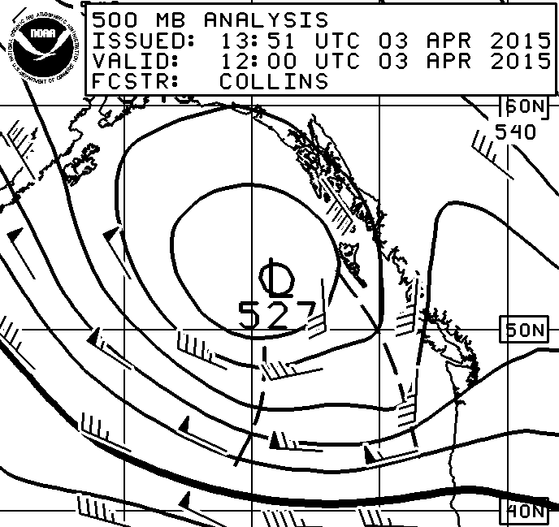
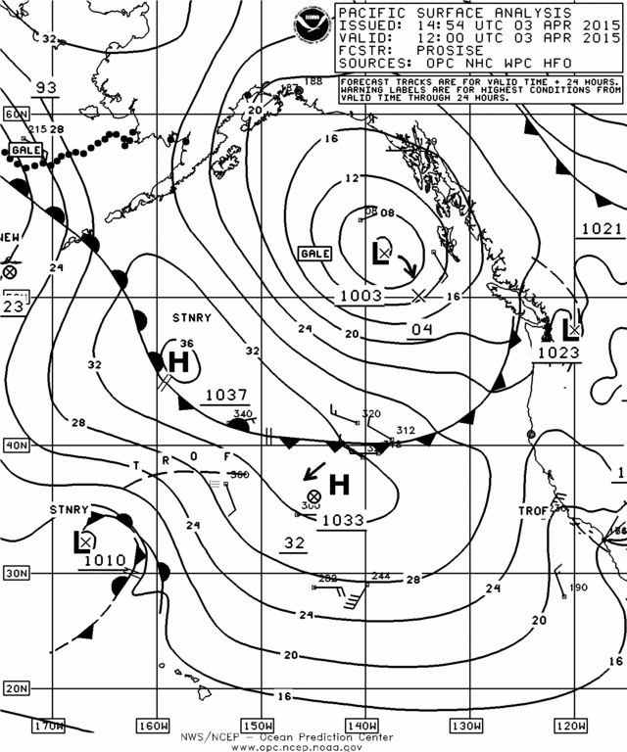
Upper Low
*
*
LIGHTNING EVENTS | 11%
NULL EVENTS | 31%

Slide 17
Summary – Warm Season
Steeper lapse rates and larger MUCAPE values associated with warm season lightning
EL temperature ≤ -20° C strongly discriminates between lightning and null events
Updraft must extend through the charge reversal temperature zone

Slide 18
Summary – Cool Season
Cold mid/upper-level airmass is usually present for steep lapse rates and sufficient MUCAPE
MUCAPE still larger for lightning events
Null events are associated with a cooler boundary layer airmass
Less favorable for supercooled liquid water in the updraft
Graupel, charge separation, and lightning are more probable in cool season environments with relatively warm boundary layers (deep WCD/warm LCL temperature)

