Slide 1
Update and Future of the EC/NOAA Freezing Spray Inter-Comparison
by
Serge Desjardins
LT Joseph T. Phillips *
National Lab for Marine and Coastal Meteorology (aka MAC Lab)
Halifax, Nova Scotia
National Weather Service - Ocean Prediction Center
EC/NOAA Marine Collaboration Workshop
02-05 May 2016
Ann Harbour, Michigan

Slide 2
Contents
Return from last workshop
Let the Equations Talk
POAC’15 Eirik Samuelsen report
Our algorithms have problems ? How do we fix them ?
A few observations
Analysis
What is NEXT ? Proposing a new approach
Probabilistic products
DiSCUSSION (Where do we go from here ?)
Overland, Stallabrass, Sawada
Collaboration for next year

Slide 3
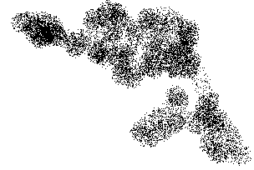
The Freezing Spray Algorithms
“Cloud of Possibilities”
Extreme
Severe
Category
Moderate
Light
Temperature
SAWADA
Wind Speed
SAWADA : ƒ(Wind Speed, Temperature)
OVERLAND : ƒ(Wind Speed, Temperature, Salinity, Sea Surface Temperature)
STALLABRASS : ƒ(Wind Speed, Temperature, Salinity, Sea Surface Temperature, Wave, RH)

Slide 4
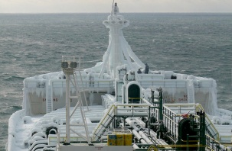
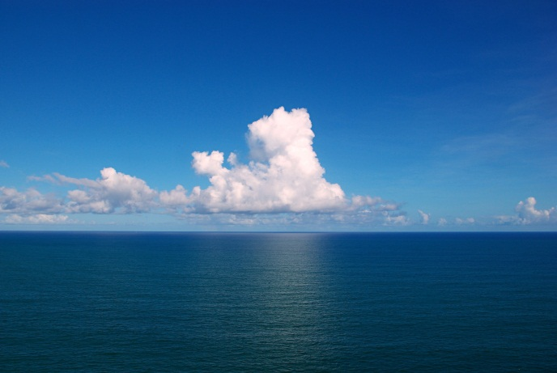
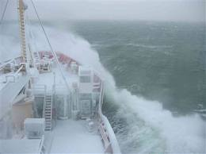
Slightly Deeper understanding of the equations
$$Freezing Aspect$$
The thermodynamic involves
Rate of icing building on an ideal cylinder
Ta,RH
Model calibration correlating
the theoretical rate of icing on the cylinder to observational data
Air
Td
Film of water
Ice
Structure
Droplet time
of flight
Ts
SEA : SST
Runoff
$R_{i }$ $l_{f }$= $R_{w }$ $C_{w }(T_{s}−T_{d}$) f(n) + $h_{a }(T_{s}−T_{a}$) + $h_{e }(e_{s}−{RH∗e}_{a}$)
From reading : Norm L. Henry report,
95-004A, Newfoundland , October 1995

Slide 5
Slightly Deeper understanding of the equations
$$R_{i}=n{ R}_{w}$$
Ri : rate of ice buildup per unit area : Icing Rate
Rw : rate of generation/delivery spray per unit area : Spray Flux
n : fraction of the total incident water that freezes : Frozen Spray
Challenges
In Rw : what does cause the spray ?
Parametrisation (Wind, Wave and Ship Vessel movement)
How high does the spray go (vessel size and shape) ?
In n : what does not freeze ?
Runoff water
thermodynamic processes associated with ice formation (parametrisation)
In Ri : what type of ship vessel (how high is the deck ?)
From reading : Norm L. Henry report,
95-004A, Newfoundland , October 1995

Slide 6
Slightly Deeper understanding of the equations
$${ N}_{} :Frozen Fraction$$
$R_{i }$ $l_{f }$= $R_{w }$ $C_{w }(T_{s}−T_{d}$) f(n) + $h_{a }(T_{s}−T_{a}$) + $h_{e }(e_{s}−{RH∗e}_{a}$)
Overland
Droplet cooling
Runoff
Evaporative cooling
$R_{i }$ $l_{f }$= $R_{w }$ $C_{w }(T_{f}−T_{w}$) f(n) + $h_{a }(T_{f}−T_{a}$) + $h_{e }(e_{s}−{RH∗e}_{a}$)
φ
$$>$$
$$>$$
$$>$$
$$>$$
$R_{i }$ $l_{f }$= $R_{w }$ $C_{w }(T_{s}−T_{d}$) f(n) + $h_{a }(T_{s}−T_{a}$) + $h_{e }(e_{s}−{RH∗e}_{a}$)
?
Runoff
Spray cloud residence time
STALLABRASS

Slide 7
ALGORITHM’s problems from POAC’15 : Eirik Samuelsen
OVERLAND
… whenever the convective heat flux is positive (Tf-Ta),
freezing will occur and the spray flux will be 18 to 23 larger than ice accretion…
… there is always a sufficient amount of water available
regardless of the sea state and the speed vessel
…the spray flux is assumed to increase
when the air temperature decreases…unphysical

Slide 8
ALGORITHM’s problems from POAC’15 : Eirik Samuelsen
STALLABRASS
… uses a droplet cooling time equal to the time it takes for the spray cloud
in total to pass vessels (spray cloud residence time)
… this lead to a very low droplet temperature
…probably too low, too much icing when compared
to the observations on the coast guard.
Since the droplet temperature is more comparable
to the temperature of the air
…makes the overall algorithm very little sensitive to SST.

Slide 9
ALGORITHM’s problems
SAWADA
 |  | Wind Speed (kt)
 |  | 0 | 5 | 10 | 15 | 20 | 25 | 30 | 35 | 40 | 45 | 50 | 55 | 60
Air Temperature ( °C) | -5 | NIL | NIL | NIL | TRC | LGT | MDT | MDT | MDT | MDT | SVR | SVR | SVR | XTM
 | -10 | NIL | NIL | LGT | MDT | MDT | SVR | SVR | SVR | SVR | XTM | XTM | XTM | XTM
 | -15 | NIL | NIL | LGT | SVR | SVR | SVR | SVR | XTM | XTM | XTM | XTM | XTM | XTM
 | -20 | NIL | NIL | LGT | SVR | SVR | SVR | XTM | XTM | XTM | XTM | XTM | XTM | XTM
 | -25 | NIL | NIL | LGT | SVR | SVR | XTM | XTM | XTM | XTM | XTM | XTM | XTM | XTM
Used by Canadian Eastern Forecasters
NO SST dependency
But …. SO SIMPLE to DEFINE environment for freezing spray

Slide 10
ALGORITHM’s problems HOW do we fix them ?
Overland : No real fix.
$$R_{i}=n{ R}_{w}$$
Constant freezing fraction
Stallabrass : Smaller droplet cooling time.
Average time for droplet cooling time
$$∆t= {\overline{τ+ \left(τ+ t_{dur}\right)}= \left(τ+ t_{dur}\right)}/2$$
$t_{dur}$ = $t_{durtot}− τ$
$t_{durtot}$ = ${φ\left(uv,WH,Vr\right)}_{}$

Slide 11
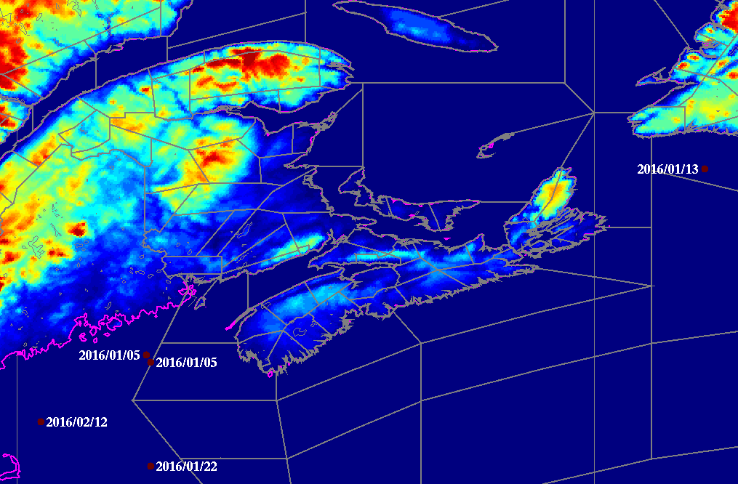
A few observations (Analysis)

Slide 12
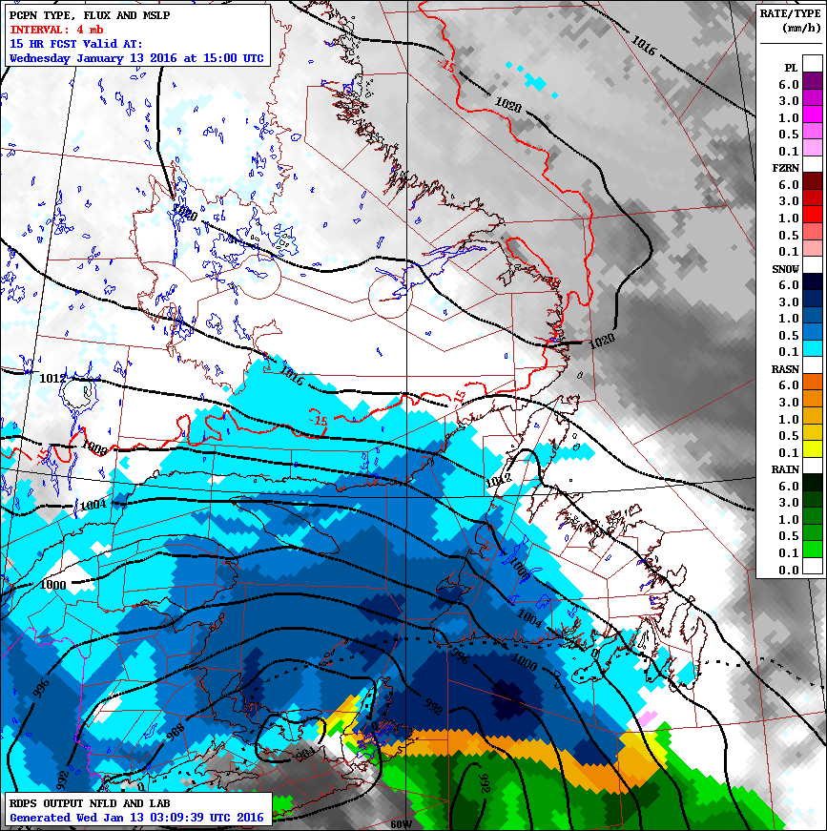

Slide 13
Jan 13, 2016
2016-01-13 13:27 | 2016-01-13 | 10:00:00 AM | GMT -4: Atlantic Standard Time | 47 03N | 058 08W | -1C | BF 9 & BF 10 | Easterly |  | Slight icing on deck and accommodation including bridge front. | Easterly x 5 Meters

Slide 14
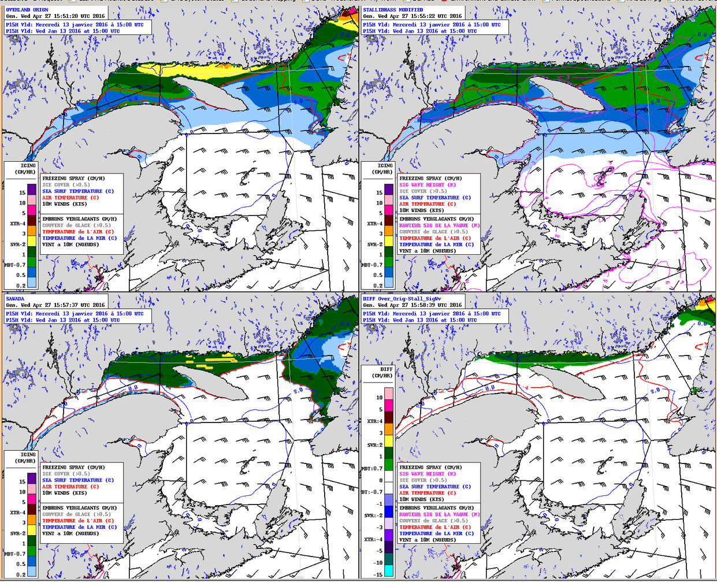
OVERLAND
STALLABRASS
X
SAWADA

Slide 15
Feb 12, 2016
12-Feb-16 |  |  | 42.635 | -69.58333 |  |  |  |  | Weather: Freezing spray, 1/8 inch per hour; Wind blowing about 45 knots
TIME UNKNOWN

Slide 16
00 FEB 12, 2016
06 FEB 12, 2016
12 FEB 12, 2016

Slide 17
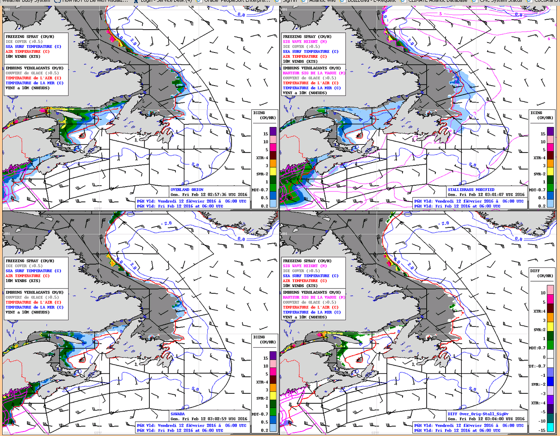
OVERLAND
STALLABRASS
SAWADA
X

Slide 18
Jan 05, 2016
05-Jan-16 |  |  | 43.67333 | -67.685 |  |  |  |  | Weather: Freezing spray
05-Jan-16 |  |  | 43.79833 | -67.75 |  |  |  |  | Weather: Snow and freezing spray
TIME UNKNOWN

Slide 19
JAN 05, 06 UTC , 2016

Slide 20
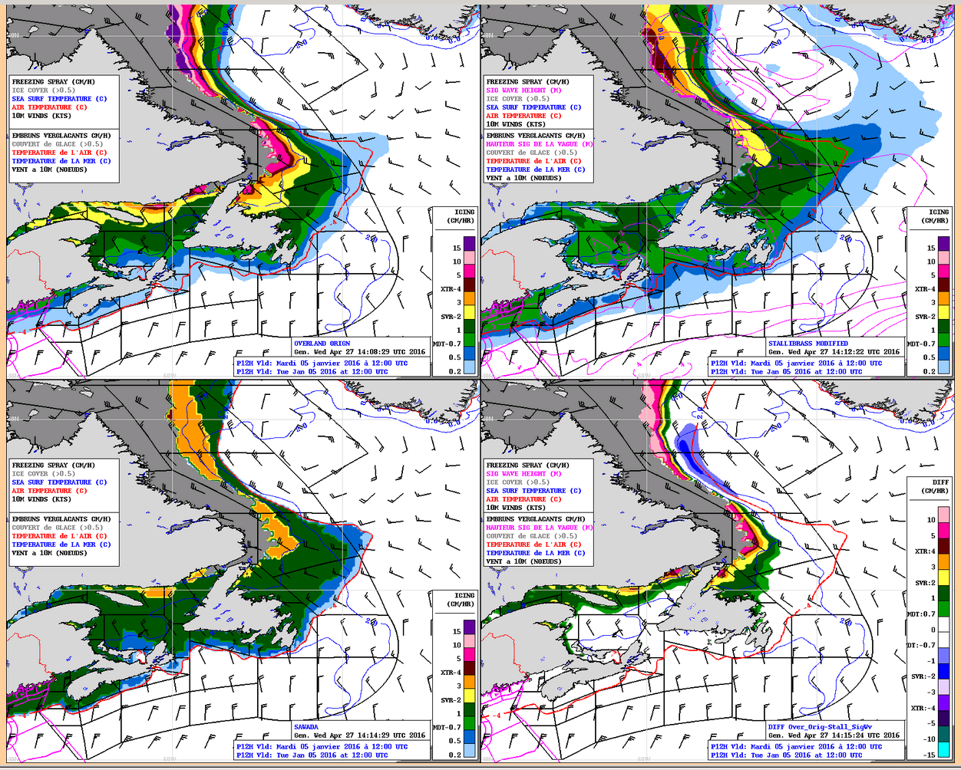
OVERLAND
STALLABRASS
SAWADA

Slide 21
Jan 22, 2016
22-Jan-16 |  |  | 41.86833 | -67.68 |  |  |  |  | weather was freezing spray, unobserved due to rough weather
TIME UNKNOWN

Slide 22
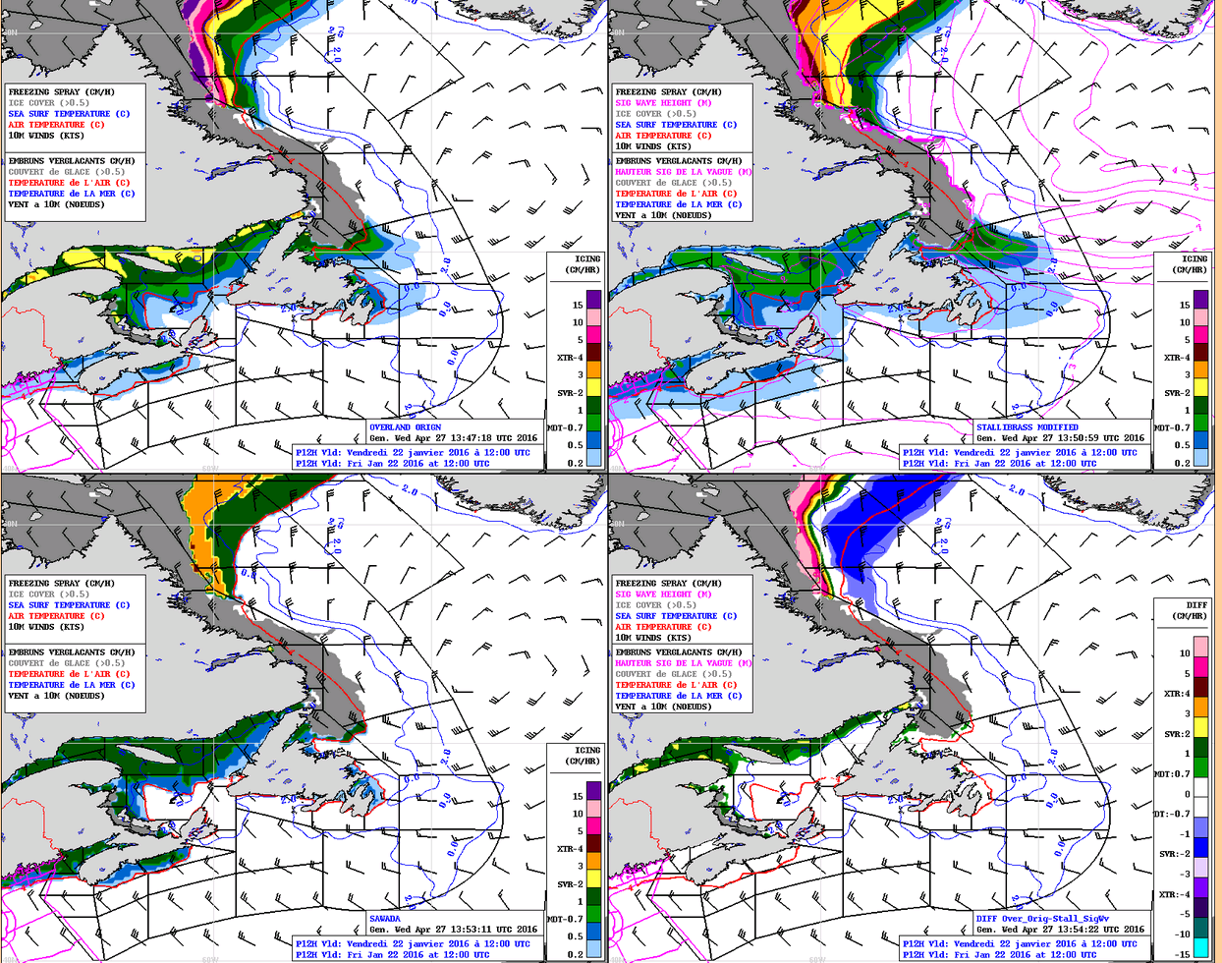
OVERLAND
STALLABRASS
SAWADA
X
Notes:
This was close to maximum extent of Freezing spray for this event.

Slide 23
Proposing a new approach (The most likely & the most threatening conditions)

Slide 24
Proposing a new approach
PROBABILITY
SPRAY
FLUX
ATMOSPHERIC
ENVIRONMENT
OVERLAND
INTENSITY
SAWADA
STALLABRASS
VESSEL
information
PICK ME, PICK ME

Slide 25
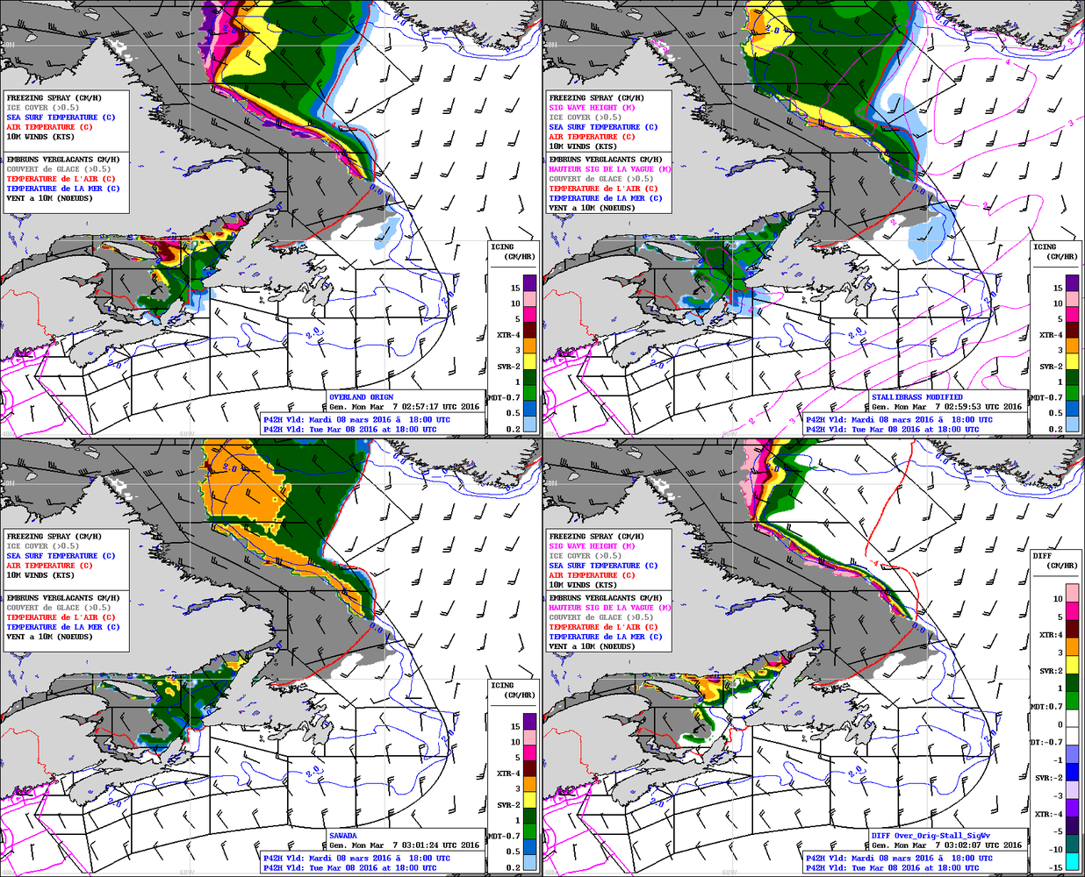
Proposing a new approach (The most likely & the most threatening conditions)
OVERLAND
STALLABRASS
March 08 2016- 18 UTC- 42HR Fcst
X
SAWADA

Slide 26
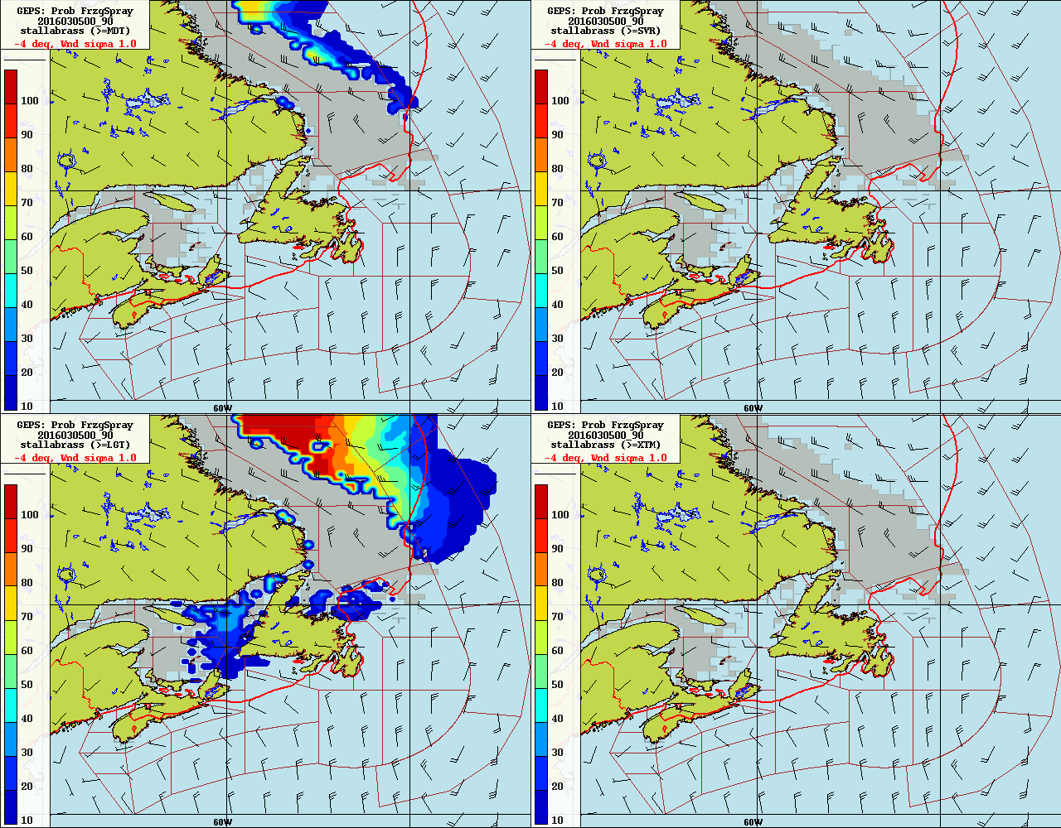
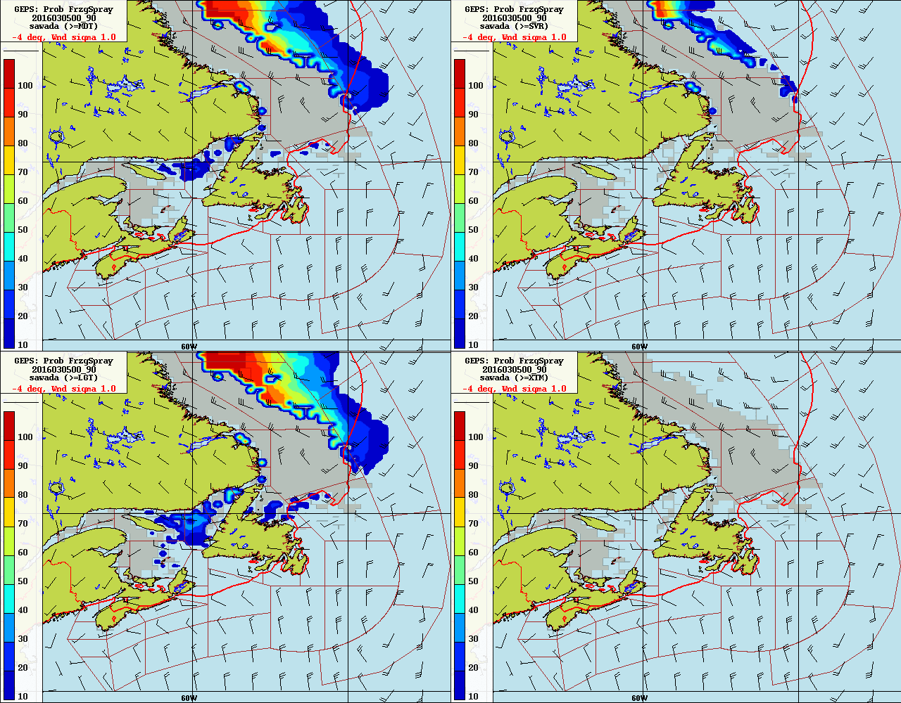
Proposing a new approach
March 08 2016- 18 UTC- 42HR Fcst
90 HR Fcst
MDT
SVR
MDT
SVR
LGT
XTM
LGT
XTM
STALLABRASS
SAWADA

Slide 27
Proposing a new approach
March 08 2016- 18 UTC- 42HR Fcst
MDT
SVR
With LGT-MODT Prob.
MODERATE
MOST LIKELY
LIGHT
LGT
XTM
STALLABRASS

Slide 28
Proposing a new approach
March 08 2016- 18 UTC- 42HR Fcst
MOST LIKELY.
MOD-SVR
MDT
SVR
MOST LIKELY
LIGHT
LGT
XTM
SAWADA

Slide 29
Proposing a new approach (The most likely & the most threatening conditions)
Most Dangerous
HIGH
Most Likely
Most Dangerous
MDT
Most Likely

Slide 30
Where do we go from here ? (Need a EC-NOAA common objective)
Overland, Stallabrass, Sawada ?
Collaboration for next year ?
From Eirik Samuelsen’ correspondances
I am not sure that you will avoid the problem with this simplification. Freezing spray is dependent of water availability, and atmospheric conditions necessary to remove the heat from this water. The water availability will vary on different parts of one single ship, and it will be some variations between ships, but probably less variation for ships with the same bow shape. If one can assume a ship type with a bow shape like an MFV (medium-sized fishing vessel), and take into account icing only on a certain position of the ship (front of superstructure), it is possible to use a further modification of the Stallabrass algorithm to predict the icing rate and hence the onset of icing.
Icing prediction can then be referred to some standard vessel characteristics:
- medium-sized fishing vessel bow shape
- superstructure icing (average value at some height above deck level, for instance 3-5 m)
- vessel speed of 10 m/s
- direction always against the wind (wave direction might be different including swells) I have actually done this and created a model for the coast guard ship data I am using. To get a modification towards a larger ship, I use a lower spray frequency, and some additionally adjustments taken from observations from USGC Midgett. I also use a simplified trajectory model to calculate the droplet cooling time and speed of the droplets from an initial droplet and wind speed.
Icing rate categories are difficult, since there is variation in the literature regarding what should be reckoned as light, moderate or severe. (For instance uses Mertins (1968) ice accumulation in 24 hours, while Overland uses instantaneous icing rate converted to hourly rates)

Slide 31
Where do we go from here ? (Need a EC-NOAA common objective)
Comments from Joseph Philllips: “Am I right in that you're proposing developing a probabilistic forecast between the three algorithms using a minimum spray flux specific to superstructure icing on a medium sized fishing vessels sailing against the wind at 10m/s? The probabilities would cover the light, moderate, severe, and extreme intensities? If so, I think this would probably be the best improvement to our service.”

