Slide 1
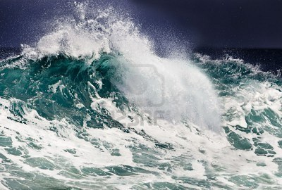
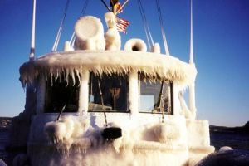
Can We Use Social Media and Smart Phones to Help us Verify and Monitor Marine Forecasts?
Jay Albrecht
National Weather Service,
Seattle WA
Notes:
Back in our 2014 workshop in Halifax, we complained about the lack of observations available to validate newly developed freezing spray algorithms for the North Atlantic. This complaint is shared by marine forecasters across our countries when it comes to other parameters such as fog, wind, waves, and weather! Maybe we can use emerging technology to help us jump this hurdle!

Slide 2
The Problems:
A general lack of marine weather information over our waters.
No maritime spotters to alert us of hazards or verify forecasts and methods
Marine users move back and forth across our international and forecast boundaries
Is smart phone and social media technology a potential solution?
Notes:
As we discussed in Halifax two years ago, we don’t have a lot of marine data over our waters, we don’t have a spotter program like land forecasters, and our mariners move back and forth across not only our forecast boundaries, but across our international boundary.
No one likes complainers and everyone likes solutions. So, could we use smart phone technology and social media to take care of these problems?

Slide 3
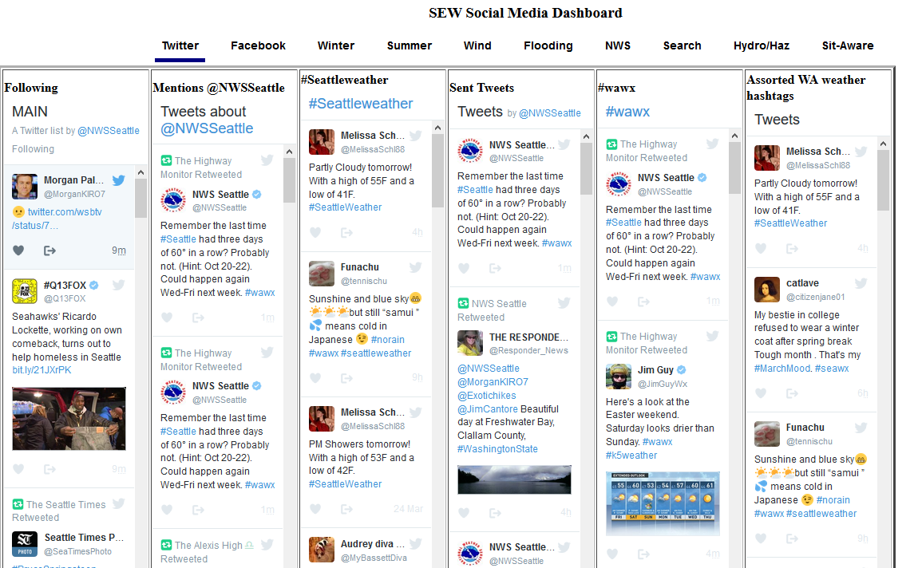
Technology has come a long way Social Media
Notes:
Social media and smart-phone technology has opened up a whole new world. This image shows a snapshot of a Social Media Dashboard application that was developed by the Information Technology Officer at the National Weather Service Forecast Office in Greer, South Carolina. It can be customized for use by any forecast office to monitor Twitter feeds, search for tweets by keyword in a geographic region, monitor local media Facebook posts, and other things. This tool has helped our office in Seattle maintain situational awareness during weather events.

Slide 4
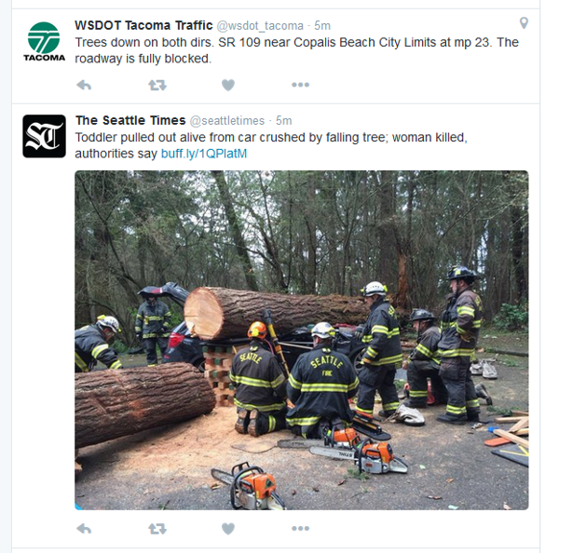
Notes:
Twitter is a valuable source of near-real-time information for public (land) forecasters during major storm events! Here are a couple of tweets that we received during a rather strong wind storm that we had in western Washington State on March 13, 2016. This storm resulted in at one fatality, a quarter-million homes without power, tree damage, and a mud slide that affected west coast Amtrack service. We were able to correlate wind speeds seen on our radar, HRRR model wind forecasts, and damage reports in real time.

Slide 5
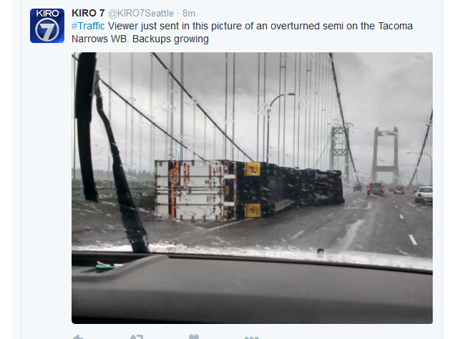
Notes:
Many Twitter users and news organizations will attach photos or other informational links in their tweets that validate what they are reporting. Here is a tweet sent of a truck that overturned on the Tacoma Narrows Bridge (the only bridge that crosses Puget Sound) due to strong winds. We received this tweet and photo from a local news station minutes after the truck overturned.

Slide 6
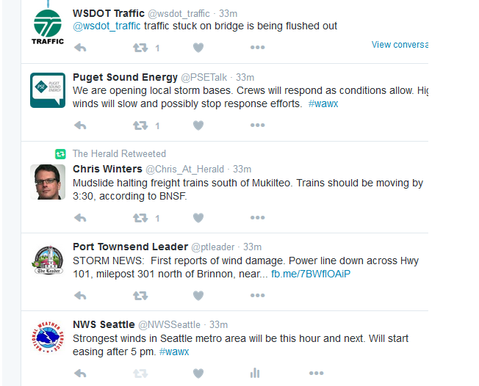
Notes:
Here are some other tweets from local and state government agencies and news organizations during the 13 Mar storm. We also sent tweets out to our followers that amplified warnings and short-term forecasts we were producing as the event evolved.

Slide 7
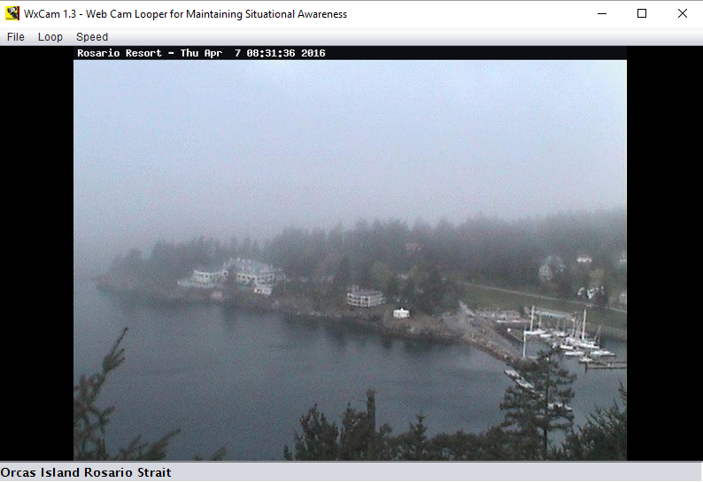
Notes:
On a separate note, we have situational awareness tools that allow us to watch our coastal waters in near real time. This is a weather camera that overlooks a marina along Rosario Strait in the northwest Washington inland waters – showing a patch of fog on an otherwise very clear day across all of our other waters. (This camera shot was taken before there was enough good light to see the small patch of fog using low-light visible satellite images). Please let me know if you’d like additional information on how you can get this piece of software. Unfortunately, weather and traffic cameras are mostly land based.

Slide 8
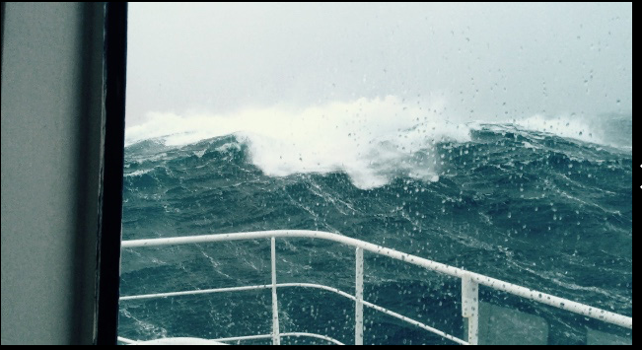
Notes:
Well, is it possible that we can successfully encourage marine users to send us observations and images in near real time over our coastal waters (when within cell phone tower range)? Observations even well after the fact can be useful to model and algorithm validators as well. This picture was taken from Instagram, another social media site. Real time pictures and tweets would be useful. It appears that some mariners are already posting some pictures.

Slide 9
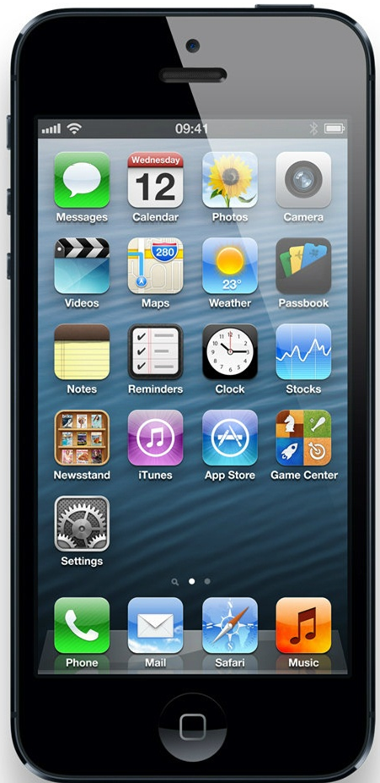
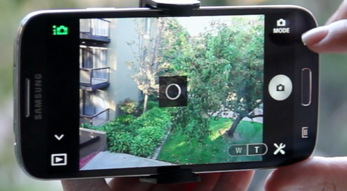
Is a Smartphone App a Possible Solution to Lack of Marine Verification Data?
Notes:
How many of you have smart phones? My guess would be that with the exception of one or two in this room, everyone has one! In my talks with fishermen, sailors, and mariners across our area, everyone has and uses these devices. Mariners are increasingly counting on internet, weather apps, and social media to get and pass weather information to their colleagues and friends. Smartphones have built-in very-high quality cameras; pictures can instantly be shared with others on social media and through email.

Slide 10
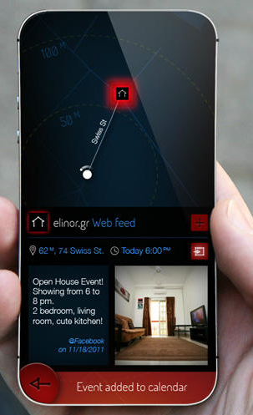
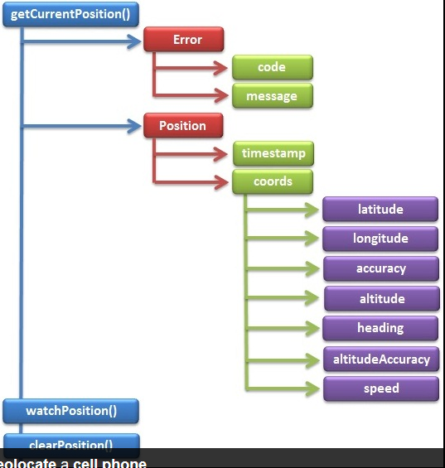
Is a Smartphone App a Possible Solution to Lack of Marine Verification Data?
Notes:
In addition to cameras, smart phones have a built-in GPS – useful for navigation – and a high-quality clock. When apps are developed to make simultaneous use of all of these built-in features, the smart phone becomes a very powerful tool. The application on the left is showing a geolocated and time-stamped picture along with mapping information – this turns out to be a real estate application. Local governments, law enforcement and various businesses have developed apps that make use of the various smartphone functions to meet their needs.

Slide 11
Are we willing to develop:
A smartphone (and/or computer/tablet) app that can be used by mariners and sailors to log marine weather data?
An app that allows a mariner to augment an observation with pictures that are geolocated and timestamped?
An app that allows and encourages mariners to send data to our organizations in real time (or after their cruise) so we could verify and validate models, methods and forecasts?
Real time information (near the coast or lakes) would be valuable for helping forecasters maintain situational awareness and keep forecasts current.
Post cruise data would be a valuable source of validation and verification information.
Notes:
Well, the question of the day, are we willing to use this newer technology to meet our needs?
I envision the capability (once developed) that would allow mariners to log their weather observations, back up their observations with geolocated and time-stamped pictures, and share the observations with weather forecasters and model developers and other mariners. I envision that when the mariner is outside of cell range, the data is stored, then shared at a later time so forecasters and developers can verify and evaluate what happened in the past.

Slide 12
If we are:
Our organizations should develop a set of requirements that will satisfy our needs and make the app fun for our customers (sailors and mariners) to use.
In order to get the application right, we should contract the development effort to a competent and reputable mobile application developer.
The application should be made available for free to the public.
The application should be advertised and made available through our forecast offices and national centers.
Notes:
If our organizations agree that this is a good idea, we should get together and write up a complete set of requirements. In order to “do it right,” we should contract the app development out to a competent developer. The app should be made available to all mariners for free and should be advertised by forecast offices or groups responsible for providing marine weather services.

Slide 13
Resulting data:
If available in real time (and permission is granted by the mariner taking the observation), it should be made available to social media feeds (Twitter, for example) for use by other mariners in the area. Data could also be made available on a mobile-friendly website.
If available in real time – be made available to local forecast offices, centers, and NOAA/EC labs
If not available in real time – be databased in such a way that forecasters, centers and labs can use the data to verify forecasts and validate algorithms
Data should include information on vessel, equipment, units, etc.
Notes:
We’ll also need a database that can be accessed by forecasters, developers and mariners alike so we can make use of the information. Users are more likely to want to see information that is made available on social media. The requirements for the app should be coordinated with requirements for the resulting database that is created for use by forecasters, centers and labs, and any software required to access and view the data along with forecasts and model/tool output.

Slide 14
Is this project feasible?
If so, let’s discuss what we can do to get this project going.
If not, what can we do to provide a capability that meets our marine forecast/method verification and validation requirements?
Notes:
Is this a feasible project? If so, let us get together and see how we can get things moving. If not, are there other ways we can accomplish the same goals?
Thank you for listening. Are there any comments?

