Slide 1
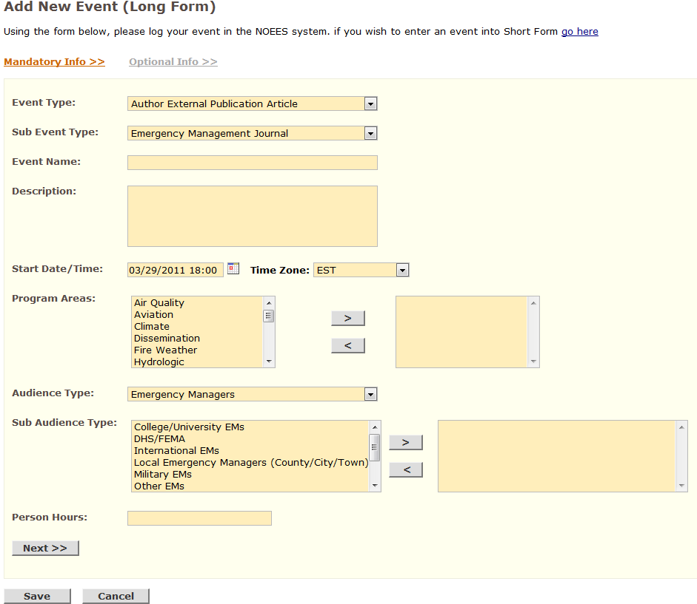
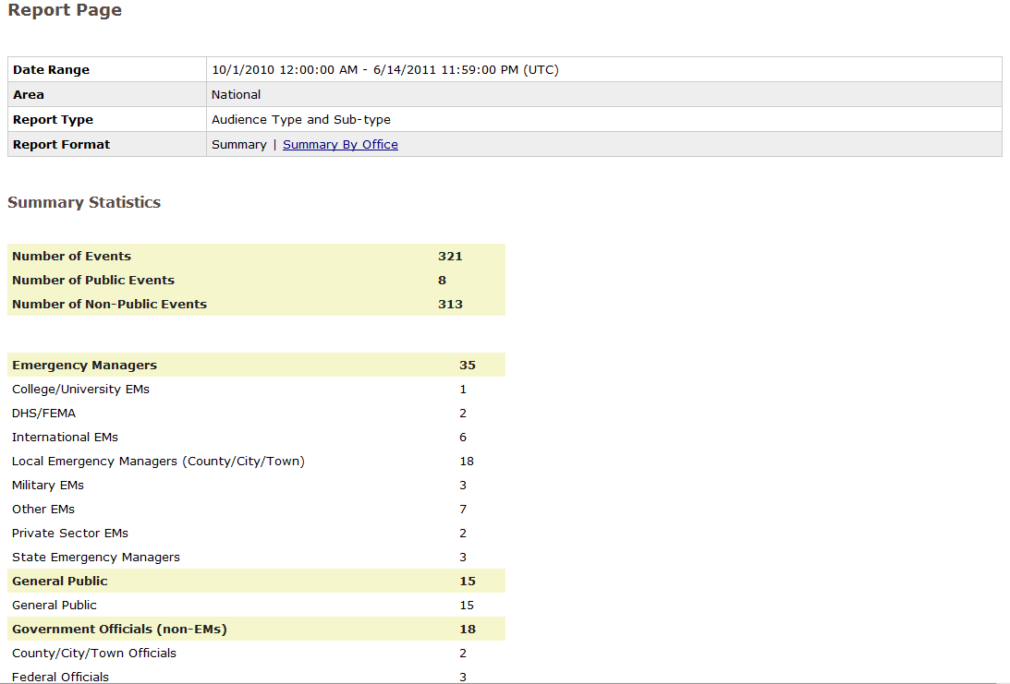
NWS Outreach and Education Event System (NOEES) Program Overview
Brenton MacAloney II
Performance and Evaluation Branch, National Weather Service
2016 NOAA-EC Bi-Lateral Marine Focus Area Workshop
May 5th, 2016

Slide 2
Presentation Overview
Background
  Impact of NWS outreach and education
  Need for a unified tracking system
  Evolution of NOEES to version 2.0
  Who has permission to use NOEES?
Using the NOEES
  Using the Short / Long Form
  Viewing Events
  Running Reports
TODAY!!!
NOEES
Program
Overview

Slide 3
Background

Slide 4
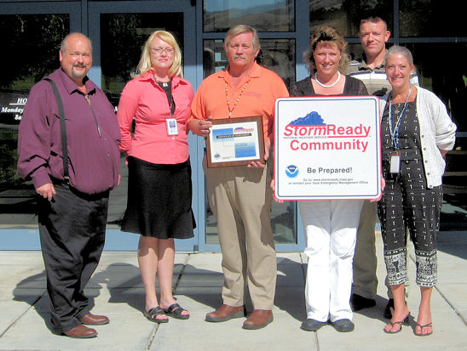
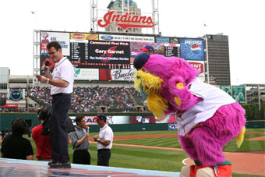
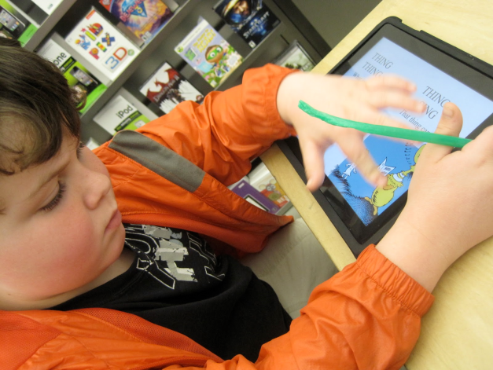
Impact of NWS Outreach and Education
Outreach and education efforts foster trust, enhance environmental literacy, and save lives in our communities
NWS committed to high quality outreach and education
New technologies will extend our reach in exciting new ways

Slide 5
Need for a Unified Tracking System
Numerous requests from Warning Coordination Meteorologists for a unified event tracking system
Benefits of a unified system
  Single database of information
  Eliminate redundant outreach and education reporting
  More efficient organizational exchange of information
  Better linkage between outreach and education efforts with NWS mission outcomes
  Capture customer/partner feedback to improve service
National team established requirements for an NWS Outreach and Education Event System (NOEES) in 2007

Slide 6
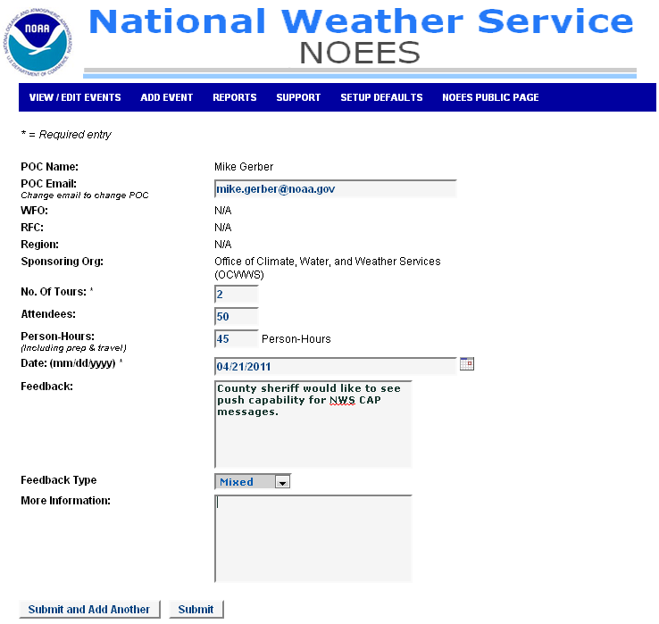
Evolution of NOEES
Requirements effort captured good ideas in local outreach applications for possible inclusion in NOEES
NOEES v1.0 released for use in October 2008
NWS HQ tracked user feedback
Gave program managers a better understanding of the needs of the field

Slide 7
NOEES 2.0
Web based system for reporting, tracking, and sharing of NWS outreach and education event information
Primarily for internal use
Provides “bean counters” with numbers showing the extent of outreach and education activities
Released for use in October 2011

Slide 8
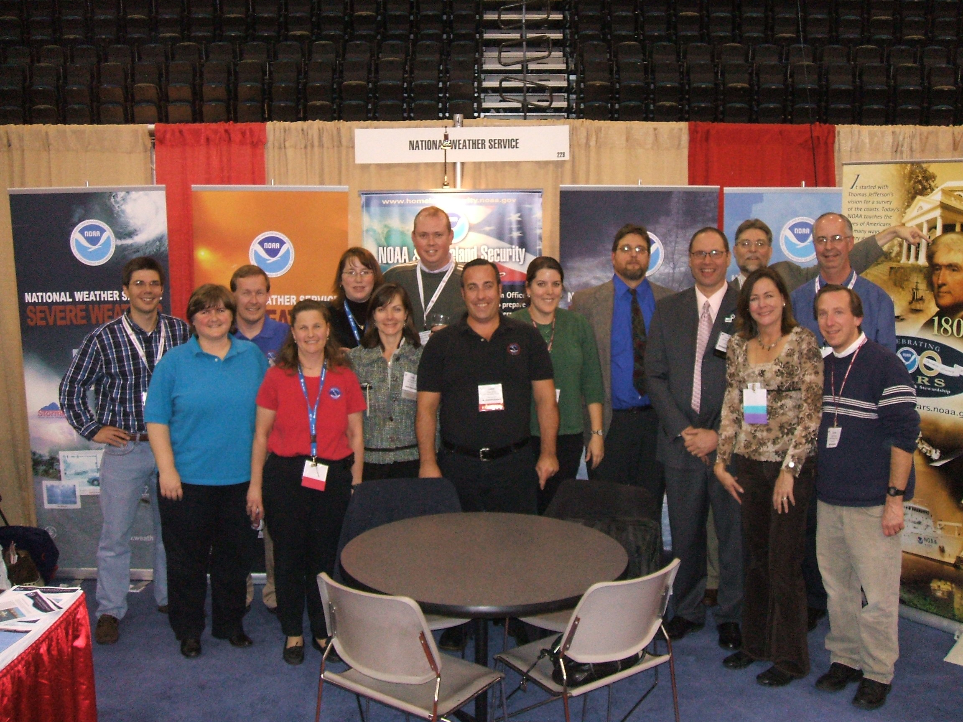
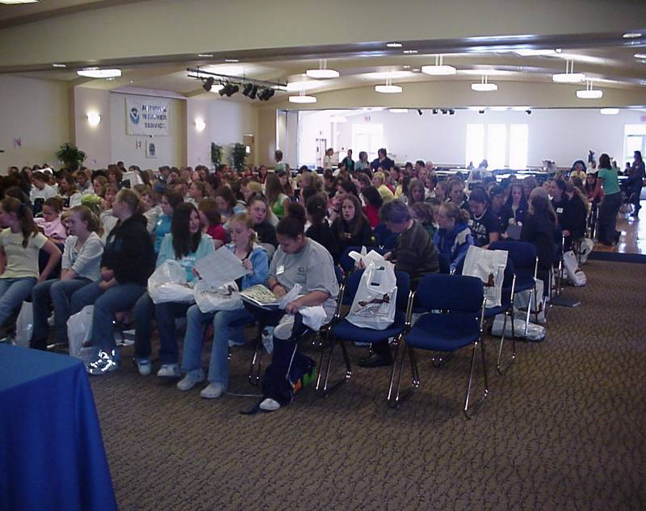
Benefits of NOEES
One-time reporting
Real-time reporting
Developed/maintained by Performance and Evaluation Branch
NOEES can be integrated with other systems
Customizable reports
Linkage to personal/office calendar systems
NOEES allows NWS to capture and archive feedback from our customers and partners

Slide 9
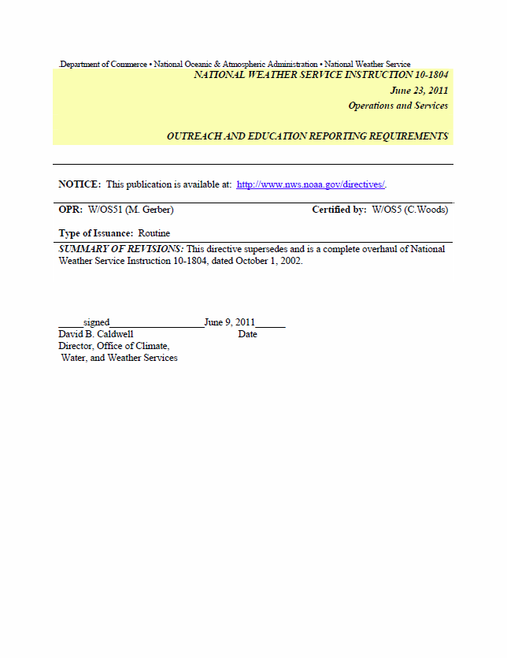
NOEES Policy
Use of NOEES required by NWS Instruction 10-1804, Outreach and Education Reporting Requirements.
Roles and responsibilities
WCMs responsible for outreach reporting, but bargaining unit members welcome to use NOEES at discretion of the WCM
Importance of reporting feedback
Managers leverage feedback from event attendees for improving services

Slide 10
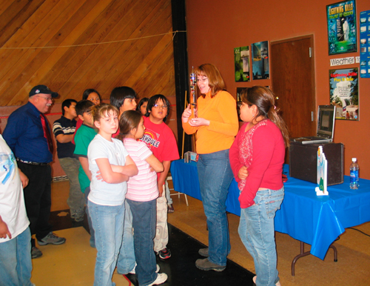
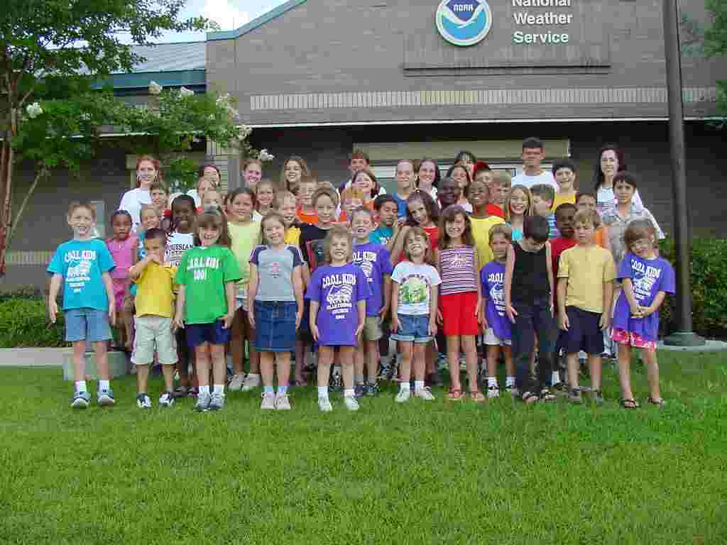
What is the NOEES Data Used For?
Some of the uses of the NOEES database include:
  Monitoring and assessing the effectiveness of NWS outreach and education efforts
  Justifying strategic budget planning and outreach and education resource allocation
  Improving reporting to elected officials
  Customer/partner feedback can be used in the validation, improvement, or termination of products and services
  Succession and internal collaboration
The NOEES is one-stop shopping for all NWS outreach and education data

Slide 11
Entering Events in NOEES
Only non-operational events are reported in NOEES
“Short” form expedites entry of common event types
  Interviews
  Office Tours
  Presentations
  School Visits
  SKYWARN Spotter Talks
“Long” form used for other event types or when entry of greater detail is desired
Information is laid out in tables online

Slide 12
Who has Permission to Use NOEES?
WCMs, SCHs, MICs, and HICs, regulate local access to NOEES event entry at field office level (i.e., WFO, RFC).
At other offices (e.g., Regions / National HQ, National Centers, etc.), all employees are granted “NOEES User” permissions by default.
Overall NOEES administration takes place at NWS HQ between the WCM program manager and Performance and Evaluation Branch.

Slide 13
Using the NOEES

Slide 14
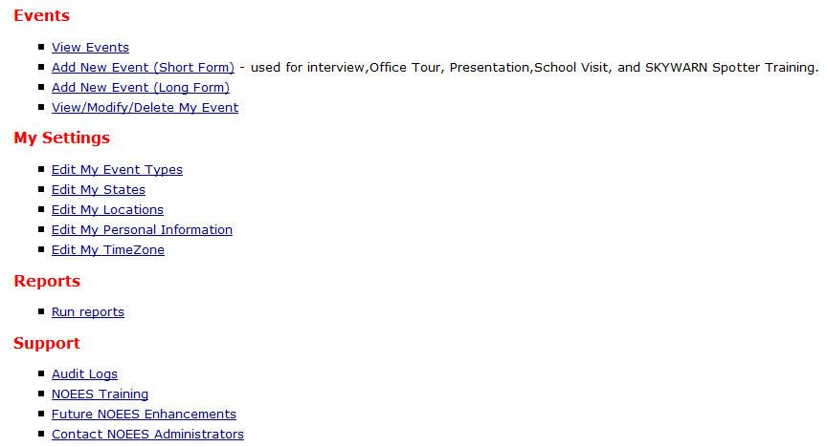
Setting Preferences with “My Settings”
The NOEES program was developed to give users a personalized experience in order to save time
Using “My Settings” users can configure NOEES in the following areas:
  Event Types
  States
  Locations
  Personal Information
  Time Zones

Slide 15
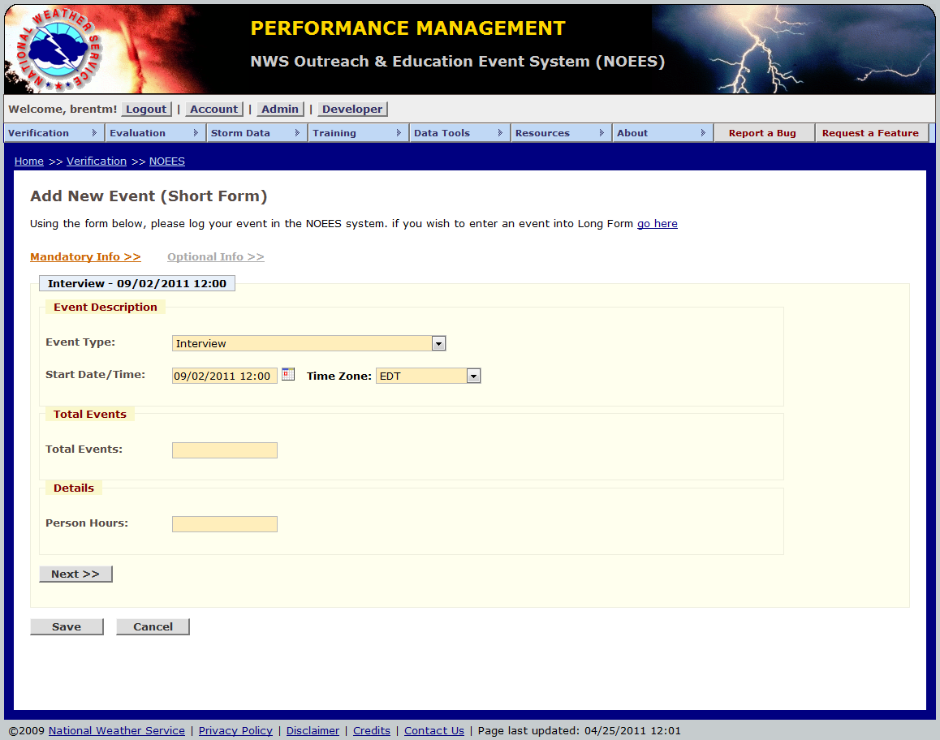
Using the Short Form
Short form used for common event types
  Interviews
  Office Tours
  Presentations
  School Visits
  SKYWARN Spotter Training
Expedites entry where minimal information required

Slide 16
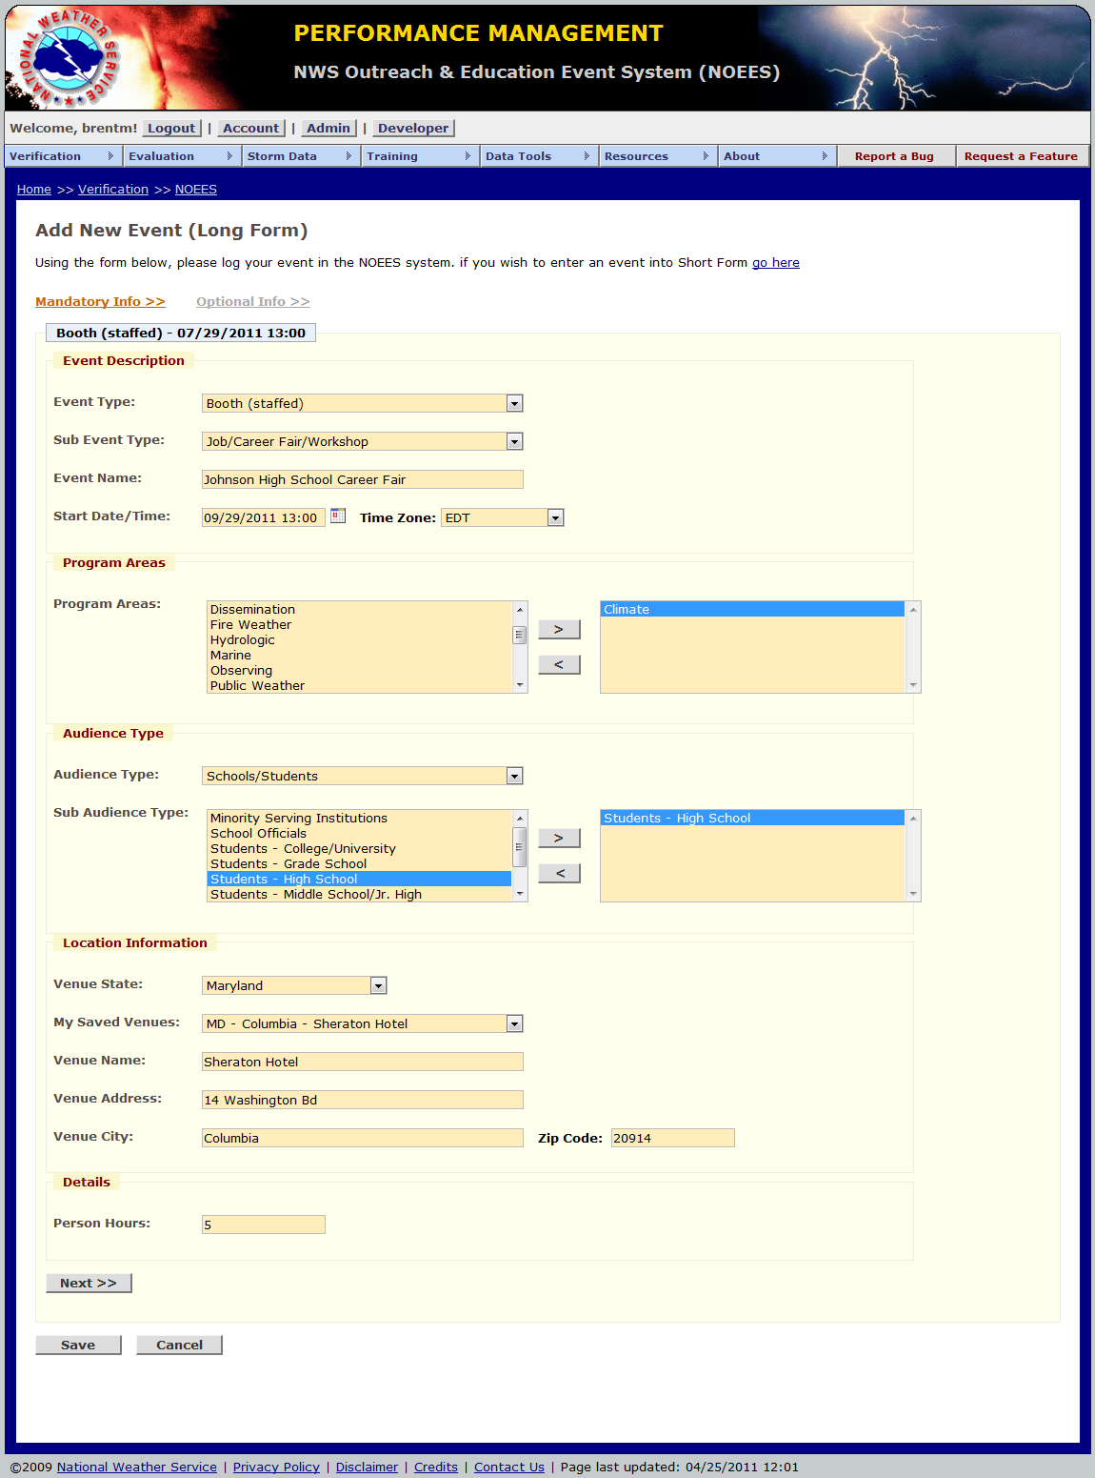
Using the Long Form
Used for all other event types
Allows for greater details
  Program areas
  Audience type
  Venue Name and Location
  Event description
  Information on Point of Contact
  Attendee feedback
  Internal notes on event
Recommended for events being posted to the web in which details are important

Slide 17

Logging Customer / Partner Feedback
Feedback may be logged in the optional section of the long and short forms
Feedback should help improve programs and services
Examples of useful feedback:
  “I would like to have my NOAA Weather Radio alert me based on storm-based warnings.”
  “Your winter storm warning allowed us to de-ice the roads and fire hydrants well before the storm.”
Examples of useless feedback:
  “The tour I took at your office was a lot of fun.”
  “You guys really nailed the forecast.”

Slide 18
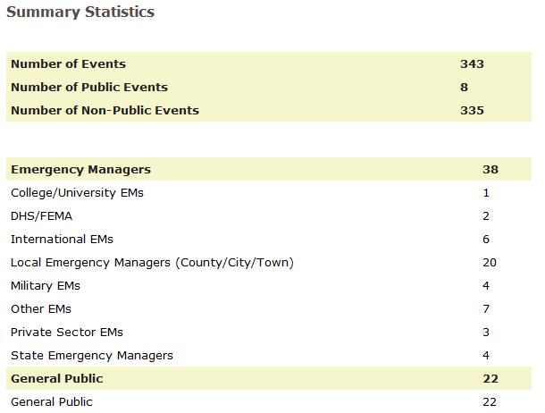
Running Reports
Reports can be run using “Run Reports”
Reports used for tabulating outreach and education event statistics
Types of reports:
  Audience Type
  Event Type
  Feedback
  Person Hours
  SKYWARN
  Topic Type

Slide 19
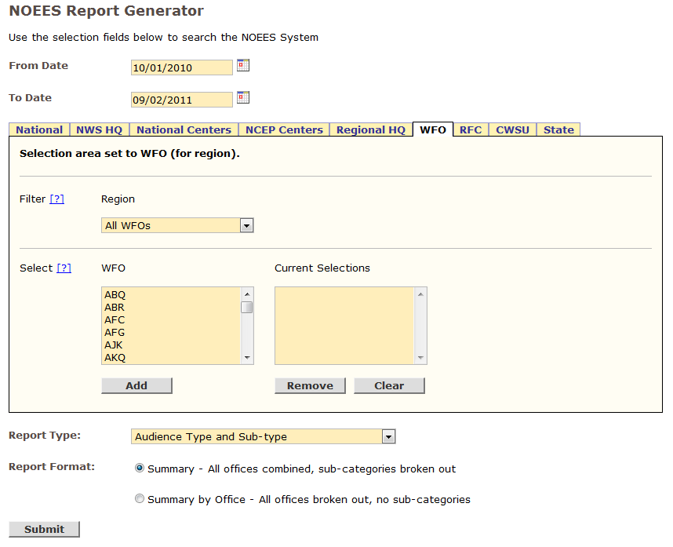
Running Reports
From / To Date
Area
  National
  NWS HQ
  National Centers
  NCEP Centers
  Regional HQ
  WFO
  RFC
  CWSU
  State
Report Type
Summary Type – all offices combined or broken out

Slide 20
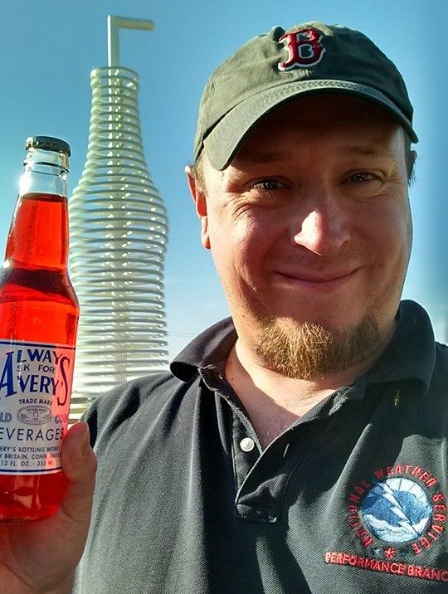
Contact Information
Do you have any questions or comments?
Brent MacAloney
E-mail: Brent.MacAloney@noaa.gov
Phone: 301-427-9301

