Slide 1
Development of a regional wave forecasting system for the Great Lakes
Natacha B. Bernier, Benoit Pouliot,
J.-H.G.M. Alves, S. Peel, M. Lépine and P. Pellerin
NOAA/EC Bi-Lateral Marine Focus Area Meeting
May 3, 2016

Slide 2
Motivation
2015 Pan and Parapan Am Games were held in the Toronto area in July and August
Public and private sectors required accurate forecasts with adequate lead times (e.g. for activation of emergency measures, rescheduling sailing events)
Only available Canadian wave guidance over the Great Lakes was available 3-hourly at coarse resolution (approx. 5km)
Can we provide better guidance, including realistic estimates of uncertainty?

Slide 3
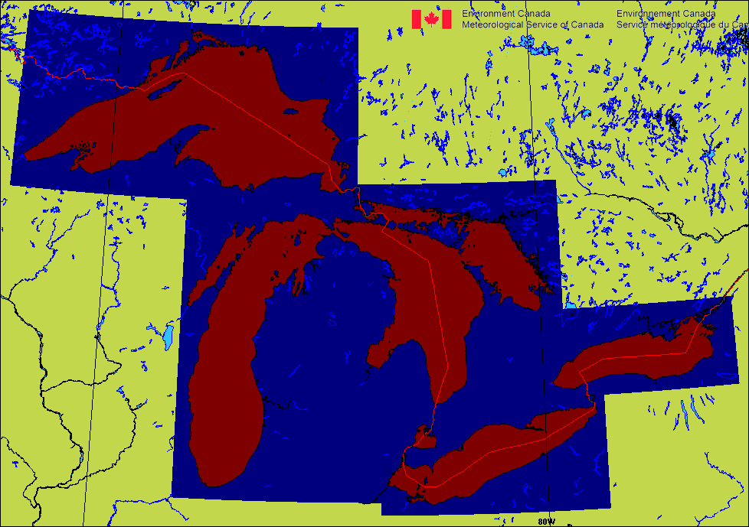
Methodology
Deterministic 1 km
12Z
48 h forecast / 2.5 km winds
18Z
48 h
Restart
00Z
48 h
06Z
48 h
Deterministic 0.25 km
00Z
6 h spin-up / 2.5 km winds
Western Lake Ontario
06Z
24 h forecast / 0.25 km winds from urban model

Slide 4
Methodology
Ensemble 2.5 km
12Z
72 h forecast
00Z
72 h forecast
One control plus 20 members
Member by member cycling allows persistence of spread
Driven by atmospheric regional ensemble at 15 km
Range to increase with atmospheric ensemble upgrades

Slide 5
Statistics - Deterministic
MAE of Significant Wave Height (Hs)
June 1 2015 to season end (Nov 2 to Dec 23)
Using 00Z runs
14 buoys on Superior, Huron, Erie & Ontario
High bias in summer
Limited bias in fall
Mean absolute error of Hs (m)
- Deterministic 1 km
- Operational deterministic 5 km
- Control member of ensemble 2.5 km
Lead time
Notes:
45001, 45003, 45004, 45005, 45006, 45008, 45012, 45132, 45135, 45137, 45142, 45143, 45149, 45164

Slide 6
Statistics - Deterministic
MAE of Significant Wave Height (Hs)
June 27 to August 31 2015
Using 06Z runs
4 buoys of West Lake Ontario
High bias in summer
Mean absolute error of Hs (m)
Lead time

Slide 7
Statistics - Ensemble
Rank histogram of Hs for JJA 2015: lead time 24 hours
Fraction
Rank

Slide 8
Statistics - Ensemble
Rank histogram of Hs for JJA 2015: lead time 72 hours
Fraction
Rank

Slide 9
Squall Line
Deterministic 0.25 km
Deterministic 1 km

Slide 10
Squall Line
Deterministic 0.25 km
Deterministic 1 km

Slide 11
Rapid Ice Change on Lake Erie
Deterministic 1 km 48 hour forecast
Initialized Feb. 2, 2016 @ 00Z
Top: Static ice from analysis
Bottom: Evolving ice from Great Lakes coupled GEM-NEMO+CICE
Notes:
20160212

Slide 12
Probabilistic Forecast
Probability of max Hs ≥ 3 m over lead time 48 to 60 hours
Up to 36 hours: 6-hourly intervals
Past 36 hours: 12-hourly intervals
Can combine parameters

Slide 13
Probabilistic Forecast
Median of max Hs
Spread of max Hs
Lead time 48 to 72 h
Modified from Bernier and Thompson 2015

Slide 14
Probabilistic Forecast
Median of time of max Hs
Spread of time of max Hs
Lead time 48 to 72 h

Slide 15
Discussion
Developed a suite of wave models for the Great Lakes
In support of forecasting for Pan Am and Parapan Am
Positive feedback from Canadian & American forecasters
Evolving ice makes a large difference in specific circumstances
High resolution adds value
Presentation of probabilistic forecast information is important

Slide 16
Future Work
Use of incremental-analysis update for better pseudo-analysis
Longer range ensembles once atmospheric ensembles updated
Coupling with atmosphere
Coupling with ice model
Coupling with currents

