Slide 1
NWS Perspective on Harmful Algae Bloom Decision Support Services for Lake Erie
Gary Garnet MIC WFO Cleveland, OH
Richard Wagenmaker MIC WFO Detroit, MI

Slide 2
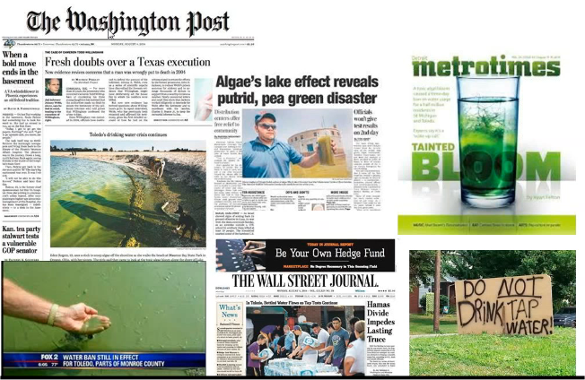
Lake Erie Algae Bloom

Slide 3
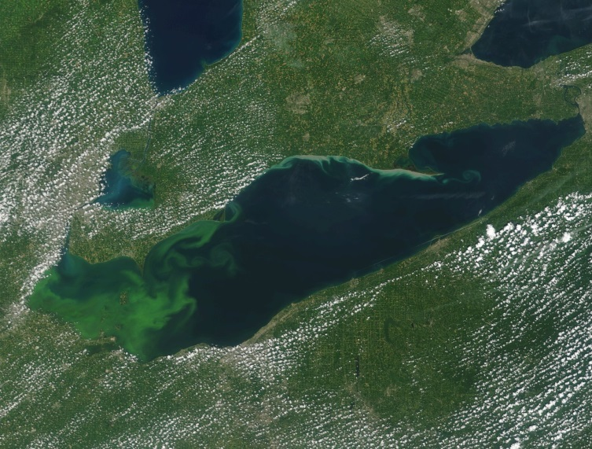
Support WFO CLE/DTX
Support Roles
EcoForecast Support Dashboard
Transition from WFO DTX
Management will integrate staff this season
Supports NOAA/NOS
Secondary support NOAA/GLERL
Local Web page
Weekly HQ briefing slides
IDSS Briefings
Social media posts

Slide 4
WFO CLE Web Page
http://www.weather.gov/cle/LakeErieHAB

Slide 5
Training and Interagency Collaboration
Interagency collaboration has led to cross discipline training,
awareness and collaboration.

Slide 6
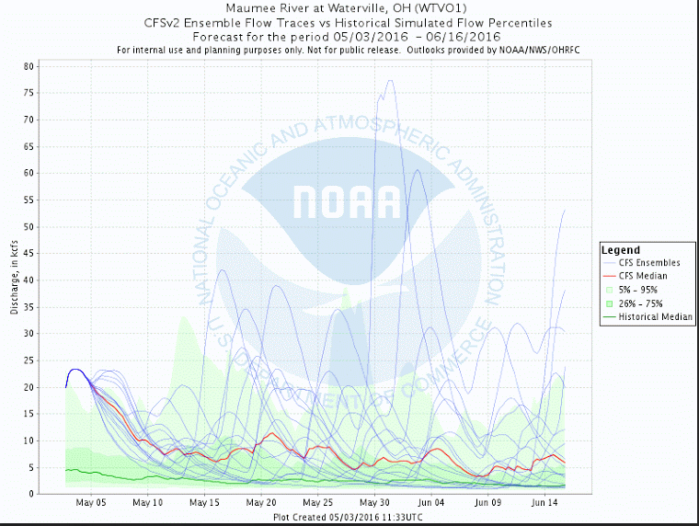
Ohio River Forecast Center

Slide 7
WFO CLE IDSS
IDSS to core partners regarding the algae season
potential as well as regular updates on the bloom
development.

Slide 8
Social Media Posts

Slide 9
Agency Briefing Slide

