Slide 1
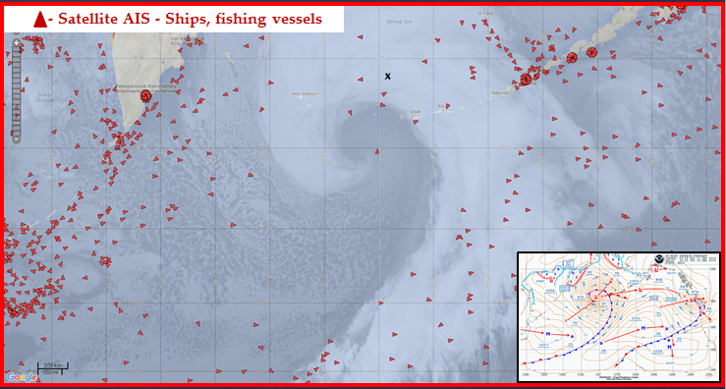
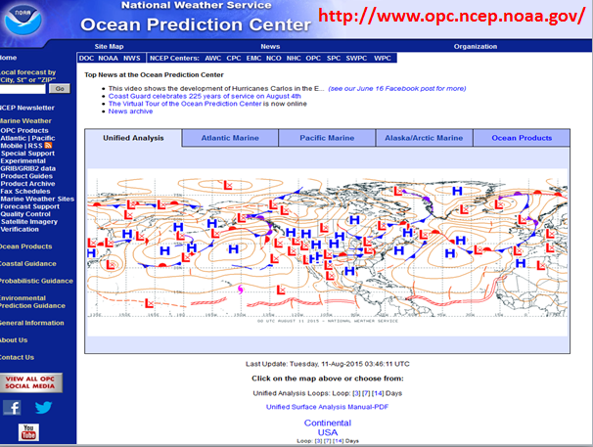
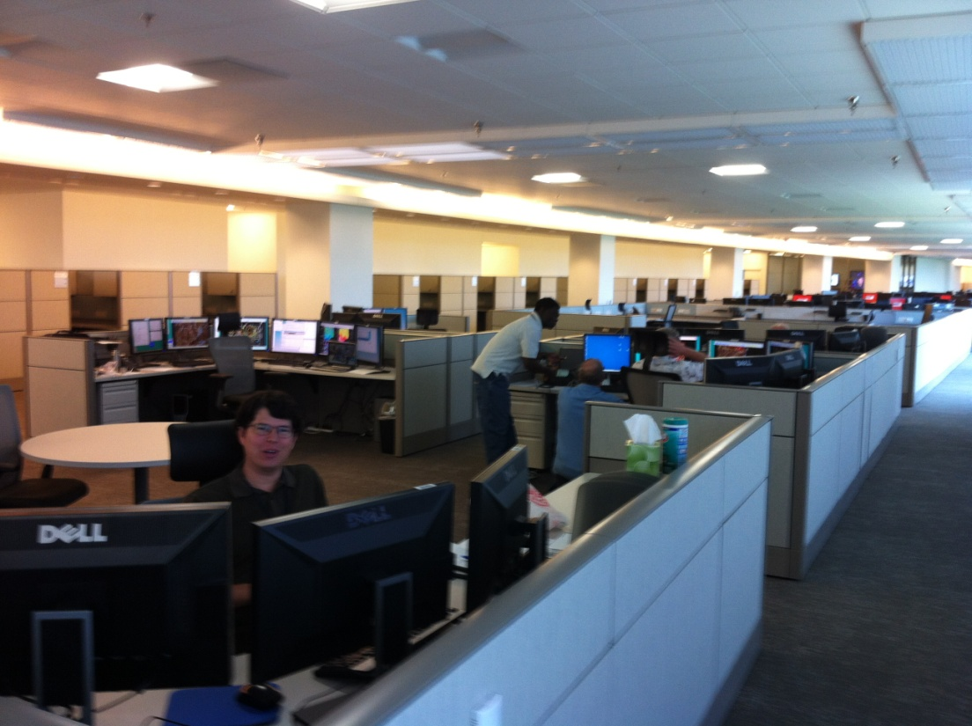
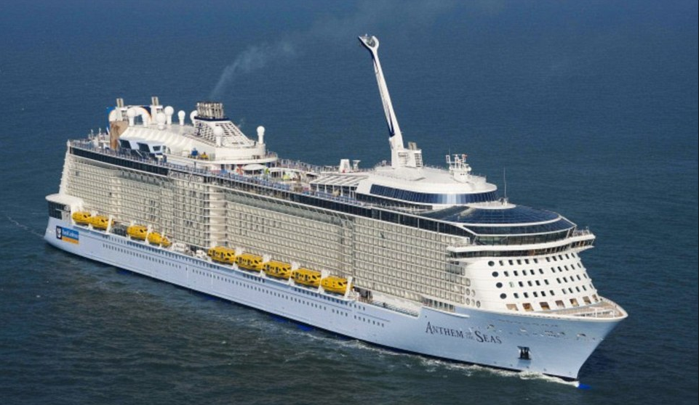
Ocean Prediction Center (OPC)
Darin J. Figurskey
Operations Branch Chief
NOAA’s National Weather Service
Ocean Prediction Center
College Park, MD
301 683 1497
darin.figurskey@noaa.gov

Slide 2
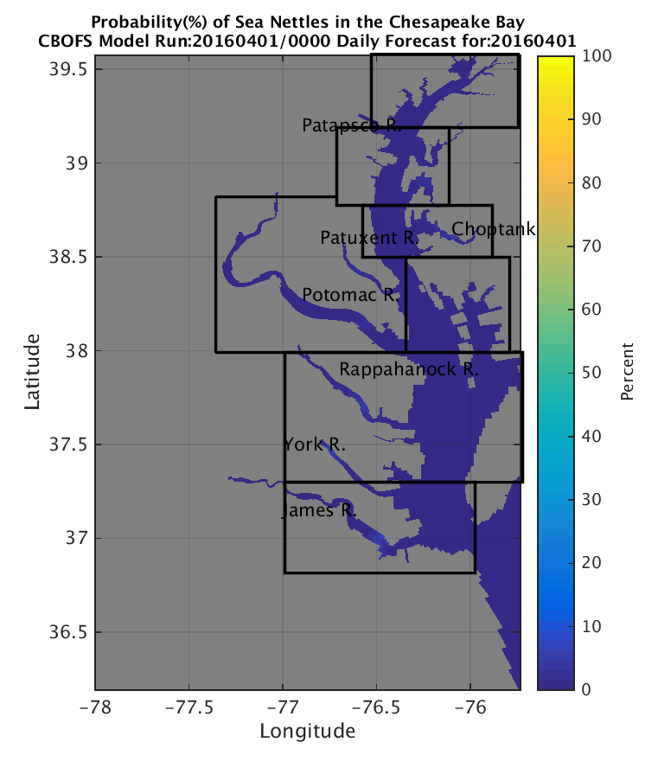
OPC Mission Areas
Marine Weather
Warning Bulletins (~20K warnings/year)
Graphical & Gridded Products (>150 products/day)
Operational Oceanography
SST, Currents, Salinity
Coastal Guidance
Storm Surge
Enabling Ecological Prediction
HAB, pathogens, hypoxia, habitat

Slide 3
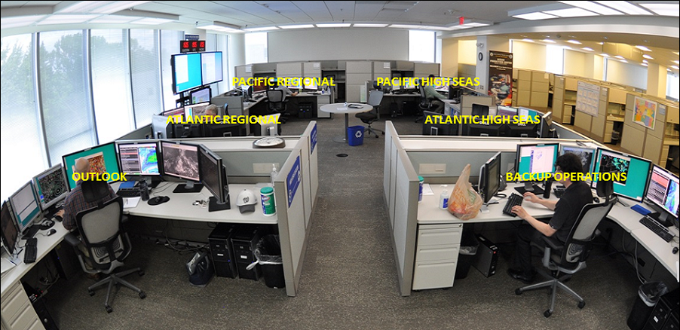
OPC Overview
Forecast Branch – 20 Forecasters
5 forecast desks, nine ten-hour shifts per 24 hours
Atlantic, High Seas and Regional
Pacific, High Seas and Regional
Outlook
Applications Branch – 5.5
Two full-time developers
NOAA Corps Officer
2.5 NOAA Affiliates (one satellite liaison split with Weather Prediction Center)
Management – 3.5
Director, Tom Cuff
Deputy Director (split with Weather Prediction Center), Kathryn Gilbert
Forecast Branch Chief, Darin Figurskey
Applications Branch Chief, Joe Sienkiewicz

Slide 4
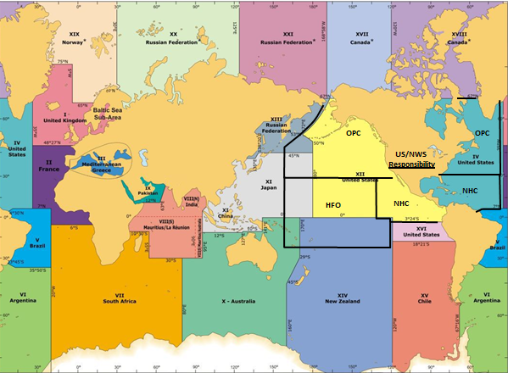
OPC Area of Responsibility

Slide 5
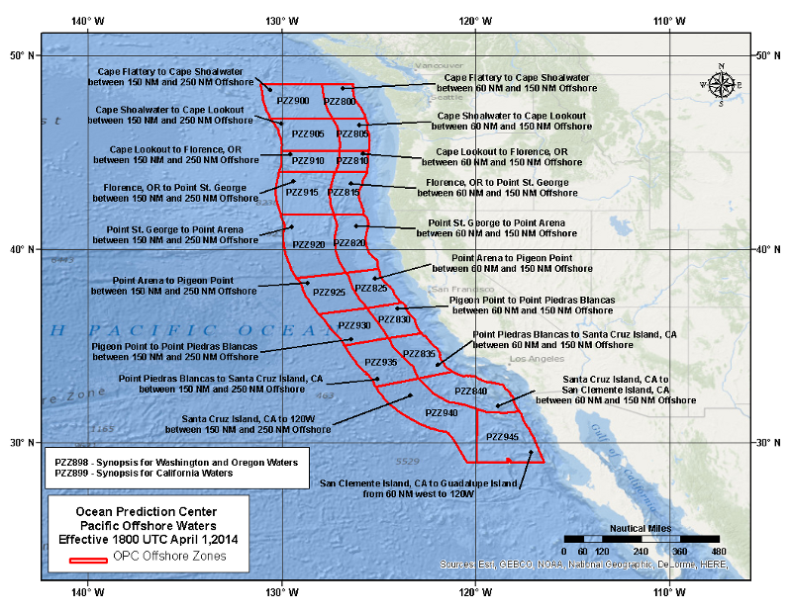
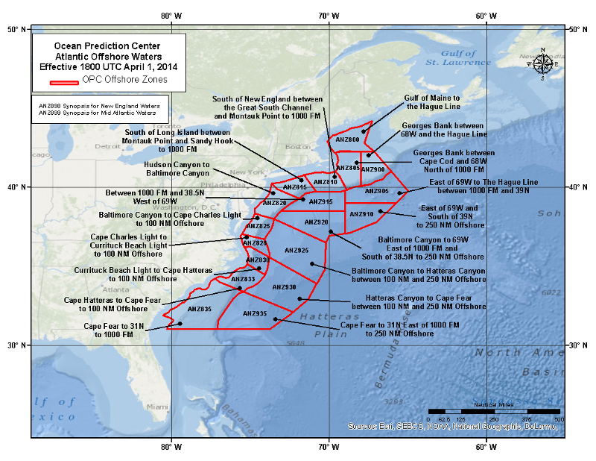
OPC Offshore Zones

Slide 6
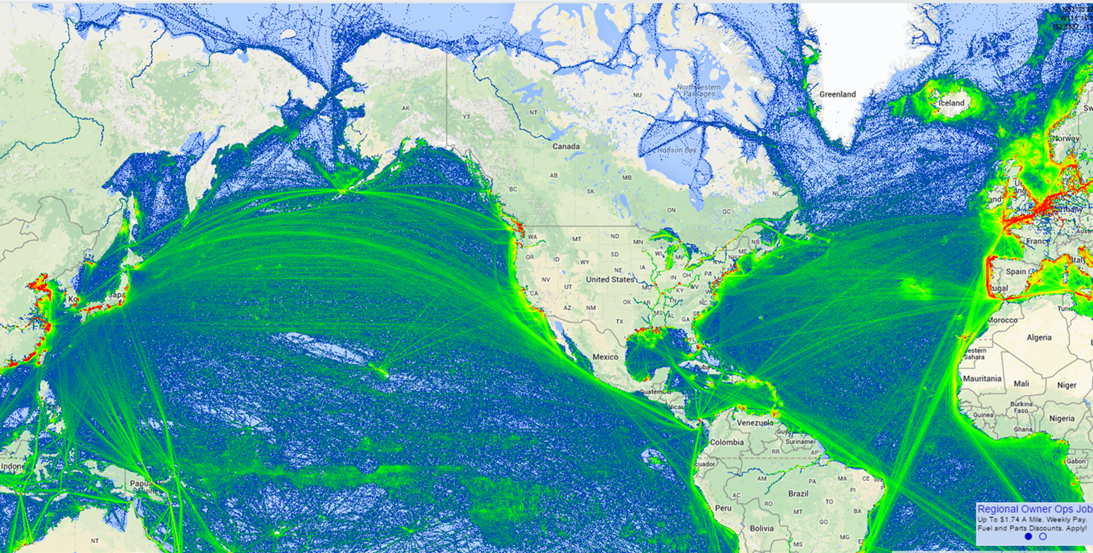
Vessel Tracks

Slide 7
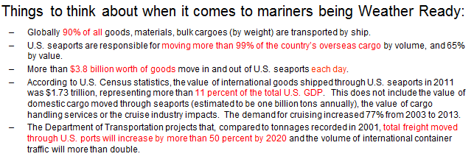
Vessel Tracks

Slide 8
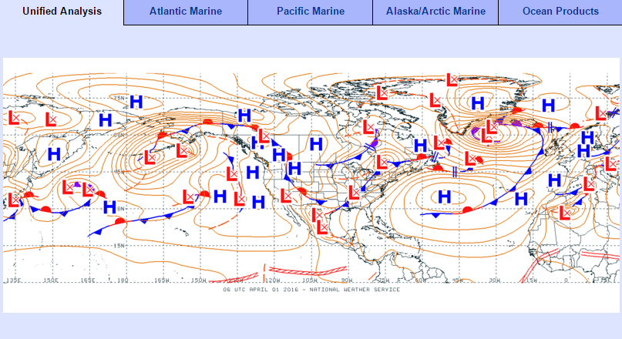
OPC Products and Services – Unified Analysis

Slide 9
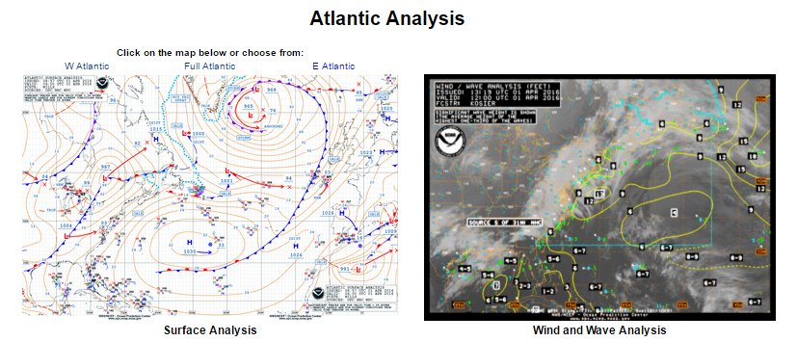
OPC Products and Services – Atlantic Analysis
Surface analysis every six hours
Wind/wave analysis every three hours

Slide 10
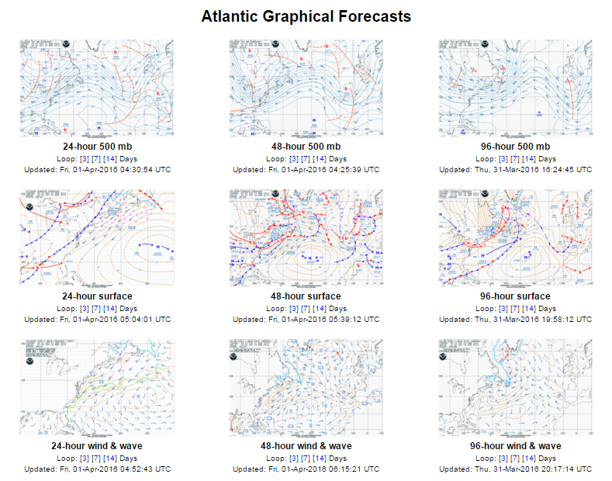
OPC Products and Services – Atlantic Forecasts
96-hour products
done once daily
Same suite of
products for Pacific

Slide 11
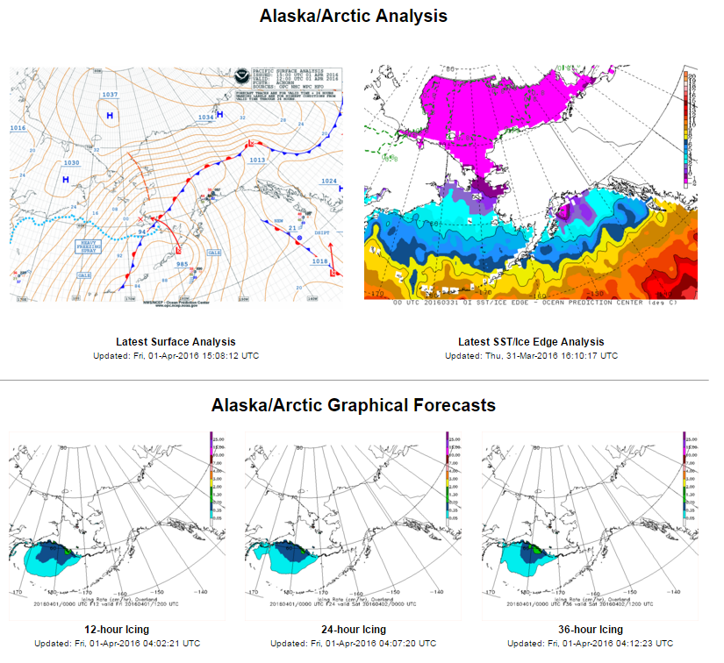
OPC Products and Services – Arctic
These are in addition to
the suite of products as
for Atlantic and Pacific

Slide 12
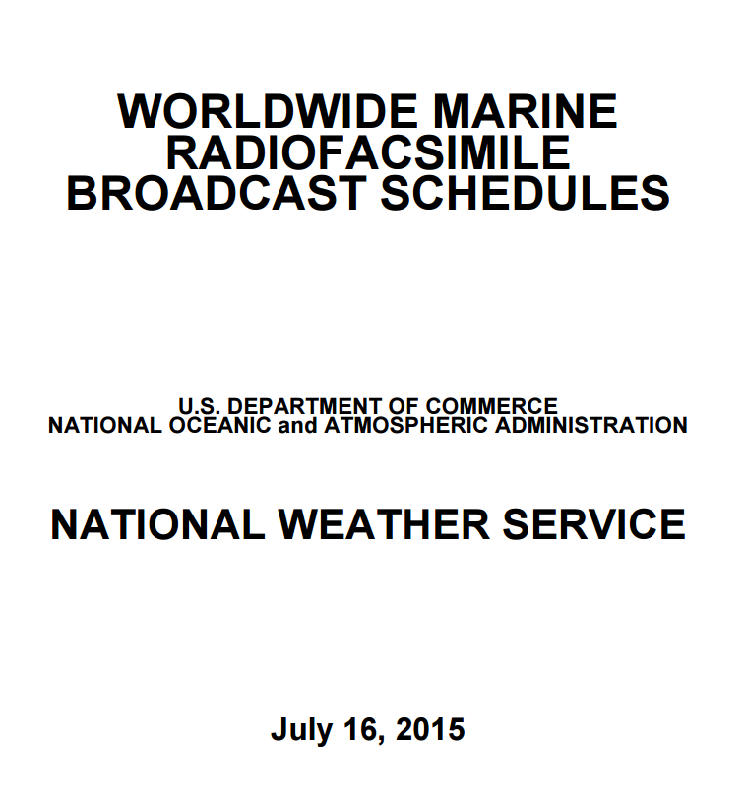
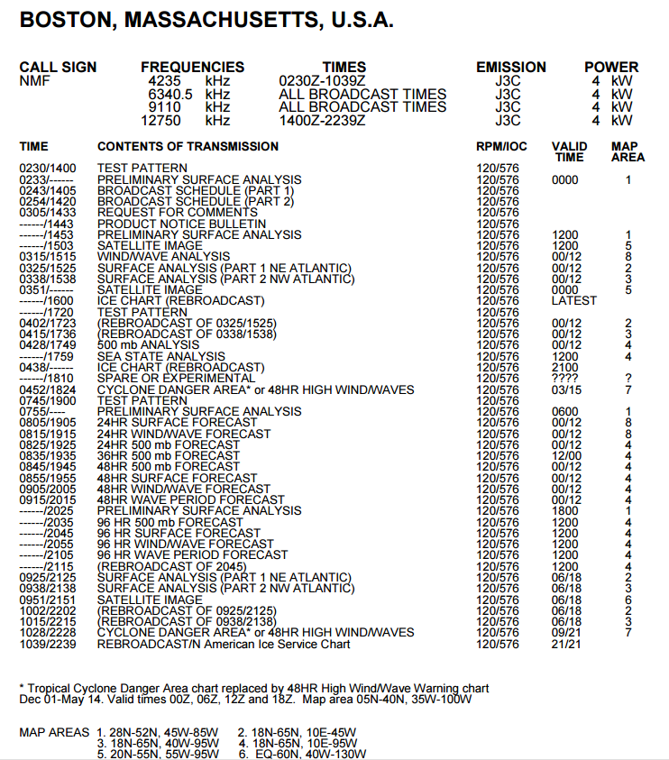
Charts and Faxes are Still Important
http://www.nws.noaa.gov/om/marine/rfax.pdf

Slide 13
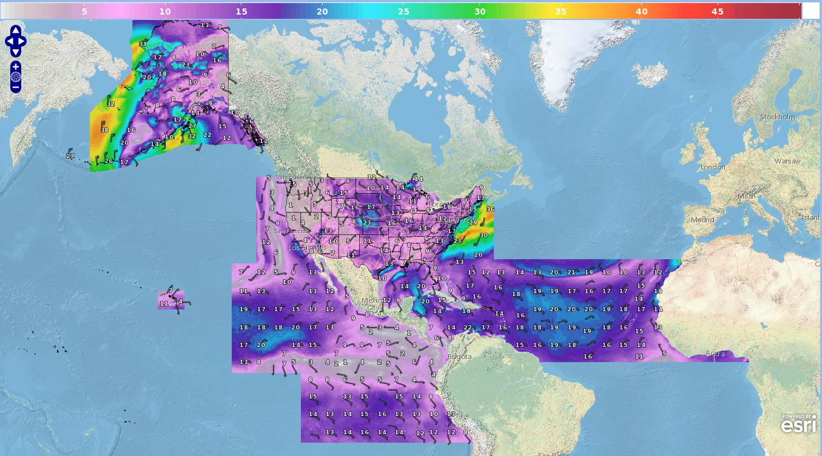
Expanding Gridded Information
http://www.opc.ncep.noaa.gov/opc_gridded_marine.php

Slide 14
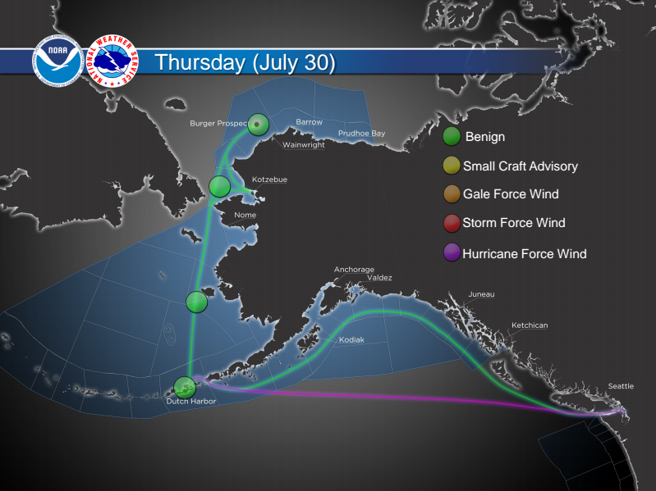
Other Future Areas of Need
Arctic
Increased traffic
Resource exploration
Strategic interest of both nations
Expansion of Forecasts in Time & Space
Gridded forecasts
Extend beyond five days to 3 to 4 weeks
Probabilistic Information
Pressure
Wind
Waves
Ice coverage
Serving all of the constituencies that need forecasts for safety of life at sea

Slide 15
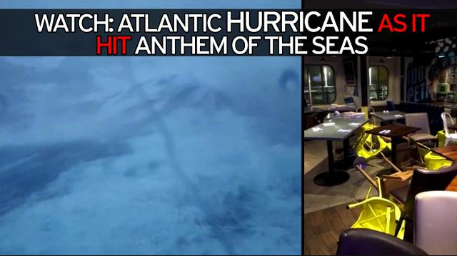
Other Future Areas of Need
Collaboration
Forecast tools
Forecast guidance improvement
Observations
Current conditions
Forecast and model validation, verification, improvement
Outreach
How do customers really use our information?
What could we do better or change?
Decision support services
Resources
Science and development
Day-to-day forecasting
Storm surge
Anthem of the Seas (courtesy mirror.co.uk)

Slide 16
Thanks!

