Slide 1
The Canadian Great Lakes Deterministic Coupled Water Cycle Prediction System PART 1
S. Dyck, F. Dupont, D. Durnford, B. Winter, D. Deacu Canadian Centre for Weather and Environmental Prediction - National Prediction Development -
Numerical Environmental Prediction
Erika Klyszejko
Weather and Environmental Monitoring - Hydrometric Monitoring
Frank Seglenieks
National Hydrological Services - Operations East -
Boundary Water Issues
V. Fortin, G. Smith, F. Roy, M. Mackay,
É. Gaborit, M. Dimitrijevic
Atmospheric S&T- Meteorological Research -Recherche en prévision numérique
R. Yerubandi
Water S&T - Watershed Hydrology and Ecology Research
Devon Telford
Prediction Services - Operations East - National Laboratory for Marine and Coastal Meteorology

Slide 2
The Needs of a short term water cycle prediction system (48-h)
 | Water Cycle (P-E+R) | Navigation | Hydro Power | Flood Warnings | Search and Rescue | Environmental Emergencies | Meteorological Forecasting | Habitat Forecasting | Ecological Forecasting
Lake Levels |  | x | x | x |  |  |  | x
Stream Flow | x |  | x | x |  |  |  | x
Lake surface currents |  | X |  |  | x | x |  |  | x
Surface Lake temperatures | x |  |  |  | x | x | X | x | x
Seasonal Ice cover | x | x | x |  | x | x | x | x
Vertical Temperature profiles |  |  |  |  |  | x |  |  | x
Meteorological forecasts | x | x | x | x | x | x | x | x | x

Slide 3
Outline
Model Components
WATROUTE – hydrological model
NEMO+CICE – 3D lake-ice model
GEM+NEMO+CICE – above coupled (2-way) with a 3D atmospheric model
The System as a whole
Application Focus: Lake Level Forecasts
Other Applications

Slide 4
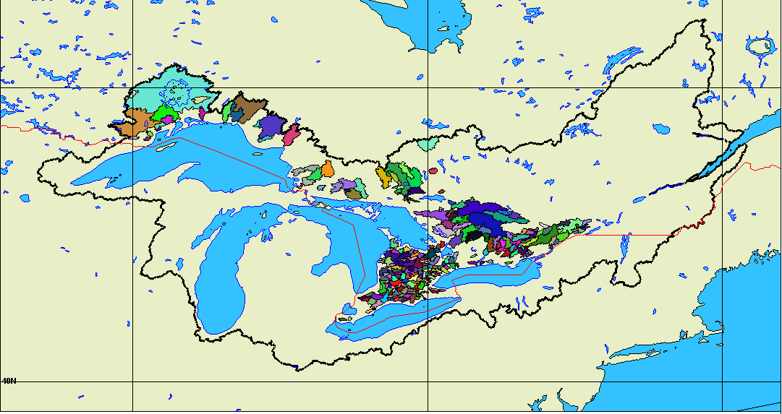
WATROUTE
Drainage:
HydroSHEDS
(SRTM 1-km)
Vegetation
Slope
Hourly imputs from GEM:
Surface runoff (ISBA-N0)
Groundwater infiltration from 2004-09 climatology (GEM-Surf)
Assimilation of gaged river discharge via direct insertion
Hindcasts include american and canadian data

Slide 5
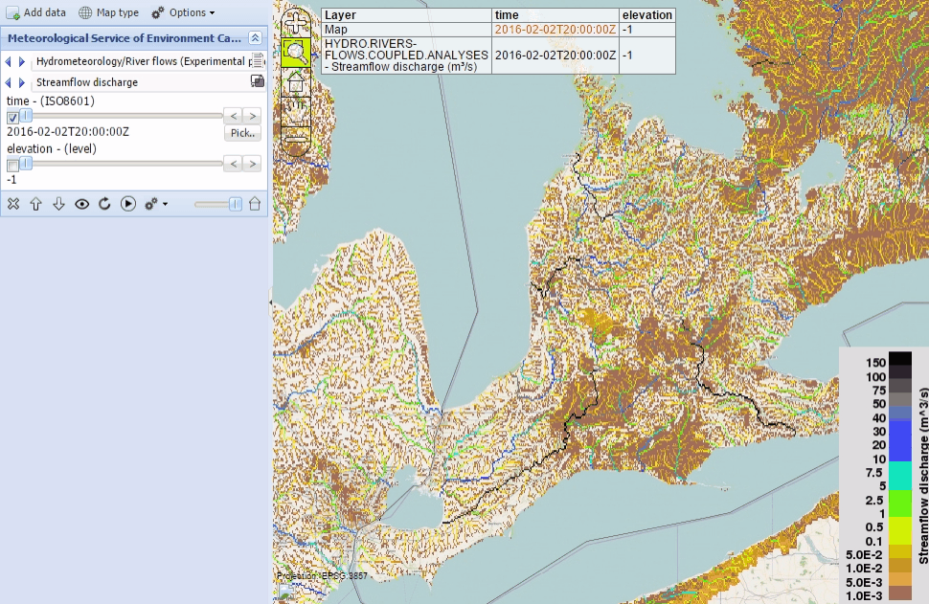
WATROUTE analysis
2016-02-02 20Z - 2016-02-04 19Z

