Slide 1
The Canadian Great Lakes Deterministic Coupled Water Cycle Prediction System PART 2
S. Dyck, F. Dupont, D. Durnford, B. Winter, D. Deacu Canadian Centre for Weather and Environmental Prediction - National Prediction Development -
Numerical Environmental Prediction
Erika Klyszejko
Weather and Environmental Monitoring - Hydrometric Monitoring
Frank Seglenieks
National Hydrological Services - Operations East -
Boundary Water Issues
V. Fortin, G. Smith, F. Roy, M. Mackay,
É. Gaborit, M. Dimitrijevic
Atmospheric S&T- Meteorological Research -Recherche en prévision numérique
R. Yerubandi
Water S&T - Watershed Hydrology and Ecology Research
Devon Telford
Prediction Services - Operations East - National Laboratory for Marine and Coastal Meteorology

Slide 2
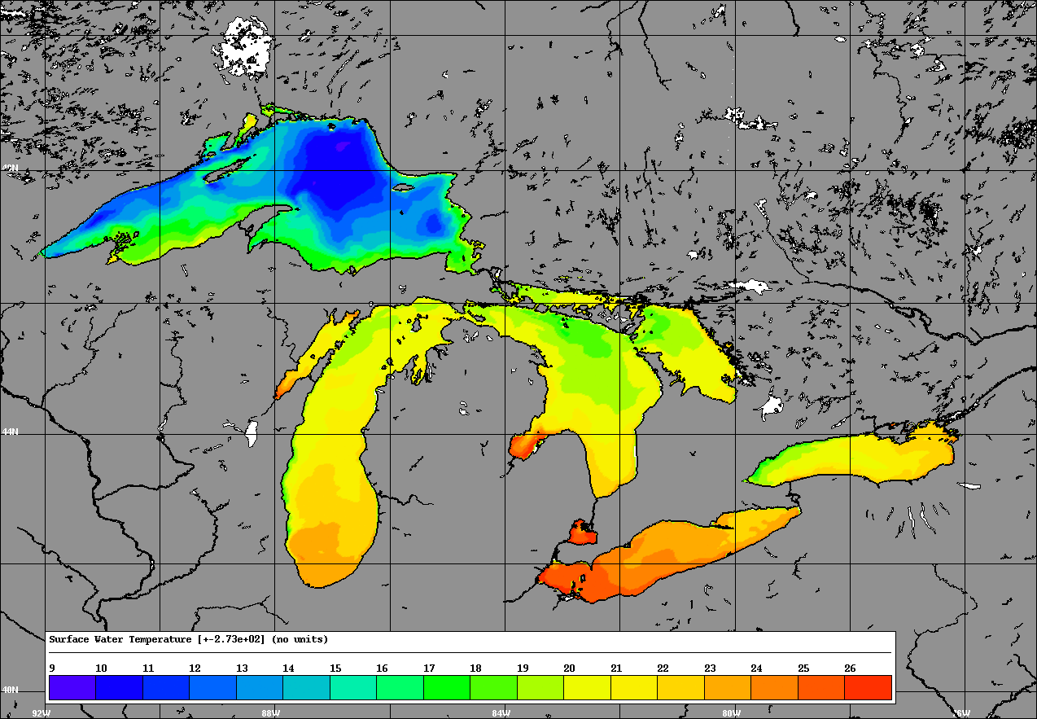
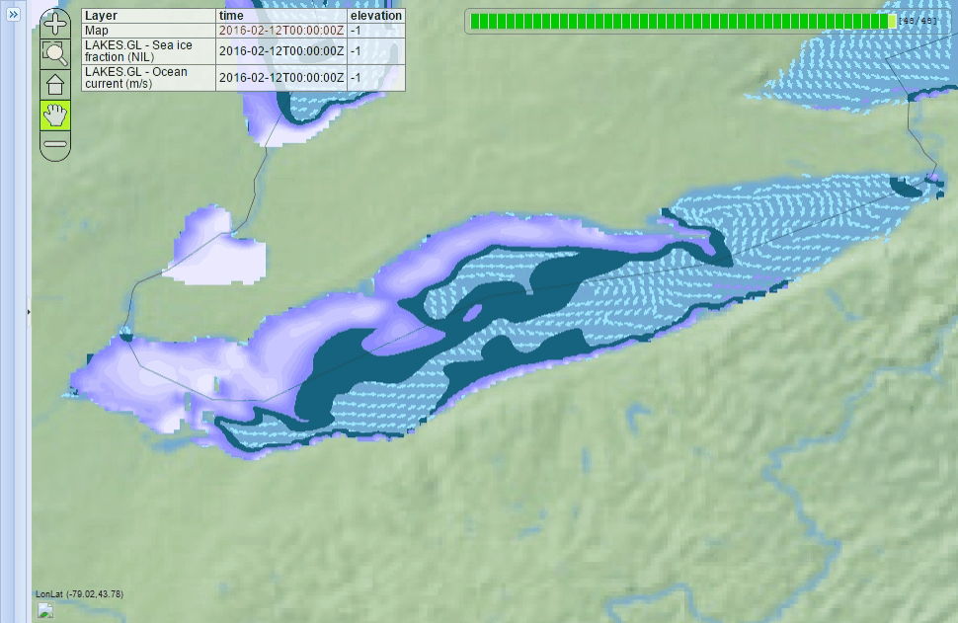
NEMO - CICE
NEMO v 3.2
2km Resolution (355x435)
Variable vertical resolution
35 levels
450s Time step
Integrated River Routing Model
CICE v 4.0
Multicategory Ice model
4 thermodynamic levels
Direct Insertion of Radarsat Image Analyses

Slide 3
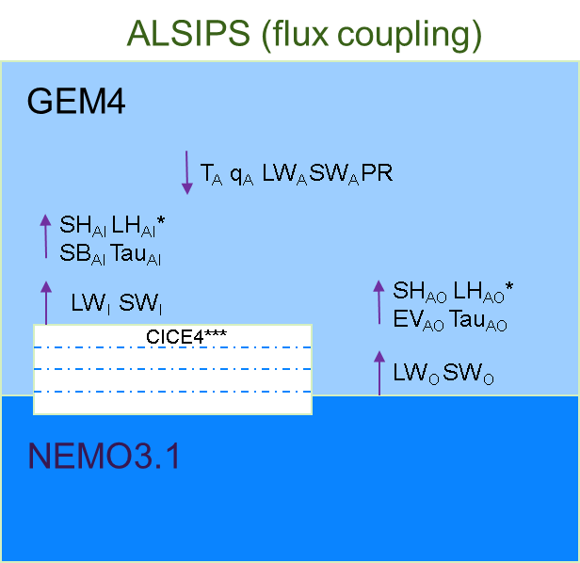
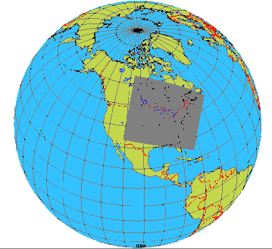
GEM - NEMO - CICE
GEM v 4.6.1
10km Resolution (355x435)
Variable vertical resolution
80 levels
225s Time step (½ NEMO)
Flux coupled with NEMOCICE

Slide 4
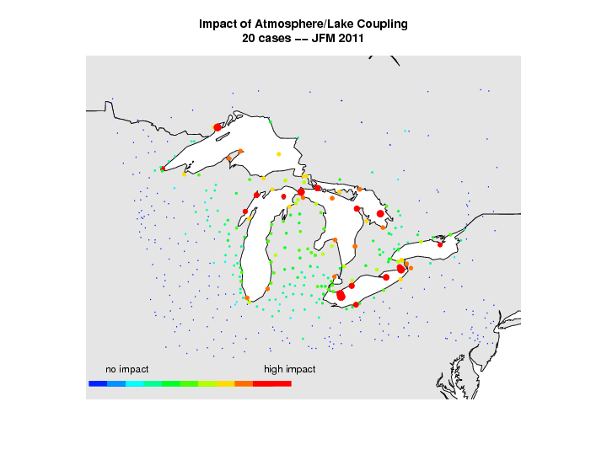
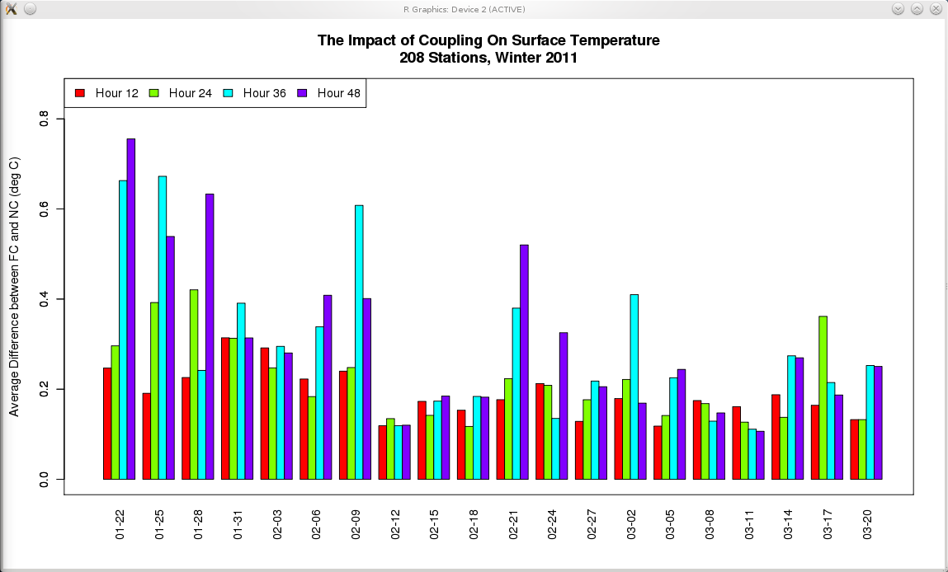

Slide 5
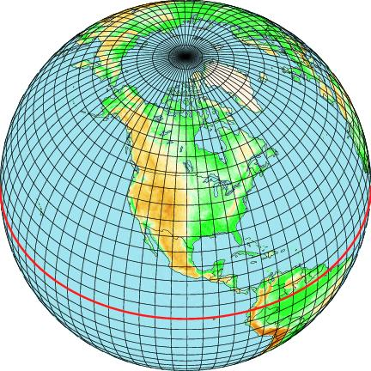
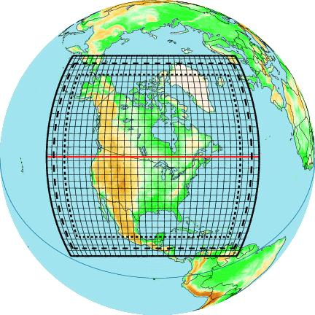
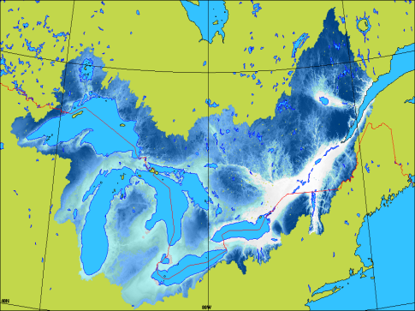
Great Lakes and St. Lawrence Water Cycle Prediction System
GEM GDPS (25 km)
GEM LAM (10 km) + NEMO+CICE (2 km)
GEM RDPS (10 km)
Runoff
Streamflow
2 forecasts/day (00Z and 12Z)
48-h forecasts
Assimilation cycle: direct insertion of RADARSAT ice cover and WSC streamflow
WATROUTE
(1km)
Notes:
- Based on operational system running over Gulf of St. Lawrence (GEM+NEMO)
- Necessary to add routing component over the Great Lakes to simulate changes in Great Lakes water level
- Makes it possible to also issue streamflow forecasts
5

Slide 6
Clients and Collaborators
ECCC
Canadian Ice Service
Boundary Waters Unit
Great Lakes / St.-Lawrence Regulation Office
National Hydrologic Service
Environmental Emergencies
Canadian Centre for Weather and Environmental Prediction
External Clients
Coast Guard
Ontario and Quebec Provincial Governments
Hydro-electric power production agencies
External Collaborators
FloodNet
IREQ (Hydro-Québec)
NOAA/GLERL
NOAA/NWS
UK Met Office
World Meteorological Organization

Slide 7
Evaluation
Pseudo-analyses and 48-h forecasts:
GEM↔NEMO↔CICE: since Novembre 2014
Used during the Pan-Am Games
RDPS→WATROUTE: since June 2015
WATROUTE←GEM↔NEMO: since novembre 2015
Accepted for Experimental Implementation
Delivery is underway

Slide 8
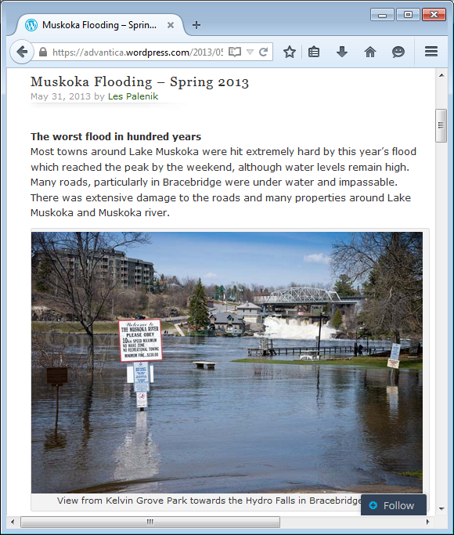
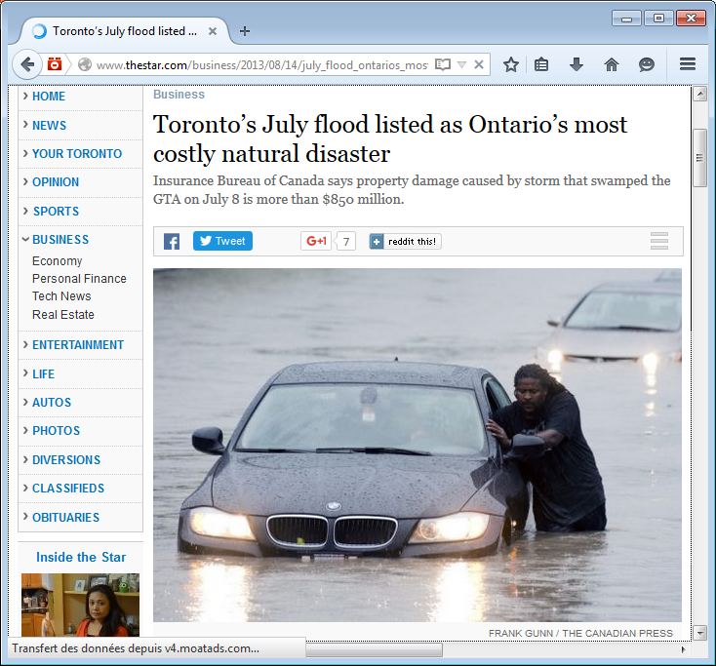
Applications: Lake Level

