Slide 1
The Canadian Great Lakes Deterministic Coupled Water Cycle Prediction System PART 3
S. Dyck, F. Dupont, D. Durnford, B. Winter, D. Deacu Canadian Centre for Weather and Environmental Prediction - National Prediction Development -
Numerical Environmental Prediction
Erika Klyszejko
Weather and Environmental Monitoring - Hydrometric Monitoring
Frank Seglenieks
National Hydrological Services - Operations East -
Boundary Water Issues
V. Fortin, G. Smith, F. Roy, M. Mackay,
É. Gaborit, M. Dimitrijevic
Atmospheric S&T- Meteorological Research -Recherche en prévision numérique
R. Yerubandi
Water S&T - Watershed Hydrology and Ecology Research
Devon Telford
Prediction Services - Operations East - National Laboratory for Marine and Coastal Meteorology

Slide 2
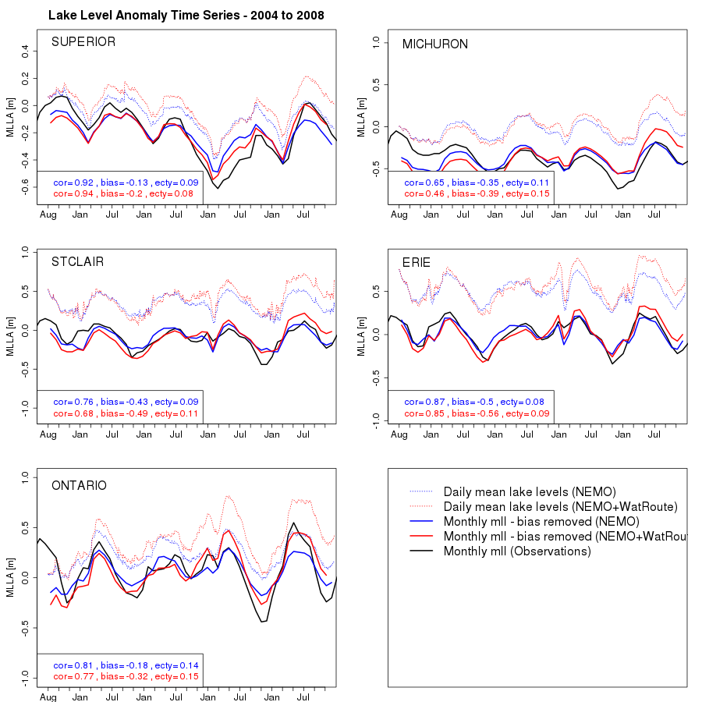
Lake Level – Long term (2004-2008)

Slide 3
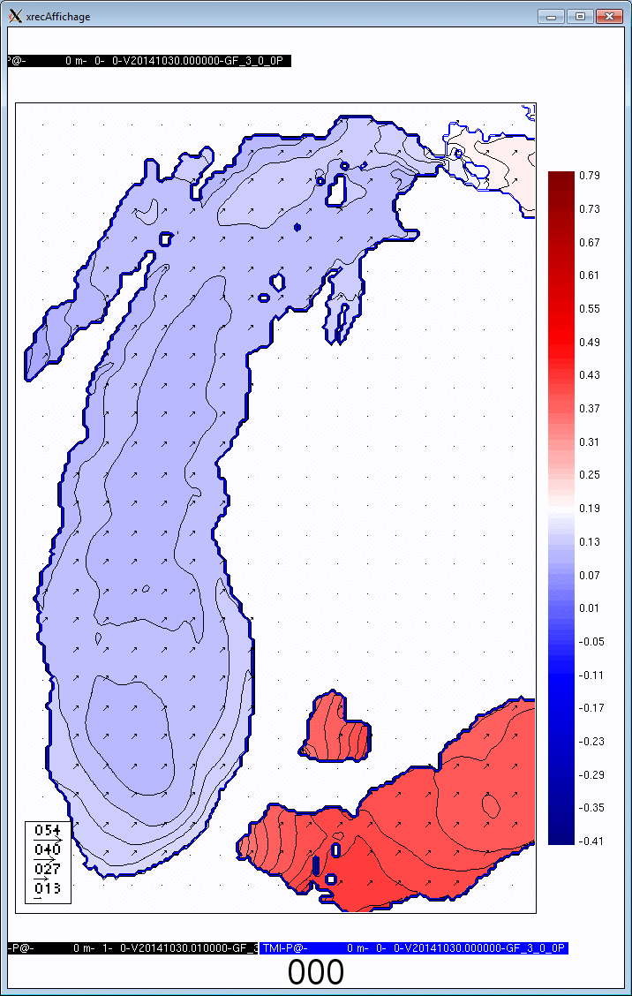
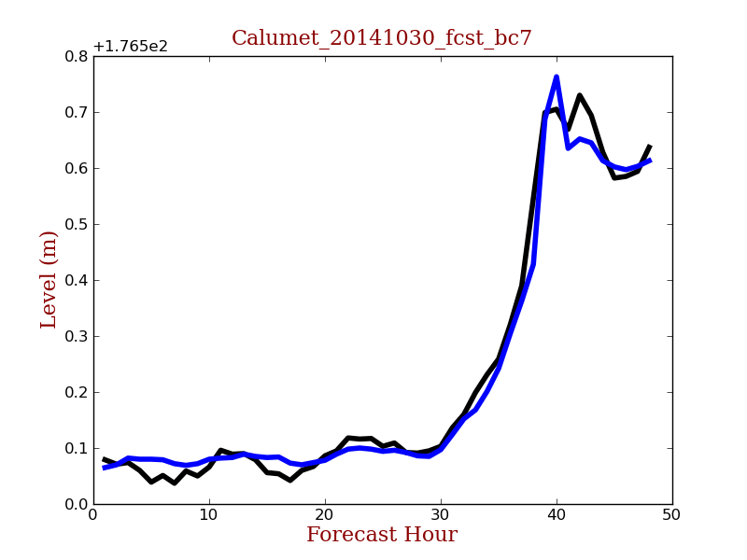
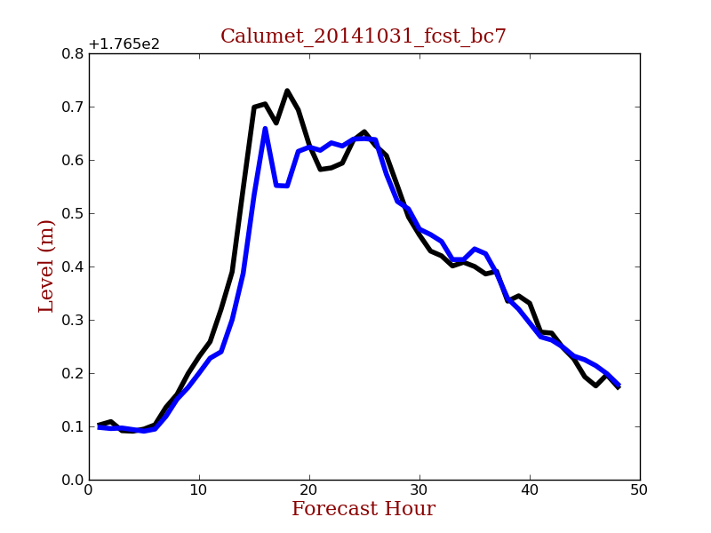
Lake Level – Short term
Halloween storm, 2014:
Forecast issued
Oct 30th
Obs.
Model
Obs.
Model
Chicago
Forecast issued
Oct 31th
Notes:
- Case study: major storm surge very well forecasted with 36h lead time
3

Slide 4
Water Level Forecasts and Observations for the Great Lakes
http://iweb.cmc.ec.gc.ca/~armnmar/
Output from the RDPS_CGL is currently being processed and made available to forecasters through National Lab for Marine and Coastal Meteorology's webpage.

Slide 5
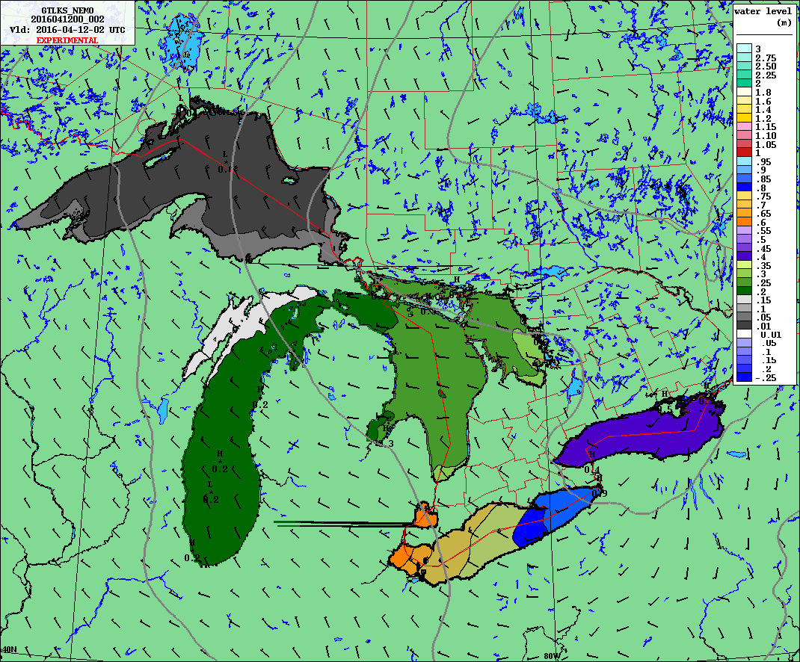
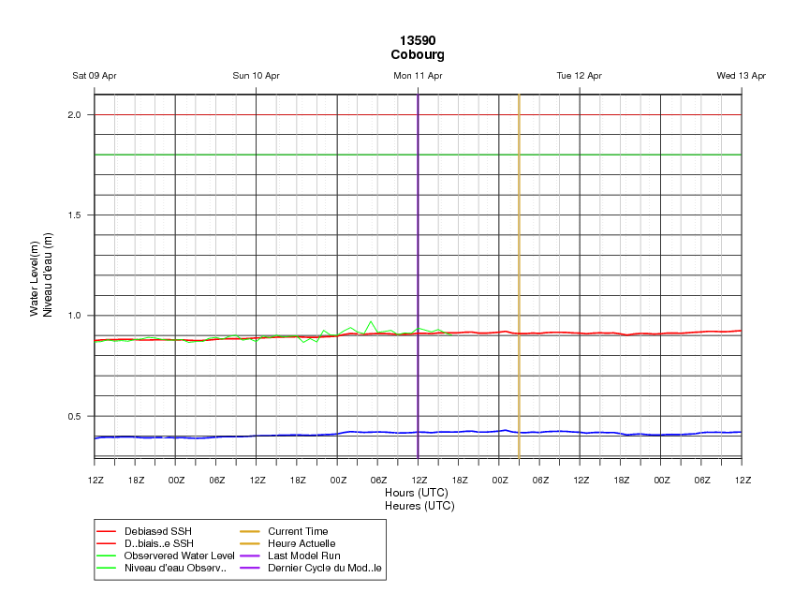
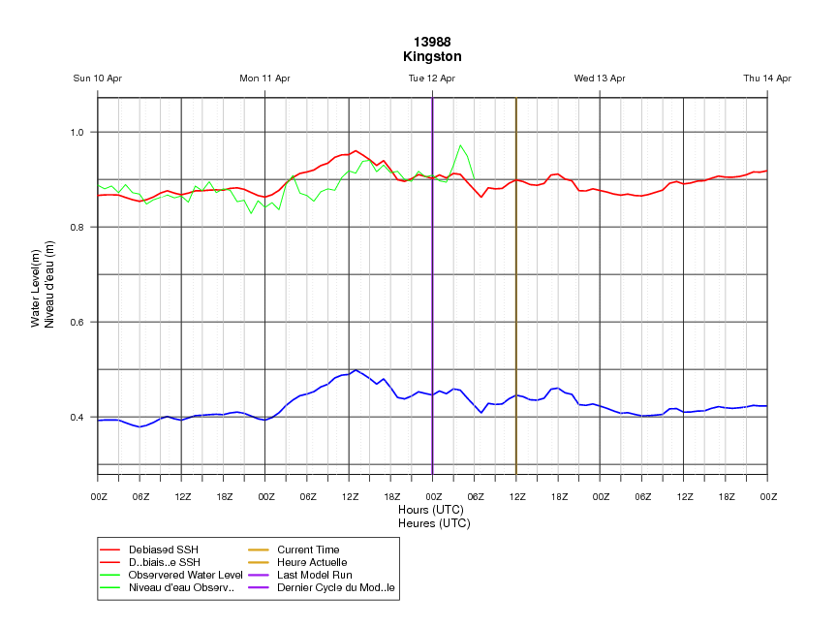
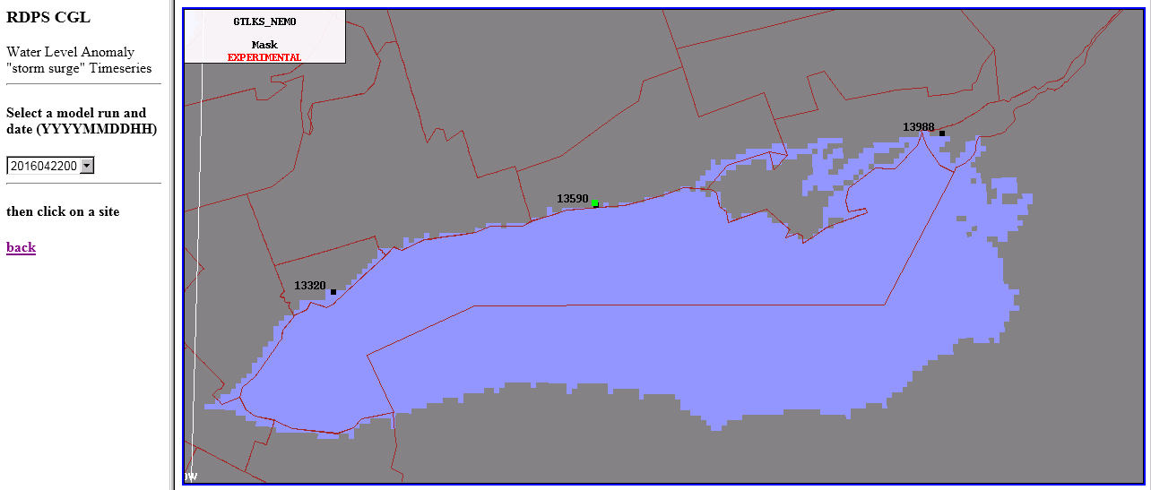
Water Level Forecasts and Observations for the Great Lakes
flooding levels
Observations
De-biases model data based on observations
Model data
Color indicates vigilance level
Green no current or forecast threat
Red current threat, based on obs
Orange forecast level 2
Yellow forecast level 1

Slide 6
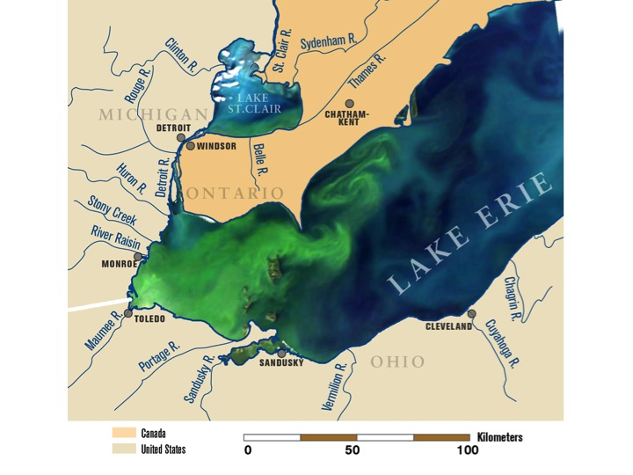
Water Quality
http://voices.nationalgeographic.com/2013/04/24/harmful-algae-blooms-plague-lake-erie-again/

Slide 7
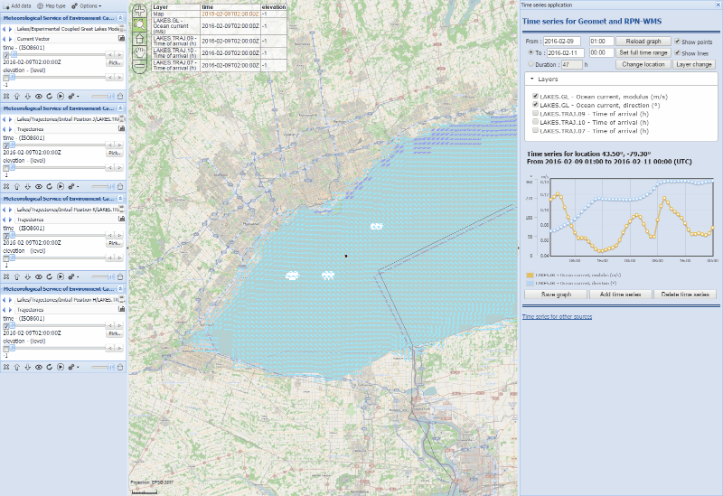
Particle tracking - Forecast issued 2016-02-09 00Z

