Slide 1
Ensemble-based wave guidance at the
US National Weather Service and the
North American Wave Ensemble System (NAWES)
PART 1
Jose-Henrique Alves
Senior Scientist, Oceanographer Marine Modeling and Analysis Branch SRG at Environmental Modeling Center (EMC)
US National Centers for Environmental Prediction (NCEP)
NOAA, College Park, MD

Slide 2
The Global Wave Ensemble System (GWES)
NCEP Global-Scale Wave Ensemble System
Operational National Weather Service (NWS) prediction suite,
Products and support 24 x 7.
State-of-the-art wave model WAVEWATCH III
Single ½ degree spatial resolution grid,
21 Members
Forcing: GEFS + MMAB hires ice analysis
Cycles/day: 4 daily cycles [00,06,12,18]Z
Primary customer base
Ocean Prediction Center (OPC),
National Hurricane Center,
US Navy (FNMOC), Environment Canada
Notes:
NCEP runs a global-scale wave ensemble system, known as GWES, which is part of the United States National Weather Service operational numerical weather prediction suite, that means is if offered to our customers and the general product on a 24x7 basis, with 24x7 support.
As most wave systems at the NWS, the GWES is built upon the state-of-the-art wave model WAVEWATCH III.
It has a single 12 degree grid extending from 80 degrees south to 80 north, which wraps around the globe in longitudes.
We run 21 members, and the forcing consists of surface winds from NCEP’s global atmospheric ensemble (GEFS), and ice analyses from NCEP’s high resolution ice analysis.
The GWES runs four daily cycles with forecasts extending to 10 days.
Our primary customer base consists of several NWS/NCEP centers, primarily the ocean prediction center and the National hurricane center, as well as north-american partners such as the US Navy via its operational center fleet numerical meteorology and oceanography center, and environment canada.

Slide 3
The Combined NCEP/FNMOC Wave Ensemble Product (NFCENS)
Combines significant wave-height from NCEP and FNMOC GWES
Part of operational National Weather Service (NWS) prediction suite,
Products and support 24 x 7.
Shared features:
State-of-the-art wave model WAVEWATCH III
Single ½ degree spatial resolution grid,
21 Members
NCEP: Forcing: GEFS + MMAB hires ice analysis
FNMOC: NAVGEM winds and ice
Primary customer base
OPC, NHC, FNMOC, Environment Canada
Cycles/day: 2 daily cycles [00,12]Z

Slide 4
Brief History of The GWES Model
Relevant changes | GEFS | Wave ensemble | Lag
Birth, 10 members | 1992 | 2004 | 12
10 to 20 members | 2005 | 2008 | 3
Resolution to 70km | 2010 | -
Resolution to 50 km | 2012 | 2014 | 4
Resolution to 30km | 2015 | ? | ?
Resolution to 15km | 2018 | ? | ?
4

Slide 5
Latest GWES System Upgrade (FY14)
Last system upgrade on July 2014
New physics package for wave growth and dissipation,
Higher resolution spatial and spectral grids
Reintroduction of hindcast phase
24h cycle: GEFS 80-member initialization cycle
Name change
Old MENS – Multi-wave Ensemble System
New GWES - Global Wave Ensemble System
5

Slide 6
Latest GWES System Change (FY16)
Last system change on Dec 2015
GEFS Upgrade
Semi-Lagrangian scheme,
Higher native spatial resolution,
More vertical levels, D
GFS Hybrid/EnKF initialization scheme.
Downstream adjustment to GWES
Updated the input stride to 3h (previously 6h),
Upped the spatial resolution of incoming winds from 1 degree to 1/2 degree,
Changed to raw winds, as opposed to bias corrected.
6

Slide 7
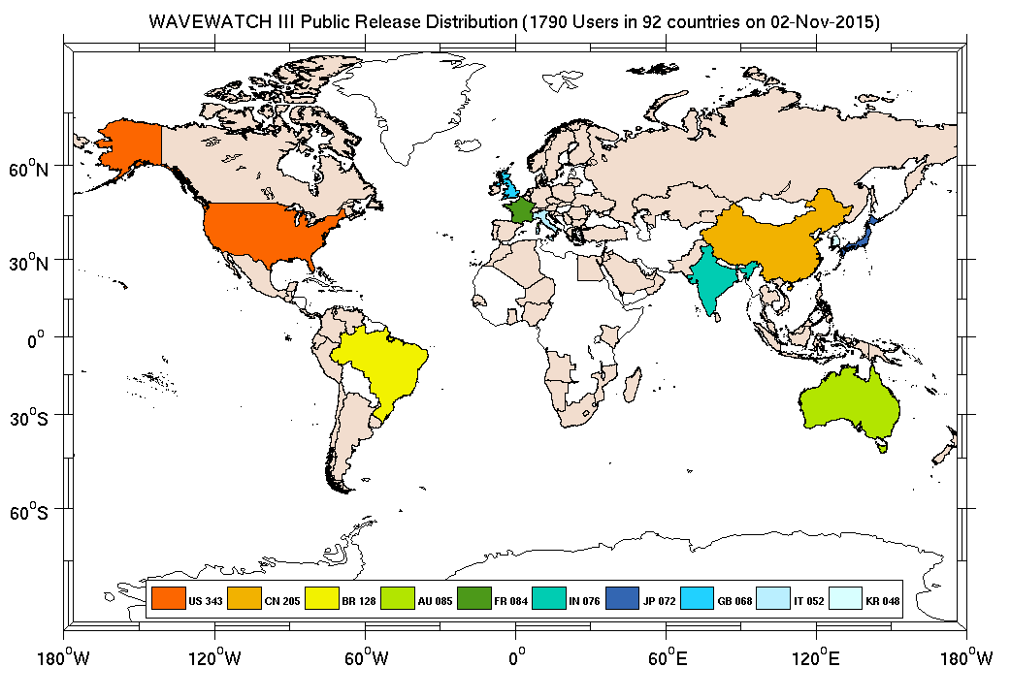
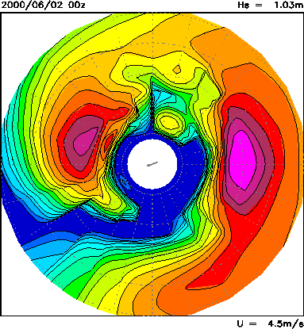
Underlying Wave Model
WAVEWATCH III: state-of-the-art numerical model for wave prediction.
Developed at NCEP in 90’s, became community model recently,
Collaborators from all over the world,
~2,000 users in 92 countries (11/2015).
WW3 is a spectral wave model,
Computes wave fields at fixed grid points
Statistical representation of waves via directional wave spectrum
T_{m}
T_{m}
Model calculates how spectrum changes due to wind and ice, computes mean wave parameters used in forecasts:
Significant wave height (Hs),
Peak and Mean wave periods (Tp, Tm),
Peak and mean wave directions (θp, θm)
θ_{m}
θ_{m}
H_{s}
H_{s}

