Slide 1
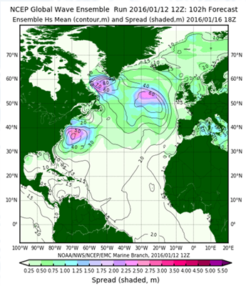
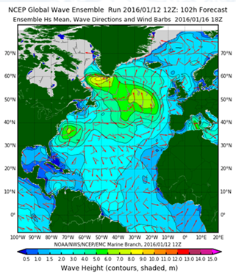
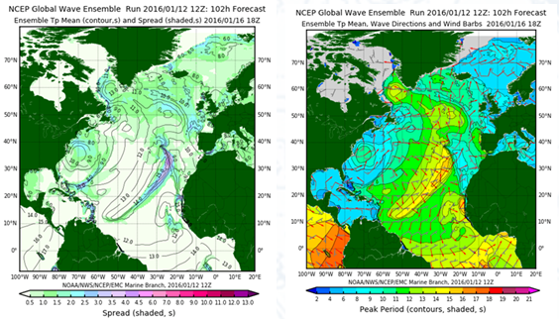
GWES Products: Full Grid (Members, Ensemble Mean, P(Hs>Ht)
[H_{s}]: Mean Significant Wave Height
[H_{s}] + Spread
[T_{p}]: Mean Peak Wave Period
[T_{p}] + Spread
Gridded dat distributed to NAWIPS
OPC and NHC
Available via NCEP operational FTP
Individual member (12 parms)
Ensemble mean (12 parms)
Ensemble spread (12 parms)
Probability exceedence (9 parms)
Added to NOMADS on next upgrade
NFCENS Hs, same schedule

