Slide 1
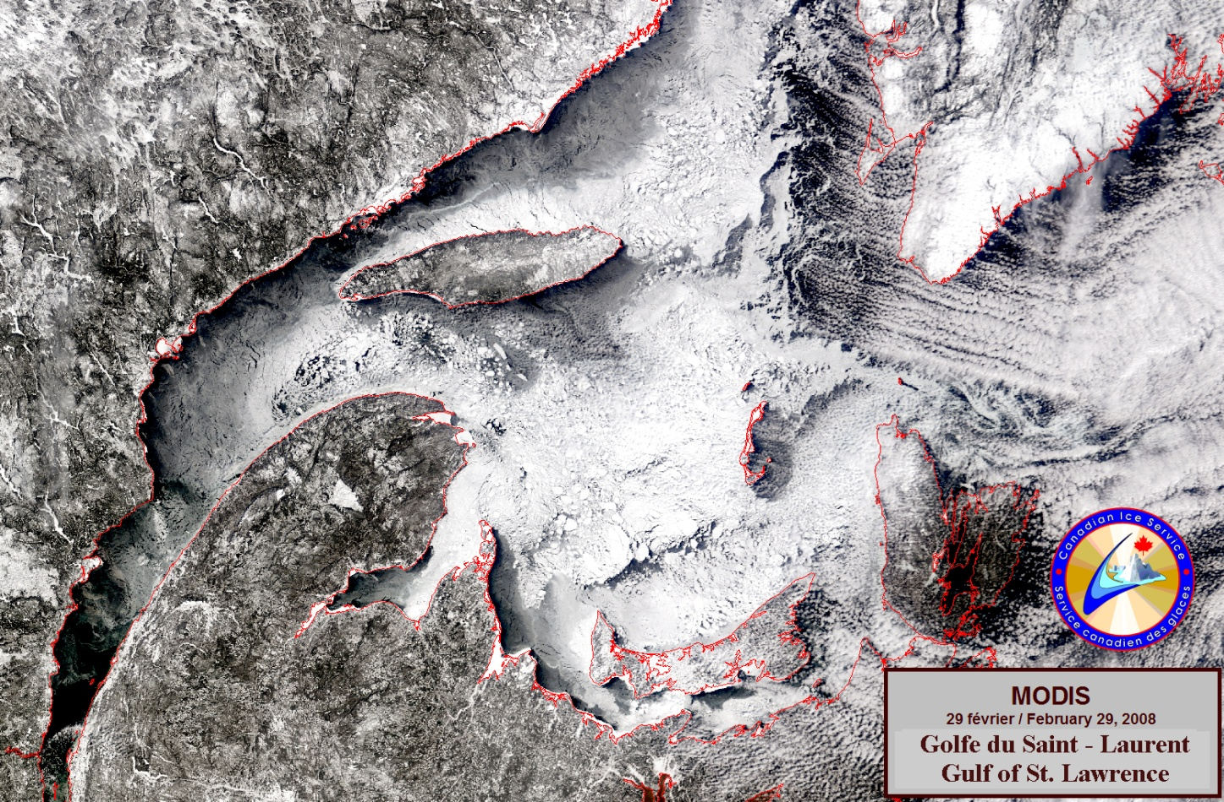
Impact of Ocean and Sea Ice Coupling on Global Medium-range Weather Forecasts
GC Smith¹, F Roy¹, J-M Belanger¹, D Deacu², H Ritchie¹, P Pellerin¹
¹ Meteorological Research Division, RPN-E
² Meteorological Service of Canada

Slide 2
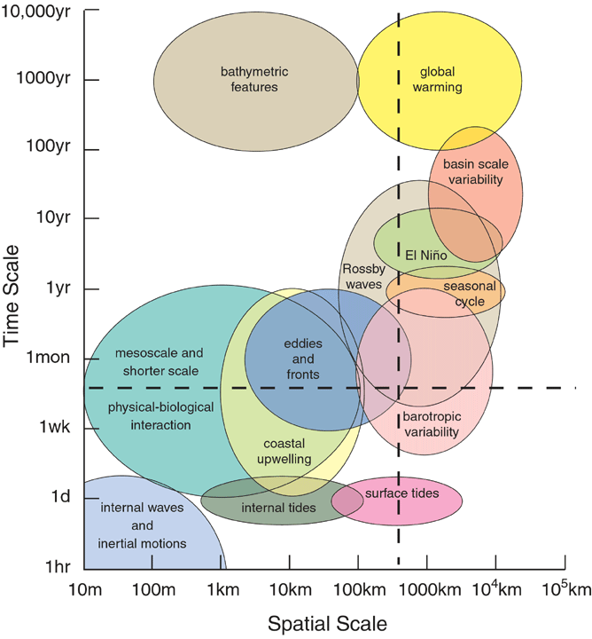
Potential benefits of coupling for numerical weather prediction
Classic view:
Ocean timescales are slow compared to the atmosphere
However, numerous short-time/space scale processes relevant for coupled NWP
Tropical convection,
Hurricanes, extra-tropical storms
Coastal upwelling,
Sea ice (polynyas, leads)
Made possible by
Global Ocean Observing System (e.g. Argo)
Improved ice-ocean modelling capacity
Brassington et al., J. Op. Ocean, 2015

Slide 3
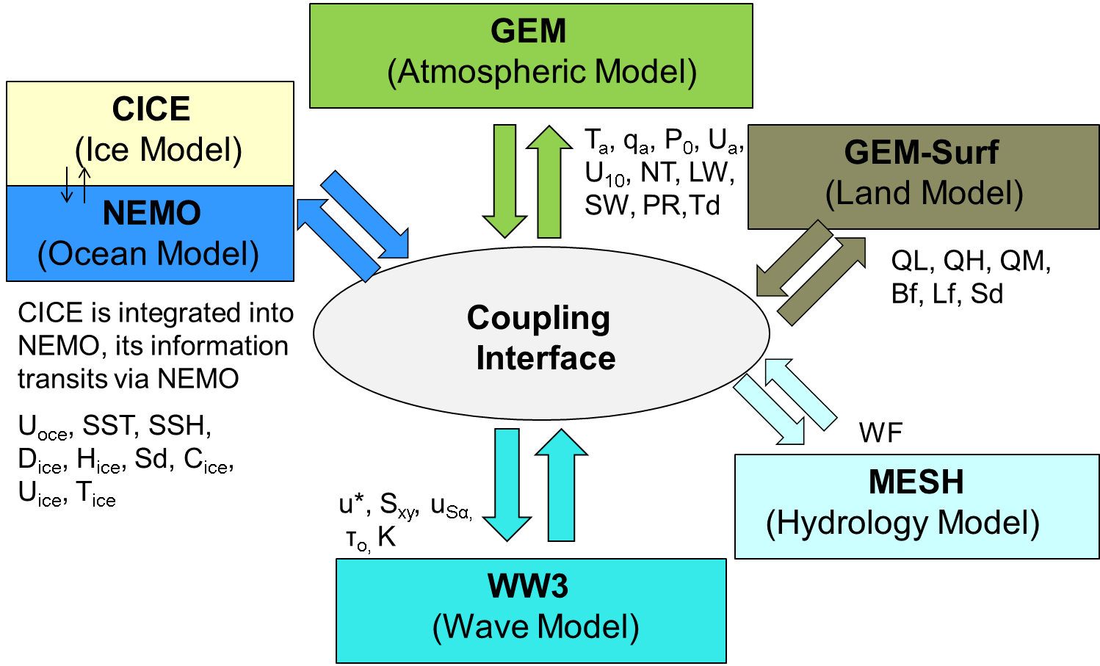
Coupling Method
Flux Coupling via GOSSIP socket server
GEM4
T_{A} q_{A}
LW_{A} SW_{A} PR
SH_{AI} LH_{AI}*
SB_{AI} Tau_{AI}
LW_{I} SW_{I}
SH_{AO} LH_{AO}*
EV_{AO} Tau_{AO}
Coupling every timestep
Calculate fluxes on fine-scale grid and aggregate
CICE4**
LW_{O} SW_{O}
NEMO3.1
Jean-Marc Belanger, Francois Roy, Natacha Bernier
Notes:
Allows coupling every timestep – rapid interactions and fast processes
Calculate fluxes on high resolution grid and aggregate

Slide 4
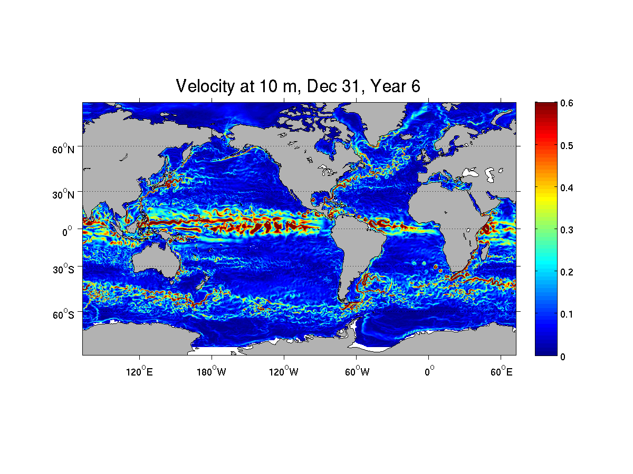
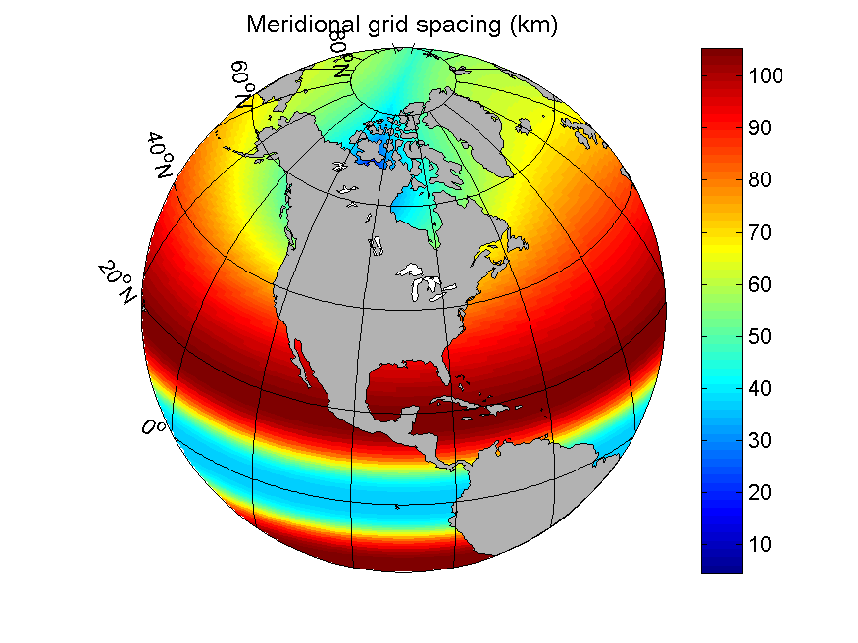
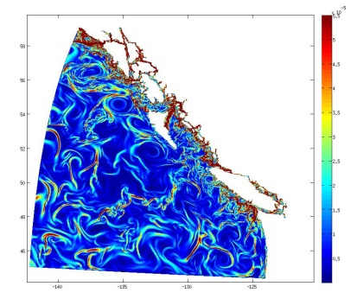
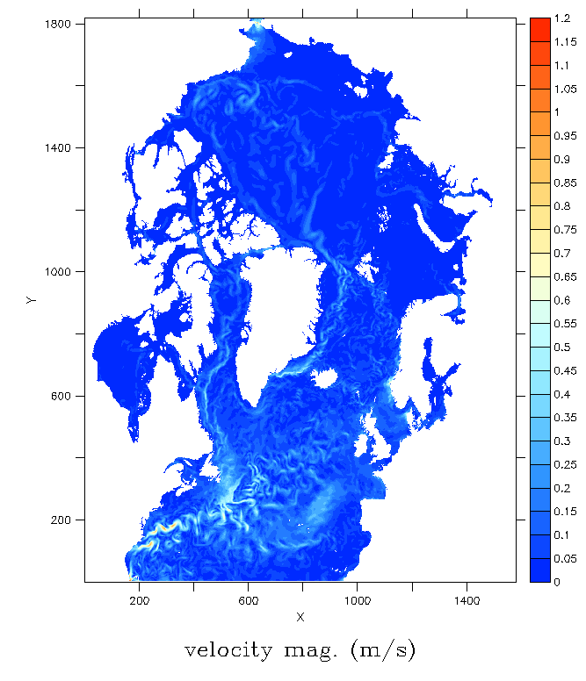
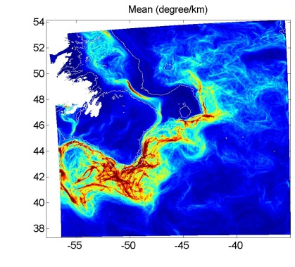
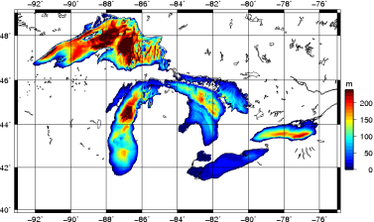
Ice-ocean modelling with
Operational
Experimental
(spring 2016)
In development
CICE
Applications and domains
1/4° Global
1° Global
Global 1/4° resolution (GIOPS)
Medium-monthly forecasting
Fully-coupled for NWP
Global 1° resolution (CanSIPS-GN)
Seasonal forecasting
N. Atlantic and Arctic 1/12° (RIOPS)
Short-to-medium range forecasting
East and West Coastal 1/36° (CIOPS)
Great Lakes 2km (RMPS-GL)
Gulf of St. Lawrence 5km (RMPS-GSL)
Short-term forecasting
Surface currents
Resolution
1/36° Northeast Pac.
Grad SST
1/12° N. Atlantic and Arctic
Surface currents
1/36° Grand Banks
Surface temperature
Bathymetry
Surface currents
Notes:
Coming back to Canada: Several configurations under development using NEMO
Other groups or systems: NRL, Topaz, DMI, etc.

Slide 5
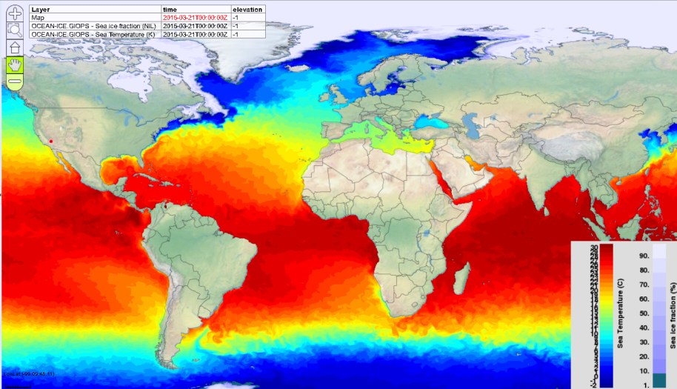
Global Ice-Ocean Prediction System
Dorina Surcel Colan, Matt Reszka, Francois Roy, Daniel Deacu, Yimin Liu, …
Produces daily ice-ocean analyses and 10day forecasts
NEMO-CICE (~1/4°), < 15km in Arctic
Mercator Ocean Assimilation System (SAM2):
Sea surface temperature
Temperature and salinity profiles
Sea level anomaly from satellite altimeters
3DVar Ice analysis:
SSM/I, SSM/IS, CIS charts, Radarsat image analyses
Experimental implementation (March 2014)
Operational since August 20, 2015
Dissemination
External cluster (pegasus)
Available on MSC Datamart (Netcdf4)
http://dd.weather.gc.ca/
WMS using GeoMet or RPNWMS
E.g., www.meteocentre.com/plus
Smith et al., QJRMS, 2015
Notes:
Develop full NWP style prediction system

Slide 6
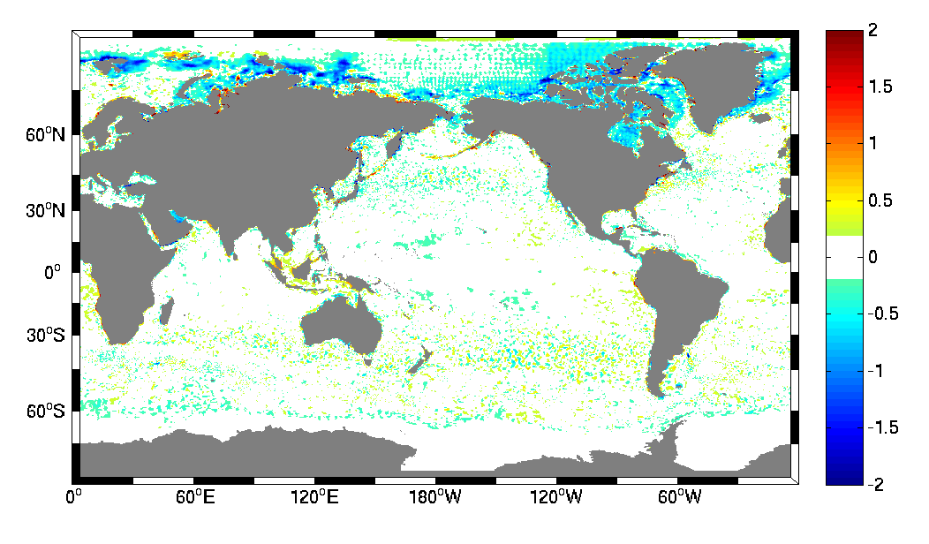
Comparison with CMC SST Analysis
Mean differences for 2011-06-01 to 2011-08-31
GIOPS – CMC SST analysis
Special attention paid to SST assimilation
Differences mostly < 0.2°C
Provide closest SST to that used during atmospheric assimilation (EnVAR)
Minimize initialization shock
Improved under-ice SST assimilation substantially reduces differences with CMCSST

Slide 7
GODAE Oceanview Intercomparison
International near real-time evaluation of global ocean forecasting systems
Sea surface temperature (SST)
2014 in review
Evaluation using surface drifters
Systems:
UK Metoffice (FOAM)
Env. Canada (GIOPS)
Mercator (PSY3, PSY4)
NCEP (RTOFS)
Australian BofM (OMAPS)
High quality SST critical for coupled forecasting
Jinshan Xu and Fraser Davidson

Slide 8
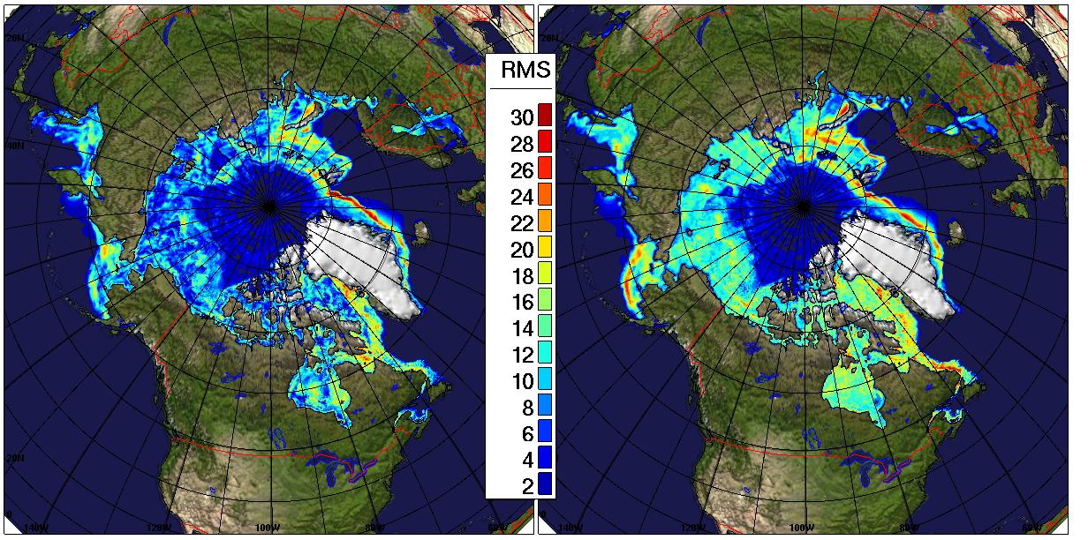
Verification of ice forecast skill
Weekly forecasts for 2011 (50 total), lead time of 168h
Compared to 3DVar analyses (where ΔIC>10%)
GIOPSv1.1
3DVAR Pers
Forecasts show lower RMS errors than persistence over most regions
Persistence equivalent to ice forecast error in uncoupled NWP forecasts
Largest improvements: East of Greenland, Baffin Bay, Hudson Bay and Barents/Kara Sea
Notes:
V1.5.7

Slide 9
Coupled Global Trials
Global Deterministic Prediction System
Backbone of NWP systems at CMC
Model: GEM, 25km resolution
Assimilation: EnVar, 6hr cycle with IAU
GIOPS
No diurnal cycle during analysis cycle
Consistent surface condition:
assimilate CMC SST and 3DVAR ice analyses
Performed summer and winter trials (42 cases each)
Forecasts every 36hrs for year 2011
Three experiments:
Coupled, uncoupled and uncoupled with GIOPS initial condition
New set of trials underway now as part of operational transfer

Slide 10
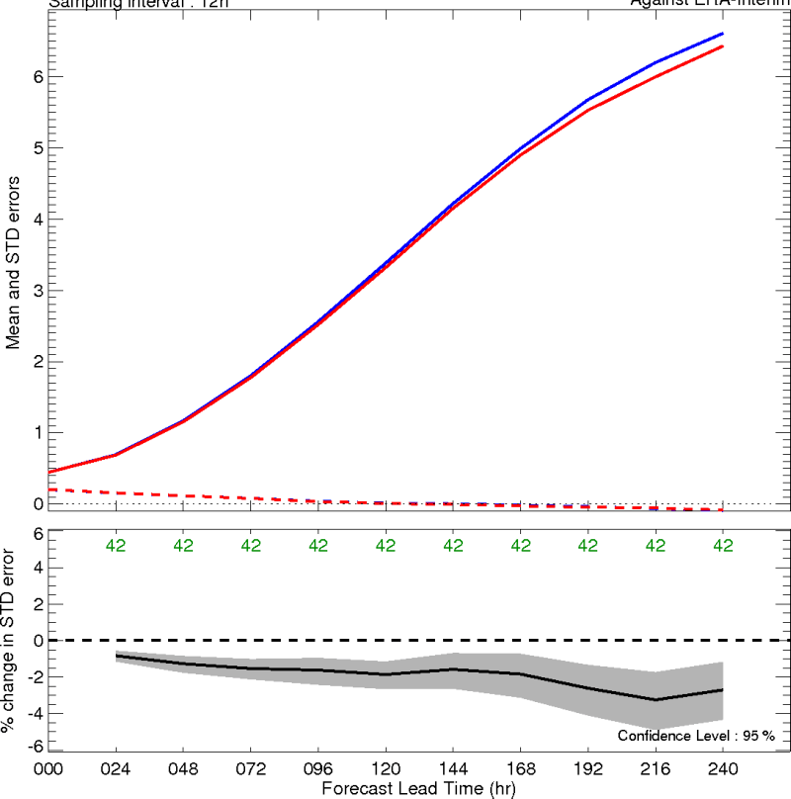
Coupled Global Forecast Trials
Jean-Marc Belanger, Francois Roy, Daniel Deacu, Ryan Muncaster
Coupled GDPS-GIOPS:
Atm: GEM 25km
Ocean: NEMO-ORCA025 (1/4°)
Ice: CICE4
Evaluation of summer trials
Daily 10day forecasts
Jul-Aug 2011
Verification against ERA-Interim
Global geopotential height at 925hPa.
Global – 925hPa Geopotential Height
uncoupled
coupled
Smaller standard deviation
Statistically significant STD reduction

Slide 11
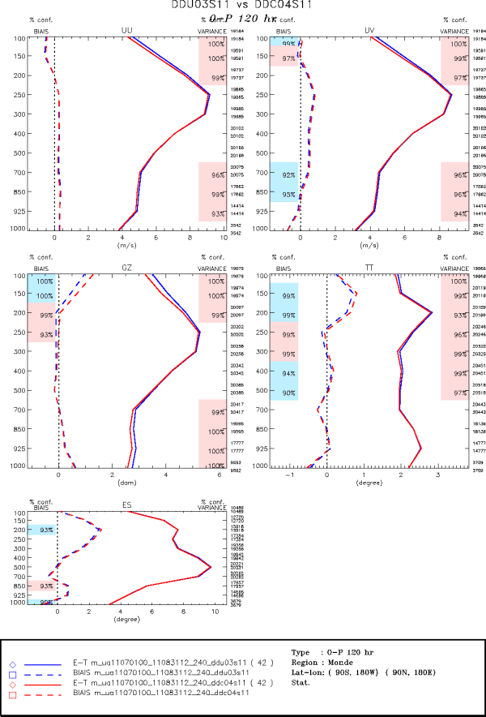
Coupled GDPS-GIOPS
Global
Winds
Coupled GEM-NEMO-CICE (forecast component only)
Comparison with Radiosondes
Results show significant impacts globally
2011 Summer trials
Global, Obs-Fcst, 120hr
Coloured boxes represent statistically significant results
Due mainly to improved Typhoon development over Pacific Ocean
Geopotential Height
Temperature
D. Deacu

Slide 12
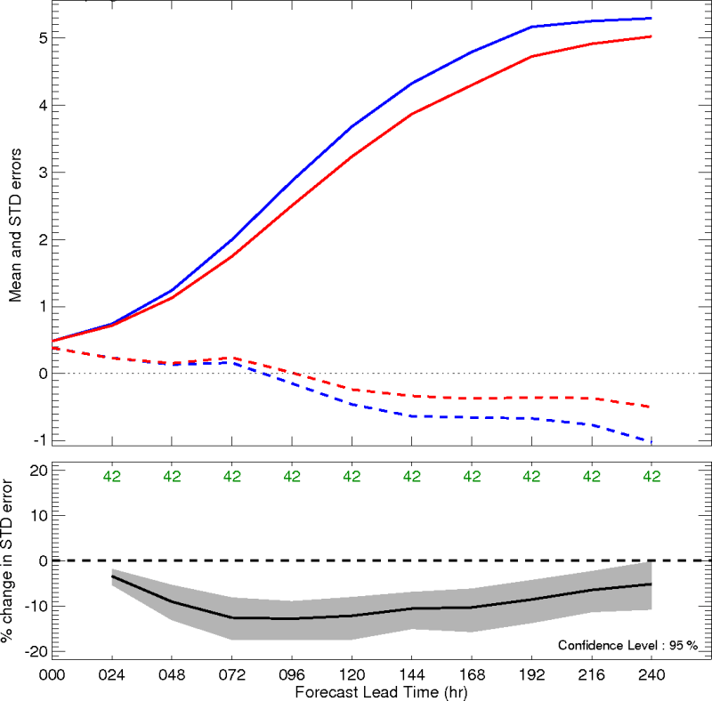
Coupled Global Forecast Trials
Jean-Marc Belanger, Francois Roy, Daniel Deacu, Ryan Muncaster
Coupled model:
Atm: GEM 25km
Ocean: NEMO-ORCA025 (1/4°)
Ice: CICE4
Evaluation of summer trials
Daily 10day forecasts
Jul-Aug 2011
Verification against ERA-Interim
Global geopotential height at 925hPa over Kuroshio region
Kuroshio – 925hPa Geopotential Height
uncoupled
coupled
Smaller standard deviation
Statistically significant STD reduction

Slide 13
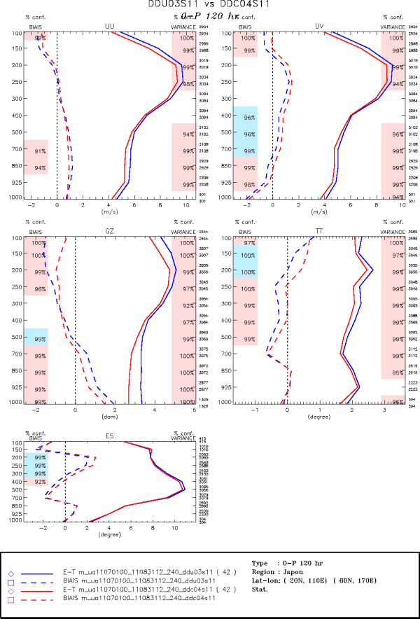
Coupled GDPS-GIOPS
Region around Japan
Winds
Coupled GEM-NEMO-CICE (forecast component only)
Comparison with Radiosondes
Results show significant impacts globally
2011 Summer trials
Global, Obs-Fcst, 120hr
Coloured boxes represent statistically significant results
Due mainly to improved Typhoon development over Pacific Ocean
Geopotential Height
Temperature
D. Deacu

Slide 14
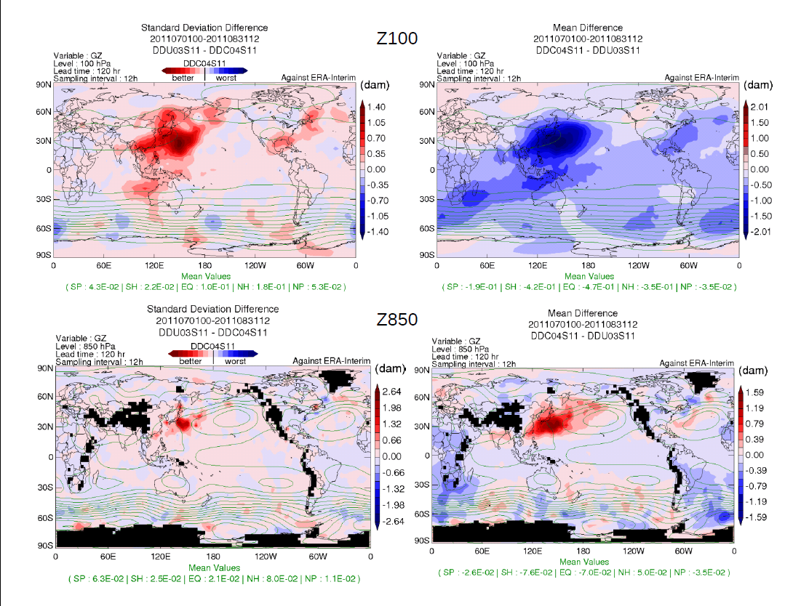
120hr
D. Deacu

Slide 15
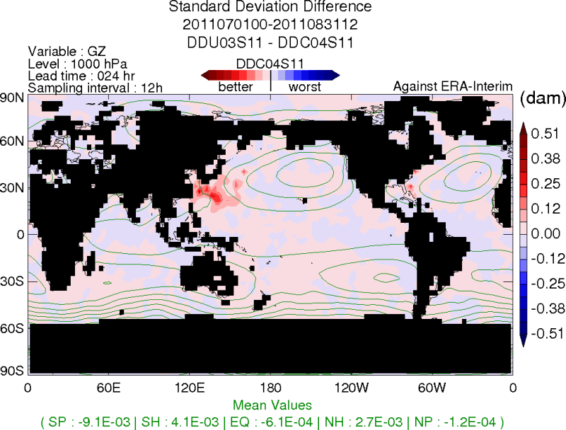
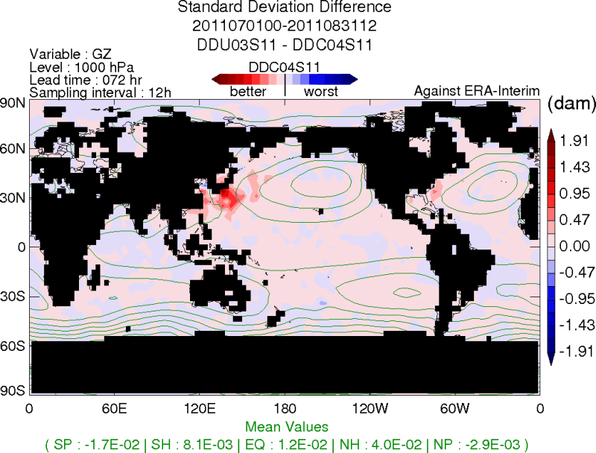
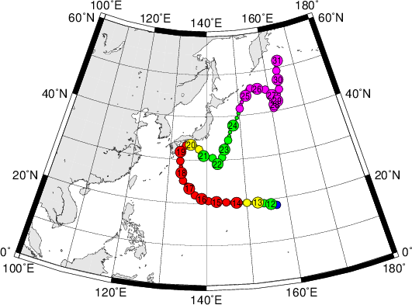
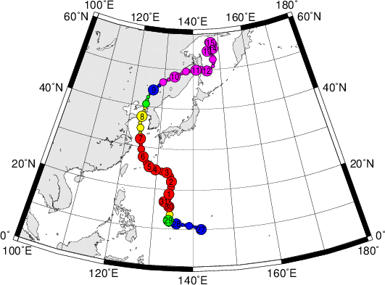
Jul-Aug 2011: Impact of Tropical Cyclones
1 day
3 days
3 days
Best track maps
from Digital Typhoon http://agora.ex.nii.ac.jp/digital-typhoon
MA-ON
MUIFA
http://en.wikipedia.org/wiki/2011_Pacific_typhoon_season

Slide 16
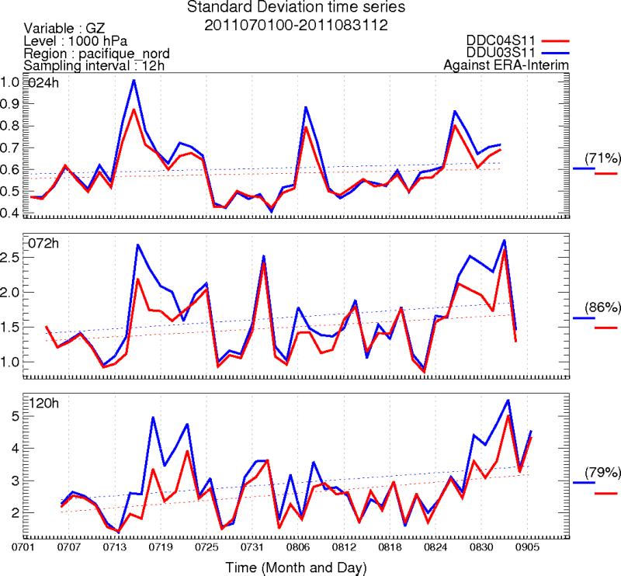
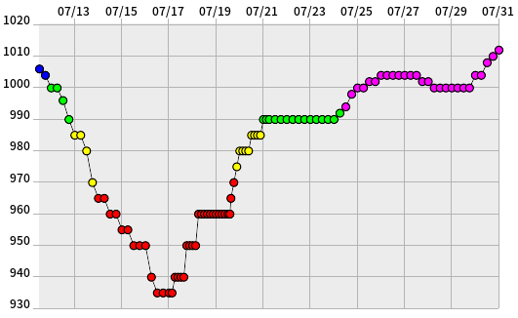
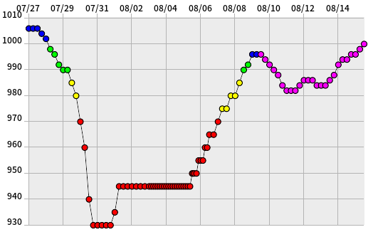
Jul-Aug 2011: Impact of Tropical Cyclones
North Pacific
uncoupled
MA-ON
coupled
MA-ON
MUIFA
MUIFA
Central pressure (hPa)
from Digital Typhoon: http://agora.ex.nii.ac.jp/digital-typhoon
http://en.wikipedia.org/wiki/2011_Pacific_typhoon_season

Slide 17
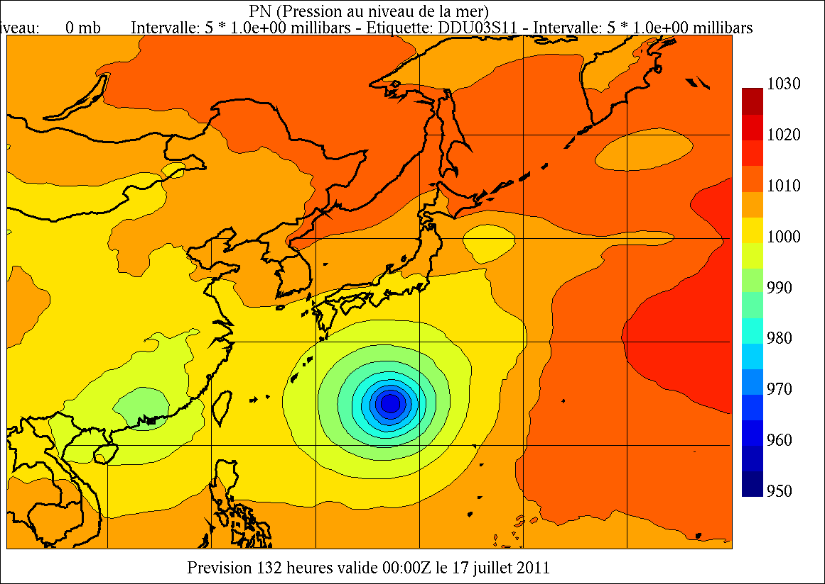
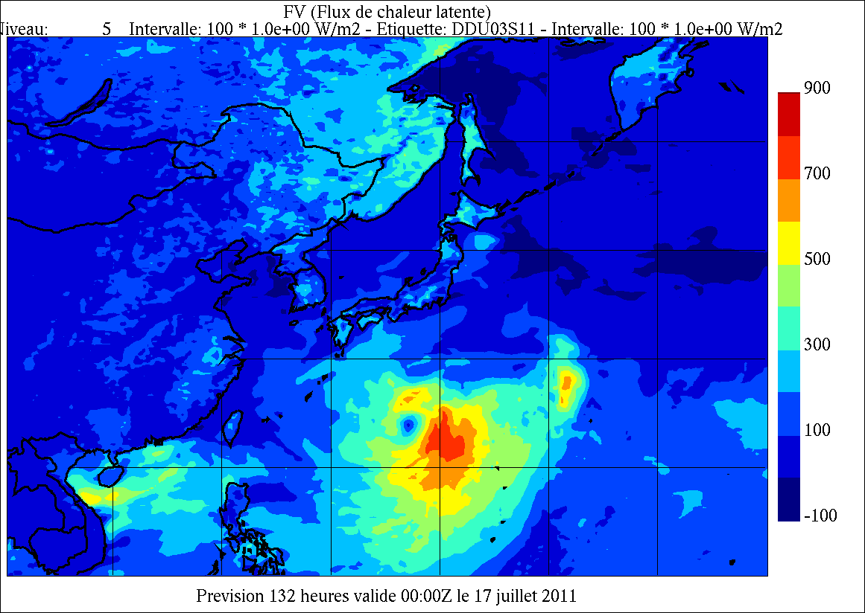
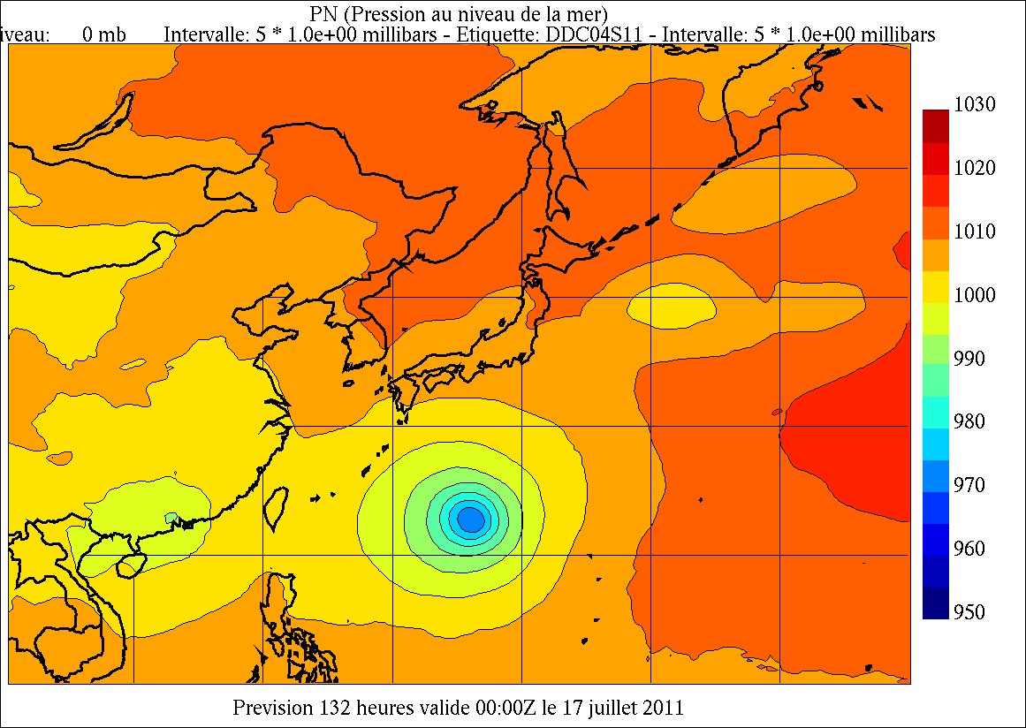
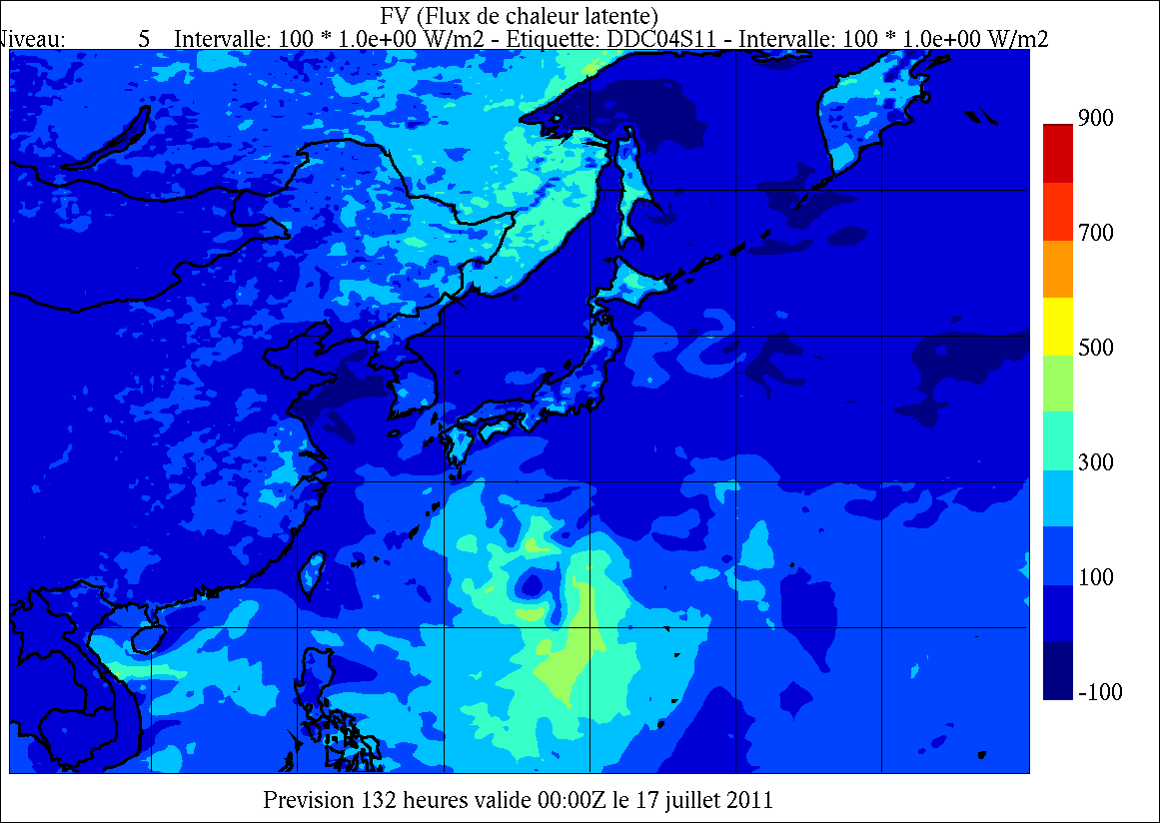
Typhoon-4 MA-ON: 132-h forecast valid at 00Z 17 July 2011
Sea level
Pressure
Latent Heat Flux
UNCOUPLED
COUPLED
Sea level pressure (hPa)
Surface latent heat flux (W/m²)

Slide 18
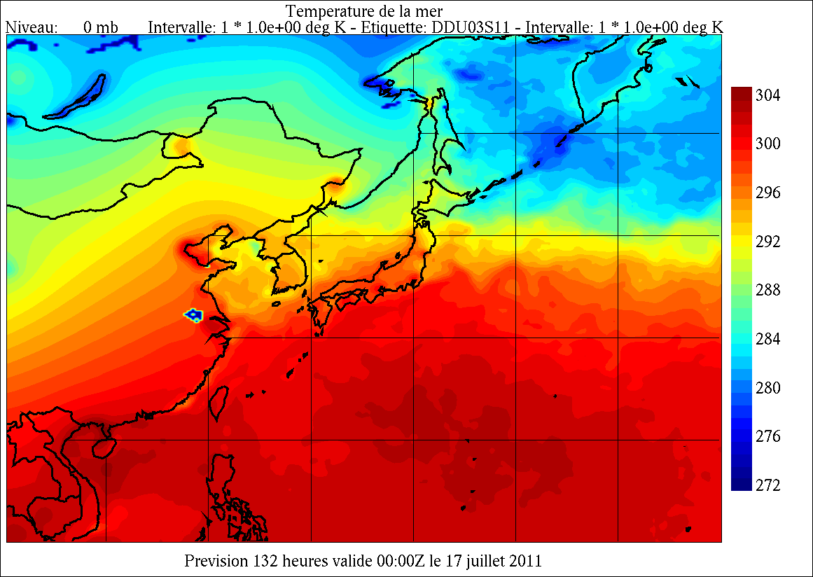
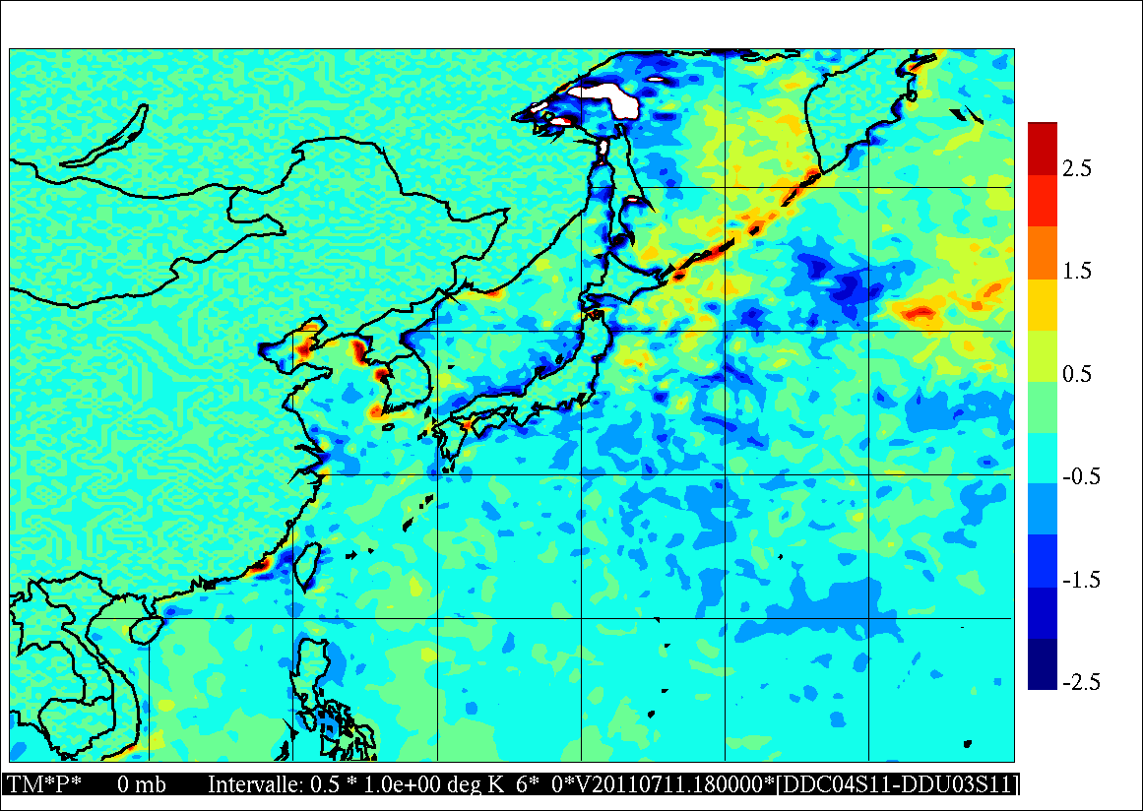
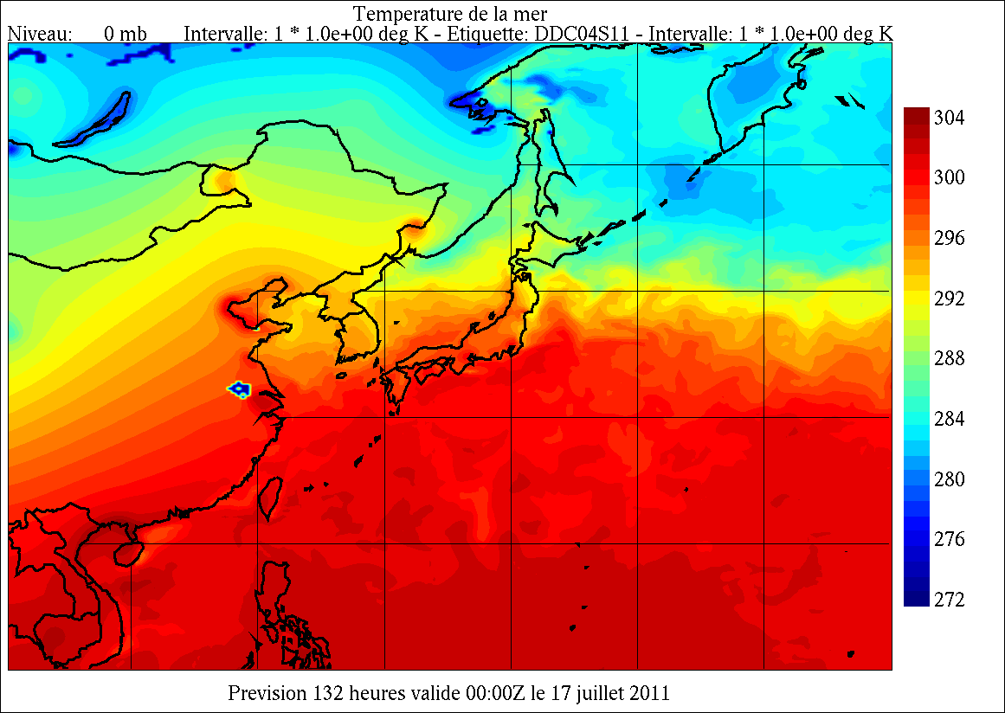
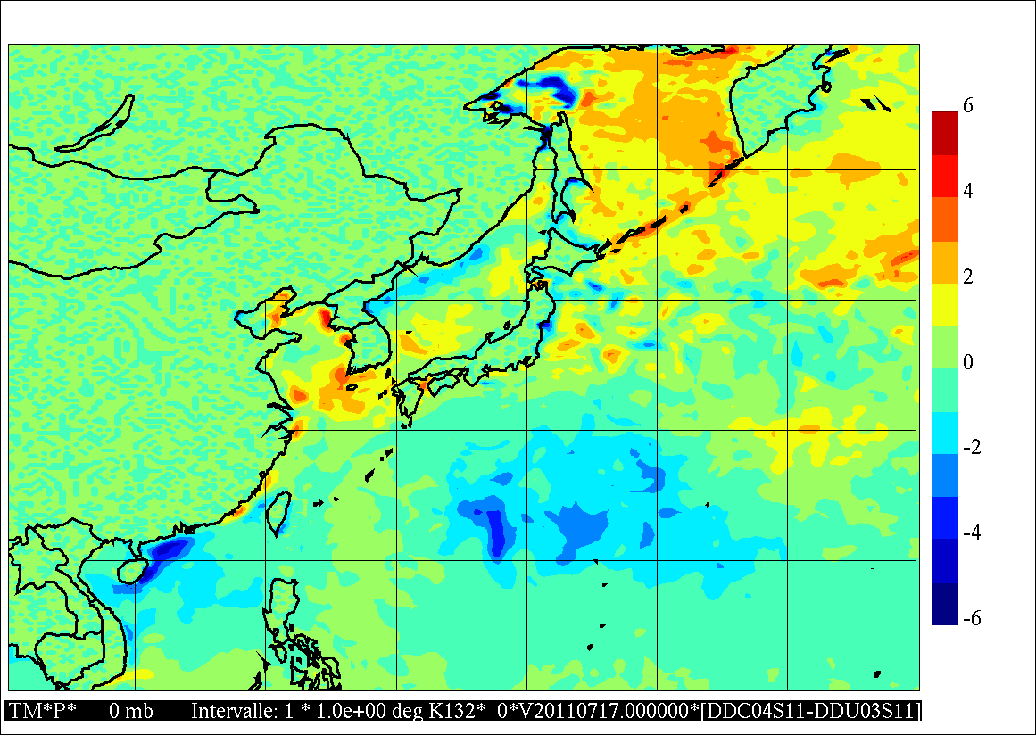
Typhoon-4 MA-ON: 132-h forecast valid at 00Z 17 July 2011
Sea surface
temperature
Coupled-Uncoupled difference
UNCOUPLED
6-h
SST held
constant
in time
Cold wake
COUPLED
132-h
Sea surface temperature (K)
SST(Coupled) - SST(Uncoupled)

Slide 19
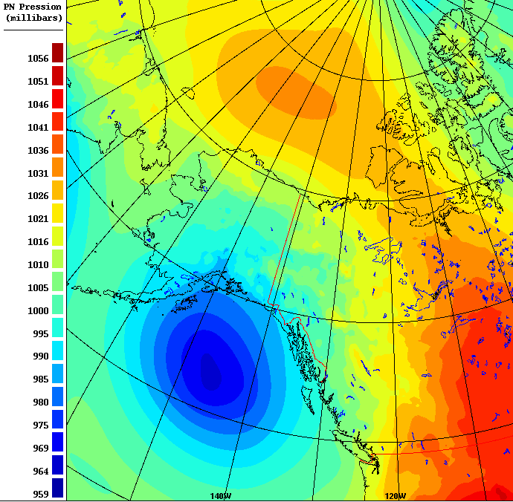
Impact of a dynamic ice cover on coupled forecasts over the Beaufort Sea
Sea level pressure
1035 mb
965 mb
(CPL-UNCPL)
Forecast from global coupled model (GEM-NEMO-CICE; 33km-15km resolution) from the Canadian Meteorological Centre
R. Muncaster, F. Roy, J.-M. Belanger

Slide 20
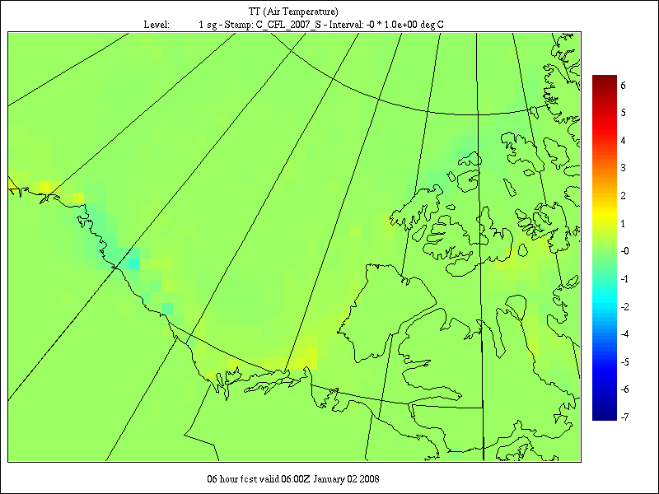
Impact of a dynamic ice cover on coupled forecasts over the Beaufort Sea
Sea level pressure
1035 mb
Coastal polynya formation sensitive to:
Atmosphere-ice and ice-ocean stresses, ice thicknesses, parameterization of ice strength (all things we know poorly!)
965 mb
Jan. 2, 2007
Difference in ice fraction
(CPL-UNCPL)
Difference in 2m temperature
Forecast from global coupled model (GEM-NEMO-CICE; 33km-15km resolution)
R. Muncaster, F. Roy, J.-M. Belanger

Slide 21
Summary and Outlook
Global coupled trials show significant (major) benefits for operational system
Benefits stem largely from more realistic surface interactions leading to improved cyclone development
Expected operational delivery for June 2016
Development of coupled ensemble medium-range, monthly and seasonal forecasting systems underway

Slide 22
Thank you!

