Slide 1
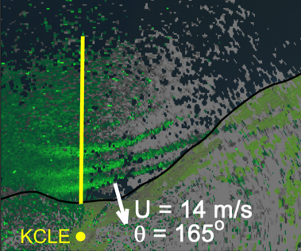
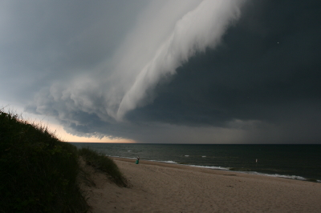

Meteotsunami Occurrences in the Great Lakes and Analysis of a Recent Case in Lake Erie
Eric J. Anderson¹, Chin Wu², Adam Bechle², Greg Mann³
¹NOAA/GLERL, Ann Arbor, MI
²U. Wisconsin-Madison
³NWS/WFO-Detroit

Slide 2
Next-Generation GLOFS
Finite Volume Community Ocean Model (FVCOM)
unstructured mesh
sigma- and sigma-z coordinates
3D integral flux equations
similar to POM
Los Alamos Ice Model (CICE)
5 lakes FVCOM
30 m - 2 km grid
connecting channels
ice
Lake Erie FVCOM (LEOFS)
Michigan-Huron FVCOM (LMHOFS)
Lake Superior FVCOM
(LSOFS)
Lake Ontario FVCOM
(LOOFS)
Huron-Erie Corridor (HECOFS)

Slide 3
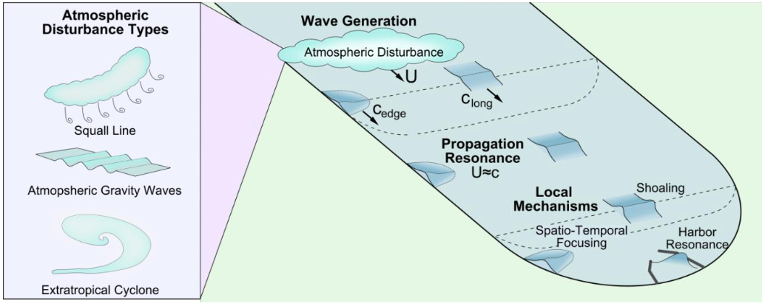
Extreme Storms: Meteotsunamis

Slide 4
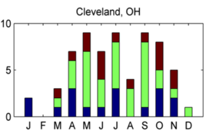
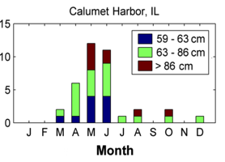
Extreme Storms in Great Lakes
Lake Michigan
Lake Erie
Number of Events
Number of Events

Slide 5
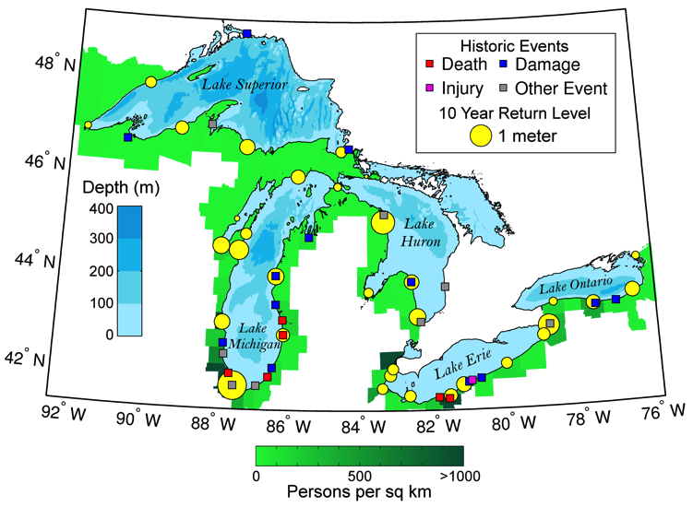
Meteotsunamis in Great Lakes

Slide 6
Meteotsunamis in Great Lakes

Slide 7
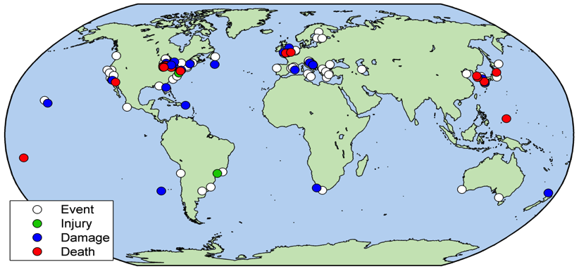
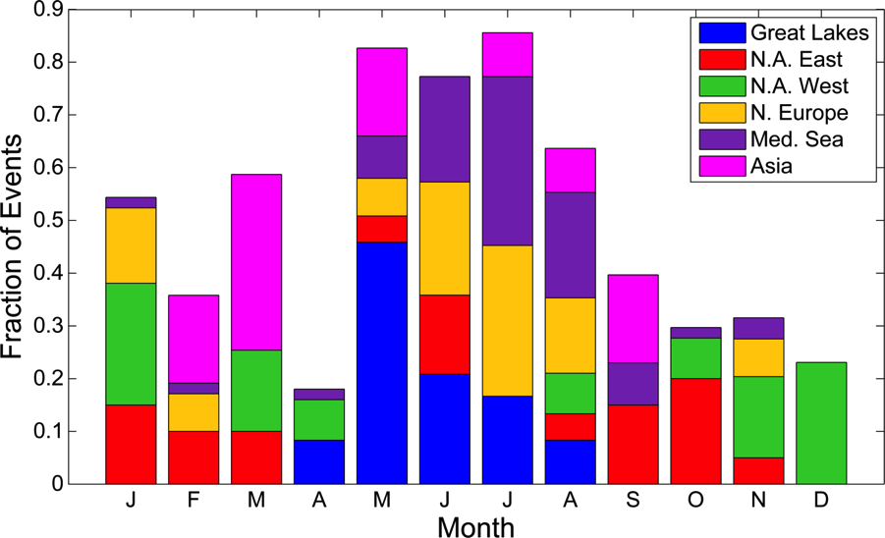
Global Meteotsunami Occurrence

Slide 8
Atmospheric Forcing

Slide 9
Meteotsunamis in Great Lakes
Meteotsunami Occurrence
Meteotsunamis in the Great Lakes
Occur in all 5 Great Lakes
Driven by linear/complex convection
Wave periods between 2 min – 2 hours
Gap in Great Lakes forecasting!

Slide 10
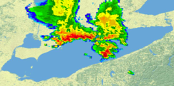
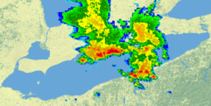
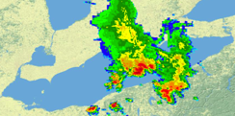
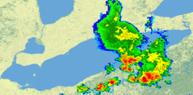
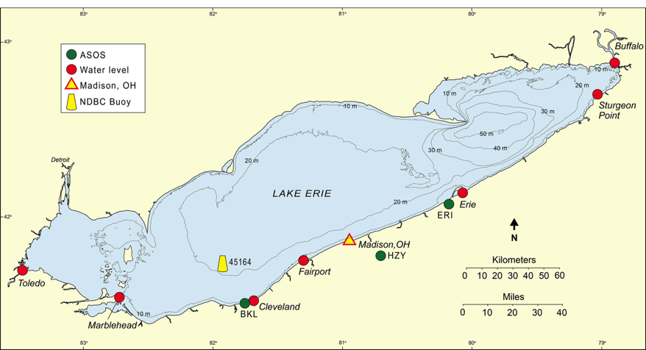
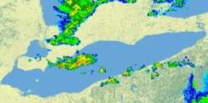
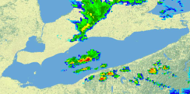
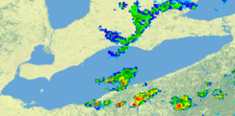
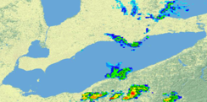
17:00 UTC
17:30
18:00
18:30
6:00pm Madison, OH
Radar (KCLE)
22:30 UTC
23:00
23:30
00:00

Slide 12
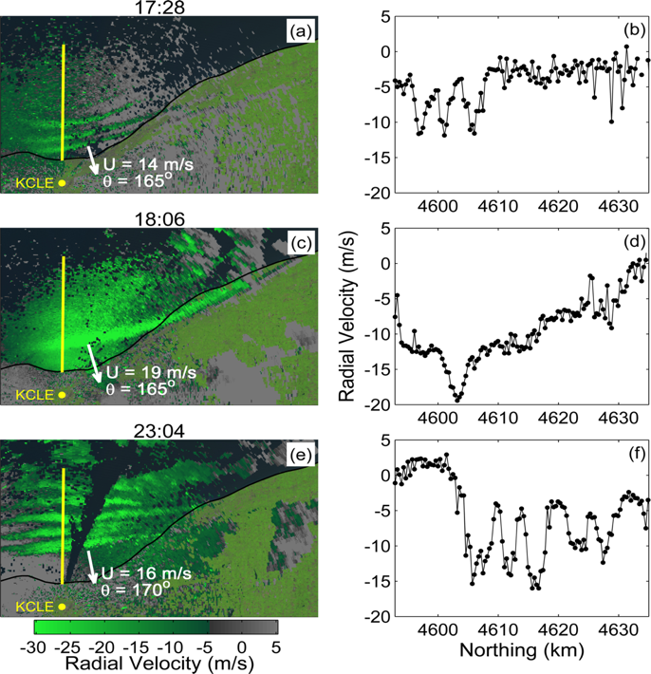
Proudman Resonance

Slide 13
Observed Conditions
Water level displacement
  6-min records

Slide 14
Observed conditions
Water level displacement
  6-min records
Bandpass filtered meteotsunami spectrum
  2 min to 2 hours
Storm front
T=60min
β=0.0025
Impact

