Slide 1
Methods
Atmospheric Conditions
GLCFS interpolated meteorology (current operations)
  Land-based (and buoy) observations
  Over-water correction
Reconstruct meteorology on May 27, 2012 (idealized squall line)
  Investigate wind/pressure observations
  Develop idealized forcing conditions to represent storm (1-min)
Modeled atmospheric conditions (hi-res simulation)
  WRF 4km resolution (5 min)
  Great Lakes basin nested grid
  NARR boundary conditions (started on May 26 at 12:00GMT)
Hydrodynamic Model
Next-generation NOAA Lake Erie Operational Forecasting System (LEOFS)
  Finite Volume Coastal Ocean Model (FVCOM)
  100-meter resolution
  Initialized from FVCOM-LEOFS model (500m-2km resolution)
  Driven by wind and pressure forcing

Slide 2
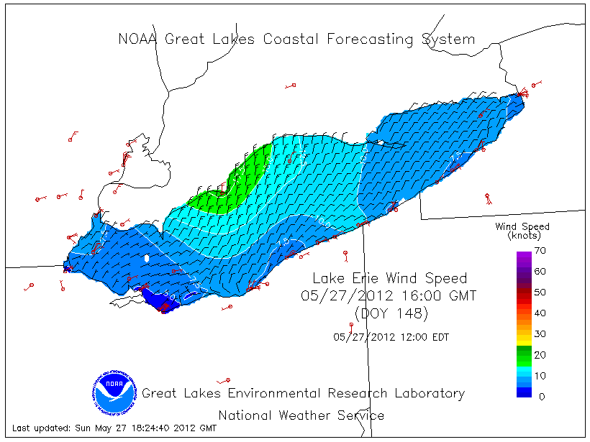
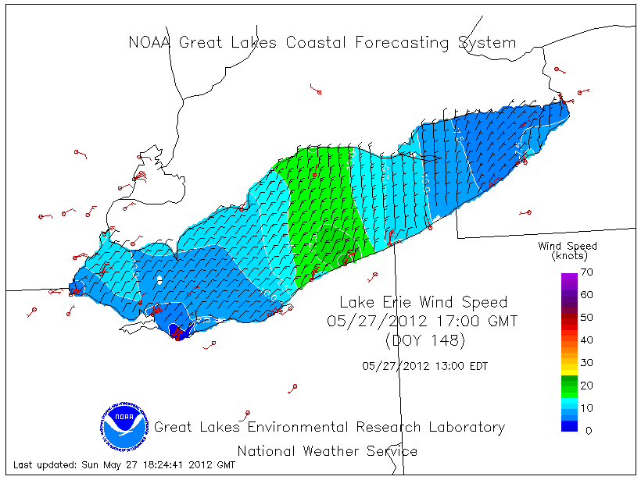
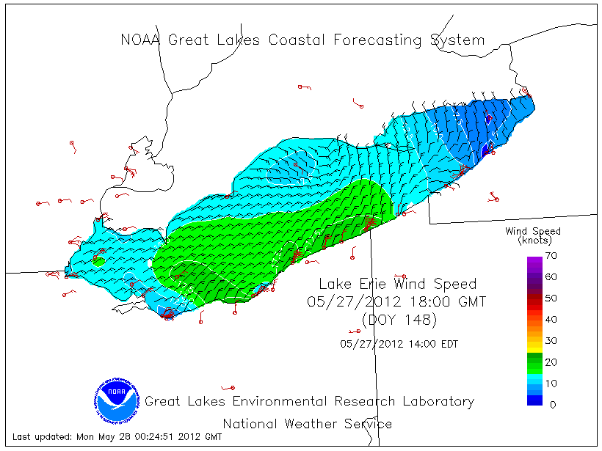
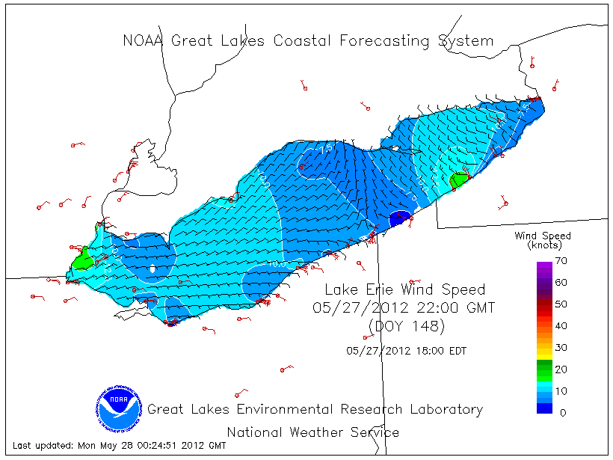
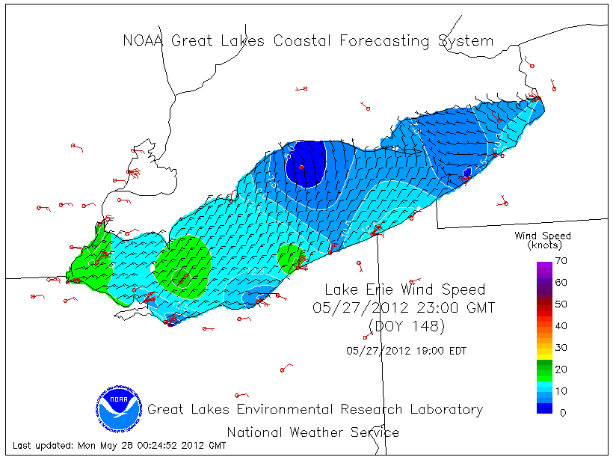
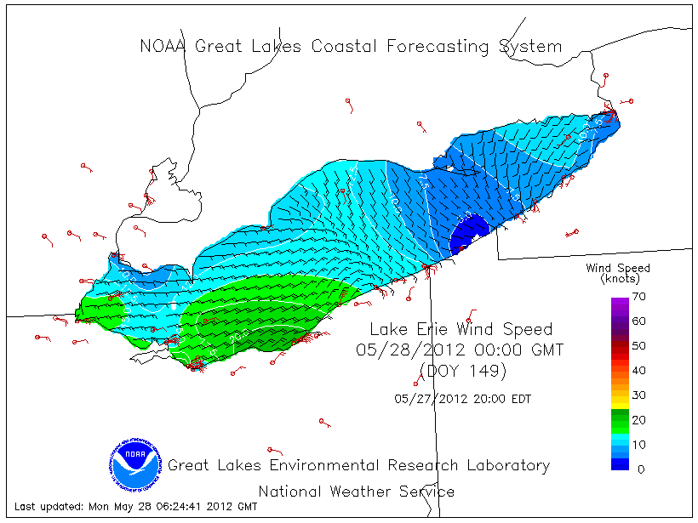
(i) GLCFS interpolated meteorology
16:00
17:00
19:00
Wind Speed
22:00
23:00
00:00

Slide 3
(i) GLCFS interpolated meteorology
FVCOM: Water Level Response

Slide 4
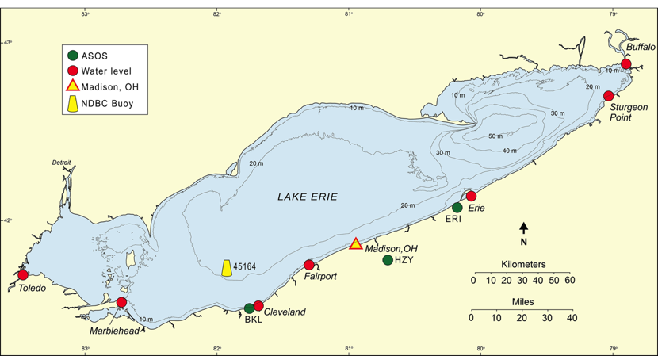
(ii) Reconstructed Meteorology

Slide 6
(ii) Reconstructed Meteorology
FVCOM: Water Level Response

Slide 7
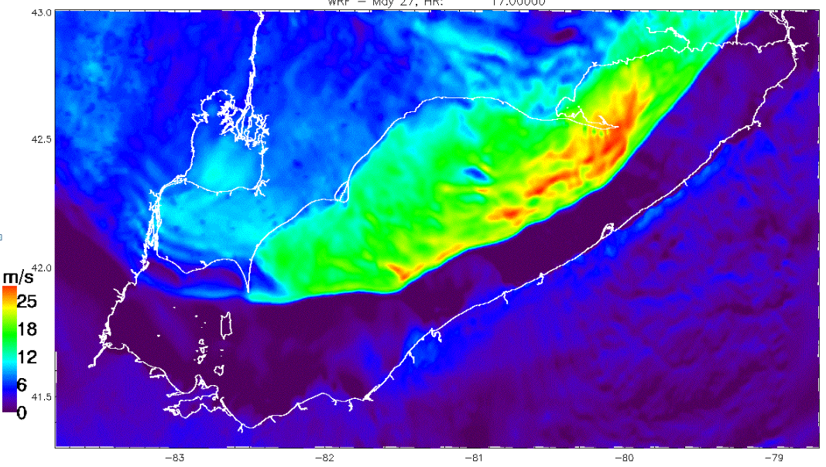
(iii) Modeled Meteorology (WRF)
(Animation Available Upon Request)
WRF: Wind Speed

Slide 8
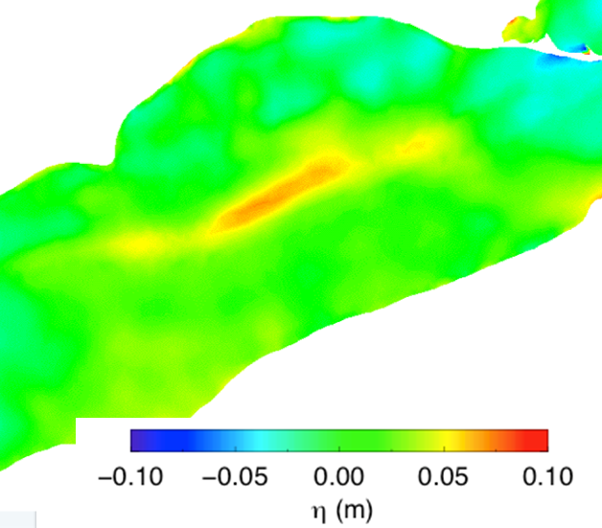
(iii) Modeled Meteorology (WRF)
FVCOM: Water Level
(Animation Available Upon Request)

Slide 10
(iii) Modeled Meteorology (WRF)
Wave reflection from 1st band
Focusing due to shape of northern coastline
Edge waves produced along southern shore
FVCOM: Water Level Response

Slide 11
(iii) Modeled Meteorology (WRF)

Slide 12
Conclusions
Meteotsunami-inducing storms can move undetected through observation network
  Derechos are increasing! [Ashley et al., 2005]
High-resolution models can capture the mechanisms behind meteotsunami formation
  Even “medium” resolution models capture general dynamics
  Atmospheric forcing conditions are crucial
Advanced weather forecast products can resolve spatio-temporal features of meteotsunami-inducing storms
  NOAA High-Resolution Rapid Refresh (HRRR); 3km met.
    Next-Generation NOAA GLOFS models use HRRR forcing

Slide 13

Questions?
eric.j.anderson@noaa.gov

