Slide 1
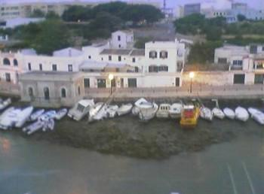
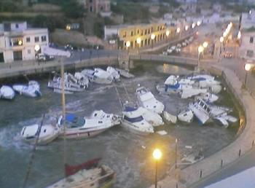
Meteotsunamis: Working Toward an Operational Forecasting Capability
Michael Angove, NOAA/NWS HQ
Tsunami Program Manager
Doug Mercer
Atlantic Storm Prediction Center
May 3, 2016
2016 NOAA-EC Bi-Lateral Marine Focus Area Workshop

Slide 2
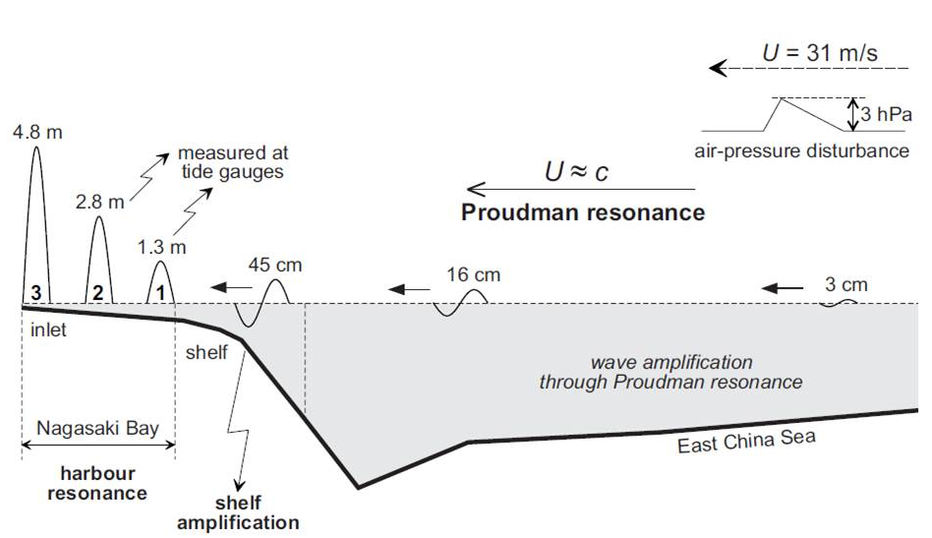
Meteotsunamis
Tsunami-like waves of meteorological vs. seismic origin
Formation dependent on intensity, direction, and speed of disturbance over water at appropriate depth
NOT same as storm surge
Source: Monserrat, Vilibić, Rabinovich; Nat. Hazards Earth Syst. Sci., 6, 2006

Slide 3
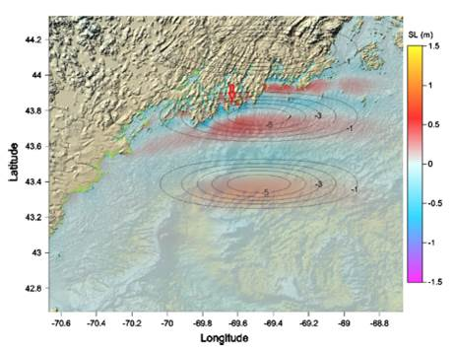
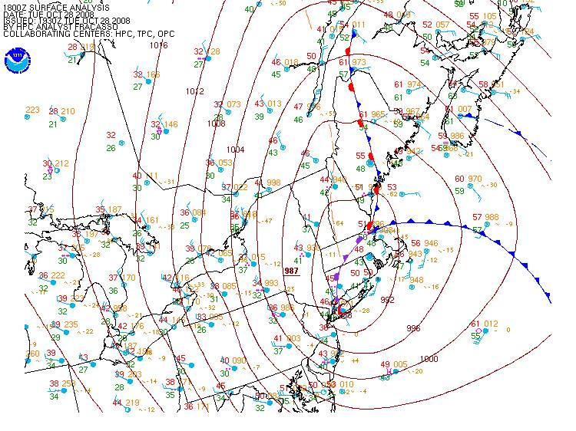
Boothbay Harbor, Maine: October 28, 2008
Waves up to 12’ high emptied and flooded the harbor at least 3 times over 15 minutes, damaging boats and shoreline infrastructure.
USGS identified as potential tsunami in post analysis
Case validated tsunami model application but…
Very difficult to depict/predict in real time
Hard to distinguish from “bad weather”
U ≈ 60kts ≈ c
U ≈ 30kts ≈ c/2
Frontal disturbance accelerates to MT Phase speed approximately 28/15Z
Wave heights were reproduced by tsunami forecast model and atmospheric gravity wave source

Slide 4
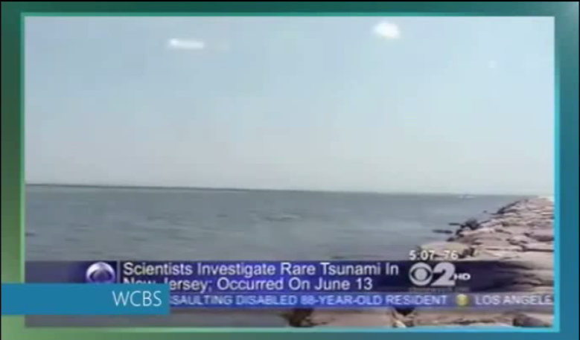
https://www.youtube.com/watch?v=QHw2KlC3a2o

Slide 5
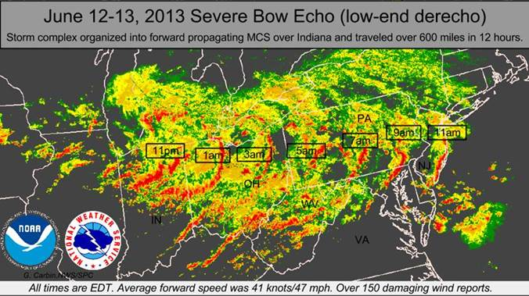
June 13, 2013
New Jersey and southern Massachusetts coasts
Barnegat Inlet, New Jersey: 3 people injured by 6-foot wave that swept them off jetty into water
Waves recorded on water-level stations from Puerto Rico to New England and tsunami buoy
Caused by weakening, low-end derecho
Alerts possible based on shelf effect

Slide 6
2013 Animation
https://www.youtube.com/watch?v=ykABRe5Yt3c

