Slide 1
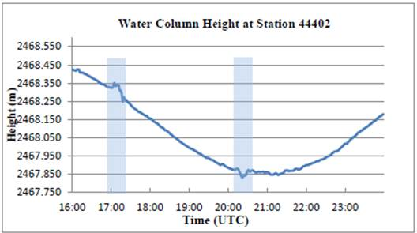
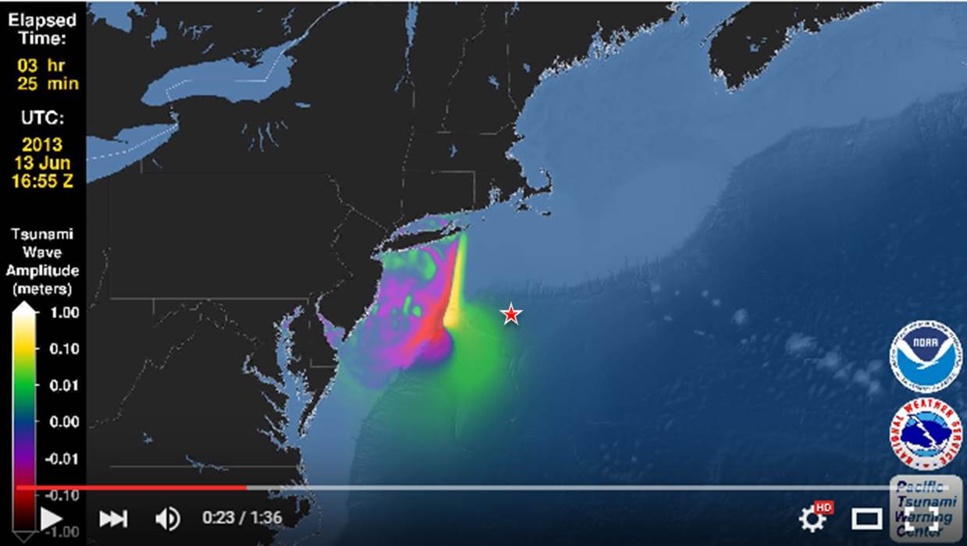
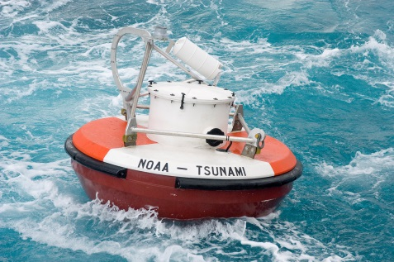
DART Systems

Slide 2
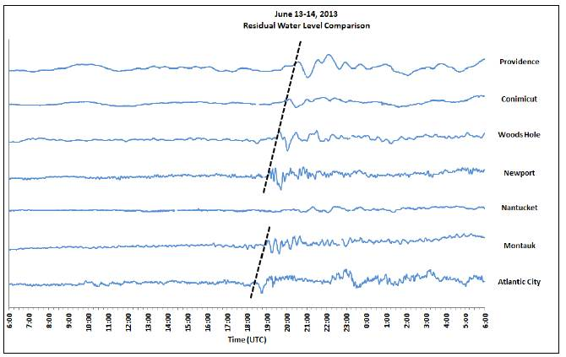
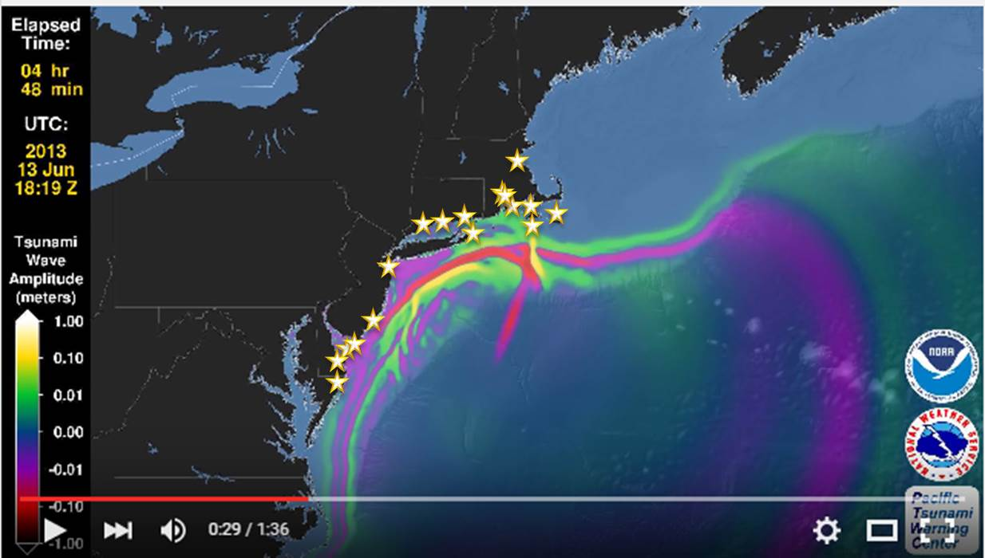
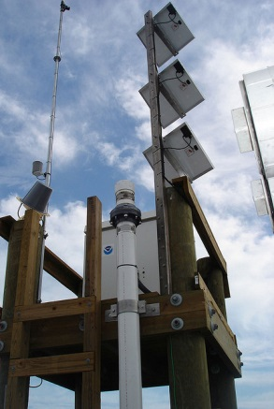
Coastal Water-Level Gauges

Slide 3
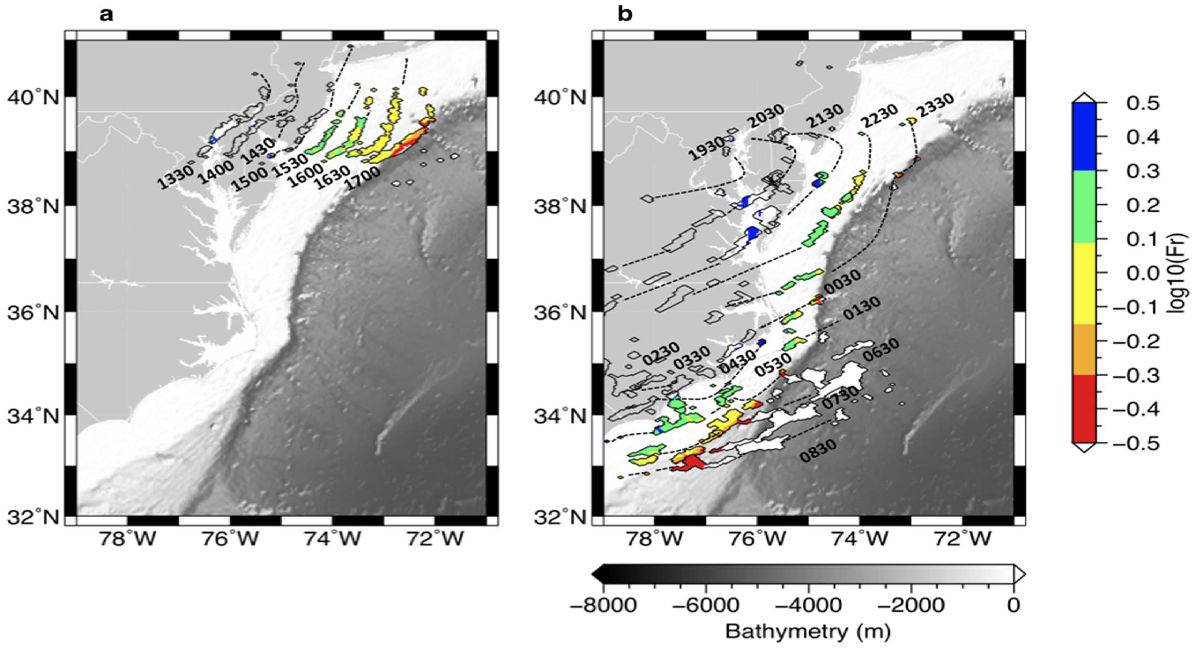
Challenges
Forecasting—Meteotsunami (MT) formation tightly constrained by depth, translational speed of disturbance, and direction; requires extremely accurate mesoscale forecast
MT Forms
No MT Forms
Detection—Even if MT forms, network of observation systems not dense enough to detect MT disturbance
Messaging—Potential for confusion with wind-driven storm surge and normal seiche activity

Slide 4
Proposed Protocol:
“Alert on Detection”
WFO monitor medium-range numerical weather prediction (NWP) to ID candidate disturbances
WFO contact National Tsunami Warning Center (NTWC) if candidate disturbance within ~24hrs of formation to discuss
WFO include potential for MT in Area Forecast Discussions and/or Special Weather Statements
Inside 12 hours, NTWC monitor tsunami detection networks; DART buoys placed in event mode, coastal gauges closely monitored

Slide 5
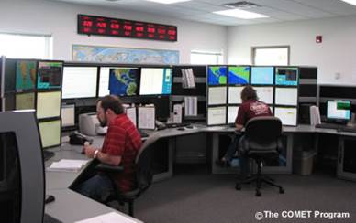
Proposed Protocol:
“Alert on Detection”
If detection made, NTWC alert local WFOs and provide estimates of amplitude and travel time to coastal locations
WFOs may issue alerts if warning criteria met (e.g., coastal flood warning)

Slide 6
Future Development
More accurate and timely “alert on detection” capability
  MT source inversion techniques
  MT historical libraries/simulations
  Denser detection network (HF Radar, moored buoys)
Work toward “alert on forecast” capability
  High-resolution mesoscale maritime NWP
  Sophisticated MT formation algorithms
  High-density sea level pressure detection network over coastal margin

Slide 7
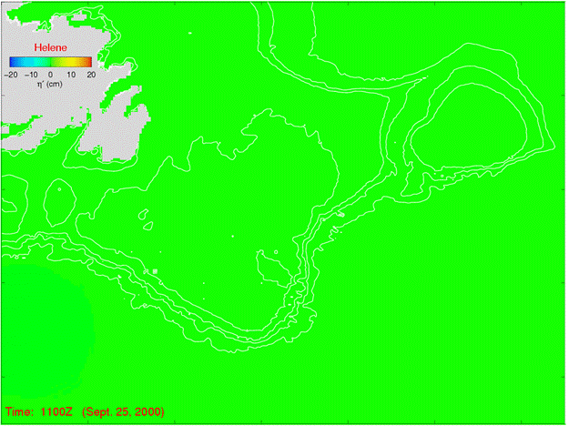
MT/TC Connection
Underrated Risk?
Hurricane Helene 25 Sept 2000

Slide 8
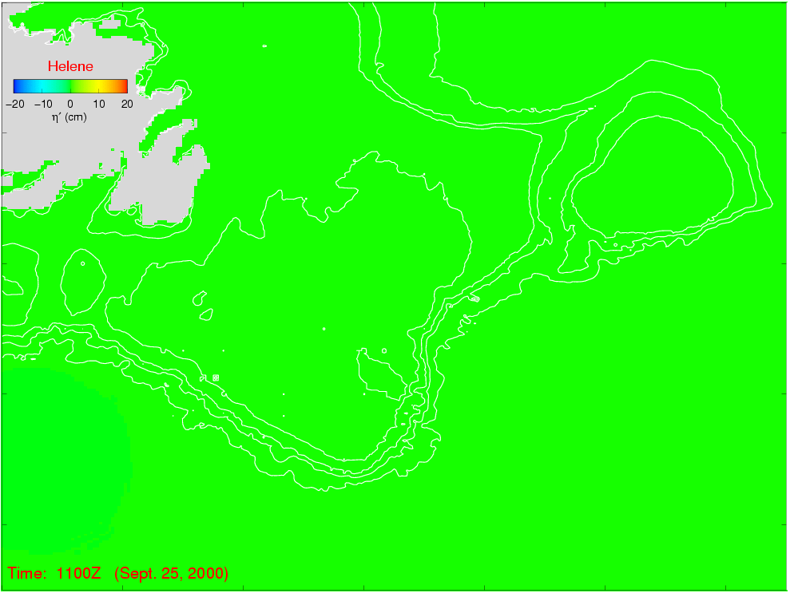
MT/TC Connection
Underrated Risk?
Hurricane Helene 25 Sept 2000

Slide 9
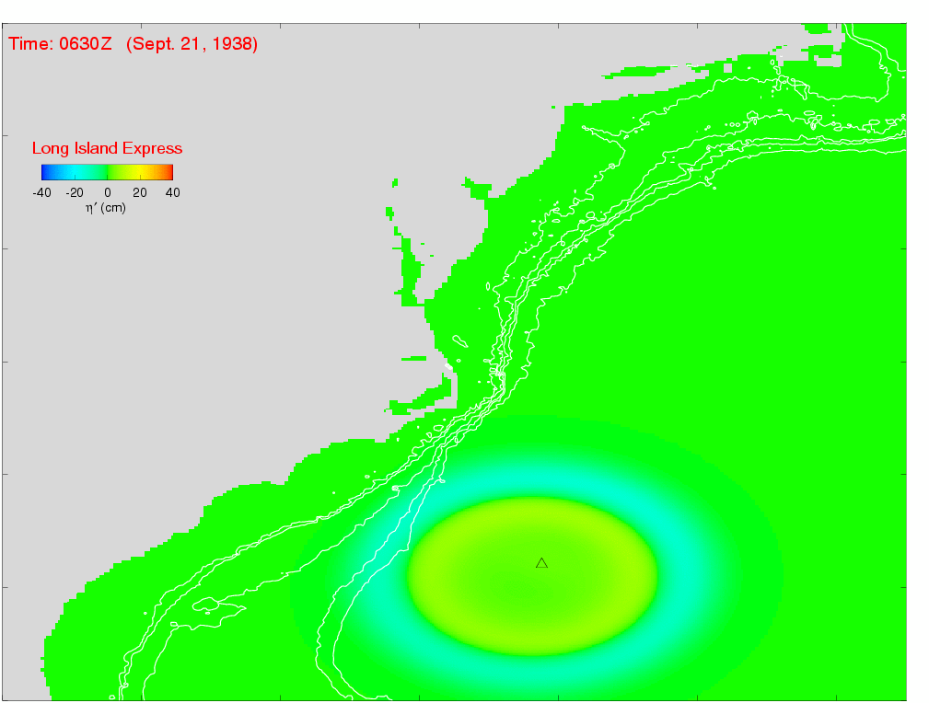
Long Island Express (1938)
Hurricane Helene 25 Sept 2000

Slide 10
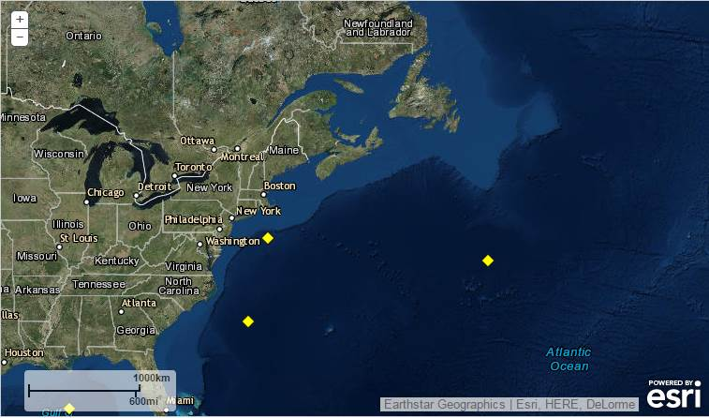
Future EC Collaboration?
MT Source Area
Potential New DART locations
DART 44402
DART 44401
DART 41424

Slide 11
Q&A
Michael Angove NOAA/NWS Tsunami Warning Program michael.angove@noaa.gov http://www.tsunami.gov
Paul Whitmore NOAA/NWS National Tsunami Warning Center paul.whitmore@noaa.gov http://ntwc.arh.noaa.gov
Meteotsunami Fact Sheet: http://nws.weather.gov/nthmp/meteotsunamis.html

Slide 12
