Slide 1
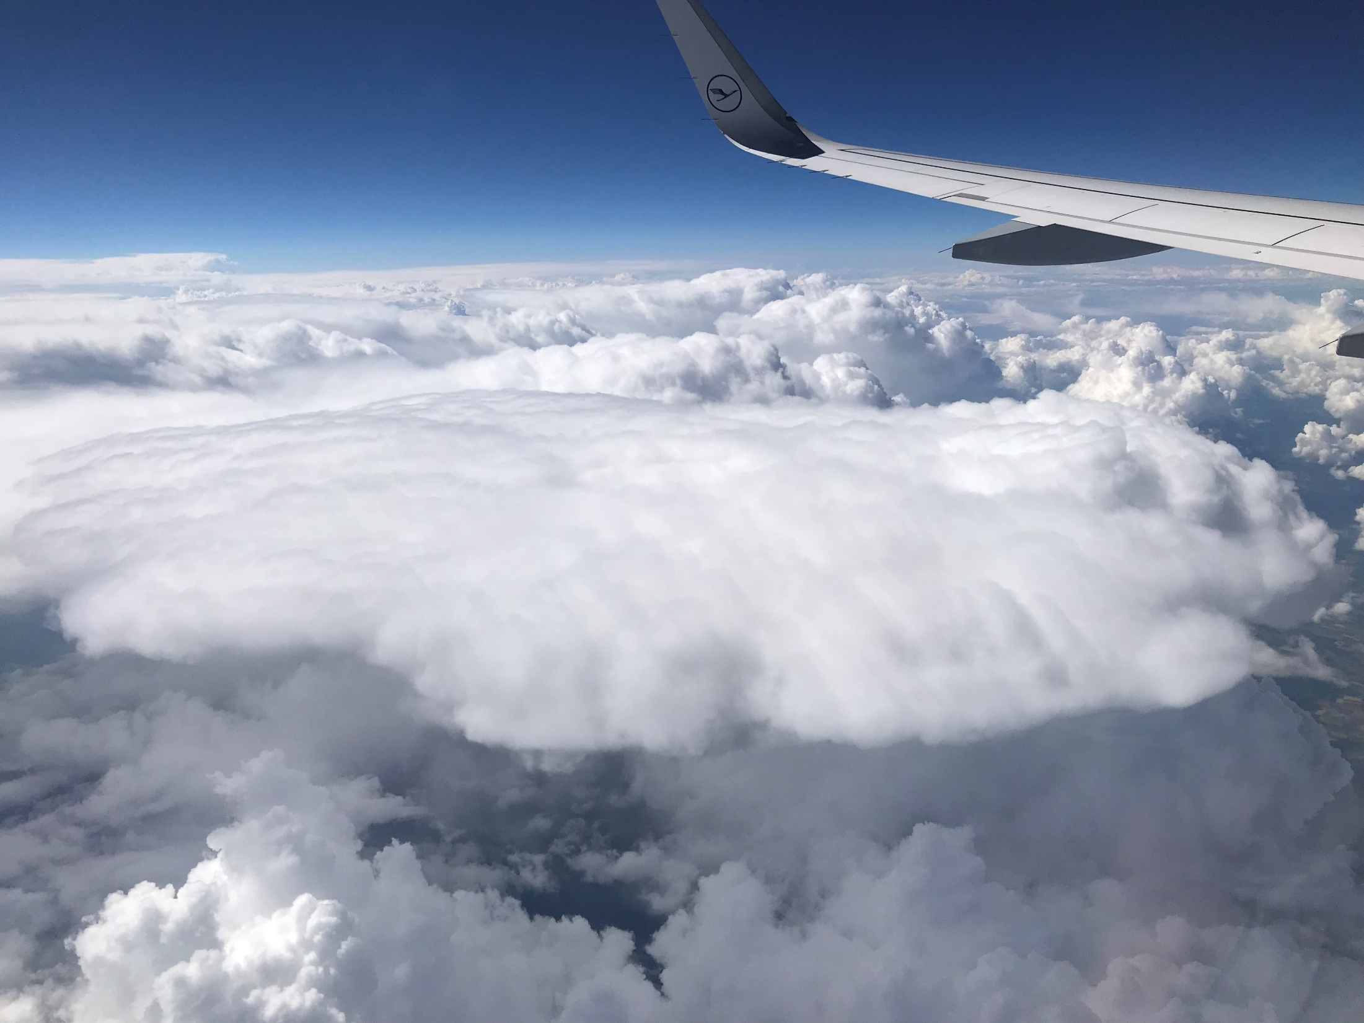
Meteorology 101
Part 1
Weather for Teachers
National Weather Service

Slide 2
“Weather is like the humidity;
it’s all relative.”

Slide 3
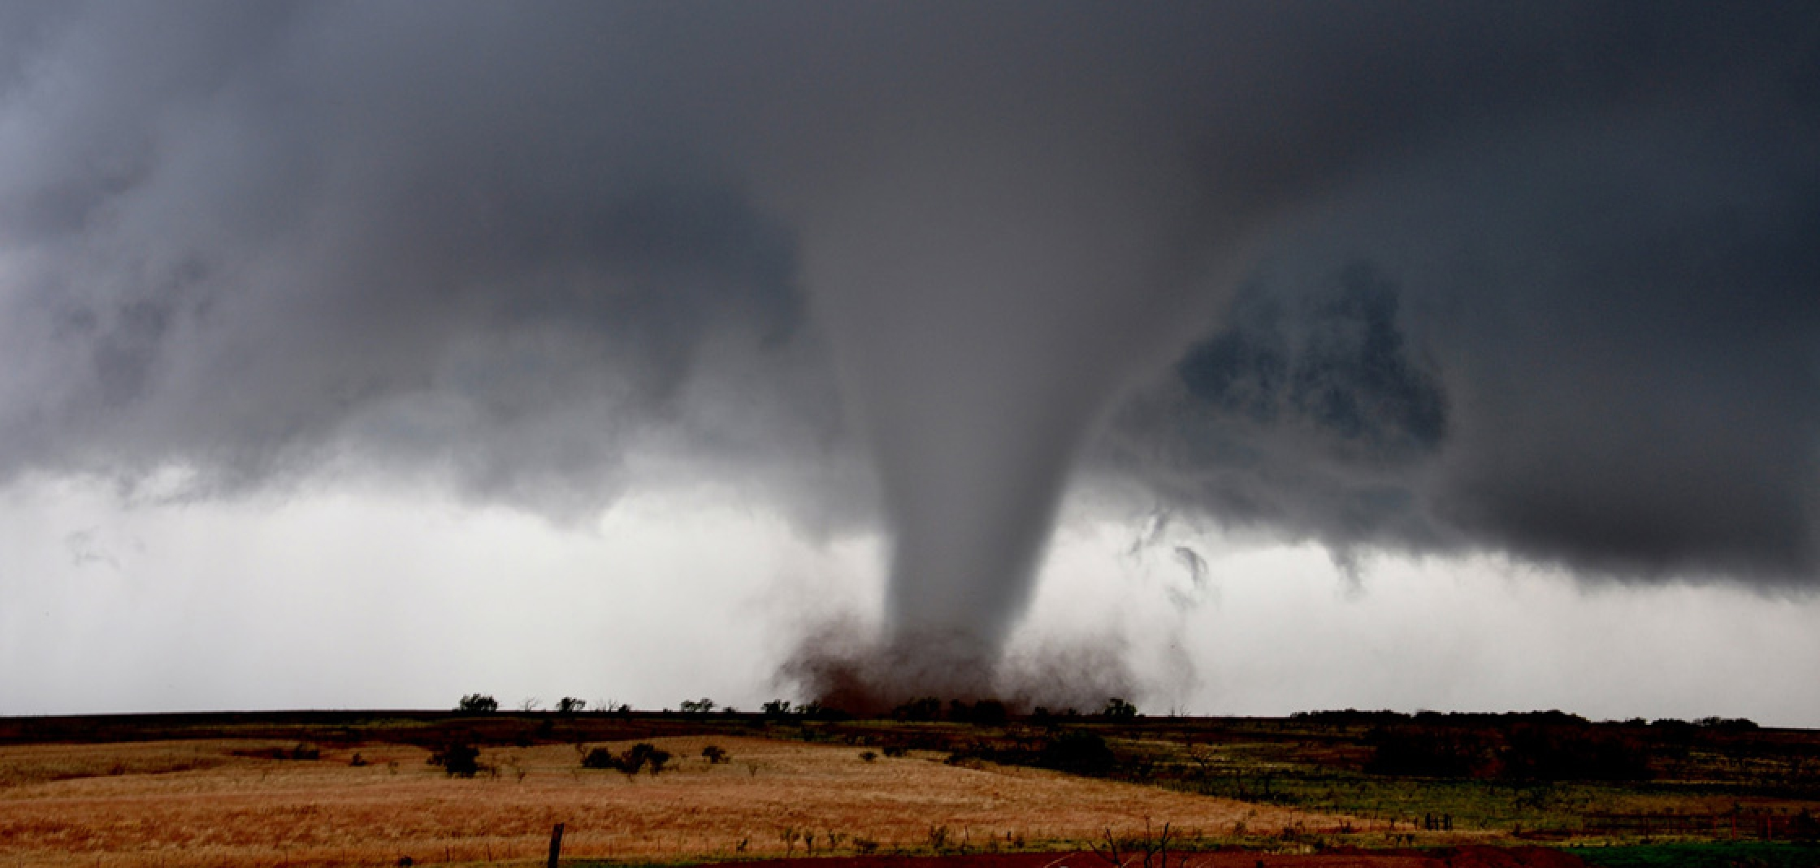
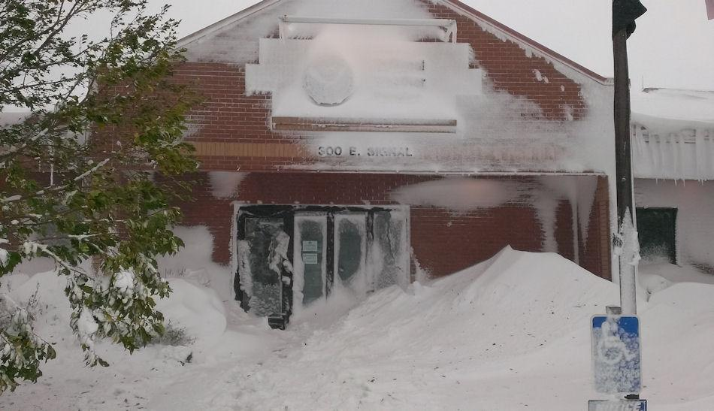
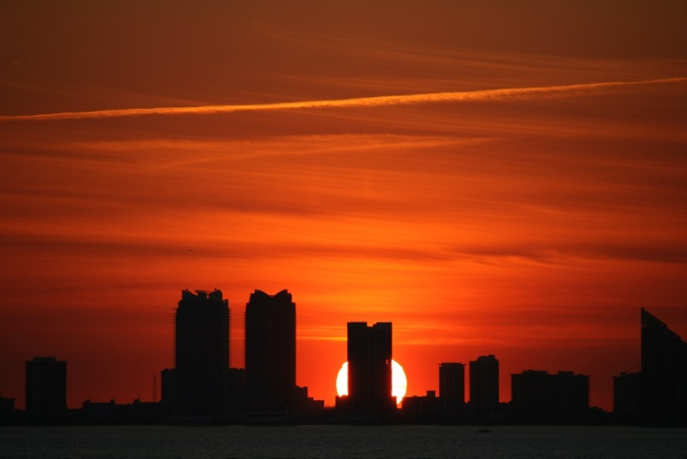
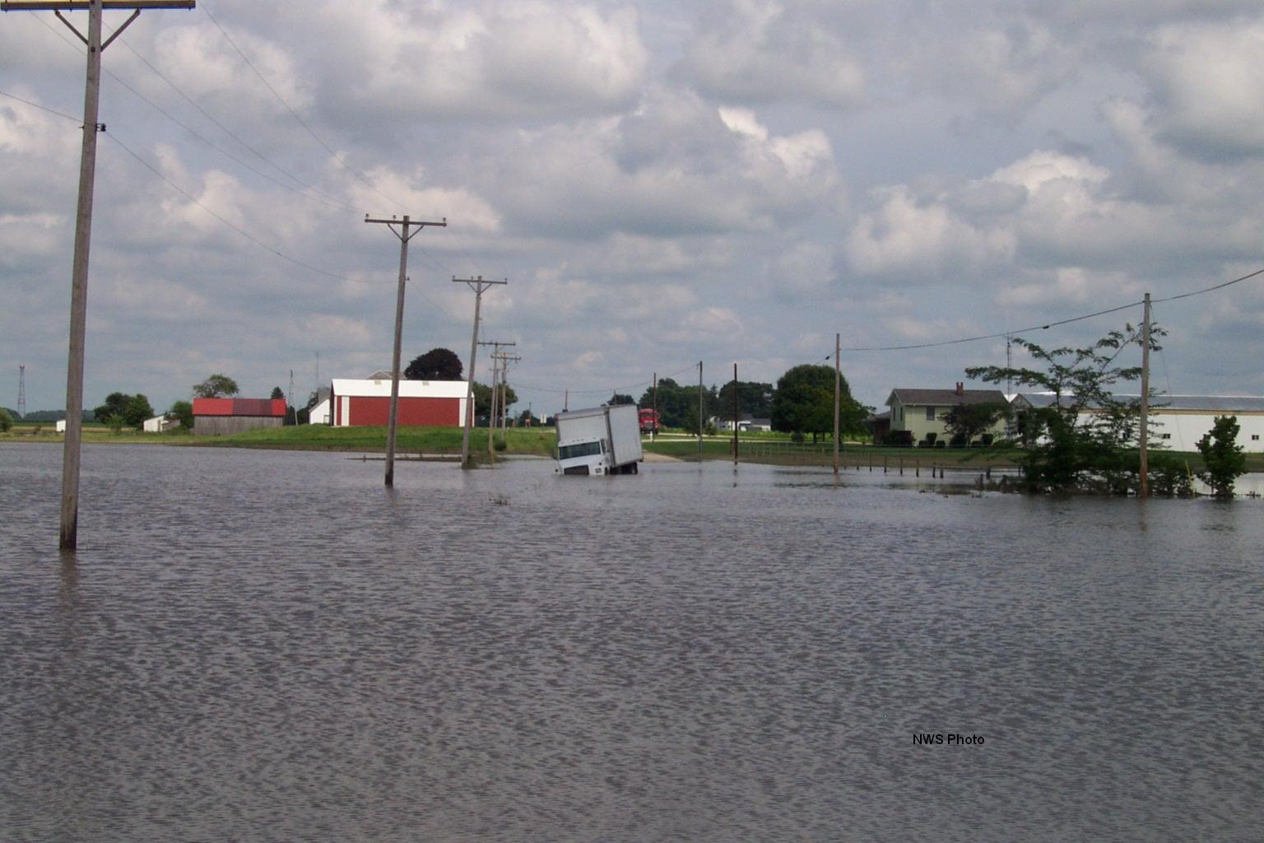
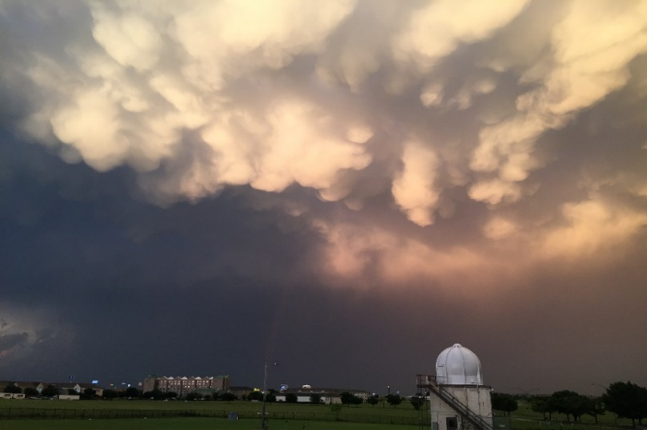
Weather is end result
Notes:
Regardless of tornadoes, blizzards, floods, threatening skies, or benign conditions exist, the weather we experience is the END result of what takes place over our heads in the atmosphere.

Slide 4
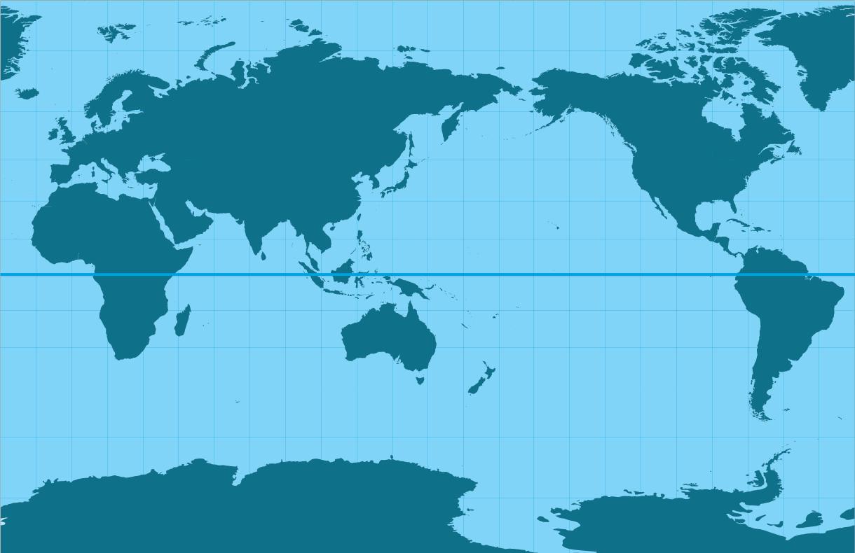
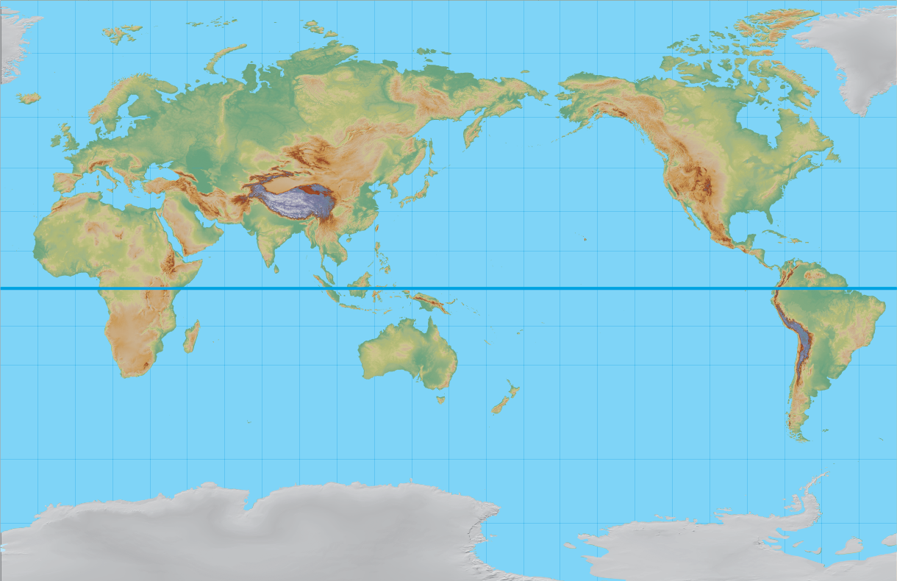
Understanding the Basics
Weather is a balancing act
Differential Heating of the Earth’s surface
Notes:
Weather is a balancing act. We have weather because the atmosphere is seeking balance in air temperature world-wide. Warm air moves poleward to raise the temperatures at the poles, Cold air moves equatorward to cool the tropics. That motion is what we observed as wind.
But there is more land in the Northern Hemisphere than in the Southern Hemisphere.
And the orientation of mountain ranges enhance or hinder airflow.
“Differential Heating of the Earth’s surface” means the oceans heat at a different rate than land, added to the varying distribution of land to sea in each hemisphere, combined with uneven heating of each hemisphere over the course of the year.

Slide 5
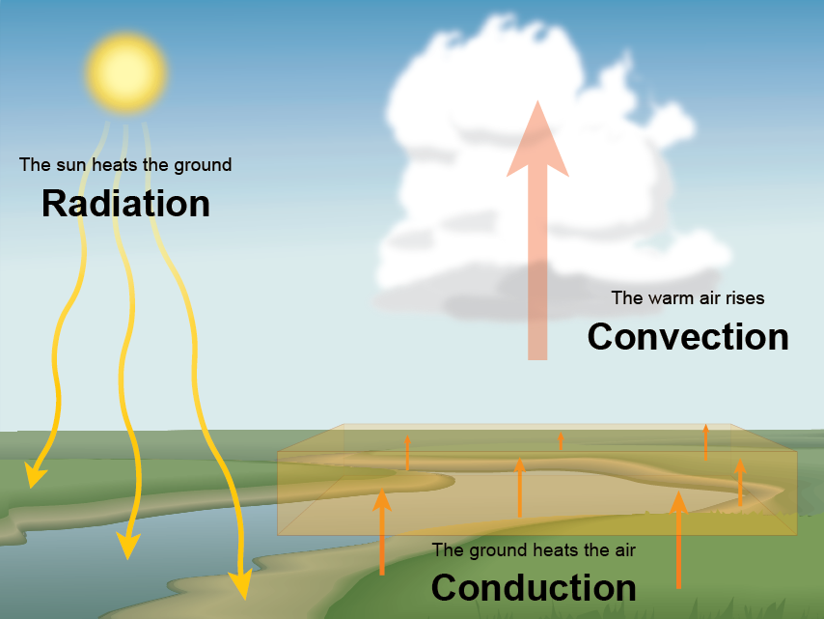


Understanding the Basics
Heat makes the wind
True, but…..
Notes:
Heat is what makes wind. The motion of air cause by heating. The Sun heats the ground. The ground heats the air. Then warm air rises.
True, but…

Slide 6
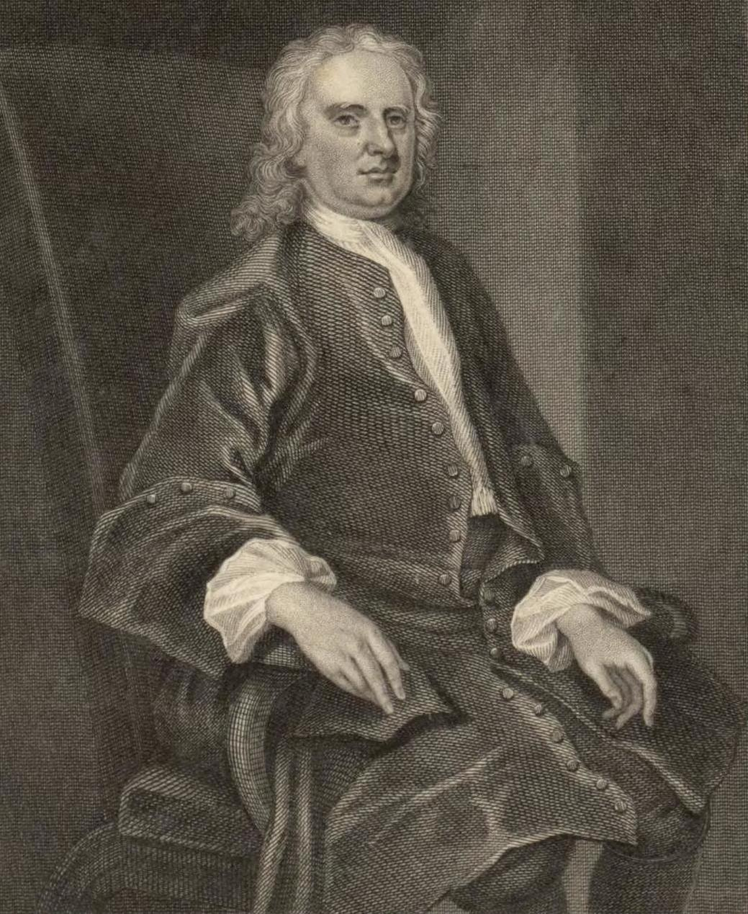
Understanding the Basics
Newton's First Law
states that an object at rest tends to stay at rest and an object in motion tends to stay in motion… unless acted upon by an external force.
For rising air, the
external force
is Gravity
Notes:
Gravity pulls cooler, more dense, air toward the earth’s surface. The cooler air spreads horizontally undercutting the warmer, less dense air forcing it to rise. What we observe as wind is the horizontal spread of more dense air undercutting less dense air.

Slide 7
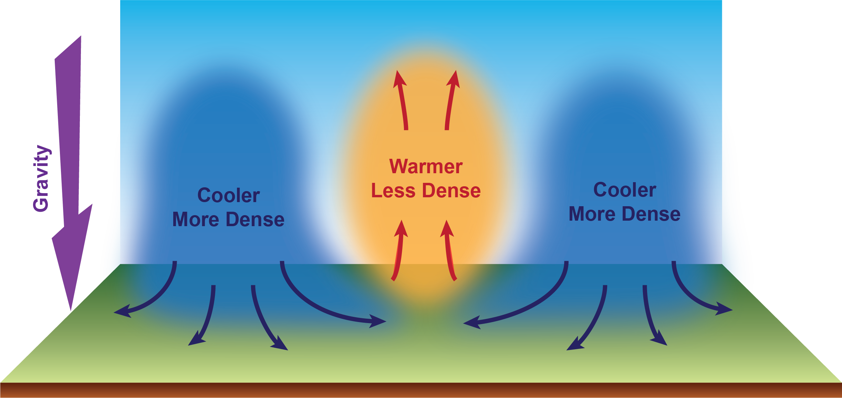
Understanding the Basics
Gravity makes the wind! (with the assistance of heat)

Slide 8
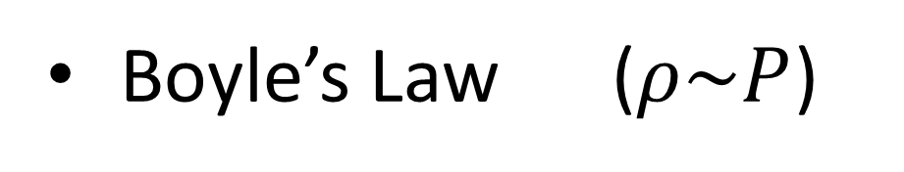
Understanding the Basics
It’s the Law: Density vs. Pressure
Density
Pressure
Density
Pressure
Notes:
As density increases pressure increases. As density decreases pressure decreases.

Slide 9
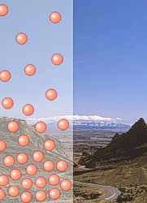
Understanding the Basics
Therefore, thanks to gravity…
Molecules closer to earth’s surface have a greater downward pull than molecule higher in the atmosphere.
So, the air density is greatest at sea level and decreases with increases elevation.
Notes:
The closer one is to a source of gravity, the greater it’s affect. Molecules closer to earth’s surface have a greater downward pull than molecule higher in the atmosphere. So, the air density is greatest at sea level and decreases with increases elevation.

Slide 10
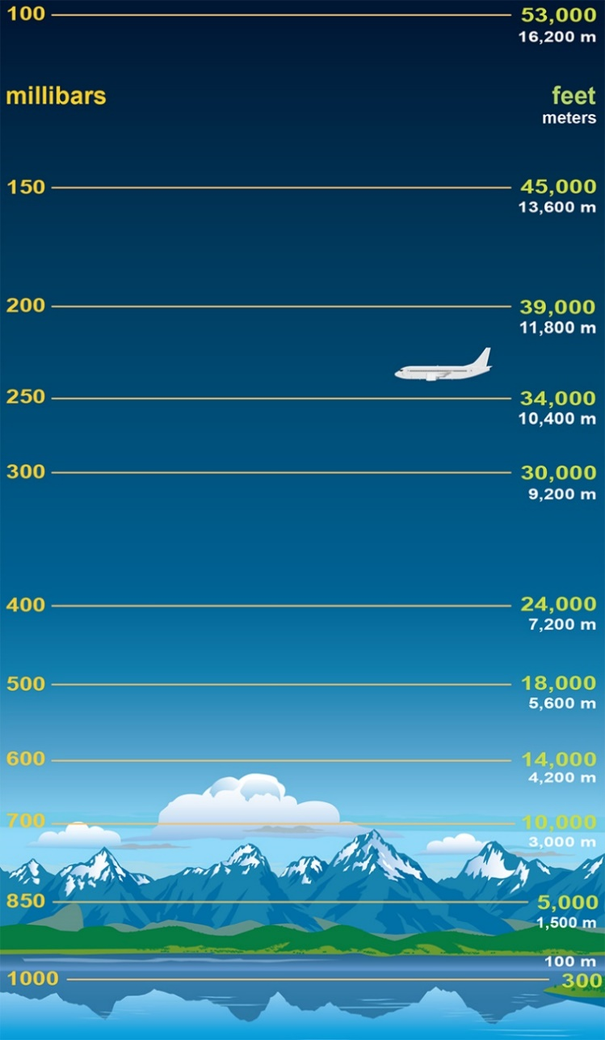
Understanding the Basics
And thanks (again) to gravity…
In Meteorology, we assume the pressure at sea level to be 1000 millibars (mb or hPa, hectopascals)
Pressure is greatest at sea level and decreases with elevation.

Slide 11
Understanding the Basics
And thanks (again) to gravity…
Pressure is greatest at sea level and decreases with elevation.
The halfway point vertically in the atmosphere is 500 millibars
and occurs at ~18,000 feet.

Slide 12

Understanding the Basics
It’s the Law (pt. 2): Temperature vs. Pressure
Pressure
Temperature
Pressure
Temperature

Slide 13
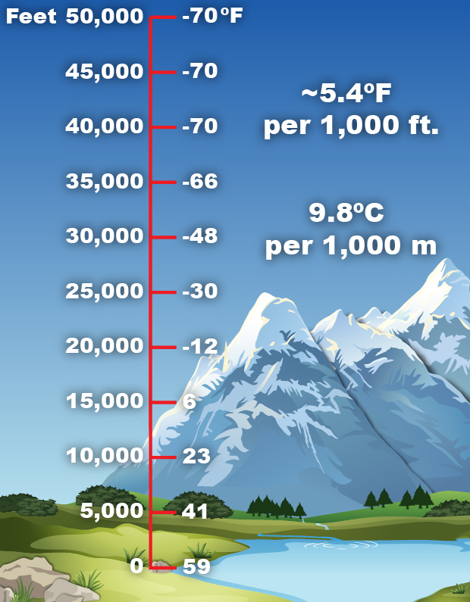
Understanding the Basics
And thanks to gravity (one more time)…
Temperature is greatest at sea level and decreases with elevation
59°F
Notes:
The standard rate at which the atmosphere cools is a decrease of about 5.4°F per 1,000 feet. But the atmosphere is never “standard”.

Slide 14
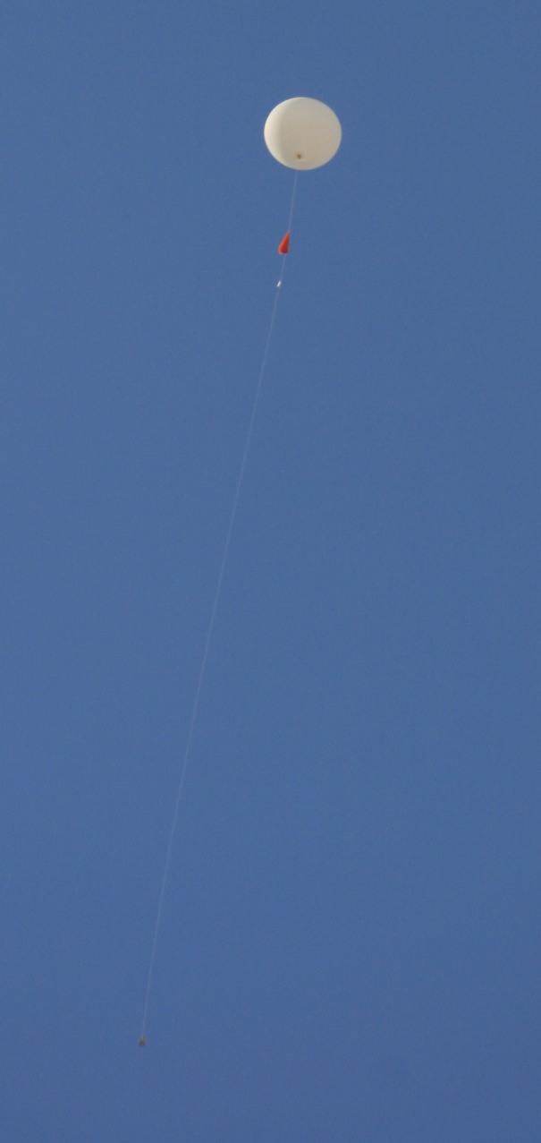
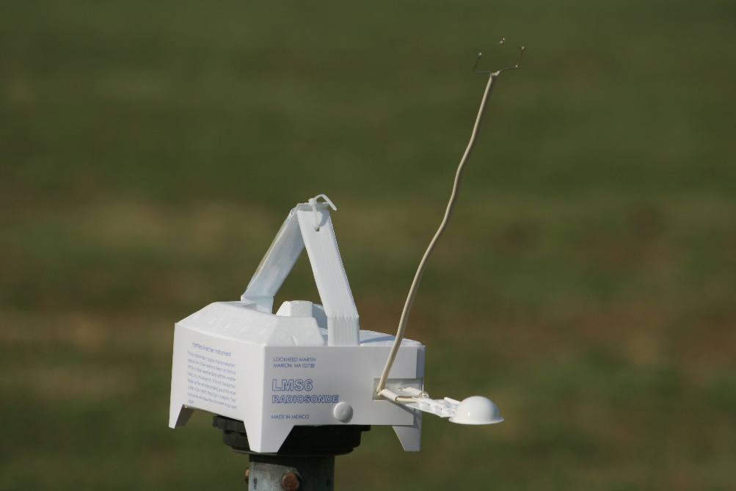
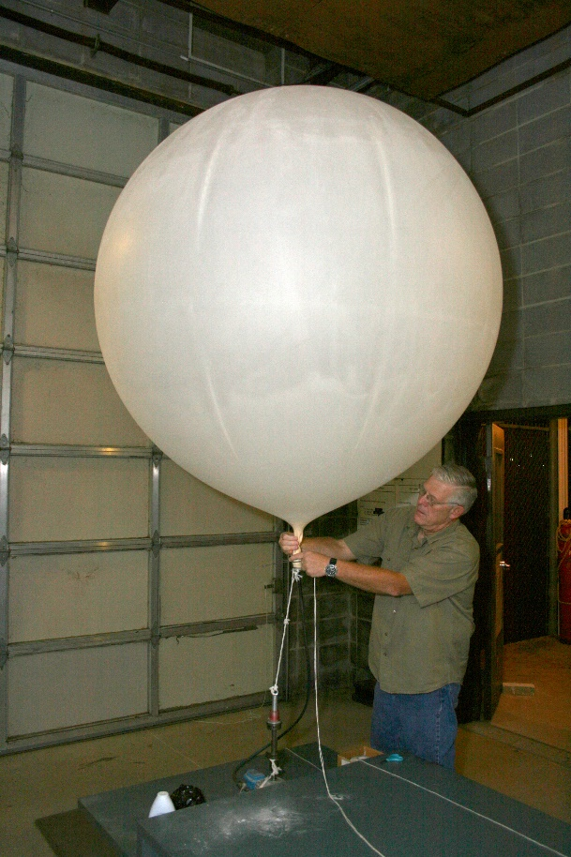
In Over Our Heads
Radiosondes
Can rise to 120,000 ft.
in about 1 hour 45 min.
6 ft. to > 20 ft.
Measures…
Temperature
Humidity
Pressure and height at which that pressure occurred
and tracked for Wind Speed and Direction
Notes:
We use radiosondes to determine the actual rate at which the atmosphere cools with height. The ‘sonde’ is in the red circle. The arrows is pointing to the parachute that opens when the balloon pops to return the ‘sonde’ to the ground.

Slide 15
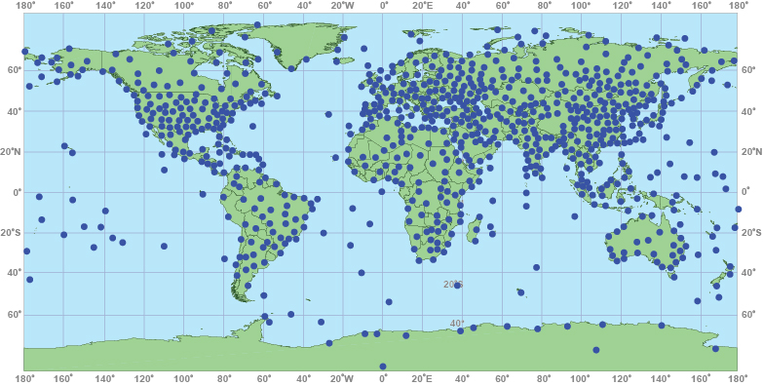
In Over Our Heads
Radiosonde Launch Locations
Notes:
World-wide locations of radiosonde launches. Note more launches in the Northern Hemisphere compared to the Southern Hemisphere. Also note, the vast areas of ocean where there is no information. Not only is there differential heating of the earth’s surface but differential ‘collection’ of information across the world. All of these launches occur at the same time.

Slide 16


Chasing Rabbits

Slide 17
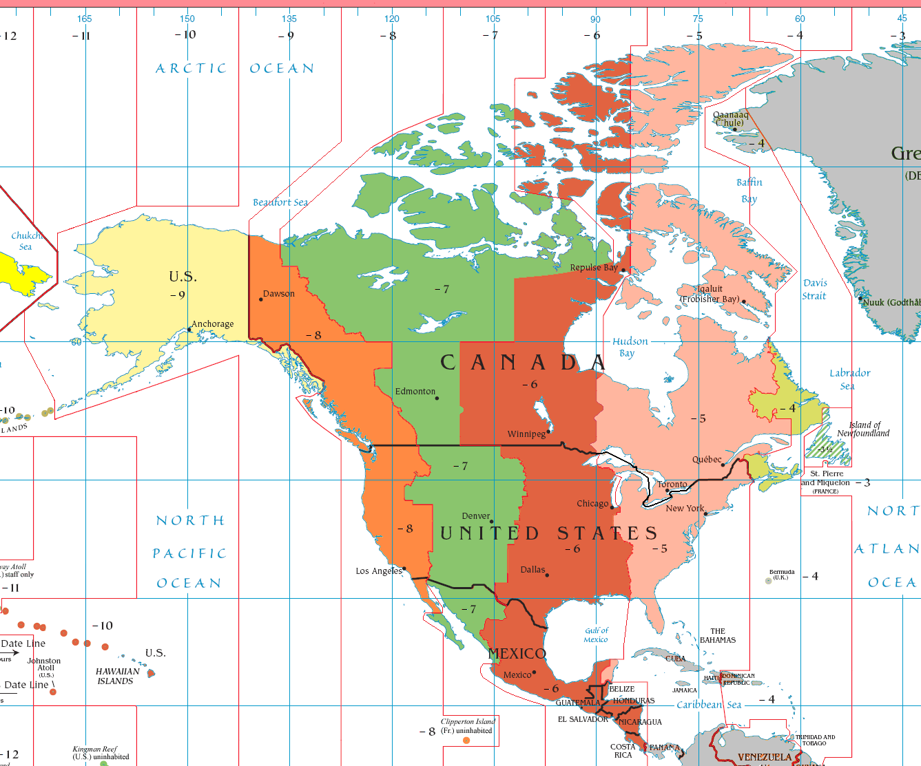
Chasing Rabbits
Z-Time a.k.a Military Time, GMT, UTC
Used in all aspects
of meteorology
Based upon a world-
wide 24-hour clock
All weather maps,
radar, and satellite
images all have
their time expressed in "Z".

Slide 18
In Over Our Heads
Radiosonde Times: 00Z / 12Z
Notes:
Radiosonde observations are at 00z and 12z. This is the approximate time the radiosonde has reached a height of 70 mb and all obtained data is transmitted to the world. Since is takes about an hour to reach 70 mb from the surface, the actual balloon release time is typically an hour before (23z and 11z).

Slide 19
In Over Our Heads
For Seattle (Quillayute)
00Z is 4 p.m. (Standard time)
3 p.m. (Daylight Saving time)
Balloon release
3 p.m. (Standard time)
2 p.m. (Daylight Saving time)

Slide 20
In Over Our Heads
For Auckland, New Zealand
00Z is Noon (Standard time)
1 p.m. (Daylight Saving time)
Balloon release
11 a.m. (Standard time)
Noon (Daylight Saving time)

Slide 21
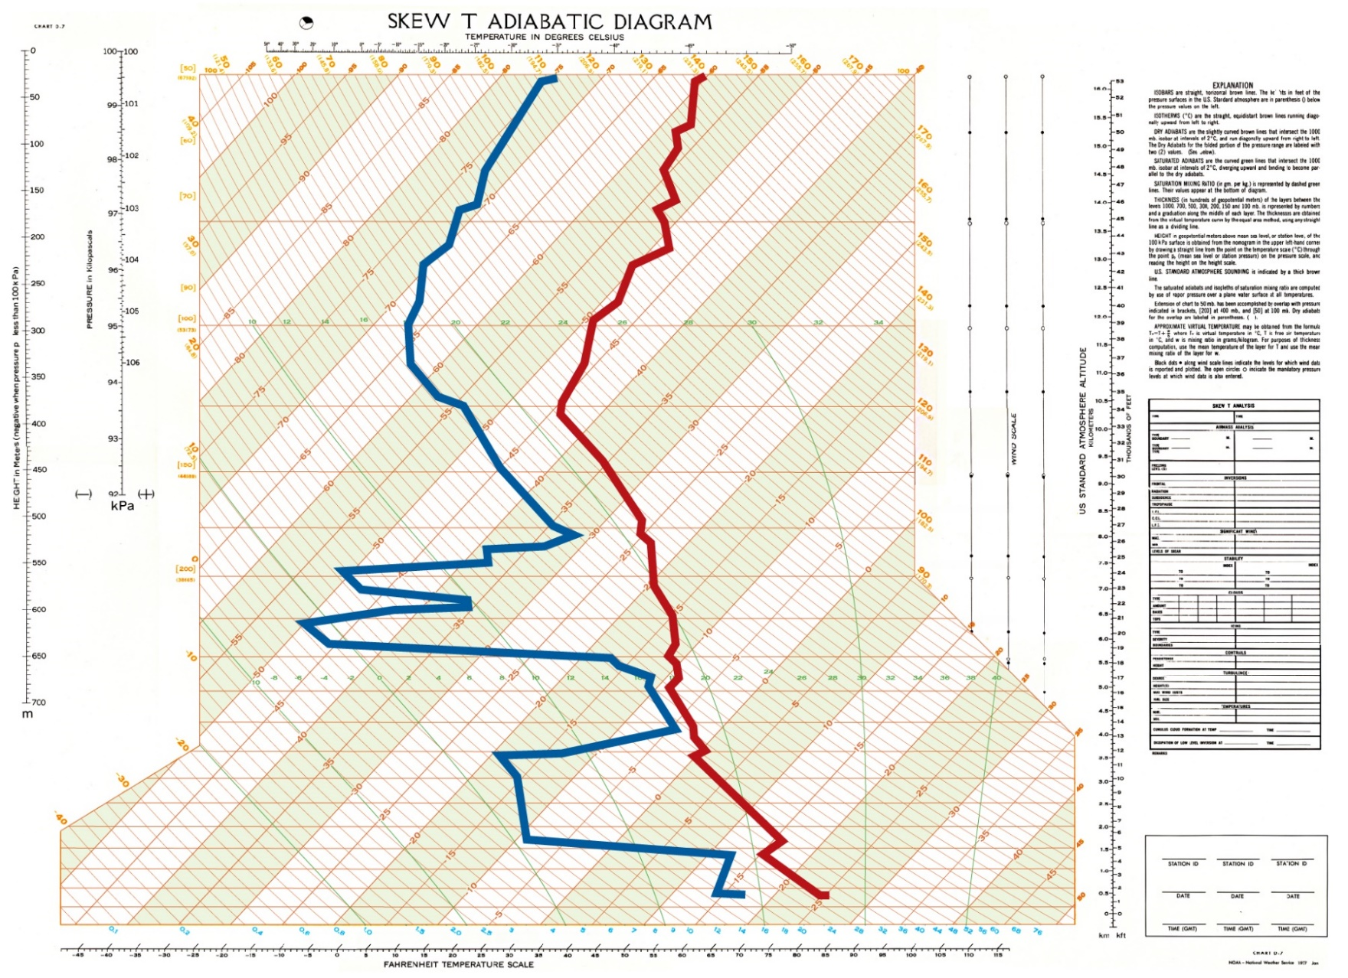
In Over Our Heads
Skew-T Diagram
Notes:
Skew-T Log-P Diagram. Temperature line are skewed at a 45° angle. Red line is the air temperature record with height. Blue line is the dew point (radiosonde reports relative humidity but is converted to dew point for this diagram).
The closer the dew point line moves toward (or away) from the temperature line indicated moisture that increases (or decreases) at any given altitude. The diagram has been simplified as there are many additional lines used in analysis. The bottom arrow indicate a temperature inversion. The box represent a layer of clouds, The top arrow is the tropopause, the boundary between the troposphere below and stratosphere above.

Slide 22

Chasing Rabbits #2
Notes:
Chasing Rabbits: Humidity vs. Dew Point

Slide 23
Chasing Rabbits #2
Relative Humidity vs. Dew Point
Relative Humidity – Ratio of moisture in the air vs. the maximum that could be in the air
Dew Point – The temperature at which, if the air were cooled, the relative humidity would be 100%.
Notes:
Relative humidity is the ratio of the partial pressure of water vapor in the mixture to the equilibrium pressure of water vapor over a flat surface of pure water at a given temperature. Dew point is an absolute value. A much better measure of the amount of moisture in the atmosphere.

Slide 24
Chasing Rabbits #2
Relative Humidity vs. Dew Point
Temp (°F) | Dew Point (°F) | Humidity
30 | 30 | 100%
40 | 40 | 100%
50 | 50 | 100%
60 | 60 | 100%
70 | 70 | 100%
Atmosphere is much, much more moist with dew point of 70°F as compared to a dew point of 30°F.
Notes:
Chasing Rabbits: Z-time

Slide 25
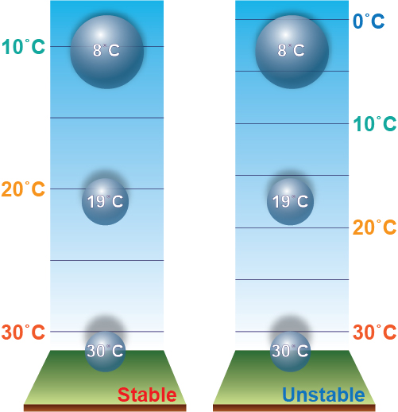
In Over Our Heads
Atmospheric Stability
Notes:
Radiosondes give use a measure of the temperature in the vertical. This tells us of the stability of the atmosphere. If a parcel of air rises into a region where the surrounding temperature is higher than the parcel then the atmosphere is stable at that elevation and parcel is no longer buoyant. If the rising parcel moves into air where the surrounding temperature is lower than the parcel the air is unstable and the parcel will continue to rise.

Slide 26
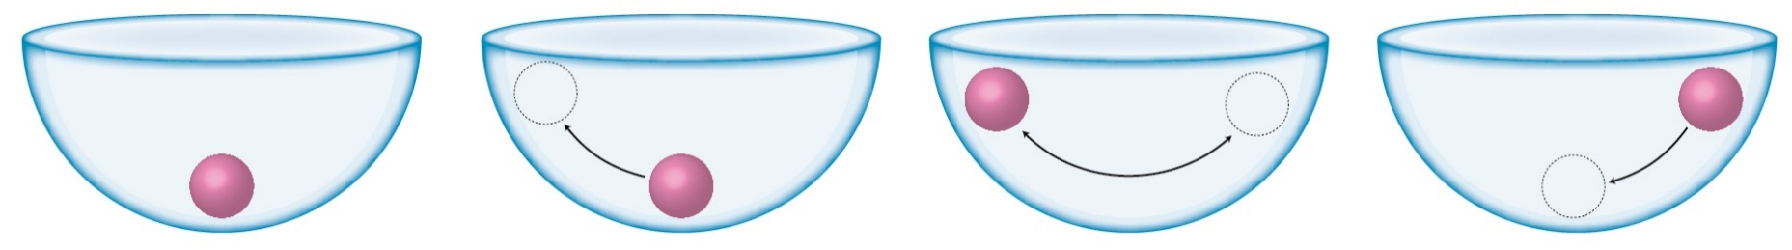
In Over Our Heads
Absolutely Stable
Notes:
Absolutely stable: The parcel is moved but when left to its own motion it returns to its initial state.

Slide 27
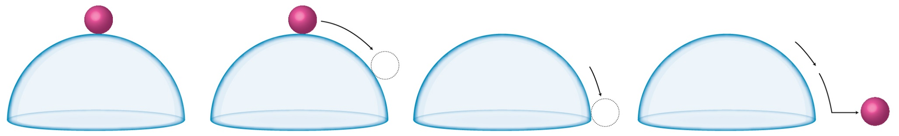
In Over Our Heads
Absolutely Stable
Absolutely Unstable
Notes:
Absolutely Unstable: The parcel is moved then continues to move on its own.

Slide 28
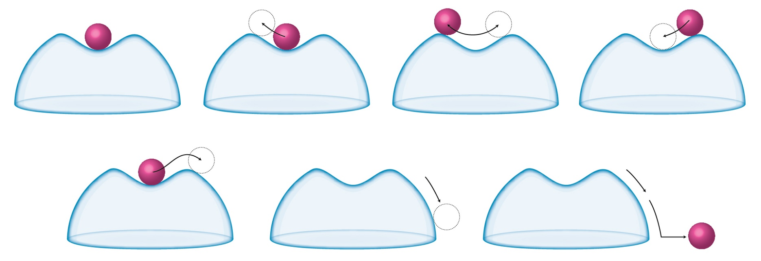
In Over Our Heads
Atmospheric Stability
Conditionally Stable
Notes:
Conditionally stable: The parcel is moved some but when left to its own motion it returns to its initial state. However, if given enough force then it moves to a tipping point where it becomes unstable. Most of the time the atmosphere is conditionally unstable.
We see this often with clear skies in the morning. Then, when the ground has received enough heating from the sun, puffy Cumulus clouds form.

Slide 29
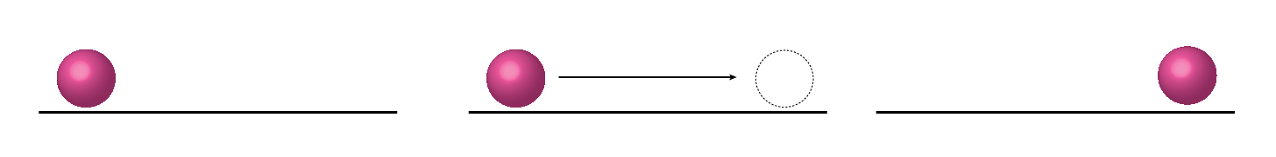
In Over Our Heads
Atmospheric Stability
Conditionally Stable
Neutrally Stable
Notes:
Neutrally stable: The parcel is moved then when the force stops the parcel stopes at it new location.

Slide 30
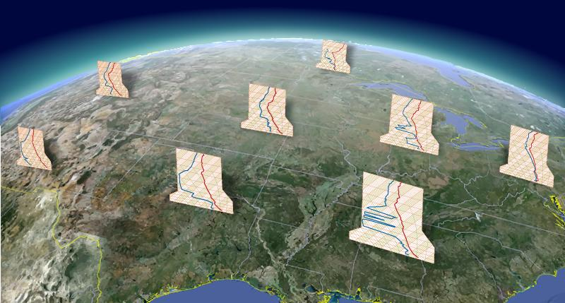
In Over Our Heads
Notes:
Sample of soundings taken on same day/time across the country. We need to look at the information provided by these observations and we do that via constant pressure charts.

Slide 31
Constant Pressure Charts
Recall radiosondes measure…
Temperature
Humidity
Air Pressure; and Height at which that pressure occurred
Tracked for Wind Speed and Direction

Slide 32
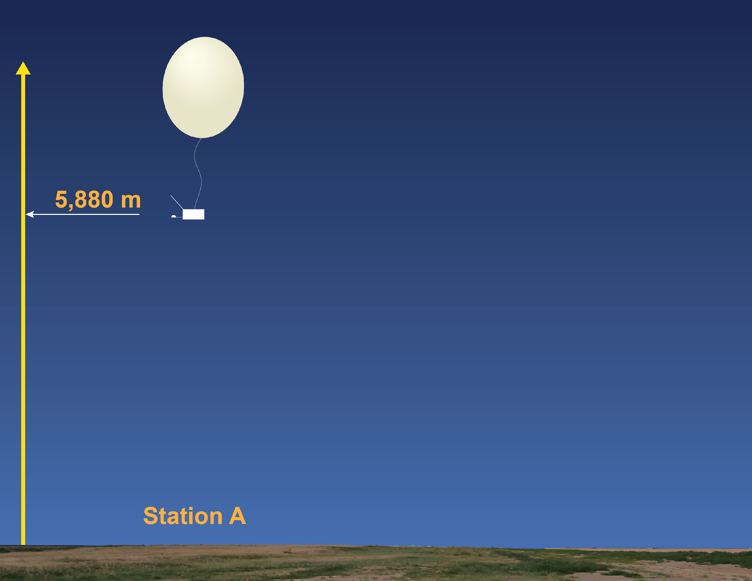
Constant Pressure Charts
Air Pressure: 500 mb
Notes:
How we view the atmosphere at specific pressure levels. Radiosonde launched from Station A reached the 500 mb level at 5,880 meters.

Slide 33
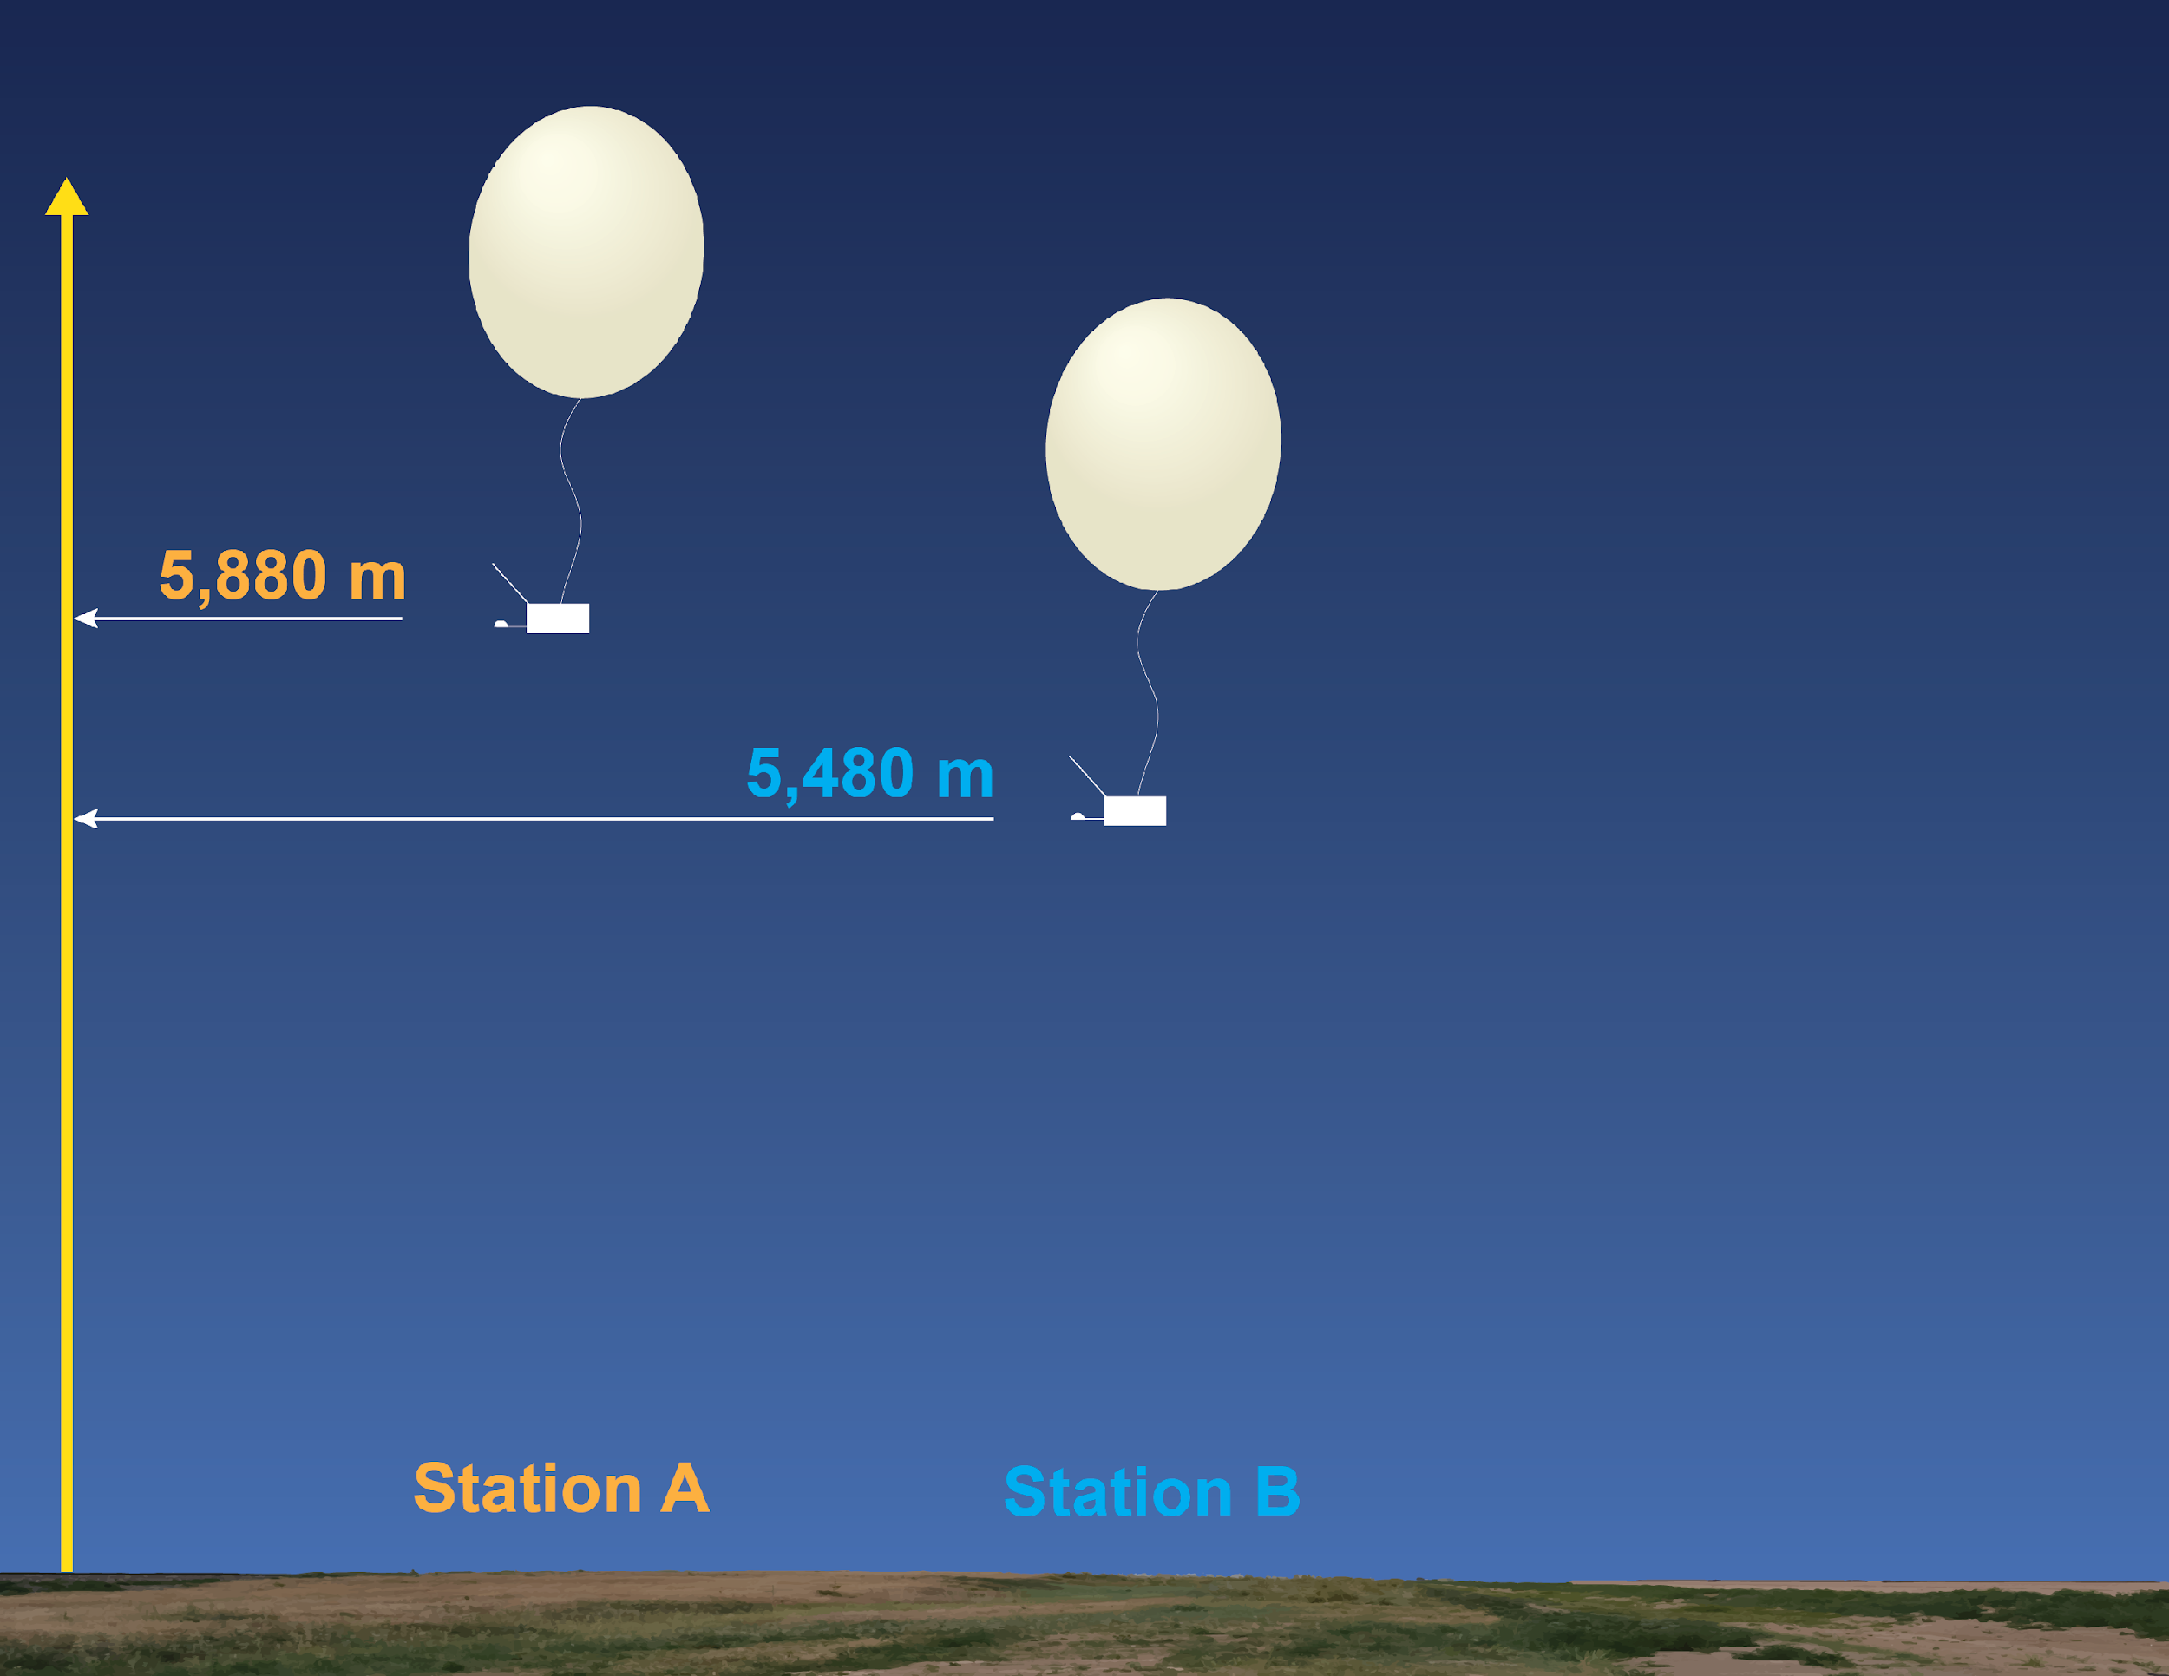
Constant Pressure Charts
Air Pressure: 500 mb
Notes:
Radiosonde launched from Station B reached the 500 mb level at 5,480 meters.

Slide 34
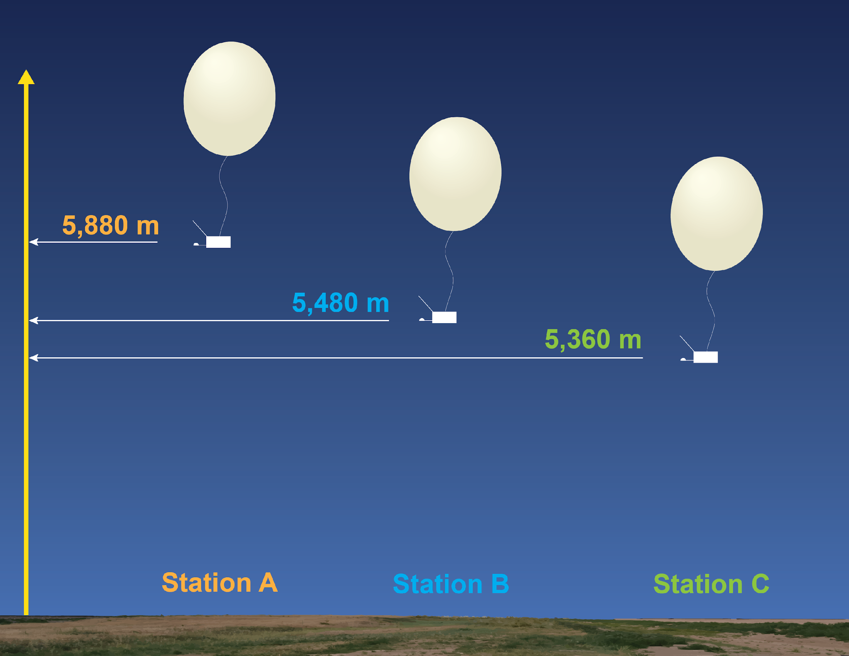
Constant Pressure Charts
Air Pressure: 500 mb
Notes:
Radiosonde launched from Station C reached the 500 mb level at 5,360 meters.

Slide 35
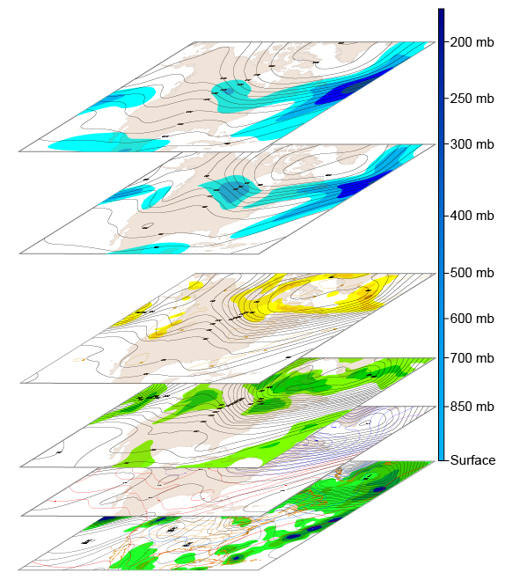
Constant Pressure Charts
Radiosonde information at certain fixed pressures levels, from around the world, are plotted onto maps for analysis.
Notes:
Constant pressure charts slice the atmosphere horizontally at specific pressure levels. These pressure levels are 850 mb, 700 mb, 500 mb, 300 mb, and 200 mb. We will look at the 500 mb level.

Slide 36
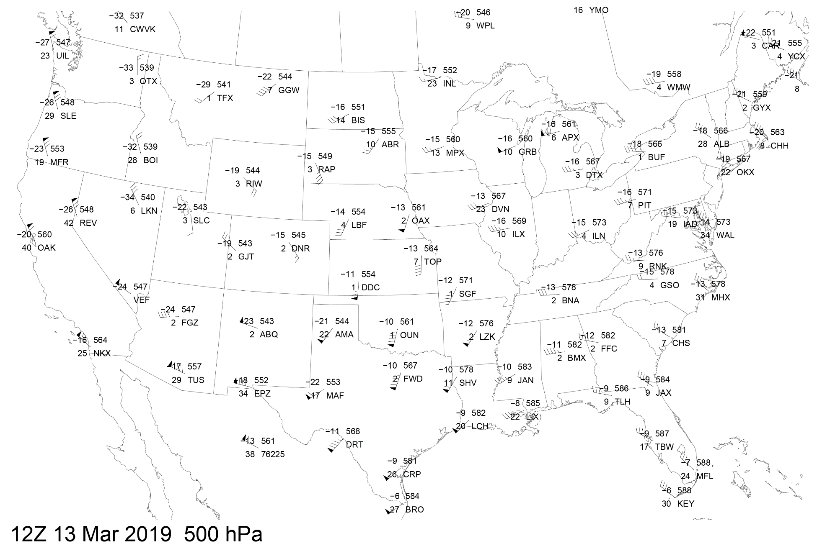
Constant Pressure Charts
Notes:
The most common map is the 500 mb level. Despite looking at the atmosphere at just 18,000 feet, this is considered the middle of the atmosphere and is often the meteorologist’s first choice in looking at the upper atmosphere.

Slide 37
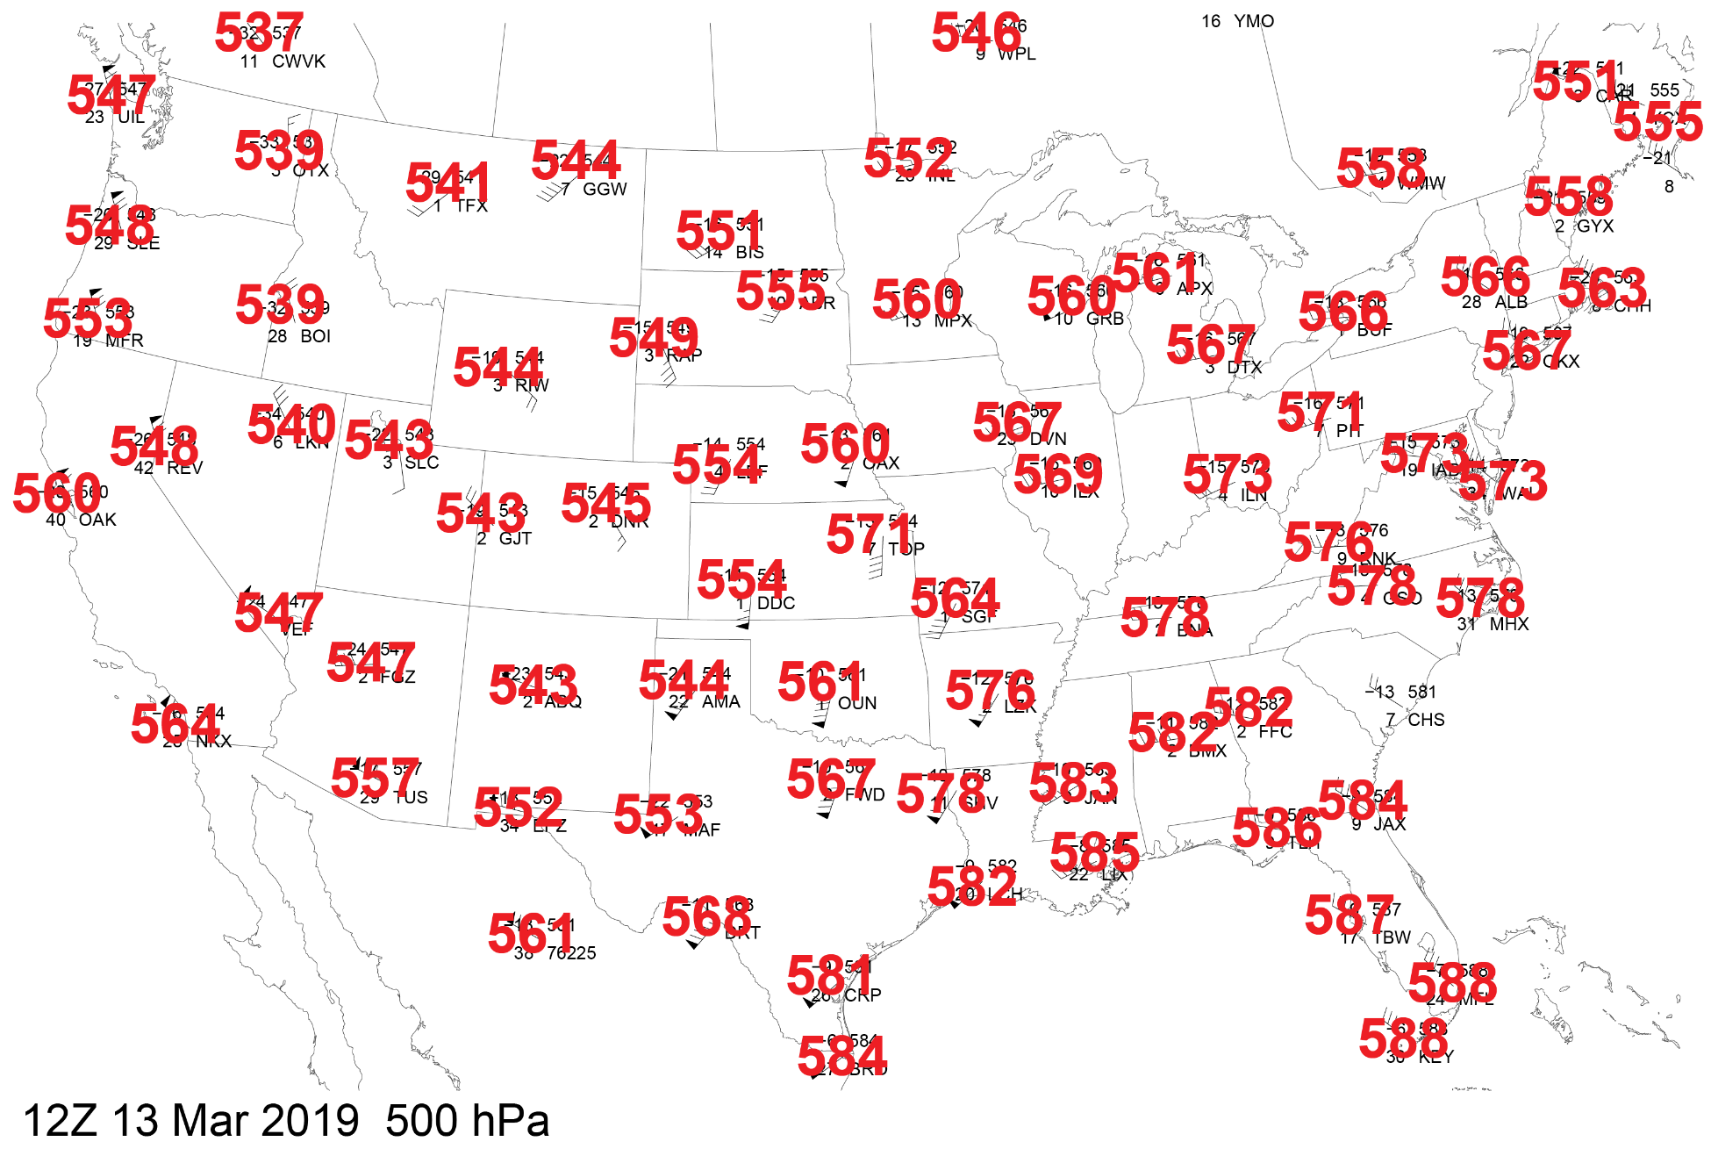
Constant Pressure Charts
Notes:
The numbers in the upper right plot (at each location) represent the height (in meters) that a pressure of 500 mb was reached. But these number are truncated.

Slide 38
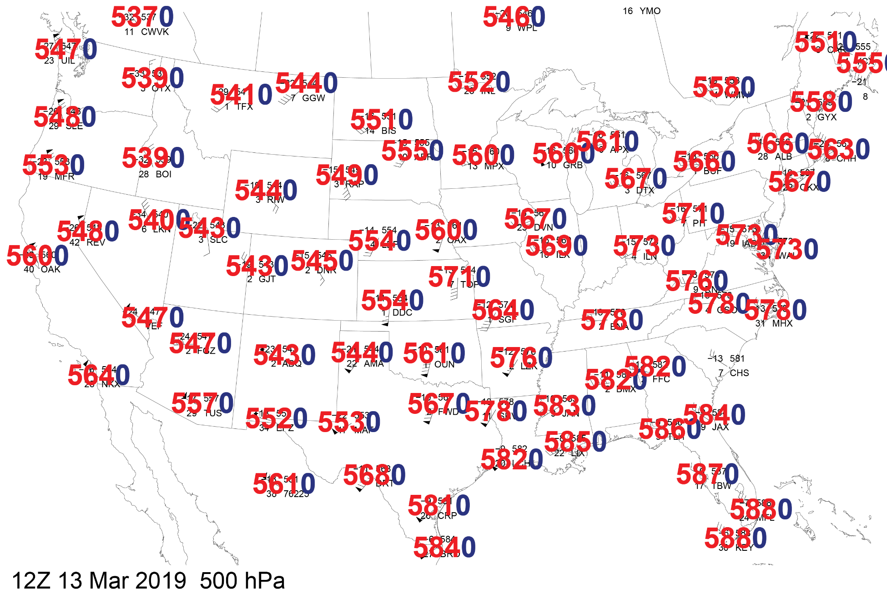
Constant Pressure Charts
Notes:
For 500 mb, add a trailing “zero” to learn the actual height (in meters).

Slide 39
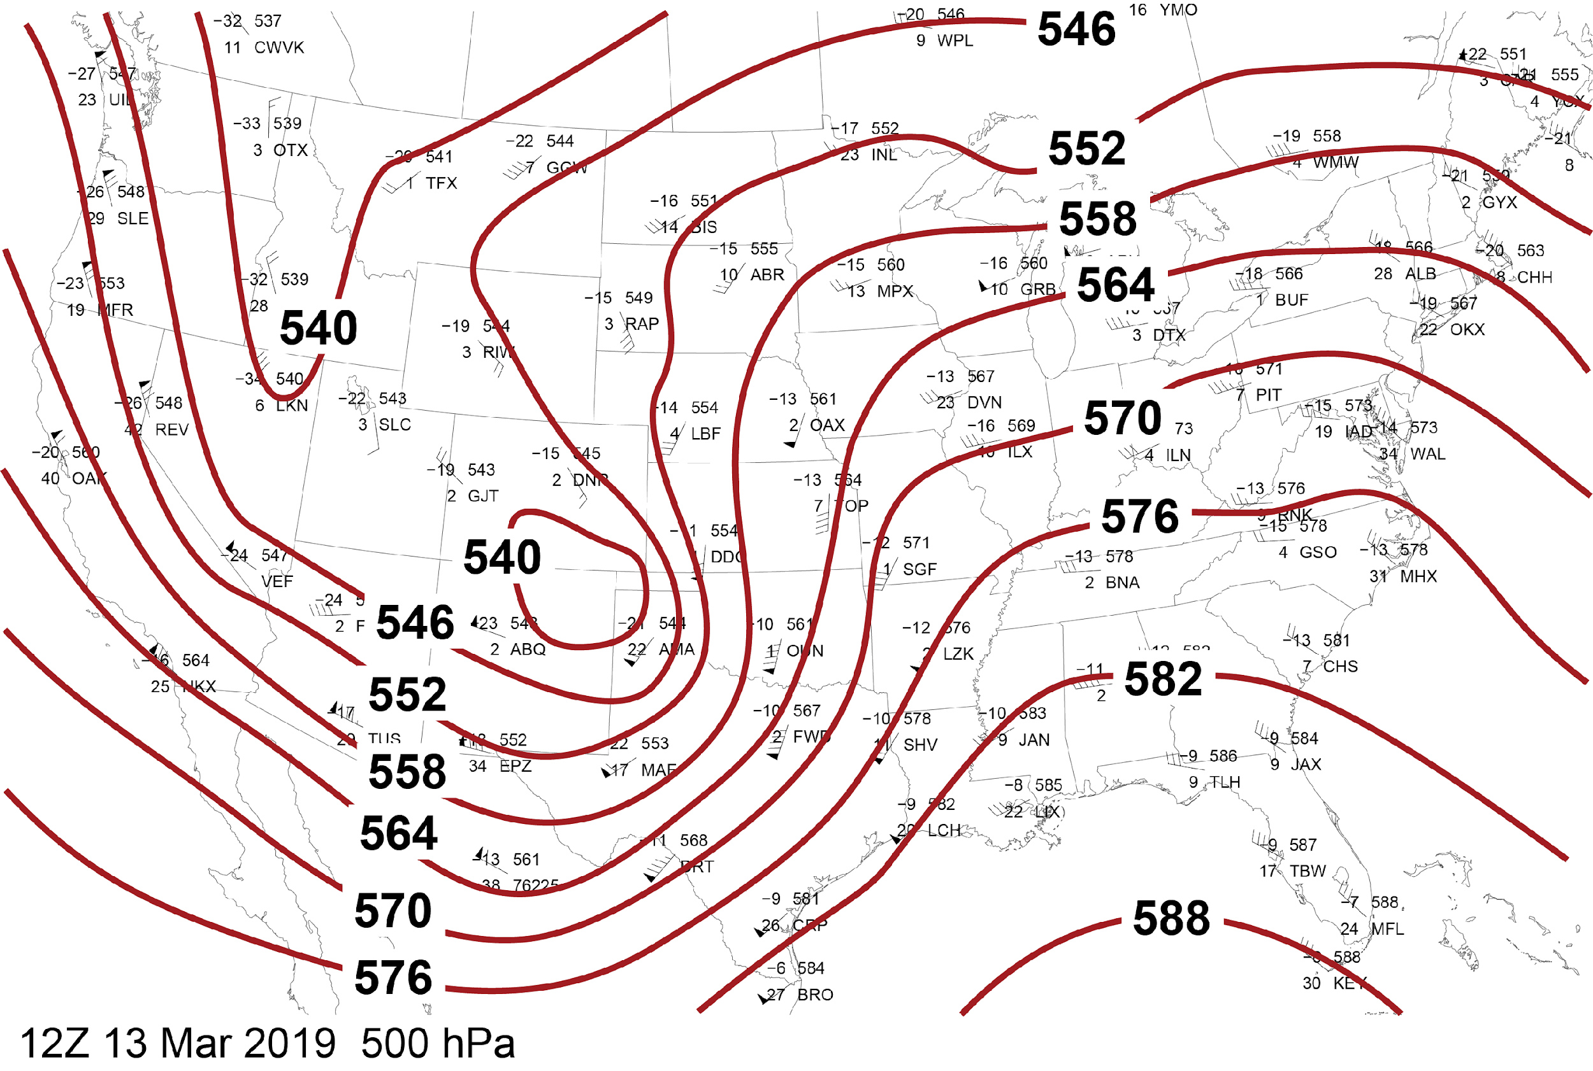
Constant Pressure Charts
Notes:
Similar to a ‘dot-to-dot’ analogy the map is analyzed using the heights and following the wind direction. These lines are called ‘contours’. In this example from March 13, 2019, the height at which 500 mb occurs is lowest over northeast New Mexico and the northern Rockies. Highest elevation of the occurrence of 500 mb is over the Gulf of Mexico.
This is a 3-d map shown in 2 dimensions.

Slide 40
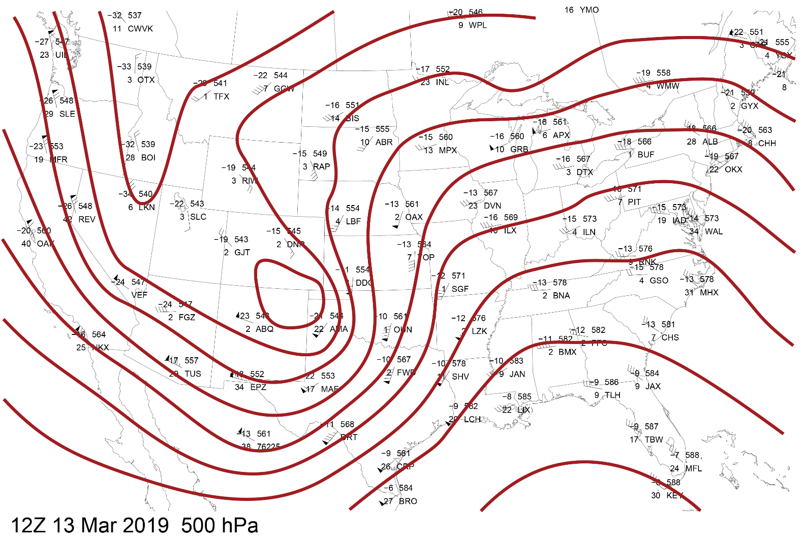
Constant Pressure Charts
Wind flows from left to right along contours* (both hemispheres)
Notes:
Asterisk – Wind mostly flows along contours but not always exactly.

Slide 41
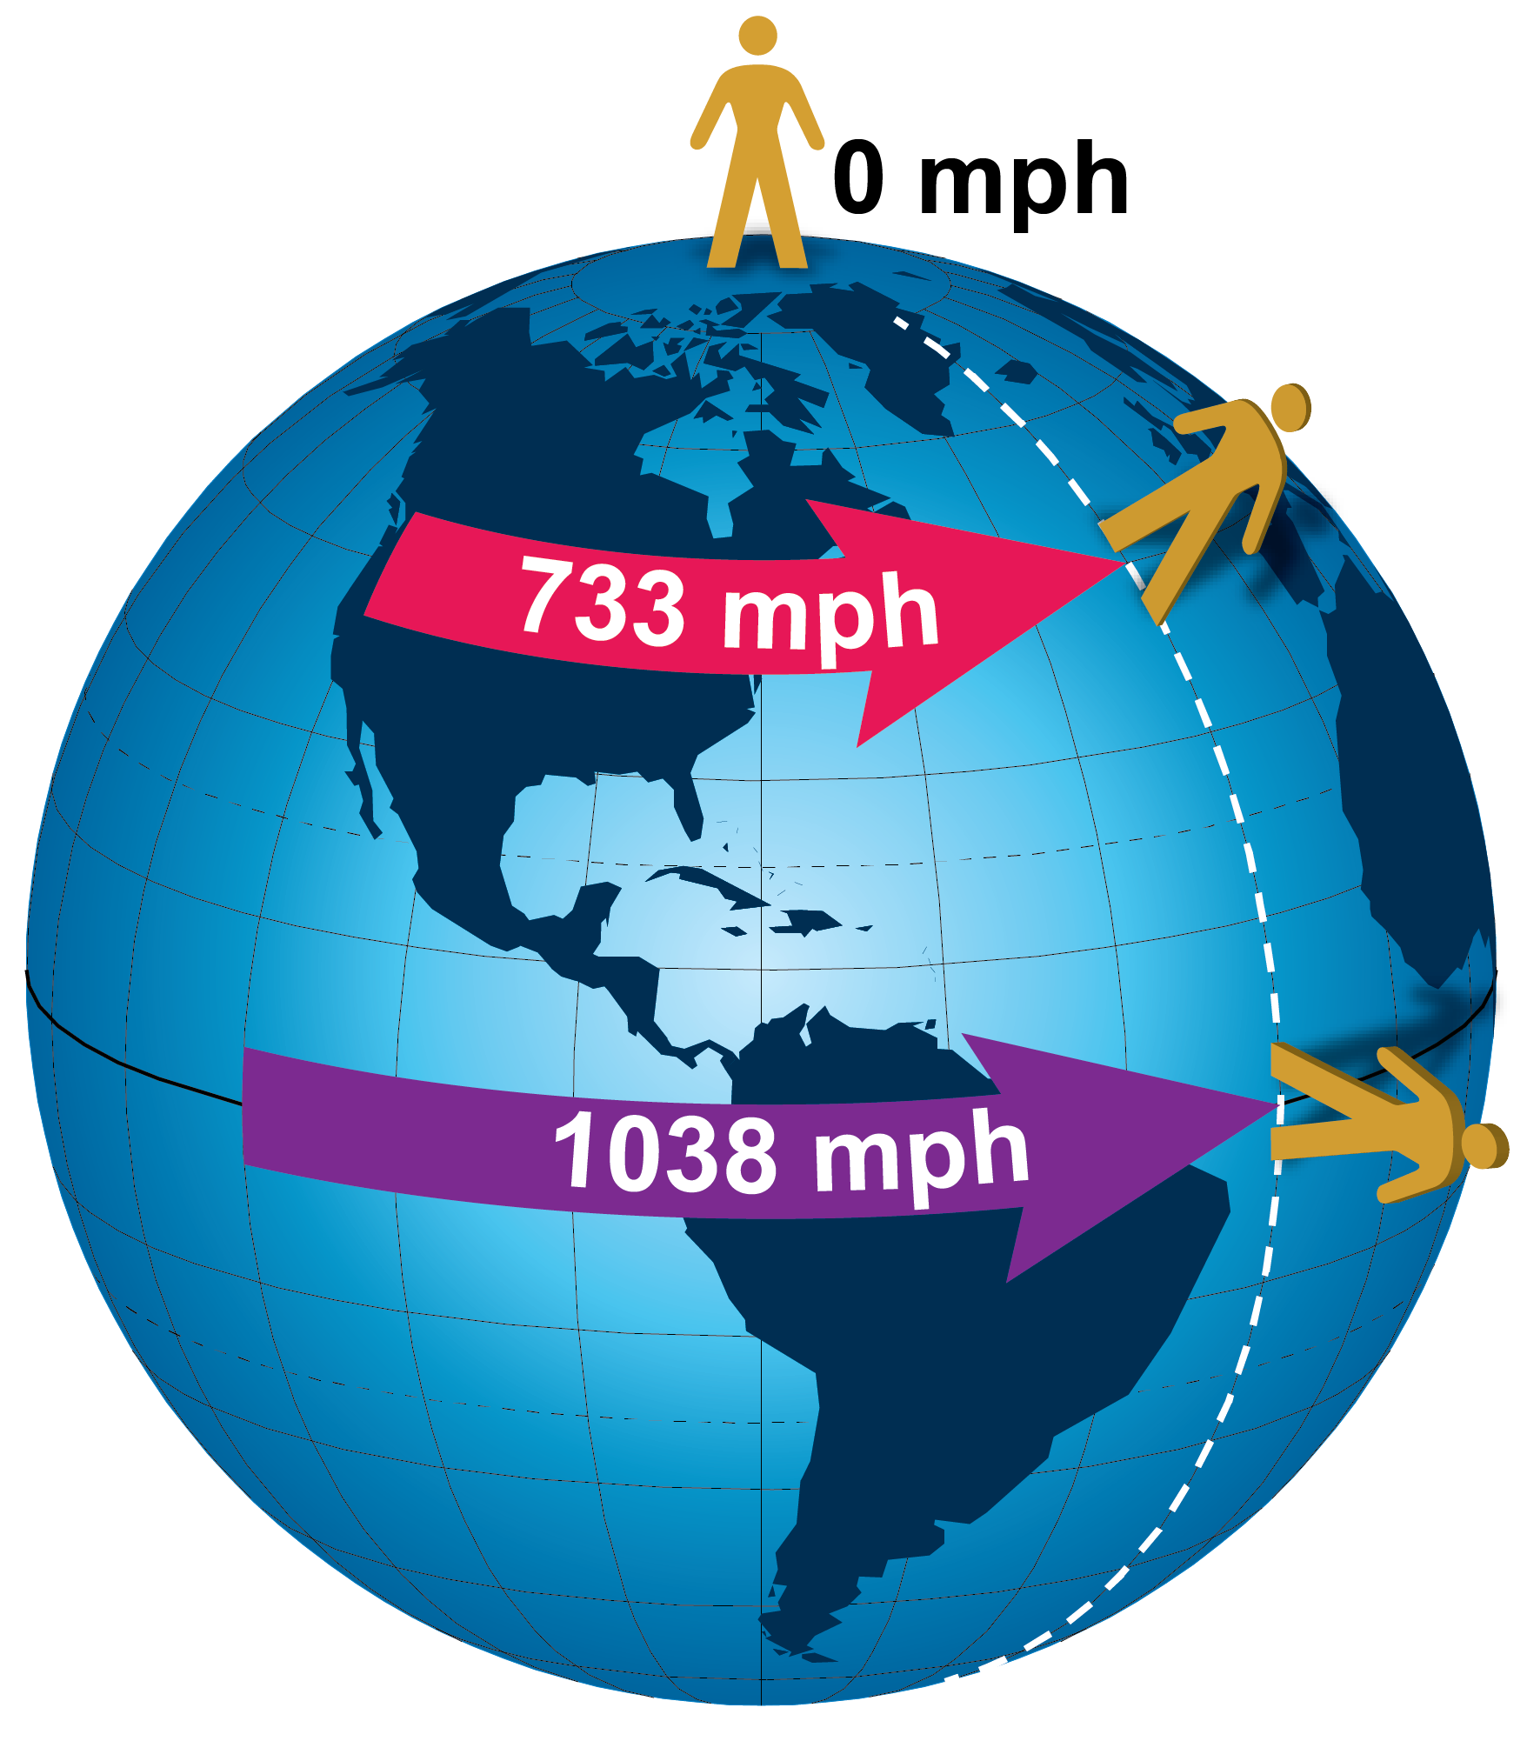
Constant Pressure Charts
Why does the wind flow from west to east?
Notes:
The velocity at which we move east in a 24-hour rotation decreases from over 1,000 mph at the equator to zero at the poles.

Slide 42
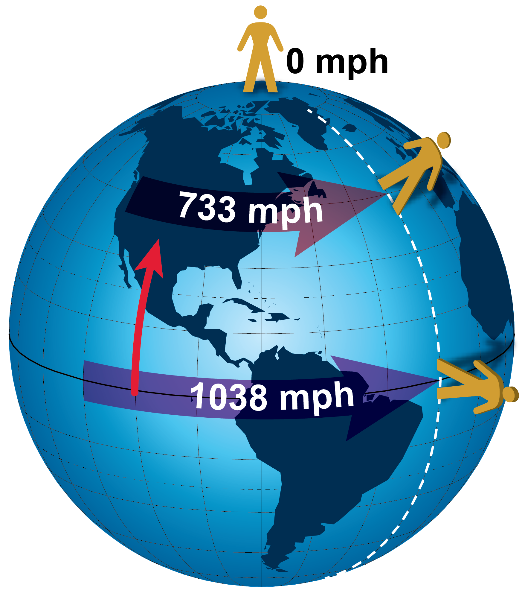
Constant Pressure Charts
Why does the wind flow from west to east?
Notes:
However, air moving toward the poles retains its eastward momentum while the rotational velocity decreases.

Slide 43
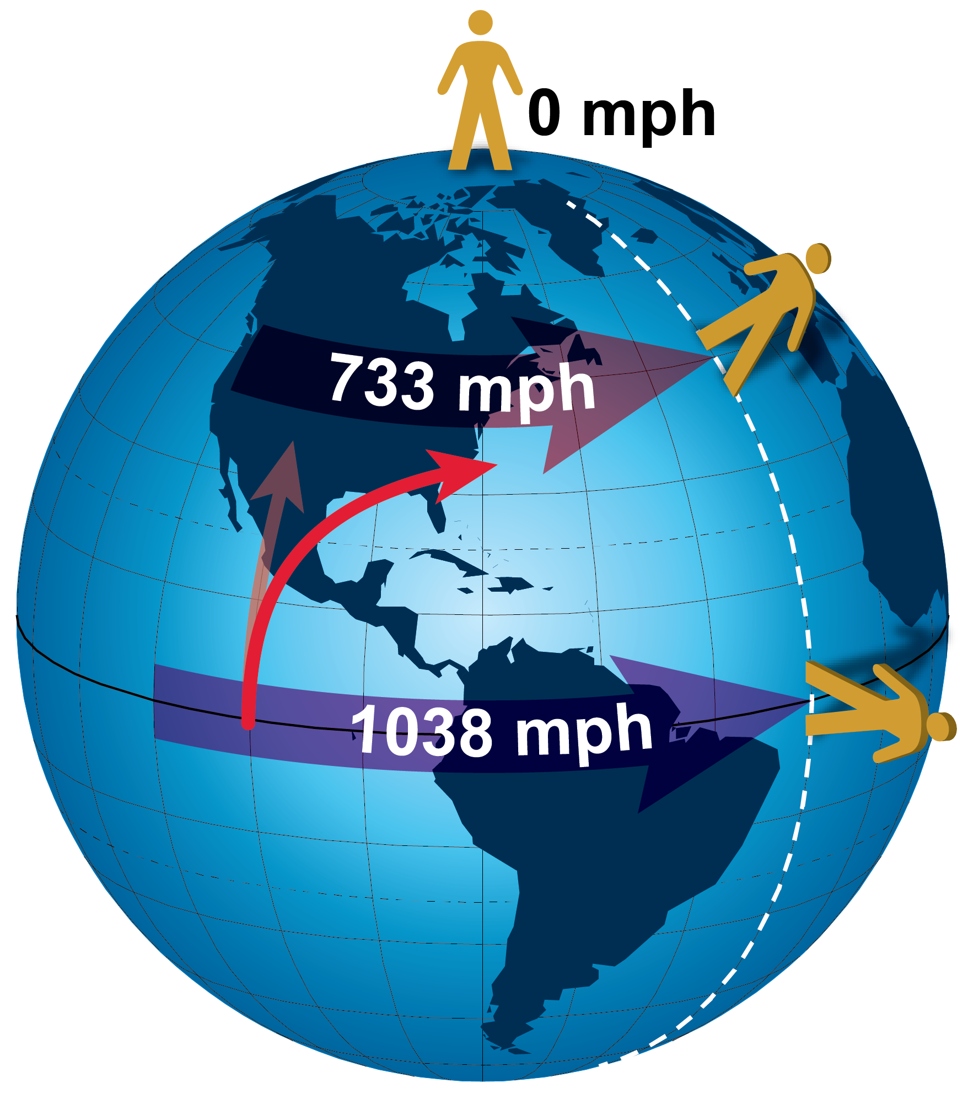
Constant Pressure Charts
Why does the wind flow from west to east?
Notes:
The result is the wind moves faster than the earth rotates so it moves from west to east (relative to us at the surface). The Coriolis effect.

Slide 44
Constant Pressure Charts
Contours are nearly always drawn at 60 m intervals
The closer the contours are to each other the faster the wind speed

Slide 45
Constant Pressure Charts
And the closer the contours are to each other the greater the “change” in weather occurs

Slide 46

Chasing Rabbits #3
Notes:
Chasing Rabbits: Gradients

Slide 47
Chasing Rabbits #3
Absolute values in meteorology are not as important as the “rate of change” in absolute values.
Called “gradient”, the greater the change in a particular value, the more intense the weather.
Notes:
For example: Gusty winds just behind a cold front. The temperature gradient (change in temperature) is greatest immediately behind cold fronts.

Slide 48
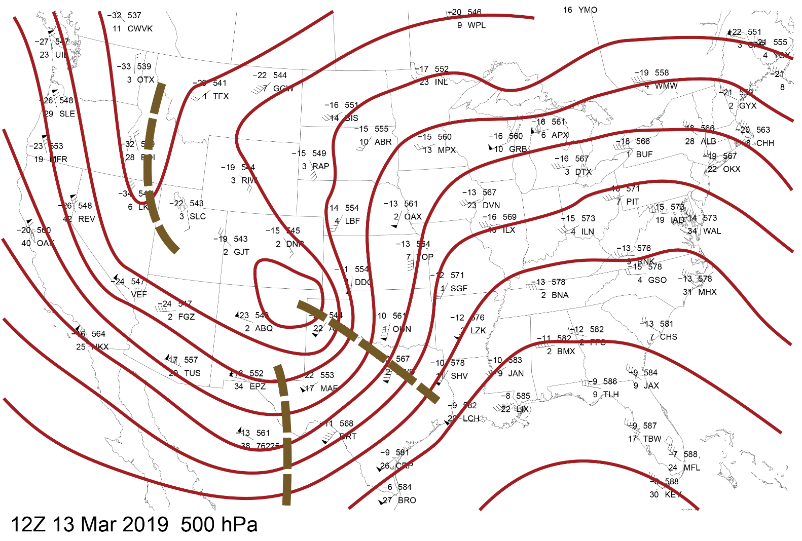
Constant Pressure Charts
Contours that dip toward the equator* are “toughs” of low pressure
Notes:
Asterisk – It is more a change in wind direction that determines if it is a trough or not. Troughs can dip toward the poles if the low pressure are is strong enough.

Slide 49
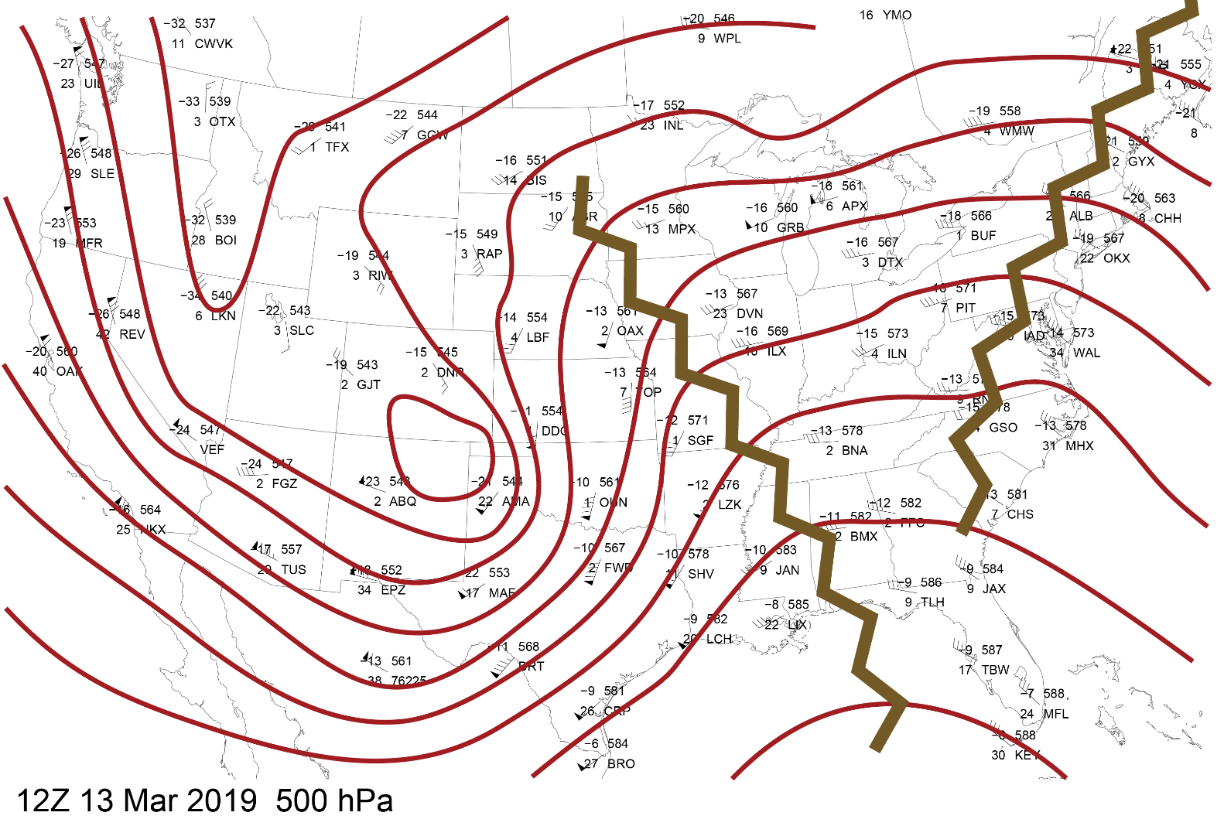
Constant Pressure Charts
Contours which extend toward the poles*
are “ridges” of high pressure
Notes:
Asterisk – Same for ridges of high pressure as well.

Slide 50
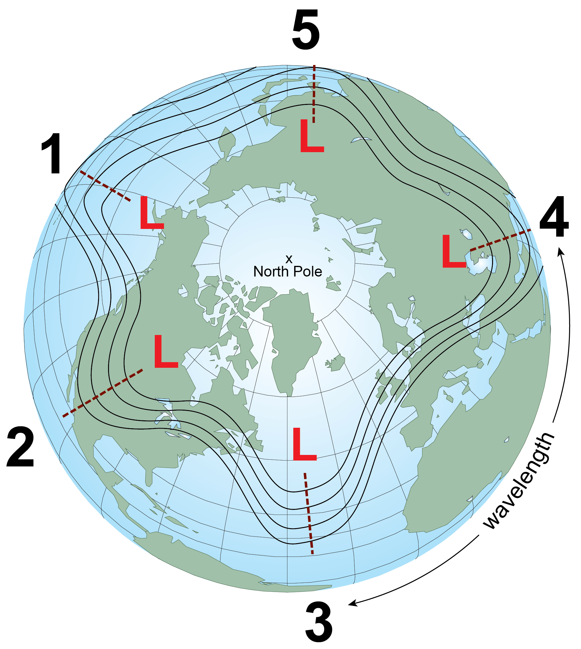
Constant Pressure Charts
Long Waves
Length varies from around 3,700 mi (6,000 km) to 5,000 mi (8,000 km) or more.
Number of waves varies from 3 to 7.
Notes:
Ridges and troughs identify where the waves are located. There are two types: Long Waves and Shorts Waves (we meteorologists didn't want to get too technical on you. :o) )

Slide 51
Constant Pressure Charts
Long Waves
Generally move very slow from west to east.
Occasionally they will become stationary or retrograde (move east to west).
Notes:
The speed at which these large waves move should not to be confused with the speed of the wind found within the waves themselves. For example, there can be a strong jet stream wind of 100 kt (115 mph / 185 km/h) moving through the long wave but the position of long wave itself move may very little. The wave itself is not moving at 100 kt, just the wind within.

Slide 52
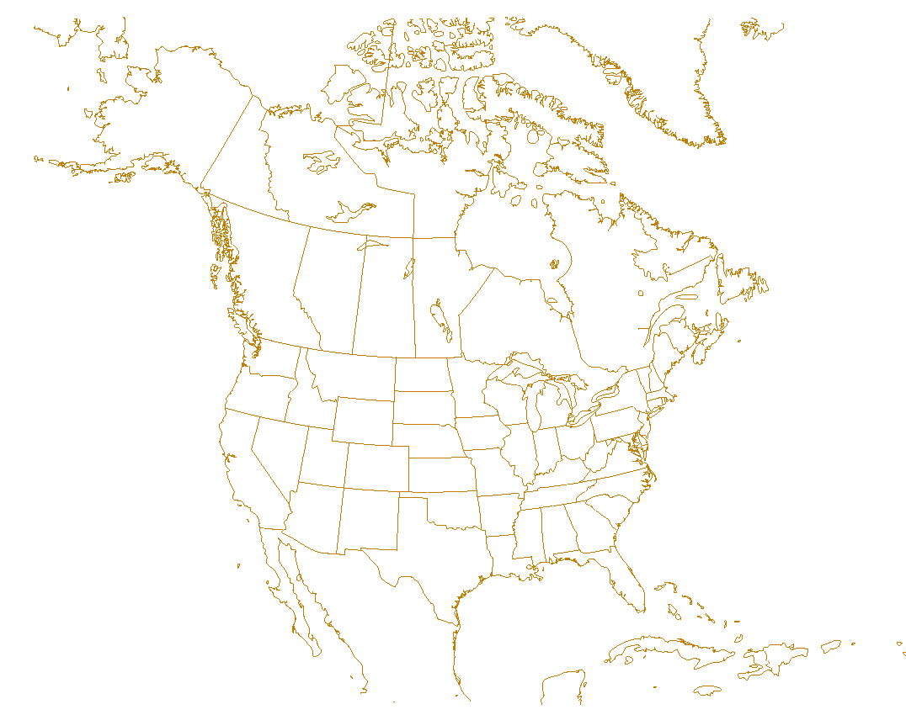
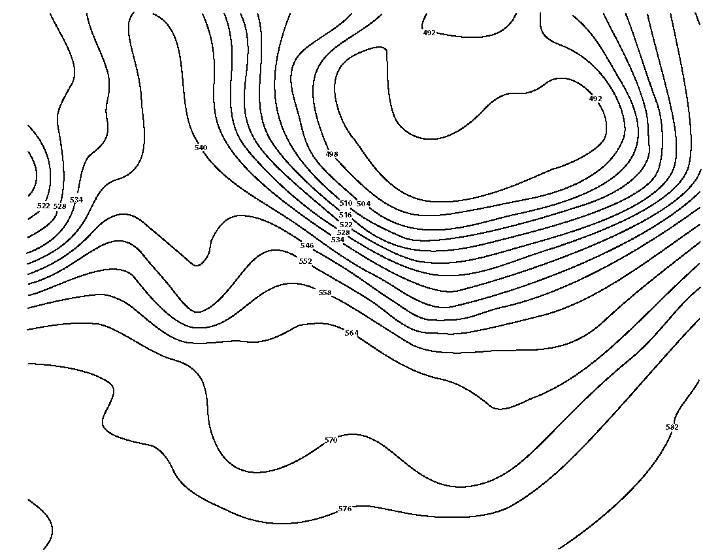
Constant Pressure Charts
Short Waves
Embedded within
the long waves and
move much faster*
and through the
long waves.
Move east (down
stream) on average
of 20 kt (23 mph) in summer and 30 kt
(35 mph) in winter.
Notes:
*Faster is relative.
This motion through the long waves causes the longwave to distort and change shape.

Slide 53
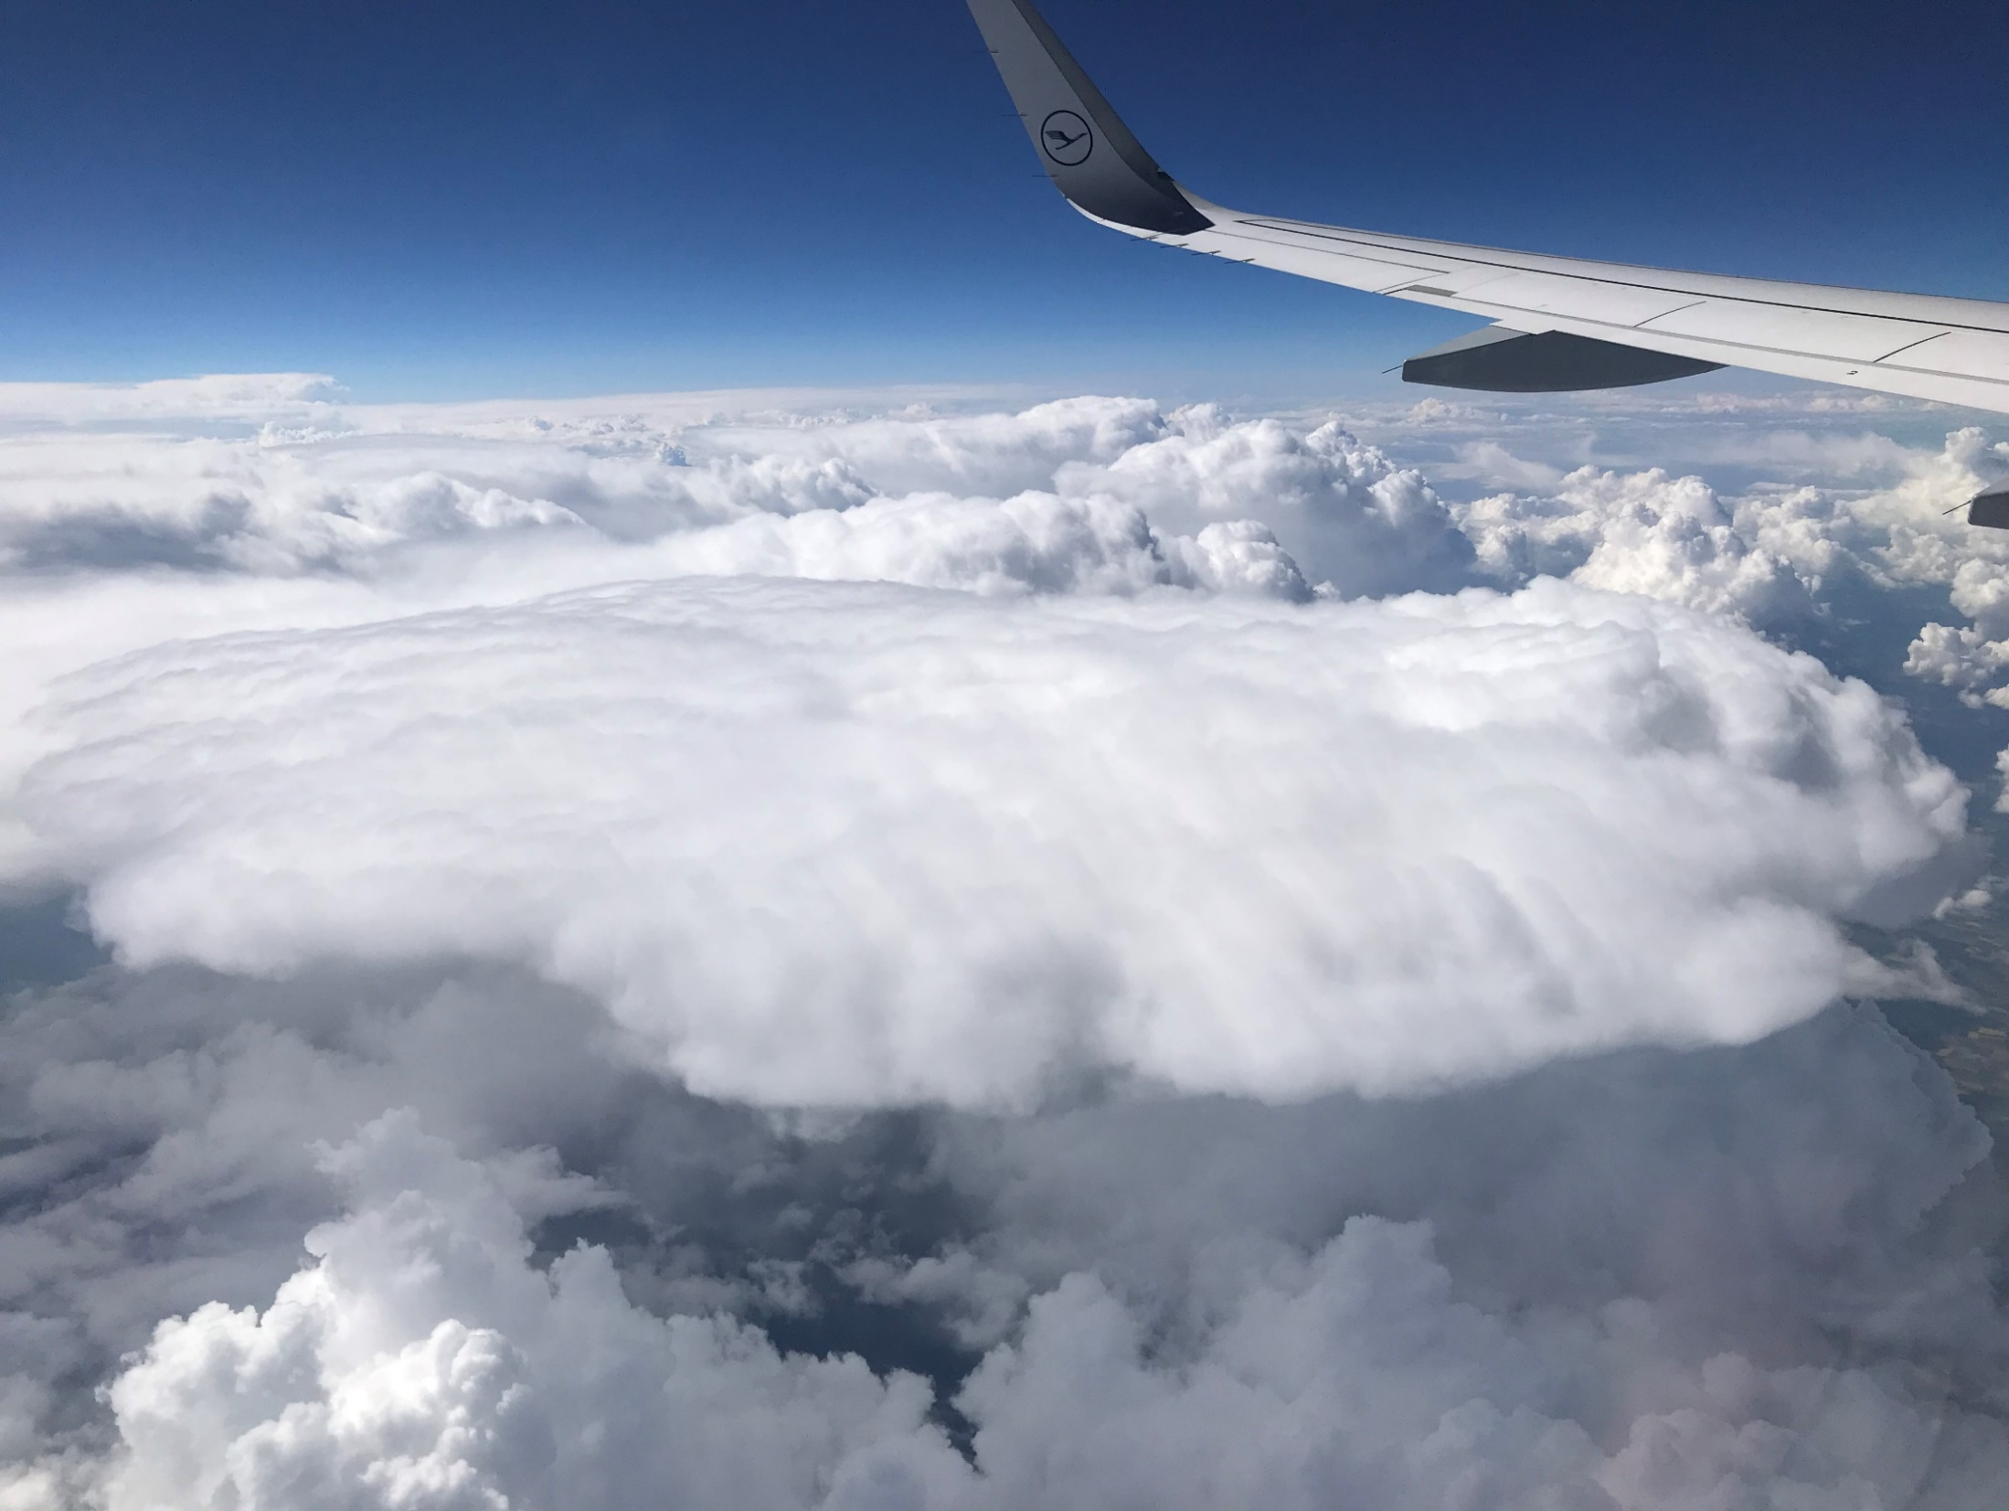
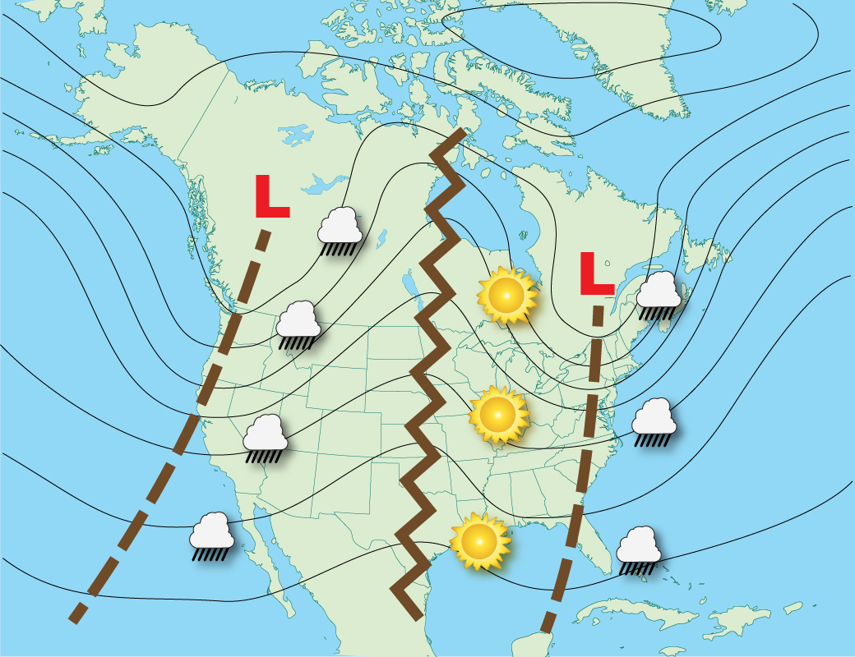
Wave Patterns
Common
Notes:
Unsettled weather typically occurs between the trough and DOWNSTREAM ridge. Fair weather typically occurs between the ridge and DOWNSTREAM trough. The following wave patterns can occur at any point on the globe, not just in the locations depicted.

Slide 54
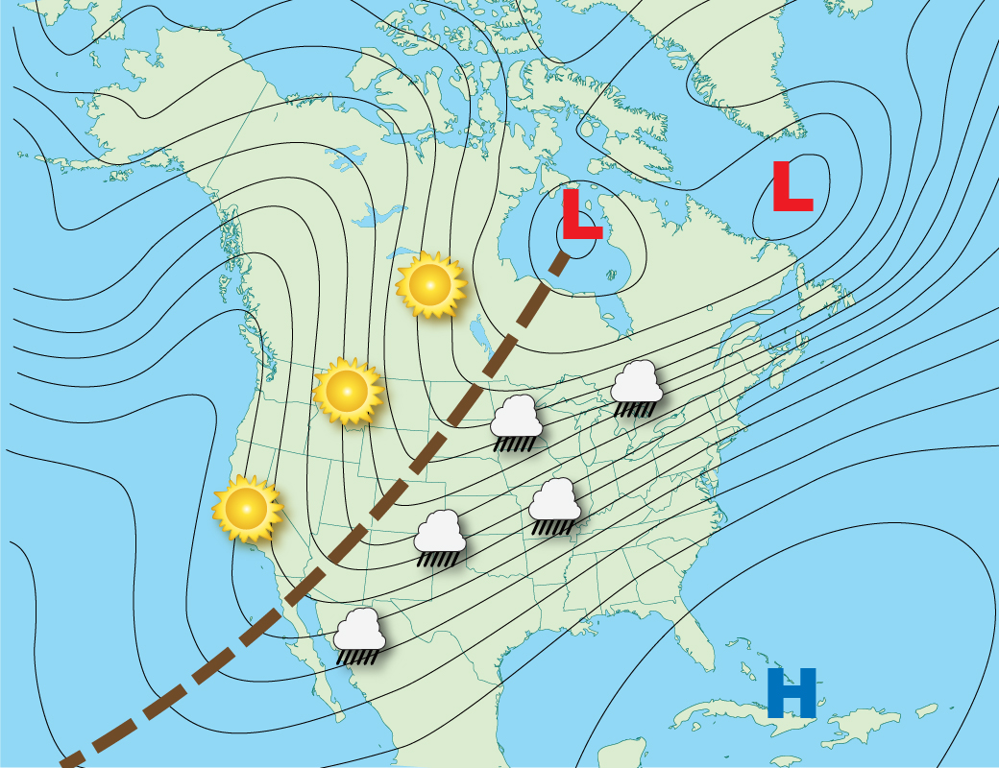
Wave Patterns
Positive Tilt
Notes:
Trough is orientated NE-SW from low pressure. Large area of unsettle weather east of trough.

Slide 55
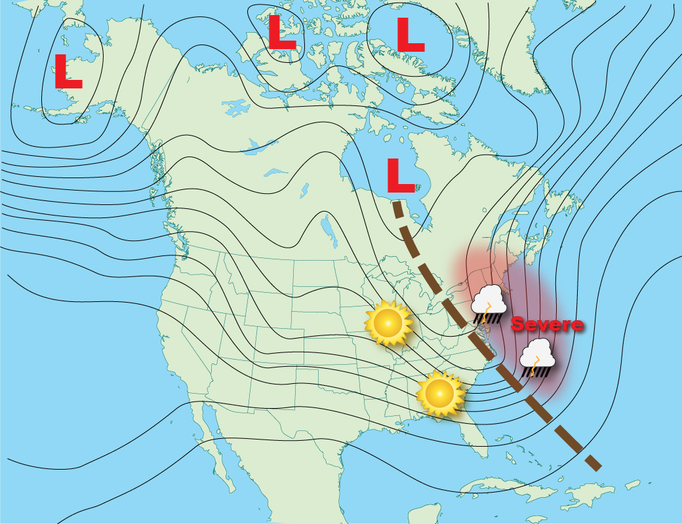
Wave Patterns
Negative Tilt
Notes:
Trough is orientated NW-SE from low pressure. Smaller area of unsettle weather east of trough but produces the most severe weather.

Slide 56
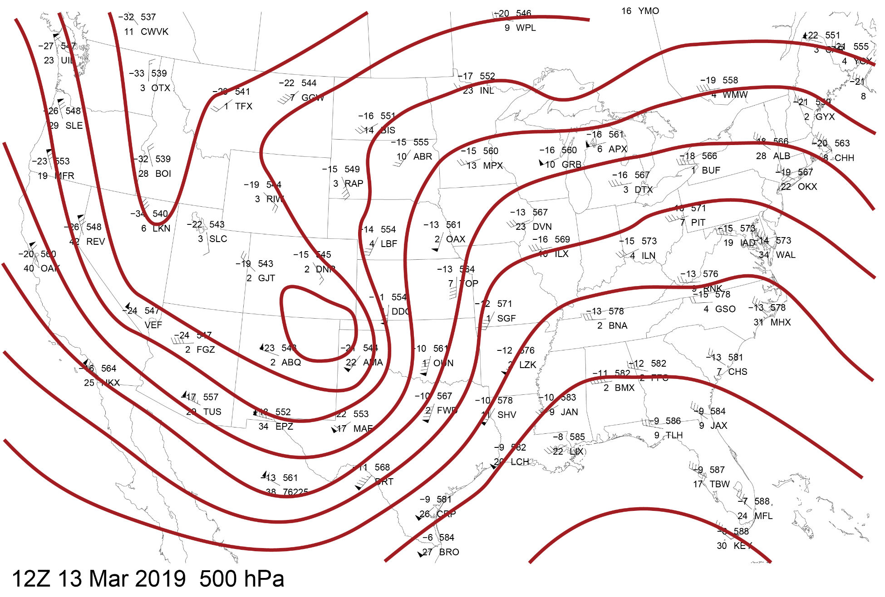
Wave Patterns
Notes:
500 mb constant pressure chart for March 13, 2019. The surface weather produced by this pattern brought wind gusts as high as 96 mph in Colorado and 89 mph in Nebraska.

Slide 57
Wave Patterns
From NASA. https://svs.gsfc.nasa.gov/4171 European jet stream visualization.
Notes:
From NASA. https://svs.gsfc.nasa.gov/4171 European jet stream visualization.

