Slide 1
National Weather Service Diversity Management
Utilizing our differences to change the future!
Notes:
This powerpoint presentation was developed by the Presentation Team which was chartered under the NWS Diversity Marketing Team. Team Leaders – Jose Garcia, Gena Morrison, Steve Kuhl. Team members – John Haase, Joe Arellano, Gina Tillis-Nash, Kristin Scotten, Jennifer Stark. The team’s charter was the development of a presentation which could be utilized by managers and diversity focals to present to their offices or work units. The presentation is intended to facilitate healthy dialog and conversation about diversity and diversity issues throughout the NWS. Presenters are encouraged to utilize and adapt this presentation to their local office and work units.

Slide 2
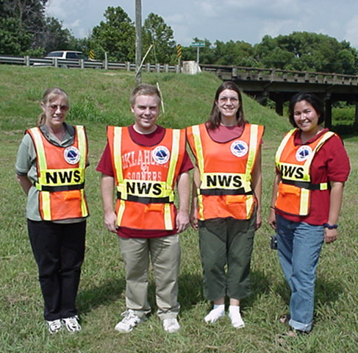
Intended Audience & Customers
All NWS employees
Management
Forecasters
Administrative
Technicians
Researchers
Students
Contractors
Volunteers
The communities, partners
and customers that we serve
Notes:
We must improve diversity management knowledge throughout the organization, including every NWS employee, SCEP/STEP students, contractors and student volunteers.

Slide 3
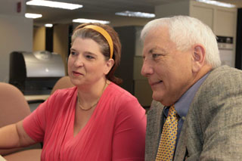
Part 3 - The Role of Office Position in Diversity
Notes:
The next several slides deal with the way we perceive the roles of office staff based on their title or position description.
In reality, our individual expertise, interests, experience and skills will often cross over to other specialties. Role of office position will vary by office and by the individual. Recognizing our differences despite being labeled or assigned to a specific role in the office will enhance our agencies ability to meet the change needs and demands of our customers in the future. Effective management of the diversity of our workforce will enable our agency to grow, change and adapt.

Slide 4
Roles of HMTs, Meteorologists, Hydrologists, Electronics and Information Technology staff and ASAs can vary from office to office and vary based on the talents and skills of the individuals in these roles.
Notes:
If you’ve worked in more than one office in the NWS in your career, you are likely to recognize that this is true. If you are new to the agency or have remained in one office, you may not recognize that many staff are cross utilized based on their experience, interests and skills. How many offices pull the ASA or SH into the ops area during a severe weather event? How many HMTs work with cooperative observers?

Slide 5
The traditional roles of staff have changed since modernization of the National Weather Service. Many staff members are cross trained or able to work in many different positions.
Notes:
Rather than focusing on the acronym that identifies a workgroup or position, it may help to recognize each individual in your office for the unique abilities and strengths they bring to the job.

Slide 6
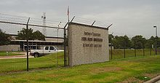
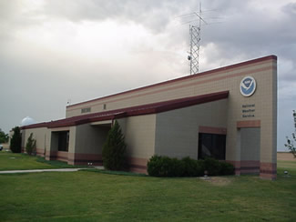
Many employees of the National Weather Service do not work in field offices. They staff regional and national headquarters offices, national centers, and CWSUs. Just by the nature of our agency, diversity is one of our greatest strengths.
Notes:
We are diversified in our locations, our expertise, and our abilities. We are a diverse agency that works for a wide range of customers and partners.

Slide 7
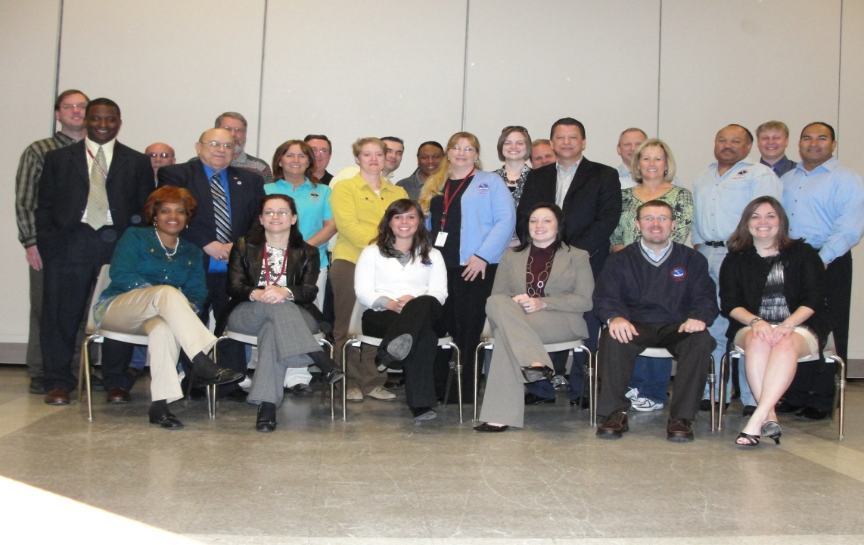
One of the benefits of working for the National Weather Service is the opportunity for individuals to develop and enhance their areas of individualized expertise. The ability to develop individualized expertise aids in job fulfillment and satisfaction. It may also help our agency to recruit and retain future employees.
Notes:
Perhaps one of the greatest strengths of our agency is the freedom for employees to work in areas that they derive satisfaction from. Staff may be granted opportunities or create their own opportunities to enhance skills through training, research or mentorships.
As our agency looks to the future, how do we ensure that we continue to attract the best and brightest into our workforce. Once they are in the workforce, how do we ensure that they stay with the agency. The business case for Diversity Management shows that employees experience a greater job satisfaction and are less likely to look elsewhere for employment if they are valued for their unique skills, creativity and are empowered to make a difference in their position.

Slide 8
So …What Does All this Mean for Me and the NWS?
Diversity is a fact of life.
Diversity is the reality for a business strategy that will make the NWS more effective.
Diversity enables everyone to perform to potential.
Diversity of thought equals world class results from each person and collective mix of teams.
Diversity in teams results in more creativity and problem-solving meaning better customer service.
Bottom Line-Greater Innovation and Productivity
Notes:
Diversity is a reality that is interwoven into the very fabric of our daily lives. It is not simply a concept or policy. Diversity is a key to the future success of the National Weather Service and we must embrace the value of diversity in order to effectively compete in a worldwide arena. Diversity is critical to the achievement of the NWS mission. Diversity empowers everyone to reach their full potential and removes barriers. It allows us to take advantage of the diversity of thought and ideas that comes from the diversity of experiences, background, and skills. Effective diversity management results in improved individual and overall NWS performance. This is due to the effectiveness of diversity on problem-solving, decision-making, innovation, and creativity.

Slide 9
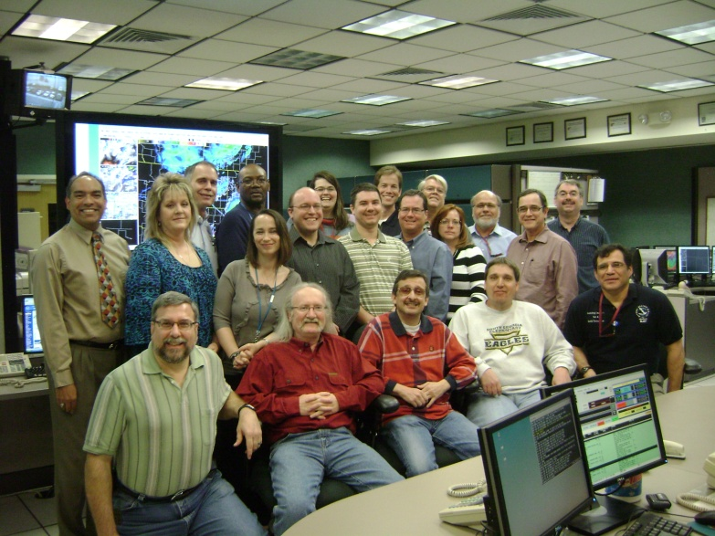
A diverse workforce is not something your NWS office or workgroup ought to have; it’s something your office already has.
The Reality …
Notes:
Simply look around the room and you can see we now have a diverse workforce. However, having a diverse workforce does not, in itself, translate to bottom line benefits for the NWS. Diversity must be managed in order for the NWS to reap the benefits of a diverse work force.

Slide 10
Doesn’t start with learning information about others so you won’t offend them… it starts with you learning to manage YOUR OWN STUFF!
Diversity Management
Notes:
A common tendency in human interaction is that of social categorization. Simply put, people often like to put other people into easily understood pigeonholes. Learning to manage diversity is not you trying to learn about someone else’s generational or culture strengths or weaknesses, race or ethnic beliefs, so that you won’t do or say things that may offend them. Diversity management must start with your own self-assessment and understanding of your perceptions, which sometimes are your truth but not necessarily the real truth. Sometimes you have to take another look at what you think you know.

Slide 11
Diversity Management – Am I Responsible?
Yes, diversity management has to be a personal responsibility.
Each and every one of us plays a significant role.
Managing diversity is no longer a choice; it is a responsibility that requires everyone’s full support and commitment.
Notes:
Every NWS employee, from an intern to the director, is personally responsible to manage diversity within their own NWS workplace and teams. The failure to manage diversity by even one person within an office or team can have dire consequences for the entire workplace. So it takes everyone’s full support and commitment toward effectively managing diversity with emphasis on what we do with diversity rather than getting diversity. Valuing diversity in all aspects of NWS operations should be a top priority.

Slide 12
Making this work for your NWS office
Important Step!
Understand and respect individual differences:
Keep an open mind toward others who are different from you. Remember that not everyone sees things the same way you do.
Notes:
The workplace will be more harmonious when we all strive to understand each other’s frame of reference and values. By being open to trying new things or doing them differently, we may find more effective ways to manage and co-exist in our NWS workplaces.

Slide 13
Keys to Effective Diversity Management
While valuing diversity is a philosophy, effectively managing diversity is a vast resource and a skill requiring knowledge, sensitivity, patience, flexibility, and training.
Building an inclusive diversity program for all employees involves mentoring, networking, and sponsorship.
Notes:
We must evaluate our cultures and determine what needs to change. Managers need to assess their own readiness to value and embrace differences. Assessments can start by examining historical misconceptions about employee diversity such as otherness is seen as a deficiency, others want to become and should become more like the dominant group, equal treatment means the same treatment, and managing diversity requires changing the people, not the culture. Mentoring, networking, and sponsorship strategies will help the NWS build an inclusive diversity program for all employees. Mentoring provides guidance, sharing of information, and nurturing for personal, career development, and professional growth which are essential to help individual employees overcome workplace challenges and barriers. Networking helps individuals acquire significant exposure that may benefit their career progression. This could be done by making contact one on one or in groups at meetings, conferences, and other critical forums. Sponsorship involves ensuring that individuals get the support and visibility needed to acquire the right opportunities to improve job and career competencies. Sponsorship perhaps more than mentoring and networking can provide opportunities for advancement by providing the individual with visible connections to key organizational stakeholders and power brokers.

Slide 14
Impact of Management on Diverse Team Performance
Well Managed Diverse Teams
Trained
Poorly Managed Diverse Teams
Conflict
Communication Skills
Value Differences
Constructive Conflict
Team Identity
Poor Communication
In-group/out-group Behavior
Isolation
Creativity
Job Satisfaction
High Productivity
Quality Outcomes
New Products & Services
High Turnover
Low Productivity
Poor Solutions
Low Job Satisfaction
Poor Attitude Toward Diversity
Notes:
Managing diversity does not mean trying to control or contain diversity, it means to enable every staff member in a team to perform to their fullest potential. Diversity Management of teams needs to focus on managing the differences within a team, capitalizing on the benefits of the diversity within teams, and also minimizing the workplaces challenges. Effective management of diverse teams will have substantial payoffs. Poorly managed diverse teams will experience difficulties in communication and unproductive conflict. In contrast, well managed diverse teams will overcome communication difficulties and result in creative and high quality productivity.

Slide 15
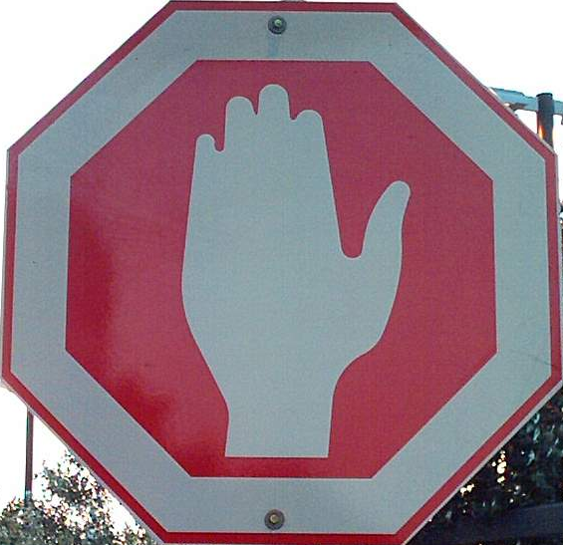
Quebec: french
Colombia: spanish
DISCUSSION TIME
israel
China
InuKtitut
japan
Notes:
This is an opportunity to check in with your audience. They may have questions, comments or ideas for managing diversity.

Slide 16
The Cold Within
Six humans trapped by happenstance In bleak and bitter cold Each one possessed a stick of wood, Or so the story's told. Their dying fire in need of logs, The first woman held hers back, For on the faces 'round the fire, She noticed one was Black. The next man looking 'cross the way Saw one not of his church, And couldn't bring himself to give The fire his stick of birch.
Notes:
This poem can be utilized to stimulate discussion on Diversity and diversity issues. The following questions may help stimulate thought and discussion. Describe how this story made you feel. What surprised you about the characters in this story? What assumption did each of the characters make about the others around the fire? What do you feel contributed to each person’s decision not to share his or her log of wood? Have you ever shared any of the thoughts or beliefs of the six characters? Would you have hesitated to share your stick of wood?
Explain the last verse. What impact does this verse have on the way you view others?

Slide 17
The Cold Within
The third one sat in tattered clothes He gave his coat a hitch, Why should his log be put to use To warm the idle rich? The rich man just sat back and thought Of the wealth he had in store, And how to keep what he had earned From the lazy, shiftless poor. The black man's face bespoke revenge As the fire passed from sight, For all he saw in his stick of wood Was a chance to spite the white.
Notes:
The Cold Within

Slide 18
The Cold Within
And the last man of this forlorn group Did naught except for gain, Giving only to those who gave Was how he played the game. The logs held tight in death's still hands Was proof of human sin. They didn't die from the cold without, They died from the cold within. *- George Kirby*
Notes:
The Cold Within

