Slide 1

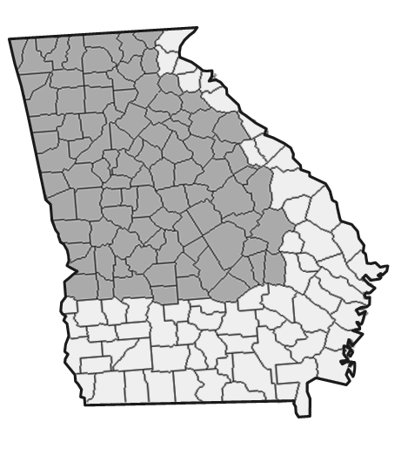
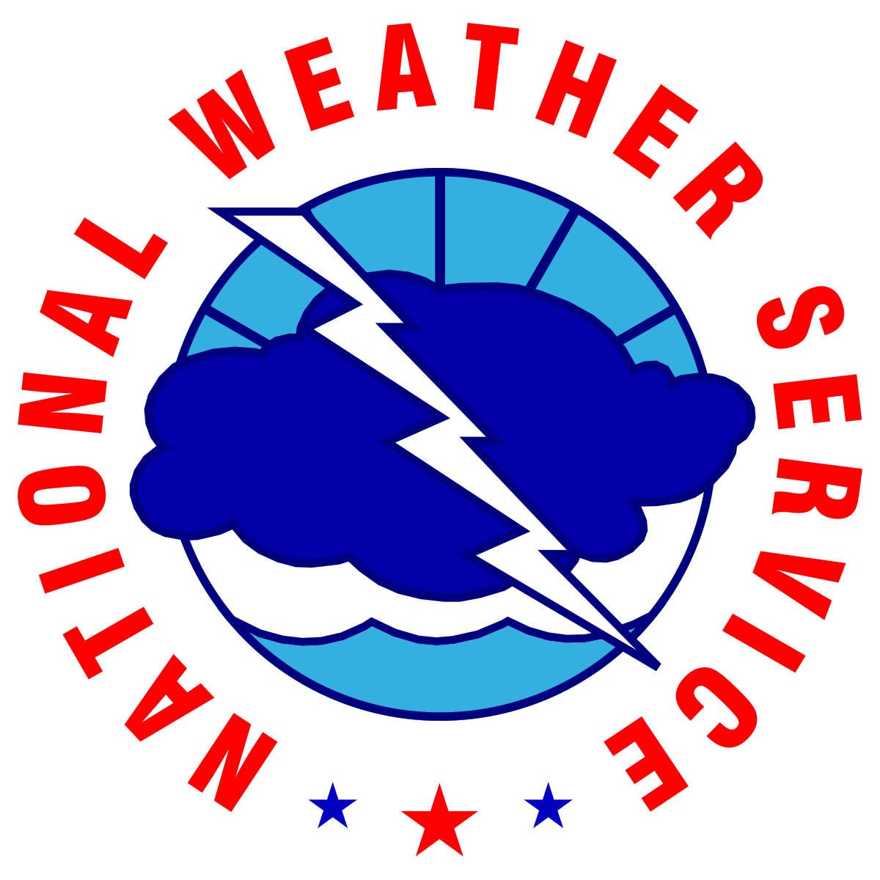


Routine Weekly Weather Briefing
For North and Central Georgia
Thursday, May 28th, 2026 Valid through next Thursday (June 4th)
Led by: Dylan Lusk - NWS Atlanta
Disclaimer: The information contained in this briefing is time sensitive and this should be taken into consideration while viewing.
‹#›
NATIONAL WEATHER SERVICE ATLANTA
weather.gov/Atlanta
Follow:
@NWSAtlanta
Updated: Thu May 28, 2026 1:50 PM

Slide 2

Key Messages and Hazard Outlook
Key Messages
Scattered showers and thunderstorms expected today with chances increasing into the weekend.
Locally heavy rainfall remains the primary concern - widespread severe not expected.
Cooler to start next week. Shower and thunderstorm chances continue.
Saturday
Monday
v
Today
Friday
Sunday
Tuesday
Wednesday
Scattered showers and storms
Scattered showers and storms
Widespread showers and storms
Cooler. Scattered showers and storms
Scattered showers and storms
Scattered showers and storms along and south of I-85
Isolated showers and storms in central GA
Risk Levels → |  | Low | Moderate | High | Extreme
‹#›
NATIONAL WEATHER SERVICE ATLANTA
weather.gov/Atlanta
Follow:
@NWSAtlanta
Updated: Thu May 28, 2026 1:50 PM

Slide 3
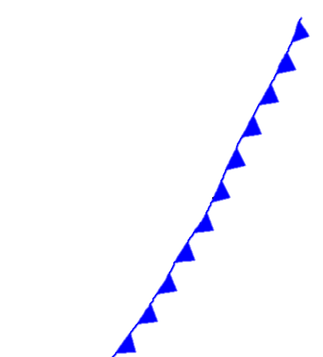


7 Day Outlook - North and Central Georgia
Today
Friday
Saturday
Sunday
Monday
Tuesday
Wednesday
Scattered Showers and Thunderstorms
Scattered Showers and Thunderstorms
Rain and Thunderstorms
Cooler. Scattered Showers and Storms
Scattered Showers and Thunderstorms
Isolated Showers and Thunderstorms Along and S of I-85
Isolated Showers and Thunderstorms Central GA
Highs:
80 to 88°F
Lows:
64 to 70°F
Highs:
78 to 85°F
Lows:
63 to 70°F
Highs:
76 to 85°F
Lows:
62 to 68°F
Highs:
68 to 80°F
Lows:
58 to 66°F
Highs:
73 to 82°F
Lows:
57 to 67°F
Highs:
75 to 85°F
Lows:
57 to 67°F
Highs:
73 to 83°F
Lows:
54 to 67°F
Scattered showers and thunderstorms expected today with chances increasing into the weekend.
Locally heavy rainfall remains the primary concern - widespread severe not expected.
Cooler to start next week. Shower and thunderstorm chances continue.
Weather Highlights
‹#›
NATIONAL WEATHER SERVICE ATLANTA
weather.gov/Atlanta
Follow:
@NWSAtlanta
Updated: Thu May 28, 2026 1:50 PM

Slide 4
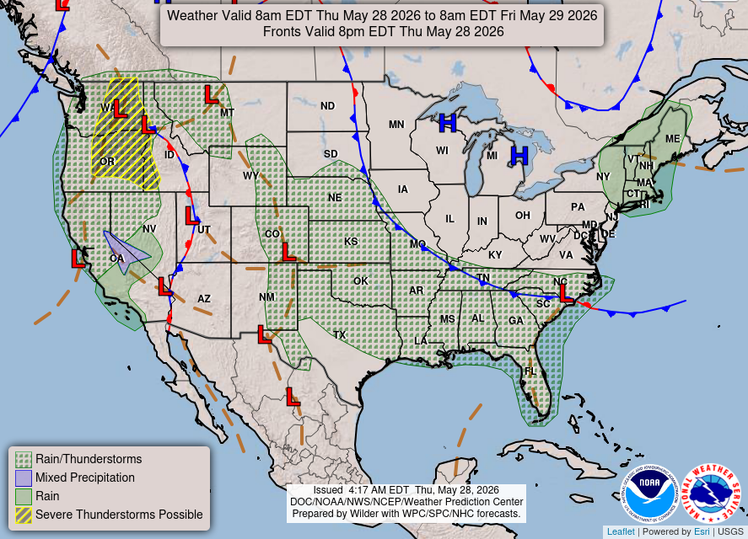
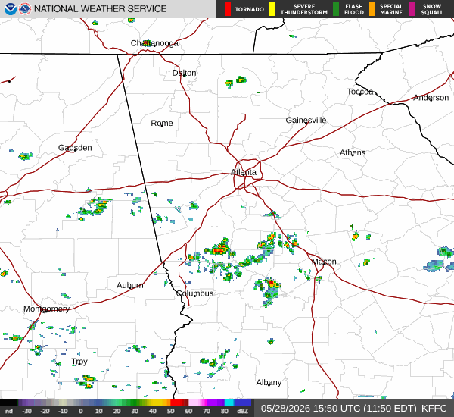
Current Weather Conditions
Some morning showers will give way to scattered afternoon and evening thunderstorms.
‹#›
NATIONAL WEATHER SERVICE ATLANTA
weather.gov/Atlanta
Follow:
@NWSAtlanta
Updated: Thu May 28, 2026 1:50 PM

Slide 5
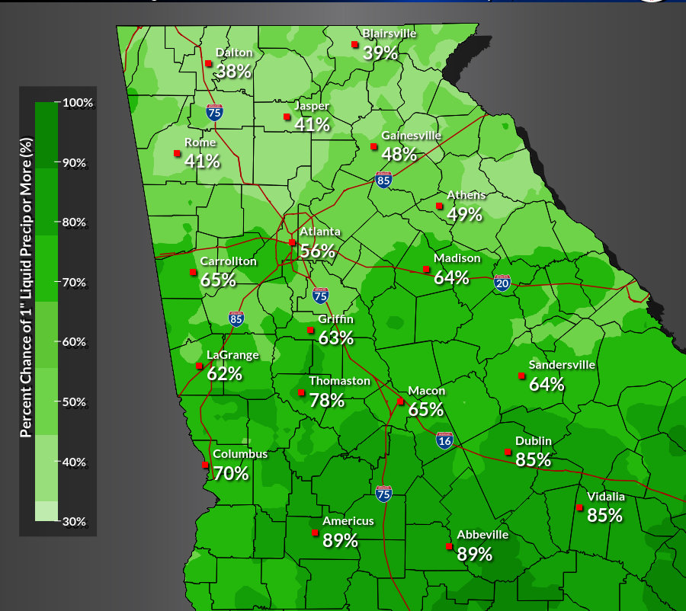

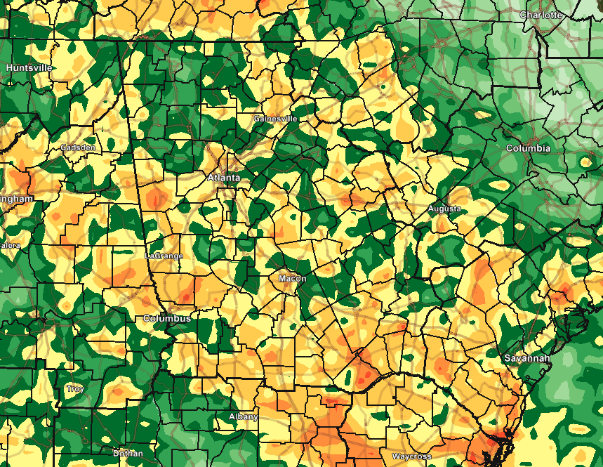
May 28, 2026
Stalled Frontal Boundary
1:50 PM EDT
Probability of Getting at Least 1” of Rain Through Sunday Morning
Key Messages:
Enhanced rainfall will likely occur along a stalled frontal boundary Friday evening into Saturday
90th percentile (Worst Case Scenario) shows the possibility of areas receiving 3-5+” of rain as thunderstorms move slowly over the area
90th Percentile (Worst Case Scenario) Through Saturday Morning
‹#›
National Weather Service
NATIONAL WEATHER SERVICE ATLANTA
weather.gov/Atlanta
National Weather Service
Follow:
@NWSAtlanta
Updated: Thu May 28, 2026 1:50 PM
Atlanta / Peachtree City, GA

Slide 6
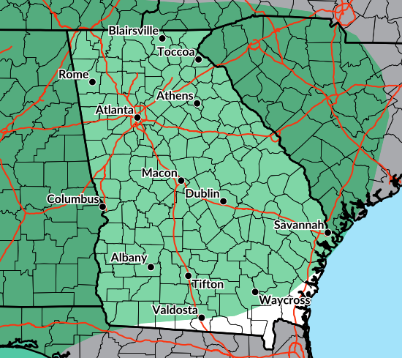
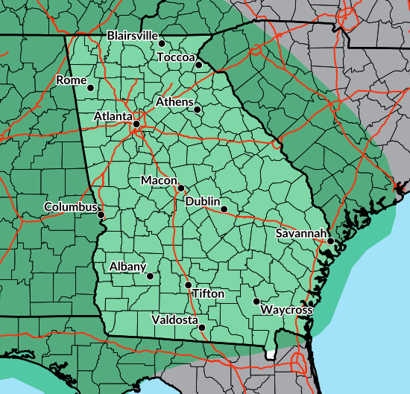
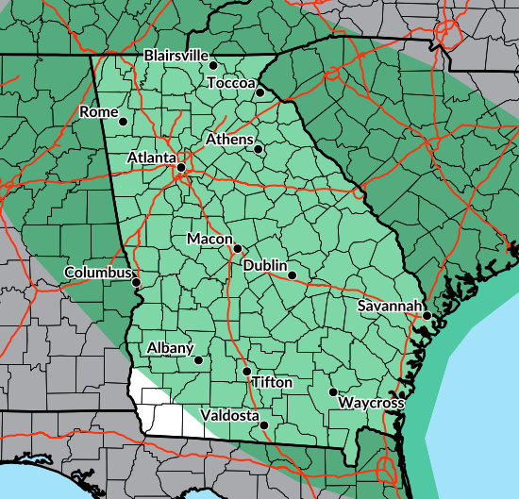
May 28, 2026
Flash Flooding Potential
1:50 PM EDT
Day 1 (Thursday) ERO
Key Messages:
Current Flash Flood Risk is Marginal (Level 1 out of 4)
Monitoring Friday for potential upgrade to Slight Risk (Level 2 out of 4) for potential heavy rainfall Friday Night into early Saturday
Day 2 (Friday) ERO
Day 3 (Saturday) ERO
Forecast Confidence:
Day 1
Parts of this area may be upgraded to a Slight Risk (Level 2 out of 4) later this afternoon
Low | Medium | High
Day 2
Low | Medium | High
Day 3
Flash Flooding Threat Level | 1 | 2 | 3 | 4
Low | Medium | High
‹#›
National Weather Service
NATIONAL WEATHER SERVICE ATLANTA
weather.gov/Atlanta
National Weather Service
Follow:
@NWSAtlanta
Updated: Thu May 28, 2026 1:50 PM
Atlanta / Peachtree City, GA

Slide 7
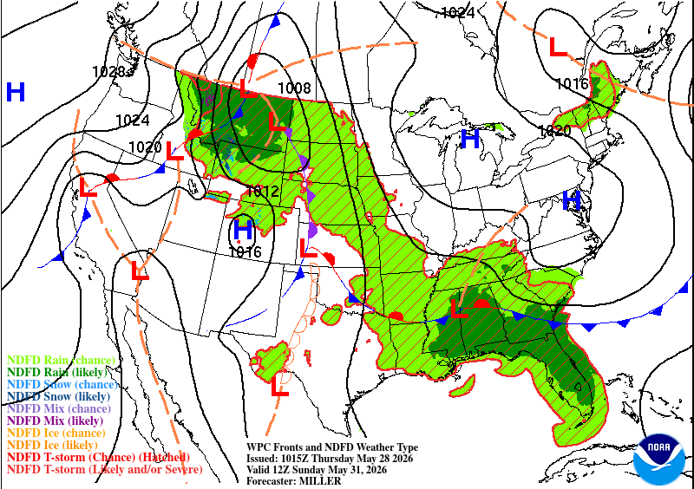
Backdoor Cold Front (The Wedge) on Sunday
Weather system bringing a front through the Northeast will allow high pressure to set up over the northern Appalachian mountains
Classic setup to bring cooler air down through the Piedmont and into north and parts of central Georgia
Highs on Sunday may only be in the 60s and 70s across much of the area
‹#›
NATIONAL WEATHER SERVICE ATLANTA
weather.gov/Atlanta
Follow:
@NWSAtlanta
Updated: Thu May 28, 2026 1:50 PM

Slide 8
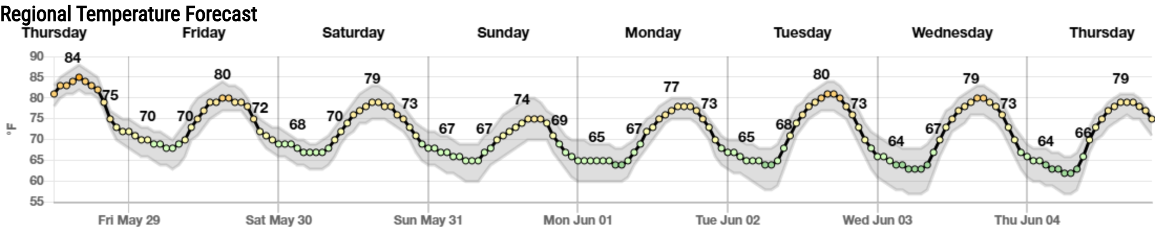
Temperatures for the next 7 Days
Slight cooling trend into weekend with cloud cover and rain chances increasing
Backdoor front moves through the area Saturday into Sunday bringing cooler air - highs in north Georgia may only reach the into 60s in some locations
Slow warming trend to begin next week
‹#›
NATIONAL WEATHER SERVICE ATLANTA
weather.gov/Atlanta
Follow:
@NWSAtlanta
Updated: Thu May 28, 2026 1:50 PM

Slide 9
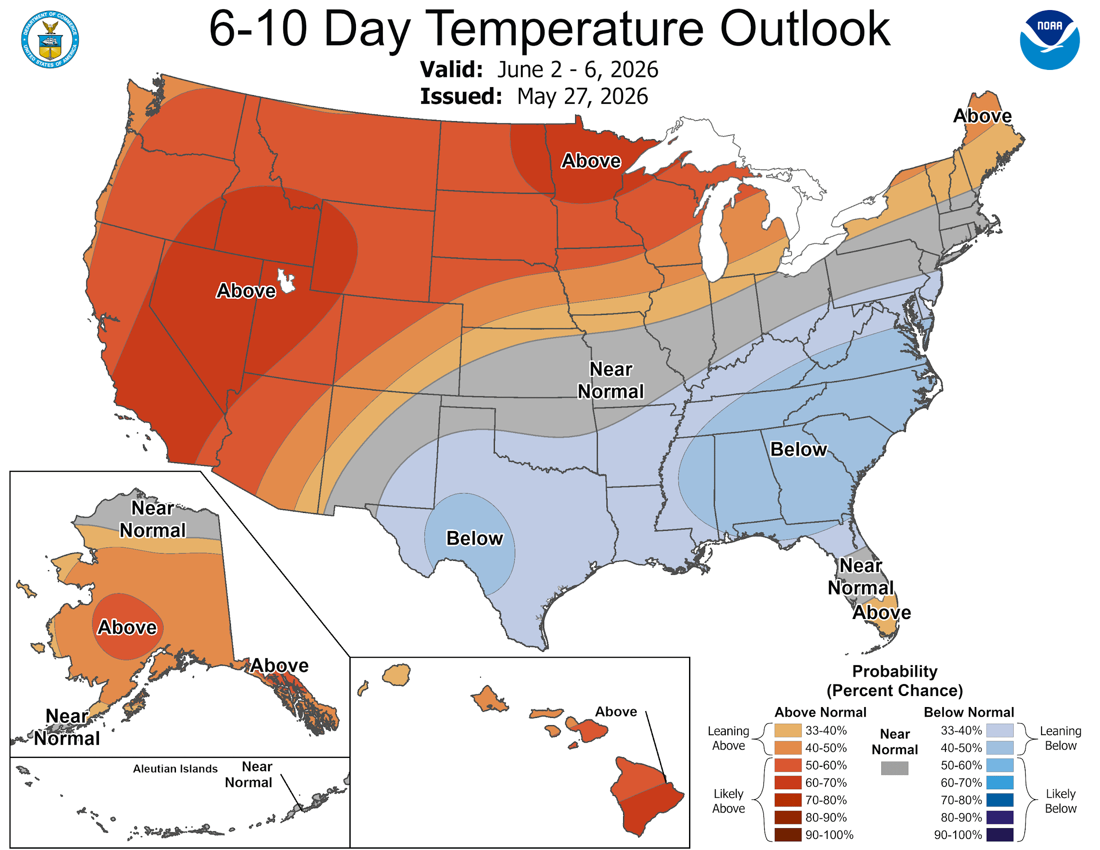
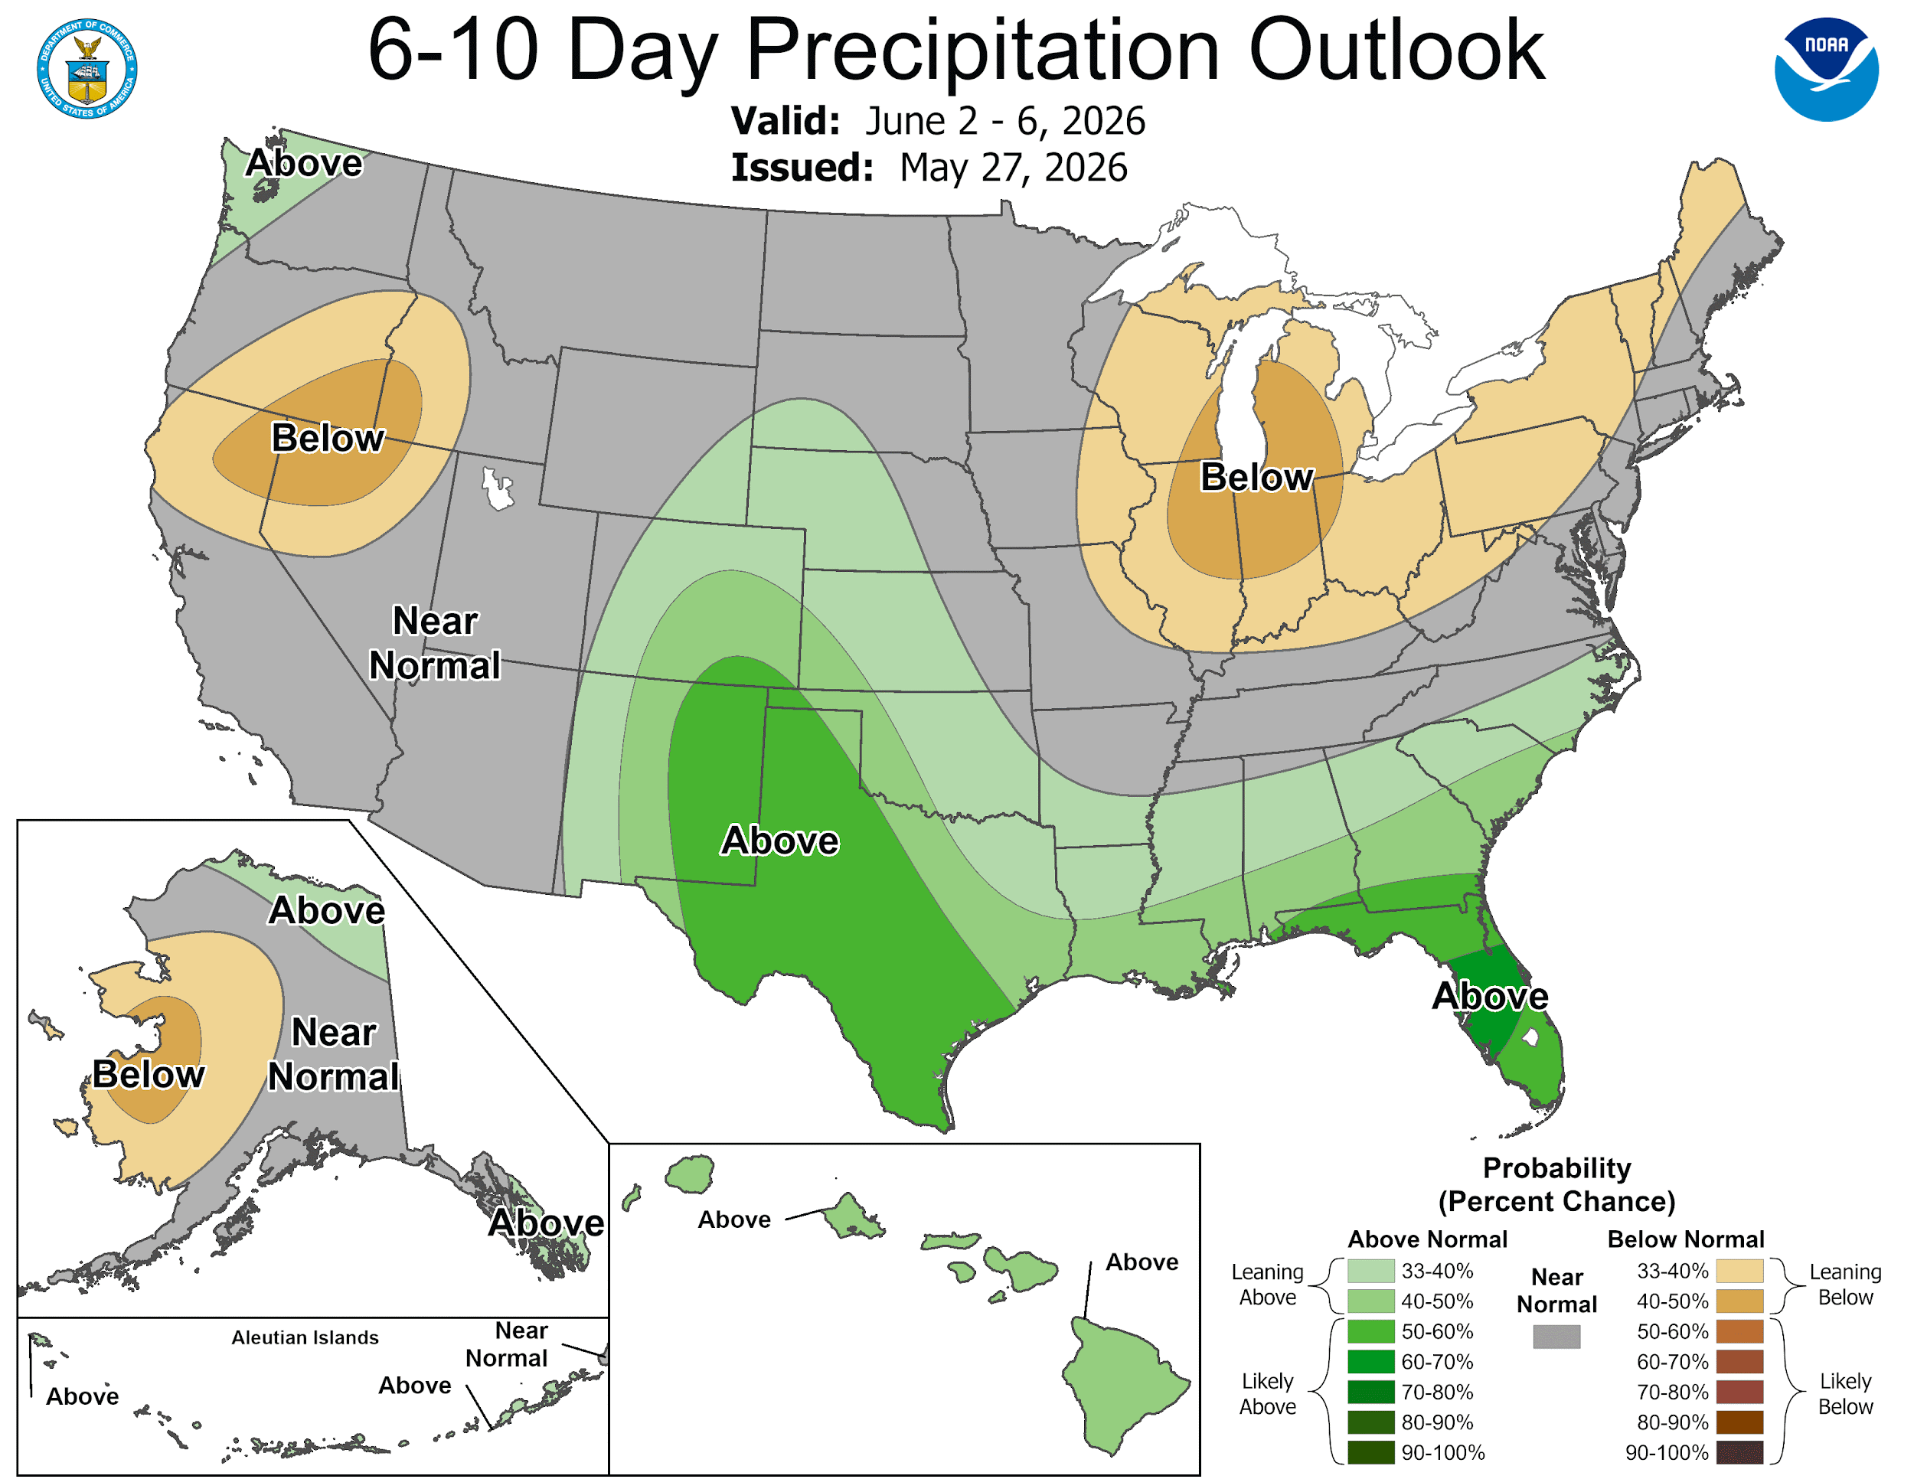
Looking ahead: June 2nd-6th, 2026
Temperatures – Leaning Below Normal
Precipitation – Leaning Above Average
‹#›
NATIONAL WEATHER SERVICE ATLANTA
weather.gov/Atlanta
Follow:
@NWSAtlanta
Updated: Thu May 28, 2026 1:50 PM

Slide 10
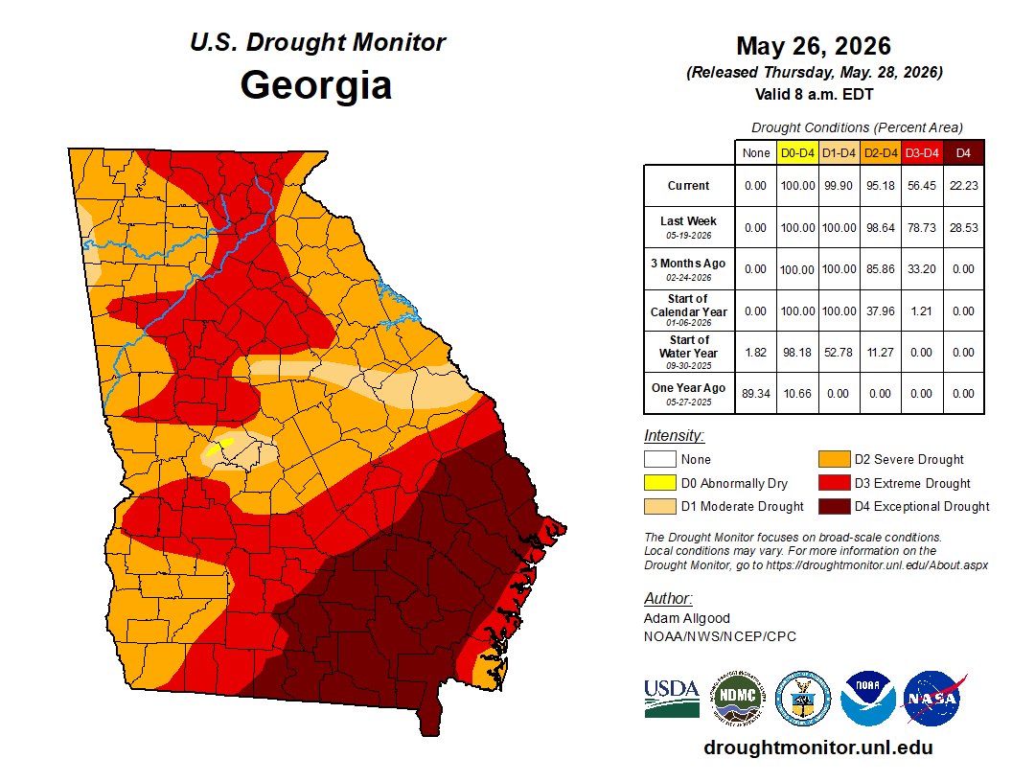
Drought Continues Despite Recent Rain
The latest Drought Monitor shows nearly all of the state under at least D1 (Moderate) to D4 (Exceptional) Drought.
D4 (Exceptional Drought) conditions continue across south & portions of central Georgia.
Recent rainfall has provided some relief with D3 (Extreme) shrinking across north and central Georgia
Will take weeks to months of sustained average to above average rainfall for complete removal
Latest Drought Information Statement (out later today): https://www.weather.gov/ffc/drought
‹#›
NATIONAL WEATHER SERVICE ATLANTA
weather.gov/Atlanta
Follow:
@NWSAtlanta
Updated: Thu May 28, 2026 1:50 PM

Slide 11
7 Day Outlook - North and Central Georgia
Today
Friday
Saturday
Sunday
Monday
Tuesday
Wednesday
Scattered Showers and Thunderstorms
Scattered Showers and Thunderstorms
Rain and Thunderstorms
Cooler. Scattered Showers and Storms
Scattered Showers and Thunderstorms
Isolated Showers and Thunderstorms Along and S of I-85
Isolated Showers and Thunderstorms Central GA
Highs:
80 to 88°F
Lows:
64 to 70°F
Highs:
78 to 85°F
Lows:
63 to 70°F
Highs:
76 to 85°F
Lows:
62 to 68°F
Highs:
68 to 80°F
Lows:
58 to 66°F
Highs:
73 to 82°F
Lows:
57 to 67°F
Highs:
75 to 85°F
Lows:
57 to 67°F
Highs:
73 to 83°F
Lows:
54 to 67°F
Scattered showers and thunderstorms expected today with chances increasing into the weekend.
Locally heavy rainfall remains the primary concern - widespread severe not expected.
Cooler to start next week. Shower and thunderstorm chances continue.
Weather Highlights
‹#›
NATIONAL WEATHER SERVICE ATLANTA
weather.gov/Atlanta
Follow:
@NWSAtlanta
Updated: Thu May 28, 2026 1:50 PM

Slide 12

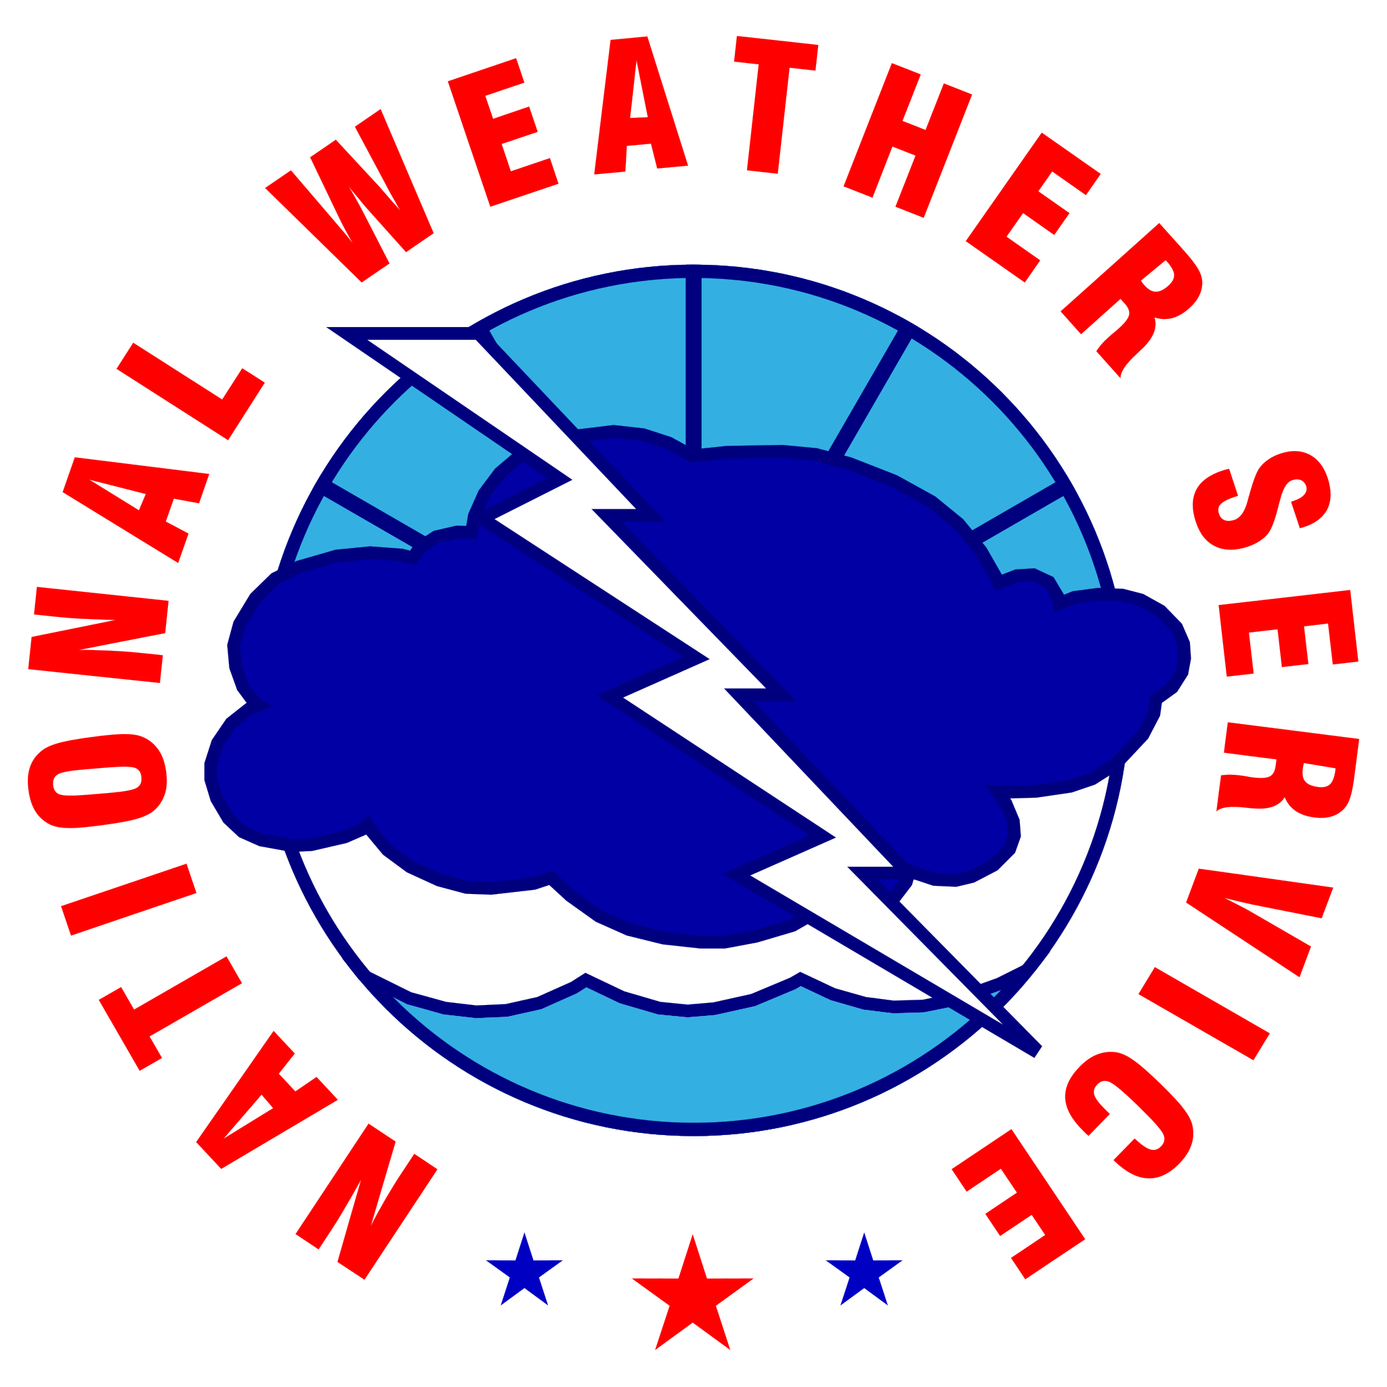







Contact Information
By Phone
770-486-1133
X
@NWSAtlanta
Via Email
nws.atlanta@noaa.gov
Instagram
nwsatlanta
Online
weather.gov/atlanta
weather.gov/ffc/briefings
Facebook
NWSAtlanta
NWS Chat
EMs, Media, and approved partners
YouTube
@NWSPeachtreeCity
Decision Support
weather.gov/ffc/dss
‹#›
NATIONAL WEATHER SERVICE ATLANTA
weather.gov/Atlanta
Follow:
@NWSAtlanta
Updated: Thu May 28, 2026 1:50 PM

