Slide 1

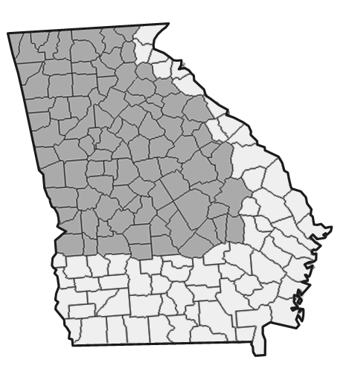
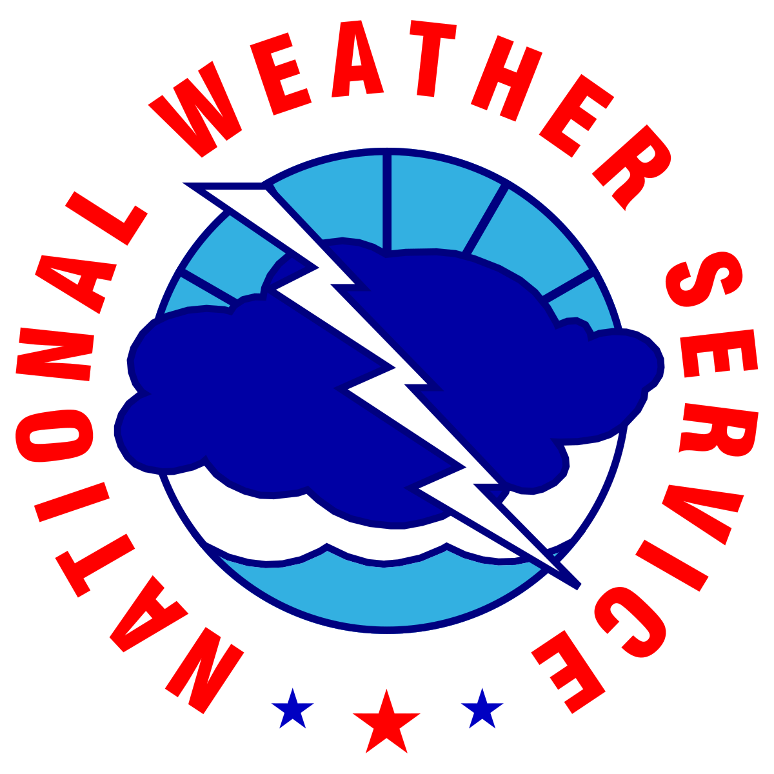


Routine Weekly Weather Briefing
For North and Central Georgia
Thursday, July 9th, 2026
Valid through next Thursday (July 16th)
Led by: Luke Culver - NWS Atlanta
Disclaimer: The information contained in this briefing is time sensitive and this should be taken into consideration while viewing.
‹#›
NATIONAL WEATHER SERVICE ATLANTA
weather.gov/Atlanta
Follow:
@NWSAtlanta
Updated: Thu Jul 09, 2026 10:36 AM

Slide 2

Key Messages and Hazard Outlook
Key
Messages
Heat concerns continue with heat index values over 100°F through Saturday. Cooler temps Sun-Tue.
Scattered afternoon showers/storms through Friday, becoming numerous to widespread over the weekend into early next week.
A few strong storms possible through Friday. Potential severe weather and localized flash flooding threats from Saturday through Monday.
Today
Friday
Saturday
Sunday
Monday
Tuesday
Wednesday
Hot with Scattered PM Storms.
Heat index 97-107
Hot with Scattered PM Storms.
Heat index 98-108
Numerous Storms
Potential for Severe Storms / Flooding
Heat index 97-107
Numerous Storms
Potential for Severe Storms / Flooding
Heat index 93-103
Numerous Storms
Potential for Severe Storms / Flooding
Heat index 88-96
Scattered PM Storms
Heat index 85-93
Scattered PM Storms
Heat index 90-98
Risk Levels → |  | Low | Moderate | High | Extreme
Disclaimer: The risk levels shown above are based on criteria for all of North and Central Georgia, not specific ongoing events in the area.
‹#›
NATIONAL WEATHER SERVICE ATLANTA
weather.gov/Atlanta
Follow:
@NWSAtlanta
Updated: Thu Jul 09, 2026 10:36 AM

Slide 3
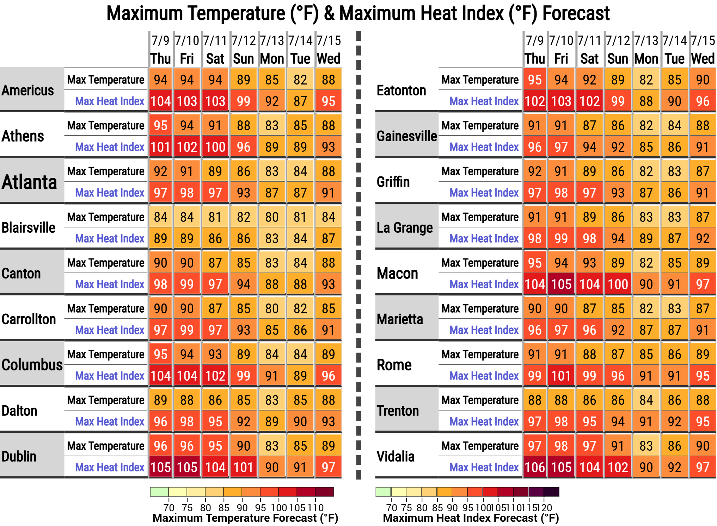
7-Day Temperature / Heat Index Forecast
Link to Table Creator (Download Table)
Heat concerns continue through Saturday with high temperatures in the 90s and heat index values in the upper 90s to low 100s
Temperatures cool back to around normal from Sunday into early next week.
Stay
hydrated
Limit strenuous time outdoors in the afternoon
Wear light-weight, light-colored clothing
Visit our Heat Page! www.weather.gov/ffc/heat
‹#›
NATIONAL WEATHER SERVICE ATLANTA
weather.gov/Atlanta
Follow:
@NWSAtlanta
Updated: Thu Jul 09, 2026 10:36 AM

Slide 4
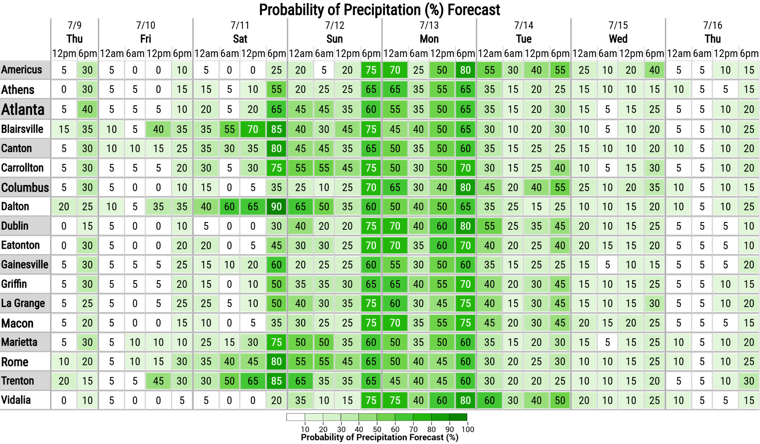
7-Day Rain Chances
Scattered afternoon showers and storms today and Friday.
Shower/storm activity ramps up over the weekend into early next week as a frontal boundary slowly drops over the area.
Link to Table Creator (Download Table)
‹#›
NATIONAL WEATHER SERVICE ATLANTA
weather.gov/Atlanta
Follow:
@NWSAtlanta
Updated: Thu Jul 09, 2026 10:36 AM

Slide 5
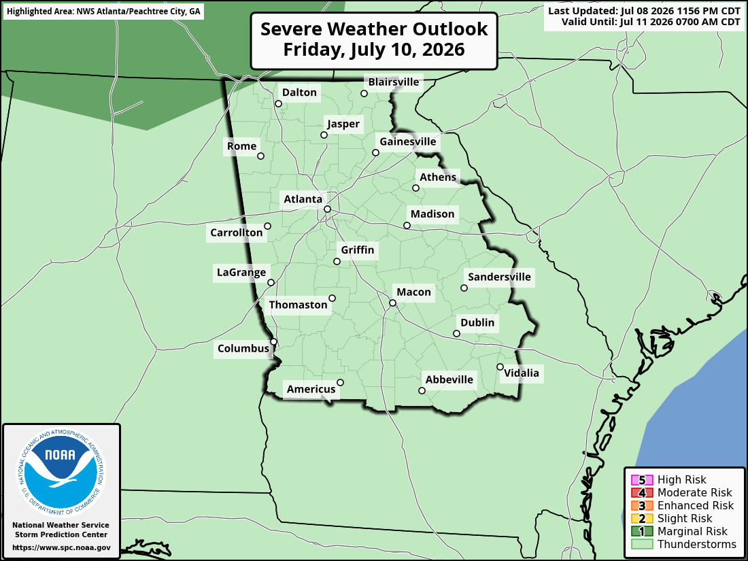
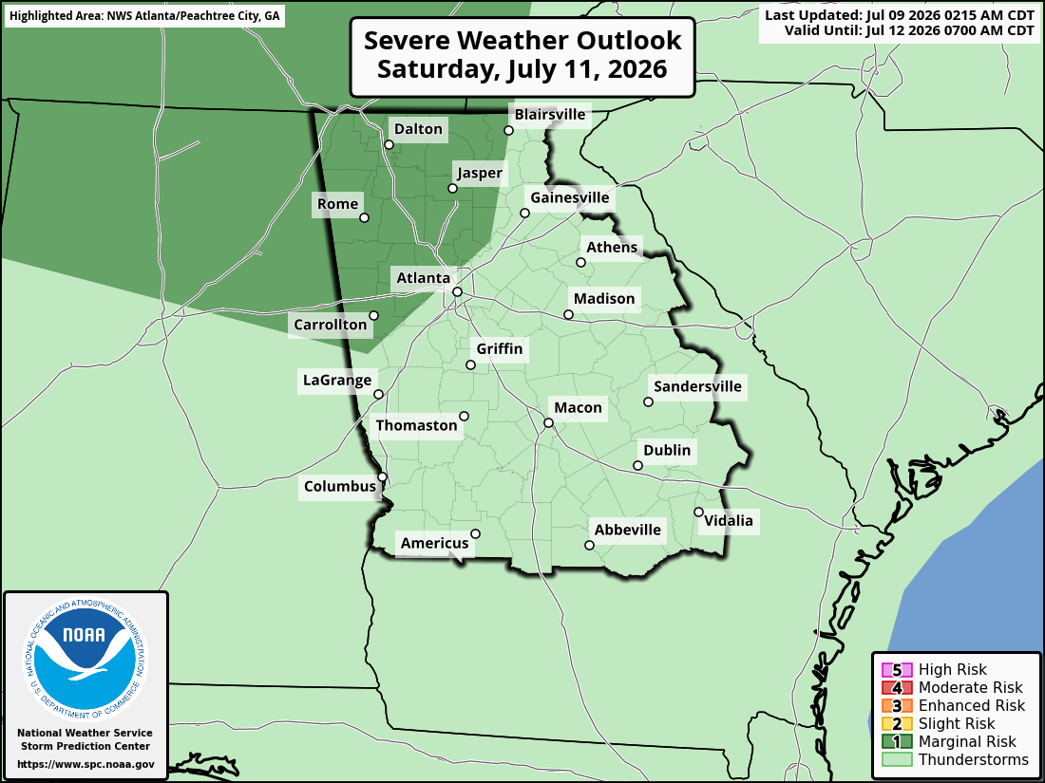
Severe Weather Outlook
(through Saturday)
The threat for strong to severe thunderstorms will increase over the weekend as the frontal boundary moves in, with the primary hazard being strong to damaging wind gusts.
Stay in touch with the forecast as the coverage and risk level of the severe weather outlooks will likely shift as we move through the weekend!
Friday
Saturday
‹#›
NATIONAL WEATHER SERVICE ATLANTA
weather.gov/Atlanta
Follow:
@NWSAtlanta
Updated: Thu Jul 09, 2026 10:36 AM

Slide 6
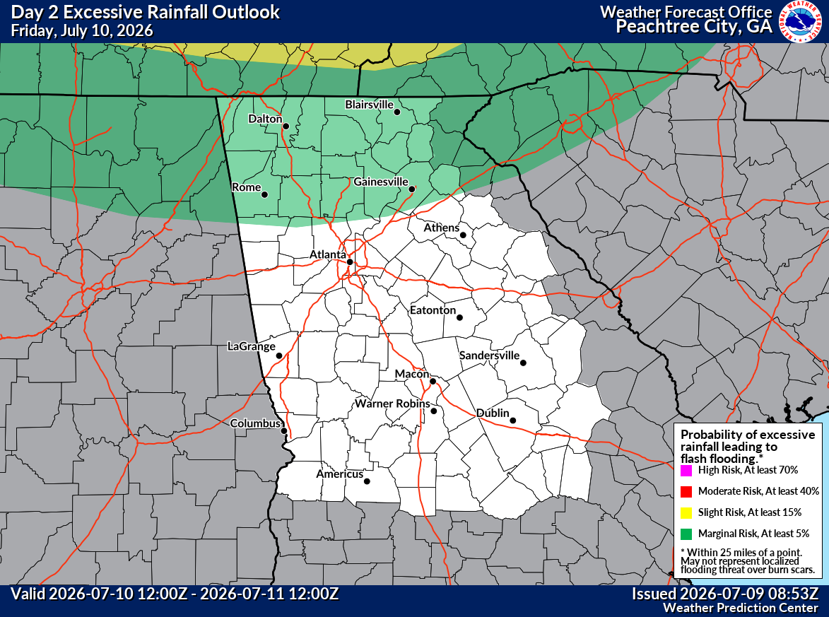
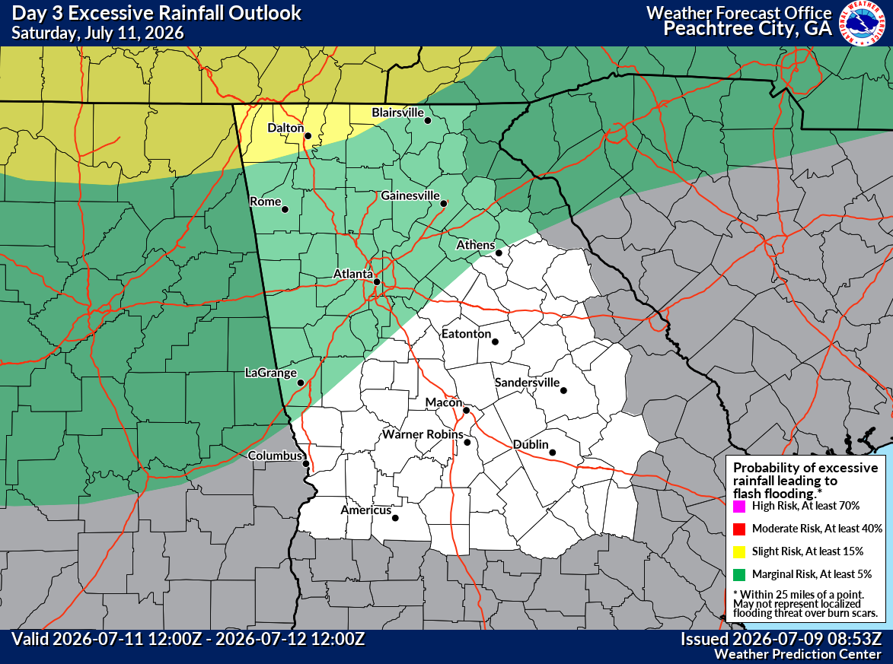
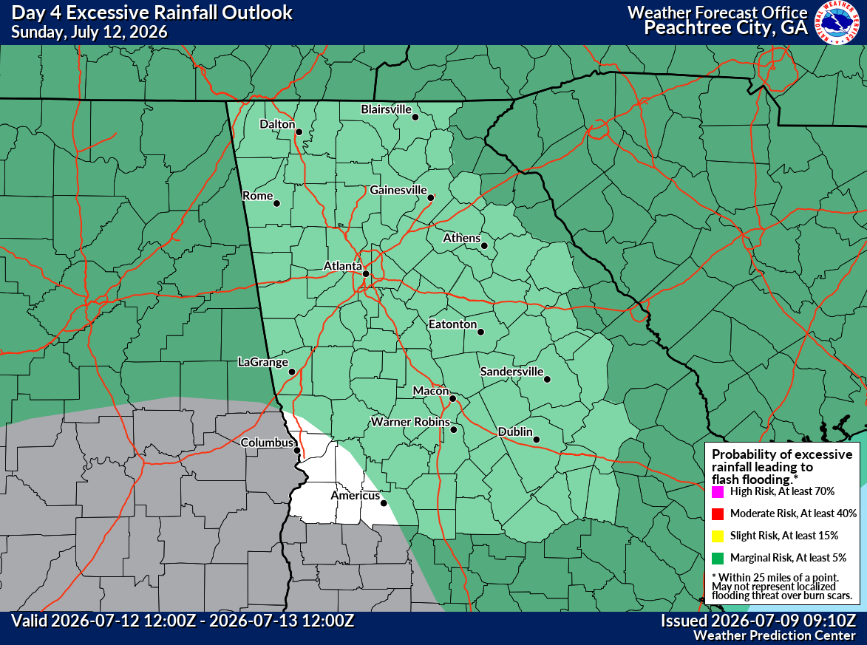
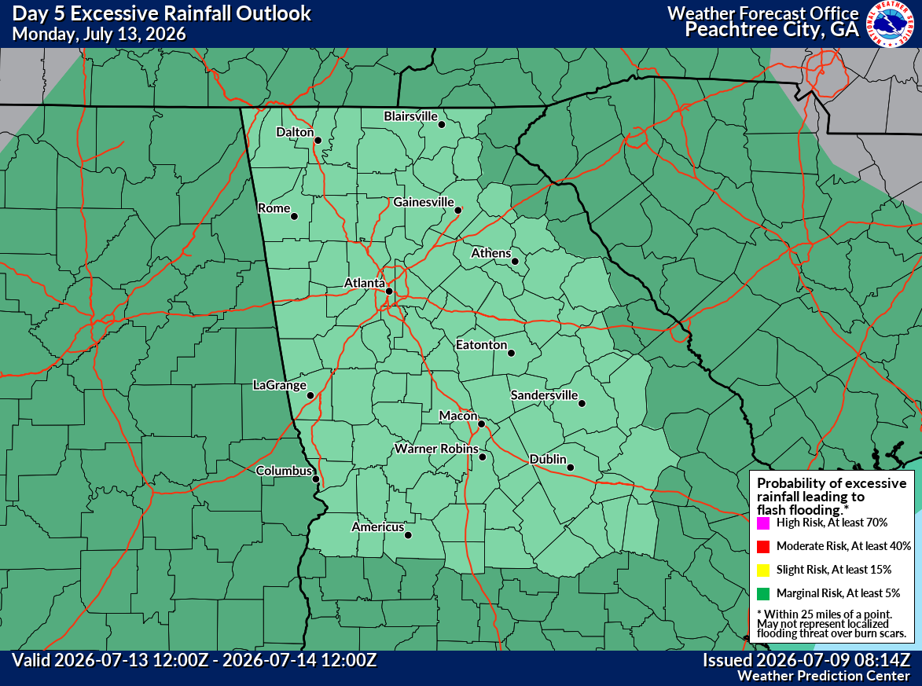
Excessive Rainfall (Flash Flood) Outlooks
A frontal boundary slowly dropping across the area over the weekend will support numerous to widespread showers and storms into early next week.
With high atmospheric moisture and storm coverage, this will create a potential for localized flash flooding, especially in urban and poor drainage areas.
Friday
Saturday
Risk of Excessive Rainfall
1
Marginal Risk, or a 5% chance
2
Slight Risk, or a 15% chance
Sunday
Monday
3
Moderate Risk, or a 40% chance
4
High Risk, or a 75% chance
*Indicates the risk of occurrence within 25 miles of your location
‹#›
NATIONAL WEATHER SERVICE ATLANTA
weather.gov/Atlanta
Follow:
@NWSAtlanta
Updated: Thu Jul 09, 2026 10:36 AM

Slide 7
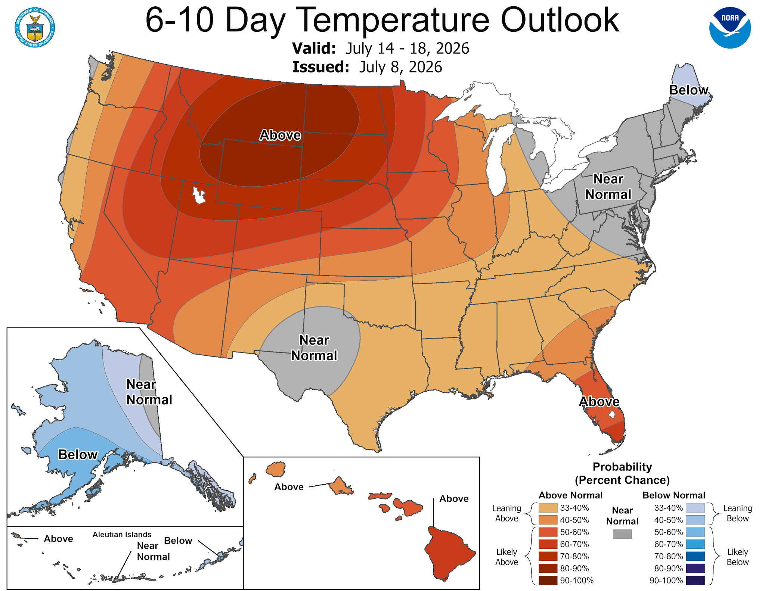
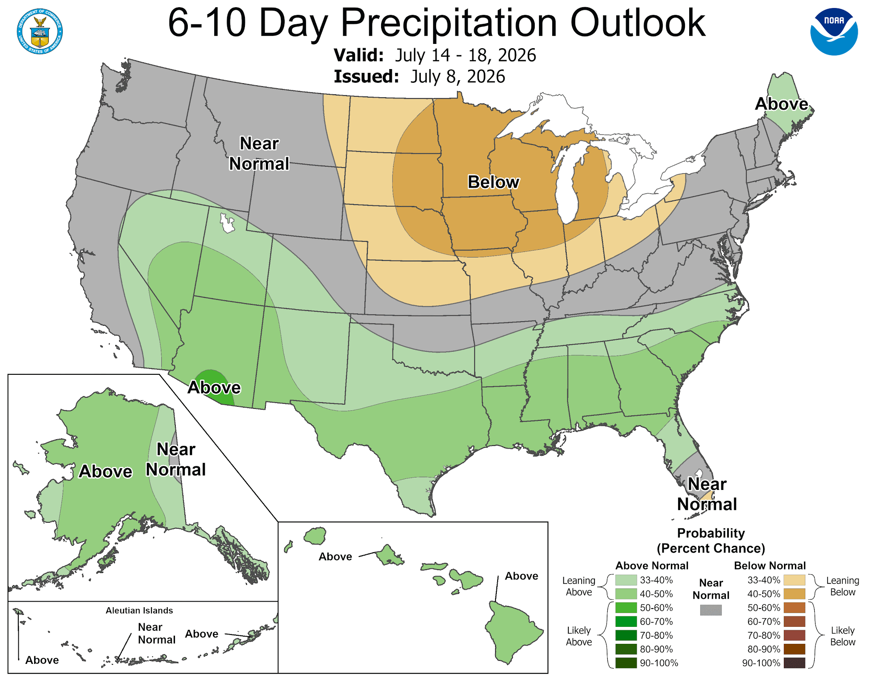
Looking ahead: July 14th - July 18th, 2026
Temperatures – Leaning Above Normal
Precipitation – Leaning Above Normal
‹#›
NATIONAL WEATHER SERVICE ATLANTA
weather.gov/Atlanta
Follow:
@NWSAtlanta
Updated: Thu Jul 09, 2026 10:36 AM

Slide 8
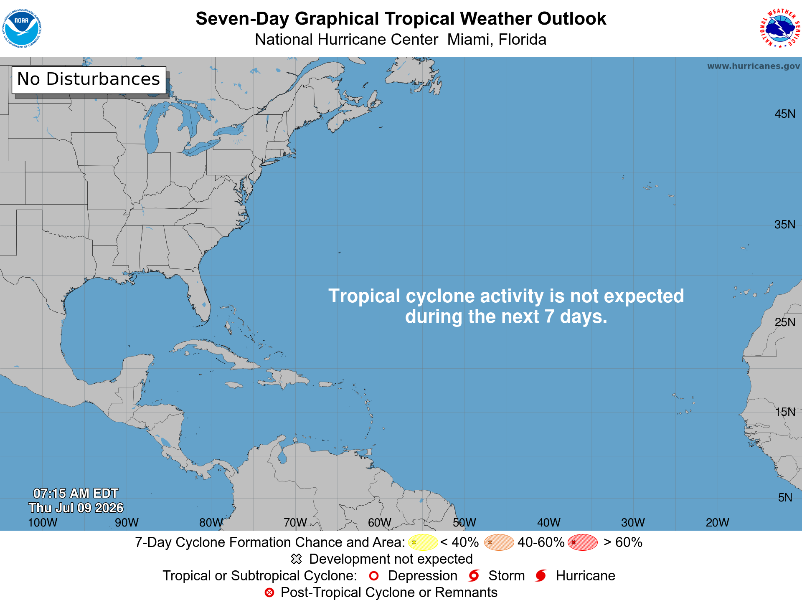
Tropical Outlook - Next 7 Days
No Tropical Activity is expected in the next 7 days
‹#›
NATIONAL WEATHER SERVICE ATLANTA
weather.gov/Atlanta
Follow:
@NWSAtlanta
Updated: Thu Jul 09, 2026 10:36 AM

Slide 9
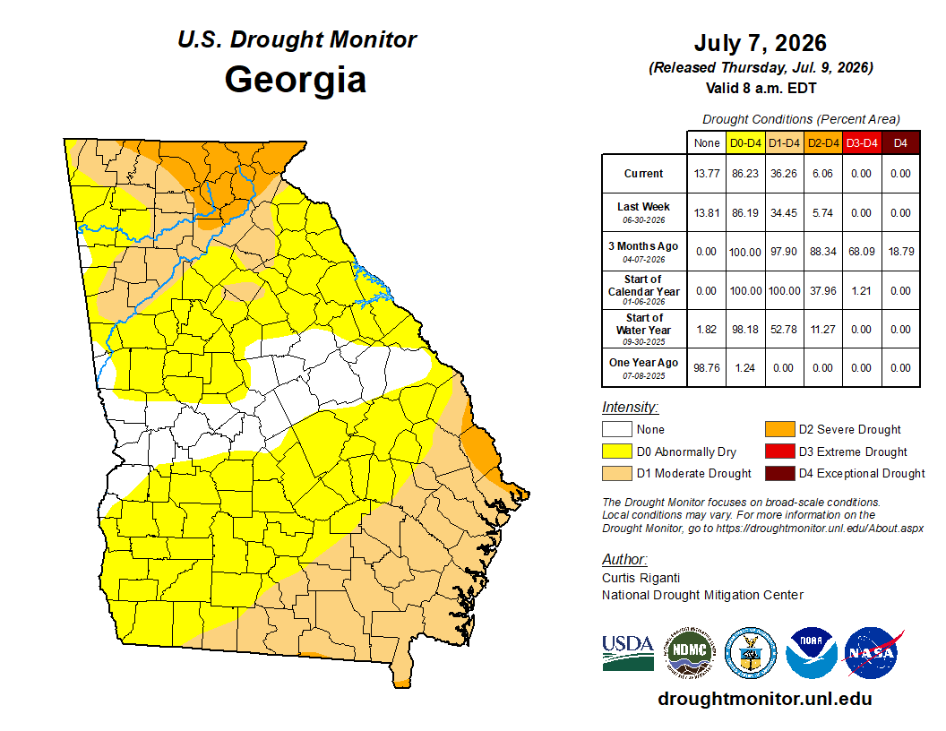
Latest Drought Update
The latest Drought Conditions update shows minimal changes from last week.
D2-D4 Drought (see legend on the right) persists across ~5% of Georgia, primarily in the far N/NE.
Wet conditions over the upcoming weekend will provide relief from the hot and relatively dry weather in recent days.
Latest Drought Information Statement (new one next week): https://www.weather.gov/ffc/drought
‹#›
NATIONAL WEATHER SERVICE ATLANTA
weather.gov/Atlanta
Follow:
@NWSAtlanta
Updated: Thu Jul 09, 2026 10:36 AM

Slide 10
Key Messages and Hazard Outlook
Key
Messages
Heat concerns continue with heat index values over 100°F through Saturday. Cooler temps Sun-Tue.
Scattered afternoon showers/storms through Friday, becoming numerous to widespread over the weekend into early next week.
A few strong storms possible through Friday. Potential severe weather and localized flash flooding threats from Saturday through Monday.
Today
Friday
Saturday
Sunday
Monday
Tuesday
Wednesday
Hot with Scattered PM Storms.
Heat index 97-107
Hot with Scattered PM Storms.
Heat index 98-108
Numerous Storms
Potential for Severe Storms / Flooding
Heat index 97-107
Numerous Storms
Potential for Severe Storms / Flooding
Heat index 93-103
Numerous Storms
Potential for Severe Storms / Flooding
Heat index 88-96
Scattered PM Storms
Heat index 85-93
Scattered PM Storms
Heat index 90-98
Risk Levels → |  | Low | Moderate | High | Extreme
Disclaimer: The risk levels shown above are based on criteria for all of North and Central Georgia, not specific ongoing events in the area.
‹#›
NATIONAL WEATHER SERVICE ATLANTA
weather.gov/Atlanta
Follow:
@NWSAtlanta
Updated: Thu Jul 09, 2026 10:36 AM

Slide 11

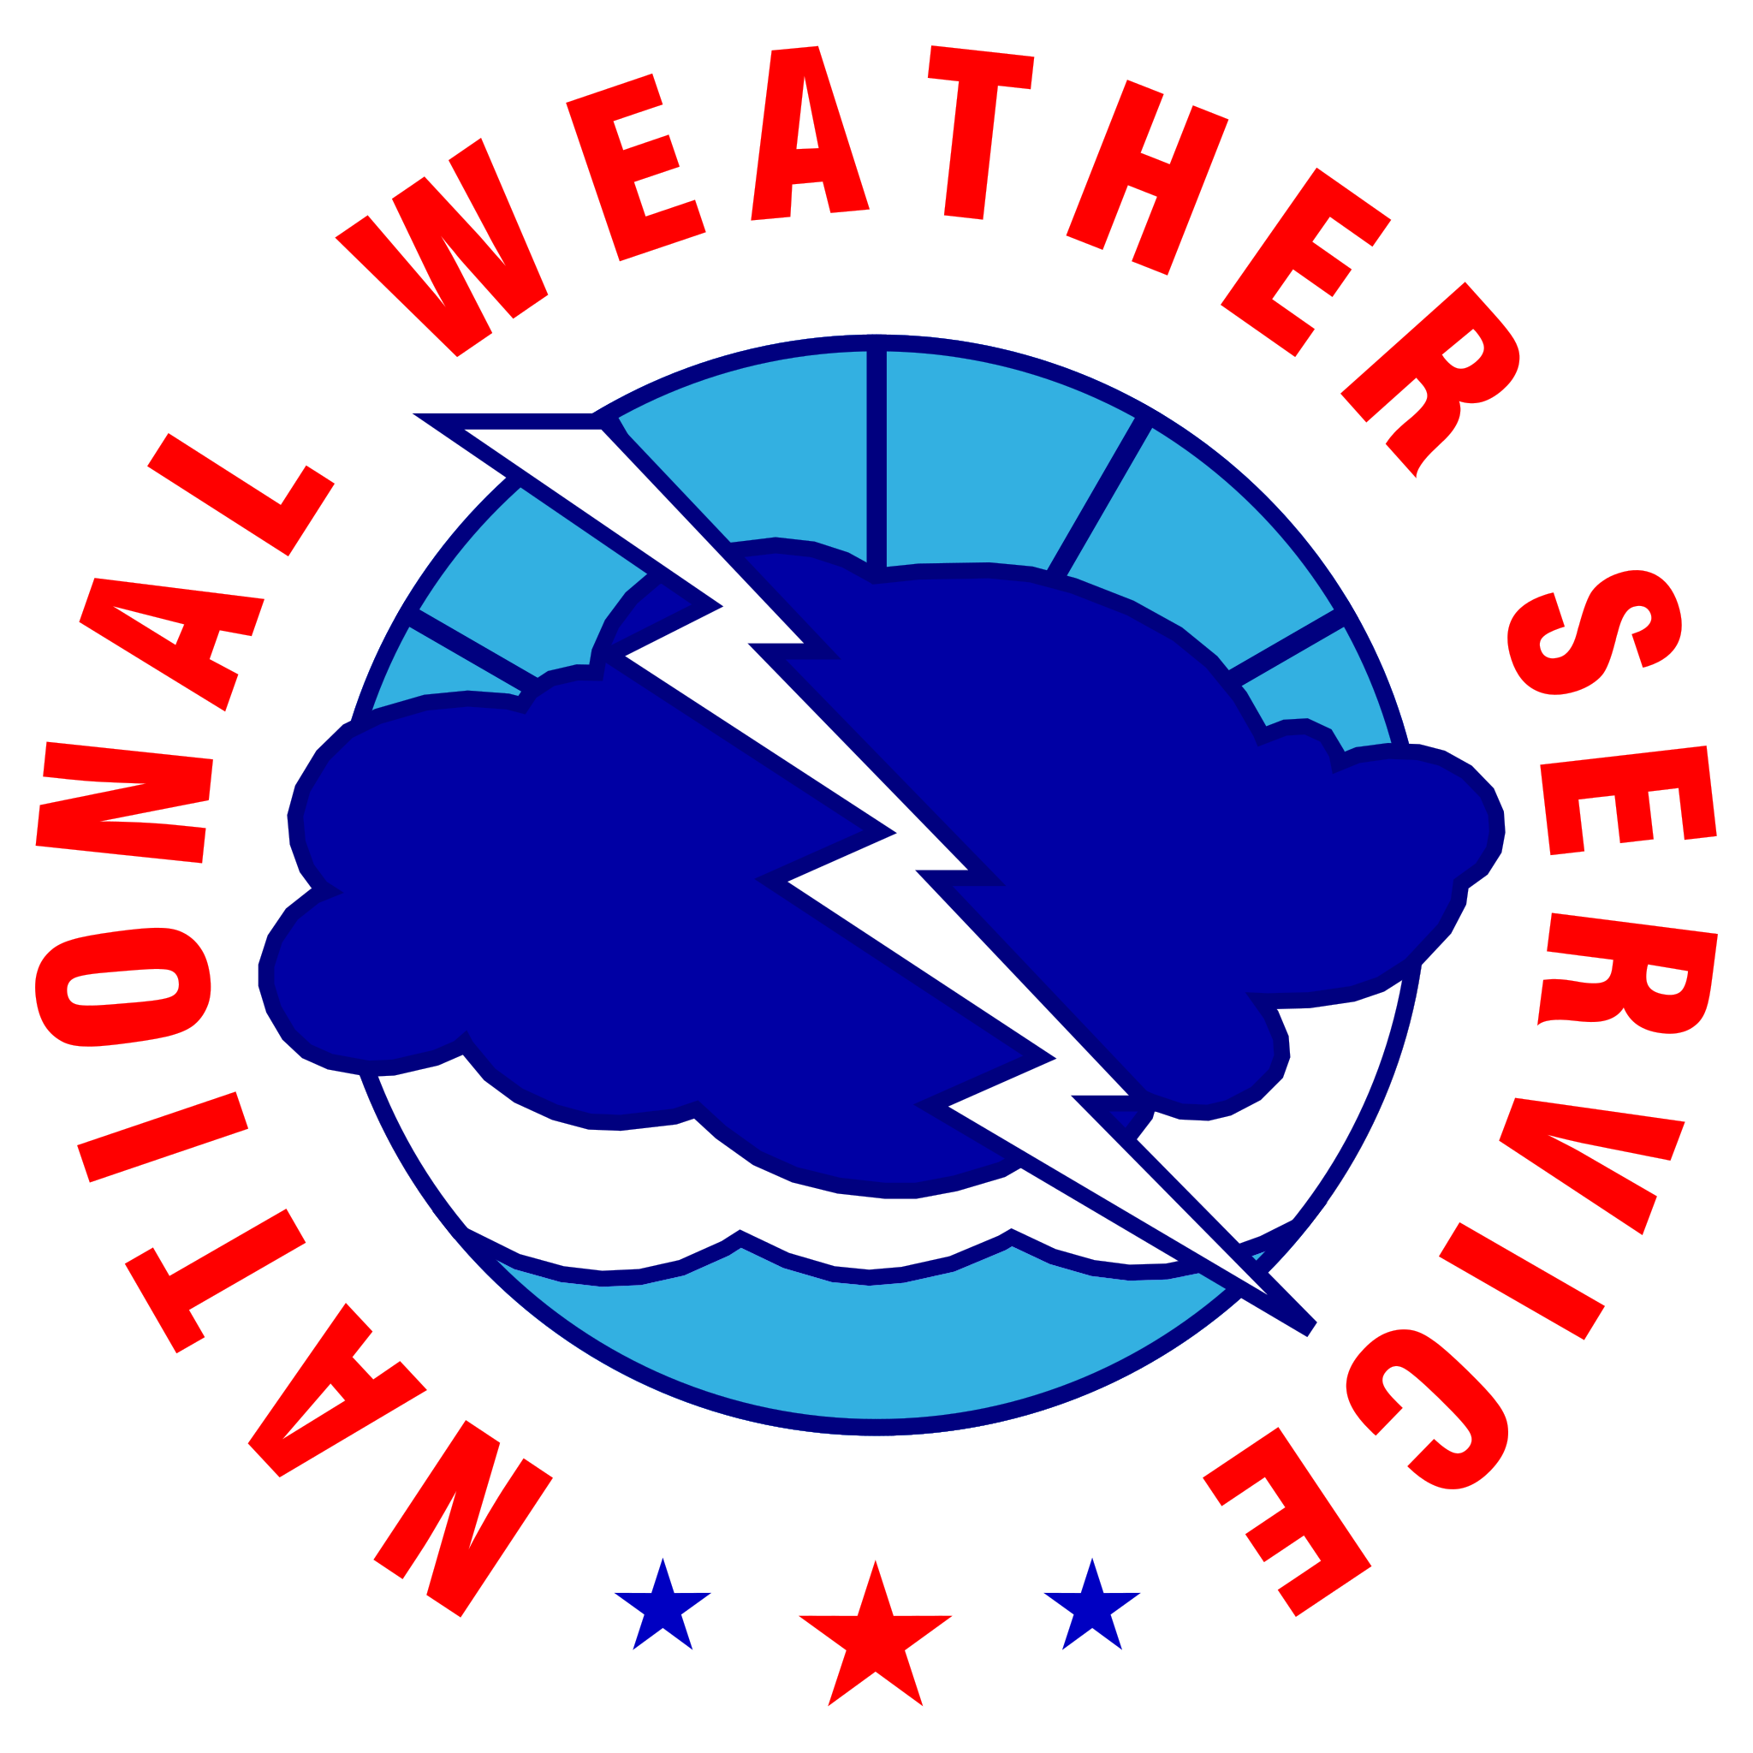








Contact Information
By Phone
770-486-1133
X
@NWSAtlanta
Via Email
nws.atlanta@noaa.gov
Instagram
nwsatlanta
Online
weather.gov/atlanta
weather.gov/ffc/briefings
Facebook
NWSAtlanta
NWS Chat
EMs, Media, and approved partners
YouTube
@NWSPeachtreeCity
Decision Support
weather.gov/ffc/dss
‹#›
NATIONAL WEATHER SERVICE ATLANTA
weather.gov/Atlanta
Follow:
@NWSAtlanta
Updated: Thu Jul 09, 2026 10:36 AM

