Slide 1
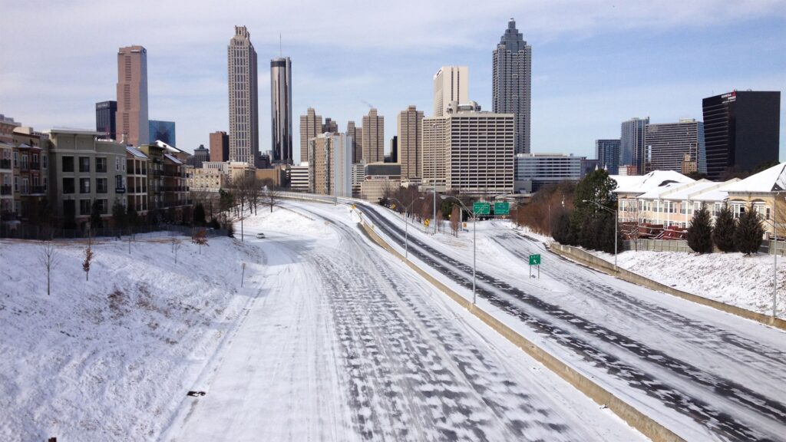
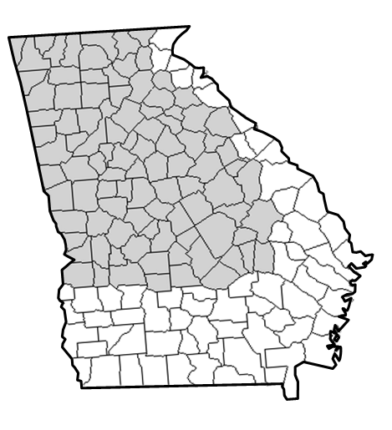
National Weather Service (Atlanta)
Other example winter
briefing
Disclaimer: The information contained in this briefing is time sensitive which should be taken into consideration while viewing.
Special Weather Briefing
For Potential Winter Weather - Sunday (1/18/26)
Valid: 2:00 PM Friday (1/16/26)
by NWS Peachtree City/Atlanta

Slide 2
Main Points / Headlines
Late Saturday night/Sunday through Monday morning (1/18-19)
The threat for wintry precip has shifted south and east for Sunday.
  Greatest risk area is now south/east of Columbus to Griffin to Madison.
  Areas north/west of I-85 looking at very minimal (if any) impacts
Where snow does occur… temperatures during day (Sunday) are trending >32F during precipitation, resulting in some melting but also a narrow area of heavy/wet snow on the backside of the precip shield.
  General accumulations up to 1” possible
  Very low chance to see max snow accumulations of 2-3” in a narrow band
Temperatures Sunday night/Monday morning expected to drop well into the 20s everywhere – likely resulting in icy/slick areas (black ice)
Notes:
Starting off by taking a look at the Climate Prediction Center’s 6-10 day outlook, conditions starting mid next week will see temperatures below normal for this time of the year. Sadly, we are also anticipating drier than normal conditions as well, meaning no help with the drought is currently in sight.

Slide 3
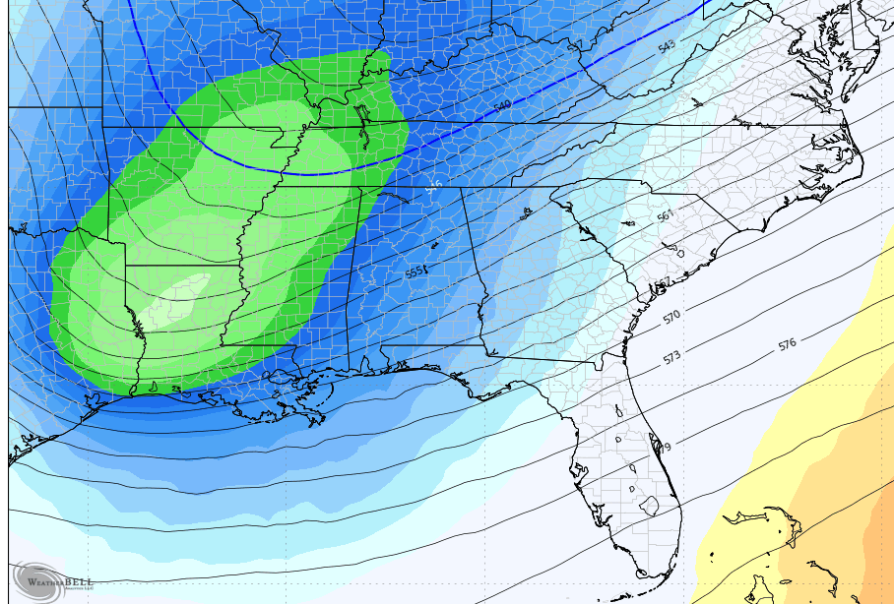
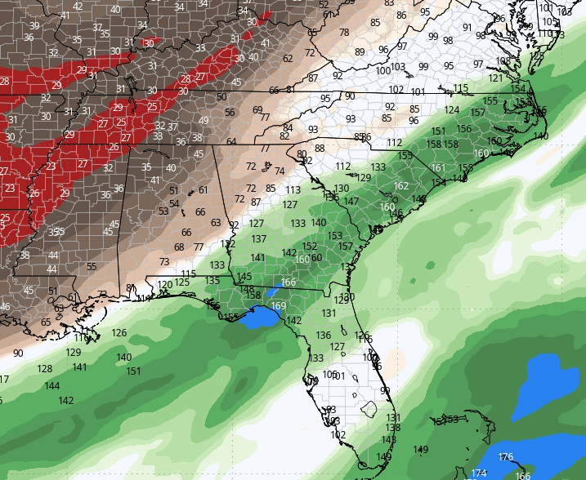
Weather Pattern / Set-up
This weekend into early Monday
L
Cold Air
An upper level trough with very cold air will move across the area (Sun-Mon)
Relatively warm/moist air will move in from the Gulf creating an “overrunning” precipitation event along and ahead of the upper trough
Notes:
Starting off by taking a look at the Climate Prediction Center’s 6-10 day outlook, conditions starting mid next week will see temperatures below normal for this time of the year. Sadly, we are also anticipating drier than normal conditions as well, meaning no help with the drought is currently in sight.

Slide 4
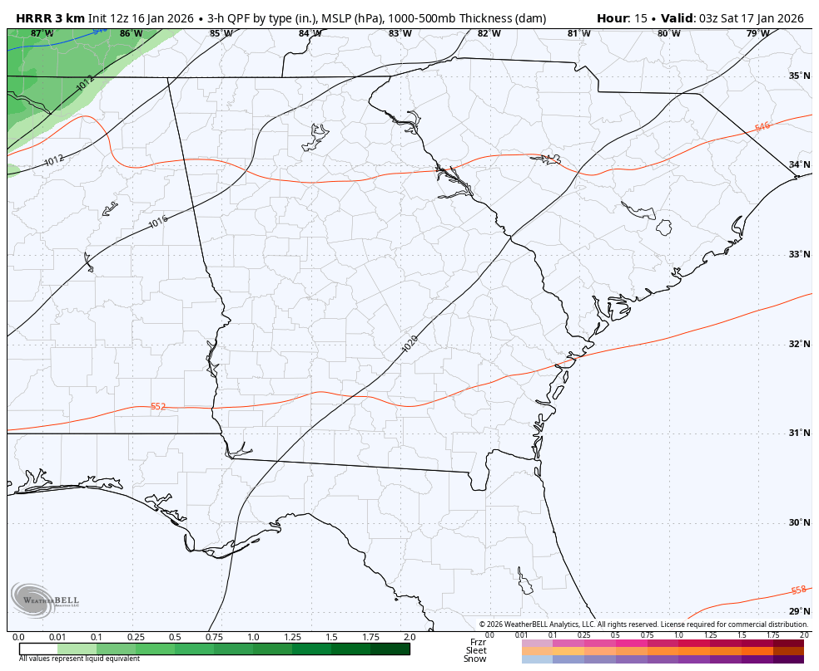
Tonight - Sat morning
Fast-moving system will bring a few hours of light rain to the area (lesser amounts south/east)
Brief ‘wintry mix’ possible in the highest of elevations of far north GA
  No major / widespread impacts
  A few slick spots as temps drop close to 32F late tonight.

Slide 5
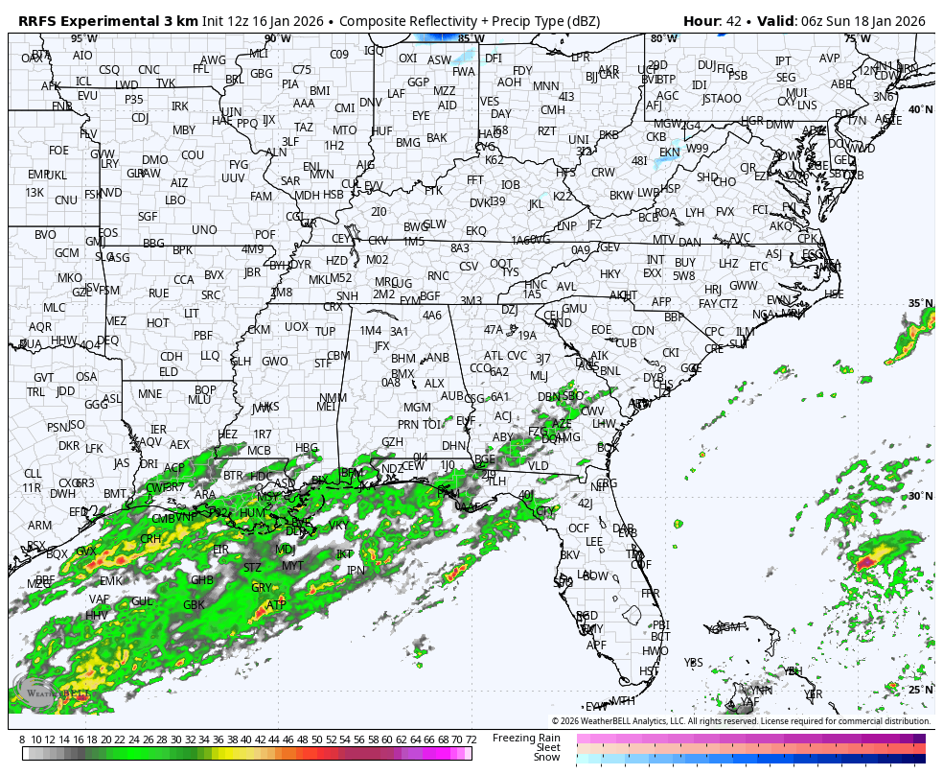
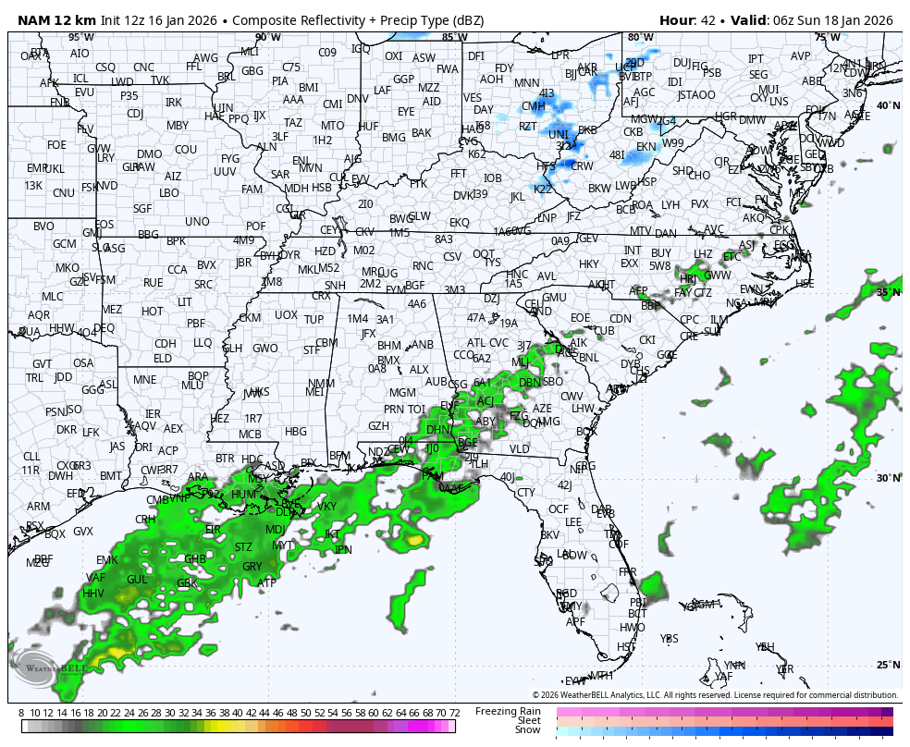
Winter precip timing (early/onset)
Saturday night / Sunday morning ~1am to 10am
Model 1 (~1am Sunday)
Model 2

Slide 6
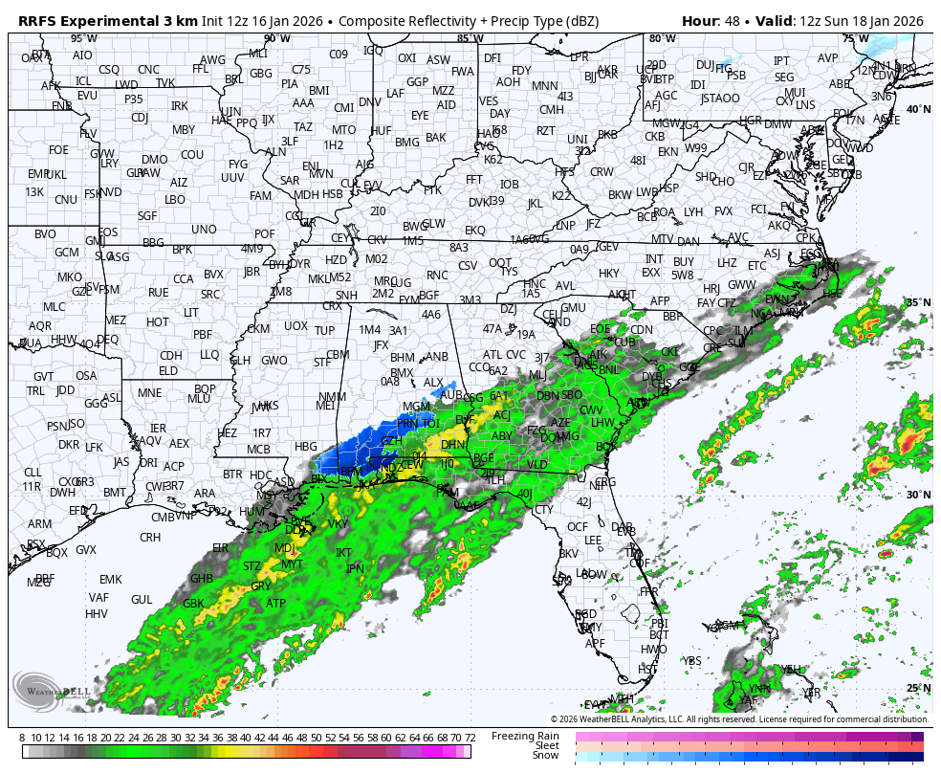
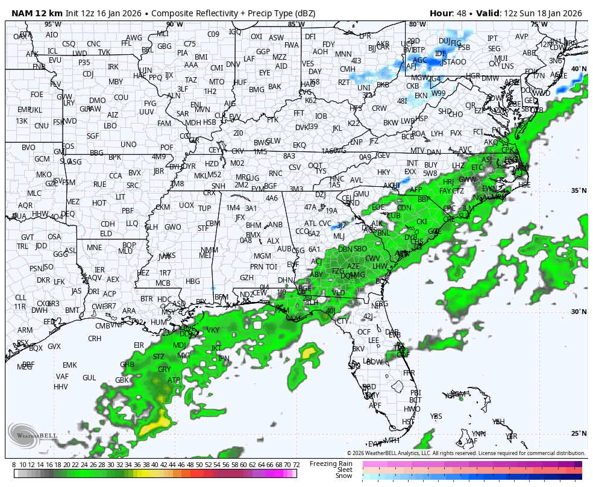
Winter precip timing (early/onset)
Saturday night / Sunday ~1am to 1pm
Model 1 (~7am Sunday)
Model 2

Slide 7
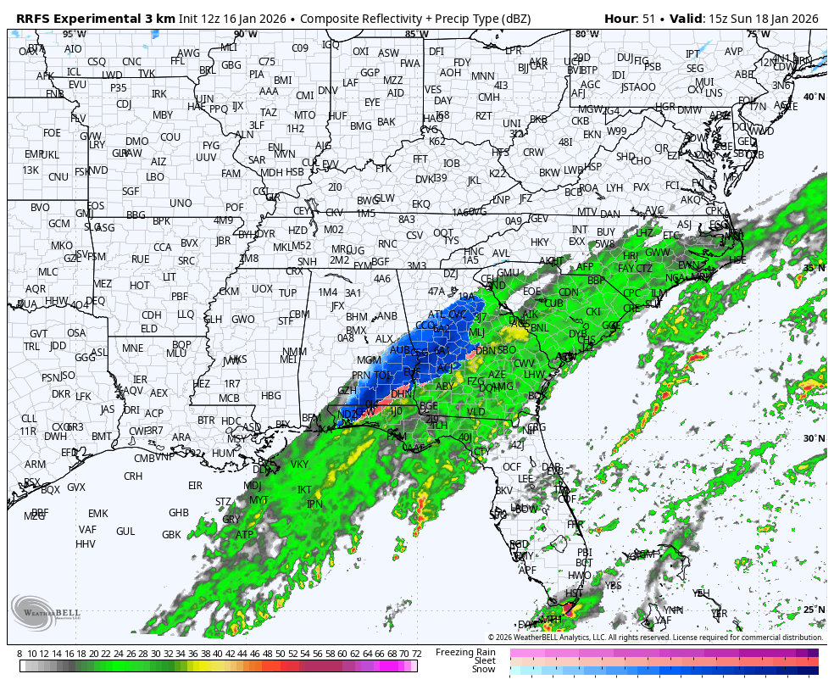
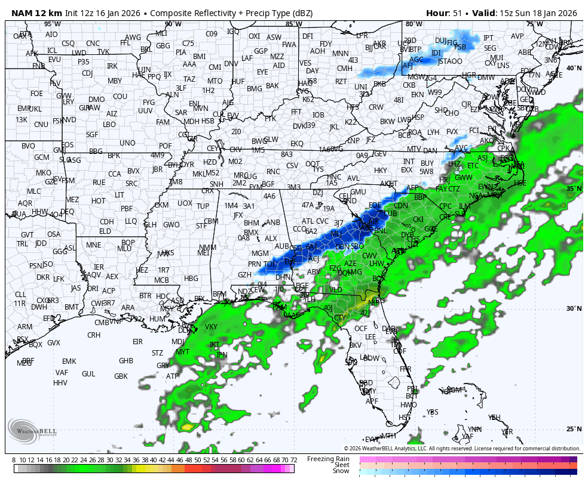
Winter precip timing
Sunday (~7am to 7pm)
Model 1 (~10am Sunday)
Model 2

Slide 8
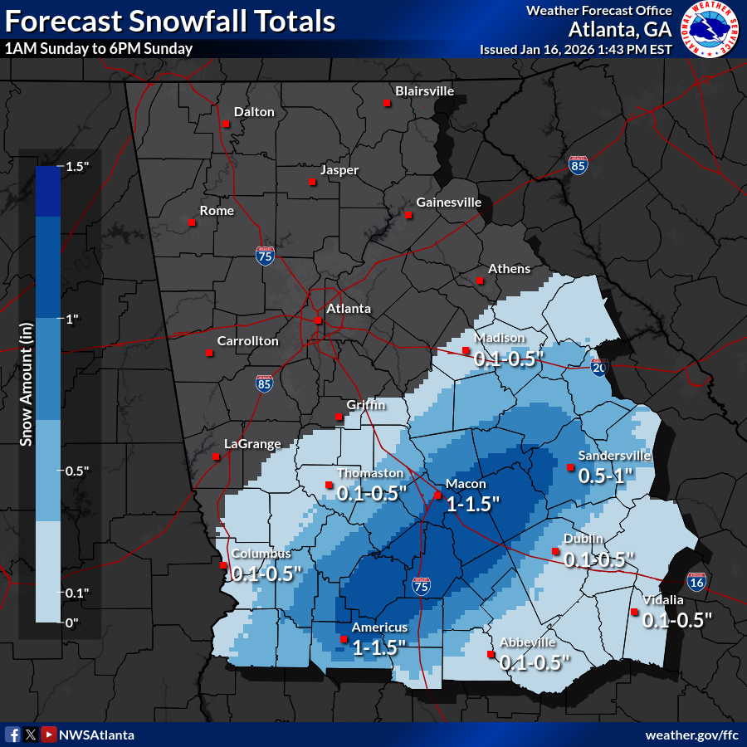
Snow Forecast (NWS)
Sunday (1/18/26)
Latest Snow forecast (from NWS)...
Keep in mind, this will change and could pivot back to the west & north as newer information comes in
This along with probabilities and “higher end” amounts are available on our NWS Atlanta Winter page: www.weather.gov/ffc/winter
Notes:
Starting off by taking a look at the Climate Prediction Center’s 6-10 day outlook, conditions starting mid next week will see temperatures below normal for this time of the year. Sadly, we are also anticipating drier than normal conditions as well, meaning no help with the drought is currently in sight.

Slide 9
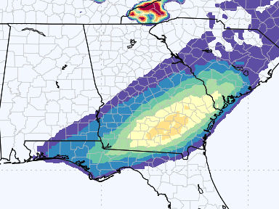
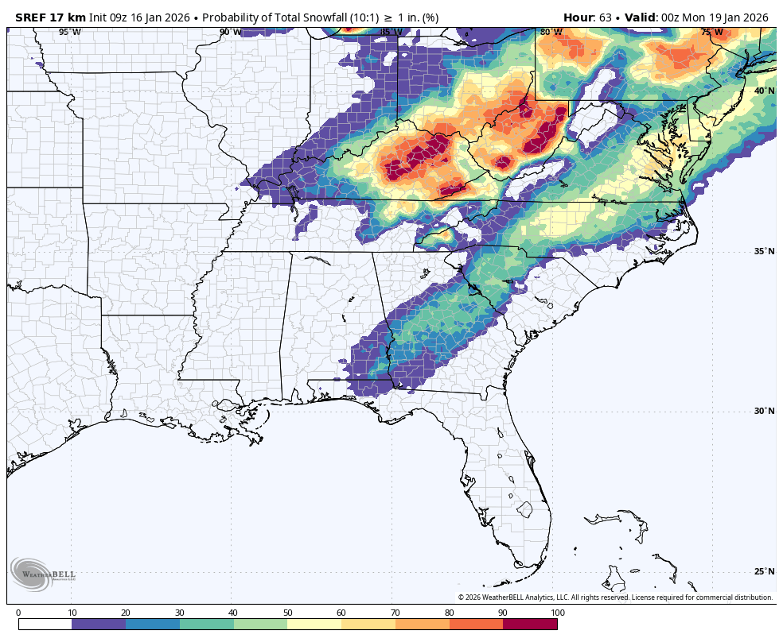
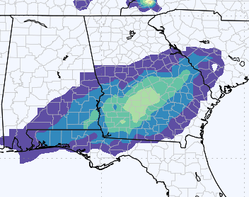
Snow probabilities > 1 inch
Short-range Ensemble (10 members) Models (15z/Jan16)
Not completely out of the woods, yet!
30-40%
Models are coming into better agreement, but still some uncertainty exists in where snow area will set up
Medium-range Ensemble (GEFS / ENS)
50-60%

Slide 10
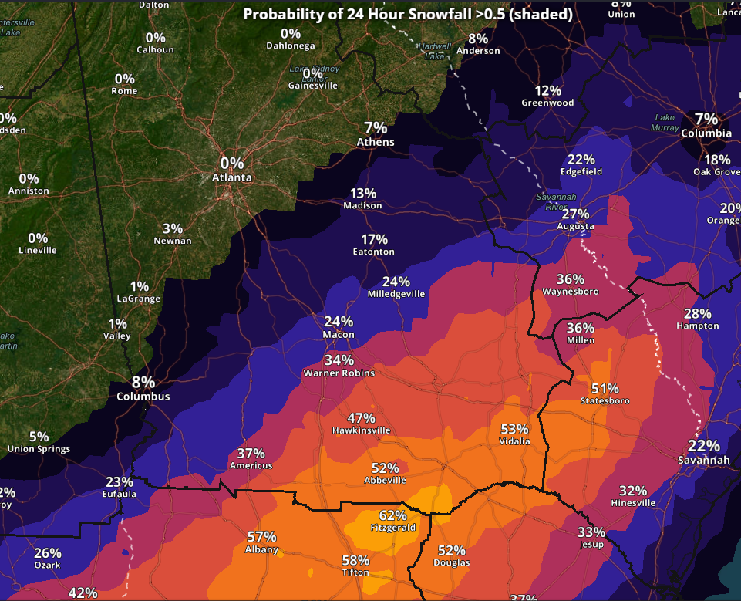
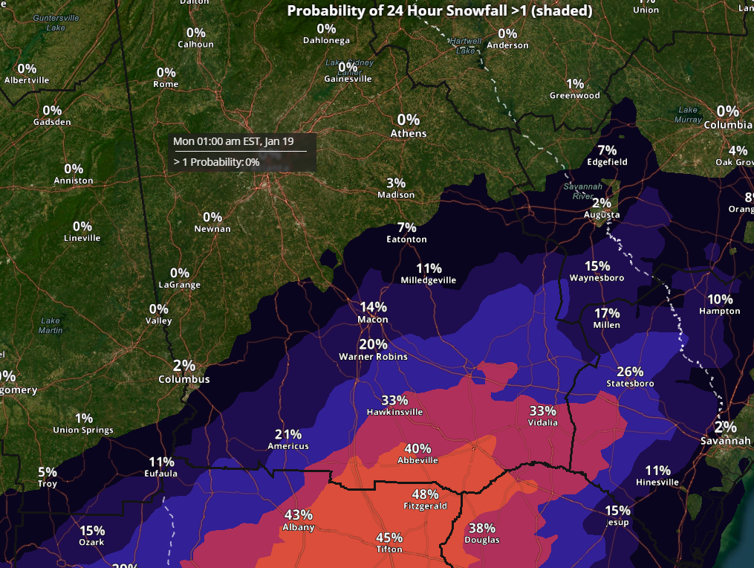
Snow Amount/Probabilities
Sunday, January 18th
% Chance of Seeing > 1” of Snow
% Chance of Seeing > 0.5” of Snow

Slide 11
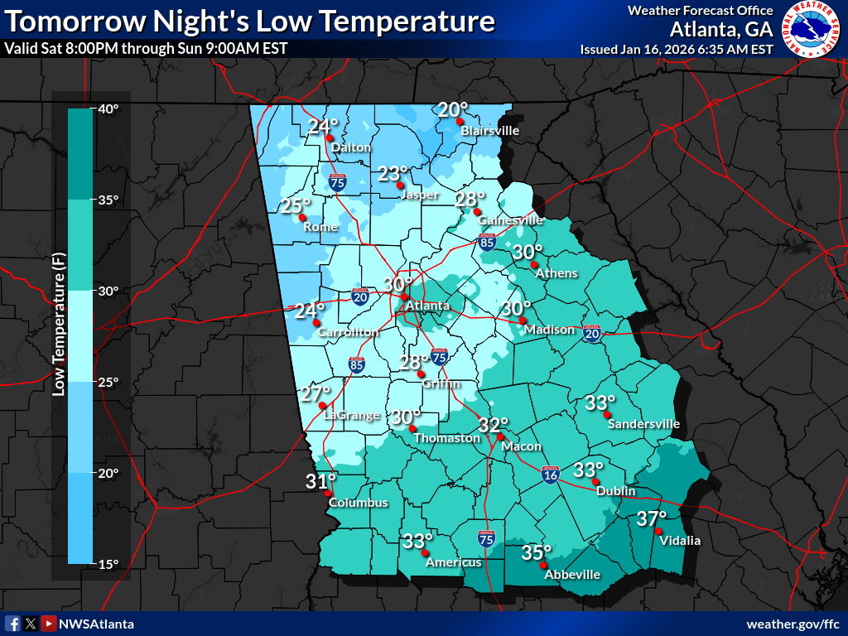
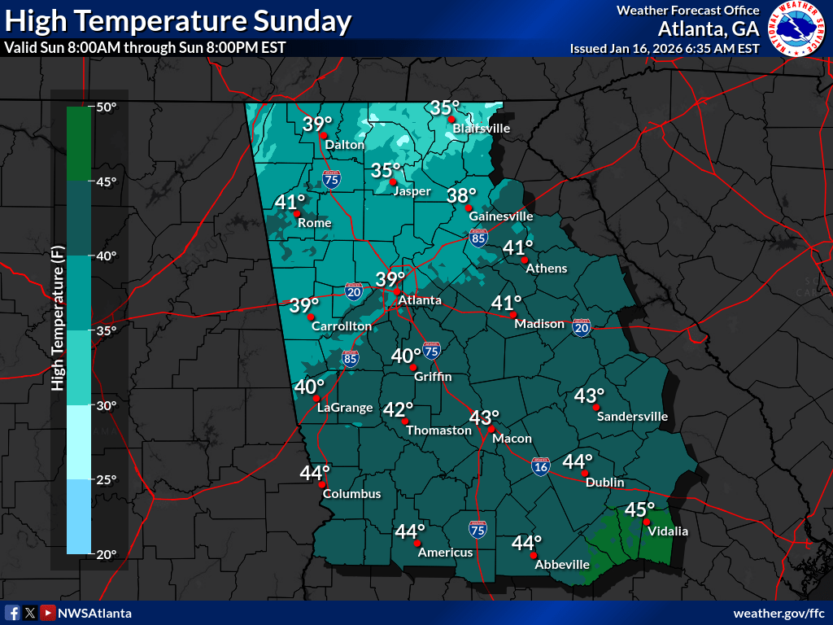
Temperatures
Saturday night through Monday
Max Temperatures could be several degrees colder during rain/snow period

Slide 12
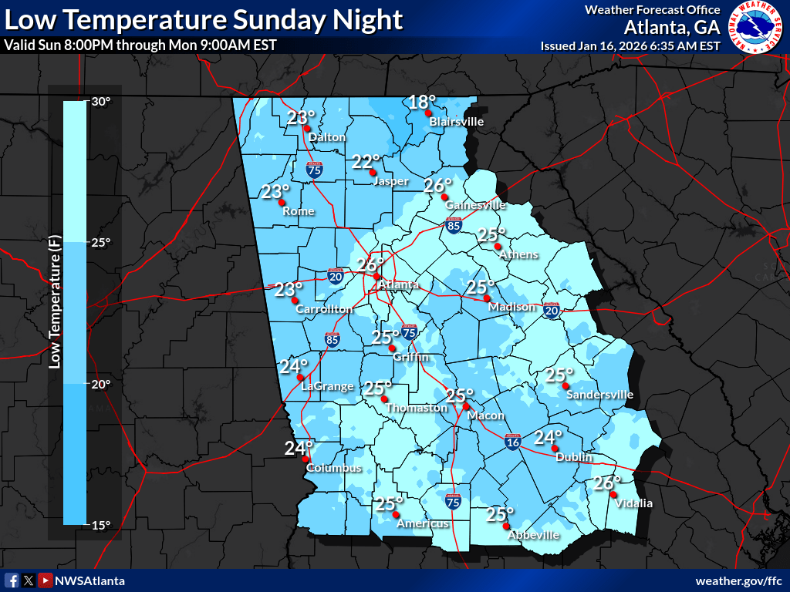
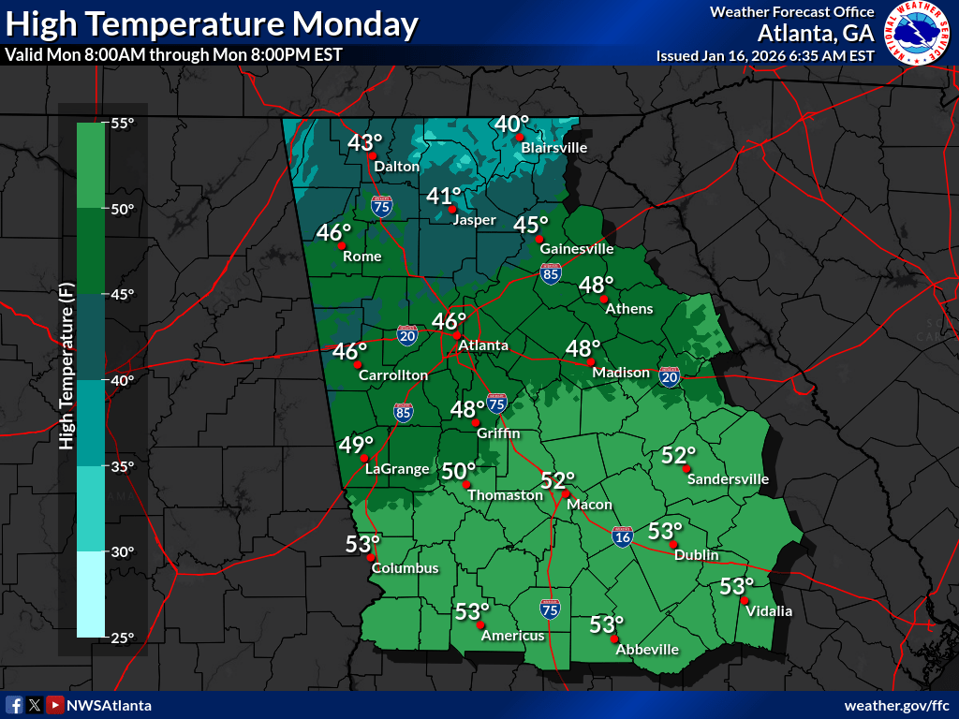
Temperatures
Saturday night through Monday

Slide 13
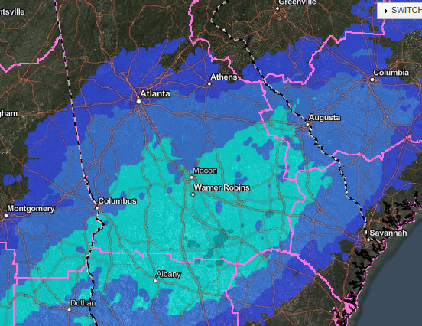
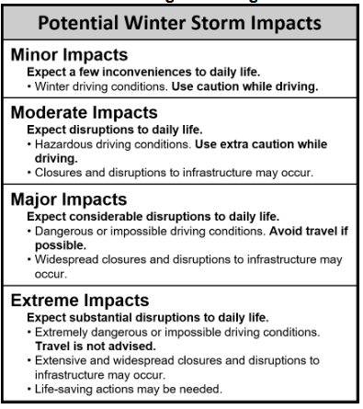
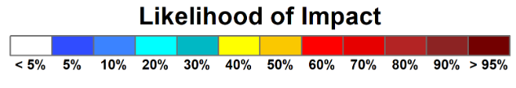
Potential Impacts (from WSSI)
https://www.wpc.ncep.noaa.gov/wwd/wssi/prob_wssi.php
Likelihood of Minor Impacts from WPC WSSI
< 10%
10-20%
20-30%

Slide 14
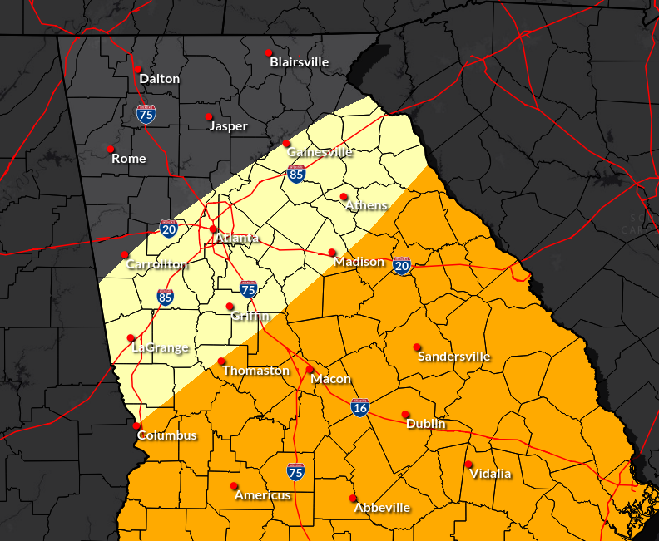
Impacts - Areas of Concern
Sunday into Sunday night
DO NOT LET GUARD DOWN!
Backside of the precip area remains unknown at this time.
Any shift (in precip) back to the west could result in accumulating snow
Little to No Impacts
LOW to MODERATE Impact area:
Higher probability of snow in this zone
Temperatures expected to be in the mid-upr 30s which will limit accumulations
Sunday night/Monday morning “refreeze” concern

Slide 15
Summary / Main Points
Late Saturday night/Sunday through Monday morning (1/18-19)
The threat for wintry precip has shifted south and east for Sunday.
  Greatest risk area is now south/east of Columbus to Griffin to Madison.
  Areas north/west of I-85 looking at very minimal (if any) impacts
Where snow does occur… temperatures during day (Sunday) are trending >32F during precipitation, resulting in some melting but also a narrow area of heavy/wet snow on the backside of the precip shield.
  General accumulations up to 1” possible
  Very low chance to see max snow accumulations of 2-3” in a narrow band
Temperatures Sunday night/Monday morning expected to drop well into the 20s everywhere – likely resulting in icy/slick areas (black ice)
Notes:
Starting off by taking a look at the Climate Prediction Center’s 6-10 day outlook, conditions starting mid next week will see temperatures below normal for this time of the year. Sadly, we are also anticipating drier than normal conditions as well, meaning no help with the drought is currently in sight.

Slide 16







Contact Info & Additional Briefings
Additional Briefings? Email updates for sure
Contact Information & Reporting
Phone: 770-486-1133
Email: sr-ffc.mets@noaa.gov
NWS Chat: For EMs, Media & Approved Partners
Reporting Hotline: 866-763-4466 (Voicemail if busy)
NWS Atlanta Winter Page: www.weather.gov/ffc/winter
X
YES
NO

