Slide 1
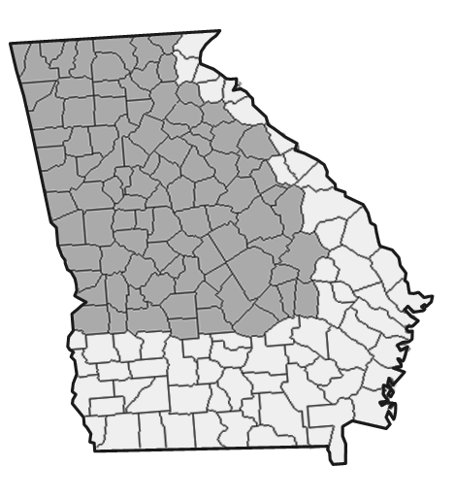
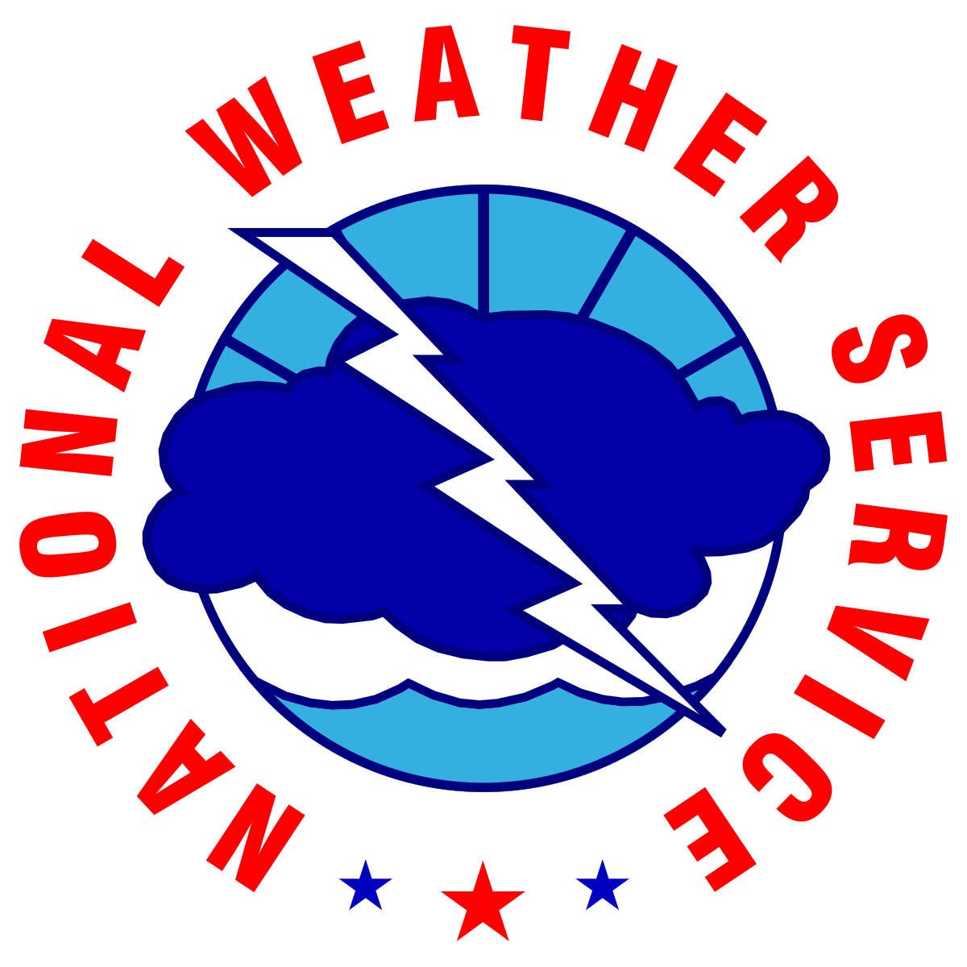


Weekly Weather Briefing
For North and Central Georgia
For the week starting
November 6, 2025
Led by: Keith Stellman - Meteorologist in Charge
Disclaimer: The information contained in this briefing is time sensitive and this should be taken into consideration while viewing.
1
NATIONAL WEATHER SERVICE ATLANTA
weather.gov/Atlanta
Follow:
@NWSAtlanta
Updated: Thu Nov 06, 2025 2:20 PM

Slide 2

Key Messages and Hazard Outlook
Scattered to widespread showers late Friday->Saturday. Isolated strong to severe storm possible
Much colder, windy Monday and Tues. Near record lows with very cold daytime temps.
Low end chances for snow flurries in the higher elevations of N GA late Monday/Tuesday.
Key Messages
Saturday
Monday
v
Thursday
Friday
Sunday
Tuesday
Wednesday
Cool, cloudy and breezy
Isolated Strong/Severe Storm Risk
Isolated Strong/Severe Storm Risk
Sunny, Mild
Windy, much colder Temps in the 30s/40s daytime
Snow flurries N GA mountains?
Near Record Cold AM. Temps in the 30s/40s daytime
Cool and Dry
Risk Levels → |  | Low | Moderate | High | Extreme
2
NATIONAL WEATHER SERVICE ATLANTA
weather.gov/Atlanta
Follow:
@NWSAtlanta
Updated: Thu Nov 06, 2025 2:20 PM

Slide 3
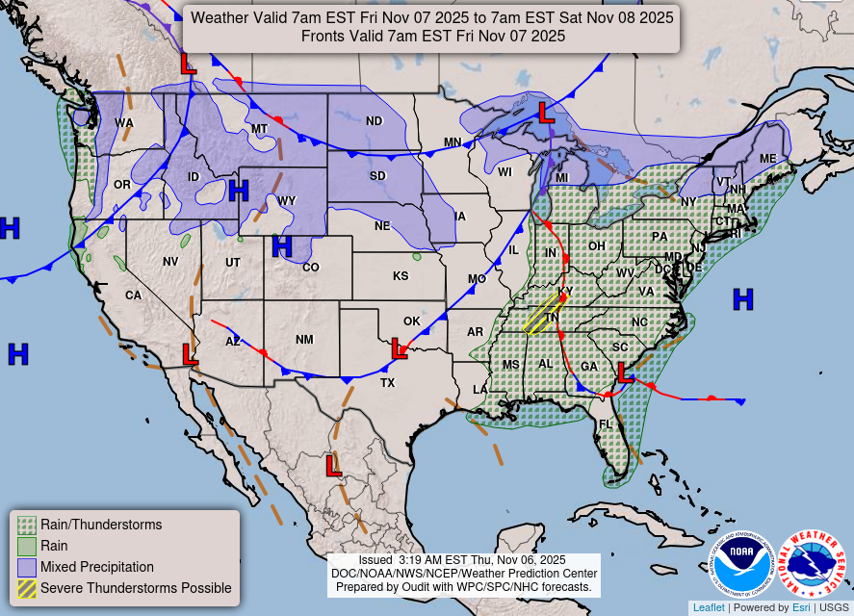

General Weather Pattern Through Saturday
A front approaches late Friday into Saturday
Scattered showers and a few storms possible late Friday through Saturday
Isolated strong to severe storms cannot be ruled out.
Dry
Dry
3
NATIONAL WEATHER SERVICE ATLANTA
weather.gov/Atlanta
Follow:
@NWSAtlanta
Updated: Thu Nov 06, 2025 2:20 PM

Slide 4
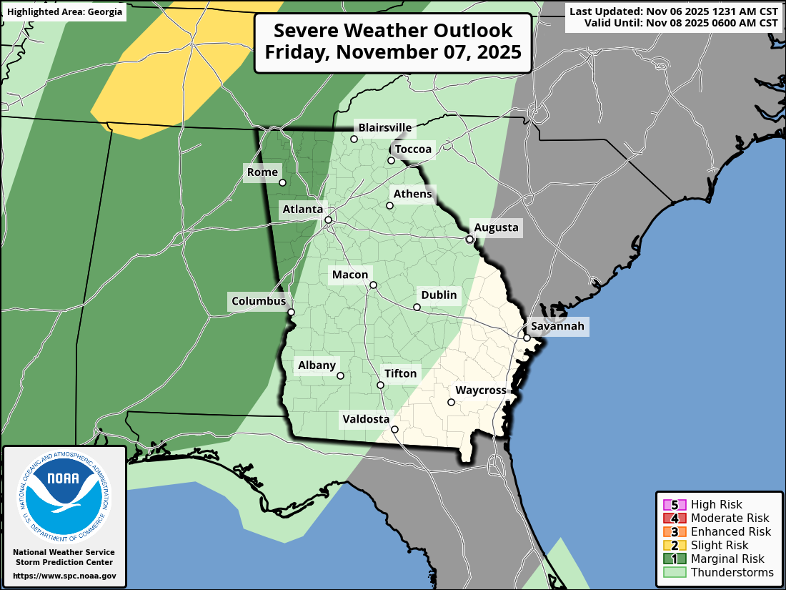
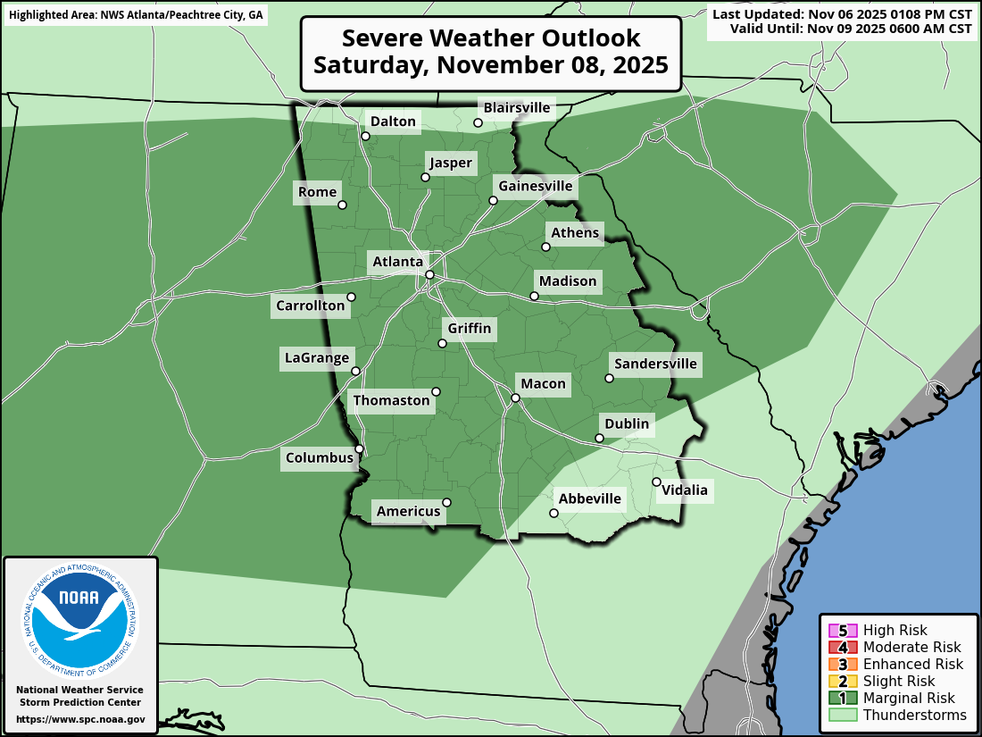
Rain/Storm Potential Friday/Saturday
Our next weather system is slated to move through beginning late Friday through early Sat
Low end risk of severe weather, a few isolated storms overnight Friday → Midday Saturday
Primary Hazards:
Damaging wind gusts
Tornado (very low)
Late Friday -> Early Saturday
Saturday (includes early AM)
4
NATIONAL WEATHER SERVICE ATLANTA
weather.gov/Atlanta
Follow:
@NWSAtlanta
Updated: Thu Nov 06, 2025 2:20 PM

Slide 5
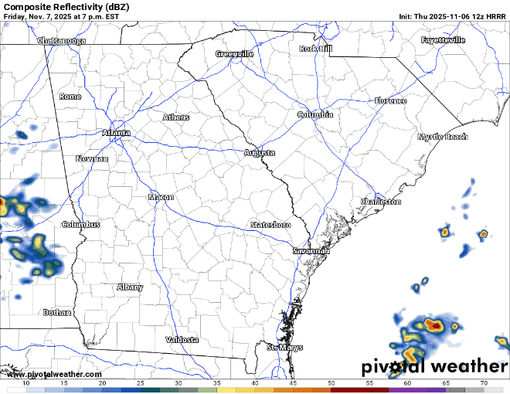
Rain Potential Friday/Saturday
This loop runs Fri 8 PM -> 7AM Sat
Best chances for a strong storm
Late Friday-> far N GA
Early Sat -> Middle GA
A few showers may linger through late Saturday
5
NATIONAL WEATHER SERVICE ATLANTA
weather.gov/Atlanta
Follow:
@NWSAtlanta
Updated: Thu Nov 06, 2025 2:20 PM

Slide 6
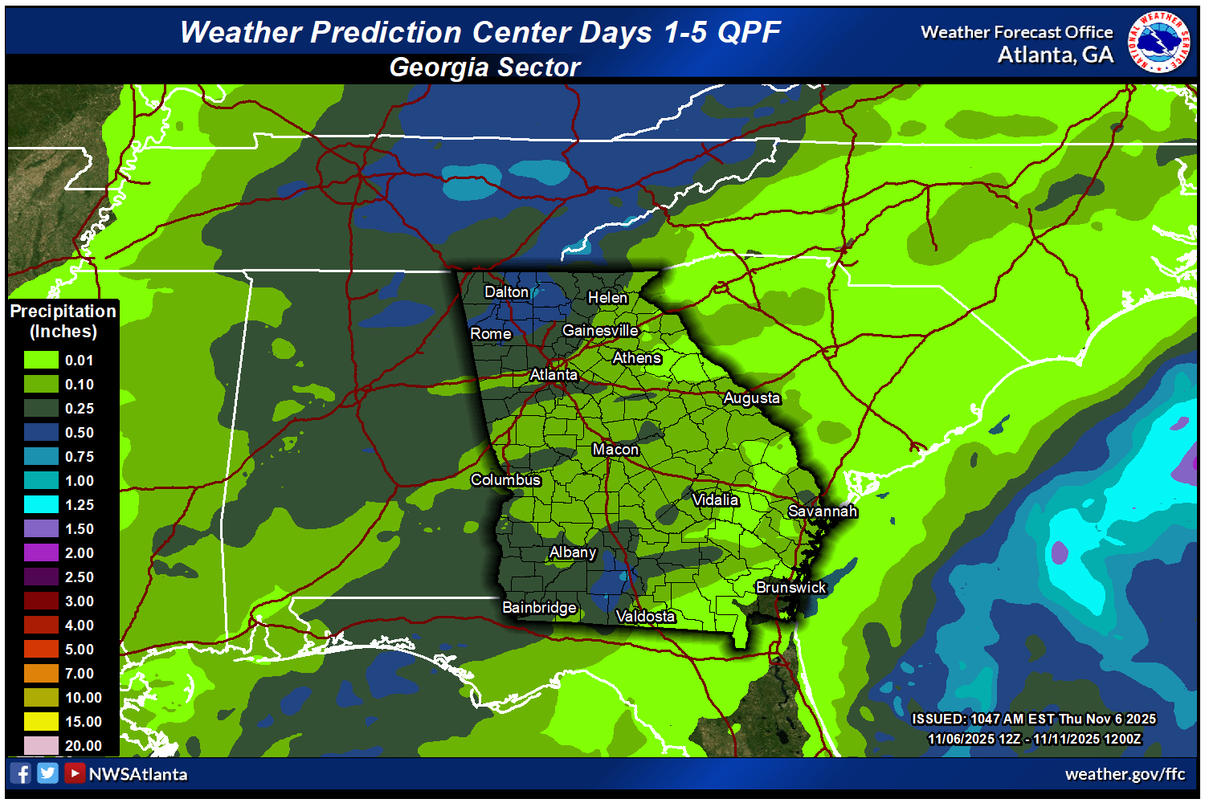
Forecast Rainfall For The Next 5 Days
Highest rainfall totals are expected across northern GA with totals of up to 1” possible
Areas along and south of I-20 will generally see around 0.25” or less. Some isolated areas could get higher with stronger storms.
6
NATIONAL WEATHER SERVICE ATLANTA
weather.gov/Atlanta
Follow:
@NWSAtlanta
Updated: Thu Nov 06, 2025 2:20 PM

Slide 7
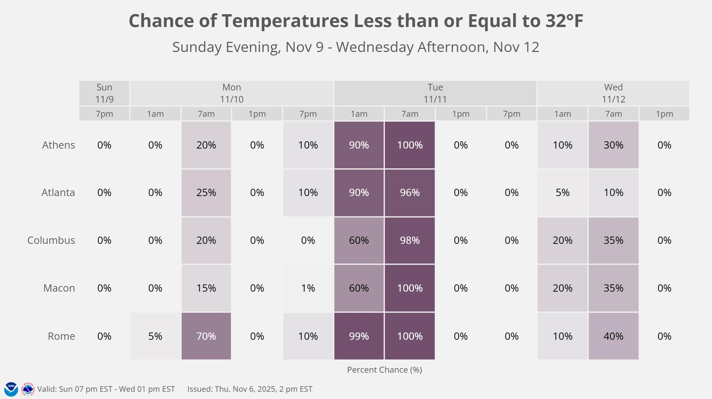
Widespread Freeze Early Next Week
What’s Going On?
The coldest conditions of the season are expected in Georgia early to middle of next week.
Confidence is high that the first widespread frost/freeze of the season will occur, with low temperatures in the mid-20s to low-30s on Tuesday morning.
What To Do?
Stay aware of the latest forecast and any frost/freeze warnings.
Have a plan for protecting outdoor plants and animals.
Protect exposed water pipes.
7
NATIONAL WEATHER SERVICE ATLANTA
weather.gov/Atlanta
Follow:
@NWSAtlanta
Updated: Thu Nov 06, 2025 2:20 PM

Slide 8
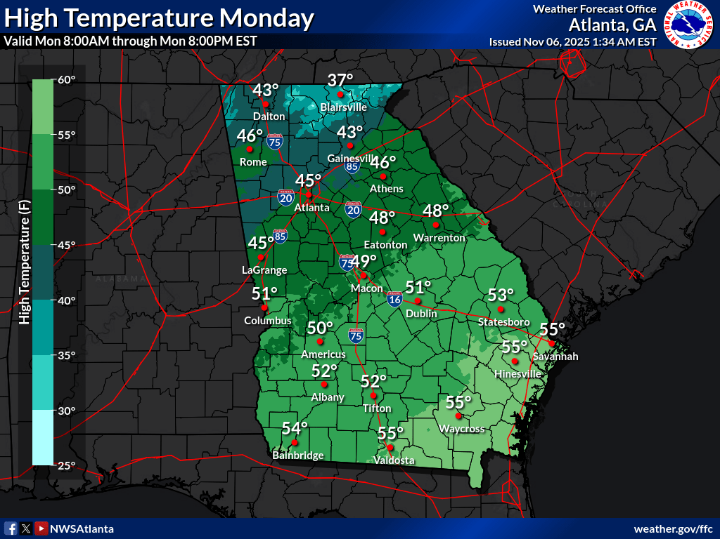
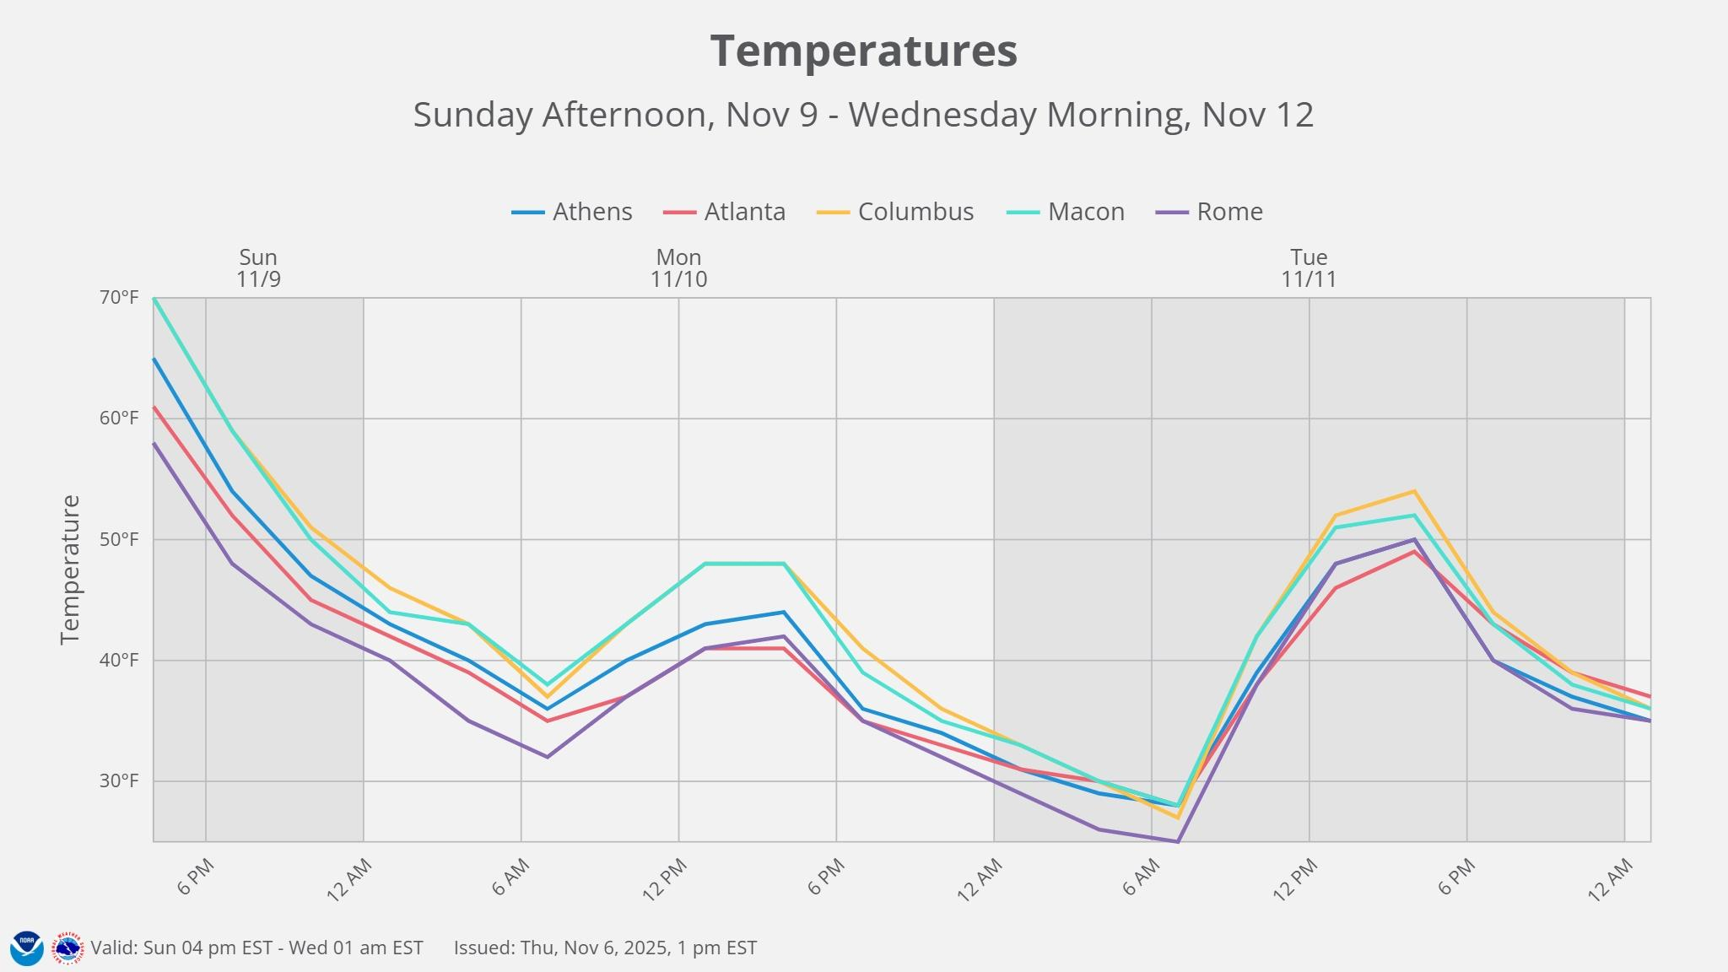
Cold Temperatures arrive Monday
Temps falling during the day Monday
Windy and Cold conditions arrive Monday
Daytime highs could be early in the day Monday, temps falling into the 30s during the afternoon
Protect exposed water pipes for the below freezing temps expected by Tuesday.
8
NATIONAL WEATHER SERVICE ATLANTA
weather.gov/Atlanta
Follow:
@NWSAtlanta
Updated: Thu Nov 06, 2025 2:20 PM

Slide 9
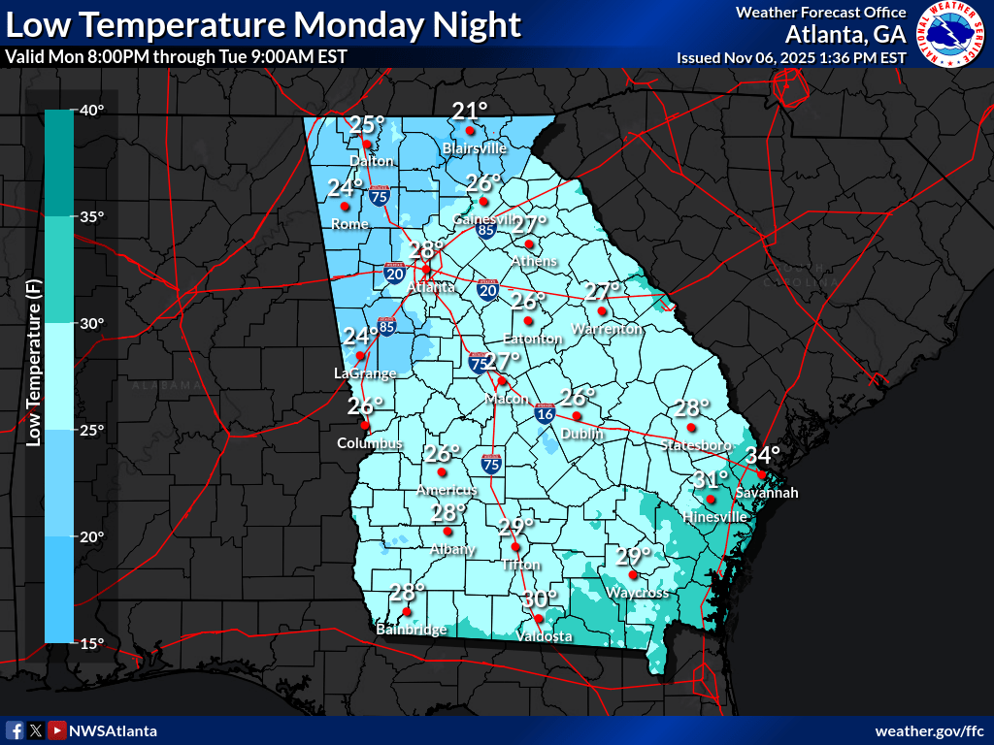
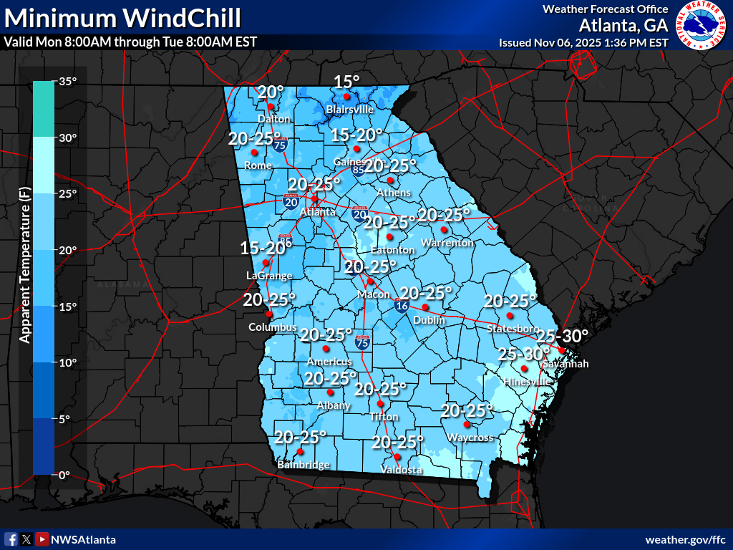
Near Record Lows Tuesday AM
Low to Mid 20’s for many locations Tuesday AM
Protect exposed water pipes for the below freezing temps expected by Tuesday.
Dress appropriately and expect wind chills in the Teens to low 20’s area wide
9
NATIONAL WEATHER SERVICE ATLANTA
weather.gov/Atlanta
Follow:
@NWSAtlanta
Updated: Thu Nov 06, 2025 2:20 PM

Slide 10
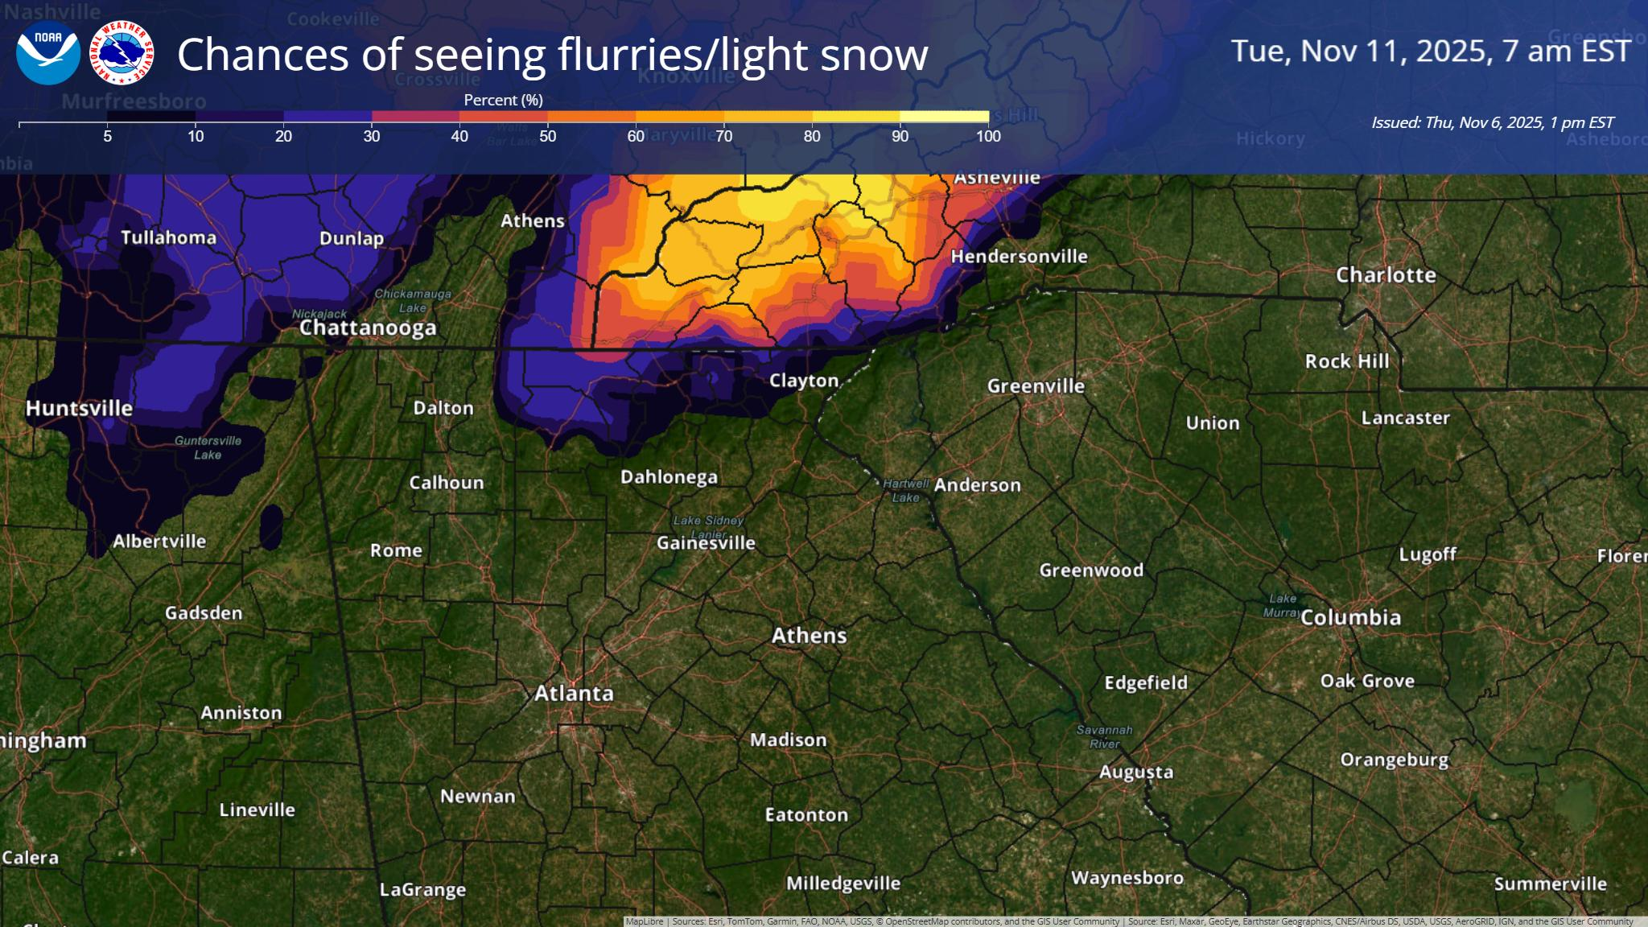
Snow Flurries?
No Impacts expected
A few light flurries or light snow possible Monday Evening → Tuesday Morning
Highest elevations of North and Northwest GA
10
NATIONAL WEATHER SERVICE ATLANTA
weather.gov/Atlanta
Follow:
@NWSAtlanta
Updated: Thu Nov 06, 2025 2:20 PM
Notes:
Saturday does look to be our coldest morning over the next several days. Locations in NE GA are more likely to see temperatures at or below freezing.

Slide 11
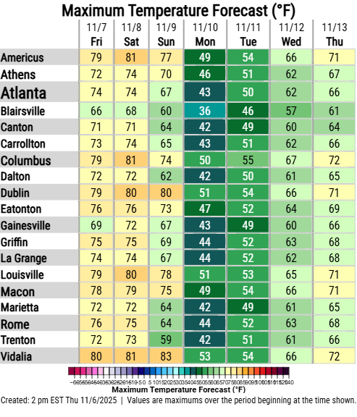
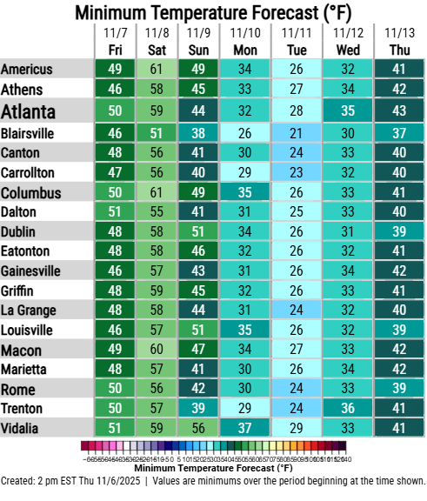
Temperature Forecast: Next 7 Days
Roller coaster temps from the weekend through mid week
Near record low highs Monday PM and near record lows Tuesday AM
11
NATIONAL WEATHER SERVICE ATLANTA
weather.gov/Atlanta
Follow:
@NWSAtlanta
Updated: Thu Nov 06, 2025 2:20 PM

Slide 12
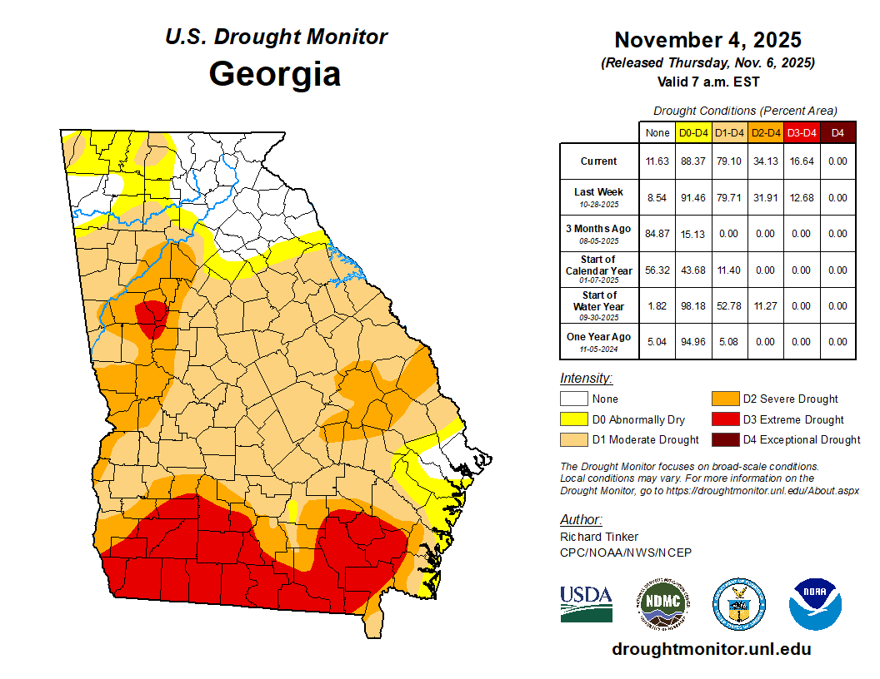
Drought Update
An area of Extreme Drought (D3) conditions remains across parts of western GA, in addition to the existing D3 across southern GA.
Rainfall has remained well below normal since early September with little prospect of substantial improvement for the foreseeable future.
12
NATIONAL WEATHER SERVICE ATLANTA
weather.gov/Atlanta
Follow:
@NWSAtlanta
Updated: Thu Nov 06, 2025 2:20 PM

Slide 13
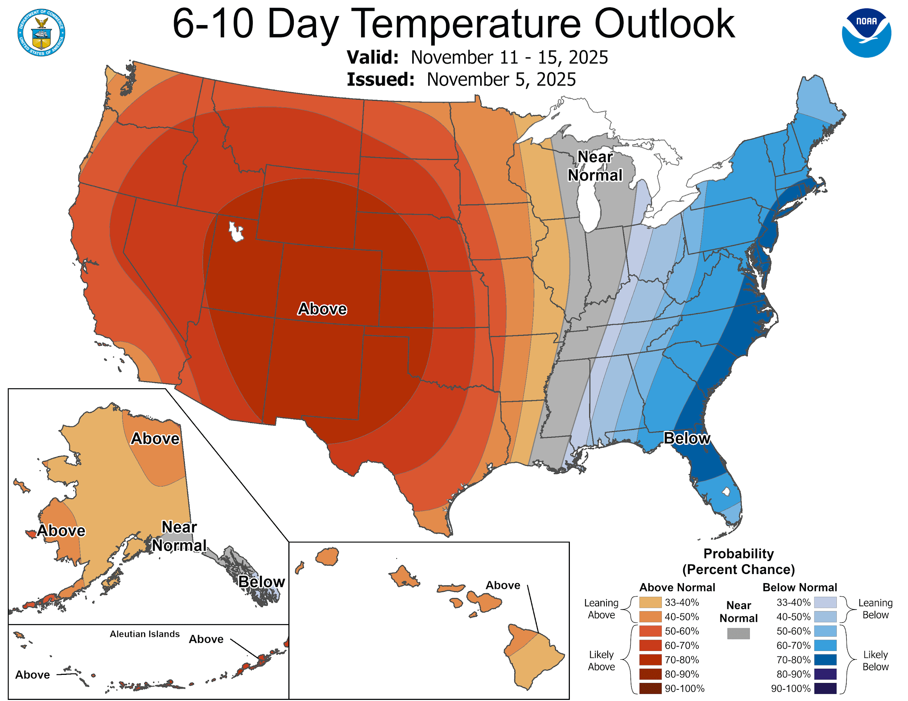
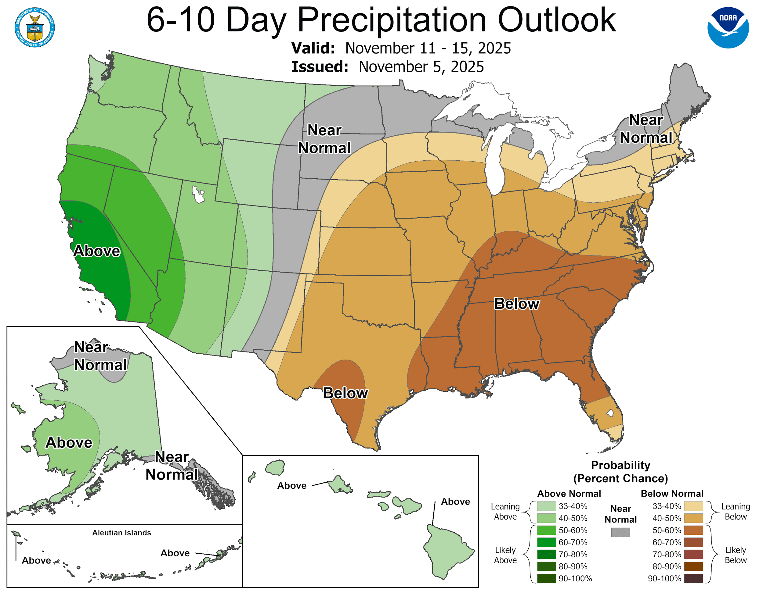
November 11 - November 15 Outlook
Temperatures - Favor Below Normal
Precipitation - Favors Drier Than Normal
13
NATIONAL WEATHER SERVICE ATLANTA
weather.gov/Atlanta
Follow:
@NWSAtlanta
Updated: Thu Nov 06, 2025 2:20 PM

Slide 14

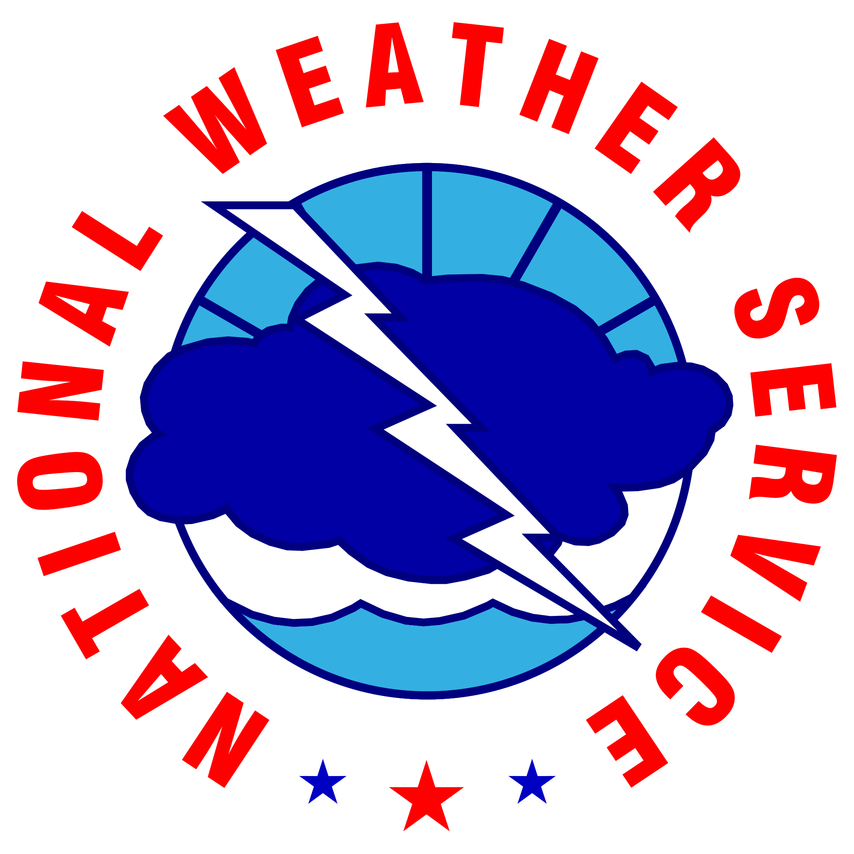








Contact Information
By Phone
770-486-1133
X
@NWSAtlanta
Via Email
nws.atlanta@noaa.gov
Instagram
nwsatlanta
Online
weather.gov/atlanta
weather.gov/ffc/briefings
Facebook
NWSAtlanta
NWS Chat
EMs, Media, and approved partners
YouTube
@NWSPeachtreeCity
Decision Support
weather.gov/ffc/dss
14
NATIONAL WEATHER SERVICE ATLANTA
weather.gov/Atlanta
Follow:
@NWSAtlanta
Updated: Thu Nov 06, 2025 2:20 PM

